Slide 1
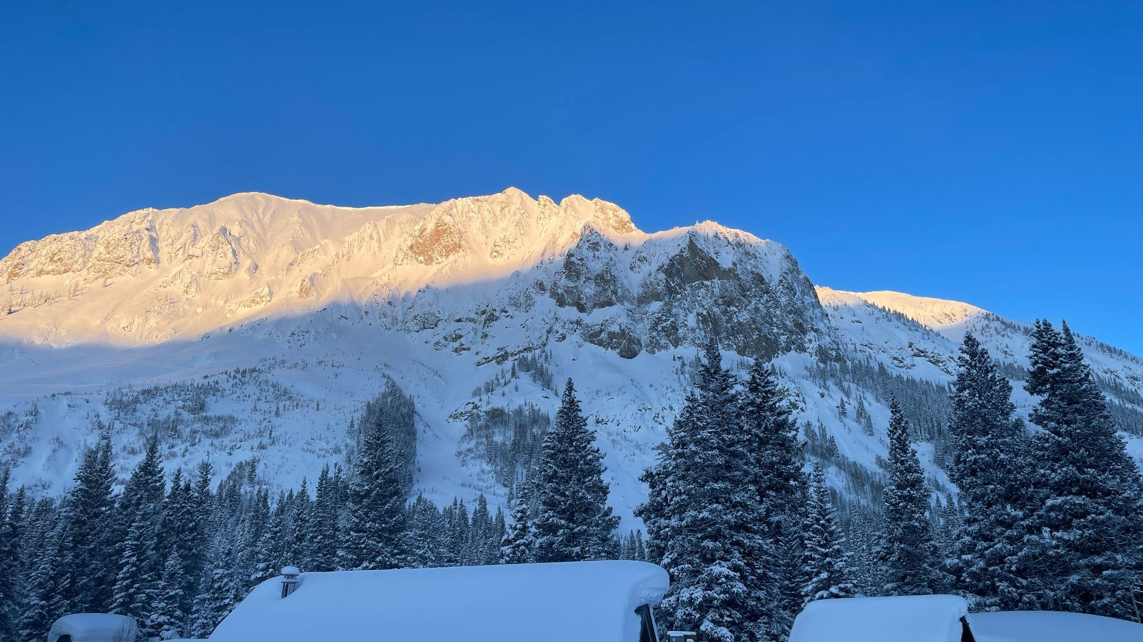


Sublimation Here, There, and Everywhere?
Scaling up sublimation under different synoptic situations
Daniel (Danny) Hogan
SPLASH/SAIL/SOS (S³) Combined Workshop
Boulder, CO
Friday, 3 November 2023

Slide 2

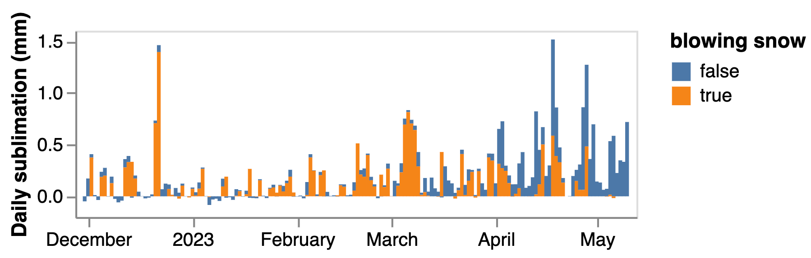
Initial Motivation
Nearly 10% of the seasonal sublimation measured at Kettle Ponds by SOS occurred during a single wind event.
Figure from Eli Schwat, GIF created from SOS image archive
Notes:
Motivation: We want to know characteristics of this event in particular. What data is needed to do that
Less busy plot.

Slide 3
Initial Motivation
Nearly 10% of the seasonal sublimation measured at Kettle Ponds by SOS occurred during a single wind event.
Dec 21-22
Figure from Eli Schwat, GIF created from SOS image archive
Notes:
Motivation: We want to know characteristics of this event in particular. What data is needed to do that
Less busy plot.

Slide 4
Initial Motivation
Time
1
How often do events like this occur here?
Nearly 10% of the seasonal sublimation measured at Kettle Ponds by SOS occurred during a single wind event.
Dec 21-22
Figure from Eli Schwat, GIF created from SOS image archive
Notes:
Motivation: We want to know characteristics of this event in particular. What data is needed to do that
Less busy plot.

Slide 5
Initial Motivation
Time
1
How often do events like this occur here?
Nearly 10% of the seasonal sublimation measured at Kettle Ponds by SOS occurred during a single wind event.
Space
2
How do these events play out in other regions?
Dec 21-22
Figure from Eli Schwat, GIF created from SOS image archive
Notes:
Motivation: We want to know characteristics of this event in particular. What data is needed to do that
Less busy plot.

Slide 6
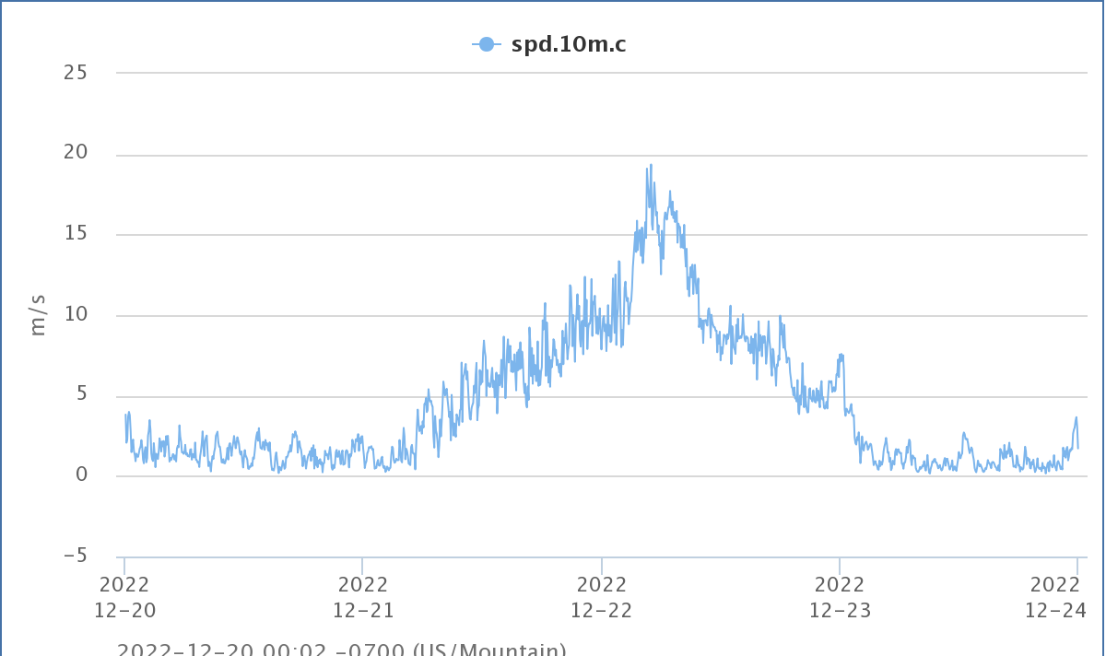
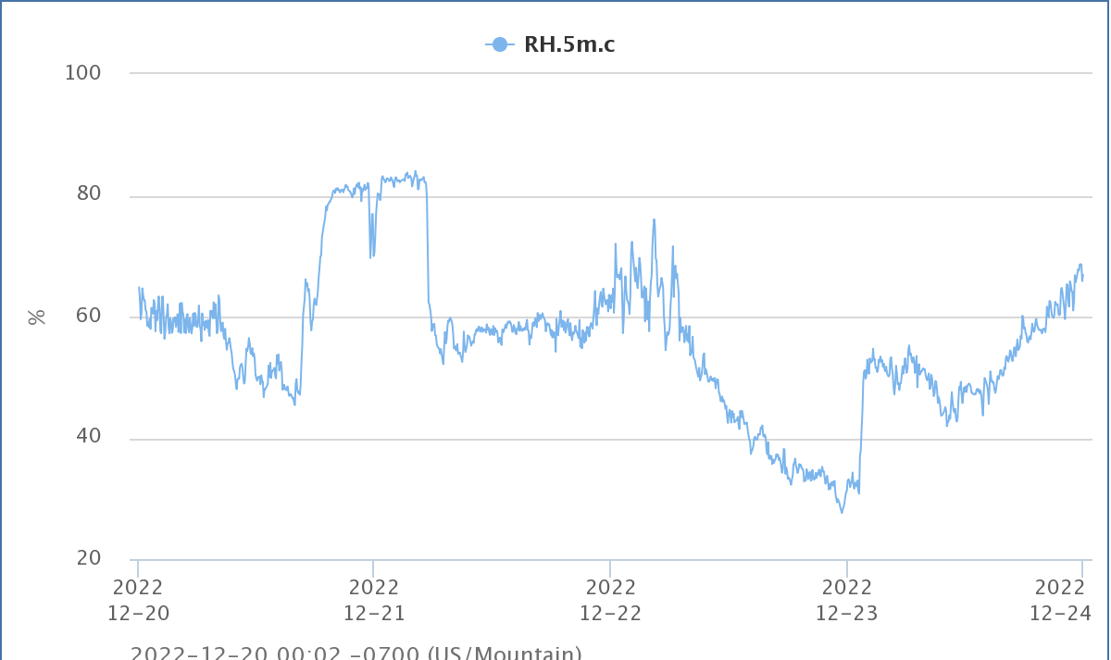
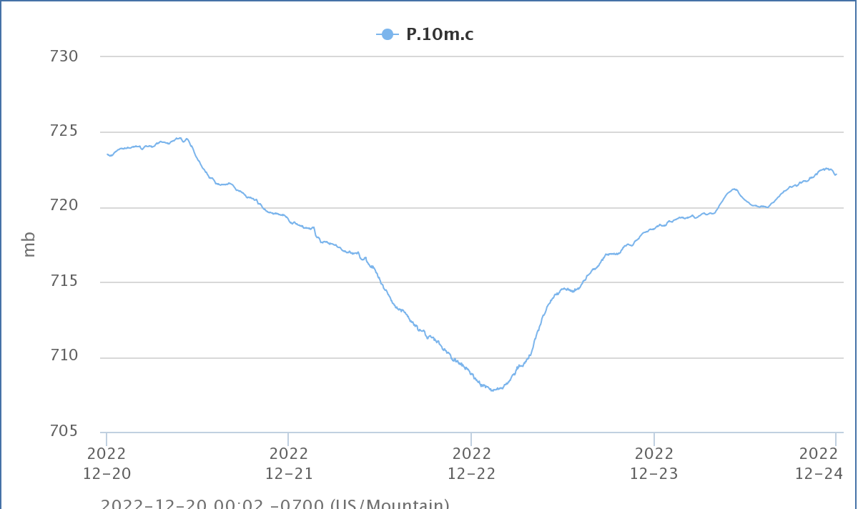
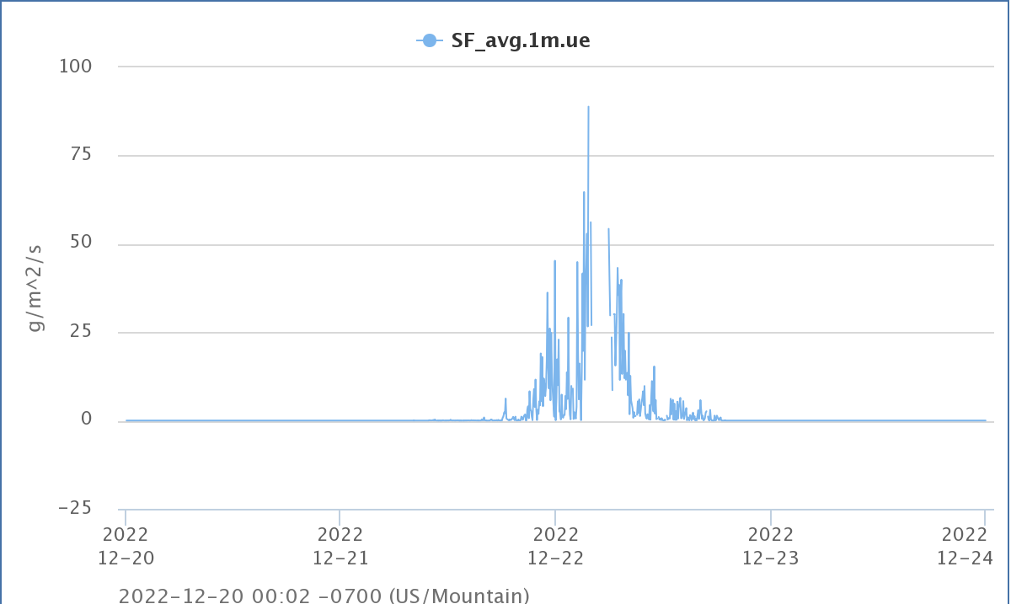
A closer look at this December 21-22 wind event…
High winds before and after front arrival
Drier air fills in behind front
Front arrival timing on 2022/12/22
Season high blowing snow flux
Notes:
Explain why this would drive sublimation: greater turbulence measured under these conditions, drier air, large gradient between a suspended snowflake and the dry air around it.

Slide 7
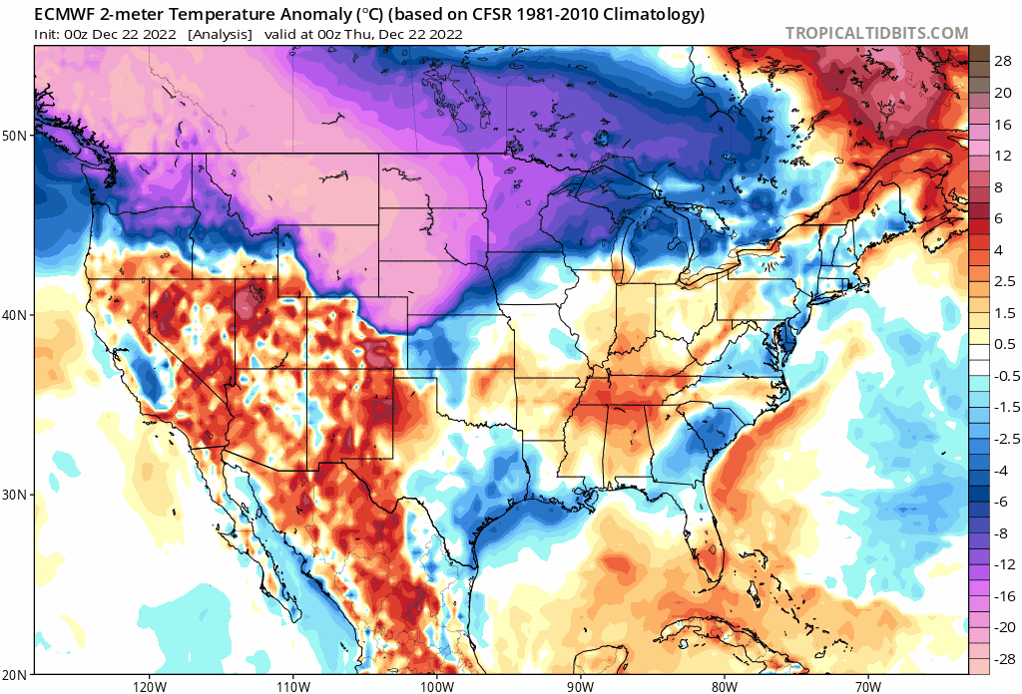
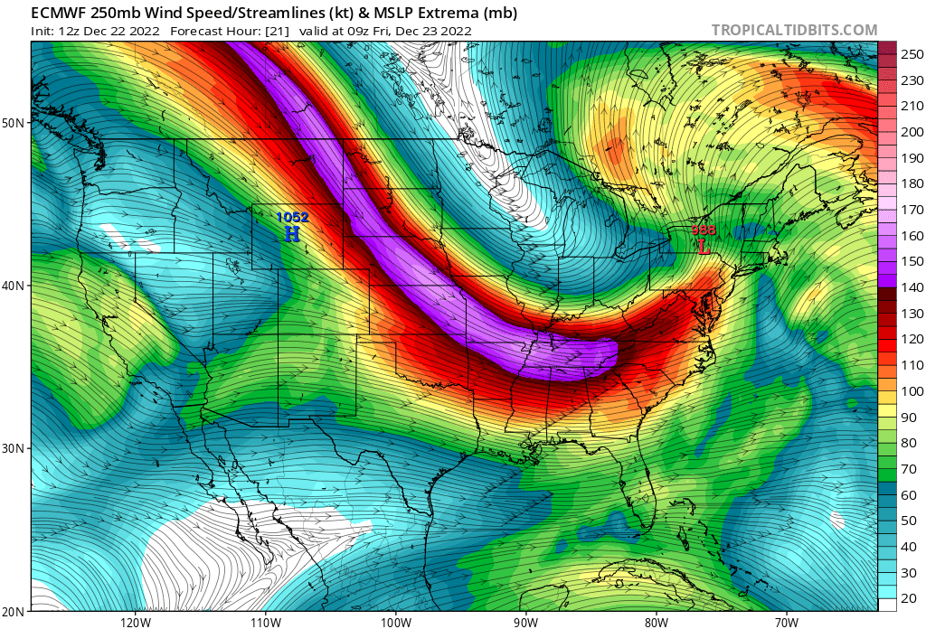
What was going on generally across CONUS?
Much colder air descending from the NW and interior Canada (ECMWF control run on 12/21/22)
Strong jet aloft (250 mb) ~70 m/s
(ECMWF control run 12/21/22)

Slide 8
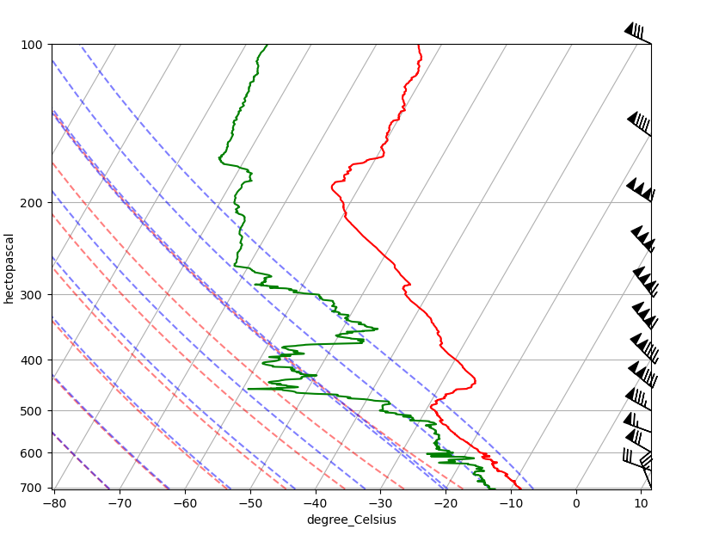
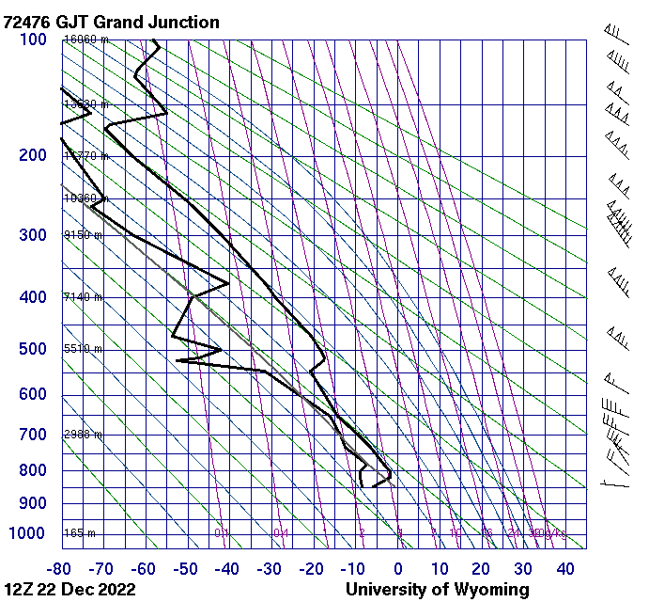
What was going on at the upper levels?
Gothic vertical sounding from 12/22
NWS observation at Grand Junction (~150 km W)

Slide 9
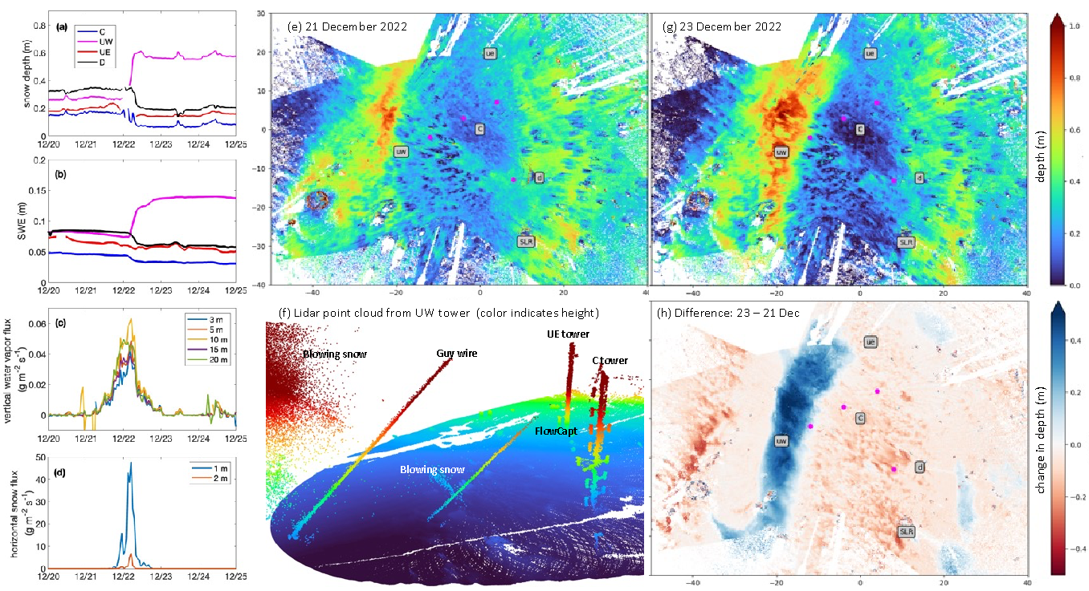
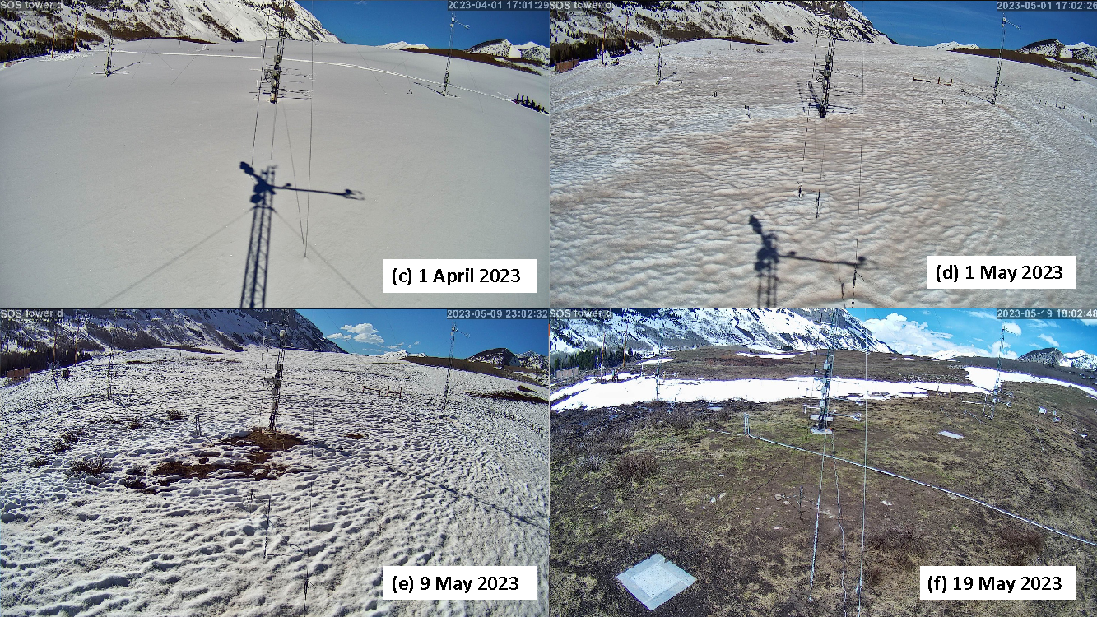
This snow dune formed from this Dec 21-22 event and persisted for the remainder of the season
Figures included in SOS BAMS submission.
Notes:
Is this pattern repeatable? Do we see this same pattern in other years? Do we see these large snow dunes form during years will storms of this character?
What can help us here?
ASO, WRF model runs

Slide 10
Big sublimation events occur during strong wind events driven by synoptic-scale systems
Focus on strong wind events over the East River
Preliminary Research Questions/Goals:
What are the characteristics of these large-scale wind events that impact the East River Valley?
What is the return period?
Can we identify impacts on the snowpack from events like this in other years?
Notes:
What’s the return period of a storm like this in winter?
How does the valley orientation play a role?

Slide 11
Big sublimation events occur during strong wind events driven by synoptic-scale systems
Focus on strong wind events over the East River
Preliminary Research Questions/Goals:
What are the characteristics of these large-scale wind events that impact the East River Valley?
What is the return period?
Can we identify impacts on the snowpack from events like this in other years?
How to get there?
Begin by investigating this event and others like it within the East River
Notes:
What’s the return period of a storm like this in winter?
How does the valley orientation play a role?

Slide 12
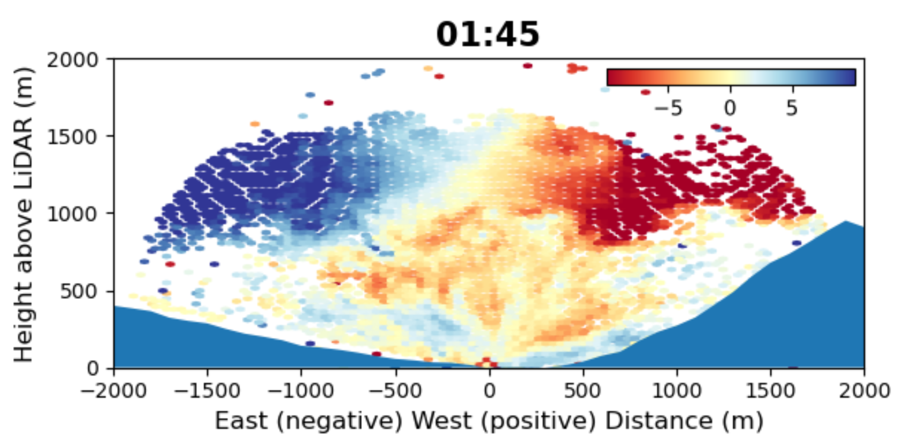
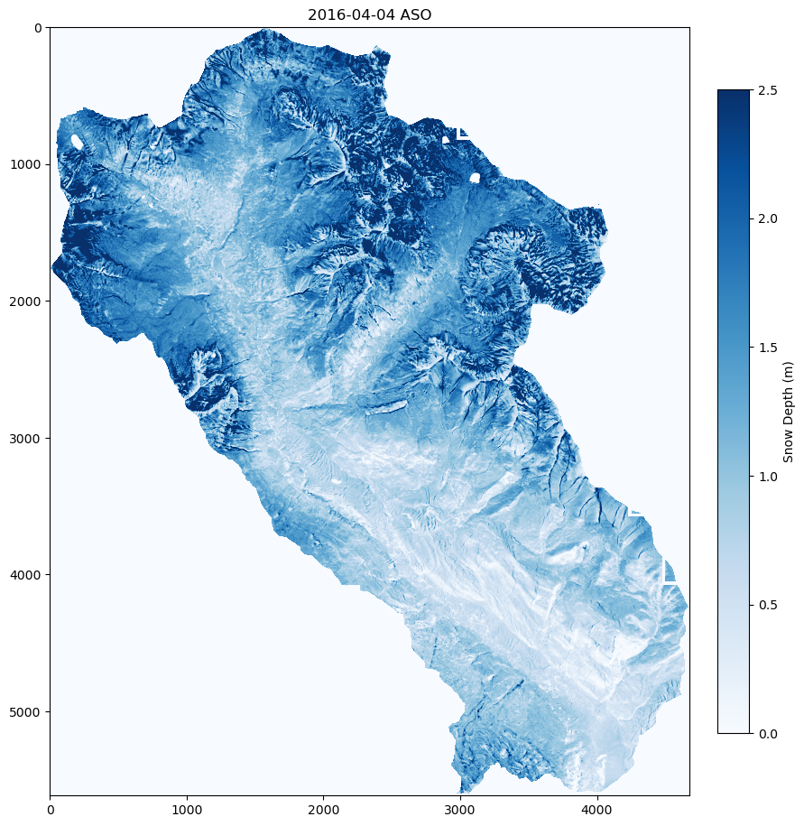
1. Focus on strong wind events over the East River
Data streams considered so far:
Storm Characteristics: What are the signals for events like this?
SOS/SAIL/SPLASH measurements throughout the valley
Vertical wind profiles from doppler lidar/radar
Model Reanalysis
Longer-term observations
Soundings
Repeat patterns: Do we see similar redistribution patterns in other years with large wind events?
High-resolution SnowModel output
2016, 2018, 2019, 2022, 2023 ASO flights
Figure from Eli Schwat
Notes:
Is this pattern repeatable? Do we see this same pattern in other years? Do we see these large snow dunes form during years will storms of this character?
What can help us here?
SOS/SAIL/SPLASH measurements throughout the valley
Model Reanalysis
Longer-term observations
Soundings
To provide us an understanding of the upper air conditions around the region
Doppler lidar/radar scans over the valley
Upper-level winds
Indication of wind speed to compare to lower levels,
investigate turbulence generation
ASO, WRF model runs
SnowModel is a spatially distributed snow-evolution modeling system designed for application in landscapes, climates, and conditions where snow occurs.

Slide 13
Motivation
Time
1
How often do events like this occur? What’s the return period?
Nearly 10% of the seasonal sublimation measured at Kettle Ponds by SOS occurred during a single wind event.
Space
2
What is the scale of the impacts at the surface?
Dec 21-22
Figure from Eli Schwat, GIF created from SOS image archive
Notes:
Motivation: We want to know characteristics of this event in particular. What data is needed to do that
Less busy plot.

Slide 14
Big sublimation events occur during strong wind events driven by synoptic-scale systems
Focus on strong wind events over the East River
Expand to inspect impacts to surrounding regions
Preliminary Research Questions/Goals:
Can we use the signals tested in the East River to resolve the impact these high wind events have on snow elsewhere in CO?
Do extreme winter-time wind events have similar storm characteristics in CO mountainous terrain?
Can these storm characteristics help us identify years when more (or less) sublimation would be expected in the region?
Notes:
What’s the return period of a storm like this in winter?
How does the valley orientation play a role?

Slide 15
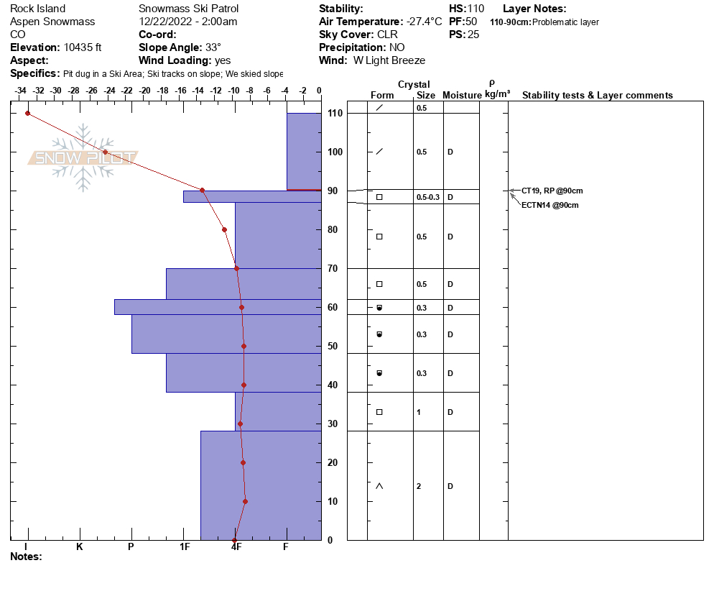
2. Expand to inspect impacts to surrounding regions
Data streams considered so far:
Storm characterization & Historical Analysis
Regional wind observations
Reanalysis data
Snow characterization
Snow surface characteristics from snow pits around the region
ASO flights
SnowModel output

Slide 16
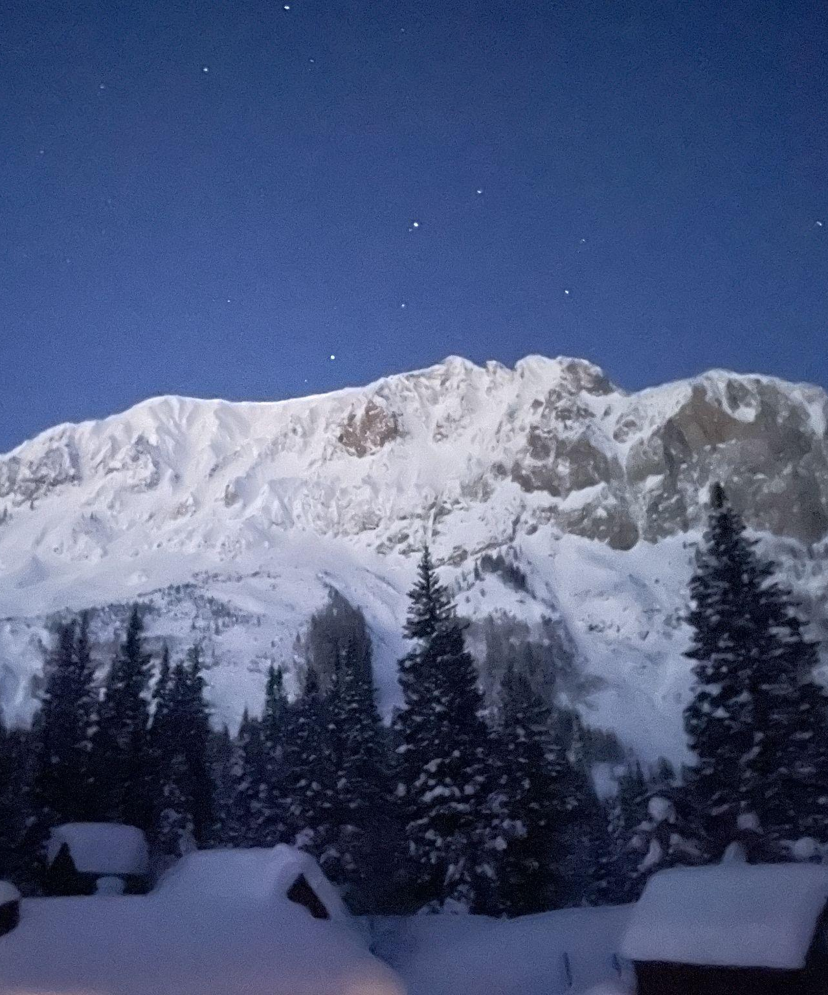
Conclusion and Goals
Feel free to reach out for collaboration!
dlhogan@uw.edu
Identify the characteristics of large-scale wind events that drive sublimation throughout the headwaters of the Colorado.
Better understand the impacts these events have on the snowpack throughout the region
Better resolve when, where, and why we may see more or less sublimation during a given year
  i.e. what is the “perfect storm” for sublimation?
Notes:
Emphasis focal points to resolve sublimation and cue into why totals may change in time and space

