Slide 1




The Study of Precipitation, the Lower-Atmosphere, and Surface for Hydrometeorology
Surface layer turbulence, SEB, and other statistics in complex terrain
Tilden Meyers and Sreenath Paleri - ARL

Slide 2
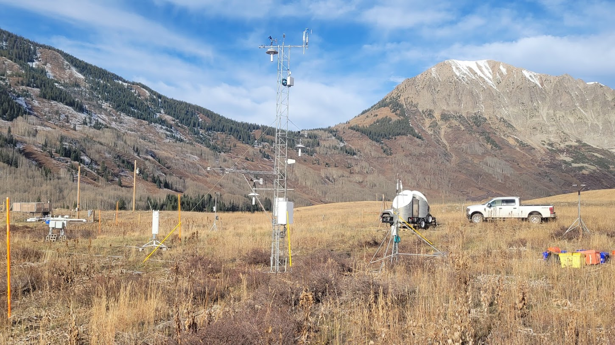
ARL assets deployed

Slide 3
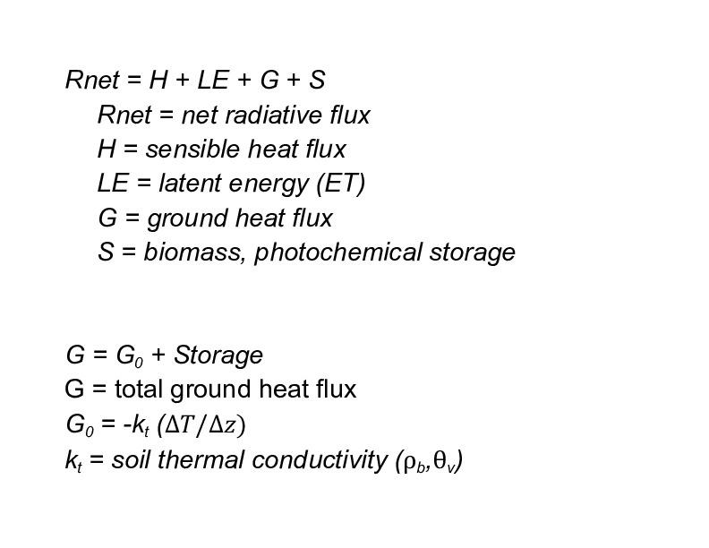
Kettle Ponds Soils (Soil Grids)
Sand 35%
Silt 42%
Clay 22%
Bulk Density 1.25 g/cm3
Percent Aggregate 10 - 20%

Slide 4
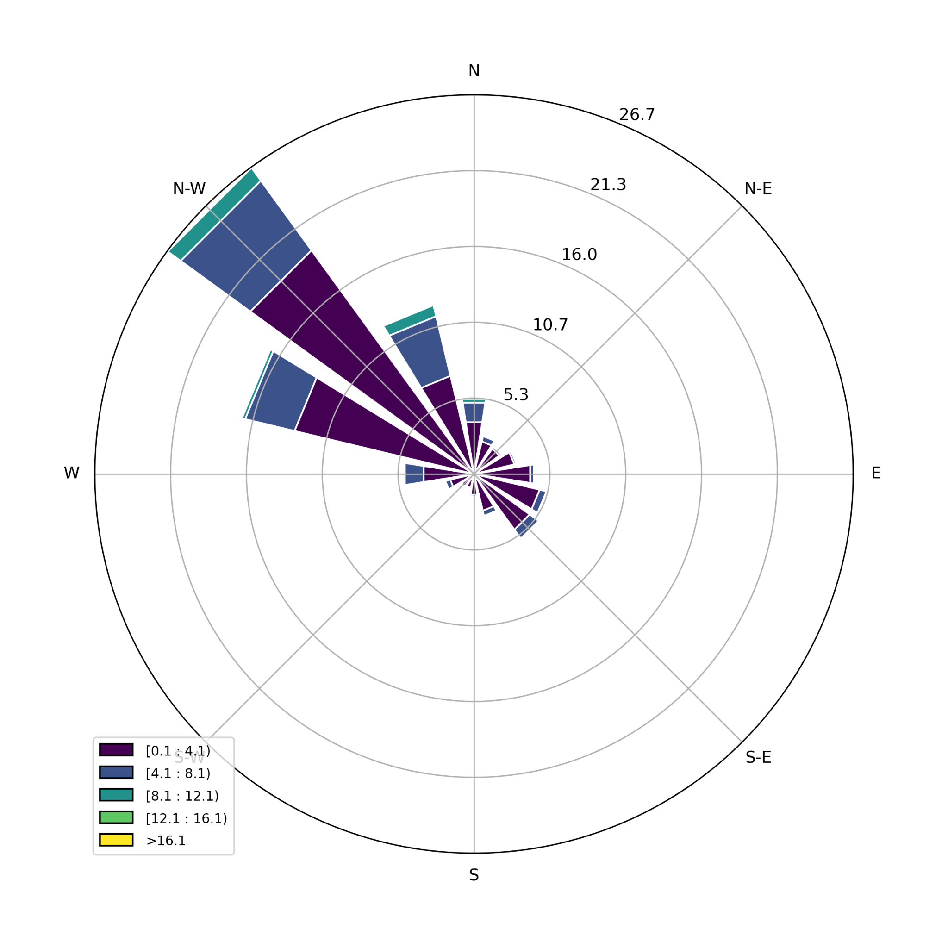
2022, whole year

Slide 5
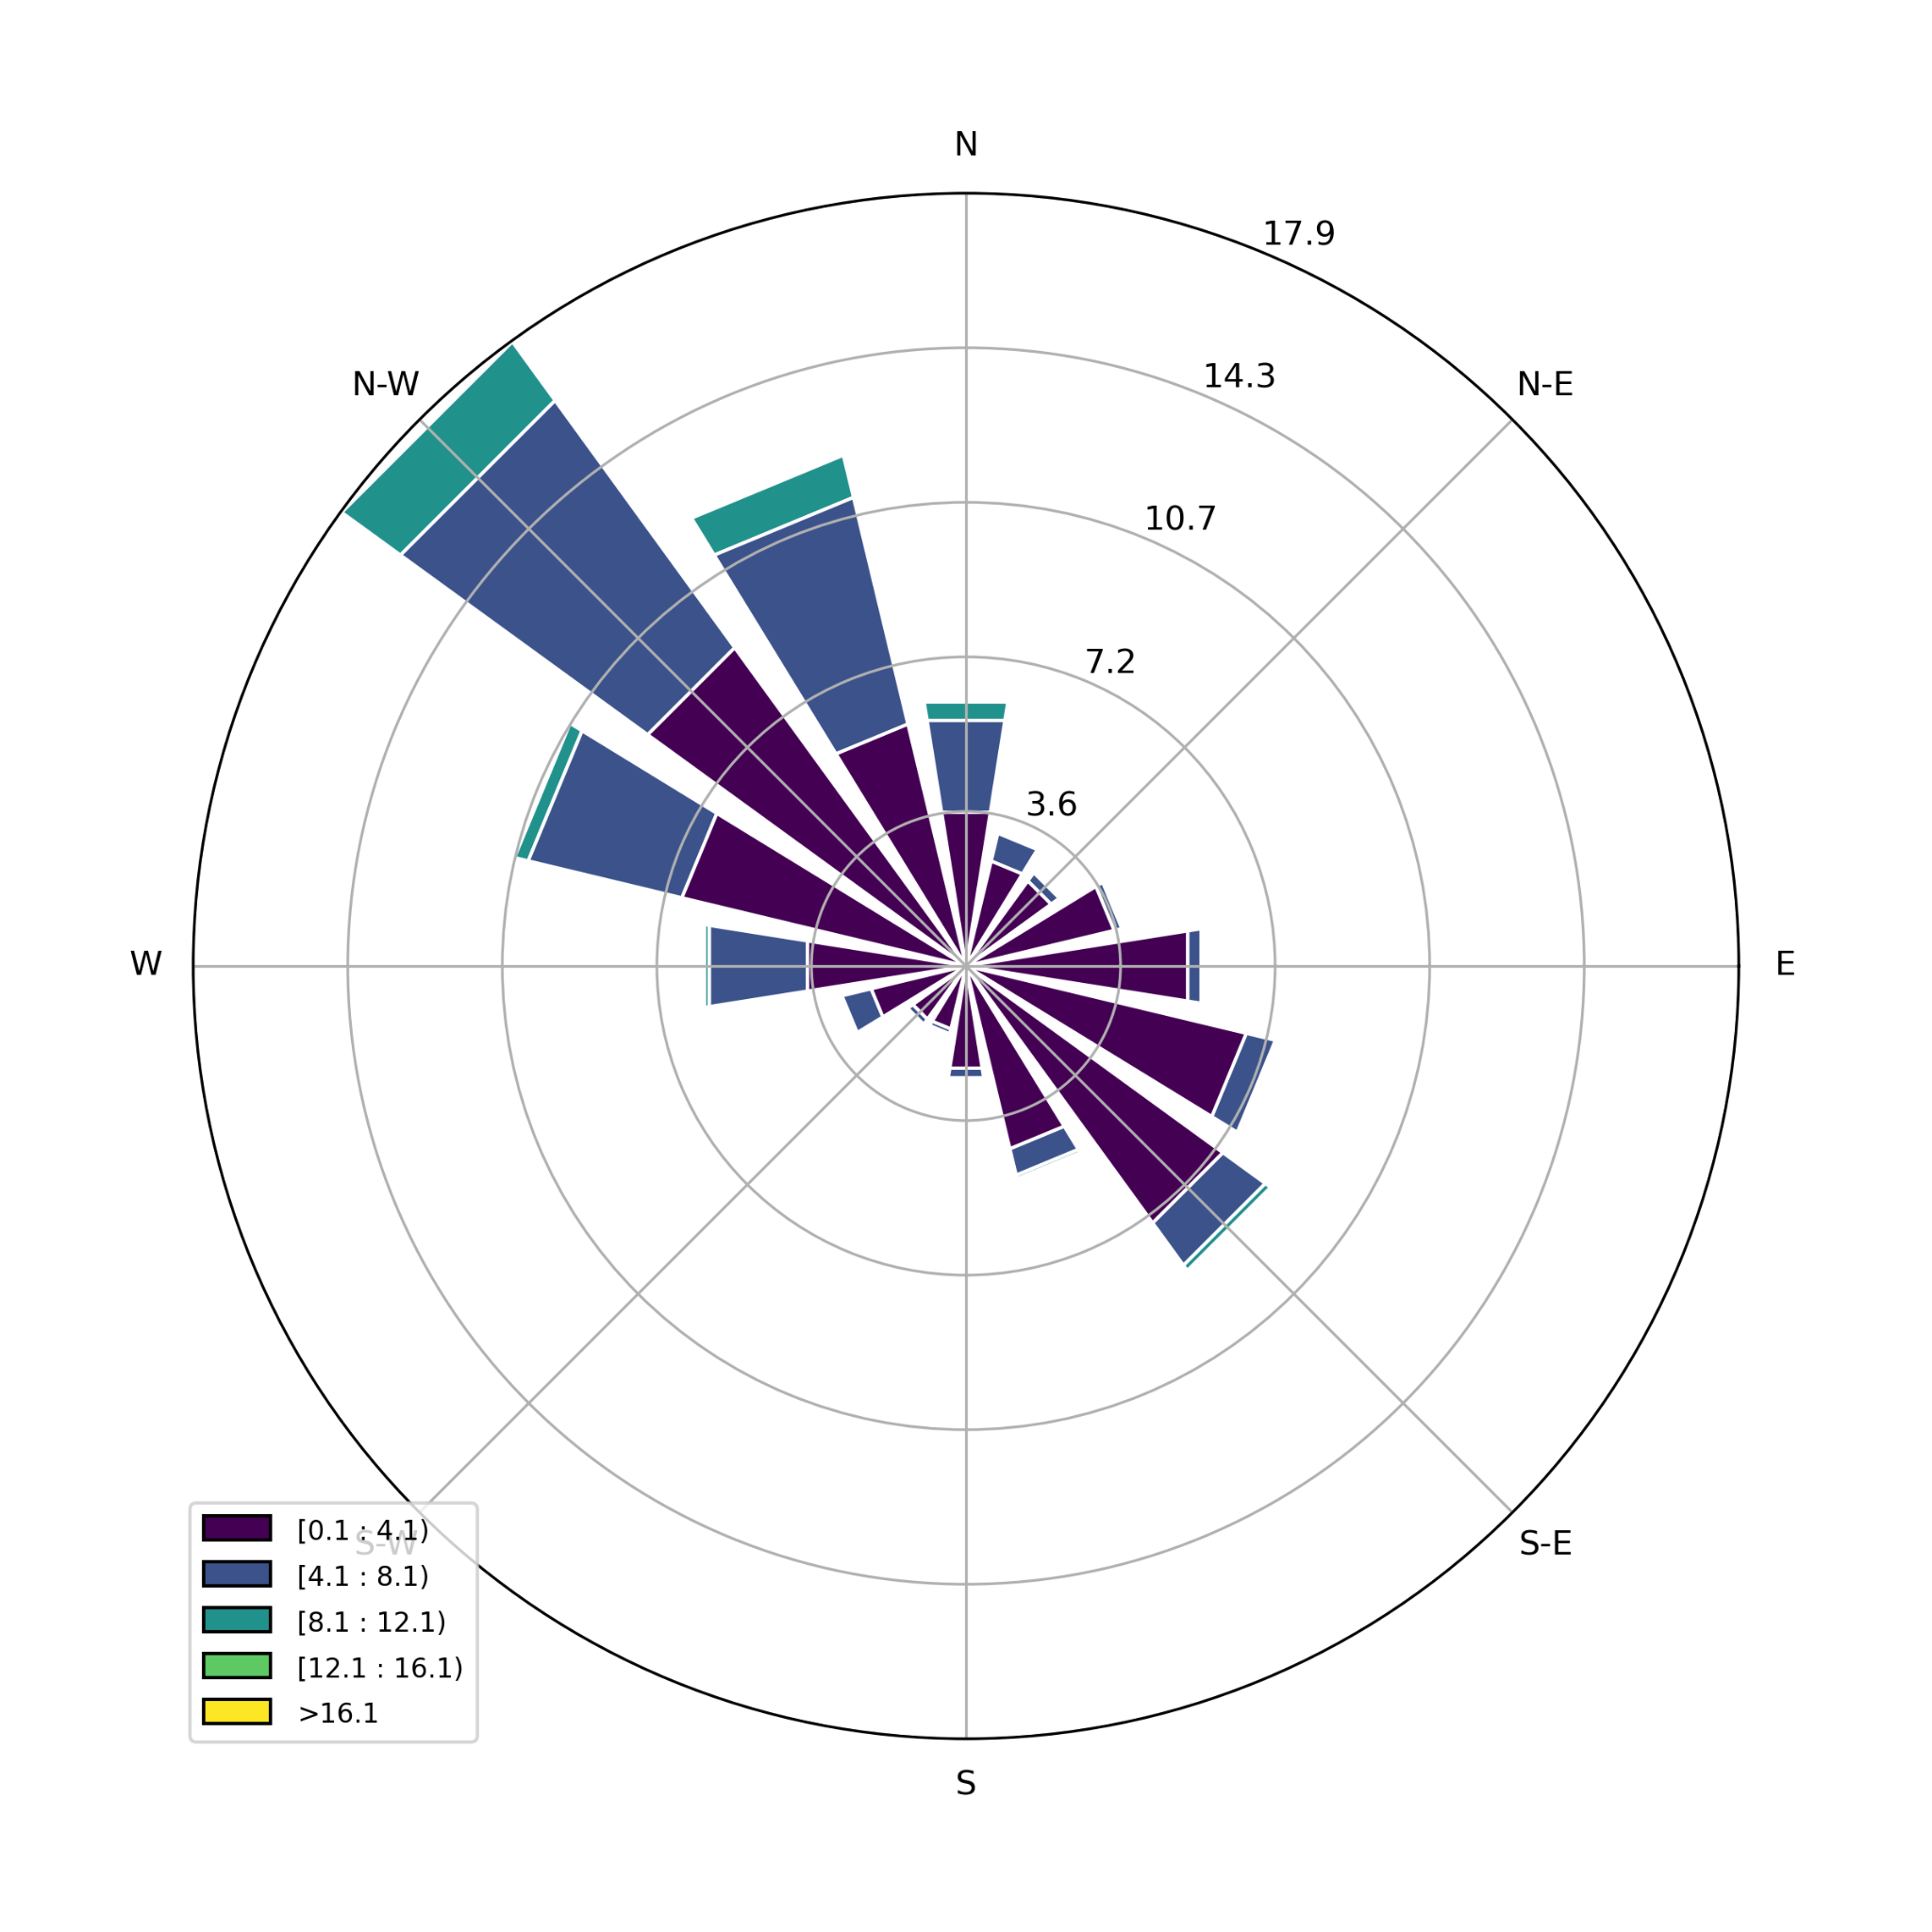
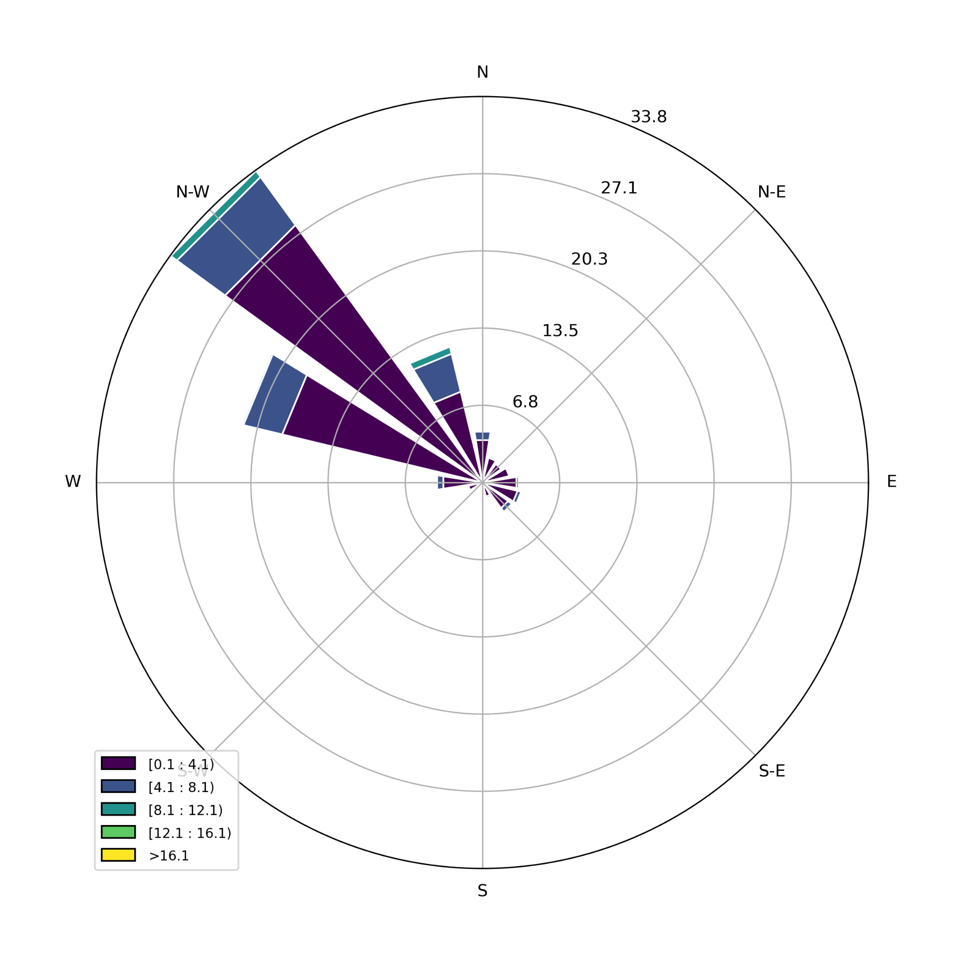
Day
Night

Slide 6
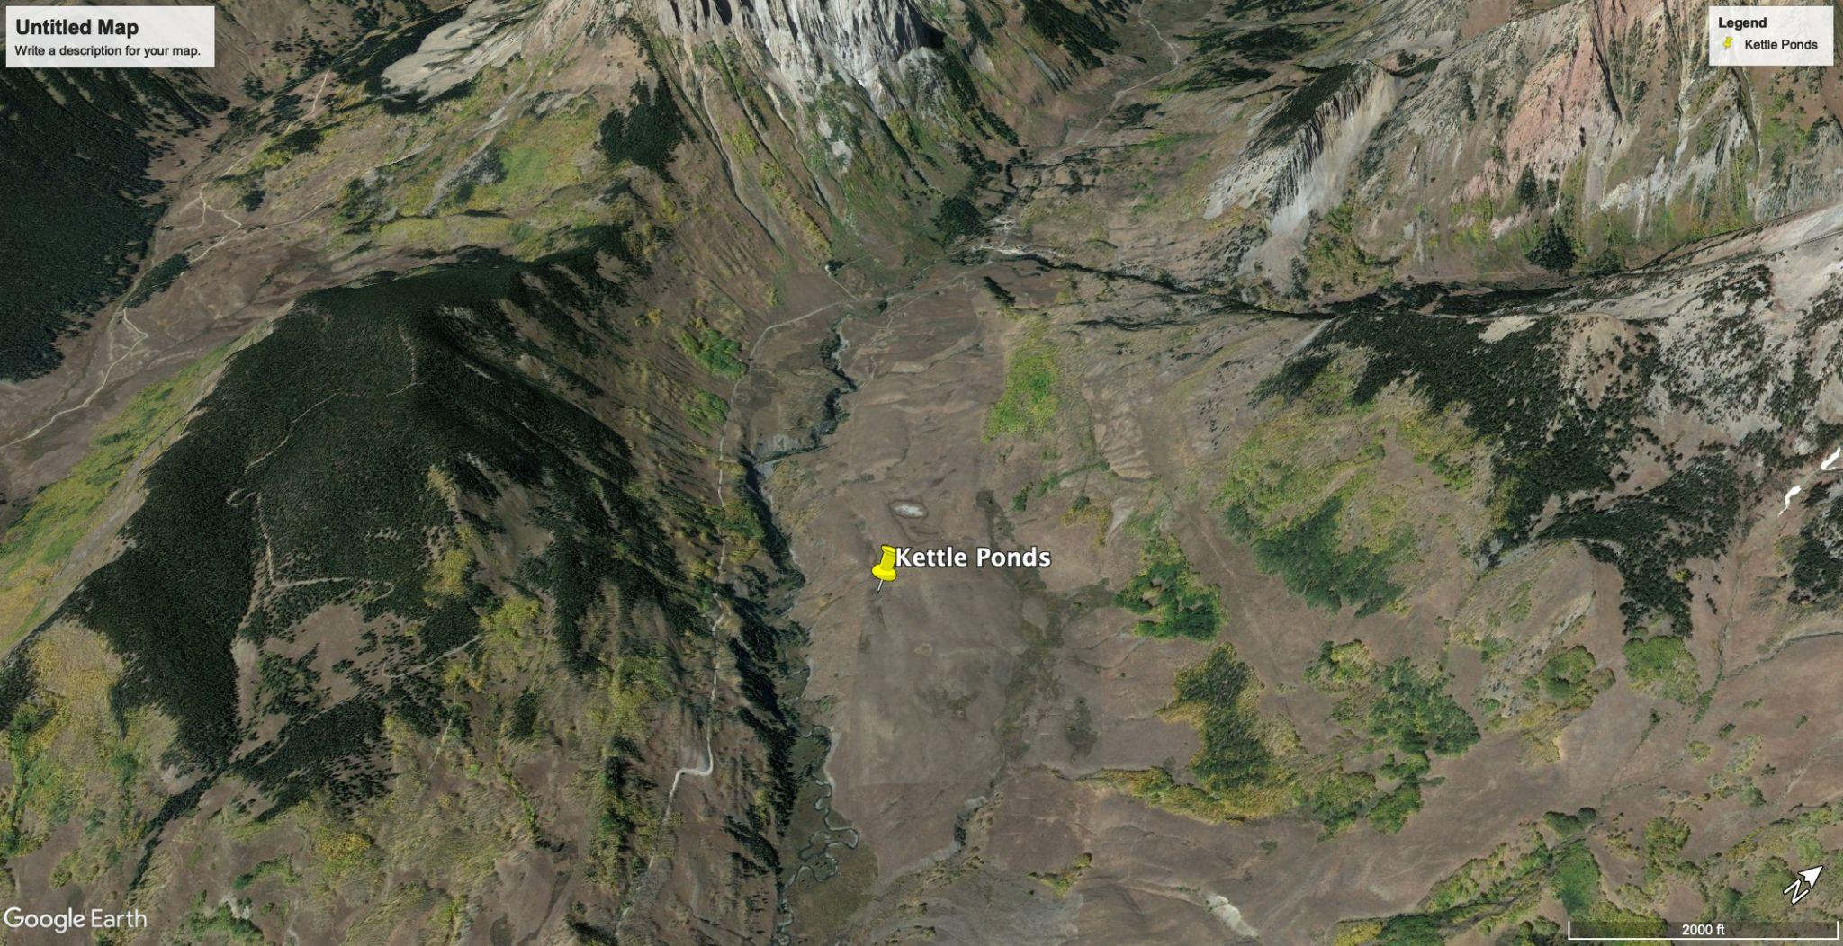
NW

Slide 7
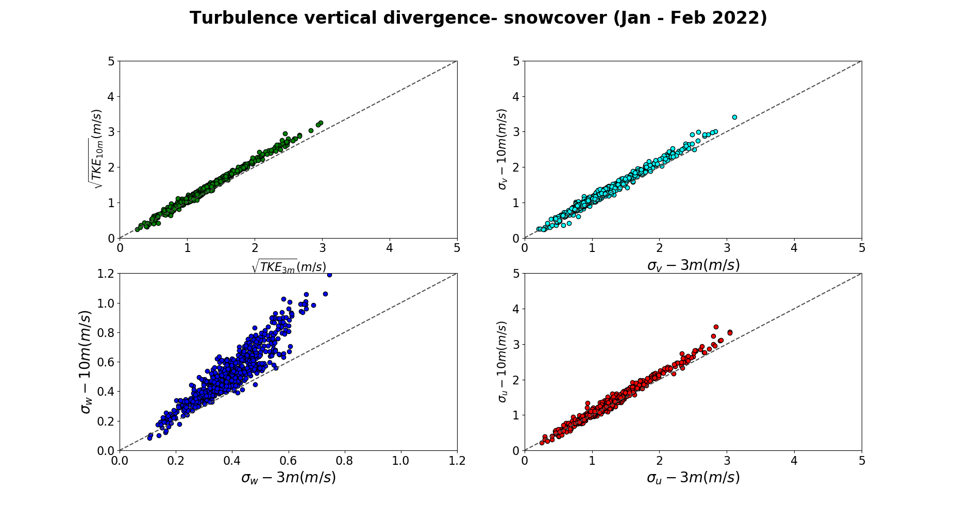

Slide 8
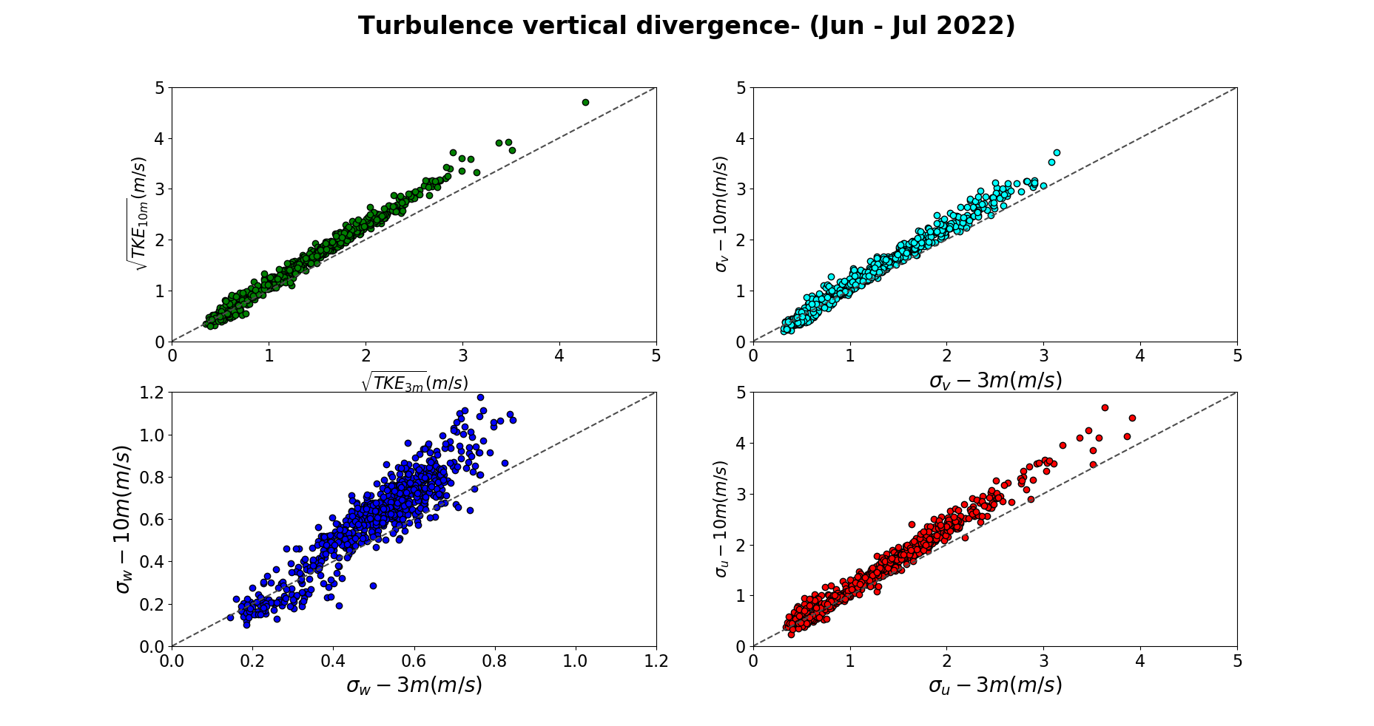

Slide 9
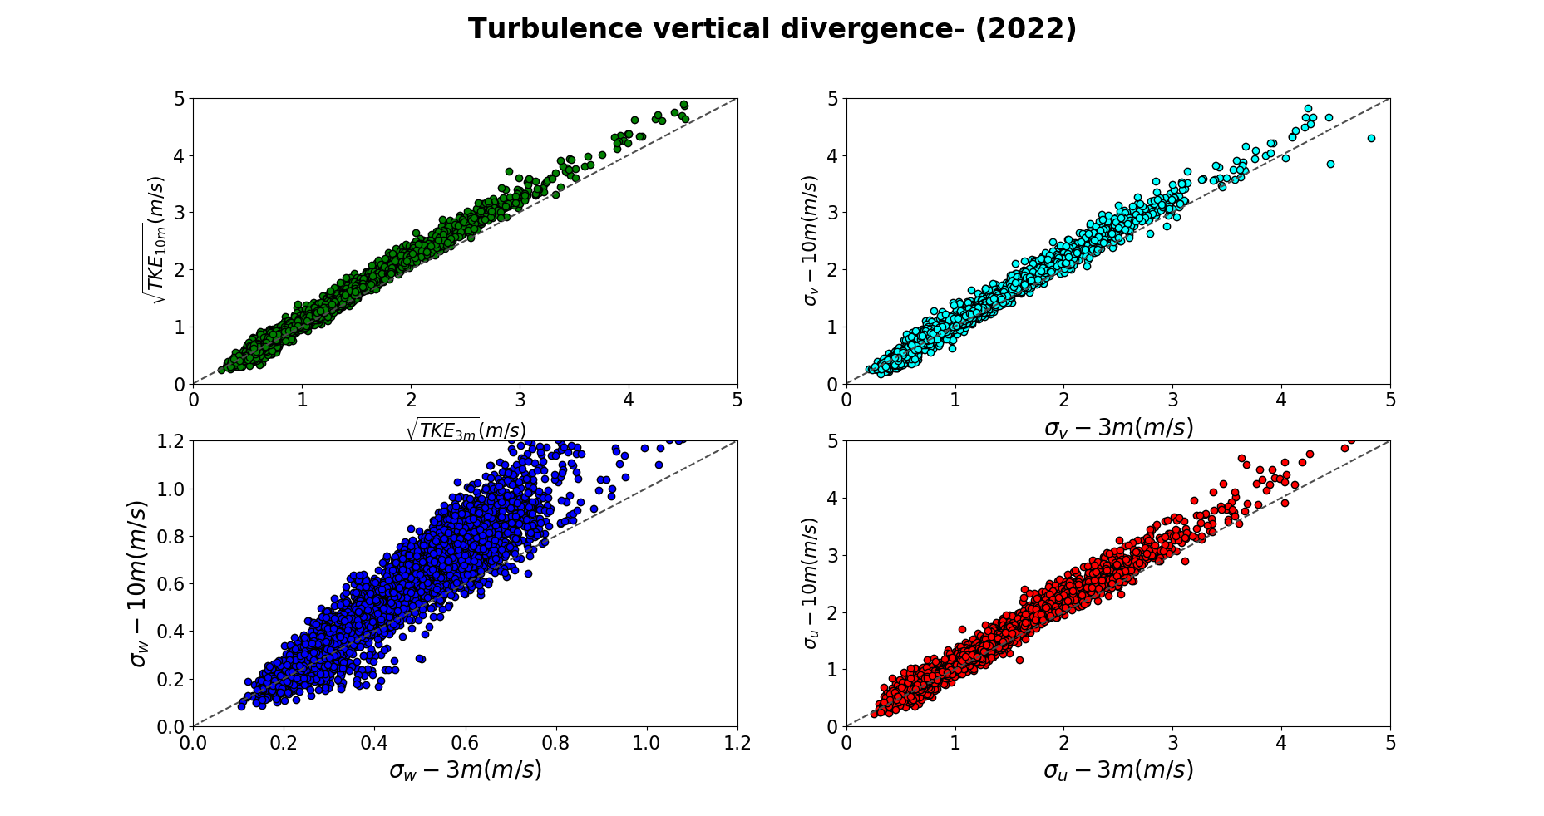

Slide 10
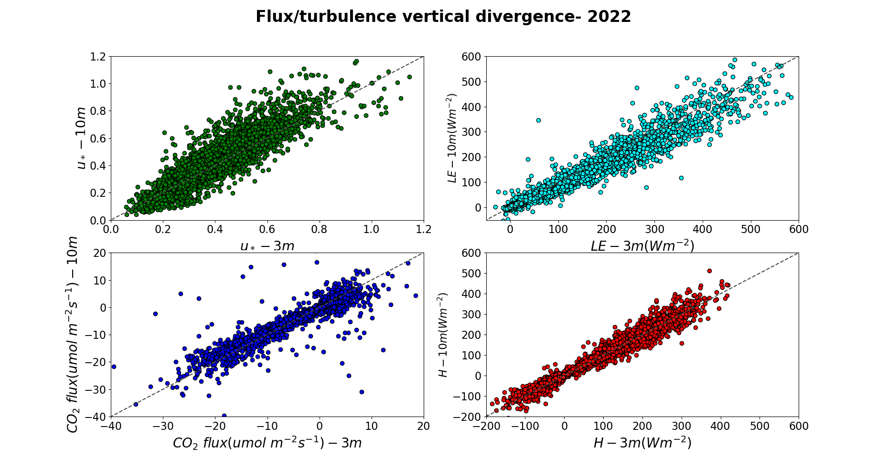

Slide 11
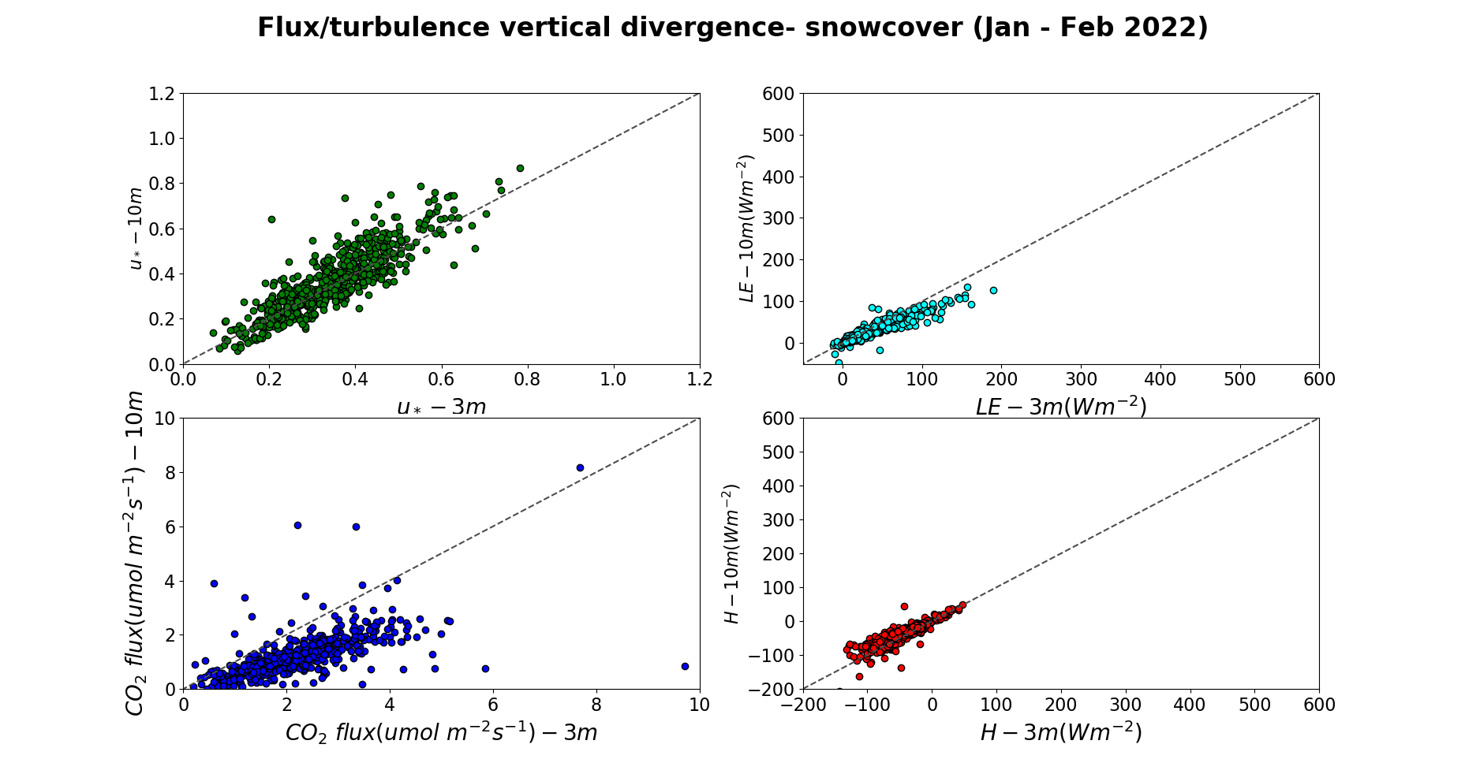

Slide 12
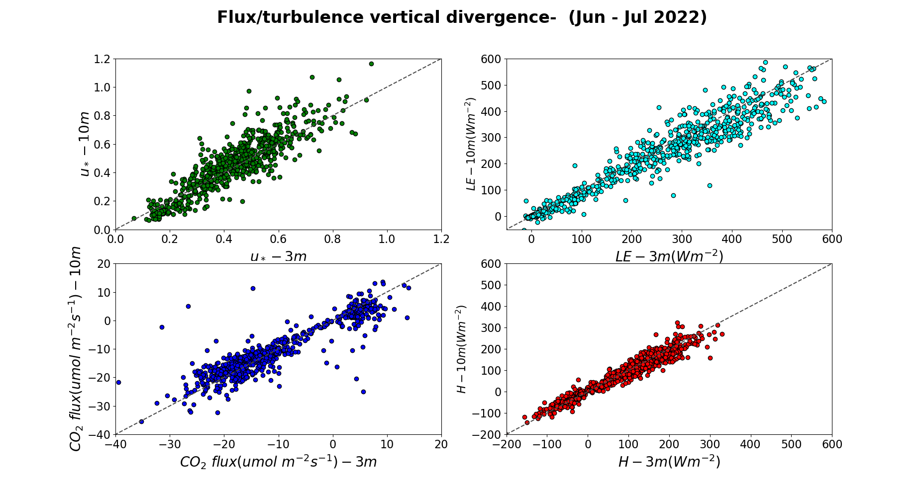

Slide 13
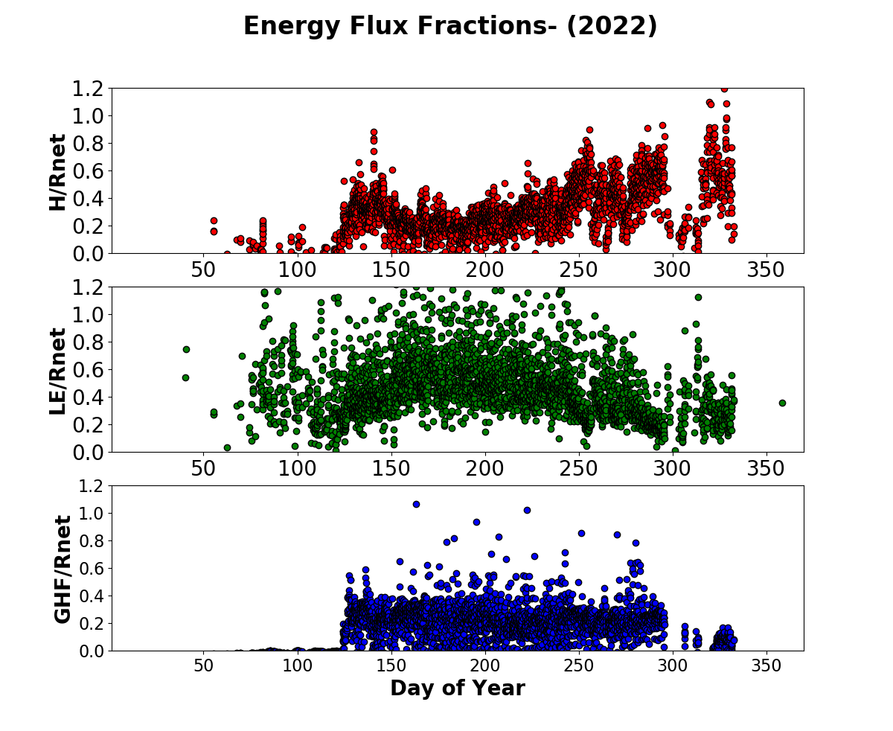

Slide 14
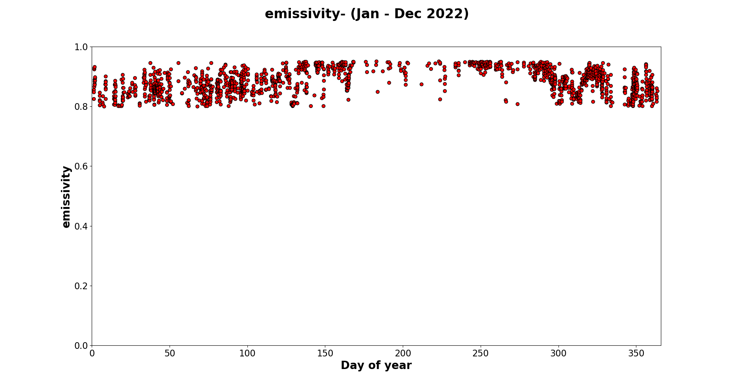

Slide 15
Plans for initial analysis
Time series of SEB over seasons
Look at soil E and plant T (model -data synthesis)
Examine flat earth LSM parameterizations with our data from the flux tower sites
Examine the seasonal change in z0
Examine BL profiles and influence of surface data—-triggers CI
generate gapfilled data sets for model evaluation
BLH and stability effects on surface turbulence

