Slide 1
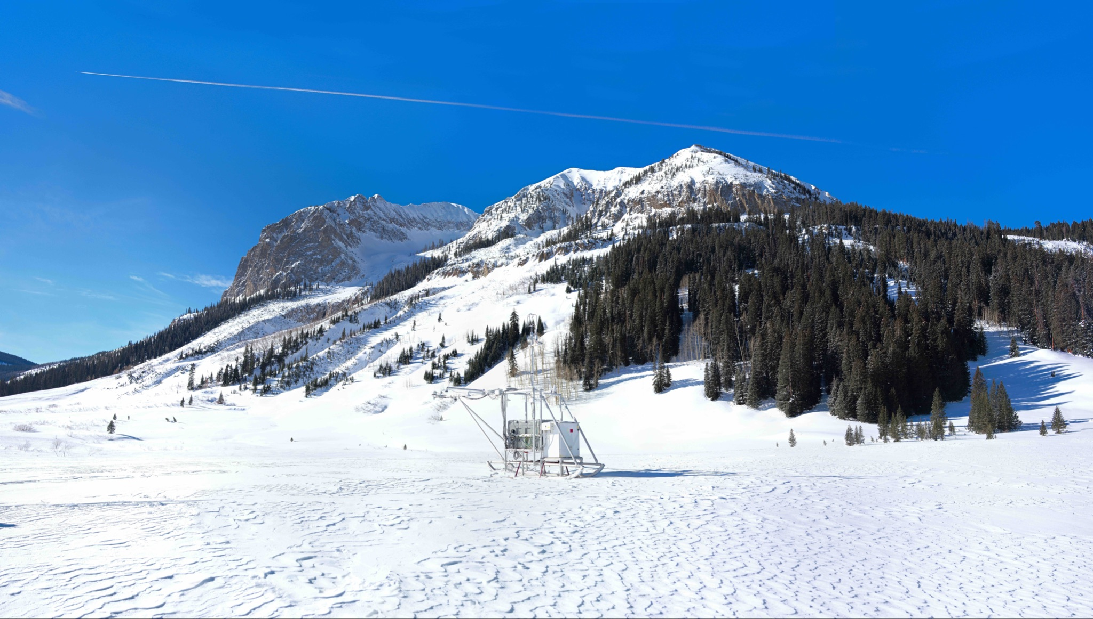




Springtime observations of surface energy and hydrologic variables over ablating snow in Colorado’s East River Watershed in 2022 and 2023
Christopher J. Cox¹, Janet Intrieri¹, Brian Butterworth^{1,2}, Gijs de Boer^{1,2}, Michael R. Gallagher^{1,2}, Jonathan Hamilton^{1,2}, Erik Hulm³, Tilden Meyers⁴, Sara Morris⁵, Jackson Osborn¹, P. Ola G. Persson^{1,2}, Benjamin Schmatz³, Matthew D. Shupe^{1,2}
¹ Physical Sciences Laboratory
2
3
⁴Air Resources Laboratory
⁵Global Monitoring Laboratory

Slide 2
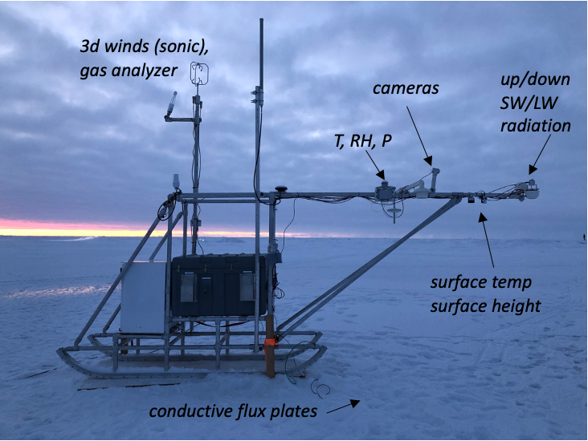
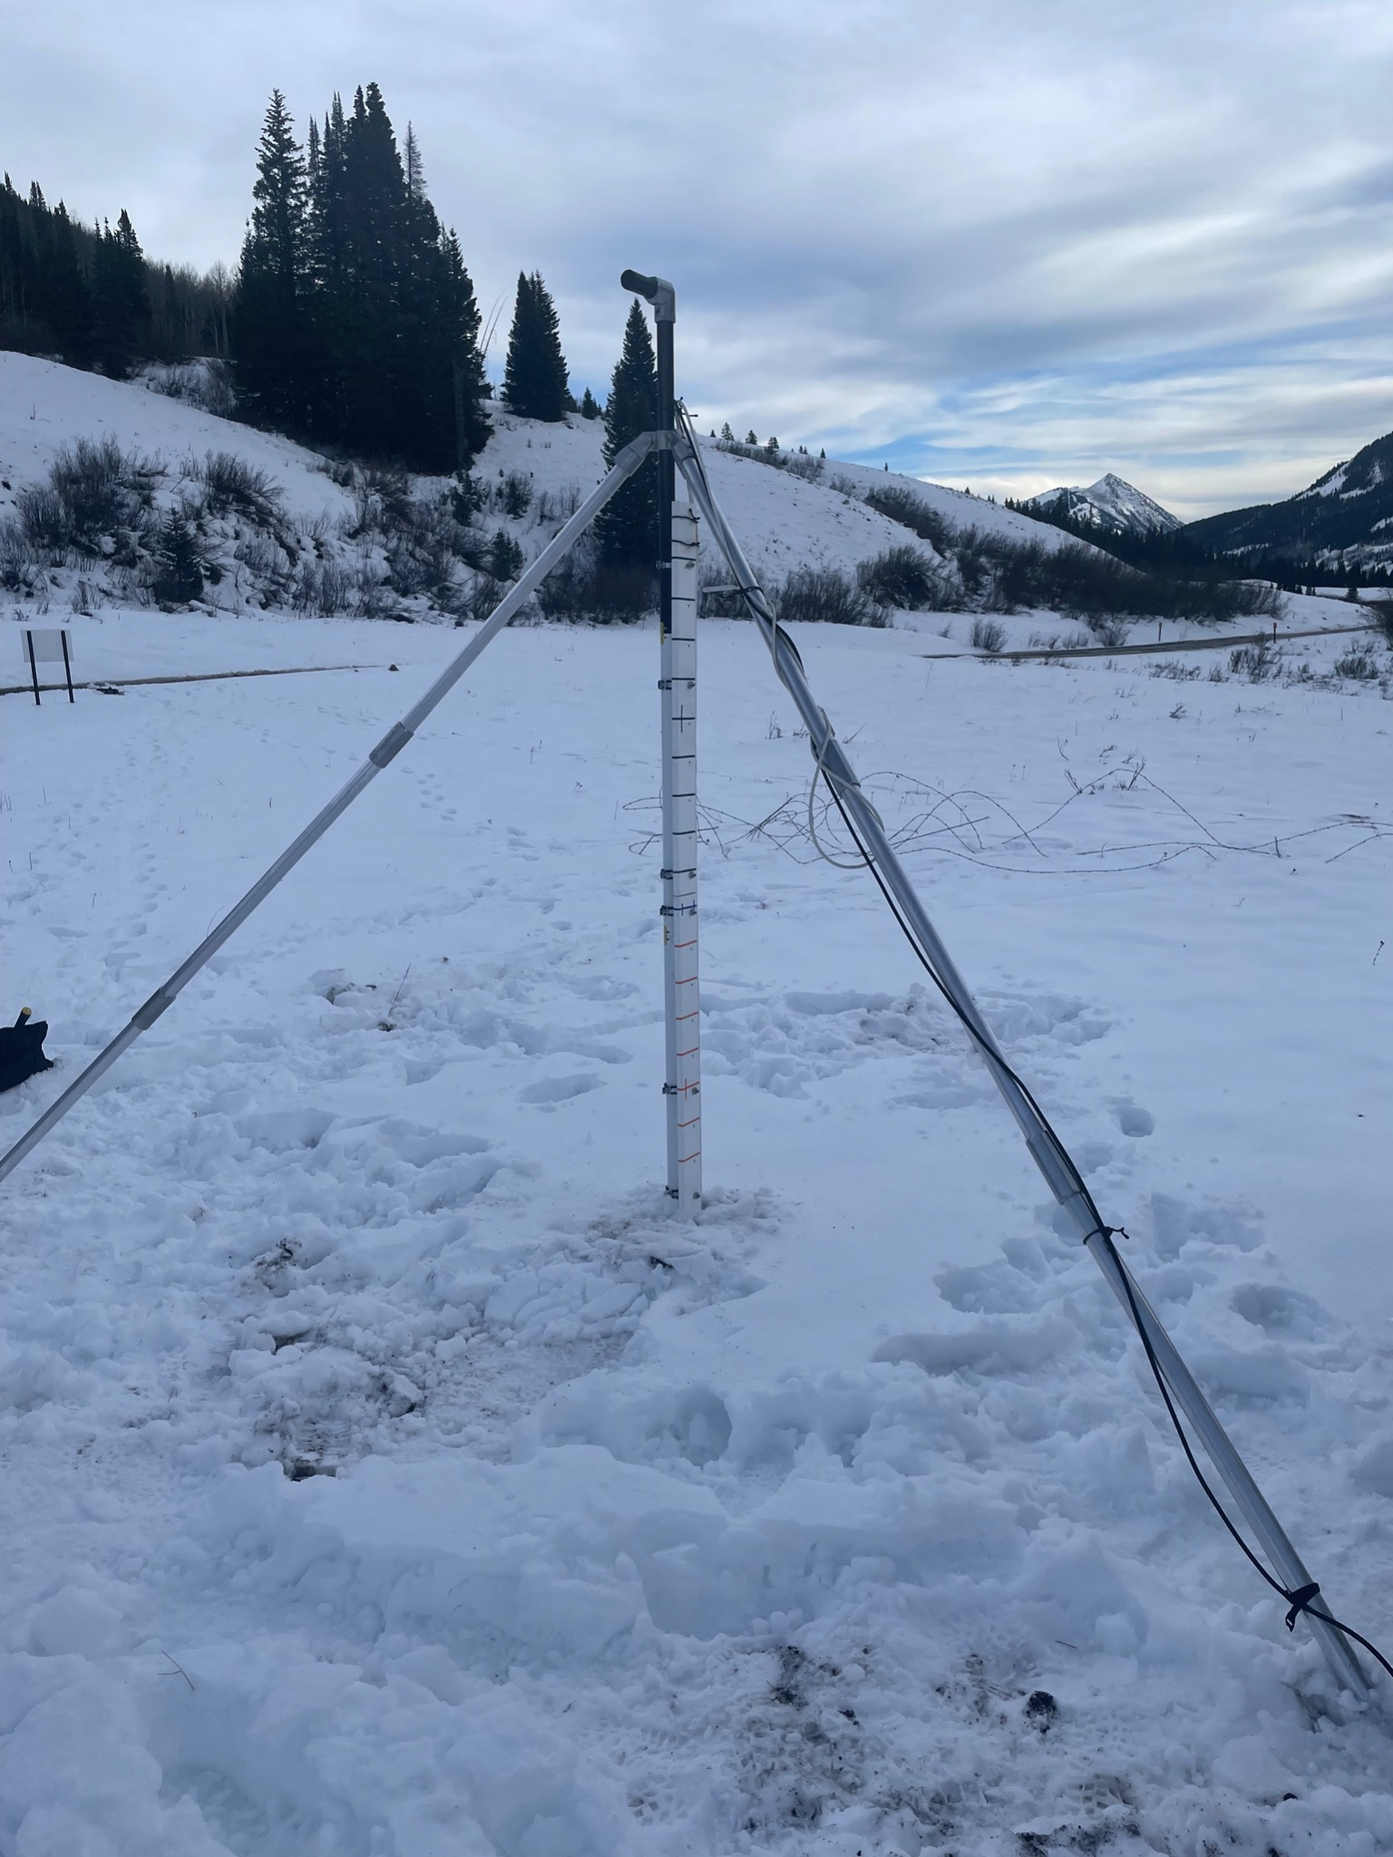
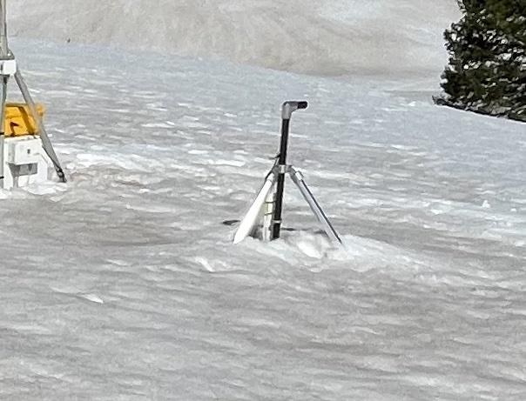
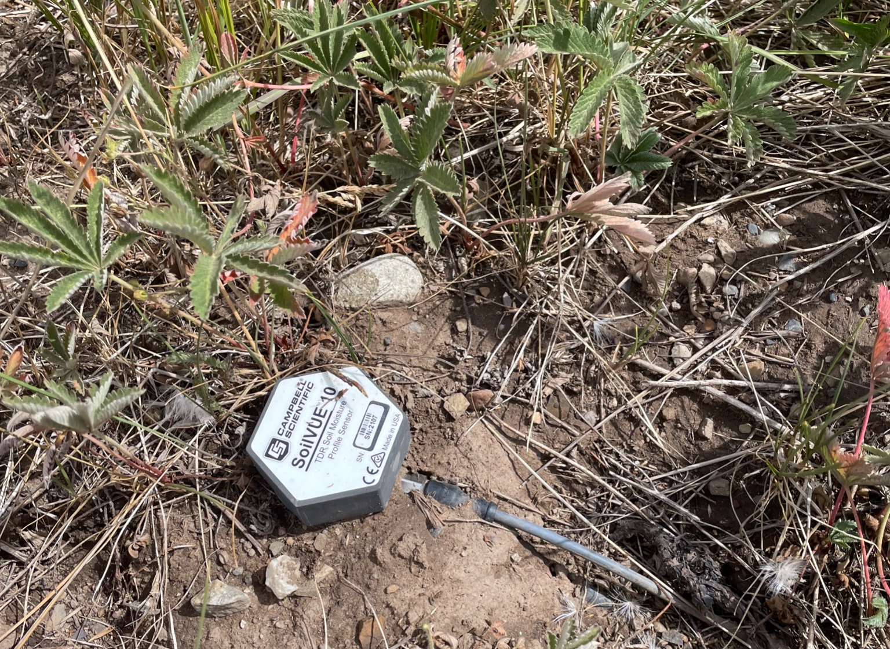
Atmospheric Surface Flux Station (ASFS)
Thermistor String (Avery year 2)
MOSAiC -> SPLASH
Soil T/VWC Probe

Slide 3
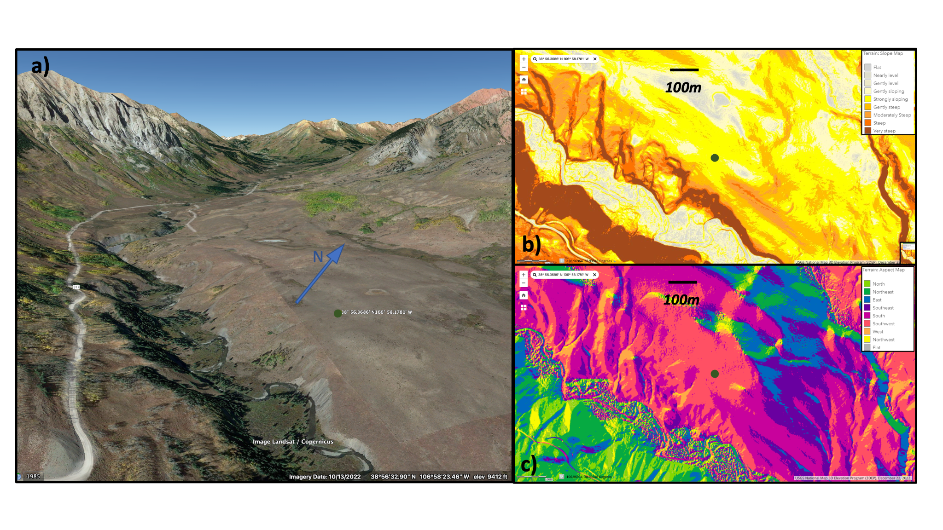
Kettle Ponds Annex (south of Gothic)

Slide 4
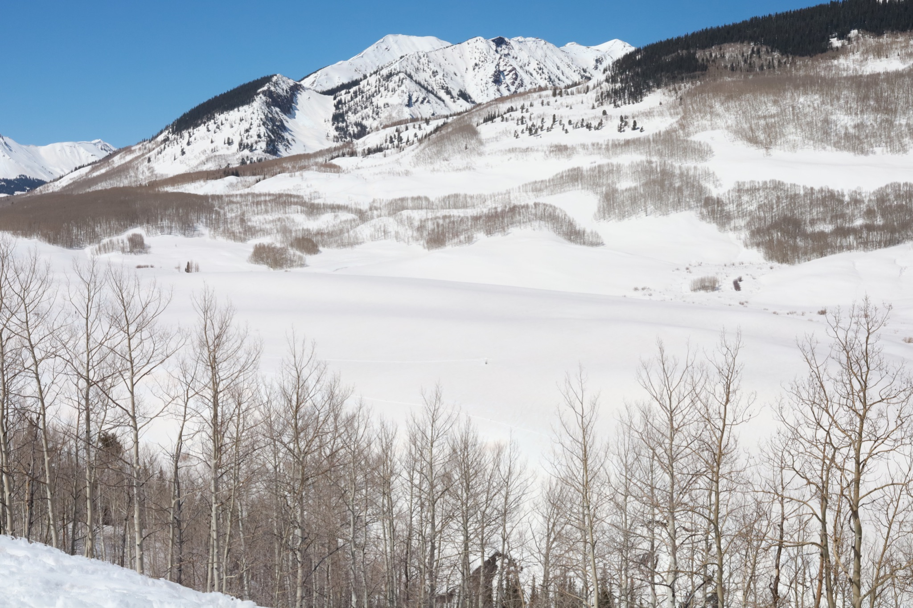
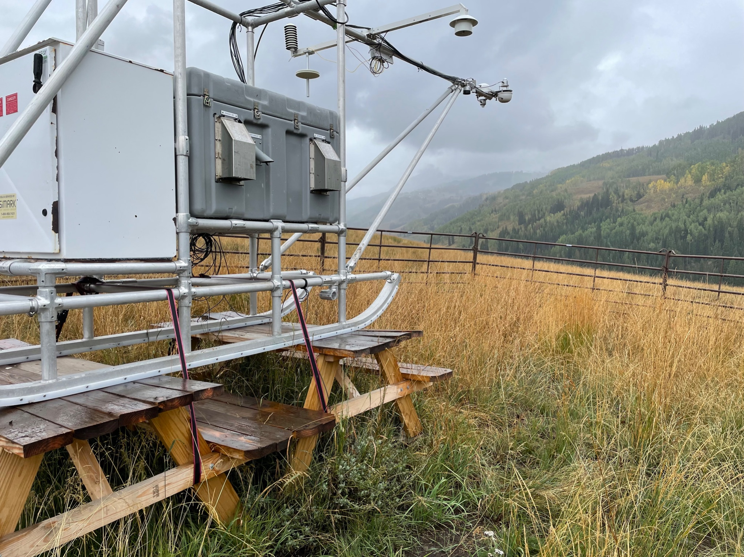
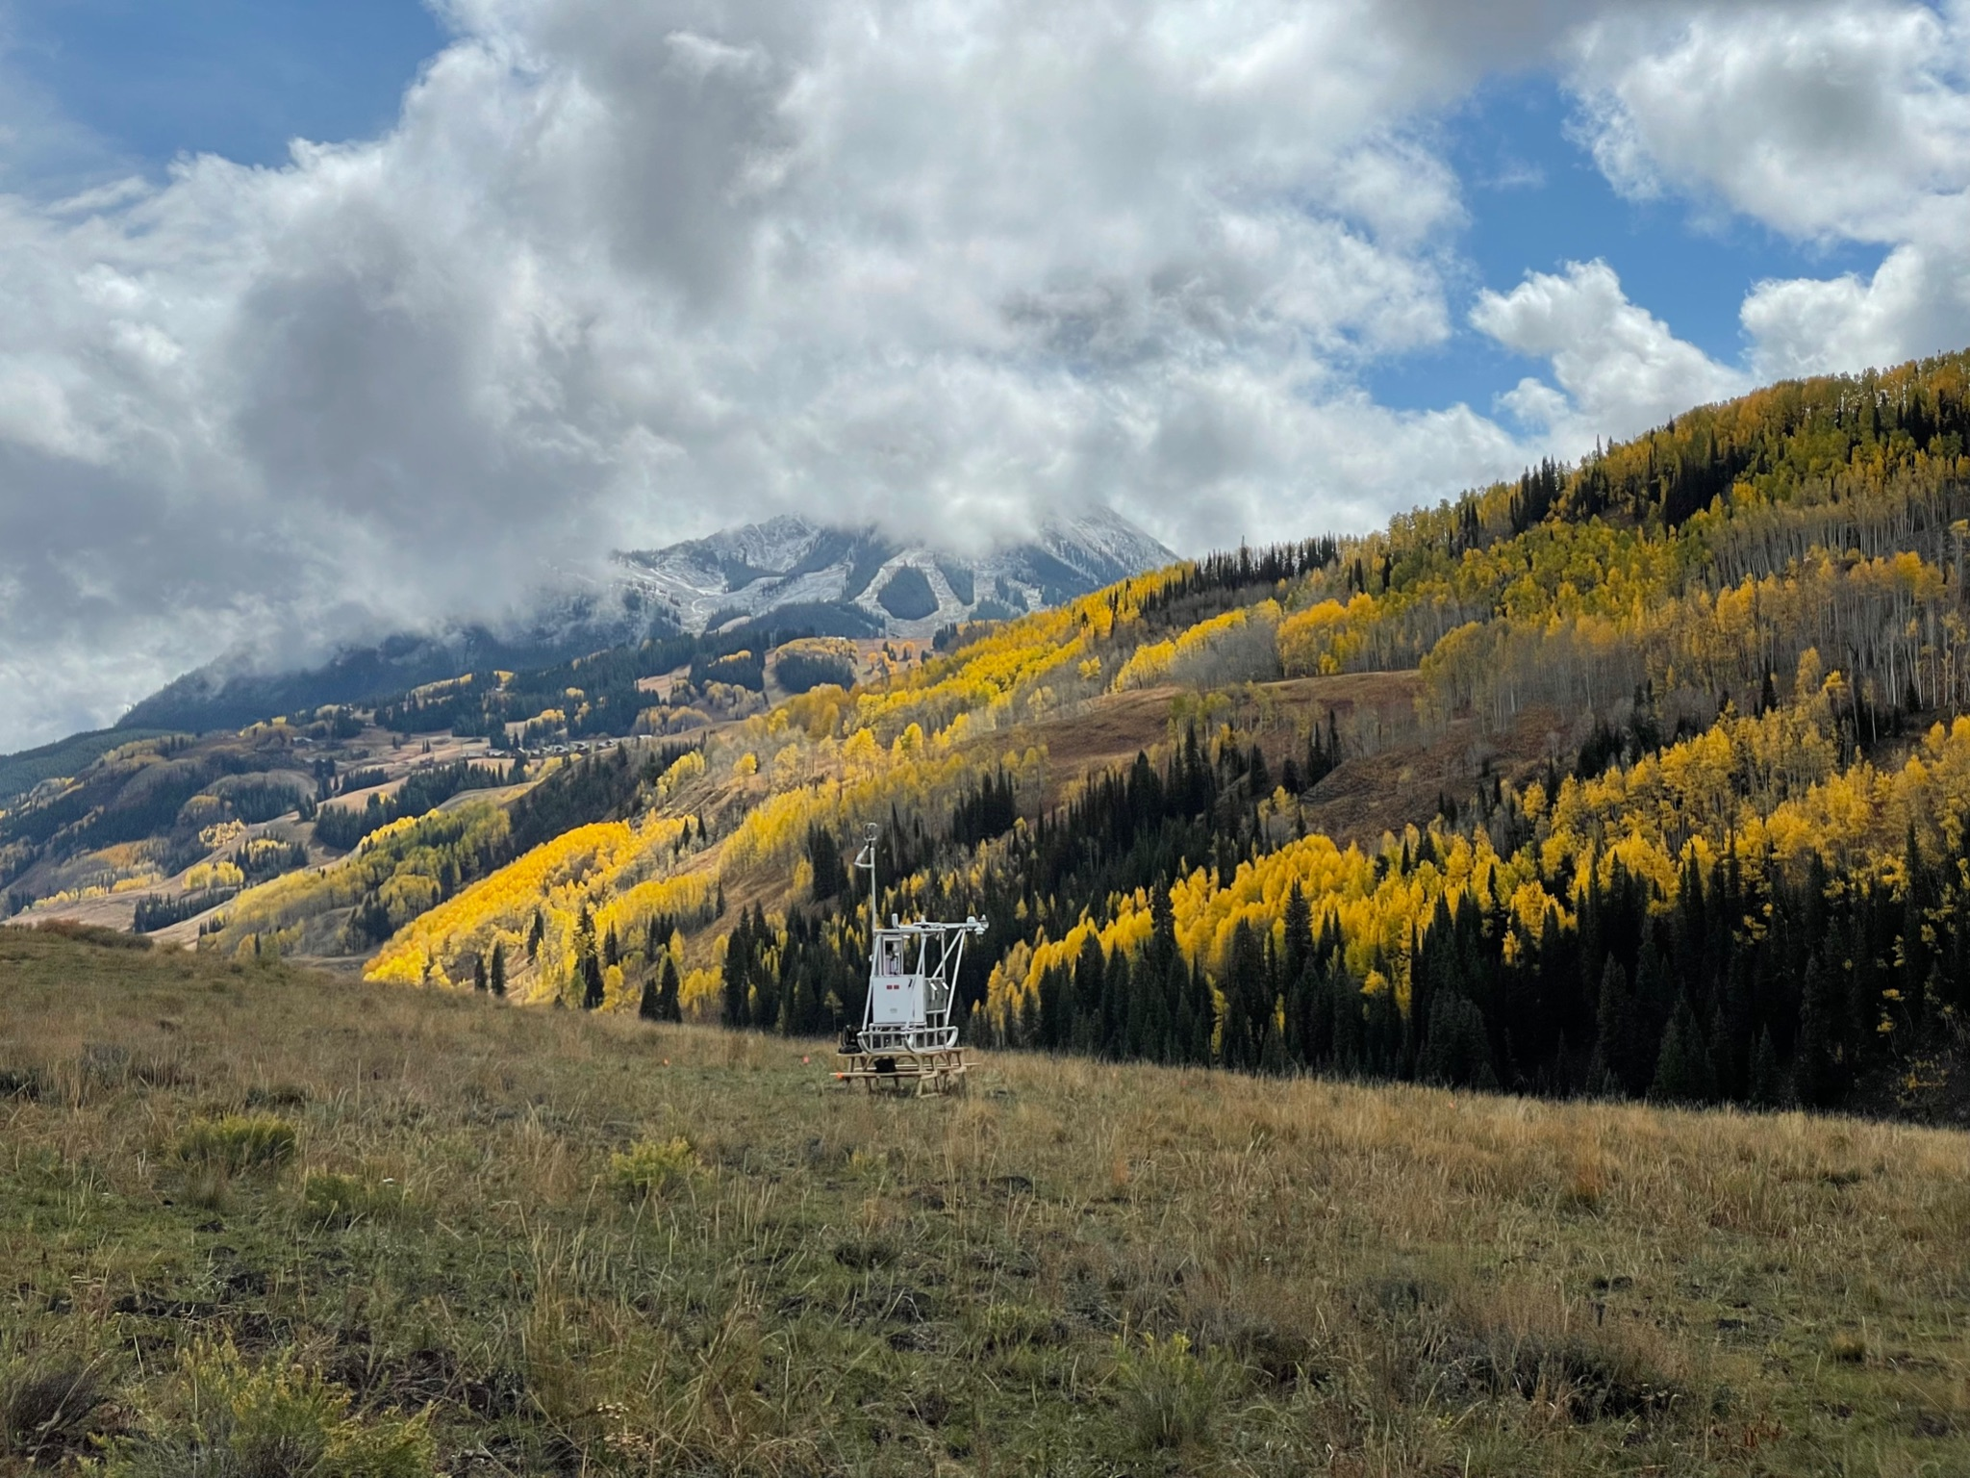
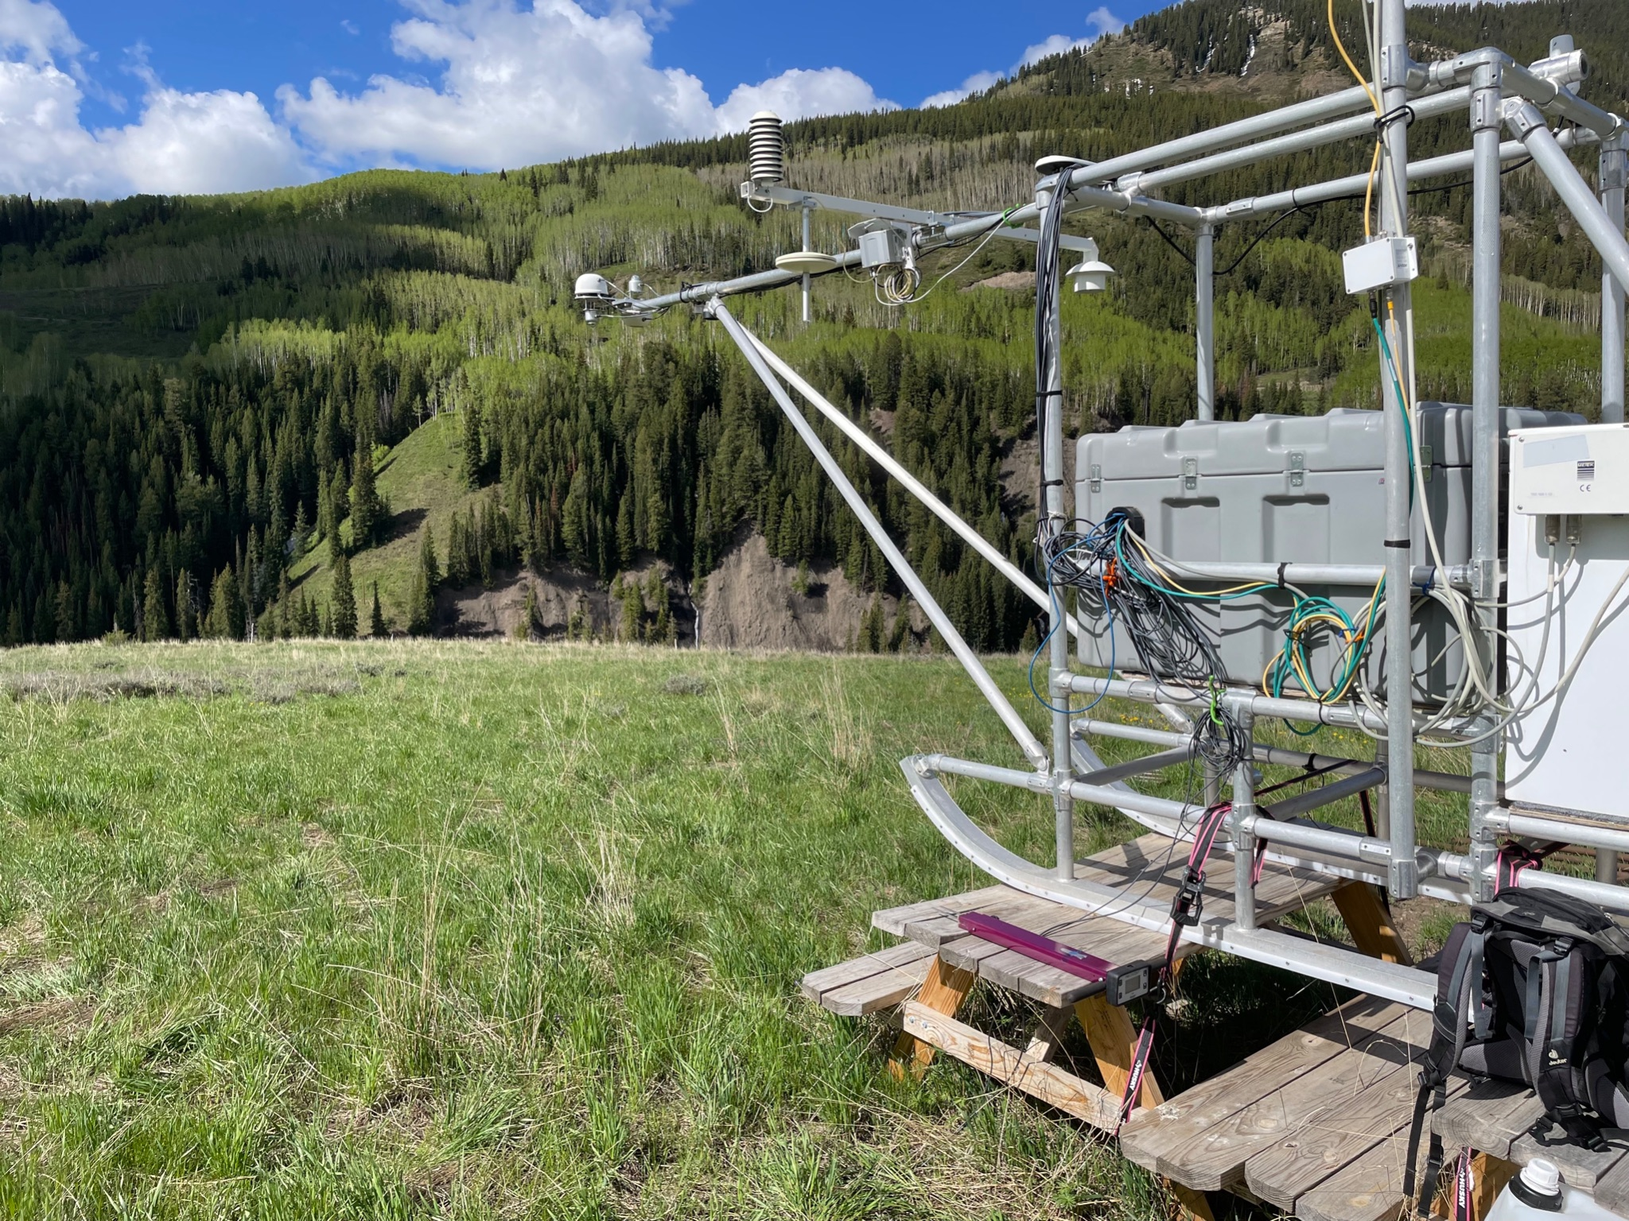
Kettle Ponds Annex (south of Gothic)
October
September
February
KPA
June

Slide 5
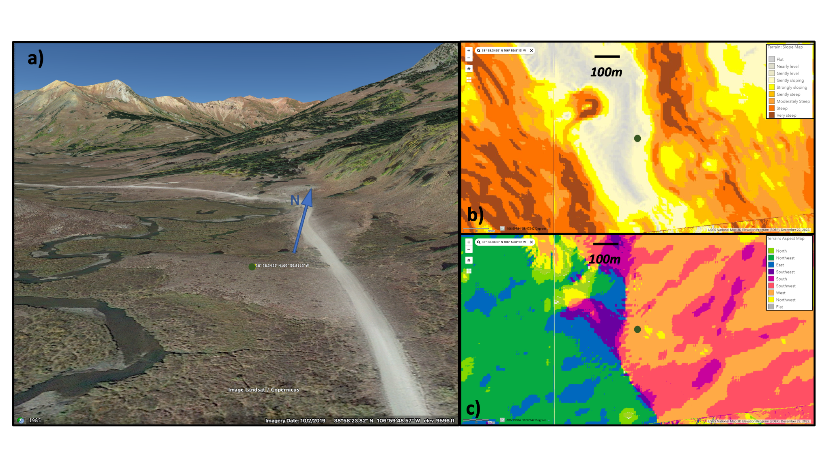
Avery Picnic (north of Gothic)

Slide 6
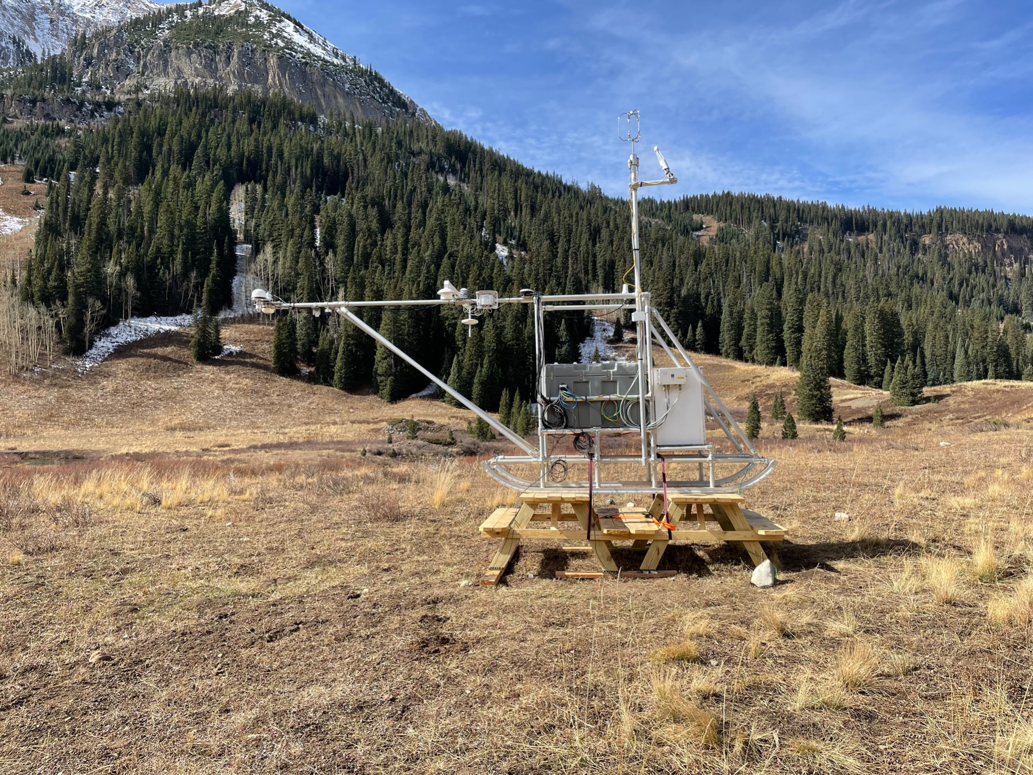
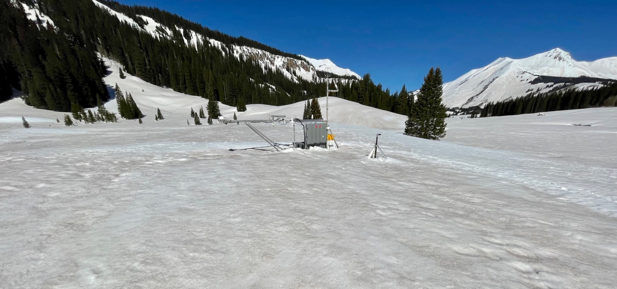
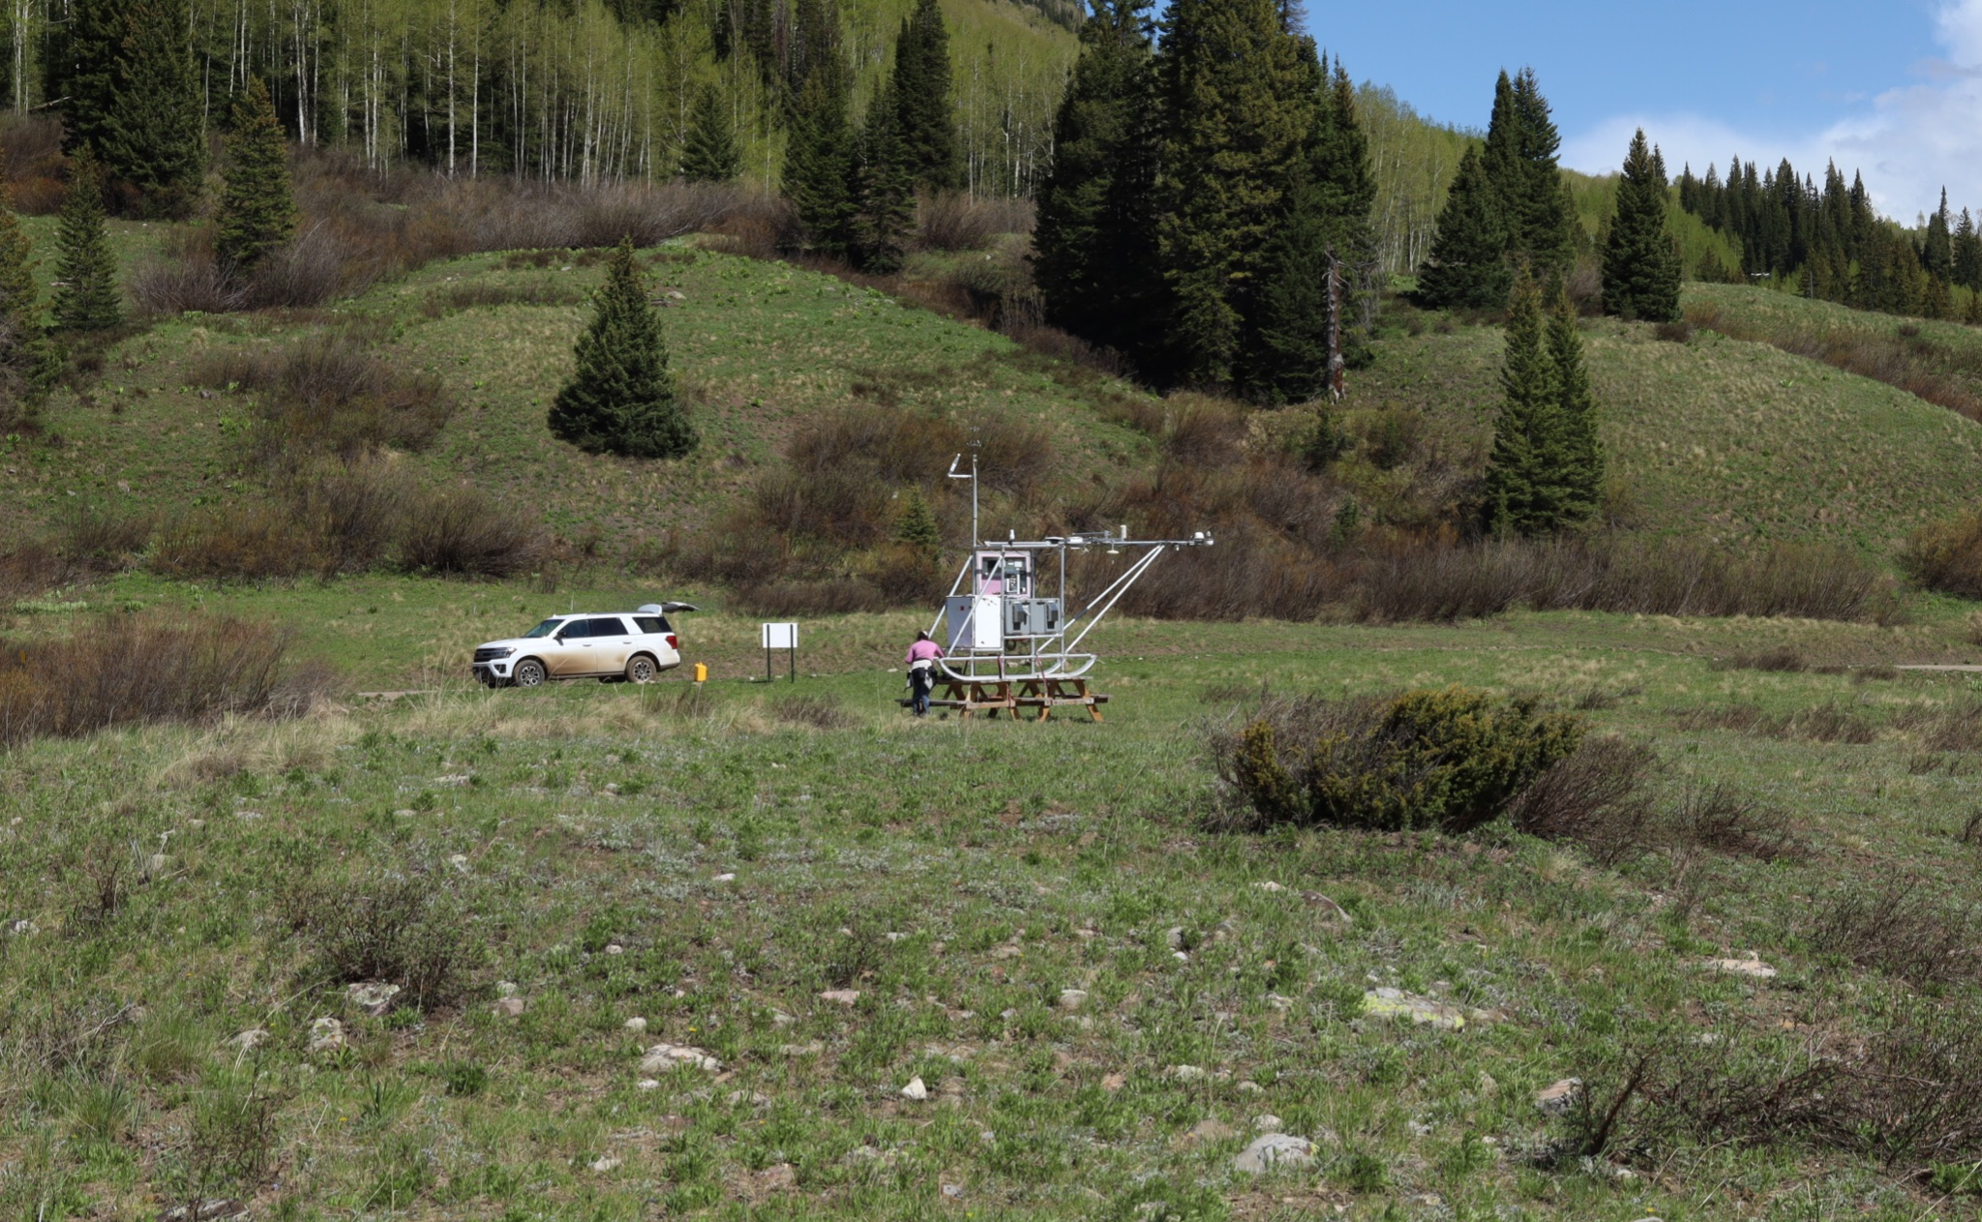
Avery Picnic (north of Gothic)
April
October
January
June
Photo: M. Gallagher

Slide 7
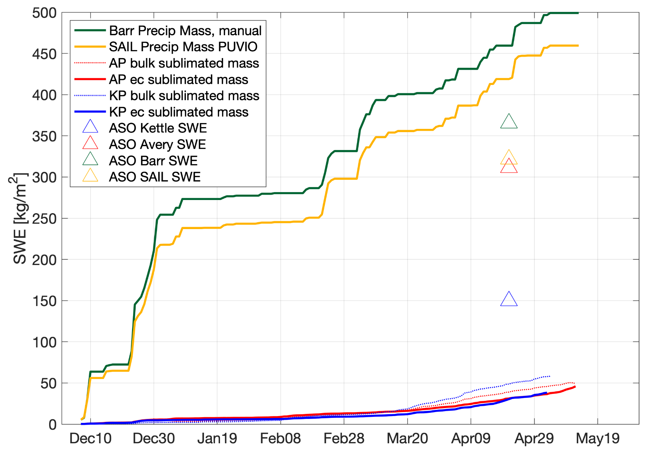
Sublimation
Winter 2021-2022
Spring 2022 Gothic cumulative snow precipitation mass 460-500 kg/m² (SWE on ground is less).
Bulk calculation of sublimated mass > than EC measurement.
EC suggests larger loss at Avery because of longer period of snow cover.
Average of all data: sublimation loss was 10% of input in WY2022 at SPLASH.
Most sublimation after peak SWE.
Peak SWE

Slide 8
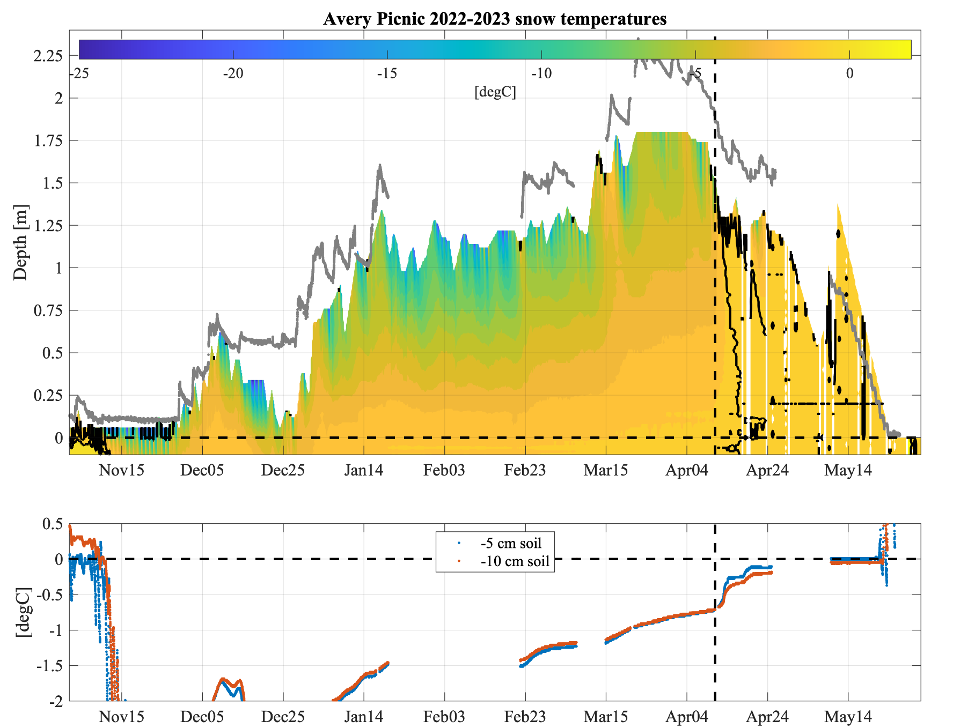
Thermistor String
Winter 2022-2023
Dust April 11 (albedo ~ 0.6)
Dust event (primarily Apr 3-4) generates melt.
Snowpack -> isothermal: likely caused by percolating meltwater.
Soil response is to warm/(thaw) beneath 1.25 m of snow ~ 1 month before snow-free.

Slide 9
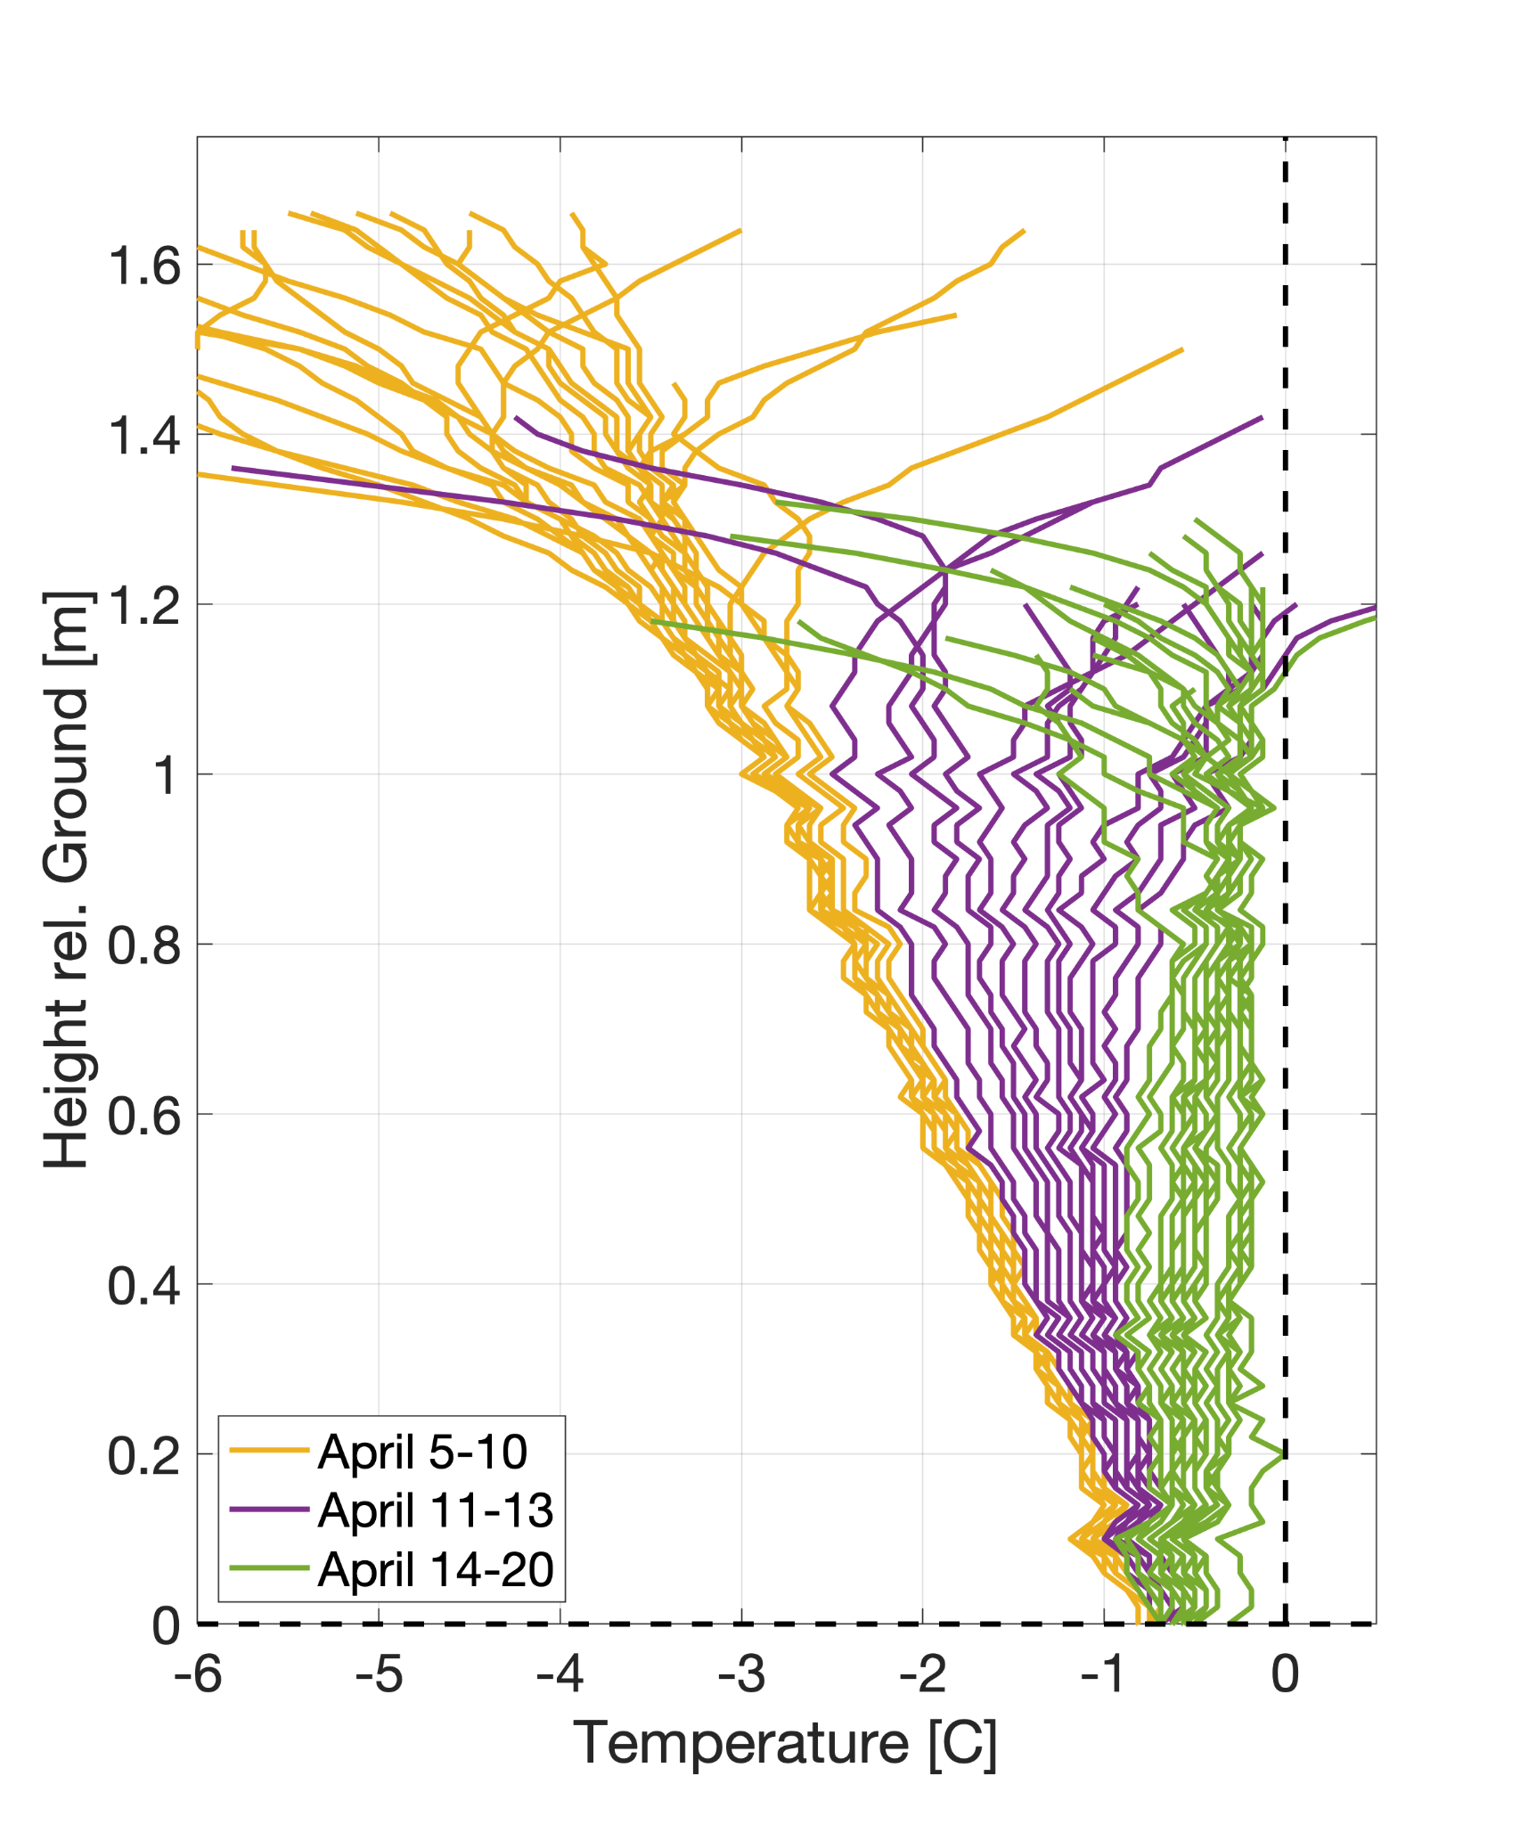
Thermistor String
Winter 2022-2023
xxxxxx
Peak SWE

Slide 10
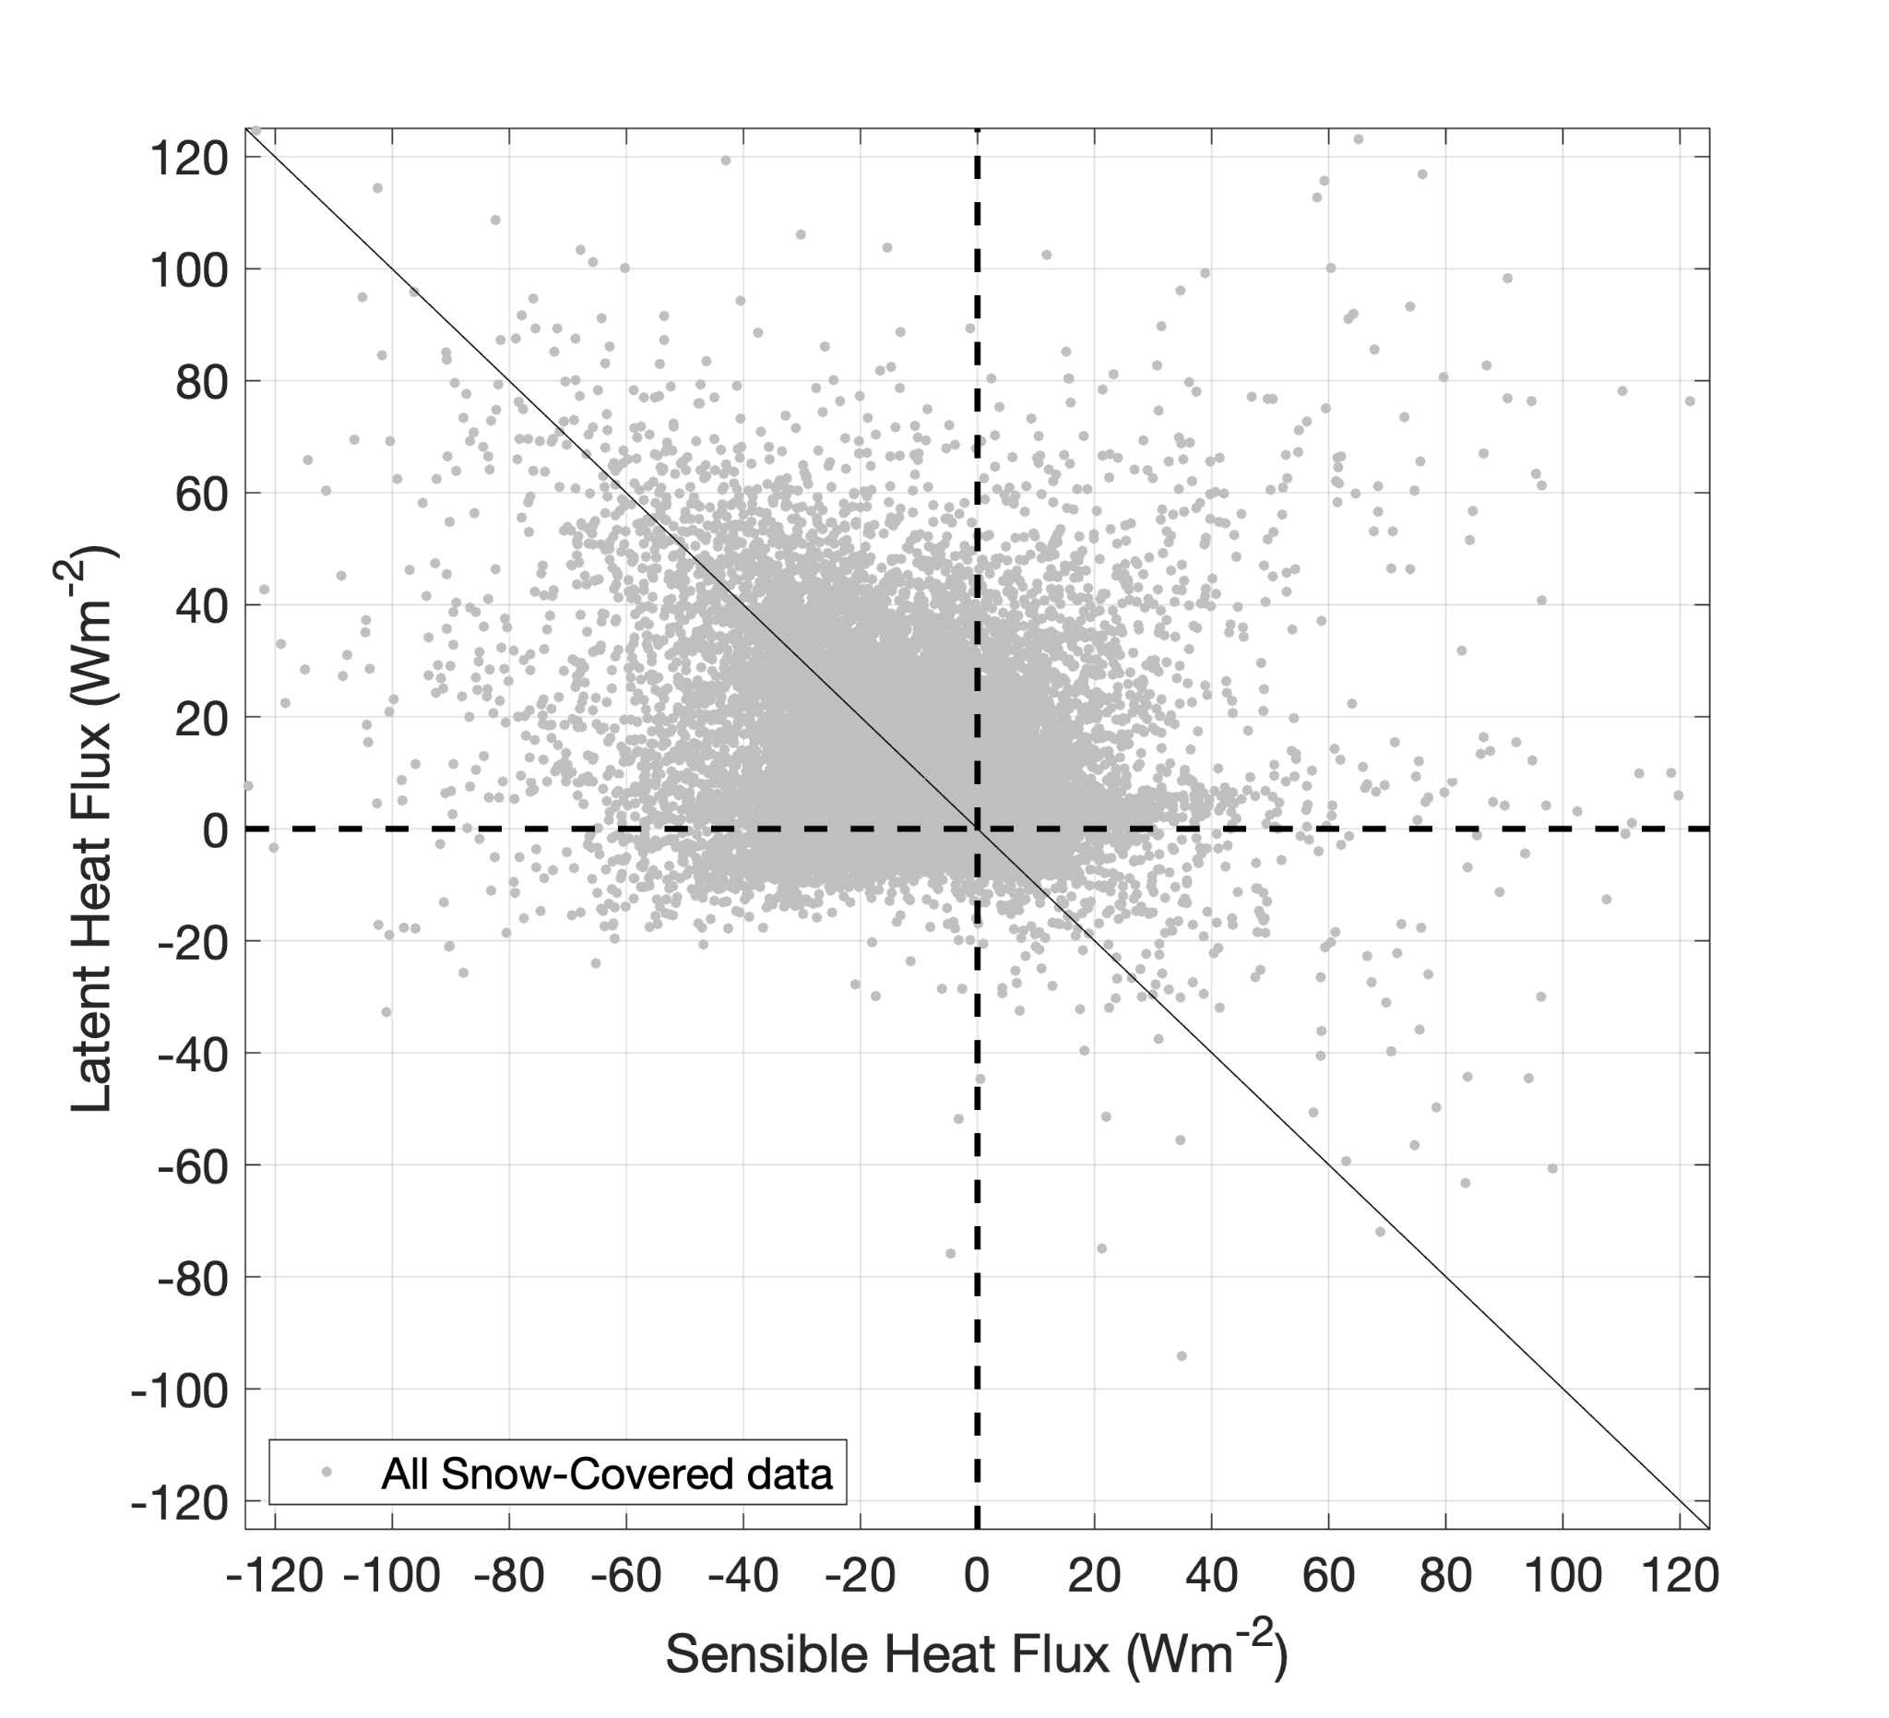
Sublimation
Snow-covered period:
  Uncorrelated in aggregate

Slide 11
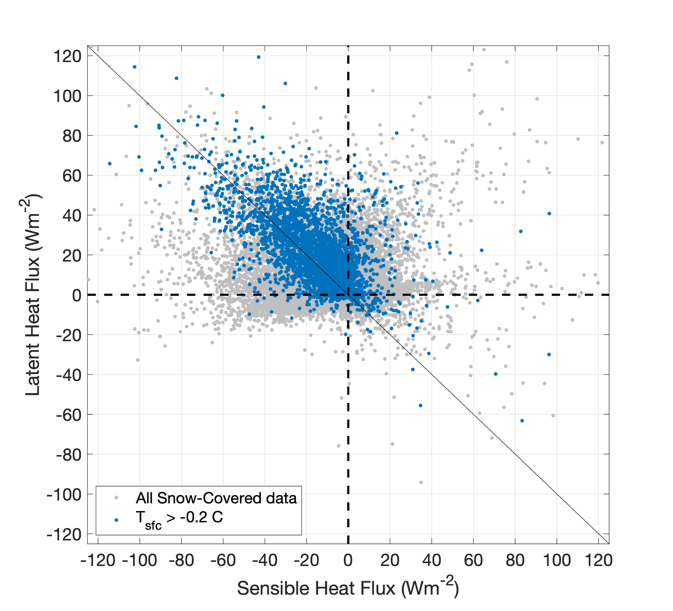
Sublimation
Snow-covered period:
  Uncorrelated in aggregate
  Two regimes: T_{air} > 0 C & T_{air} < 0 C

Slide 12
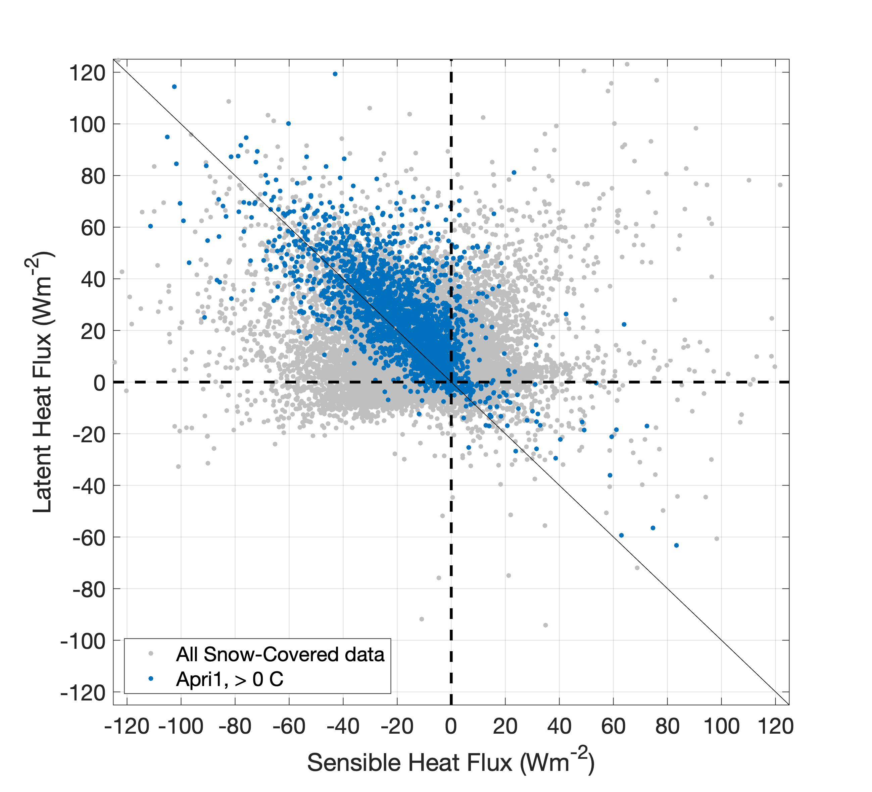
Sublimation
Snow-covered post-peak SWE period:
  Uncorrelated in aggregate
  Two regimes: T_{air} > 0 C, April

Slide 13
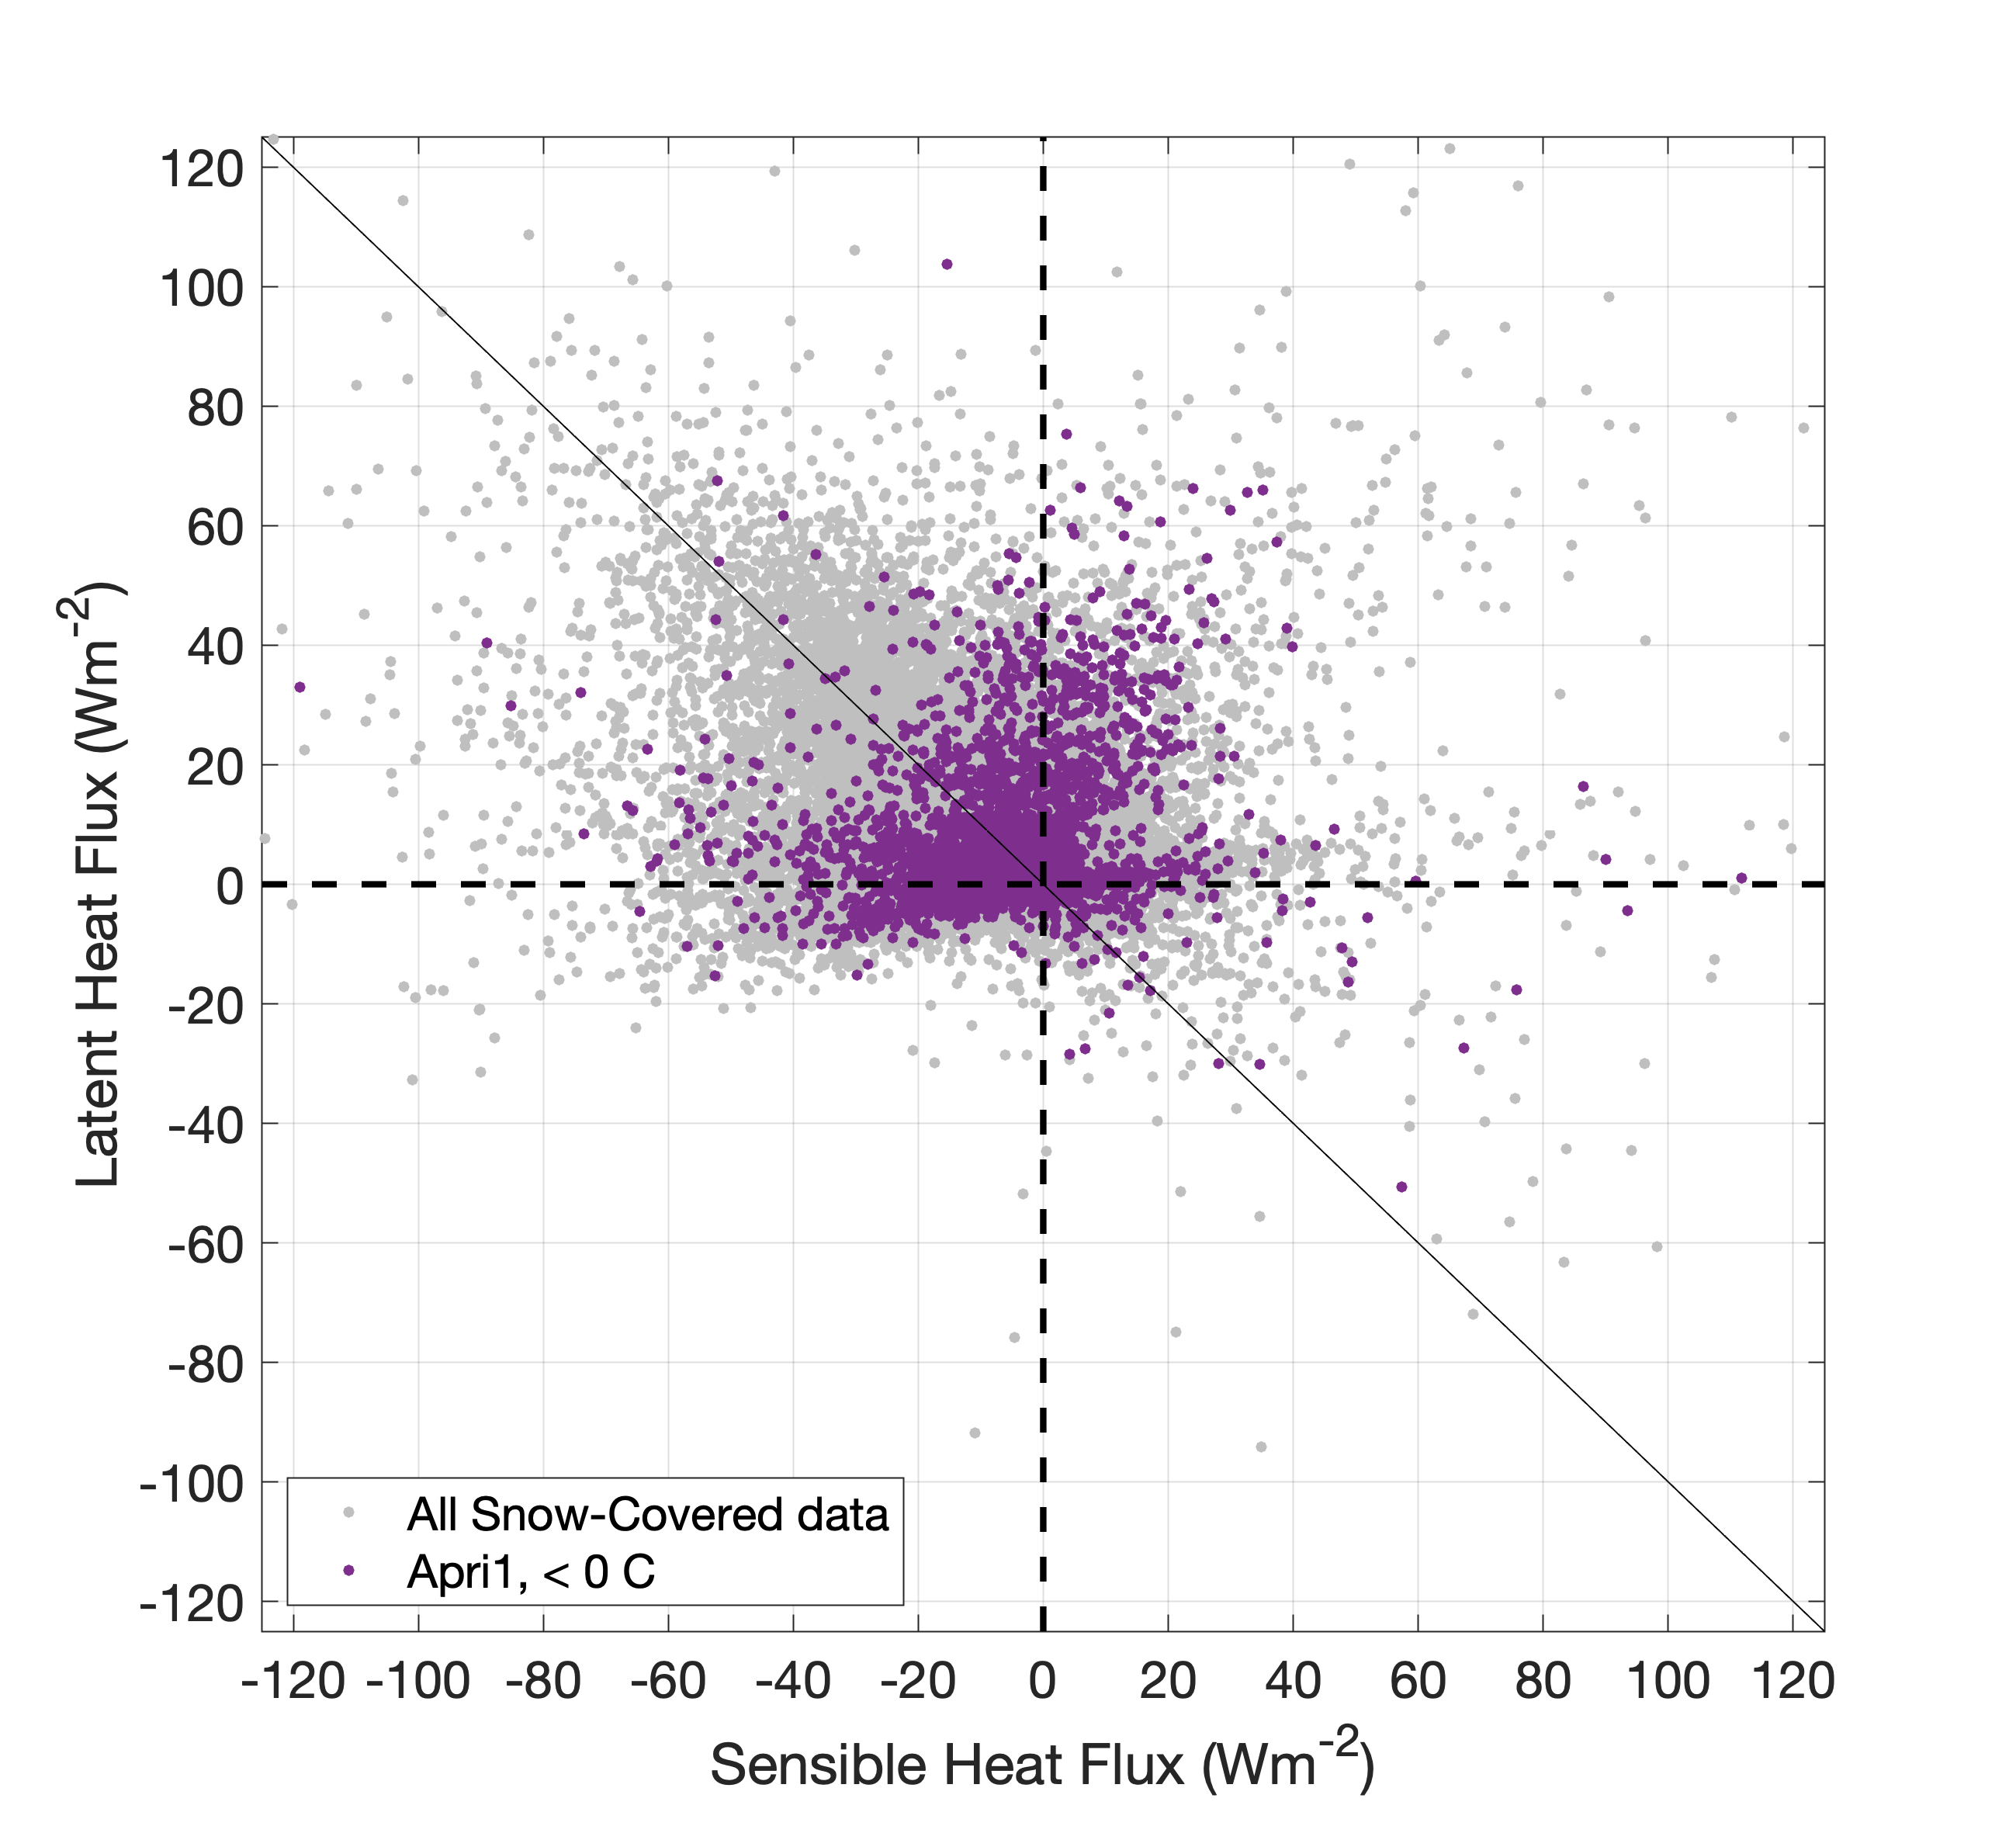
Sublimation
Snow-covered post-peak SWE period:
  Uncorrelated in aggregate
  Two regimes: T_{air} < 0 C

Slide 14
Sublimation
Snow-covered period:
  Uncorrelated in aggregate
  Two regimes: T_{air} > 0 C
~ balance of sensible and latent heat fluxes is unexpected.
…but maybe not surprising in the case where sensible heat flux is a driver and conduction/outgoing LW are suppressed.
Q_{forcing} = H_{sensible} + H_{latent} + LWU - C + Melt
Radiative forcing
Turbulent, radiative, conductive, melt responses

Slide 15
Sublimation
Snow-covered period:
  Uncorrelated in aggregate
  Two regimes: T_{air} > 0 C
~ balance of sensible and latent heat fluxes is unexpected.
…but maybe not surprising in the case where sensible heat flux is a driver and conduction/outgoing LW are suppressed.
May be a melt->evaporation regime
Q_{forcing} - H_{sensible} = H_{latent} + LWU - C + Melt
Radiative, turbulent forcing
Turbulent, radiative, conductive, melt responses

Slide 16
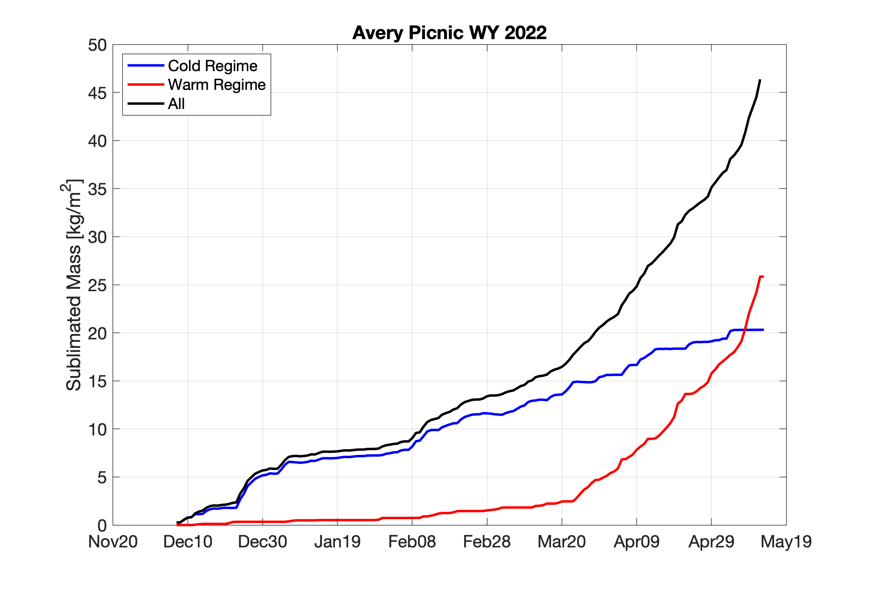
Sublimation
Peak SWE

Slide 17
(Preliminary) Conclusions
Wintertime sublimation ~40-46 kg/m⁻² (8-10% of input) in WY2022.
Initial rapid ablation events coincide with wetting/thawing response in soil & isothermal response in snowpack: we interpret as percolating meltwater.
Post-peak SWE sublimation dominated by tendency to balance turbulent sensible forcing in periods when above-freezing air in contact with surface.
  Balance due in part to constraints on conductive/LWU responses when snow surface ~ 0 C.
  When melt co-occurs, radiative and turbulent forcing apparently drive sublimation and melt, respectively. A curious partitioning…

Slide 18
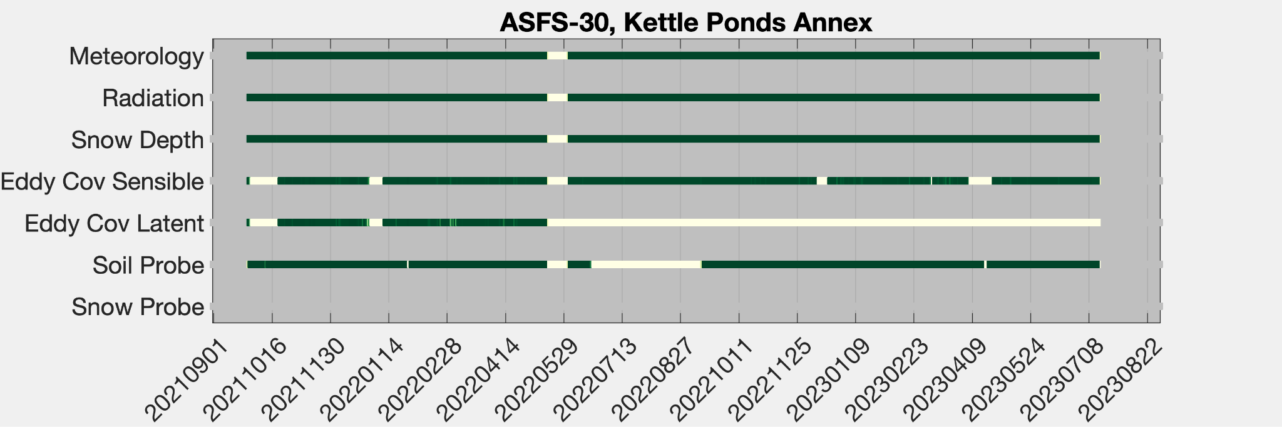
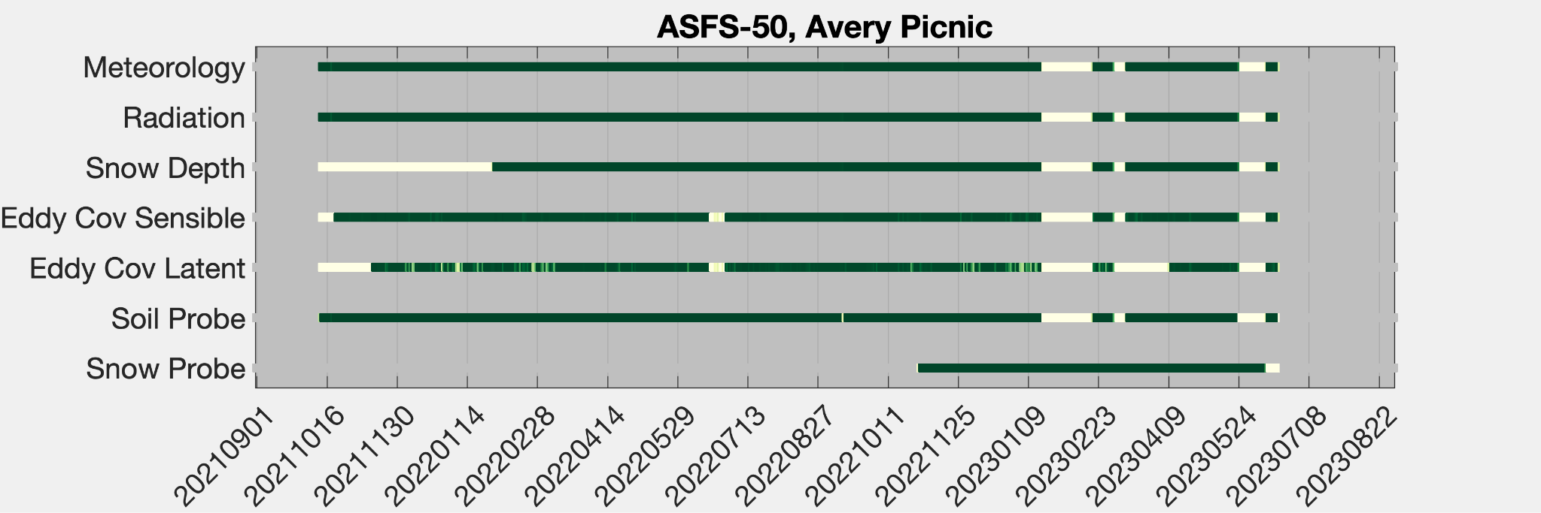
Uptime
28 September 2021 - 19 July 2023
]
]
97% uptime (most)
87% (latent)
only year 1
cable damage summer 2021
sensor not installed at this site
12 October 2021 - 21 June 2023
]
90% uptime (most)
74% (latent)
72% (snow)
]
only second winter

Slide 19
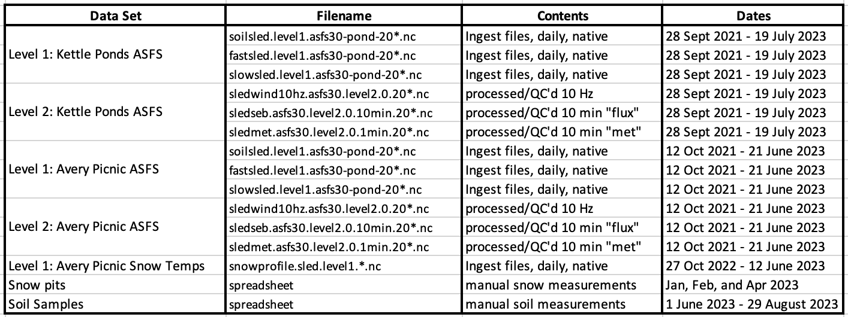
Looking forward…
Data paper in preparation for Earth System Science Data
Daily netCDF upload to Zenodo, planned for November 2023

