Slide 1
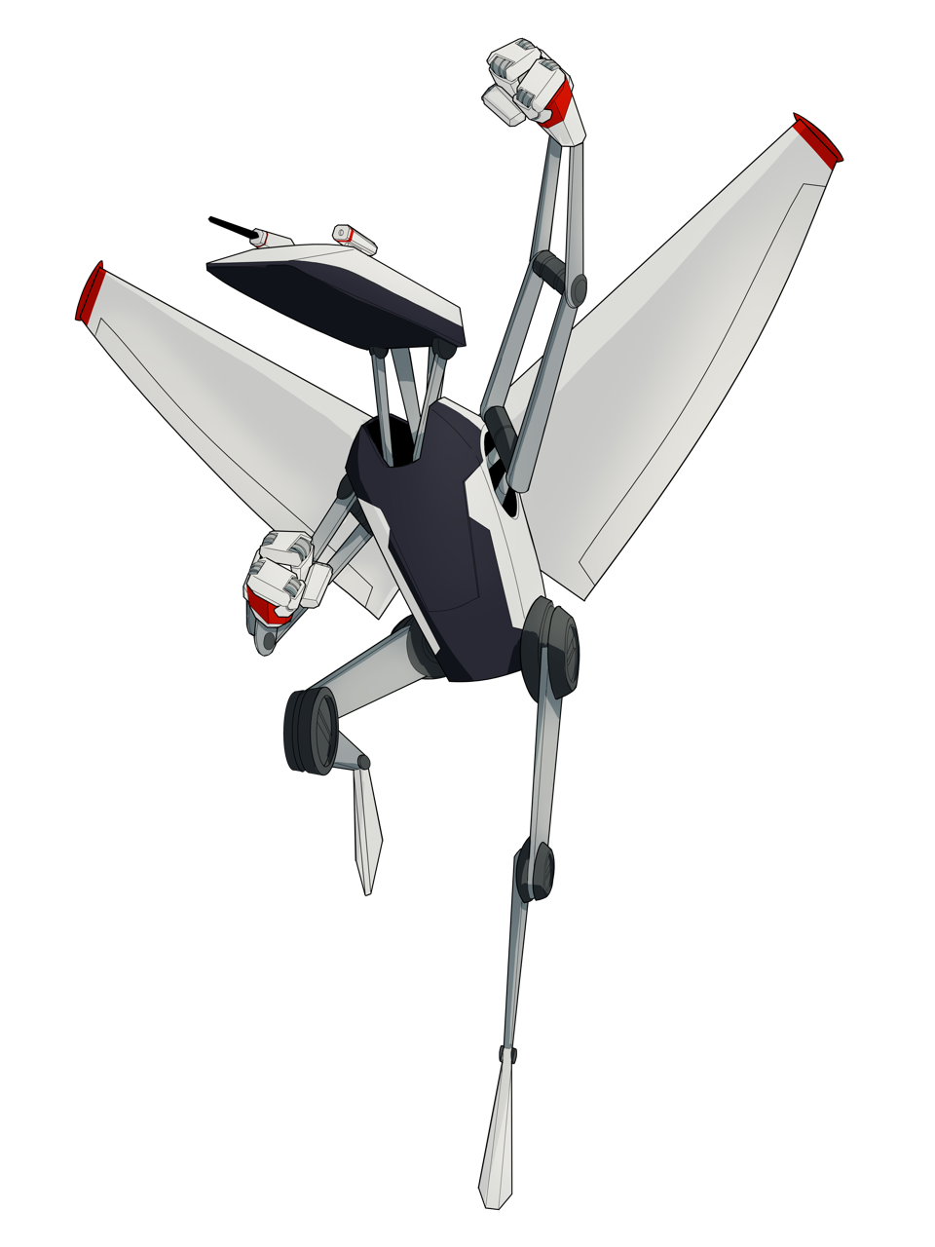


UAS-Based Observations of Surface Properties During SPLASH
Gijs de Boer
Janet Intrieri
Jonathan Hamilton
Darren Jackson
Jack Elston
Maciej Stachura
Jake Longenecker
Michael Rhodes
Brian Argrow

Slide 2
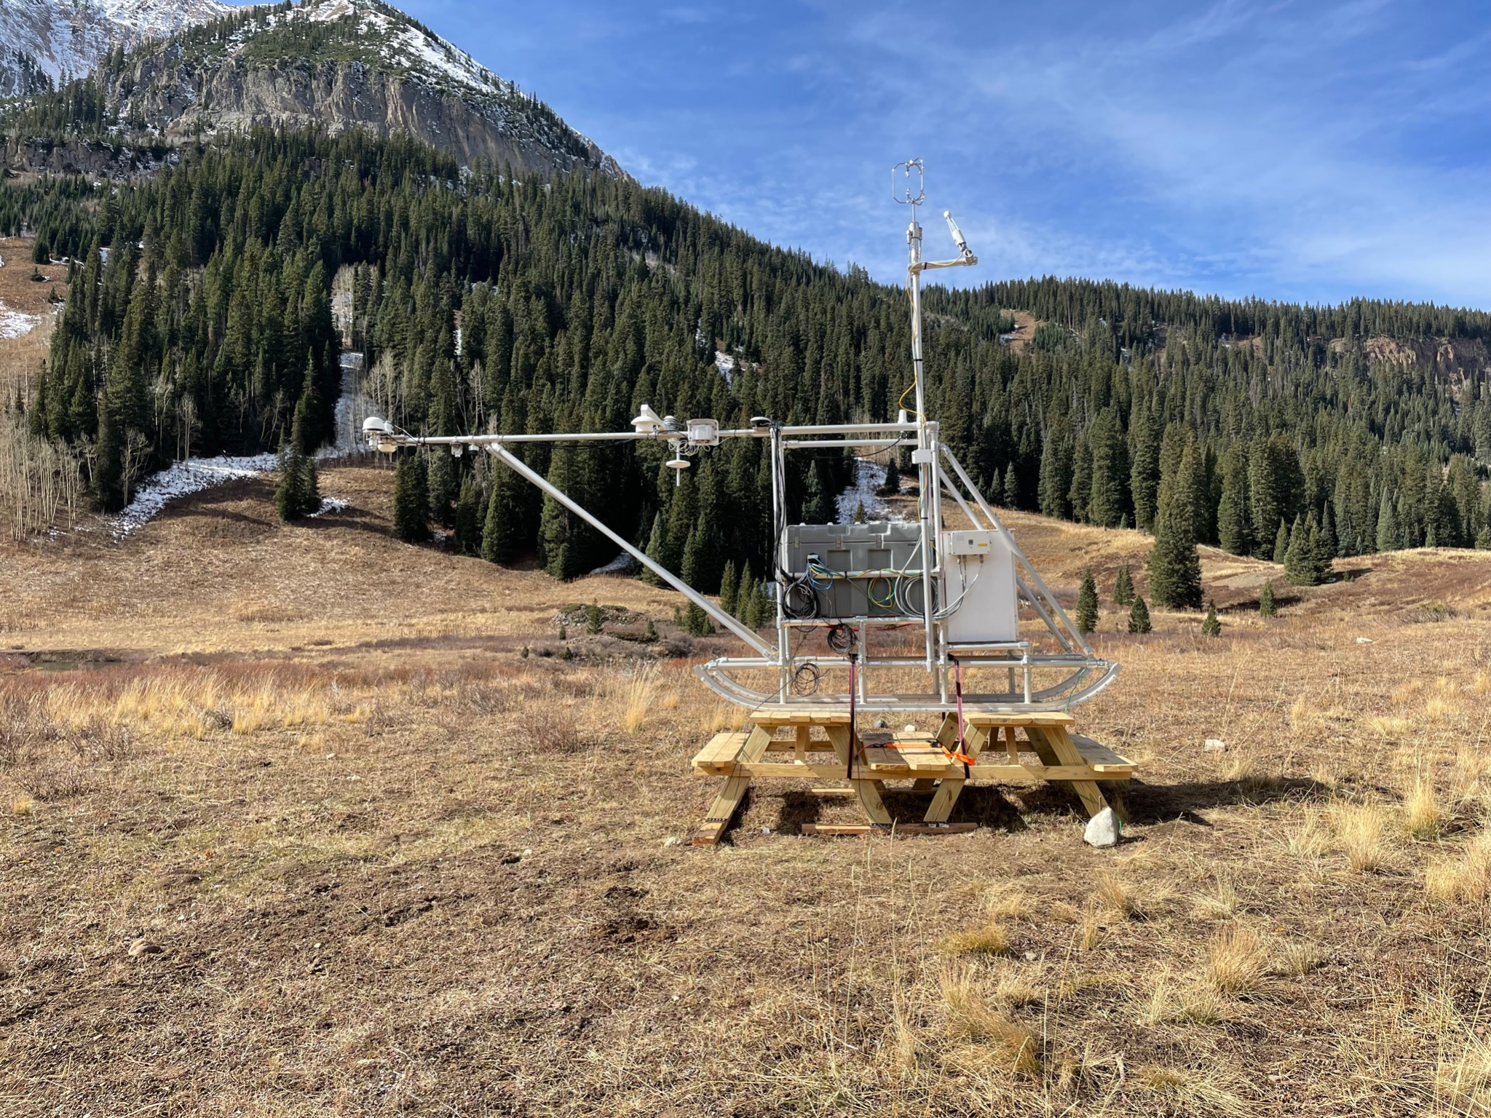
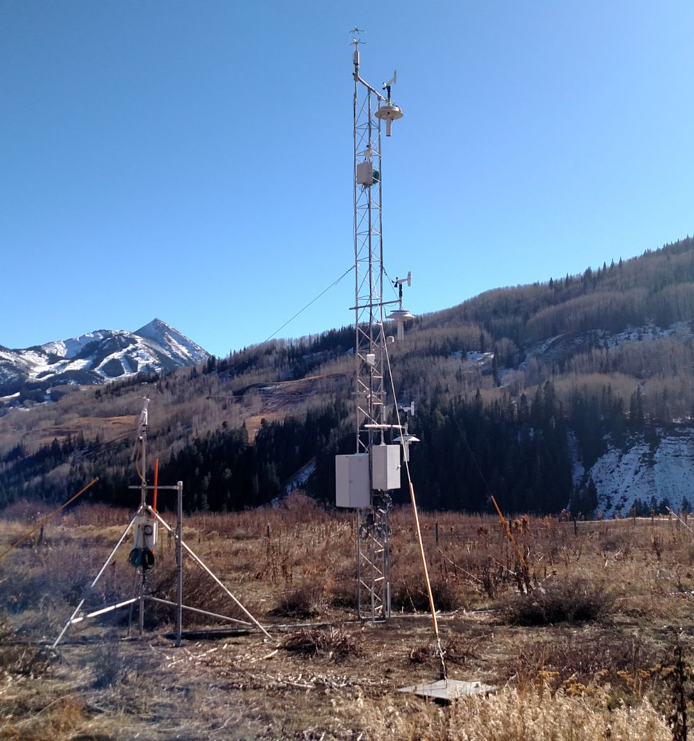
Traditional Surface Sensing

Slide 3
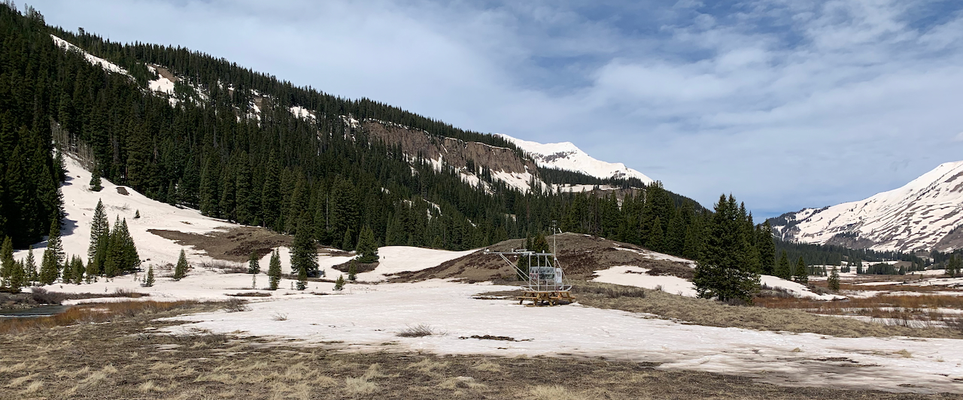
Traditional Surface Sensing

Slide 4
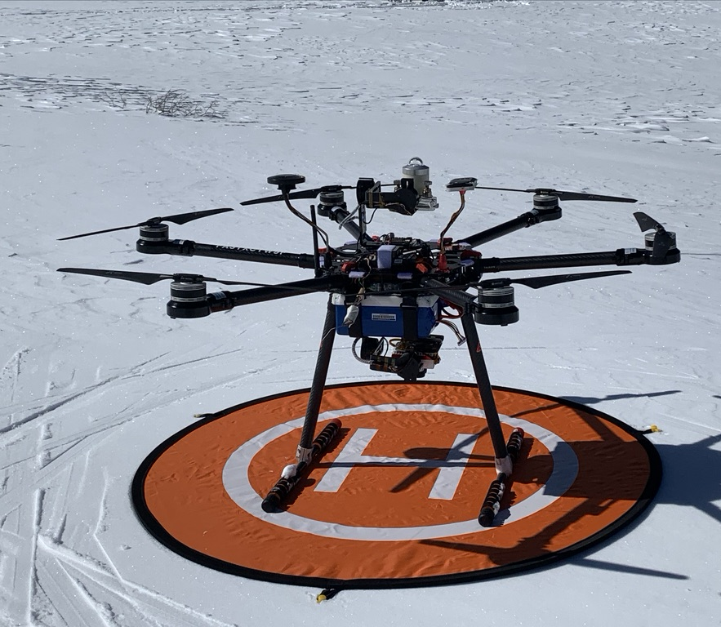
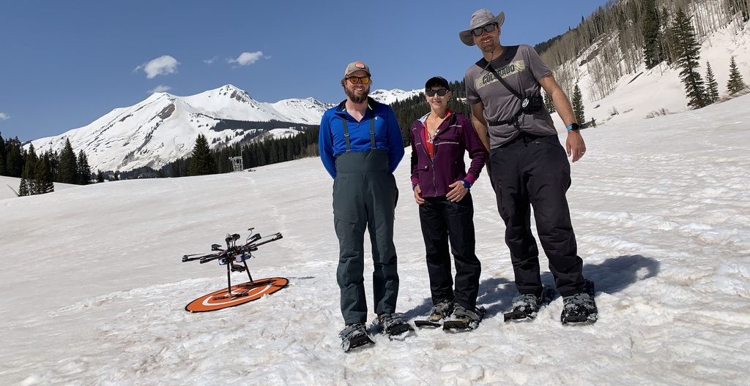
UAS/Sensor Systems and Deployment Timeline
Stabilized Kipp and Zonen Pyranometer (x2)
University of Colorado HELiX (left) deployed with custom Kipp and Zonen PR-1 Pyranometers and multispectral camera to measure up- and downwelling shortwave irradiance, albedo, surface features, NDVI, and more.
Deployments in March, April, May, and June 2022.
Observed impacts of dust on snow and surface albedo evolution over spatial area.
RedEdge-MX 5 channel Camera

Slide 5
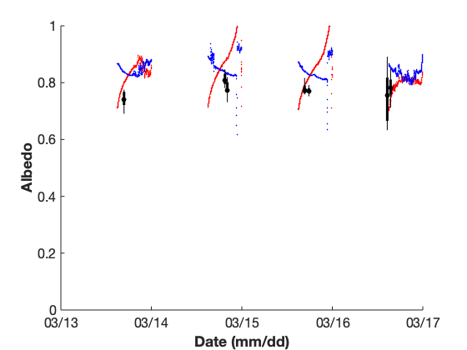
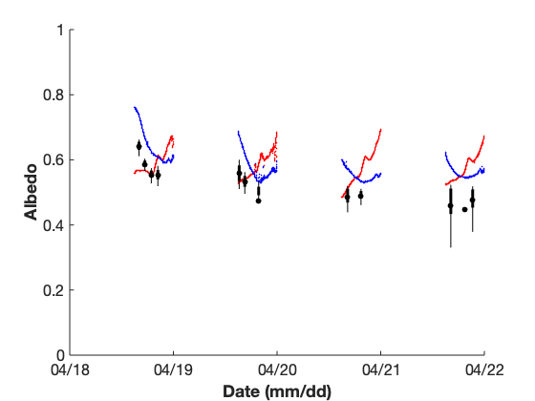
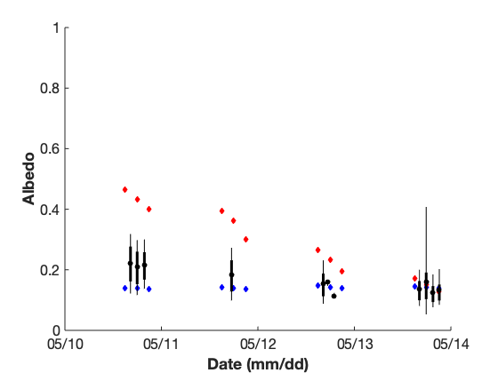
Evolution of Surface Albedo
1
Mean
10 25 75 100
0.8
Albedo
0.6
0.4
0.2
HELiX
Avery ASFS
KP ASFS
0
03/13
03/14
03/15
03/16
03/17
04/19
04/20
04/21
04/22
05/11
05/12
05/13
05/14
Date (mm/dd) 2022

Slide 6
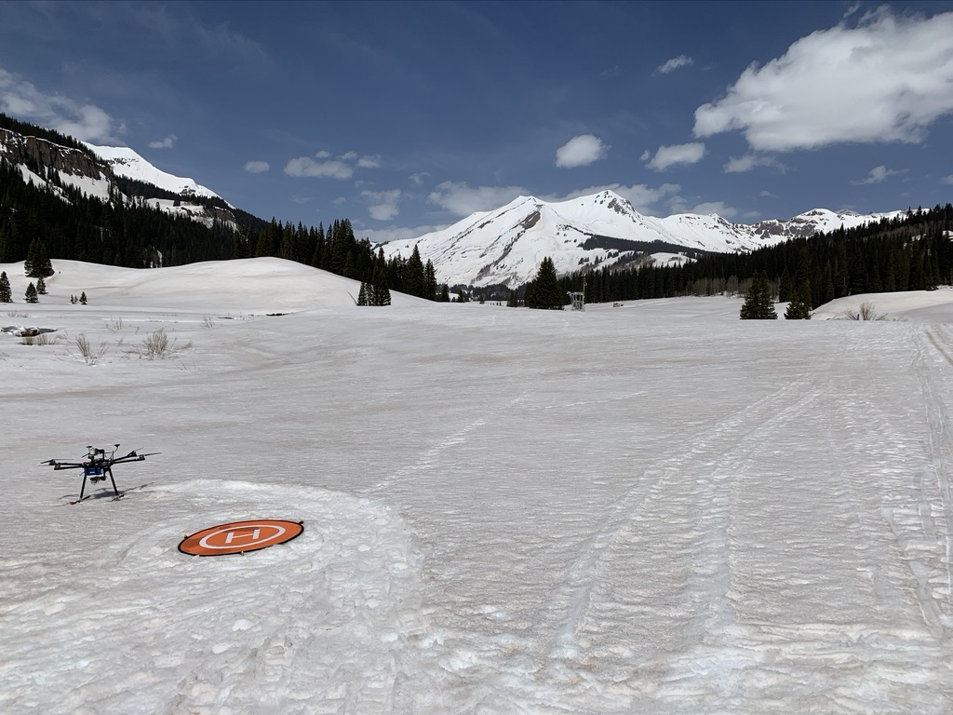
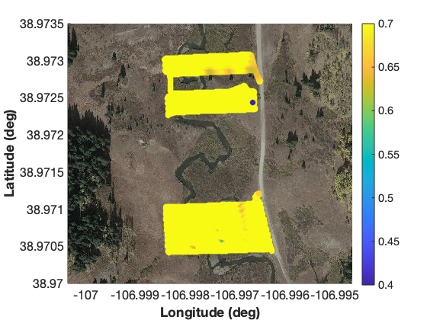
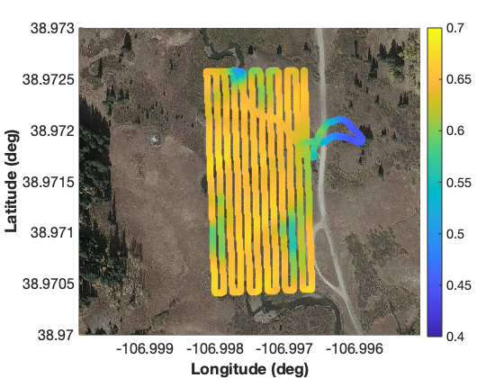
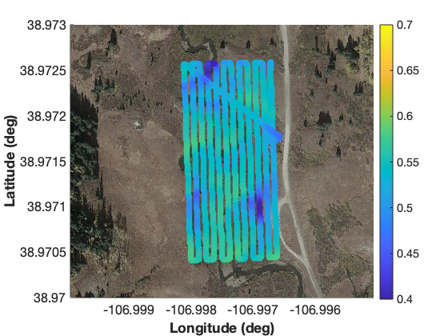
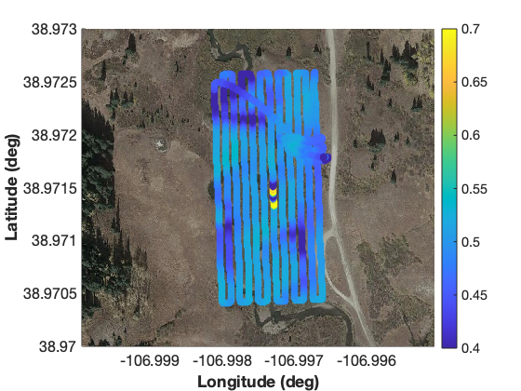
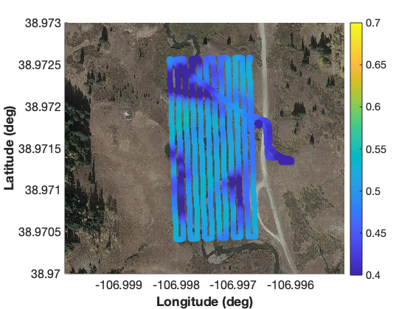
Influence of Dust on Snow
03/12-03/16
Significant snow melt was observed during the April deployment. During this time, dust that had previously been deposited in the snowpack emerged at the surface, and the snowpack became significantly wetter. Together, these events resulted in a substantial reduction of the snow surface albedo. March flights showed albedos in this area of around 0.8, while the April albedos decreased from around 0.65 to 0.45 over the course of four days. Additionally, the river began to open up, resulting in even lower albedos values (<0.4). All flights in these figures were conducted around 10 am MDT.
Albedo
04/18
04/19
04/20
04/21
Albedo

Slide 7
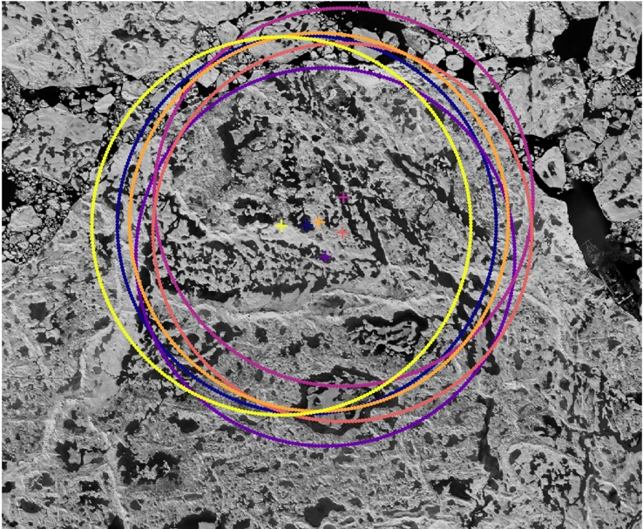
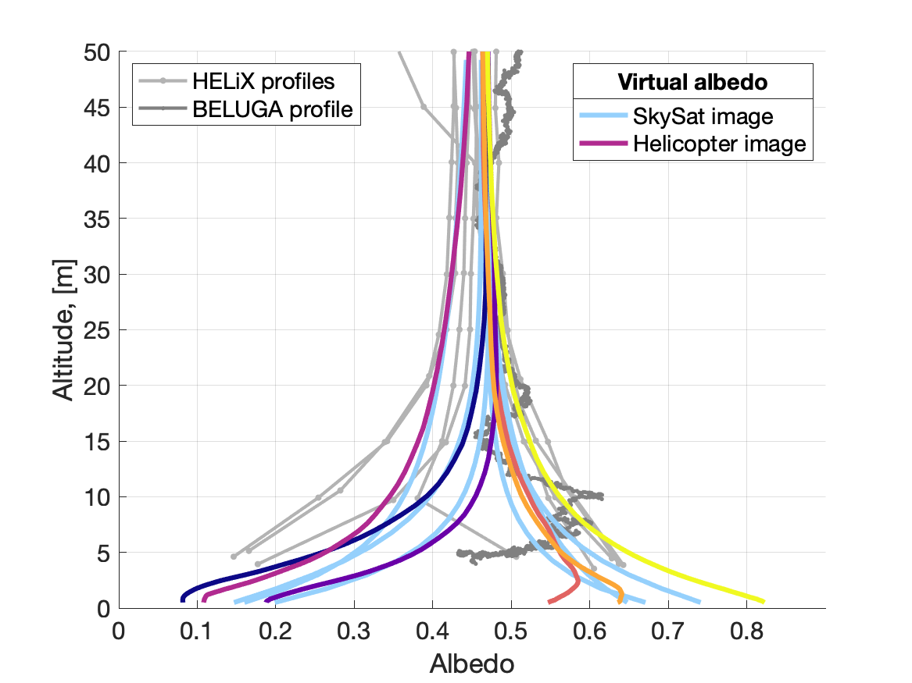
Scale-Dependent Representative Albedo Values

Slide 8
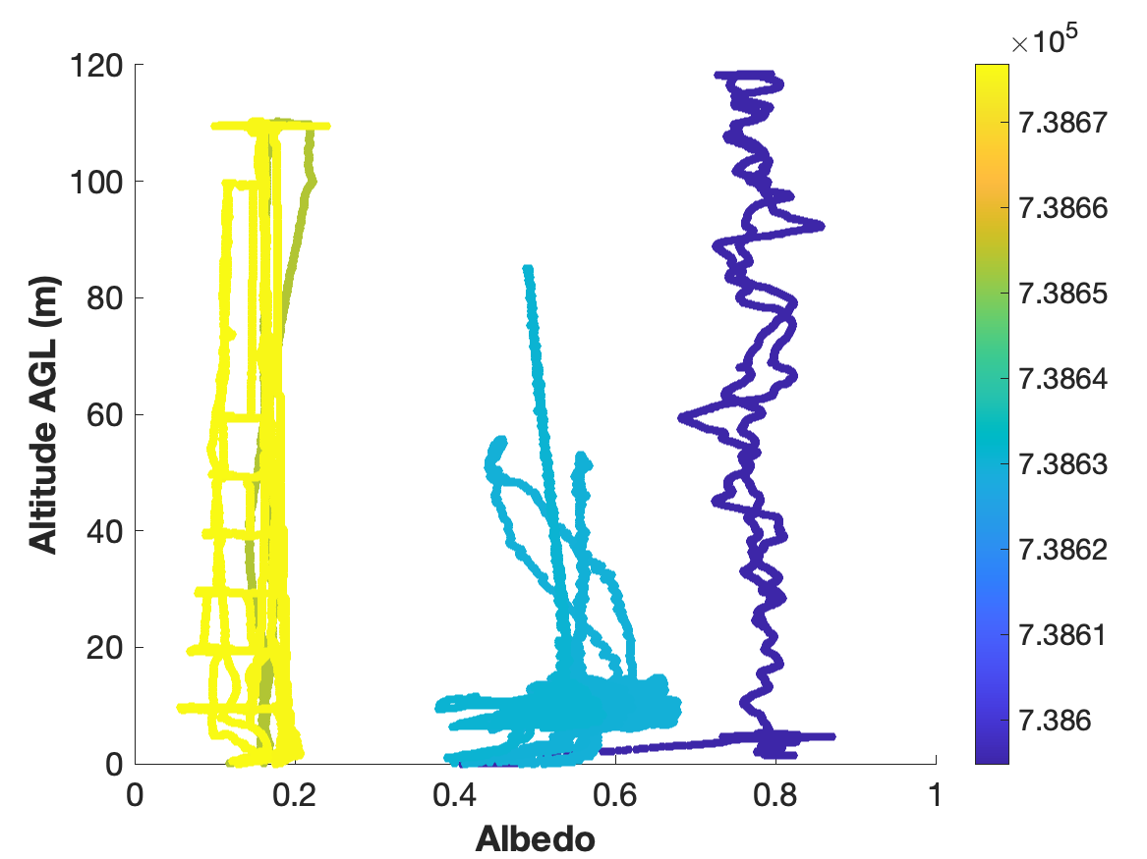
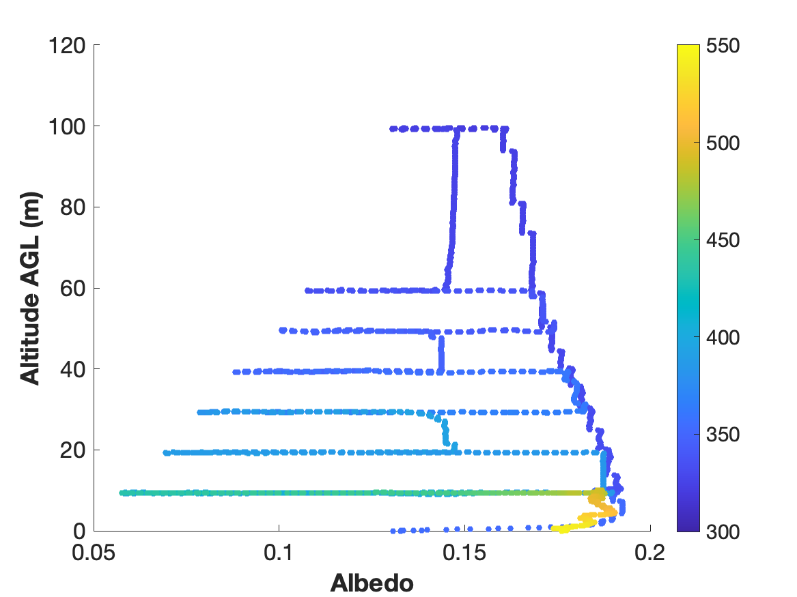
Scale-Dependent Representative Albedo Values
05/29
05/19
05/09
04/29
04/19
04/09
03/30
03/20

Slide 9
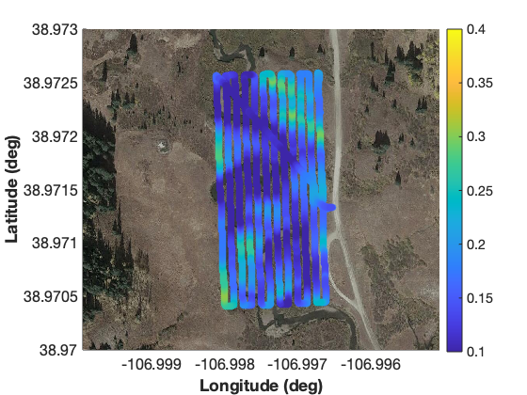
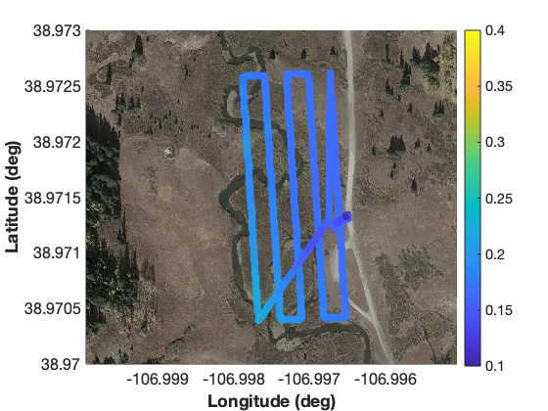
Scale-Dependent Representative Albedo Values

Slide 10
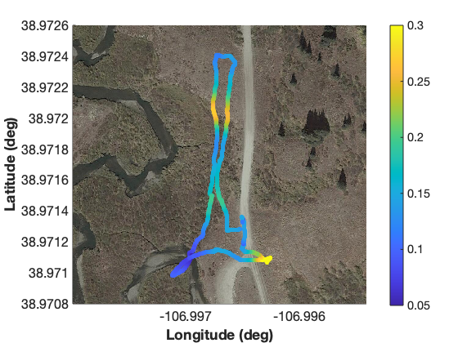
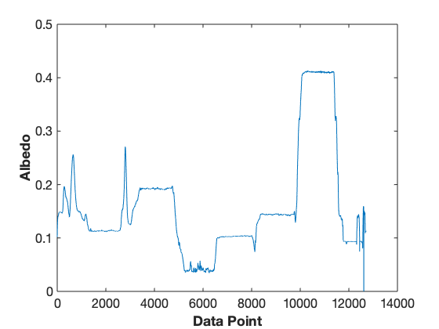
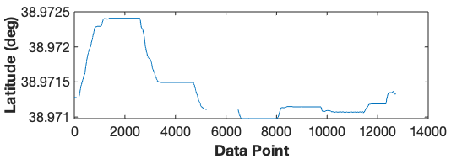
Albedo of Different Features

Slide 11
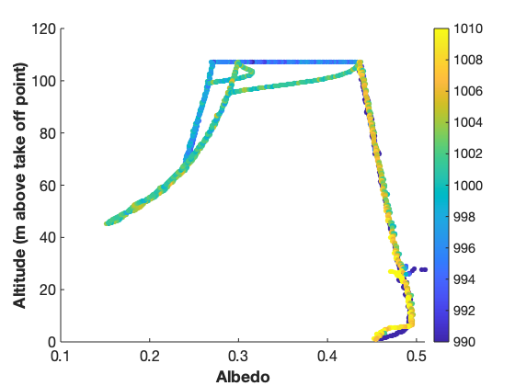
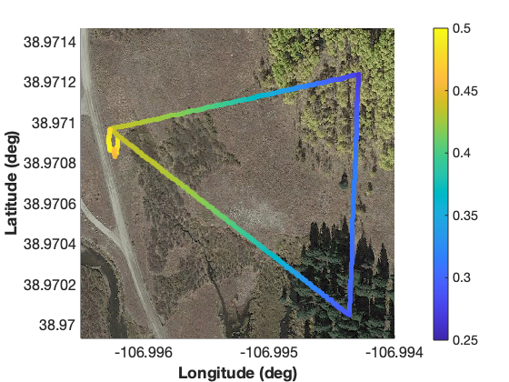
Albedo of Treed Areas
Initial evaluation of HRRR simulations appears to show that the HRRR surface albedo is significantly lower than observed. As a result, a question was posed about the influence of the mix of surface cover on grid-box-scale albedo. Using the HELiX, we flew over different surface types to understand the individual contributions of different types of surfaces and vegetations while the underlying is snow-covered.
Early In Flight / Late In Flight →
Downwelling SW Irradiance (W/m²)

Slide 12
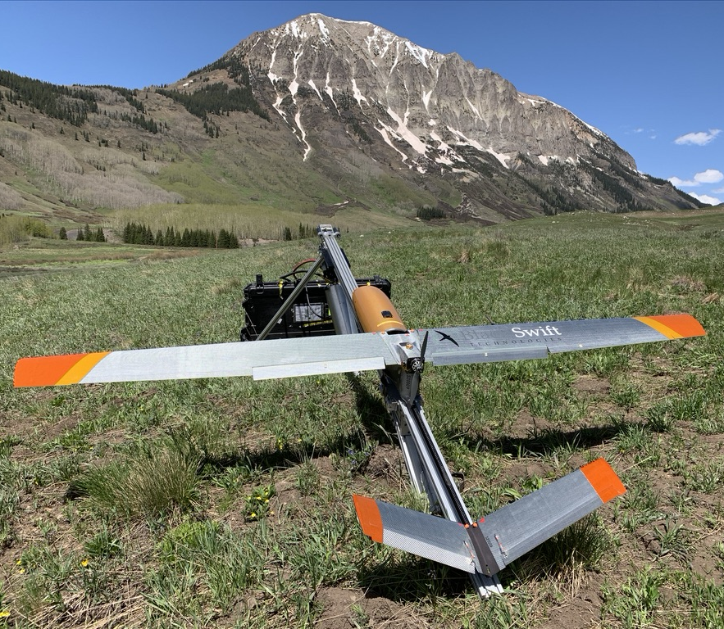
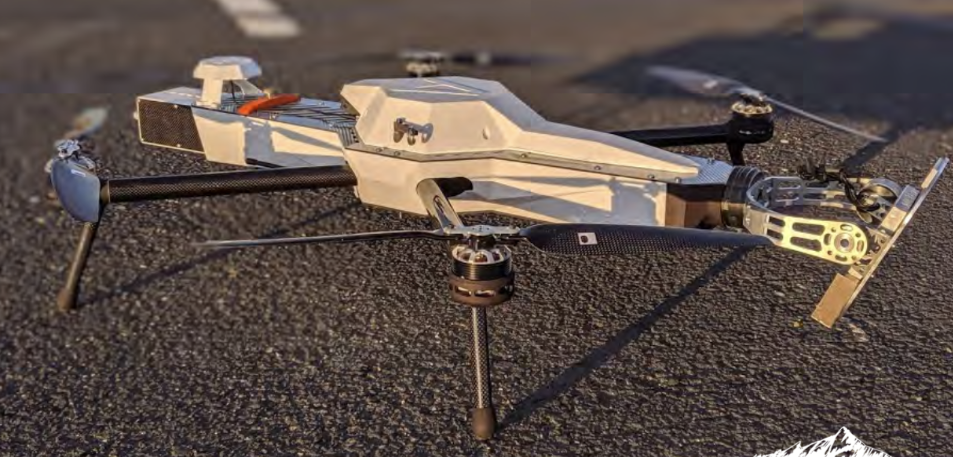
UAS/Sensor Systems and Deployment Timeline
Black Swift Technologies S2 (left) and E2 (above) deployed with L-band radiometer and multispectral camera to measure soil volumetric water content, surface temperature, surface elevation and NDVI.
Deployments in mid-October, early June, and early September for two years.

Slide 13
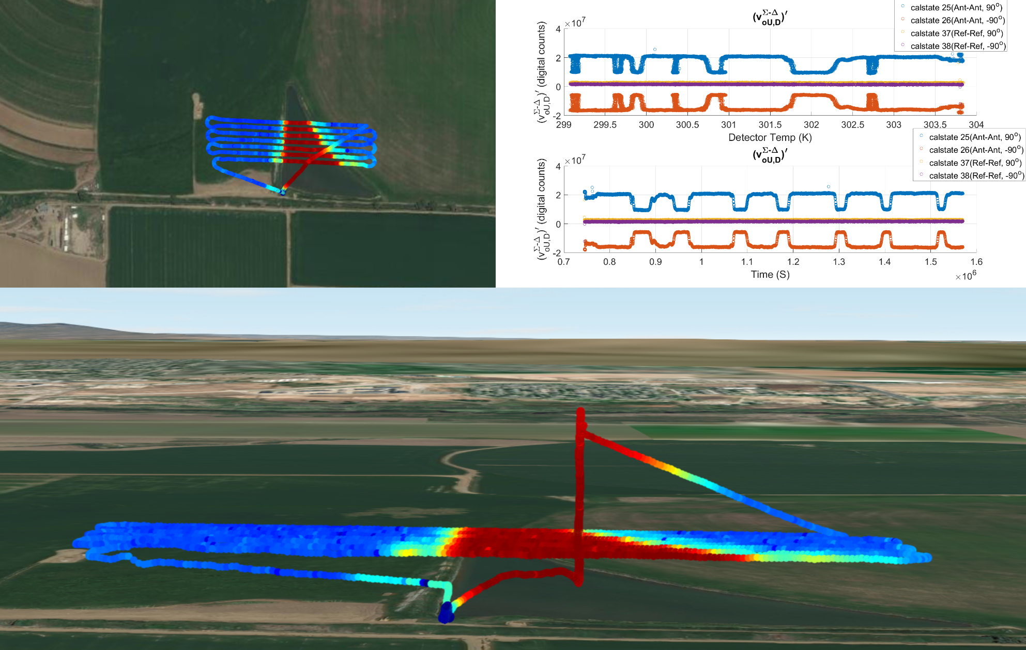

Advancing Technical Readiness
With funding from the NOAA Weather Program Office, our team has worked to deploy and evaluate the performance of Black Swift Technologies UAS-based soil moisture sensing capabilities. The system includes an L-band radiometer to detect soil moisture levels in the top ~5 cm of the surface.
As part of this work, the payload was deployed on a new UAS platform (E2). Additionally, sensor thermal stability was improved, resulting in more consistent soil moisture measurements. This has helped advance an off-the-shelf sensor system.

Slide 14
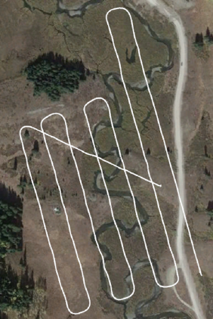
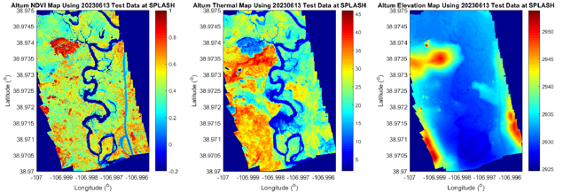
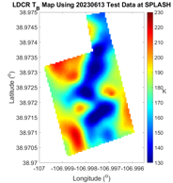
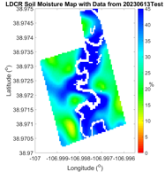
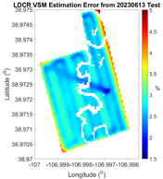
Mapping Soil Moisture and Other Surface Properties

Slide 15
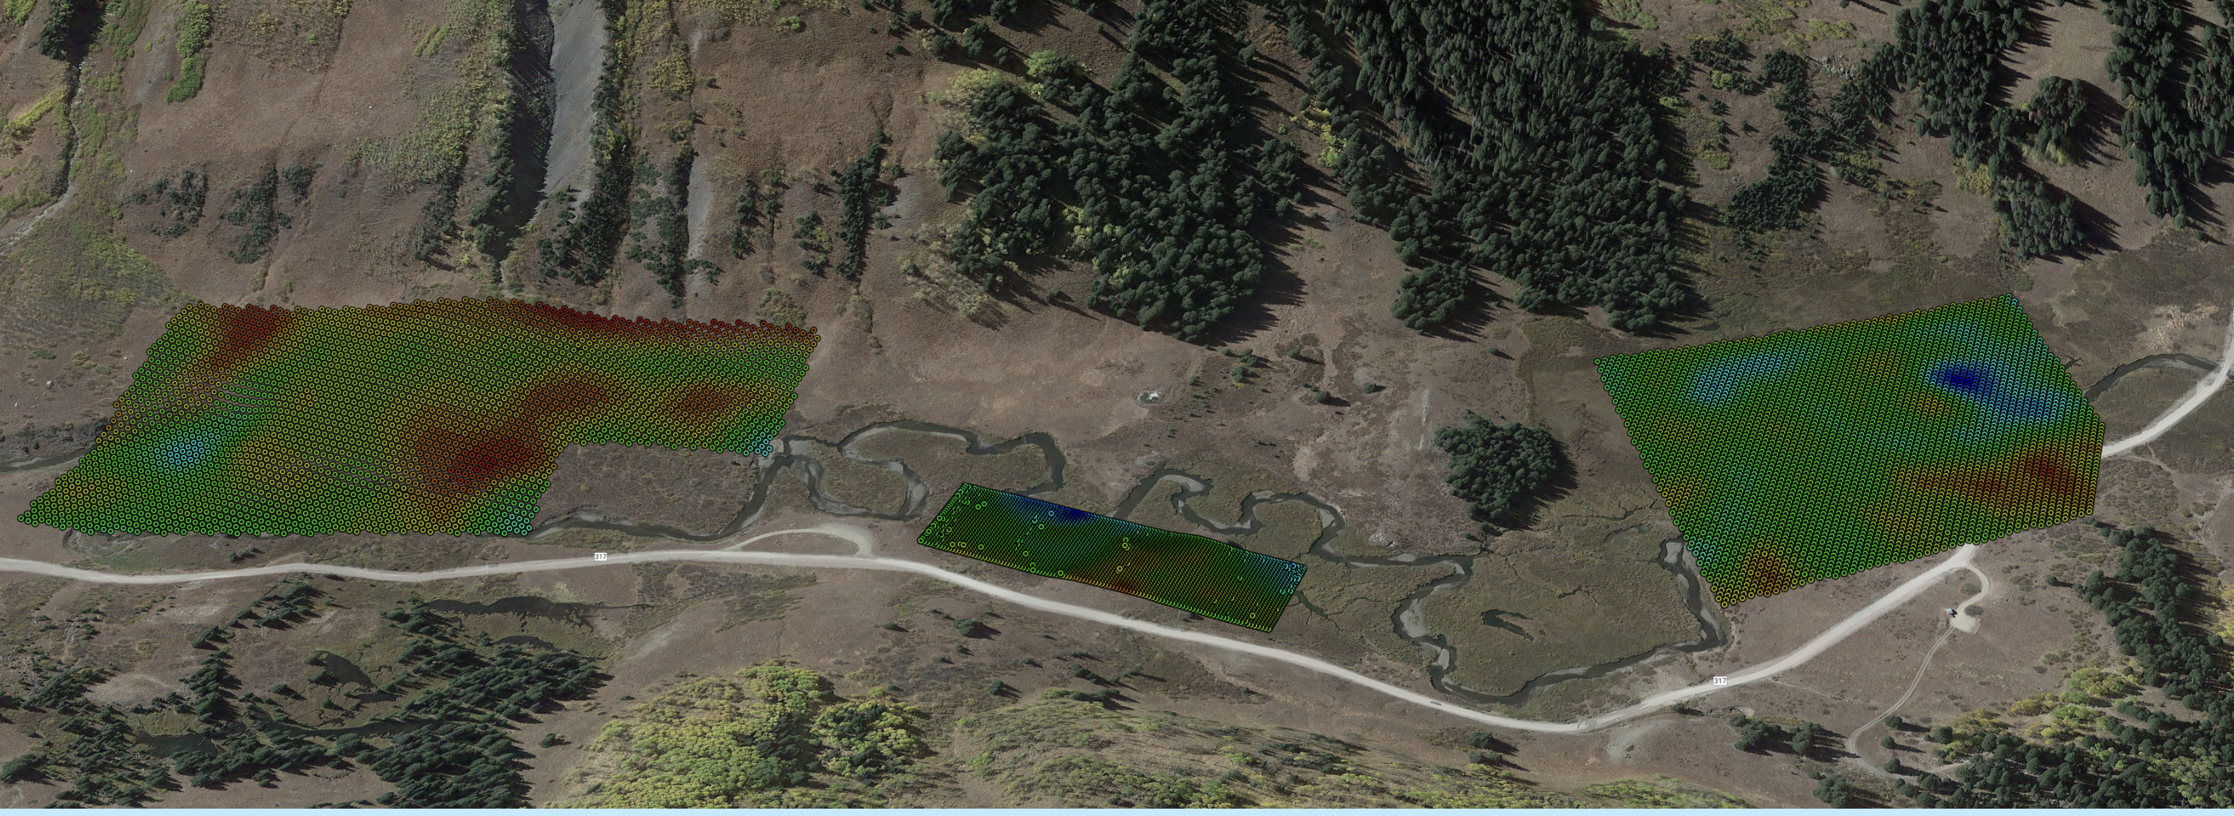
Mapping Soil Moisture and Other Surface Properties

Slide 16
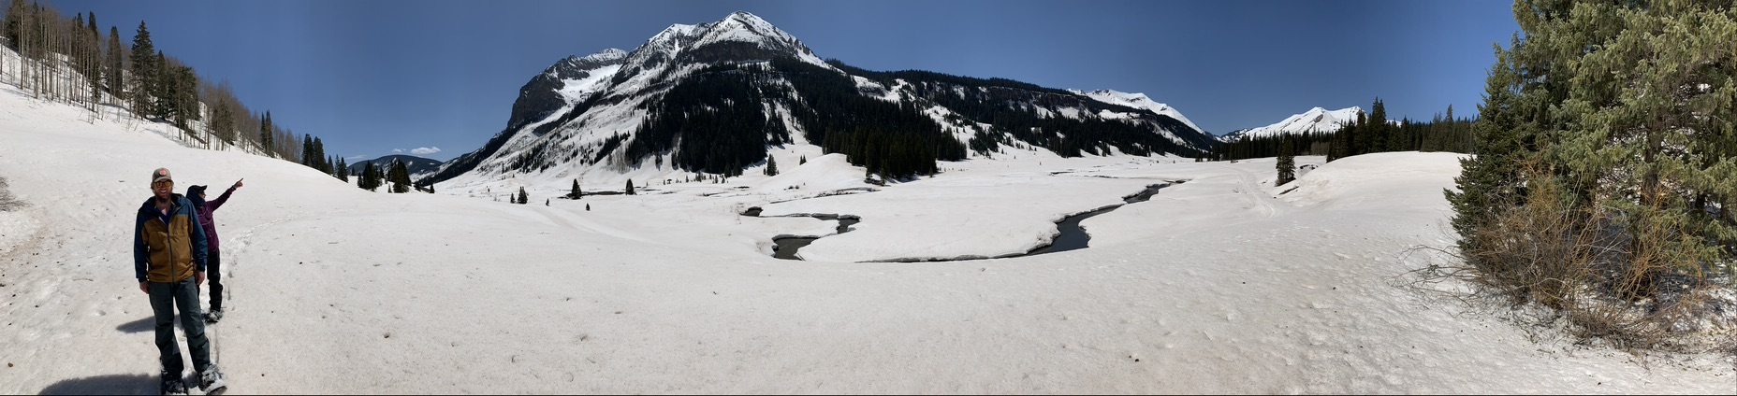
Summary
UAS were deployed in SPLASH to collect information on the spatial and temporal evolution of surface properties, including albedo, soil moisture, elevation, temperature, and NDVI.
Datasets are published and available to the public through Zenodo.
Significant technological advancements were made as a part of this work, improving system readiness and commercial viability.
Conducting flights throughout the year would help provide a detailed perspective on the complexities associated with the seasonal evolution of key properties.

