Slide 1
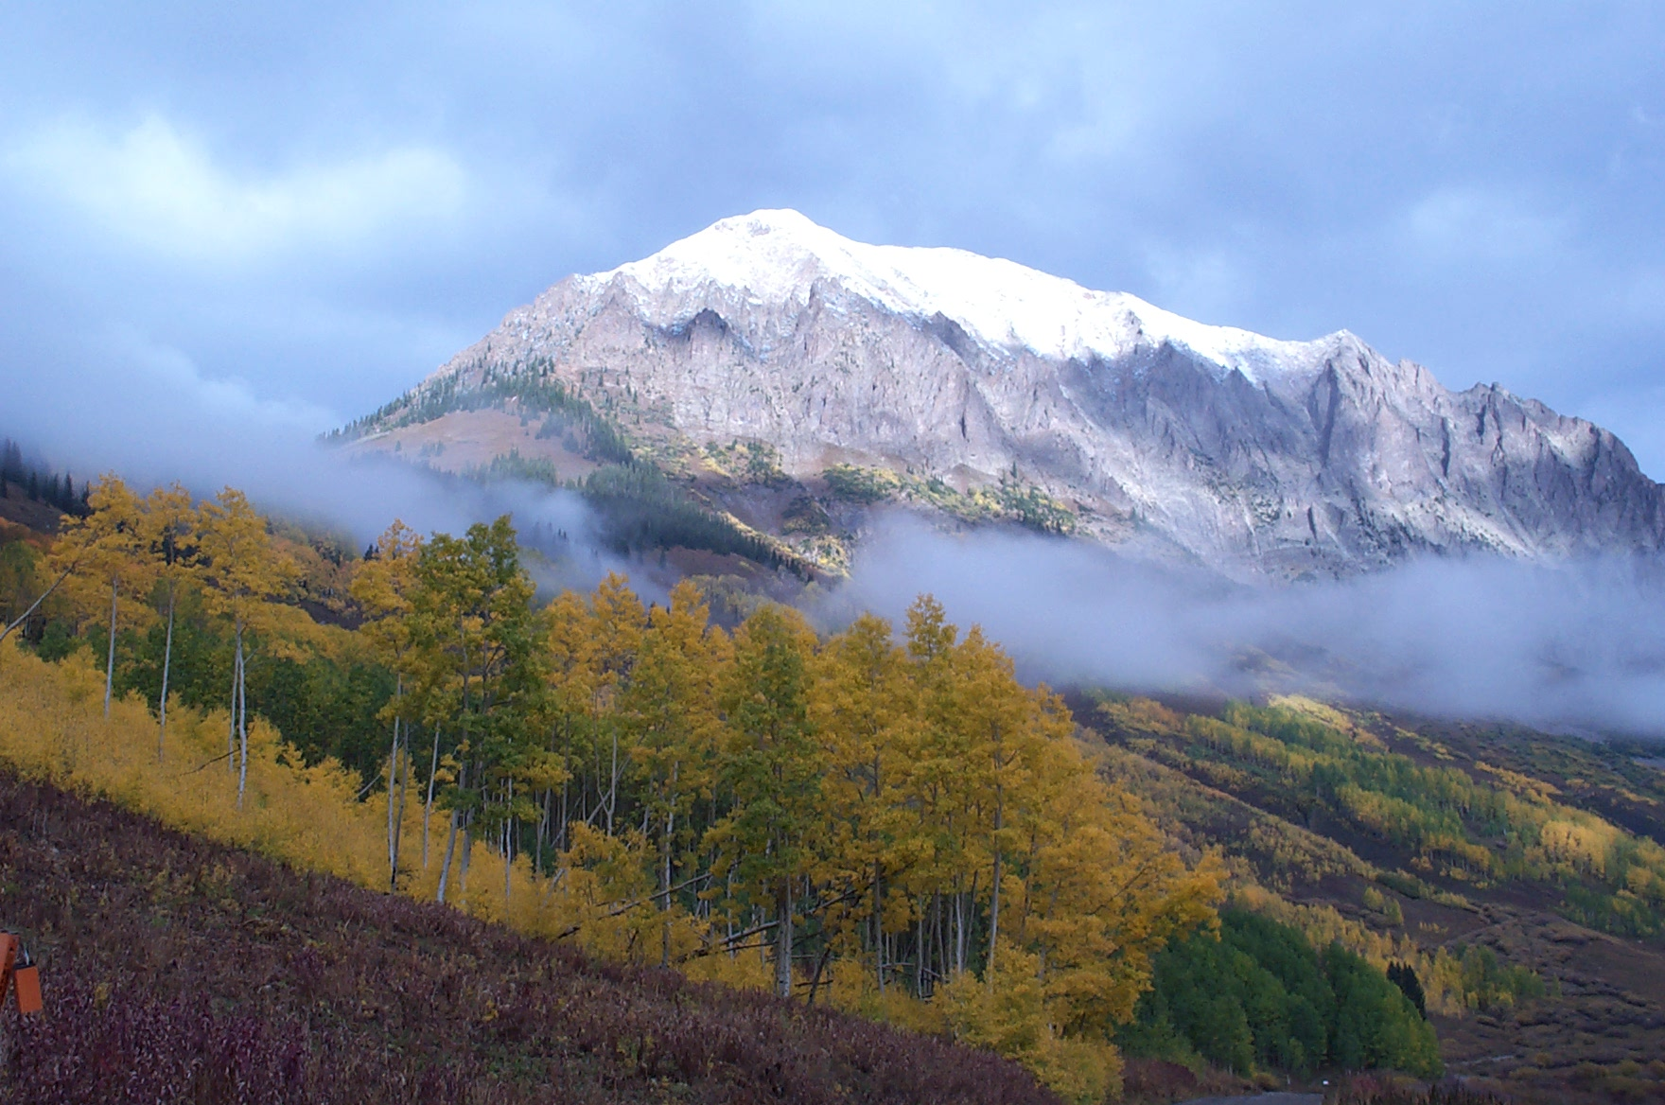
Tracking Fine-scale Land Surface Dynamics Using UAS Imagery
Ian Breckheimer, PhD
Research Scientist, RMBL

Slide 2
Landscape Ecology
Pattern
Process
What controls carbon and water fluxes
in complex landscapes?

Slide 3
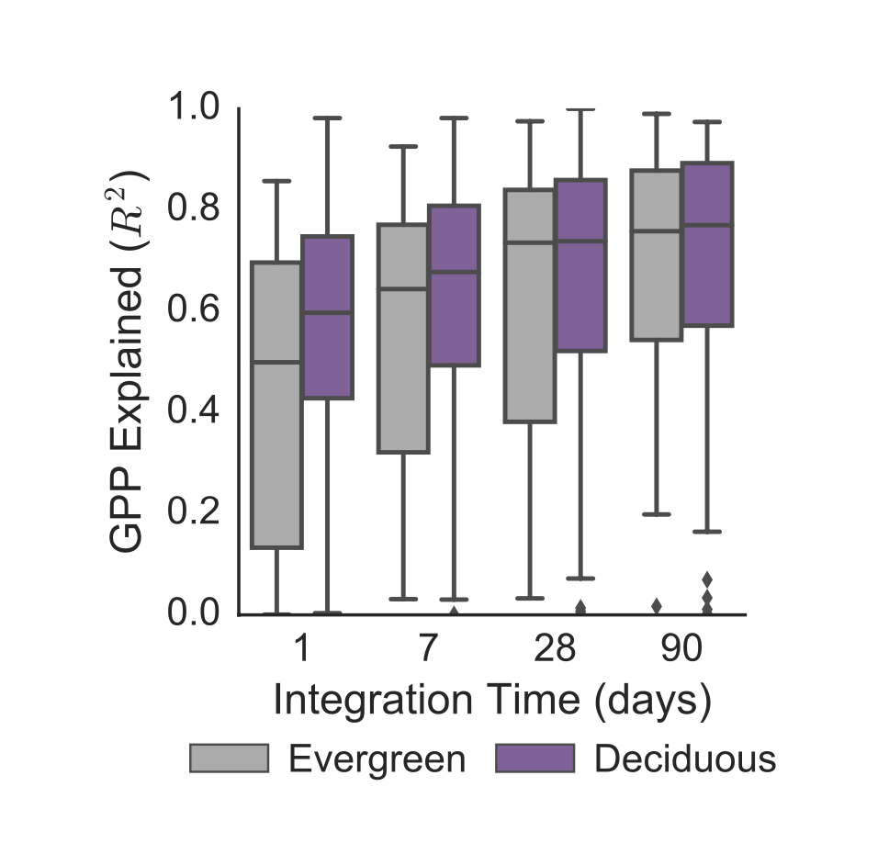
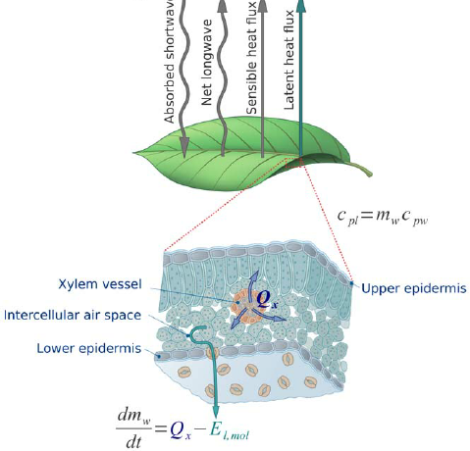
Spectral Proxies for ET and GPP
NIRv
Assumption: processes are energy limited
Badgley et al. 2019

Slide 4
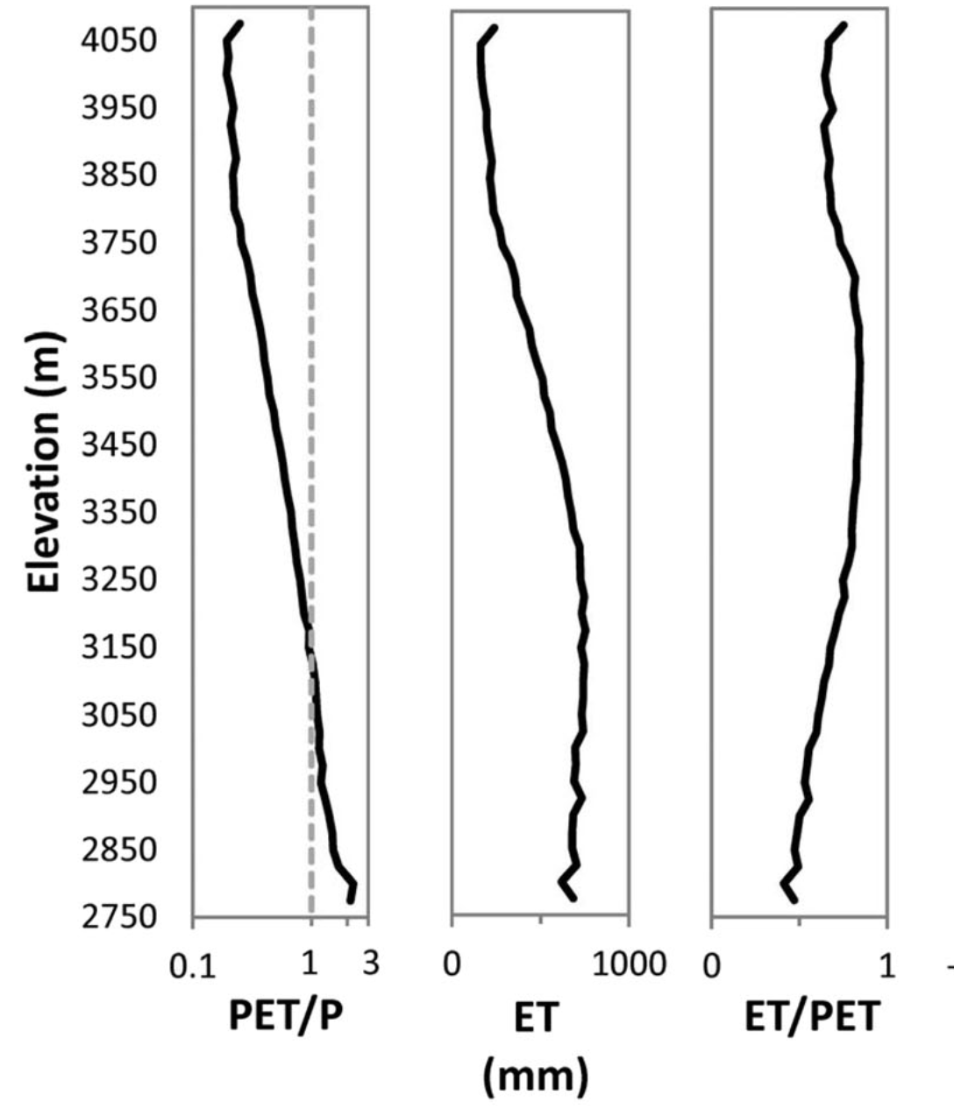
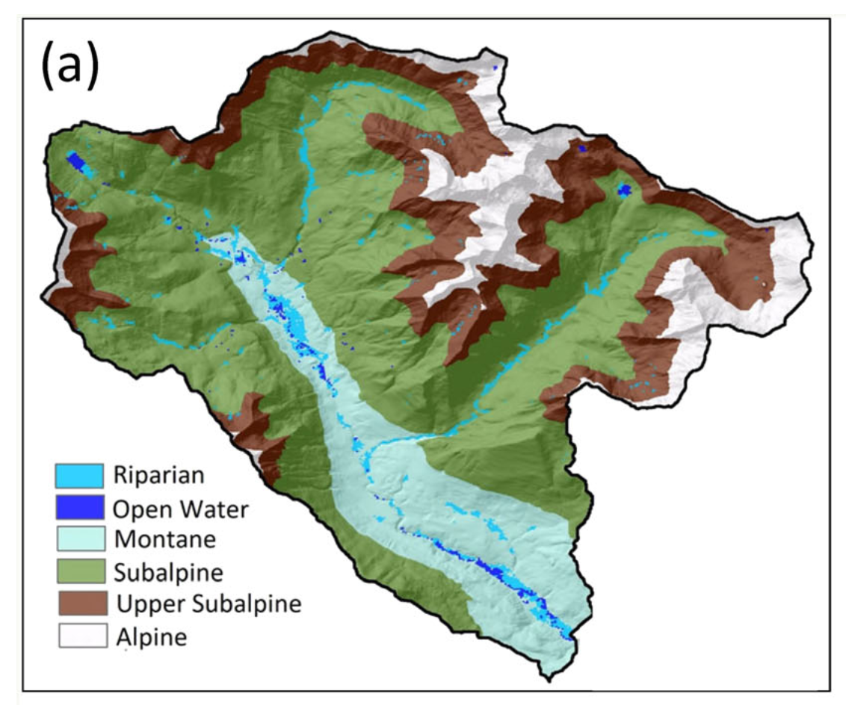
Energy and Water Limitation in the SAIL Domain
Gothic
Figures: Carroll et al. 2020

Slide 5
Driving questions:
How much variability is there in the vegetation seasonal cycle at small scales?
Is the seasonal pattern of vegetation greenness in Gothic consistent with an energy limited system?
How representative is the footprint of the ARM Eddy Covariance system (ECOR)?

Slide 6
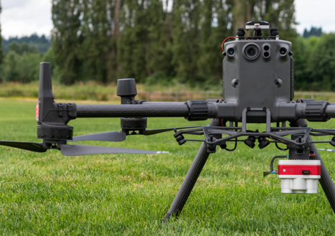
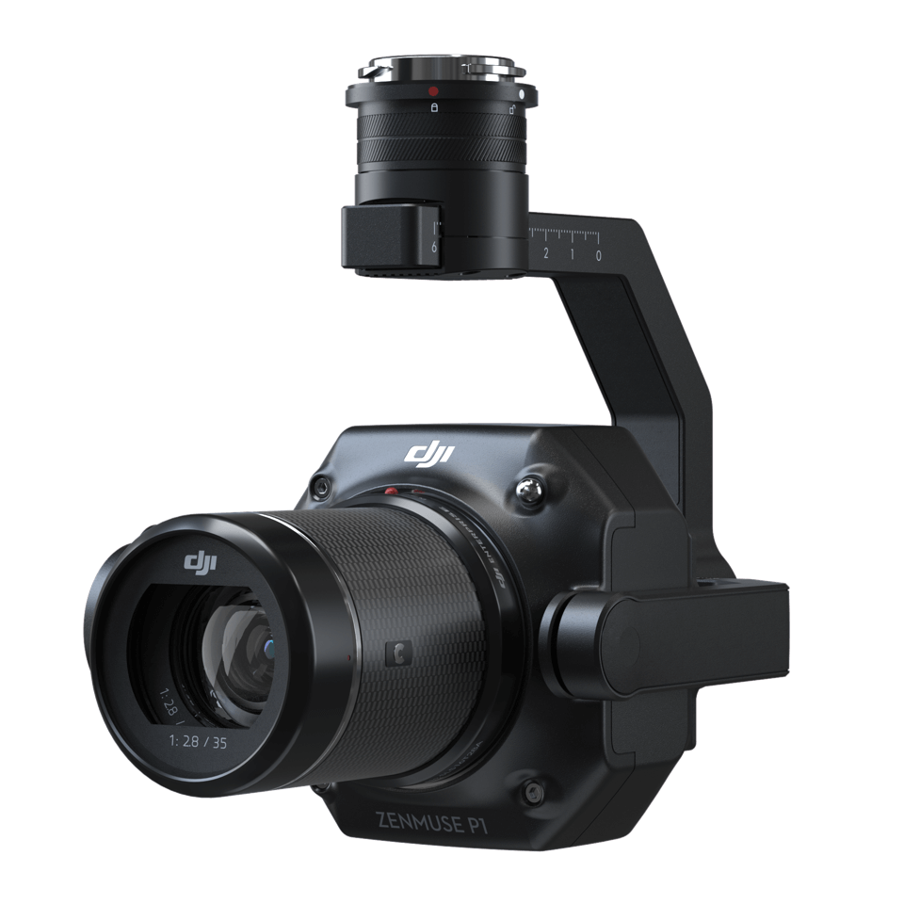
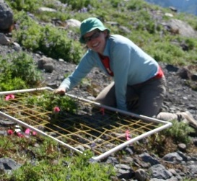
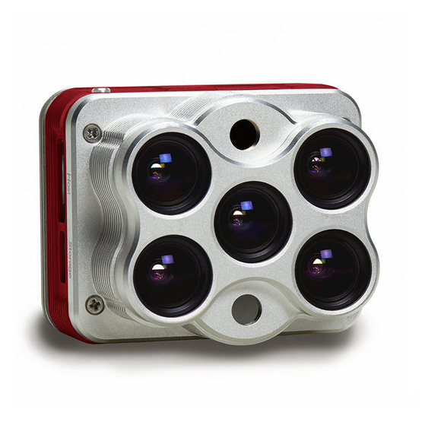
Data: RMBL UAS Platform and Sensors
DJI m300 RTK
DJI P1
20 ha coverage / flight
1 cm RGB, 5 cm Multispectral
60 cm Thermal IR
5 cm DEMs and DSMs
3 cm georeference accuracy
Micasense Altum

Slide 7
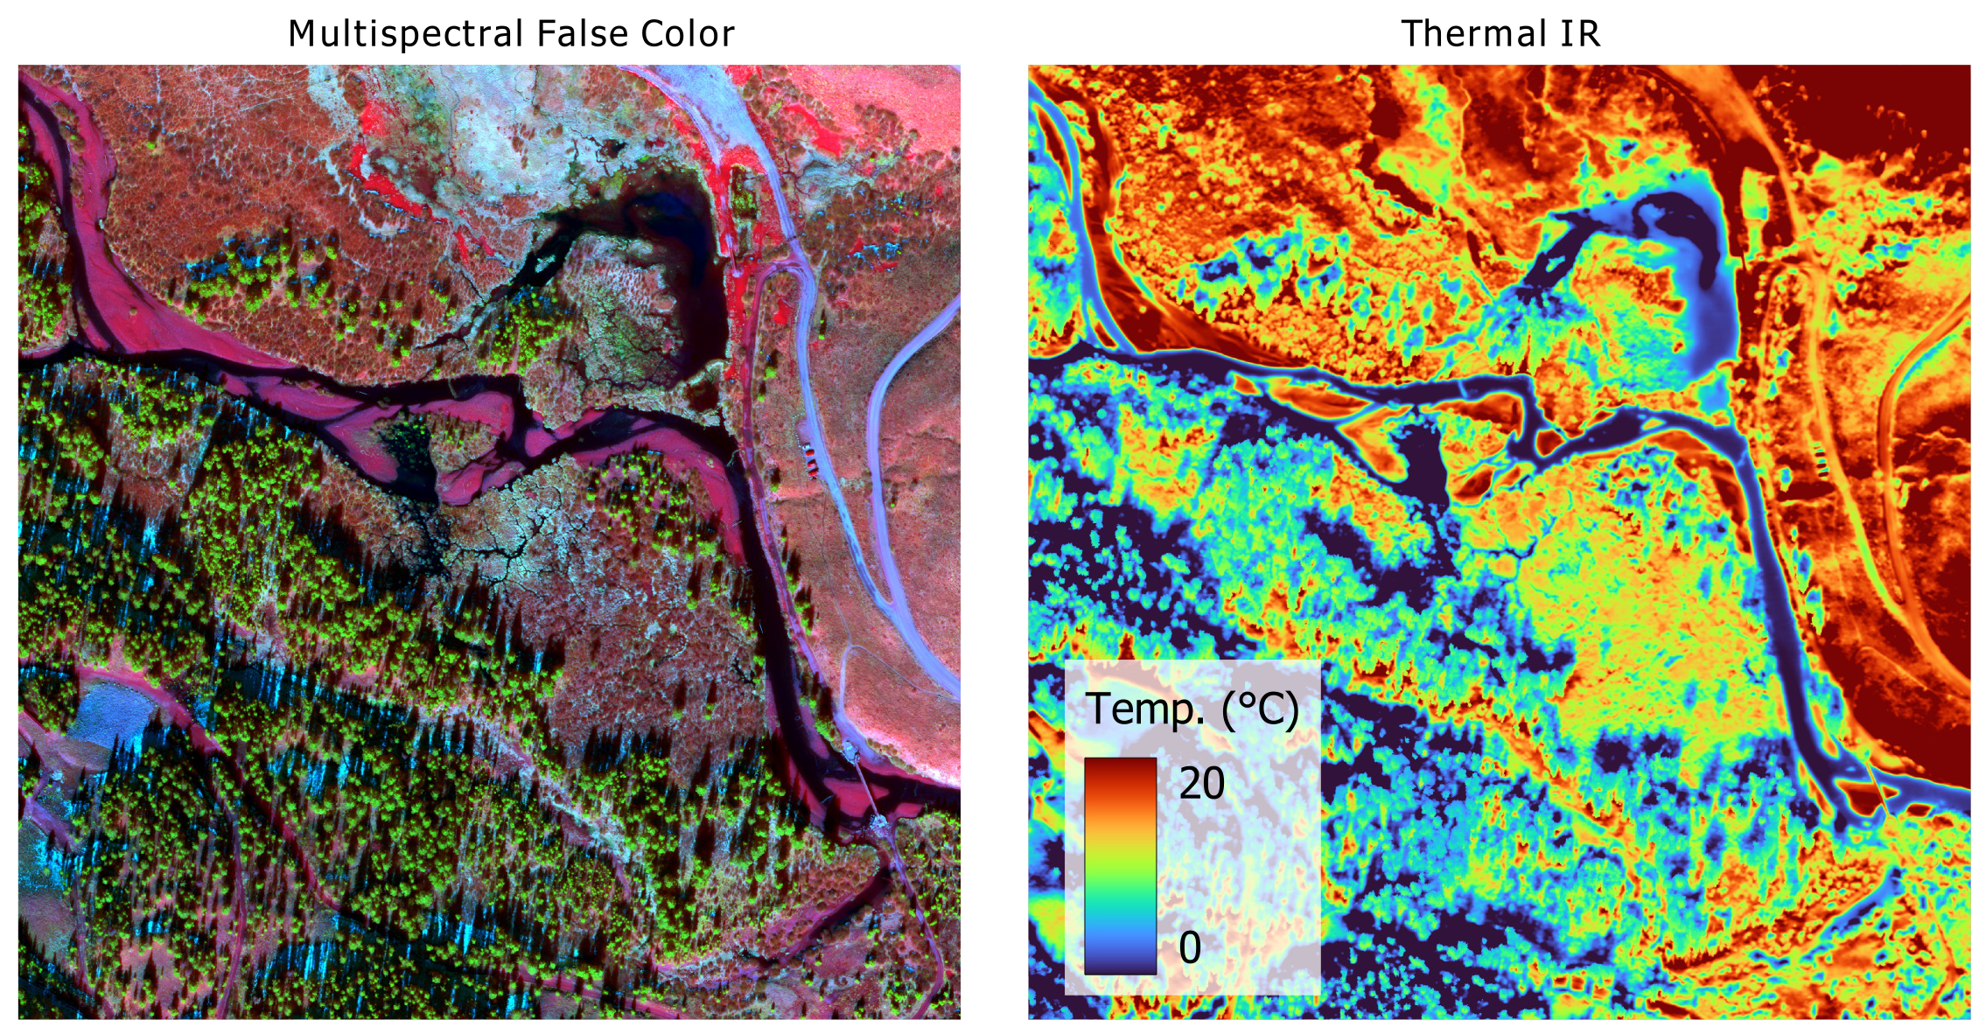
Data: RMBL UAS Platform and Sensors

Slide 8
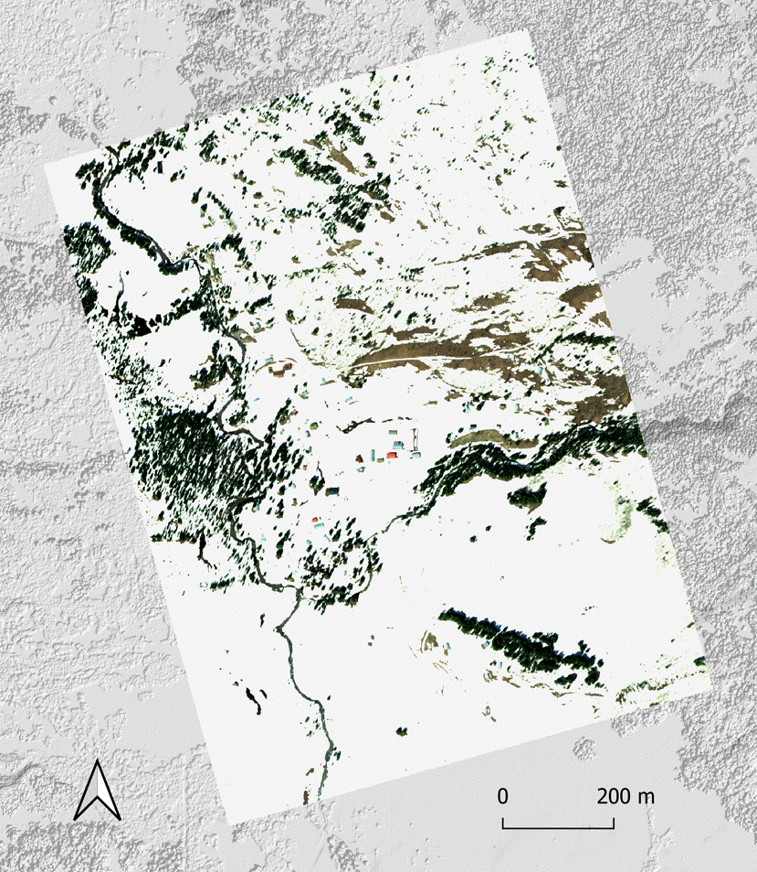
2022 Gothic UAS Field Campaign
~Weekly April – November
22 Mosaics passed QA / QC
5 cm apparent reflectance in
B, G, R, Red-edge, NIR Bands
Data up on ESS-Dive in December

Slide 9
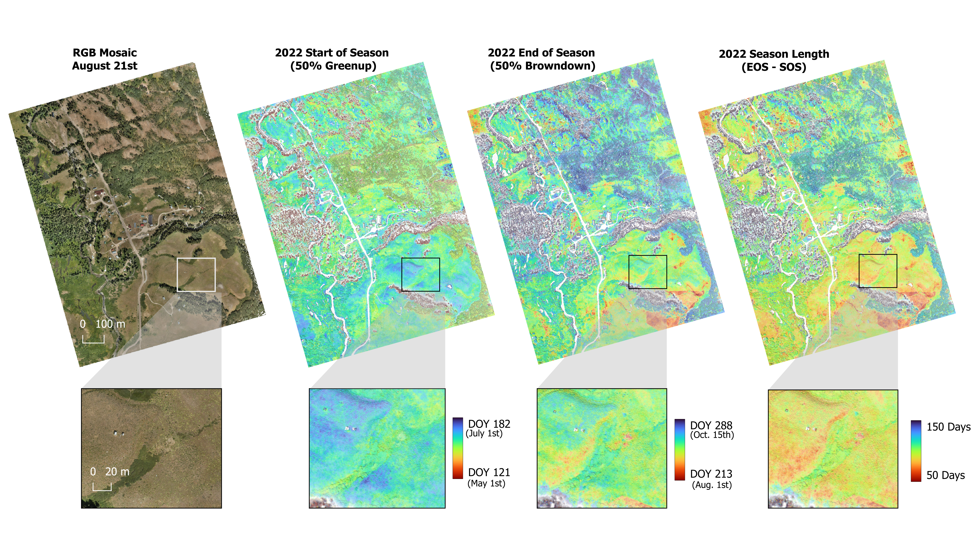
Small-scale variability
ECOR
Breckheimer et al. in prep

Slide 10
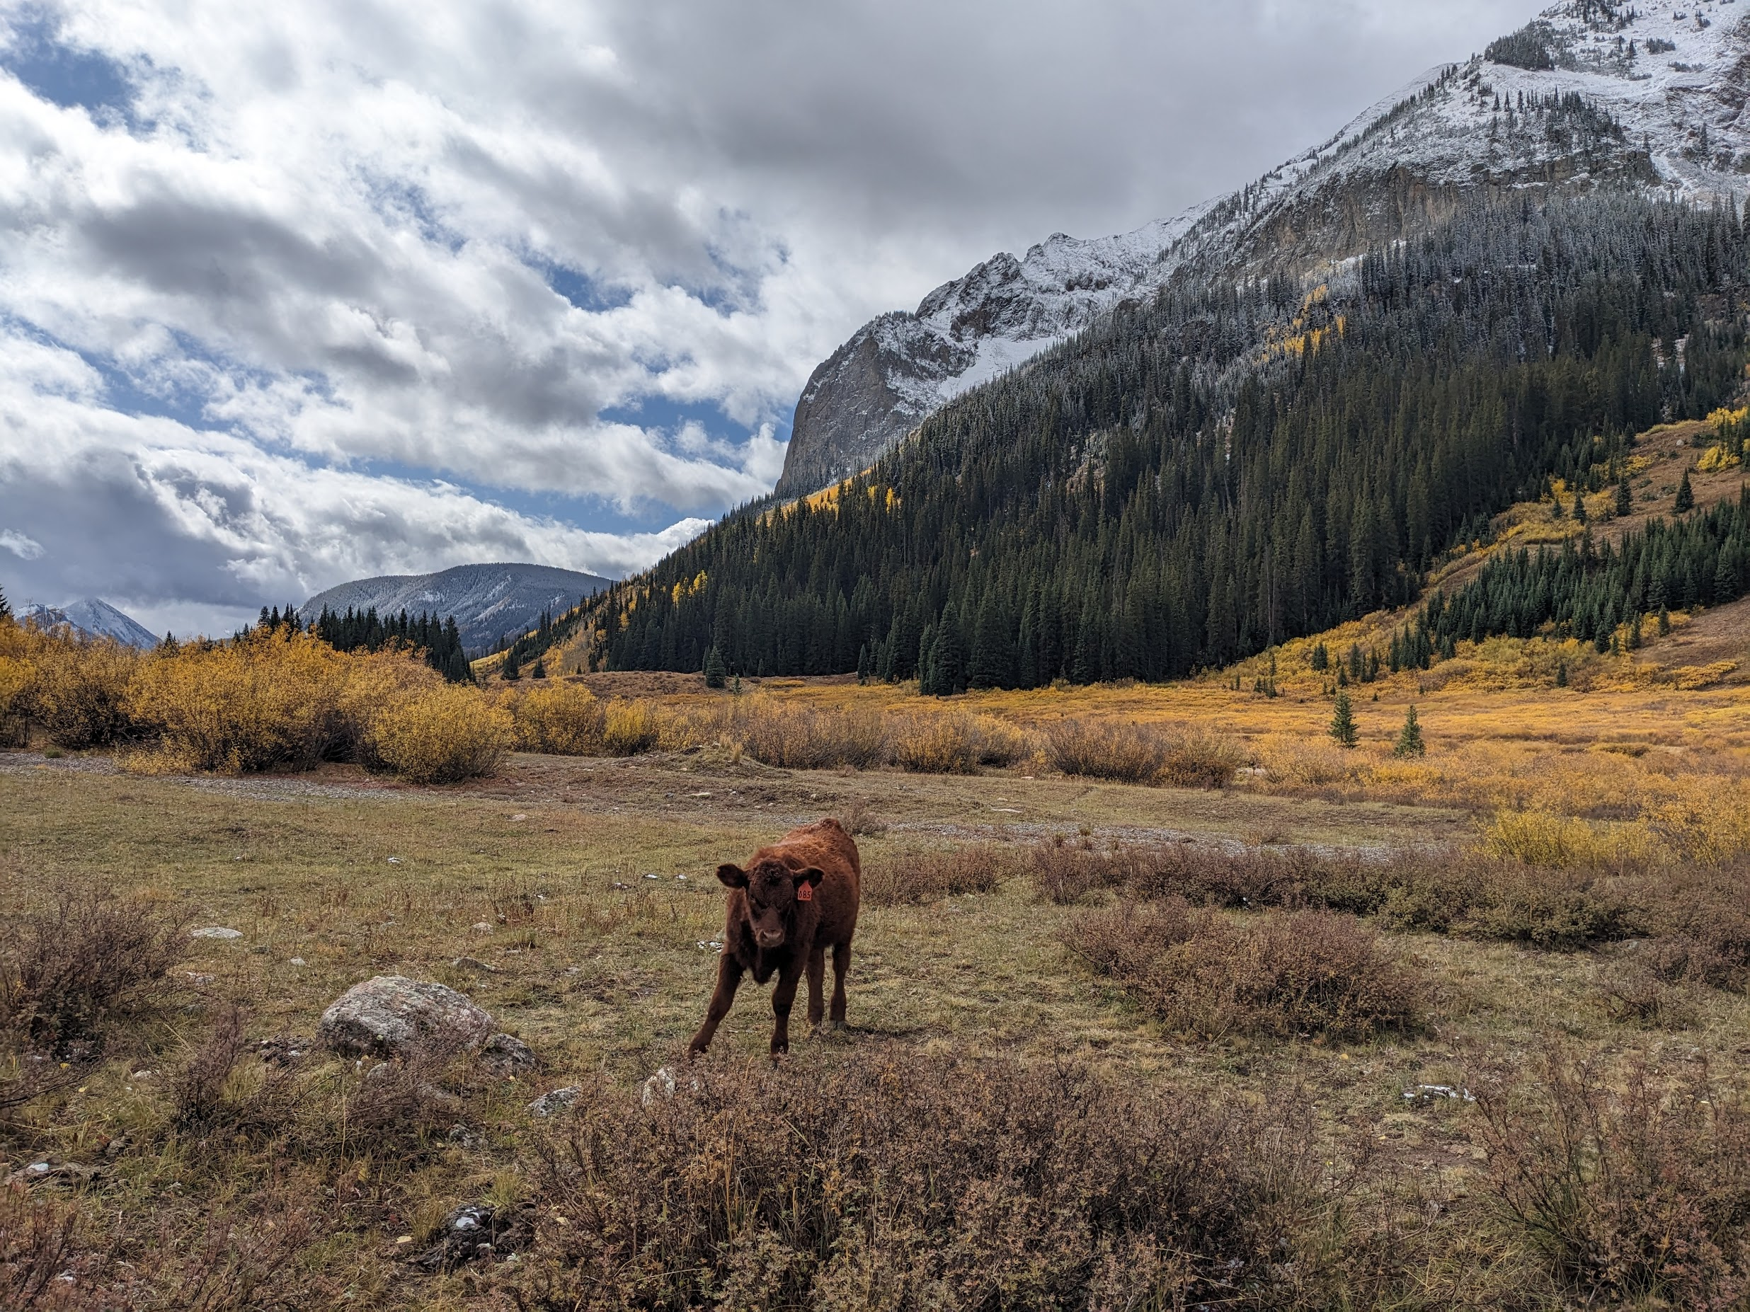

Slide 11
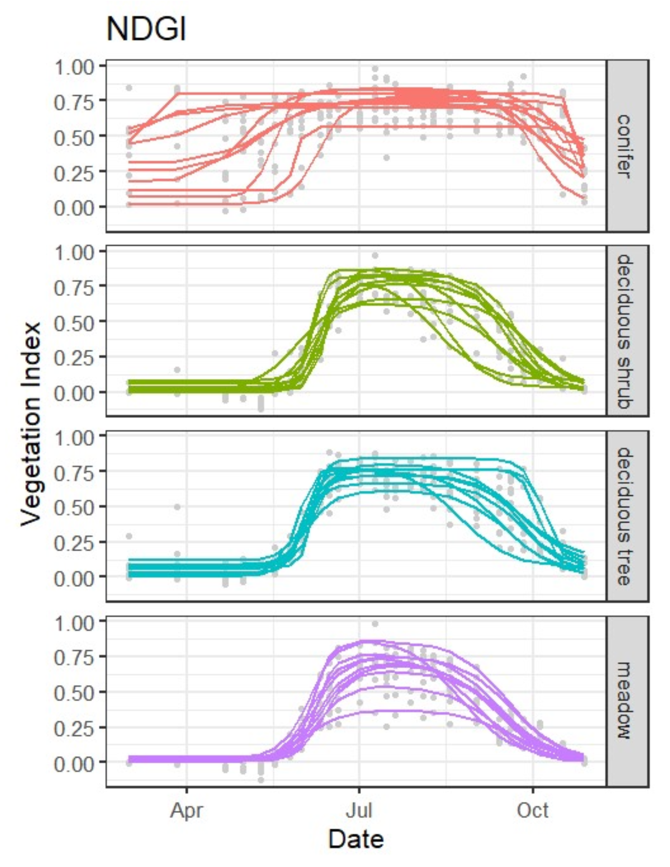
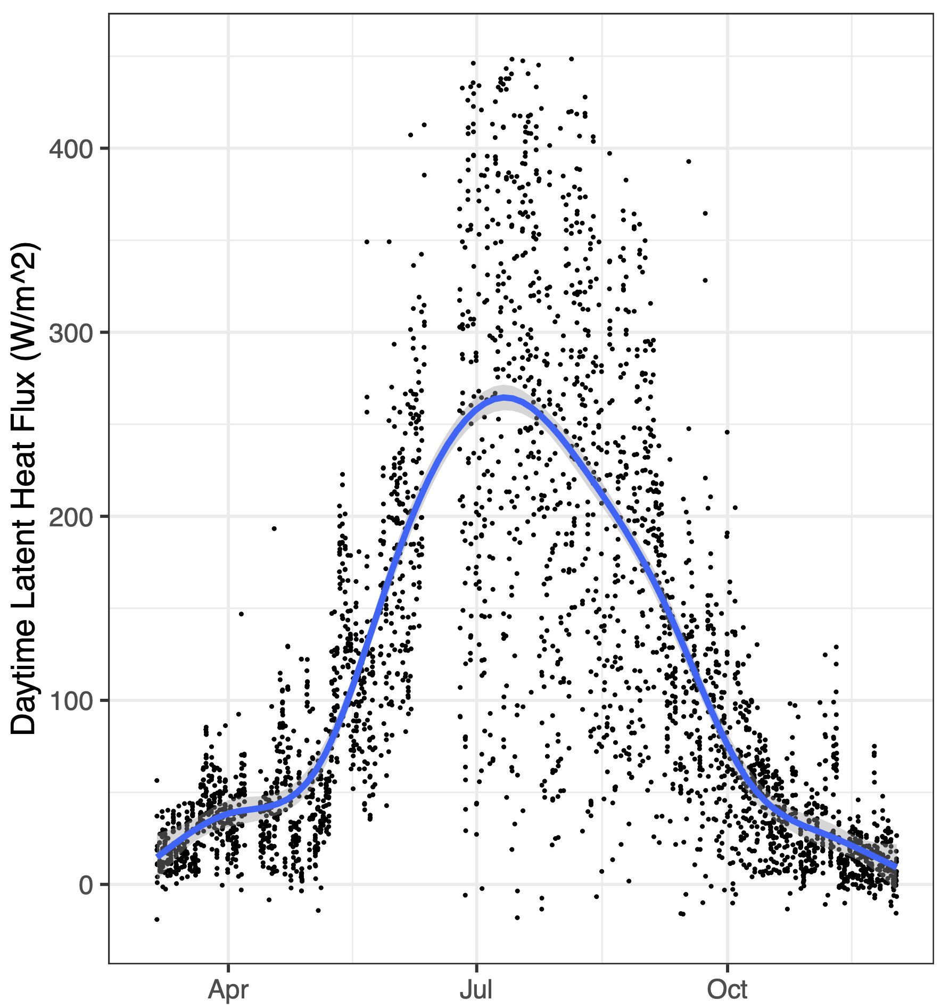
Water-limited Seasonal Pattern?
Breckheimer et al. in prep

Slide 12
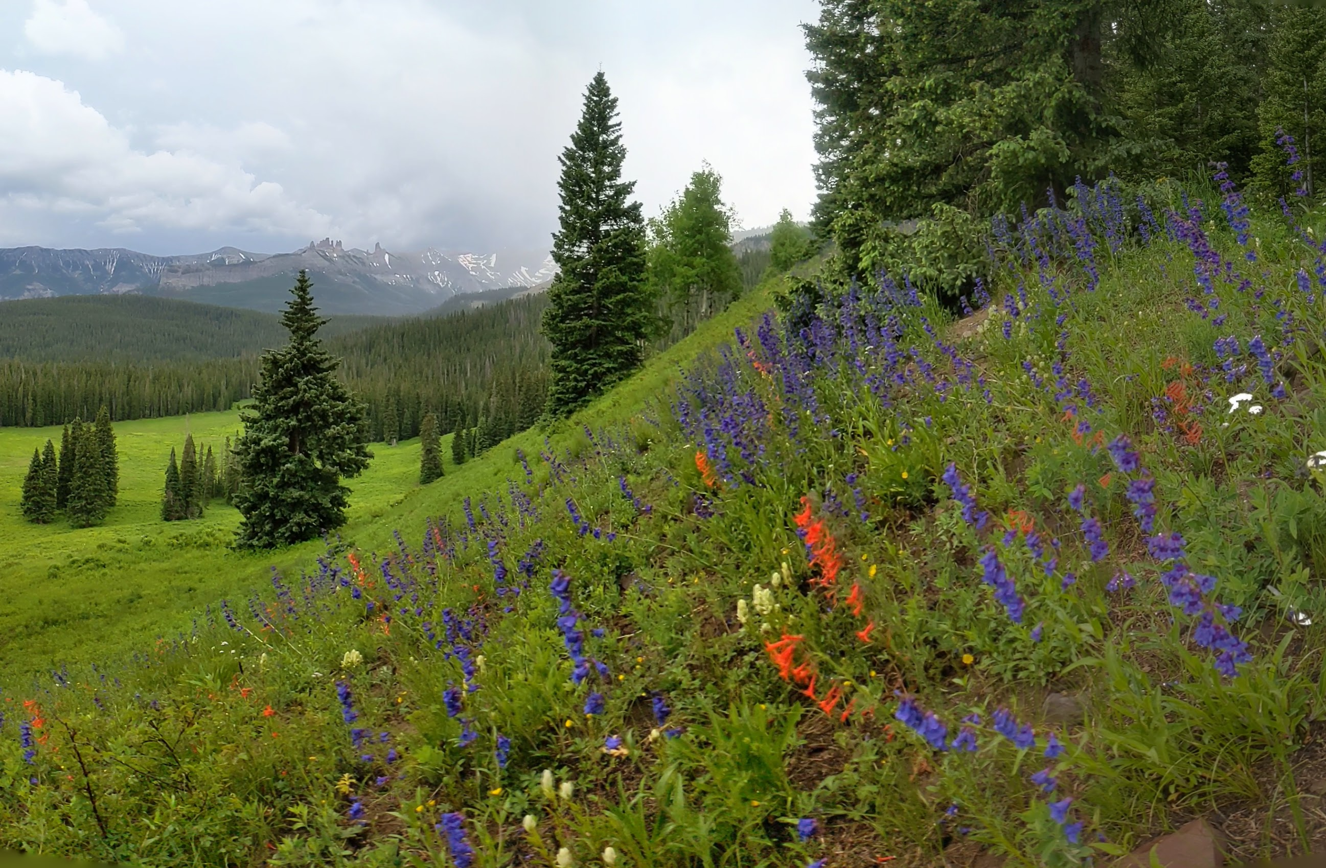

Slide 13
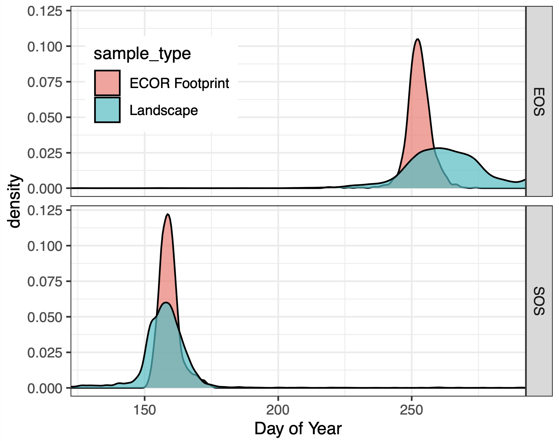
ECOR Footprint Representativeness?
Landscape
ECOR
Footprint
Breckheimer et al. in prep

Slide 14
What about thermal IR?
N
100 m

Slide 15
In Summary
Large m-scale variability in vegetation seasonal dynamics (30 – 60 days in a small landscape.
Latent heat fluxes closely match vegetation seasonal greenness pattern. Spectral proxies might work well for meadows.
Gothic ECOR is representative of landscape for start-of-season, but not end-of-season.

Slide 16
Thanks!
Contact Me:
Ian Breckheimer
ikb@rmbl.org
Github: @ibreckhe
Mastadon: tinyplant@mapstodon.space
Website: https://tinyplant.org

Slide 17
Supplemental Slides

Slide 18
RGB True Color
N
100 m

Slide 19
CIR False Color
N
100 m

Slide 20
NIRv
N
100 m

Slide 21
Digital Surface Model
N
100 m

Slide 22
Winter True Color
January 7th 2022
billy barr
cabin
AMF2 Base Area
N
100 m

Slide 23
Snow Depth
January 7th 2022
N
100 m

Slide 24
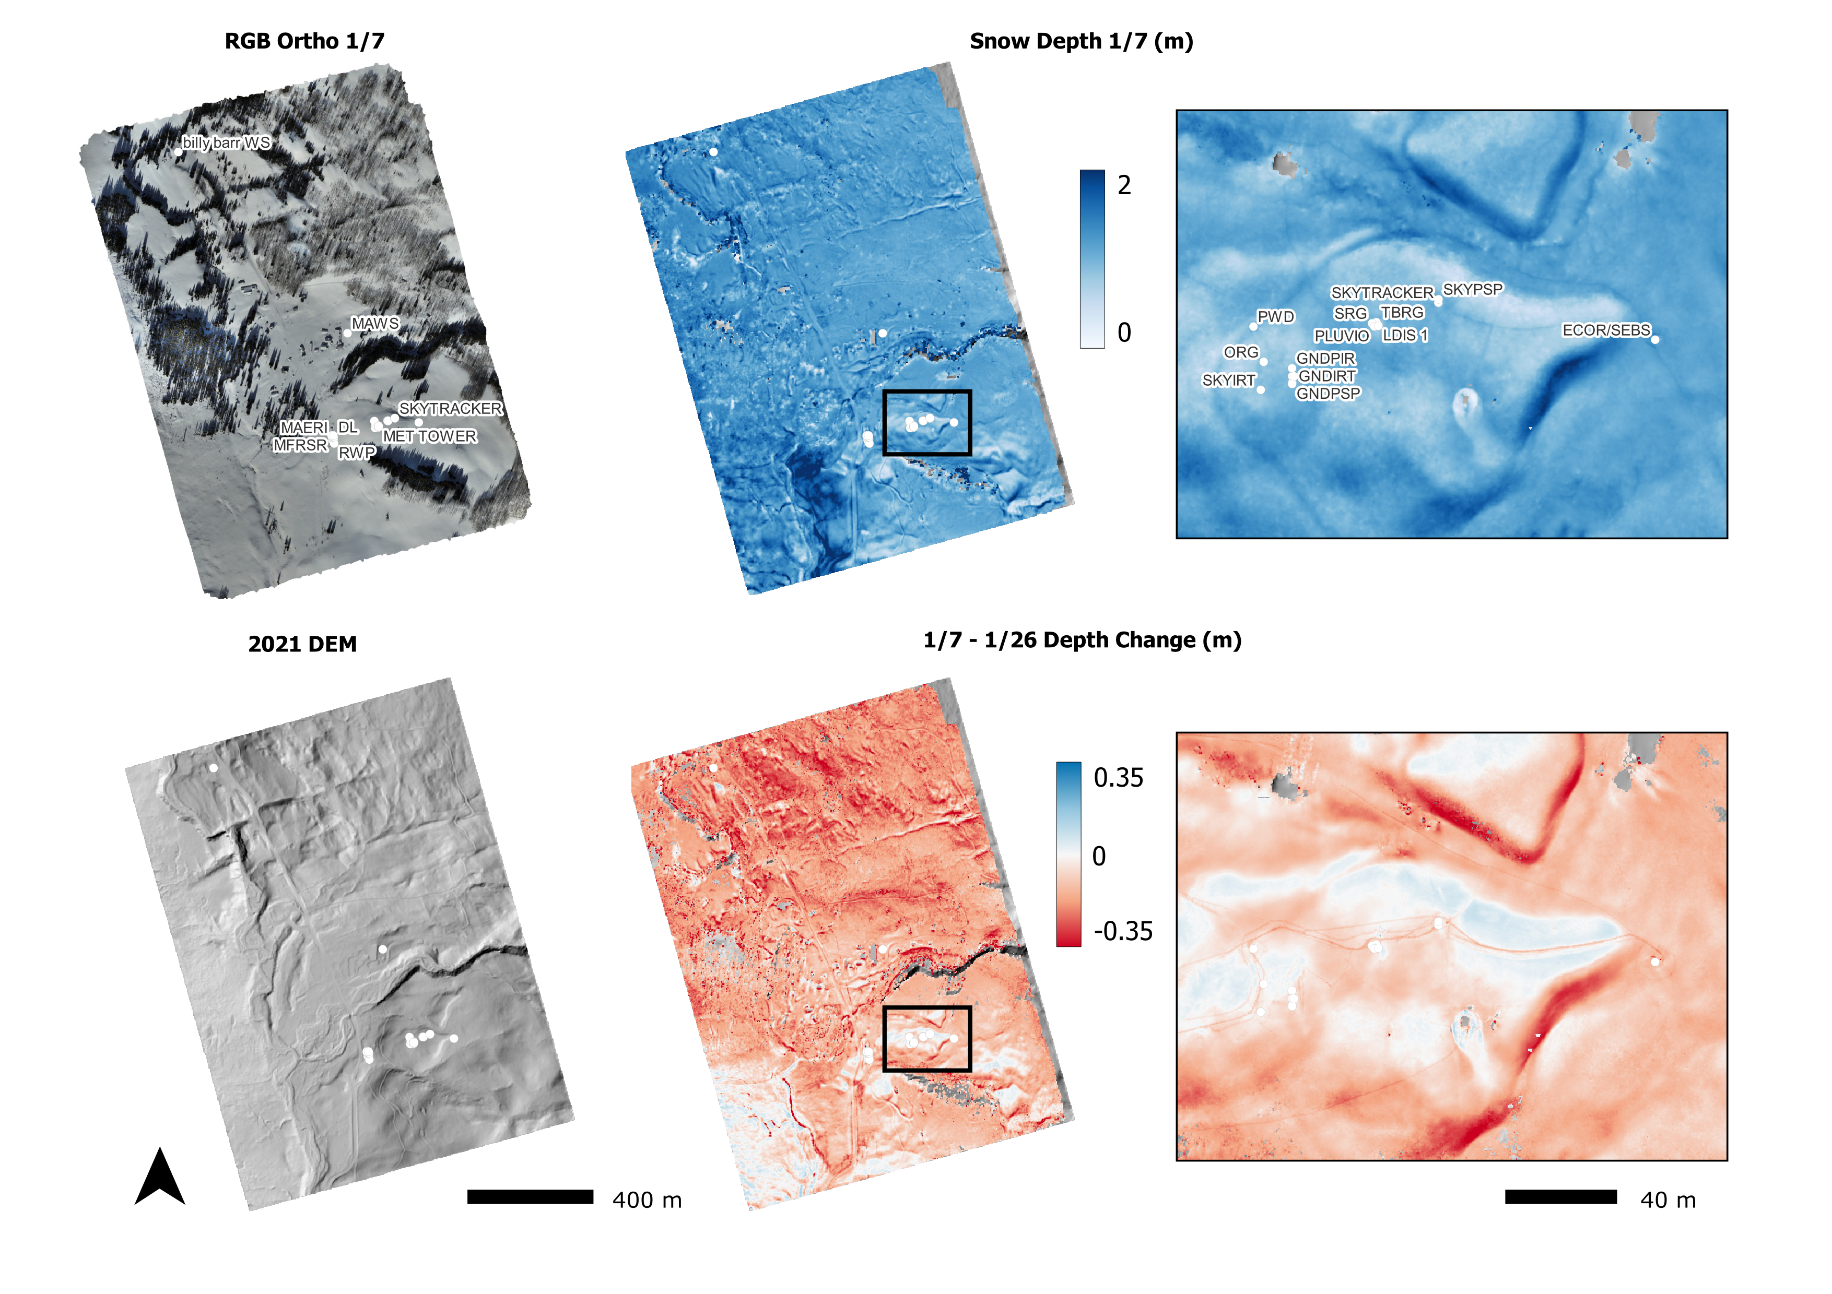
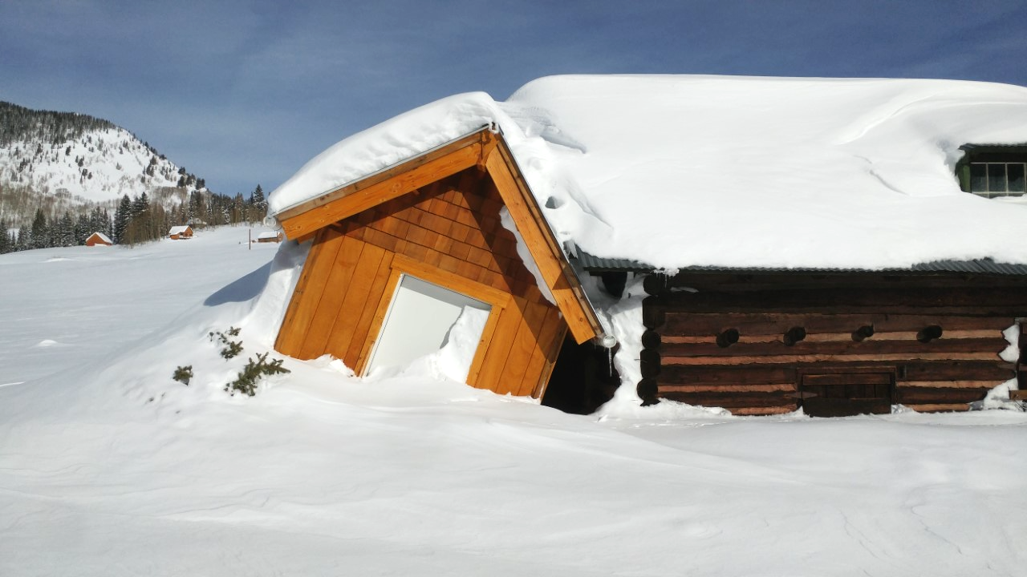
Winter Flights Every 2-3 Weeks
Storm Winds
billy barr Snow Depth (cm)
Avalanche Runout
Data: billy barr, Photo: Benn Schmatz

