Slide 1
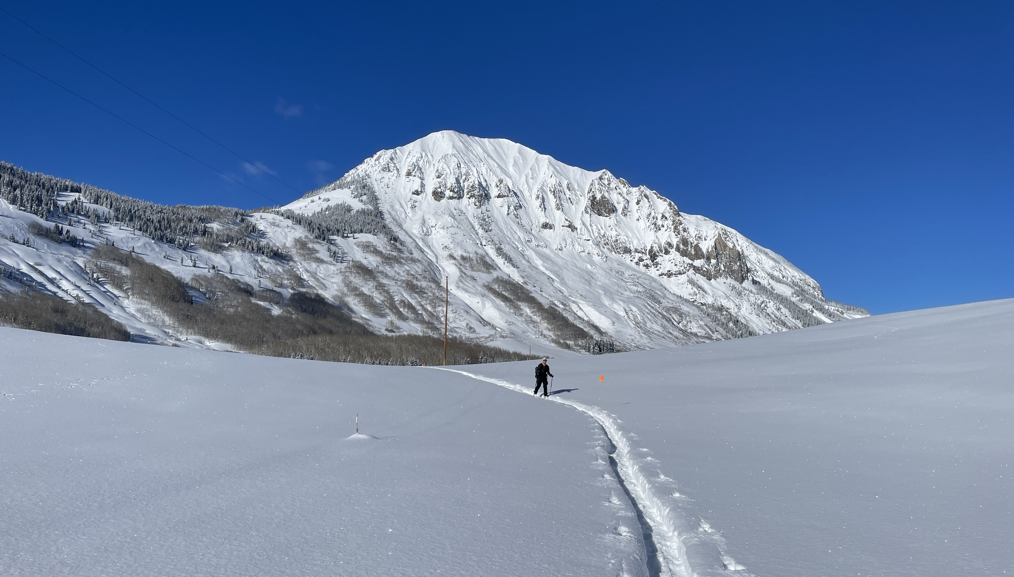
How much snow sublimated during the Winter of 2022-2023?
Measuring and modeling seasonal sublimation with measurements from the SoS campaign
…and ideas for collaborating with the SAIL and SPLASH Campaigns
elilouis@uw.edu
Notes:
Motivation:
- The mystery of missing water in the Colorado river – per unit of precip, less water is ending up as streamflow
- Some have hypothesized that sublimation could be the cause of this missing water – some model runs in the UCRB have estimated 40% of the snowpack is lost to sublimation

Slide 2
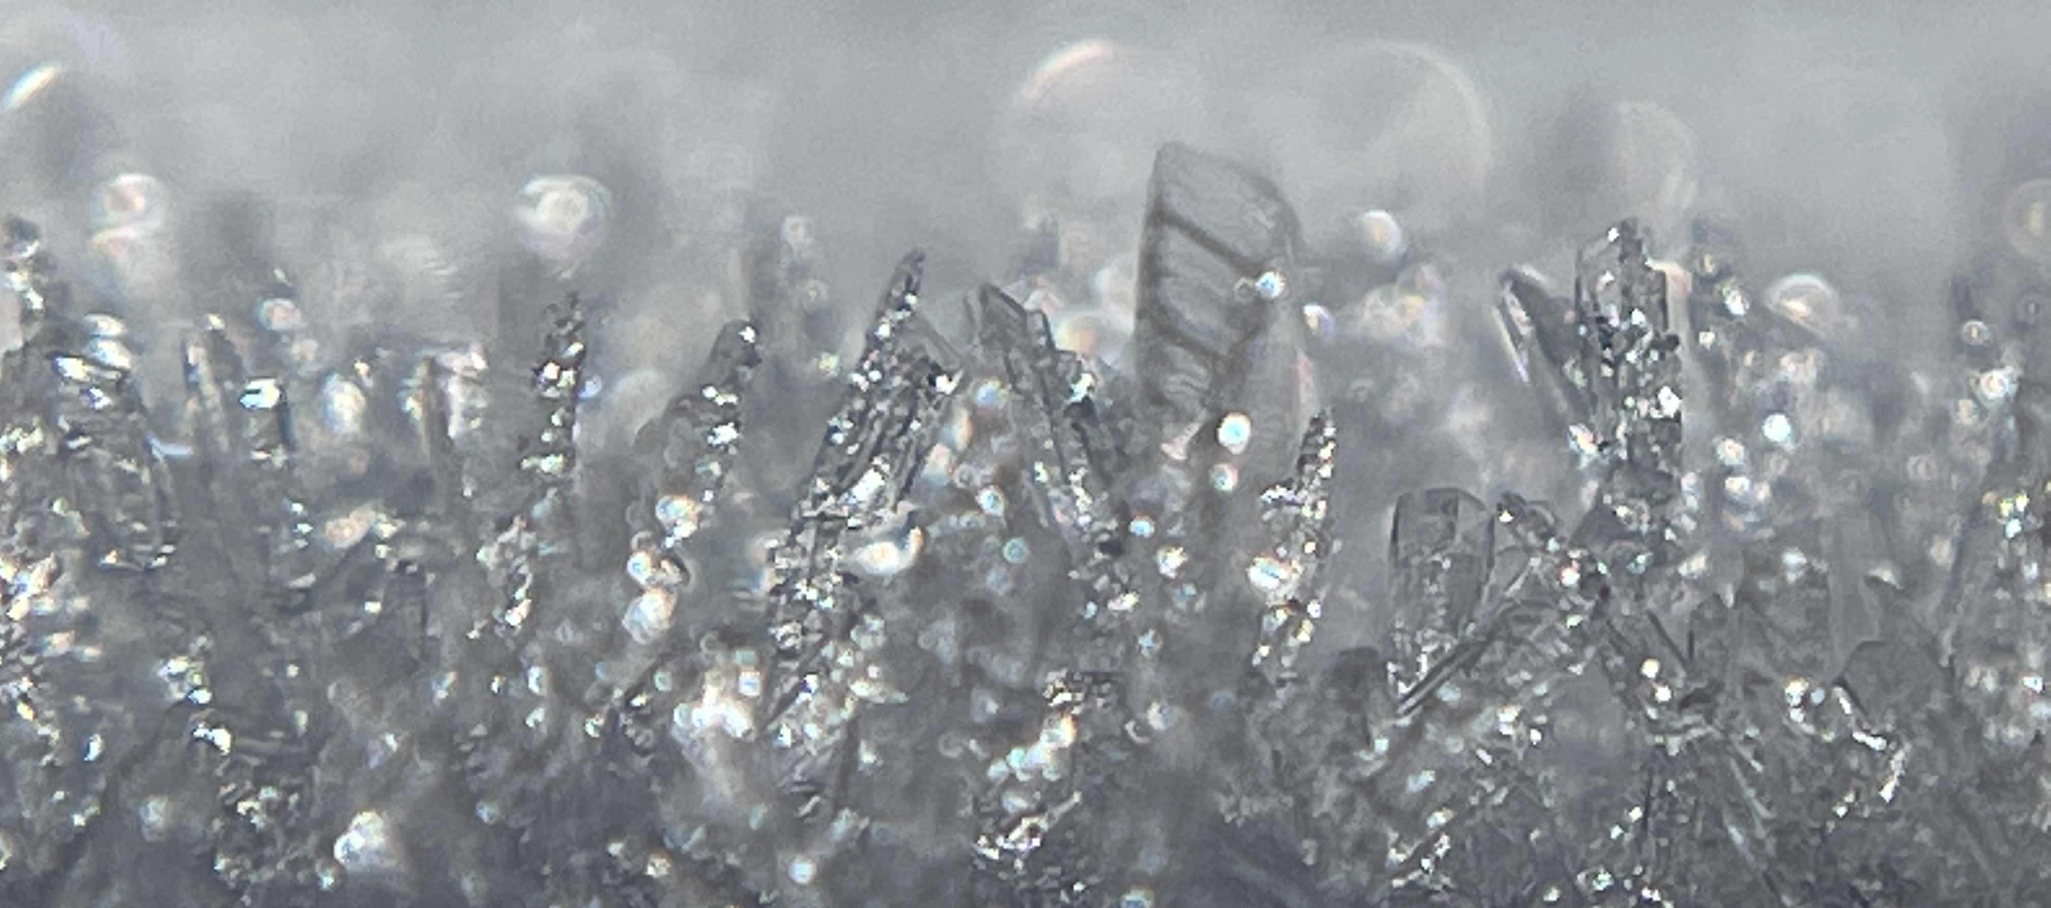
Research Questions
How much sublimation did we measure at Kettle Ponds over the 2022-23 snow season? How much sublimation occurs during blowing snow and non-blowing snow conditions?
How do estimates by the eddy covariance measurements and mean-profile (MOST/bulk aerodynamic) methods compare?
elilouis@uw.edu

Slide 3
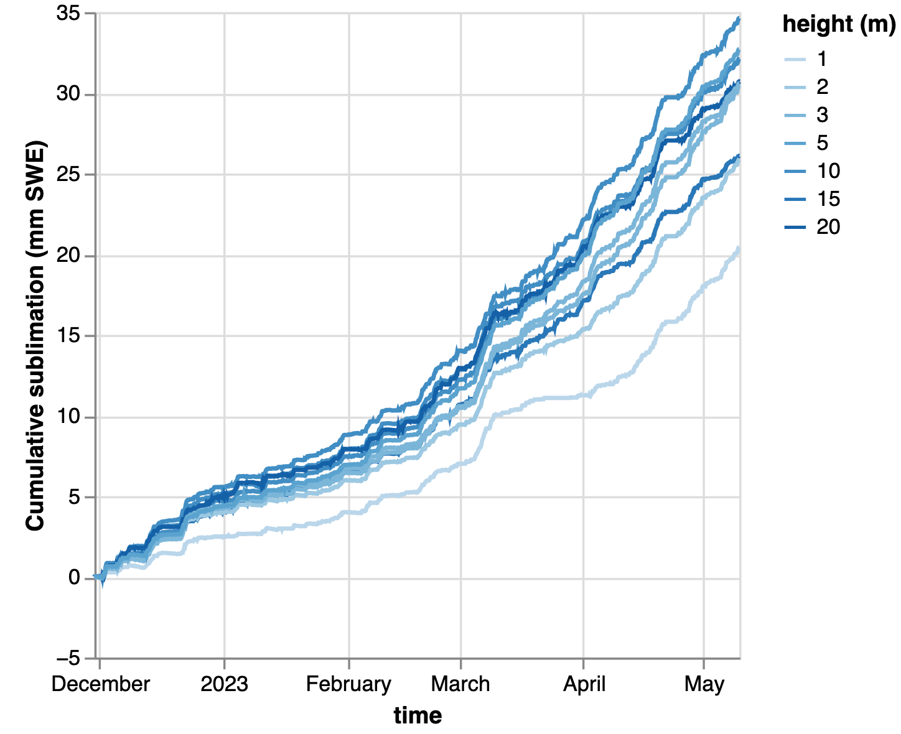
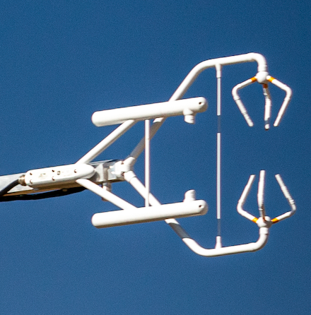
Measuring seasonal cumulative sublimation
~3 – 5% of winter precipitation (702mm) (5-8% of seasonal max SWE, 437mm)
EC
Seasonal cumulative sublimation (mm SWE)
elilouis@uw.edu
Notes:
EXTRA NOTES:
We measured sublimation during the “snow-on” season, which we define as the time period with complete snow cover at Kettle Ponds, approximately November 30 to May 10
Precipitation was measured by SPLASH/NOAH (Tilden’s dataset, precip guage with the Wyoming shield)
SWE measured with SOS’ C tower snow pillow
Sublimation during blowing snow includes 5-minute measurements where either of the two FlowCapt sensor measured any blowing snow flow. The FlowCapt sensor appears to be sensitive even at its detection threshold of 0.01 g/m^2/s (instrument is accurate to 0.01).

Slide 4
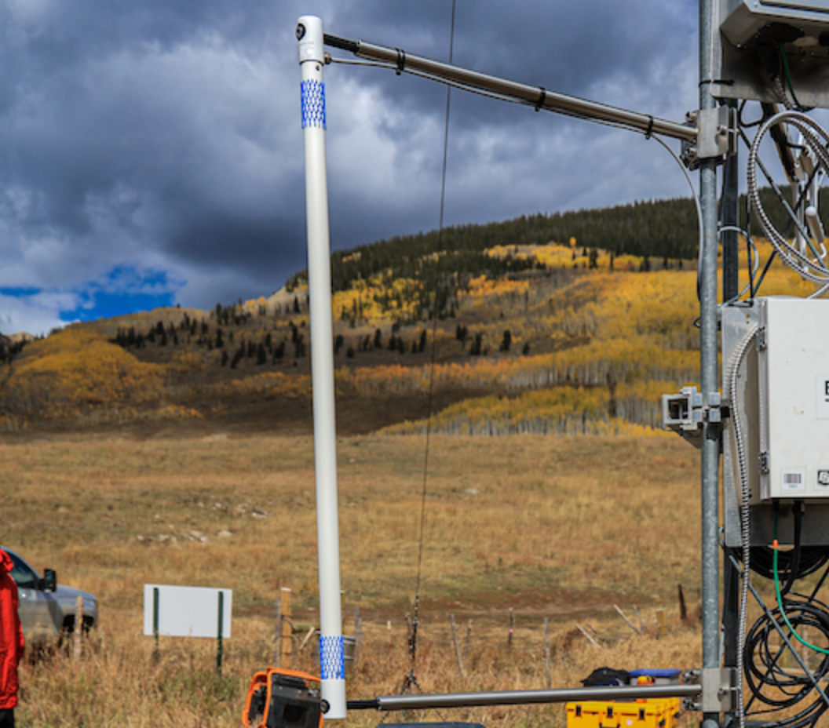
Measuring seasonal cumulative sublimation
Daily sublimation
(mm SWE)
Blowing Snow
~3 – 5% of winter precipitation (702mm) (5-8% of seasonal max SWE, 437mm)
Sublimation during blowing snow
EC
accounted for ~43% of moisture lost
FlowCapt blowing snow sensor
Seasonal cumulative sublimation (mm SWE)
elilouis@uw.edu
Notes:
EXTRA NOTES:
We measured sublimation during the “snow-on” season, which we define as the time period with complete snow cover at Kettle Ponds, approximately November 30 to May 10
Precipitation was measured by SPLASH/NOAH (Tilden’s dataset, precip guage with the Wyoming shield)
SWE measured with SOS’ C tower snow pillow
Sublimation during blowing snow includes 5-minute measurements where either of the two FlowCapt sensor measured any blowing snow flow. The FlowCapt sensor appears to be sensitive even at its detection threshold of 0.01 g/m^2/s (instrument is accurate to 0.01).

Slide 5
Measuring seasonal cumulative sublimation
Daily sublimation
(mm SWE)
Blowing Snow
~3 – 5% of winter precipitation (702mm) (5-8% of seasonal max SWE, 437mm)
Sublimation during blowing snow
EC
accounted for ~43% of moisture lost
Sublimation cannot account for missing CO river water?
FlowCapt blowing snow sensor
Seasonal cumulative sublimation (mm SWE)
elilouis@uw.edu
Notes:
EXTRA NOTES:
We measured sublimation during the “snow-on” season, which we define as the time period with complete snow cover at Kettle Ponds, approximately November 30 to May 10
Precipitation was measured by SPLASH/NOAH (Tilden’s dataset, precip guage with the Wyoming shield)
SWE measured with SOS’ C tower snow pillow
Sublimation during blowing snow includes 5-minute measurements where either of the two FlowCapt sensor measured any blowing snow flow. The FlowCapt sensor appears to be sensitive even at its detection threshold of 0.01 g/m^2/s (instrument is accurate to 0.01).

Slide 6
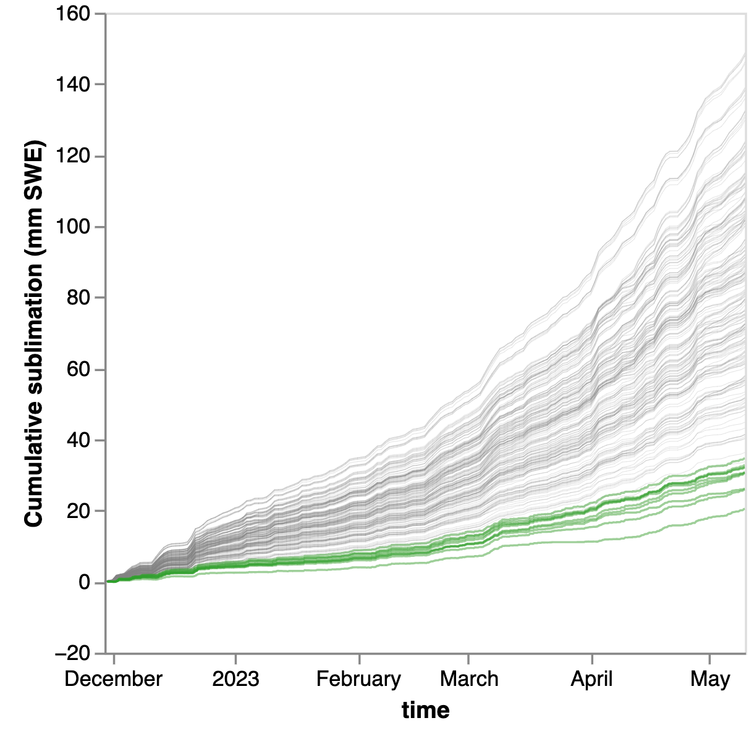
Modeling seasonal cumulative sublimation
Use “offline” turbulence method (Monin Obukhov Similarity Theory) to run model ensemble (n=240) (Lapo, 2018)
Many different stability functions
Range of z₀, 1e-5 to 1e-3
Multiple surface temperature measurements
Models estimate between 5 – 21% of winter precipitation (702mm)
max model run 149mm
MOST Ensemble
Min model run 33.7mm
SOS EC measurements
elilouis@uw.edu
Notes:
Extra Notes:
…or… 8-34% of seasonal max SWE (437mm)
Lowest model - Louis b = 12 Tsurf_c e_sat_alduchov 1e-05 – 33.7
Highest model - MO Beljaars Holtslag Tsurf_rad_d e_sat_metpy 0.001 148.754604

Slide 7
Modeling seasonal cumulative sublimation
Use “offline” turbulence method (Monin Obukhov Similarity Theory) to run model ensemble (n=240) (Lapo, 2018)
Many different stability functions
Range of z₀, 1e-5 to 1e-3
Multiple surface temperature measurements
Models estimate between 5 – 21% of winter precipitation (702mm)
Models very sensitive to z₀, insensitive to stability function
Models sensitive to T_{s}
max model run 149mm
Z₀=1e-3
Z₀=1e-4
MOST Ensemble
Z₀=1e-5
Min model run 33.7mm
SOS EC measurements
elilouis@uw.edu

Slide 8
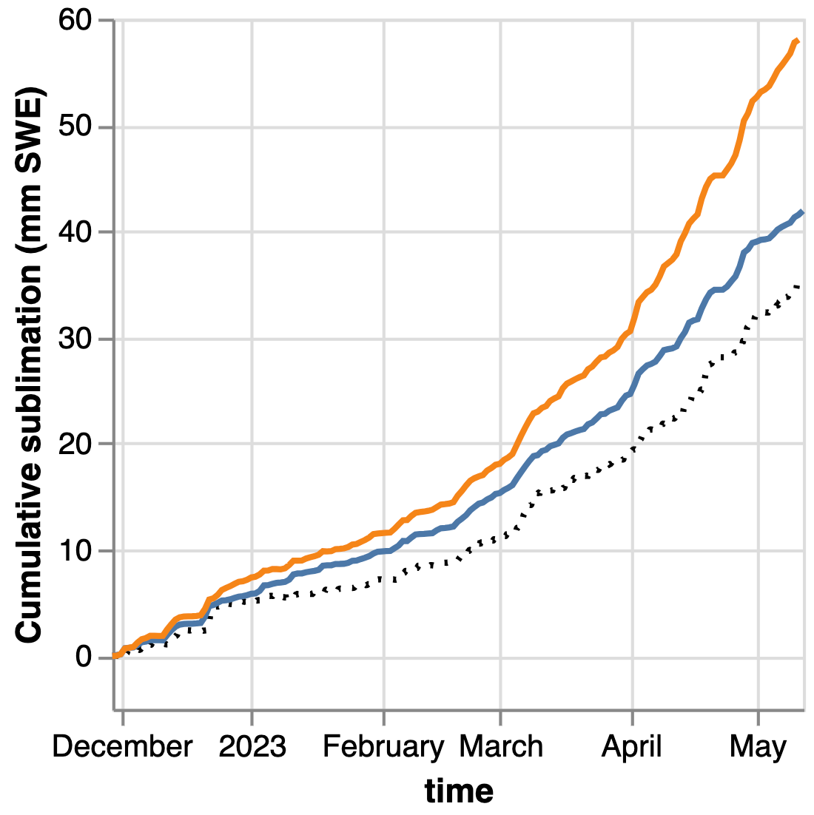
Modeling seasonal cumulative sublimation
Focus on 2 model runs that (relatively) closely match measurements, varying only by surface temperature measurement used (Pyrgeometer vs LW Radiometer)
Seasonal cumulative sublimation estimated by 2 model runs,
varying only by the input T_{s} measurement
LW radiometer
Pyrgeometer
SOS Measured

Slide 9
Modeling seasonal cumulative sublimation
Focus on 2 model runs that (relatively) closely match measurements, varying only by surface temperature measurement used (Pyrgeometer vs LW Radiometer)
Seasonal cumulative sublimation estimated by 2 model runs,
varying only by the input T_{s} measurement
LW radiometer
Pyrgeometer
Why do surface temperatures matter?
SOS Measured

Slide 10
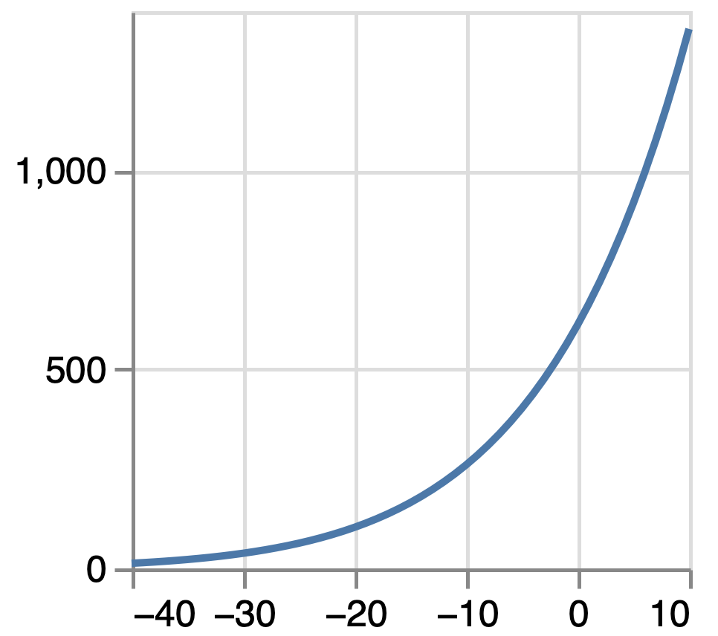
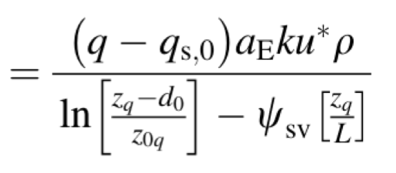
Modeling seasonal cumulative sublimation
Focus on 2 model runs that (relatively) closely match measurements, varying only by surface temperature measurement used (Pyrgeometer vs LW Radiometer)
Seasonal cumulative sublimation estimated by 2 model runs,
varying only by the input T_{s} measurement
LW radiometer
Pyrgeometer
Saturation vapor pressure curve
MOST states that sublimation ∝ vapor pressure gradient, which depends on the saturated vapor pressure at the snow surface, a function of T_{s}
$$q_{s,0}$$
$$(Pa)$$
SOS Measured
$$latent$$
$$heat$$
$$flux$$
$$T_{s} (˚C)$$
Notes:
In the case of these two model runs, the different T_s measurements result in a 150% increase in estimated sublimation (although that only means an increase from 5.7 to 8.5% of total winter precip)
What we're seeing here is the effect of the surface temperature sensors measuring different temperatures...

Slide 11
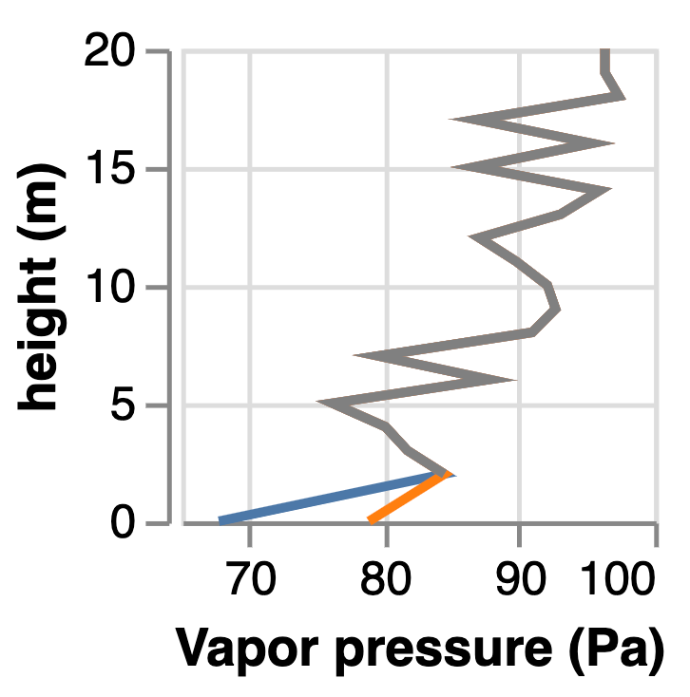
Modeling seasonal cumulative sublimation
We observed frequent disagreement between temperatures calculated using the pyrgeometer and the downward-facing LW radiometer
And small differences in surface temperature result in significant differences in near-surface vapor pressure gradient
Nighttime vapor pressure profile based on two measures of T_{s}
Surface temp. (T_{s})
measurements,
Feb. 1-2, 2023
LW radiometer
Pyrgeometer
elilouis@uw.edu
Notes:
So why do we care? We see that turbulent fluxes calculated with MOST are sensitive to surface temperatures. If our two measurements of surface temperature disagree enough to change the total seasonal sublimation, than we can be pretty sure that models (like VIC, NoahMP), which often get surface temperature very wrong, are in part unable to correctly predict sublimation because of incorrect surface temperature.
EXTRA NOTES:
The profiles shown are from 2000 (8pm) on February 2nd

Slide 12
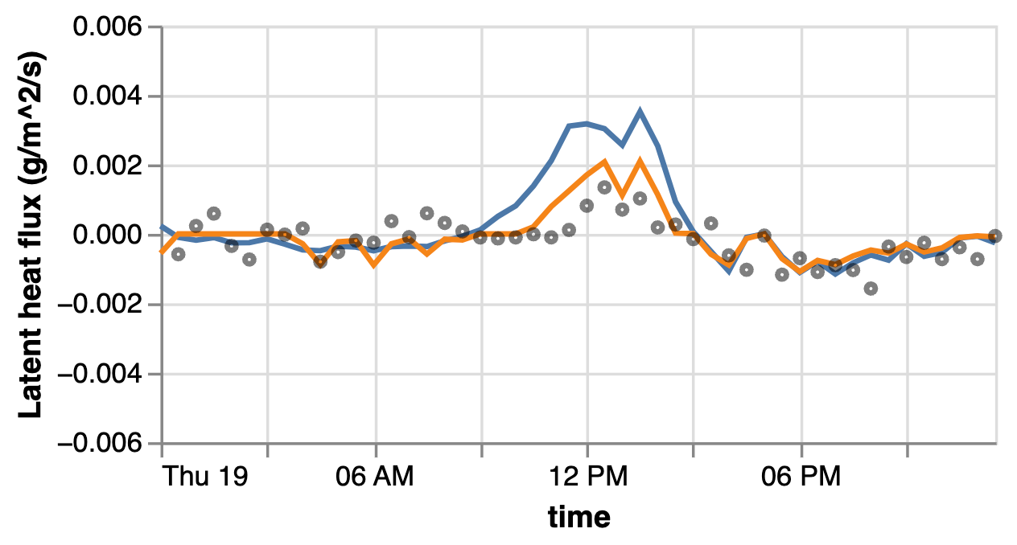
Modeling seasonal cumulative sublimation
This is what the difference in choice of T_{s} measurement looks like on a single day
Switching gears slightly…
Modeled and measured latent heat flux,
January 19, 2023
Model run using
LW radiometer
Model run using
Pyrgeometer
SOS Measured
Notes:
All of this uncertainty leads us to two thoughts –
one, it would be nice to have more measurements of sublimation,
and two, it would be nice to have more measurements of surface temperature…

Slide 13
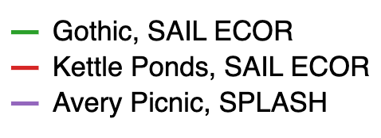
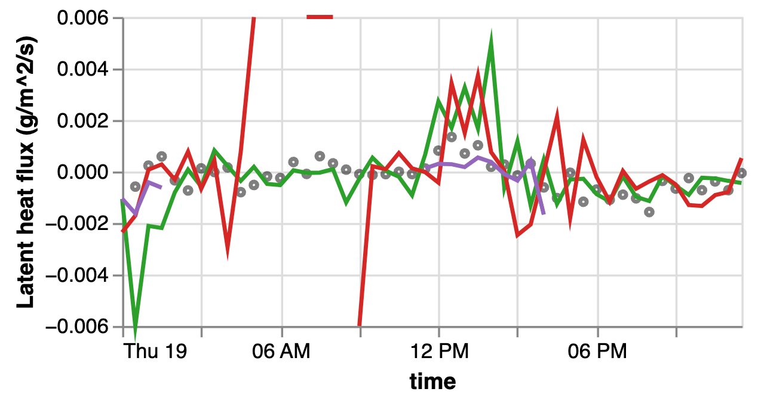
Differences in turbulence measurements across sites/campaigns are of similar order of magnitude as differences in modeled sublimation due to different T_{s} measurements
Different amounts of noise in measurements indicate that cleaning/preprocessing methods influence calculated turbulent fluxes
Modeling seasonal cumulative sublimation
This is what the difference in choice of T_{s} measurement looks like on a single day
Switching gears slightly…
Measured latent heat flux as multiple sites,
January 19, 2023
Modeled and measured latent heat flux,
January 19, 2023
Model run using
LW radiometer
Model run using
Pyrgeometer
SOS Measured

Slide 14
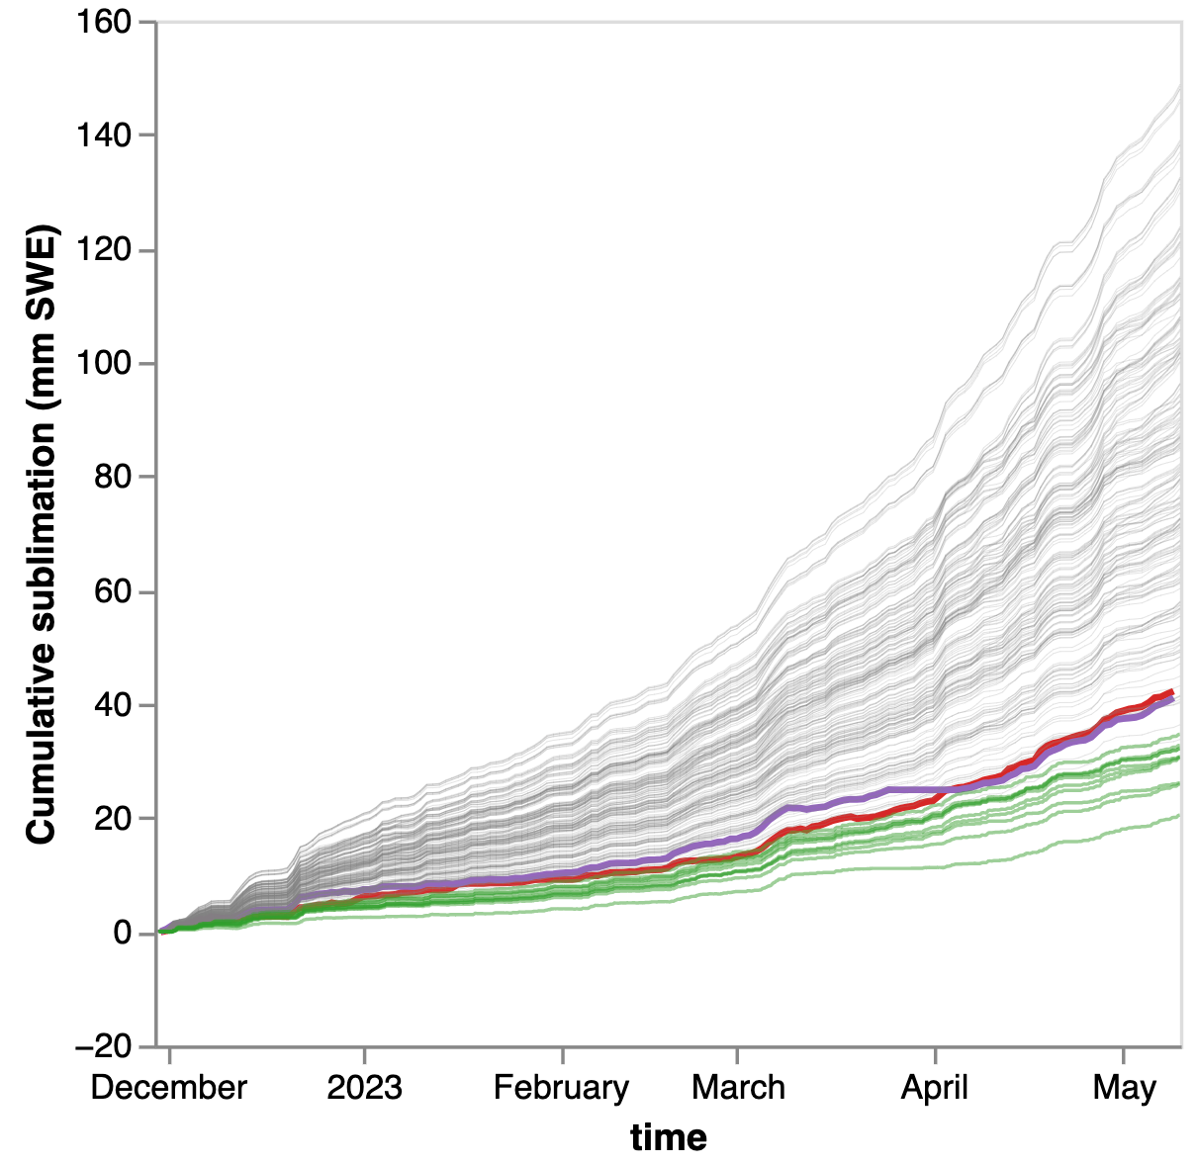
Measuring seasonal cumulative sublimation… again
MOST Ensemble
SAIL turbulent flux measurements result in very close sublimation estimates despite being ~2km away
SAIL ECOR, Gothic
SAIL ECOR, Kettle Ponds
More variability in turb. flux measurements that are all at the same site
SOS, Kettle Ponds
elilouis@uw.edu

Slide 15
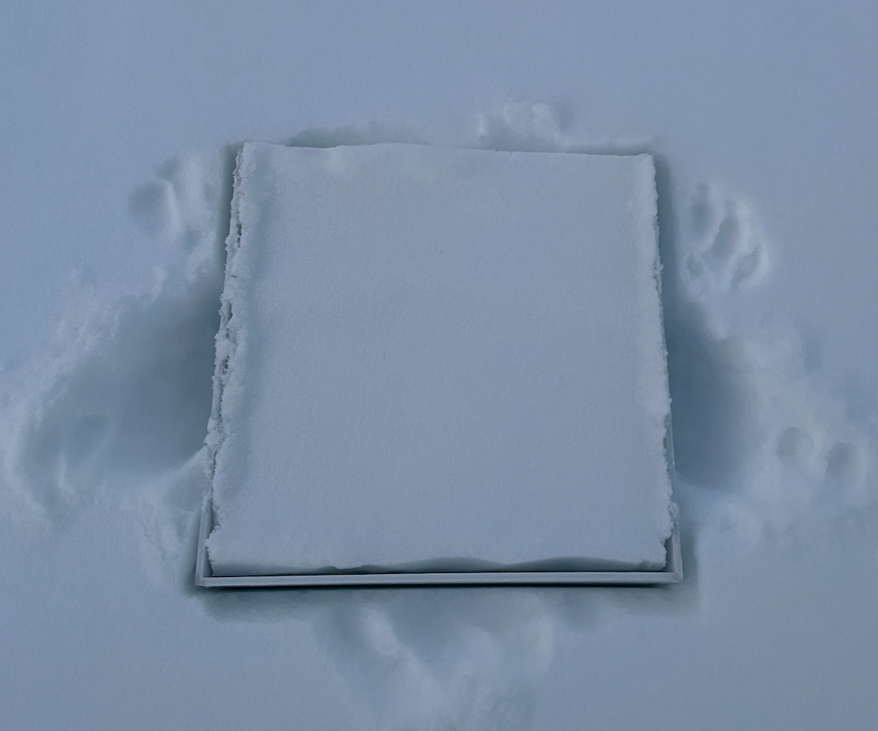
Stossel box
Daily sublimation measured two ways
Incorporating SAIL and SPLASH measurements
Stossel box/
lysimeter
Eddy
Covariance
Vertical profiles of Latent heat flux, Kettle Ponds
Winter (Feb 2)
Moving forward:
Calculate z₀ for the study sites, identify the “best” MOST model runs
Explore hypothesis that EC measurements under-measure surface fluxes –
Why does MOST almost always overestimates sublimation?
Could lateral advection of moisture mean that EC measurements to not represent the surface flux?
Ideas for collaboration:
Compile all raw turbulent flux measurements, apply same processing/cleaning steps
Use MEP model to calculate sublimation
Compile all T_{s} measurements, explore novel methods for estimating T_{s}
Examine land surface model runs, compare estimated and measured T_{s}
12pm
Spring (Mar 30)
12pm
elilouis@uw.edu

Slide 16
References
Abatzoglou, J. T., Rallings, A., Bernacchi, L., Viers, J. & Medellín-Azuara, J. California’s Missing Forecast Flows in Spring 2021 – Challenges for seasonal flow forecasting. California WaterBlog https://californiawaterblog.com/2021/07/18/californias-missing-forecast-flows-in-spring-2021-challenges-for-seasonal-flow-forecasting/ (2021).
Alduchov, O. A. & Eskridge, R. E. Improved Magnus form approximation of saturation vapor pressure. J. Appl. Meteorol. 35, 601–609 (1996).
Bolton, D., 1980: The computation of equivalent potential temperature. Mon. Wea. Rev., 108.
Lapo, K. E. (2018). Turbpy Python package for simulating turbulence. Seattle, WA: University of Washington. https://doi.org/10.5281/ zenodo.1421061
elilouis@uw.edu

Slide 17
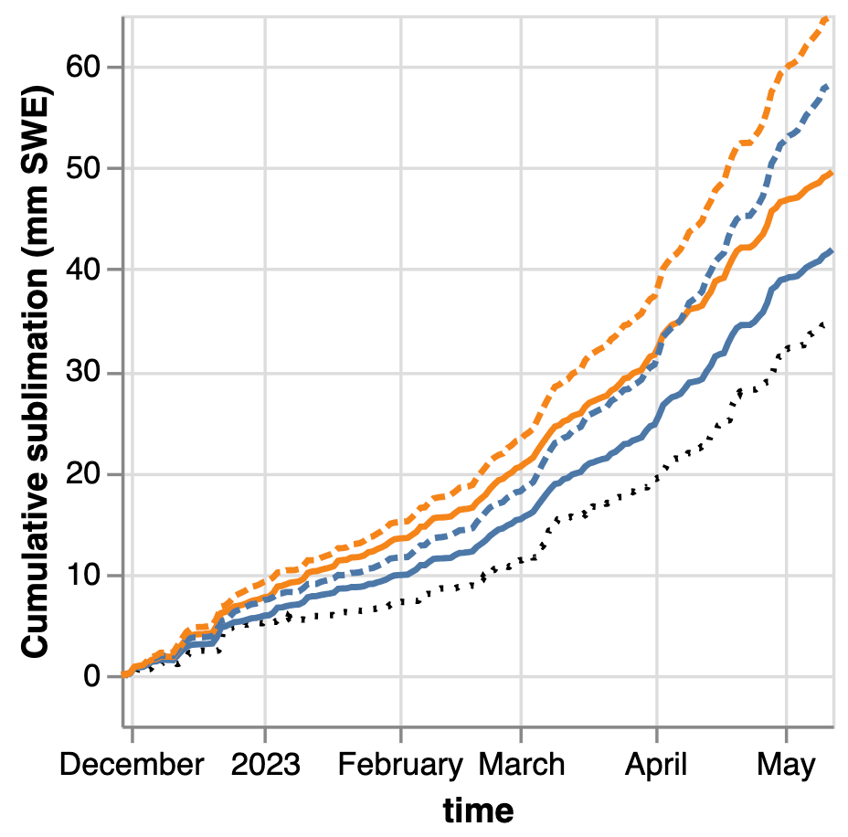
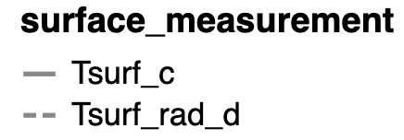
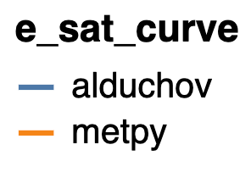
Seasonal cumulative sublimation estimates using different surface temperature measurements (RQ3)
Only looking at lowest model runs (z₀=1e-5)
Choice of temperature sensor influences modeled sublimation due to systematic cold-bias at night of the Pyrgeometer, and its occasional cold bias during daytime
Choice of e_{sat} curve matters (for calculating saturated vapor pressure at snow surface from surface temperature)
Pyregometer
LW Radiometer
Alduchov (1996)
Bolton (1980)
Measured

Slide 18
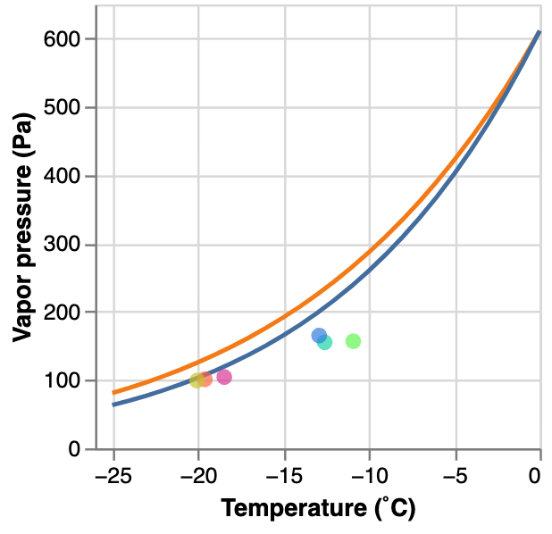
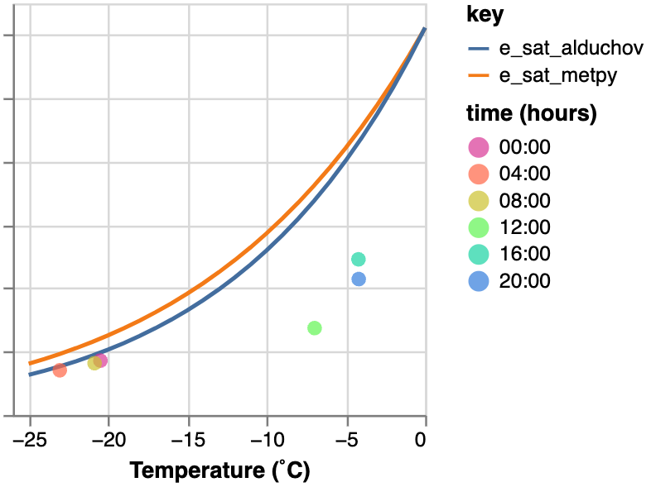
Seasonal cumulative sublimation estimates using different surface temperature measurements (RQ3)
Look at model runs with z₀=1e-5, selecting one stability function for simplicity (limiting to n=4 model runs)
Choice of temperature sensor influences modeled sublimation due to systematic cold-bias at night of the Pyrgeometer, and its occasional cold bias during daytime
Choice of e_{sat} curve matters (for calculating saturated vapor pressure at snow surface from surface temperature) – especially during winter-time, when near-surface vapor pressure gradients are small
Pyregometer
February 1, 2023
March 28, 2023
Alduchov (1996)
LW Radiometer
Bolton (1980)
Alduchov (1996)
Bolton (1980)
Measured (EC)

Slide 19
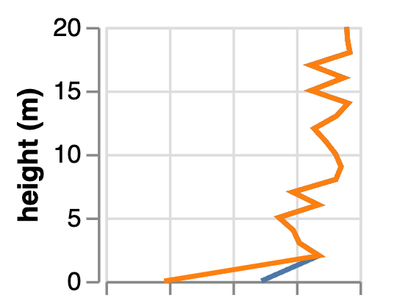
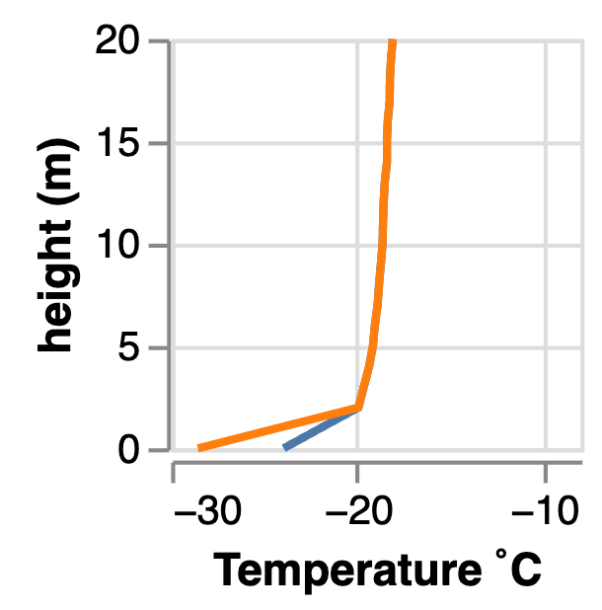
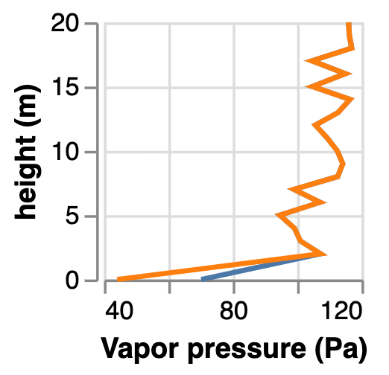
Effect of sat vapor pressure curve
T_{s} measurement
Pyrgeometer
e_{sat} Bolton (1980)
e_{sat} Alduchov (1996)

