Slide 1
Observed Relationships Between Daily Cycles of Radiation, Clouds, and Streamflow in the East River Watershed
William Rudisill and Dan Feldman
SAIL/SPLASH/SOS Science Meeting
November 2, 2023
Boulder, CO

Slide 2

Liquid water path
Ice water path
Cloud depth
Cloud temperature (longwave)
Problem Statement and Motivation
The impact on clouds on the surface energy balance (SEB), snowmelt, and streamflow in snow-dominated, mountain watersheds is relatively poorly explored
How do the radiative impacts of clouds impact streamflow responses? Is there a relationship between cloud cover and diurnal streamflow amplitudes?
+ Longwave
- Shortwave
(?)

Slide 3
Determining Cloud Radiative Effects
$$CRE_{SW}=F_{SW}^{Clear}↓-F_{SW}^{AllSky}↓$$

Slide 4
Determining Cloud Radiative Effects
$$CRE_{SW}=F_{SW}^{Clear}↓-F_{SW}^{AllSky}↓$$
Observed by SAIL SEBS system
Modeled using RRTMG radiative transfer model with clouds turned OFF
Location | SAIL AMF2 — M1 (Gothic)
Net Radiometer | Kipp and Konen CNR4/CNF4
Spectral range | 300 to 2800 nm (shortwave)

Slide 5
Determining Cloud Radiative Effects
$$CRE_{SW}=F_{SW}^{Clear}↓-F_{SW}^{AllSky}↓$$
$$CRF_{SW}=(1-α)CRE_{SW}$$
Broadband shortwave albedo (daily avg.)
$$α=\frac{F_{SW}↑}{F_{SW}↓}$$

Slide 6
RRTMG Configuration
Model Input | Source
Aerosol optical depth at 550 nm | Cimel sun photometer. Monthly averaged values are used.
Water vapor profile | Interpsonde. RH is scaled by microwave radiometer retrievals. Lowest level from met stations.
Temperature profile | Interpsonde. Lowest from met stations.
Barometric pressure | Interpsonde. Lowest level from met stations.
Ozone profile | NOAA ozone sonde located in Boulder (currently using 1 profile)
Using RRTMG Version 4
Correlated K-method with 14 spectral bands
Used in NWP models, GCMs, etc.
Models extinction of radiation by water vapor, carbon dioxide, ozone, methane, oxygen, nitrogen, aerosols, and Rayleigh scattering.
Climlab—RRTMG provides pre-compiled binaries with a python wrapper function)

Slide 7
RRTMG: Clear Sky
Downwelling Shortwave Flux (w/m²)
Left: RRTMG Modeled downwelling shortwave flux compared against SAIL observations at the M1 site.
    To do: verify AOD information is being used appropriately. Using ECMWF aerosol option with AOD at 550 nm input

Slide 8
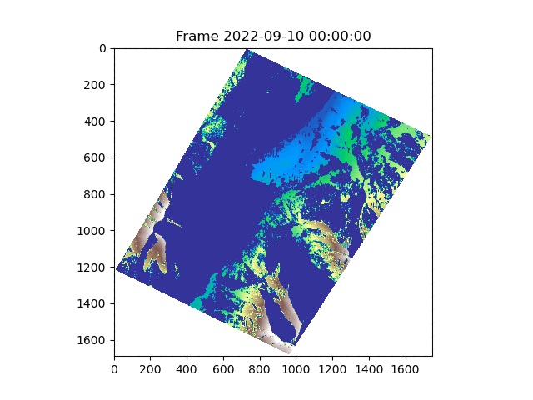
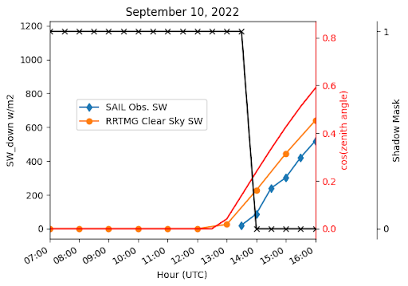
Aside: Terrain Shadowing
A) Terrain shadow mask (blue) and terrain elevation By hour for 2022-09-10. Based on the NEON digital elevation model upscaled to 5 meters.
B) Cosine of the solar zenith angle (red), modeled downwelling solar radiation (orange), observed downwelling solar radiation (blue), and presence/absence of shadows (black) for September 10, 2022. Time is in UTC
**13:00 UTC is 07:00 a.m local time

Slide 9
Results: Shortwave Cloud Radiative Forcing and Cloud Radiative Effect
Daily and Weekly averaged quantities:
Daytime cloud fraction measured by the total-sky imager
Land surface albedo measured by the SEBS at M1
Cloud Radiative Effect
Cloud Radiative forcing
Both CRE and CRF are at their maximum during the warm season — more potent clouds and lower albedo

Slide 10
Emergence of Sub Daily Cycles of Cloud Cover
Seasonal characteristics of the
diurnal cycle of cloud detection
Blue: cloud detection probability
Red: Clear Sky SW downwelling (rrtmg no-clouds)
Green: SEBS Observed downwelling SW (M1)
Notes:
4-minute data from Kollias algorithm VAP (“ARSCLKAZR1KOLLIAS”)
is assigned “1” if a cloud base is detected and “0” if not.
Uses micropulse lidar, cielometer, KAZR backscatter — ultimately ingested into the ARSCL VAP (?)

Slide 11
Results: Relationship between Daily Avg. CRE and Cloud Properties
Left: Daily avg. relationships between average liquid water path (LWP) retrieved from the SAIL microwave radiometer, cloud cover percentage from the the total-sky imager, and CRE (Clear - All-Sky)
High CRE SW values are achieved when the liquid water path is high
Reflection by surrounding terrain during dry, cloudless days (also at low sun angles; not shown)?

Slide 12
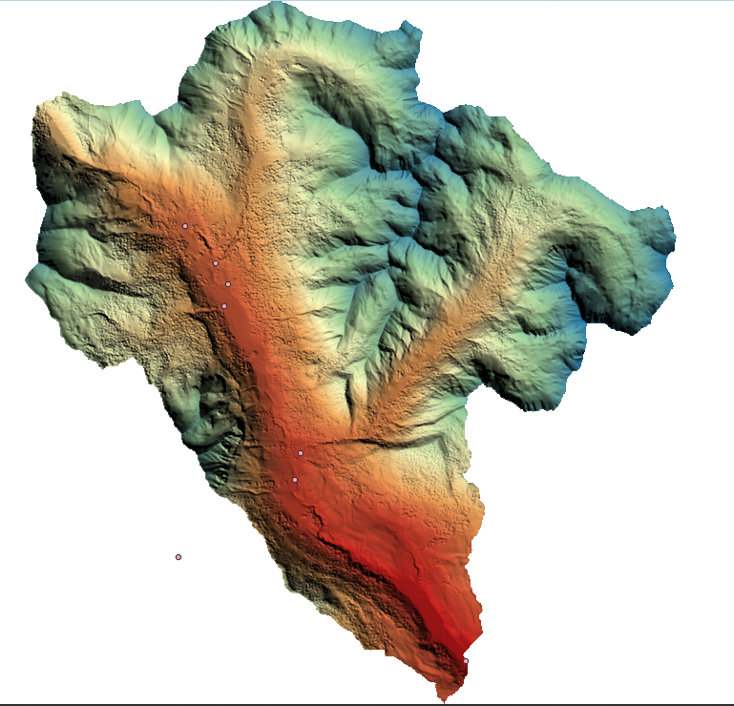
How does (??) this relate to streamflow?
Streamflow in snow-dominated watersheds shows daily fluctuations in response to the land surface energy balance through snowmelt and evapotranspiration (opposite relationship with solar radiation!)
The East River Watershed
Observed Streamflow
Stream gauge at “pumphouse” station collected
by the East River SFA (Carroll et. al; available on ESS-DIVE)

Slide 13
How does (??) this relate to streamflow?
Overnight T2m below zero inhibits melt+streamflow
Cloud cover and CRE are not well correlated with T2m anomalies (not shown)
Streamflow does not rise rise with T2m, beginning around ~6/7 (suggesting snow limitation)

Slide 14
How does (??) this relate to streamflow?
Date — 2022
$$\begin{aligned}\overset{̂}{q}(t)=αsin(w(t+ϕ))+d\end{aligned}$$
$$\begin{aligned}\overset{̂}{q}(t)\end{aligned}$$
: the hourly (t) detrended streamflow
$$t$$
: hour in radians
streamflow
(cms)
$$α$$
: amplitude of the wave
$$w$$
: phase velocity (cycles per period)
$$ϕ$$
: phase
$$d$$
: gain
Orange: observed streamflow
Blue: fitted sine wave
***hour is in UTC

Slide 15
How does (??) this relate to streamflow?
Daily Streamflow amplitude vs. daily avg. CRE for the snowmelt period (April-15 to July-15)
Amplitudes are a significant fraction of the total discharge (sometimes ~25%)
The highest amplitude days generally happen when skies are clear
Rainfall likely has an impact as well (high CRE with moderate amplitude)

Slide 16
Conclusions and Next Steps
Shortwave CRE and CRF are the strongest in May — October (monsoon flow)
We can detect the emergence of a diurnal cloud cycle that emerges during the summer time (do models, e.g. HRRR show the same?)
Clouds appear to influence streamflow amplitudes during peak melt (what about summer time ET induced cycles?)

Slide 17
Conclusions and Next Steps
To Do Items:
Quantify CRE in the longwave — overnight LW might be interesting
Characterize the sensitivity of the diurnal character of streamflow to CRE and other snowmelt fluxes (LW and sensible heat flux in particular — neural network??)

Slide 18
Thank you
Would you like to collaborate?
WilliamRudisill@lbl.gov
Thanks!

