Slide 1
Exploring Mountain Valley Winds and Cloud Formation
Winds affect
clouds affect
radiation affects
surface fluxes affect
winds…
Ethan Gutmann
NCAR / RAL
Jessica Lundquist, Danny Hogan, Eli Schwat (UW), Daniel Kirshbaum (McGill)
November 2, 2023 – S3 Science Summit
Notes:
NOTE: Background image can be used as is or changed for a particular presentation in the “Slide Master” button found under the “View” tab.

Slide 2
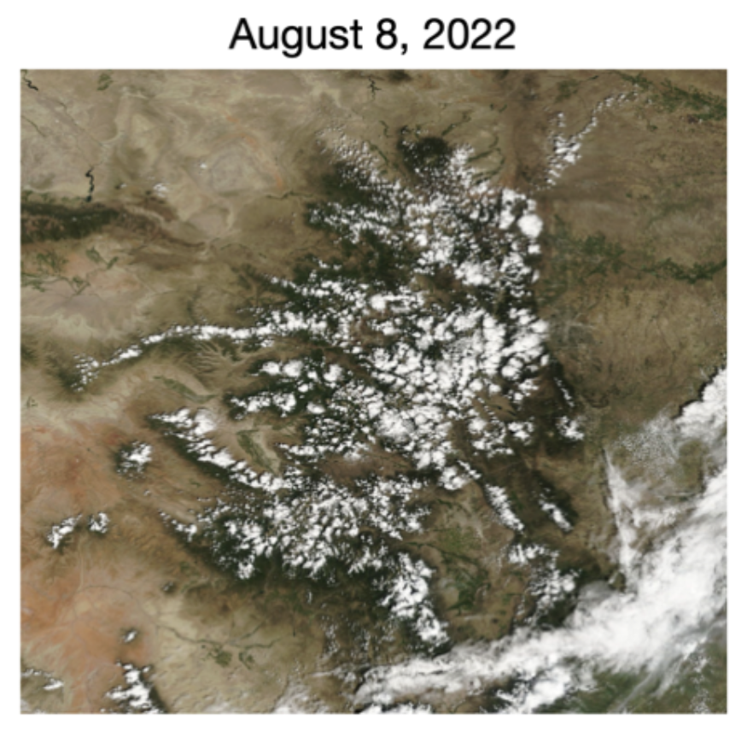
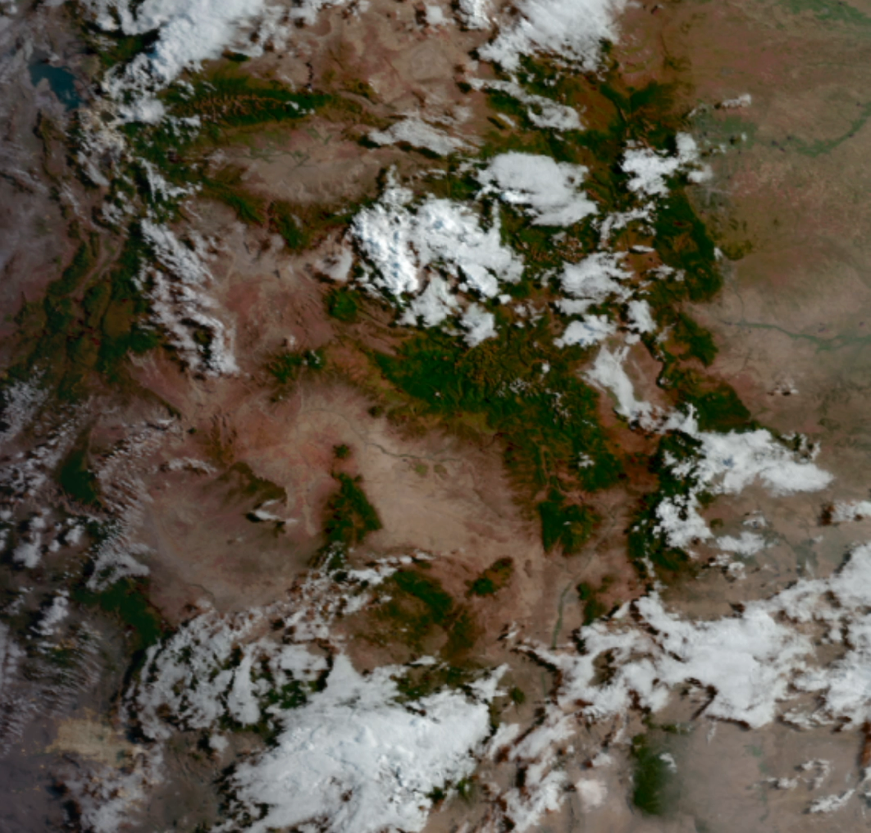
Clouds Respond to Flow over Mountains
Cloud formation is strongly controlled by terrain forced ascent
Synoptic environment must be conducive
  Adequate moisture and instability
  Different behavior with stronger vs weaker forcing
Weak thermally driven cloud initiation persistent in summer
How does terrain organize ascent beyond direct forcing (dz/dt = U * dz/dx)
x
MODIS observation of terrain tied cloud cover

Slide 3
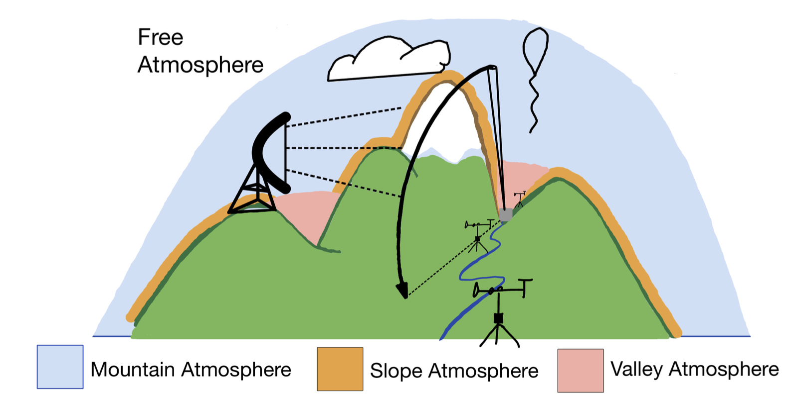
Mountains Organize Atmospheric Flow Across Scales
Leveraging SAIL / SPLASH / SOS
Soundings
Lidar
Surface stations
Cloud observations
Enable examination of mountain circulation over multiple scales and feedbacks to the free atmosphere
Slope effects harder to observe
Stations (mostly) located in valley and lidar/radar see larger scales

Slide 4
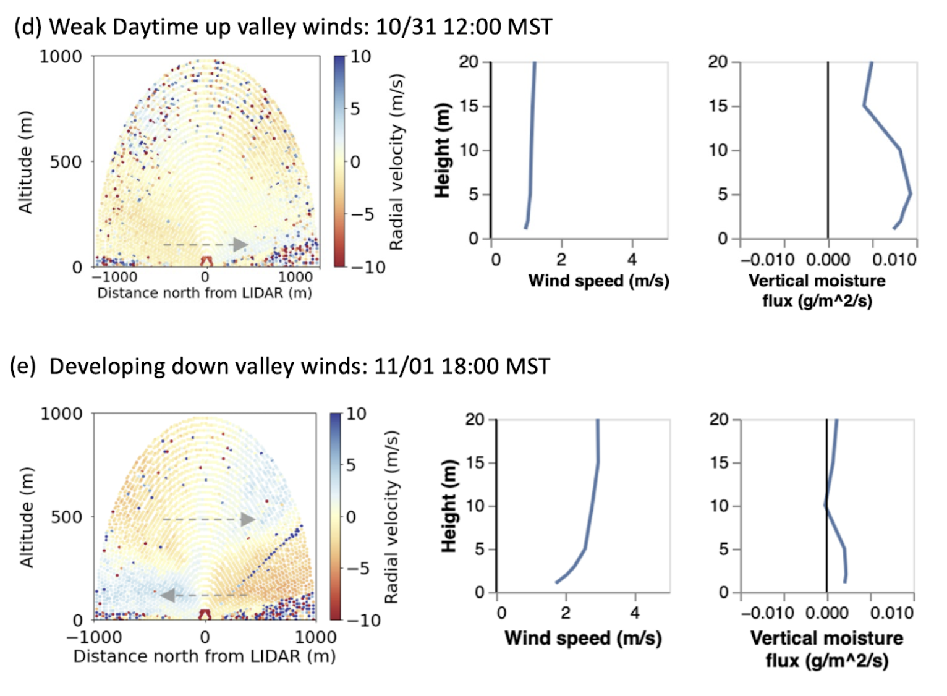
Mountains Organize Atmospheric Flow Across Scales
Leveraging SAIL / SPLASH / SOS
Doppler Lidar shows change in wind direction over the day
Shows depth/height of valley wind (~250 m downvalley, ~150m up-valley?)
Weak up-valley winds associated with larger land surface moisture fluxes than stronger downvalley flow
Figure: Eli Schwat

Slide 5
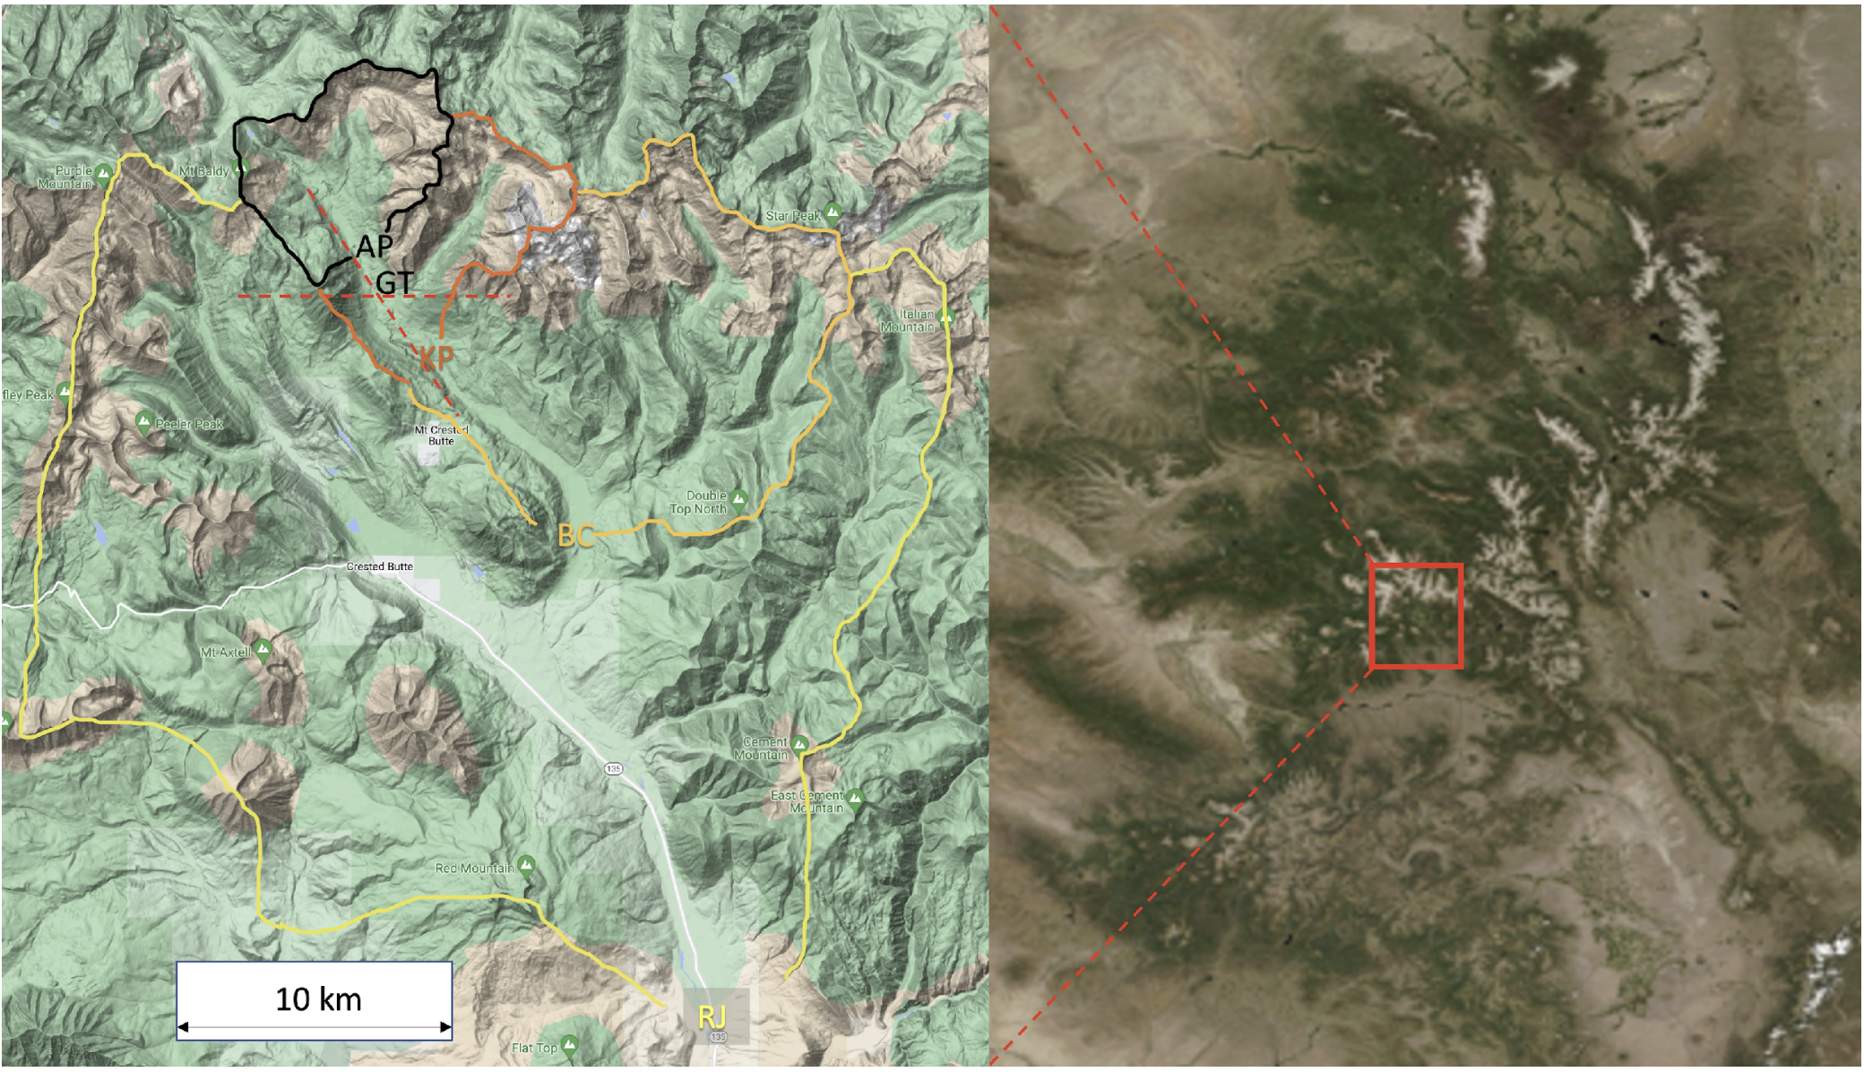
Mountains Organize Atmospheric Flow Across Scales
How do valleys channel winds?
Cold air drainage
Warm air chimneys?
Surface stations observed diurnal wind direction/strength at the outlet of nested airsheds
  Avery Picnic (AP)
  Gothic Townsite (GT)
  Kettle Ponds (KP)
  Brush Creek (BC)
  Roaring Judy (RJ)

Slide 6
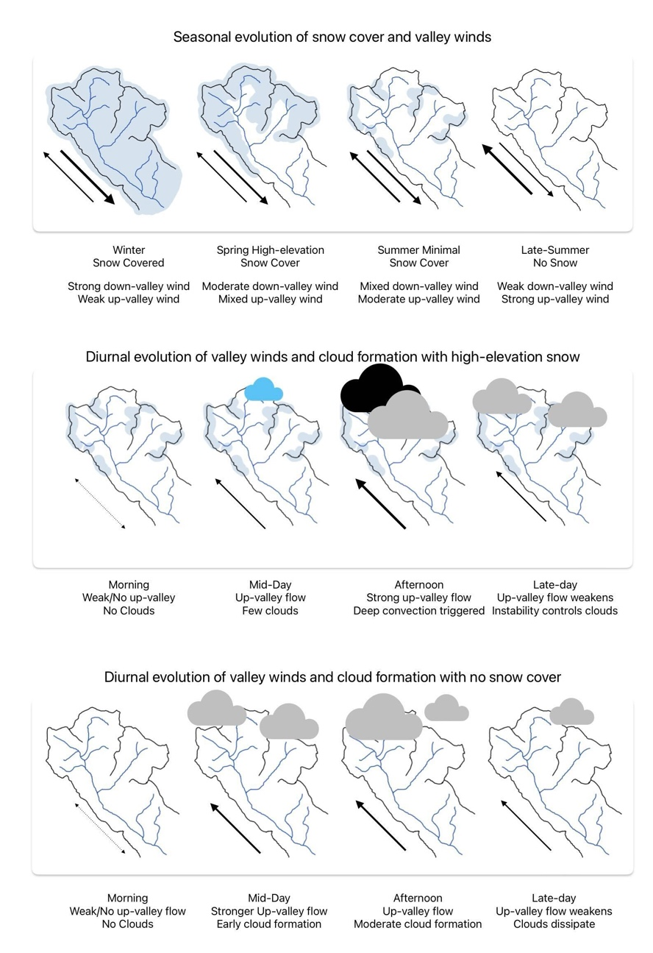
Valley winds and Snow Cover / Moisture
Seasonal and Diurnal Evolution
Snow cover weakens elevated heating
As snow melts, albedo changes, daytime thermal circulation strengthens
Thermal up-valley flow leads to afternoon clouds and convection initiation
Are there cases when excess thermal flow in the morning creates early cloud cover and shuts down stronger afternoon convection?

Slide 7
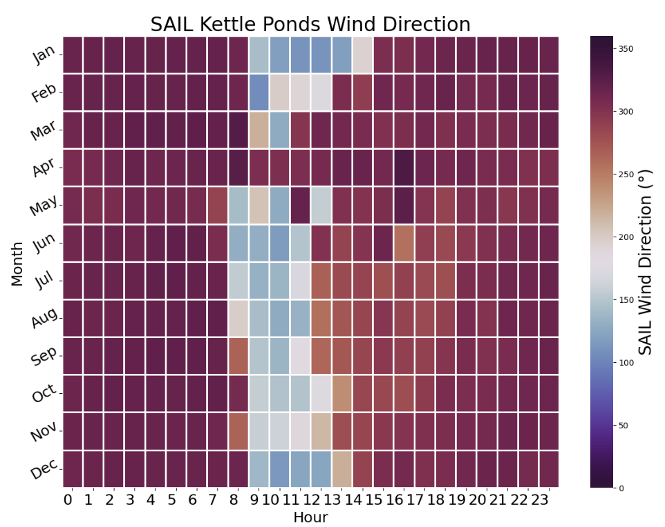
Seasonal and Diurnal Cycle of Valley Winds
Predominantly down-valley flow
Consistent flow up-valley mid-day
…except maybe Mar, Apr, May with warmer background air and wide spread snow coverage?
In Jul, Aug, Sept does up-valley flow persist later in the afternoon?
How does land surface control strength and direction of valley winds?
How does the valley scale morphology influence diurnal valley winds?
Figure: Danny Hogan

Slide 8
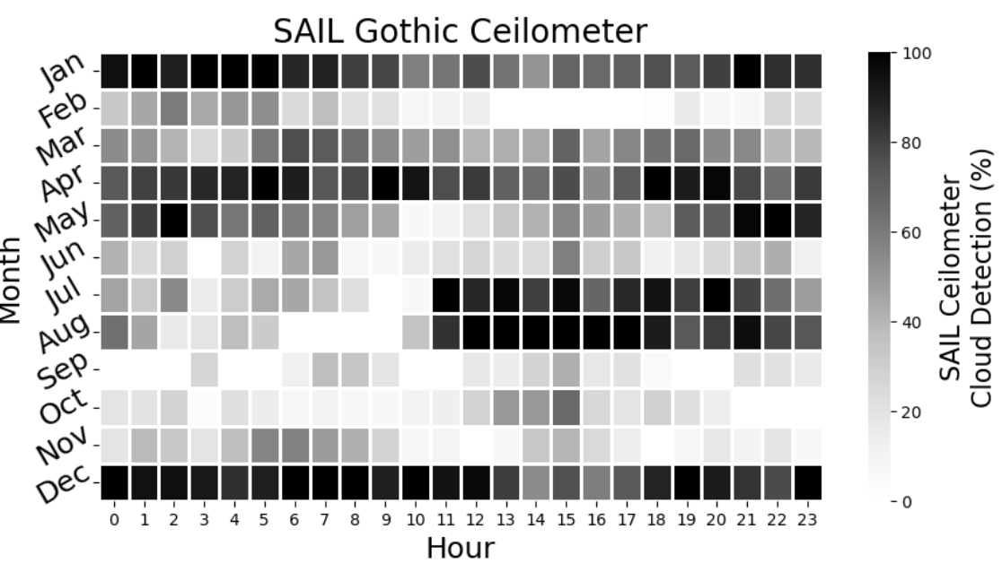
Seasonal and Diurnal Cycle of Cloud Cover
How do valley circulations influence cloud cover?
Minimal diurnal cycle in Mar, Apr, May
Strong afternoon cloud cover in Jul, Aug
  Controlled by thermal flow or synoptic monsoon circulation?
How much variation is there year to year?
Figure: Danny Hogan

Slide 9
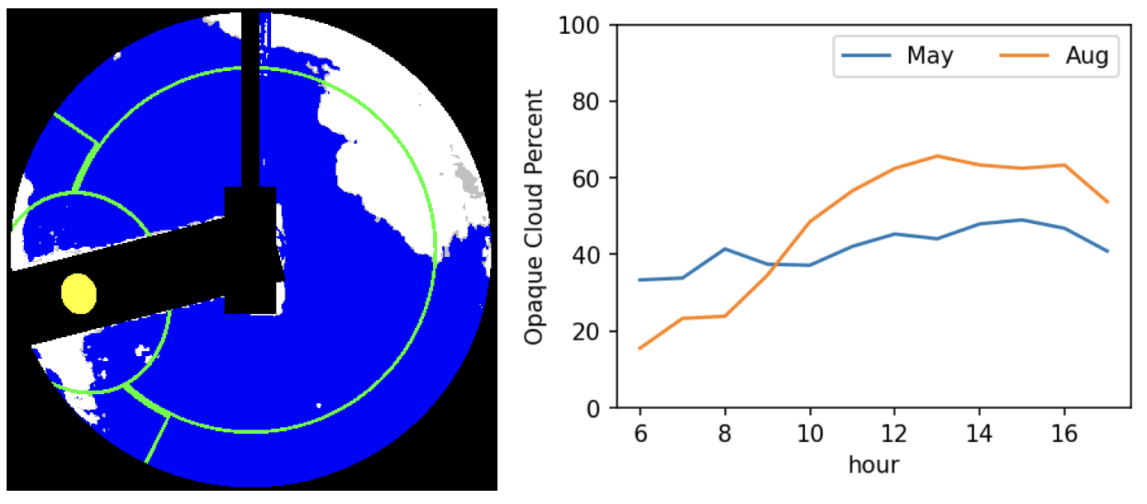
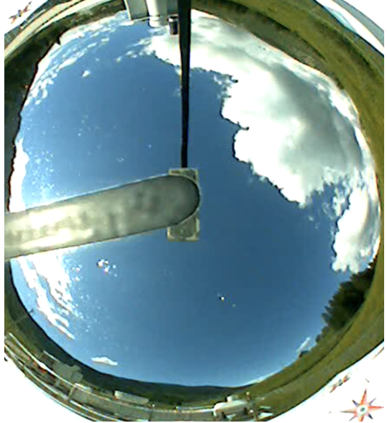
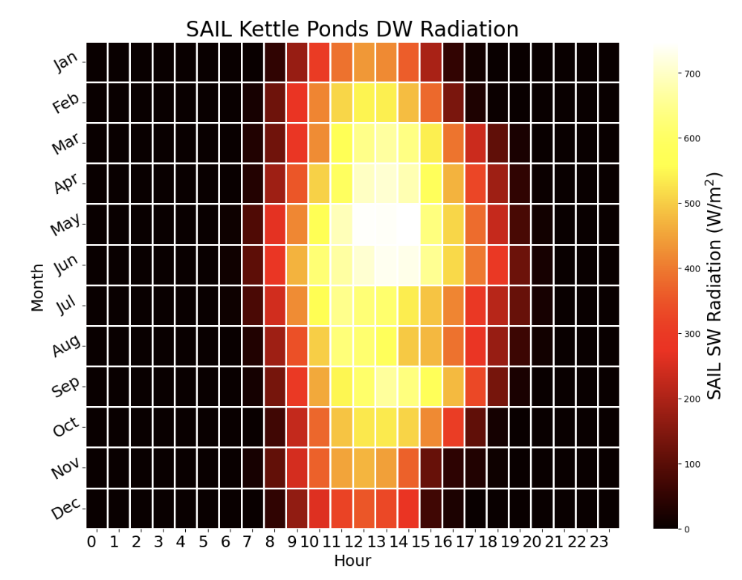
Where are the clouds?
Total Sky Imager
Quantifying cloud cover and locations with TSI
Can we identify ridge top / valley top clouds in TSI?
  only around Gothic…?
Leverage GOES / MODIS / VIIRS
Cloud cover from radiometers
Figure: Danny Hogan

Slide 10
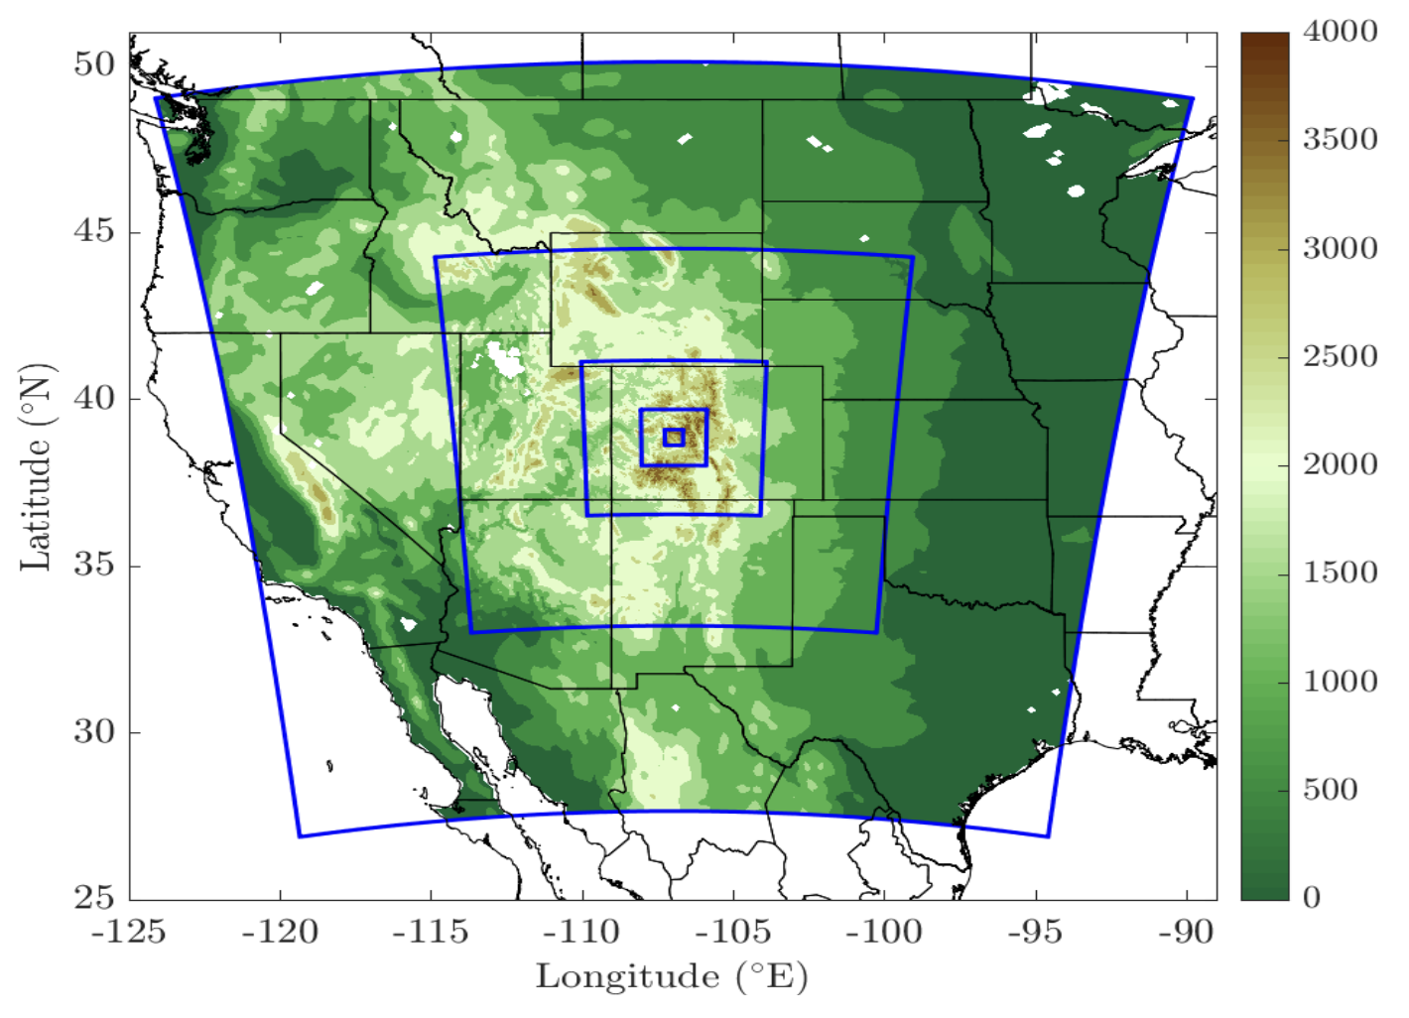
Feedbacks upon Feedbacks
Winds affect clouds affect radiation affect heat flux affect winds…
Teasing apart causation with LES experiments
~50-100m grid over the east river basin
Possible outer nests shown, leveraging existing SAIL WRF runs might help
Control surface feedbacks
Model 3D wind field effects
Comparisons with SAIL wind lidar
Figure: Daniel Kirschbaum

Slide 11
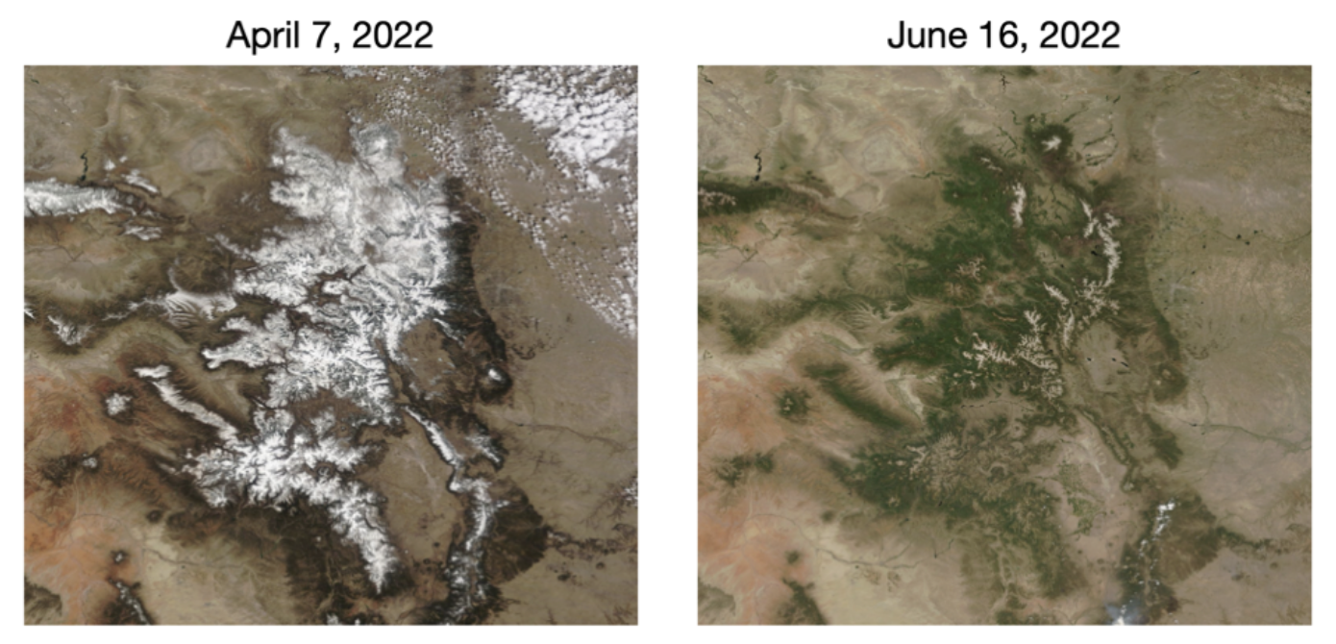
Summary
S3 datasets provide detailed views of mountain meteorology
Diurnal cycles in wind, clouds, radiation all have interrelated seasonal cycles
Open questions related to how valley morphology and land surface states affect strength and timing of valley circulations
  how those circulations feedback to cloud formation
The answers to this work will provide a basis for future atmospheric model development in complex terrain

