Slide 1



Past Observations of Airflow and Precipitation in the Complex Terrain
of Western North America: Relevance to SAIL/SPLASH
Ola Persson
CIRES, University of Colorado, Boulder, CO; NOAA/ESRL/PSD, Boulder, CO USA
Synoptic scale dynamics and synoptic structure
Mesoscale dynamics & precipitation organization
Orographic dynamical effects on precipitation growth & distribution
- mountain waves – spatial variability in w and precip, incl. “rain shadows”
- blocking of low-level airflow – shift terrain-forced w
- spatial and temporal variability, relationships to terrain features, stability
4. Microphysical effects – orographically related
- supercooled liquid water and riming – affecting fall velocity, precipitation trajectories
- enhanced seeder-feeder growth mechanism
Illustrate with observations from: Washington Cascades, Oregon Cascades, California Coast
Range, northern Colorado Park Range (CAMPS 2010-2011)
Scorer Parameter (l)
k - wave number associated with underlying terrain
(wide ridge, small k; narrow ridge, large k)
N - Brunt-Väisälä frequency
U - cross-barrier wind speed and
- evanescent waves if k > l
- vertically propagating waves if k < l
- if l² decreases rapidly with height,
wave trapping possible
z - vertical height coordinate
Non-Dimensional Mountain Height, M = N h/U
(inverse Froude number)
- blocking if M > 1

Slide 2
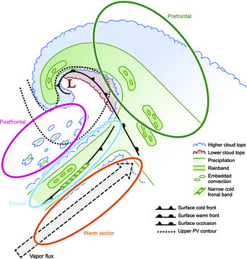
Mesoscale precipitation features within mid-latitude cyclones unaffected by terrain
Mesoscale precipitation features
- dynamically formed (frontally forced
lifting, CSI, embedded convection)
- both pre- and post-frontal regions
- provide spatially and temporally
varying precipitation rates without
orographic effects
Warm-frontal
Wide cold-frontal
Some low-level features (e.g., NCFR)
may not be present in complex terrain
through topographic disruption of
organization processes
- warm-frontal and wide cold-frontal
rainbands forced at 3-7 km height and
may be present over Rockies
From Houze (2012), adapted from Matejka et al (1980) and Houze (1981)

Slide 3

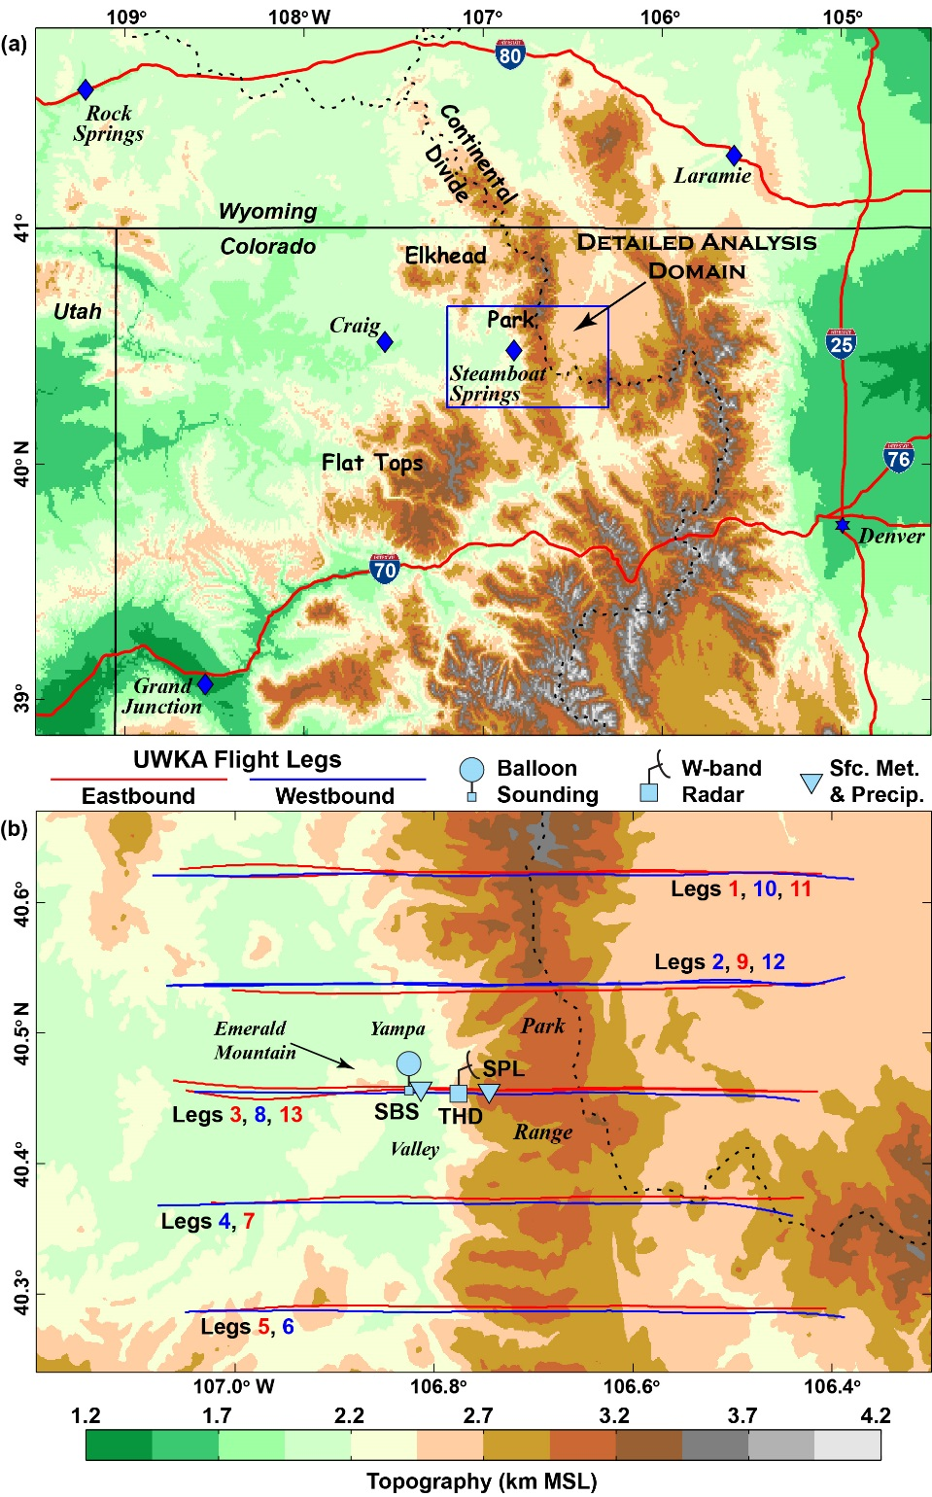
Colorado Airborne Multiphase Cloud Study (CAMPS) (Dec 2010 - Feb 2011)
Measurement Sites/Dec 15, 2010 Flight tracks
U Wyoming King Air Aircraft
- W-band Doppler tail radar
- microphysics probes
- basic met measurements
- gust probe
Dec 15, 2010
13 flight legs; 1644-1924 UTC
6.1 5.4 4.6 km
1644, 1829, 1846 UTC
1653, 1819, 1856
1707, 1806, 1910
1717, 1756
1730, 1742
Kingsmill et al. (2016)

Slide 4
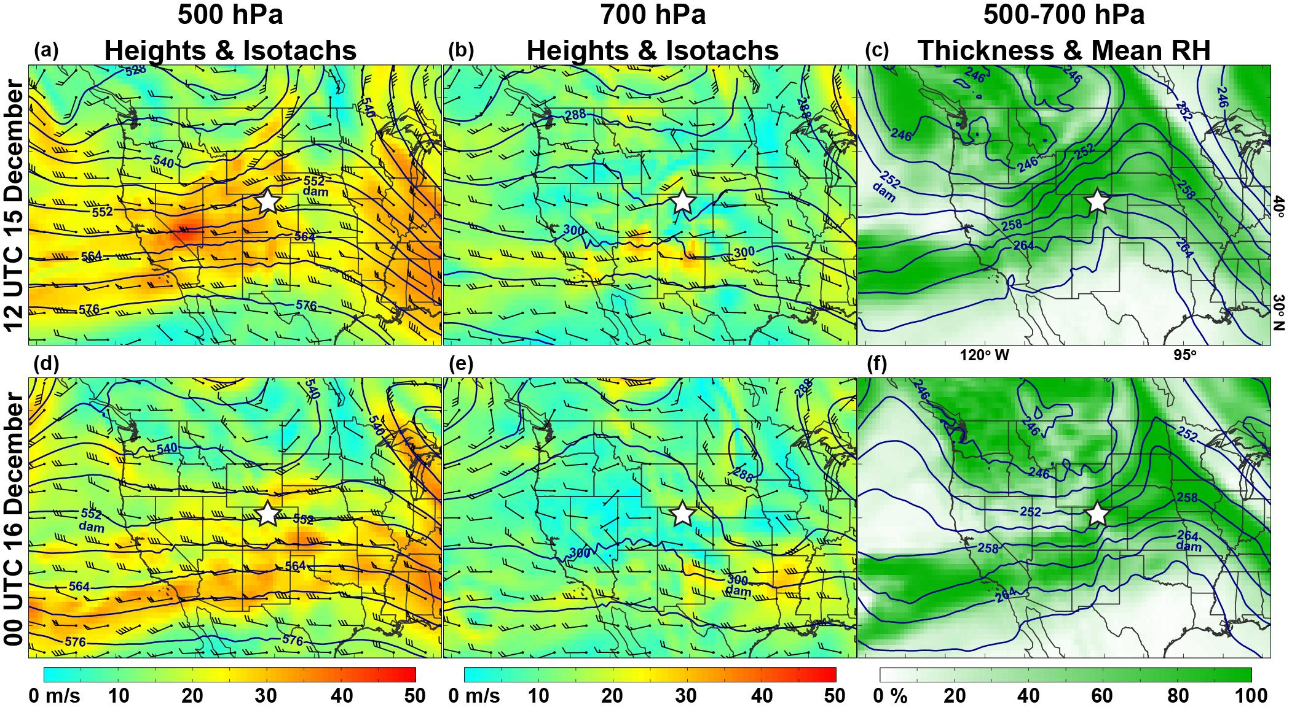
Dec 15, 2010 Synoptic Conditions
12 UTC 15 December
00 UTC 16 December
- cooling occurring over Park Range during aircraft flights 16-20 UTC (passage of cold front)
- airflow aloft changing from ~ 255° to ~270°
- location/period consistent with wide cold-frontal rainband
Kingsmill et al. (2016)

Slide 5
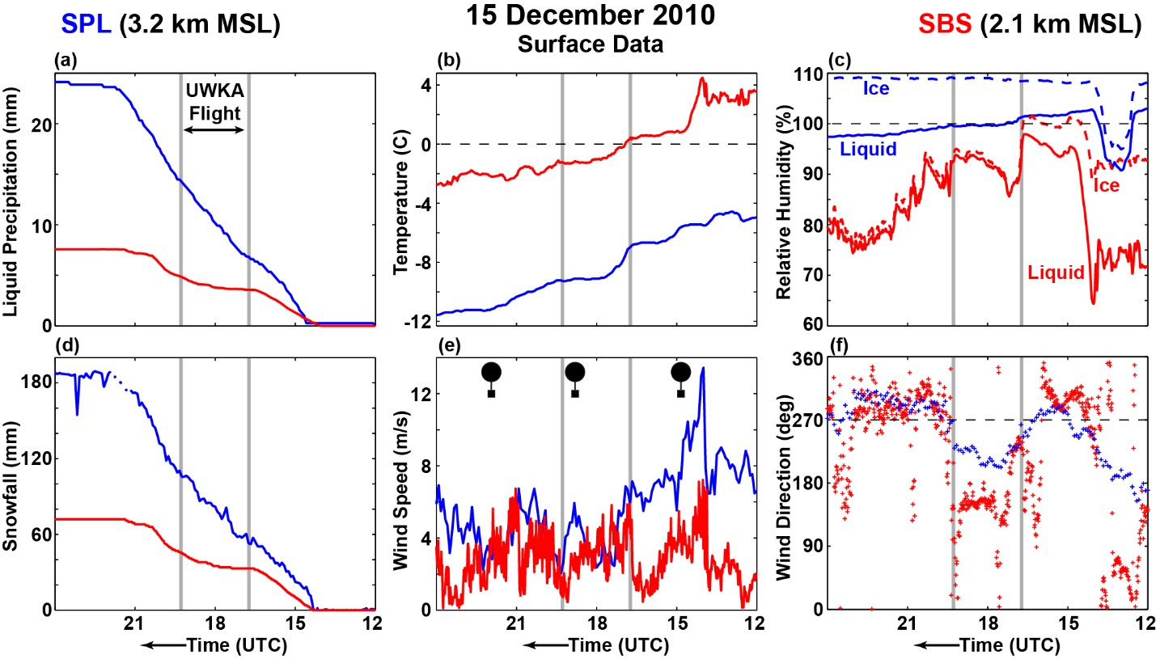
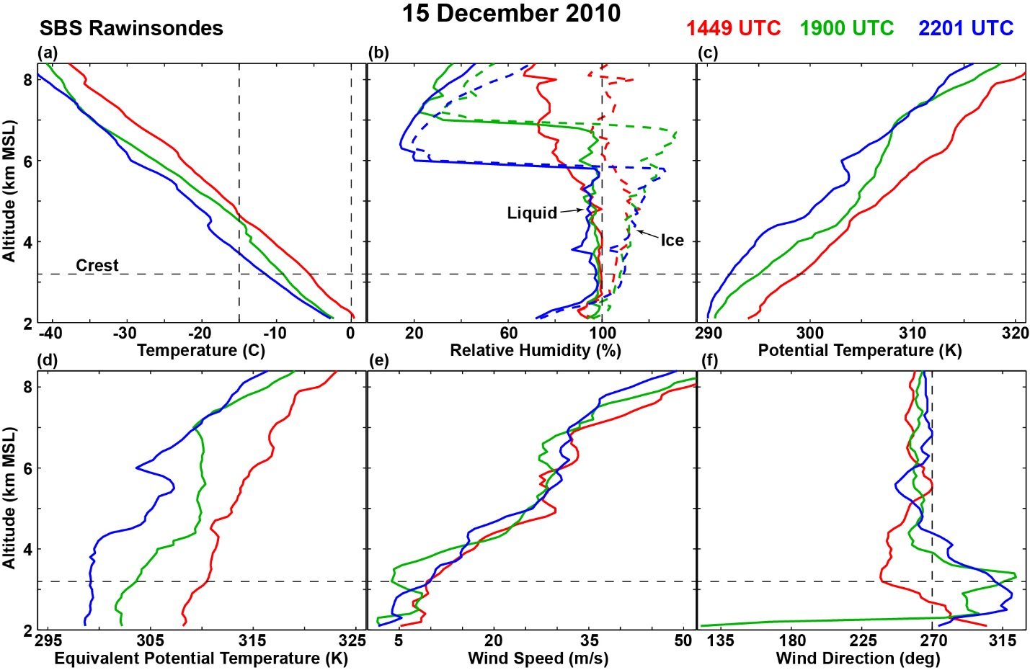
Surface observations
upwind of Park Range (Steamboat Springs; SBS; 2.1 km MSL) and
at its upper slope (Storm Peak Lab; SPL; 3.2 km MSL)
- snow starts at same time at both, but ends
2 h later at SPL
- intensity greater at SPL; little snowfall at
SBS 17-18 UTC
- 3X as much snow fell at SPL as at SBS
- T decreases with time at both
- saturated at SPL throughout; only early at SBS
- winds stronger at SPL early & late
- SBS winds easterly 1730-1900 UTC
Soundings at SBS
- steady cooling from sfc to 8 km
- drying aloft, above 7 km at 19 UTC
- potential instability 4.5-7.0 km at 19 UTC
Kingsmill et al. (2016)

Slide 6
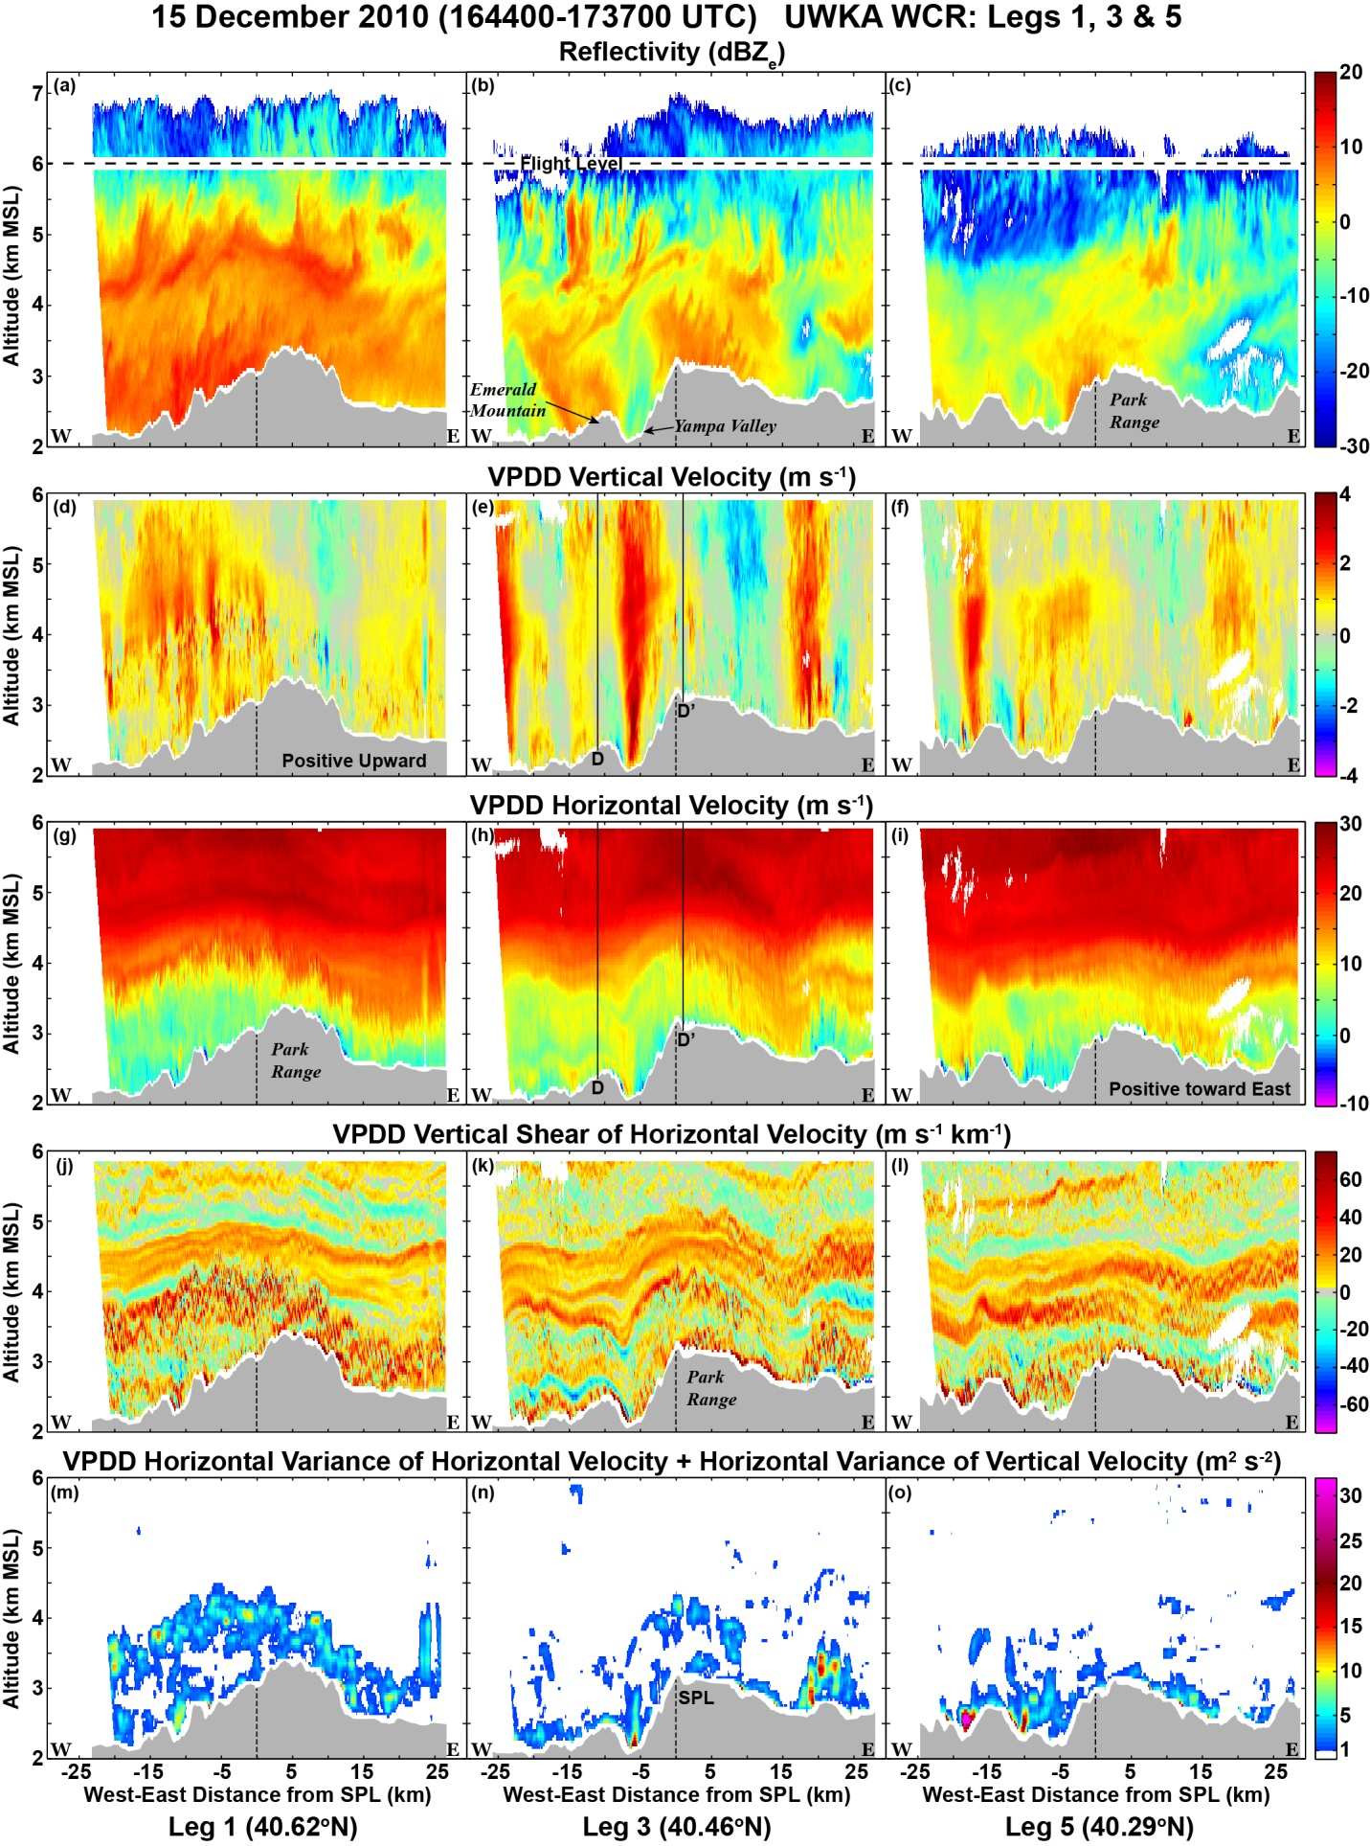
Radar data from transects 1,3,5
- within 53 min period (spatial
variability?)
- terrain profiles differ in upwind
topography & escarpment slope
- enhanced reflectivity on upwind slopes
or peaks, even for small terrain peaks
- small-scale upper-level generating cells
evident for all legs; precipitation growth
below flight level decreases N to S
- w fields very different between legs;
the more gradual slope produces larger-
scale updraft; steep escarpment
produces strong, narrow updraft; many
small peaks have obvious updrafts;
downdraft to lee of main peak only
consistent feature
- shear layers & mountain waves vary
from leg to leg
- velocity variance (turbulence) varies in
magnitude & location from leg to leg
Kingsmill et al. (2016)

Slide 7
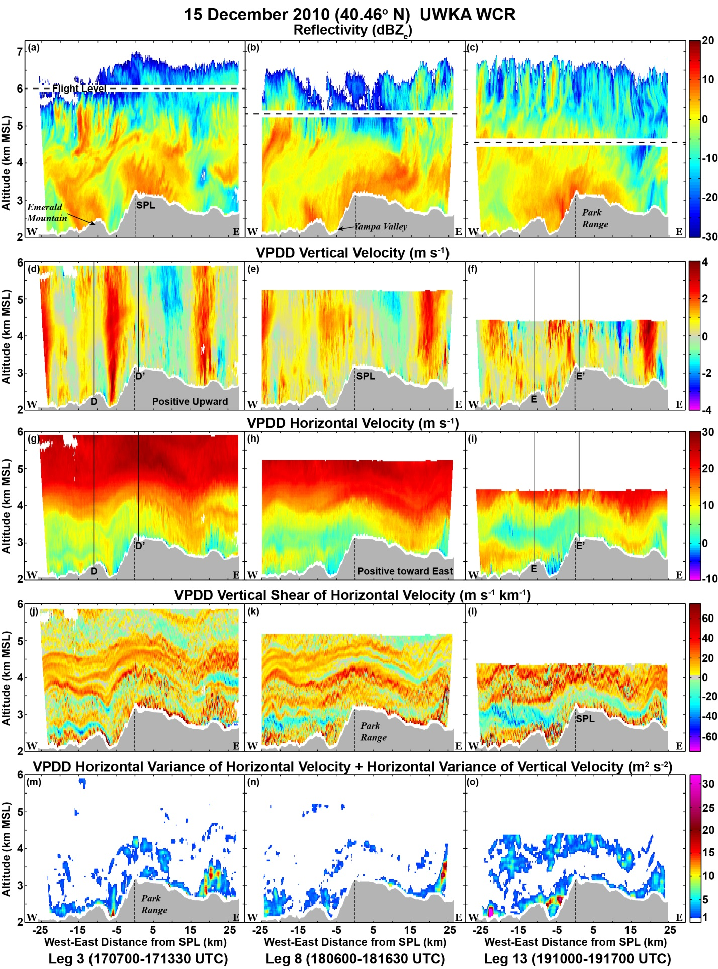
~2 hr temporal evolution:
Changes between Legs 3, 8, 13
- enhanced reflectivity on upwind slopes
or peaks, even for small terrain peaks
- upper-level generating cells evident for
all legs but vertical scale of GCs increases;
layer 4.5-7 km destabilizes in 1900 sounding
(Leg 13)
- updrafts weaken and broaden with time
- temporal variability in shear layers,
mountain waves, & velocity variance
(turbulence), though significance unclear
Kingsmill et al. (2016)

Slide 8
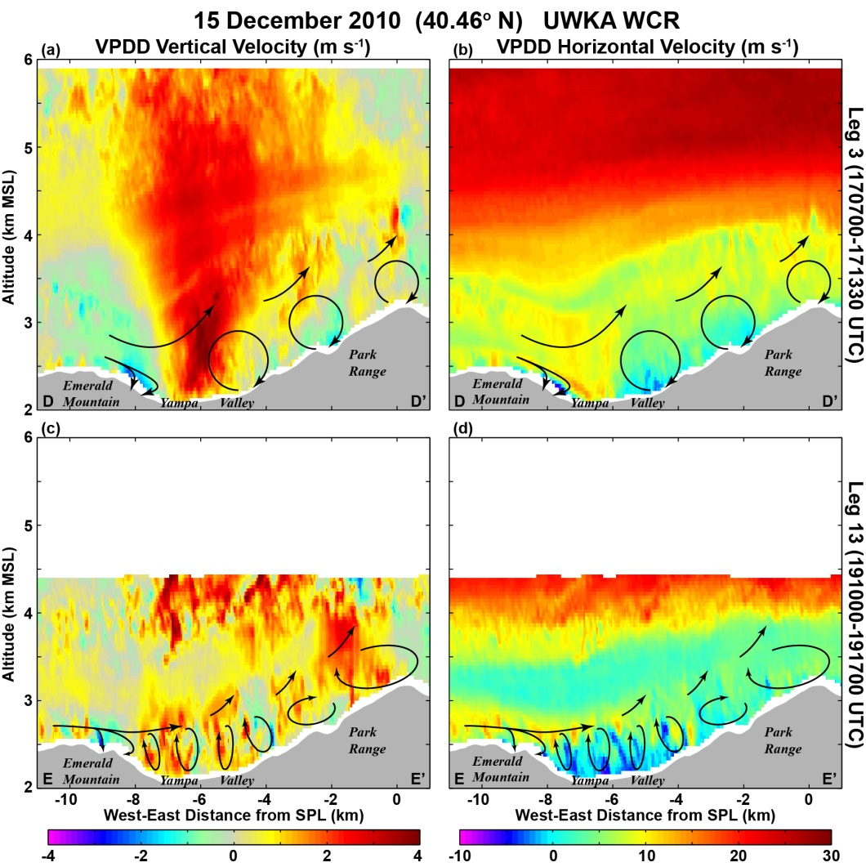
Effects from smaller-scale terrain features
- shallow mountain waves and flow separation
- trapped waves to lee of Emerald
Mountain produce local updraft/
downdraft areas
- changes in vertical stability &
air flow (Scorer parameter &
inverse Froude number) between
Legs 3 and 13 changes character
of downwind circulations/rotors
Figure 9. Horizontally-expanded view of the leg 3 (a),(b) and leg 13 (c),(d) UWKA WCR data over subsection D-D’ shown in Figures 8(e),(h) and 10(d),(g) and subsection E-E’ shown in Figure 10(f),(i). Horizontal coordinate system is relative to the longitude of SPL. VPDD-derived (a),(c) vertical velocity and (b),(d) horizontal velocity. Colour scale for vertical velocity at bottom of (a),(c) and for horizontal velocity at bottom of (b),(d). Terrain profile shown in gray at the bottom of each panel. Solid black lines with arrowheads are annotations for airflow.
(Kingsmill et al. 2016)

Slide 9
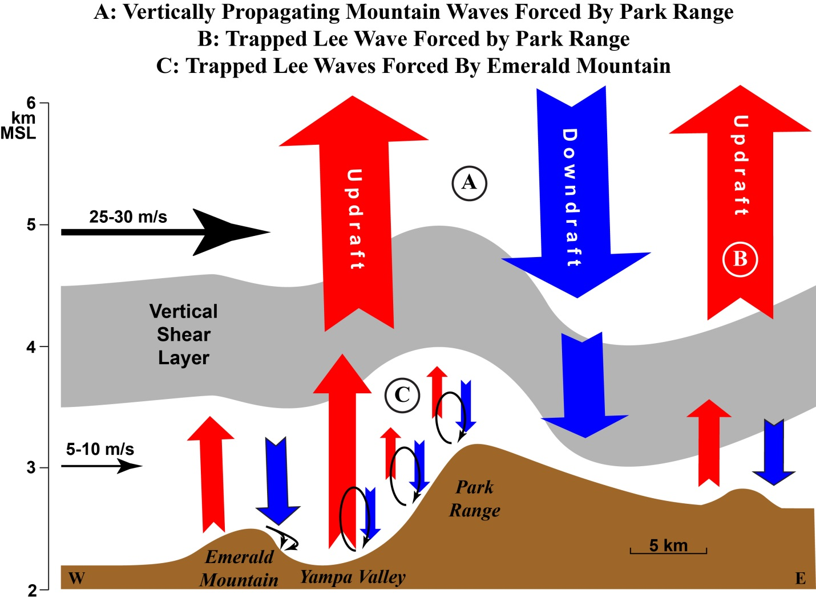
Kingsmill et al. 2016

Slide 10
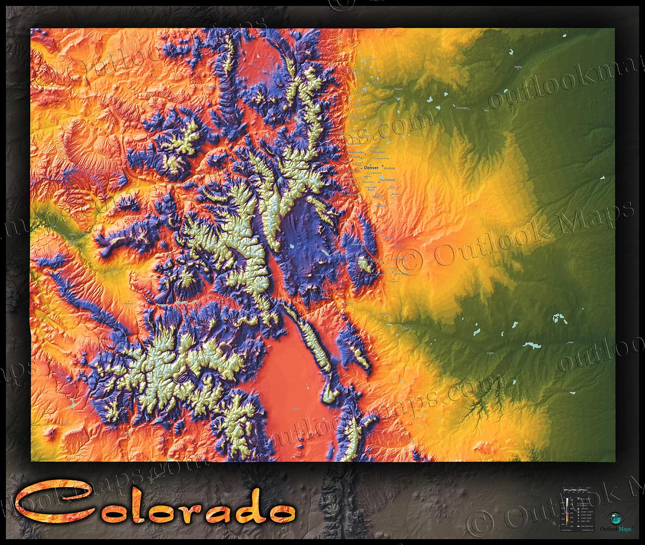
SAIL/SPLASH terrain much more complex than for CAMPS. Expect:
- significant, spatially and temporally varying flow separation
- dominant valley eddies & flows
- complex low-level orographic precipitation enhancement
- rapid changes in scale-interaction processes
- to understand precipitation events, need to separate synoptic, mesoscale & local precipitation variability. Will be difficult.
CAMPS 2010
SAIL/SPLASH 2021-2023
x
x
x

Slide 11
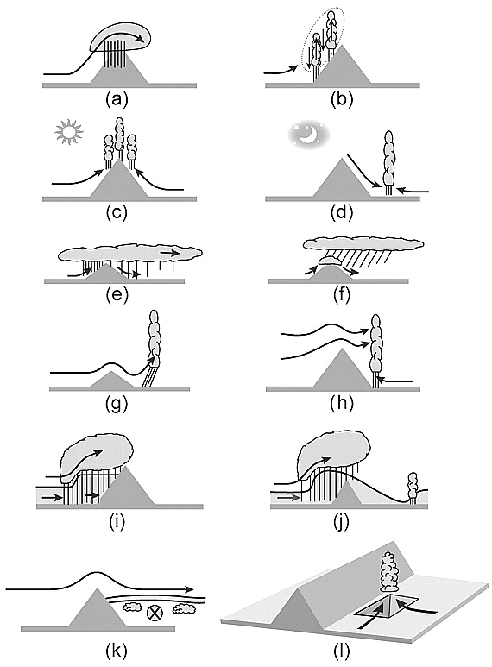
Mechanisms by which mountains and hills affect precipitating clouds
Houze 2012
Orographic lifting of stable
air enhances cloud/precipitation
Orographic lifting of unstable
air triggers convection
Daytime heating of slopes
induces updrafts and convergence
& convection over the peak
Nighttime cooling & drainage
flow induces convergence
& convection in the valley
Uplift produces cloud over
peak that acts as feeder cloud,
enhancing precipitation growth
Orographic lifting of stable
air enhances cloud/precipitation
Upper-level lee wave updraft
and valley convergence
triggers convection
Mountain lee wave updraft
triggers convection
Weak upwind blocking enhances
upwind precipitation but also
triggers lee-wave convection
Low-level blocking extends
topographic lifting upwind
Low-level stable air produces
lee flow separation and
low-level clouds
Small hills enhance
convergence/lift, triggering
local convection

Slide 12
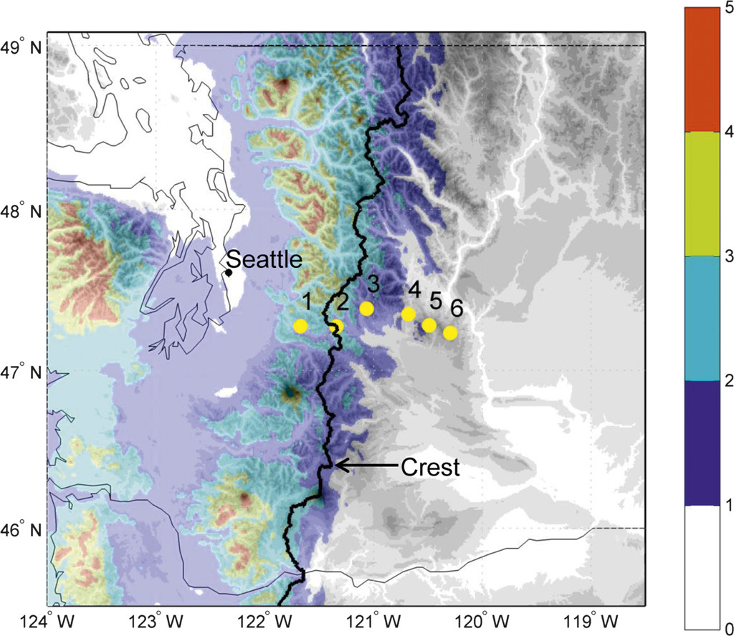
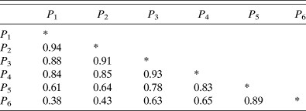
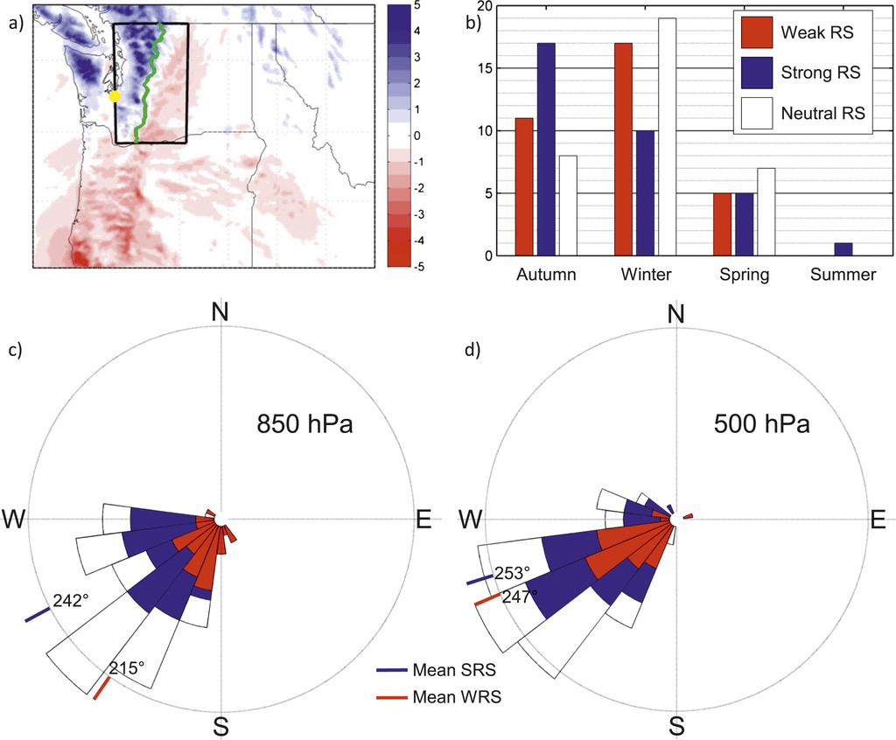
Synoptic/mesoscale modulation of orographic
“rain shadows”
Siler et al 2013
Annual precipitation is 2-3X as large on windward side
of Cascades as lee side
Table 1: Correlation coefficients of DJF precipitation among the six SNOTEL stations shown in Fig. 1. The data span 28 seasons from 1982 to 2010. Stations are numbered in ascending order from west to east. (Each time series normalized by subtracting mean & dividing by std dev)
Annual Precipitation (m)
Annual precipitation (color contours, m) and elevation (gray contours, 300-m intervals) over the Cascades. Yellow circles, numbered sequentially from west to east, mark the locations of SNOTEL stations included in the rain-shadow index analysis. PRISM Climate Group, Oregon State University.
Low normalized precipitation correlation between
windward and leeward sites
- variable (strong & weak) rain-shadow (RS) effect
Number of storms with weak (red), strong (blue), and neutral (white) rain shadows by season. Weak-rain-shadow (strong-rain-shadow) storms are the 33 storms with the lowest (highest) rain-shadow index values among the 100 wettest storms from 2005 to 2010
Upwind
wind rose
- weak RS has more
southerly 850 hPa wind
component
Number of storms
Strong RS
Weak RS

Slide 13
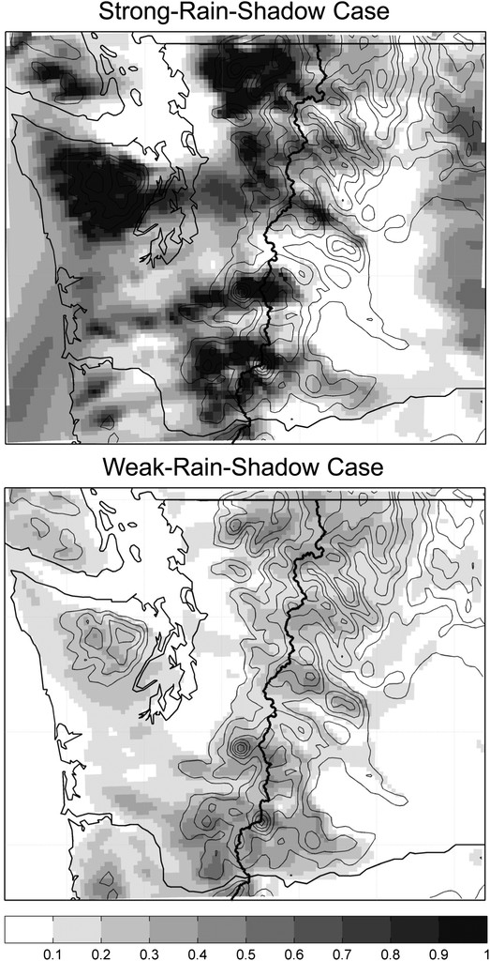
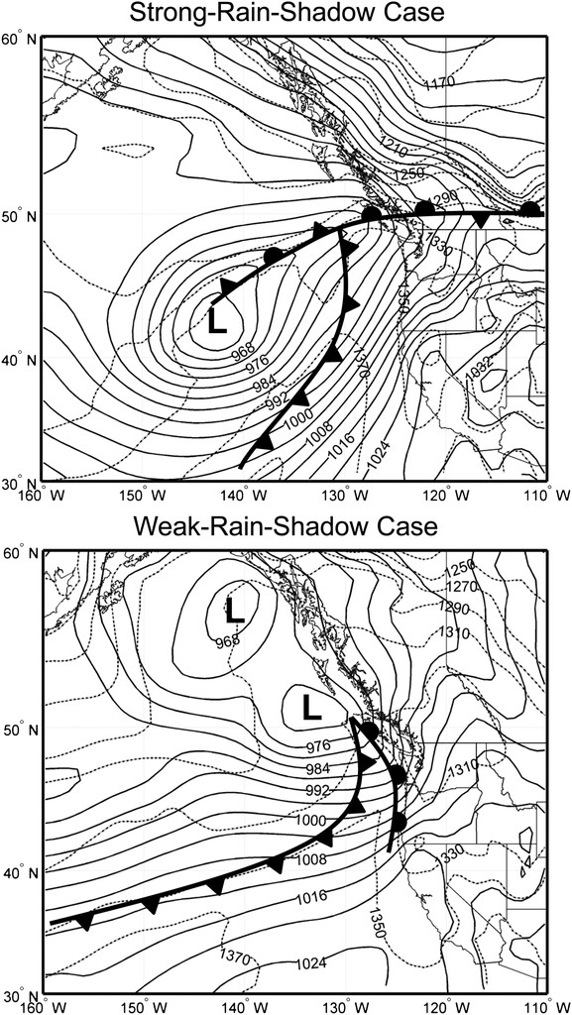
12-18 UTC 3 Dec 2007
B
Warm-sector precip
(little warm-air advection;
little vertical wind shear)
A
03-09 UTC 1 Feb 2006
B
Warm-frontal precip
(significant warm-air
advection and vertical wind
shear; low-level stable air
& blocking)
A
Average hourly precipitation in cm during the 6 h of maximum precipitation for (top) the strong RS and (bottom) the weak RS case. Source is the MM5 model, 4-km resolution
Sea level pressure (solid contours, hPa) and 1000–850-hPa thickness (dotted contours, m) at the beginning of the 6-h period of maximum precipitation for (top) the SRS and (bottom) the WRS case. Source is the ERA-Interim dataset.

Slide 14
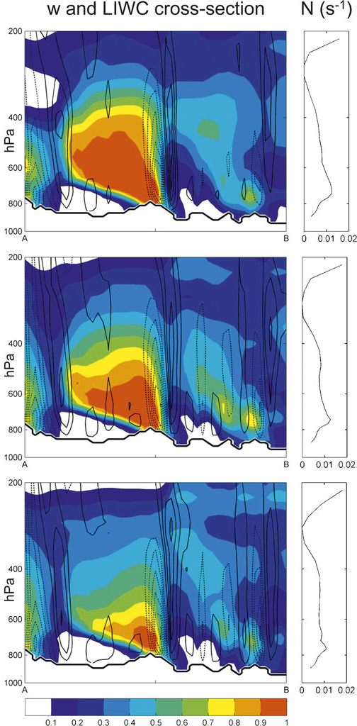
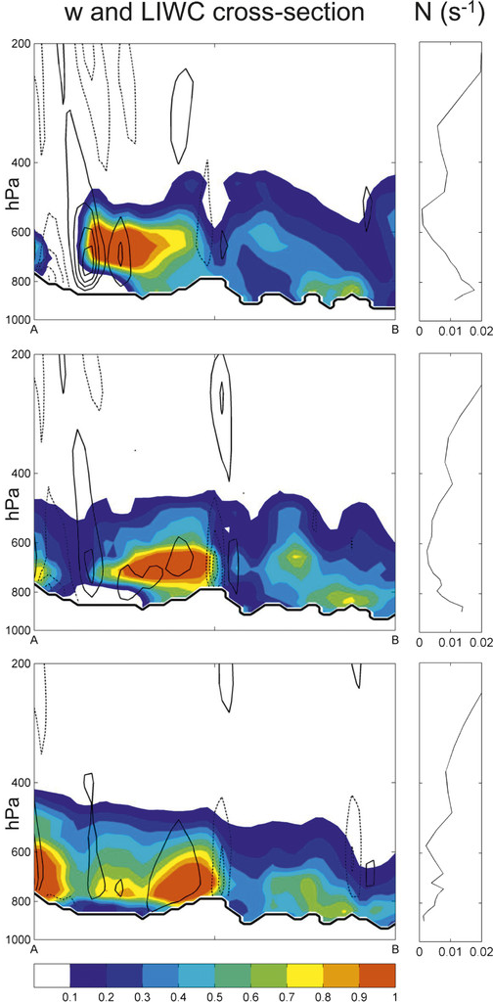
Strong RS
Weak RS
Deep, strong mtn waves; strong downdraft near mid-point
Trapped, weak mtn waves; weak, shallow downdraft near mid-point
Hour 1
Hour 3
Hour 5
Wind, moisture, and static stability. Vertical cross sections of liquid/ice water and vertical winds along the 200-km transect between points A and B in the left. Colored contours depict the liquid plus ice mixing ratio (g kg⁻¹). Solid (dashed) contours represent upward (downward) vertical winds at intervals of 0.5 m s⁻¹. (right) Moist Brunt–Väisälä frequency averaged over a 9000 km² area just upstream of the transect. Source is the MM5 model, 4-km resolution.

Slide 15
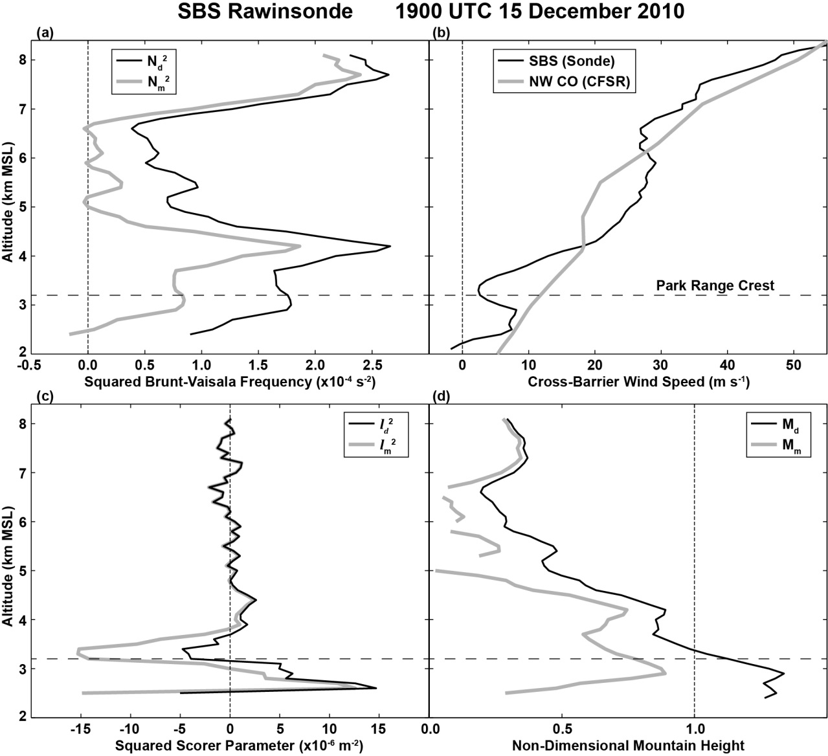
Vertical Stability Analysis:
Scorer Parameter and Non-Dimensional Mountain Height
Scorer Parameter (l)
N is the Brunt-Väisälä frequency,
U is the cross-barrier wind speed and
(2)
z is the vertical height coordinate.
k - wave number associated with underlying terrain
(wide ridge, small k; narrow ridge, large k)
evanescent waves if k > l
vertically propagating waves if k < l
if l² deceases rapidly with height,
wave trapping possible
Non-Dimensional Mountain Height (M)
(inverse Froude number)
Figure 11. Vertical profiles of parameters derived from the SBS rawinsonde released at 1900 UTC. (a) Squared Brunt-Väisälä frequency (black-dry,gray-moist), (b) cross-barrier wind speed (black), (c) squared Scorer parameter (black-dry,gray-moist) and (d) non-dimensional mountain height (black-dry,gray-moist). The gray curve in (b) was derived from an average of CFSR data over northwest Colorado.
M = N h/U
Blocking if M > 1

Slide 16
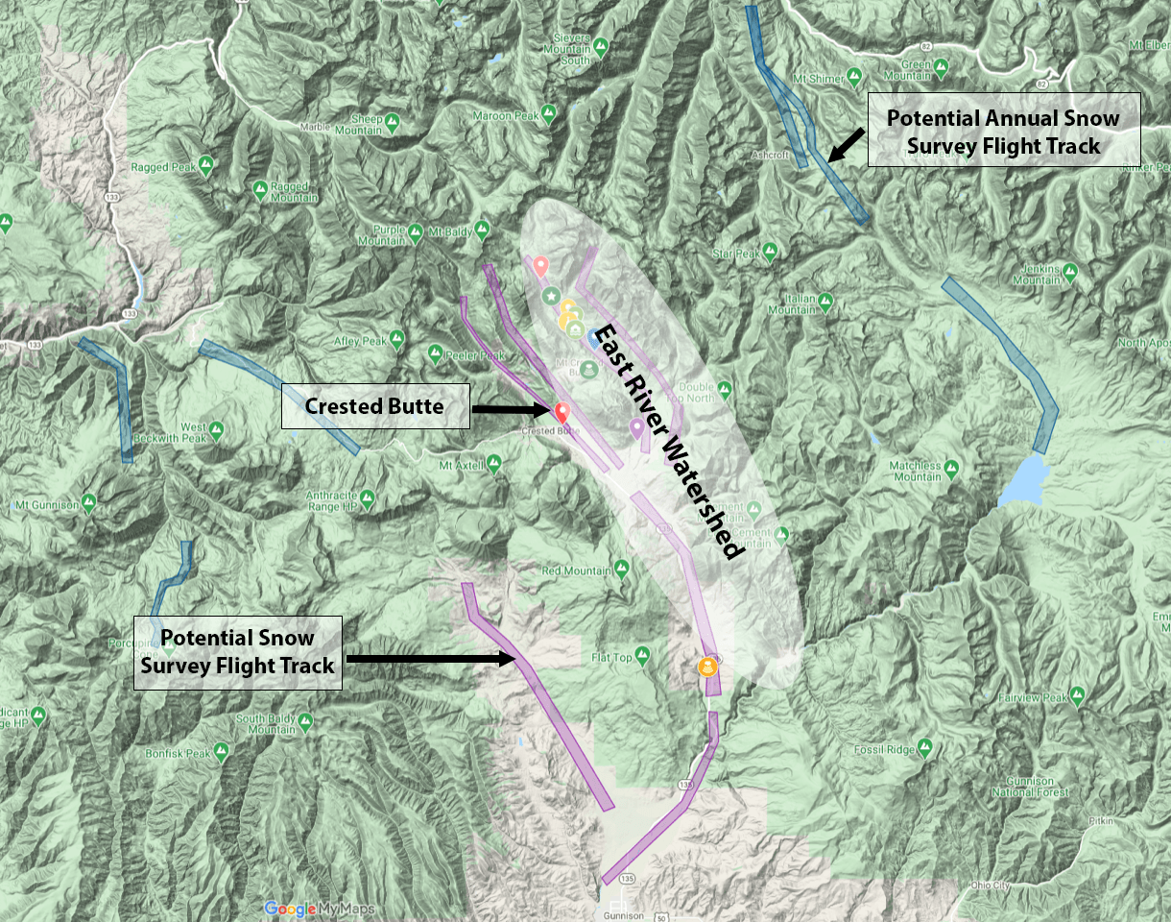
Broad Conclusions of Previous Studies
a) local topography influences airflow and microphysical growth, resulting in large mountain/valley
differences in precipitation rates and accumulations
b) orographic/synoptic airflow interactions are complex and depend on large-scale stability, wind direction,
vertical shear, and orographic details, and often produce:
i) mountain waves leading to complex vertical air motion patterns at and above mountain top
ii) blocking leading to shear zones, turbulent layers enhancing precipitation, and low-level circulations
iii) low-level, small-scale microphysical precipitation enhancement or suppression
c) synoptic/mesoscale interactions with relatively simple orography vary greatly both spatially and temporally
- expect even greater spatial/temporal variability within a complex ridge and valley region
d) complex airflow response to complex terrain produces complex precipitation growth and distribution
a) mapping of winter snowpack over ridges and valleys crucial for determining snow accumulation and runoff
b) expect significant spatial/temporal variability of airflow and precipitation rates within a complex ridge and valley region, such as East River watershed

Slide 17
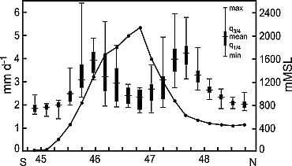
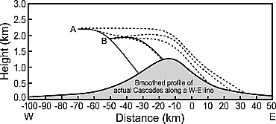
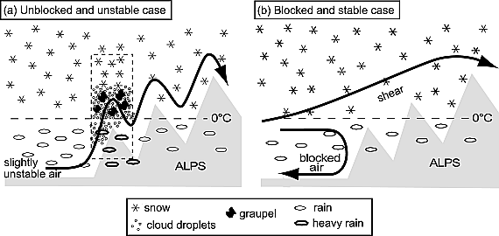
Terrain Effects on Precipitation; Impacts of microphysics & stability
Annual zonal mean of station precipitation
across the eastern Alps (N = 10-30 & 45-80)
Effects of riming on snow particle trajectories
(Hobbs et al. 1973)
Alp mean
topography
wind
Heavily rimed
Least rimed
Frei and Schär [1998]
Conceptual model of the airflow and microphysics of orographic precipitation mechanisms in MAP
i) Maximum precipitation on mountain slopes
ii) Local variability also large near slopes
iii) Upwind riming determines whether
snow falls on upwind or leeward slope
iv) Unstable ambient air produces numerous
mountain waves and enhanced riming
and precipitation over local peaks
v) Stable ambient air leads to upwind
blocking, fewer mountain waves, but
a turbulent shear zone above the peaks
Medina and Houze [2003]

Slide 18
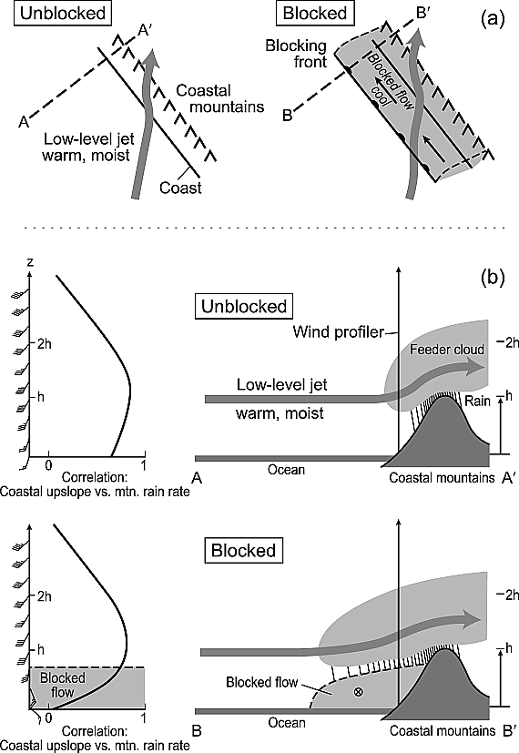
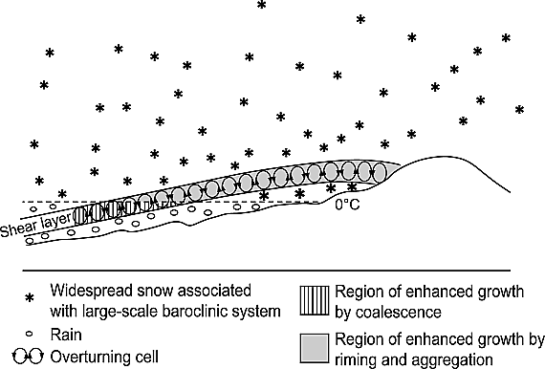
Effects on Airflow and Precipitation by Terrain Blocking
Impact of terrain blocking of low-level frontal airflow
on precipitation distribution along California coastal
mountains (Neiman et al 2002)
Dynamical and microphysical mechanisms responsible for orographic enhancement of precipitation during storms with stable stratification. Houze and Medina [2005].

Slide 19
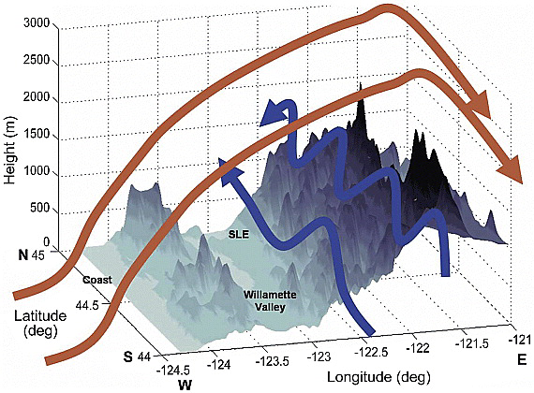
Three-dimensional schematic of topography and wind flow over a portion of the Oregon Cascade Mountains as observed from 23:00 to 01:00 UTC 13–14 December 2001. Blue arrows show strong southerly low equivalent potential temperature airflow at low levels along the windward (west facing) slopes. Red arrows show the high equivalent potential temperature airflow that surmounted the low equivalent potential temperature airflow and exhibited a vertically propagating mountain wave structure anchored to the mean north-south Cascade crest. From Garvert et al. [2007]. Copyright 2007 American Meteorological Society.

Slide 20
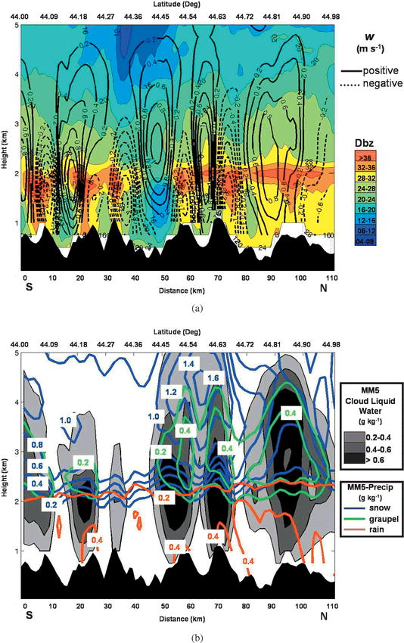
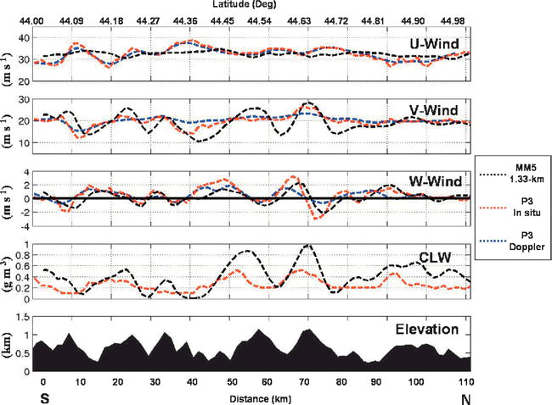
NOAA P-3 Observations
Effects of Real, Complex Orography
- example from Oregon Cascade foothills
- ~10-20 km orographic scale
- ~ 20-30 km vertical velocity scale &
CLW scale
- ~ 10-30 km precipitation variability
MM5 Simulation
Garvert et al 2007

Slide 21
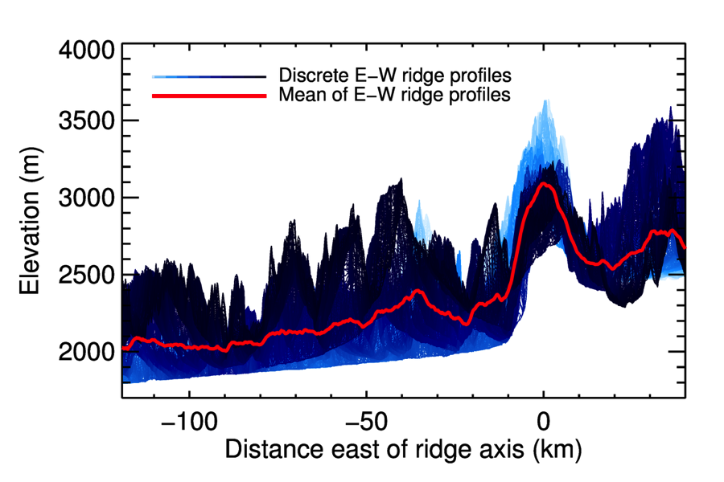
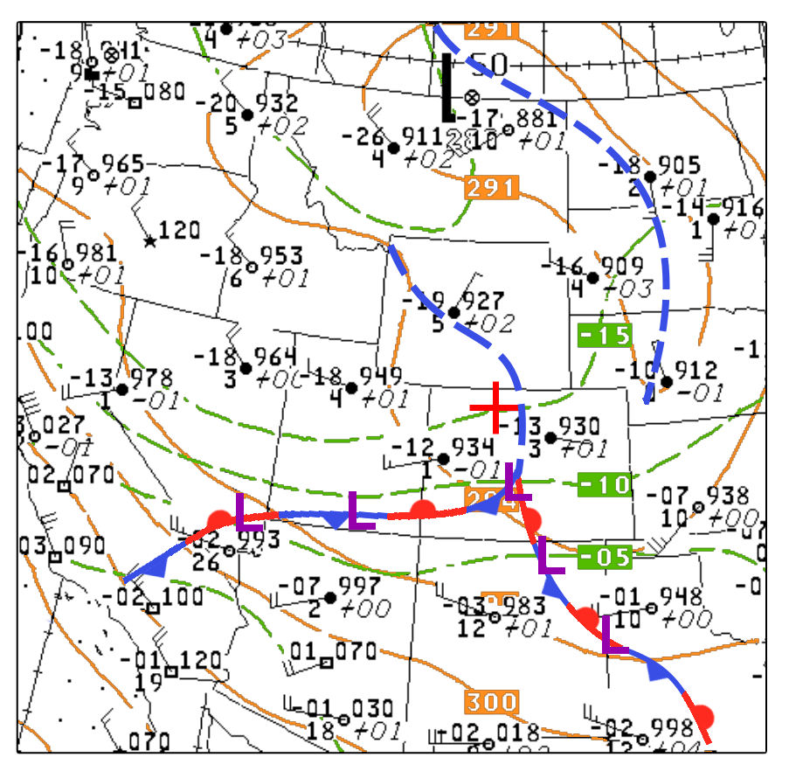
Colorado Airborne Multiphase Cloud Study (CAMPS)
December 2010 – February 2011
700 hPa height (orange); T (green);
NWS sfc frontal analysis
00 UTC, Jan 10, 2011
University of Wyoming King Air Aircraft
a) 24 CAMPS flights
b) basic met, gust probe, microphysical in-situ
c) W-band Doppler cloud radar
- three-beam sampling (up, down, down-fore)
- down & down-fore beams synthesized to obtain
along-track horizontal (U) and vertical (W) winds
using vertically-pointing dual-Doppler technique
(VPDD; Damaini and Haimov, 2006) in vertical plane
below flight level (40X40 m grid)

Slide 22
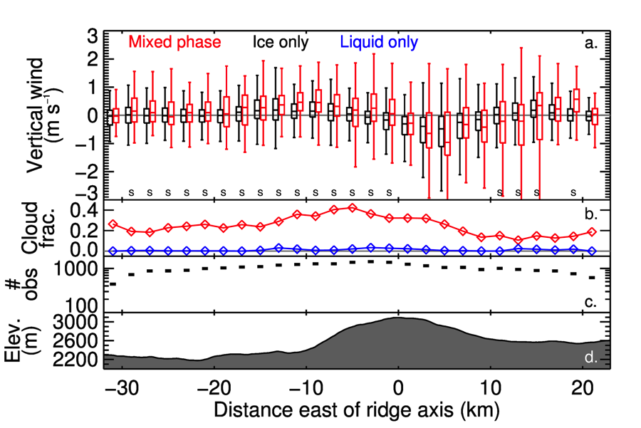
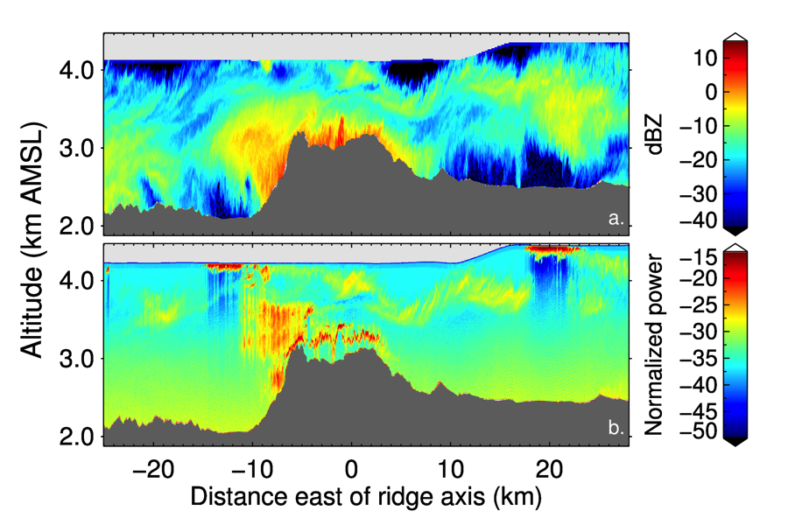
Dynamic/Orographic effects on microphysics
10-flight composite analysis
- enhanced updraft (downdraft) on upwind (lee)
slope
- 2-3 m/s variability on upwind side;
3-5 m/s on downwind side
- upwind updraft statistically greater for mixed-
phase clouds than ice-only
- highest fraction of mixed-phase clouds on upwind
slope
Meridional mean surface elevation
Aircraft transect Jan 9 2011, 23:19-23:34 UTC
Equivalent radar reflectivity (dBZ)
- enhanced precipitation near Park Range ridgetop & upwind slope
- liquid water cloud (strong backscatter) near ridge top and on upwind slope
Normalized lidar backscatter power
Dorsi et al 2016

Slide 23
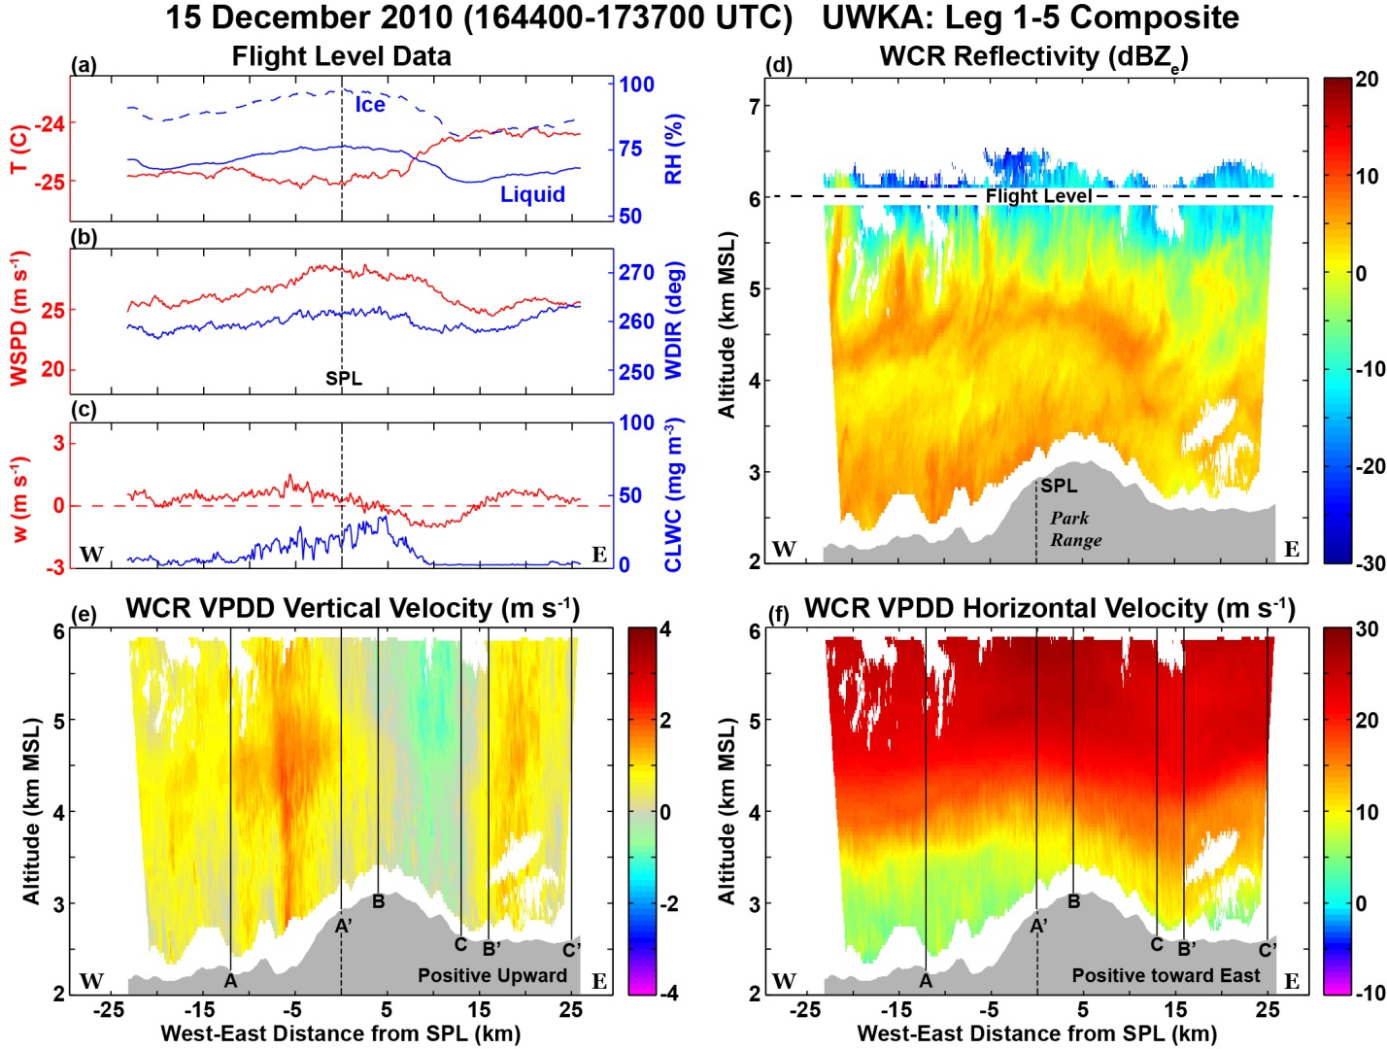
Composite mean terrain profile for legs 1-5 shown in gray at the bottom of (d)-(f). Vertically-oriented solid black lines in (e)-(f) indicate horizontal bounds (A-A’, B-B’ and C-C’) of WCR data plotted in Figure 6.

Slide 24
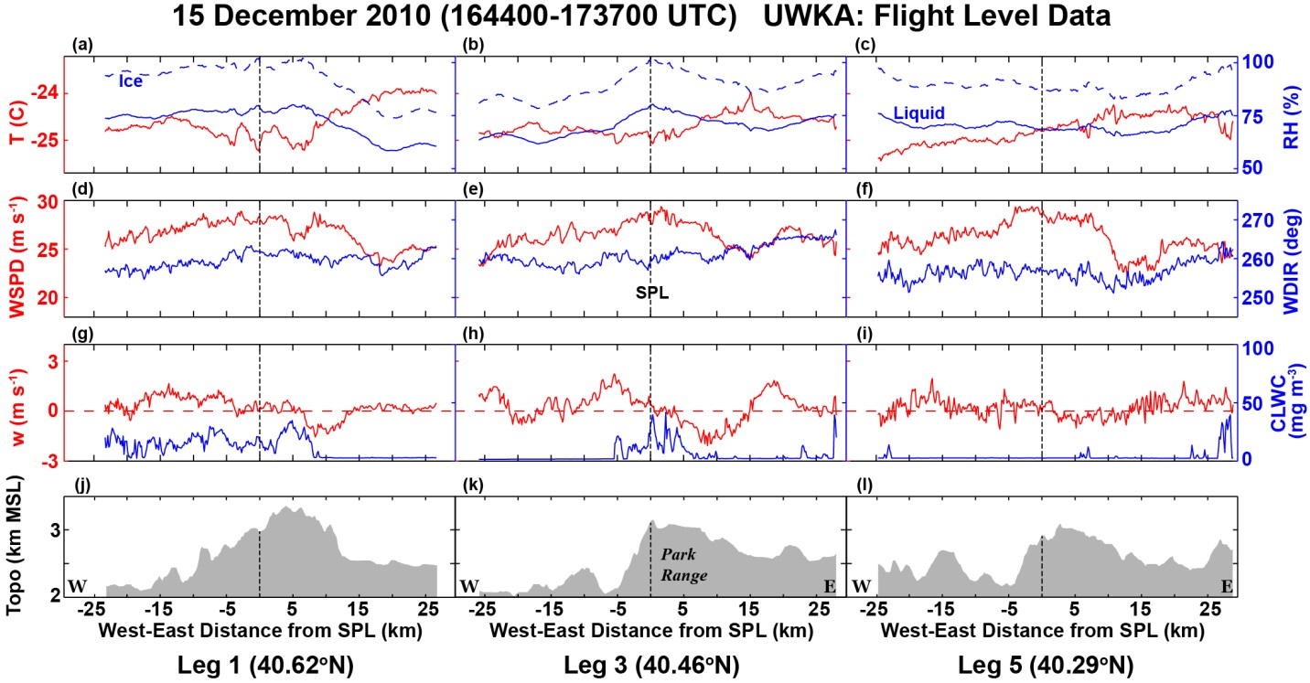
Flight level data from 3 transects at 6.1 km with different terrain profiles
- Terrain profiles differ in upwind topography & escarpment slope
- T warms from W to E in all
- Wind speed peaks near terrain peak in all
- W varies from transect to transect; downdraft just lee of peak
- CLW relative to terrain varies

Slide 25
REFERENCES (there are many more – e.g., see reference lists in Kingsmill et al. 2016 or Houze 2012)
Damaini, R., and S. Haimov, 2006: A high-resolution dual-Doppler technique for fixed multiantenna airborne radar. IEEE Trans. Geosci. Remote Sens., 44, 3475-3489.
Dorsi, S. W., M. D. Shupe, P. O. G. Persson, D. E. Kingsmill, and L. M. Avallone, 2015: Phase-specific characteristics of wintertime clouds across a mid-latitude mountain range. Mon. Wea. Rev., 143, 4181-4197. DOI:10.1175/MWR-D-15-0135.1
Frei, C., and C. Schär (1998), A precipitation climatology of the Alps from high‐resolution rain‐gauge observations, Int. J. Climatol., 18,873–900, doi:10.1002/(SICI)1 097-0088(19980630)18:8<873::AID-JOC255>3.0.CO;2-9
Garvert, M. F., B. Smull, and C. Mass (2007), Multiscale mountain waves influencing a major orographic precipitation event, J. Atmos. Sci., 64, 711–737, doi:10.1175/JAS3876.1
Hobbs, P. V., R. C. Easter, and A. B. Fraser (1973), A theoretical study of the flow of air and fallout of solid precipitation over mountainous terrain: Part II. Microphysics, J. Atmos. Sci., 30, 813–823, doi:10.1175/1520-0469(1973)030<0813:ATSOTF>2.0.CO;2
Houze, R. A., Jr. (1981), Structure of atmospheric precipitation systems: A global survey, Radio Sci., 16, 671– 689, doi:10.1029/RS016i005p00671
Houze, R. A., Jr. (2012), Orographic effects on precipitating clouds, Rev. Geophys., 50, RG1001, doi:10.1029/2011RG000365
Houze, R. A., Jr., and P. V. Hobbs (1982), Organization and structure of precipitating cloud systems, Adv. Geophys., 24, 225–315, doi:10.1016/S0065-2687(08)60521-X
Houze, R. A., Jr., and S. Medina (2005), Turbulence as a mechanism for orographic precipitation enhancement, J. Atmos. Sci., 62, 3599–3623, doi:10.1175/JAS3555.1
Kingsmill, D. E., P. O. G. Persson, S. Haimov, and M. D. Shupe, 2016: Mountain waves and orographic precipitation in a northern Colorado winter storm. Q. J. R. Meteor. Soc., 836-853. DOI:10.1002/qj.2685
Matejka, T. J., R. A. Houze Jr., and P. V. Hobbs (1980), Microphysics and dynamics of clouds associated with mesoscale rainbands in extratropical cyclones, Q. J. R. Meteorol. Soc., 106, 29–56, doi:10.1002/qj.49710644704.
Medina, S., and R. A. Houze Jr. (2003), Air motions and precipitation growth in alpine storms, Q. J. R. Meteorol. Soc., 129, 345–371, doi:10.1256/qj.02.13.
Neiman, P. J., F. M. Ralph, A. B. White, D. E. Kingsmill, and P. O. G. Persson (2002), The statistical relationship between upslope flow and rainfall in California’s coastal mountains: Observations during CALJET, Mon. Wea. Rev., 130, 1468–1492, doi:10.1175/1520-0493(2002)130<1468:TSRBUF>2.0.CO;2
Siler, N., G. Roe, and D. Durran, 2013: On the dynamical causes of variability in the rain-shadow effect: A case study of the Washington Cascades. J. Hydrometeor., 14, 122-139. DOI: 10.1175/JHM-D-045.1

