Slide 1



Aerosol Influences on
Ice Nucleating Particles (INPs) in SAIL
AOS inlet
1
2
3
4
INP filters
Paul DeMott, Russell Perkins, Sonia Kreidenweis, Thomas Hill, Allison Aiken, Swarup China, Nurun Nahar Lata, Jessie Creamean and Daniel Feldman
5
6

Slide 2
Introduction, Background, and Motivation
1
Ice nucleating particles (INPs) play a critical role in water resources in mountainous regions, through their influence on precipitation formation
Wintertime cloud seeding activities, and natural events such as wildfires and dust transport, may perturb ‘background” aerosol and INP concentrations
  Can these impacts be discerned?
  What is their effect on observed INP concentrations and characteristics?
The ARM Surface Atmosphere Integrated Field Laboratory (SAIL) campaign obtained unprecedented measurements of ice nucleating particles (INPs)
  an entire seasonal cycle (plus)
  spatial distributions via observations that were ground based, at different terrain elevations, and in the vertical via tethered balloon deployments
Synthesis of aerosol and environmental data can help define influences on cloud microphysical development in this region (links to climate and hydrology)
2
3
4
5
6

Slide 3
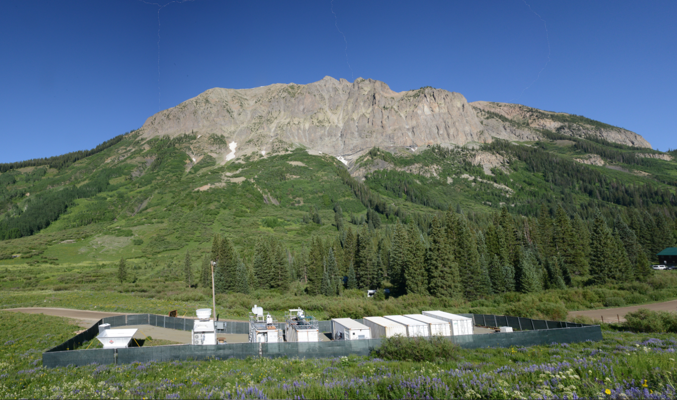
Goal:
Develop seasonal, three-dimensional view of INP distributions
1
2
3
4
SAIL-VAP (TBS)
SAIL-NET
5
6
AMF (18 months of IS filters)

Slide 4
Relevant Projects:
1
Seasonal vertical aerosol profiling for aerosol-cloud-precipitation interactions to advance mountainous hydrological process science
  Analysis of aerosol samples (IcePuck) on tethered balloon flights (TBS): INP spectra
  Co-PI DeMott / Kreidenweis; A. Aiken PI, LANL, FICUS ARM EMSL user facility award, 2022-2024
Single Particle Characterization for Interpreting Ice Nucleating Particle Measurements in the SAIL Field Study
  Analysis of collected aerosol via CCSEM, HRTEM, INSEM
  Compare to CSU Ice Spectrometer analyses
  PI DeMott / Kreidenweis, EMSL Large Scale Research user facility award, 2022-2024
New Award: Comprehensive Characterization of the Seasonal Cycles of Ice Nucleating Particles for Studies of Precipitation Drivers in SAIL
  ARM INP Mentor samples; analysis of IcePuck samples from TBS and SAIL-NET
  Synthesis of aerosol and environmental data
  PI Perkins, DOE-ASR, 2023-2026
2
3
4
5
6

Slide 5
Objectives and Anticipated Outcomes
1
Support SAIL science objectives:
  establish aerosol regimes, the processes controlling the life cycle of aerosols in those regimes, and quantify the impacts of aerosols in those regimes on the atmospheric and surface radiative budget
  quantify the sensitivity of cloud phase and precipitation to cloud condensation nuclei (CCN) and ice-nucleating particle (INP) concentrations
Connect a comprehensive investigation of INP concentrations, compositions, and inferred sources measured during SAIL, with size-resolved aerosol collections to be analyzed on a single particle basis at EMSL, and other aerosol and environmental data
Anticipated outcomes:
  Synthesized descriptions of seasonal and “special event” INP populations, and their relationships to ambient aerosols
  new INP parameterizations applicable for use in aerosol-cloud interaction studies for western U.S. mountain regions, tested in collaborative numerical modeling studies of aerosol-cloud-precipitation interactions
2
3
4
5
6

Slide 6
INP Measurement Method
1
2
3
4
5
6

Slide 7
Results and Discussion: annual INP cycle
1
2
Diverse annual cycle present in processed AOS data from 2021-2022.
Apparent active biological INPs present in warm season (Spring to Fall)
but biological INPs are mostly absent in Winter.
Greater than 1 order of magnitude variability in INPs at any temperature over the year.
3
4
INPs active at
-15°C
5
6
2023 S3 Combined Workshop

Slide 8
Results and Discussion: annual INP cycle
1
2
Diverse annual cycle present in processed AOS data from 2021-2022.
Apparent active biological INPs present in warm season (Spring to Fall)
but biological INPs are mostly absent in Winter.
Greater than 1 order of magnitude variability in INPs at any temperature over the year.
3
4
INPs active at
-15°C
6/9 case:
high “bio”
5
2/14 case:
low “bio”
6
2023 S3 Combined Workshop

Slide 9
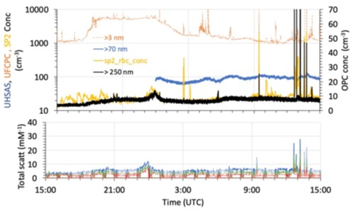
Results and Discussion: Assembling case studies (mid-Winter and late Spring here)
1
Typical winter was low dust and INPs from some type of other mostly organic particle type (biomass burning?).
2
3
Dark traces are PM10 (light is PM1) for 700, 550, and 450 nm)
4
Typical warm season had apparent arable dust influences and biological INPs during plant growth.
5
6

Slide 10
Results and Discussion: annual INP cycle
1
2
Diverse annual cycle present in processed AOS data from 2021-2022.
Apparent active biological INPs present in warm season (Spring to Fall)
but biological INPs are mostly absent in Winter.
Greater than 1 order of magnitude variability in INPs at any temperature over the year.
3
4
INPs active at
-15°C
12/13 case:
high “bio” in December?
Cloud seeding?
5
6
2023 S3 Combined Workshop

Slide 11
Will the local influences of cloud seeding and snowmaking be detectable? Challenging.
Look for winter periods with unexpected INP spectral signatures. This one could be explained by a regional dust incursion, or snowmaking adding bio-INPs via Snomax used in snowmaking machine water. The spectra also looks like that expected from the regional cloud seeding network, but seeding generators were not operating on this day.
Conundrum: Would snowmaking have commenced at 4 pm and ended by 8pm? Dust in STAC analysis suggests this was a short transport event, although 1 biological particle in 1000 overall particles analyzed could still explain 1 per liter INPs acting like Snomax.

Slide 12


Acknowledgements
1
This research was supported by the U.S. Department of Energy’s Atmospheric System Research, an Office of Science Biological and Environmental Research program (BER), under DE-SC0021116.
Data were obtained from the Atmospheric Radiation Measurement (ARM) User Facility, a U.S. Department of Energy (DOE) Office of Science user facility managed by BER.
We also acknowledge support from the Environmental Molecular Sciences Laboratory User Facility LSR grant 60299 and FICUS grant 60379.
2
3
4
5
6

