Slide 1

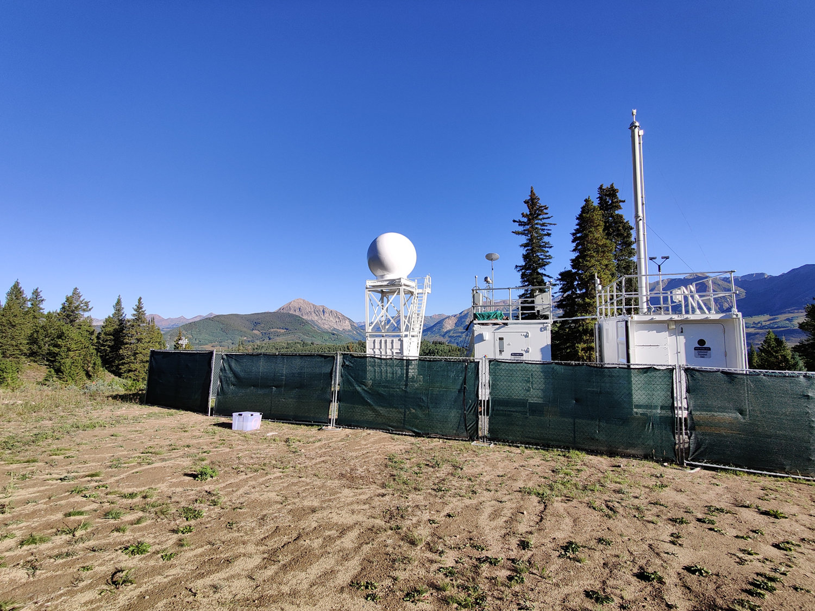








Evolution of wildfire individual particles’ physicochemical properties during September at SAIL Crested Butte Mountain site
ZEZHEN CHENG¹, Nurun Nahar Lata¹, Ashfiqur Rahman¹, Gregory Vandergrift¹, Maria Zawadowicz², Allison Aiken³, Paul Demott⁴, Daniel Feldman⁵, Swarup China¹
¹ Environmental Molecular Sciences Laboratory, Pacific Northwest National Laboratory (PNNL) ² Brookhaven National Laboratory ³ Los Alamos National Laboratory ⁴ Colorado State University ⁵ Lawrence Berkeley National Laboratory
PNNL is operated by Battelle for the U.S. Department of Energy
Notes:
03/07/2022

Slide 2
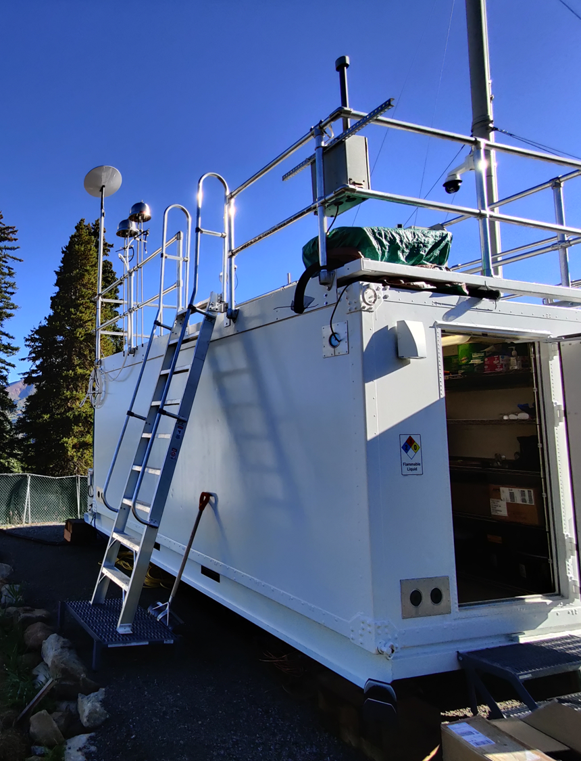
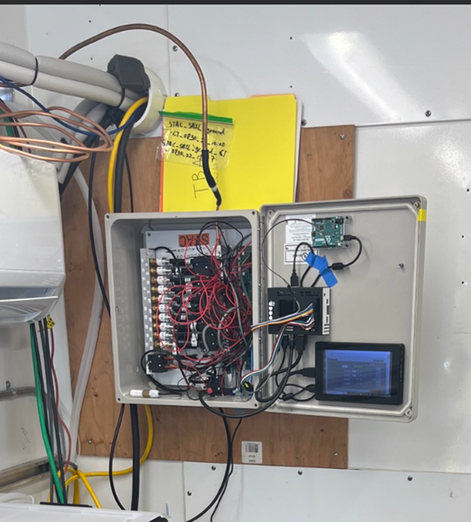
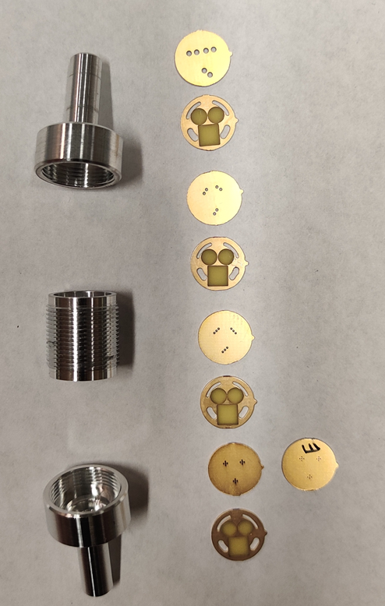

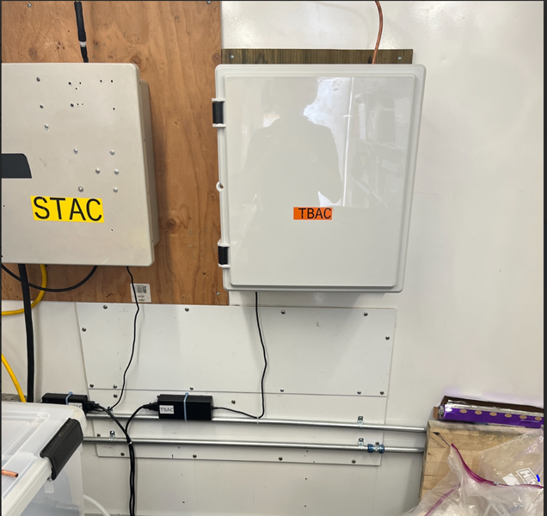
Size and time-resolved automated aerosol sampling
Size- and Time-resolved Aerosol Collector (STAC)
Aerosol inlet
Stage A
2.27 µm
Stage B
0.62 µm
Stage C
0.42 µm
Stage D
0.12 µm
Stage E
0.07 µm
4-stage STAC impactor
Environ. Sci.: Atmos., 2022. DOI: 10.1039/D2EA00097K

Slide 3

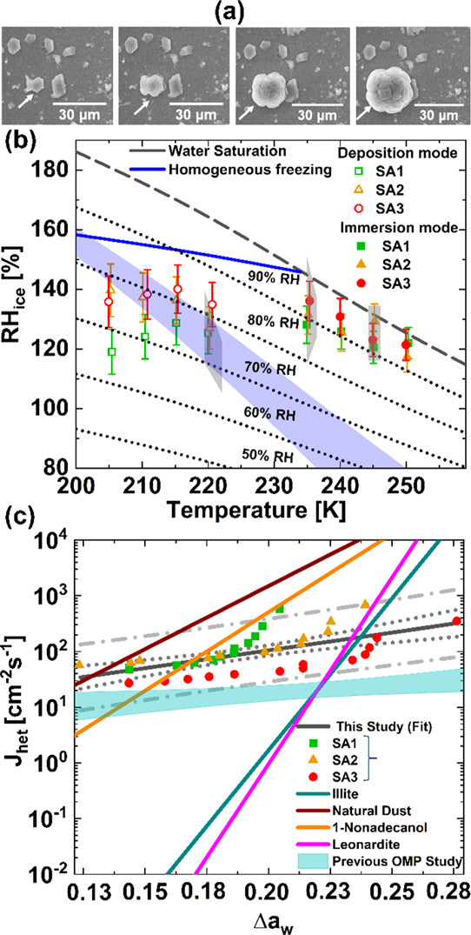
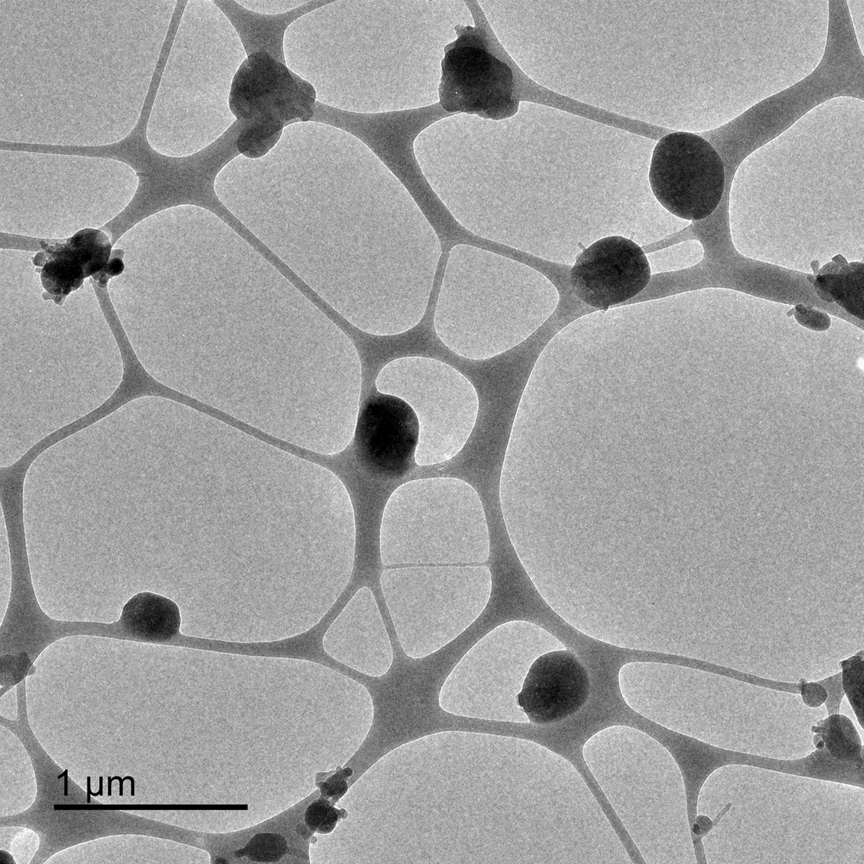
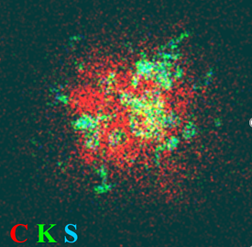
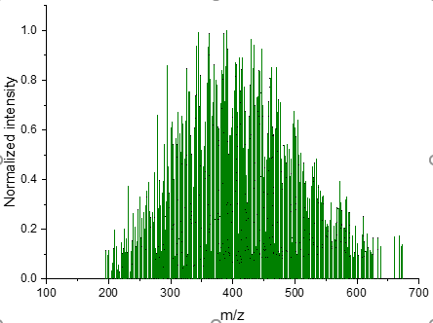
Multi-modal offline analyses using the STAC platform
Computer-Controlled Scanning Electron Microscopy with Energy-Dispersive X-ray spectroscopy (CCSEM-EDX)
Scanning Transmission X-ray Microscopy with Near-Edge X-ray Absorption Fine Structure spectroscopy (STXM-NEXAFS)
Chemical composition
Morphology
Functional groups
Cheng et al., RSC Adv., 2021, 11
Peltier cooling stage interfaced with an ESEM
Phase state and hygroscopicity
Lata et al., ACS Earth Space Chem., 2021, 5
Ice nucleation stage interfaced with an ESEM
Ice nucleation
4-stage STAC Impactor
TEM analysis
Chemical composition and morphology
ToF-SIMS
XPS
In-situ liquid IR SNOM
Surface chemistry
Mass spectrometry (nano-DESI)
Molecular composition and viscosity estimation
Notes:
computer-controlled scanning electron microscopy with energy-dispersive X-ray spectroscopy (CCSEM-EDX)

Slide 4
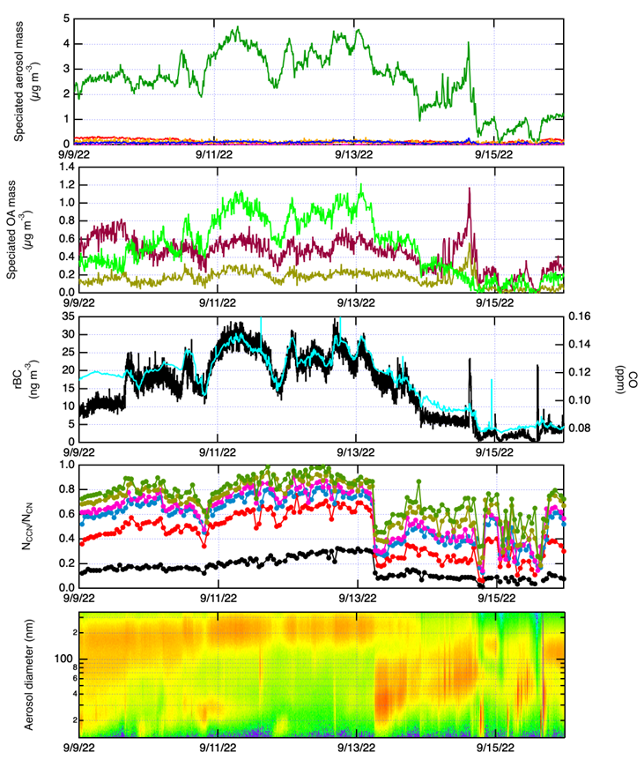
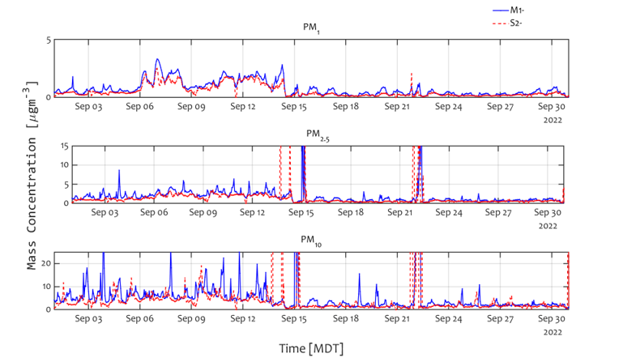
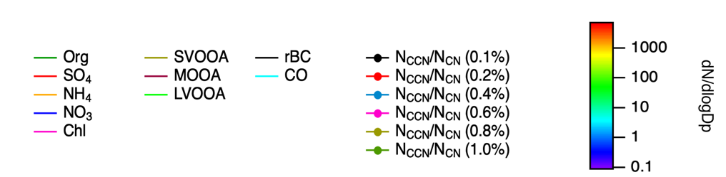
Interesting wildfire events-September 2022
Data from Maria Zawadowicz
Data from Allison Aiken

Slide 5
Wildfire influence aerosol composition: SEM imaging
09/06
09/07
09/08
09/09
09/10
09/11
09/13
Stage A
Stage B
Stage C
Stage D

Slide 6
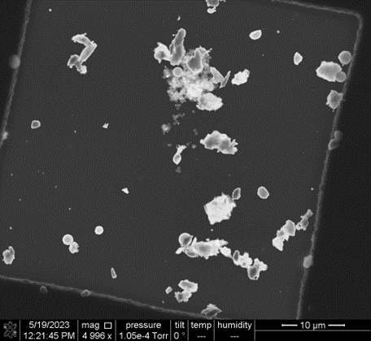
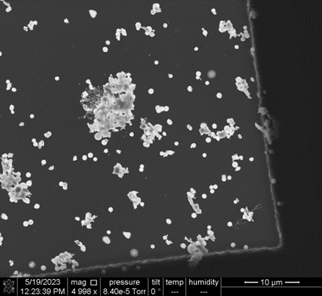
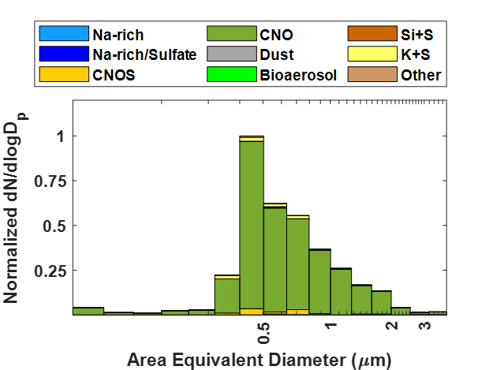
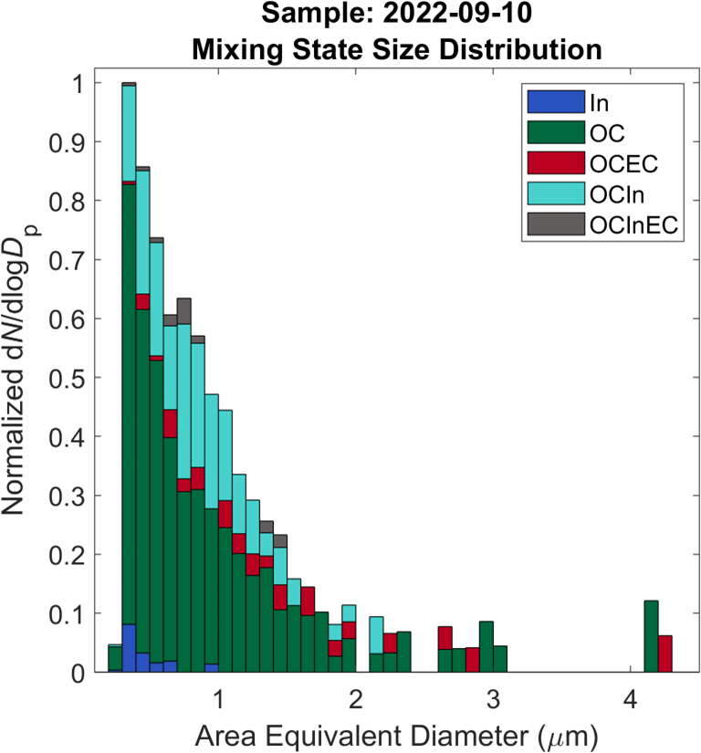
Case study: wildfire smoke heavily influenced sample (09/12/2022)
Stage A
Stage B
Spore
Soot w/ dust and OC
Dust w/ tar balls
dust
Tar balls
Stage D
Stage C
OC and OCS,
Inclusions might be inorganic sulfate

Slide 7
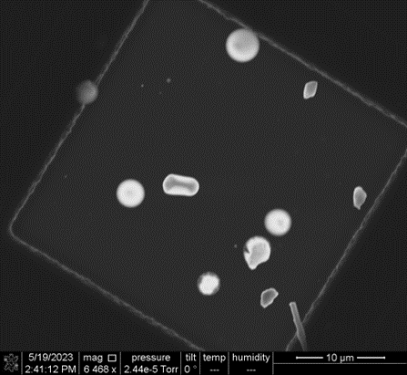
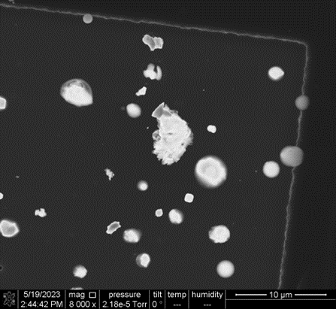
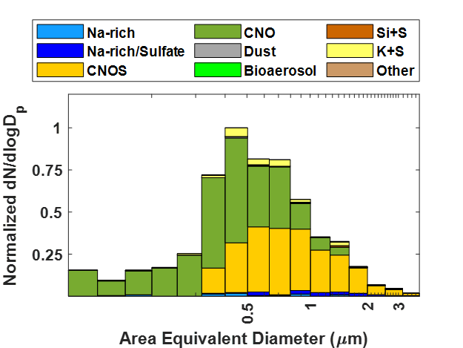
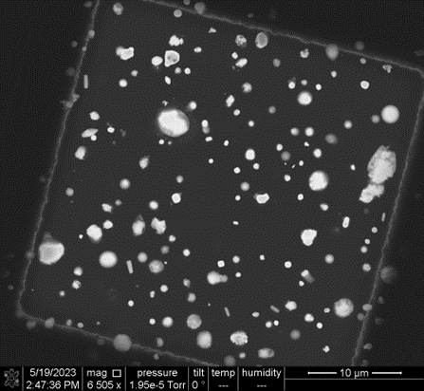
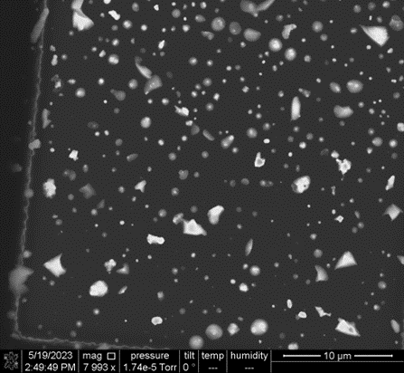
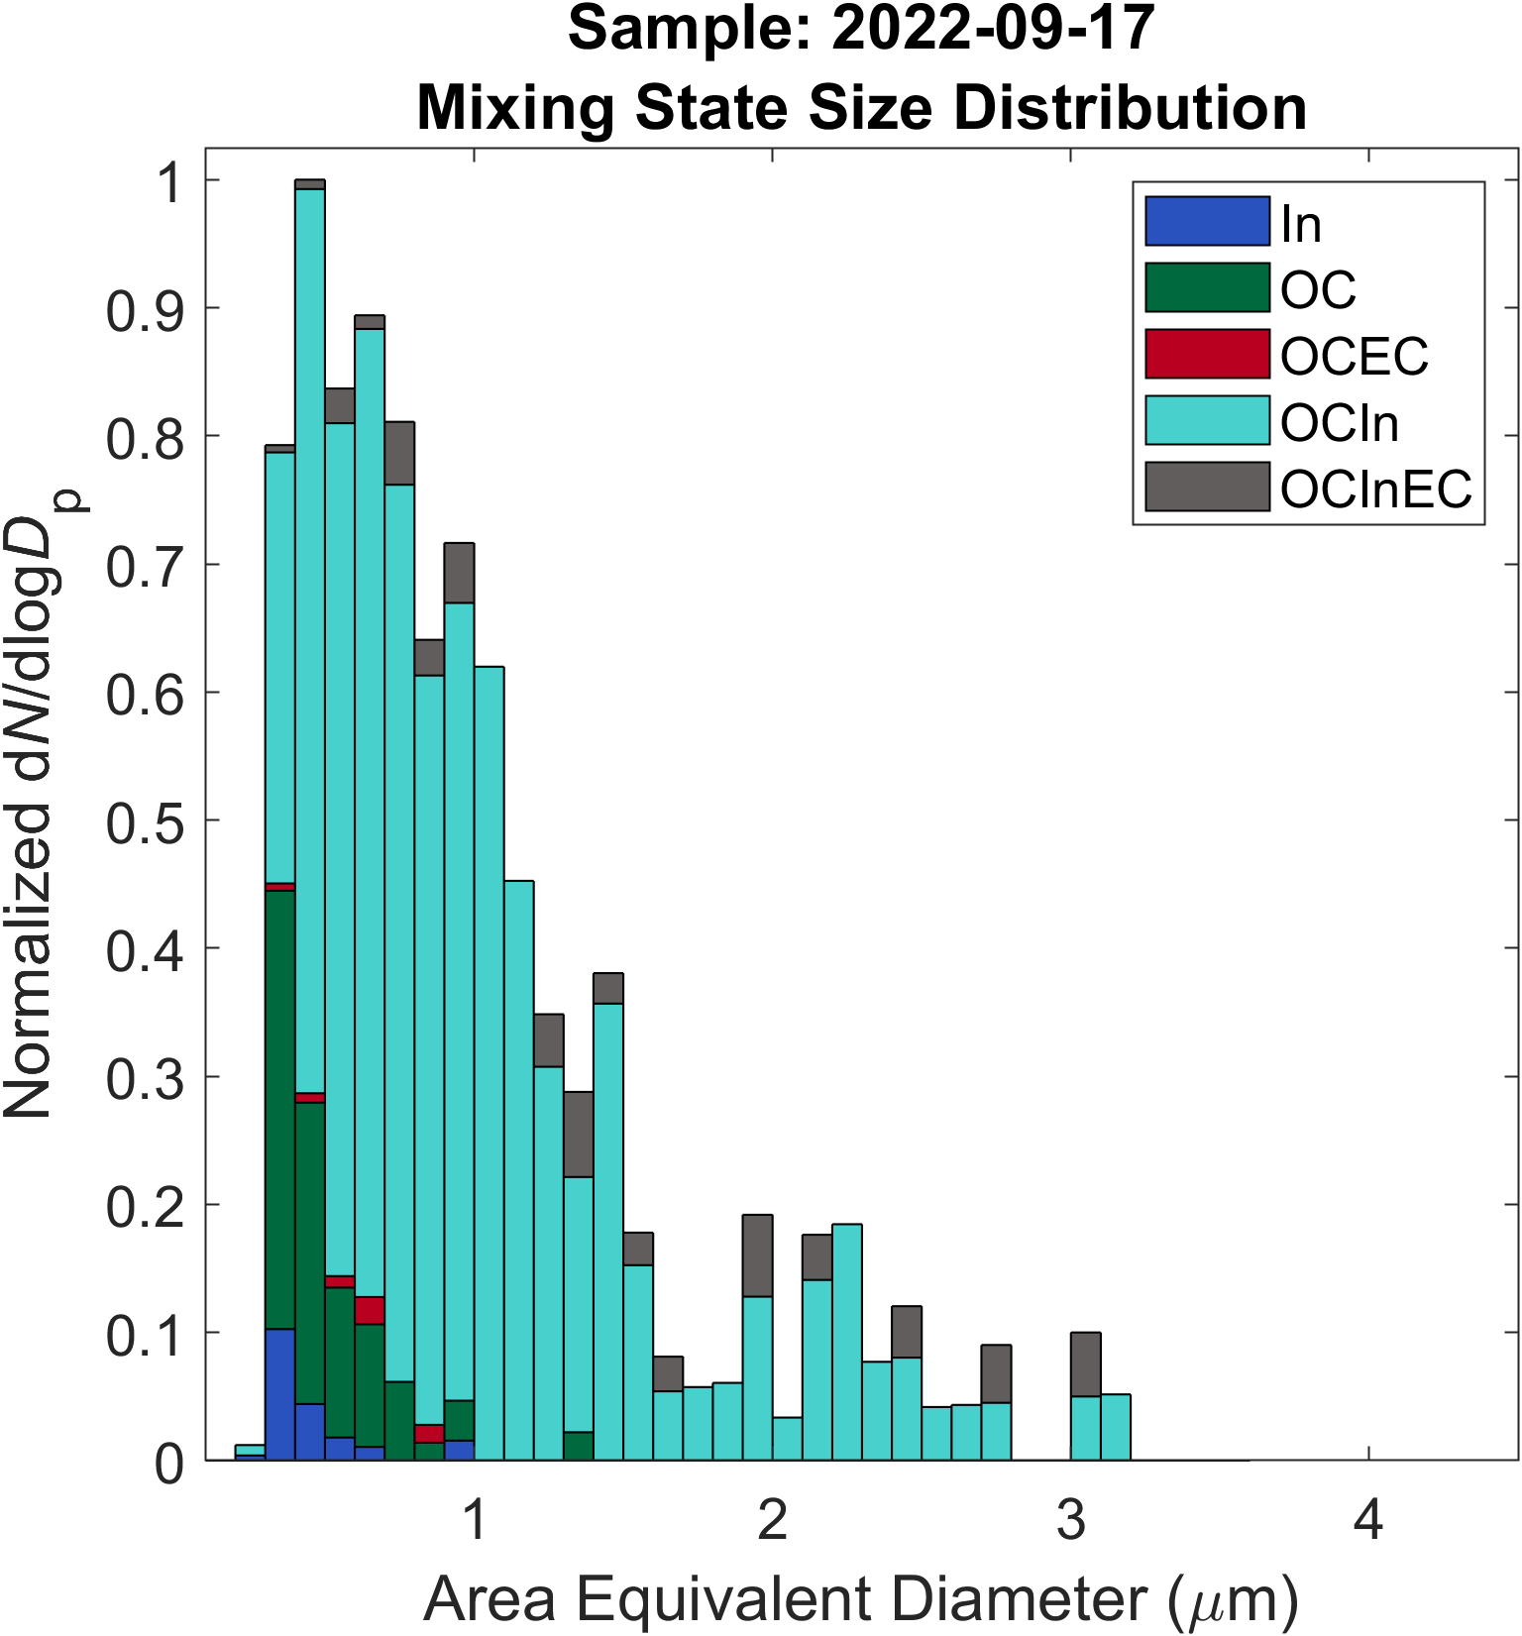
Case study: wildfire smoke lightly influenced sample (09/17/2022)
Stage B
Stage A
Bioaerosol
dust
dust
Stage C
Stage D

Slide 8
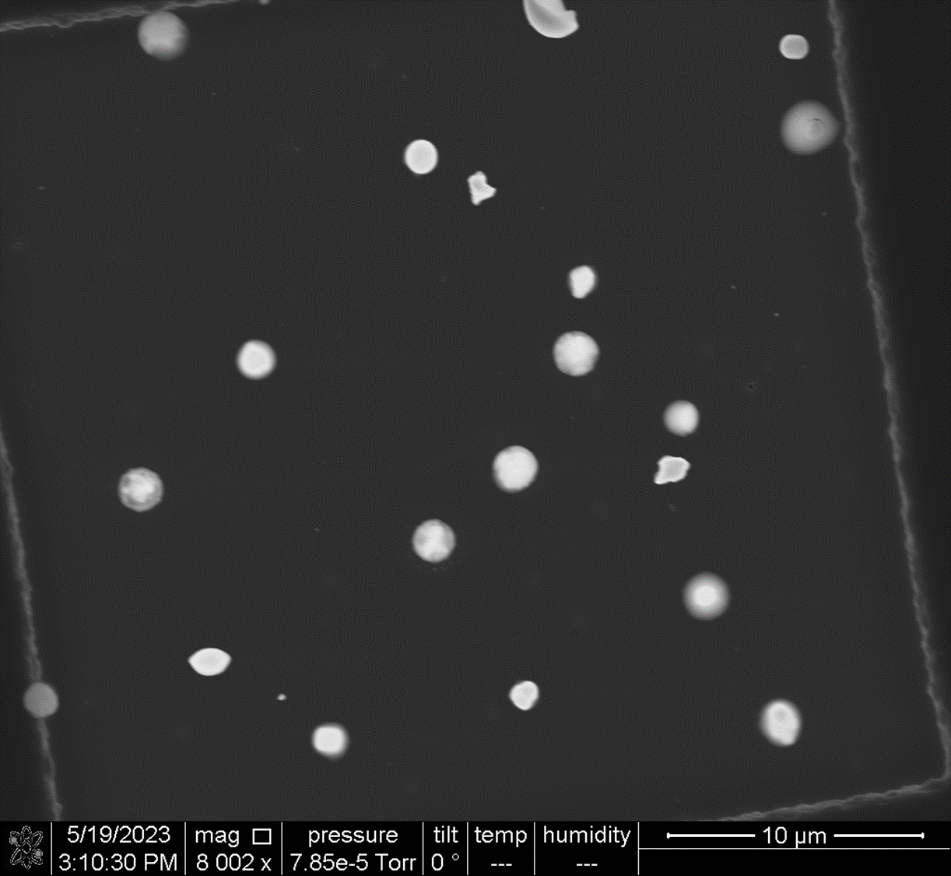
Presence of bioaerosols
09/08/2022
09/13/2022
09/18/2022

Slide 9





Acknowledgement

Slide 10






Thank you, and questions?
Proposal/sample submission calls
FICUS Research with ARM and EMSL
(call opens in January)
  Projects 24 months (depending on FICUS proposal call type) that connect researchers with EMSL and ARM
  Large-scale EMSL Research
  (call opens in December)
  Projects up to 24 months to advance scientific understanding
  Exploratory Research
  (call opens in June)
  Projects up to 10 months that employ certain highlighted capabilities
Proposal calls
emsl.pnnl.gov/proposals
Contact infor: Zezhen Cheng
Email: Zezhen.cheng@pnnl.gov
Office: (509) 372-6270
Notes:
MONet is a national open science network designed to produce comprehensive molecular-level and microstructural information on the composition and structure of soil, water, resident microbial communities, and biogenic emissions.

Slide 11

Thank you, and Questions?
Contact infor: Zezhen Cheng
Email: Zezhen.cheng@pnnl.gov
Office: (509) 372-6270

Slide 12
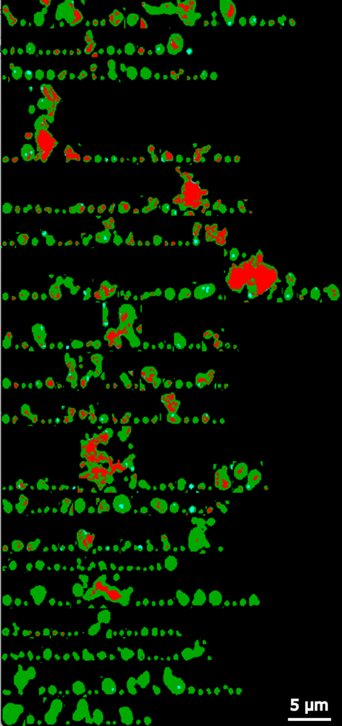
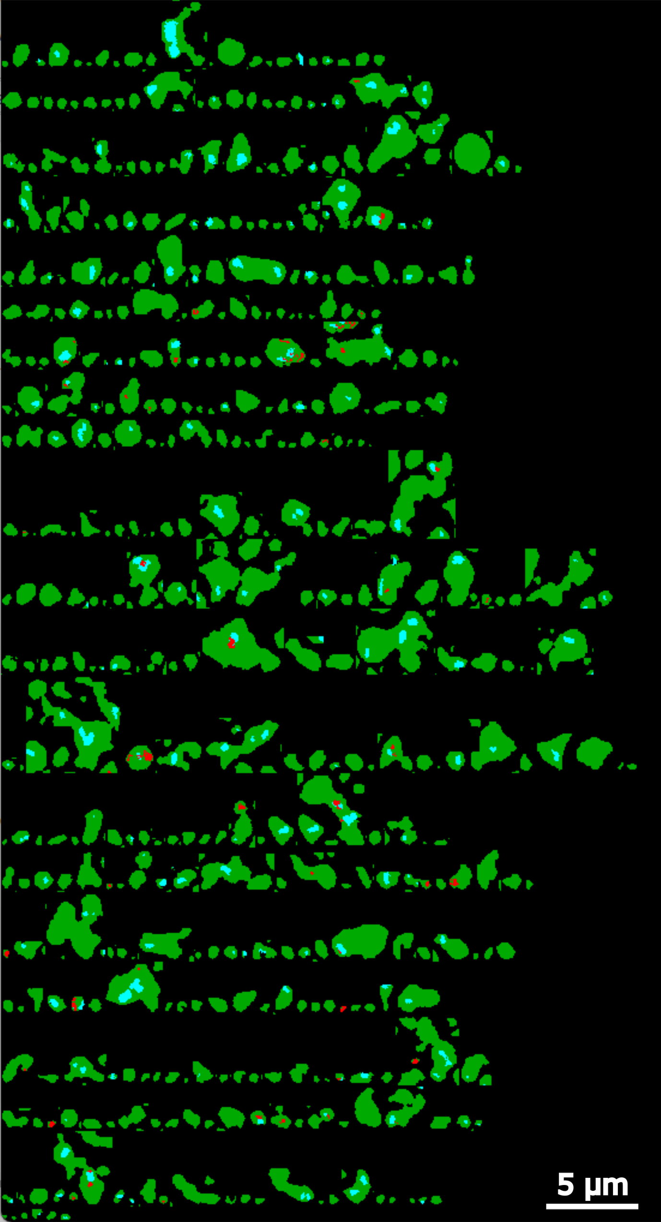

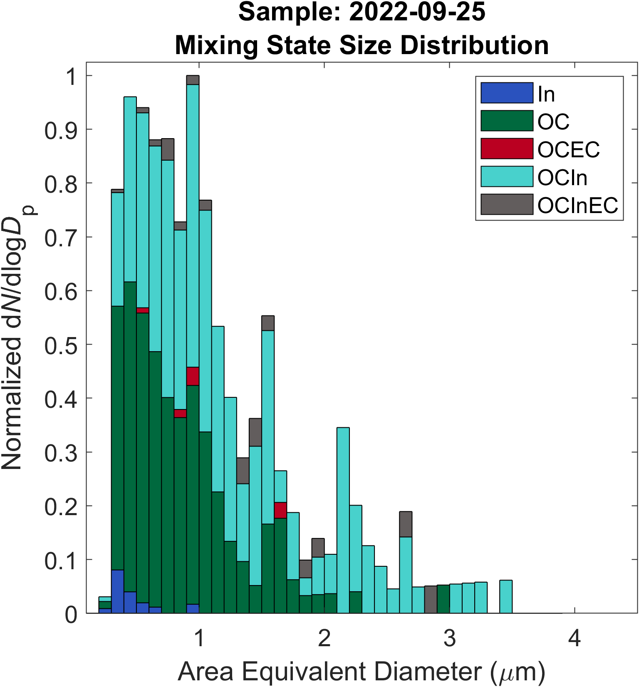
Chemical imaging and mixing state
2022-09-25
2022-09-10
2022-09-10
2022-09-25

Slide 13
08/30/2022
Stage D

Slide 14
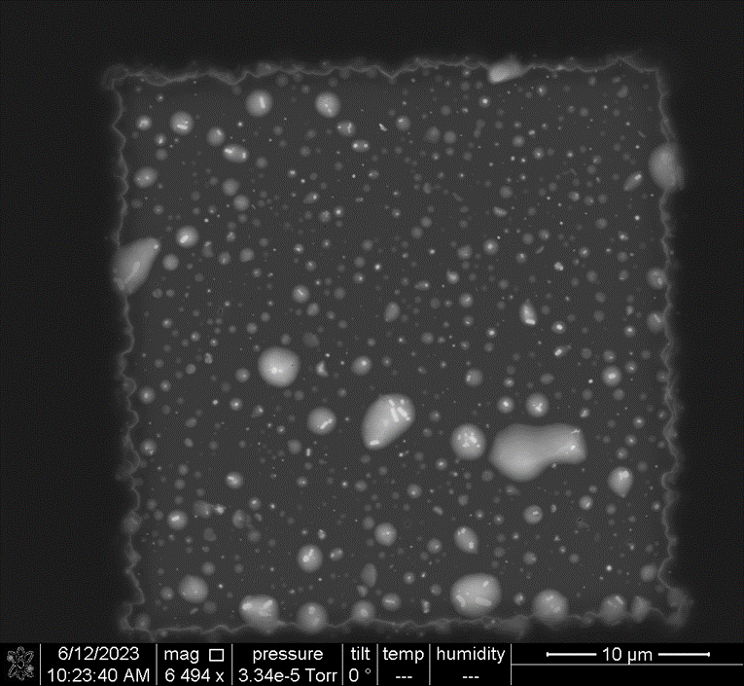
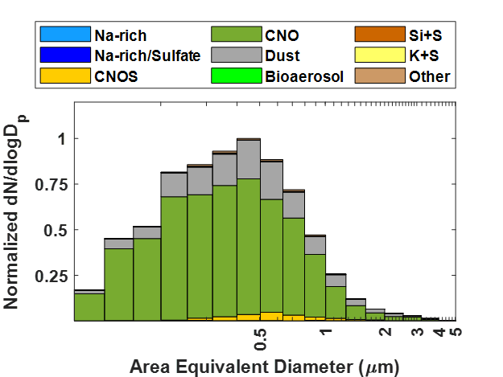
09/03/2022
Stage D

Slide 15
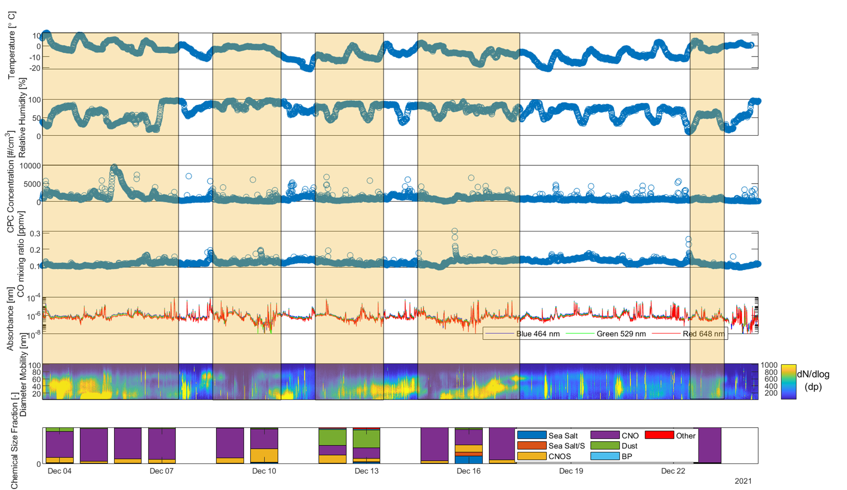
Development of size and time-resolved automated aerosol sampler for unmanned aerial systems

Slide 16
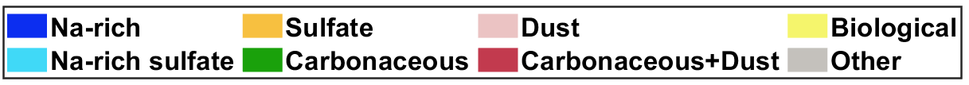
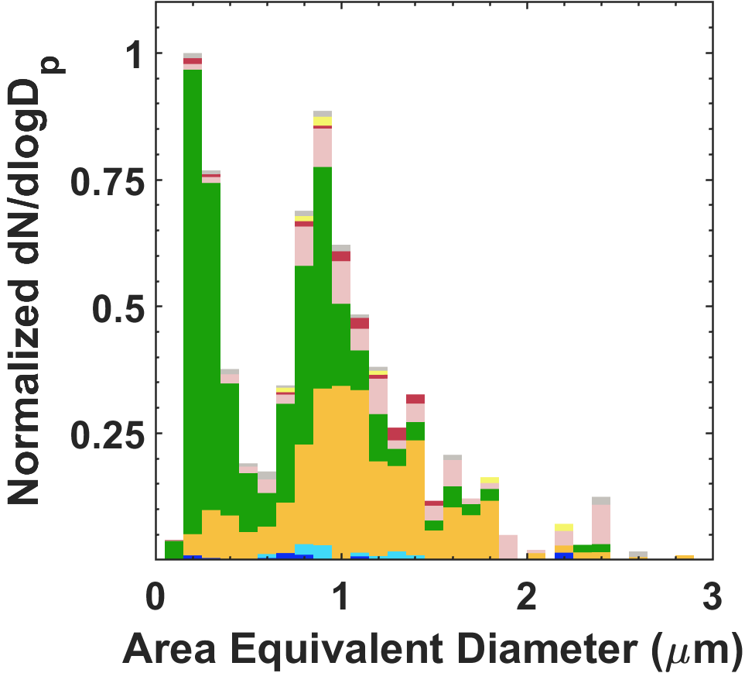
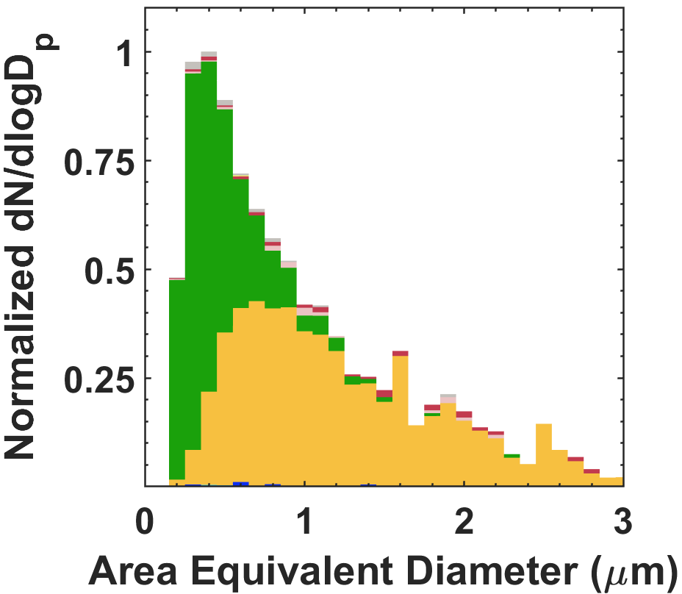
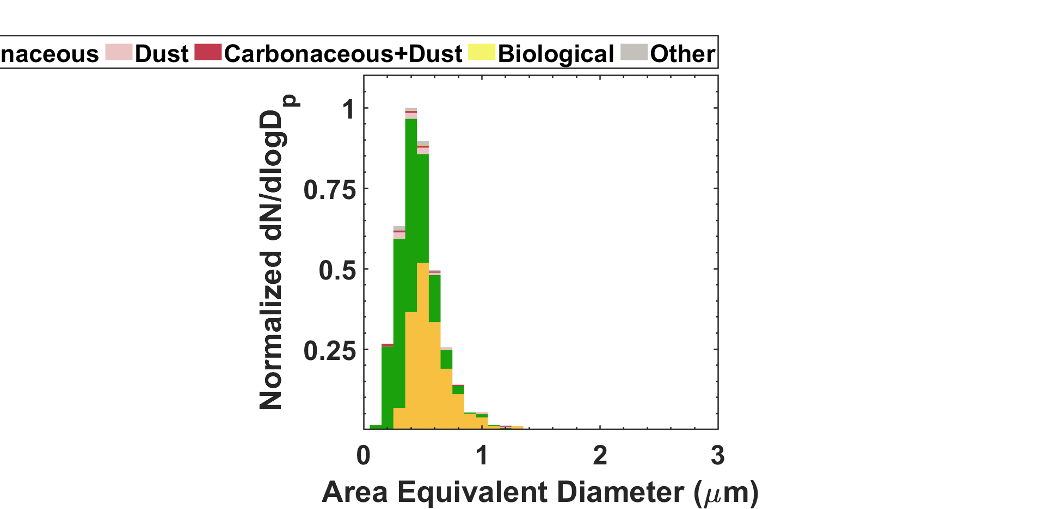
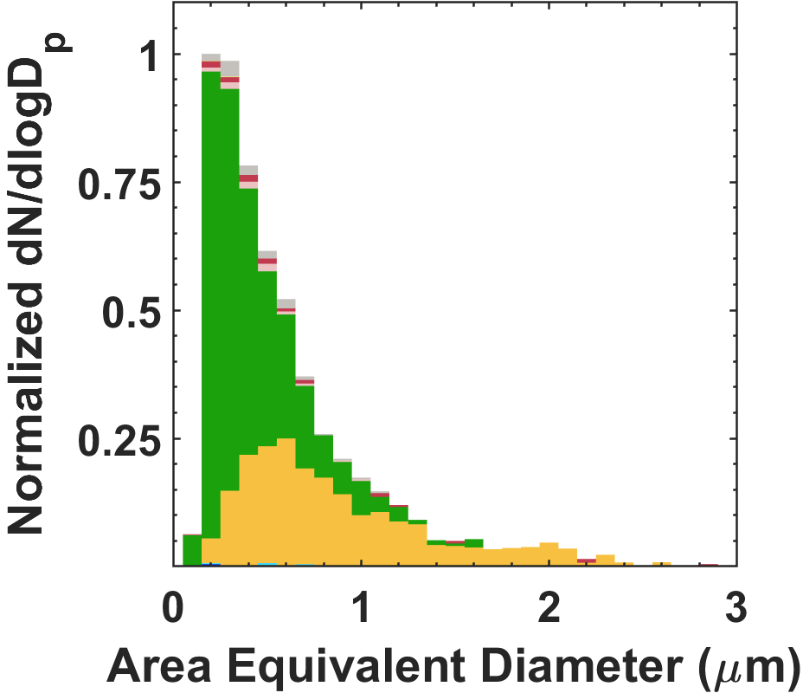
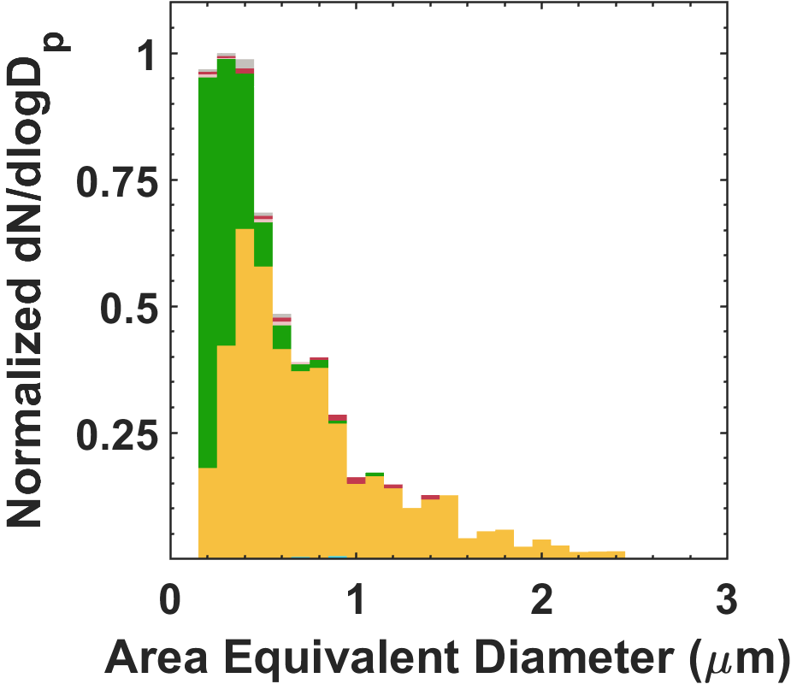
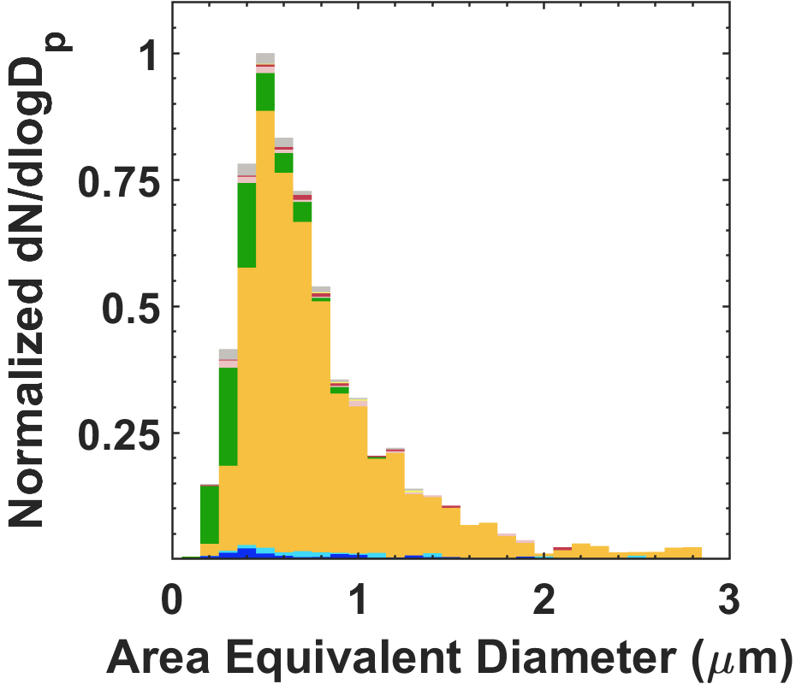
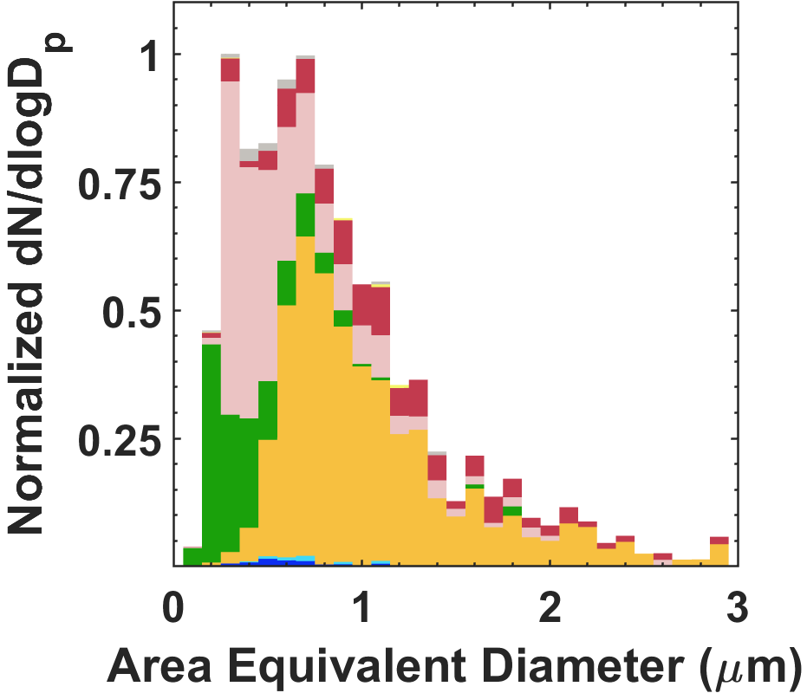
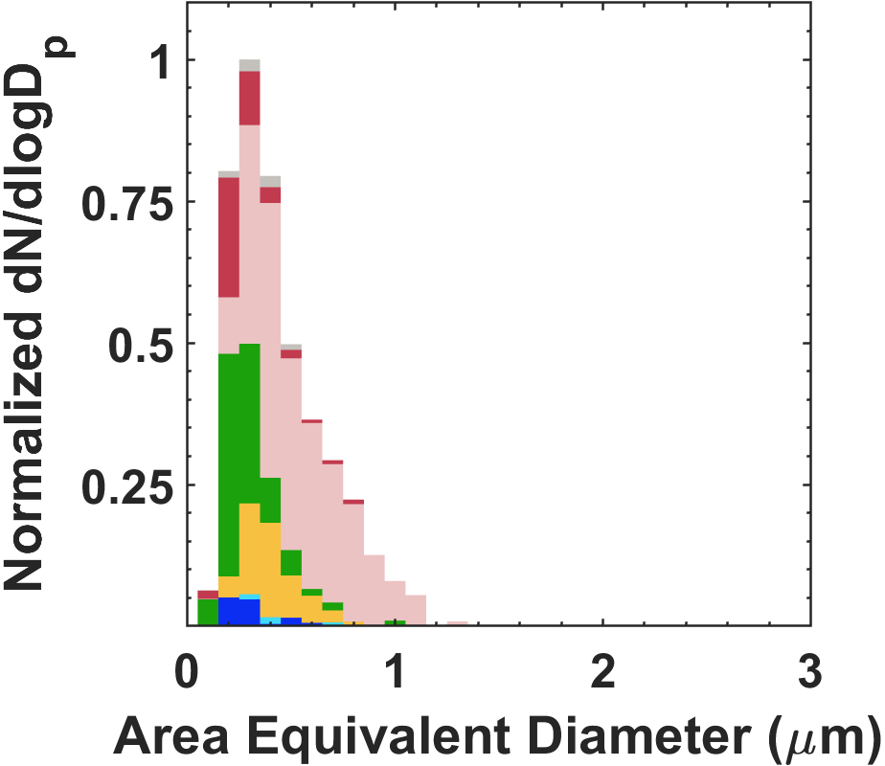
Size-resolved aerosol composition
12/4/21
12/05/21
12/06/21
12/07/21
12/09/21
12/10/21
12/12/21
12/13/21

Slide 17
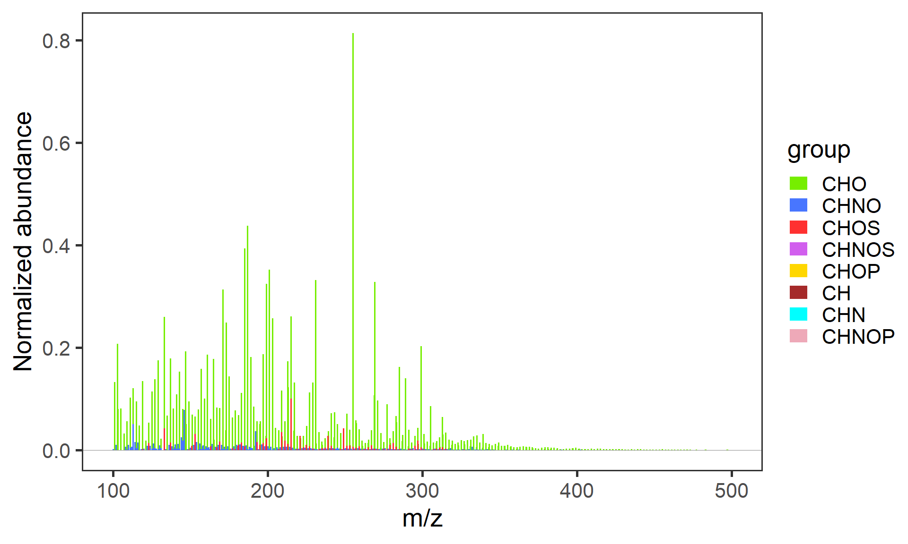
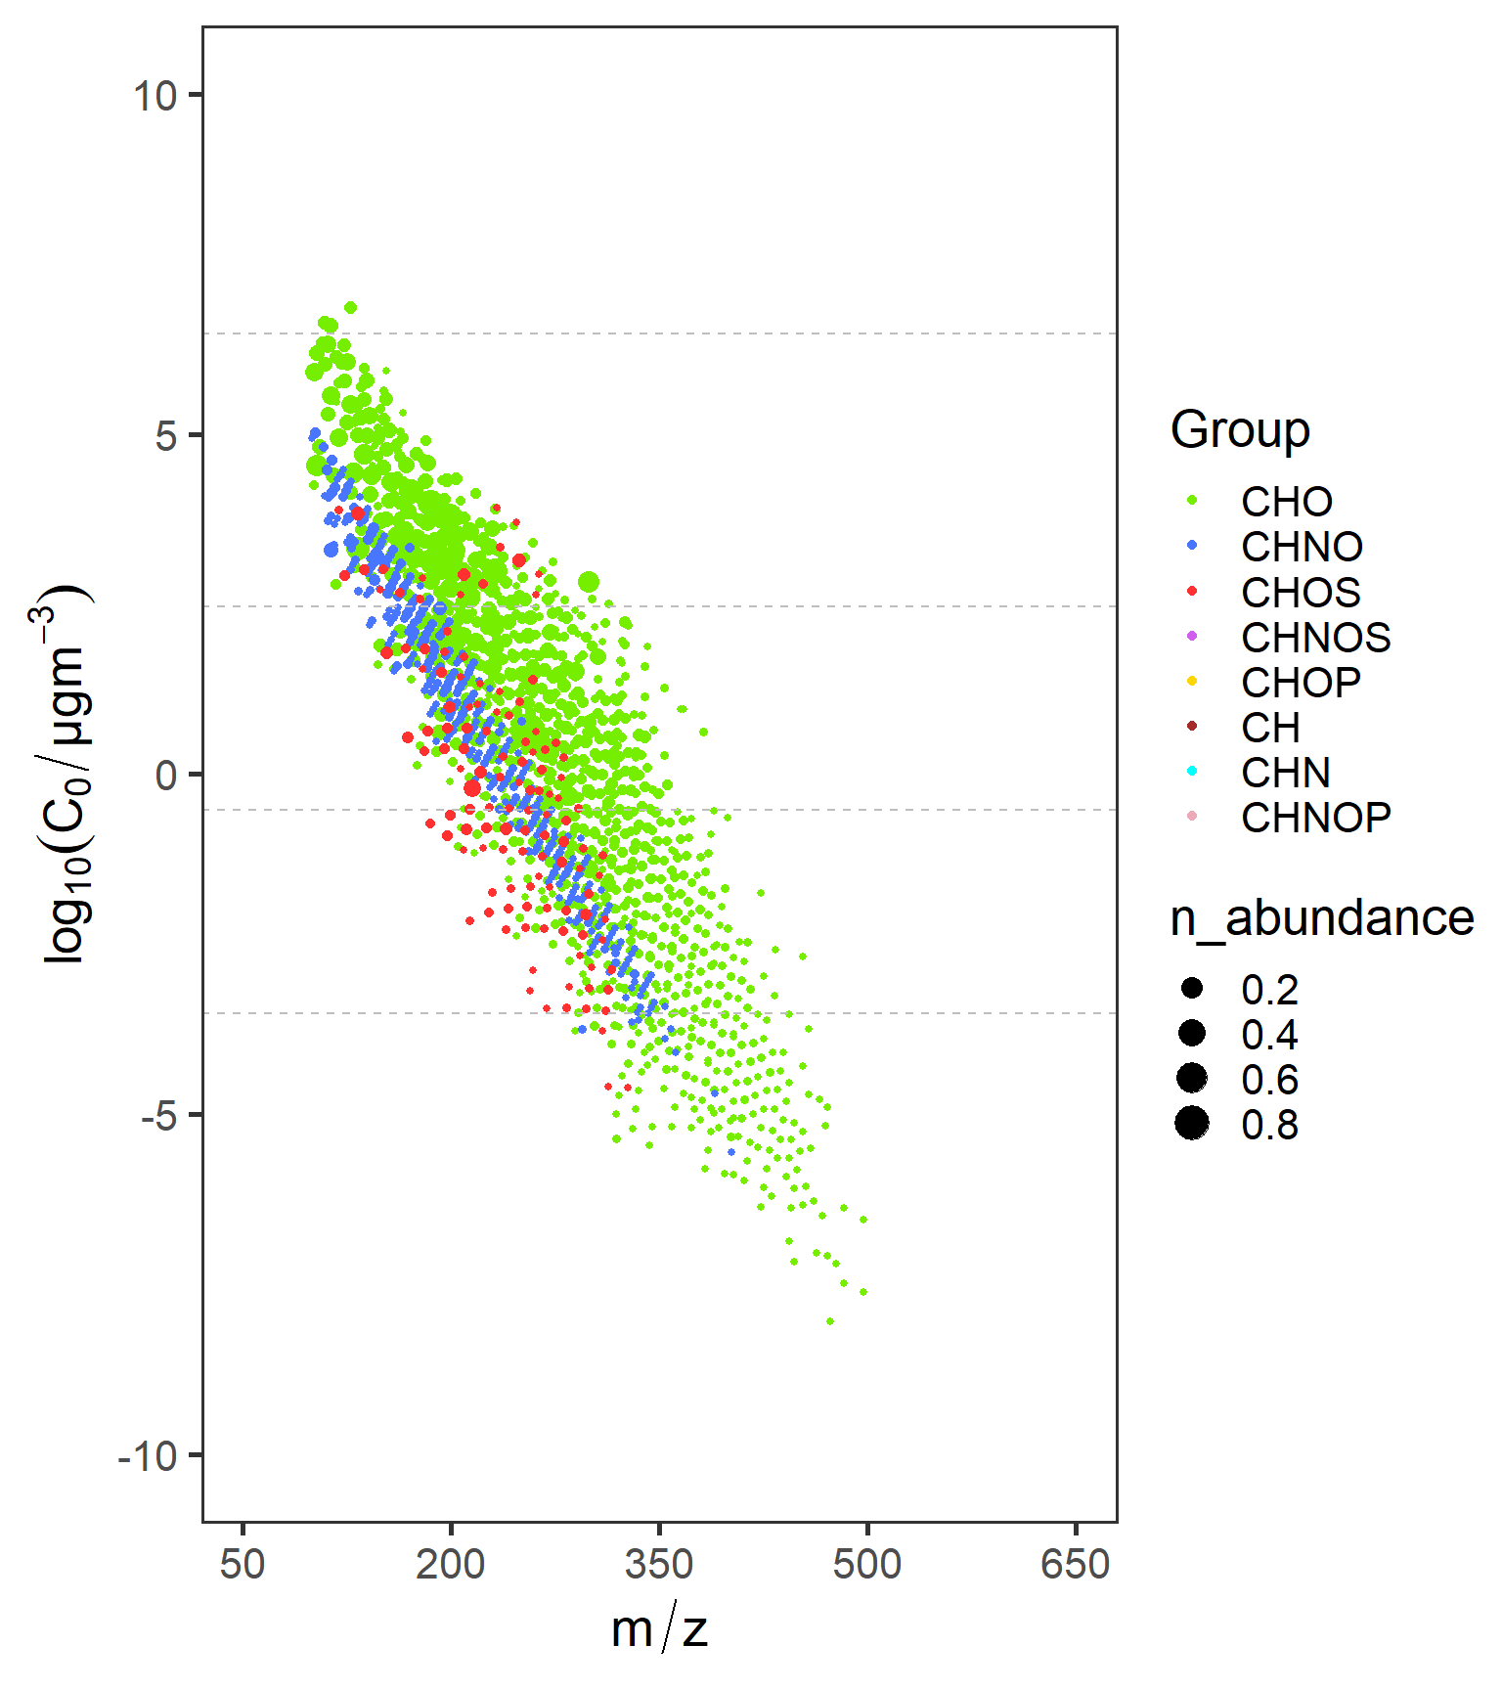

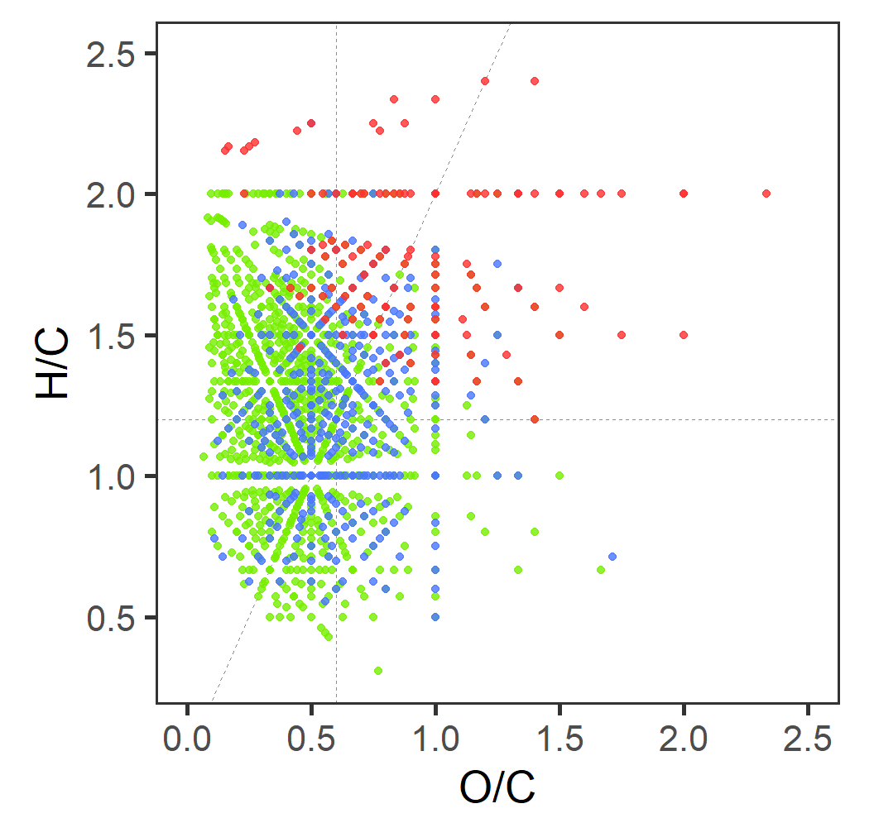
Molecular Composition by nano-DESI HRMS
050923- Daytime

Slide 18
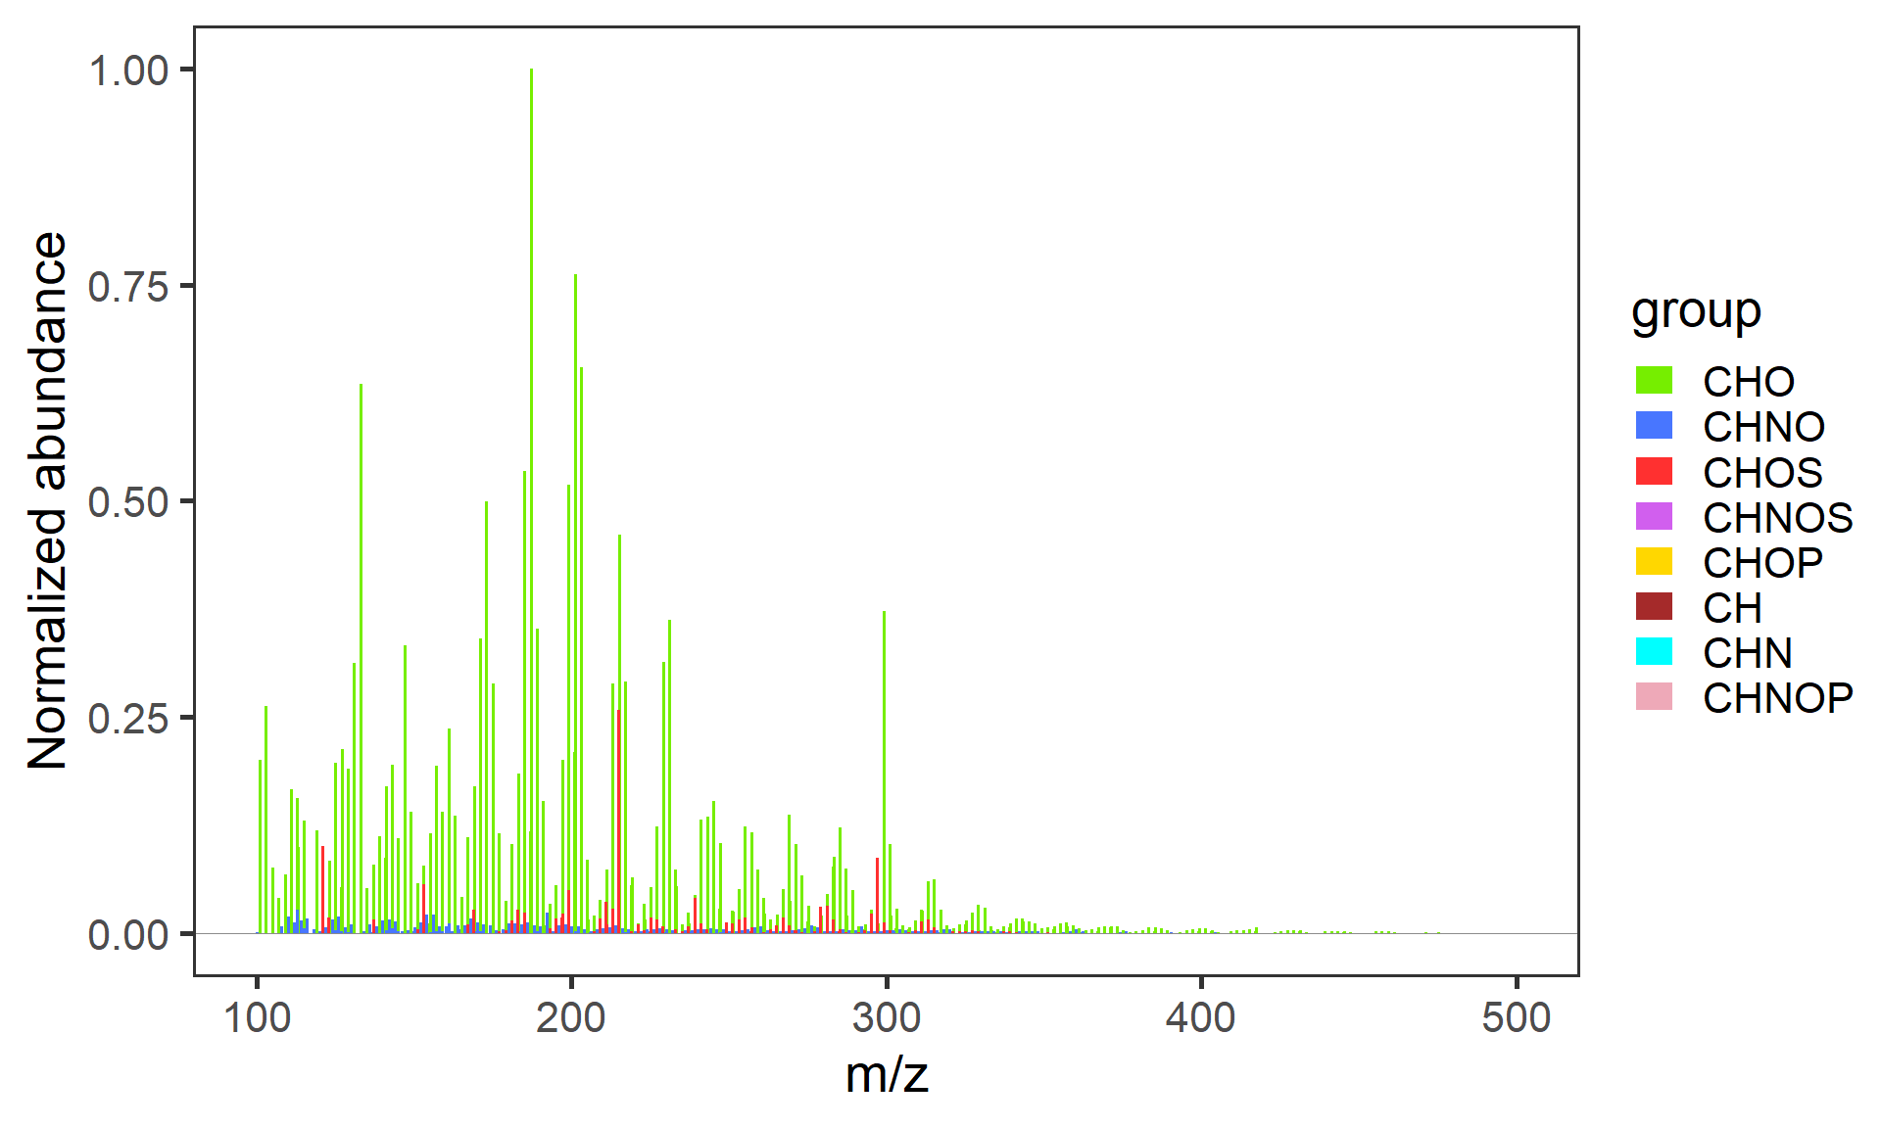

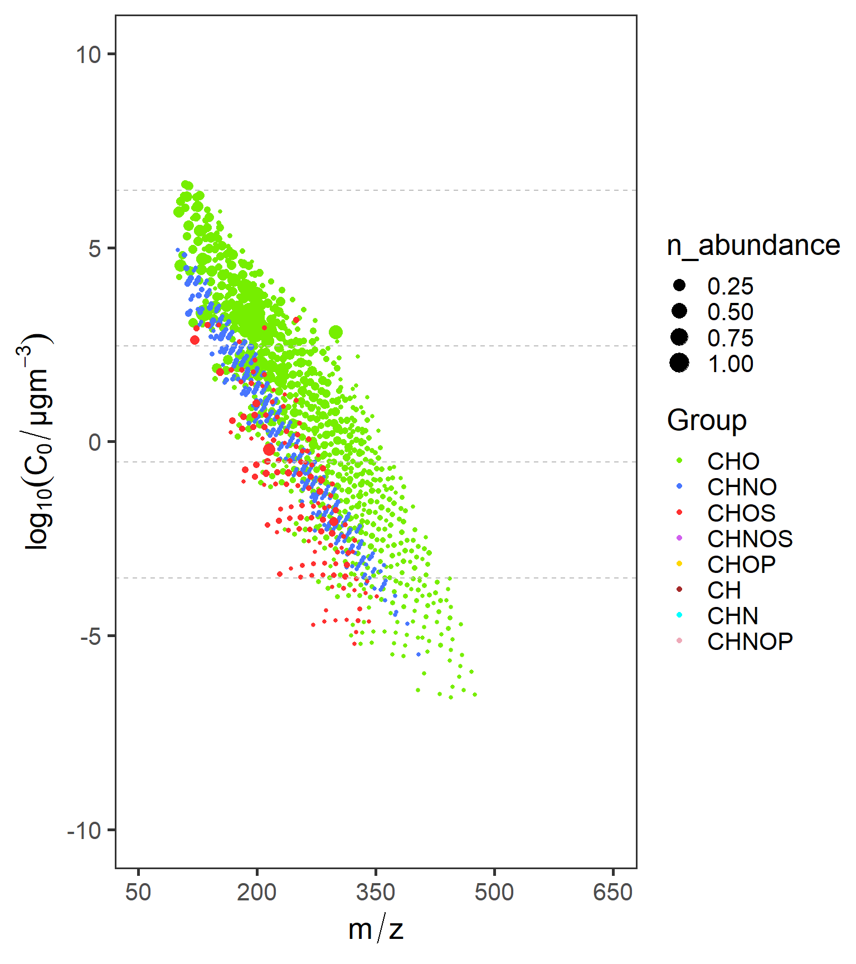
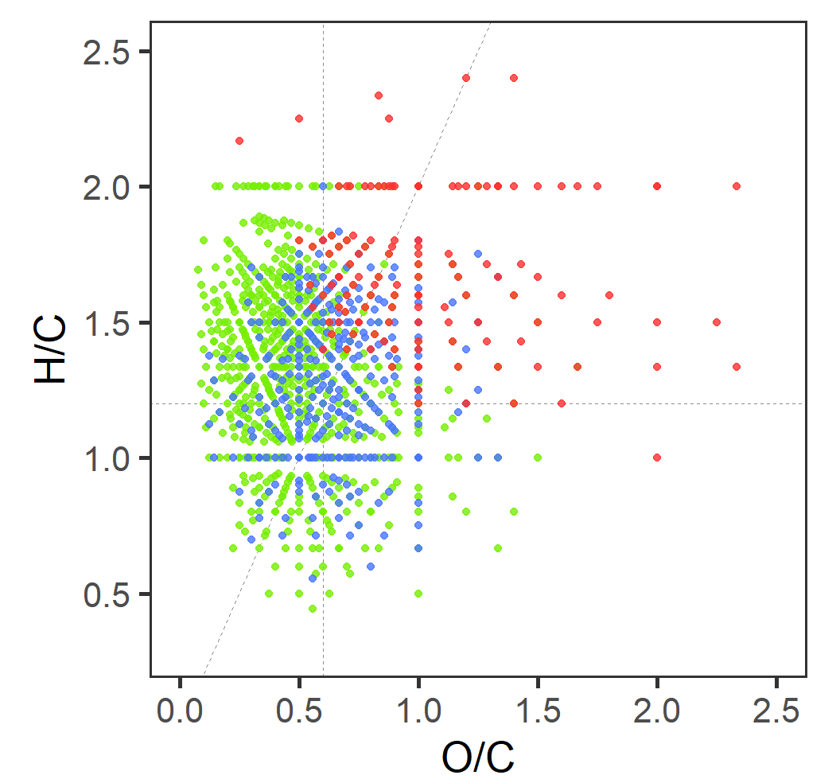
Molecular Composition by nano-DESI HRMS
050923- Nighttime

