Slide 1
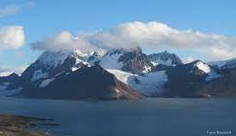
Proposed research
erhtjhtyhy
Aerosol-cloud-precipitation interactions over complex topography: process-level understanding and E3SM v3 performances
Dr. jiwen fan
Deputy Division Director
Environmental Science Division
Argonne National Laboratory
fanj@anl.gov
November 2, 2023

Slide 2
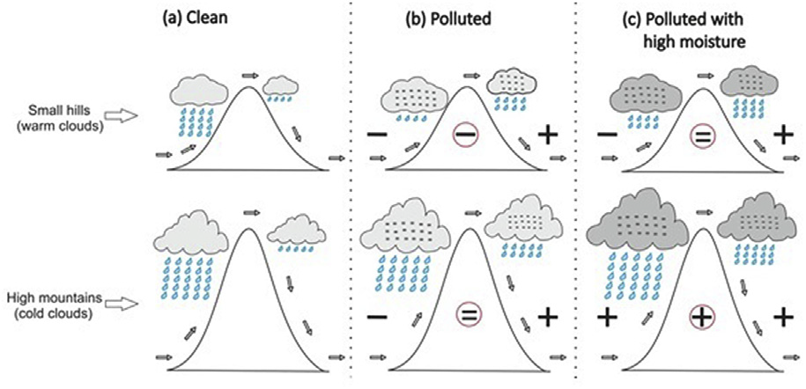
Aerosol-orography-precipitation interaction (AOPI) : process-level understanding study
AOPI depends on aerosol regimes, meteorological/cloud conditions, and terrain features
Choudhury, et al., 2019, Atmos. Envir.

Slide 3
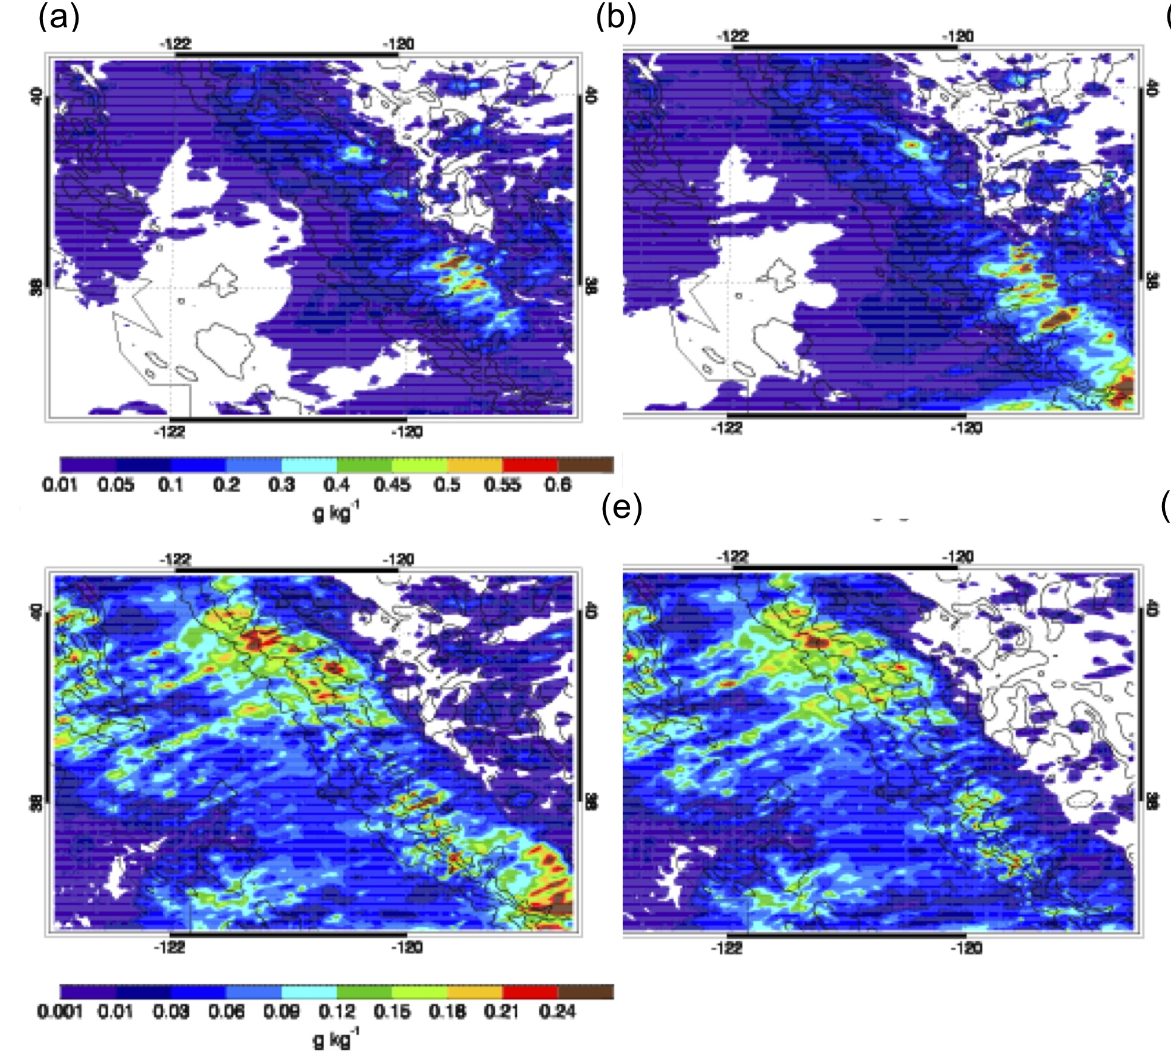
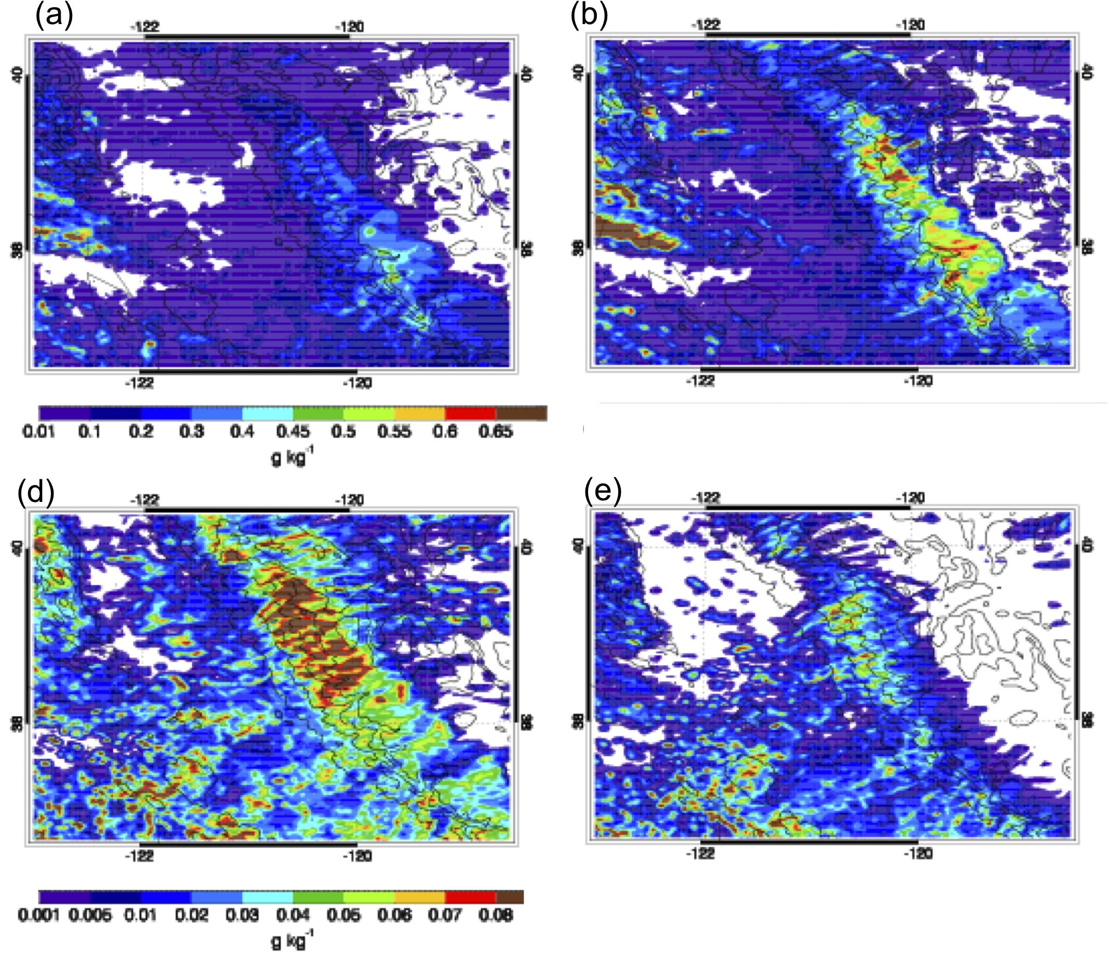
Dust impact on snow precipitation depend on mixed-phase cloud temperature (CalWater-1)
NoDust
Dust
NoDust
Dust
Snow
Rain
Cold mixed-phase clouds (CTT < -20ºC): drastically increase snow and reduce rain
Warm mixed-phase clouds (CTT > -20ºC): the effects not significant because ice formation is limited.
Fan et al., 2014, ACP

Slide 4
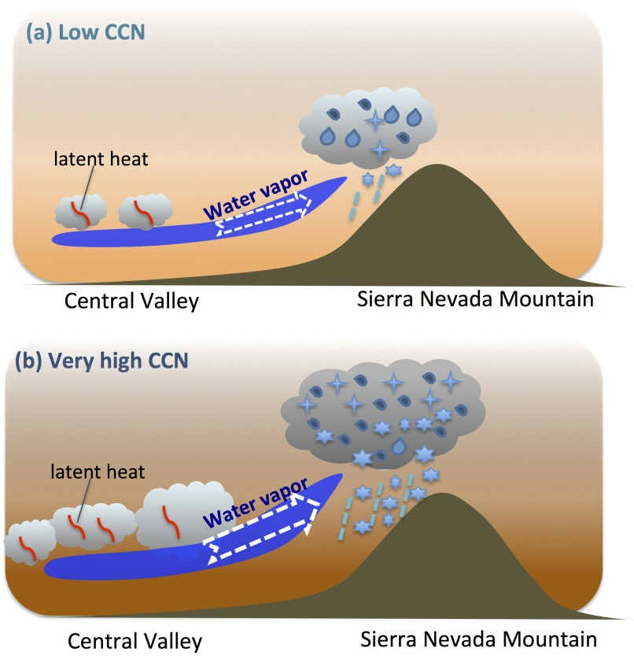
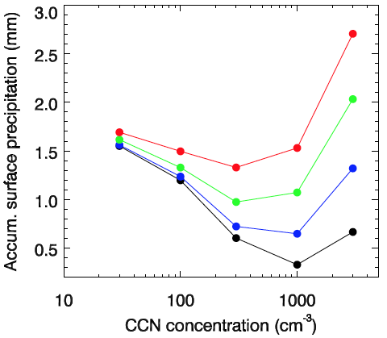


CCN impact can change circulation and lead to a large enhancement of snow
Hypothesis: CCN impact local circulation, leading to much more active mixed-phase clouds and drastic enhancement in snow precipitation
CCN and INP (dust) impacts on mixed-phase cloud precipitation
Cold mixed-phase clouds
Warm mixed-phase clouds
CTT < -20ºC
CTT > -20ºC
More shallow clouds in the valley
Strengthened local circulation thus more zonal transport of moisture
Fan et al. 2017, ACP
This effect does not occur when (i) ice processes is turned off and/or (ii) the topography is removed.
Invigoration of mixed-phase clouds

Slide 5
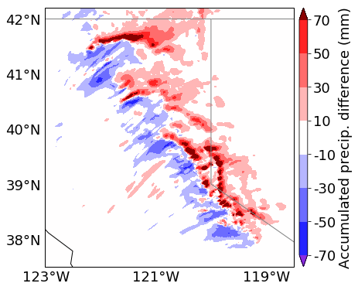
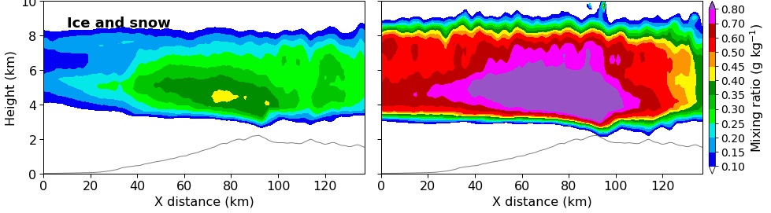
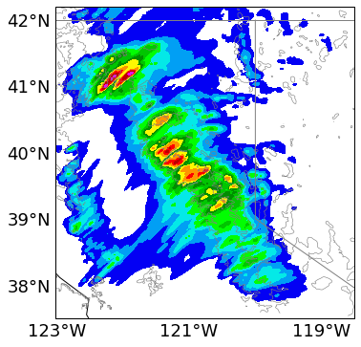
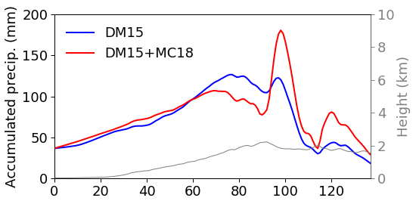
Notable spillover effect by marine INPs from AR during ACAPEX
DM15
DM15
DM15+MC18
Effects of marine INPs
The first study showing the spillover effect of INPs (previous studies Saleeby et al. 2010, JAMC, showed this effect by CCN
Why do marine INPs have the spillover effect but dust INPs do not?
- Marine INPs are mainly brought by ARs and the windward side gets them first.
Lin et al., 2022, ACP

Slide 6
Proposed a model - data integration study
SQ: How does the aerosol-precipitation relationship vary with different aerosol regimes (dust, biomass burning), and atmospheric dynamic and thermodynamic conditions?
Analyze the relationships of CCN and INP with precipitation (rate and SD), cloud microphysical properties (e.g., LWC/IWC, cloud phase), and updrafts under typical meteorological conditions of warm and cold seasons
Propose observationally-motivated hypotheses
Perform detailed high-res simulations for typical cases of warm and cold seasons and associated sensitivity tests to test the hypotheses
WRF-SBM-MOSAIC
Gao, Fan, et al., JAMES, 2016
Allow to predict aerosol particles with aerosol lifecycle and aerosol-cloud interaction processes more physically considered

Slide 7
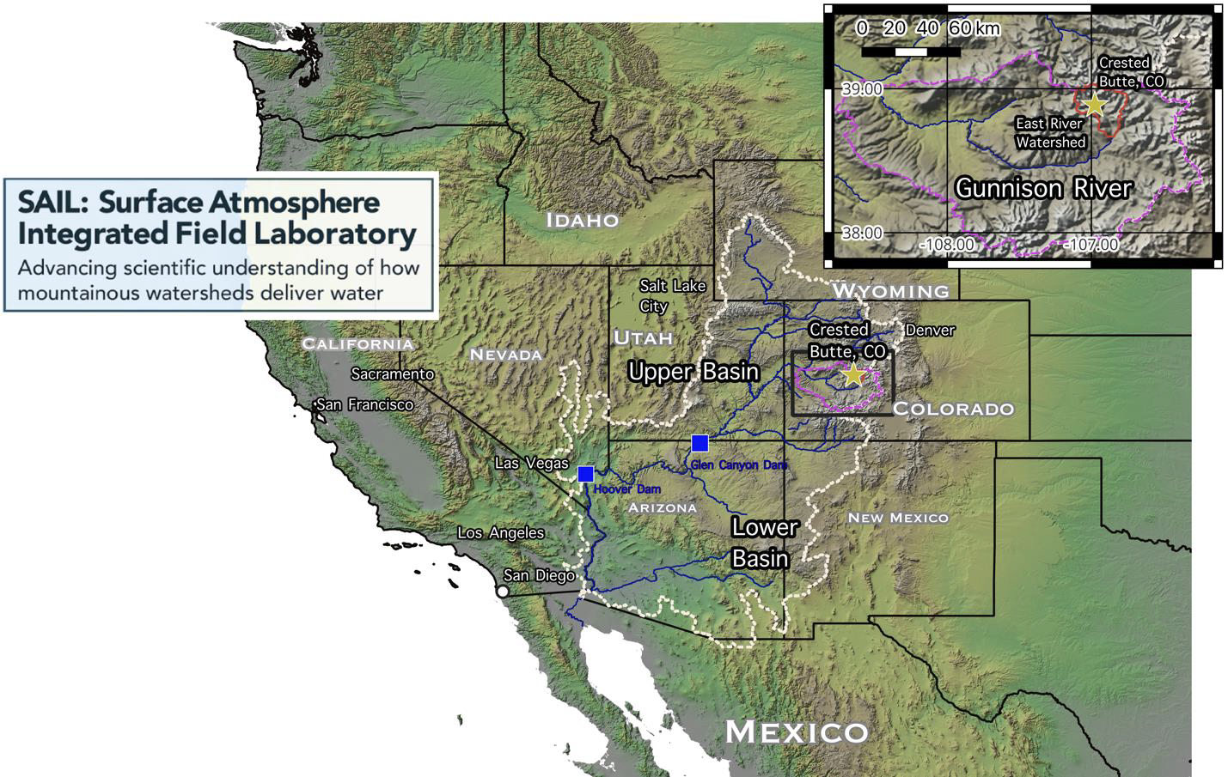
E3SM v3 new cloud physics and aerosol-cloud interaction evaluation and further development
E3SM v3: to be finalized by the end of this month
Feldman et al. 2023, BAMS

Slide 8
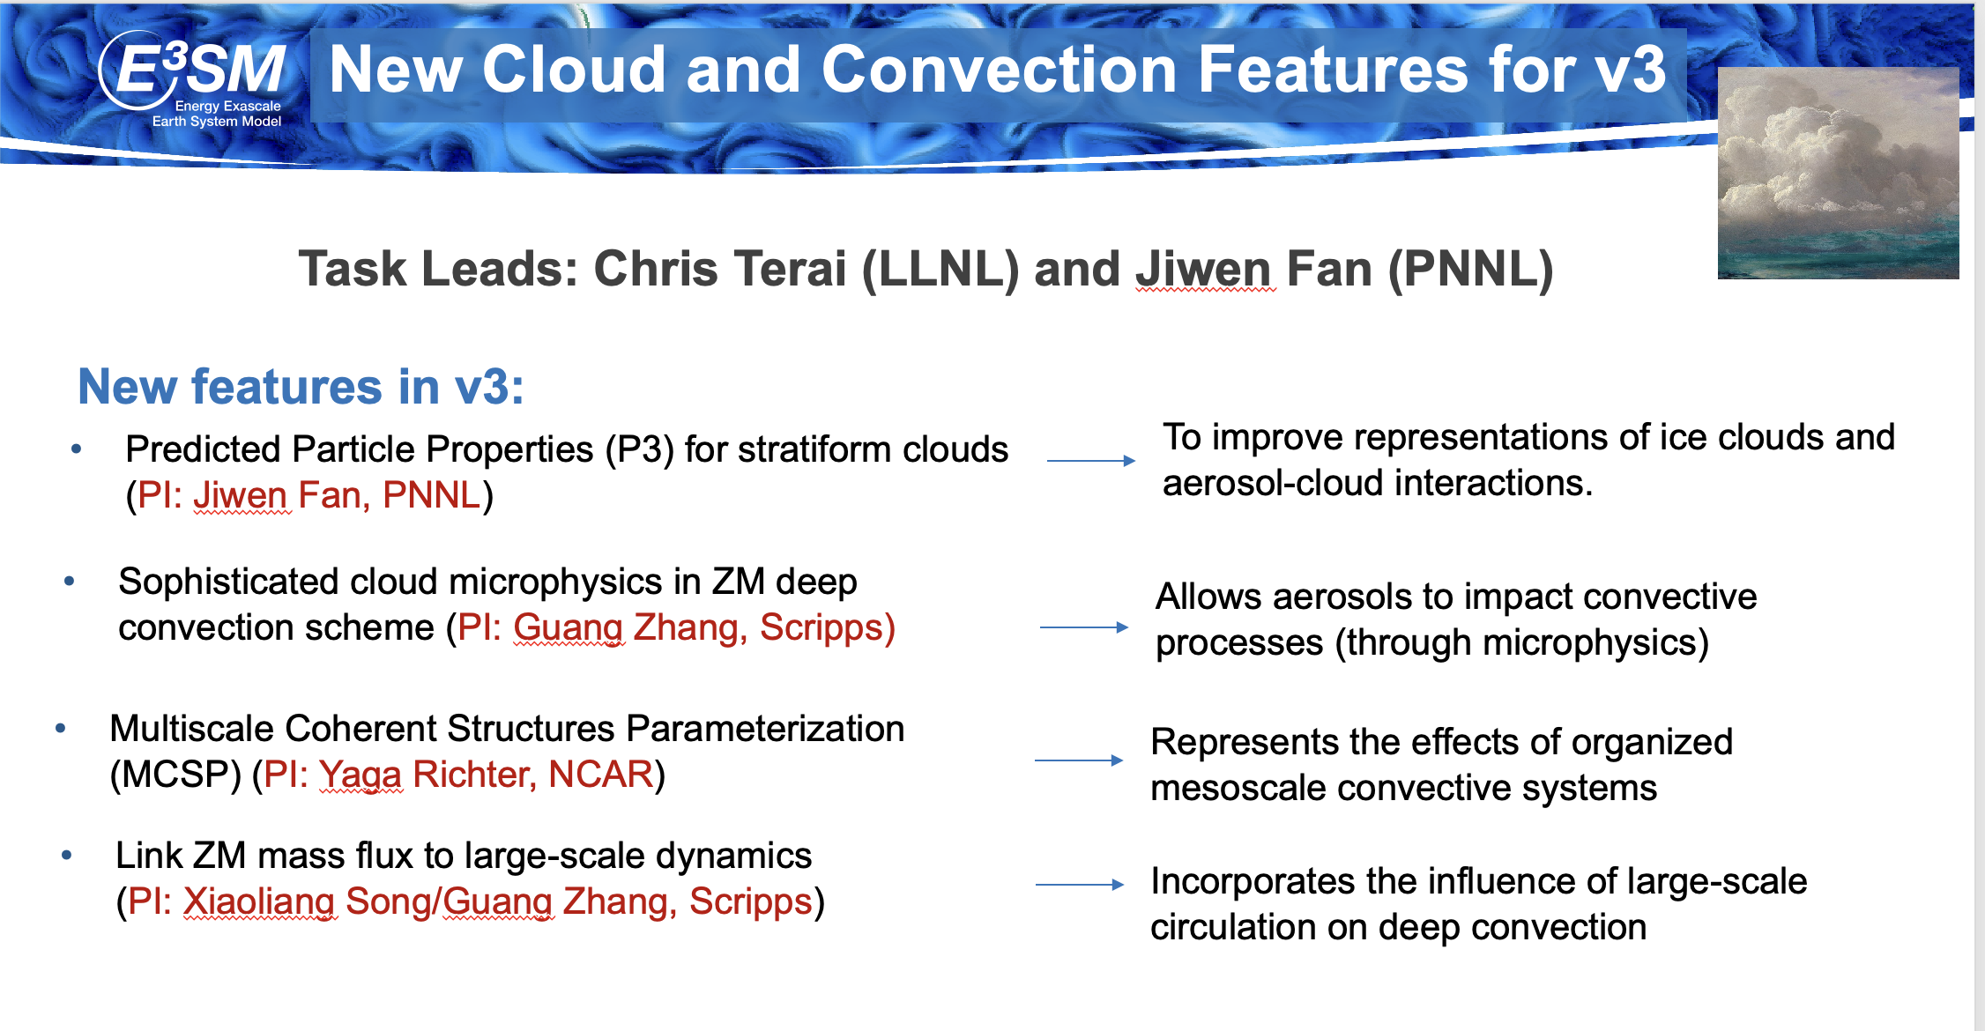
E3SM v3 new cloud physics and aerosol-cloud interactions
How do they perform over the complex terrain region? what are the deficiencies? how to improve further?
Evaluation across scales using regionally refined mesh (RRM); focus on snow precipitation and mixed-phase/ice-phase properties where P3 has more advanced representations
From Shaocheng Xie at the E3SM All-Hands meeting July 2023

Slide 9
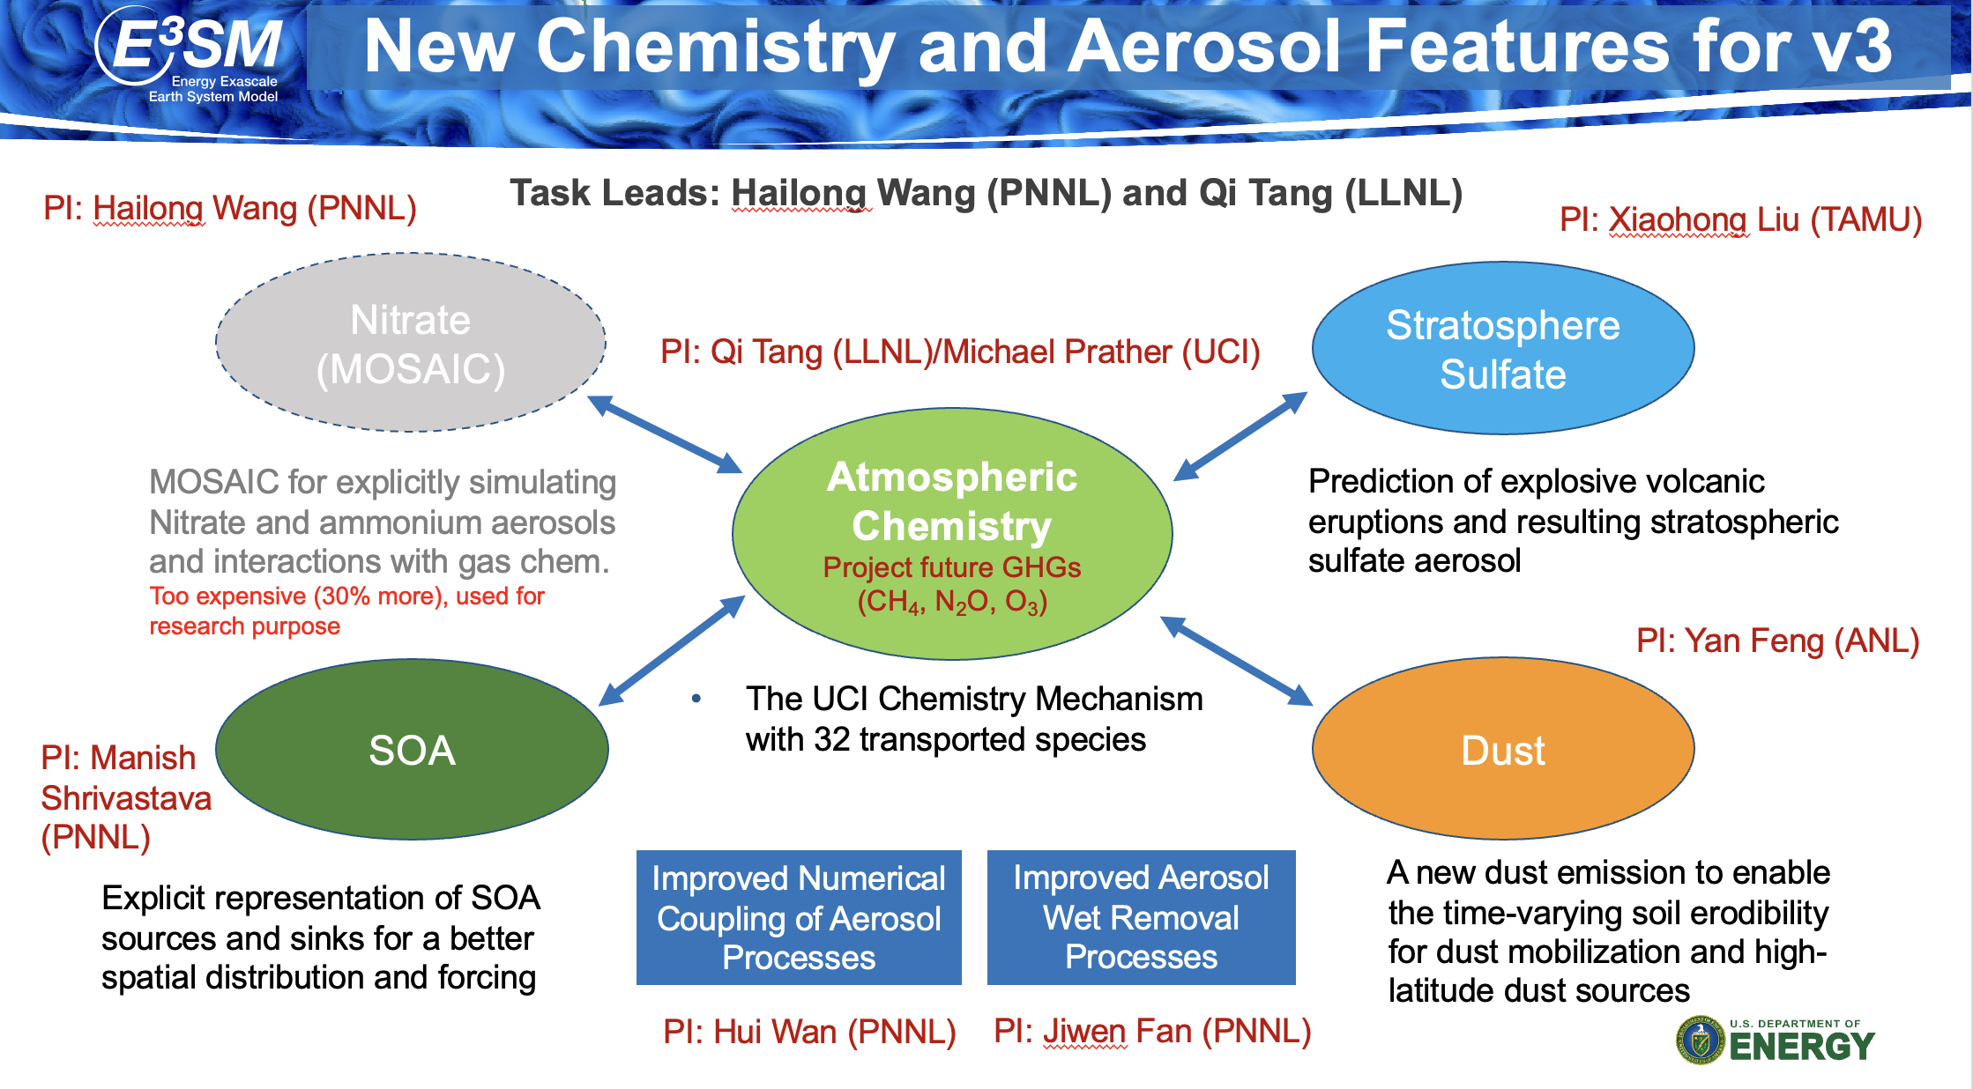
E3SM v3 new chemistry and aerosol features
How are aerosols (dust, biomass burning, etc) simulated by E3SM v3?
From Shaocheng Xie at the E3SM All-Hands meeting July 2023

Slide 10
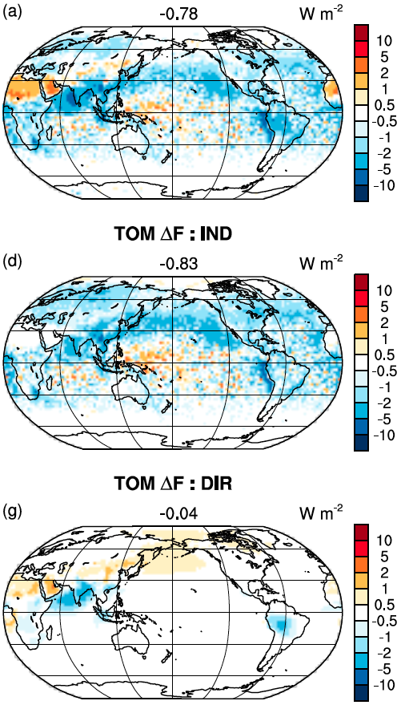
E3SM v3 aerosol-cloud interactions (ACI)
Shan et al., JAMES, In review
P3 reduces aerosol forcing by 0.15 W m⁻²
The improved wet removal treatment reduces indirect forcing by 0.27 W m⁻² and reduces the positive direct forcing by 0.22 W m⁻²
With the tuning of some aerosol and cloud parameters, E3SM v3 gives much improved anthropogenic aerosol forcings in global mean compared with v2, leading to the reproduction of historical temperature trends over the industrial period
Total aerosol forcing
Indirect forcing
direct forcing
- 0.78
- 0.83
- 0.04
How do these features perform in terms of ACI in this region? What are the major problems of E3SM in simulating ACI in this region?

