Slide 1
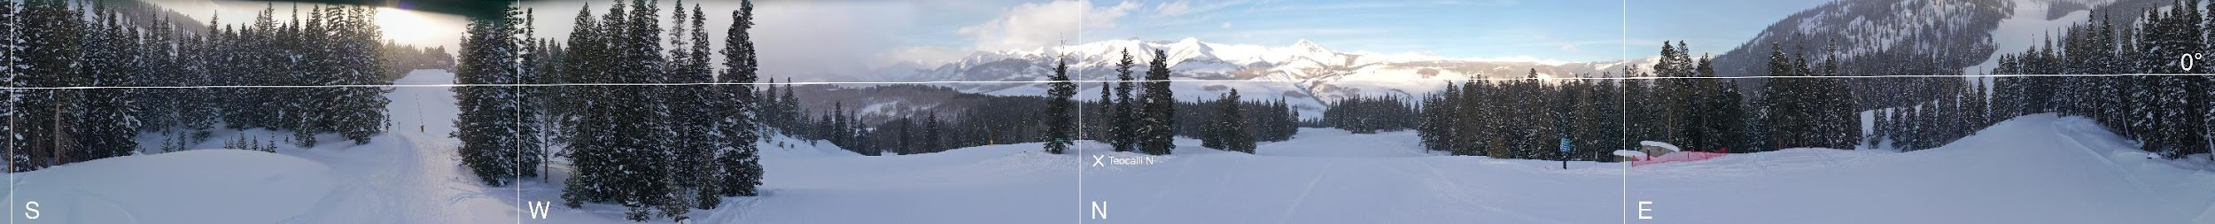
Investigating aerosol formation and growth during SAIL
Jim Smith, Anna Kapp
UC Irvine
S3 Workshop
November 2, 2023
Acknowledgement: 2022 EMSL FICUS grant 60379

Slide 2
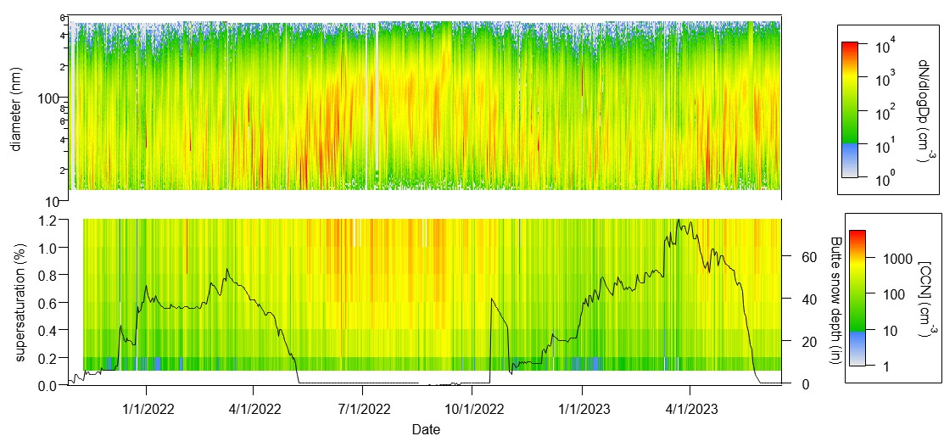
Particle size distribution and [CCN] – Entire campaign
New particle formation events in Spring and Fall. Spring events reappeared in 2023.
CCN concentrations peak in summer months and correspond to periods of >100 nm particles.
Notes:
2

Slide 3
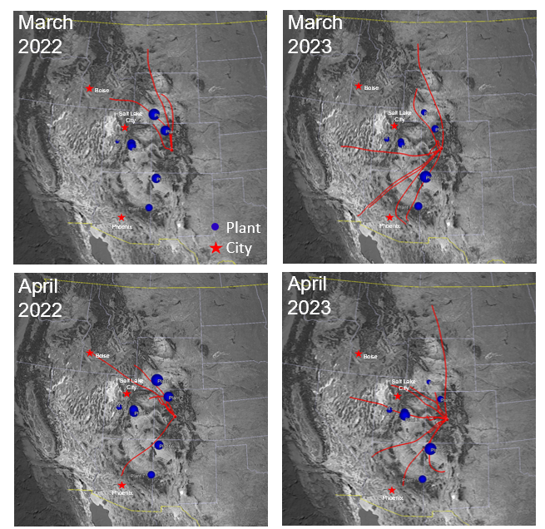
What is the source of newly formed particles?
Major cities
Coal-fired power plants
(blue circle dia. = power)
24-hr HYSPLIT back trajectories performed for each NPF day in the month.
NPF periods correspond to air masses that pass over regions with high power production.
Additionally, many back trajectories pass over major cities.
Notes:
3

Slide 4
What is the composition of newly formed particles?
400-725 m
0-400 m
Sampling from the ARM tethered balloon system (TBS)
Particles collected by
the STAC sampler for size-resolved analysis
Individual particles analyzed by CCSEM-EDX
@ EMSL
Composition appears constant with altitude
Nanoparticles were enriched with oxidized organics (CNO compounds)
UTC
plots: Zezhen (Jay) Cheng
Notes:
4

Slide 5
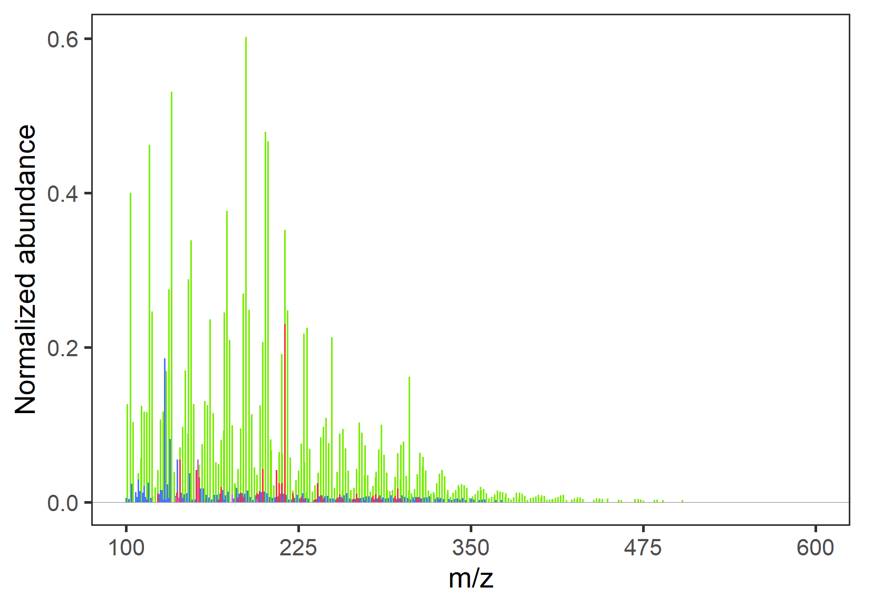
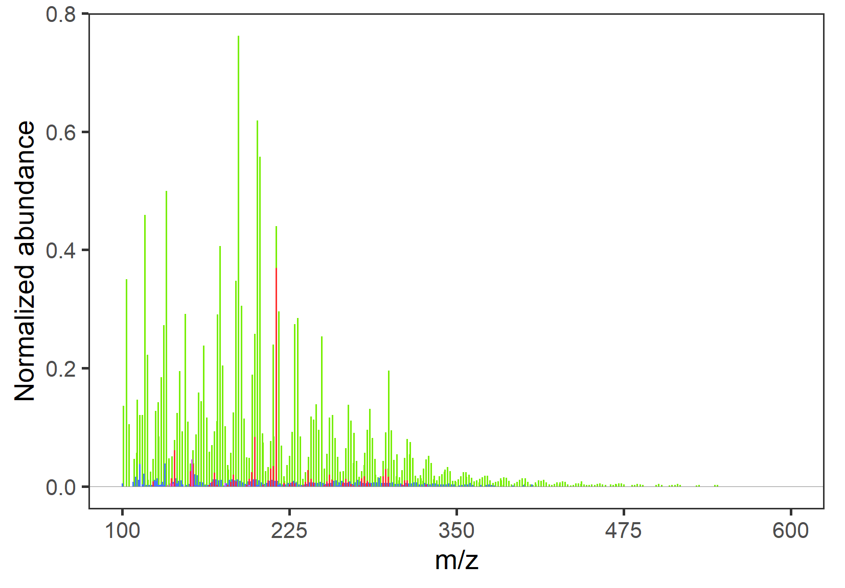
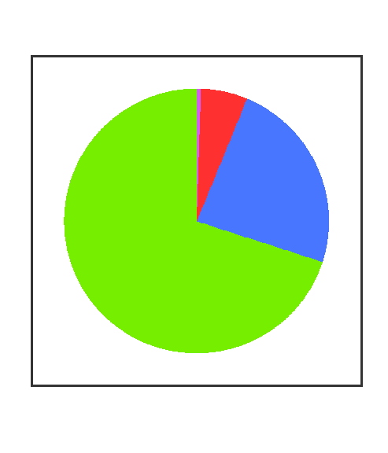


What is the composition of newly formed particles?
400-725 m
0-400 m
Particles collected by
the TBAC sampler for bulk compositional analysis
Individual particles analyzed by nano-DESI high resolution mass spec.
Composition appears constant with altitude
Particles were enriched with multifunctional oxidized organics
UTC
plots: Greg Vandergrift
Notes:
5

Slide 6
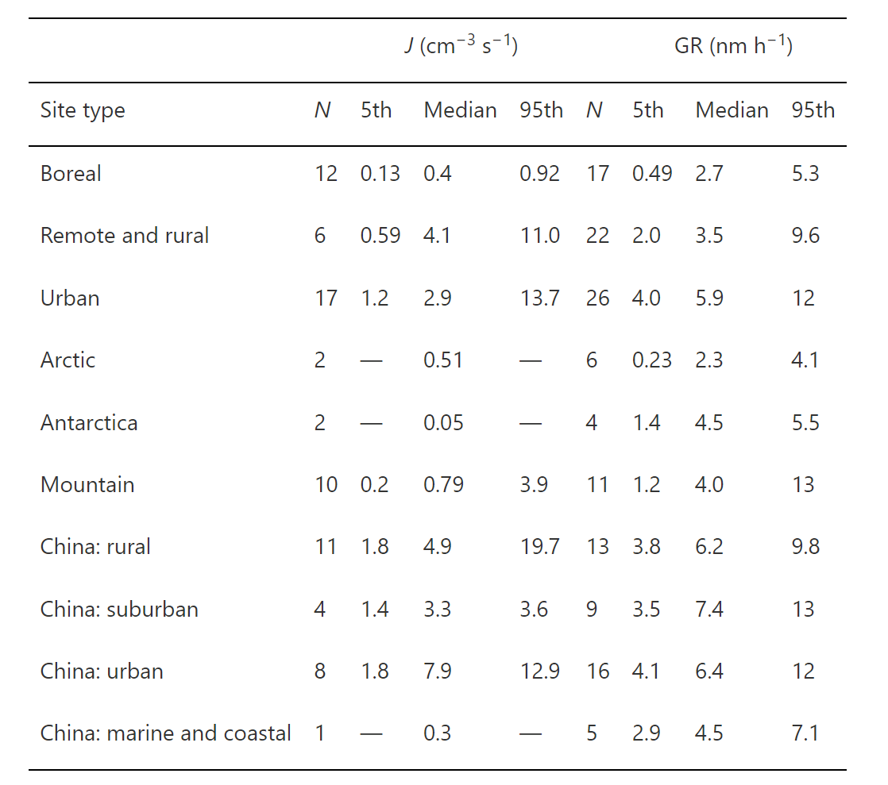
What are growth rates of newly formed particles?
Kerminen, et al., Env. Res. Lett., 2018
March-April-May feature prominent nucleation mode developing at ~10AM local time
Evidence of particle growth during other seasons
June-July-August characterized by dominant ~100 nm mode and no clear nucleation mode
Growth rates are low compared to forested and mountain sites
Notes:
6

Slide 7
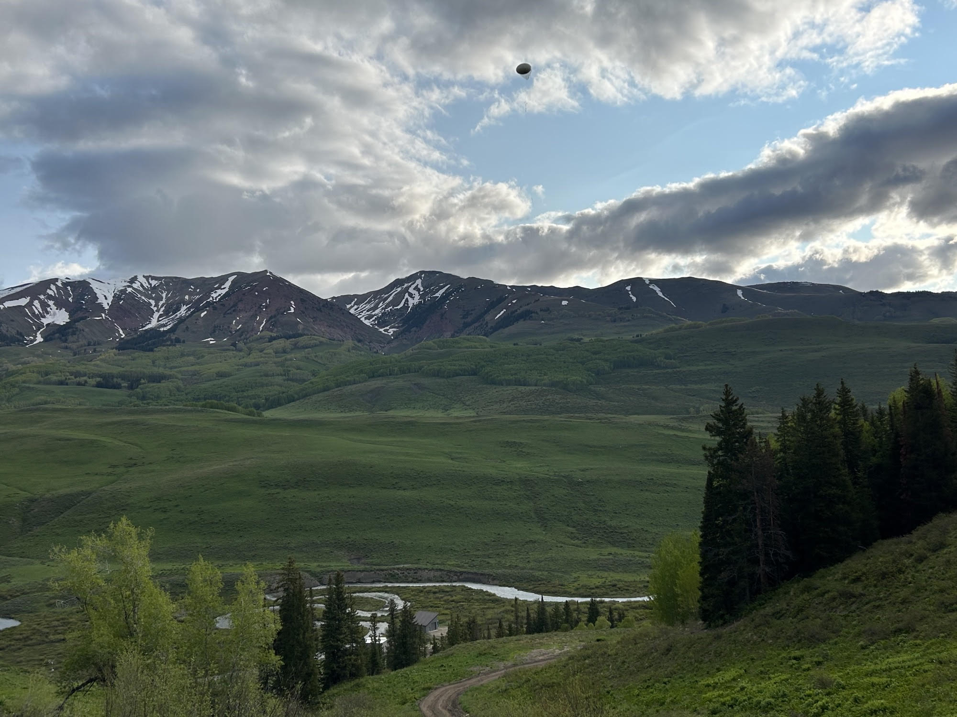
Summary
Increase in atmospheric
new particle formation events in
winter-spring transition period
(February – June) and, to some
extent, summer – fall transition.
Particles may have initially formed
from anthropogenic sulfur sources.
Newly formed particles are growing
slowly here (< 1 nm/hr) by multifunctional organics
June 2023 tethered balloon
deployments are providing insights
into particle composition and point
to multifunctional organic compounds in particles.
Chemical characterization on-going at EMSL.
Photo: Dari Dexheimer June 14 2023
Notes:
7

Slide 8
Particulate (PM1) organics – Seasonal diurnal patterns
UTC
UTC
UTC
UTC
Particulate organics highest in June-July-August with noontime peak
Notes:
8

Slide 9
Particulate (PM1) sulfate – Seasonal diurnal patterns
UTC
UTC
UTC
UTC
Particulate sulfate highest in March-April-May (flat diurnal pattern) and June-July-August (noontime peak)
Notes:
9

