Slide 1
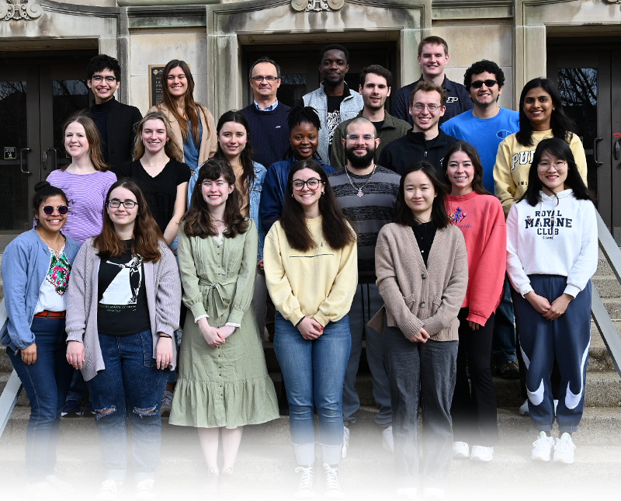



Chemical Characterization of the Light-Absorbing Atmospheric Aerosols and Their Deposits in the Colorado Rockies Snowpacks
S.A.L. Sharpe,¹ F. Rivera-Adorno,¹ T. Olayemi,¹
Q. Xie,¹ E. Hulm,² M. Fraund,³ R. Moffet,³ A. Laskin¹
¹Department of Chemistry, Purdue University, West Lafayette, IN
²Rocky Mountain Biological Laboratory, Crested Butte, CO
³Sonoma Technology, Inc., Petaluma, CA

Slide 2

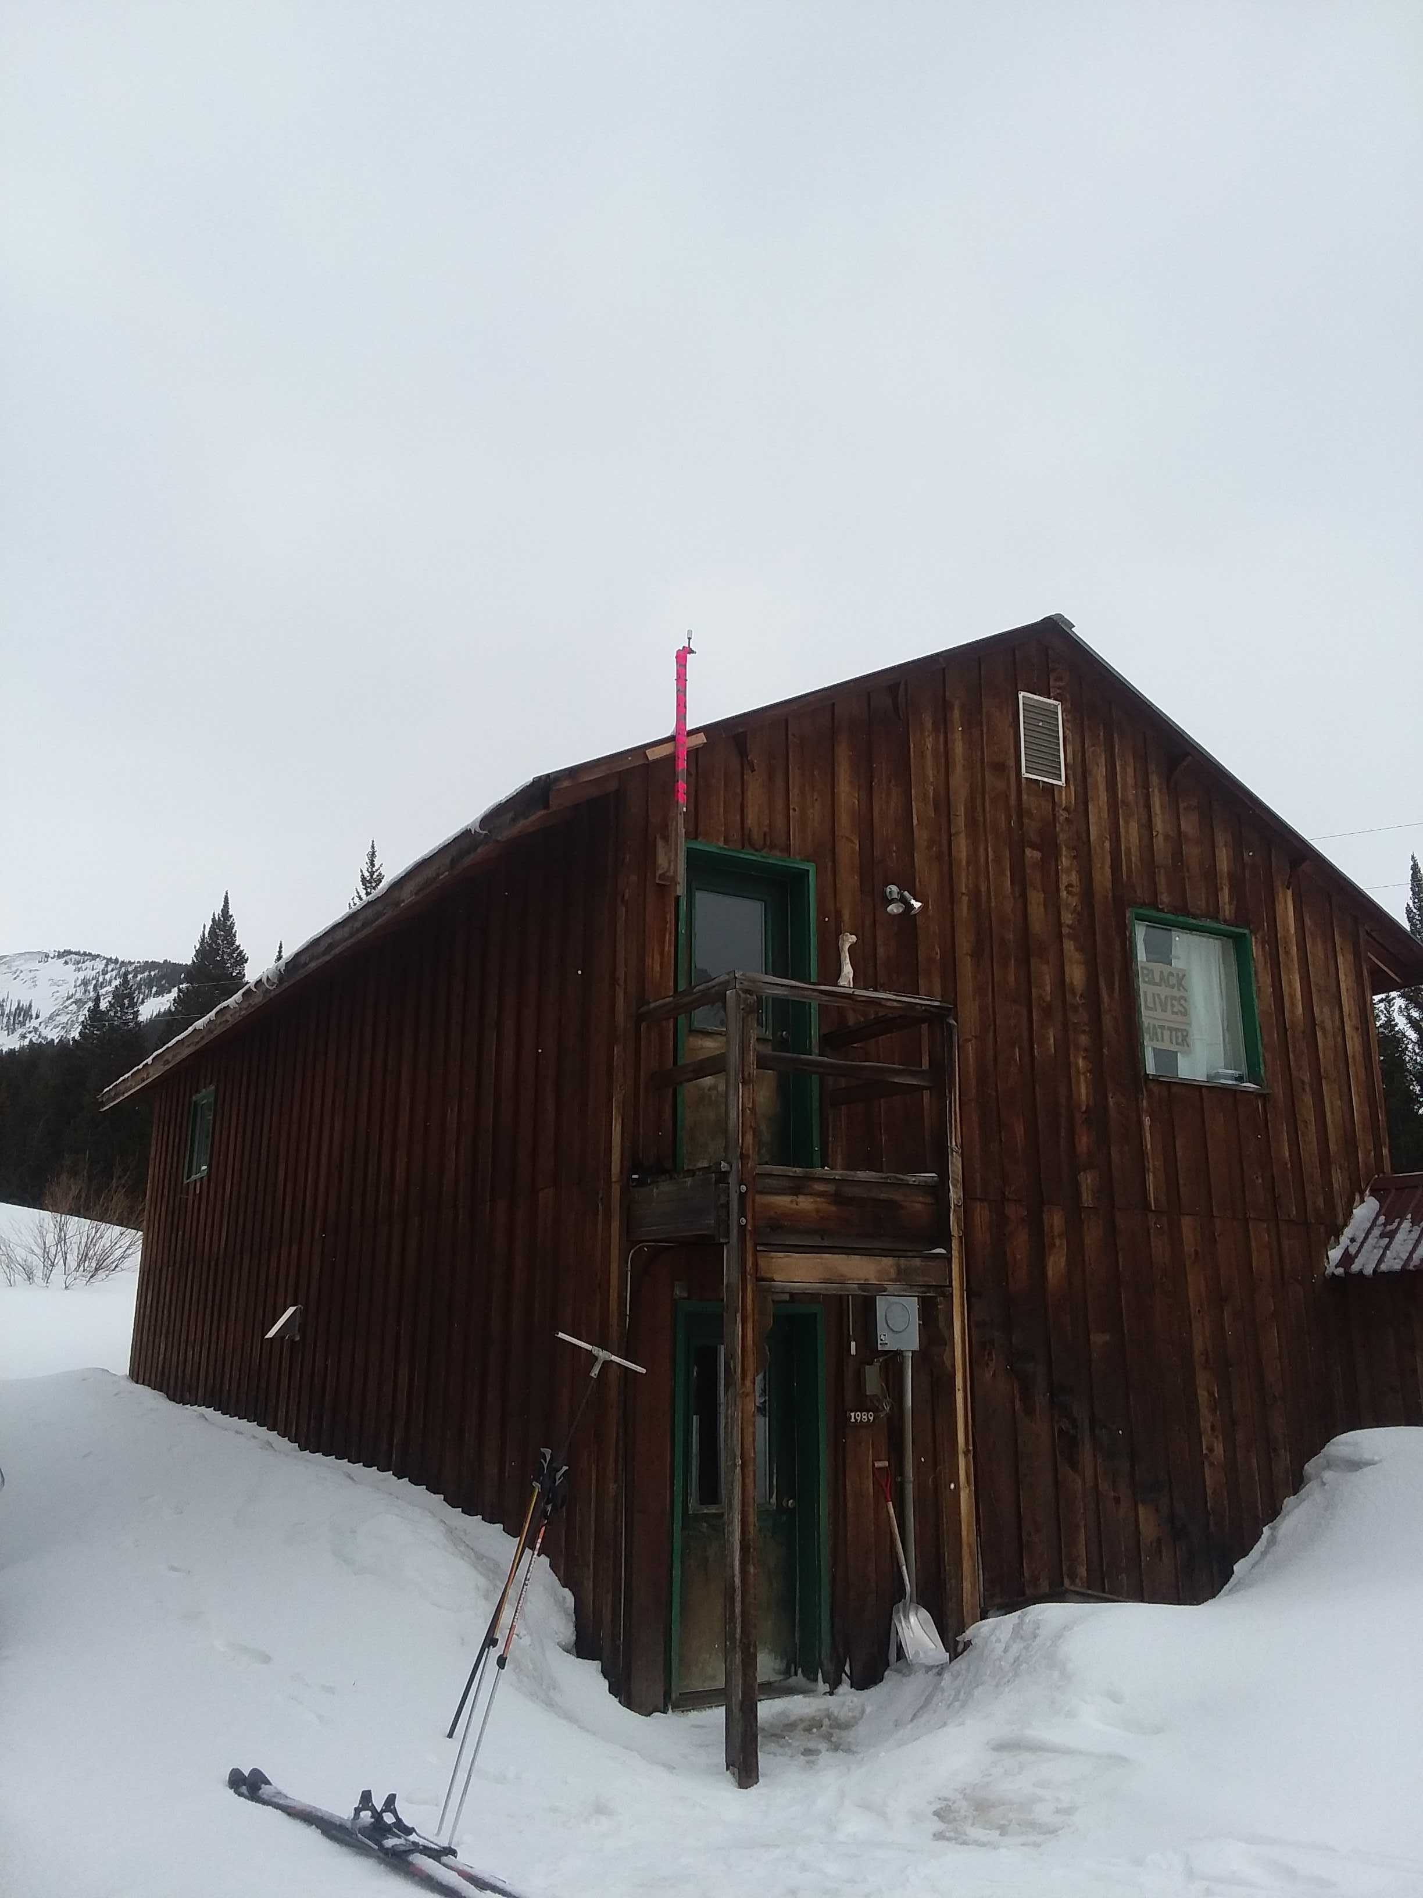
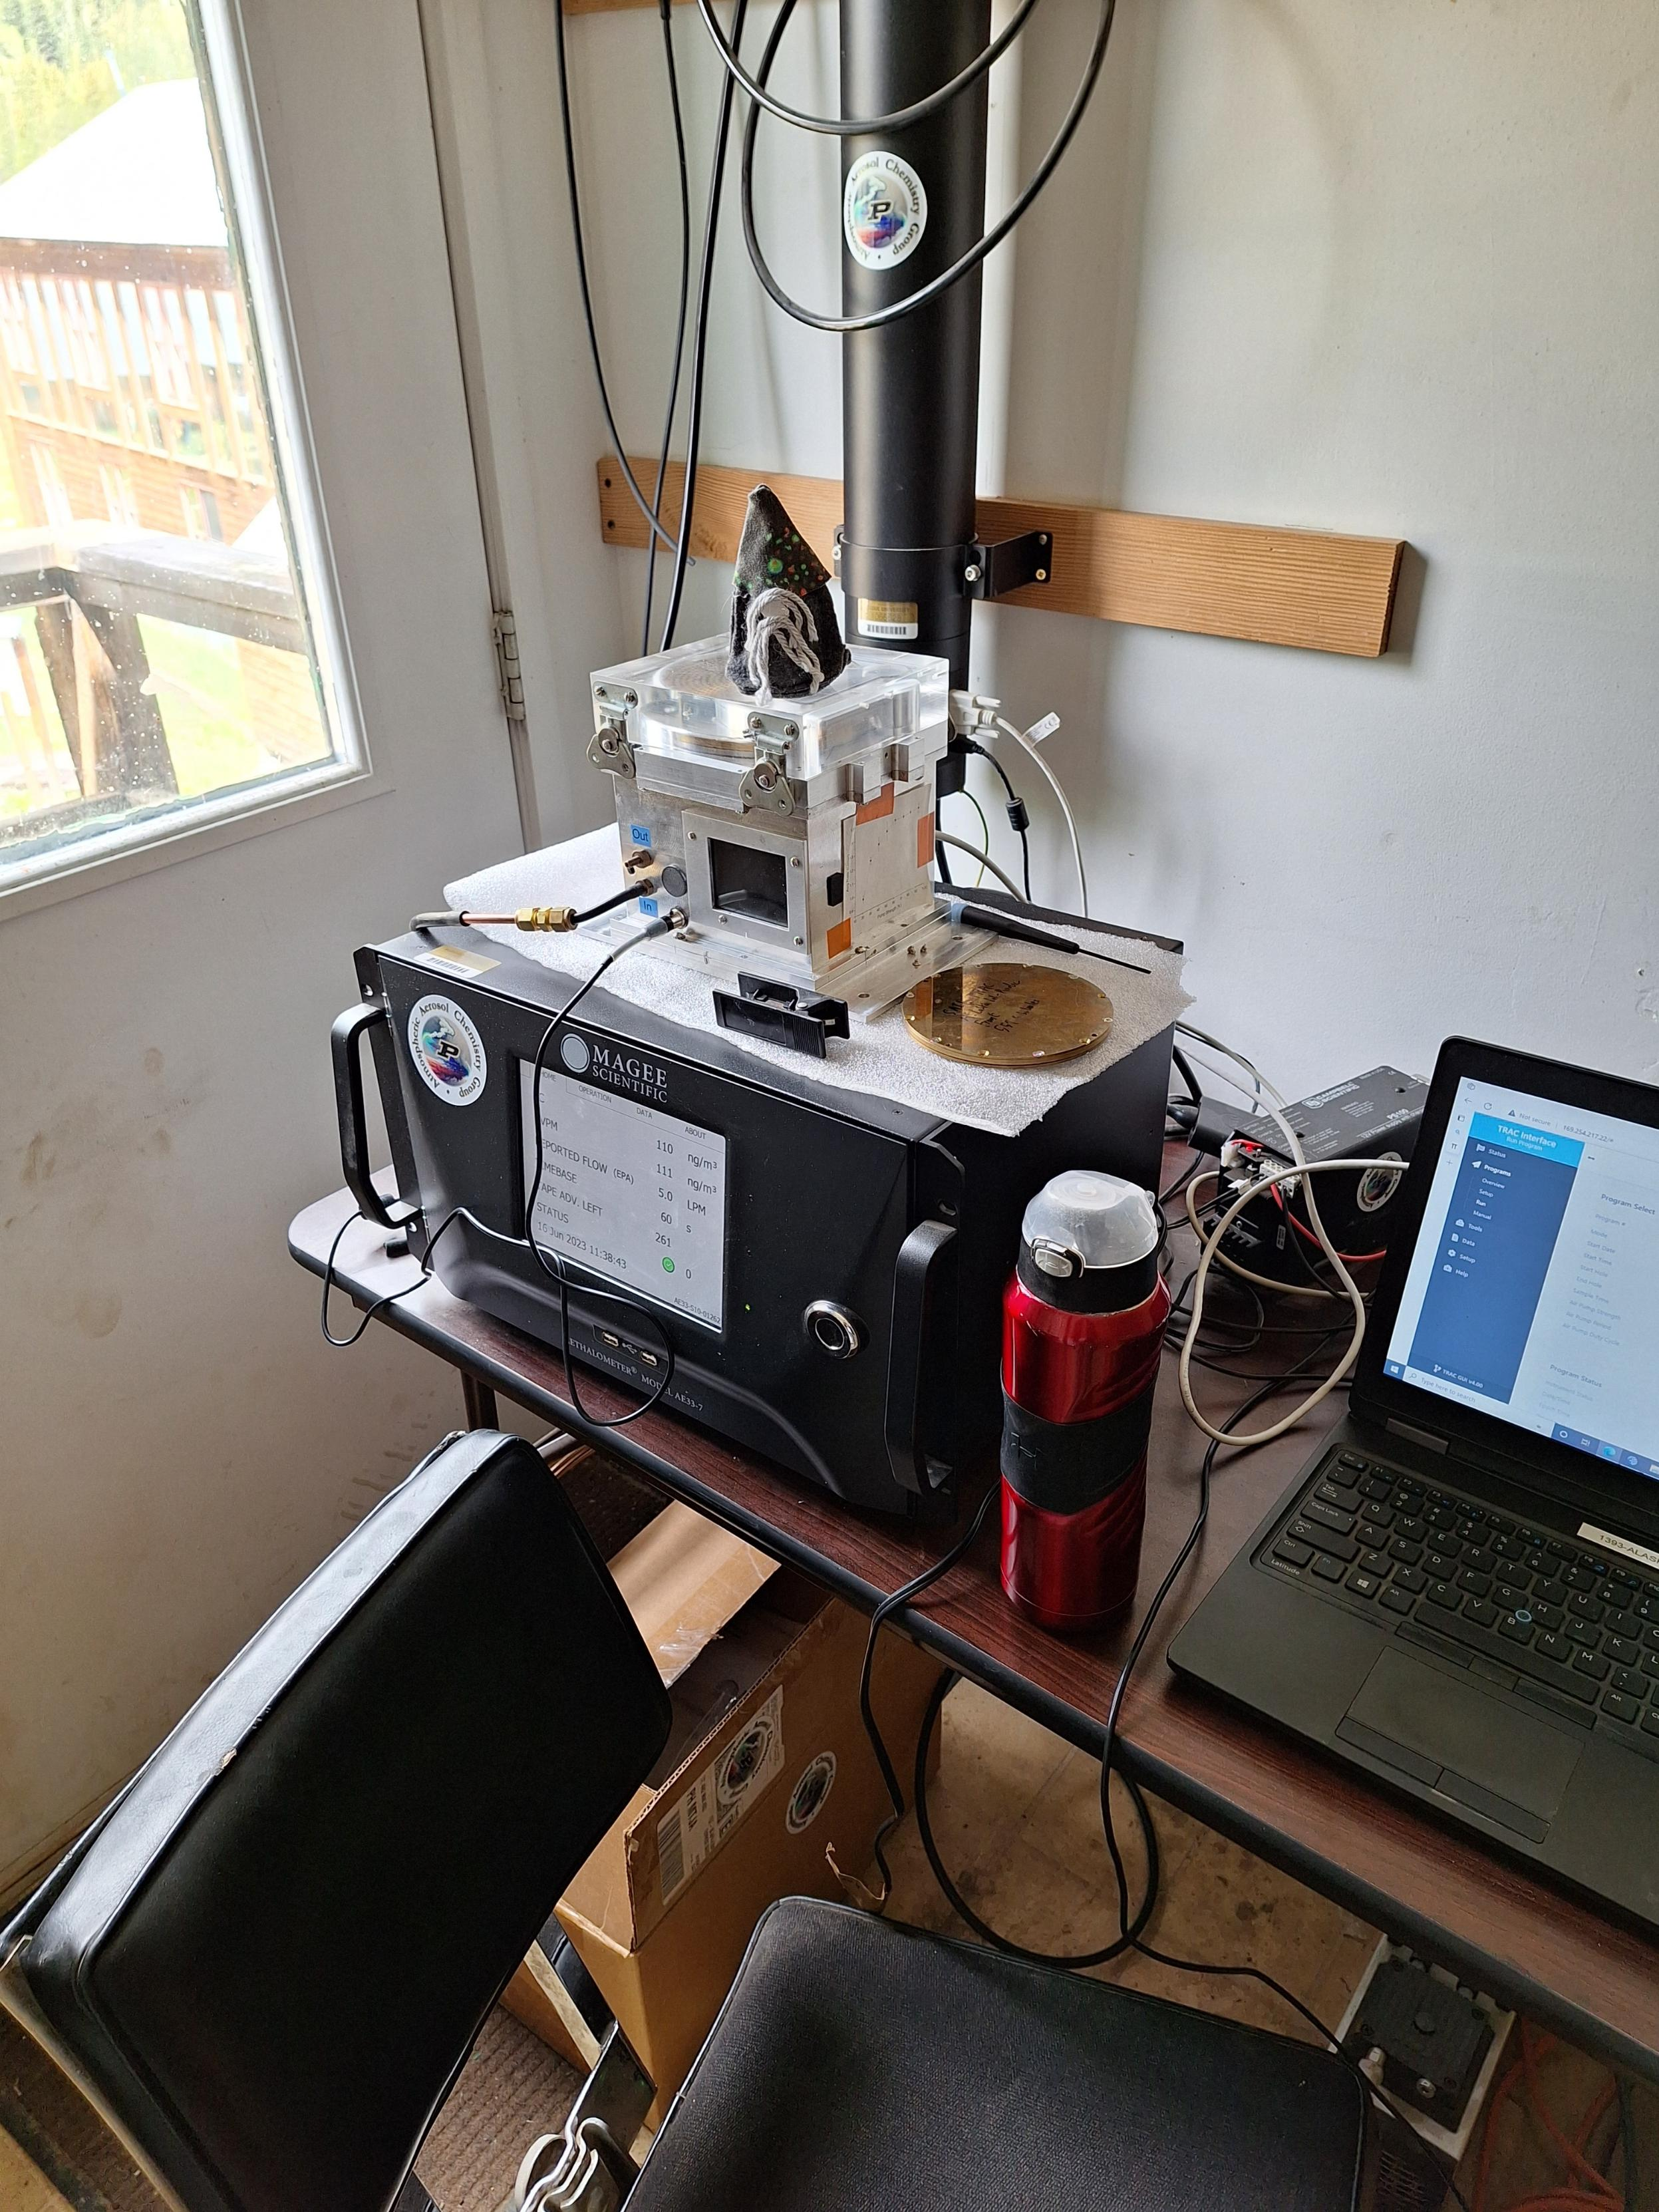
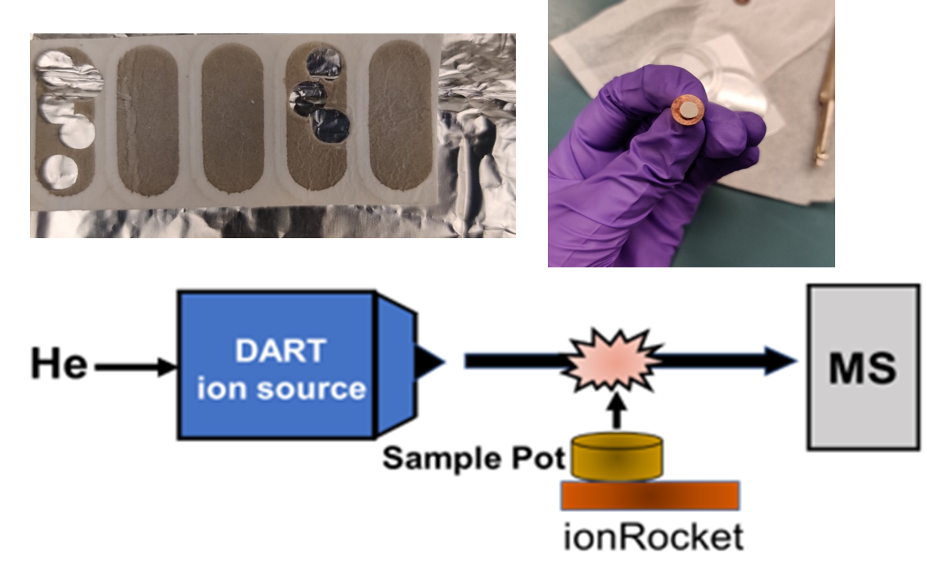
Real-Time Monitoring and Sampling of LAP at RMBL site
TRAC (Time-Resolved Aerosol Sampler)
operation period: June 16, 2023 – Oct. 8, 2023
- ‘particle’ sampling on TEM substrates
Inlet ↓
AETHALOMETER (Magee Scientific AE33)
operation period: April 5, 2022 – Oct. 8, 2023
a. monitoring of BC & BrC concentrations
b. ‘bulk’ sampling on a PTFE filter tape

Slide 3
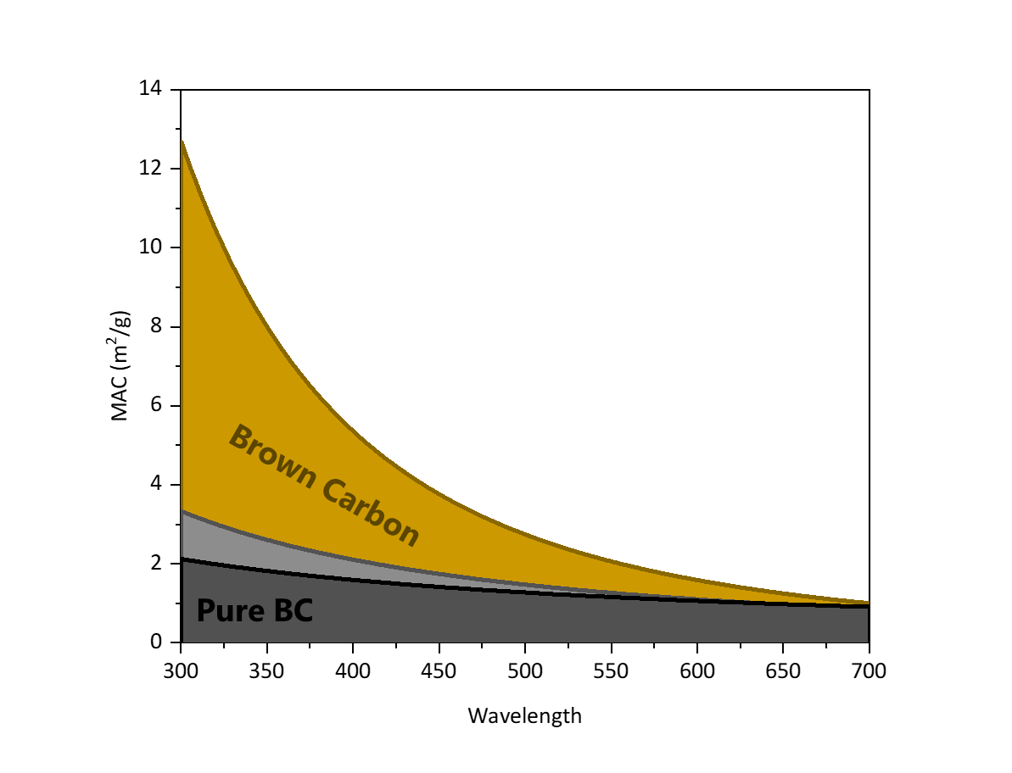
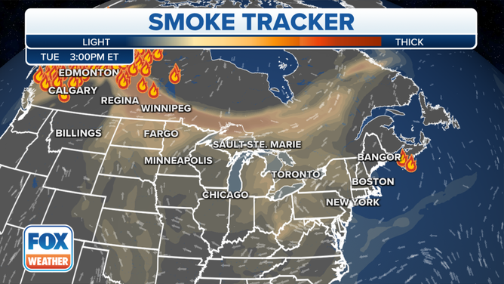
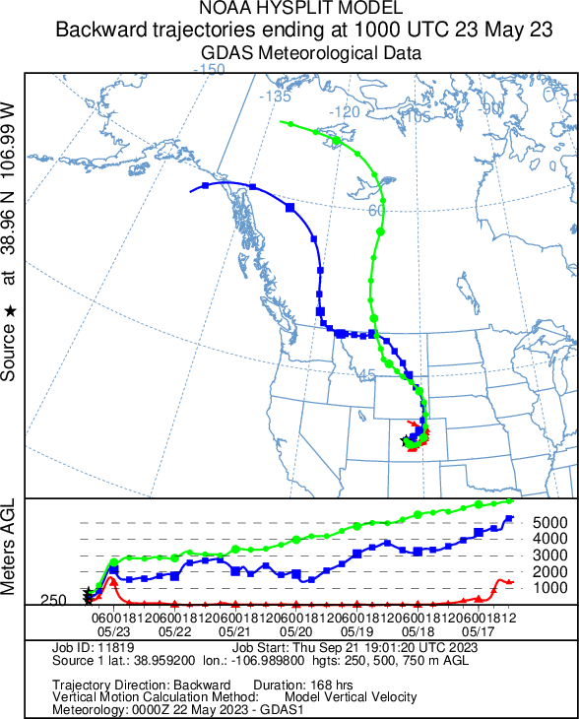




Aged BrC from Canadian Wildfires: May 20–25, 2023
$$MAC\left(λ\right)=Cons×λ^{−AAE}$$
$$AAE_{BrC}>1.2$$
$$AAE_{BC}=1.2$$
$$AAE_{BrC}\sim 1.5−2.0$$

Slide 4
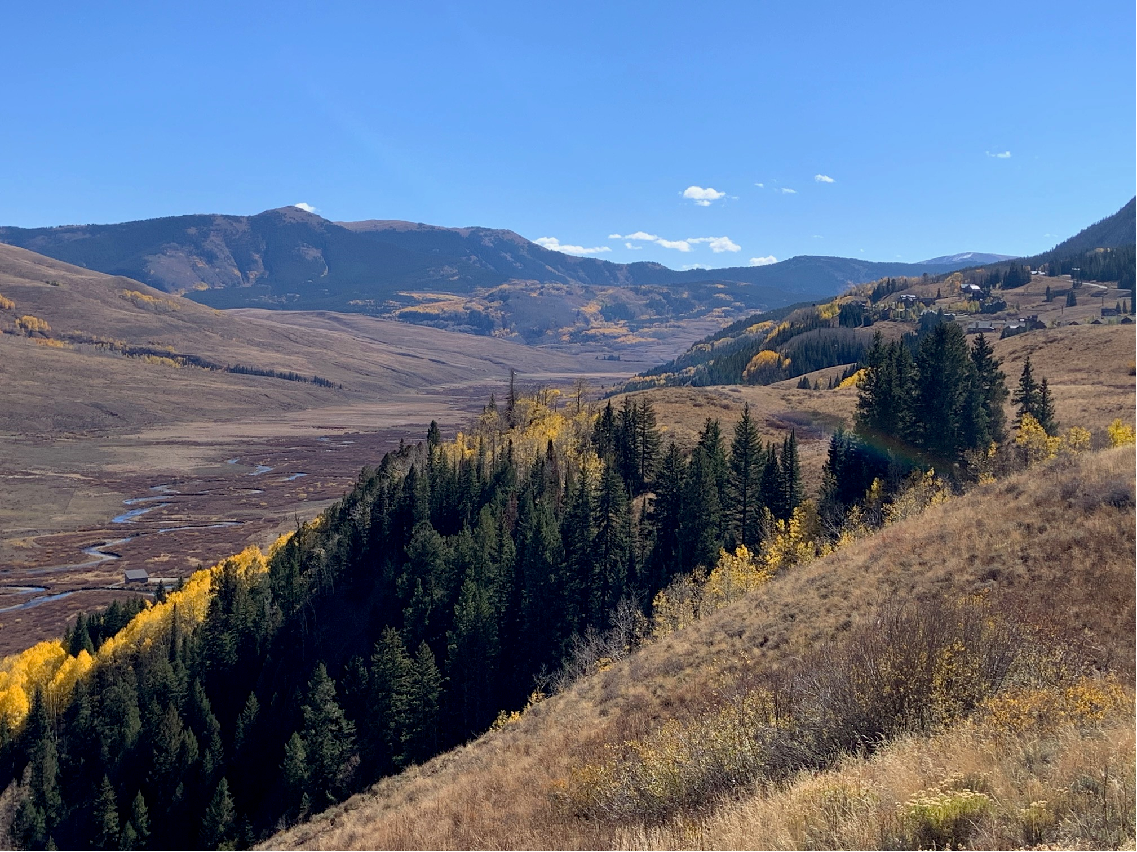

Fresh BrC from Local Emisson Sources: June 13-20, 2023
$$AAE_{BrC}\sim 2.0−2.5$$
houses
Gothic valley

Slide 5
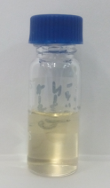
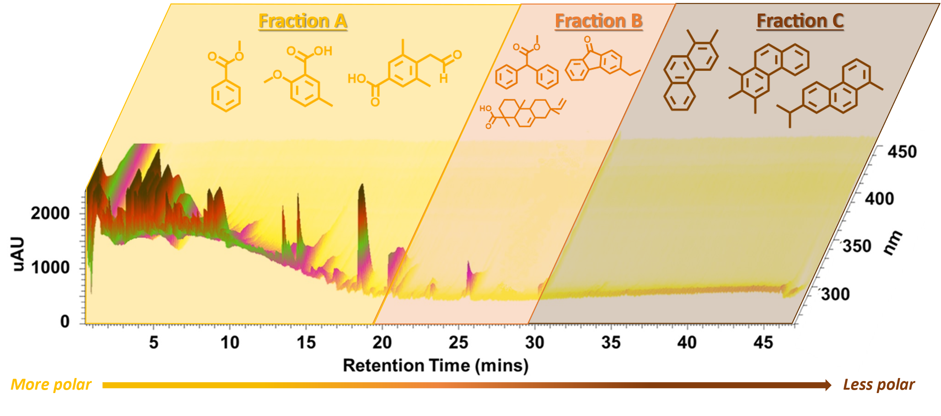
Chemical Analysis: I. Composition↔ Optical Properties
UPLC
PDA
HRMS
Component-specific Assessment of BrC contributors based on HRMS and UV-Vis

Slide 6
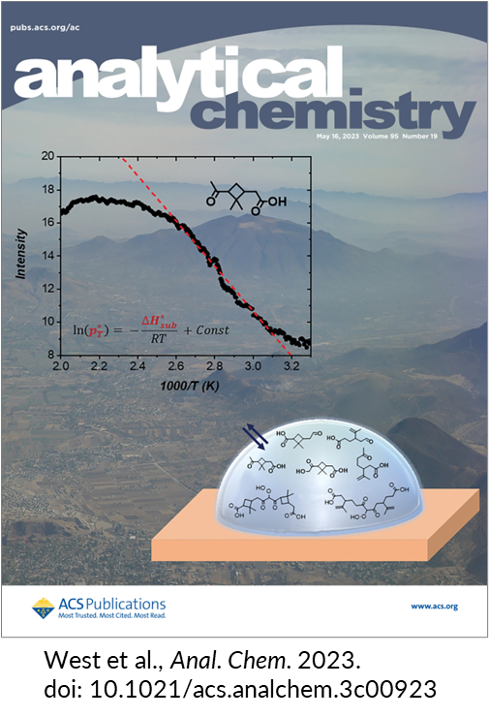
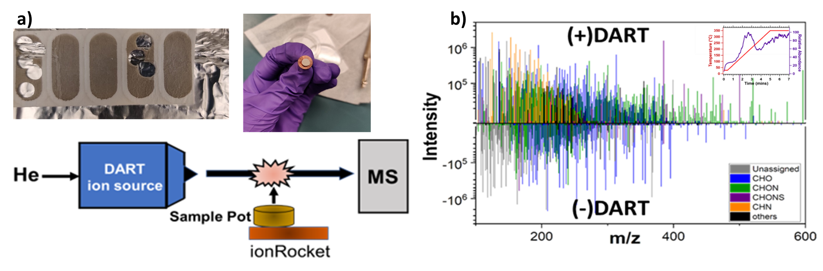
Chemical Analysis: II. Composition↔ Volatility Basis Sets
AE33 tape with samples collected over a 15-month period
TPD-DART-HRMS platform

Slide 7
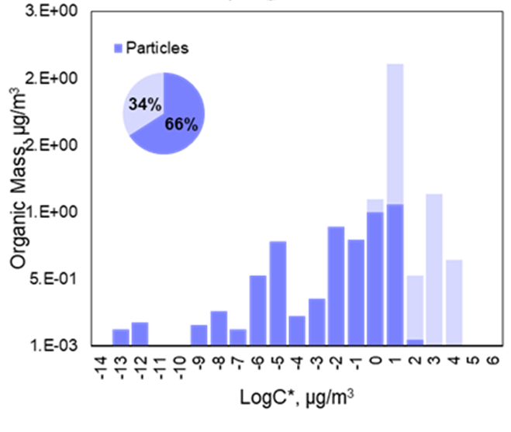
Chemical Analysis: II. Composition↔ Volatility Basis Sets
AE33 tape with samples collected over a 15-month period
Volatility Basis Sets of Organic Constituents
(assessment of gas-particle partition at various Atmospheric Temperatures and Mass Loadings)
T= 15 C, OM = 10 μg/m³
Gas-phase
Aerosol-phase
TPD-DART-HRMS platform

Slide 8
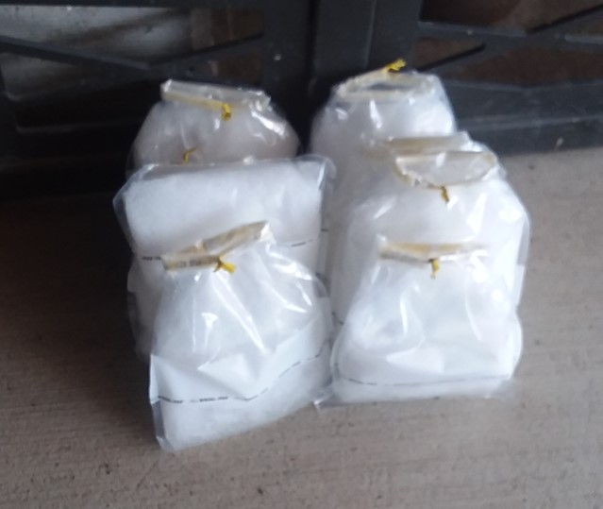
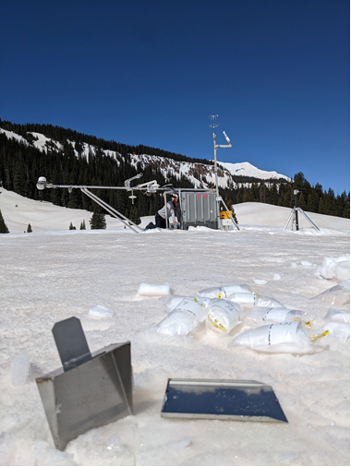

Light Absorbing Particles Deposited on Snow: March 2023
March 28-30, 2023
April 3, 2023
$$AAE_{BrC}\sim 2.0−3.0$$
Courtesy of NOAA

Slide 9
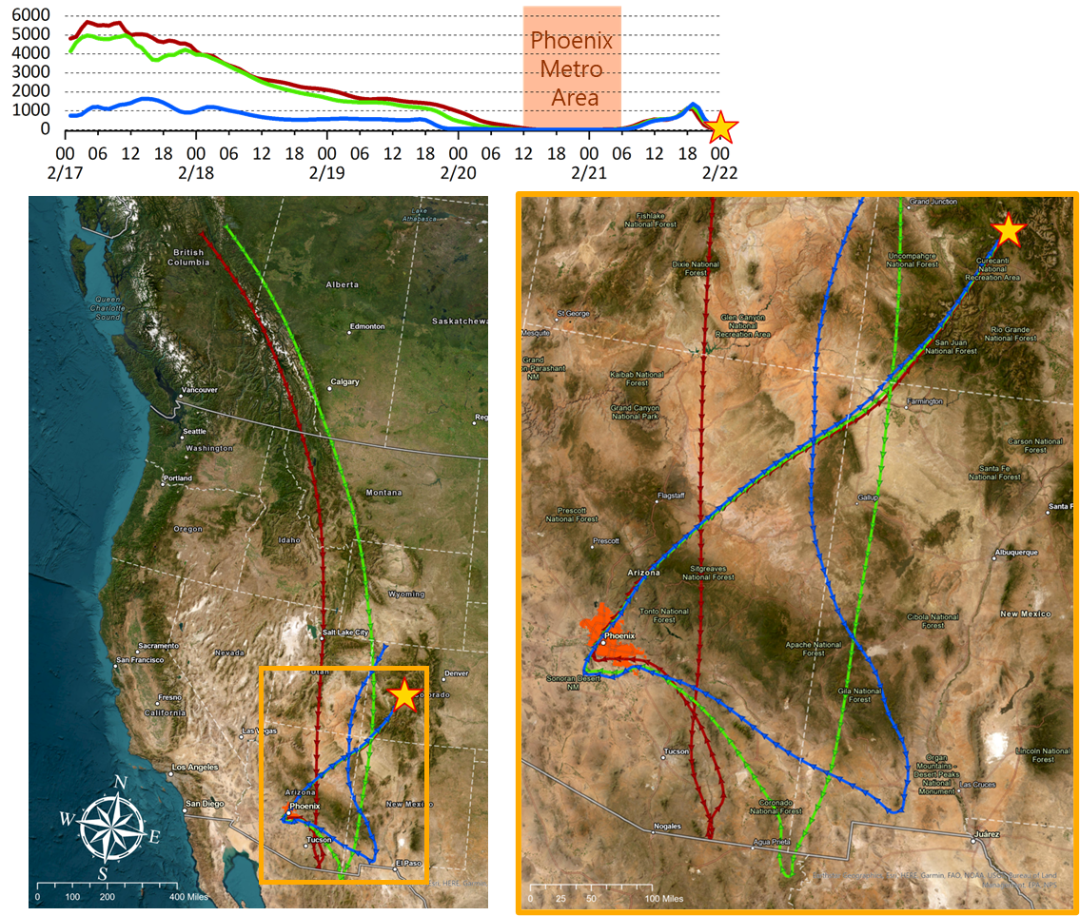
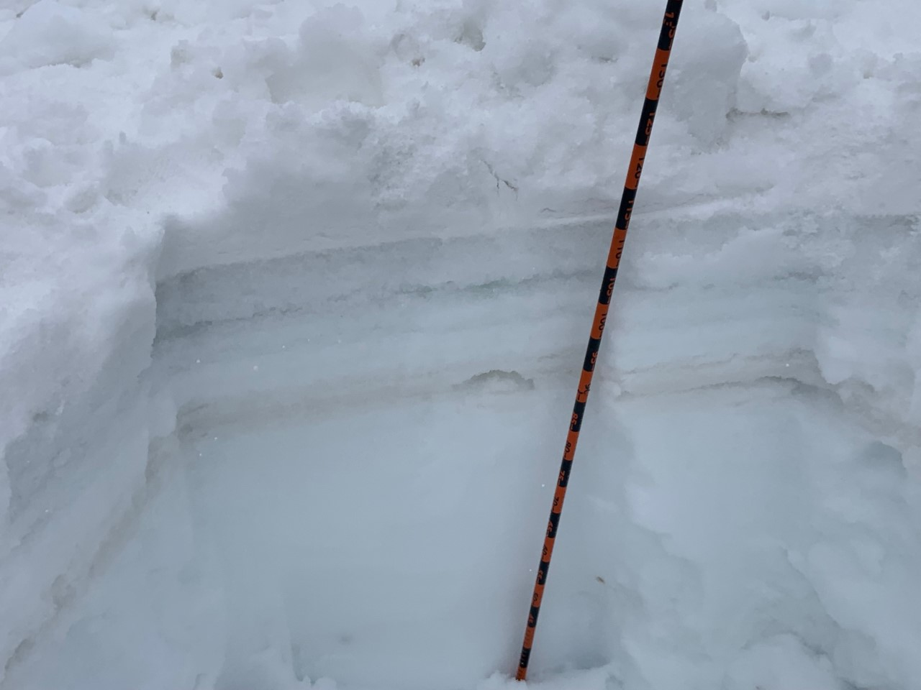
Light Absorbing Particles Deposited on Snow: Feb 2022
February 22, 2022
LAP

Slide 10

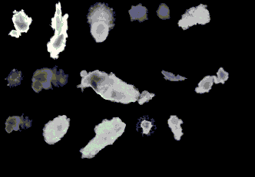

Multi-modal Characterization of LAP Deposited in Snow
Detection of water-soluble BrC chromophores by HPLC–PDA–HRMS
nebulized
dried
Multi-modal Characterization of insoluble LAP
18% RH
Detection of MD particles by scanning electron microscopy and x-ray microanalysis
Detection of BC particles by scanning transmission x-ray microscopy

Slide 11
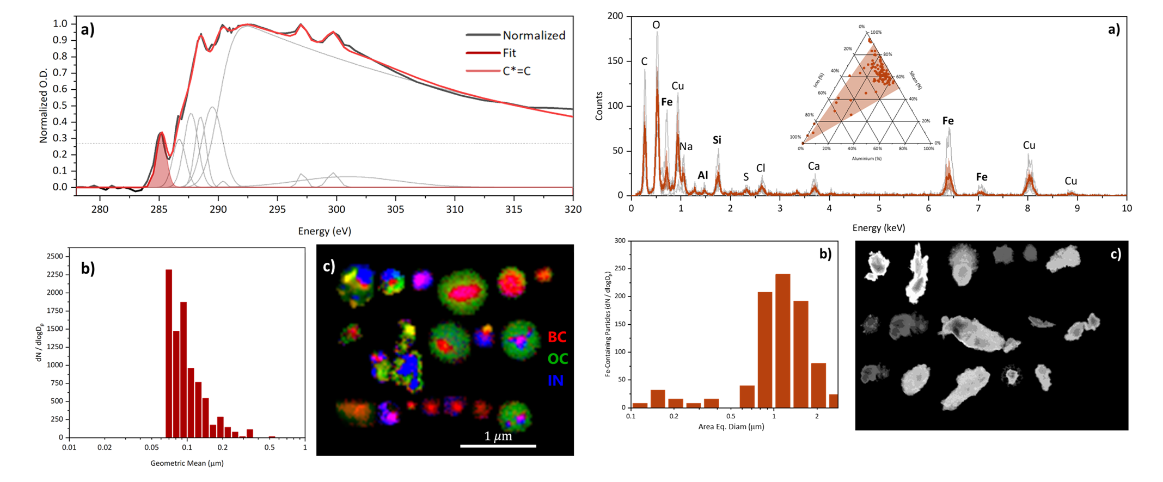
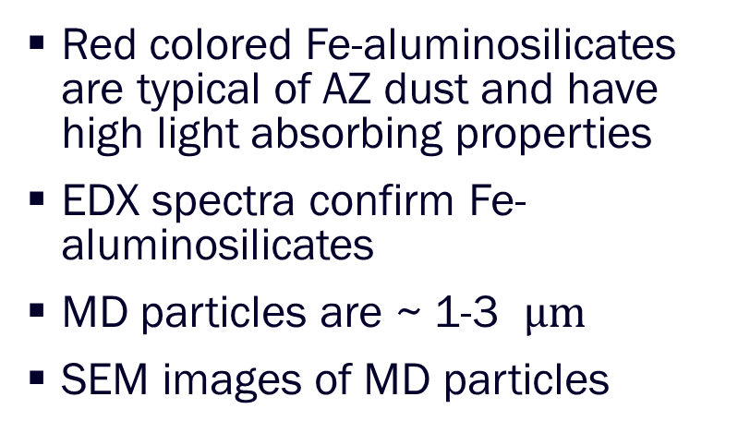
Mineral Dust Deposits in Snow
Red colored Fe-aluminosilicates are typical of AZ dust and have high light absorbing properties
EDX spectra confirm Fe-aluminosilicates
MD particles are ~ 1-3 $μm$
SEM images of MD particles

Slide 12
Black Carbon Deposits in Snow
STXM/NEXAFS spectra show BC inclusions based on alkene peak contribution above 35% threshold
BC inclusions range from 30 nm to 200 nm
BC inclusions are coated by soluble components (as expected)

Slide 13
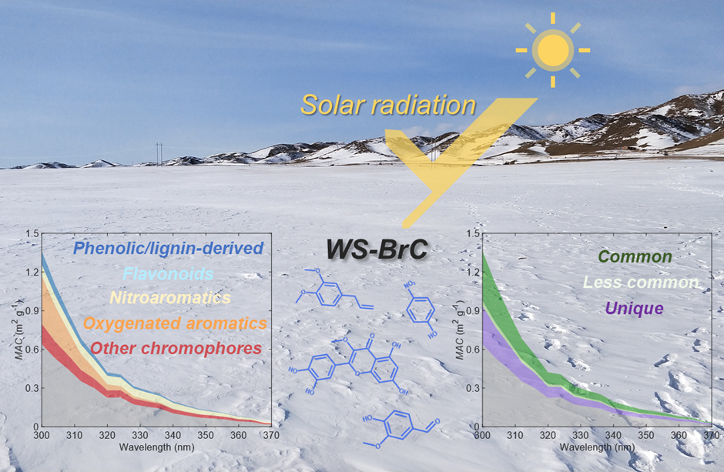
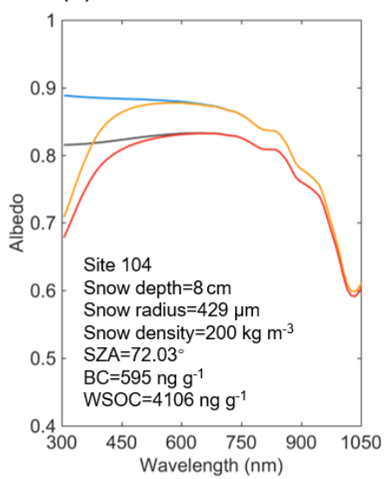
Where We are Going …
Zhou et al EST 2022, 56, 4173-4186
Zhou et al ACP 2021, 21, 8531-8555

Slide 14
Collaborative Topics and Needs
Correlation and comparison with airborne optical properties of particles.
Advanced Meteorological Observations for better source apportionment
Modeling of Snow Properties with LAP deposits: changes in snow albedo, accelerated melting.
Assessment of Regional Effects of LAP and BrC: radiative forcing, impact on clouds
….

