Slide 1
The role of vertically-pointing Ka-band radar in studies
of precipitation processes using SAIL/SPLASH data
Sergey Y. Matrosov
CIRES, University of Colorado and NOAA Physical Sciences Laboratory

Slide 2
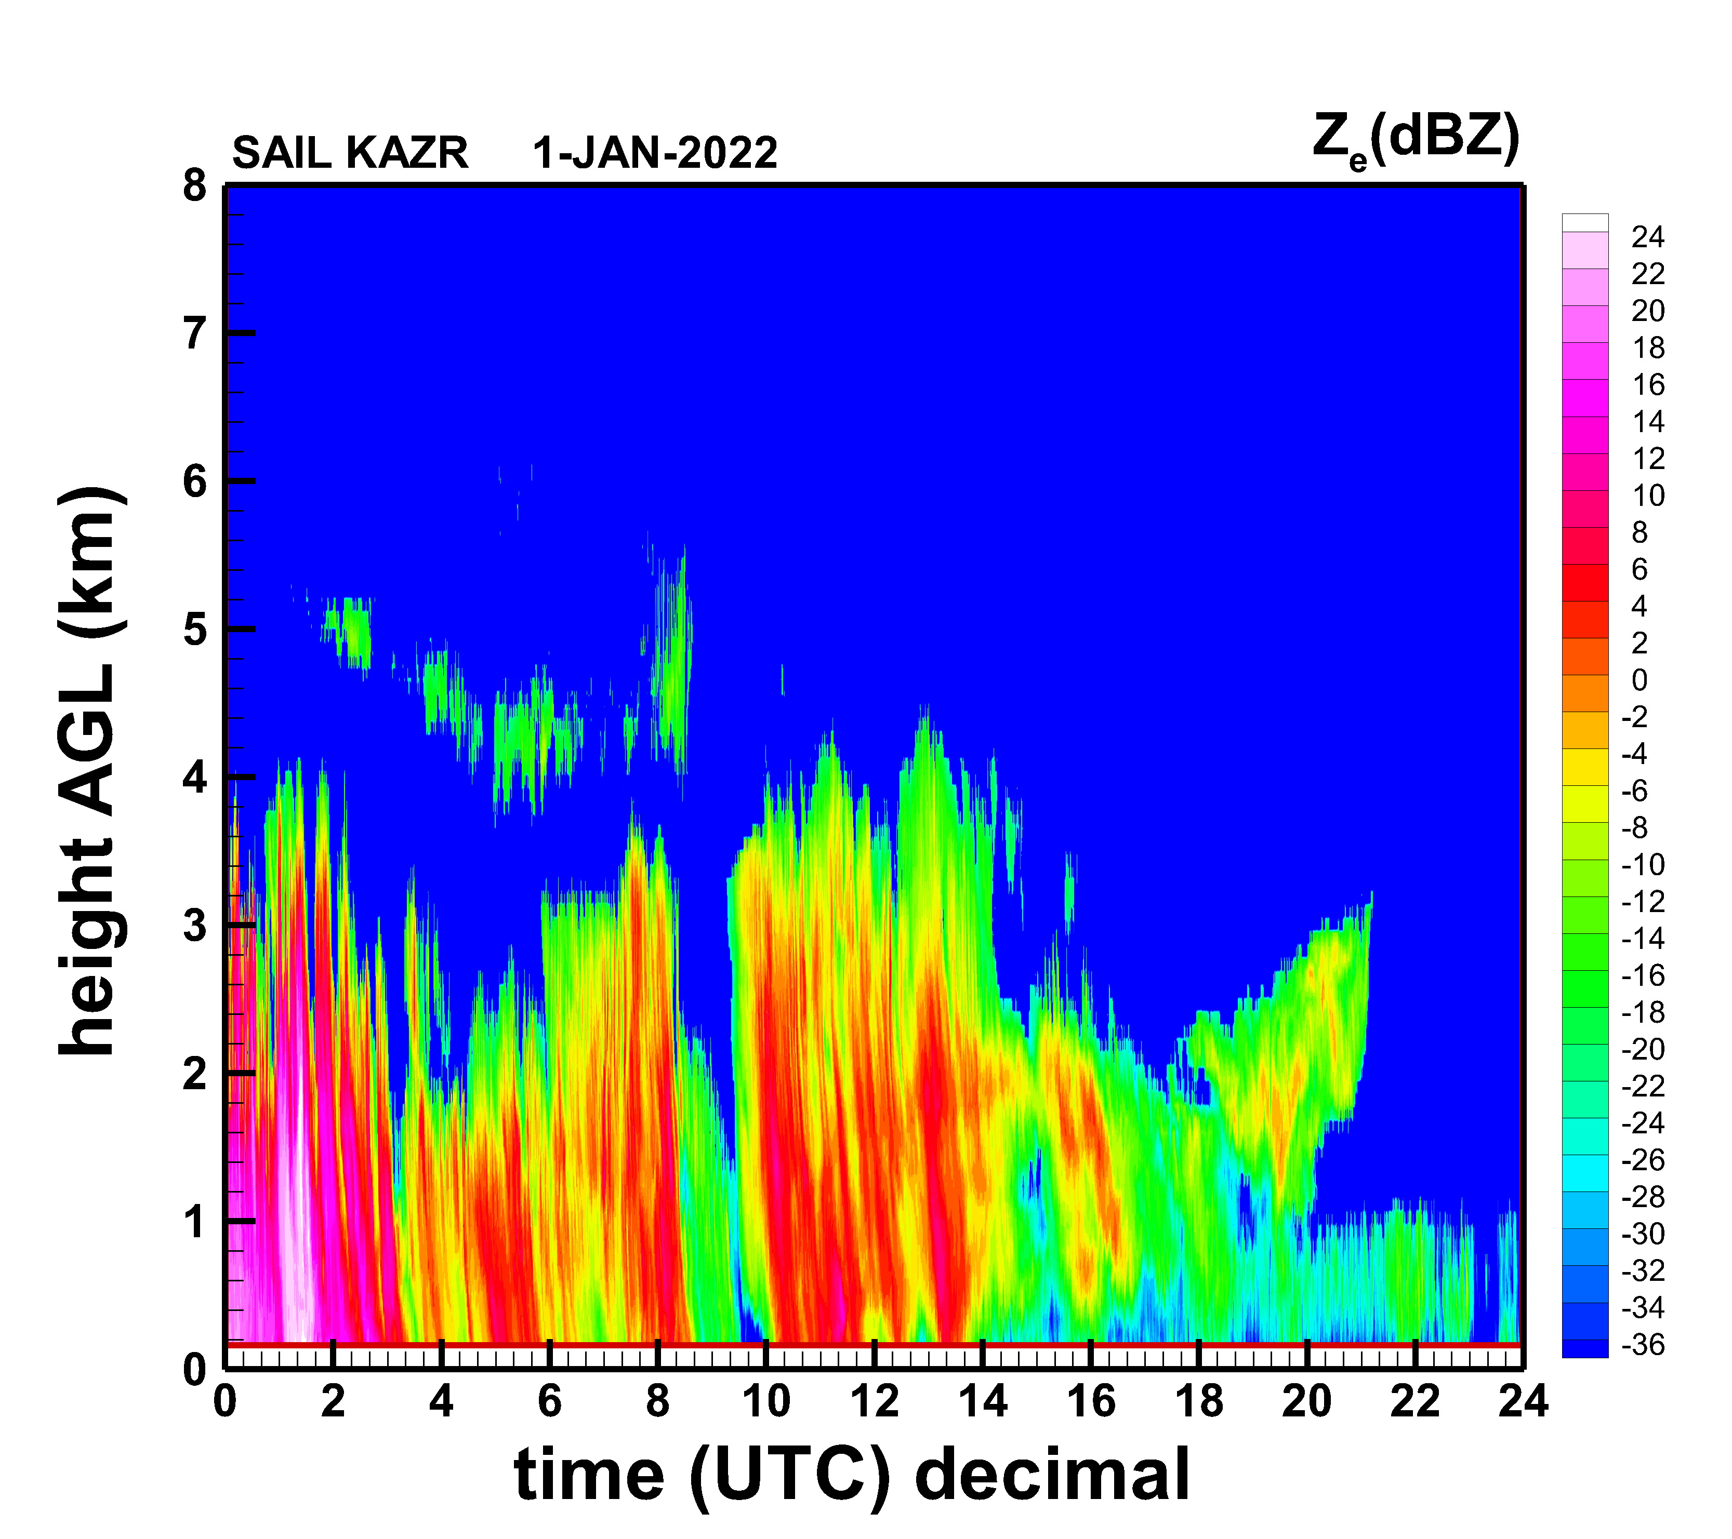
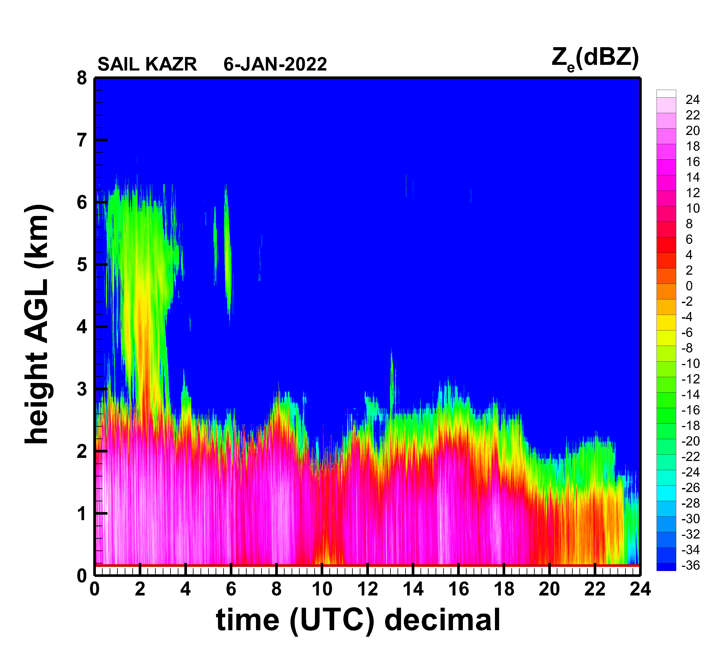
Examples of KAZR reflectivity measurements in SAIL/SPLASH
SAIL Ka-band ARM zenith-pointing radar (KAZR)
is a useful tool for retrieving solid (and liquid) precipitation properties
KAZR data can be used for high temporal and
vertical resolution estimates of snowfall rate,
ice water content, characteristic size of falling snowflakes, their degrees of riming
Synergy of KAZR measurements with radar
data at other frequencies available at SAIL/SPLASH allows for more robust retrievals of snowfall
microphysical parameters (e.g., snowflake size)

Slide 3
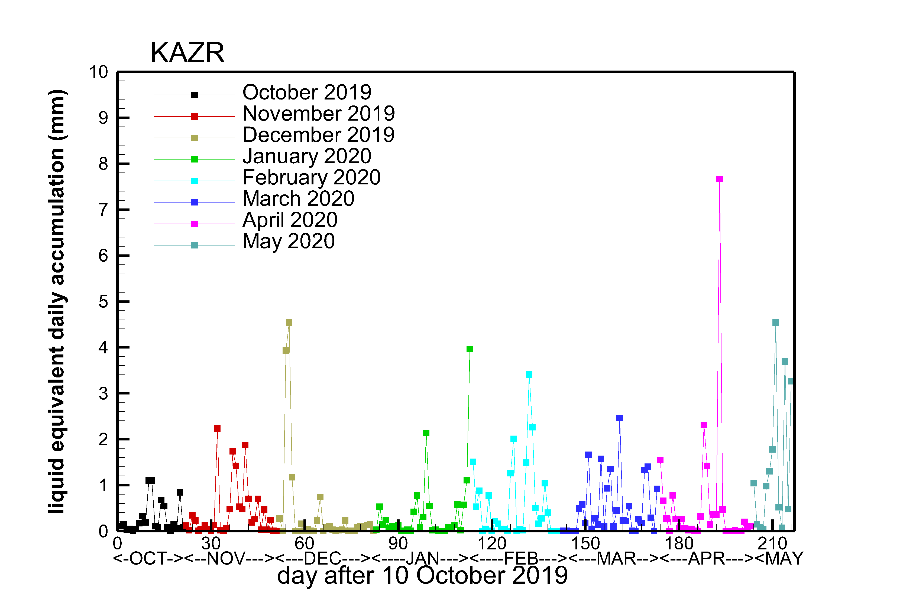
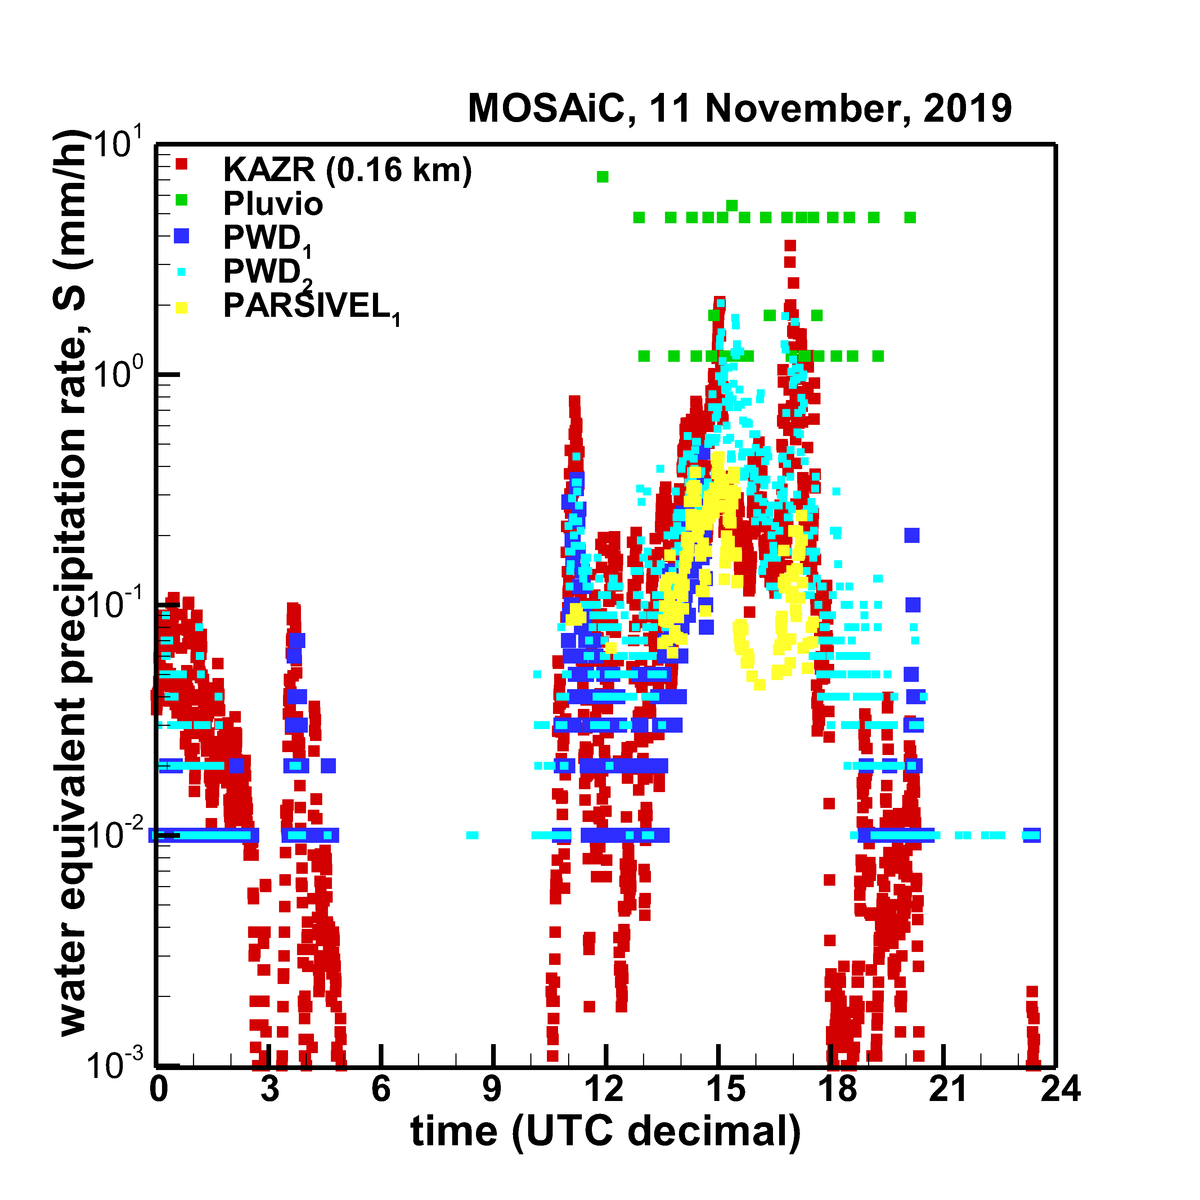
SAIL KAZR was previously used in MOSAiC to derive high
temporal (~ 30 sec) resolution snowfall rate estimates

Slide 4
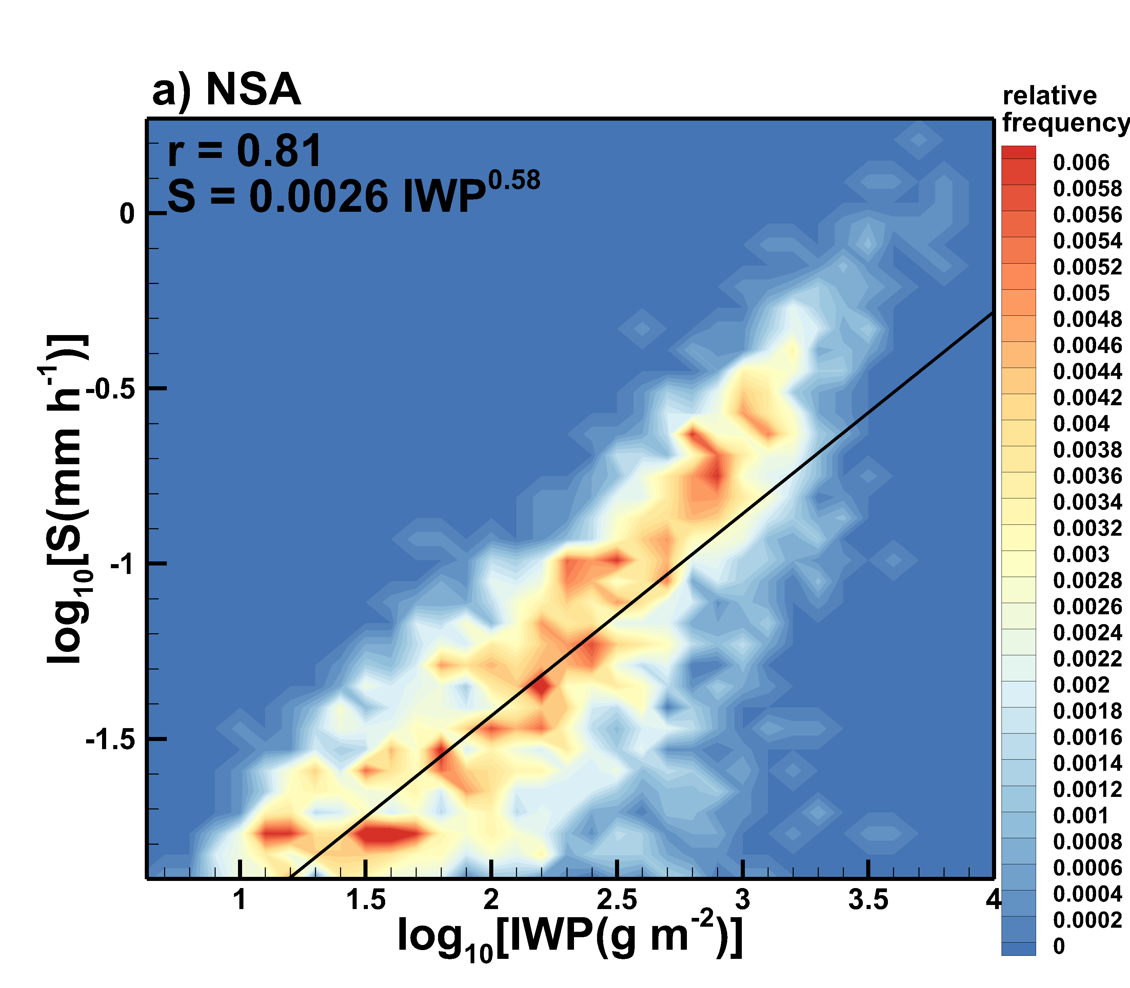
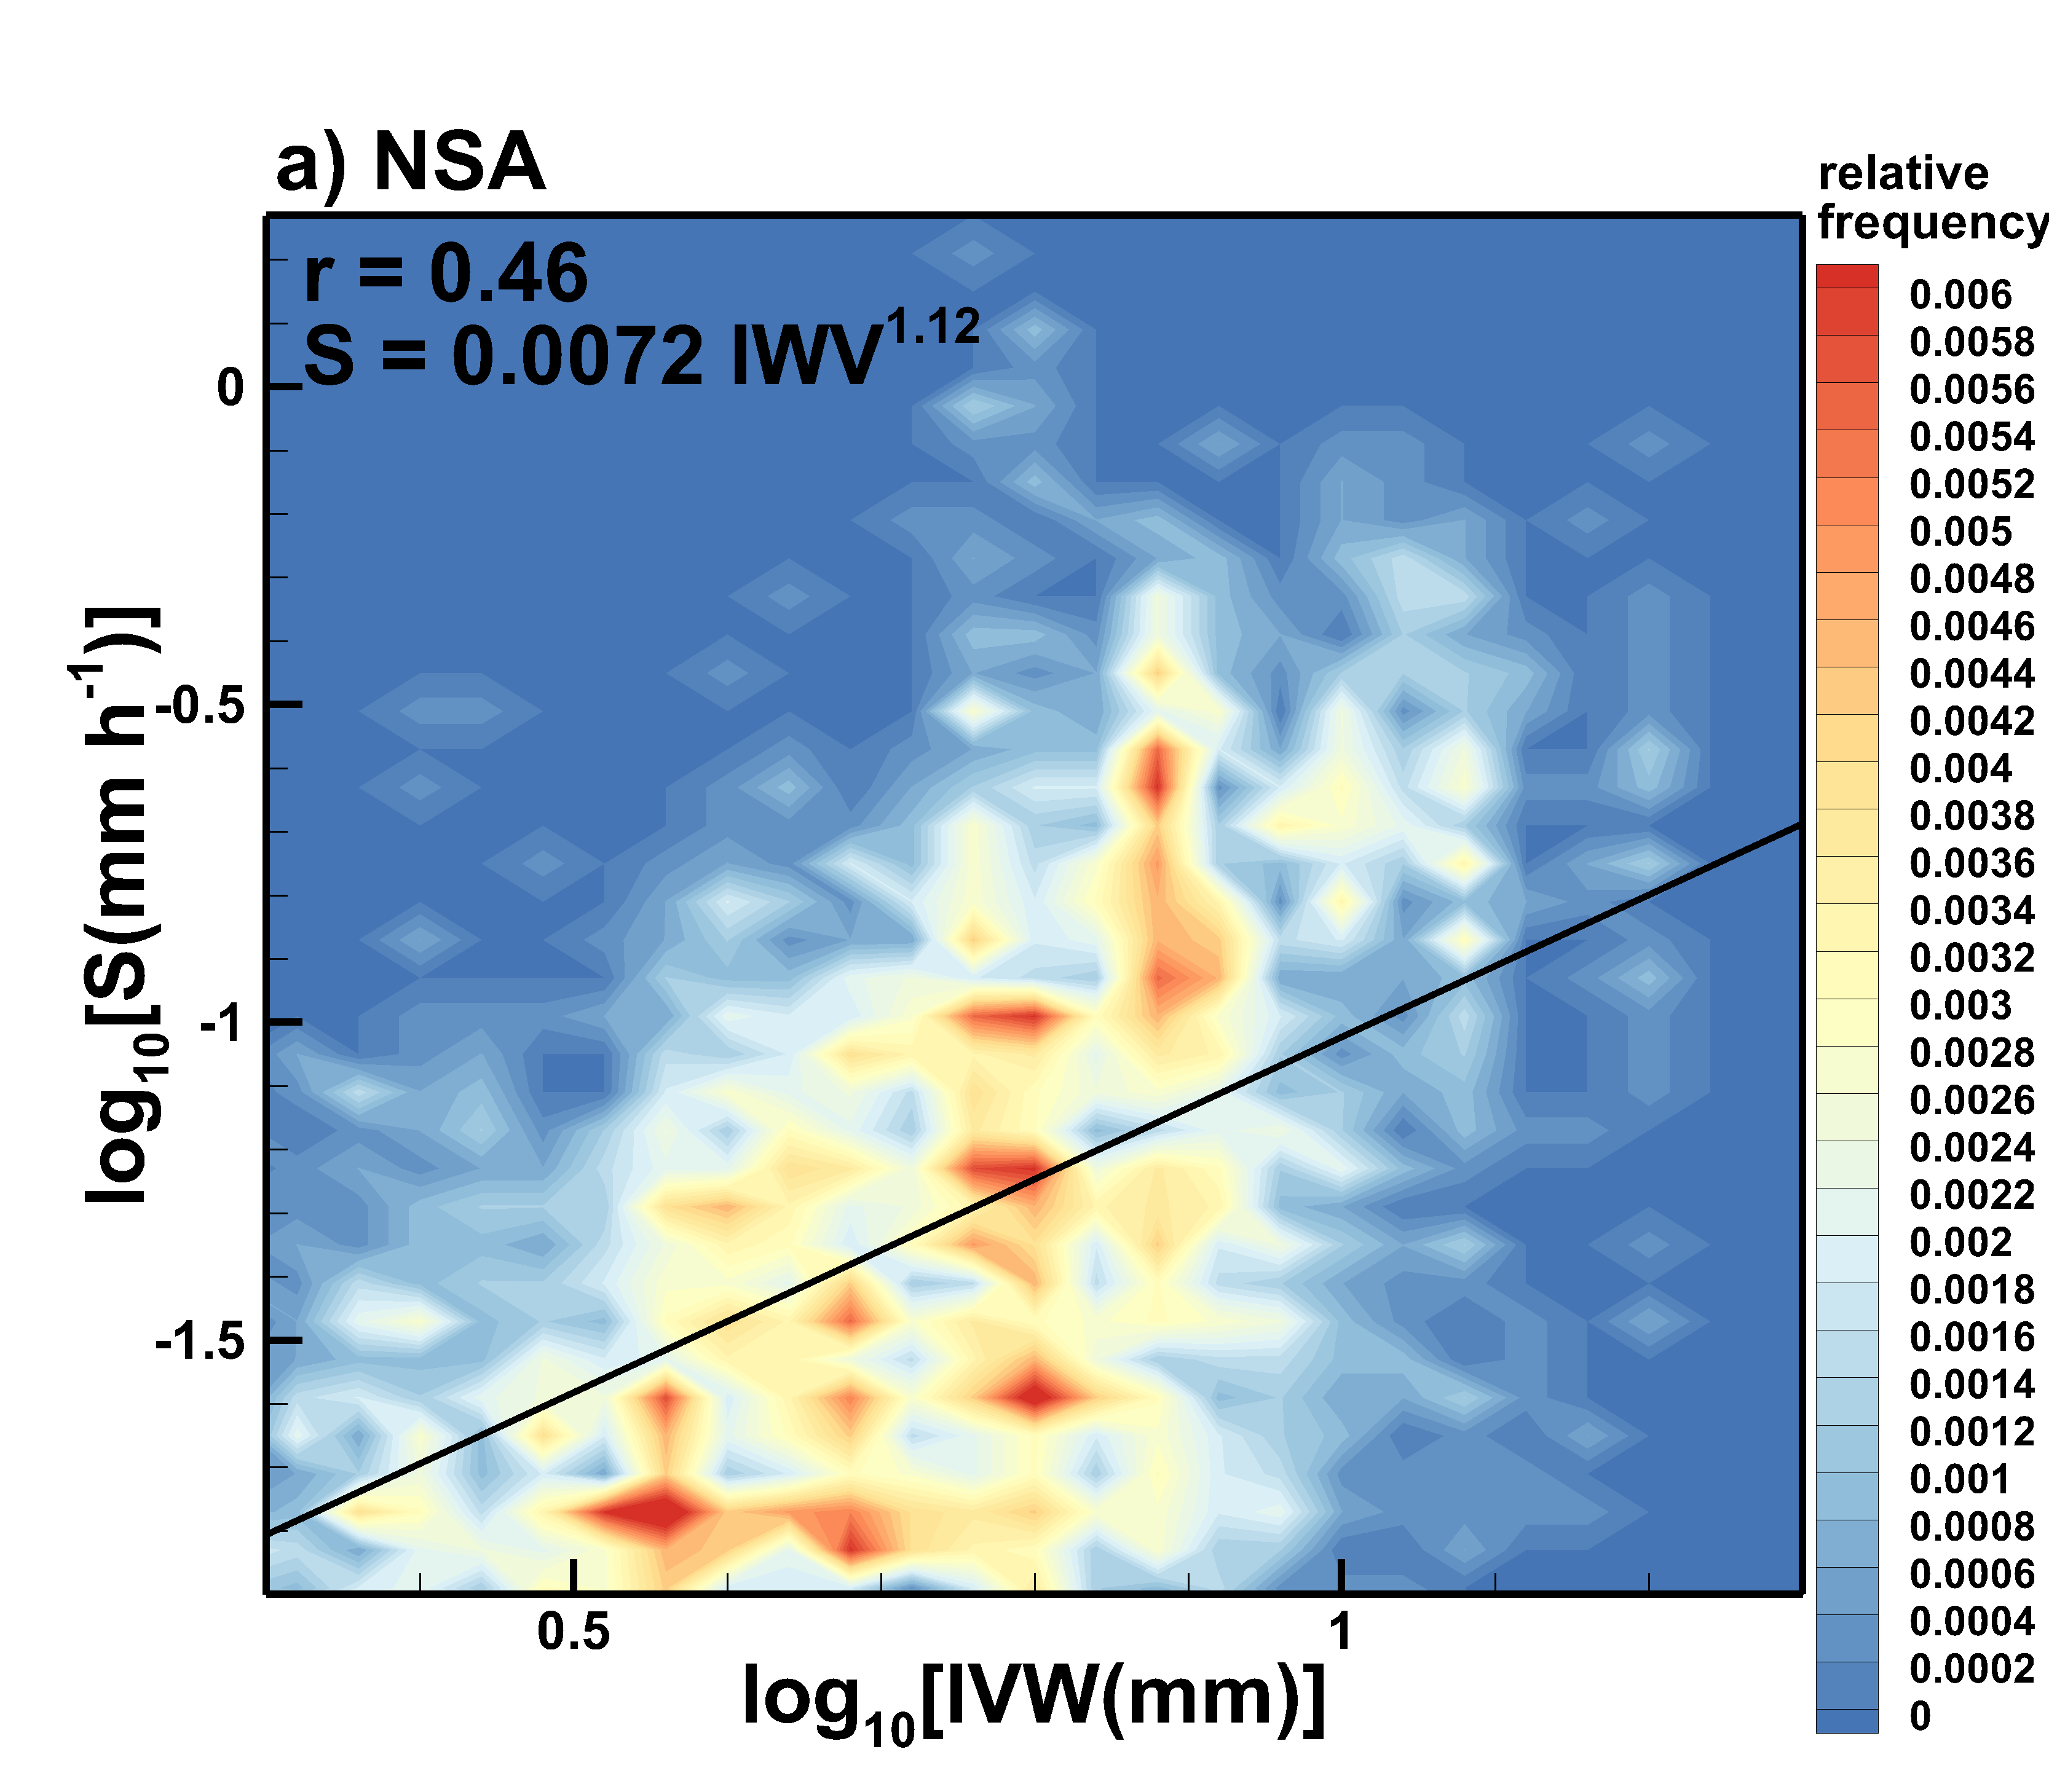
Radar-based retrievals of mean precipitation (snowfall) rate (S)
and cloud ice water path (IWP) combined with concurrent MWR-based estimates of integrated water vapor (IWV) and supercooled liquid water content (LWP) can be used for evaluating moisture conversion processes in the atmosphere

Slide 5
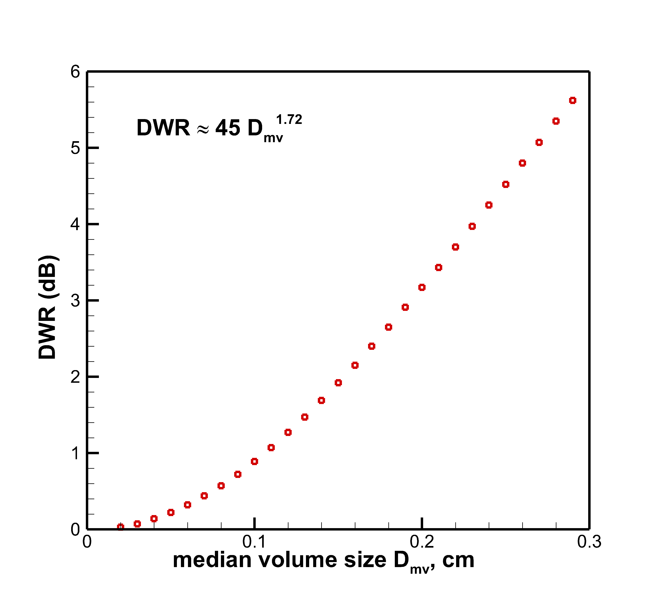
Potential SAIL/SPLASH KAZR – scanning X-band radar synergy
(a Ka-S band example)
2018/01/04
Modeling S-Ka-band DWR vs
snowflake characteristic size
height
Ka-band (SUNY)
height
S-band (WSR-88D KOKX)
0
24
Time, hours
Oue et al. 2023

Slide 6
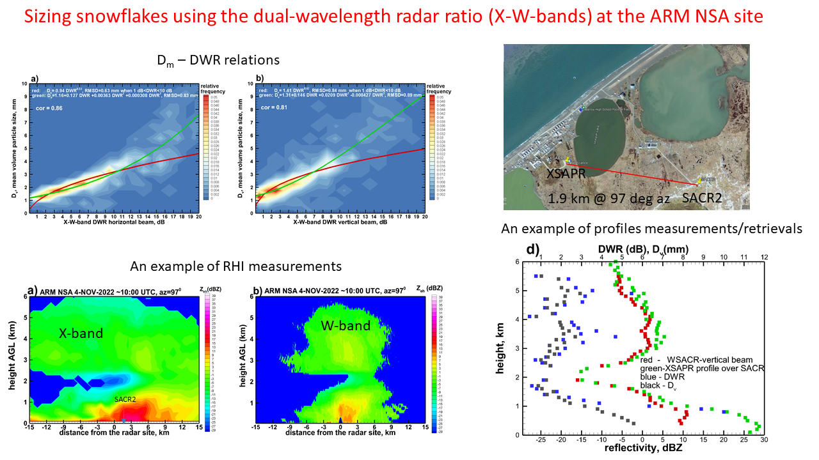
Potential SAIL/SPLASH W-X-band scanning radar synergy

Slide 7
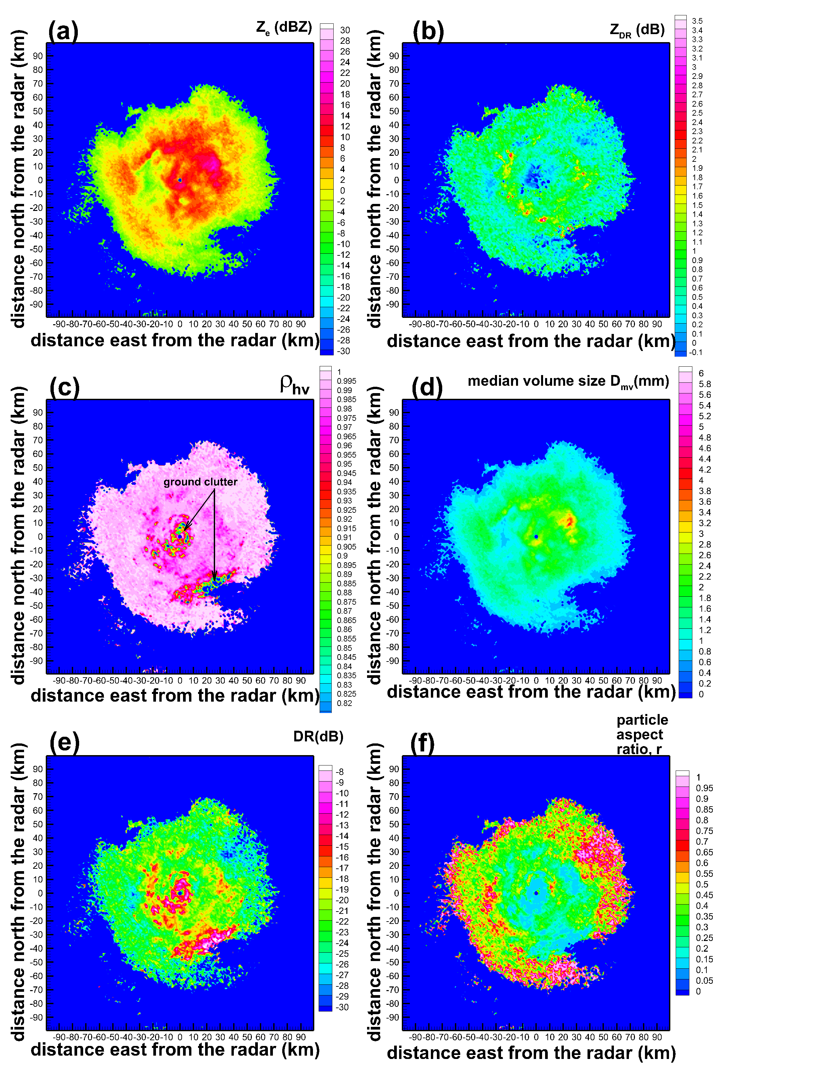
KDLH radar scan at 4.5deg on 5 March 2013 at 19:27 UTC
An example of using a STSR polarimetric
precipitation radar for estimating particle shapes
(an approach applicable to X-band radars)

Slide 8
Conclusions
ARM zenith-pointing radar measurements provide information for high spatial
and temporal resolution retrievals of snowfall microphysics and QPE
Multi-sensor retrievals (e.g., KAZR + MWR) allow for simultaneous estimates
of precipitation, cloud and water vapor parameters providing a framework for
better understanding the efficiency of atmospheric moisture conversion
Combination of measurements at different radar frequencies available at SAIL-SPLASH
can be used to improve retrievals of cloud and precipitation microphysical parameters

