Slide 1





SAIL/SPLASH/SOS (S3) Combined Workshop 2023
November 2nd , 2023
Quantitative Precipitation Estimation in SPLASH and SAIL
By
Sounak Biswas^{(1)&(2)}, V. Chandrasekar⁽¹⁾, and Robert Cifelli⁽²⁾
Colorado State University, Fort Collins, Colorado.
NOAA Physical Sciences Laboratory, Boulder, Colorado.

Slide 2
Overview, Background and Motivation
Improving the ability to forecast water supply in the American West demands understanding of the major atmospheric physical processes and land-atmosphere interactions impacting how mountainous watersheds in the Rocky Mountains produce precipitation and generate surface runoff. To better understand these processes, two field experiments are being conducted in the East River watershed of the Colorado Rocky Mountains from 2021 to 2023. The ultimate goal is to improve the ability to forecast water supply in the American West.
The Study of Precipitation, the Lower Atmosphere and Surface for Hydrometeorology or SPLASH experiment is being led by the NOAA Physical Sciences Laboratory (PSL).
The U.S. Department of Energy (DOE) is leading the Surface Atmospheric Integrated Field Laboratory or SAIL experiment in the same region.
Both SPLASH and SAIL campaign are a collaborative effort of multitude of national labs, research institutes and universities.
SPLASH and SAIL experiments will provide complementary observations in the study domain that will help characterize precipitation, aerosols, clouds, winds, radiation, temperature and humidity at a wide range of spatial and temporal scales.

Slide 3
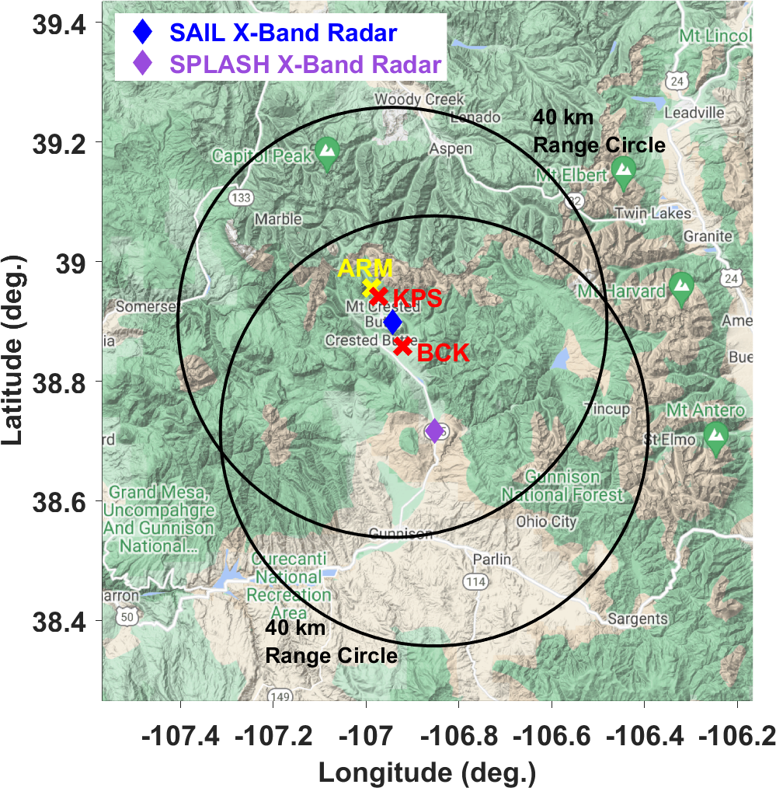
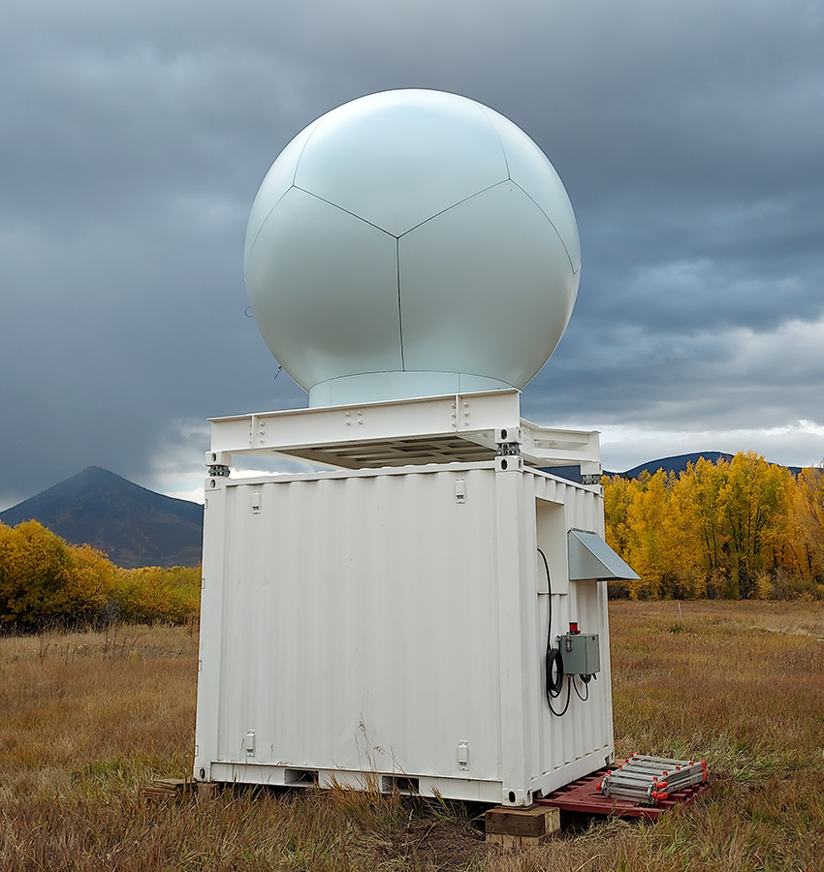
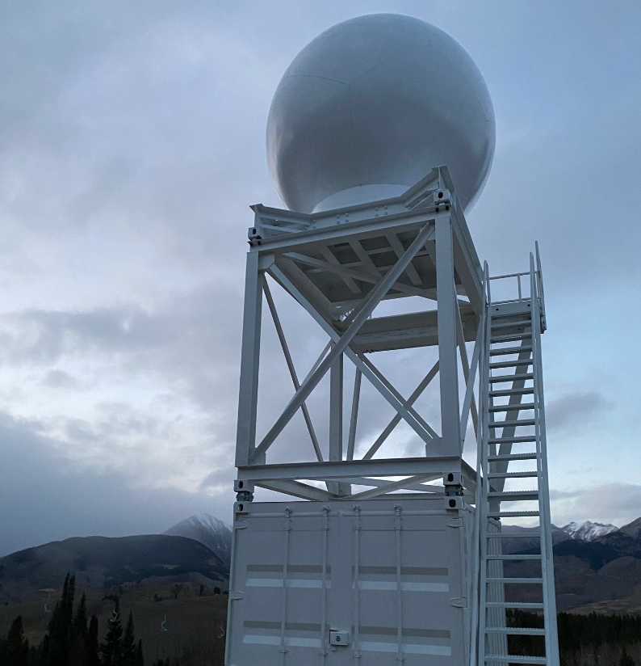
Dual-polarization X-Band Scanning Radars in SPLASH and SAIL
Image Reference: https://www.psl.noaa.gov/splash/
Image Courtesy: Francesc Junyent
SPLASH X-Band Radar (XRJY)
Lat: 38.7168^{O} N
Lon: -106.8529^{O} W
Height: 2504 m (MSL)
SAIL X-Band Radar (XSAIL)
Lat: 38.8984^{O} N
Lon: 106.9432^{O} W
Height: 3149.2 m (MSL)

Slide 4
X-Band Radar Technical Specifications & Scan Configuration
SPLASH X-Band Radar Scan Strategy
PPI scans every ~5 minutes at elevations 1º,2º,4º,6º,8º,10º,12º, & 15º.
Wintertime RHI scans every ~5 minutes along the azimuths 175º, 176º, 177º, 178º, 179º, 180º, 181º, 182º, 183º, 184º, 185º, 332º, 334º, 336º, 338º, 340º, 342º, 344º, 346º, 348º, 350º, & 352º.
Summertime RHI scans every ~5 minutes along the azimuths 175º, 177º, 179º, 181º, 183º, 334º, 336º, 338º, 340º, 342º, & 344º.
Few Important Technical Specs.
Tx. Frequency | 9.4 GHz
Range Resolution | 60 m
3 dB Beam Width | 1.25º
Polarization | H,V (Dual-Pol)
SAIL X-Band Radar Scan Strategy
PPI scans every ~5 minutes at 1º, 2º,4º,6º,8º,10º,12º & 15º.
Wintertime RHI scans every ~5 minutes along the azimuths 326º, 328º, 330º, 332º, 334º, 336º & 339º.
Summertime RHI scans every ~5 minutes along the azimuths 326º, 327º, 328º, 329º, 330º, 331º, 332º, 333º, 334º, & 336º.

Slide 5
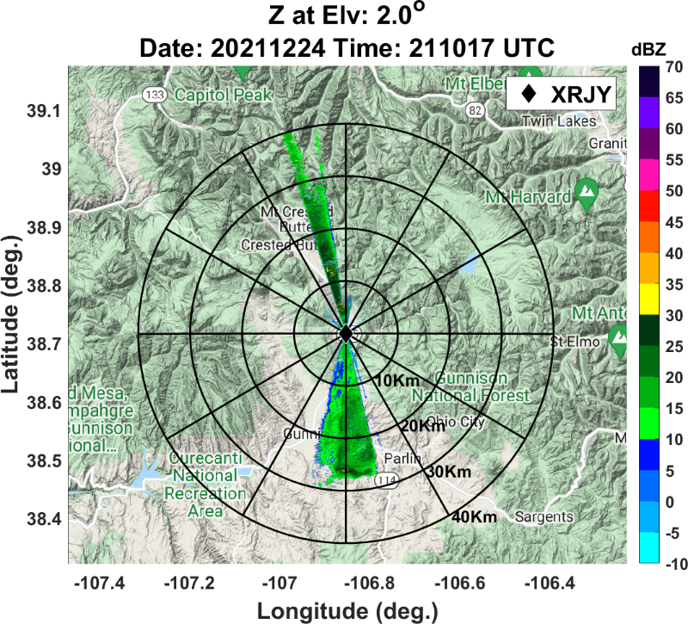
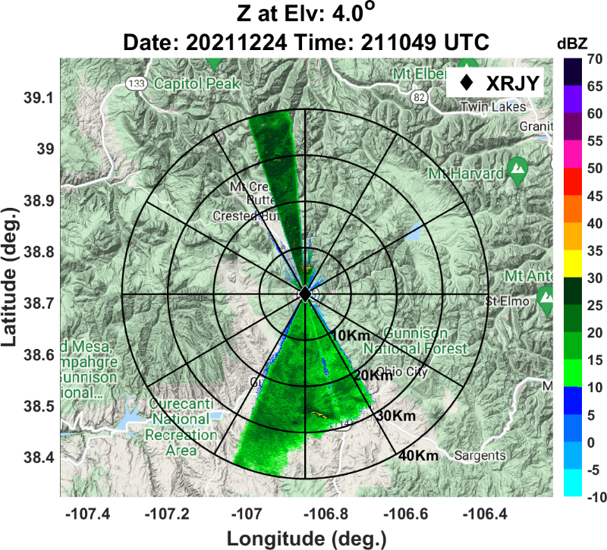
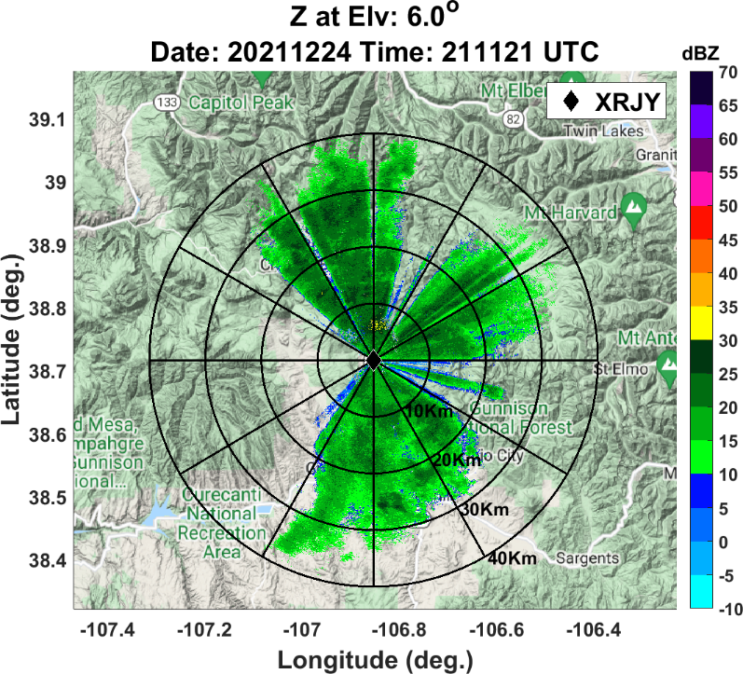
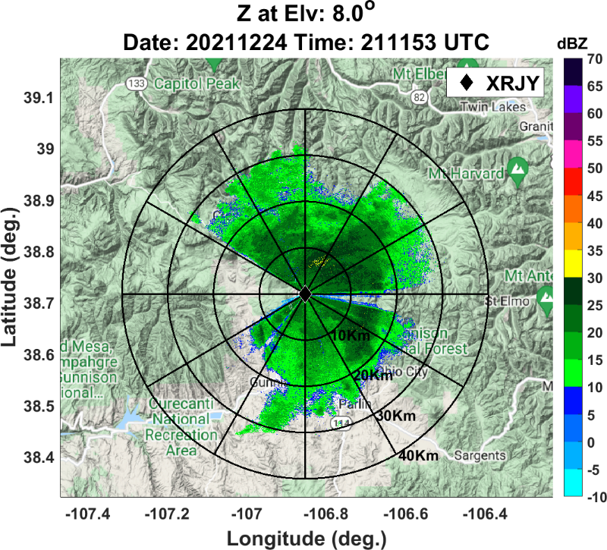
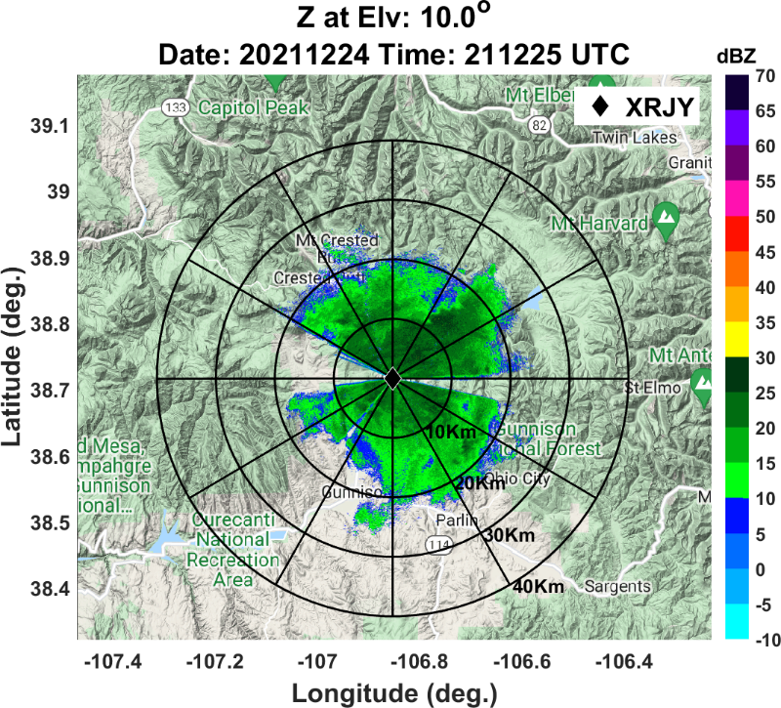
X-Band Radar Beam Blockage at different elevations

Slide 6
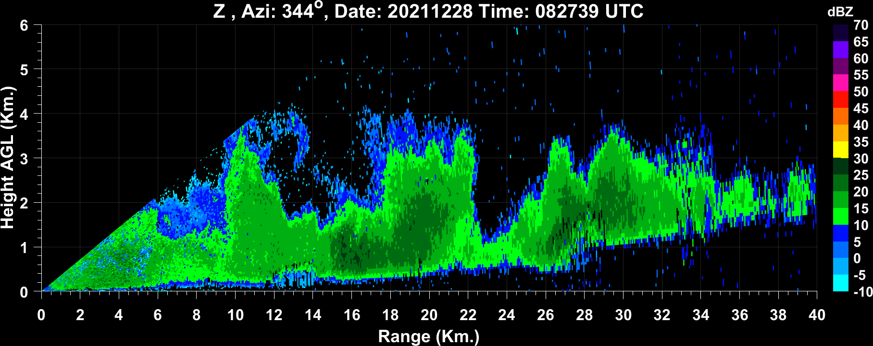
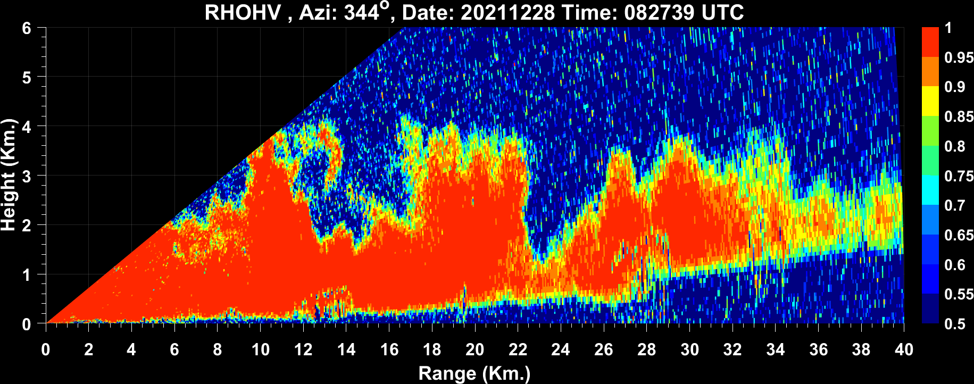
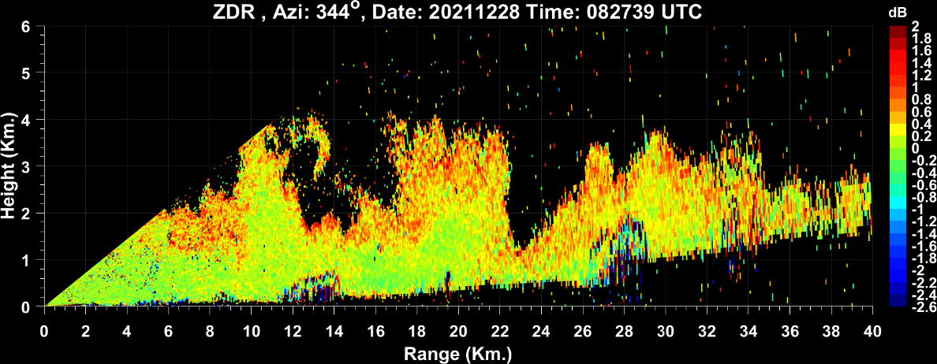
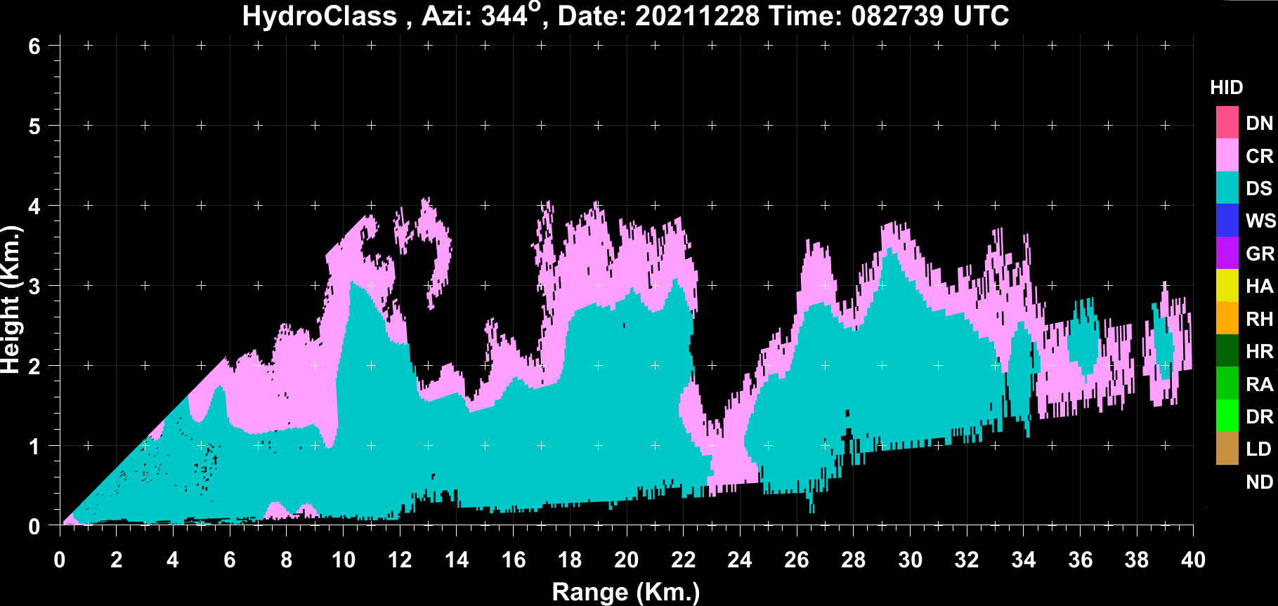
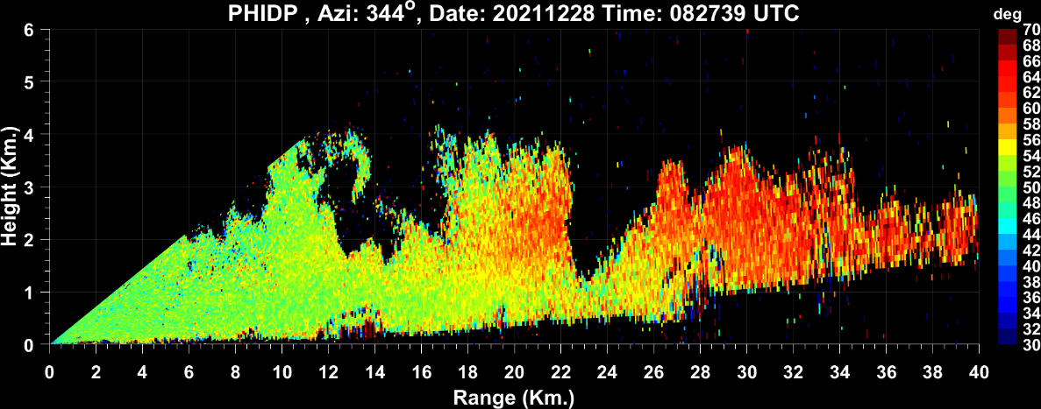
Example of SPLASH X-Band Radar RHI Scan Observations from Dec 28th, 2021
Z_{H}
ρ_{HV}
Z_{DR}
HID
CR (Pink) - Ice Crystals
DS (Light blue) - Dry Snow Aggregates
Φ_{DP}
Hydrometeor classification based on Bechini & Chandrasekar (2015)
Reference: Bechini, Renzo, and V. Chandrasekar. "A semisupervised robust hydrometeor classification method for dual-polarization radar applications." Journal of Atmospheric and Oceanic Technology 32, no. 1 (2015): 22-47.

Slide 7
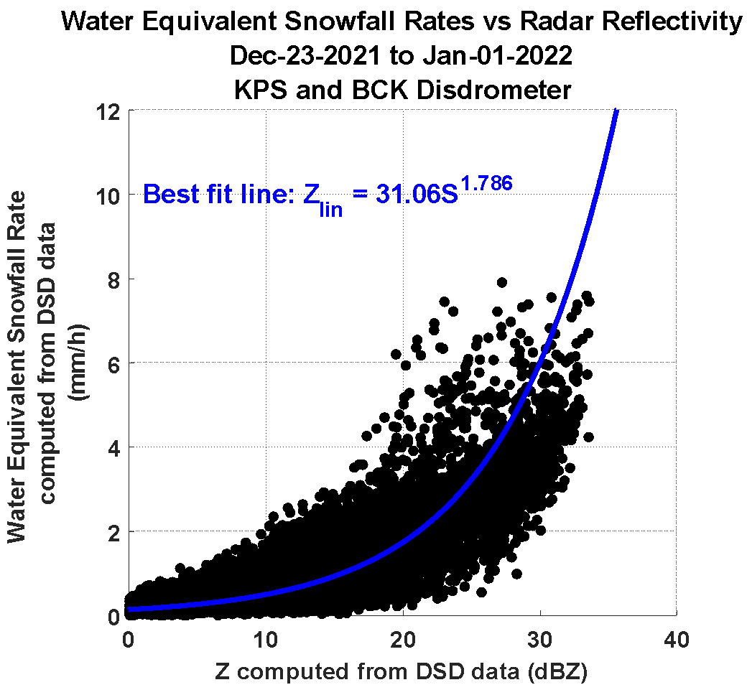

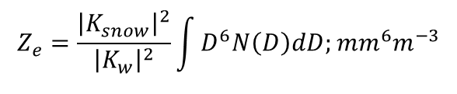
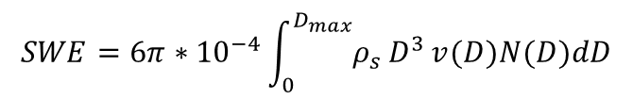
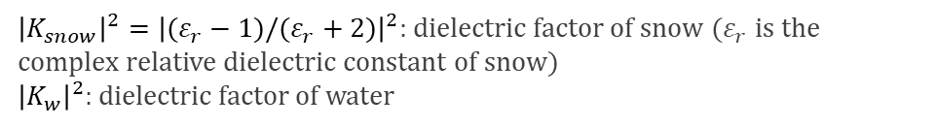
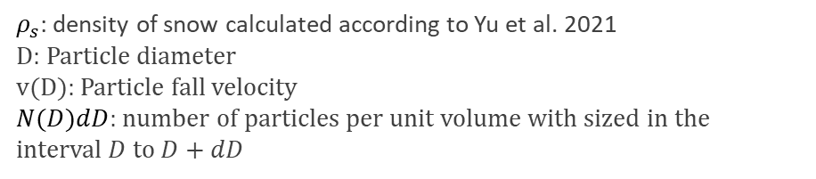
Radar based Snow Water Equivalent (SWE) Rate Estimator Calculation using Disdrometer Data
For winter-time precipitation, measurements of radar reflectivity are used to develop a Z-S relationship.
Reference:
[1] Huang, Gwo-Jong, Viswanathan N. Bringi, Robert Cifelli, David Hudak, and Walter A. Petersen. "A methodology to derive radar reflectivity–liquid equivalent snow rate relations using C-band radar and a 2D video disdrometer." Journal of Atmospheric and Oceanic Technology 27, no. 4 (2010): 637-651.
[2] Yu, Tiantian, V. Chandrasekar, Hui Xiao, and Shashank S. Joshil. "Snowfall estimation using dual-wavelength radar during the Pyeongchang 2018 Olympics and Paralympic winter games." Journal of the Meteorological Society of Japan. Ser. II 99, no. 1 (2021): 67-77.

Slide 8
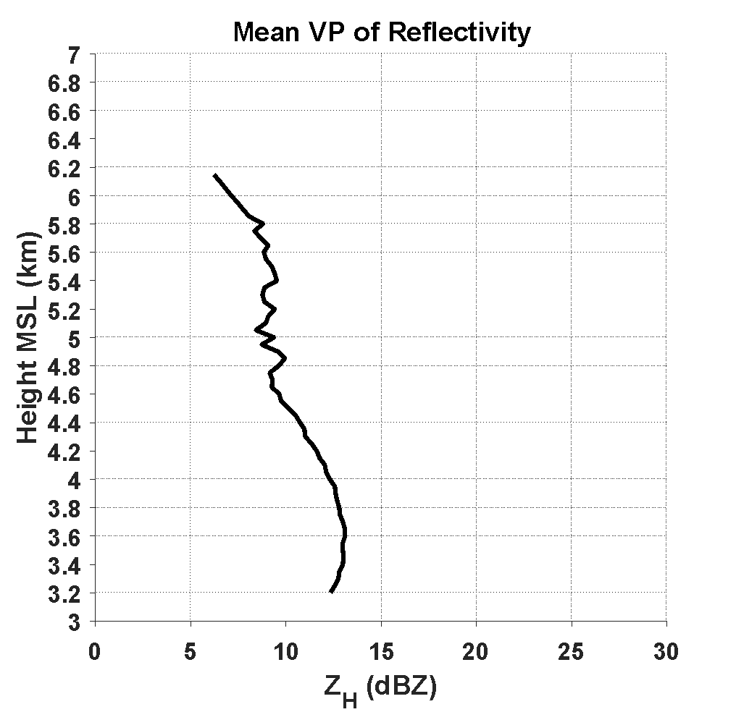
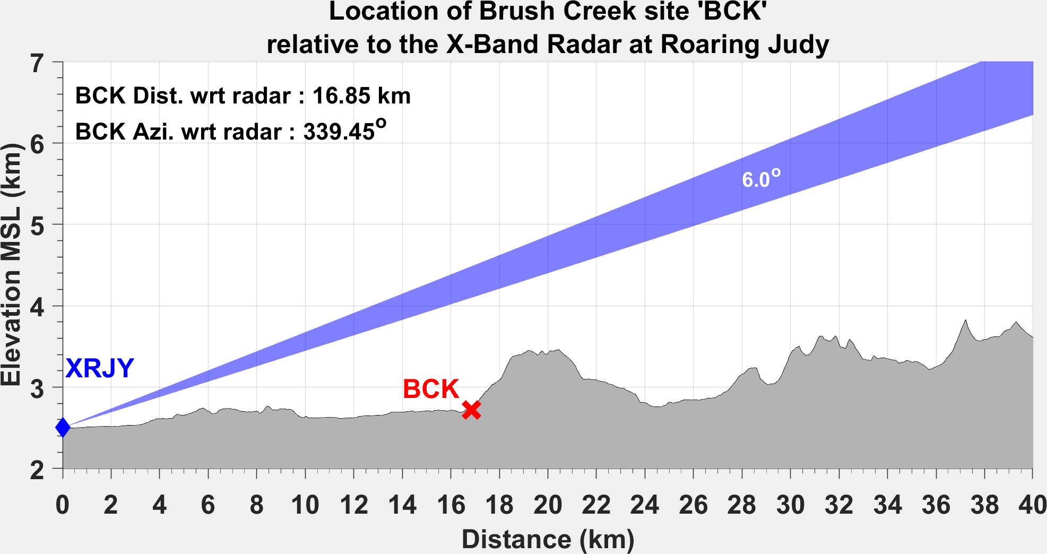
Vertical Profile of Reflectivity (VPR) Correction
Hydrometeors evolve as they fall which gets manifested in the vertical structure of storms. This gives rise to gradients in the vertical profiles of radar observables such as the reflectivity. To estimate QPE at ground, radar reflectivity measurements at distance ranges from PPI scans needs to be projected at the ground level. This is known as VPR correction.
Beam Height at BCK
1.47 km AGL
Slope: 2.5 dB/km
BCK site is situated at 16.65 km. The radar 6º beam center height at BCK site is about 1.47 km AGL. Therefore VPR correction is required in order to accurately quantify precipitation at ground.
Vertical profiles of radar reflectivity are constructed from the RHI scans from Dec 2021 snow events that are not blocked due to terrain. The mean vertical profile of reflectivity is found to have a slope of 2.5 dB/km.

Slide 9

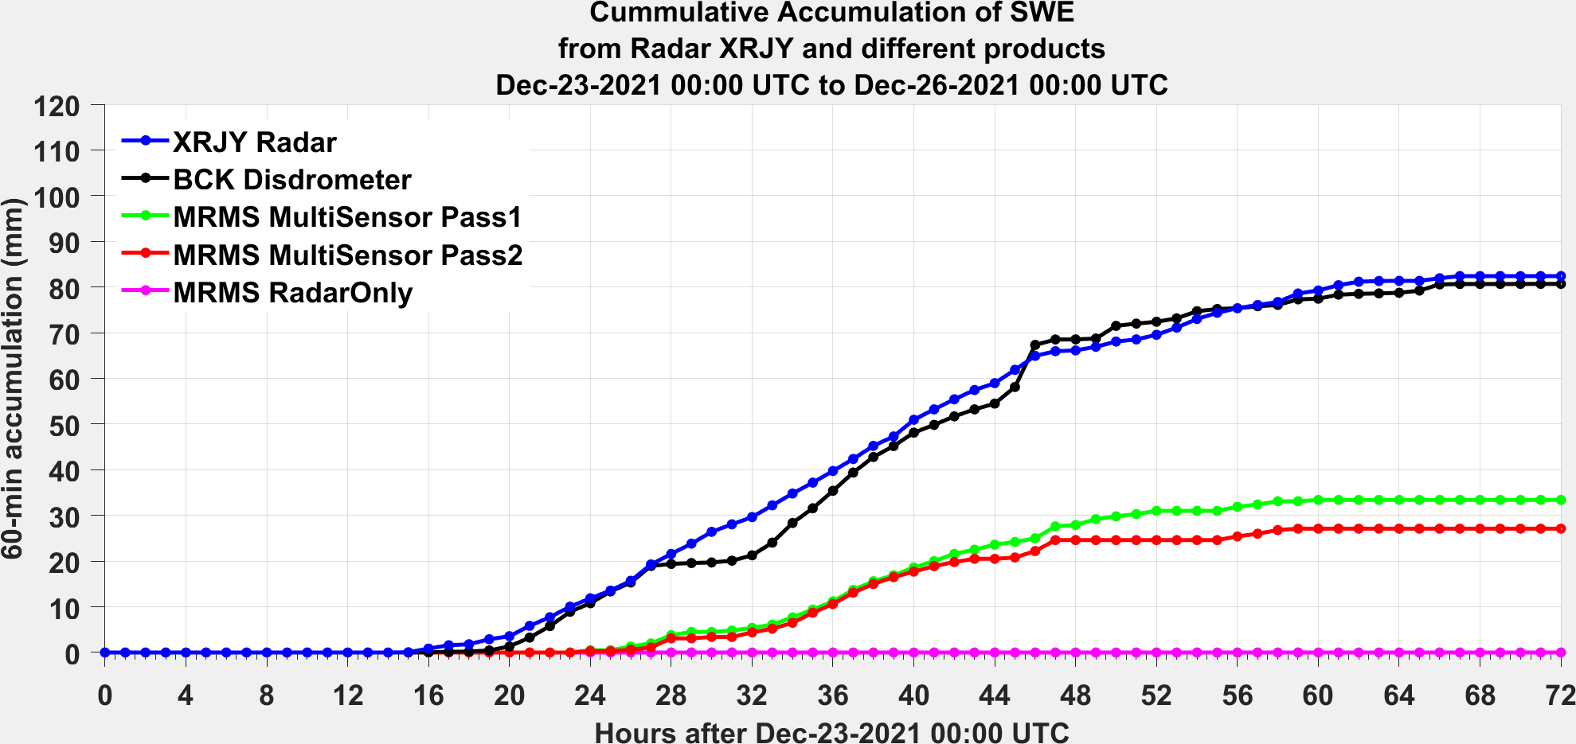
Example of Winter-time Precipitation Estimation from SPLASH X-Band Radar
Dec 23rd 2021 to Dec 26th 2021 (Santa Slammer Event)
BCK site
Ground accumulation of SWE estimates computed from the 6º SPLASH X-Band PPI scans and cross compared with precipitation estimates from the disdrometer and different MRMS products at the BCK site.
It's important to note that the 6º scan data was specifically selected because the SPLASH Radar scans below 6 degrees of elevation are significantly blocked, primarily due to the presence of terrain and nearby trees in this particular location.
The overall performance of the X-Band based QPE is good. Due to insufficient coverage of the nearest NWS radar KGJX, the MRMS RadarOnly product is unable to provide any precipitation estimate. Both MRMS MultiSensor Pass1 and Pass2 products are significantly underestimating precipitation at Brush Creek.

Slide 10
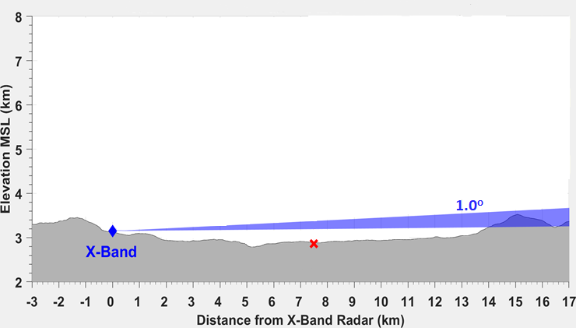
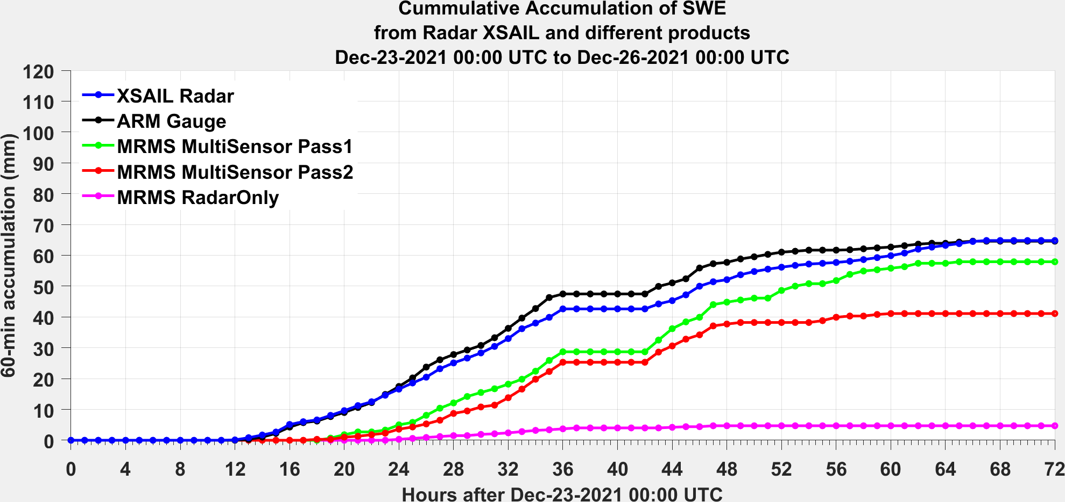
Example of Winter-time Precipitation Estimation from SAIL X-Band Radar
Dec 23rd 2021 to Dec 26th 2021 (Santa Slammer Event)
Location of ARM site
relative to the SAIL X-Band Radar at Crested Butte
ARM Dist. wrt radar : 7.496 km
ARM Azi. wrt radar : 328.87º
ARM site
SAIL
ARM
Ground accumulation of SWE estimates computed from the 1º SAIL X-Band PPI scans and cross compared with estimates from the Pluvio-2 precipitation gauge at the ARM site along with different MRMS products.
The SAIL X-Band radar has clear and unobstructed view of the ARM site.
The radar based SWE estimates agree well with gauge estimates. However, it's worth noting that both MRMS MultiSensor Pass1 and Pass2 products consistently underestimate SWE for December 23rd and December 24th, although Pass1 QPE catches up towards the end of December 25th.
As before, the MRMS RadarOnly product performs the worst due to coverage limitations of the nearest NEXRAD, KGJX.

Slide 11
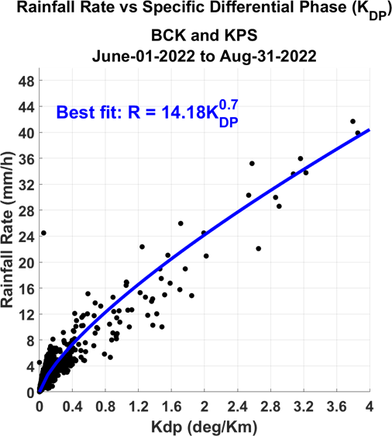


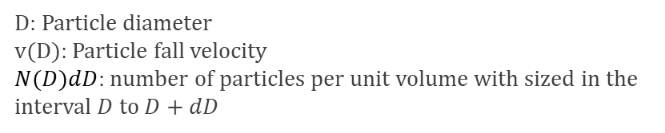
Development of radar based polarimetric estimator for rain using Drop Size Distribution data from Parsivel disdrometers
For warm season, Specific Differential Phase (K_{DP}) measurements are used to develop a Rainfall-K_{DP} relationship.
Warm Season
where λ is the radar wavelength;
f_{h} and f_{v} are the complex forward scattering amplitude at horizontal and vertical polarizations.
The still air rainfall rate (R) is defined as:

Slide 12
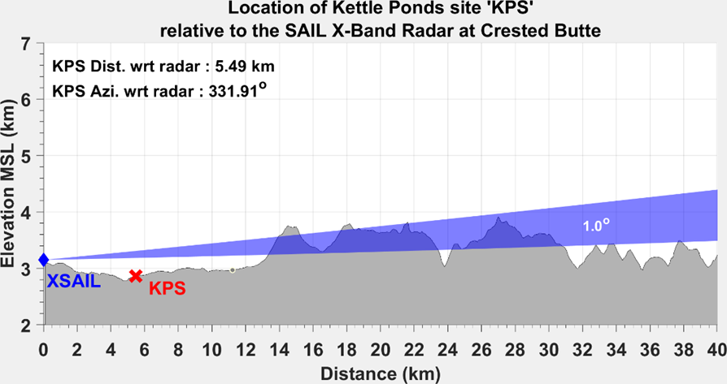
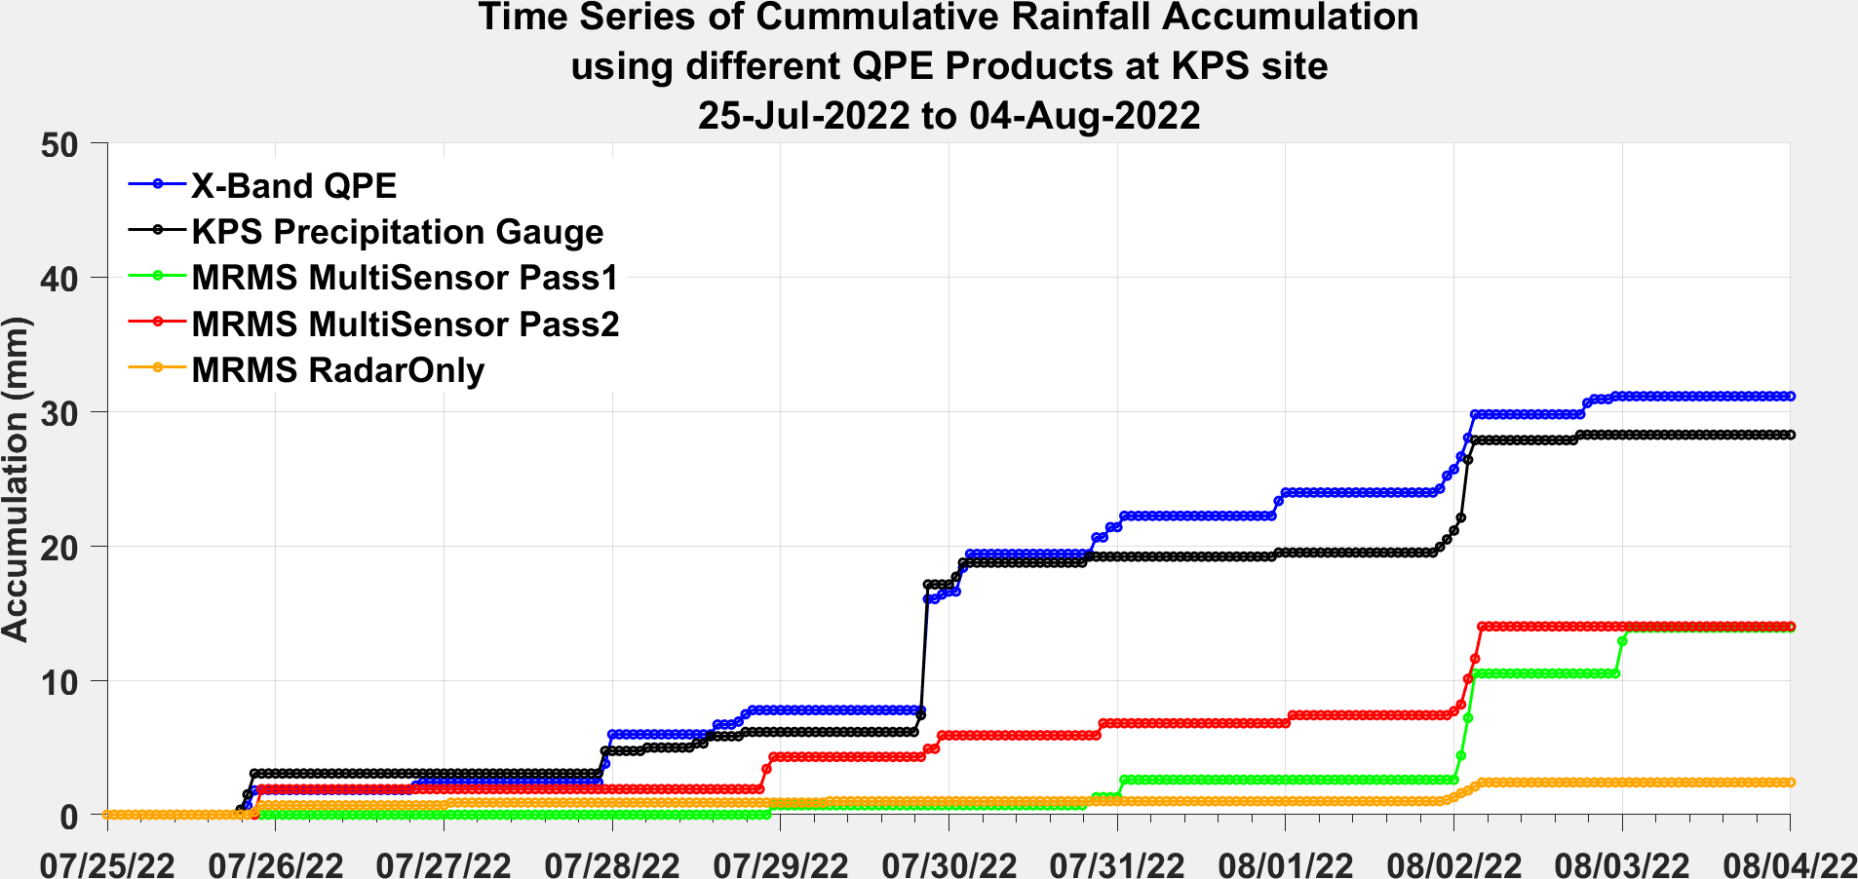
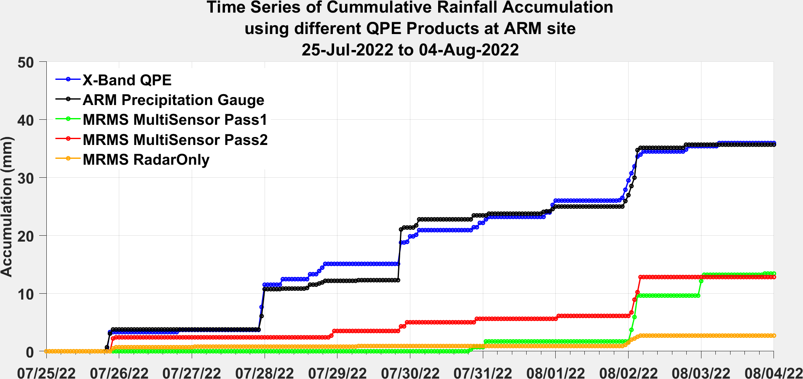
Example of Summer-time Precipitation Estimation from SAIL X-Band Radar.
July 25th 2022 to August 4th 2022
KPS site
Location of ARM site
relative to the SAIL X-Band Radar at Crested Butte
ARM Dist. wrt radar : 7.496 km
ARM Azi. wrt radar : 328.87º
ARM site
ARM
Comparison of Radar derived Rainfall from the 1º SAIL PPI scans with estimates from precipitation gauge and different MRMS operational products at both KPS and ARM sites.
Rainfall estimates obtained from radar the data exhibit a strong agreement with the measurements from rain gauges, indicating a high level of accuracy. Conversely, the operational MRMS products tend to underestimate rainfall.

Slide 13
Summary
Initial observations from the X-Band Radars in SPLASH and SAIL demonstrate the potential of accurately quantifying precipitation.
This study presents preliminary results of radar-based QPE for both warm and cold seasons. This also demonstrates the feasibility of using disdrometer measurements to derive radar based precipitation estimators that can be used to accurately estimate precipitation.
Application of the Z-S and R-KDP relations to the X-Band radar data demonstrates overall good performance against in-situ estimates. This also suggests accurate radar based precipitation estimation is possible with radar based estimator relations that are more tailored for East River Watershed region of the Colorado Mountains.
More precipitation events will be analyzed to help quantify radar derived QPE uncertainties.
Future studies will involve development of QPE maps. Techniques for filling up the blocked regions in the radar domain requires careful investigation.

