Slide 1
Open Radar Science in SAIL
JOE O’BRIEN¹, MAX GROVER¹, ROBERT JACKSON¹, ZACH SHERMAN¹, BHUPENDRA RAUT^{1,2},
SCOTT COLLIS¹, ADAM THEISEN¹, MATT TUFTEDAL¹, DAN FELDMAN³, V CHANDRASEKAR⁴
¹Argonne National Laboratory, Lemont, IL
²Northwestern-Argonne Institute of Science and Engineering, Northwestern University, Evanston, IL
³Lawrence Berkeley National Laboratory, Berkeley, CA
⁴Colorado State University, Fort Collins, CO
2023 SPLASH/SAIL/SOS Combined Meeting, Boulder, CO
November 2nd, 2023

Slide 2
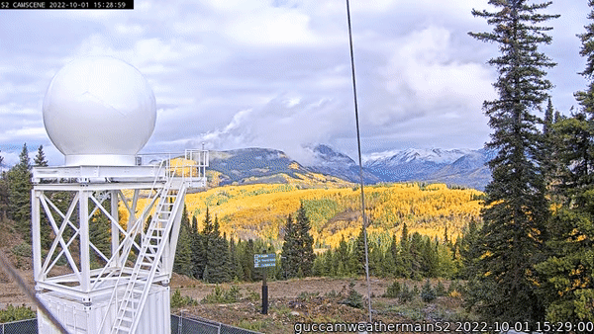
OUR ROLE IN SAIL
Creation of Open-Source Material for collaborative research
Py-ART
xradar
ACT
Jupyter Notebooks
Creation of Value Added Products (VAP) for Quantitative Precipitation Estimates (QPE)
CMAC:
Corrective Moments to Antenna Coordinates
SQUIRE:
Surface Quantitative Precipitation Estimate
RadCLss
Extracted Radar Columns and In-situ Sensors
guccamweathermainS2 GIF: provided by Dan Feldman

Slide 3
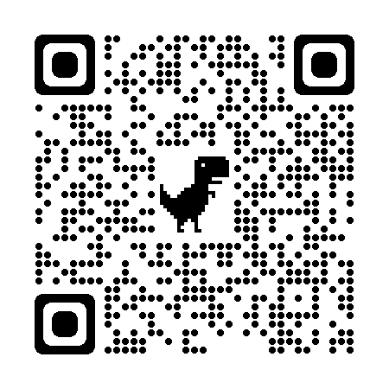
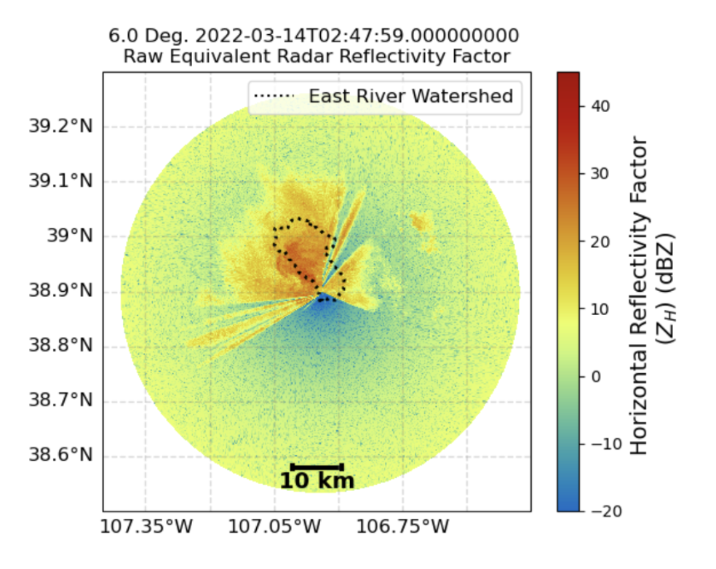
Python ARM Radar Toolkit
Documents and Examples
Py-ART (https://arm-doe.github.io/pyart/)
Py-ART created a way of representing radar data in the Python programming language that mirrors the CF-Radial standard.
Py-ART’s central core is a data model for gated data with pointing information.
Py-ART has a cloud functions to correct, retrieve and grid radar data.
There is now a rich ecosystem of packages that interact: CMAC, Py-DDA, CSU tools… etc..
November 2nd, 2023
Notes:
The workhorse of all our products: Py-ART After bullet three: Describe Plan Position Indictor (PPI) Scan – Antenna coordinates

Slide 4
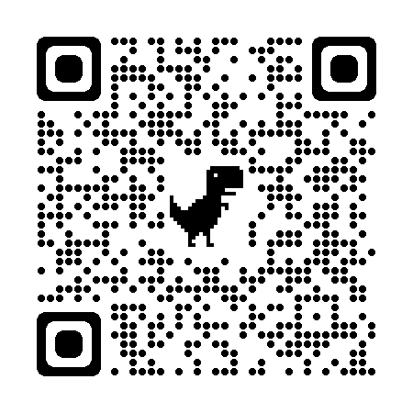
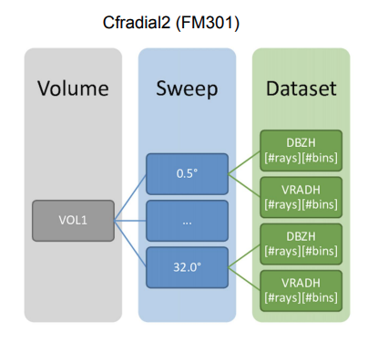
Xradar – Xarray Data Model for Weather Radar (https://github.com/openradar/xradar)
Documents and Examples

Slide 5
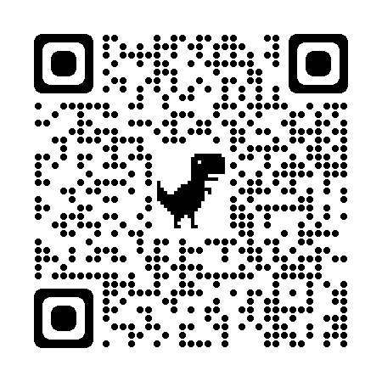
Atmospheric Community Toolkit (ACT) (https://github.com/ARM-DOE/ACT)
Documents and Examples
an open source Python toolkit for working with atmospheric time-series datasets of varying dimensions.
Also based on Xarray!
is meant to have functions for every part of the scientific process; discovery, IO, quality control, corrections, retrievals, visualization, and analysis.
Open-Science in the Rockies (2022): https://github.com/ARM-Development/open-science-rockies-2022

Slide 6
Corrective Moments to Antenna Coordinates (CMAC)
At its core is the identification of primary scatterers within a radar gate (i.e. gate ID)
Fuzzy Logic method based on polarimetric radar variables
Used to create tags for each gate that are used in downstream processing
To estimate precipitation:
Empirical relationships of the equivalent radar reflectivity factor (Z_{e}) to liquid-equivalent snowfall rates (Ze = aS^{b}) are typically applied

Slide 7
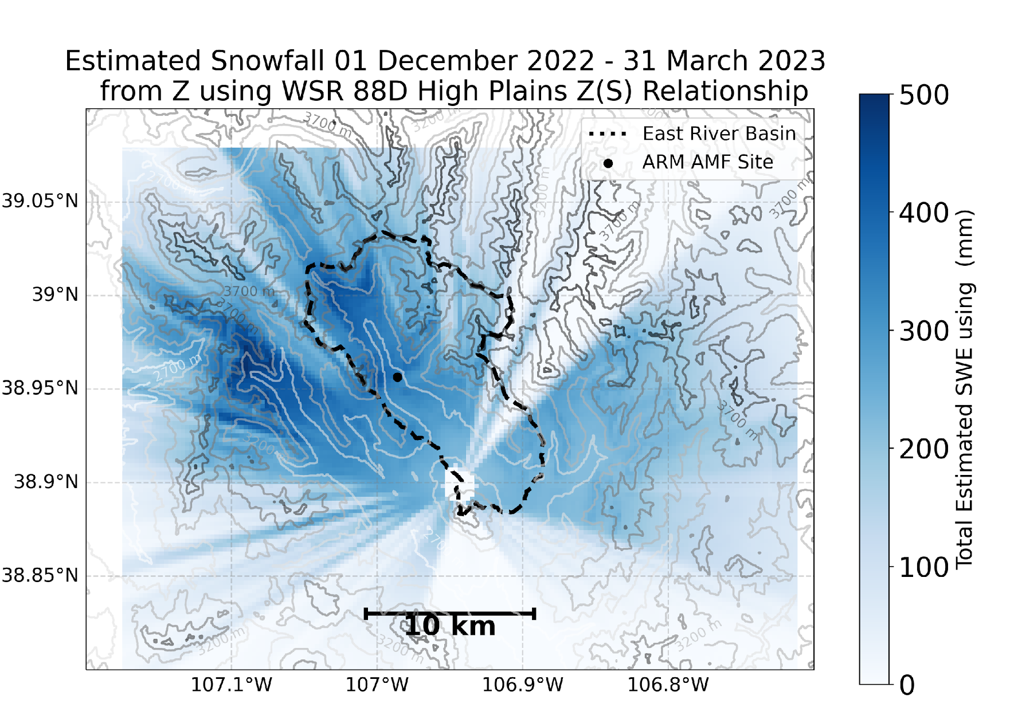
Surface Quantitative Precipitation Estimation (SQUIRE)
CMAC radar product that is gridded to a cartesian grid
Transformation of native radar antenna coordinates to cartesian coordinates
Extraction of the lowest valid gate available for each grid cell
250 m grid spacing
spatial domain of 20 km (x) x 20 km (y) x 5 km (z), all in units of distance from the radar.
Jan – March 2022, Dec 2022 – March 2023 now available

Slide 8
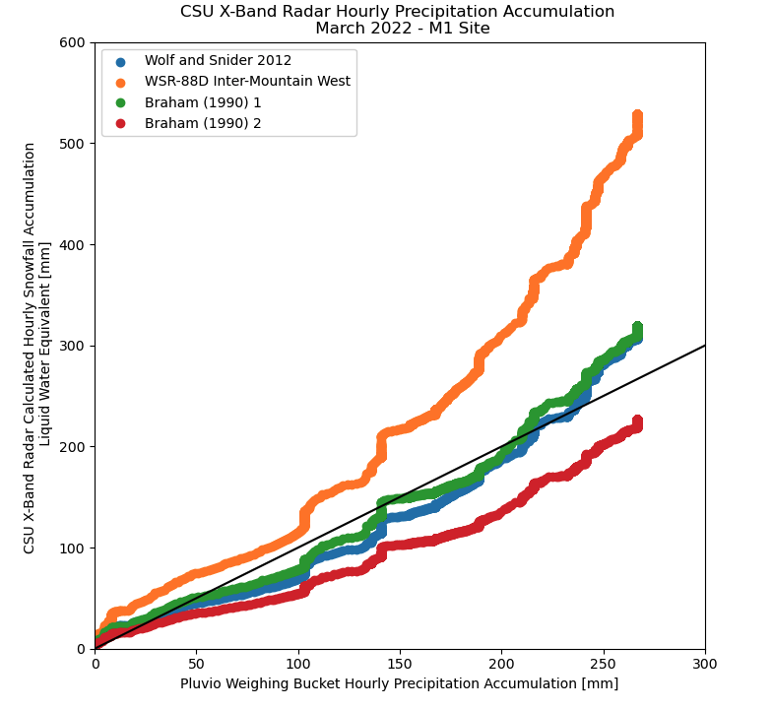
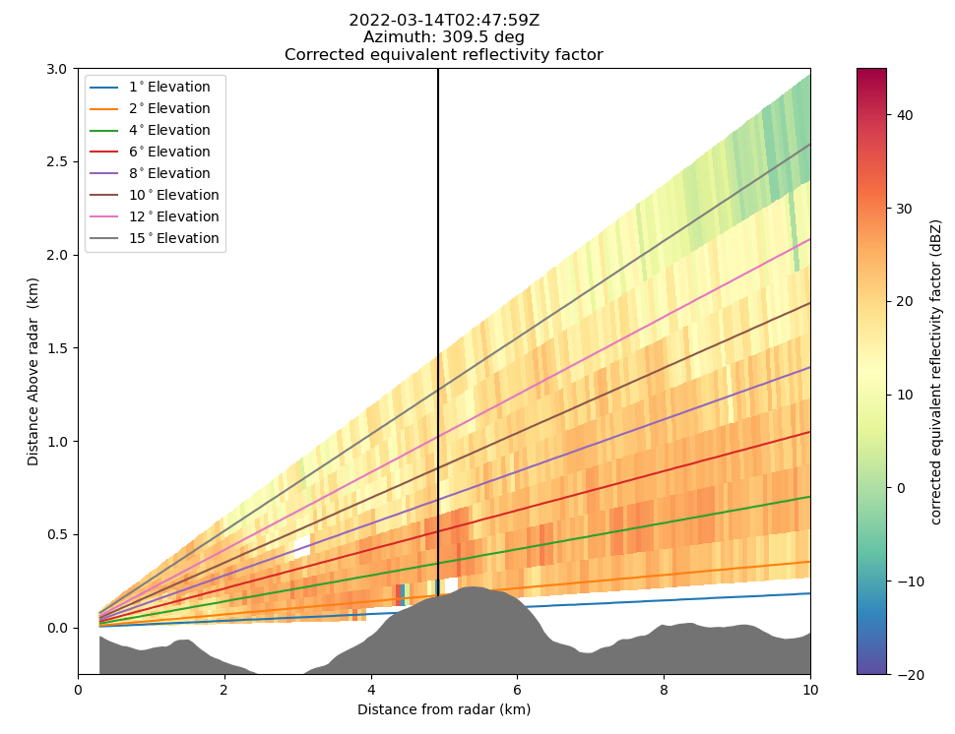
Extracted Radar Columns and In-Situ Sensors (RadCLss)
Py-ART Utility:
New: pyart.util.column_vertical_profile()
To allow for direct comparison between radar estimated precipitation and observed precipitation at locations of interest.
Utilizing Py-ART and ACT:
In-situ sensors are collocated with the extracted radar column above the sites
Winter 2022 Data Available by the Jan ‘24

Slide 9
FY24 Goals
FY24 goals:
CMAC processing of rest of the campaign
Further analysis into CMAC KDP processing
Comparison of multiple methods for calculating differential phase PhiDP and its range derivate KDP were conducted for 25 August 2022
KDP processing inspired by Giangrande et al. (2013) Linear Programming (LP) method found to be the most robust for conditions observed during SAIL.
Validation of SQUIRE
Release RADCLss product
Including CMAC Rain calculation

Slide 10
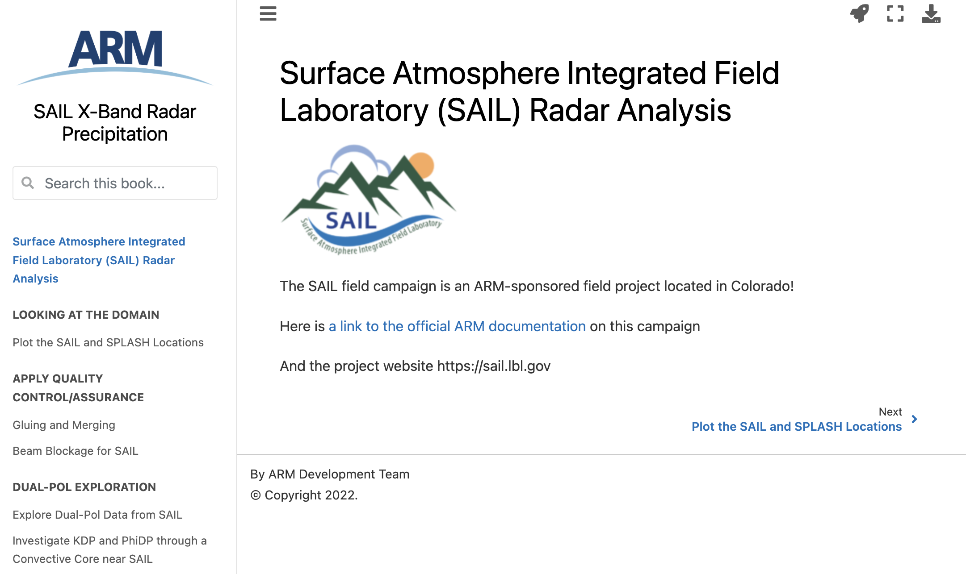
Open Science in the Rockies (Continued)
Seasonal Classification
Creation of Epochs to determine surface precipitation type
Would appreciate input for any scientifically interesting cases and why
Example:
22 Dec 2022 Blowing Snow Event
Crowd-sourcing this information will help create `analysis ready` periods for students and researchers new to the SAIL (SPLASH/SOS) datasets
Open Science Jupyter Notebooks
Workflow or Case examples appreciated!
https://arm-development.github.io/sail-xprecip-radar/

