Slide 1
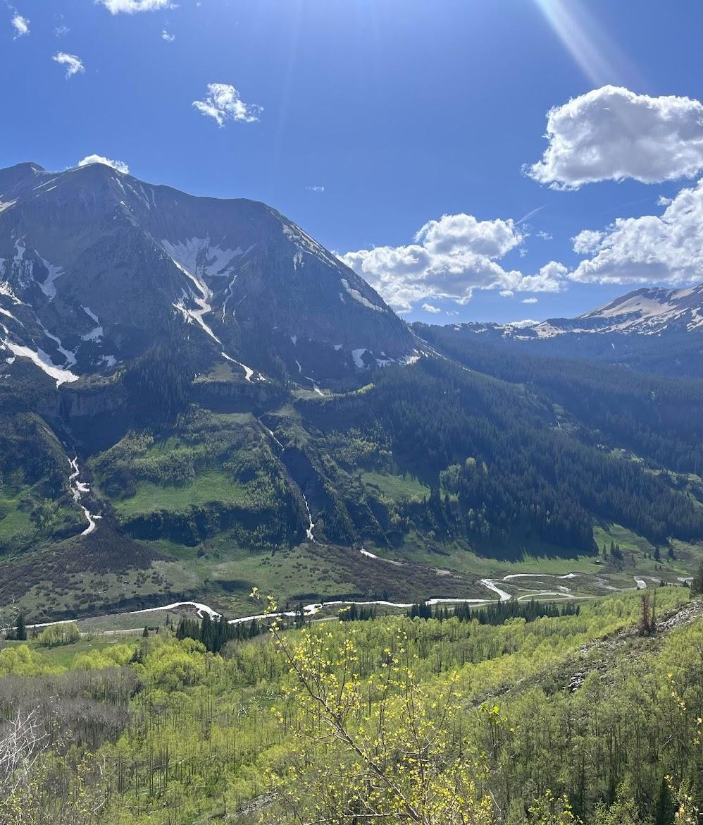

X-band Radar and Surface-based Observations of Cold Season Precipitation in Western Colorado’s Complex Terrain
S3 Workshop, November 2nd 2023
Stella Heflin, Mimi Hughes, Sounak Biswas, Annareli Morales, Rob Cifelli, Joseph Sedlar, Dan Feldman, V Chandrasekar, Patrick Kennedy
smheflin@uw.edu

Slide 2
Science Goals
SPLASH Campaign Goal
Advancing weather and water prediction capabilities in areas with complex terrain
Research goal
Qualitatively and quantitatively understand temporal and spatial variability in cold-season precipitation in complex terrain
Investigate potential factors of variability
Why?
Better model and predict Colorado River Watershed water resources in complex terrain of Upper Basin using novel microphysical data for this region

Slide 3
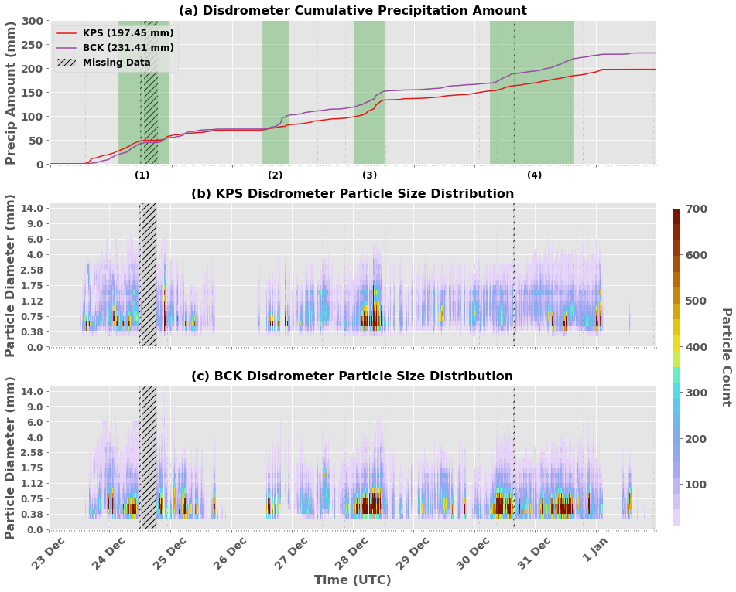
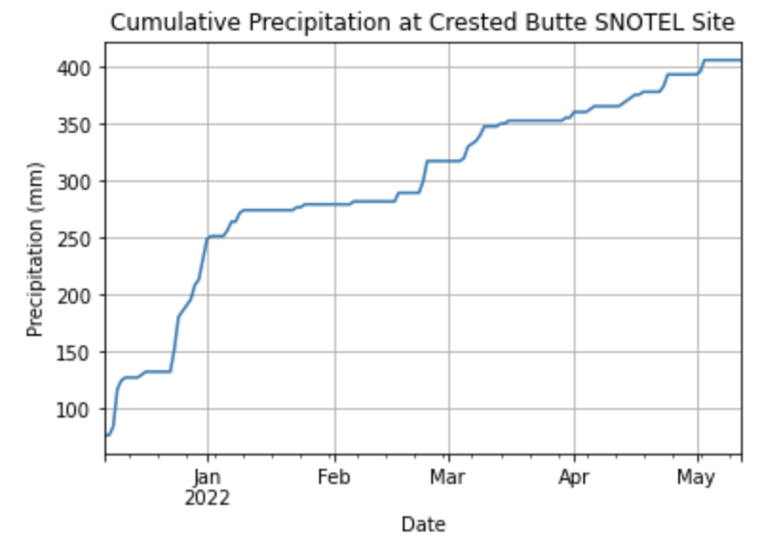
Santa Slammer:
December 23, 2021 - January 1, 2022
Four distinct storm periods within larger event (green)
Each period has unique precipitation characteristics
Evaluated at BCK and KPS

Slide 4
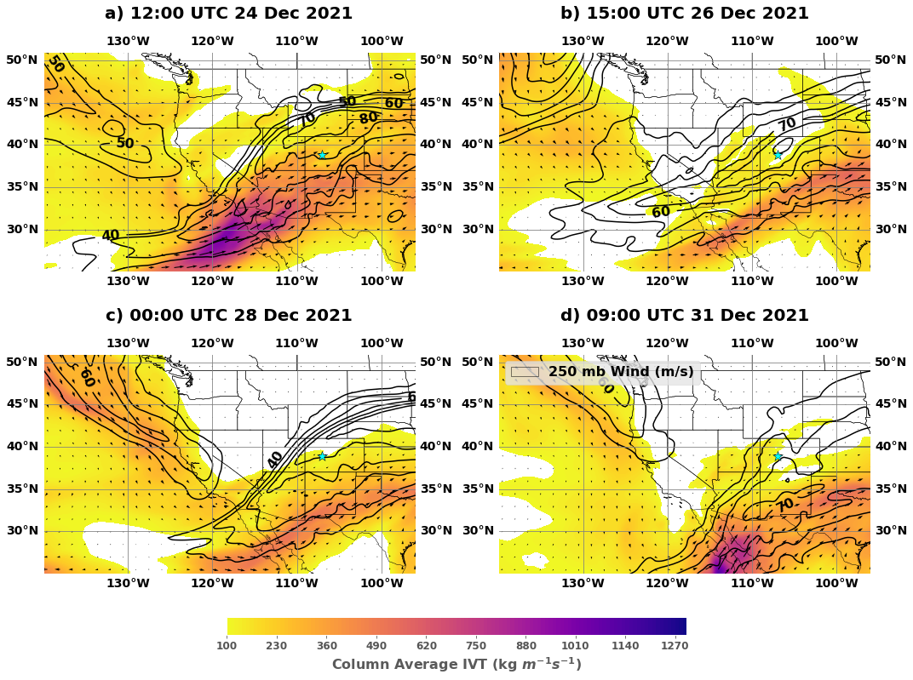
Synoptic Conditions
Four distinct observable periods of moisture flux – used to bound the four Storm Periods
Note: Period 1 in Figure (a) has > 300 kg / m-s of IVT → inland penetrating AR?
Notes:
Blue stars represent ESW

Slide 5
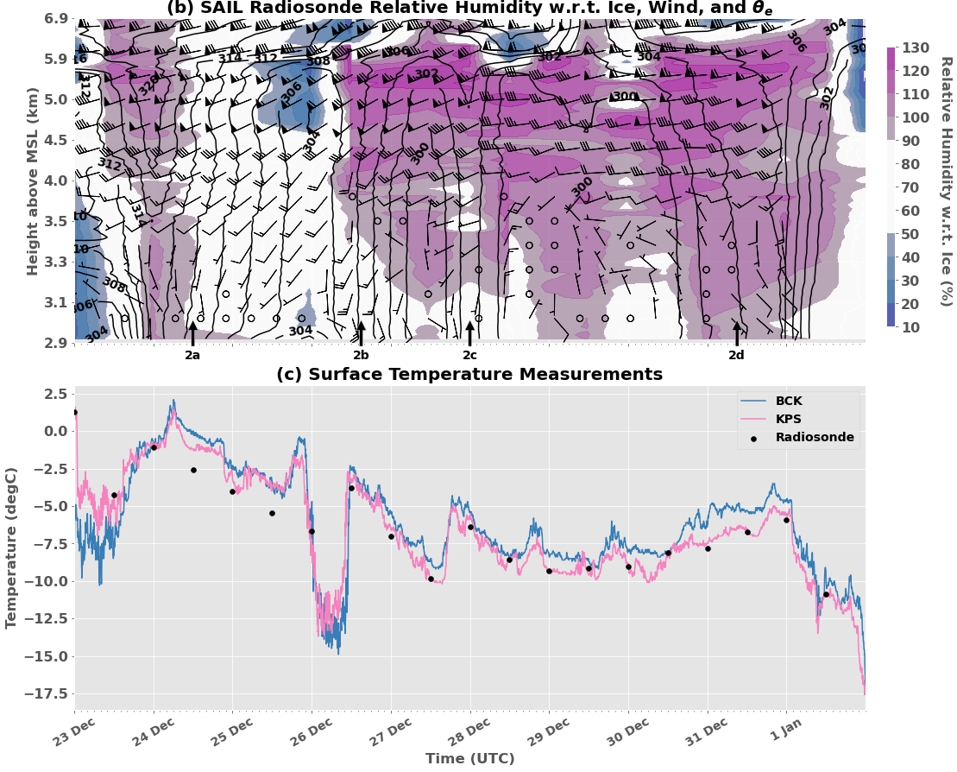
Synoptic Conditions
Each storm period associated with unique frontal system
Shallow cold pool corresponds to clear window on Dec. 25-26
Notes:
Arrows correspond to ERA5 plots on previous slide

Slide 6
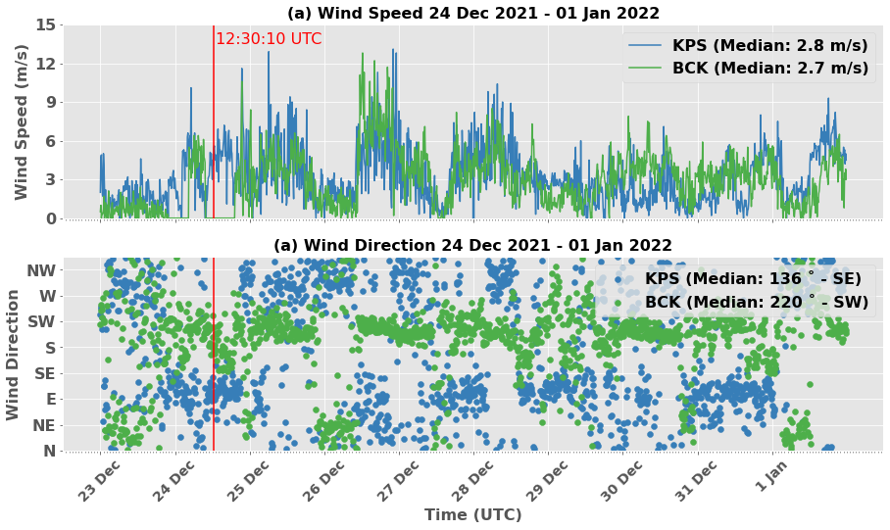
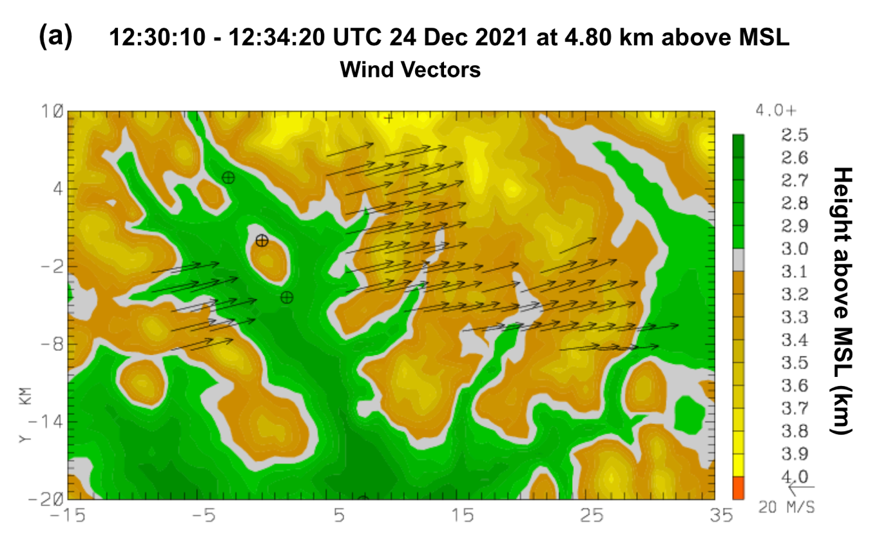
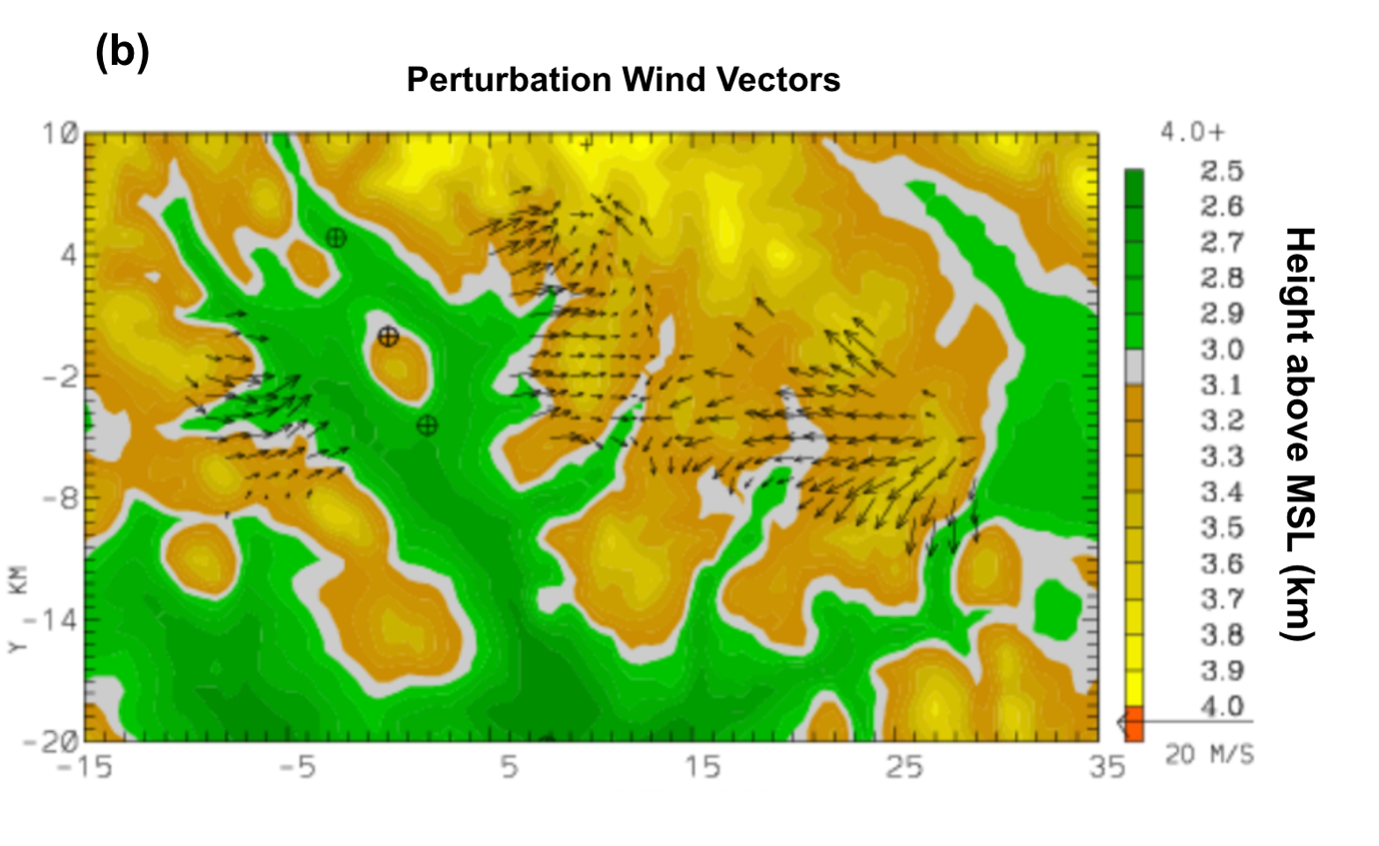
Local + Regional Winds
(Above) Wind at both sites of similar magnitude
(Above) KPS - SE and BCK - SW, aligned with surface topography
(Right) Dual-Doppler shows us dominant flow is cross-valley (aligned w/ synoptic) during intense precipitation

Slide 7
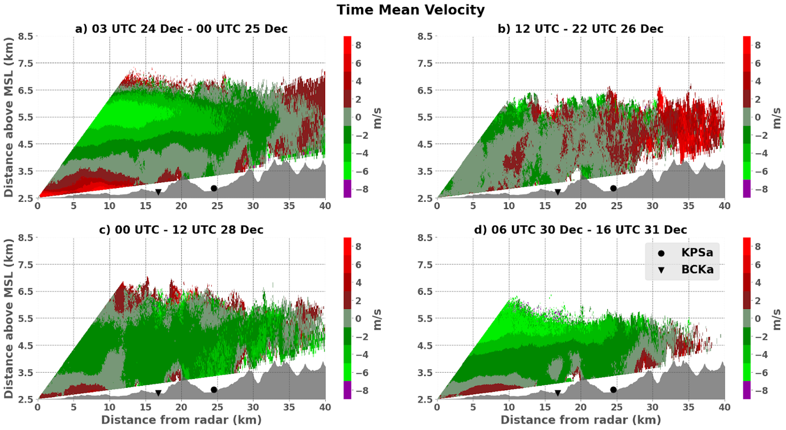
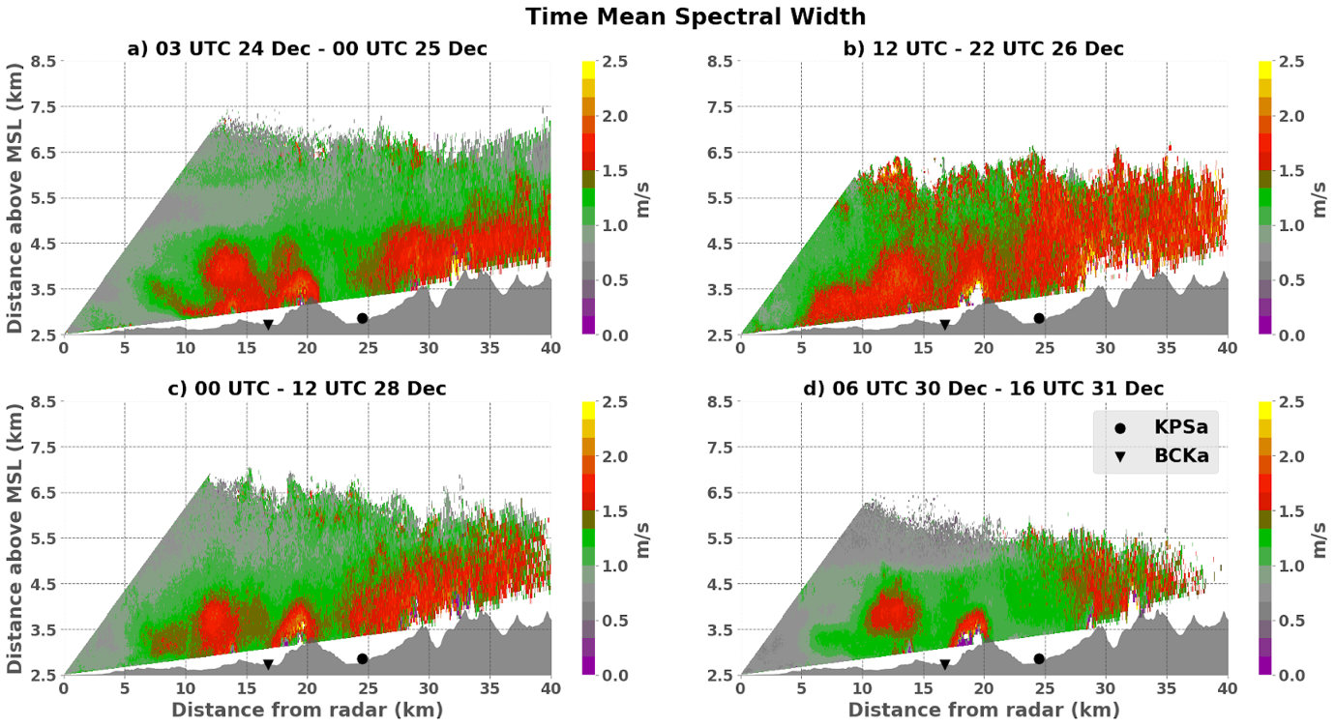
Spectral Width - Below
Proxy for turbulence
Enhanced over Mt. Crested Butte (~20 km from radar)
Also enhanced over topography to right of KPS, only sometimes extends downstream to site
Radial Velocity - Above
Vertical directional shear observed in Period 1 Fig (a) and Period 4 Fig (d)
Outbound velocities → upslope winds → increased turbulence over topography
Notes:
Red = AWAY, green = TOWARDS
Vertical shear associated with orographic precip enhancement

Slide 8
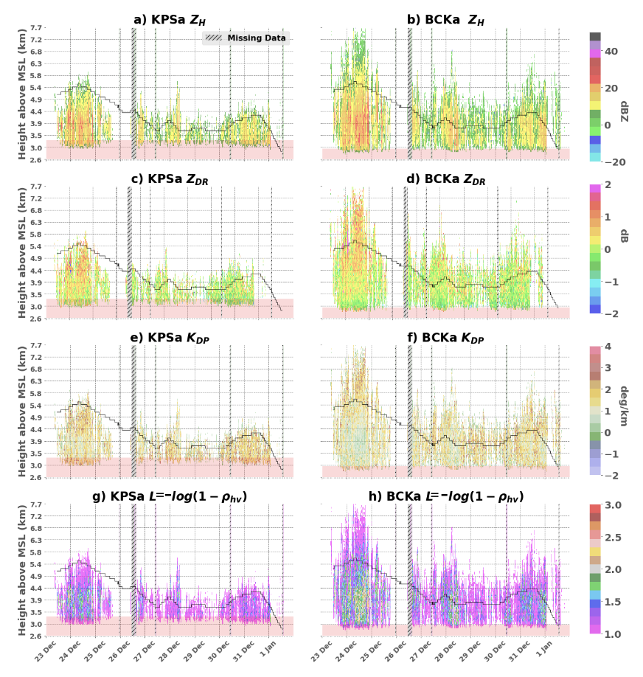
Dual-pol Variables
Period 1 (red box) shows
enhanced ZDR and KDP above -15 degC isotherm (black) → dendritic crystal growth!
decreasing RHOHV and enhanced ZH towards surface → aggregation!
Periods 2 - 4 shows:
weaker signatures of aggregation, associated with cooler temps
Notes:
The red shading denotes the areas where data were filtered out due to possible partial beam blockage. Missing data is shown in hatch markings.

Slide 9
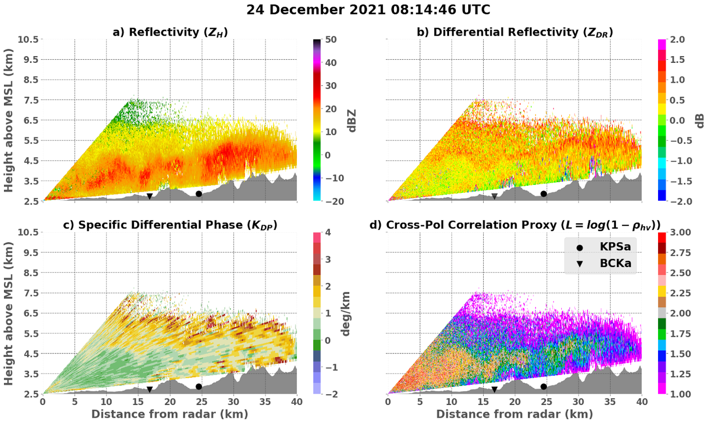
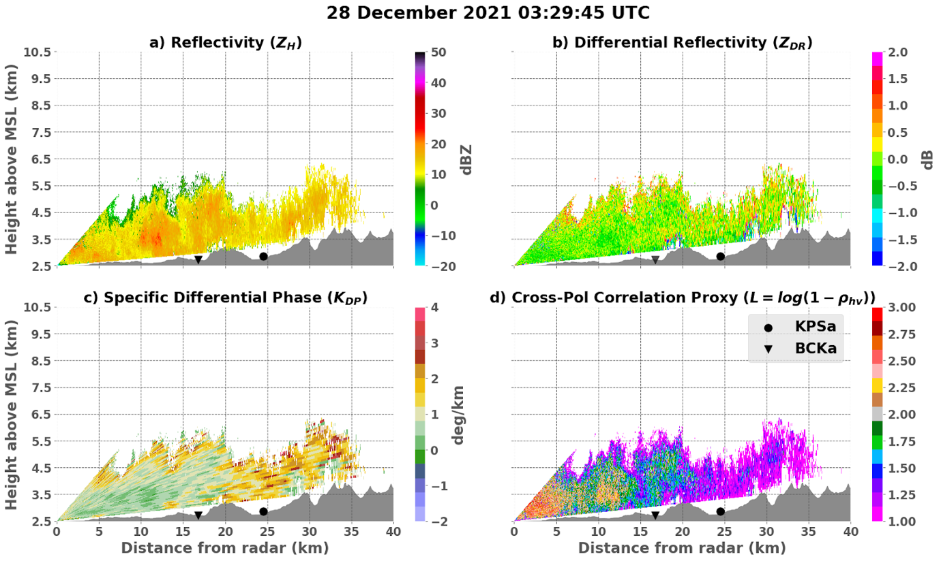
Strong synoptically + orographically driven aggregate formation
Storm Period 1
vs
Weaker precipitation, less forcing
Storm Period 3
Deep cloud base
Signatures of dendritic growth, transitioning to aggregation below 4.5 km
Shallow cloud base
Small crystals
No signatures of aggregation or dendritic growth

Slide 10
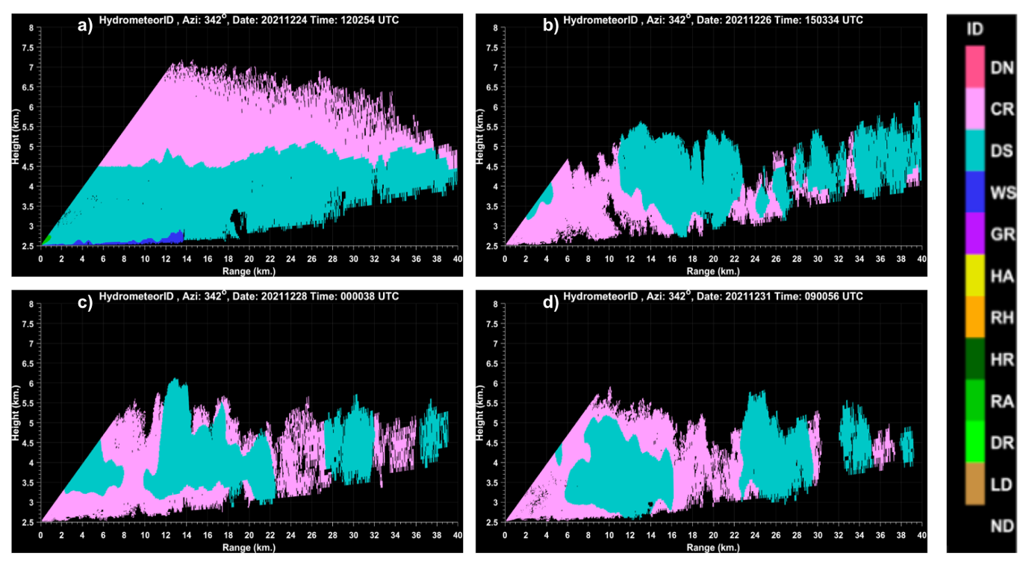
Hydrometeor ID
Pink - small crystals
Blue - aggregates
Storm Period 1 Figure (a) - clearly defined crystal and aggregate layers
All other time periods have aggregate layer windward of orography – indicating forcing

Slide 11
Conclusions
Temporal variability driven by differences in synoptic conditions (i.e., temperature, wind speed and direction)
Spatial variability driven by terrain, orographic enhancement occurs preferentially at BCK during this event
Impacts of orographic flow on precipitation microphysics consistent with previous findings (Schneebeli et al. 2013; Zagrodnik et al. 2019; Campbell and Steenburgh 2014; González et al. 2021, etc.)
Identification of low-density aggregates versus higher density crystals from radar dual-pol data can provide information about surface snowpack density

Slide 12
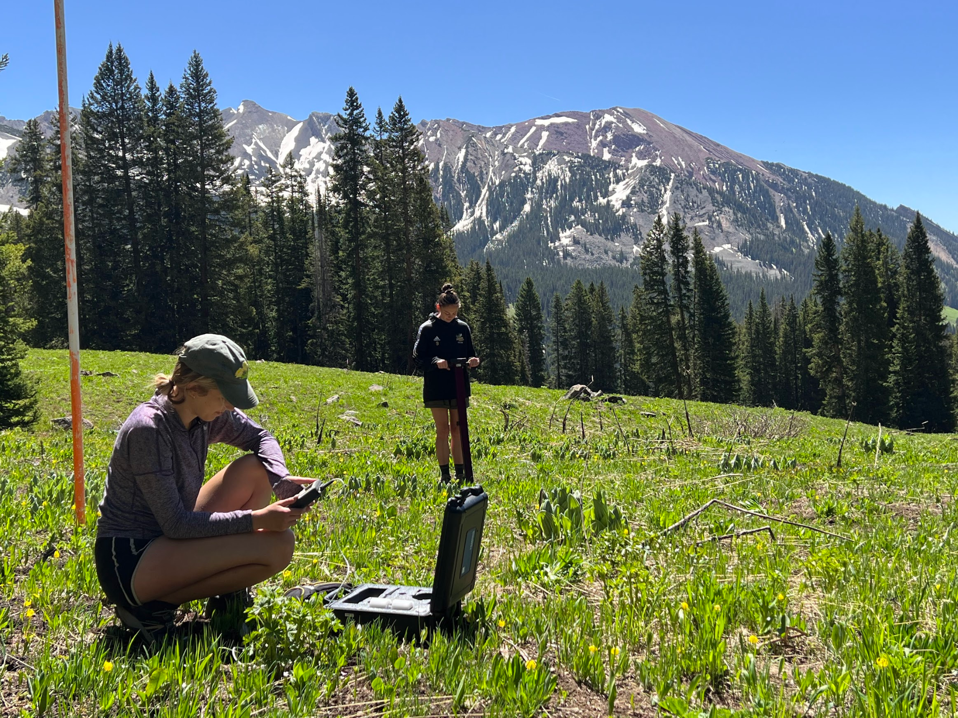

Questions?
This work funded in part by
NOAA Office of Education EPP/MSI Scholarship
NOAA DOE ARM Program
NOAA Cooperative Agreements

Slide 13
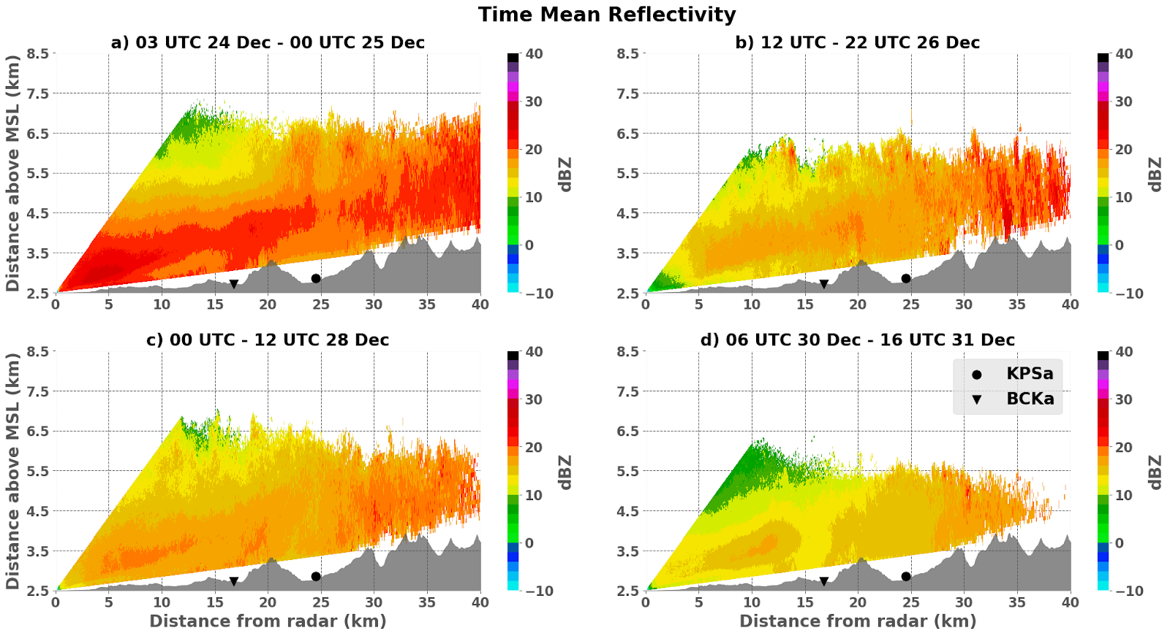
Reflectivity
Enhancement of reflectivity over topography
Specifically down-valley of Mt. Crested Butte (~20 km) and orography to right of KPS
Orographic forcing responsible for spatial variability in observed precip

Slide 14
Campaign | Instrument | Location
SPLASH | Dual-pol X-band radar | Roaring Judy Fish Hatchery (RJY) (38° 43' 0.4794" N, 106° 51' 10.44" W) 2,504 km MSL
SAIL | Dual-pol X-band radar | Mount Crested Butte (38˚53’54.0996” N, 106˚56’35.304” W) 3,137 m MSL
SPLASH | OTT Parsivel disdrometer | Kettle Ponds (KPS) (38° 56' 31.2000" N, 106° 58' 22.7994" W) 2,863 m MSL Brush Creek (BCK) (38° 51' 33.1200" N, 106° 55' 15.2400" W) 2,723 m MSL
SPLASH | Surface meteorological instrumentation (thermometers, anemometers, etc.) | Kettle Ponds (KPS) Brush Creek (BCK)
SAIL | Radiosondes | ARM site in Gothic, CO (38˚57’22.1688” N, 106˚59’16.2816” W) 2,886 m MSL

