Slide 1



NCAR/EOL SOS Field Data Archive and SOS Data Management
Presented by Jessica Lundquist on behalf of
The NCAR/EOL Data Management Team:
Greg Stossmeister, Linda Cully, Scot Loehrer, Daniel Choi and
Linda Echo-Hawk (echohawk@ucar.edu)
eol-archive@ucar.edu

Slide 2
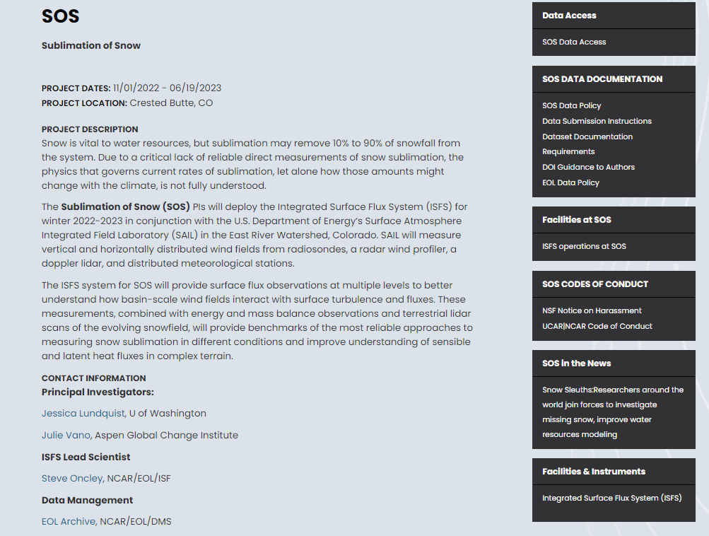
NCAR/EOL SOS Project Page
Project Description
Long-Term Data Archive Access
SOS Data Policy
Data Submission Instructions
Dataset Documentation Guidelines
Publications
Meetings and Presentations
https://www.eol.ucar.edu/field_projects/sos

Slide 3

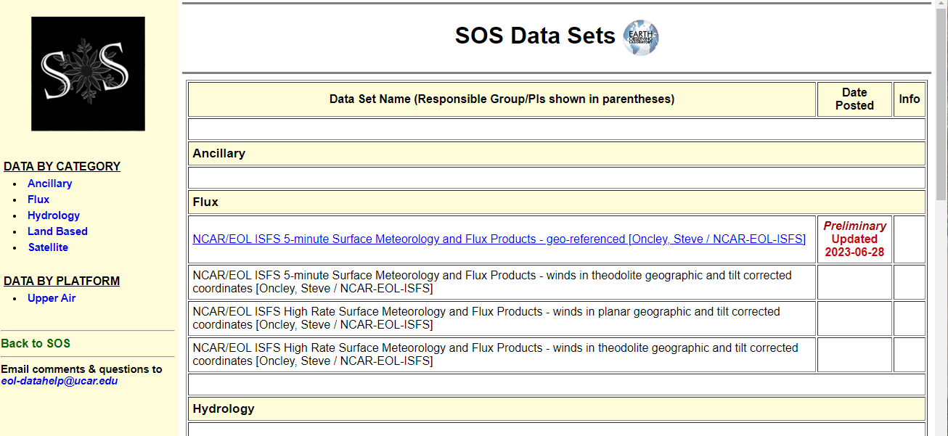
SOS Field Data Master List
Submissions to the Field Data Archine (FDA) are linked to the Master List for ordering
Expected data sets are listed too
Follow the link in the Data Access block on the SOS Project Page https://data.eol.ucar.edu/master_lists/generated/sos/

Slide 4
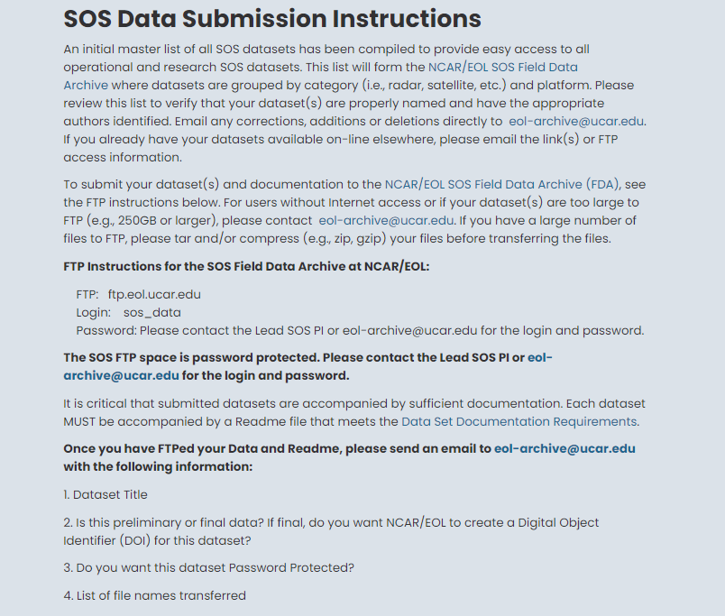
SOS Data Submission Instructions
Once you have completed your submission send me (echohawk@ucar.edu) an email to let me know so I can get it into the queue for loading into the SOS Field Data Archive
Linked in the Data Documentation Block on SOS Project Page

Slide 5
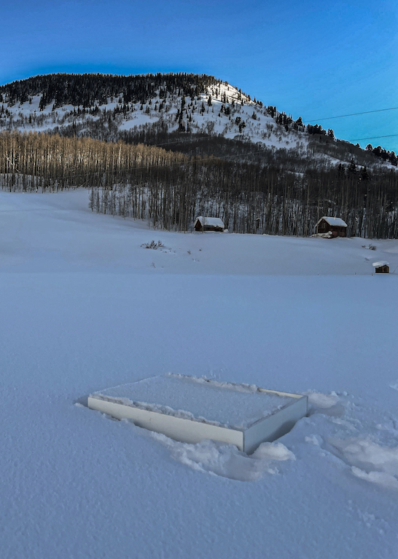
Additional Datasets Submitted (or Soon to be Submitted) to the Drive
Terrabytes of Lidar point cloud data
Weather blog: (https://depts.washington.edu/mtnhydr/Pages/NewDataPages/SOSdata.html)
Snow Pit Data (next page)
Stossel Box Data (see photo right)
Thermistor Harp Data (shown yesterday)

Slide 6
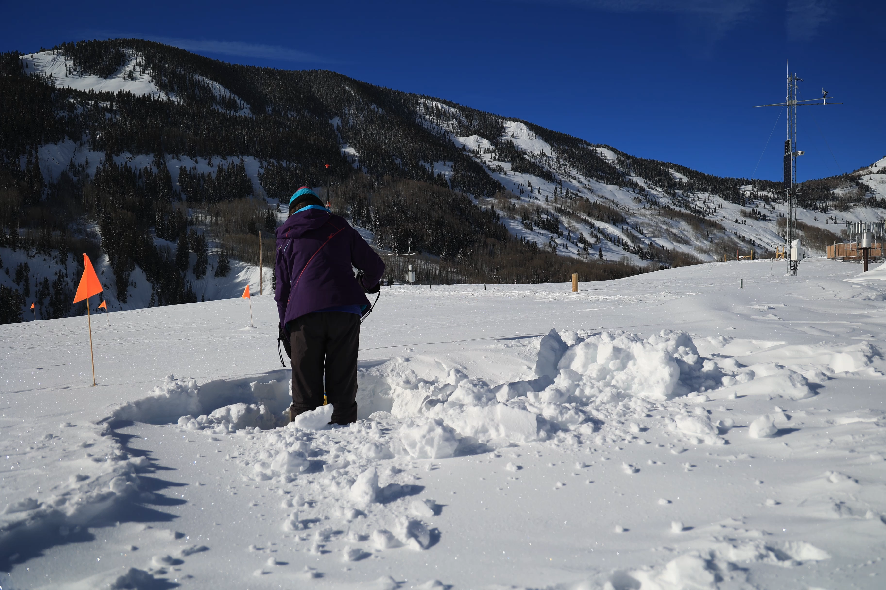
https://www.agci.org/projects/sublimation-of-snow-sos-project/snow-pits
Notes:
Overview
In this video, we meet Danny and Eli, two UW graduate field researchers spending the winter of 2023 on a remote field experiment at the Rocky Mountain Biological Laboratory in the mountains of Western Colorado. In this video, viewers will come to appreciate what’s involved in field research, see how collecting field observations/data is a logistically, physically, and sometimes even emotionally challenging endeavor, and learn about the rewards it can bring – as well as learning about snow sublimation and why it’s important to study.

Slide 7
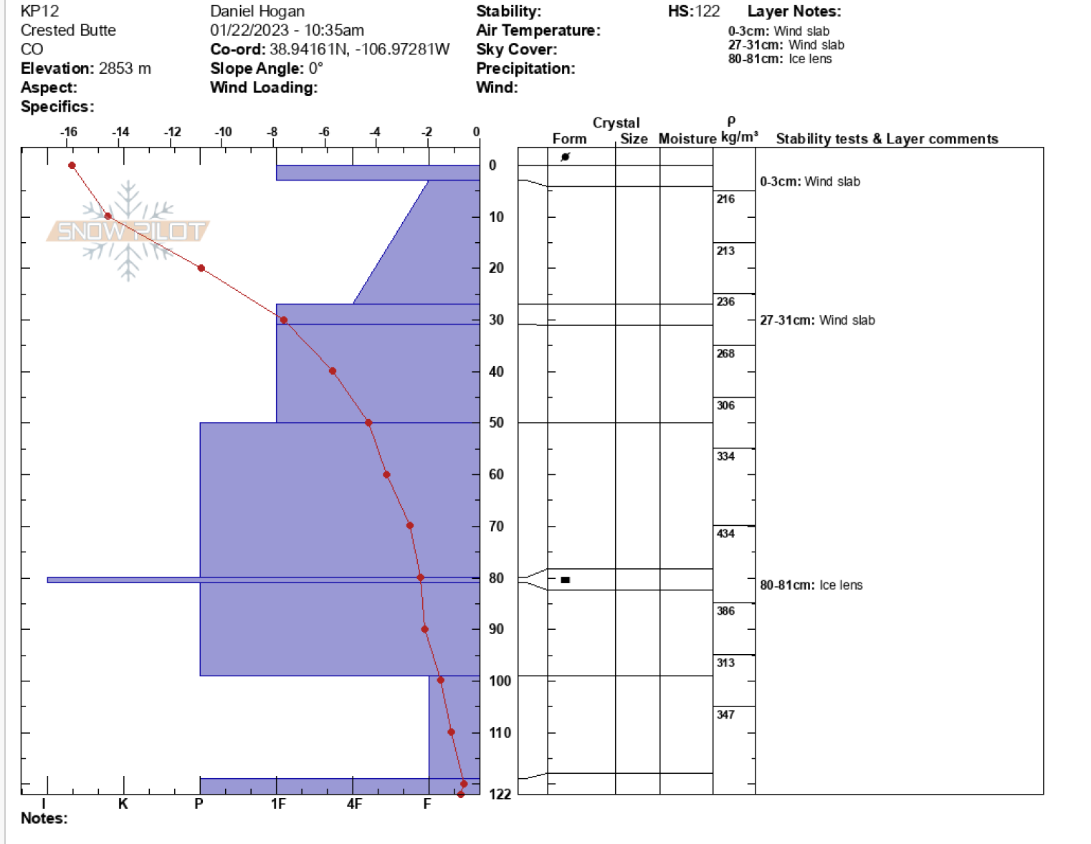
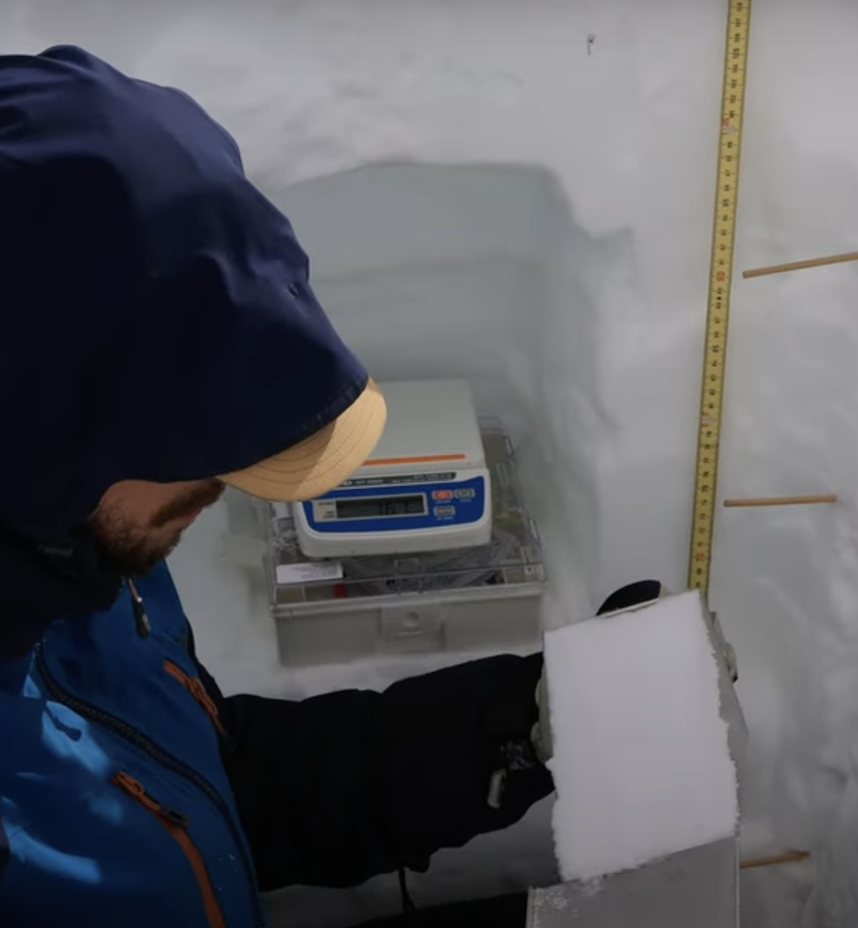
Example Snow Pit Measurement Entry (22 January 2023)

Slide 8
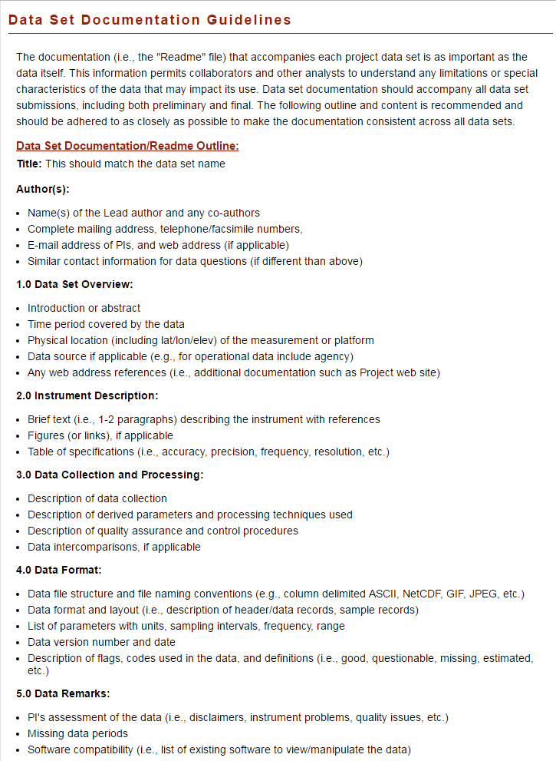
SOS Data Documentation Guidelines
Provides a sample format and suggested content for the documentation files provided with data sets:
  Contact information including a listing of author(s)
  Overview of the data set
  Instrumentation description including specifications (accuracy, precision, etc)
  Data collection methodology
  Data processing and quality control descriptions
  Format description
  Assessment of data quality
Linked in Data Documentation Block on SOS Project Page
Or https://www.eol.ucar.edu/node/4871

Slide 9
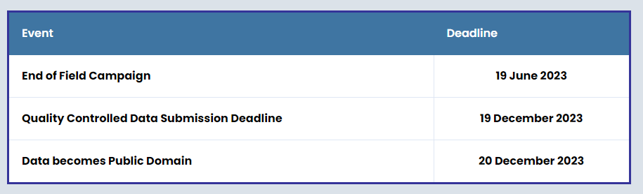
SOS Data Policy Deadlines
Linked in the Data Documentation Block on SOS Project Page
Or https://www.eol.ucar.edu/content/sos-data-policy

Slide 10
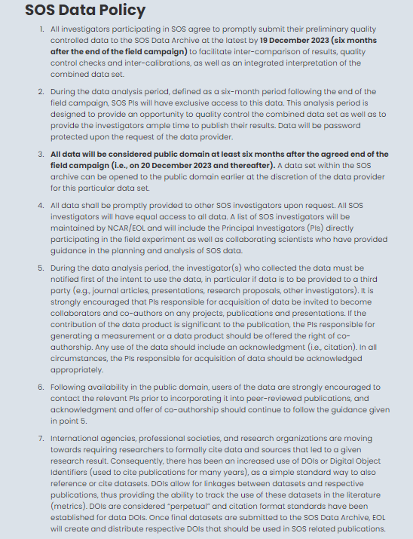
SOS Data Policy Details
Preliminary data due
19 December 2023
(6 months after the end
of the field campaign)
A Digital Object Identifier (DOI) will be created for “final” data.
Linked in the Data Documentation Block on SOS Project Page
Or https://www.eol.ucar.edu/content/sos-data-policy

Slide 11
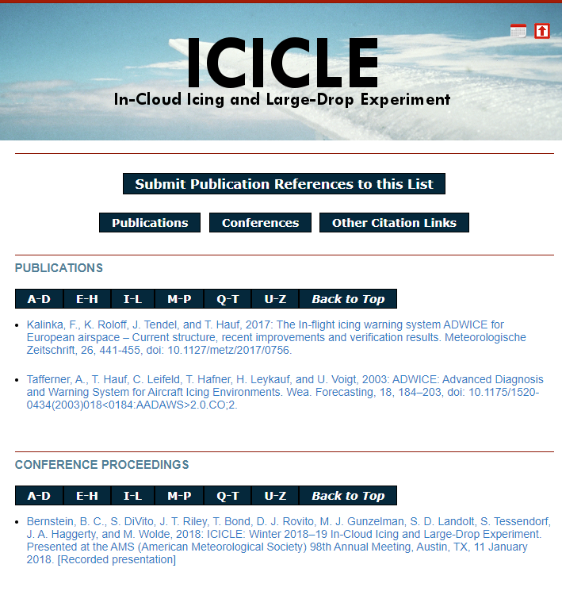
A Publications Page similar to this will be created as publication references are received
Will contain links to SOS publications as they become available
Includes refereed papers, reports, theses, and conference presentations
Right now, you can find more at the bit.ly/sublimation-of-snow page by AGCI, but long term, there will be an archive at NCAR

Slide 12

Please contact us with your
Data Management questions. We’re here to help!
echohawk@ucar.edu or eol-archive@ucar.edu

