Slide 1



The Study of Precipitation, the Lower-Atmosphere, and Surface for Hydrometeorology
ARL surface layer observations in support of SPLASH
Tilden Meyers, Mark Heuer, Randy White, Sreenath Paleri, Tom Wood and John Kochendorfer
NOAA/OAR/Air Resources Lab
BIG THANKS to Eric Hulm and Ben Schmatz

Slide 2
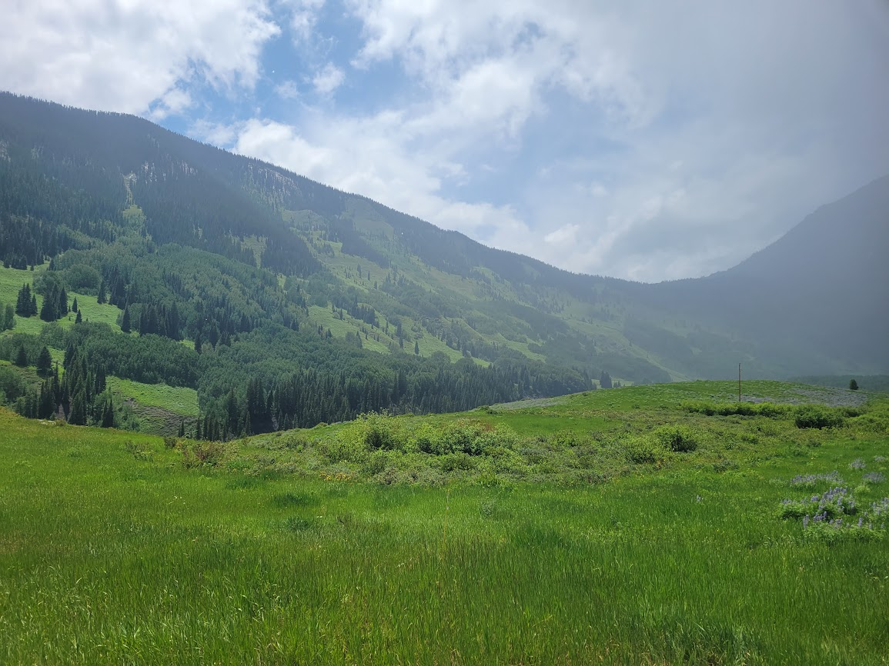
Concerns!
complex terrain
heterogenous landcover
representativeness
katabatic flows, winds
poor data comms
wintertime accessibility
subsurface rocks and
aggregates
“I’ve got a feeling we are not in Kansas anymore…”
Notes:
If I were to pick a location that on the surface would appear to violate our measurement constraints for EC, this would be it. At the same time, we as observationalists need to go beyond our comfort zone and perhaps find ways to provide the needed obs like fluxes, turbulence statistics and mean state variables in less than ideal conditions.

Slide 3
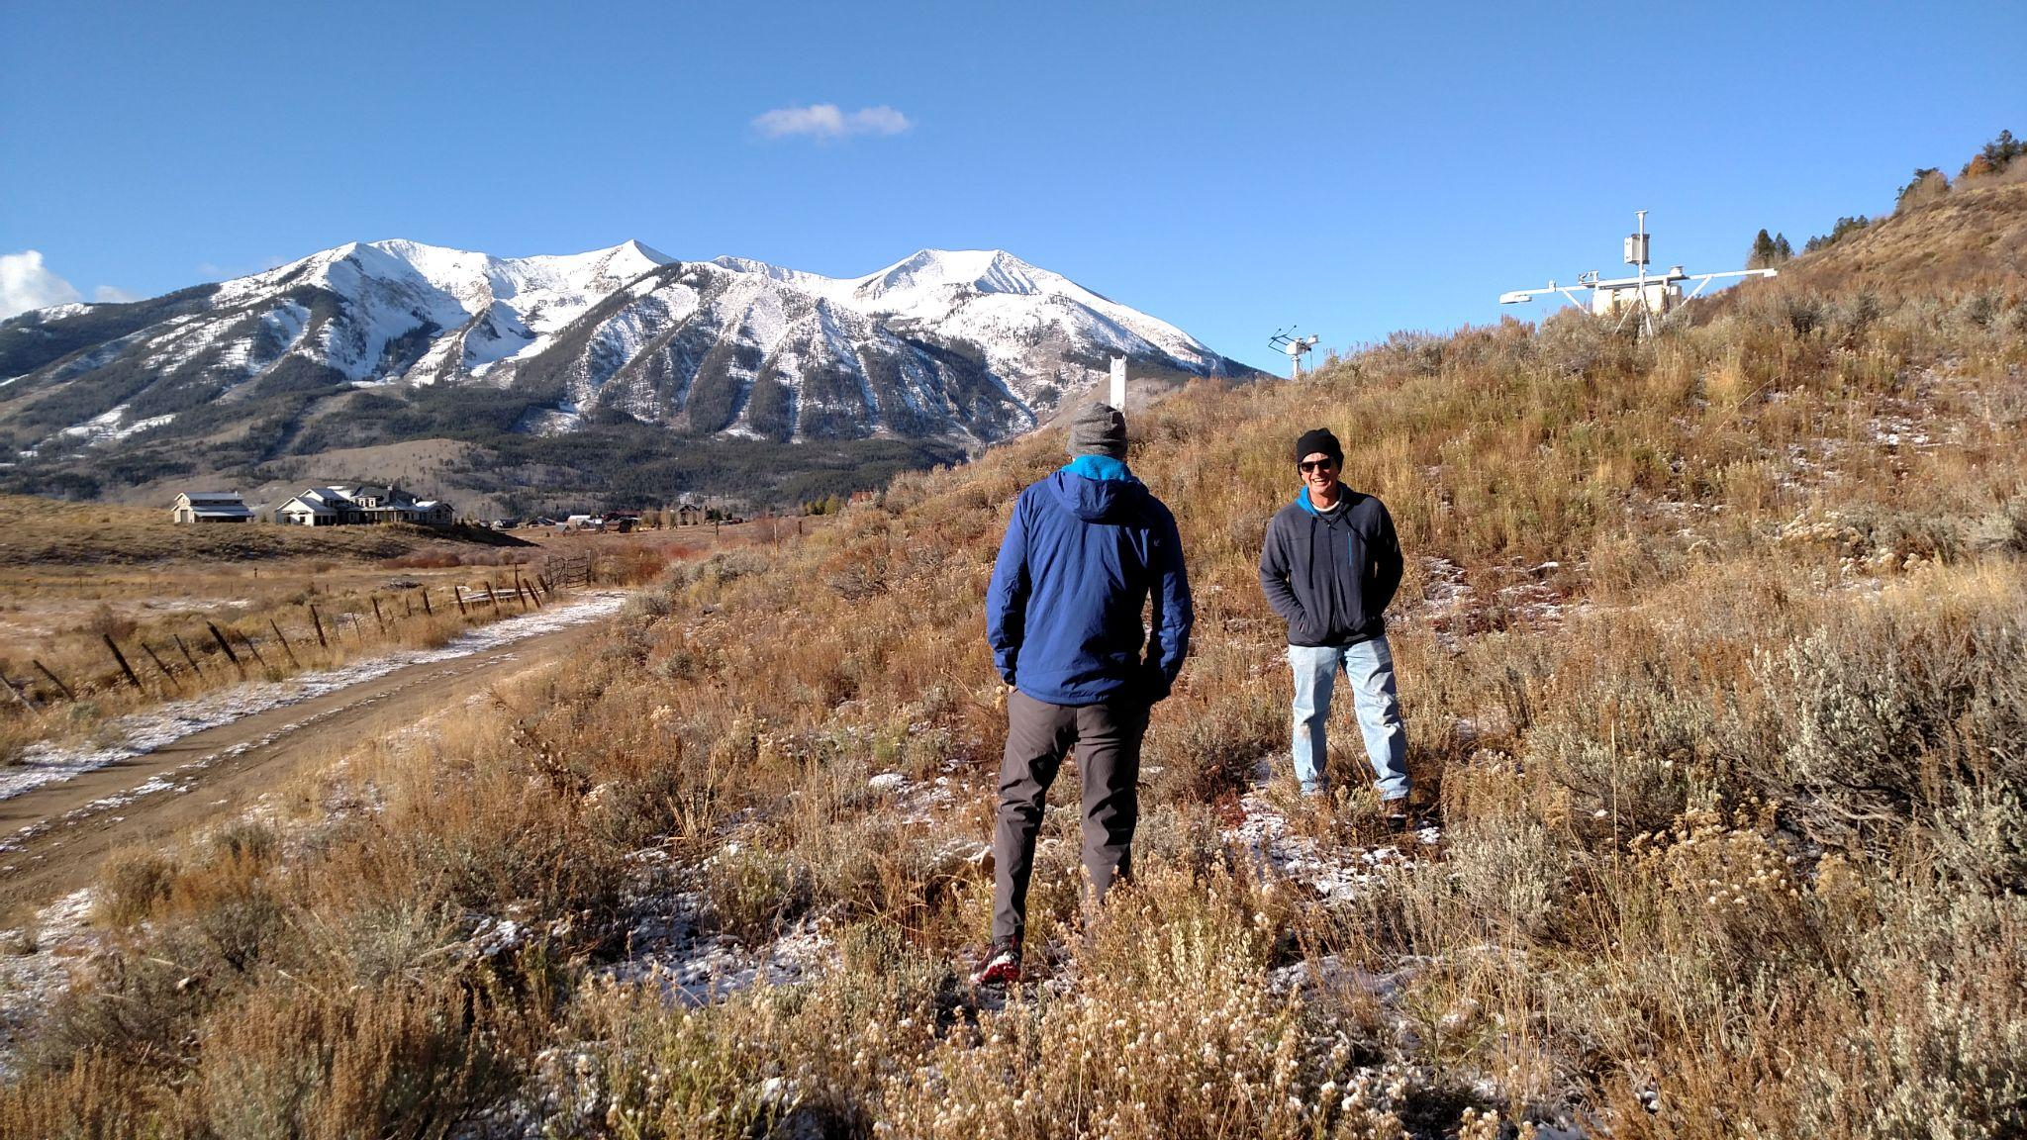
“what the @$#? are we doing here”?

Slide 4
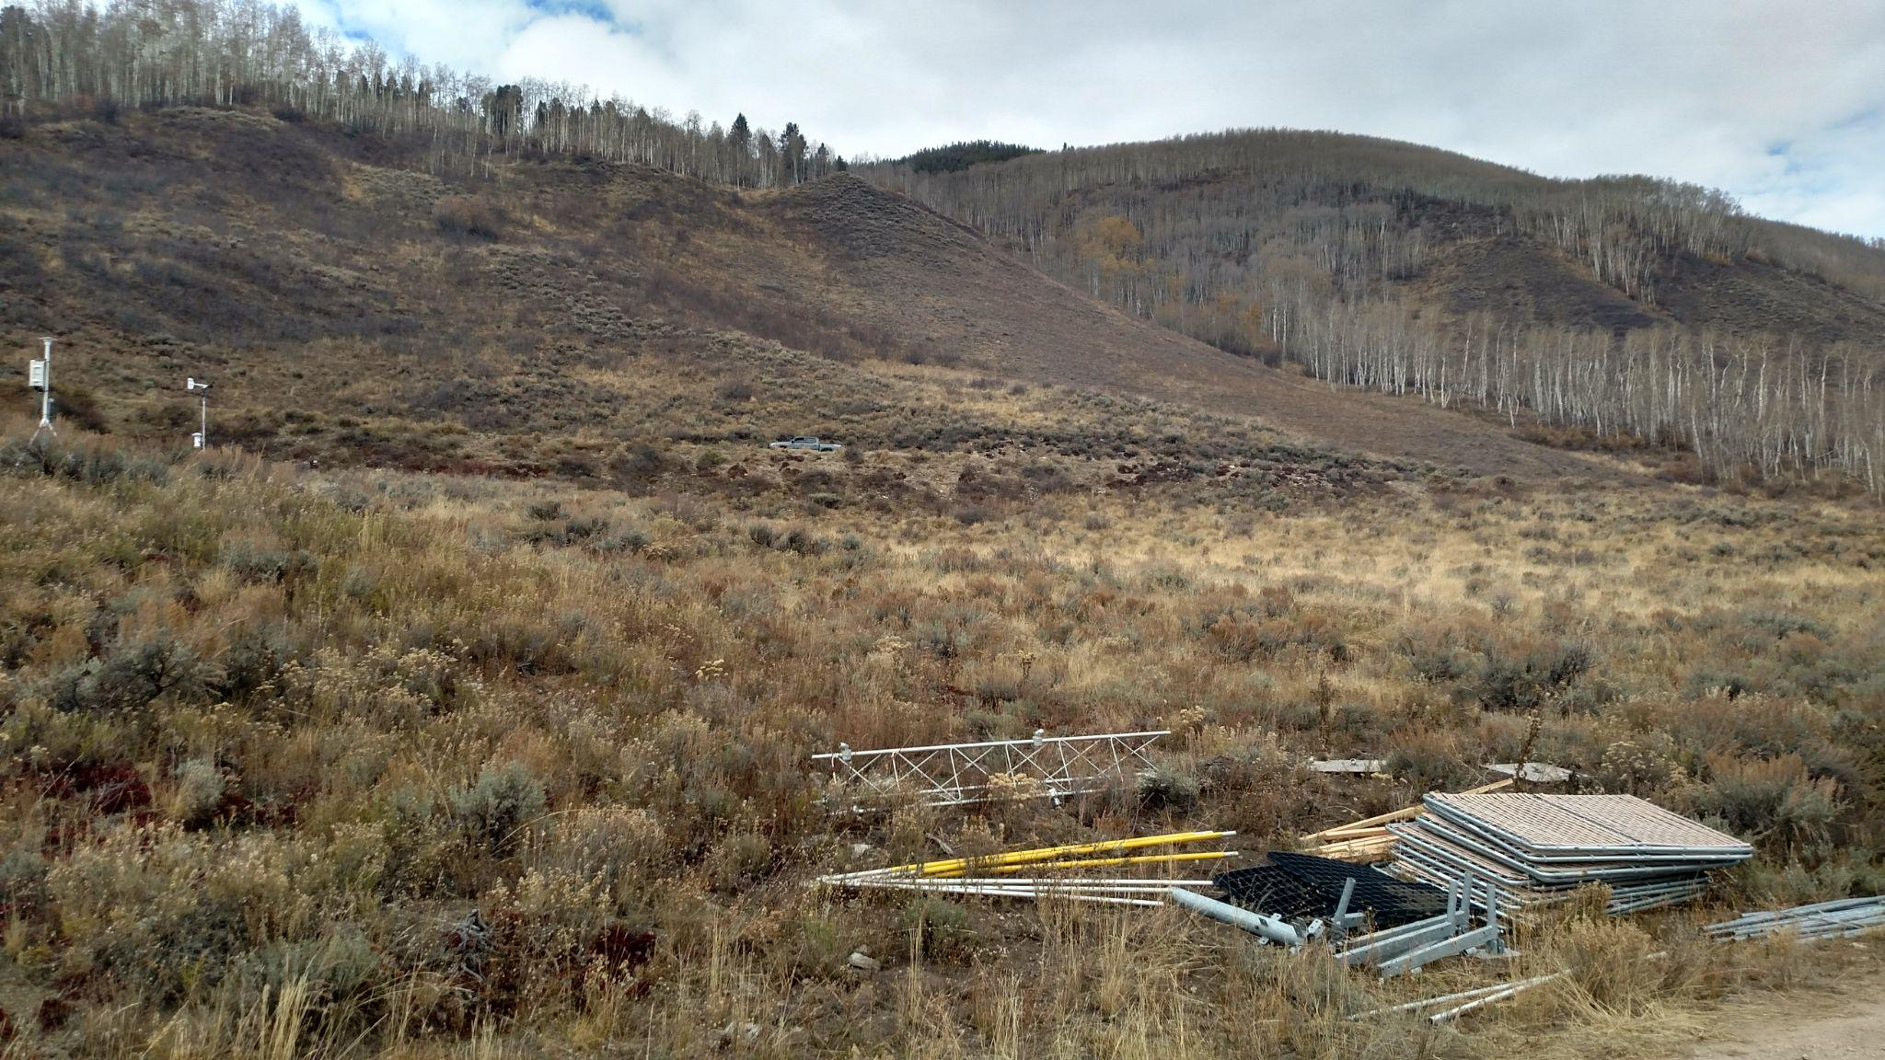

Slide 5
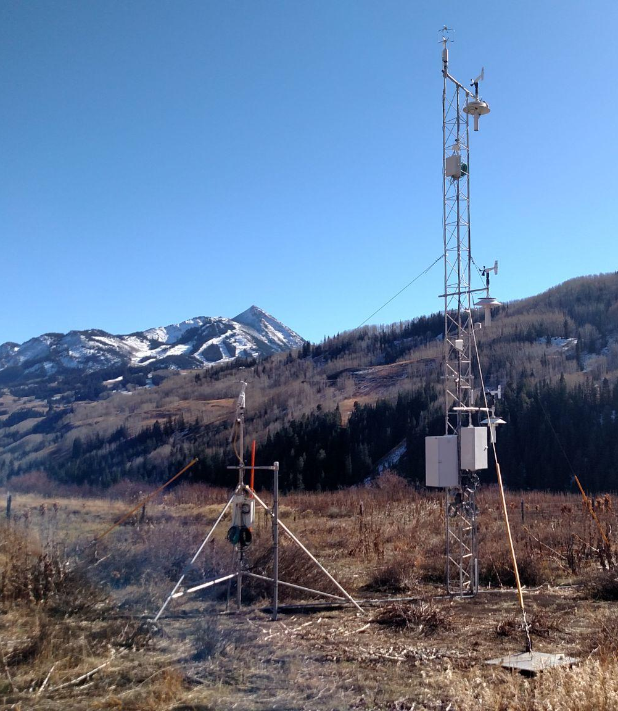
Eddy covariance at 3 and 10 m
LI-7500 DS for H2O and CO2
Smartflux system with RM Young VRE Sonic
EddyPro processing software
10 Hz sampling, output 30 minute average
EC Data Processing
Block averaging
Sensor separation
frequency response
Angle of Attack
2-dimensional Coordinate rotation
Will also compute using Planar Fit method
Output
u*, CO₂ flux, H, LE, 𝛔_{u},𝛔_{v},𝛔_{w} →→TKE, z₀

Slide 6
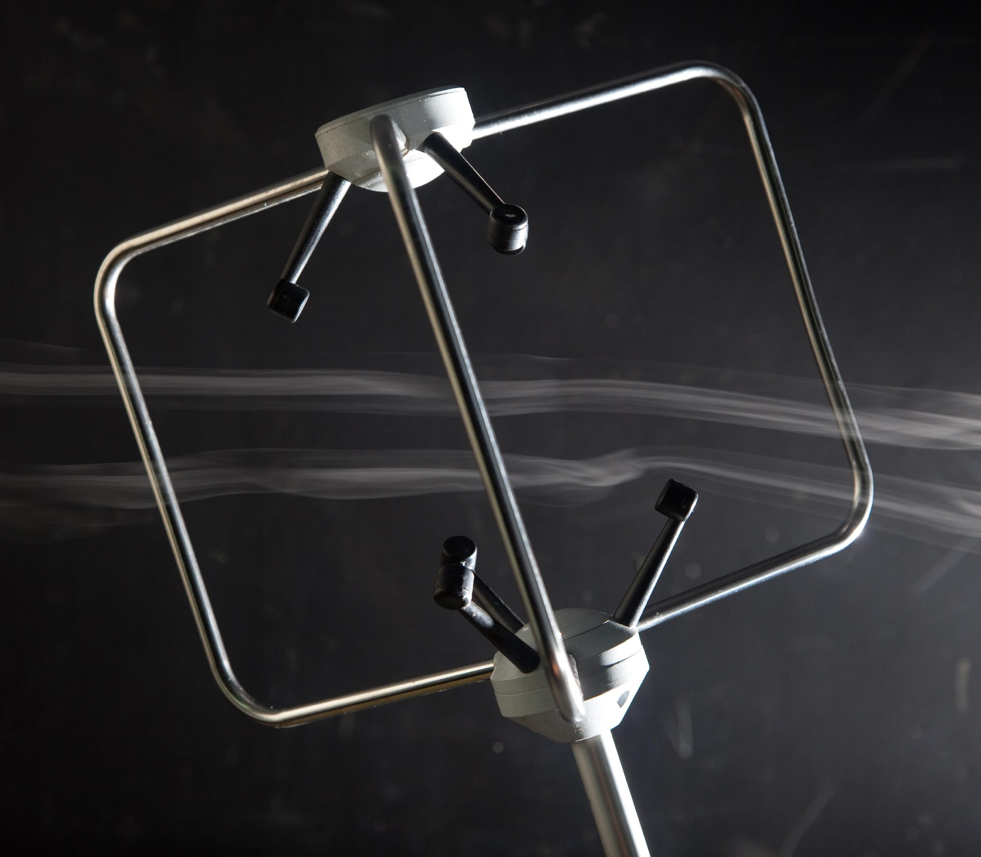
Angle of Attack - The angle of the vertical wind relative to the horizontal component. Non-orthogonal sonic configurations have been shown to underestimate the vertical wind component ranging from 5 - 15%.
Nakai, T 2012. Ag and Forest Met. Gill R2, 10 - 14%
Kochendorfer,J. 2014, Bound. Lay Met. RMY 81000VRE, 10 - 15%
Frank, J. 2016. JTEC. CSAT3, 8 - 10%
Horst, T. 2015. CSAT3, 4 - 5%
Thomas, T. (M.Sc 2017) CSAT, Gill R3, Gill R50 ~ 10%
Pena, A. 2019. Atmos Meas. Tech, CSAT3, METEK-1 ~ 10%
http://https://www.apptech.com/wp-content/uploads/2016/08/Evolution-of-Sonic-Anemometry.pdf
https://www.apptech.com/wp-content/uploads/2016/04/Flow-Distortion-Errors-in-a-non-orthogonal-Sonic-Anemometer-1.pdf

Slide 7
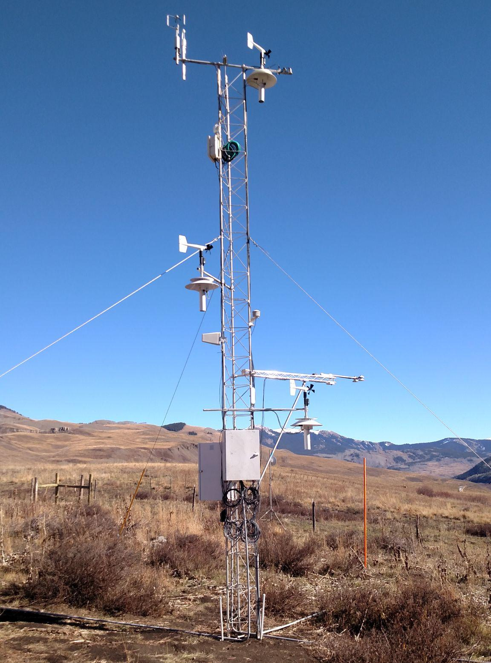
3 level profile system
Air temperature (2 PRT’s each level in aspirated shield) and wind speed and direction RM Young propeller anemometer
4 component net radiometer (Hukseflux NR01), SW_in, SW_out, LW_in, LW_out, and PAR_in, PAR_out.
3 downward looking IRT’s (infrared radiometric temperature) Apogee SS-111.
(using paper by Thakur et al in www.nature.com/scientificreports/ to determine surface emissivity

Slide 8
Tower Measurements
Sensors | Hukseflux 4 component net radiometer, LICOR PAR, IRT, Ta, Ws
Sample heights | ~ 3 m, 5m, 10 m
Sample rate | 5 sec
Averaging period | 1 min
Measured quantities | SW🡻,SW🡹,LW🡻,LW🡹,PAR🡻,PAR🡹
Derived quantities | Shortwave albedo, Ts, broadband NDVI, Ri

Slide 9

CSI Soilvue10 (TDR) Probes for soil moisture/temperature
SDI-12 Outputs VWC, Ts, dielectric, conductivity (x 2 reps)
soil temperature probes (precision thermistors) at 2, 5, 10, 20, 50 cm) (x3 reps)
— 5 cm
— 10 cm
— 20 cm
— 30 cm
— 40 cm
— 50 cm

Slide 10
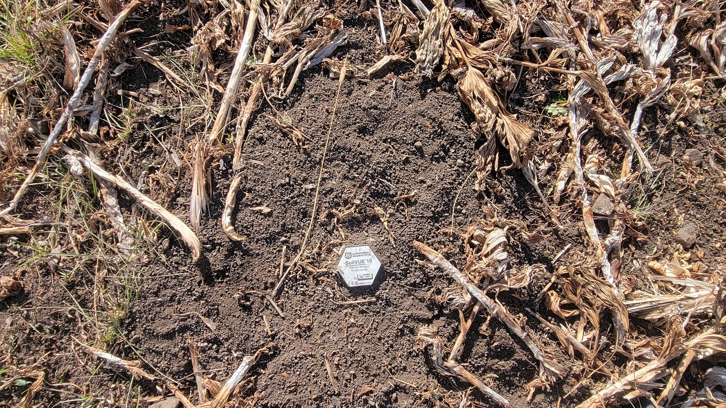

Slide 11
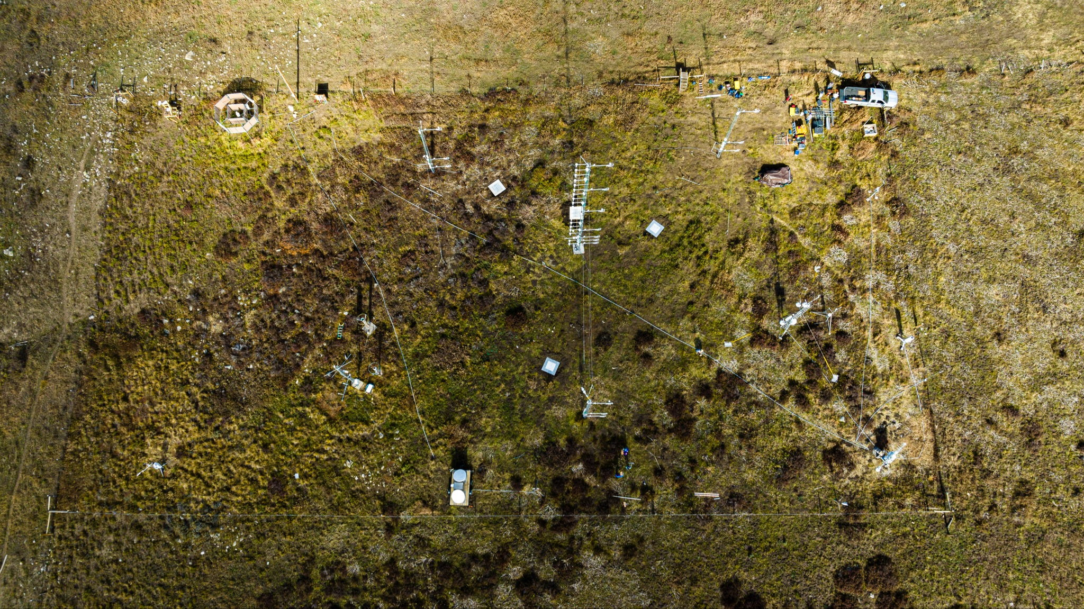

Slide 12
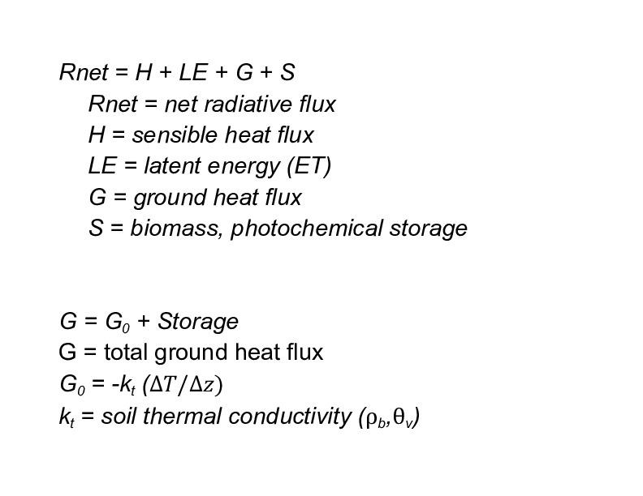
Kettle Ponds Soils (Soil Grids)
Sand 35%
Silt 42%
Clay 22%
Bulk Density 1.25 g/cm3
Percent Aggregate 10 - 20%

Slide 13
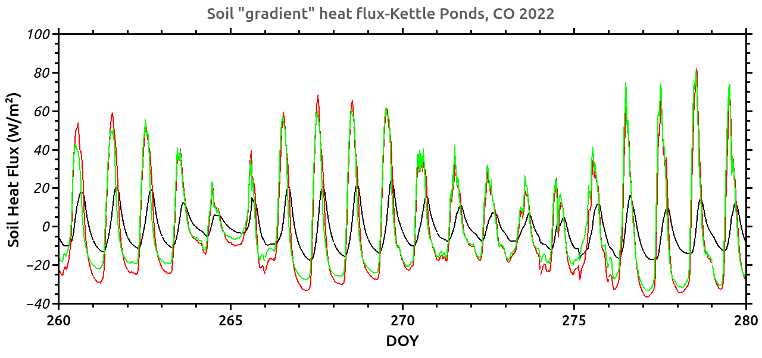

Slide 14
Following the work of
Cobos and Baker (2003), Vadose Zone Journal, 2:589-594.
Oschner et al.,(2006). Agronomy Journal, 98:1005-1014.
Evett et al. (2012), Advance Water resources, 50:41-54.
Peng et al (2017) J. Hydromet. 18:2285-2295.
The soil heat flux is determined using thermal gradient method of heat flux calculation and the change in heat storage over the averaging period.
G = k_{t}(T_{5cm} - T_{10cm})/5 cm 3 temperature, vwc profiles
k_{t} = k_{dry} + exp(𝛃 - 𝜃^{-𝜶}) 𝛃, 𝜶 fitting parameters
G_{storage} = (T_{layer,i} - T_{layer,i -1})C_{v}*𝜟Z/𝜟t
C_{v} = volumetric heat capacity ,𝛒_{d},𝜃_{v}
𝜟Z = layer thickness
T_{layer,i} = soil temperature of layer at time i.
3
k_{dry} = -0.56n + 0.51,, Peng et al
n = porosity
He et al.(2021) Soil and Tillage Research, 213. 8 other models
rms ≅ 0.08 W m⁻¹ K⁻¹

Slide 15
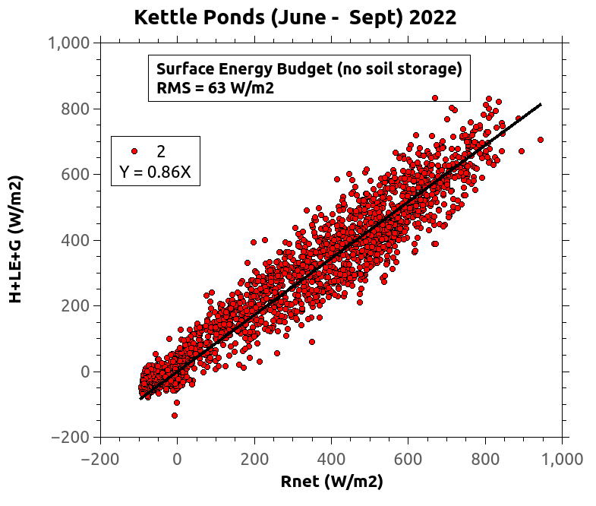
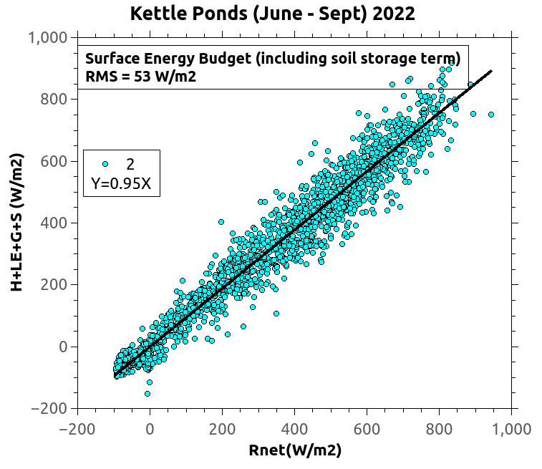
Are we closing the Surface Energy Budget?

Slide 16
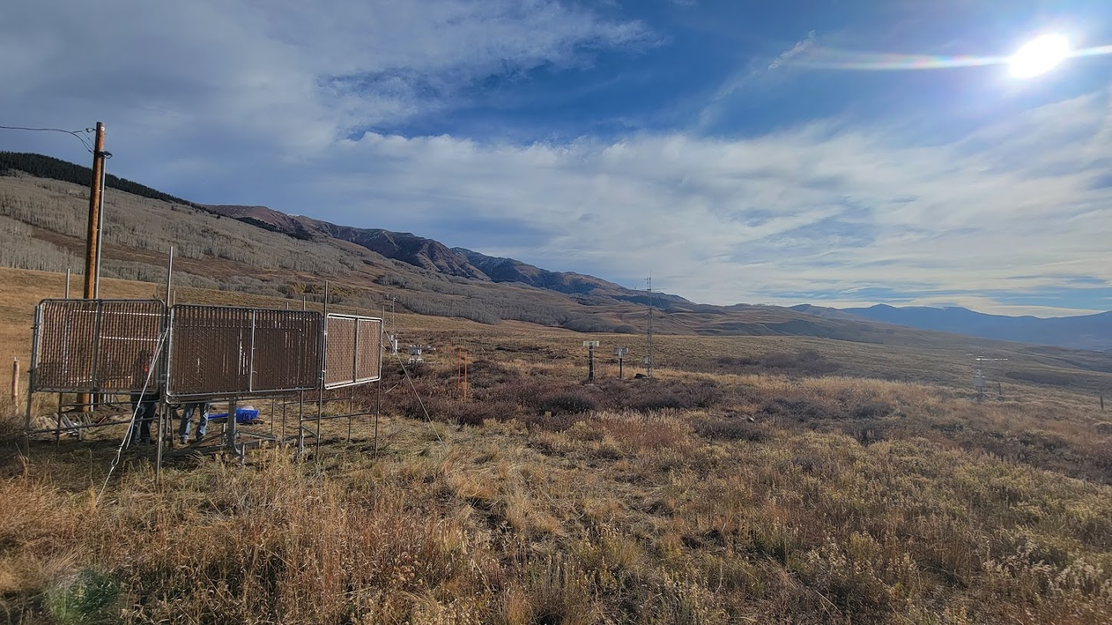

Slide 17
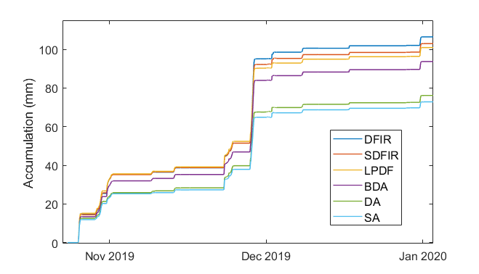
Typical Winter Accumulations from Marshall, CO
Notes:
This is a few months of winter precipitation from all of the different wind shields available at the Marshall testbed. The performance of the LPDF and the SDFIR were fairly comparable. This also gives you an idea of how well the other wind shields at the site performed, and why the choice of wind shield is important.

Slide 18
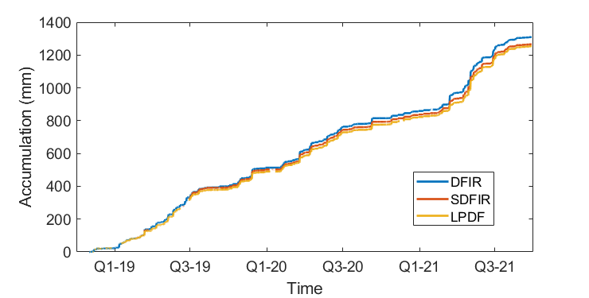
Marshall, CO reference liquid and solid accumulation
Notes:
This is the accumulation of all of the LPDF precipitation data we have from Marshall, along with the corresponding DFIR and SDFIR precipitation measurements. During this time, the LPDF compared quite well to the SDFIR, and they both performed well in comparison to the DFIR.

Slide 19
Take Home Messages
Apply angle of attack corrections if appropriate (10%)
Use modeled kt with measured profiles of Ts and 𝜃v to compute soil heat fluxes, know your soil physical properties, have at minimum 3 soil profiles
check magnitudes of biomass heat storage terms and photochemical storage
Correct solid precipitation for shield and gauge configuration

Slide 20
EXTRA Slides

Slide 21
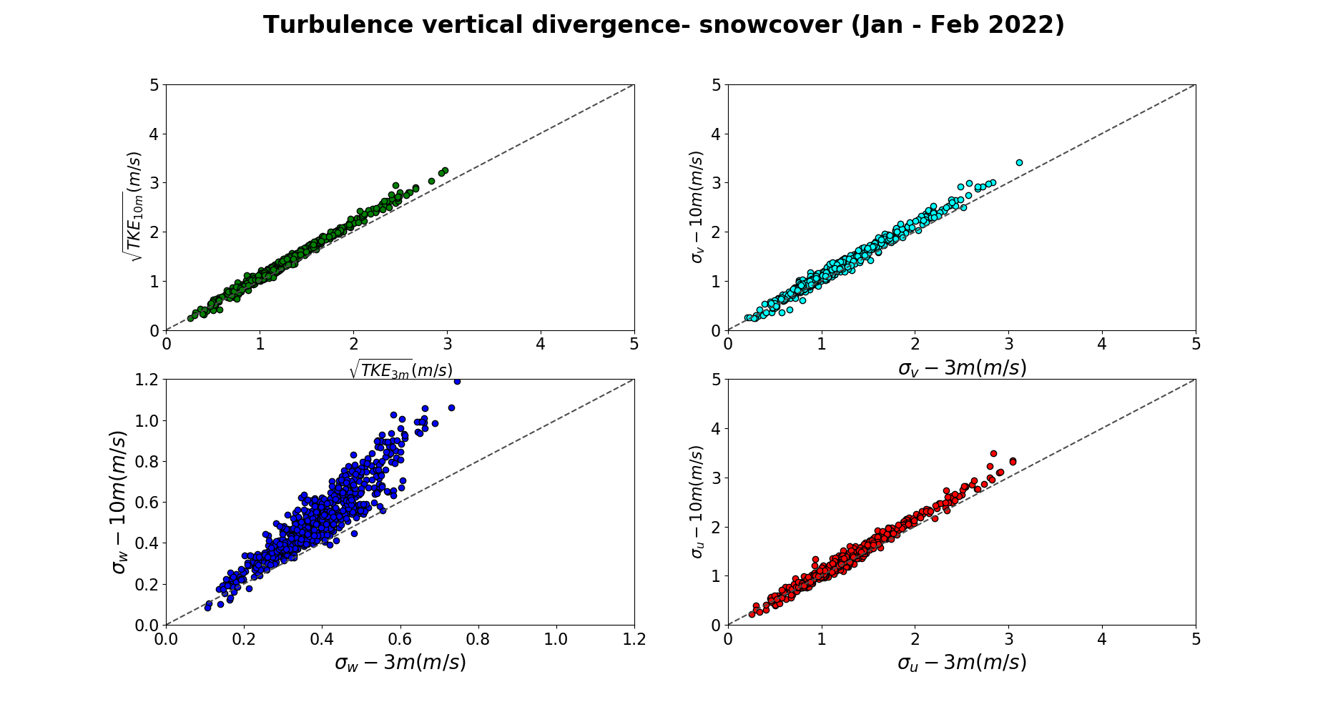

Slide 22
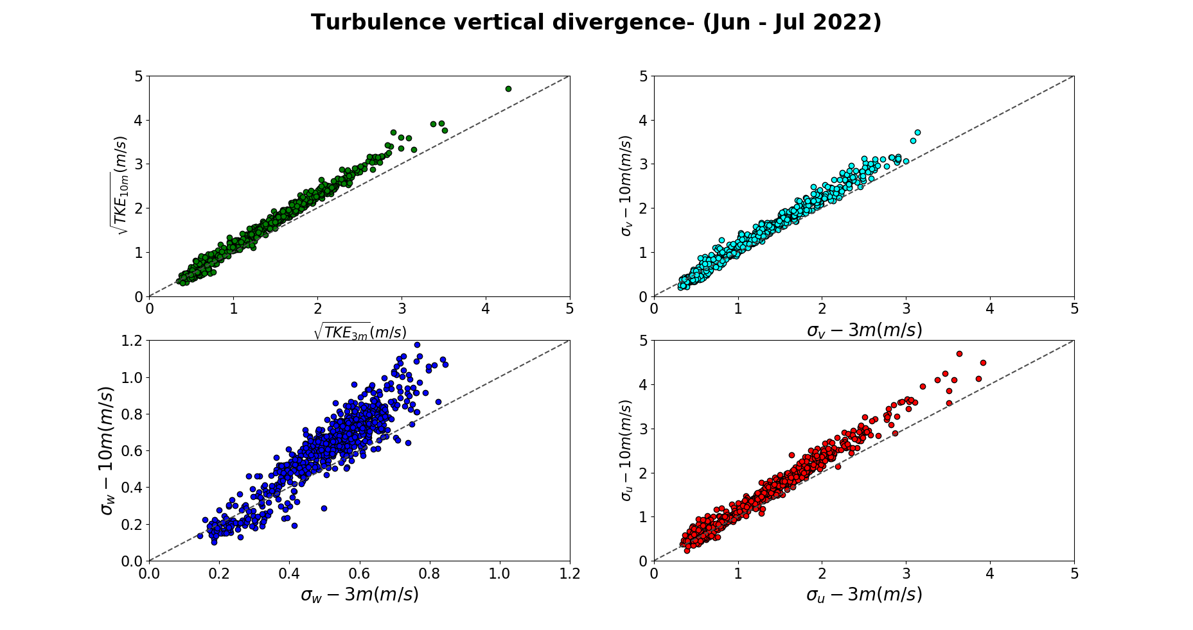

Slide 23
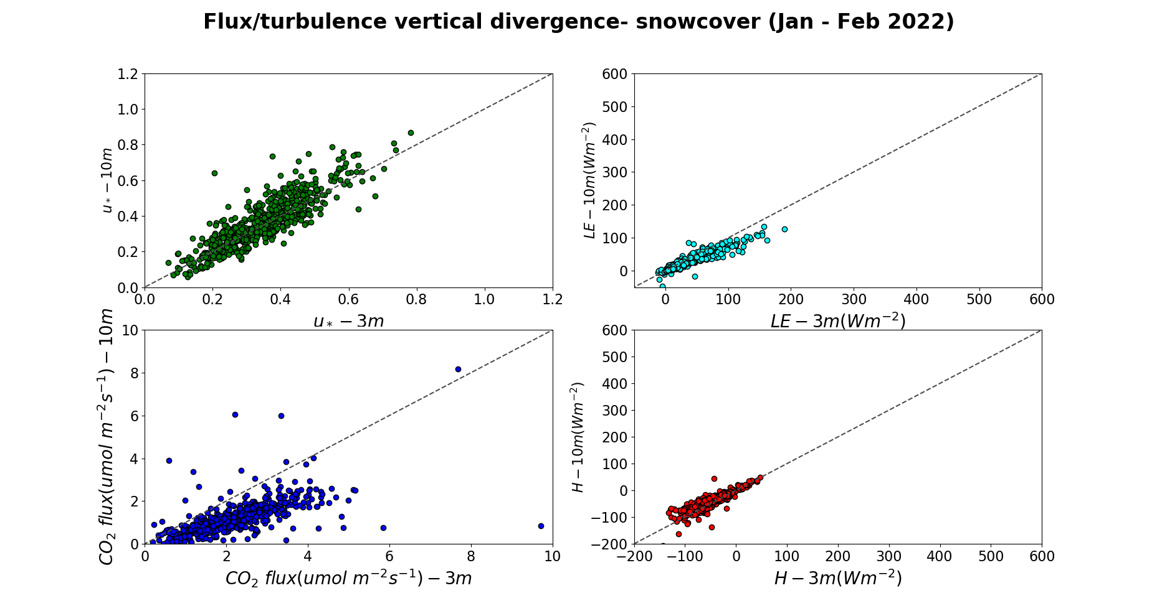

Slide 24
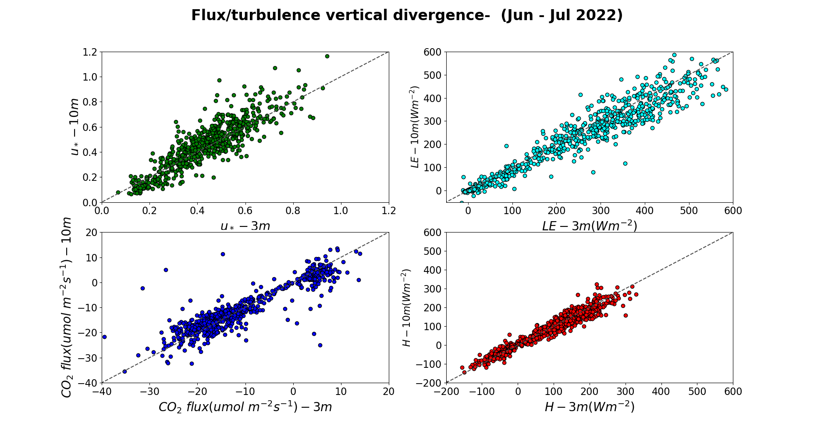

Slide 25
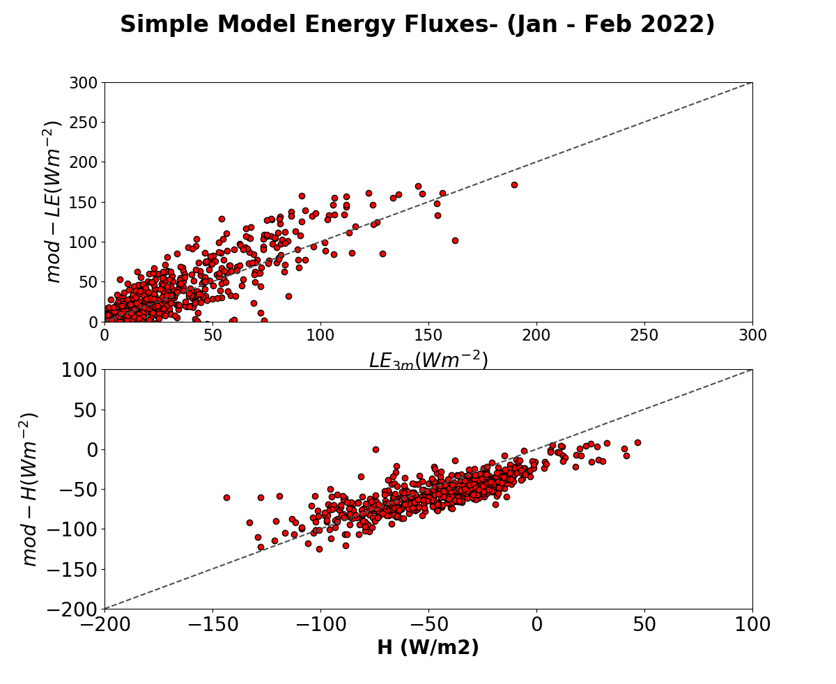

Slide 26
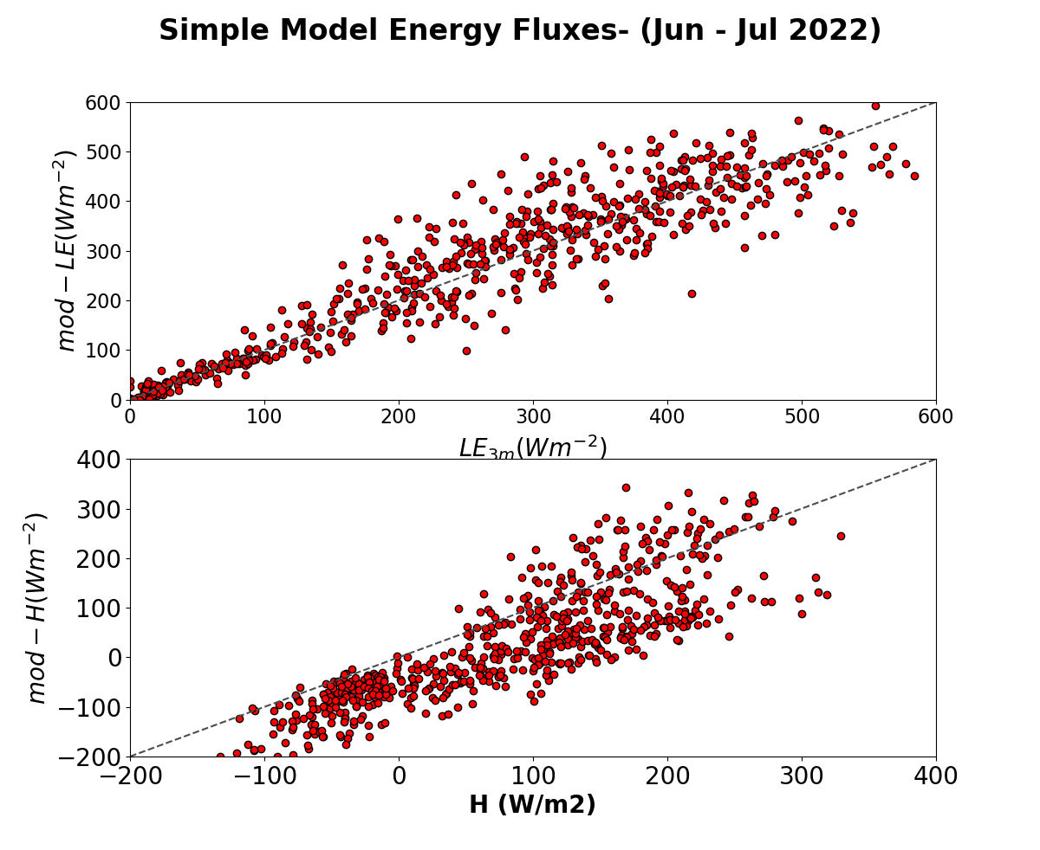
LE = Rnet - H - G

Slide 27
Plans for initial analysis
Time series of SEB over seasons
Look at soil E and plant T (model -data synthesis)
Examine flat earth LSM parameterizations with our data from the flux tower sites
Examine the seasonal change in z0
Examine BL profiles and influence of surface data—-triggers CI
BLH and stability effects on surface turbulence

