Slide 1
Snowfall observations during the second SAIL winter with dual-pol W-band radar and Video in-situ snowfall sensor (VISSS)
Project overview:
SAIL workshop Nov 2, 2023
PIs: Heike Kalesse-Los & Maximilian Maahn
PhD: Anton Kötsche
PostDoc: Veronika Ettrichrätz
Notes:
HKL: add

Slide 2
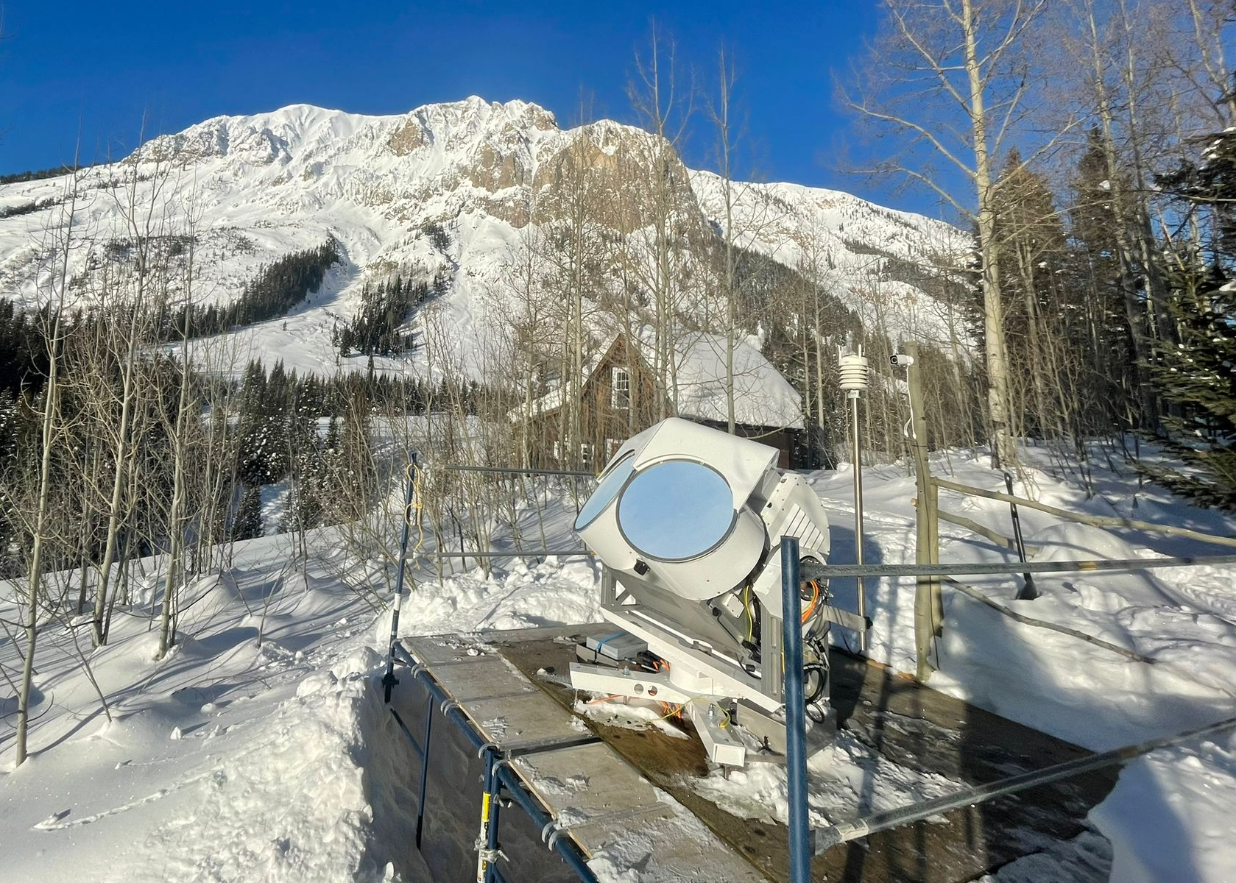
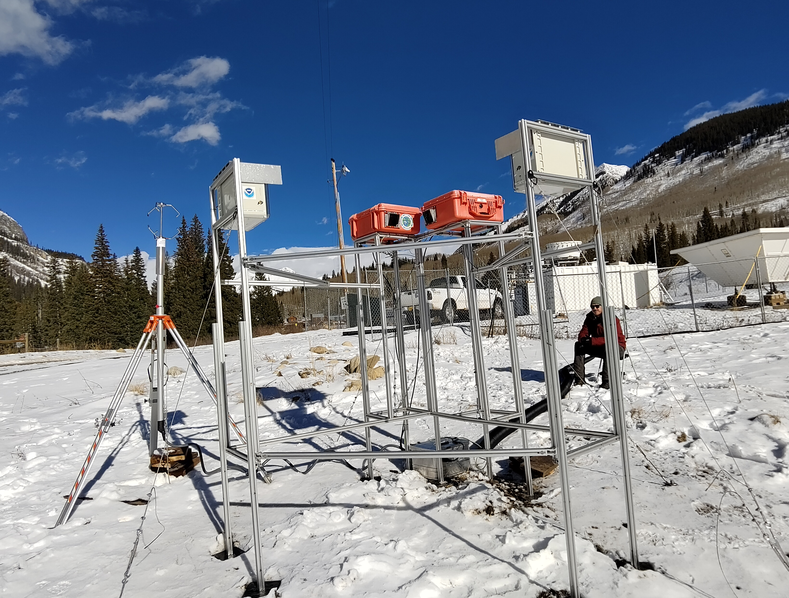
THE corsipp Campaign (Nov 15, 2022 – June 6, 2023)
Dataset | Snowfall observations during the second SAIL winter
94 GHz W-Band Cloud Radar LIMRAD94
In-Situ Snowfall Camera VISSS
Court: Ben Schmatz
Court: Isabelle Steinke
Notes:
Project erklären, Wer, Was, Wo, SPP Prom Lgogo, Logistics,

Slide 3
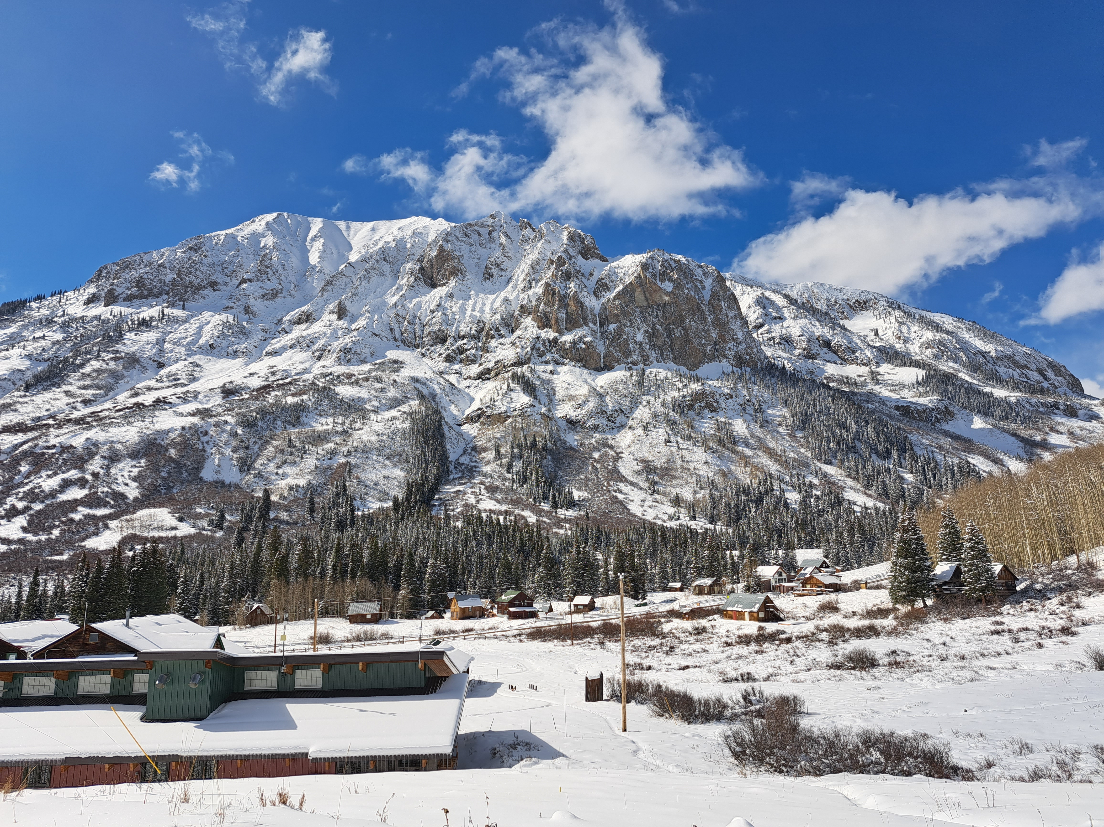
Dataset | Snowfall observations during the second SAIL winter
https://www.google.de/maps
Loc: Gothic (CO) at Rocky Mountains Biological Laboratory (RMBL)
Alt: 3000m ASL
Notes:
Colorado River Watershed

Slide 4
RESEARCH QUESTIONS
Motivation | Snowfall observations during the second SAIL winter
1: What is the frequency of occurrence of riming and secondary ice production at an orographically-influenced site ?
2: What is the influence of riming and secondary ice production on snowfall rates at an orographically-influenced site ?
3: What are external drivers for riming, secondary ice production processes and snowfall rates ?
Notes:
What are external driver

Slide 5
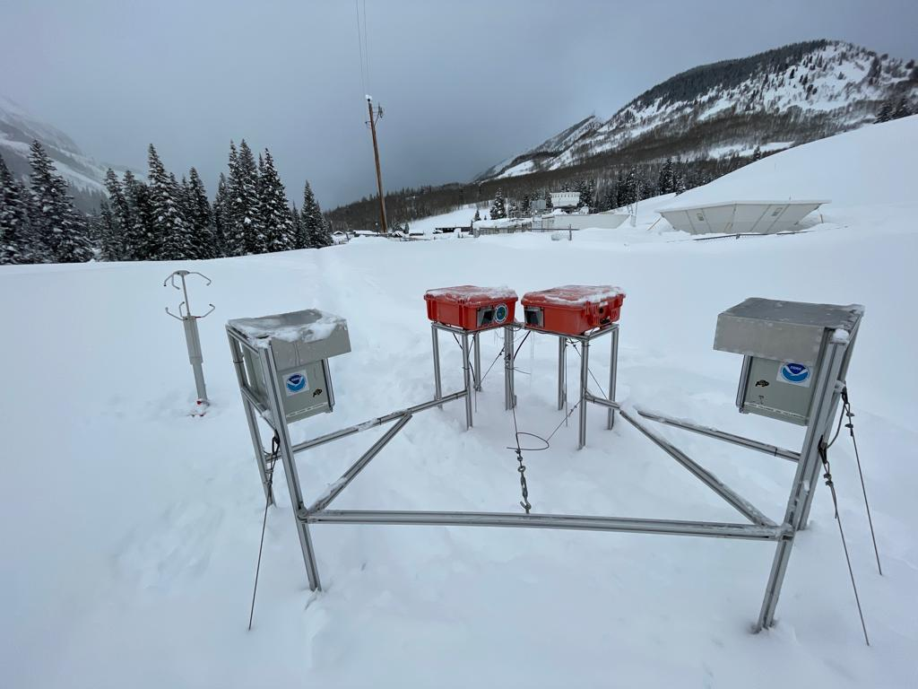
Dataset | Snowfall observations during the second SAIL winter
Court: Isabelle Steinke
​Winters deepest snowpack: 246 cm on March 22 Total snowfall this winter: 916 cm
Court: Ben Schmatz
Notes:
Add limrad pics

Slide 6
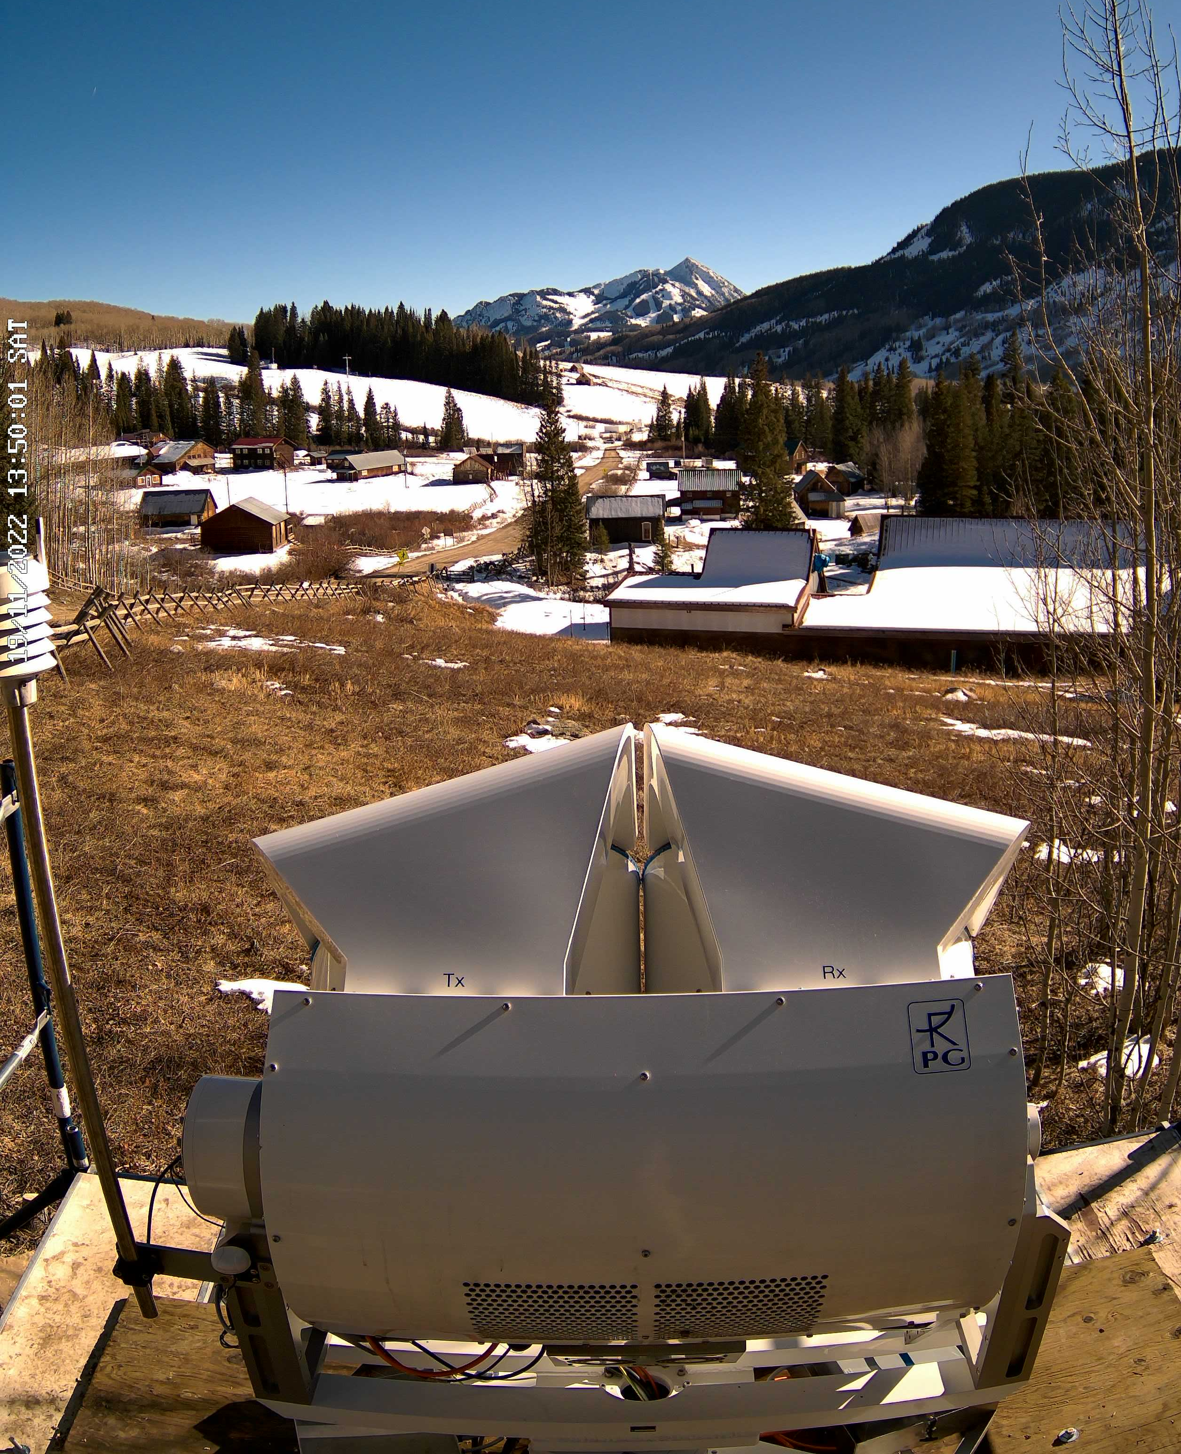
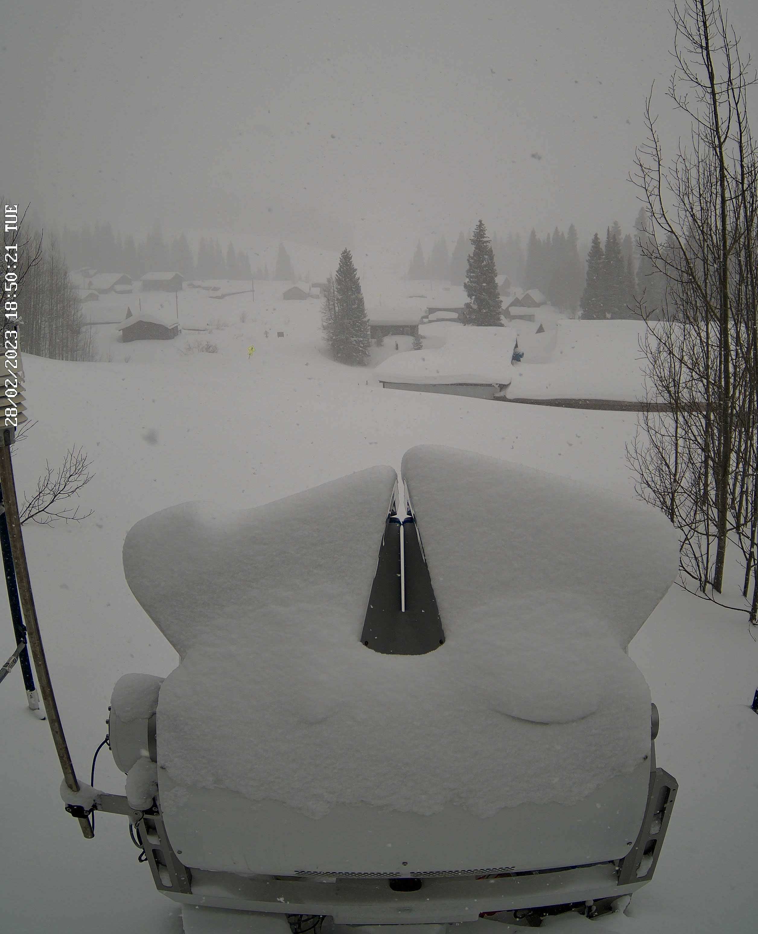
Dataset | Snowfall observations during the second SAIL winter
Notes:
HKL: Add photo credits
Add limrad pics

Slide 7
Instruments | Snowfall observations during the second SAIL winter
VIDEO IN SITU SNOWFALL SENSOR (VISSS)
Two camera systems oriented at a 90° angle to the same measurement volume
Captures Pictures of Snowflakes
Other properties of particles are derived (Size, PSD, Complexity etc.)
Framerate: 250 Hz
Measurement volume: approx. 8 x 8 x 6 cm
VISSS-minimum detection size of particles: 200 μm
VISSS measurements since Nov 5, 2022
(Maahn et al., 2023)
Notes:
animate

Slide 8
Uni Leipzig RPG Dual-Pol Cloud Doppler 94 GHz Radar (LIMRAD94)
Instruments | Snowfall observations during the second SAIL winter
Scan strategy: 15 min scan cycle with vertically-pointing mode, RHIs toward the KAZR, constant elevation observation at 40 degree and an hourly wind PPI at 85 degree
Frequency: 94 GHz ± 100 MHz (λ=3.19 mm)
Doppler resolution: 4.4/6.1 cm/s
Range resolution: 11.9/23.8 m
Polarization: simultaneous-transmission-simultaneous-reception (STSR) mode radar
Antenna: Bi-static Cassegrain with 500 mm aperture
Beam Width: 0.48°
Sampling Rate: 2.8 s
Court: Ben Schmatz
Notes:
Observations either in constant elevation (40deg) or in scanning mode. Bild von Scann/CEL at Colorado

Slide 9
Data coverage of LIMRAD94
Instruments | Snowfall observations during the second SAIL winter
15.11.2022 – 06.02.2023: Constant elevation measurements at 40° elevation.
→ Z (40°), KDP (40°), ZDR (40°), RHV (40°), PhiDP (40°), Slanted LWP (40°)
07.02.2023 - 17.04.2023: Scanning Measurements with scanning strategy explained on next slide.
Z (0-90°), KDP (0-90°), ZDR (0-90°) , RHV (0-90°) , PhiDP (0-90°) , LWP (0-90°), LDR (90°)
17.04.2023 – 22.05.2023: Constant elevation measurements at 40° elevation.
Z (40°), KDP (40°), ZDR (40°), RHV (40°), PhiDP (40°), Slanted LWP (40°)
22.05.2023 – 30.05.2023: Scanning Measurements with scanning strategy explained on next slide.
Z (0-90°), KDP (0-90°), ZDR (0-90°) , RHV (0-90°) , PhiDP (0-90°) , LWP (0-90°), LDR (90°)
30.05.2023 – 05.06.2023: Vertically poiting measurements for reflectivity calibration with disdrometer
Notes:
HKL: Add scan strategy on next slide; add VISSS data availability (ask Max/Veronika), mention data gaps in March-April

Slide 10
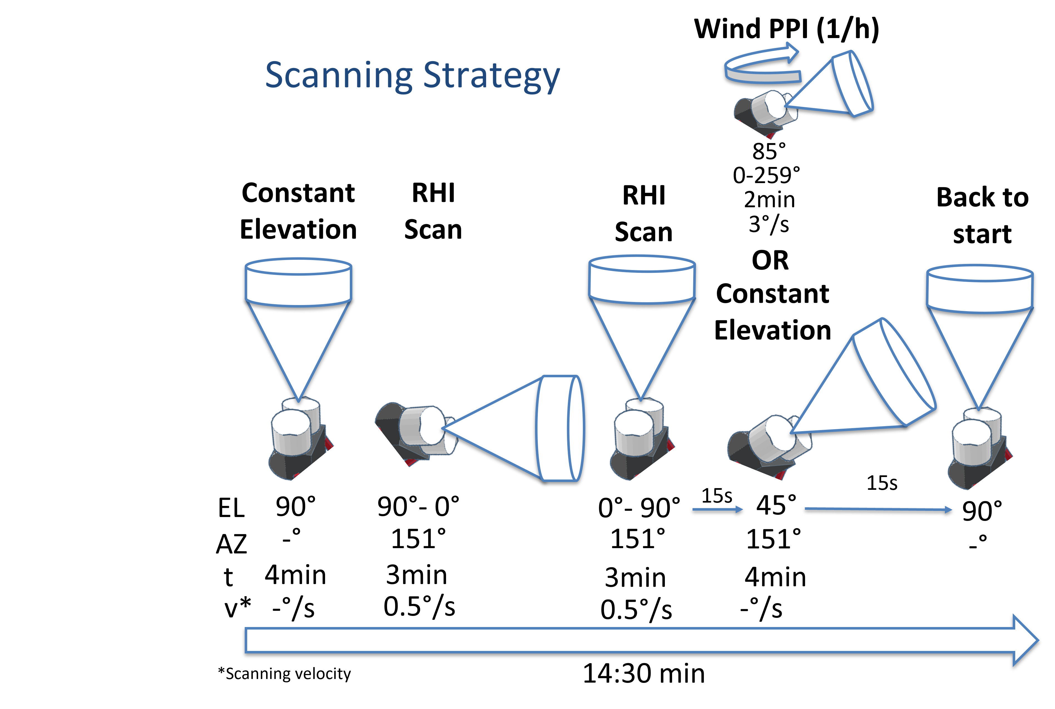
Instruments | Snowfall observations during the second SAIL winter
Notes:
Chandra PI X Band

Slide 11
Instruments | Snowfall observations during the second SAIL winter
35 GHz
Notes:
Chandra PI X Band

Slide 12
Exemplary data of measurements at 40° Elevation (before we started scanning)
Instruments | Snowfall observations during the second SAIL winter
Comparing Radar Reflectivities of x-, Ka- and w-band
Notes:
HKL:
Title: comparing instead of mathcing?
Add correlation coefficients and regression equations for roughly Rayleigh ranges (W vs Ka: < 10 dBz; W vs X: -10 to 10 dBz, Ka vs X: -5 to max Ze)
State/write How many days of data are used in this plot? Was there cloud liquid (and thus liquid attenuation) present? (Check Cloudnet target classification)

Slide 13
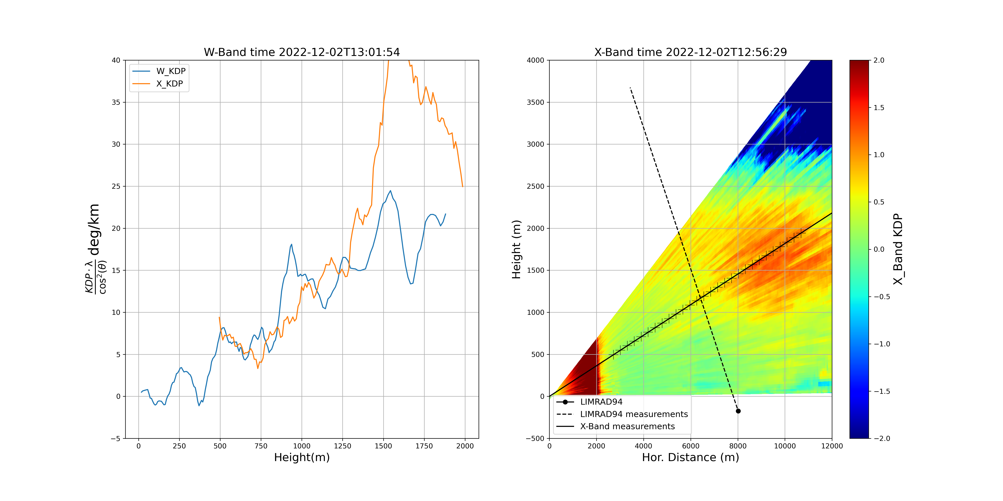
Exemplary data of measurements at 40° Elevation (before we started scanning)
Matching KDP of x-band and w-band
Instruments | Snowfall observations during the second SAIL winter

Slide 14
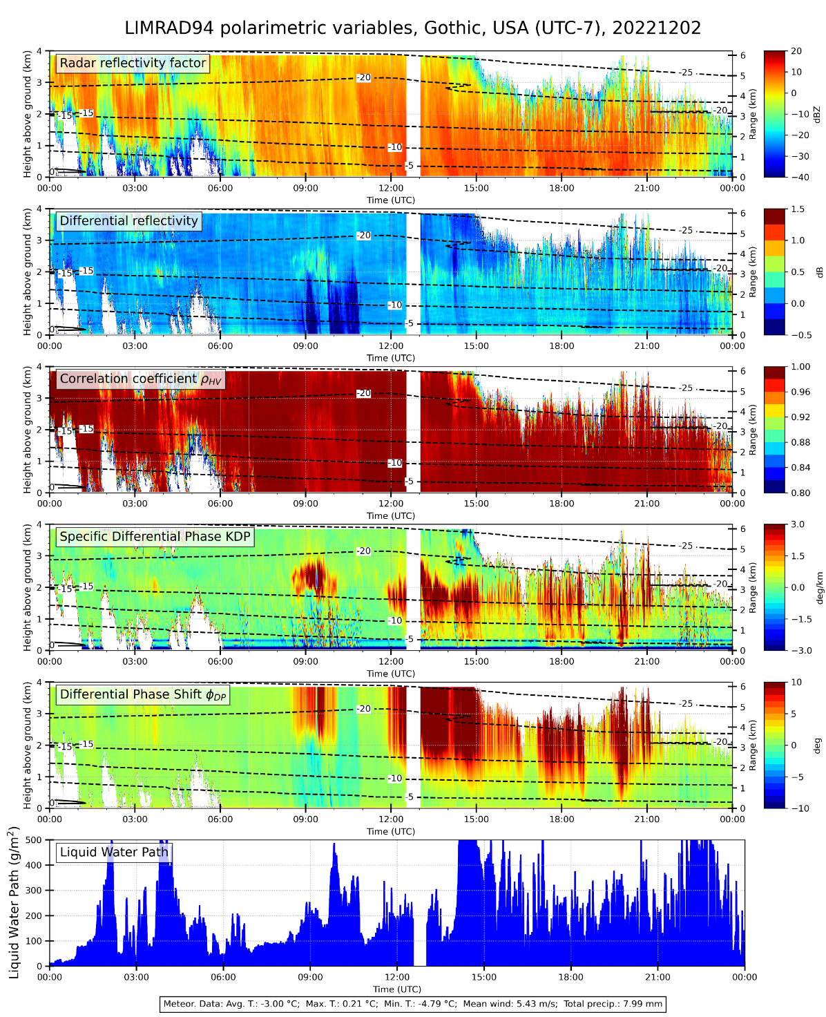
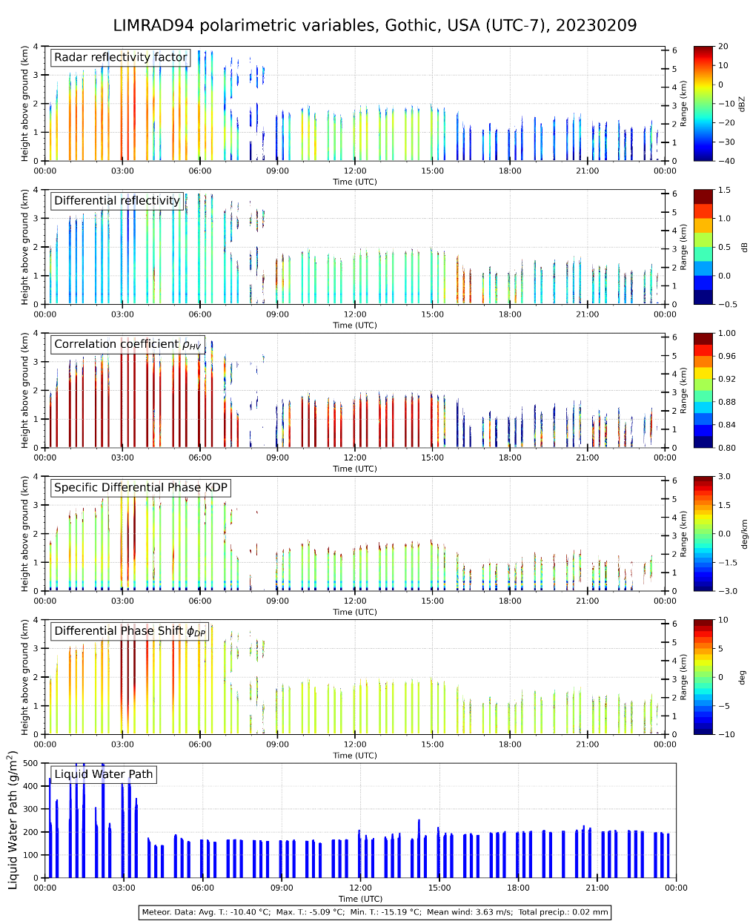
W-Band CEL 40°
Exemplary data of measurements at 40° Elevation (before we started scanning)
W-Band Scanning RHI
W-Band CEL 40° while scanning
https://monsun.meteo.uni-leipzig.de/~remsens/
Notes:
HKL: CEL = constant elevation angle?

Slide 15
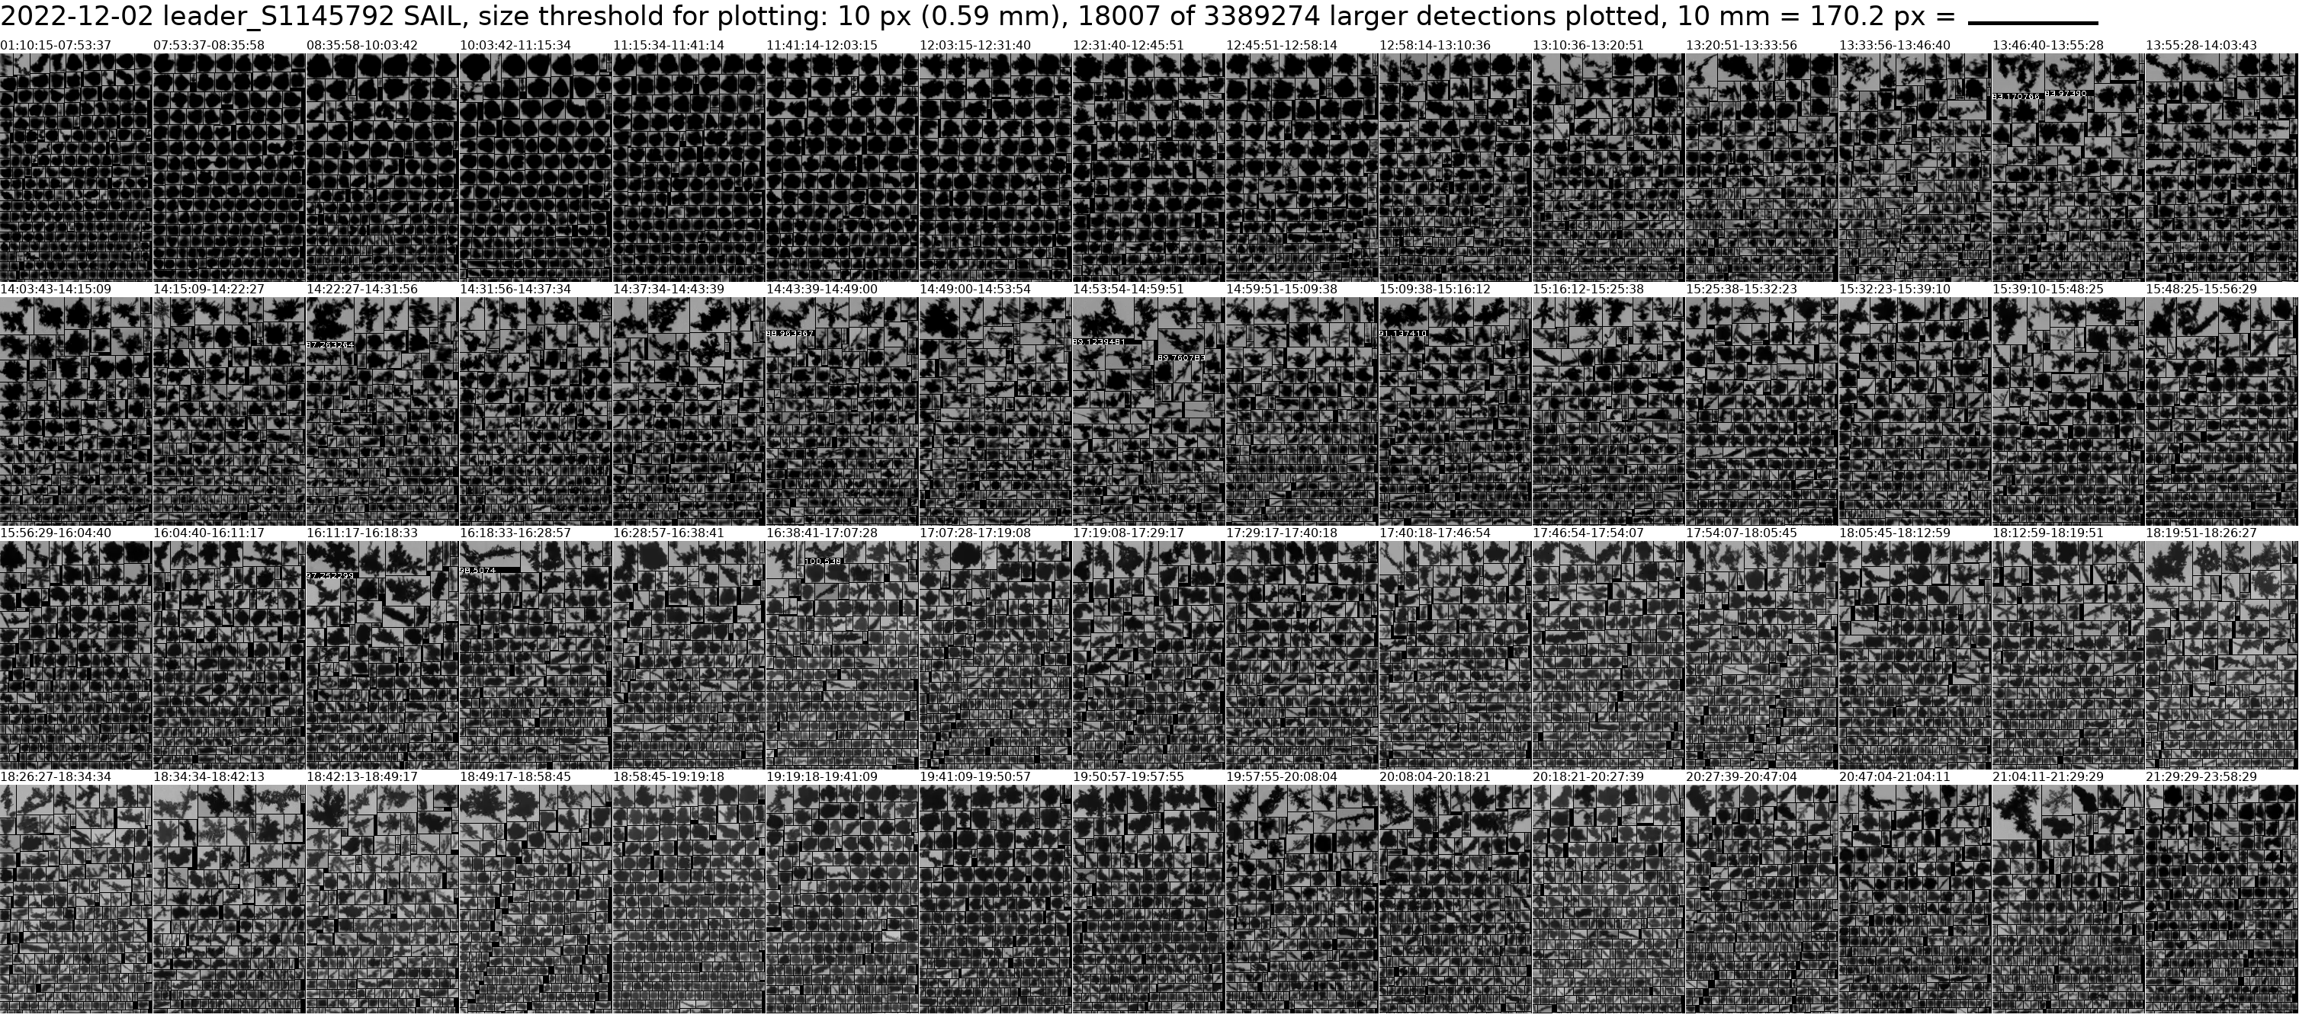
Exemplary data of measurements at 40° Elevation (before we started scanning)
Snowfall camera images
https://monsun.meteo.uni-leipzig.de/~remsens/

Slide 16
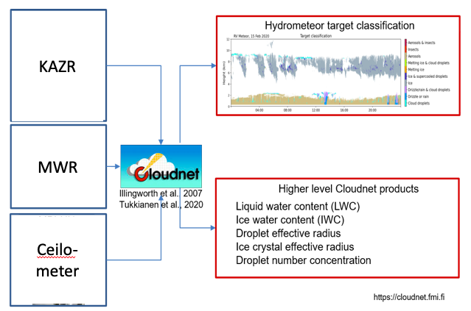
Application of Cloudnet Retrievals
Instruments | Snowfall observations during the second SAIL winter
BA Thesis of Peter Pasdzierny in Heike‘s group
35 GHz
Notes:
Chandra PI X Band

Slide 17
Thank You
Anton Kötsche
Leipzig Institute of Meteorology (LIM)
AG Remsens
Prager Straße 34
T +49 341 97-36654
anton.koetsche@uni-leipzig.de
www.uni-leipzig.de

