Slide 1
Exploring the SAIL ARM Data Products: An Overview
Damao Zhang
The ARM Translator Group
ARM Translator
Pacific Northwest National Laboratory
SAIL/SPLASH/SOS Workshop

Slide 2
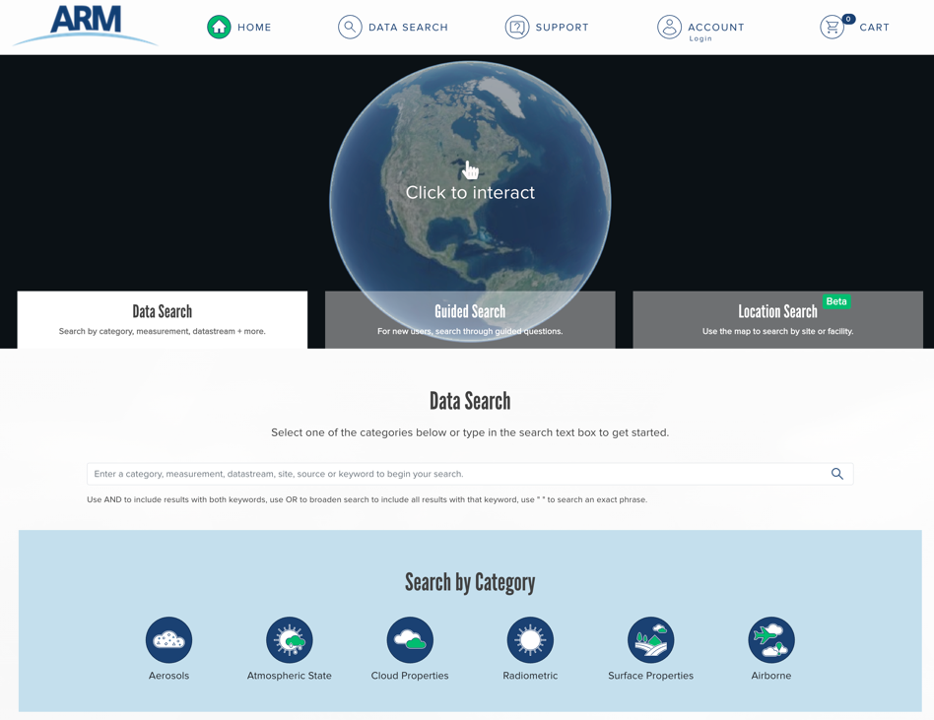
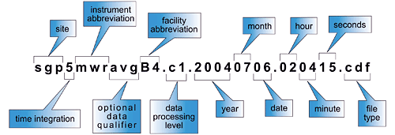
ARM Data Products
https://adc.arm.gov/discovery/
ARM data format
Most are in NetCDF
Quick-look plots of ARM data
https://dq.arm.gov/dq-plotbrowser/
ARM file naming conventions:
ARM data levels:
a-level data: converted to NetCDF and calibration factor applied
b-level data: QC checks applied
c-level data: Value-added data product (VAP)
2
Notes:
VAPs are higher-order data products which I will talk more in detail later

Slide 3
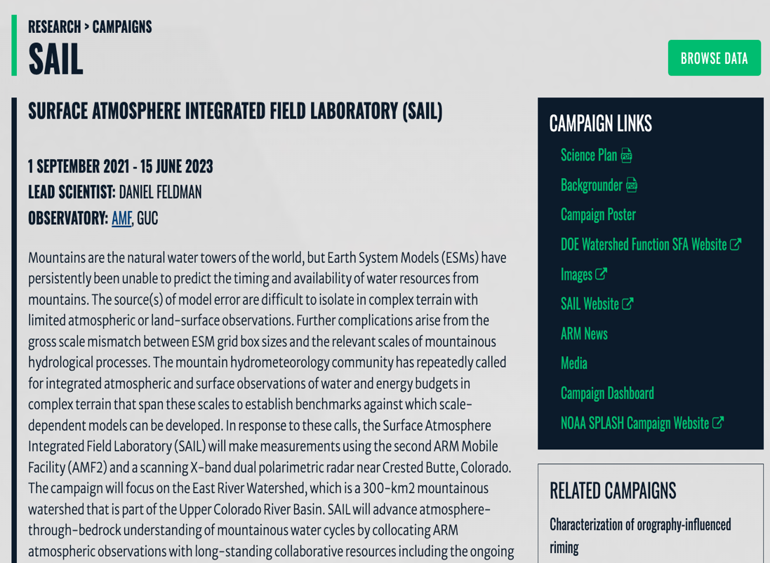
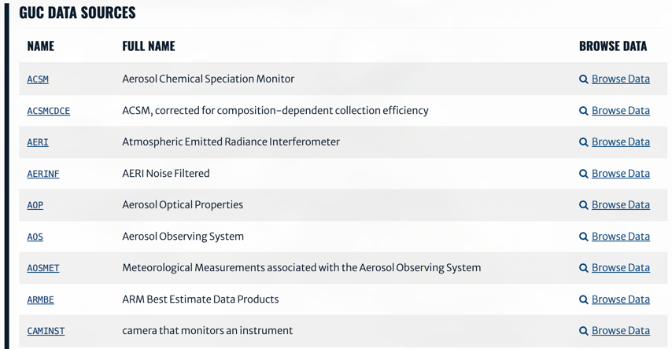
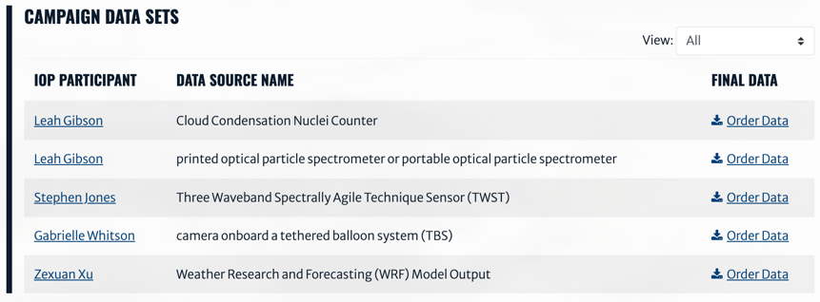
ARM SAIL Data Products
https://www.arm.gov/research/campaigns/amf2021sail
3
Notes:
If you want to share your SAIL data products, you are welcome to upload the data to ARM data discovery as a PI product

Slide 4
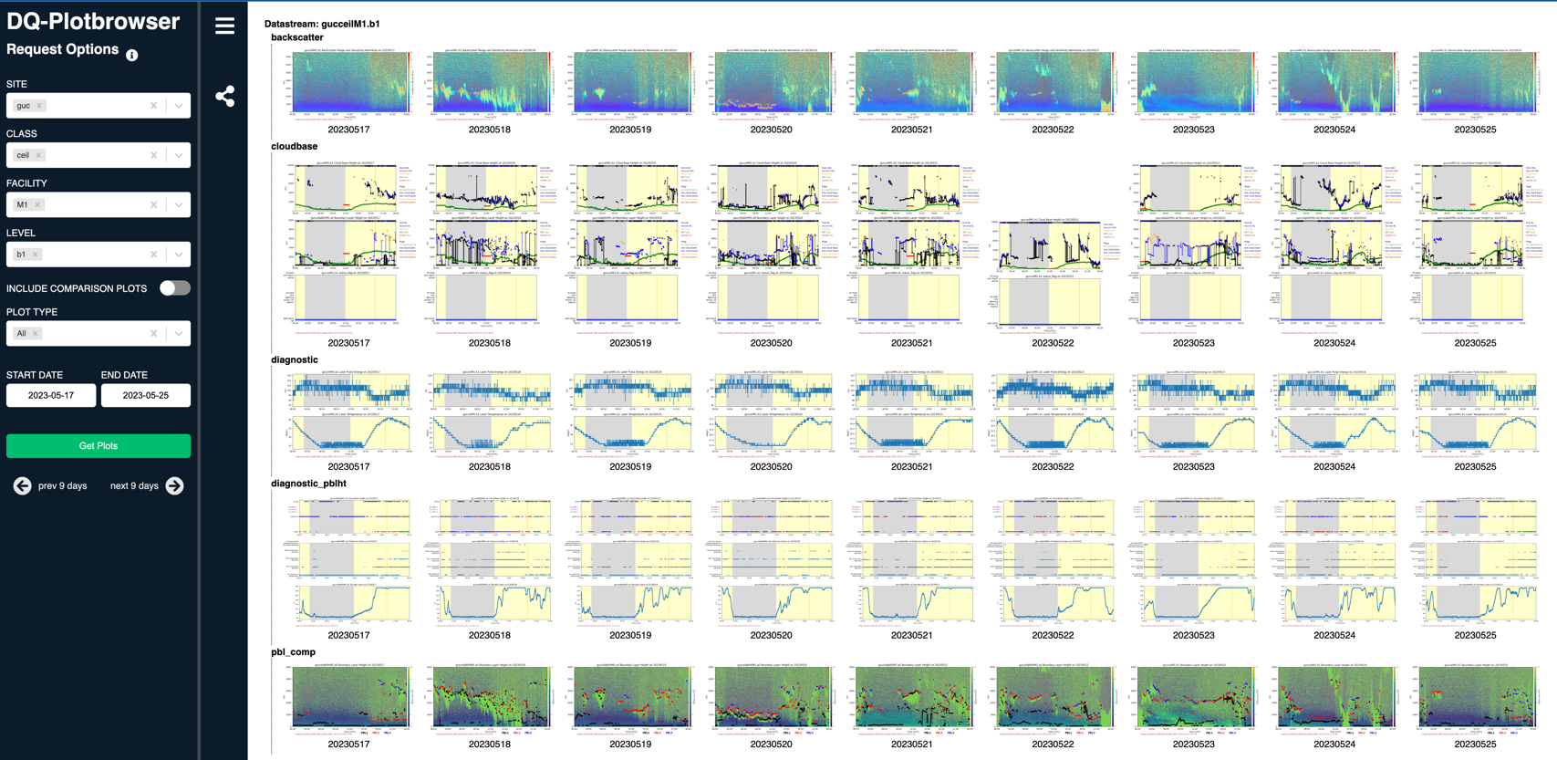
ARM SAIL Data Quicklooks
https://dq.arm.gov/dq-plotbrowser/
4

Slide 5
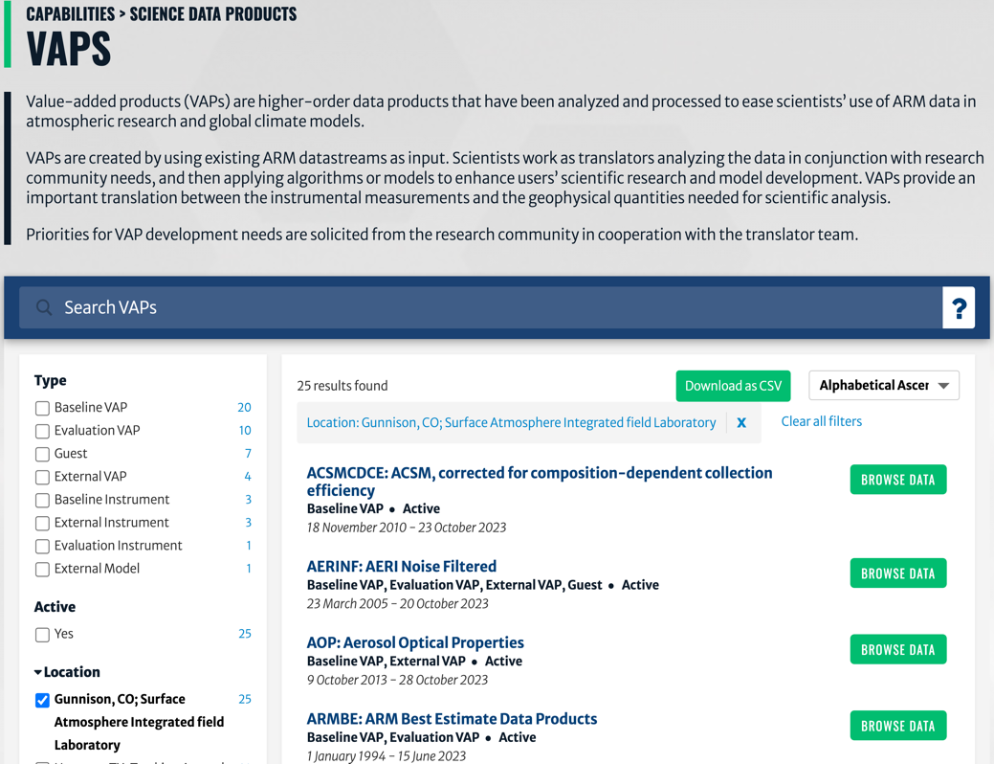
ARM Value-added Products (VAPs)
https://www.arm.gov/capabilities/vaps
VAPs are higher-order data products that have been analyzed and processed using well established retrieval algorithms/ methods to ease scientists’ use of ARM data in atmospheric research and global climate models
Aerosol macro-, and micro-physical, and chemical properties
Cloud macro- and micro-physical properties
Precipitation retrievals
Atmospheric environment and radiation budget
Modeling VAPs
5
Notes:
VAPs take calibrated ARM measurements as inputs to provide retrieved or quality controlled products using well established methods/retrieval algorithms.

Slide 6
The ARM Translator Group
ARM Translator Group
Translators are liaisons between the scientific community and ARM infrastructure staff members, and develop Value-Added Products, or VAPs, from the direct output of ARM instruments or other VAPs.
Shaocheng Xie
Modeling POC
John Shilling
Aerosol POC
Lead Translator
Damao Zhang
High-Latitude POC
Scott Collis
Convective POC
Scott Giangrande
Warm Clouds POC
Krista Gaustad
Software Development
Ken Kehoe
Data Quality
6
Notes:
ARM VAPs are developed and managed by the ARM translator group.

Slide 7
‘Core’ VAPs
VAP | Translator / Contact | Derived Quantities
ACSMCDCE | Shilling | Organic, sulfate, nitrate, ammonium, chloride mass concentration
AOP | Shilling | Aerosol optical properties, scattering, backscattered radiation
CCNKAPPA | Shilling | Kappa, a representation of aerosol hygroscopicity
(KAZR) ARSCL | Giangrande | Cloud boundaries, layers, fraction, and best estimates radar quantities
MPLCLDMASK | Zhang | Vertical cloud layers detected by lidar backscatter profiles
MWRRET | Zhang | Precipitable water vapor, cloud liquid water path
**SPHOTCOD | Giangrande | Cloud optical depth, liquid water path, cloud drop effective radius
CMAC | Collis | Corrected gate moments. CF-Radial format
LDQUANTS | Giangrande | Dual-polarization radar estimates (Z, ZDR), drops size distribution
INTERPSONDE | Giangrande | Continuous (fixed temporal, height grid) radiosonde data
AERINF | Zhang | Noise-filtered longwave radiance
PBL Height - SONDE | Zhang | Multiple PBL height estimates from multiple radiosonde methods
DLPROF | Zhang | Profiles of horizontal winds and vertical velocity statistics
QCRAD / RADFLUX | Zhang | Quality Controlled LW and SW radiation data
**QCECOR | Xie | Improved surface turbulence fluxes from ECOR measurements
ARMBE | Xie | Best estimate of cloud, radiation, atmospheric, and surface properties
**VARANAL | Xie | Advective tendency, atmospheric state, precipitation
Core VAPs:
Employ mature, robust algorithms
Expect to deliver at all AMF deployments
Most are automated or semi-automated and standardized
** VAPs are under processing and will be available soon
7
Notes:
'core’ VAPs are available shortly after the data were collected or after the field campaign is finished.
A lot of acronyms, which will be illustrated later

Slide 8
Additional High-value VAPs
VAP | Translator | Derived Quantities | Status
**AOD-MFRSR | Shilling | Aerosol optical depth derived from MFRSR measurements | Upon request
**LIDARAEROMASK | Zhang | Aerosol feature mask, aerosol layer top and base | Under processing
**MICROBASEKaPlus | Giangrande | Vertical profiles of cloud microphysical properties | Upon request
**THERMOCLDPHASE | Zhang | Cloud vertical and layer thermodynamic phase mask | Under processing
SQUIRE | Collis | Ameliorate blockage issues by taking lowest non-blocked gate | Available
**RadCLss | Collis | Retrievals of precipitation rate from radar measurements | Under processing
**TROPoe | Zhang | Retrievals of temperature and water vapor profiles, liquid water path and effective radius | Under processing
**PBLHT-Lidar | Zhang | Continuous boundary layer height estimates from MPL and DL | Under development
Require more manual testing and evaluation to create a robust product
For additional questions on VAPs and VAP availability, please contact the Translators
Translators prioritize VAP processing according to community feedbacks and requests
8
Notes:
Motivation

Slide 9
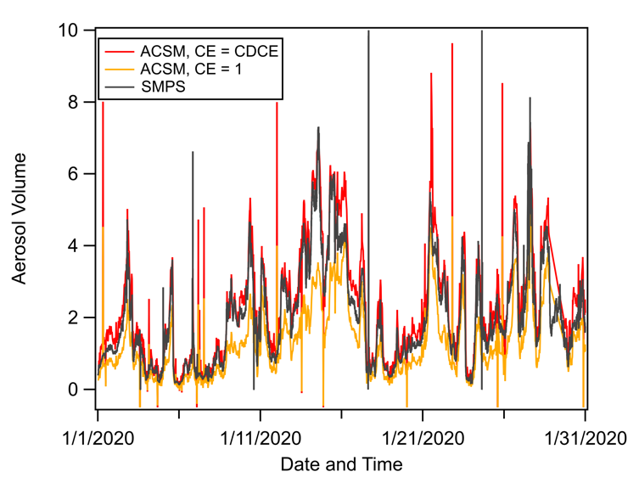
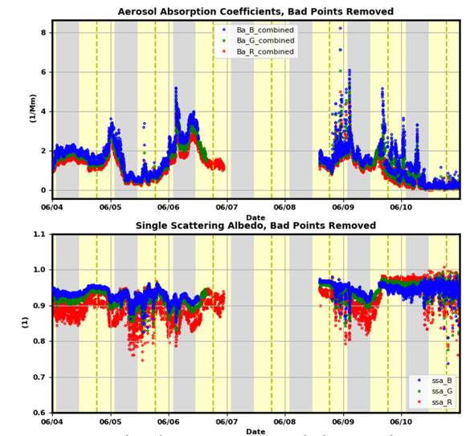
AEROSOL Property VAPs
Translator: John Shilling, john.shilling@pnnl.gov
ACSM Composition-Dependent Collection Efficiency (ACSMCDCE) VAP
Aerosol Optical Properties (AOP) VAP
Absorption Coefficient
SSA
Inputs: ACSM measured mass concentration of particulate organics, nitrate, sulfate, chloride, and ammonium.
High aerosol acidity:
CDCE = (1 – 0.73*(NH4meas/NH4pred))
High Ammonium Nitrate Fraction (ANMF):
CDCE = (0.0833 + 0.9167*ANMF)
Inputs: Particle soot absorption photometer (PSAP) extinction and Nephelometer scattering at 650 nm (red), 530 nm (green), and 465 nm (blue).
Outputs: aerosol absorption coefficient, corrected scattering, SSA, and Angstrom Exponent (absorption and scattering), asymmetry parameter at 1 min resolution
9
Notes:
Note that some figures do not use SAIL data
ACSMCDCE: calculated the necessary correction based on the ACSM-measured chemical composition-> particle rebounding after impaction, improves the mass closure between ACSM and co-located particle-sizing instruments, 10 min resolution
AOP: Nephelometer (700, 550, and 450 nm), applied several correction (amplification effects, shadowing or filter-loading effects), temporal resolution 1 min, aerosol intensive properties

Slide 10
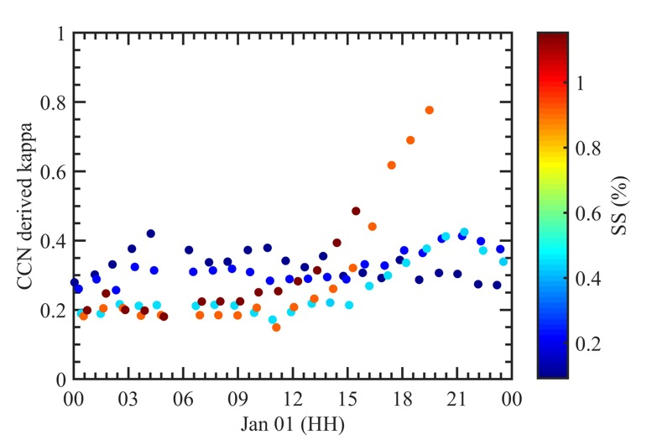
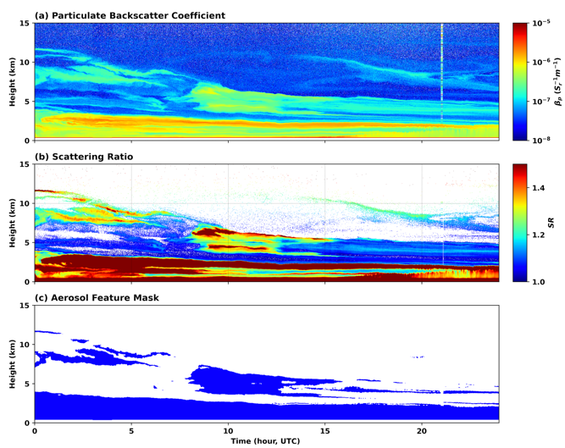
AEROSOL Property VAPs
Translator: John Shilling, john.shilling@pnnl.gov
Translator: Damao Zhang, damao.zhang@pnnl.gov
CCN kappa (CCNSMPSKAPPA) VAP
**Aerosol Feature Mask (LIDARAEROMASK) VAP
Inputs: CCN from the cloud condensation nuclei counter (CCNC) and aerosol particle size data from the scanning mobility particle sizer (SMPS) .
Outputs: the particle hygroscopicity (kappa) parameter at ~ 5 min (Petters and Kreidenweis 2007)
Inputs: High Spectral Resolution Lidar (HSRL) backscatter coefficient profiles and scattering ratio
Outputs: aerosol feature mask, aerosol layer base and top height at 30s and 30m resolutions
$$SR(z)=\frac{β_{p}(z)+β_{m}(z)}{β_{m}(z)}$$
10
Notes:
Kappa: Hygroscopicity parameter to quantify the ability of aerosols to activate into cloud water droplets, assumptions: all particles have uniform chemical composition and mixing state, and surface tension
6 values of SS = {0.1, 0.2, 0.4, 0.6, 0.8, 1.0} at every 10 minutes

Slide 11
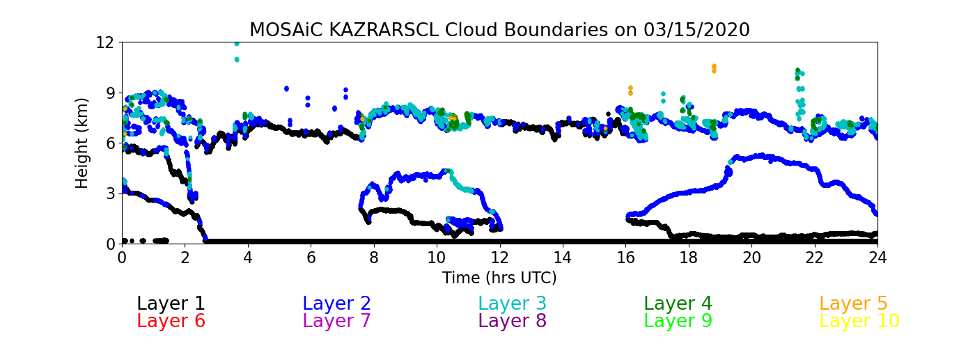
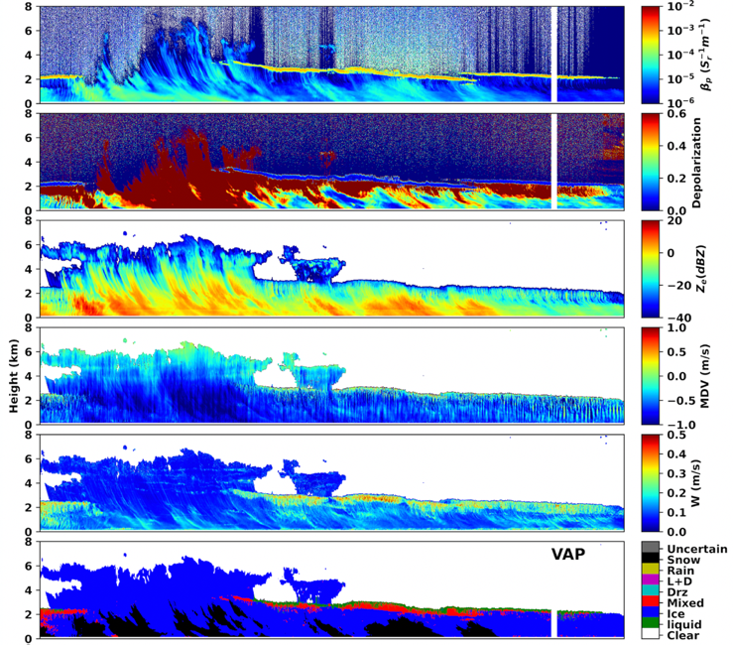
Cloud Property VAPs
Translator: Scott Giangrande, sgrande@bnl.gov
Translator: Damao Zhang, damao.zhang@pnnl.gov
Active Remote Sensing of Clouds (ARSCL) VAP
**Cloud thermodynamic phase (THERMOCLOUDPHASE) VAP
Backscatter
Depolarization
Reflectivity
Doppler Velocity
Radar Reflectivity
Spectral Width
Cloud Phase
Cloud detection using radar reflectivity, Doppler velocity, Doppler spectral width, lidar backscatter, and microwave radiometer
Provides cloud boundaries up to 10 layers at 4 s and 30 m resolution
The multisensor method (Shupe 2007) uses measurements from depolarization lidar, cloud radar, microwave radiometer, and temperature sounding
Cloud hydrometeors are classified as ice, snow, mixed-phase, liquid, drizzle, or rain at 30 s and 30 m resolution
11
Notes:
Motivation

Slide 12
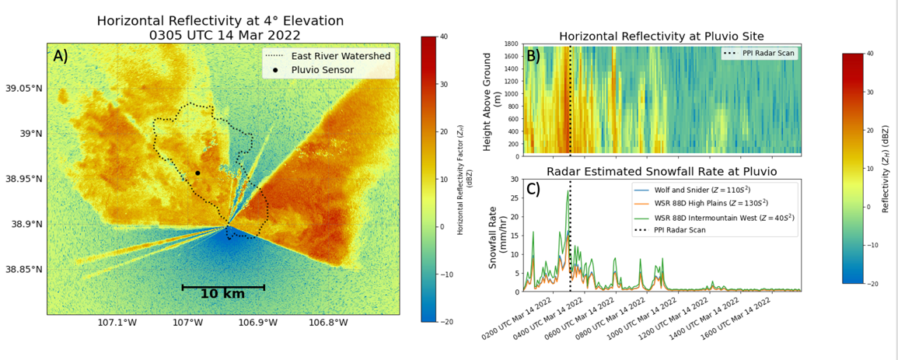
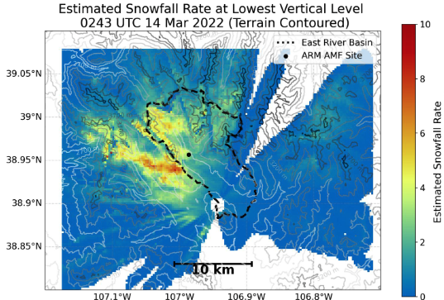
Precipitation VAPs
Translator: Scott Collis, scollis@anl.gov
CORRECTED RADAR MOMENTS IN ANTENNA COORDINATES (CMAC) VAP including several S(Z) (A)
**Radar Columns and In-Situ Sensors (RadCLss) VAP for aiding retrieval development (B) and (C)
SURFACE QUANTITATIVE PRECIPITATION ESTIMATION (SQUIRE) VAP seeks to ameliorate blockage issues by taking lowest non-blocked gate (D)
All open source
D)
12
Notes:
Motivation

Slide 13
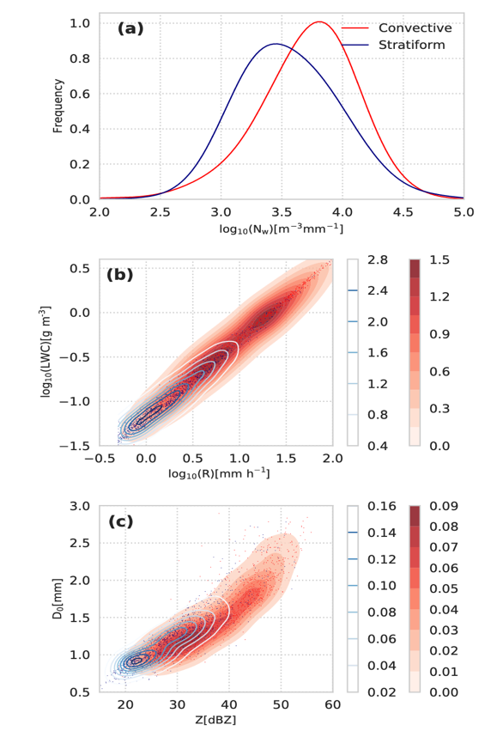
Precipitation VAPs
Translator: Scott Giangrande, sgrande@bnl.gov
Laser Disdrometer Quantities(LDQUANTS) VAP
Inputs: Measured drop size distribution, precipitation intensity, diameter dimension, rain fall speed
The VAP estimates rainfall rates and several geophysical quantities, parameterized DSD fits (gamma or exponential assumption type methods)
Radar-equivalent quantities, including dual-polarization radar quantities (e.g., Reflectivity Factor Z, Differential Reflectivity ZDR) are also calculated.
13
Notes:
Filter drops with unrealistic fall speeds.

Slide 14
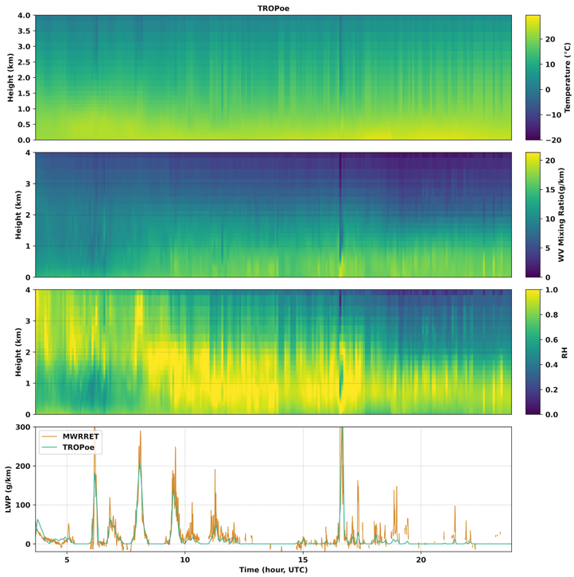
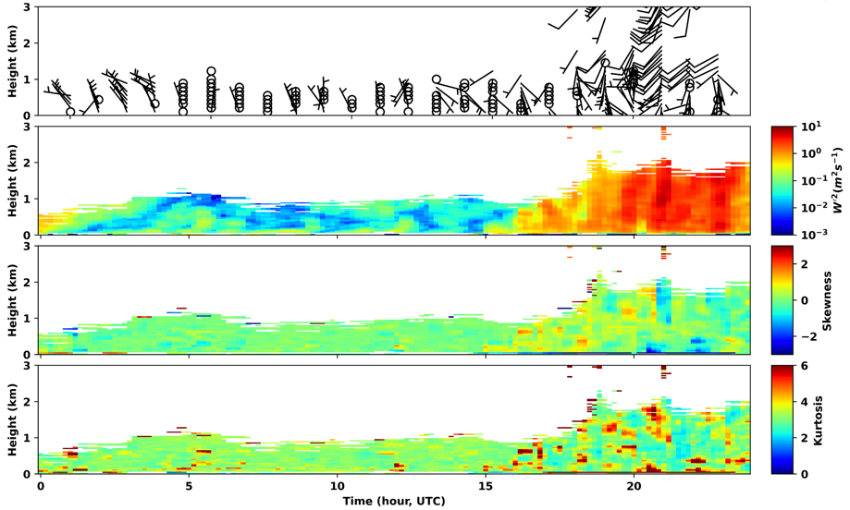
Atmospheric Environment VAPs
Translator: Damao Zhang, damao.zhang@pnnl.gov
**Tropospheric Remotely Observed Profiling via Optimal Estimation (TROPoe) VAP
DLPROF-Wind and DLPROF-WSTATS VAPs
Temperature
WV mixing ratio
RH
DLPROF-WIND: profiles of horizontal wind speed and direction every ~15 min using the traditional velocity-azimuth-display (VAP) algorithm
DLPROF-WSTATS: 30 min temporal resolution
Physical-iterative retrieval of boundary-layer temperature and water vapor mixing ratio profiles and cloud properties (LWP and effective radius) at 5 min resolution
14
Notes:
DLPROF-Wind: PPI scan every 15 min, 8-beam in ~40 s, 60 degree elevation angle, using the traditional velocity-azimuth-display (VAD) algorithm
DLPROF-WSTATS: 30 min temporal resolution, height-resolved measurements of clear-air vertical velocity variance, skewness, and kurtosis are crucial to understanding turbulent mixing in the ABL, convective initiation and cloud life cycles. Skewness->turbulence driven by surface heating or cloud-top cooling; Kurtosis: quantifies extreme values-> studying turbulence intermittency

Slide 15
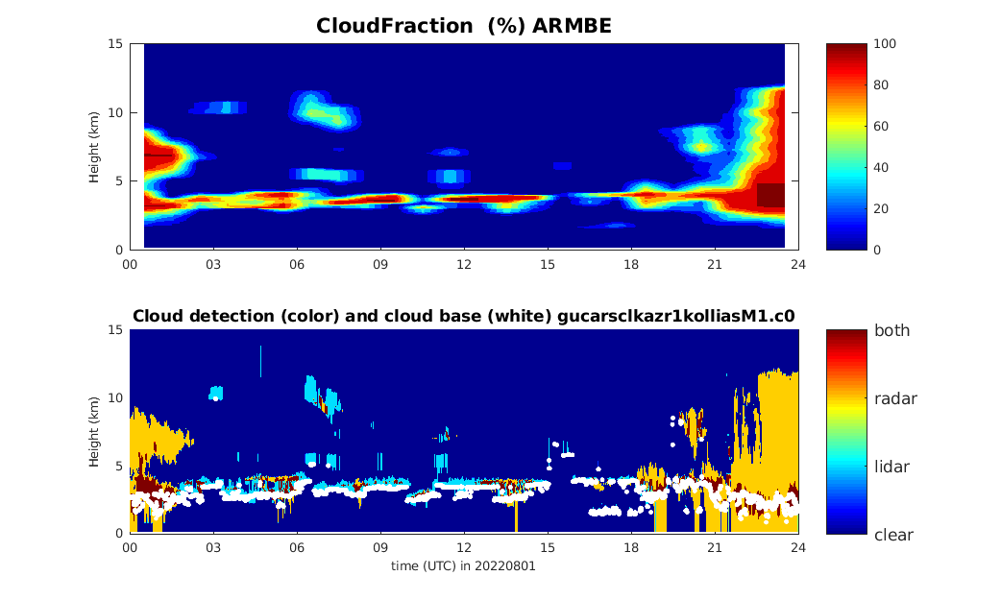
Modeling VAPs
Translator: Shaocheng Xie, xie2@llnl.gov
Cheng Tao, tao4@llnl.gov
ARMBEATM
ARMBECLDRAD
RH (%)
Cloud Fraction (%)
Precipitation
Cloud Mask
ARMBECLDRAD cloud fraction (up) derived from cloud measurements from the ARSCL data product (down) on Aug 1st, 2022.
ARMBEATM relative humidity (up) and surface precipitation (down) in Jan-Apr 2022.
15
15
Notes:
The ARMBE VAP assembles a best estimate of cloud, radiation, atmospheric quantities, and surface/land properties into one single dataset with a temporal resolution of 1 hour (easier to compare with GCMs)
ARMBE-AMT: surface precipitation, surface sensible and latent heat fluxes, and other atmospheric state variables
ARMBE-CLDRAD: cloud and radiative fluxes

Slide 16
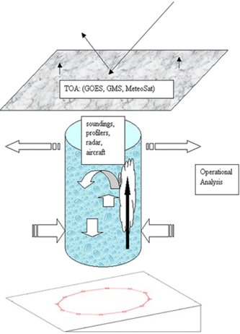
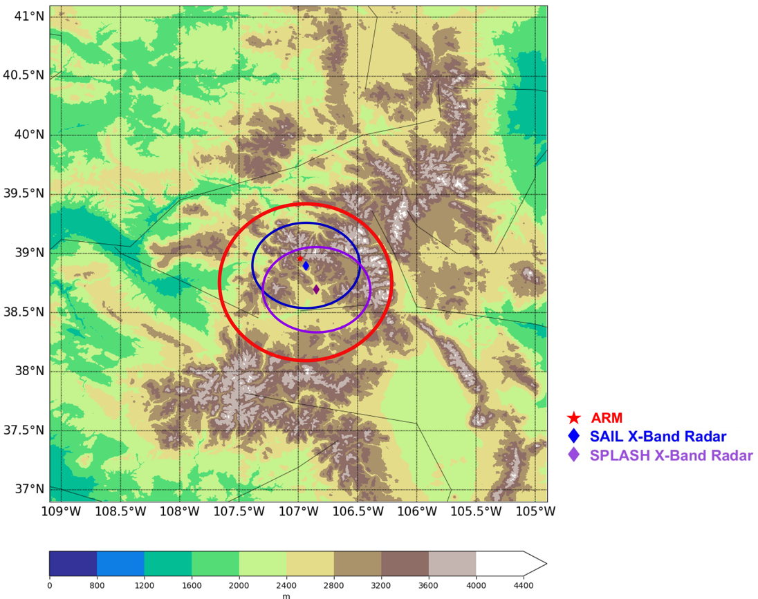
Modeling VAPs
Translator: Shaocheng Xie, xie2@llnl.gov
Cheng Tao, tao4@llnl.gov
**Constrained Variational Analysis (ARANAL) VAP
Plan for Large-Scale Forcing for SAIL (9/1/2021 – 6/15/2023)
Analysis Domain: (can be revised to meet project needs)
Location-fixed domain
Domain size: 75 km in radius
Use the terrain-following sigma coordinate to derive the VARANAL
16
16
Notes:
VARANAL forcing data are used to drive single-column models, cloud-resolving models and large-eddy simulation models
The VARANAL VAP calculates the large-scale vertical velocity and advective tendencies from sounding measurements of winds, temperature, and water vapor mixing ratio over a network of a small number of stations

Slide 17
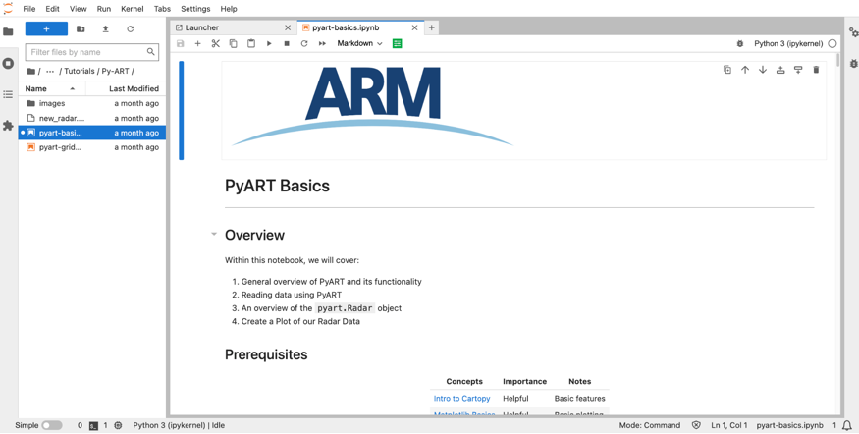
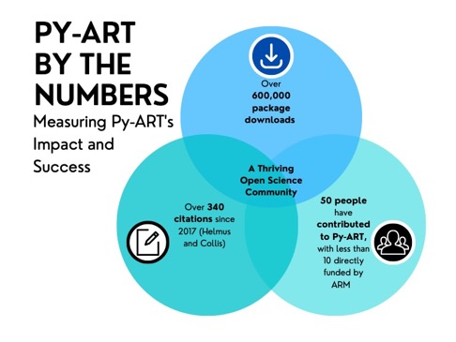
ARM Data Analysis Tools
Atmospheric data Community Toolkit (ACT): https://github.com/ARM-DOE/ACT
Python-ARM Radar Toolkit (Py-ART): https://github.com/ARM-DOE/pyart
ARM JupyterHub: https://jupyterhub.arm.gov/hub/
17
17

Slide 18
Extra Slides
18
18
Notes:
Motivation

Slide 19
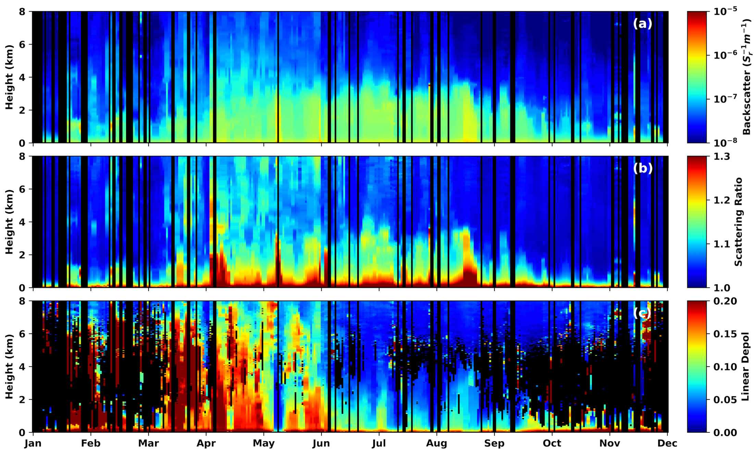
SAIL Aerosol Vertical Profiles
19
19
Notes:
Motivation

Slide 20
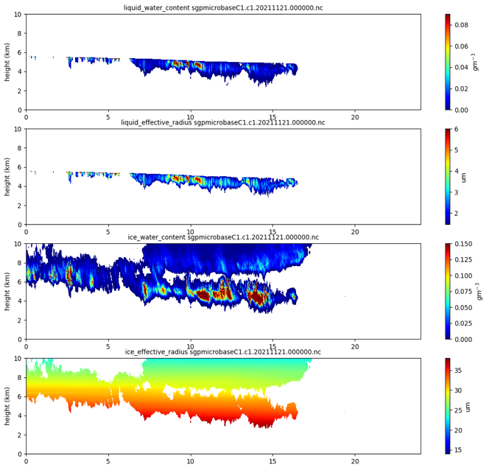
Cloud VAPs
Baseline Microphysical Retrieval (MICROBASE) VAP
LWC
Depolarization
Liquid Eff. Radius
IWC
Ice Eff. Radius
Cloud Microphysical property retrievals using radar, micropulse lidar, microwave radiometer, and radiosonde sounding observations
Uncertainty and validation using radiative closure
20

Slide 21
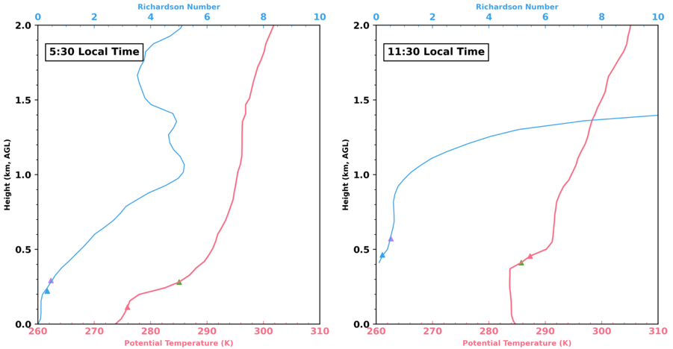
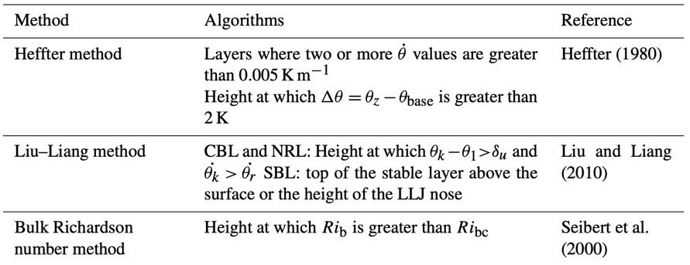
Atmospheric environment VAPs
Planetary Boundary Layer Height (PBLHT)-SONDE VAP
PBLHT-Lidar VAPs
21
Notes:
Description of PBLHT-SONDE and PBLHT-Lidar

Slide 22
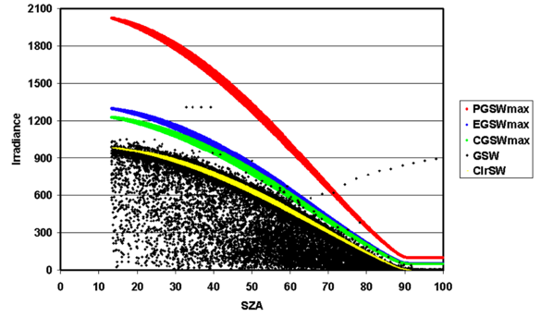
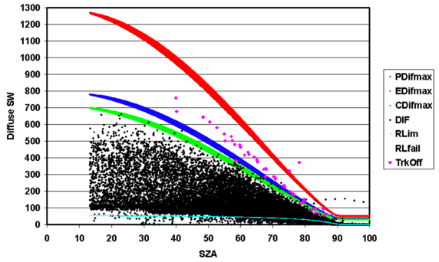
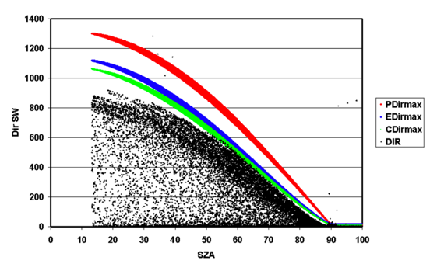
Radiation VAPs
Surface Radiation Measurement Quality Control Testing (QCRAD) VAP
Quality-controlled ARM radiation data for:
Total, direct, and diffuse downwelling SW
Upwelling SW
Downwelling and upwelling LW irradiance
22
Notes:
QCRAD uses climatological analyses of the surface radiation measurements to define reasonable limits for testing the data for unusual data values
SW: P-> physically possible limits; E->Extremely rare minimum limits; C->climatological limits
LW: maximum and minimum limits

