Slide 1
Evaluation of SPLASH-observed and HRRR Soil Moisture
Darren Jackson (CIRES/PSL)
Tanya Smirnova (GSL), Mimi Hughes (PSL), Kelly Mahoney (PSL), and Janet Intrieri (PSL)
S3 Workshop
November 1, 2023

Slide 2
Introduction
Examine 2022 warm season (May – October) soil moisture and precipitation between the HRRR model and SPLASH observations
Show model and observation differences in soil moisture at various depths from 0 - 50 cm
Evaluate observation and soil moisture response to summer precipitation events and drydown periods

Slide 3
Observation and Model Data Background
SPLASH Observations
ARL and PSL sites use SoilVUE 50 cm probes with soil moisture and temperature observations at 5, 10, 20, 30, 40, 50 cm
SNOTEL sites use Stevens HydraProbe that have soil moisture data at 2, 8, 20 in (~ 5, 20, 50 cm)
UAS observations and handheld probe data of soil moisture at ~ 5 cm
Precipitation gauge data available from ARL at Kettle Ponds and SNOTEL at Butte and Schofield Pass sites
HRRR Model
HRRRv4 with the RUC LSM land surface model that has 9 soil levels
Model levels of 0, 1, 4, 10, 30, 60 cm interpolated to SoilVUE and HydraProbe levels used at SPLASH and SNOTEL sites
All data acquired from 1-hour forecast data. Focus is on analyzed fields rather than forecasted fields.
* All measurements were average to hourly data

Slide 4
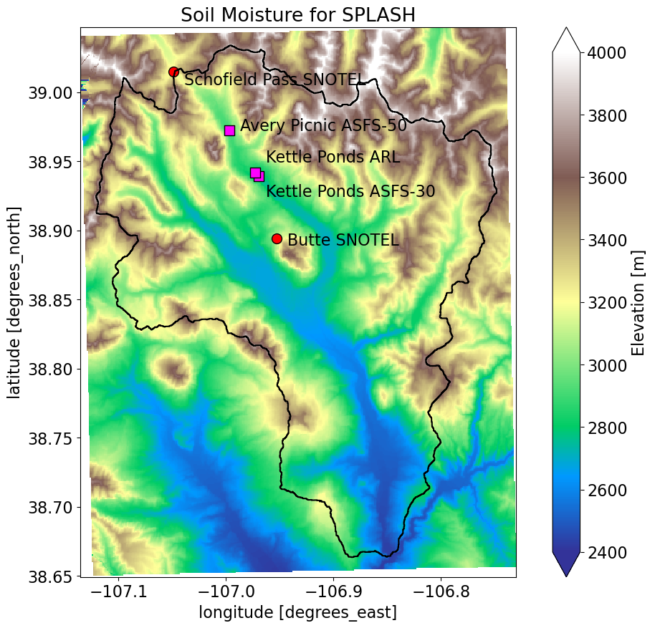
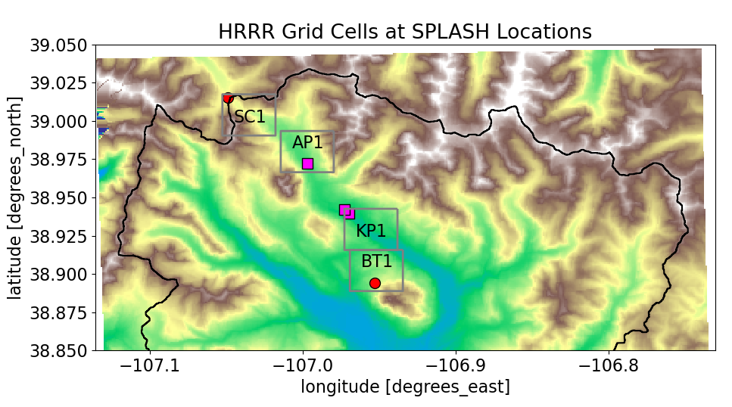
Location of SPLASH Observations and HRRR Grid Cells
Map (left) shows the SPLASH domain and locations of soil moisture observations
Map (top) shows the 3-km HRRR grid cells collocated with SPLASH sites
KP1 has not the nearest grid to Kettle Ponds but likely better represents the land surface conditions in the East River valley at Kettle Ponds

Slide 5
Soil Characteristics at Avery Picnic and Kettle Ponds
CSU Laboratory Tested Soil Samples
Sample | Depth (in) | Soil Texture (%) |  |  | Soil Type
 |  | Sand | Silt | Clay
AYP | 2 | 40 | 35 | 25 | Loam
KPA | 2 | 35 | 42 | 22 | Loam
KEP1 | 2 | 43 | 35 | 22 | Loam
* HRRR grid cells at Avery Picnic and Kettle Ponds are assigned as loam
Soil Characteristics for Loam Soils
Source | Porosity (m³/m³) | Field Capacity | Wilting Point
HRRR | 0.451 | 0.314 | 0.137
Saxton and Rawls (2006) | 0.46 | 0.28 | 0.14
Dingman (2002) | 0.42-0.47 | 0.18-0.27 | 0.08

Slide 6
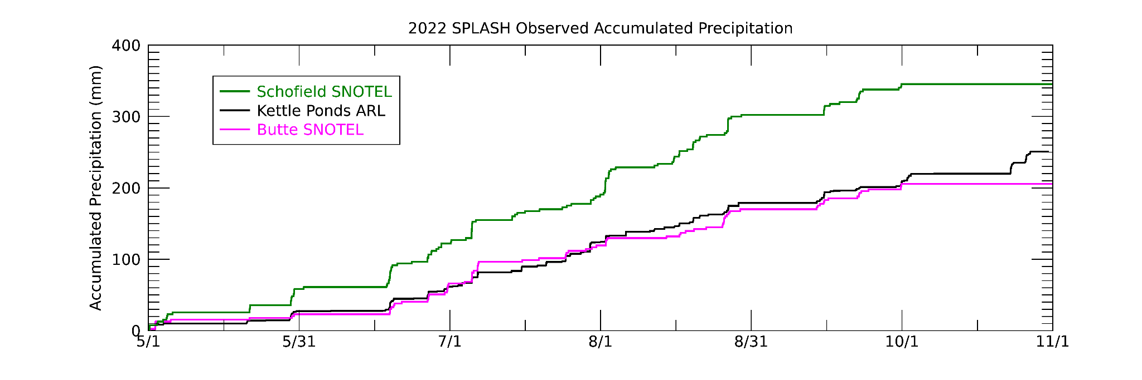
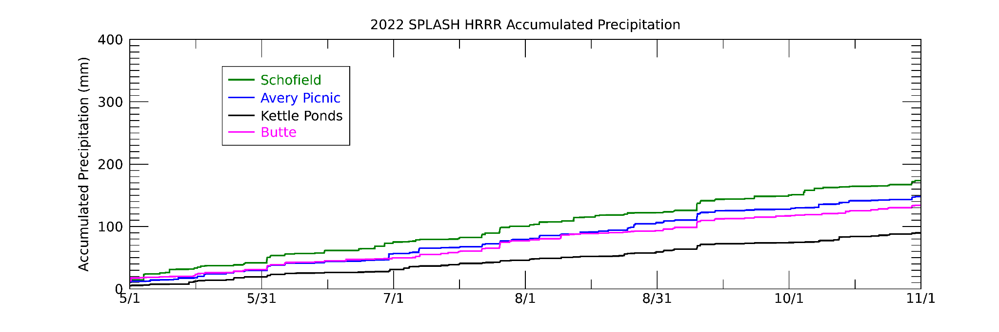
2022 Seasonal Accumulated Precipitation
Observed accumulated precipitation exceeds HRRR accumulated precipitation at three SPLASH locations
HRRRv4 has known dry bias due to its ensemble data assimilation plus the impact of precipitation spin up over 1-hour forecast period that drives the evolution of soil moisture

Slide 7
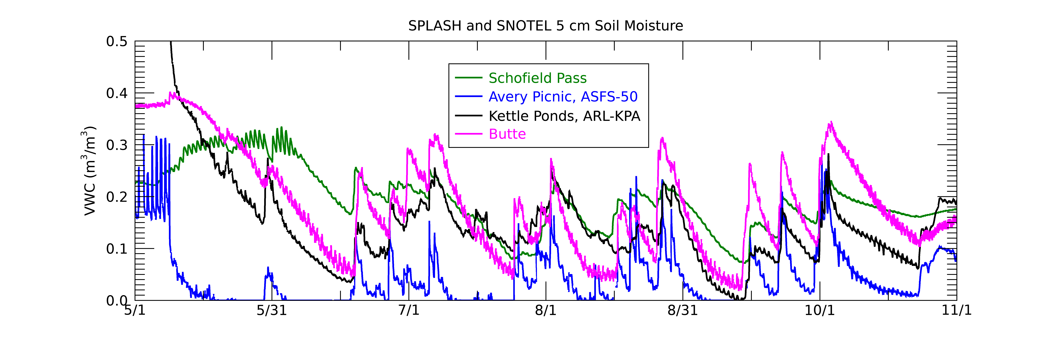
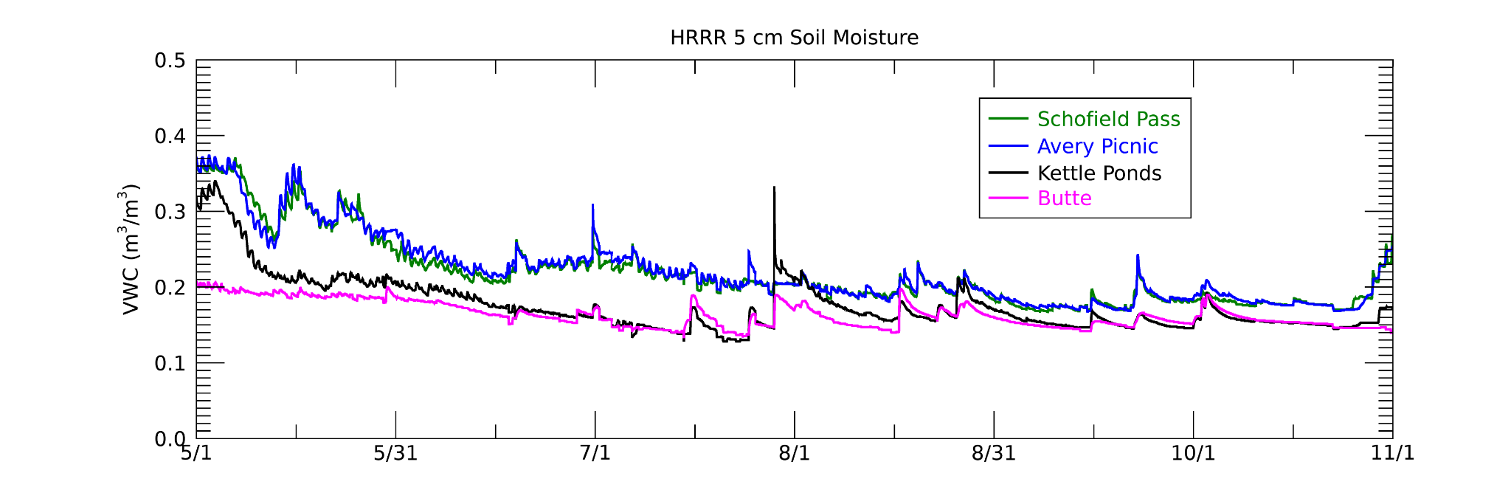
Seasonal 5 cm Soil Moisture Variability
Loam Porosity
Observations have greater variability after precipitation and the following drydown
HRRRs drydown rate during dry periods less than observations
SoilVUE near-surface soil moisture retrievals have a known dry bias (Wilson et al. 2022)

Slide 8
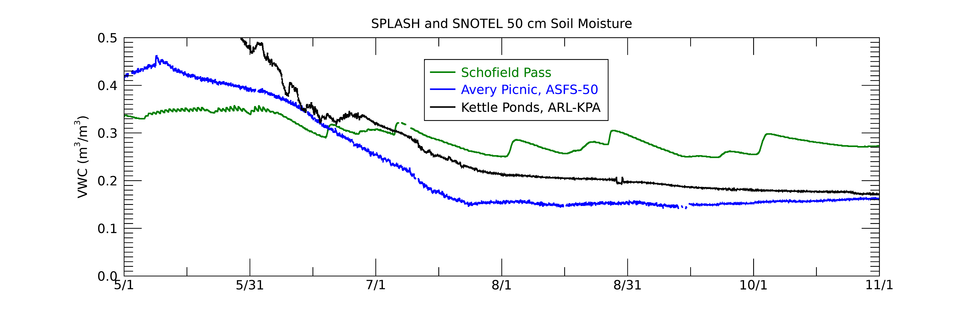
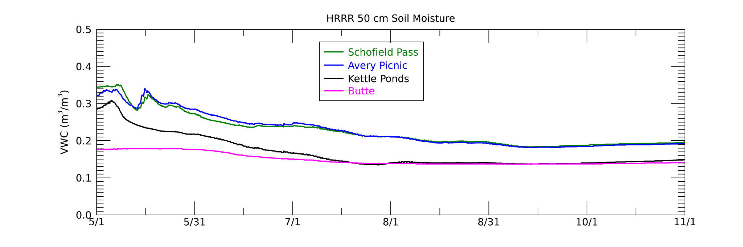
Seasonal 50 cm Soil Moisture Variability
Observations are wetter in the snowmelt period at AP and KP due to less SWE in HRRR model at these locations
HRRR internal deep soil moisture climatology has been modified over past 15 years and this comparison indicates good agreement for AP and KP

Slide 9
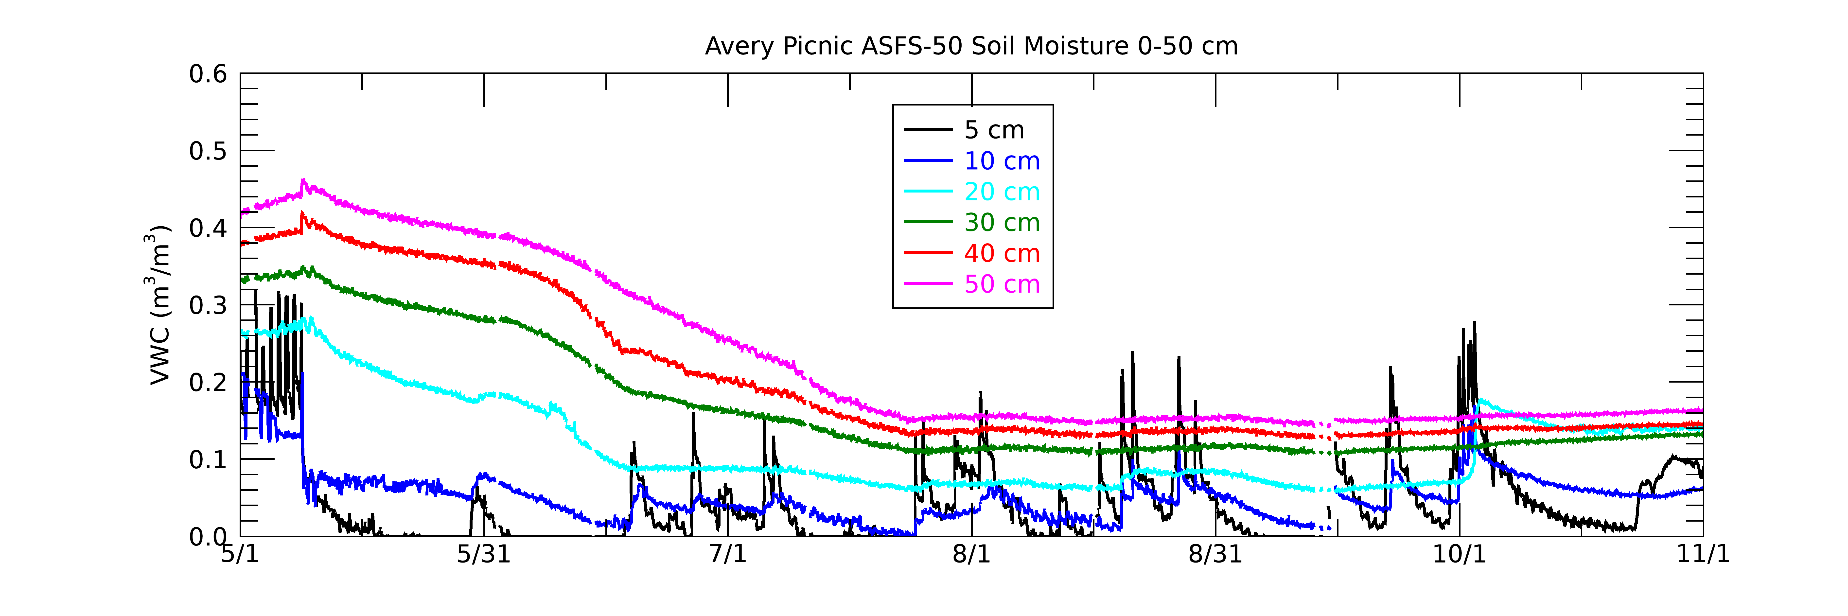
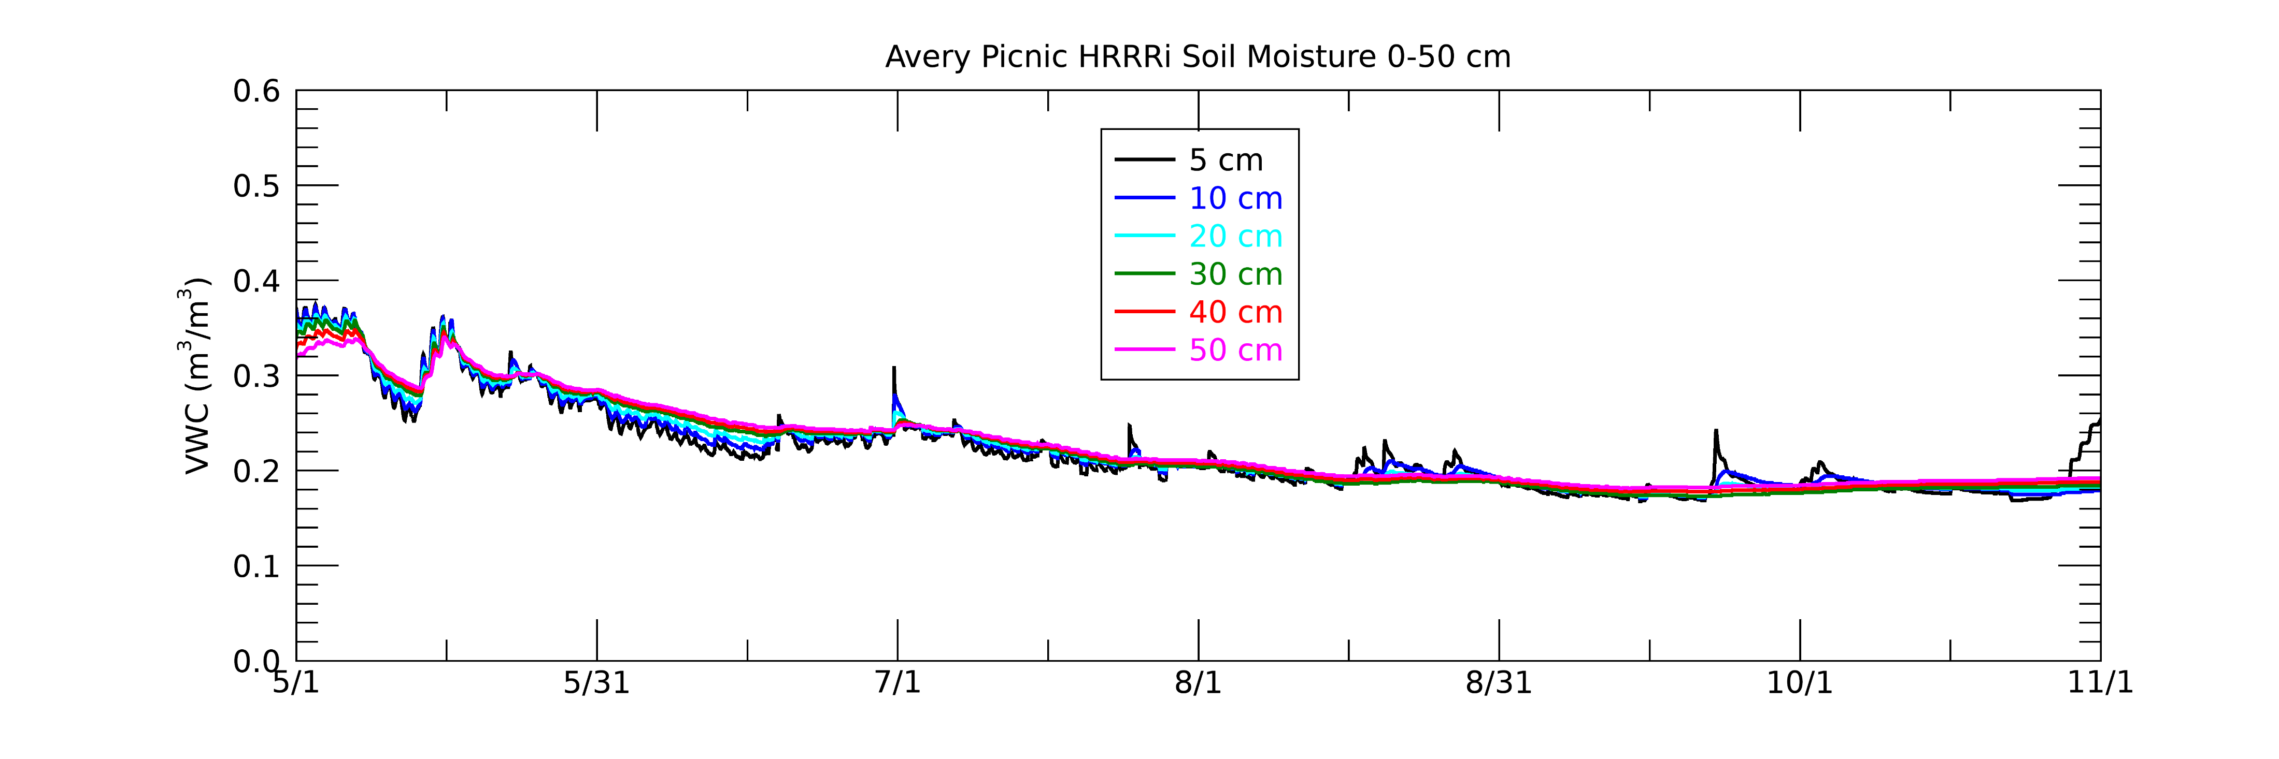
Seasonal 0-50 cm Soil Moisture Comparison
Loam Porosity
Observations have a greater vertical gradient than HRRR particularly during snowmelt period and early summer
Observation and HRRR 20-50 cm soil moisture tend to converge by end of October
5 and 10 cm observed soil moisture generally drier than HRRR except during rainfall periods

Slide 10
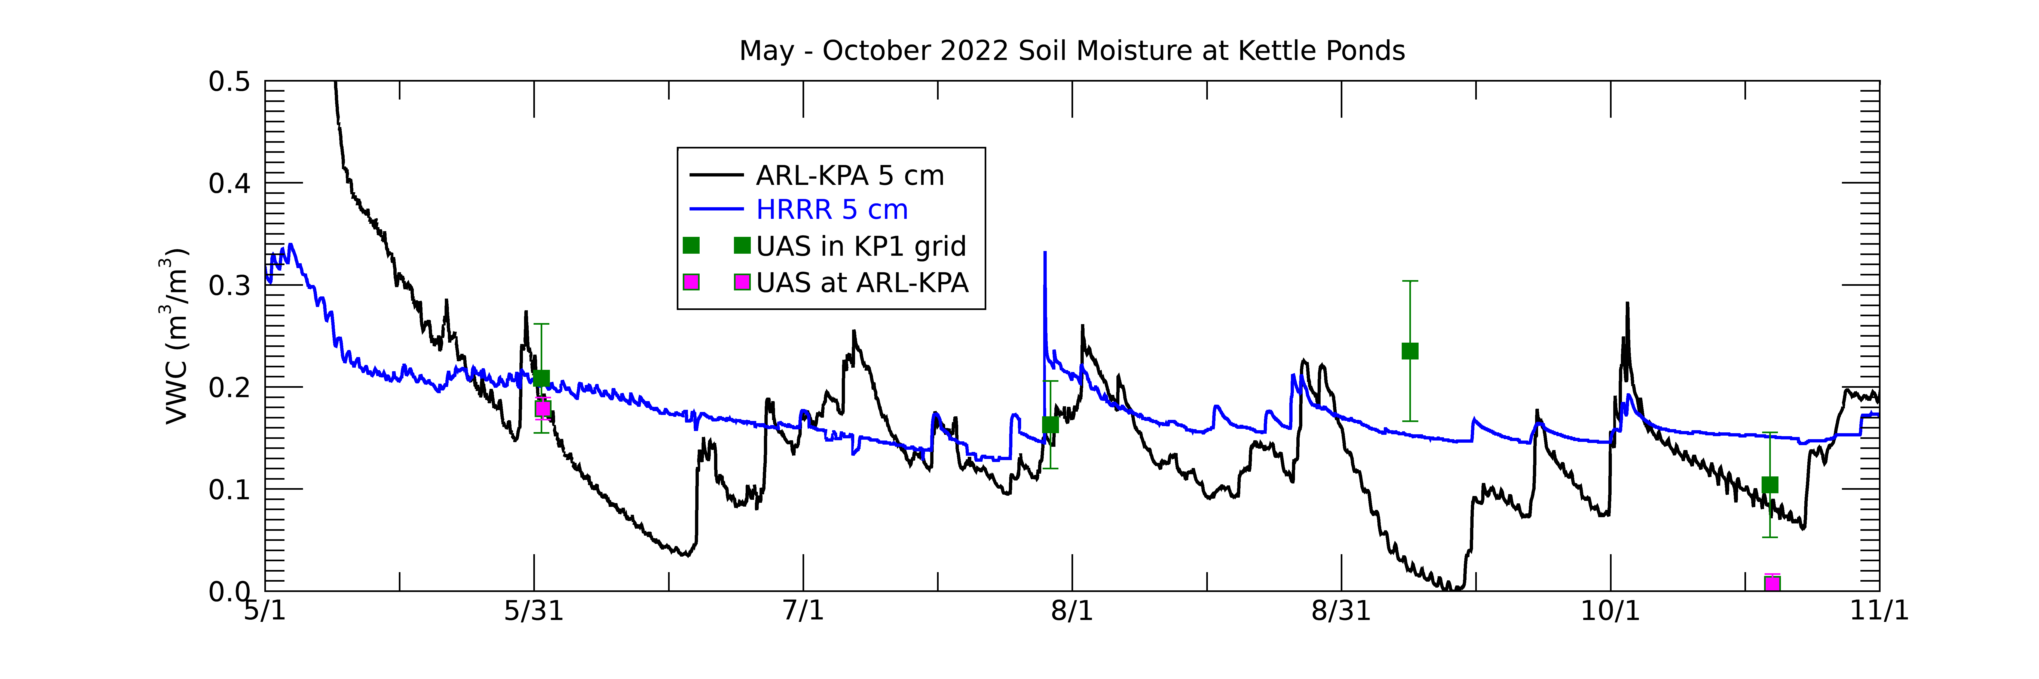
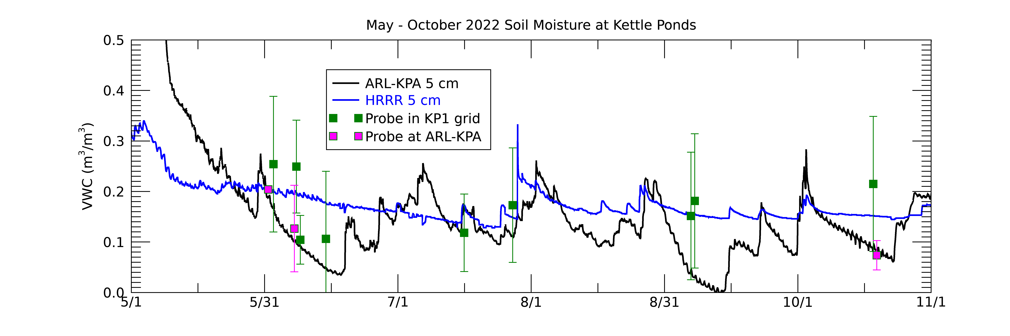
5 cm Soil Moisture Comparison with UAS and Probe Data
UAS observations agree well in June and July with HRRR and ARL SoilVUE 5 cm soil moisture but have larger departures in September and October
Probe area mean (green) agree well with HRRR and Probe data near KPA (magenta) agree well with KPA SoilVUE.
SoilVUE locations at KP and AP are located in relatively drier soils.
Probe Drydown rate in June is consistent with SoilVUE observations.

Slide 11
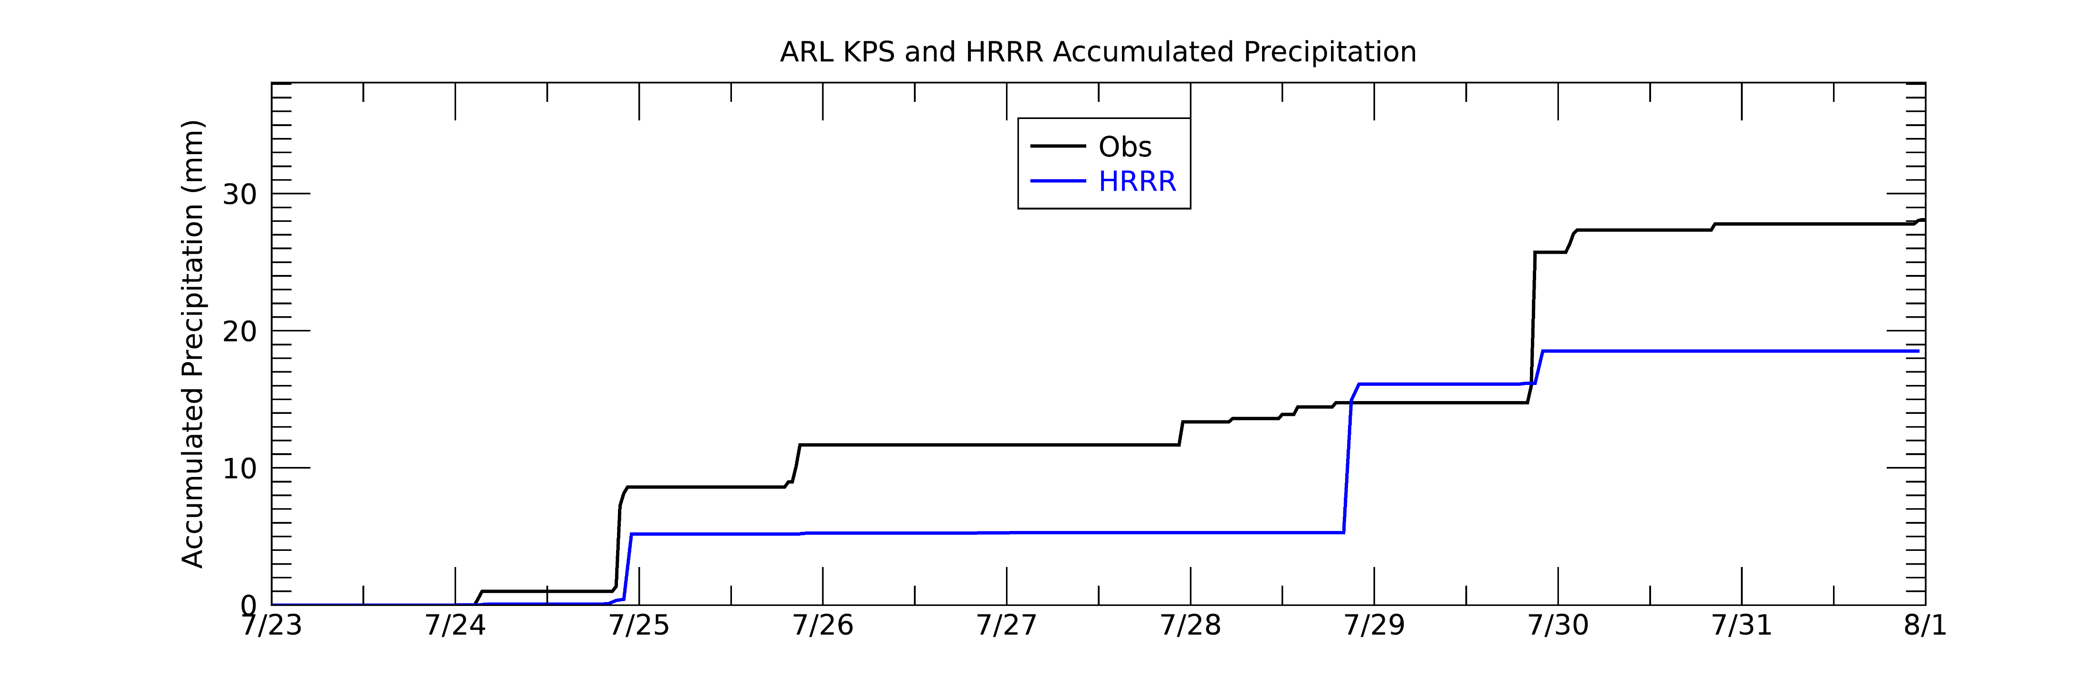
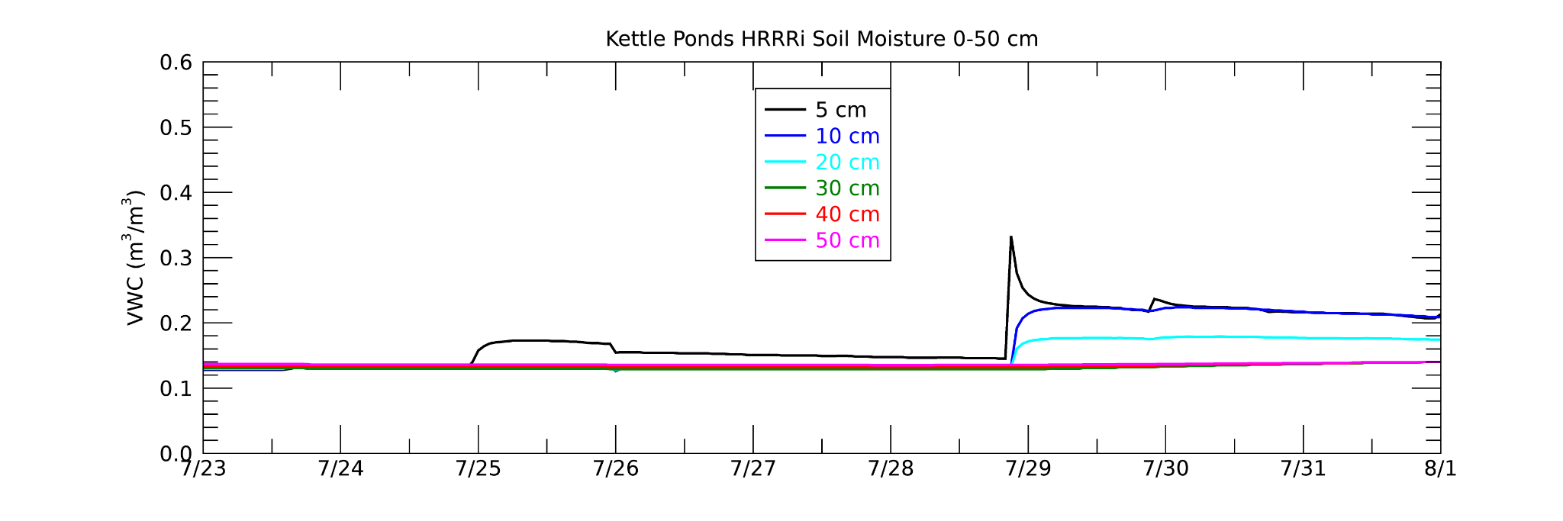
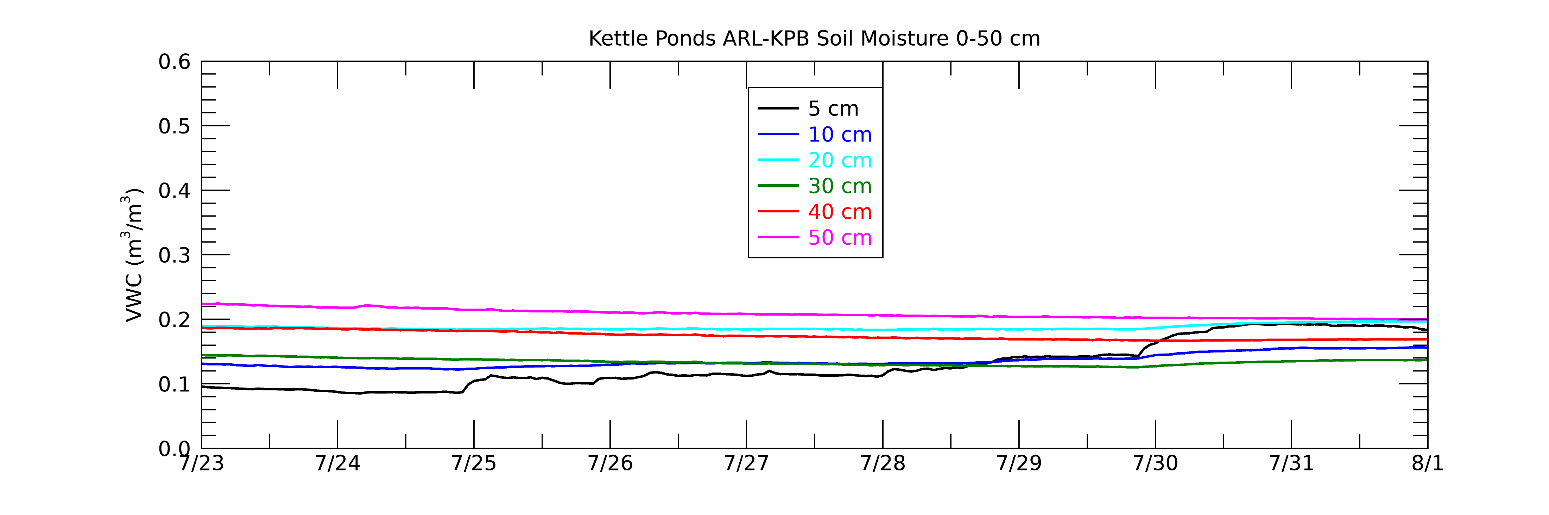
July 23-31, 2022 Rainfall Event at Kettle Ponds
HRRR multi-day accumulated precipitation in better agreement for this event than most 2022 summer events
HRRR near-surface (0-20 cm) soil moisture response evident on July 25th and 29th
Observational response more gradual but overall increase of 0.1 m³/m³ at 5 cm similar between model and observations
More vertical gradient in soil moisture at depth in observations
HRRR
ARL-KPB

Slide 12
SUMMARY
HRRR precipitation is less than observations which likely impacts the smaller near-surface soil moisture response relative to observations.
HRRR soil moisture near the surface is wetter than observations and drier than observations at depth particularly during snowmelt and early summer period.
HRRR demonstrated it can have a multi-day increase in soil moisture similar to observations during multi-day precipitation event.
Next Step: Evaluating HRRR and observational surface fluxes may help explain differing soil moisture drydown rates between HRRR and observations.

