Slide 1
RRM-SCREAM simulations around ARM sites and field campaigns
November 1, 2023
Hsi-Yen Ma
and
Yunyan Zhang, Peter Bogenschutz, Jishi Zhang
Lawrence Livermore National Laboratory

Slide 2
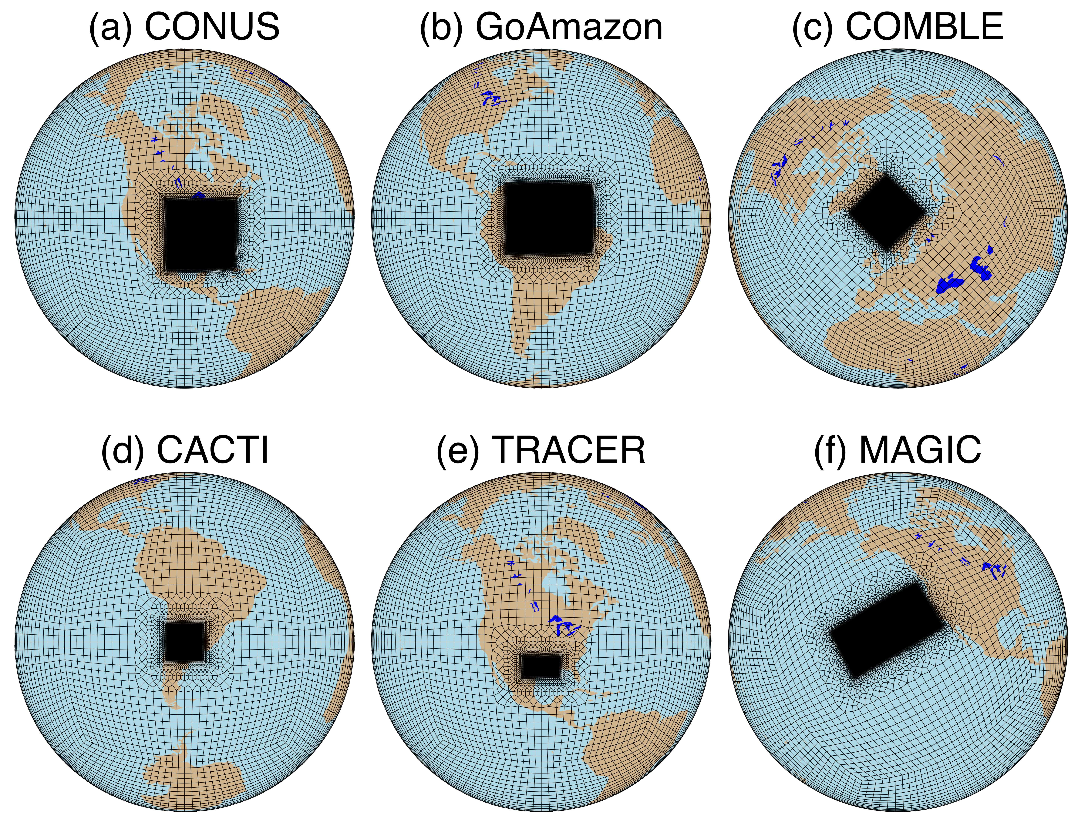
RRM-SCREAM
RRM: Regionally-refined Model
RRM: An effective and efficient tool for high-resolution model development and diagnosis
Six RRM-SCREAM configurations are proposed to study convection over land, marine low clouds and land-atmosphere interactions in THREAD.
Inner domain (refined region) will be ~3.25 km or 1.6 km, and will be free-running. Outer domain will be ~100 km, and the dynamical fields in the outer domain will be nudged toward the ERA5 reanalysis
RRM-SCREAM configurations

Slide 3
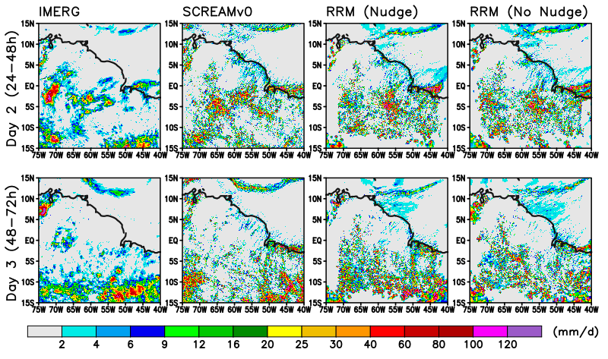
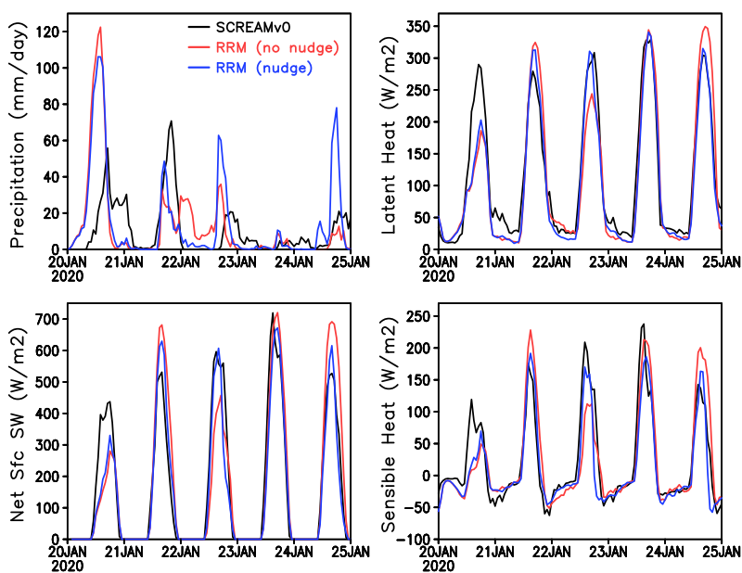
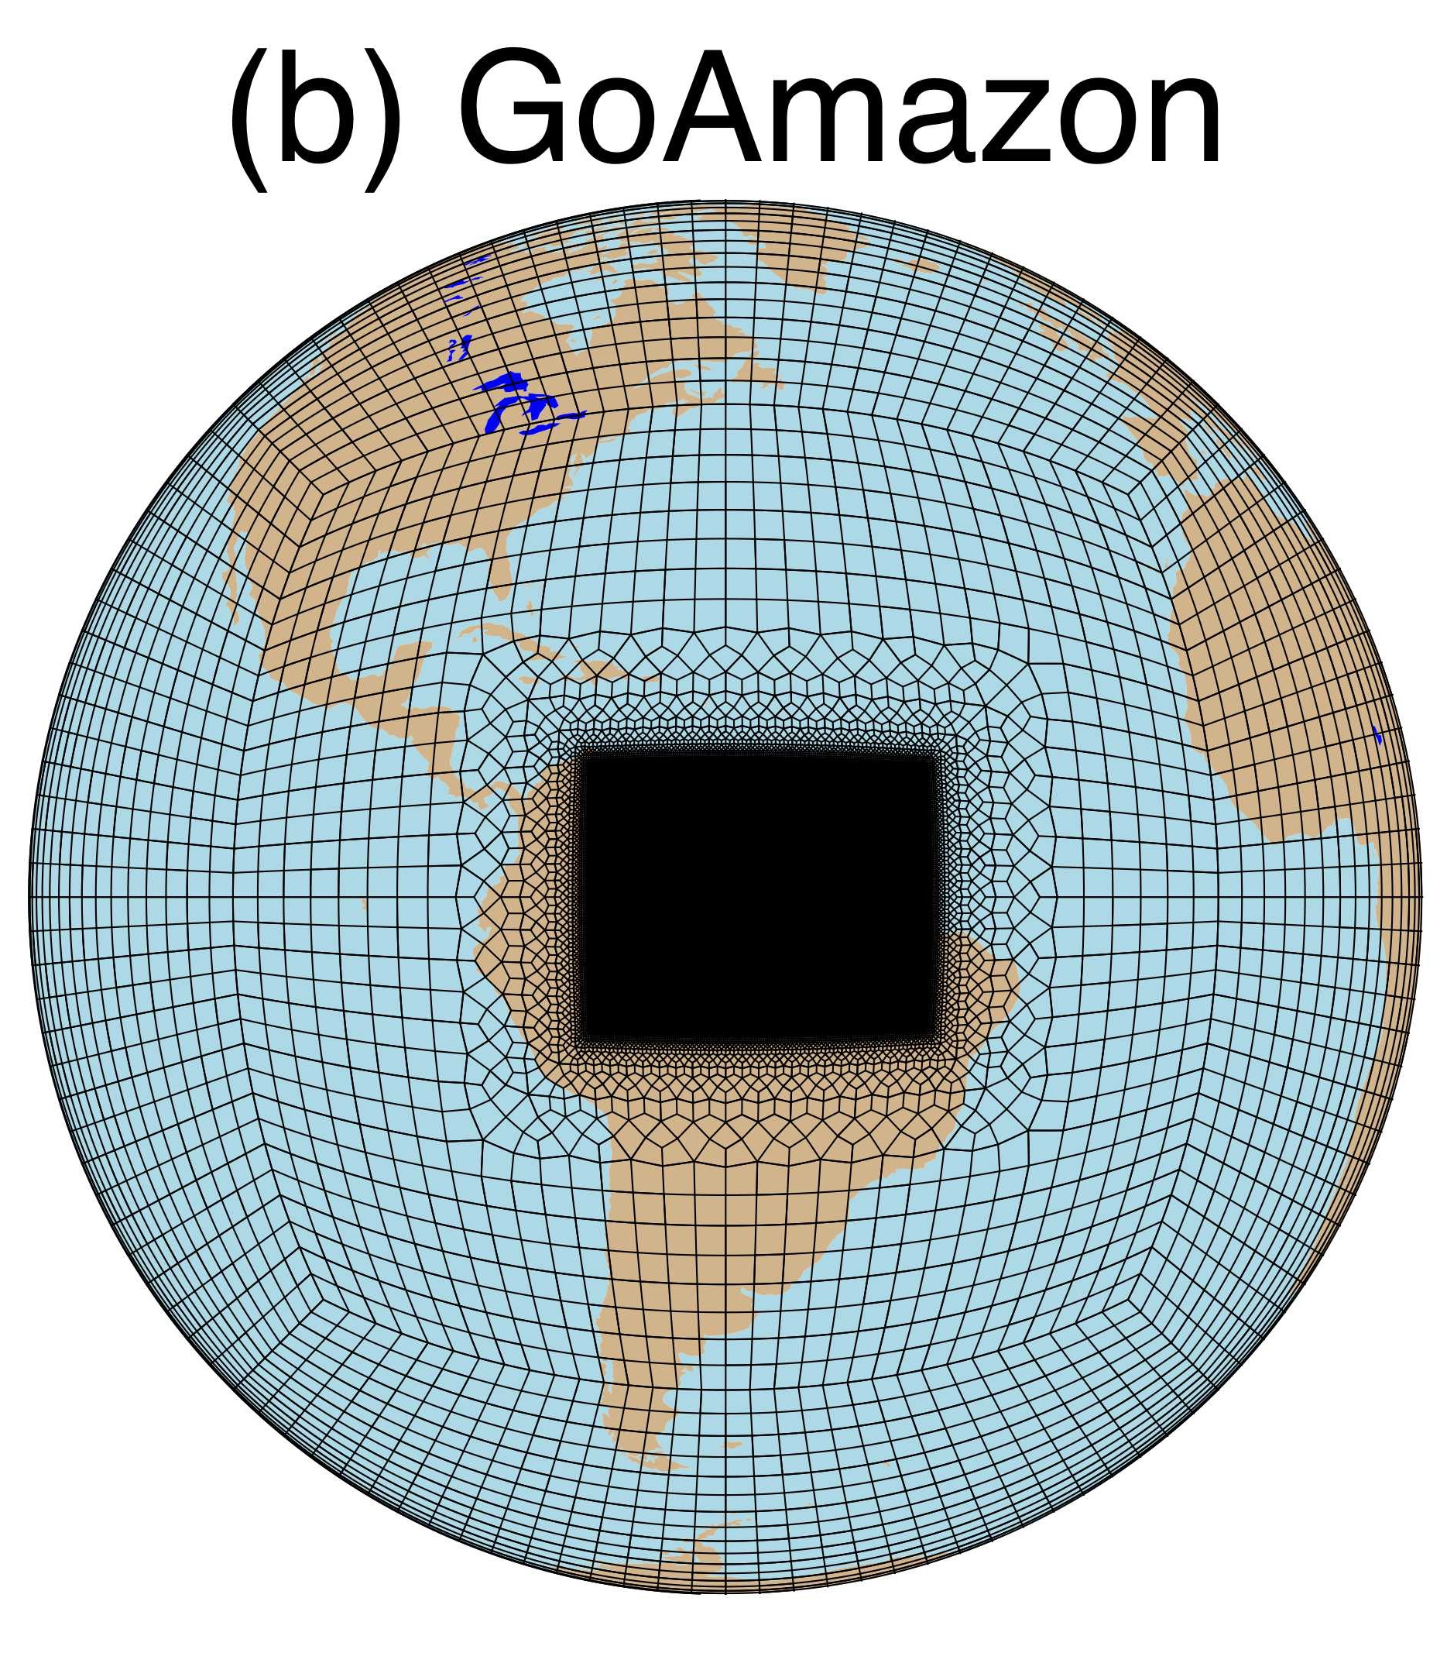
Precipitation
Validation of RRM-SCREAM simulations
AMF domain (128km radius)
Experiments:
  SCREAMv0, starting from 2020/01/20, 40-day long (DYAMOND II)
  2 RRM-SCREAM, 5-day long hindcasts starting from 2020/01/20 (w/ and w/o nudging)

Slide 4
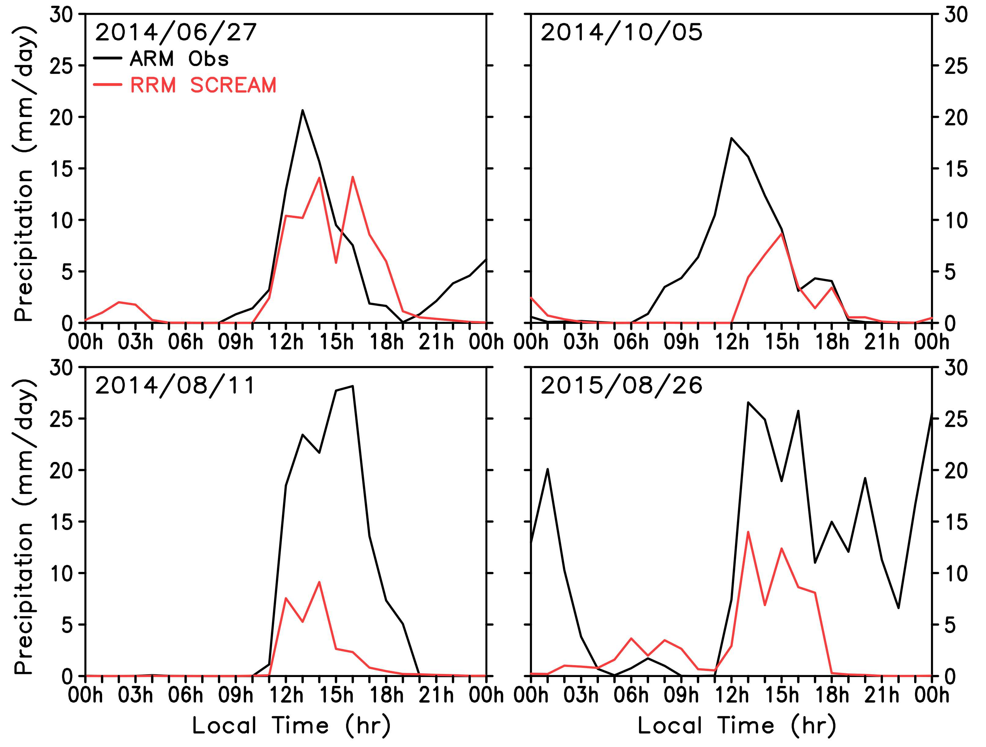
Transition of shallow to deep convection (GoAmazon)
Case study:
  Transition of shallow to deep convection:
    Single-peak days: 2014/6/27, 2014/10/05
    Double-peak days: 2014/8/11, 2015/8/26

Slide 5
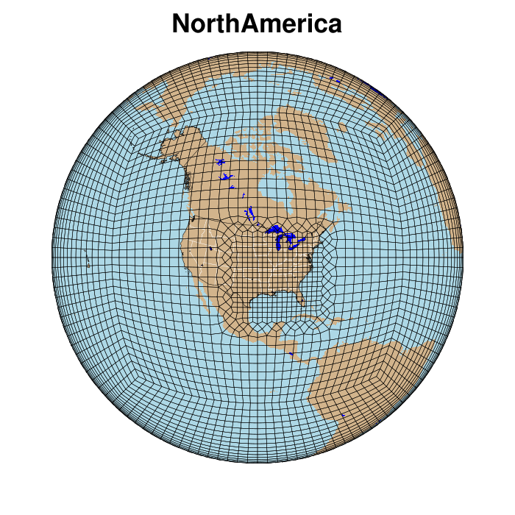
Discussion
How to better coordinate our modeling effort (RRM-SCREAM) with SAIL field campaign?
  Observations and model needs for SAIL and planned experiments
    Case studies to address specific science questions
  RRM-SCREAM experiment and domain design
    Experiment domain design
    Land component configuration (land surface conditions validation and land initializations for snow)
Current RRM domain to cover SGP, TRACER and AMF3 BNF.

