Slide 1

Improving ensemble weather prediction system initialization: disentangling the contributions from model systematic errors and initial perturbation size
Tom Hamill (tom.hamill@noaa.gov) +1 (303) 497-3060
NOAA Earth System Research Laboratory, Physical Sciences Division
Boulder, CO USA 80305
seminar at Cornell University, Ithaca NY, 15 October 2019

Slide 2
Today’s seminar
Background material on ensemble weather prediction, data assimilation.
Data and methodology for a proposed decomposition of initial-condition errors, separating systematic and random.
Application of the methodology to surface temperature errors in the premier ensemble prediction system, the European Centre for Medium-Range Weather Forecasts (ECMWF) ensemble.
Broader implications.

Slide 3
Numerical weather prediction 30 years ago
observations around time t
forecast for time t
data assimilation
state estimate for time t
weather
forecast
model
forecast for
time t+Δt
1
1
forecast to many days
or weeks

Slide 4



The problem with deterministic predictions
Truth
Forecast

Slide 5
Numerical weather prediction currently
observations around time t
ensemble
forecast to time t
ensemble
data assimilation
ensemble of
state estimates for time t
ensemble of
weather
forecasts
ensemble forecast to
time t+Δt
1
1
ensemble forecast to many days
or weeks

Slide 6
Numerical weather prediction currently
observations around time t
ensemble
forecast to time t
ensemble
data assimilation
ensemble of
state estimates for time t
ensemble of
weather
forecasts
ensemble forecast to
time t+Δt
1
1
ensemble forecast to many days
or weeks
statistical
postprocessing

Slide 7
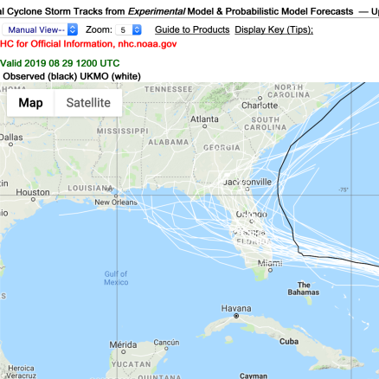
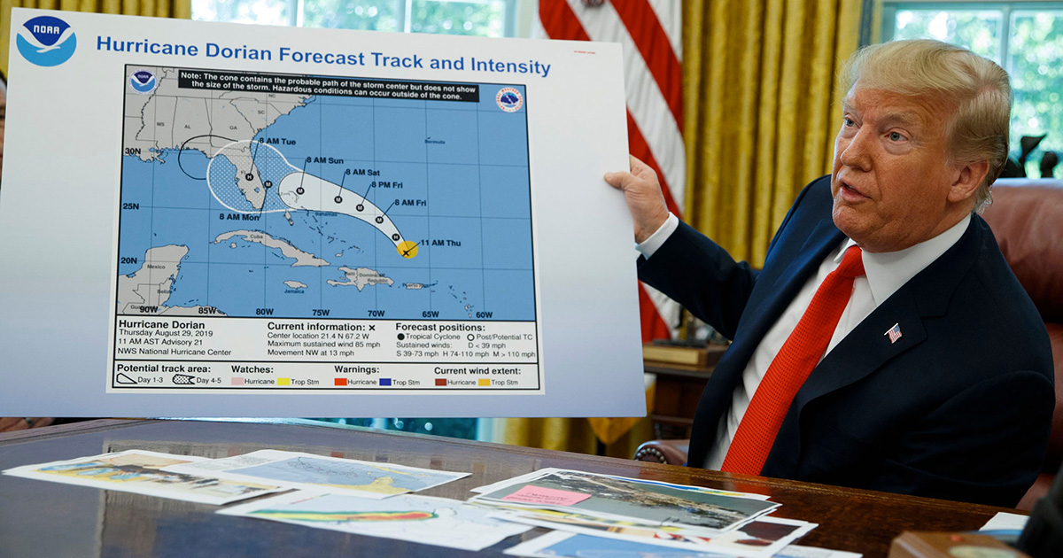
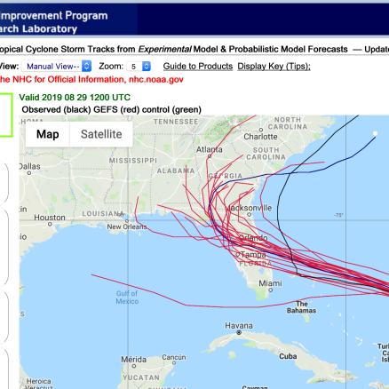
Ensemble predictions have penetrated popular culture and politics.
European Centre
12 UTC 29 August 2019 track information
National Weather Service

Slide 8
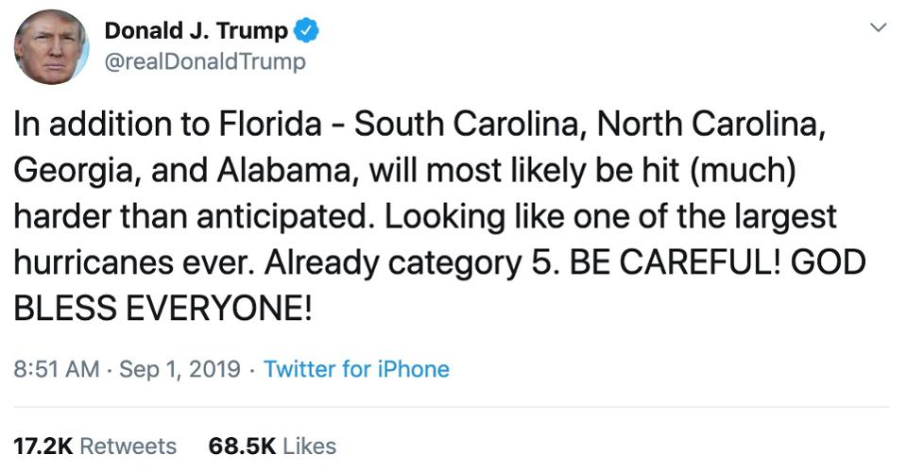
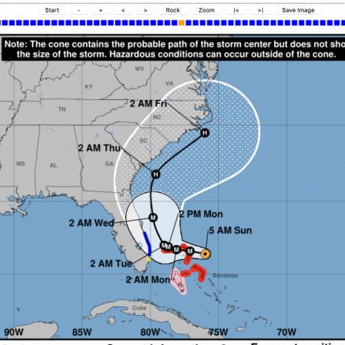
Cone of uncertainty the morning of the infamous tweet

Slide 9
Still, this does illustrate a common problem in ensemble prediction systems.
The observed track, in black, was outside the range
of the ensemble prediction system.
With an n-member ensemble, this should happen
only 2/(n+1) of the time, assuming the ensemble
forecast and truth are draws from the same distribution.
We wish to improve ensemble prediction systems
so the forecasts are reliable at all leads.
Ref: Hamill, T. M., 2001: Interpretation of rank histograms for
verifying ensemble forecasts. Mon. Wea. Rev., 129, 550-560.

Slide 10
The dual challenge we face in generating useful ensembles of predictions.
ensemble
members’
trajectories
t=t+Δt
t=0
reality

Slide 11
The dual challenge we face in generating useful ensembles of predictions.
properly simulating the growth of initial errors due to chaos. How big is the initial error, and how are errors related between state components?
ensemble
members’
trajectories
t=t+Δt
t=0
reality

Slide 12
The dual challenge we face in generating useful ensembles of predictions.
ensemble
members’
trajectories
t=t+Δt
t=0
properly simulating the growth of initial errors due to chaos.
reality
2. ameliorating, or simulating the often substantial error due to model imperfections
or simplifications.

Slide 13

With cycled data assimilation, the second problem, model uncertainty and bias, affects the first
(initial condition uncertainty).
observations around time t
ensemble
forecast to time t
ensemble
data assimilation
ensemble of
state estimates for time t
ensemble of
weather
forecasts
ensemble forecast to
time t+Δt
1
1
ensemble forecast to many days
or weeks
statistical
postprocessing

Slide 14
With cycled data assimilation, the second problem, model uncertainty and bias, affects the first
(initial condition uncertainty).
observations around time t
ensemble
forecast to time t
ensemble
data assimilation
ensemble of
state estimates for time t
ensemble of
weather
forecasts
ensemble forecast to
time t+Δt
1
1
ensemble forecast to many days
or weeks
statistical
postprocessing

Slide 15
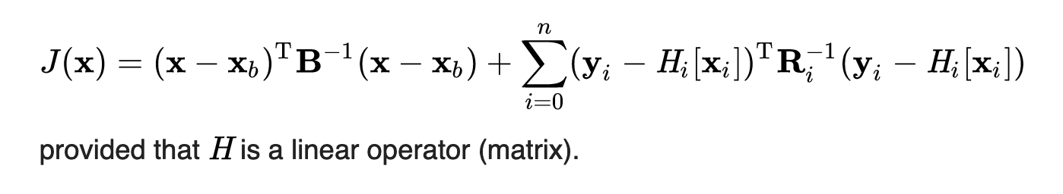
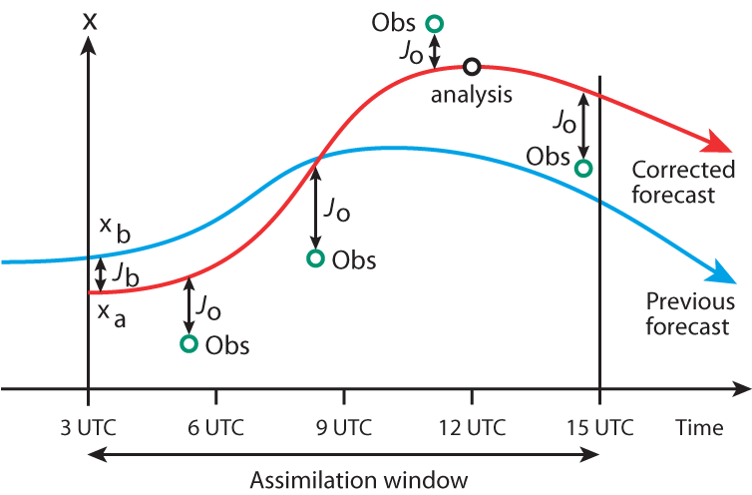
A bit more on data assimilation systems.
The 4D-Var (four-dimensional variational analysis) procedure used at ECMWF minimizes a functional which represents the adjustment of the background forecast trajectory to best fit the observations, each weighted proportional to the inverse of their error covariance.
= J_{b} + J_{o}
x_{b}: background state
H: operator, model → observations
B: background-error covariance.
R: observation error covariance
n+1 observations
An assumption is that the background
forecast state is statistically unbiased.

Slide 16
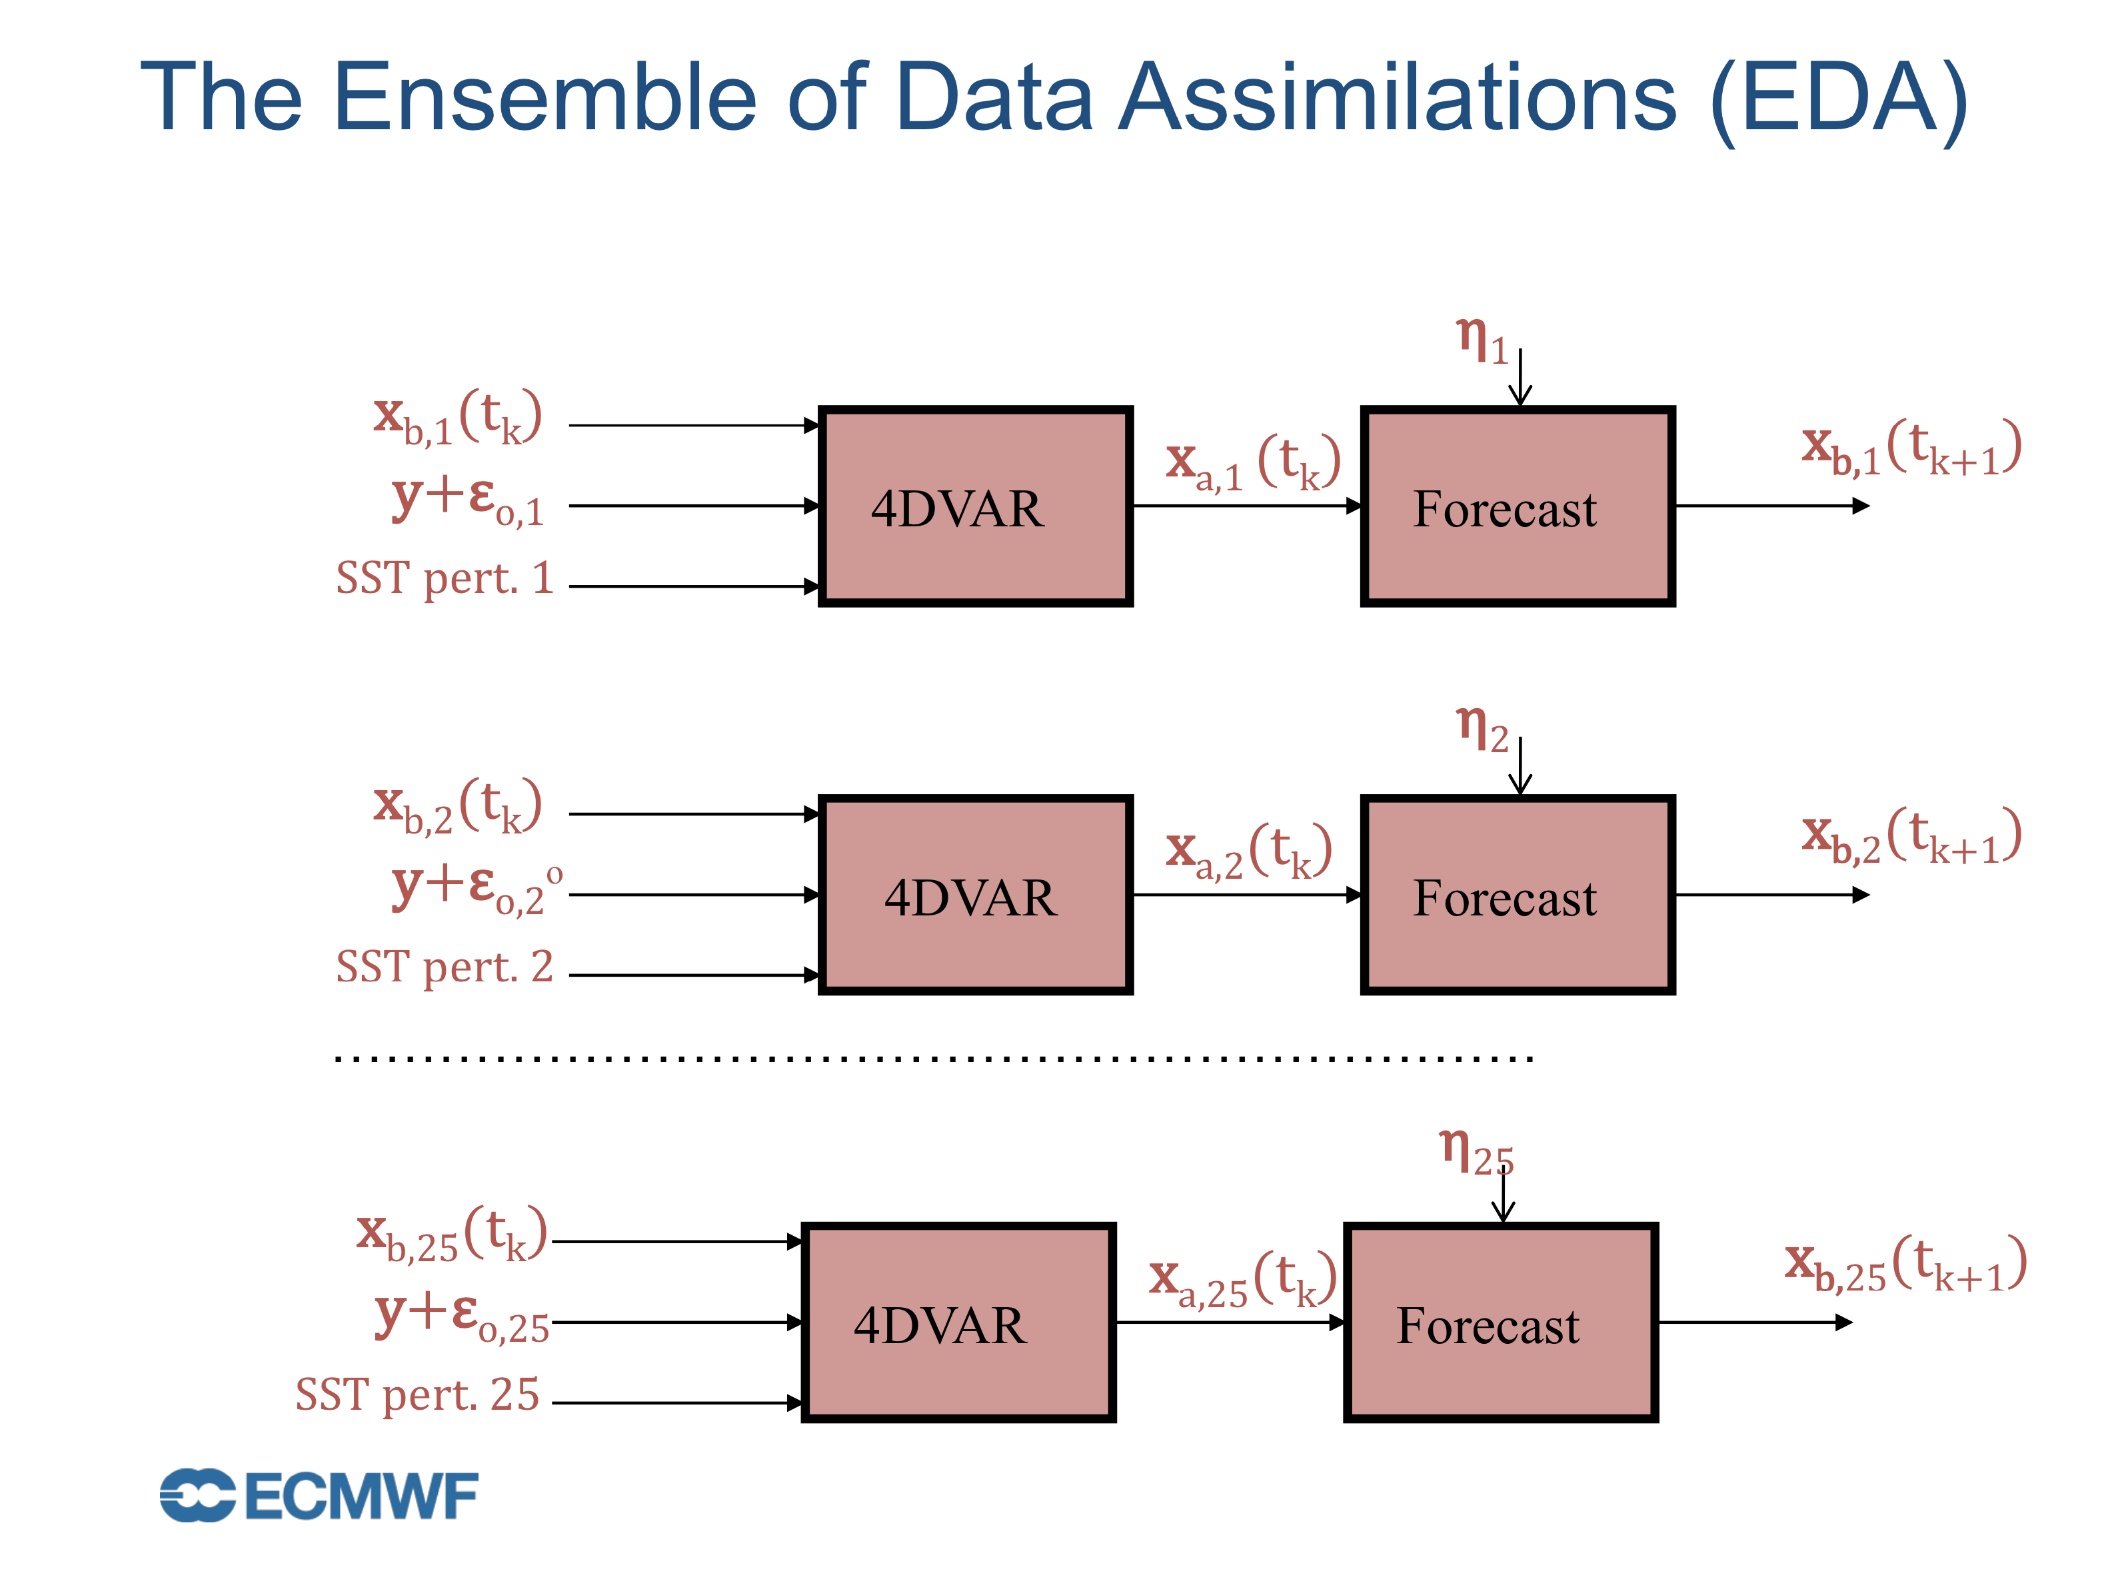
Error statistics B for the background forecast are estimated from short-range forecasts initialized with EDA
ECMWF now runs 50-member ensemble
of EDA at a reduced resolution to estimate
forecast uncertainty in the higher-resolution
control state.
Statistics of differences between the EDA
members are used in conjunction with
“singular vector” perturbations that grow
quickly to set the initial magnitude and
structure for perturbed ensemble initial
conditions.
https://www.ecmwf.int/sites/default/files/elibrary/2018/17996-advancing-data-assimilation-global-nwp-ecmwf-perspective.pdf

Slide 17
Let’s pick a variable – surface temperature – T_{2m} -- that’s particularly problematic and of great forecast importance.
ensemble
members’
trajectories
t=t+Δt
Is the truth outside
the range of forecasts
because the span
of initial conditions
is too small? Then fix
the initial conditions
to have greater diversity.
t=0
Is the forecast
bias due to
imperfections in the
forecast model?
Then fix those
(a better model, and/or
improved treatment
of model uncertainty)
reality

Slide 18
Proposed diagnostic procedure
YES
Fix the forecast model or the data assimilation
ECMWF T_{2m}
analysis grid
(initial condition)
is the error systematic, consistent over time?
ECMWF T_{2m}
analysis
“error”
Compute Difference
Change system so initial condition perturbations consistent with non-systematic error statistics
My independently generated T_{2m}
analysis (~truth)
NO

Slide 19
ECMWF initial-condition data
½-degree T_{2m} ECMWF 4D-Var analyses over US at 00 UTC, all of 2018. These are the “control” initial conditions around which a set of perturbed ensemble members’ initial conditions are centered.
  These analyses optimized to produce an overall high-quality forecast, but they are not optimized specifically for accurate, unbiased surface temperature.
½-degree sets of ECMWF’s T_{2m} 00 UTC perturbed initial conditions. For determining the current magnitude of initial-condition spread (standard deviation).
Data from TIGGE web site (available 2 days after forecast is issued)

Slide 20
An independently generated “OI” analysis of T_{2m} will be regarded as reference.
Why might this be better than ECMWF’s estimate?
  ECMWF’s analyses are tailored to fit all the observations and producing overall high-quality atmospheric analysis. It comparatively de-emphasizes surface analysis accuracy.
  Surface analyses may be affected by the land state. If that’s poorly estimated, near-surface background forecasts are poorly estimated.
  My proposed procedure will leverage terrain-related details that the ECMWF system doesn’t produce. ECMWF system uses smoothed terrain representation for numerical stability.
T_{2m} analysis over the CONUS is based on optimal (statistical) interpolation (OI) with a somewhat novel background-error covariance model. More details in supplemental slides. Data inputs:
  A PRISM climatology background “forecast.” -- unbiased, unlike ECMWF.
  ~ 1300 station observations.
  Novel objectively defined background-error covariance function, details in supplemental slides.

Slide 21
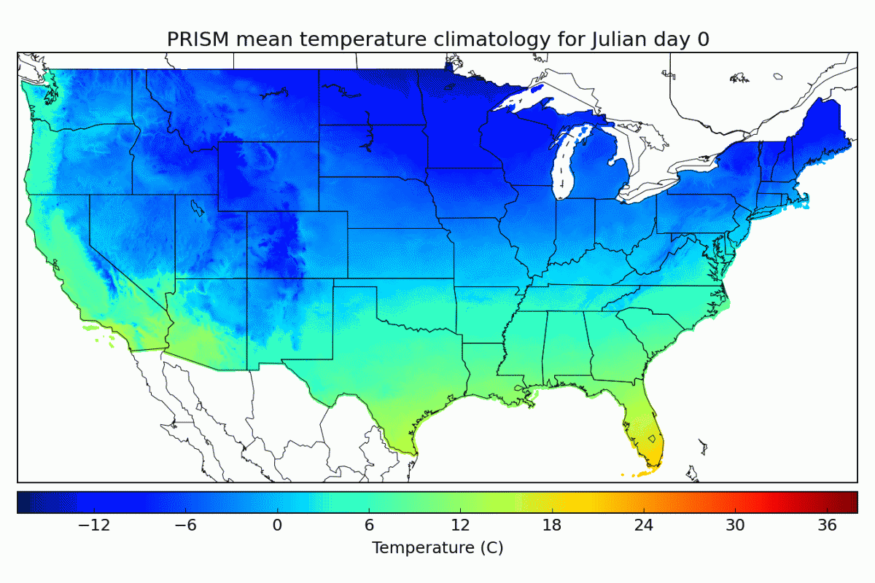
PRISM yearly cycle of daily mean temperature
A distinct PRISM climatology is cubic-spline fit to every day of the year using climatologies of surrounding months.
PRISM ref: Daly et al. 2008, Int. J. Climatol. DOI: 190.1002/joc.1688

Slide 22
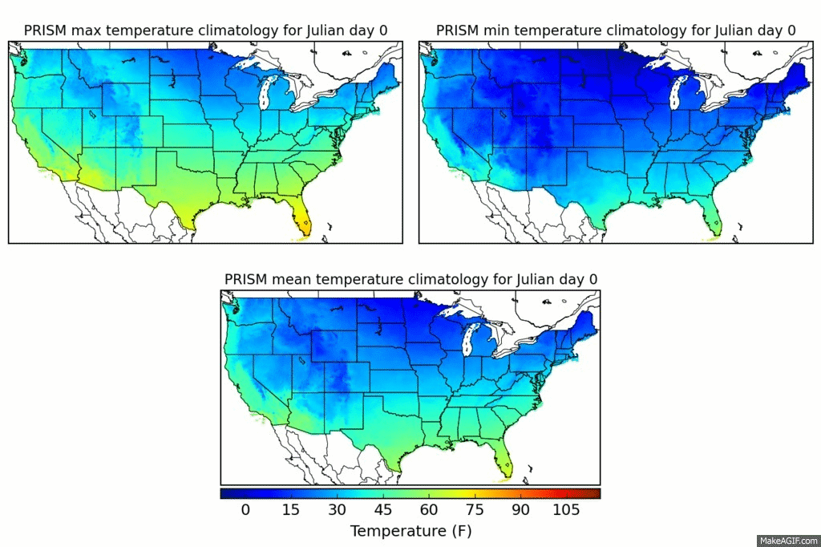
PRISM yearly cycle of T_{max}, T_{min}, T_{mean}
Tmax, Tmin included and used in next step to estimate diurnal cycle.

Slide 23
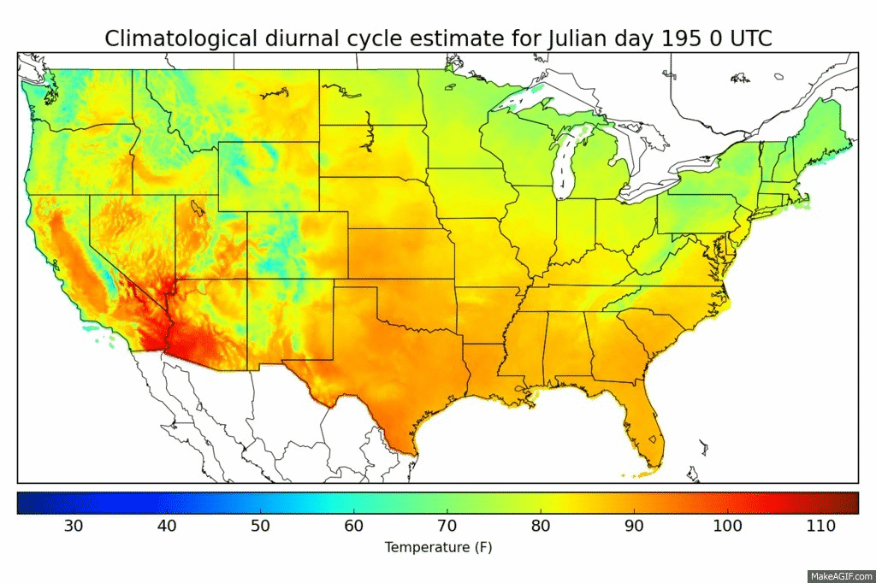
PRISM-based estimate of daily diurnal cycle for a day in July 14
PRISM max and mean used to set the overall magnitude of diurnal cycle, and Kriged station estimates
of the diurnal cycle used to set hourly variations within the PRISM-defined max/min range.

Slide 24
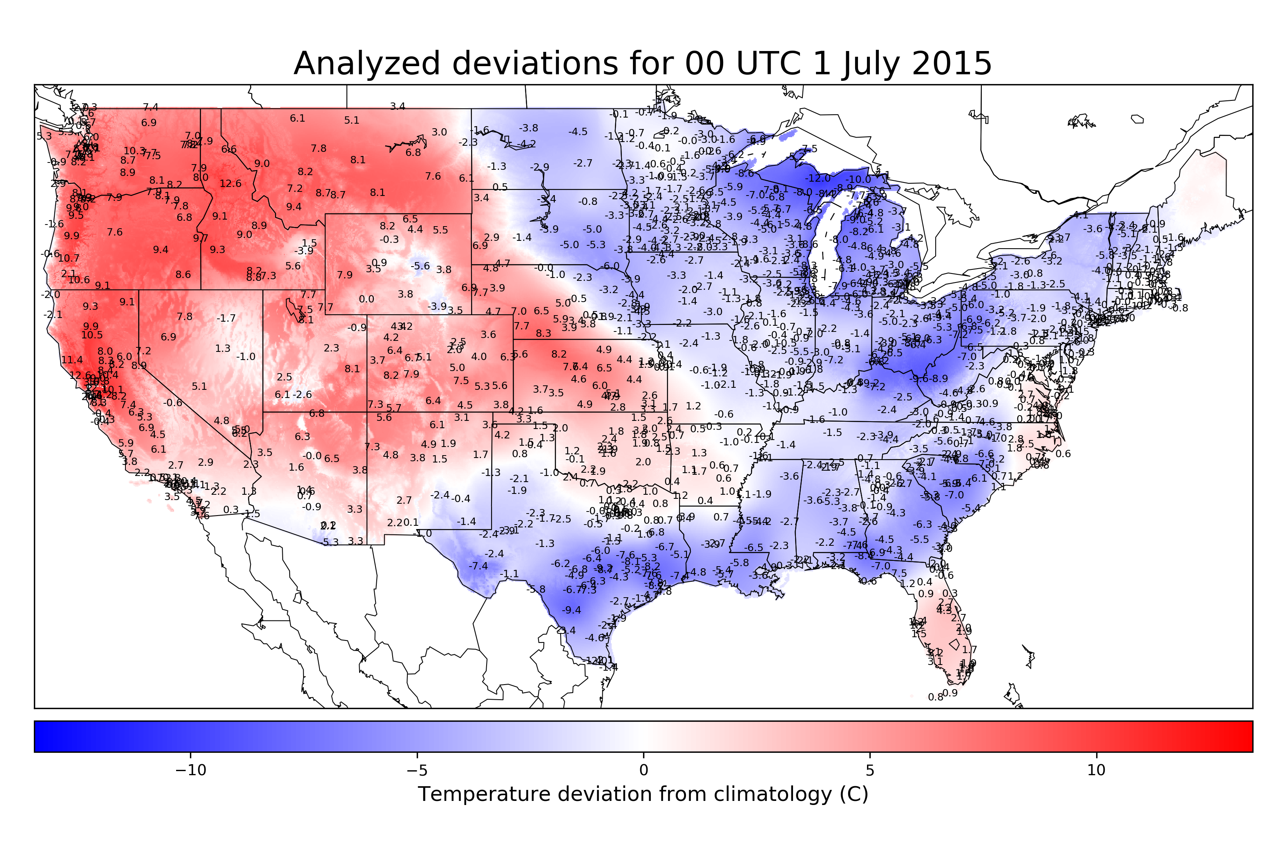

Slide 25
Schematic of the OI procedure for generating a surface
temperature analysis using “PRISM” climatology as background
PRISM gridded climatology at time t
surface observations at time t
Determine obs anomalies from climatology
Observation anomalies from climatology at time t
Statistical interpolation
Gridded, analyzed anomalies from climatology at time t
Add to produce 1-h analysis
Gridded analyzed T2m at time t
PRISM: more here.
OI procedure described
in supplemental slides.
Error
covariances

Slide 26
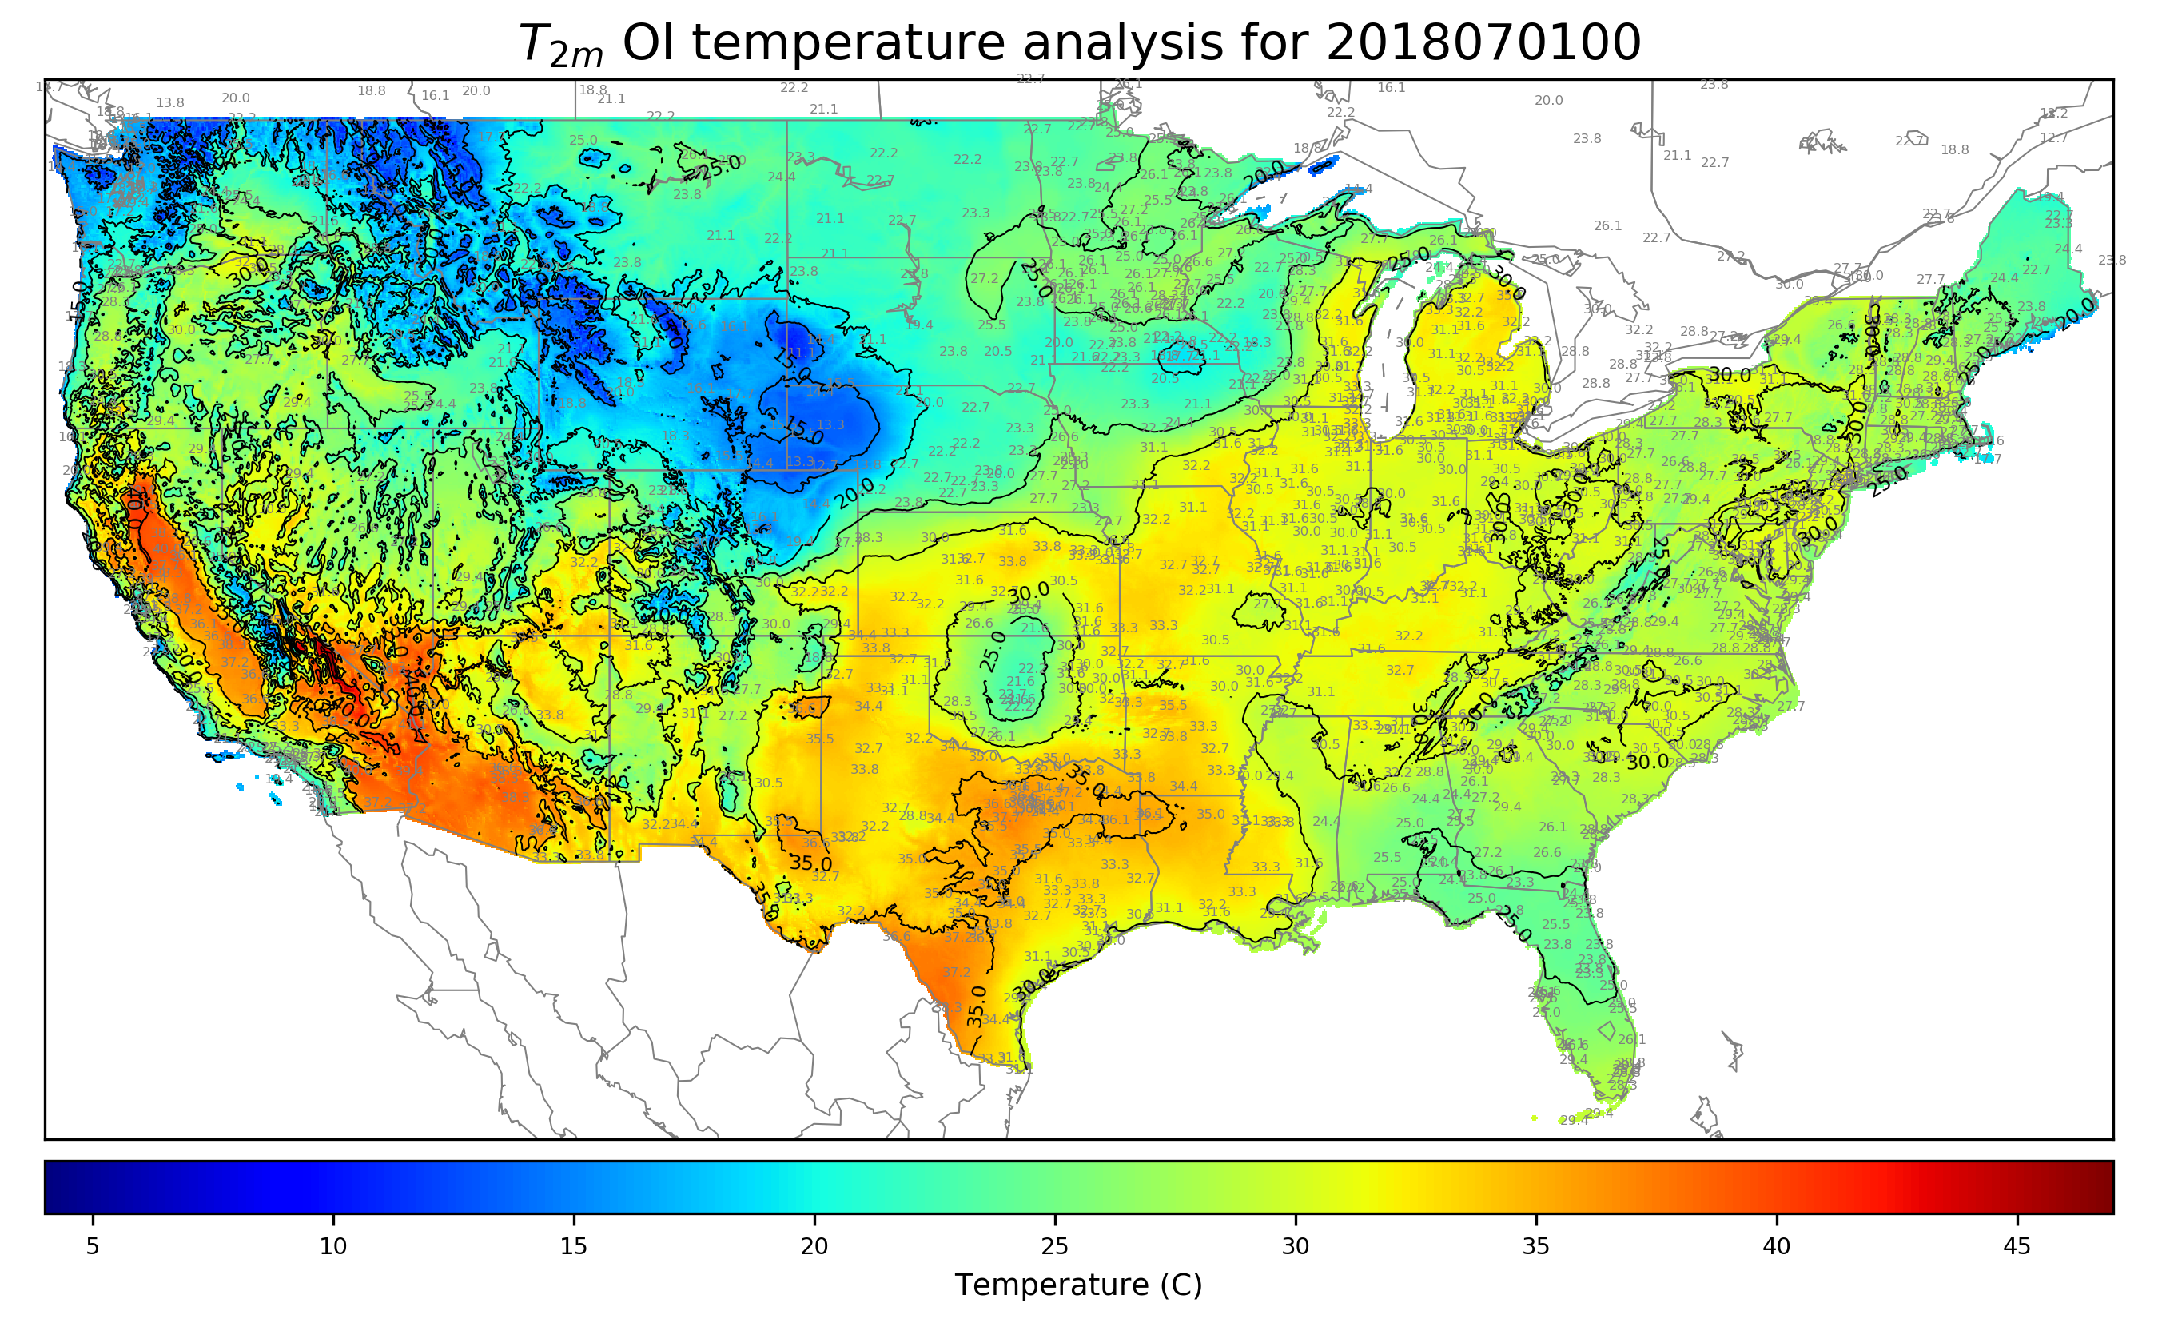
High-resolution CONUS OI T_{2m} analysis: example
Station observations
in gray, deg C.
This analysis, upscaled
to grid of ECMWF
TIGGE data, will
be regarded as truth.
Again, details on the
methodology in
supplemental slides.

Slide 27
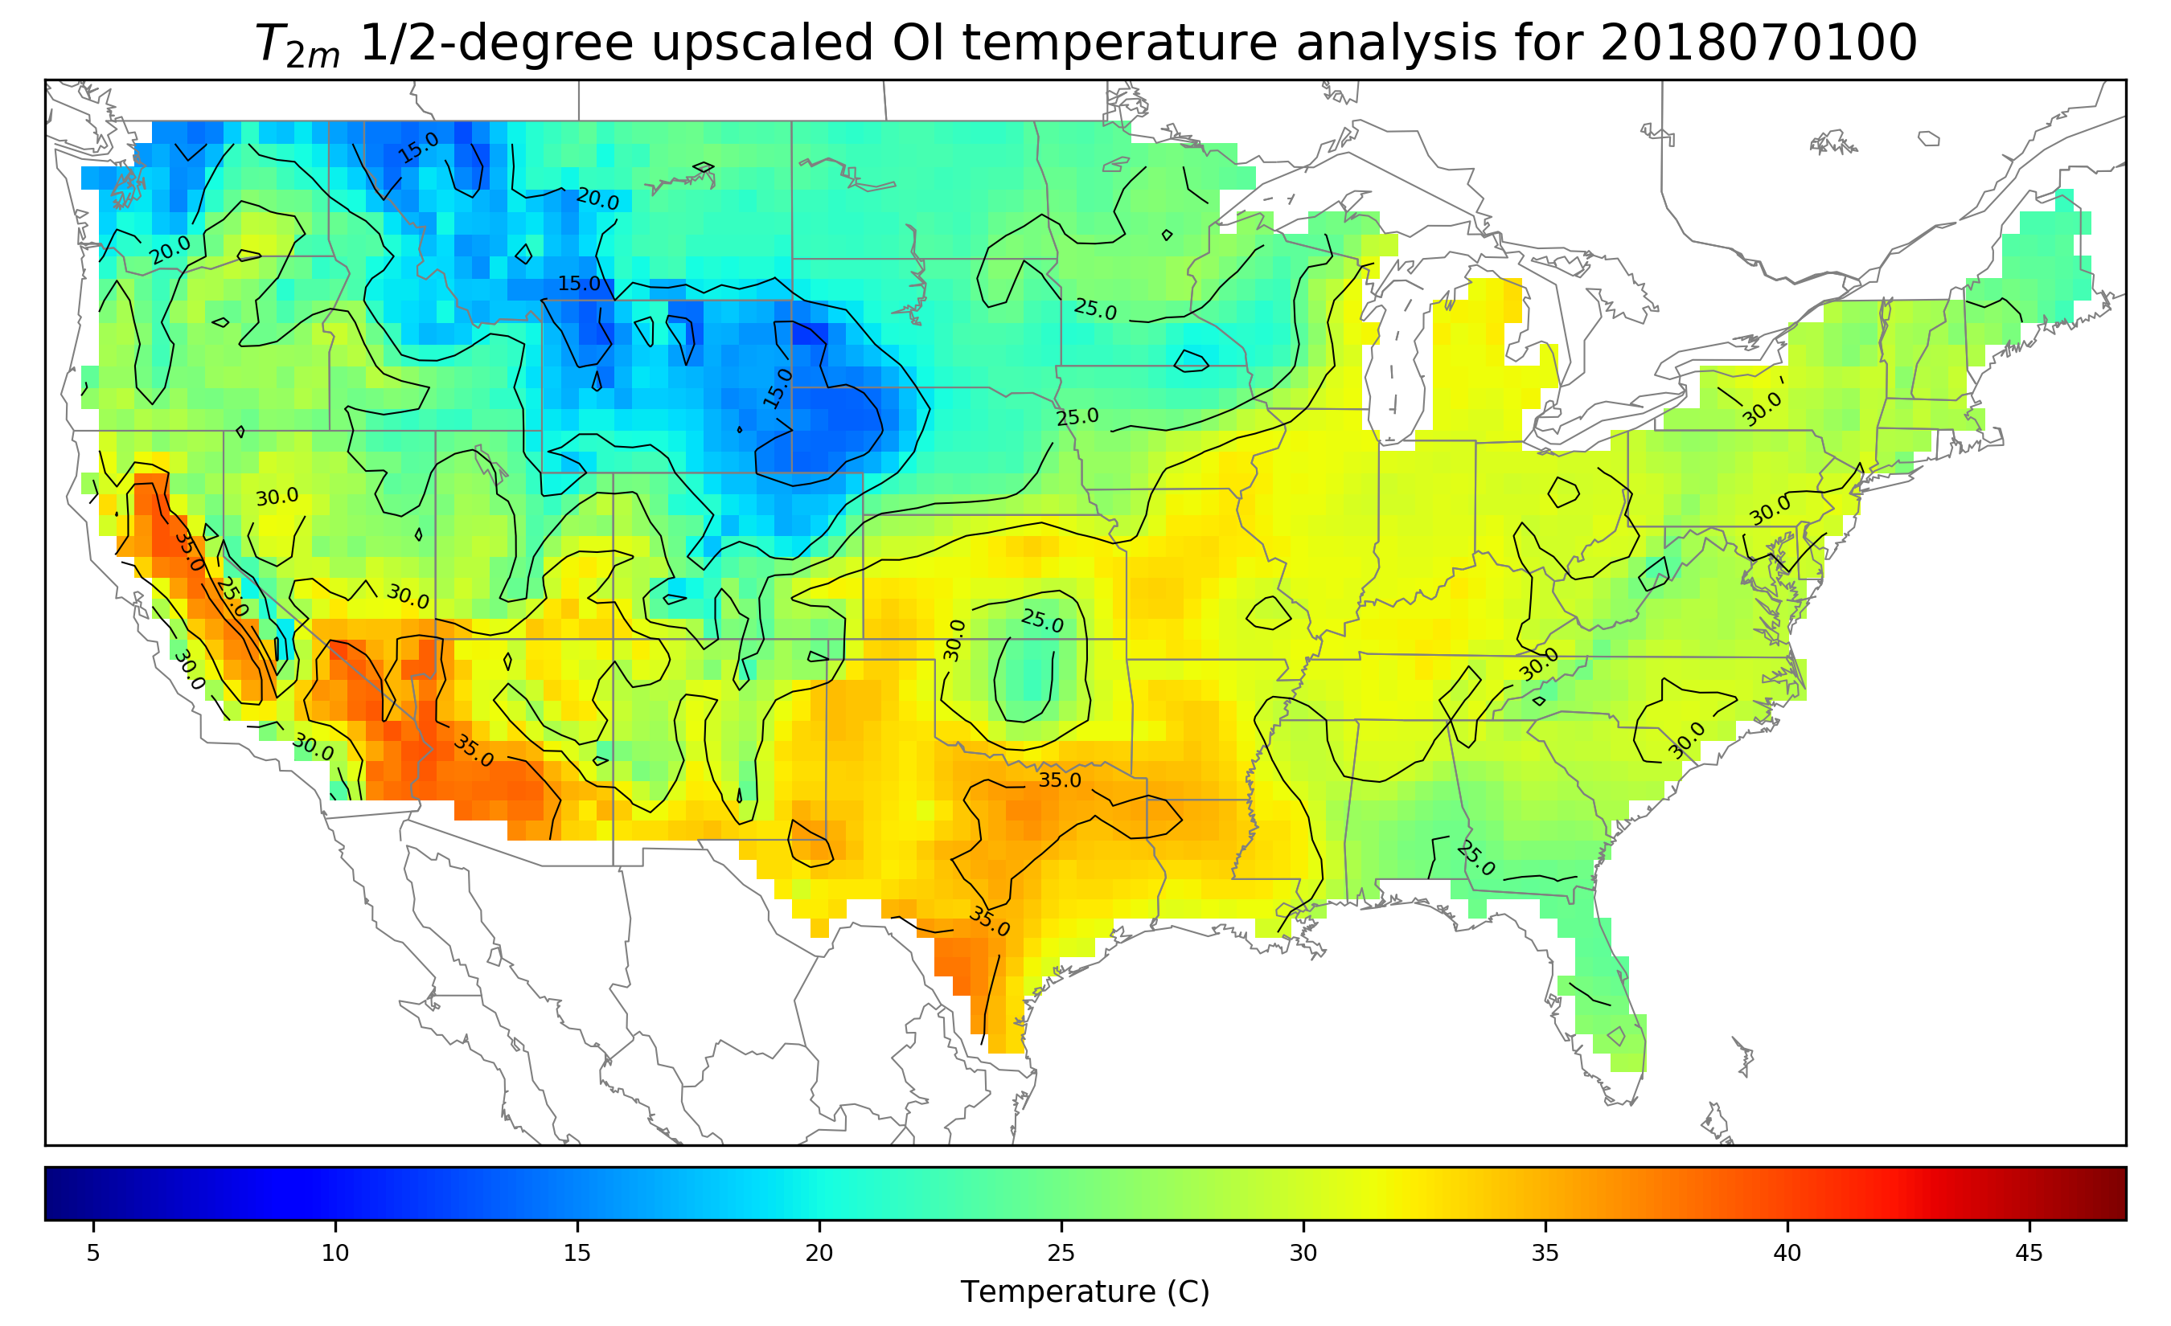
T_{2m} analysis upscaled to ½ degree for comparison
PRISM climatology only
available in CONUS, so
½-degree analysis thus
produced only at grid
points where full set of
high-res. analysis points
are available.
10 cross-validated
analyses were produced,
withholding 10% of
observations. When
comparing analyses at
points with vs. without
observations, RMS
difference is ~ 0.6 C.

Slide 28
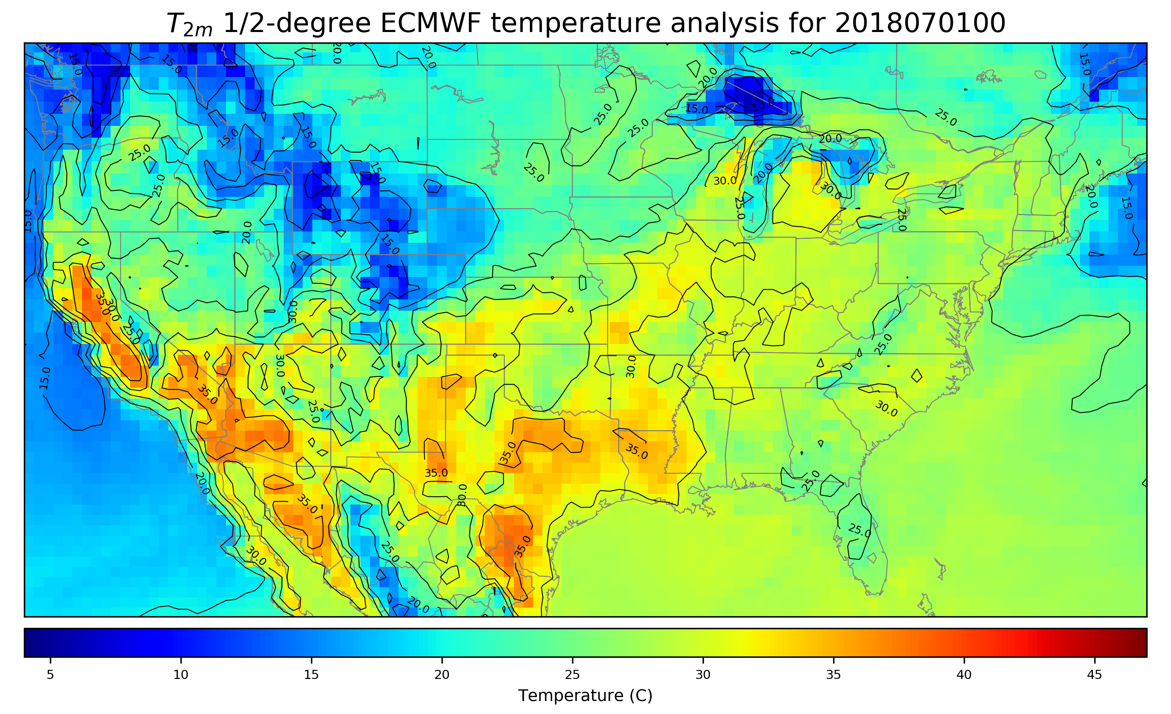
ECMWF operational T_{2m} analysis

Slide 29
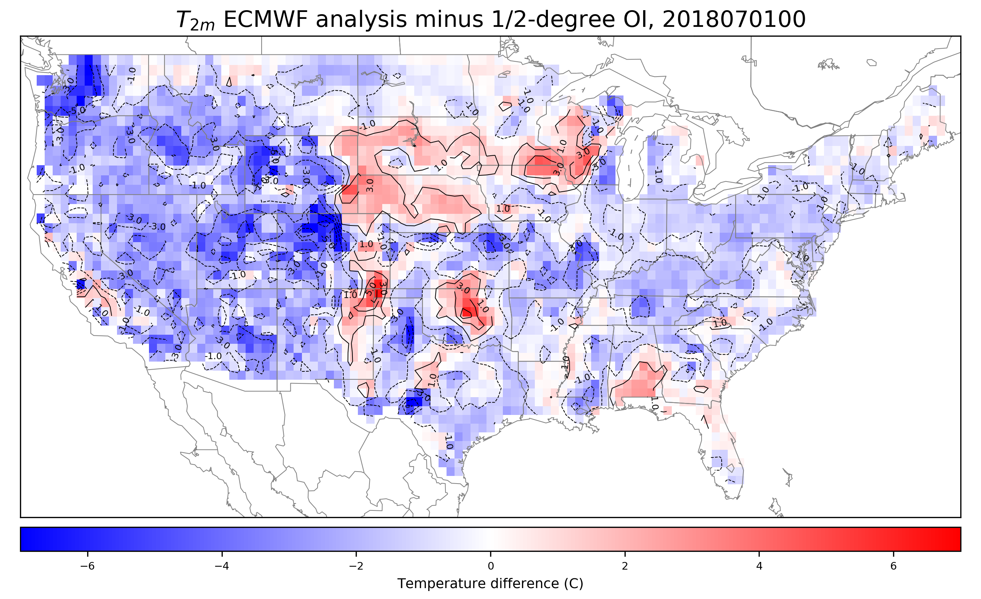
T_{2m} differences over US, ECMWF – OI
Many areas with
differences of several
degrees C. Is this
systematic or random?
Let’s consider an
error decomposition
and then look at some
time series from a
location roughly at
the dot.

Slide 30
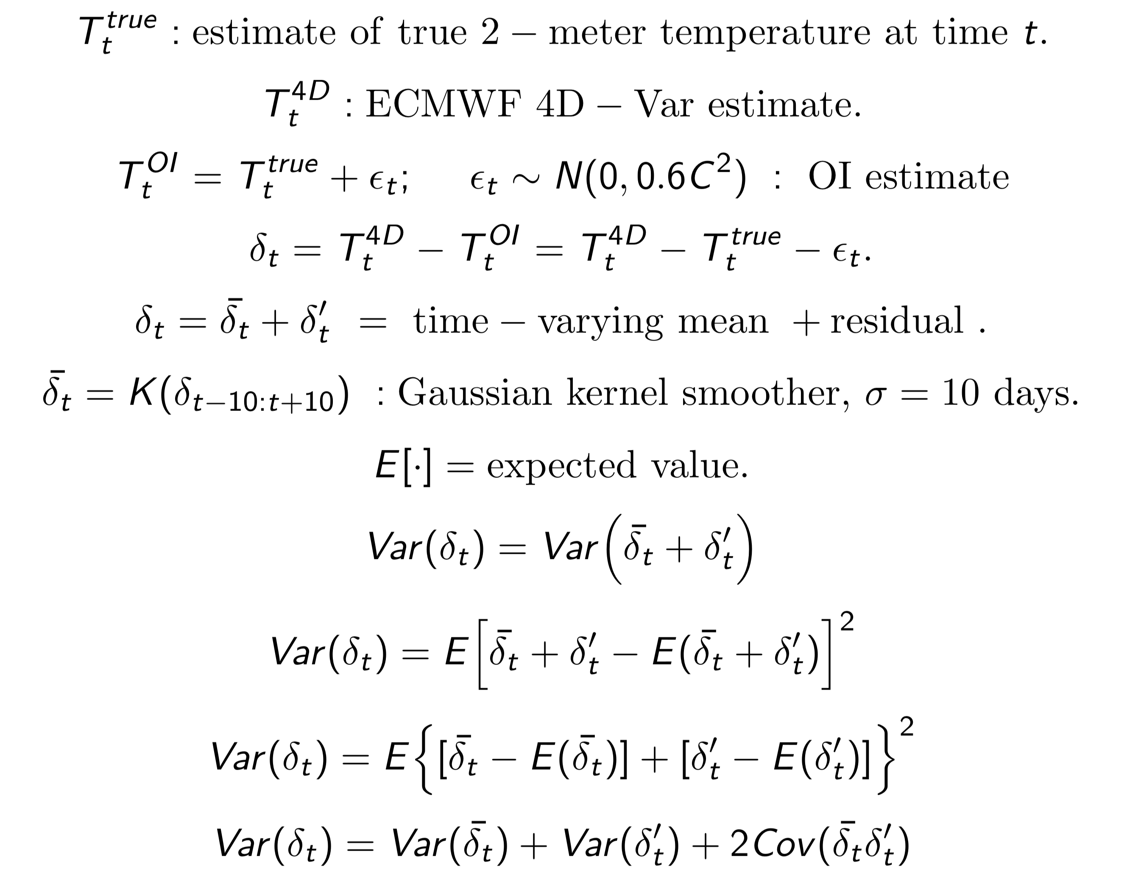
A proposed error decomposition to apply to each grid point.

Slide 31
A proposed error decomposition to apply to each grid point.
known from
4D-Var - OI
time series

Slide 32
A proposed error decomposition to apply to each grid point.
determined after application
of Kernel smoother to time series

Slide 33
A proposed error decomposition to apply to each grid point.
Residual, computed from
subtraction of smoothed
time series

Slide 34
A proposed error decomposition to apply to each grid point.
Computed after time-varying mean
and residual are available

Slide 35
A proposed error decomposition to apply to each grid point.
These terms involve systematic error of the forecast model
and data assimilation system. They are addressed
by fixing the prediction system to eliminated biases.

Slide 36
A proposed error decomposition to apply to each grid point.
Assertion is that these reflect the random errors in the estimate of the initial state. Assuming statistical independence of the OI analysis error from the ensemble perturbations, then the size of ensemble perturbations plus OI analysis error variance should be consistent with these.

Slide 37
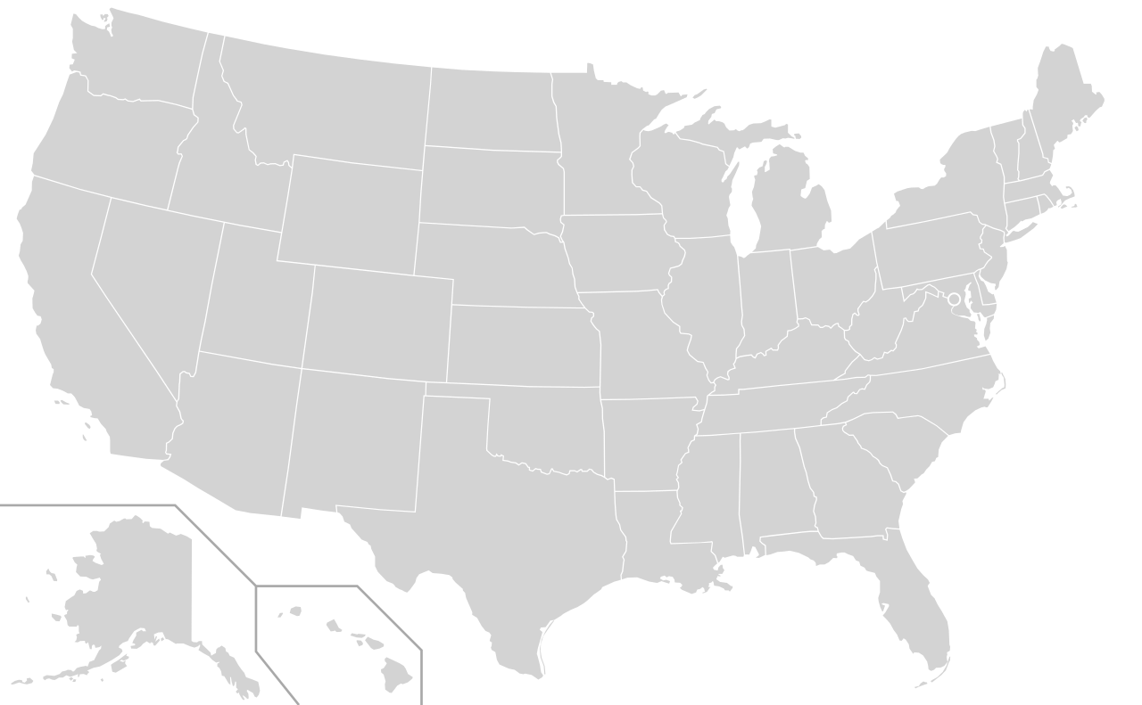
Separating systematic from residual errors: an example.
Here are the time series of
the ECMWF 2-meter temps
(red) and OI (blue).
Next, subtract the OI
analysis now so that
ECMWF data are
plotted as anomalies
(next slide).

Slide 38
Anomalies of ECMWF analyses from OI
Red line represents
time-dependent mean.

Slide 39
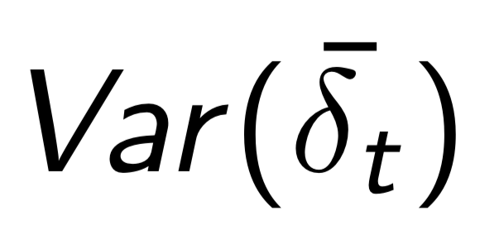
Systematic error estimate, used to estimate
These are reduced over time through prediction
system improvement, including shrinking the model grid spacing, improved parameterizations, treatment of model bias in the data assimilation system.

Slide 40
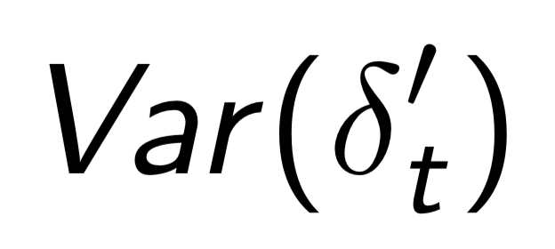
Residual errors, used to estimate
Assertion is that the of the ensemble perturbations’ variance
plus analysis error variance should be consistent with this residual variance.

Slide 41
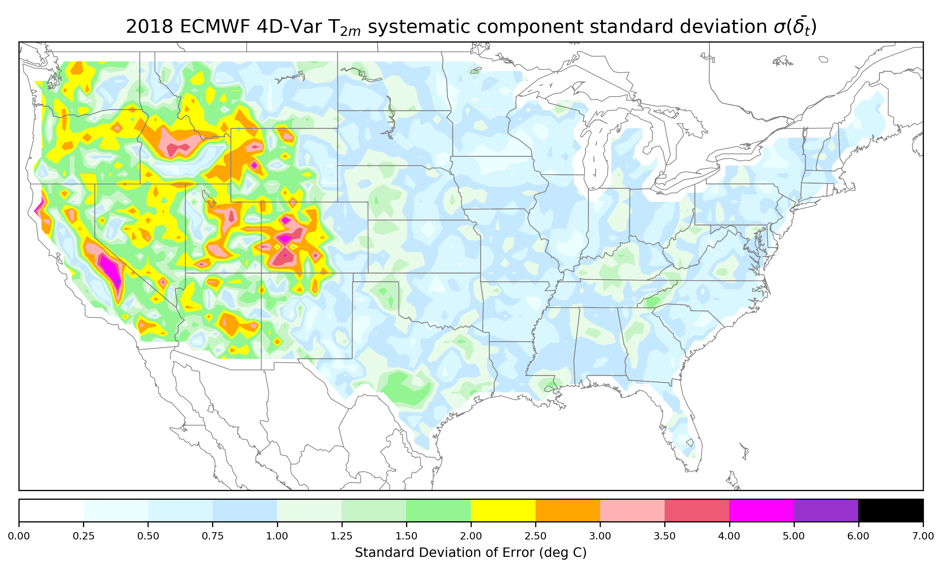
Systematic error standard deviation, Jan-Dec 2018
These appear to be linked
in many instances to
mountainous regions. In
flatter areas, systematic
errors of ~ 0.75 – 1.5 C
are common.
The large errors in the
western US might be
reduced by smaller
grid spacing, perhaps
better snow analyses,
as this affects surface
energy budget and
thus background bias.

Slide 42
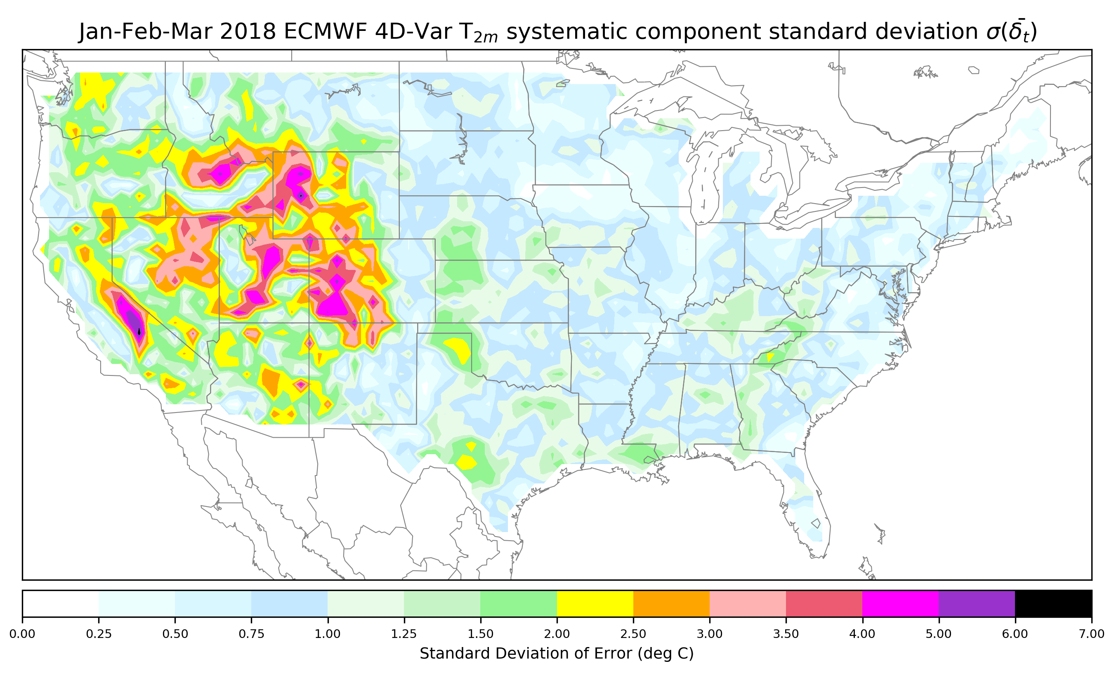
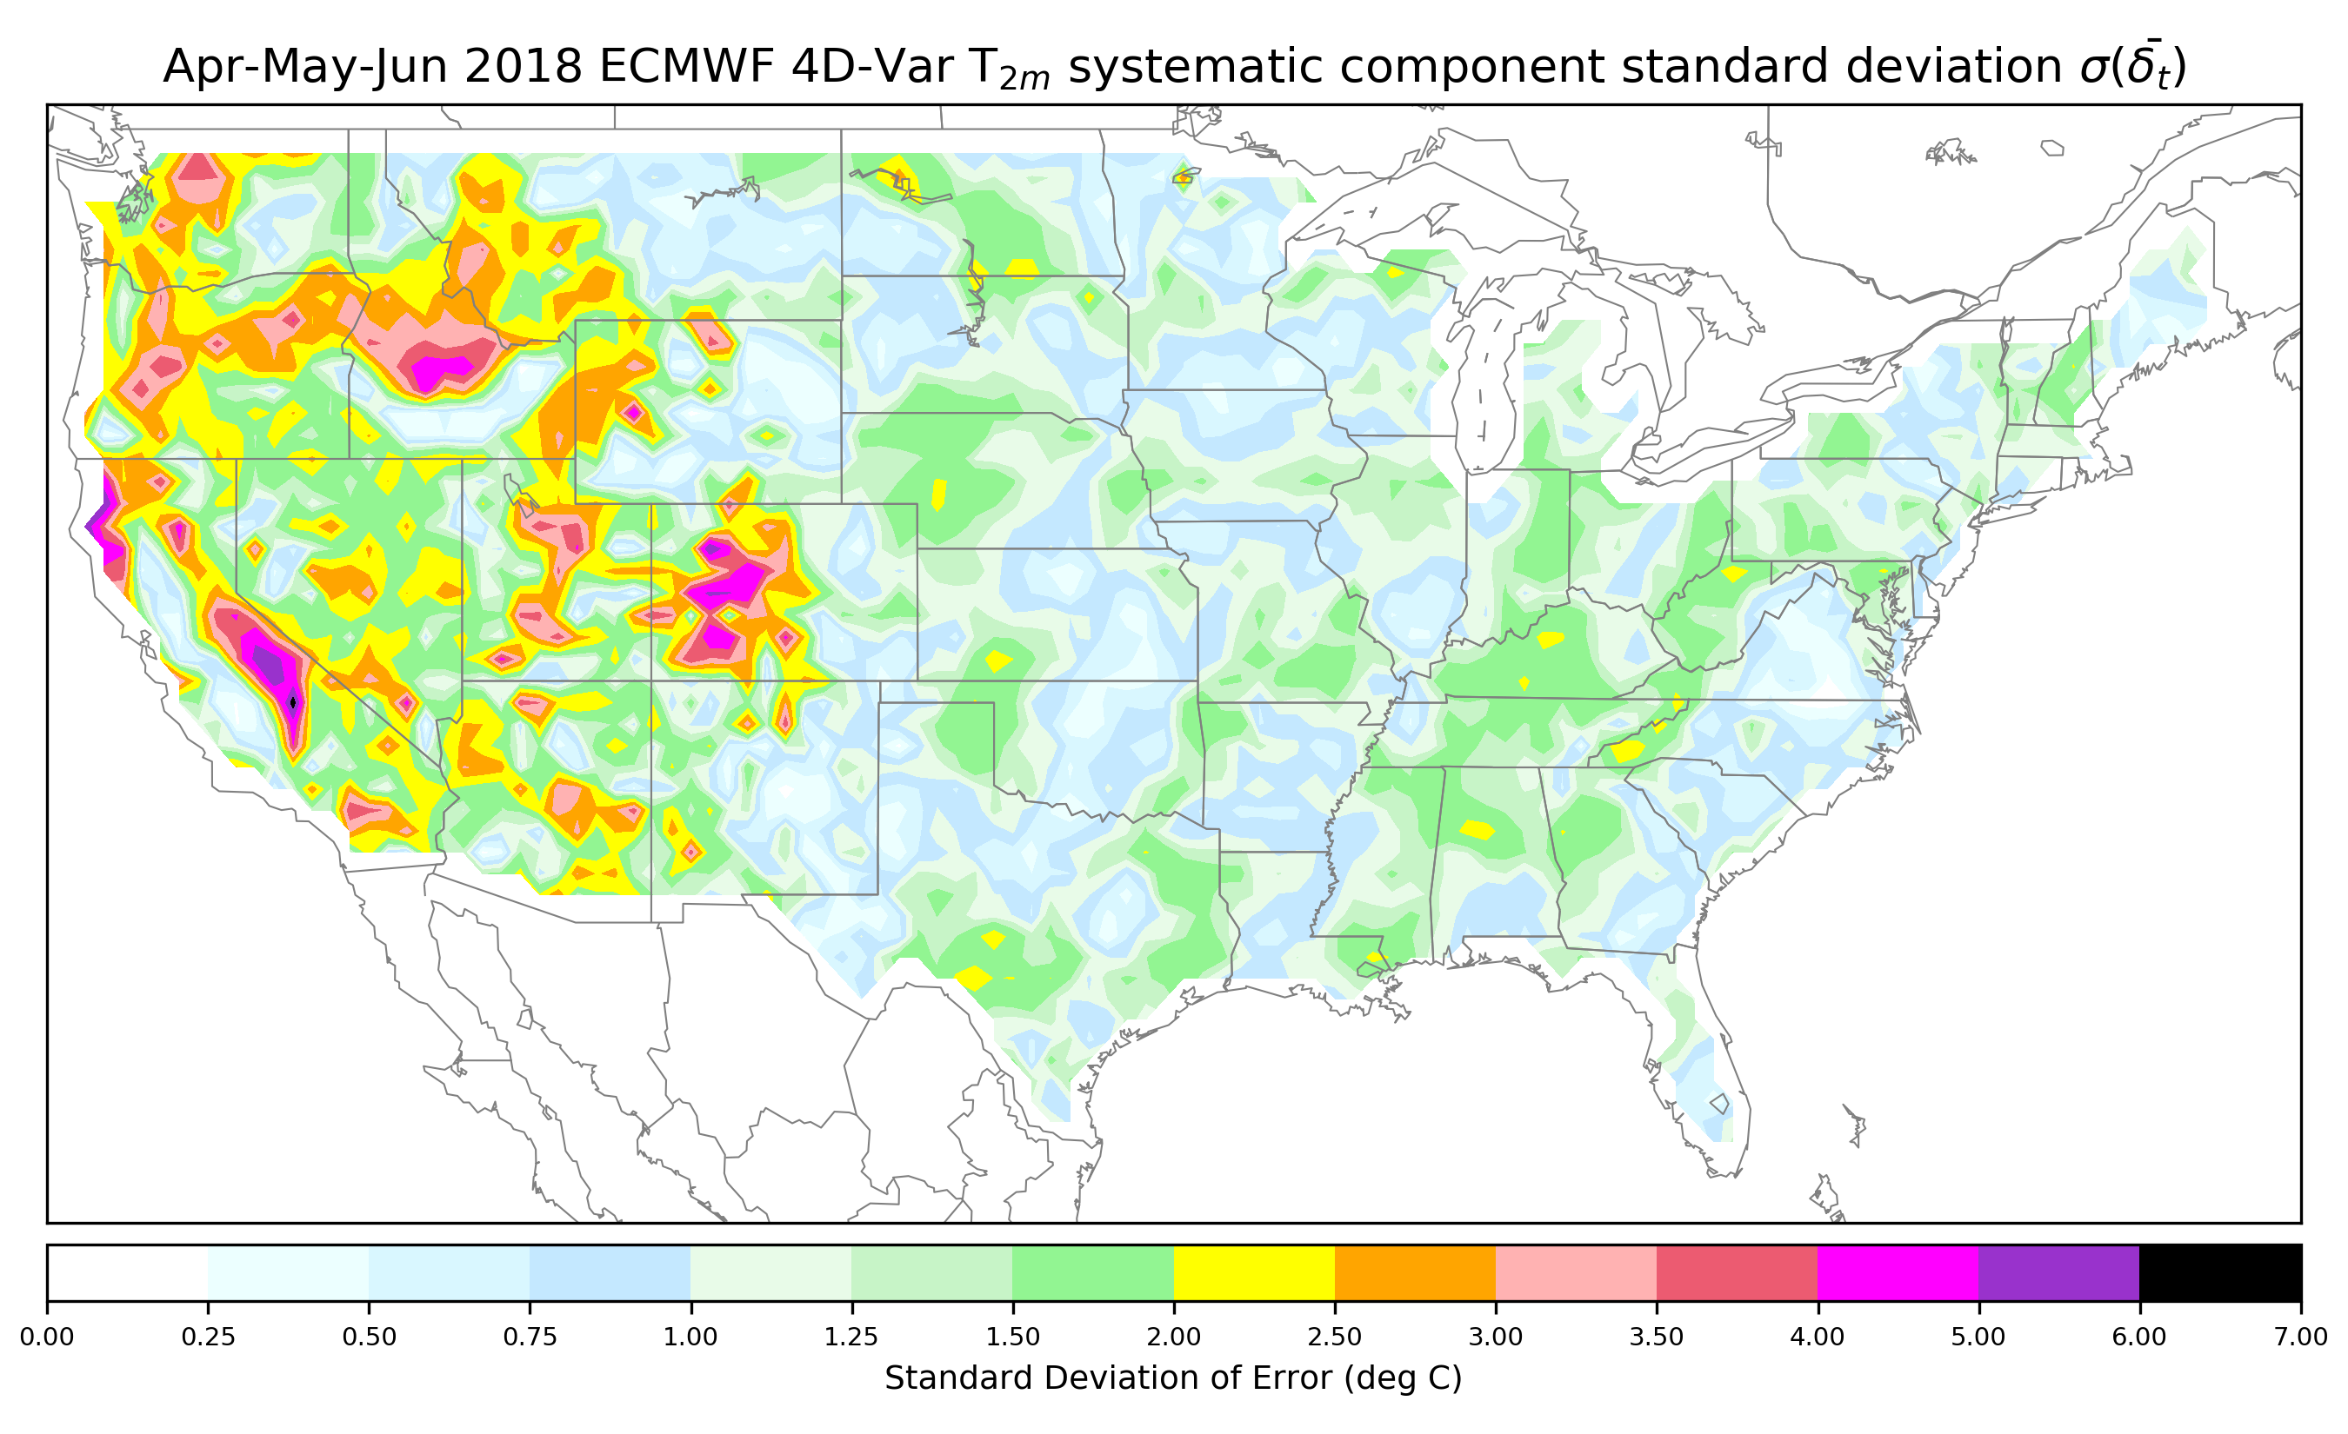
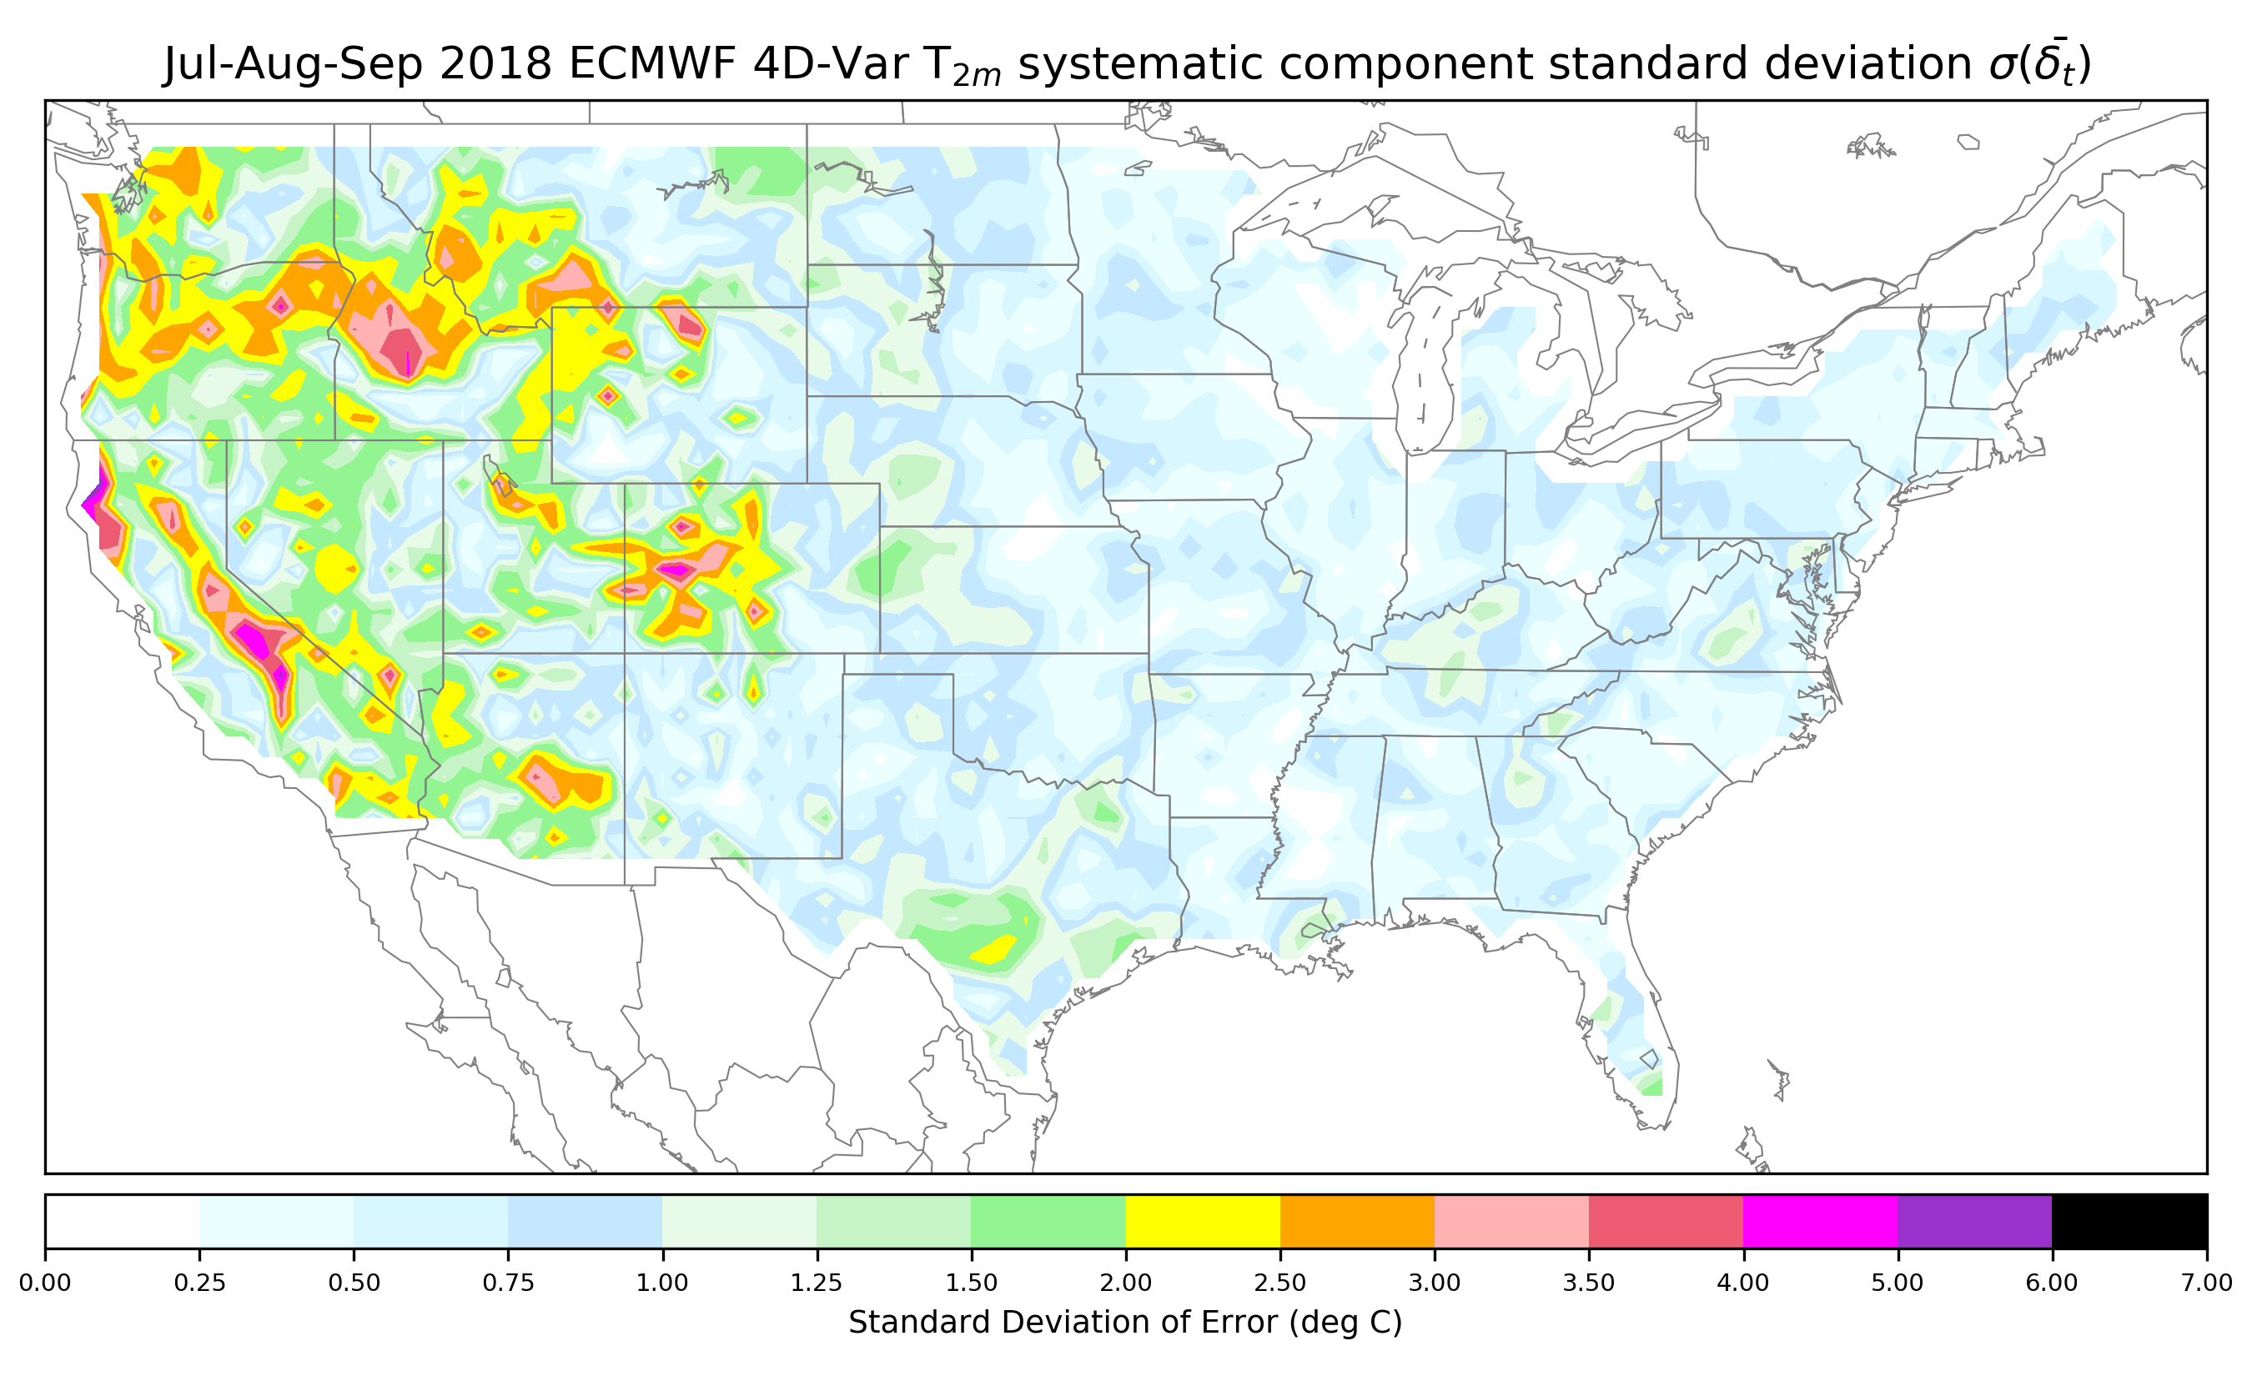
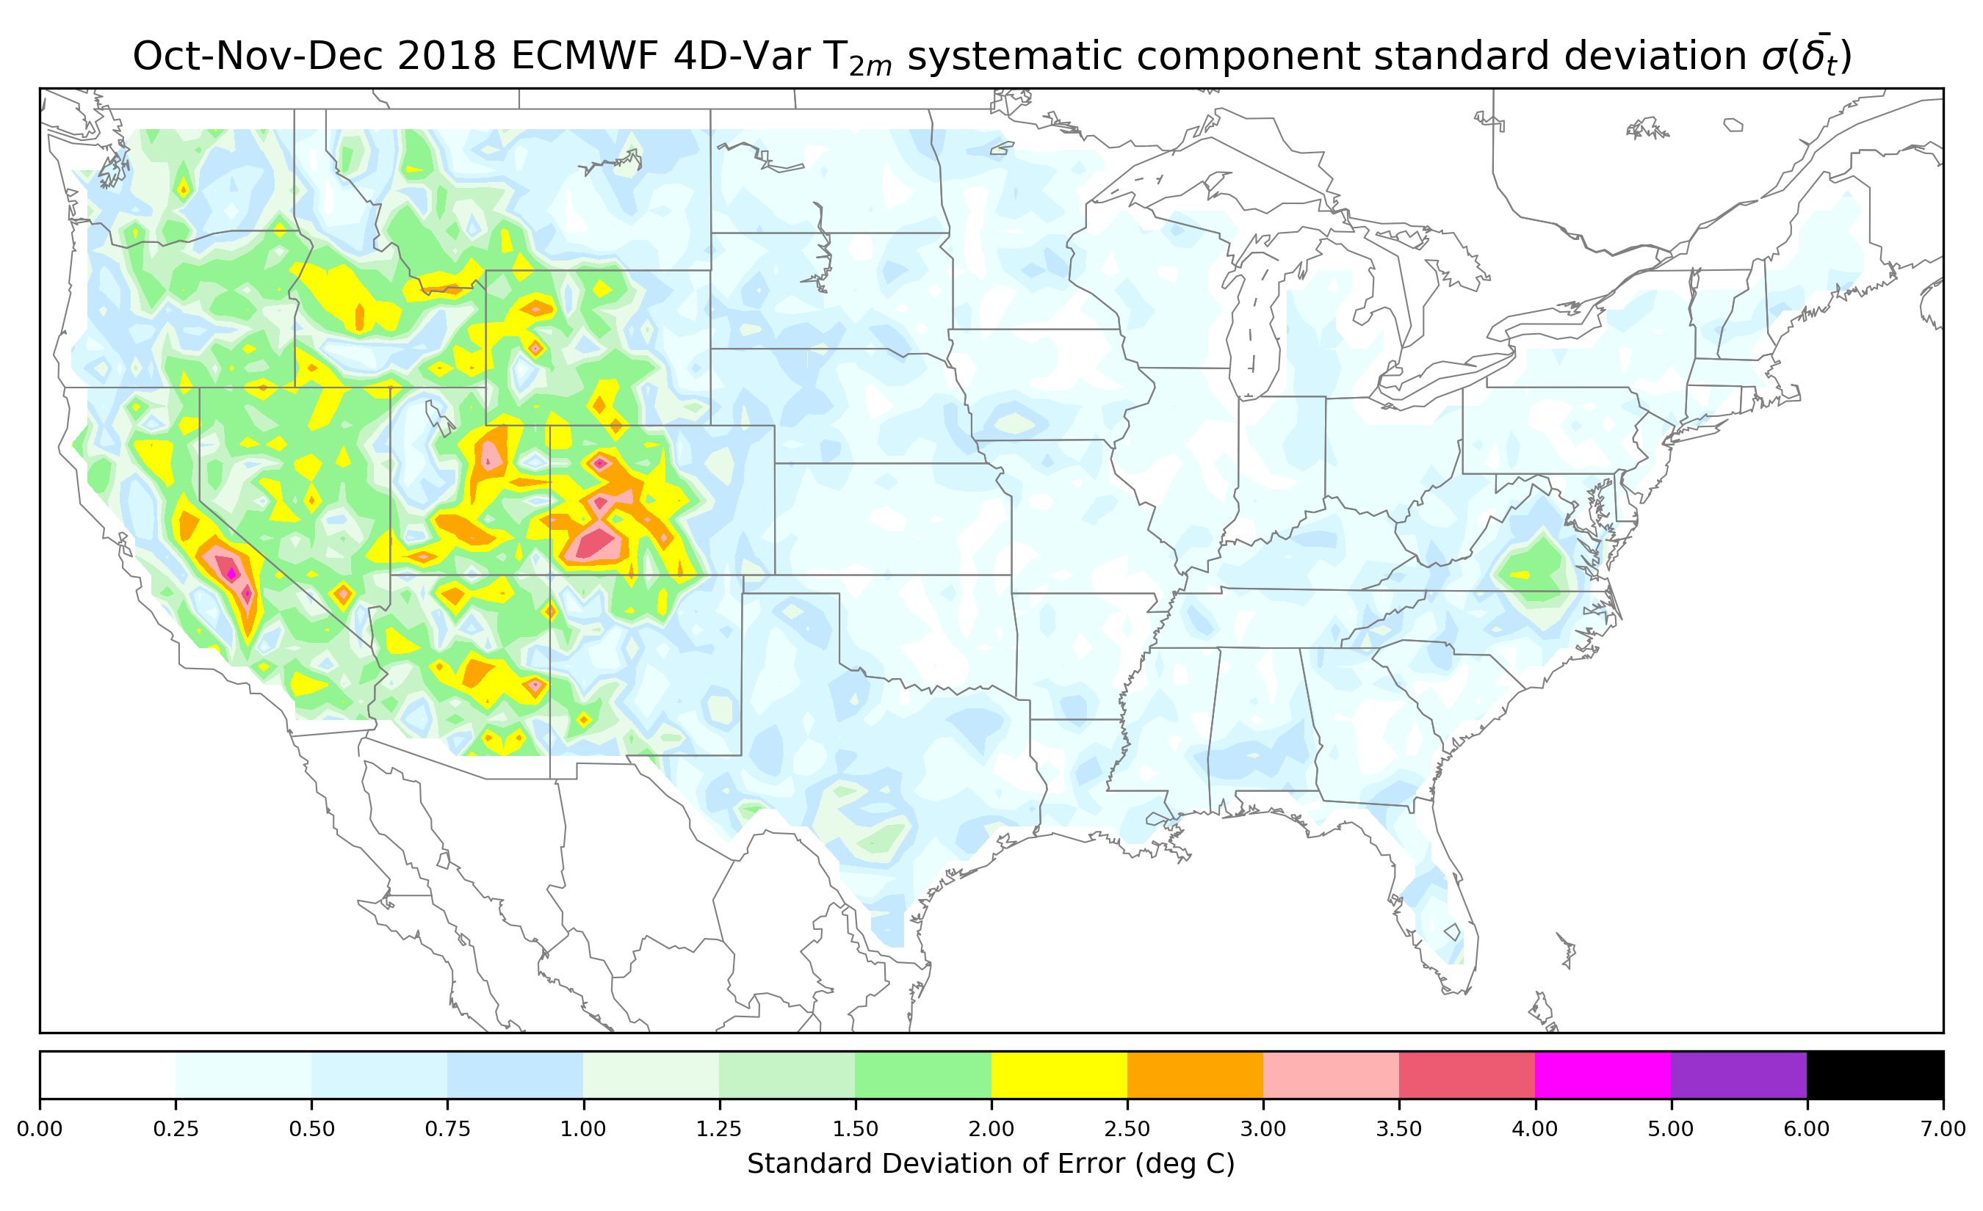
Systematic errors for 3-month seasons
Errors in the
mountainous
regions are larger
in the winter and
spring.
Perhaps related
to issues of
mis-specification
of snow cover,
which then
makes the
background
forecast used in
the data
assimilation
system biased.

Slide 43
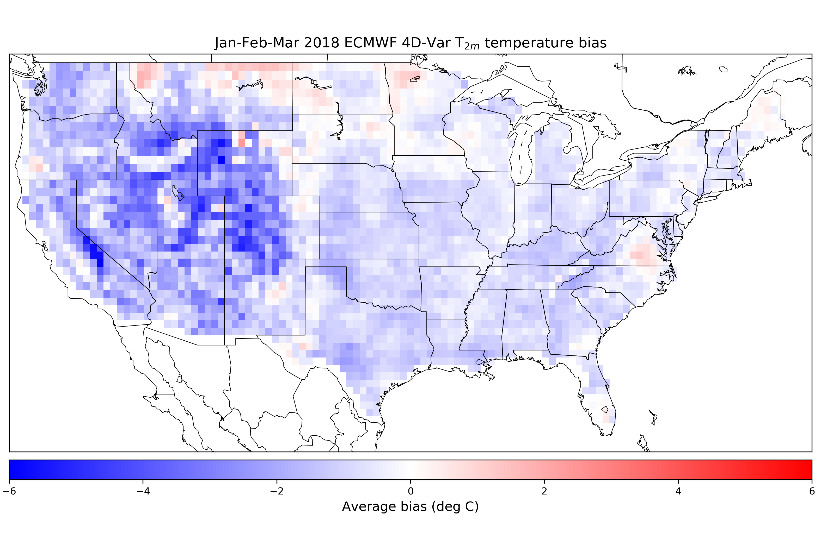
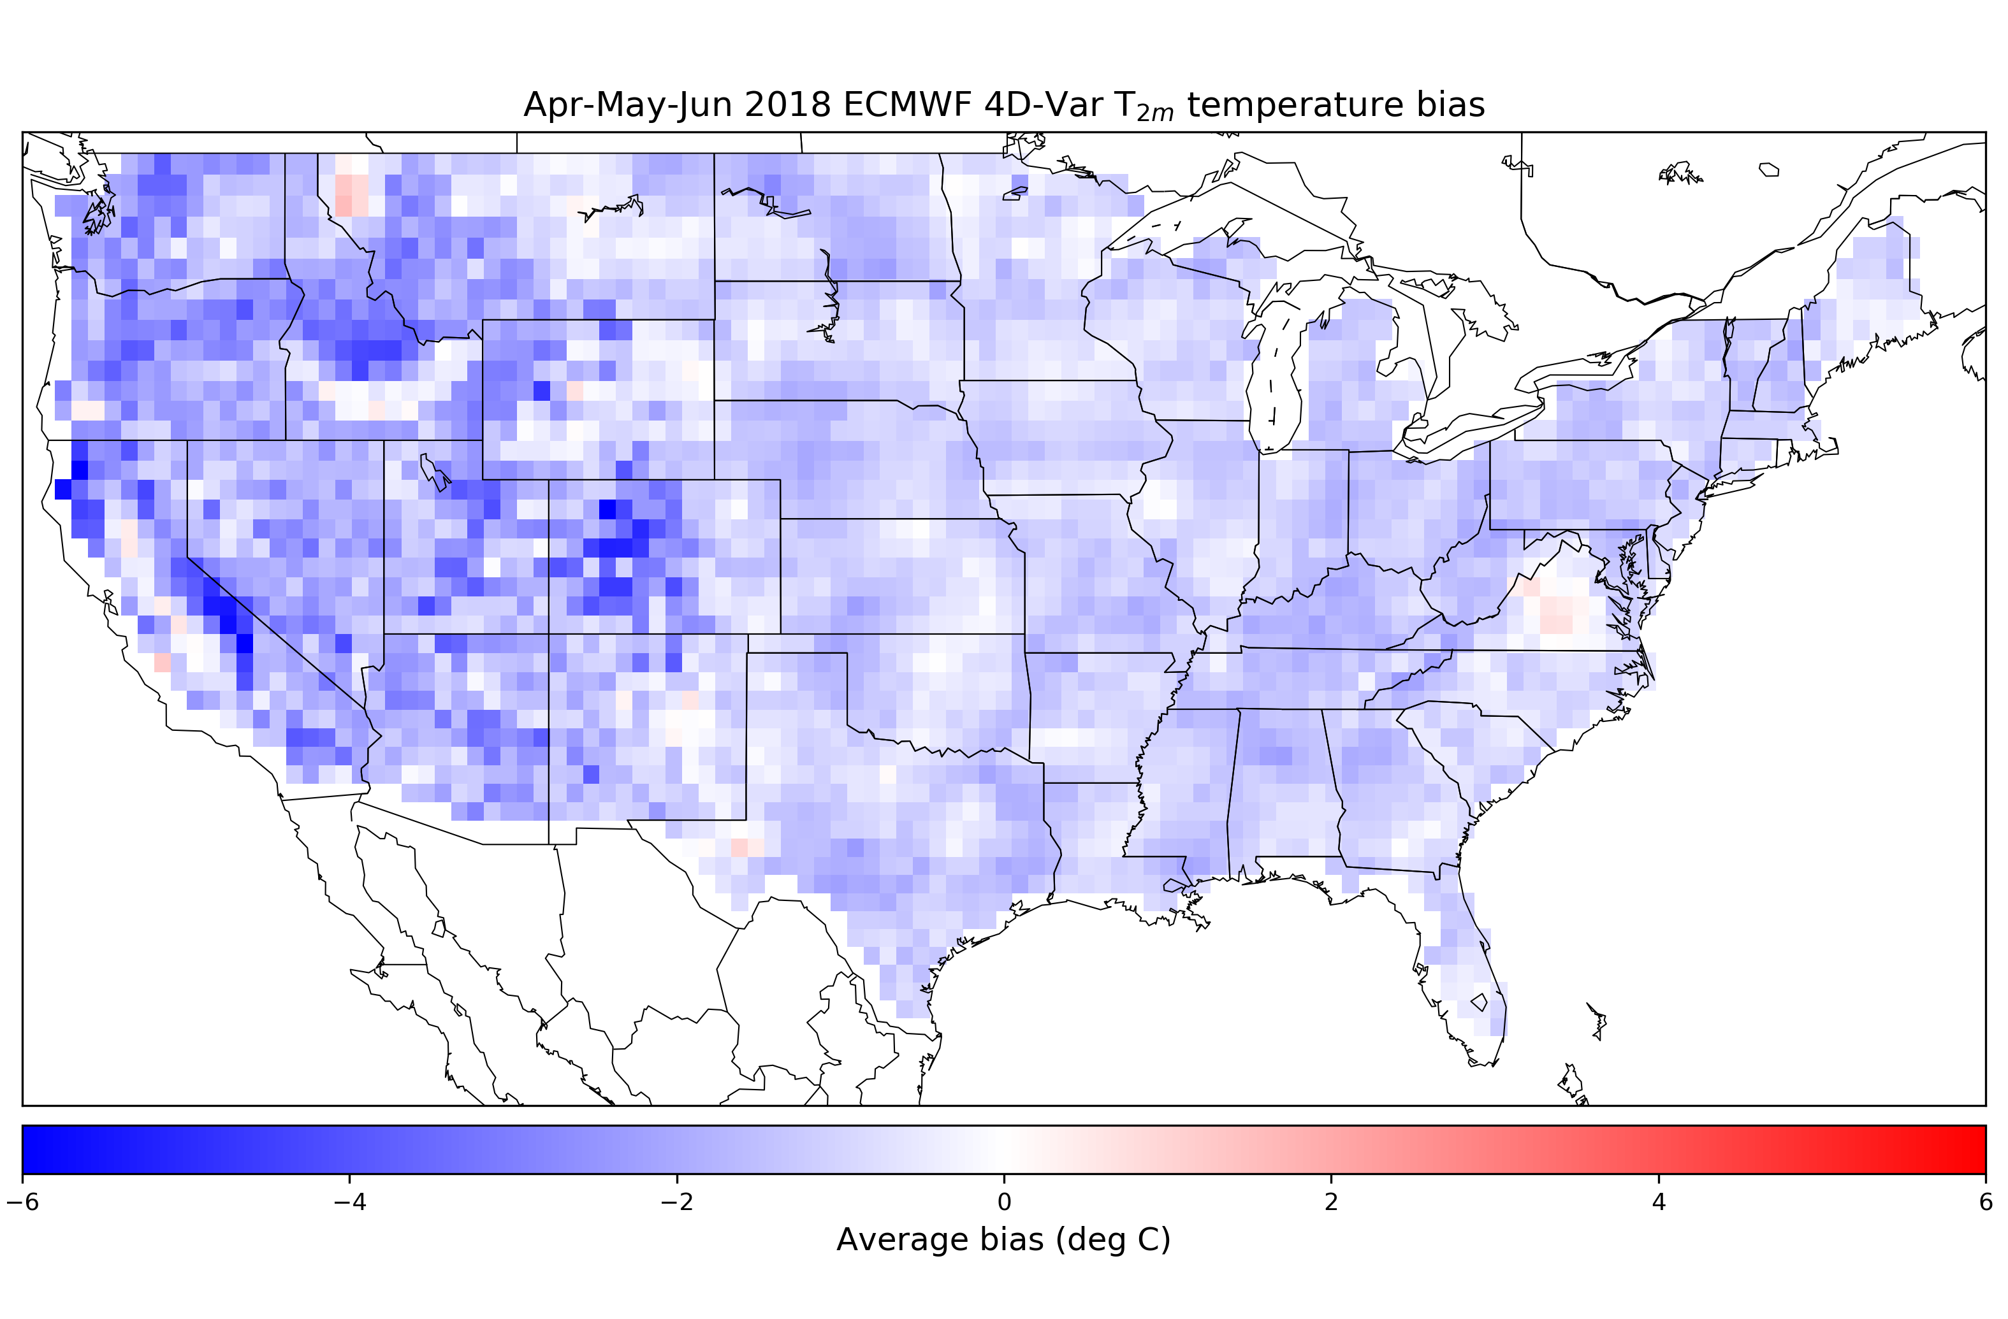
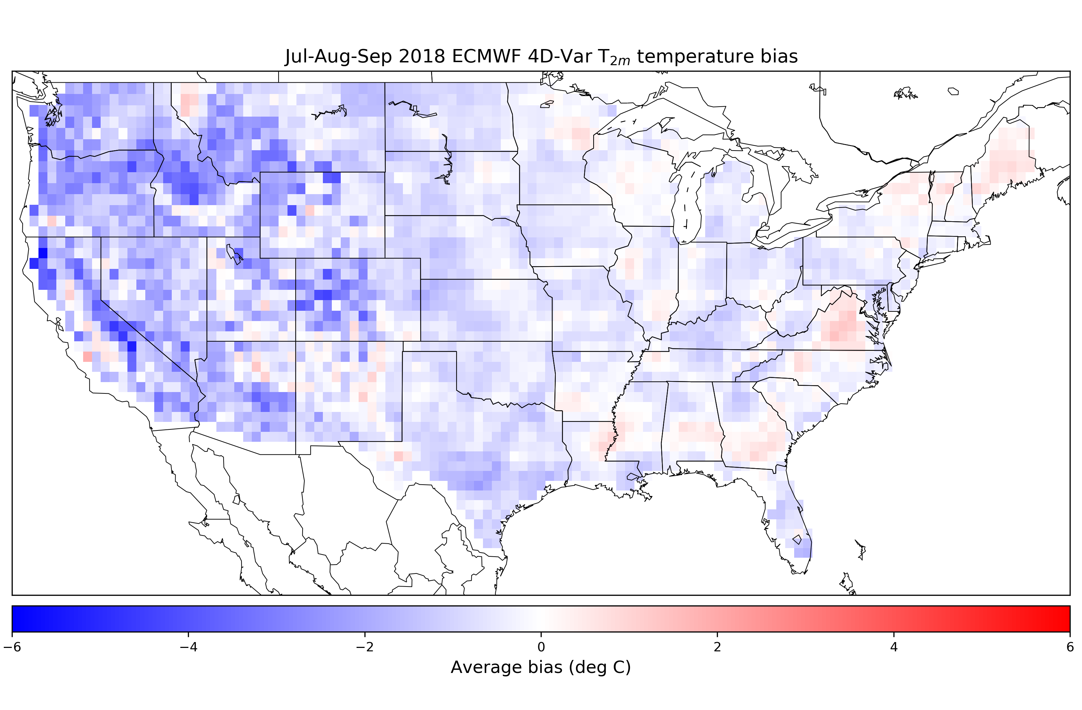
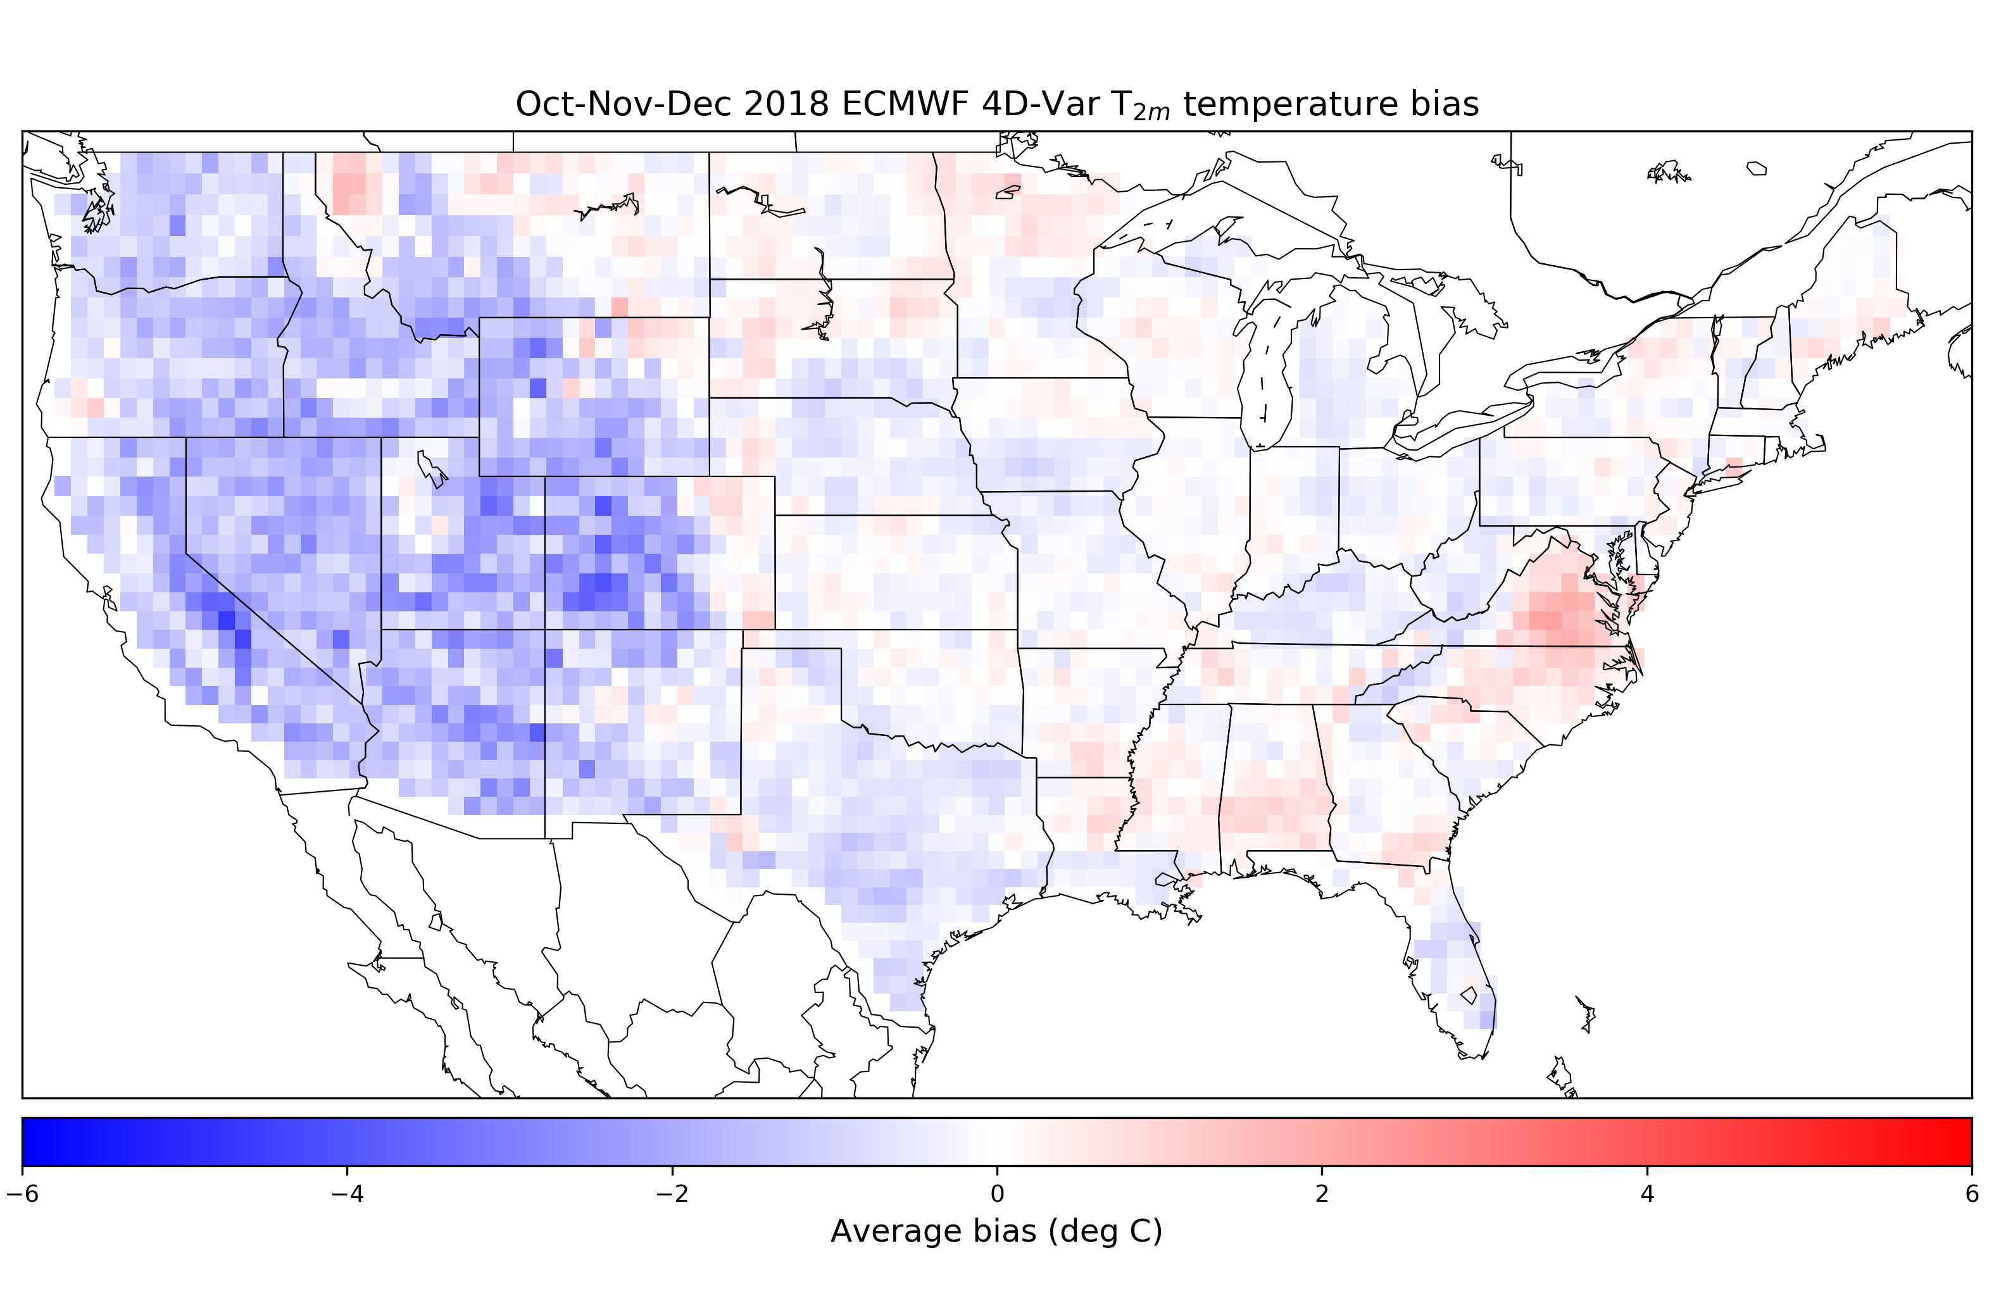
Seasonal biases of surface temperature
ECMWF has a quite
systematic cold bias
of 2-meter temperature.

Slide 44
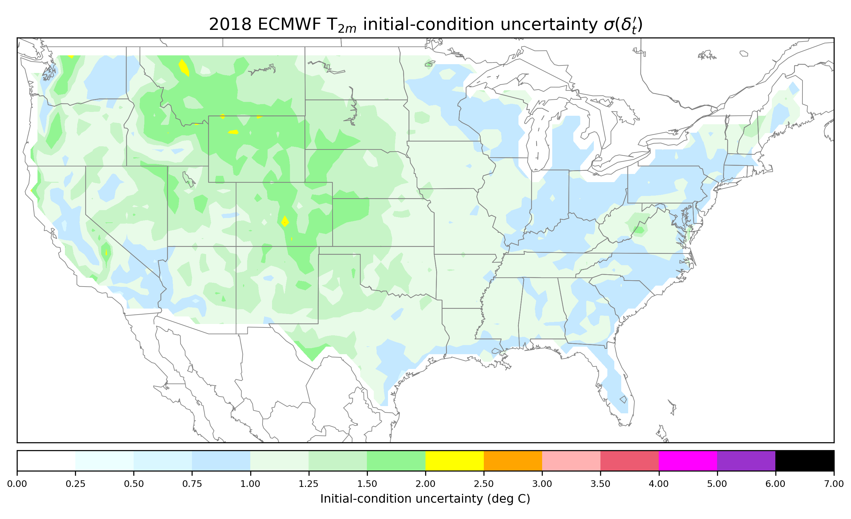
Initial-condition uncertainty estimate from residual
The time-averaged
size of ensemble
perturbations should
be consistent with this.

Slide 45
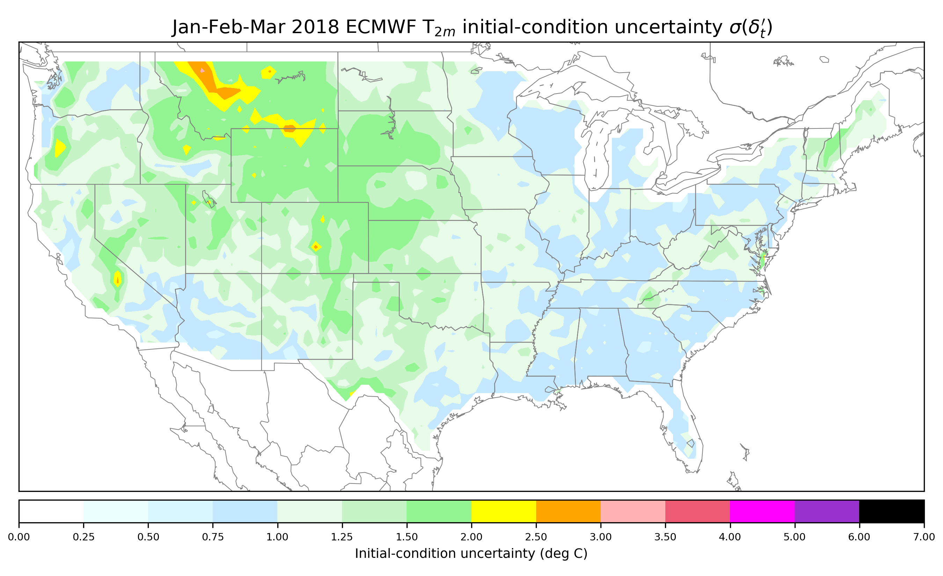
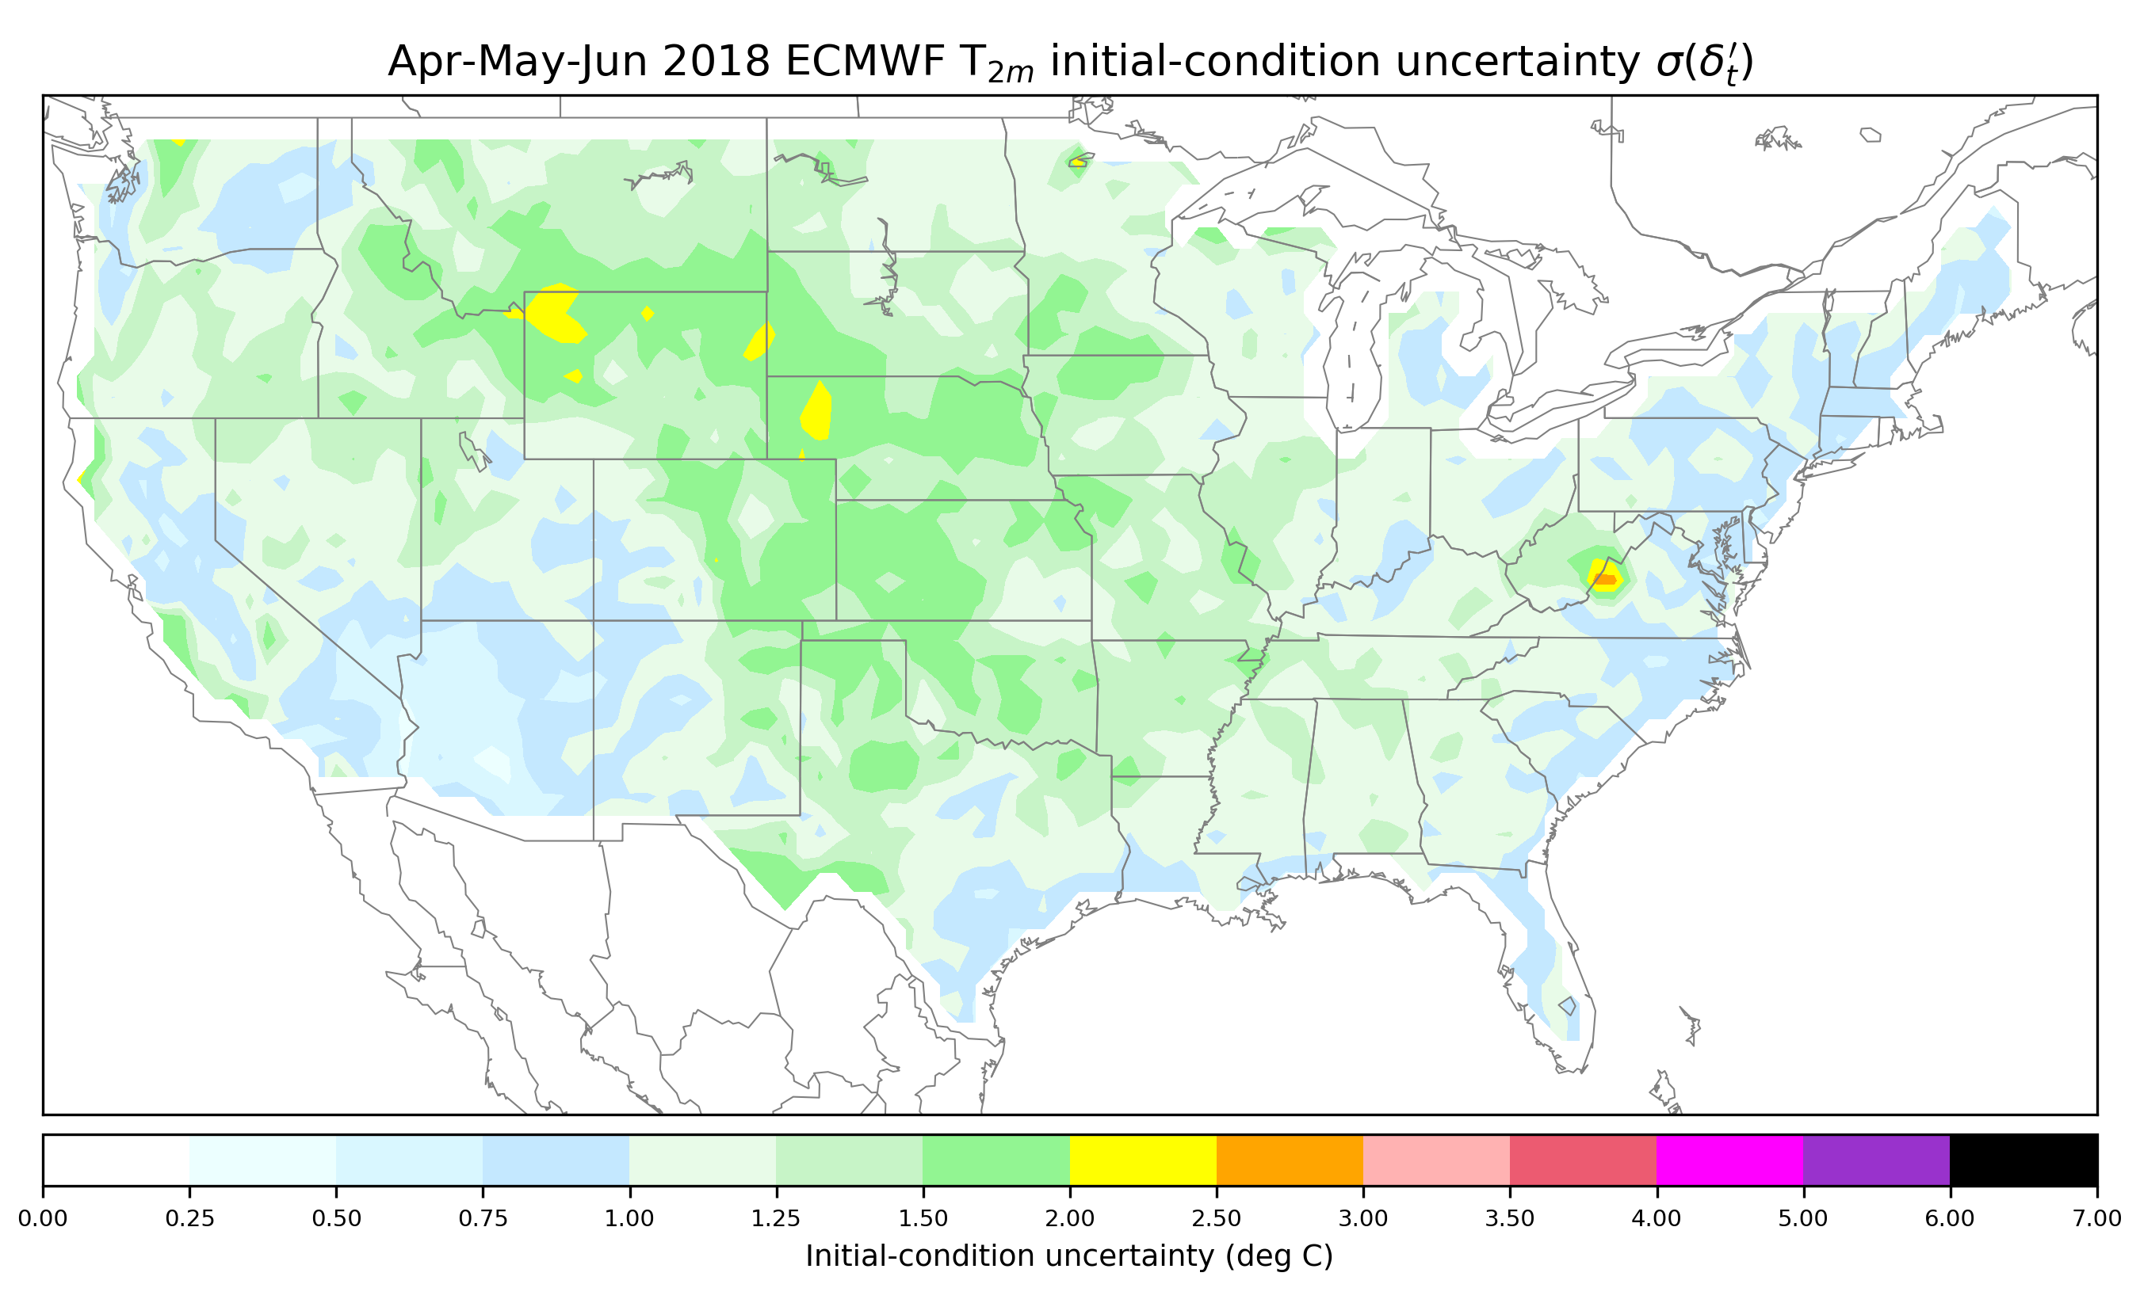
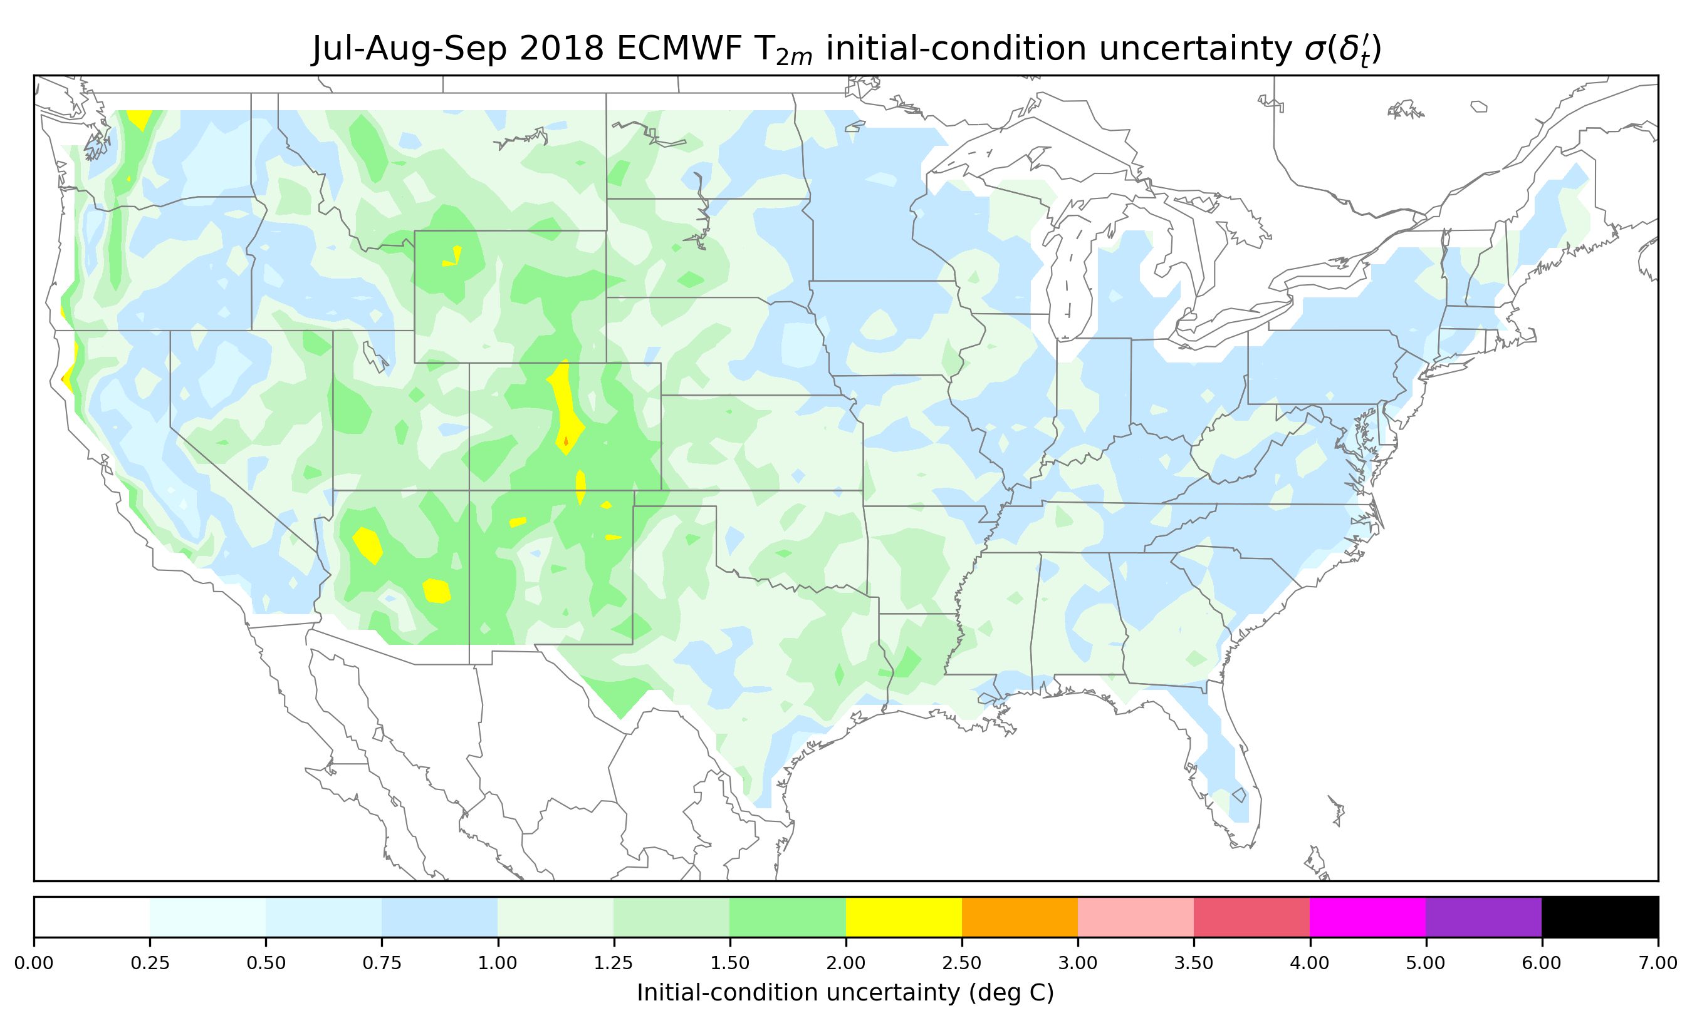
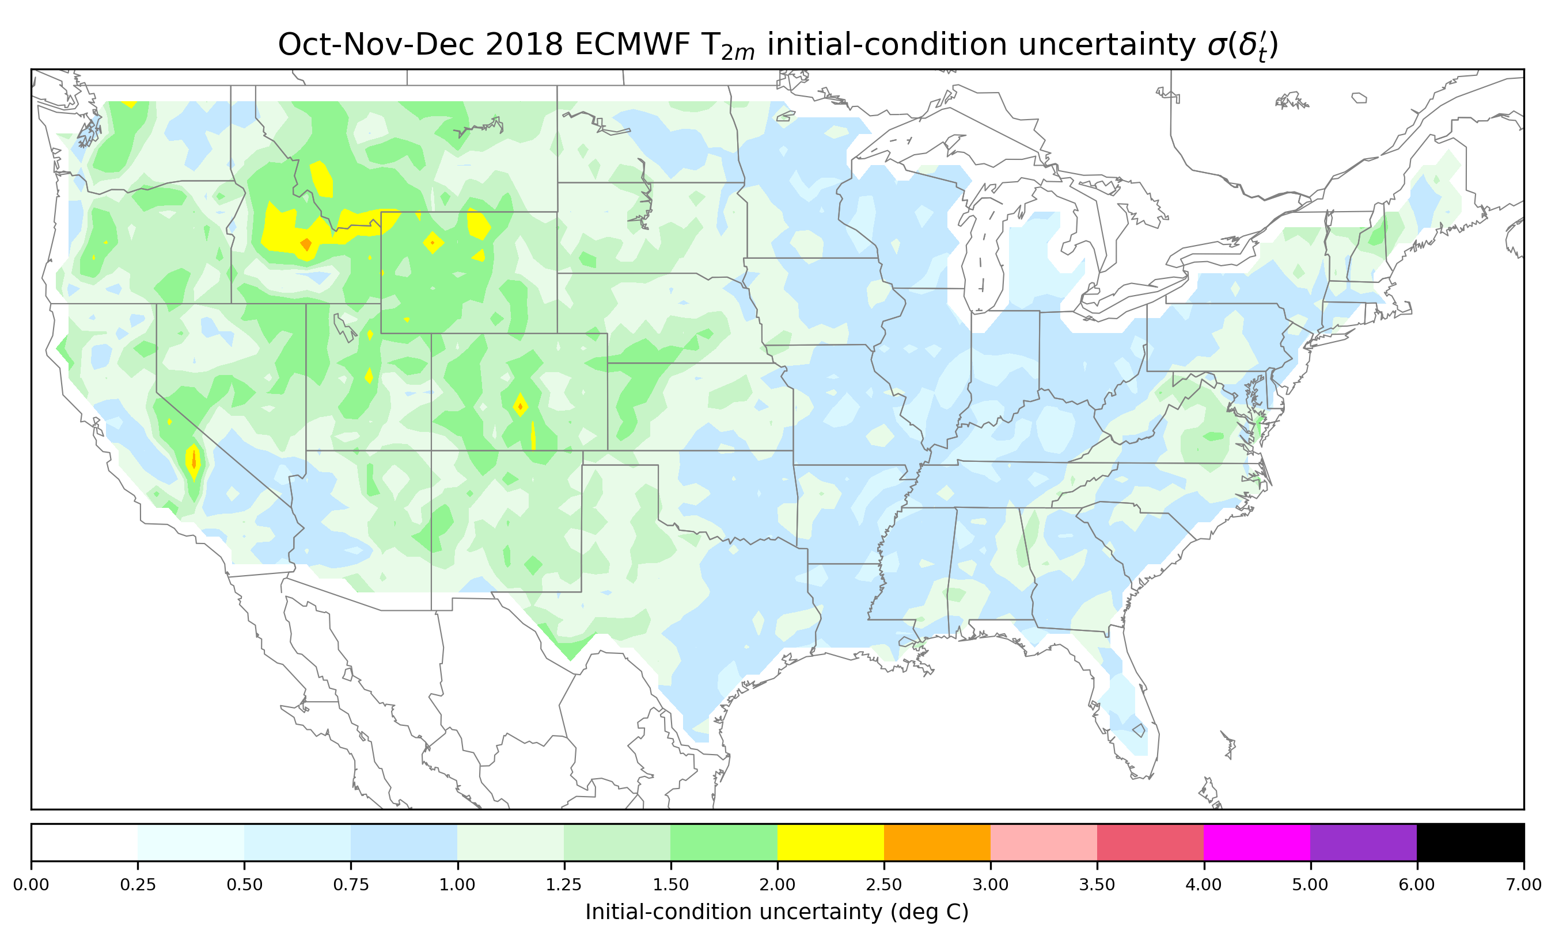
Initial-condition uncertainty from residual estimate by season
Winter and spring
season are quite variable in the
Great Plains, perhaps
due to snow and soil moisture mis- estimation
affecting surface-
temperature
variability? Soil
moisture is most
variable in Great
Plains springtime.

Slide 46
A proposed error decomposition to apply to each grid point.
How will we estimate this?
Assertion is that these reflect the random errors in the estimate of the initial state. Assuming statistical independence of the OI analysis error from the ensemble perturbations, then the size of ensemble perturbations plus OI analysis error variance should be consistent with these.

Slide 47
Estimate of analysis-error variance
The OI analyzed state is estimated with the common DA equation
x_{a} = x_{b} + BH^{T} (HBH^{T} + R)⁻¹ ( y - Hx_{b} )
The matrix product HBH^{T} provides the background-error covariances between observation sites. Were it computationally tractable to produce, the resultant analysis-error covariance matrix would be estimated by
Pª = (I - KH) B = B – KHB = B - BH^{T}(HBH^{T} + R)⁻¹ HB
Since HBH^{T} + R is symmetric and positive definite, we can re-express this as
Pª = B - [BH^{T}(HBH^{T} + R)^{-1/2}] [BH^{T}(HBH^{T} + R)^{-1/2}]^{T}
It is numerically possible to find the diagonal elements of this array. But it is still relatively computationally expensive. An approximation is thus used instead based on cross validation.

Slide 48
Cross-validation procedure to determine OI analysis variance.
Produce 10 analyses of the surface temperature for every day of 2018 at 00 UTC at the ~4-km PRISM grid spacing. Withhold 10% of the observations assimilated in each simulation.
Upscale each simulation to ½ degree.
For each of the 10 analyses, determine the ½-degree grid points nearest to each withheld observation.
  At these locations, determine the difference between the analyzed state where the observation was withheld against the mean analyzed state for the other 9 simulations where the observation was assimilated.
  Determine statistics of the differences at these locations.
Use a Cressman (1959) successive-corrections procedure to grid the data available only at select locations.

Slide 49
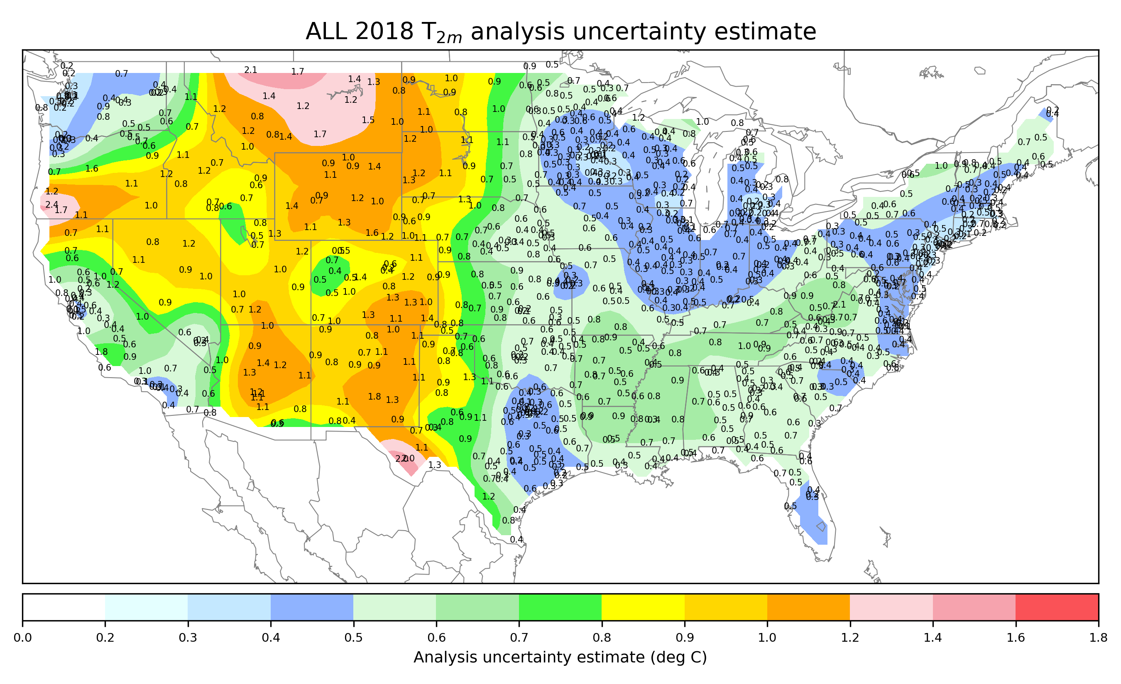
Full-year estimate of analysis uncertainty standard deviation
the numbers are
the estimates at
grid points nearest
to stations.

Slide 50
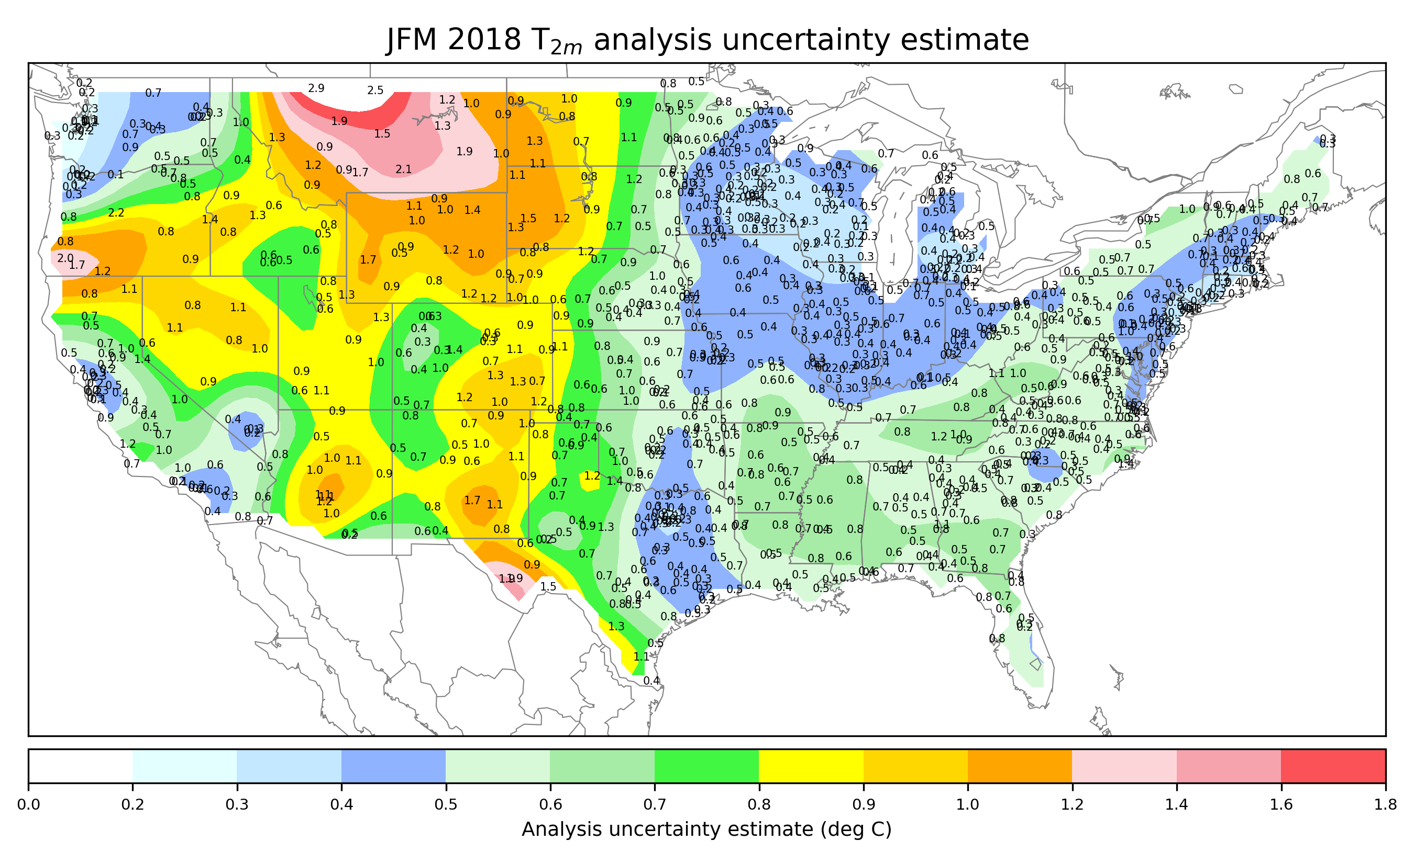
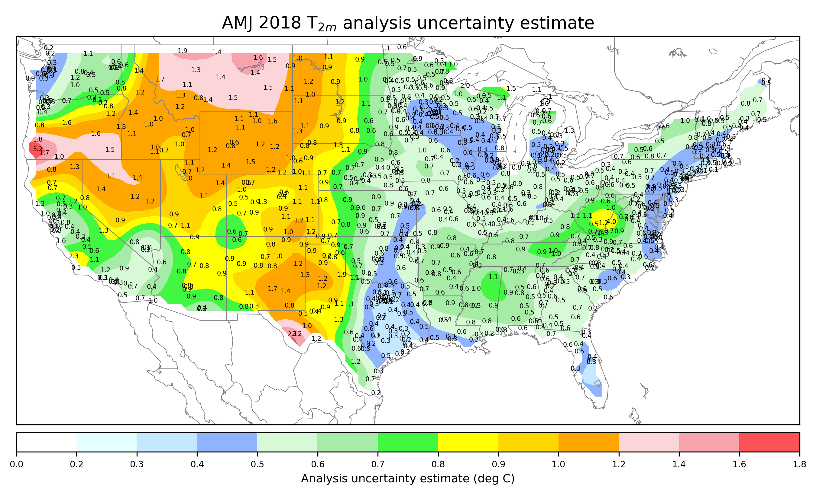
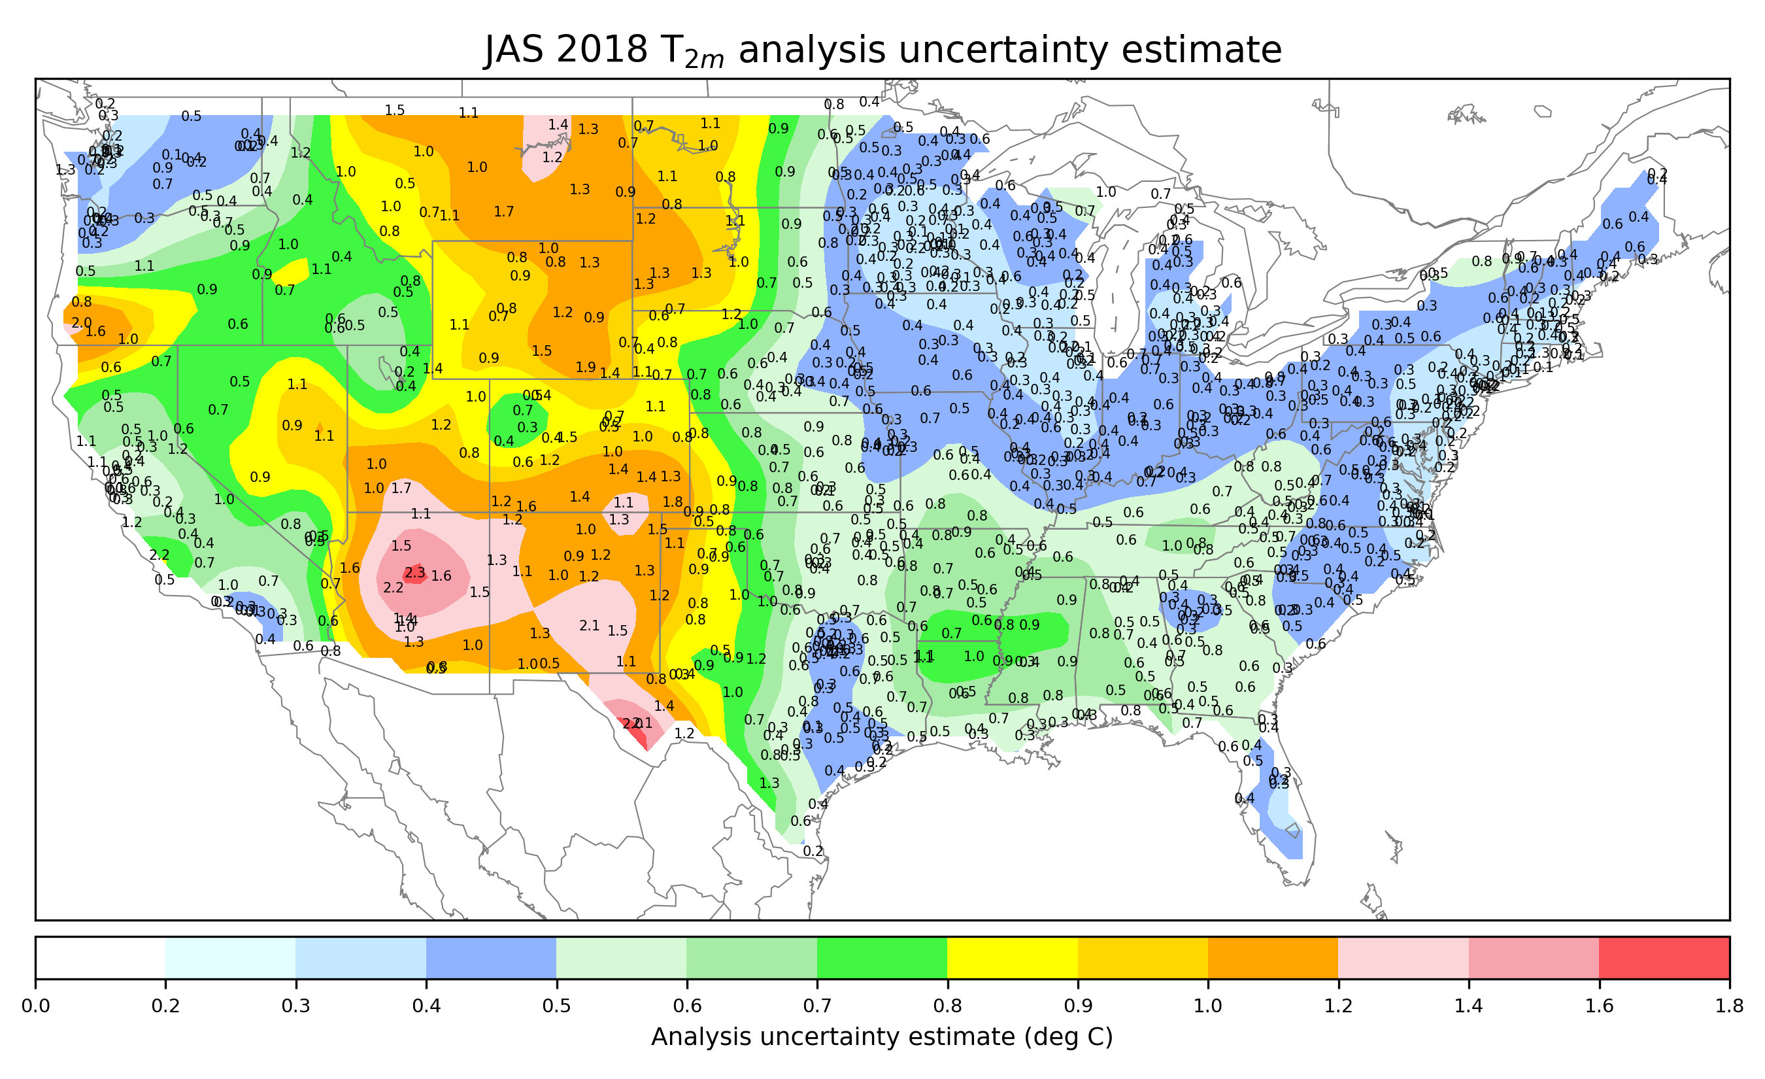
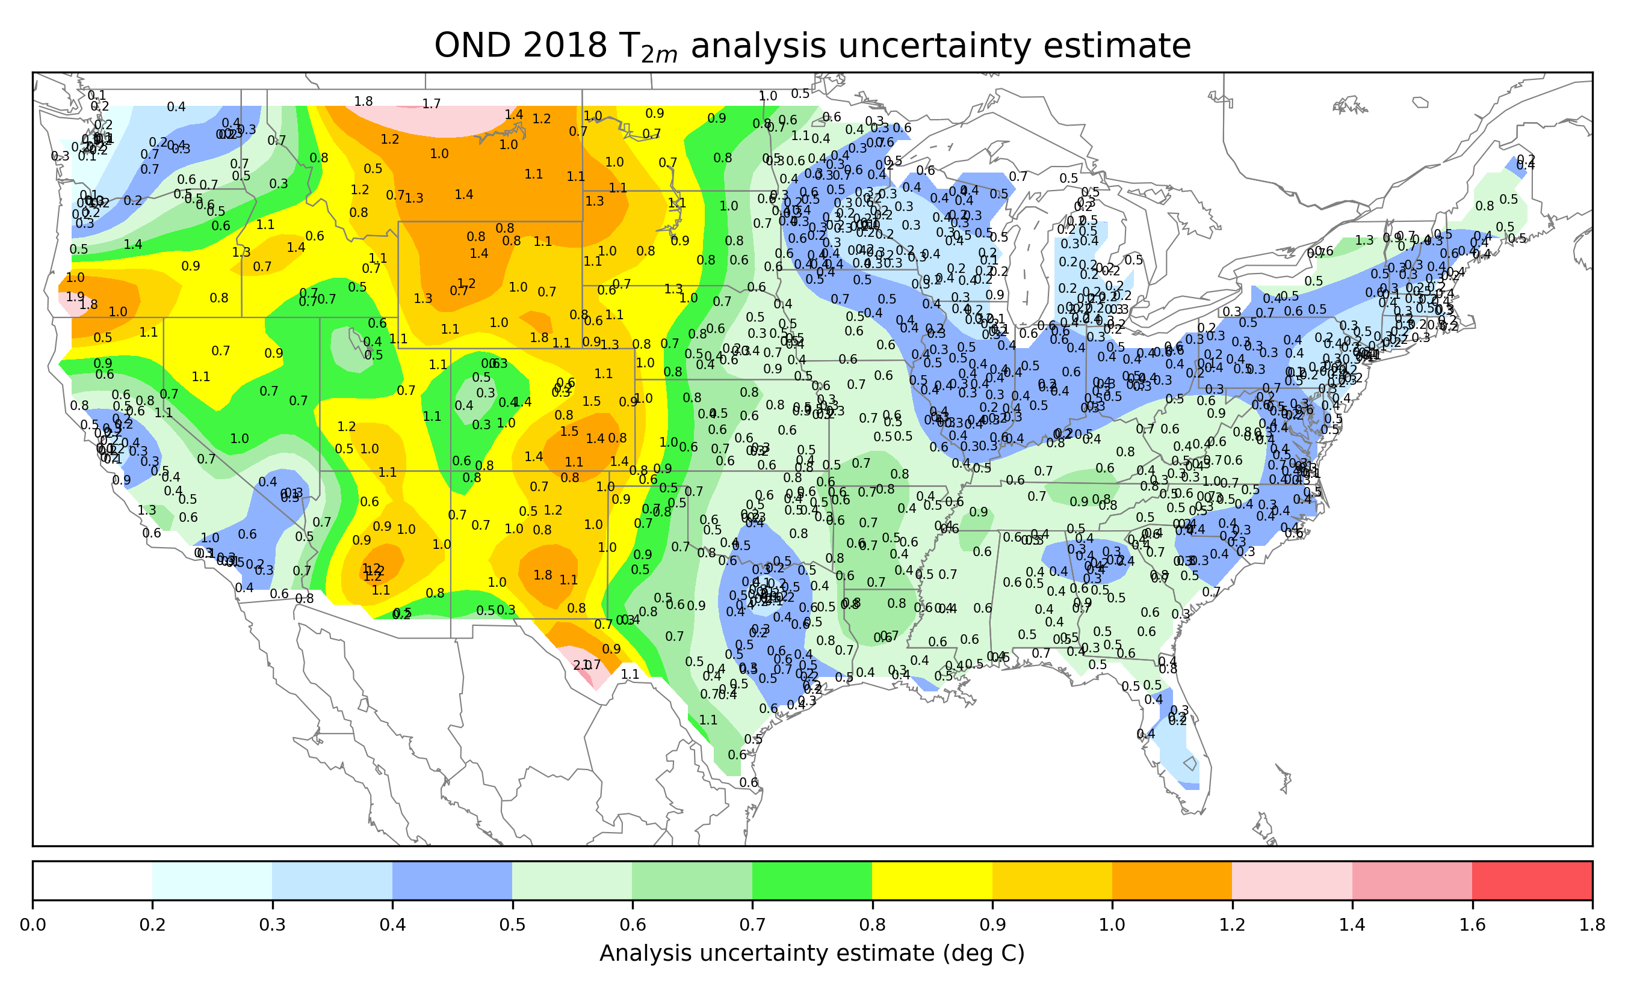
…and OI analysis uncertainty estimate by season

Slide 51
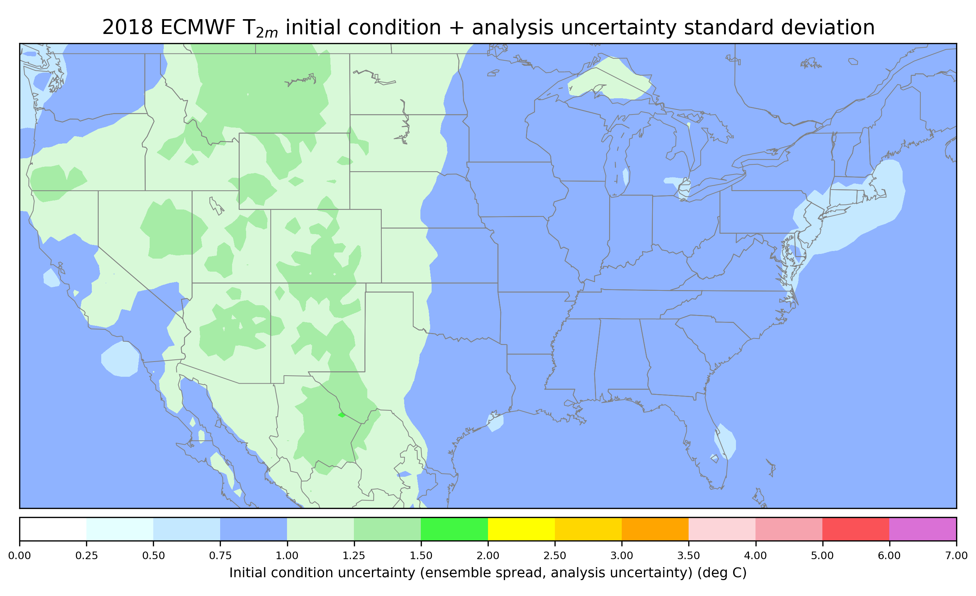
ECMWF initial condition spread + OI analysis uncertainty estimate, calculated in the same manner as initial-condition uncertainty.
This was calculated as the [ECMWF initial condition spread**2 + the OI analysis
uncertainty (spread) **2]^{1/2} . Assumes the two are statistically independent. We compare
this to the initial-condition uncertainty estimate.

Slide 52
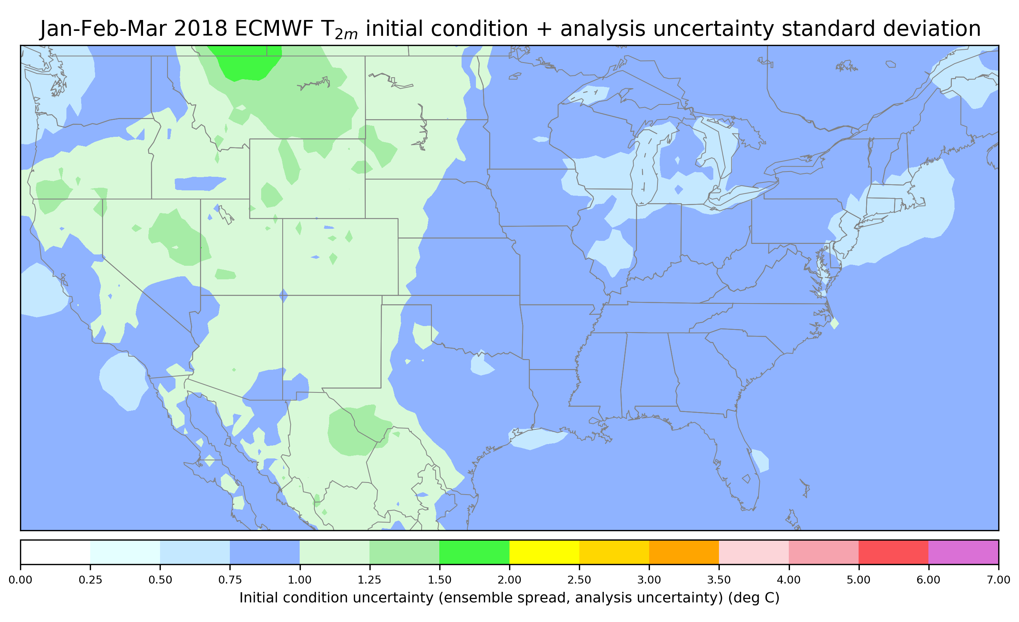
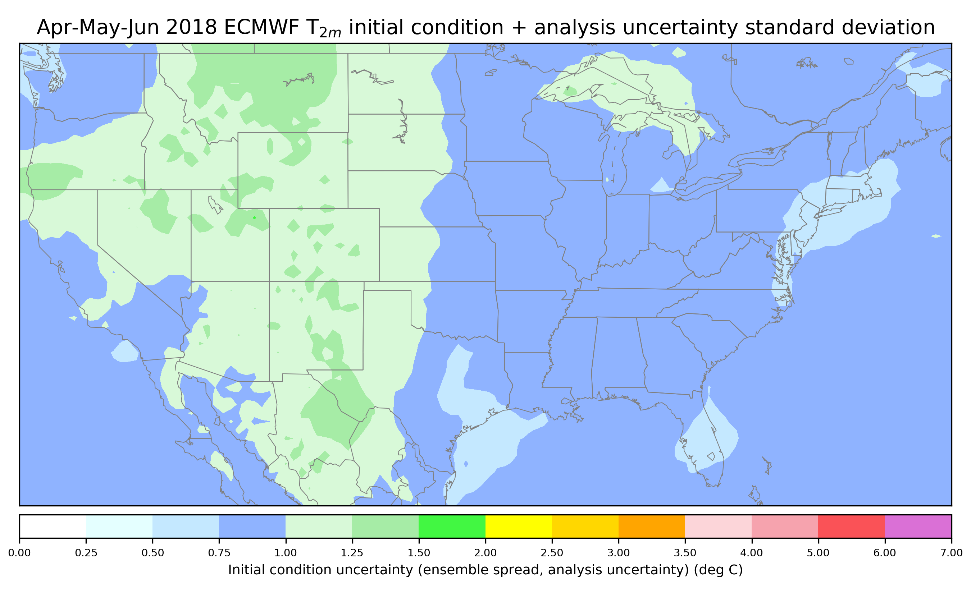
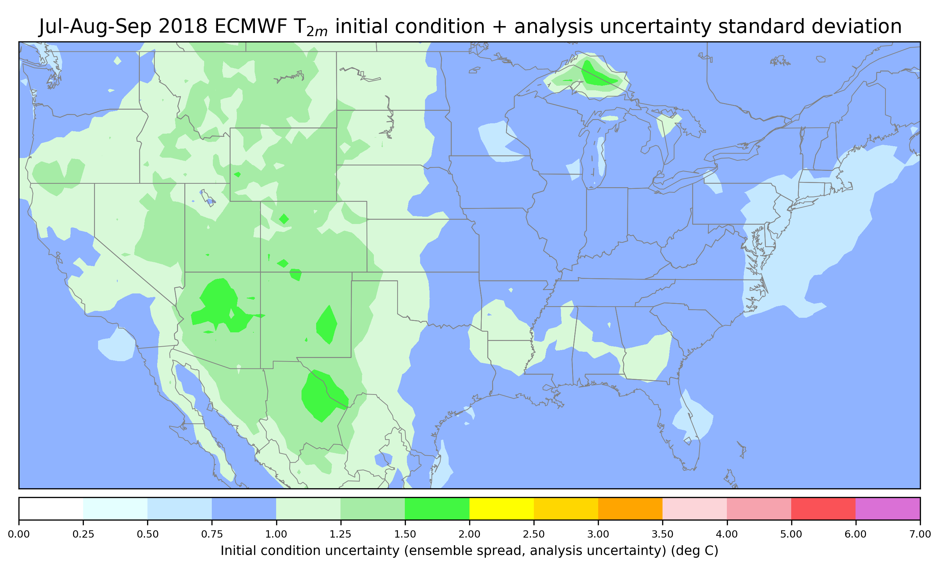
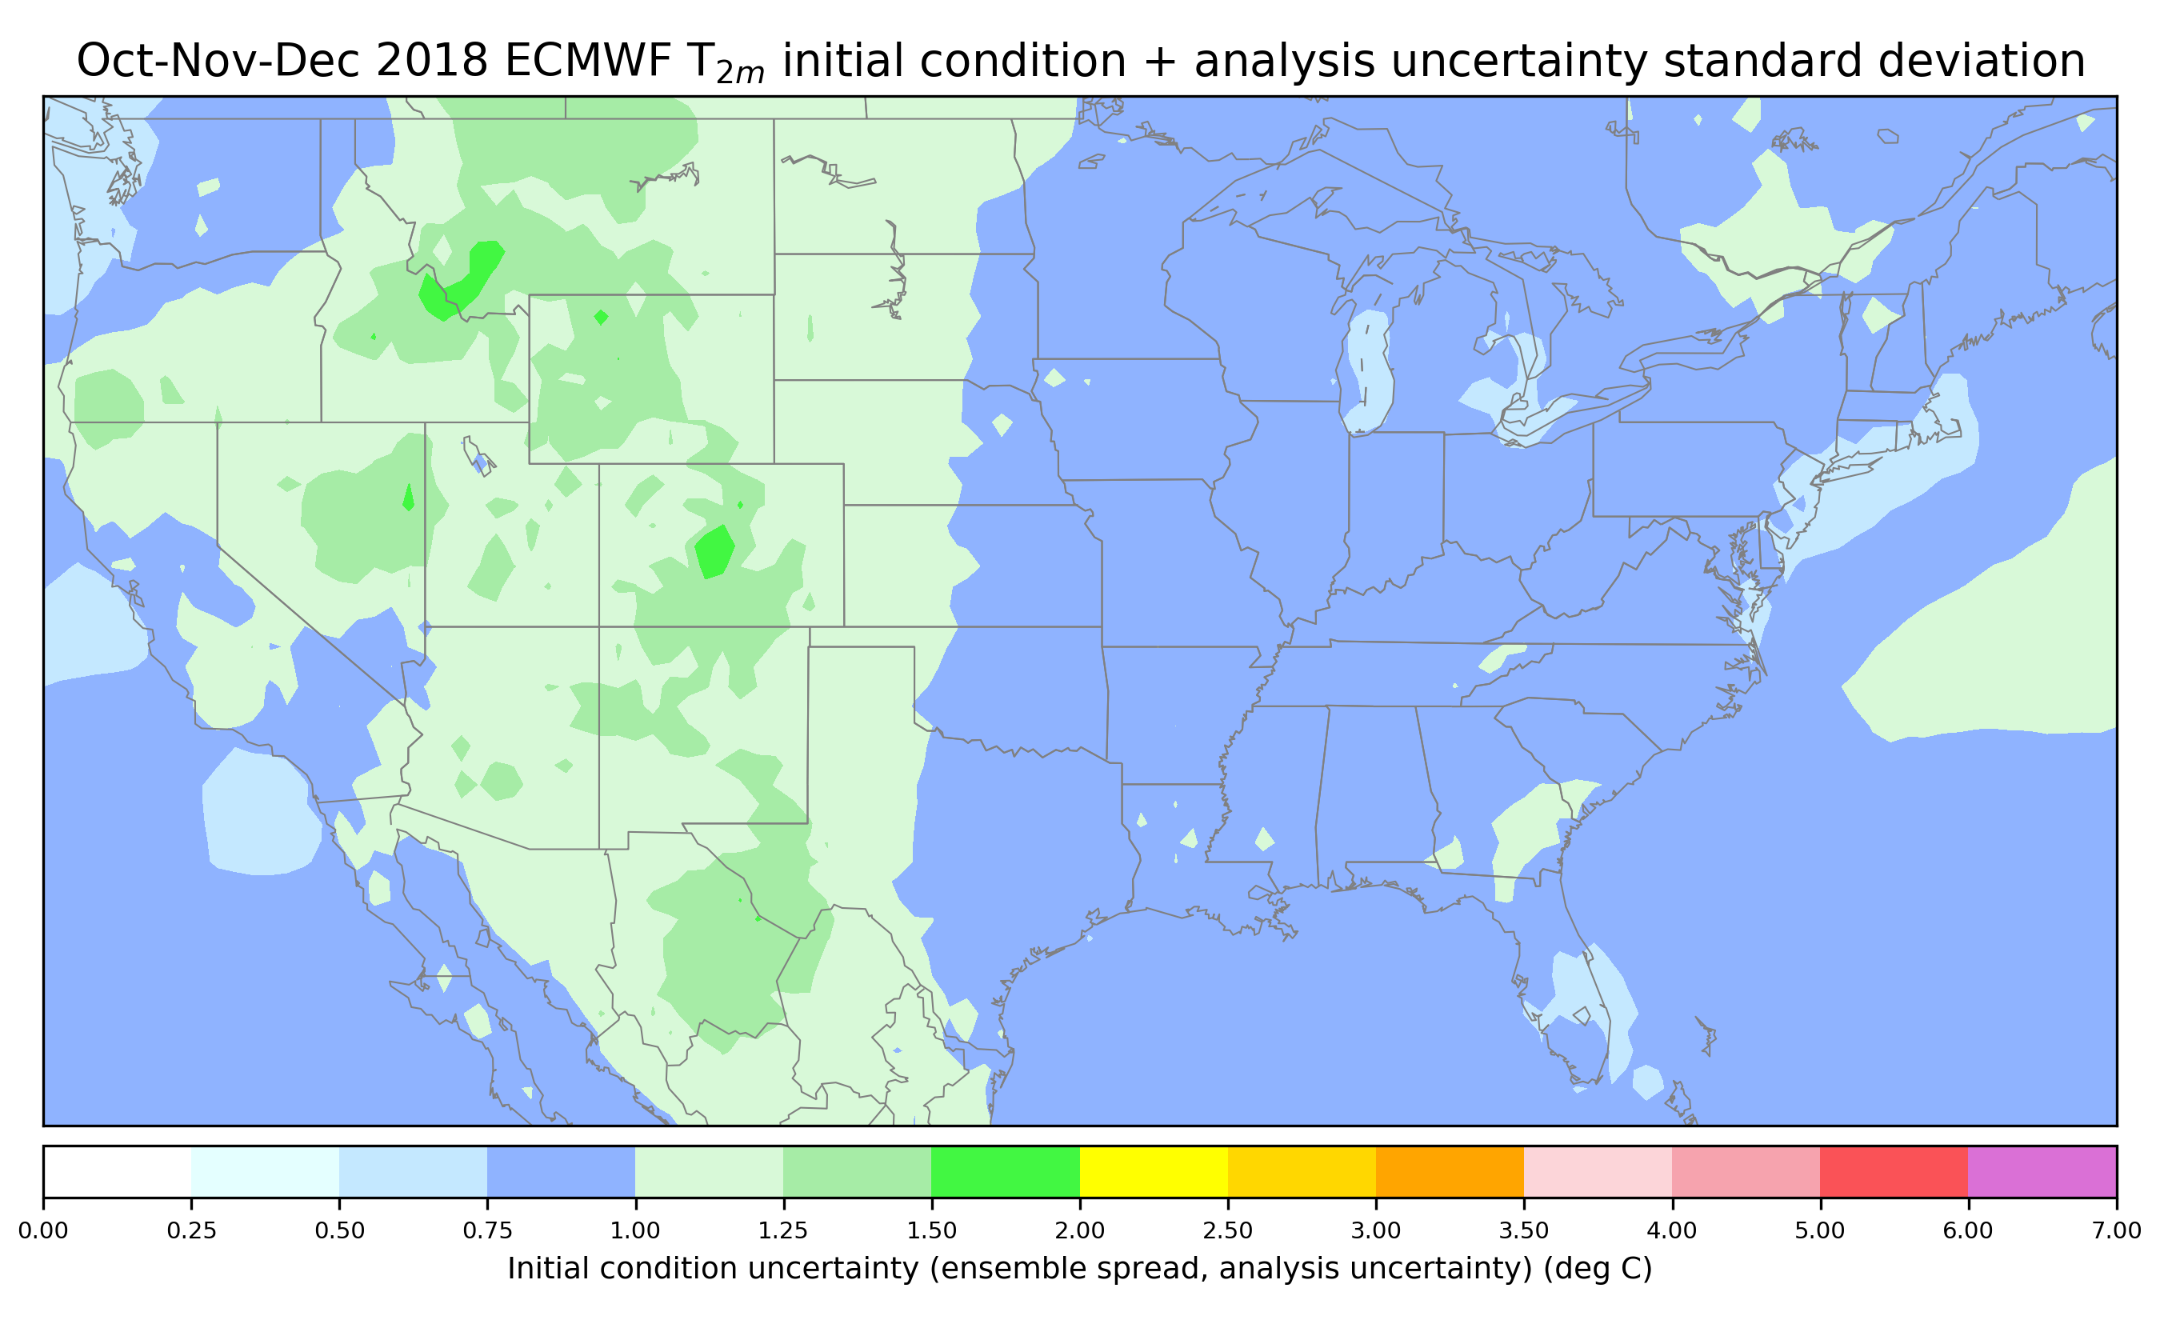
Seasonal ECMWF initial condition spread + OI analysis uncertainty estimates
Compare to seasonal initial-condition uncertainty estimates.
To make comparison
more clear, let’s
look at the ratio
of the two (next slide).
Ideally this should be near 1.0 everywhere.

Slide 53
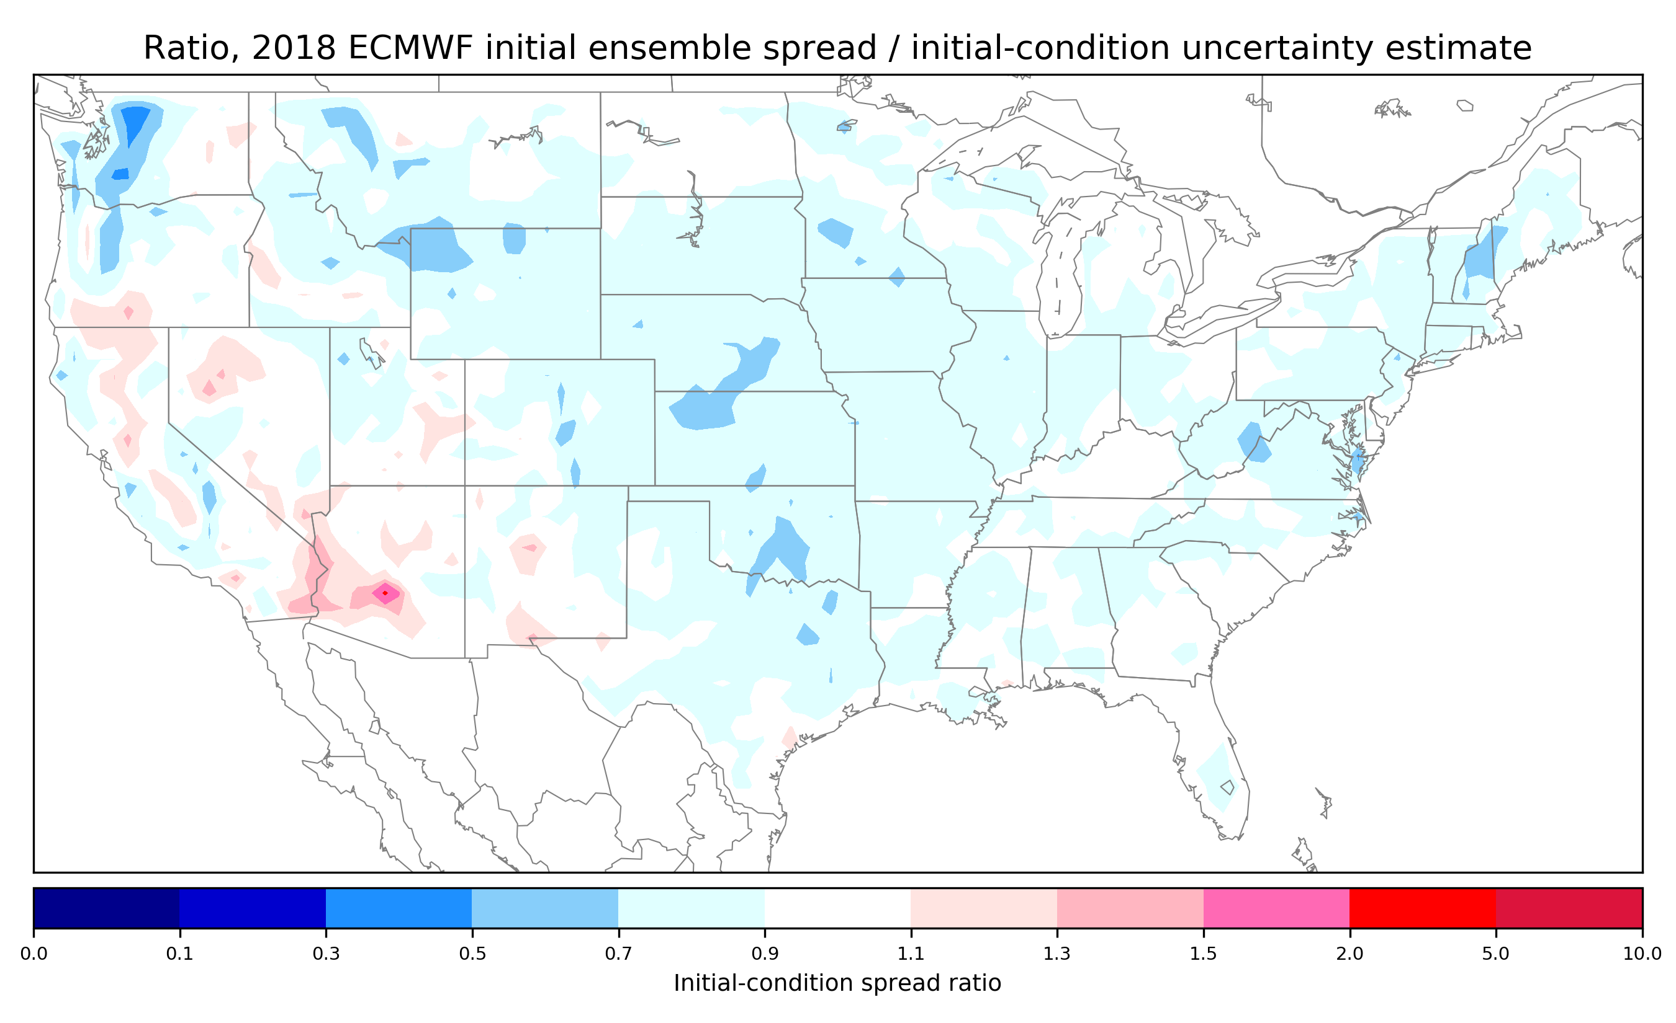
Ratio, T_{2m} ECMWF initial condition spread / random error magnitude, all 2018
It appears that
overall, T_{2m}
perturbations in the
ECMWF ensemble
should be larger
by roughly a
factor of two.
Seasonality?

Slide 54
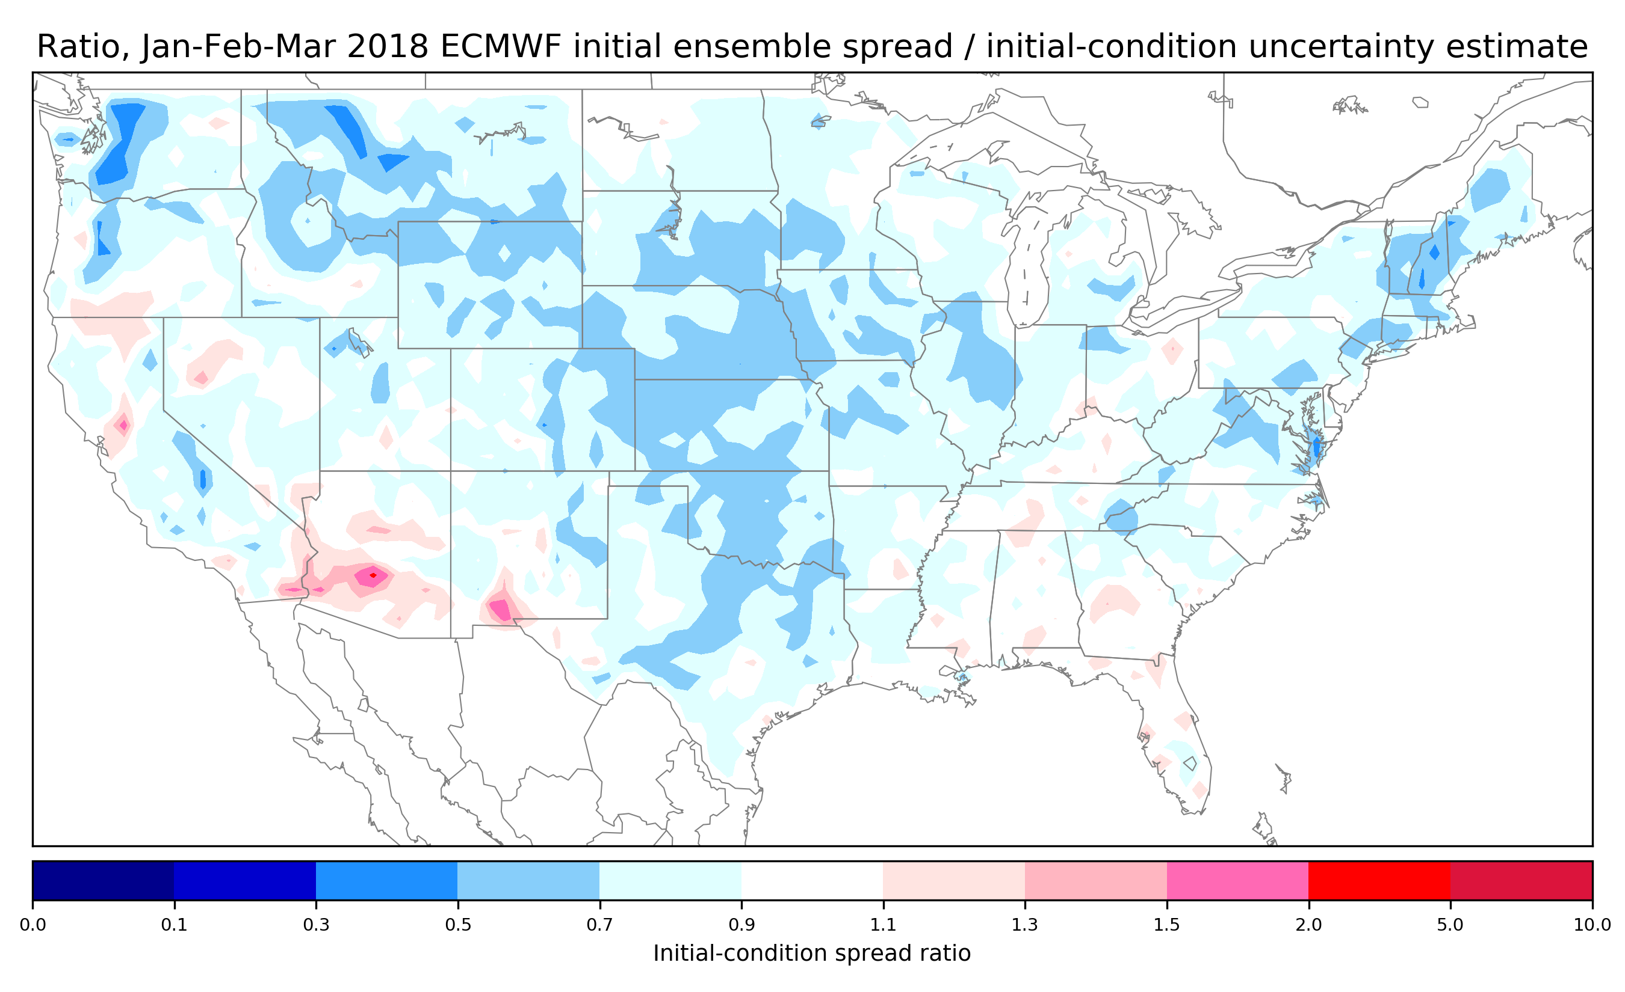
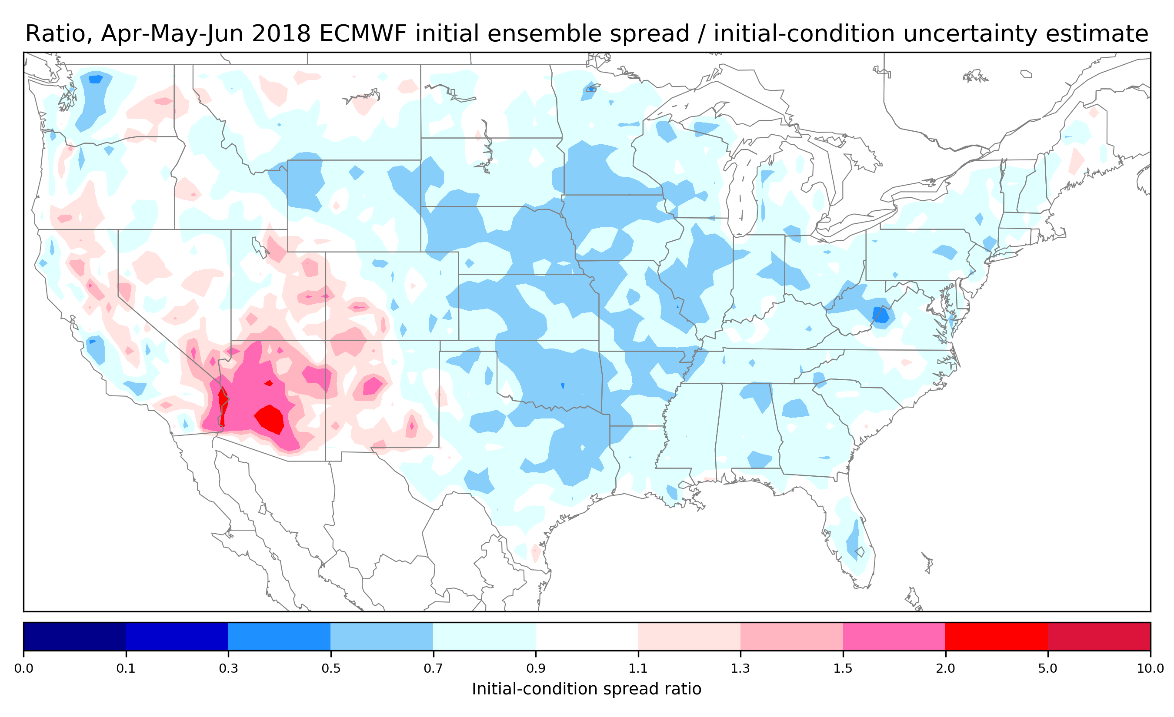
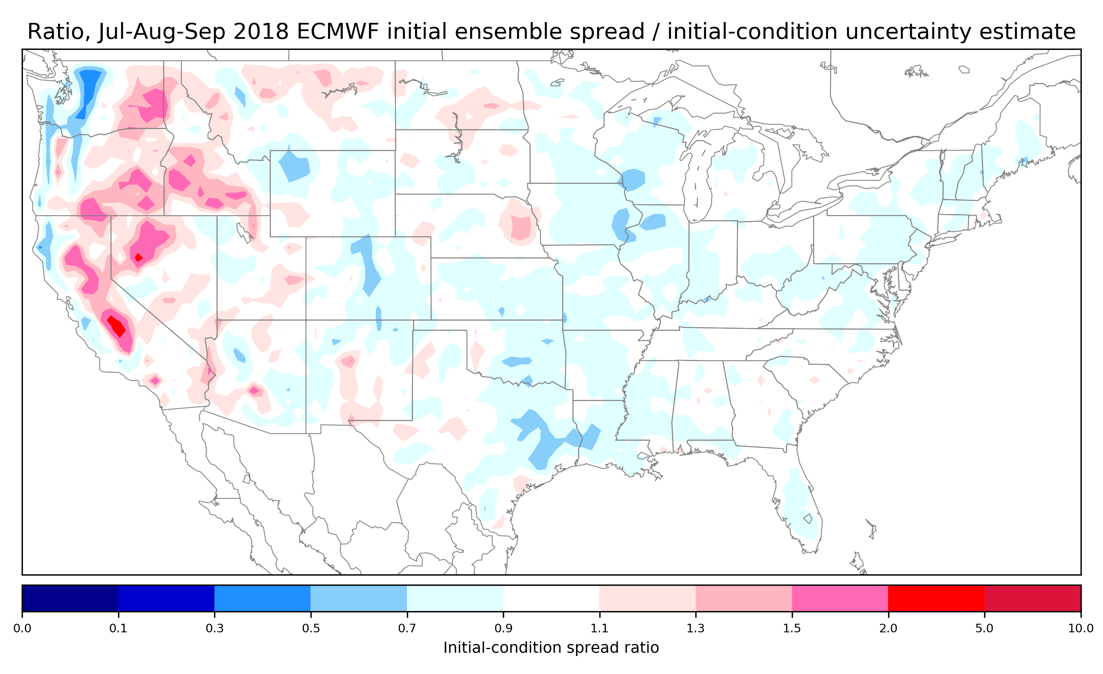
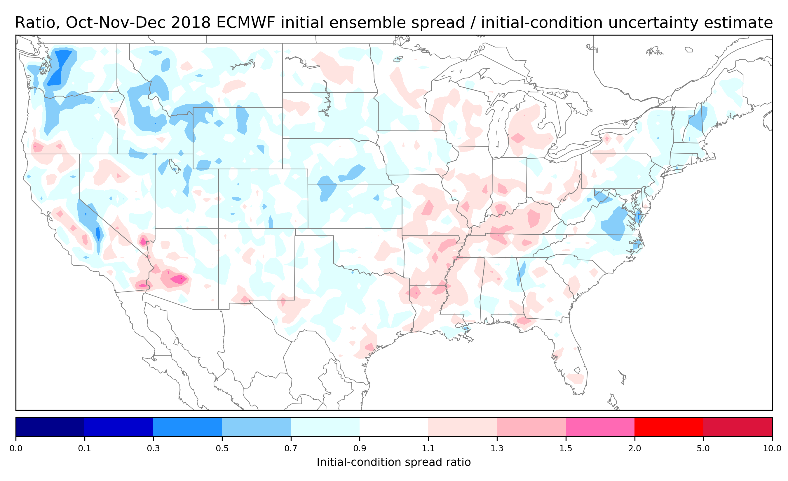
Ratio, ECMWF initial condition spread / random error magnitude by season
This suggests that an initial- condition spread deficiency exists in some areas (Great Plains) and is greater in winter and spring.
There are areas
in the southwest
US (spring)
and western US
(summer) where
there is possibly
an excess of spread.

Slide 55
What ECMWF methodological changes may provide greater spread in ensembles of T_{2m} analyses?
ECMWF now runs 25-member ensemble
of EDA at a reduced resolution to estimate
forecast uncertainty in the higher-resolution
control state.
Statistics of differences between the EDA
members are used in conjunction with
“singular vector” perturbations that grow
quickly to set the initial magnitude and
structure for perturbed ensemble initial
conditions.
https://www.ecmwf.int/sites/default/files/elibrary/2018/17996-advancing-data-assimilation-global-nwp-ecmwf-perspective.pdf

Slide 56
Suggested ECMWF fix #1: change stochastic physics related to surface-energy budget.
A greater variety of background spreads
is desirable. Changes to achieve this might include:
greater variety in background soil temperatures and soil moistures, perhaps through stochastic physics in the soil state. These affect variety of surface energy balance among ensembles and thus T_{2m} variety.
Methods to increase variety of snow amount and fractional snow cover, be it through greater variety in ensembles of precipitation forcings or perturbations to their initial state.
Techniques that introduce a greater variety of downward solar radiation to the surface (physically based stochastic parameterizations of deep convection, microphysics?). These drive variety in energy partitions at the surface.
https://www.ecmwf.int/sites/default/files/elibrary/2018/17996-advancing-data-assimilation-global-nwp-ecmwf-perspective.pdf

Slide 57
Suggested ECMWF fix #2: improved perturbations of the observations in their ensembles of data assimilations.
Do the perturbed observations correctly represent the spatial correlations of errors common in measurements? Or are they treated as independent? Assuming
independence when not warranted will result in less spread in the resulting ensembles of analyses.
Perhaps modify the structure of the R
matrix used in the data assimilation
to better reflect these correlations, and generate perturbed observations consistent with the correlated R.
https://www.ecmwf.int/sites/default/files/elibrary/2018/17996-advancing-data-assimilation-global-nwp-ecmwf-perspective.pdf

Slide 58
Conclusions.
A decomposition of 2-meter temperature (T_{2m}) error into residual and systematic components is proposed, facilitated by an optimal interpolation analysis that leverages an unbiased background.
Systematic errors in the initial state are not negligible.
  Larger in more mountainous regions of western US.
  Of order 1K or more over much of the US.
  Larger in the cool season.
ECMWF’s initial ensemble spread is somewhat smaller on average than the residual error – the two should be comparable in magnitude.
  Suggestions to provide greater spreads of backgrounds used in ensemble DA, address correlations of observation error statistics in DA.

Slide 59
Supplementary slides.

Slide 60
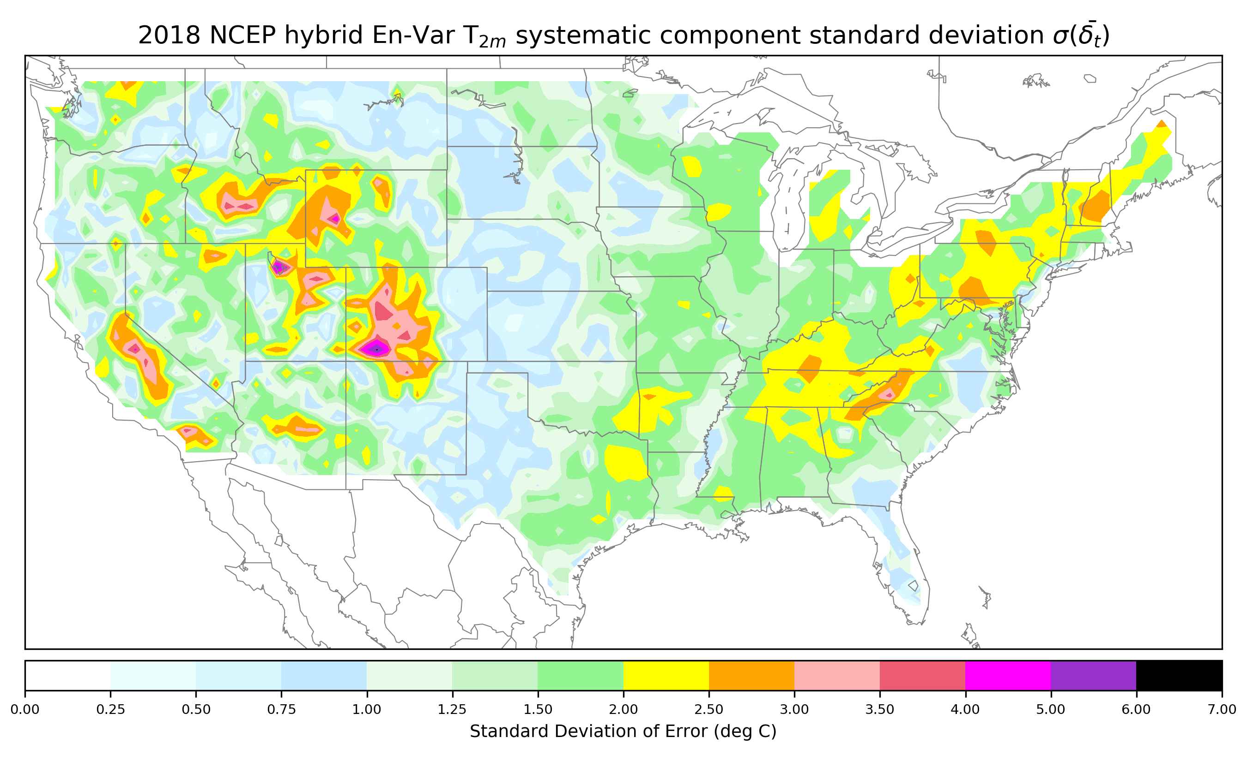
NCEP systematic error standard deviation, Jan-Dec 2018
Similar errors in western
US to ECMWF. Larger
errors in midwest and
Appalachians.

Slide 61




Systematic errors for 3-month seasons
Errors in the
mountainous
regions are larger
in the fall and winter. Spring and summer systematic errors are larger in the eastern US.

Slide 62

NCEP yearly biases of surface temperature
NCEP has a quite
systematic cold bias
of 2-meter temperature.

Slide 63




NCEP seasonal biases of surface temperature
NCEP has a quite
systematic cold bias
of 2-meter temperature,
widespread across
US.

Slide 64

NCEP initial-condition uncertainty estimate from residual
The time-averaged
size of ensemble
perturbations should
be consistent with this.

Slide 65




NCEP initial-condition uncertainty estimate by season

Slide 66
NCEP initial condition spread, calculated in the same manner as errors.
We compare this to
the initial-condition
uncertainty estimate.
These need to be recalculated.

Slide 67
NCEP initial condition spread for 3-month seasons.
Compare to seasonal initial-condition uncertainty estimates.
To make comparison
more clear, let’s
look at the ratio
of the two (next slide).
Ideally this should be near 1.0 everywhere.
These need to be recalculated.

Slide 68
Ratio, T_{2m} NCEP initial condition spread / random error magnitude, all 2018
It appears that
overall, T_{2m}
perturbations in the
NCEP ensemble
should be larger
by roughly a
factor of three or
more, an even bigger
problem than ECMWF.
Seasonality?
These need to be recalculated.

Slide 69
Ratio, ECMWF initial condition spread / random error magnitude by season
The initial- condition spread
for the NCEP
system is
problematic
throughout the
year.
These need to be recalculated.

Slide 70
Gaussian smoothing kernel: cross-validated fit as function of temporal length scale

Slide 71

Methodology for creating a diurnally varying PRISM gridded climatology

Slide 72

Methodology, continued

Slide 73
Schematic of the procedure for generating a surface temperature
analysis using “PRISM” climatology as background
PRISM gridded climatology at time t
surface observations at time t
Determine anomalies from climatology
Observation anomalies from climatology at time t
Statistical interpolation
Gridded, analyzed anomalies from climatology at time t
Add to produce 1-h analysis
Gridded analyzed T2m at time t
now consider details of the statistical interpolation

Slide 74


Slide 75
Description of the statistical interpolation procedure, including a model for the background-error covariances of a climatological background state.

Slide 76


Slide 77

0.0 (background is climatology)

Slide 78


Slide 79


correlation with an exponential decay appears realistic for surface data

Slide 80


