Slide 1
Revised supplemental locations for POP12. Updates.
(1) changing the supplemental location penalty function and its effects.
(2) determining a location-dependent number of supplemental locations.
Tom Hamill, ESRL/PSD
7 December 2015

Slide 2
Algorithm for supplemental locations
Overview: For every grid point in our domain with valid precipitation data, we seek a set of supplemental points that have similar precipitation climatology and similar terrain characteristics. Data from these supplemental locations are used when generating CDFs used in quantile mapping procedure in order to reduce variability due to small sample size.
Principles: we don’t want our supplemental locations to be:
  too close to each other (else non-independent data).
  tremendously far away from the original point (else likely different synoptic meteorological factors in play, and potentially different model biases that vary with these synoptic factors).
  so few in number that we can’t build CDFs for quantile mapping that represent the long-term biases of the forecast model.
  so many in number that we are forced to supplement with locations that are clearly a poor match, with potentially different systematic biases.
There’s no perfect answer here; we have one hand tied around our back (by being forced to use short time series of past forecasts) and we just hope to do our best given this limitation.

Slide 3
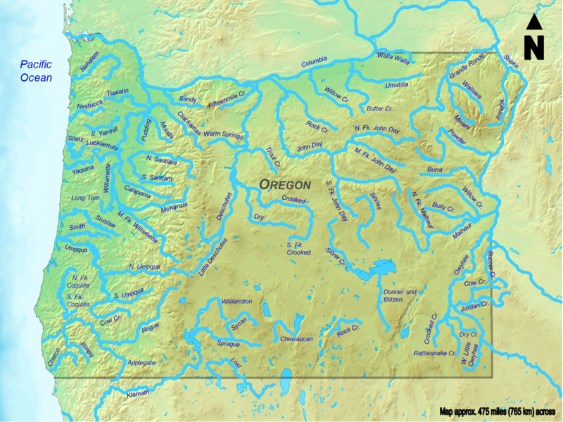
Illustration of the challenge at hand (here with single location and multi-decadal reforecast data)
Different systematic errors exist even at nearby locations, making it complicated to supplement training data with data from other locations based simply on physical proximity.

Slide 4
Proposed algorithm for determining supplemental locations (revised)
Let Δ_{I,J,K,L} = a penalty function measuring the (arbitrarily) weighted difference in precipitation and terrain and geography between two grid locations I,J and K,L
Δ_{I,J,K,L} = ΔP_{I,J,K,L} + ΔZ_{I,J,K,L} + ΔTF_{I,J,K,L}+ ΔD_{I,J,K,L} where
  ΔP_{I,J,K,L} penalizes the difference in precipitation CDFs.
  ΔZ_{I,J,K,L} penalizes difference in terrain heights (revised).
  ΔTF_{I,J,K,L} penalizes differences in terrain “facet” orientations with terrain smoothed at 3 different scales (new).
  ΔD_{I,J,K,L} measures differences in the horizontal distance between the supplemental and original grid point.

Slide 5
Algorithm for supplemental locations
Iterate to find up to n=100 supplemental locations for each grid point (I,J)
  Evaluate Δ_{I,J,K,L} for every (K,L) in domain.
  Find the K,L inside the CONUS with the minimum Δ_{I,J,K,L}, and make this the next supplemental location. Keep track of this penalty amount for i = 1, … , n at each (I,J).
  Once a supplemental location found, rule out as possible supplemental locations all other grid points within some distance d_{min} from (I,J) and all previously selected supplemental locations.
  Proceed to find next supplemental location.
  Points outside of CONUS forced to find supplemental locations inside CONUS (with its more reliable precip analyses) for better or worse.

Slide 6
Algorithm for supplemental locations, continued.
Let _{I,J} be the (x,y) indices of the current location
Let _{K,L} be the (x,y) indices of a potential supplemental location
Let Z_{I,J} = terrain height
Let P_{I,J} = cumulative probability distribution (a vector)
Let q_{I,J}^{min} = index of quantile associated with first nonzero value in P_{I,J}
Let q_{I,J}^{max} = index associated with 95th percentile of P_{I,J}
Let c1, c2, c3, c4, be user-determined weights.
Let Δ_{I,J,K,L} = ΔP_{I,J,K,L} + ΔZ_{I,J,K,L} + ΔTF_{I,J,K,L} + ΔD_{I,J,K,L}
    [precip] [terrain ht] [terrain facet] [horiz. distance]
ΔP _{I,J,K,L} = c1 * SUM{ABS [P_{I,J}(q_{I,J}^{min} : q_{I,J}^{max} ) - P_{I,J}(q_{K,L}^{min} : q_{K,L}^{max} ) ]} / (q_{I,J}^{max} -q_{I,J}^{max} )
ΔZ_{I,J,K,L} = c2 * [1. – exp{- ABS(Z_{I,J}-Z_{K,L})} / 2500] {see next page}
ΔTF_{I,J,K,L} = c3*{see next several pages}
ΔD_{I,J,K,L} = c4 * SQRT((I-K)**2 + (J-L)**2) ! in grid points, not actual distance

Slide 7
ΔZ_{I,J,K,L} = c2 * [1. – exp{- ABS(Z_{I,J}-Z_{K,L})} / 2500]
where Z_{I,J}and Z_{K,L} are terrain heights at two locations
function in red graphed here, w/o coefficient c2. Want some general way of penalizing differences in terrain elevation.

Slide 8
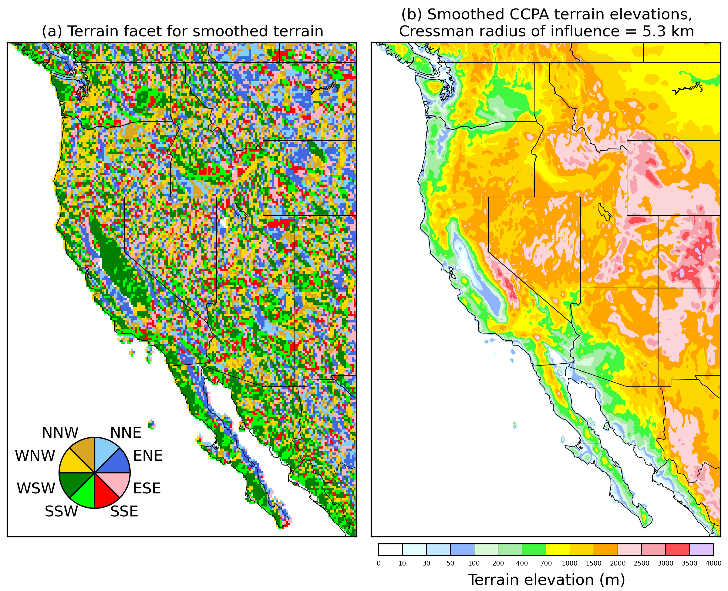
Terrain facets (following Daly/PRISM)
Procedure for determining facets follows Daly et al., Climate Research, 2002, 22, 99-113, and refs therein.
Input terrain was upscaled to 1/8
degree from NDFD database Geoff supplied.
Terrain smoothed with Cressman (1959) weight function. Here the radius of influence = 0.5 grid points at 1/8-degree; (very little smoothing of terrain). After smoothing, terrain
facet algorithm of Daly et al. applied.

Slide 9
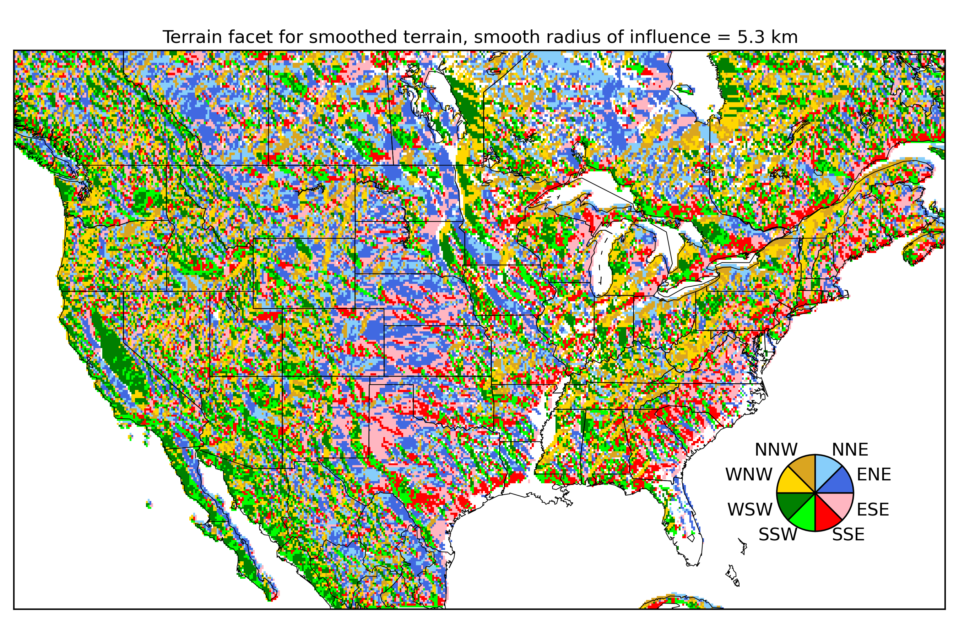
Full CONUS terrain facets (w. little smoothing)

Slide 10
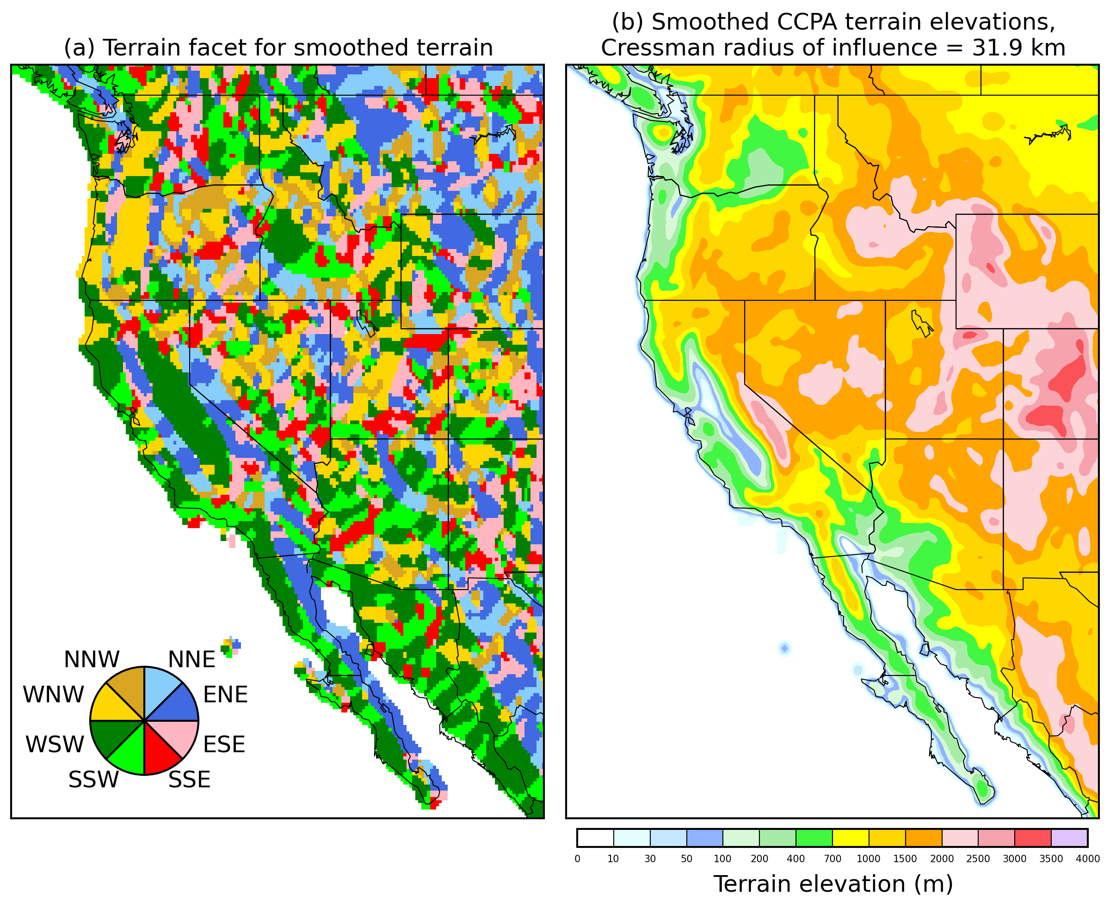
Terrain facets (following Daly/PRISM)
Here’s the terrain
facets with a
moderate
amount of
smoothing of the
terrain height.

Slide 11
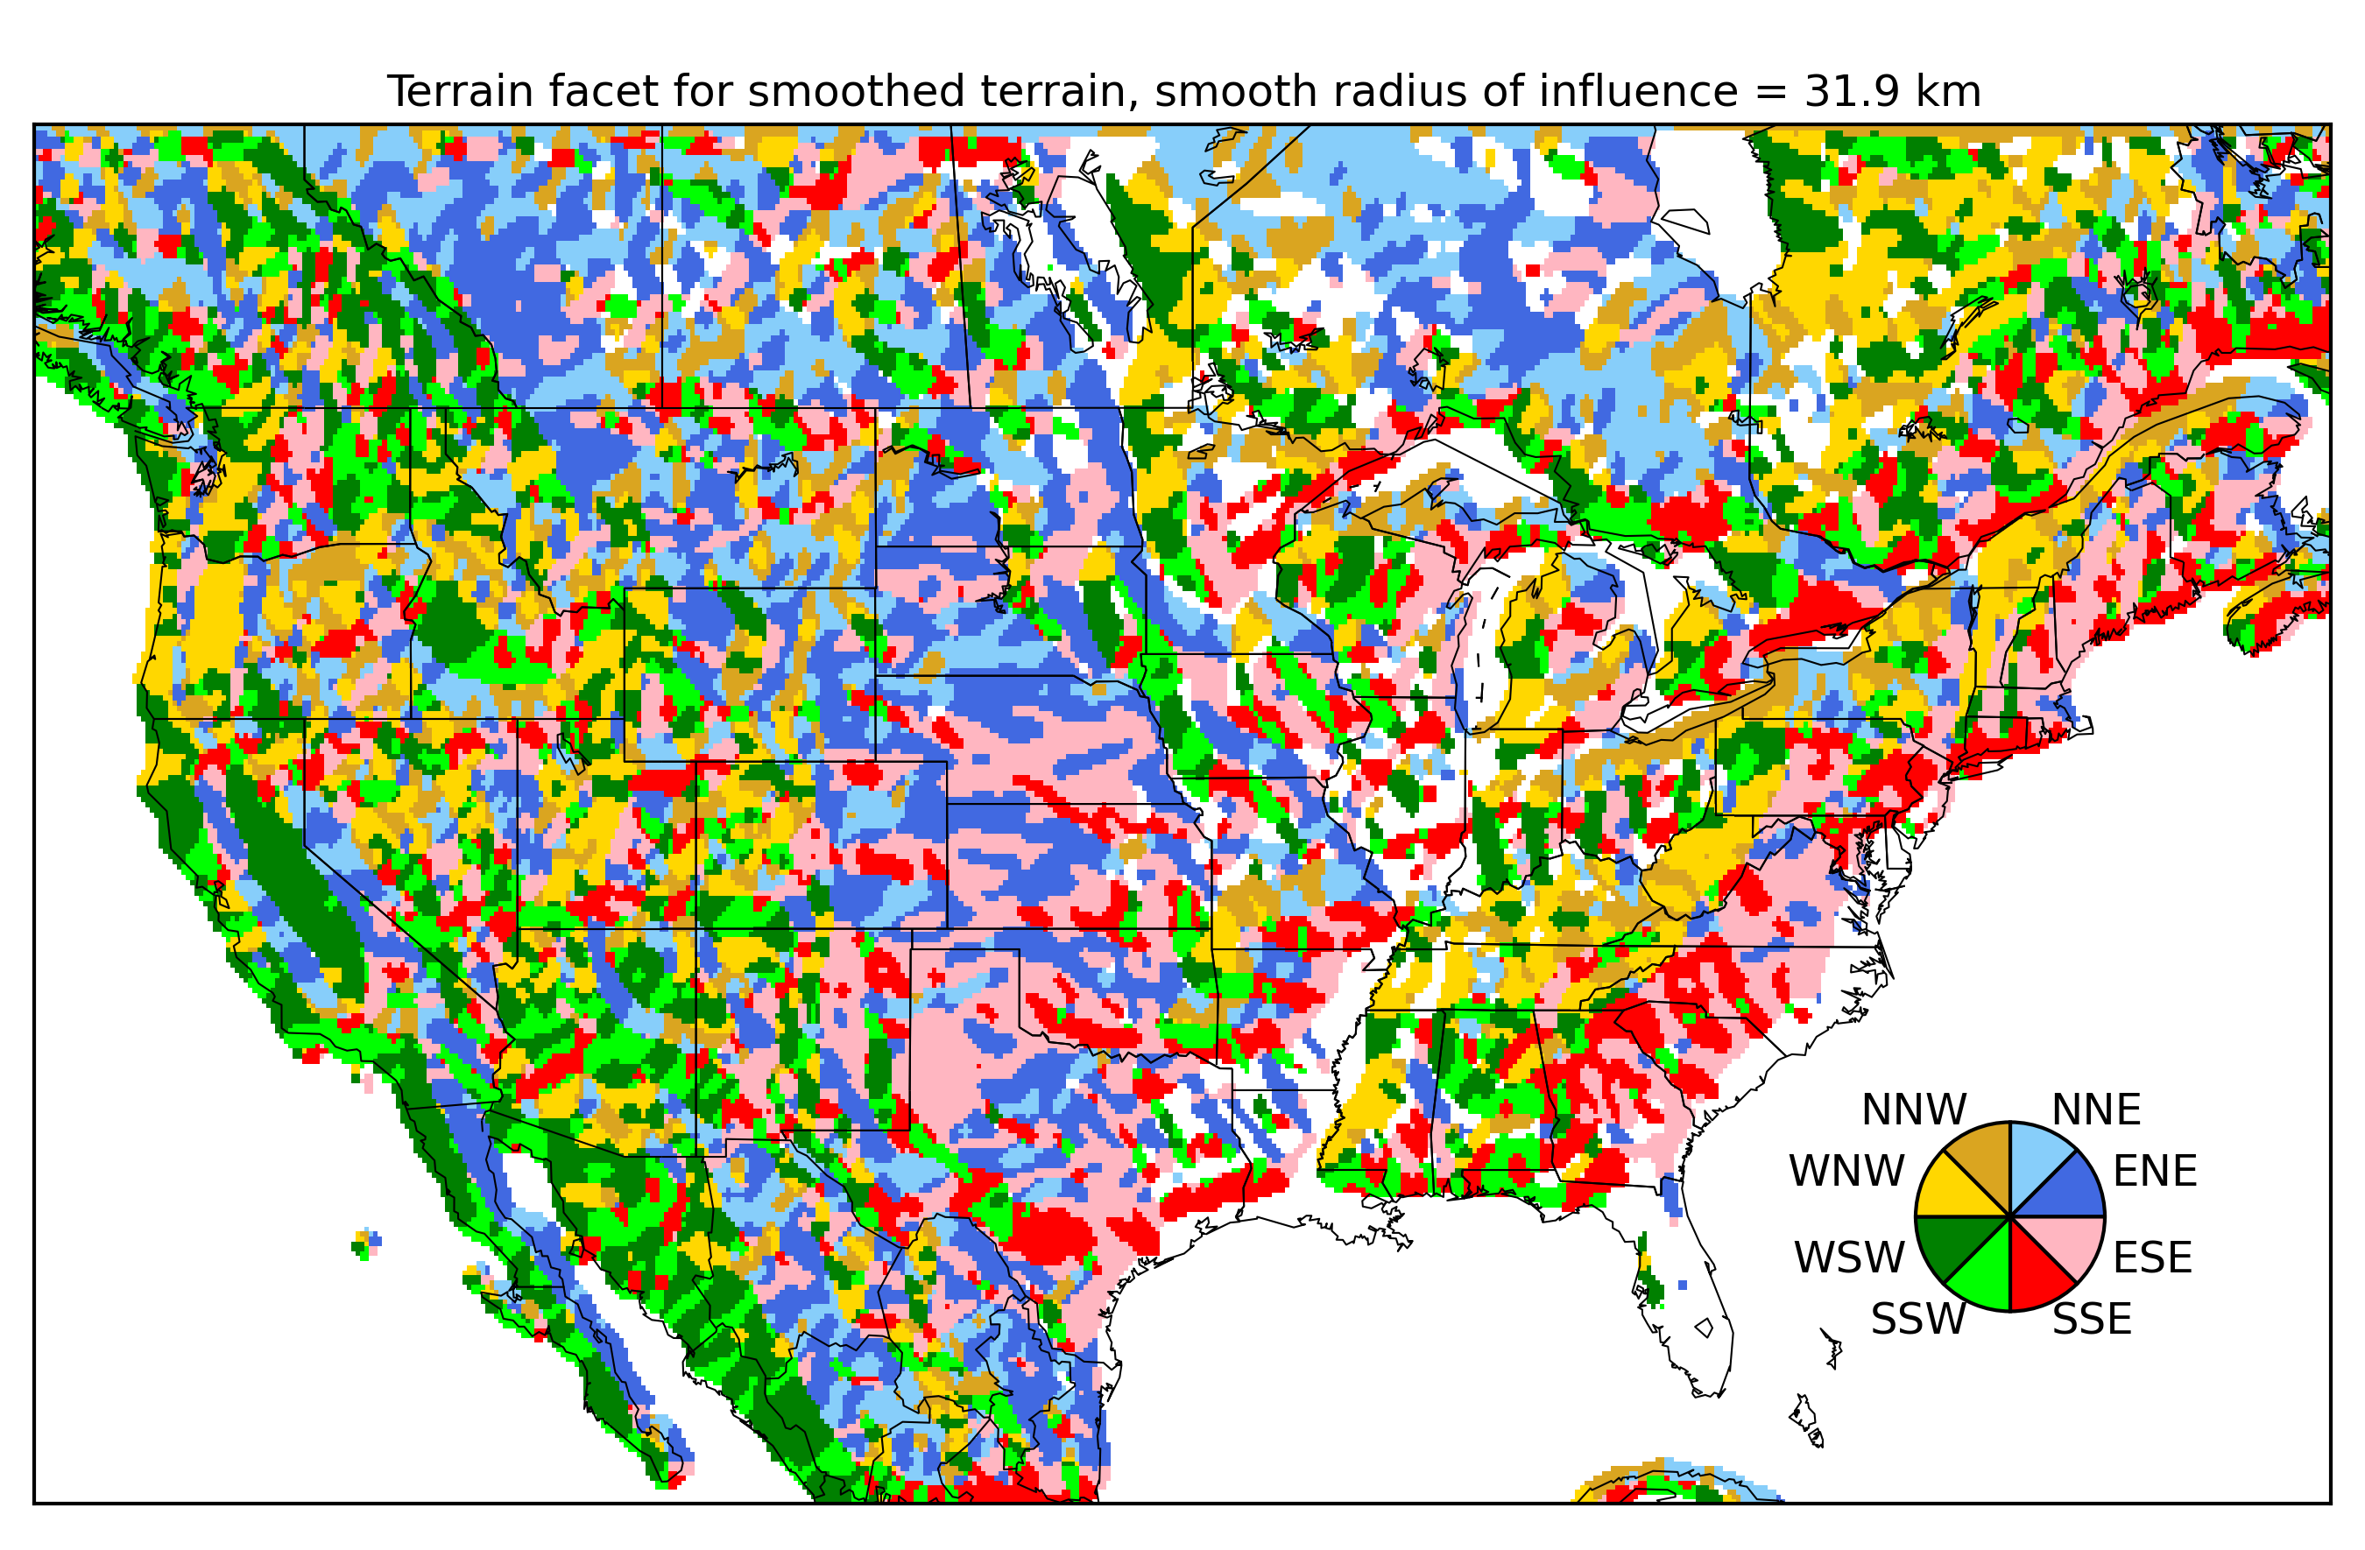
Full CONUS terrain facets (w. moderate smoothing)

Slide 12
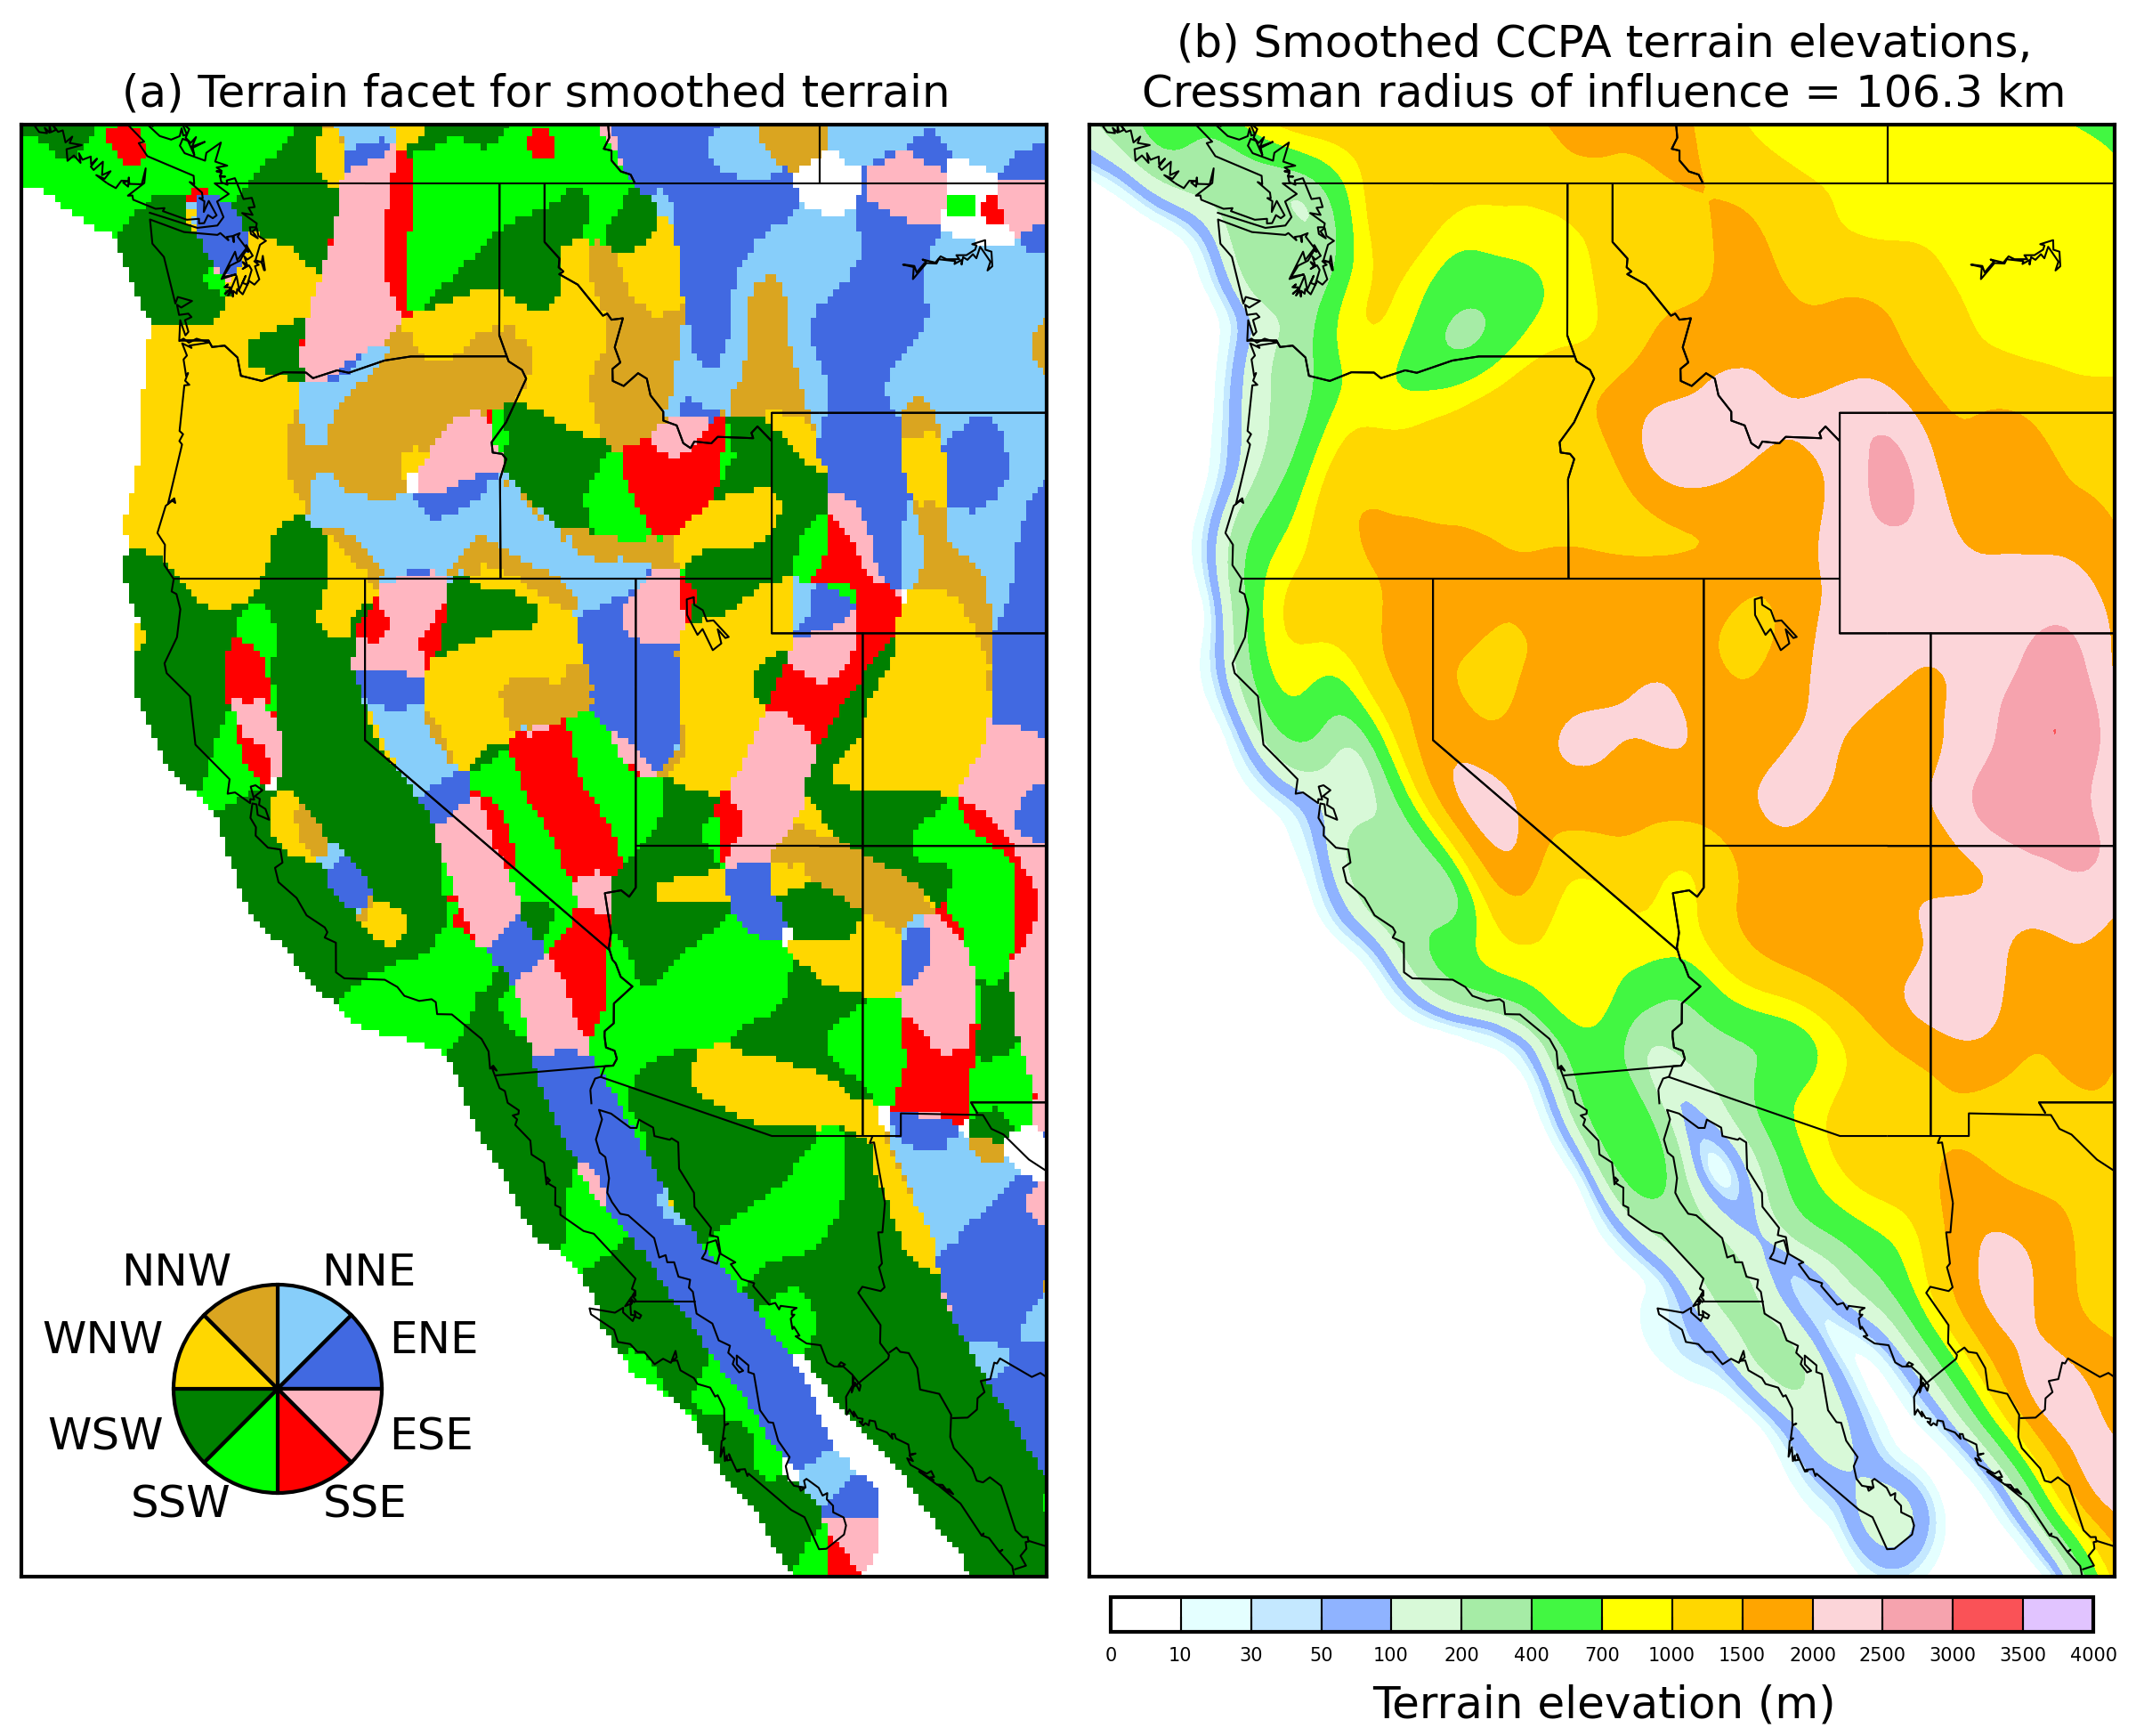
Terrain facets (following Daly/PRISM)
Here’s the terrain
facets with a
large amount of
smoothing of the
terrain height.

Slide 13
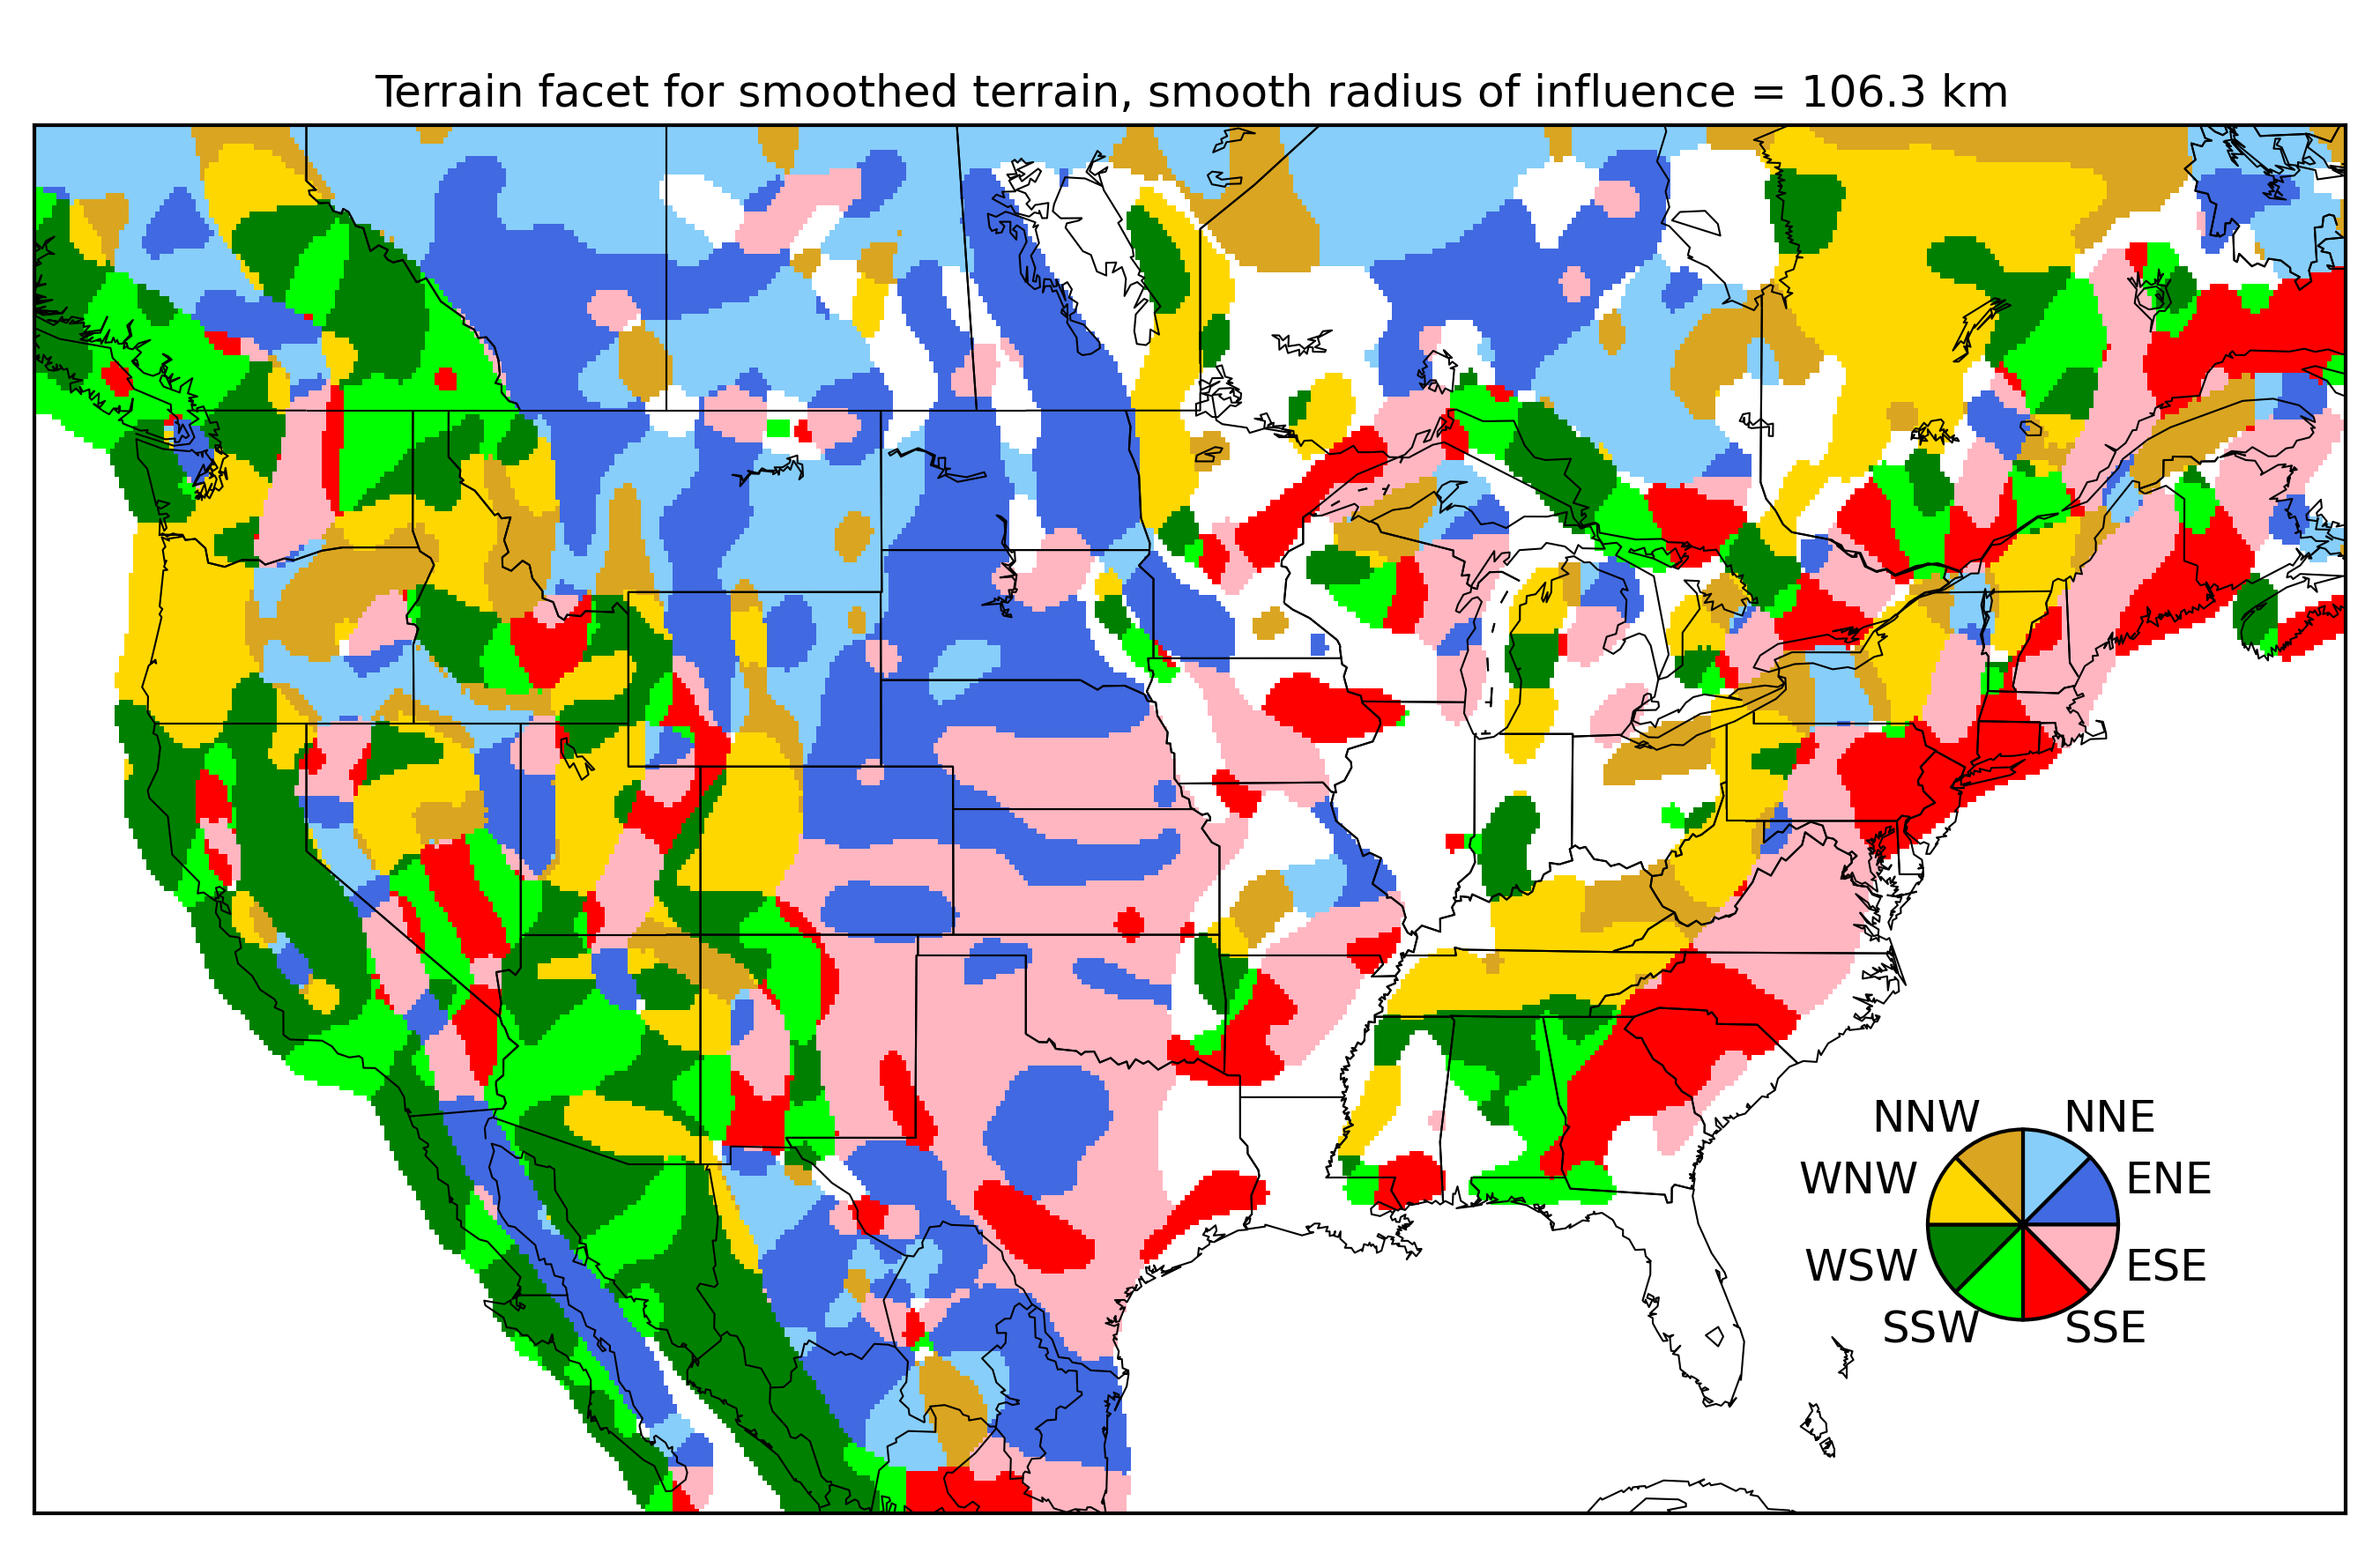
Full CONUS terrain facets (w. large smoothing)

Slide 14
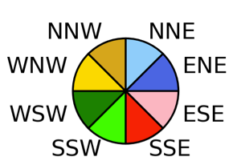
Terrain facet penalty
points of compass are assigned facet numbers 1-8, with 10 being flat.
penalty averages the difference in terrain facet at the three scales.
Inspired by Daly algorithm, but not exactly following his approach (he seeks a weight, I seek a penalty).
idiff_short = MIN(ABS(ifacet_short(I,J) - ifacet_short(K,L)) , &
ABS(ifacet_short(I,J) - (ifacet_short(K,L)-8) ), &
ABS(ifacet_short(I,J) - (ifacet_short(K,L)+8))) ! wraparound
idiff_medium = MIN(ABS(ifacet_medium(I,J) - ifacet_medium(K,L)) , &
ABS(ifacet_medium(I,J) - (ifacet_medium(K,L)-8) ), &
ABS(ifacet_medium(I,J) - (ifacet_medium(K,L)+8)))
idiff_long = MIN(ABS(ifacet_long(I,J) - ifacet_long(K,L)) , &
ABS(ifacet_long(I,J) - (ifacet_long(K,L)-8) ), &
ABS(ifacet_long(I,J) - (ifacet_long(K,L)+8)))
facet_avg = REAL(idiff_short + idiff_medium + idiff_long) / 3.
IF (facet_avg .le. 1.0) THEN
penalty_facetdiff = 0.0
ELSE
penalty_facetdiff = 1.0 - 1.0 / (facet_avg)**1.5
ENDIF
ΔTF_{I,J,K,L} without coefficient c3

Slide 15
The current parameter settings
Parameter | Value
Minseparation | 6 grid points
Maxseparation | 250 grid points
c1 (weight to CDF weight coefficient) | 0.1
c2 (terrain facet weight coefficient) | 0.6
c3 (terrain height weight coefficient) | 0.4
c4 (distance penalty) | 0.001
A few other details: precipitation CDF provided at 107 quantiles, with extra discretization
in the high-end tail of the distribution, but otherwise every percent of the distribution.
Also, new supplemental locations are defined for every grid point inside a new mask
(see next slide) on Chrissy’s expanded grid. This will give us proper information, e.g., in
Columbia River basin.

Slide 16
New “mask”
Created by thinning the CCPA data to only the set of points where the 0th quantile of the distribution was different from the 100th quantile.

Slide 17
Results
Comparison of old and new supplemental locations
A look at penalty functions, and how they change from one location to another.
Deciding on a location-dependent number of supplemental observations using a threshold of the penalty function

Slide 18
Sample old supplemental locations
Large symbol is the grid point of interest, small are the 20 extra supplemental locations.
Pardon the legend mis-labeling (a python matplotlib bug, bug report submitted).

Slide 19
New supplemental locations
Show each location individually, since we plot 100 potential supplemental locations, which often overlap between locations.

Slide 20
Berkeley CA, January
An aside: is the
diminishing
precip as one goes further north in Canada realistic? It looks to me like it might be some artifact of processing.
V Fortin (CMC) also points out how you can see
beam blockage in
the radar near Montreal reflected in the climatology.
?
Big symbol is station location. Smaller black symbols for first 20 supplemental locations. Dark gray 21-40, lighter gray 41-60, lightest 61-100.

Slide 21
Portland, OR, January
Surely
precips
don’t diminish
away from
coast as
implied in this
climatology.
Garbage in,
garbage out;
(expect calibration
problems for these
locations).

Slide 22
Bozeman, MT, January
Personally, I like the scatter here; hopefully means we find enough rain events
somewhere across all these dots to diagnose model biases adequately.

Slide 23
Boulder, CO, January

Slide 24
Phoenix, AZ, January

Slide 25
Lubbock, TX, January

Slide 26
Omaha, NE, January
extension all the way to the Gulf coast might be warranted by the climatological
similarity, but I bet there are different weather regimes at play in these two regions.

Slide 27
Bismarck, ND, January

Slide 28
Little Rock, AR, January

Slide 29
Chicago, IL, January
Looks fine to my eye

Slide 30
Cincinnati, OH, January
The similarity with NH and ME makes me go “hmmm” but the spread of locations is good.

Slide 31
Atlanta, GA, January

Slide 32
New York City, January

Slide 33
Orlando, January
Similarity with Missouri and such is … interesting and possibly unhelpful.

Slide 34
San Antonio, January

Slide 35
Baltimore, January

Slide 36
Now consider some summer supplemental locations.

Slide 37
Berkeley CA, July
Big symbol is station location. Smaller black symbols for first 20 supplemental locations. Dark gray 21-40, lighter gray 41-60, lightest 61-100.

Slide 38
Portland, OR, July

Slide 39
Bozeman, MT, July

Slide 40
Boulder, CO, July

Slide 41
Lubbock, TX, July

Slide 42
Omaha, NE, July

Slide 43
Bismarck, ND, July

Slide 44
Little Rock, AR, July

Slide 45
Chicago, IL, July

Slide 46
Cincinnati, OH, July

Slide 47
Atlanta, GA, July

Slide 48
New York City, July

Slide 49
Orlando, July

Slide 50
San Antonio, July

Slide 51
Baltimore, July

Slide 52
Penalty functions, January
Consider how the penalty function increases with supplemental location number for these sites.
For some stations,
generally those in
more complex
terrain of the western
US, or with
higher precipitation
climatologies,
the penalties ramp up
more quickly
for supplemental
data location numbers.

Slide 53
Penalty functions
Consider how the penalty function increases with supplemental location number for these sites.
Suppose we made a
penalty threshold,
here 0.30, and at
the value of n
(supplemental data
location number)
where the threshold
is exceeded, this is
how many supplemental
sites we use for this
location.
What would a map of
this look like? (next page)

Slide 54
Proposed number of supplemental locations
Generally there are fewer supplemental locations used in mountainous west and in Appalachians, but there are exceptions. What’s going on in AR/MO/OK/KS? What’s going on in the upper Great Plains? MS?

Slide 55
Average penalty over first 50 possible supplemental locations, January
Which of the component penalties leads to maxima in TN, MS, etc?

Slide 56
Average CDF difference penalty over all 50 possible supplemental locations
Fitting the
precipitation
CDFs, which
are weighted
highly overall
in the penalty,
has a big impact
on TN, MS.
These penalties are generally larger where it’s moister overall, or where there is great spatial
heterogeneity in the moisture, leading to the challenge of finding a good fit with nearby locations.

Slide 57
Average terrain difference penalty over all 50 possible supplemental locations
As expected,
generally larger in
regions with
complex terrain.

Slide 58
Average facet difference penalty over all 50 possible supplemental locations

Slide 59
Average location difference penalty over all 50 possible supplemental locations
This tends to
be larger where one must go further away to find grid points with similar terrain, terrain facet, and CDF.
Algorithm forces OCONUS points
to find supplemental
locations in CONUS, hence
the maxima in
Gulf of Mexico,
Canada, Florida.

Slide 60
My comments and suggestions
Our odyssey over the last few month has illustrated how:
  challenging it is to get a good result with a short forecast training data set.
  how there are significant problems with the precipitation analyses outside the CONUS, affecting product quality on borders.
Suggested approach:
  I tidy up and deliver code and data sets to you using newly calculated supplemental data locations (and the number of locations that we choose to use for a given grid point).
  We take a careful look at the experimental POP12 web graphics to make sure we’re comfortable.
  Iterate with more changes only if absolutely necessary.
  Hopefully proceed to implementation in the not too distant future.
Longer-term strategy:
  Move product development to NDFD grid.
  Explore the viability of Canadian CAPA analyses for our Stage IV deficiencies over Canada, but perhaps also over US coastal waters.
  Possibly test enhancing my existing POP12 algorithm using Michael’s enhanced quantile mapping approach, which is less sensitive to small sample size in tails of distribution.
  Produce comparative evaluations of my quantile-mapping, statistical downscaling approach vs. Michael’s approach using data sets provided by MDL.
Much longer-term strategy.
  Push the development of much improved precipitation analyses on 2.5-degree grid covering US and Canada as a major goal for post-processing.
  Pending analysis of CAPA data, set up a durable infrastructure to ingest CAPA data, and produce united, high-resolution forecast products over the CONUS, Canada, and Alaska.
    share these with Canada.

Slide 61
Final comments
Are you understanding all this? Questions? We’re late in the process, and I can tweak, so if you have reservations/questions/suggestions, now is the time to make them.
I hope to work with Michael to test the CGSD software with these supplemental locations, GEFS reforecast data, at 1/8-degree in the next month or so, to see if they have an impact. For such large training sample sizes, I’m not expecting a big impact.

