Slide 1

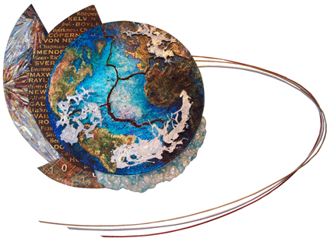
Verifying reforecast-calibrated probabilities for 6-10 day and week +2 850 hPa temperatures
NOAA Earth System
Research Laboratory
Tom Hamill
NOAA Earth System Research Lab
(303) 497-3060; tom.hamill@noaa.gov
Also: Gary Bates, Jeff Whitaker, Don Murray

Slide 2
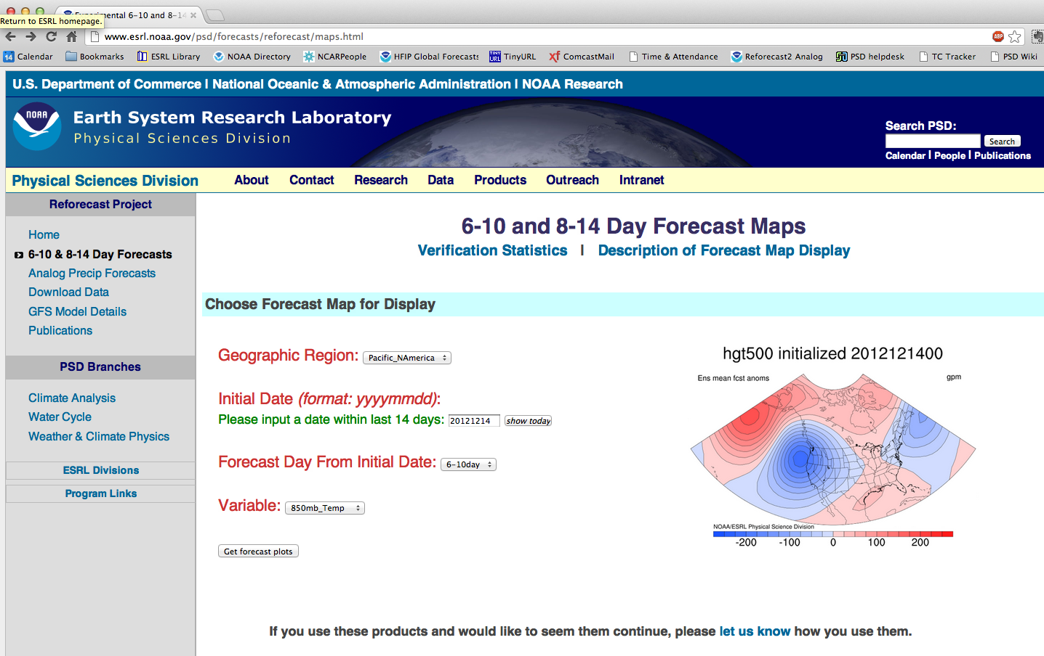
Previously: web page for calibrated V1 reforecasts

Slide 3
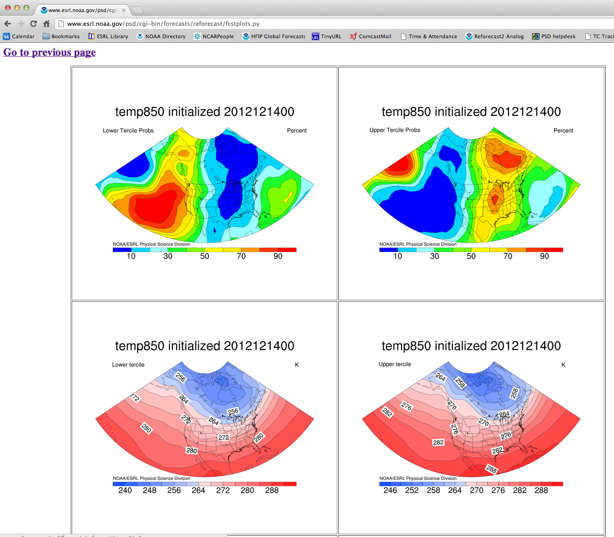
Typical T850 experimental product from ESRL
these sorts of
products are
presumably
useful to CPC.

Slide 4
We’d like to replace this web page with one that serves up calibrated forecasts from reforecast v2.
How much improvement will we see over the raw GEFS forecasts?

Slide 5
Method for testing calibration with version 2 reforecasts
Post-processed using the “nonhomogeneous Gaussian regression” of Gneiting et al. (MWR, May 2005). Linear regression approach, but allows the raw ensemble spread to define the amount of spread in the predicted Gaussian forecast distribution.
Reliability diagrams composited over data from Dec 1984 – Dec 2011.
Data is limited to the 1-degree, lat-lon grid that encompasses CONUS.
Cross-validated, with regression model’s training data excluding a given year’s data, e.g., train 2011 based on 1984-2010 data.
Forecast/analysis pairs every third day for the given month and the surrounding two months (x 26 years) used as training data. This means 3x10x26 = 780 training samples typically used.
When evaluating “raw”ensemble in following plots, actually evaluating a Gaussian pdf fit to the sample mean and spread.

Slide 6
+5 to +10 day forecasts (120 to 240 h)

Slide 7
Reliability and BSS: lower decile
Reliability and BSS

Slide 8
Lower quintile

Slide 9
Lower tercile

Slide 10
Upper tercile

Slide 11
Upper quintile

Slide 12
Upper decile

Slide 13
+7 to +14 day forecasts (168 to 336 h)

Slide 14
Reliability and BSS: lower decile

Slide 15
Lower quintile

Slide 16
Lower tercile

Slide 17
Upper tercile

Slide 18
Upper quintile

Slide 19
Upper decile

Slide 20
Conclusions
Reforecast-based post-processing of T850 for 6-10 days and week +2 appears to be working satisfactorily.
Once we have surface CFSR data here at ESRL, we’ll repeat for 2-meter temperature.
Intend to replace our reforecast V1 web page in the next month or so with this.

