Slide 1

Downscaling and processing of meteorological forecasts
Tom Hamill
NOAA Earth Systems Research Lab
Physical Sciences Division
Boulder, Colorado USA
+1 (303) 497-3060; tom.hamill@noaa.gov
presentation to CUAHSI short course, NCAR, 22 May 2019; much material borrowed from Michael Scheuerer

Slide 2
A high-level schematic for
hydrologic ensemble prediction
Land-surface-state
observations
(snow, streamflow, …)
Weather - climate
ensembles
Meteorological
pre-processor
Hydrologic data
assimilator
Ref: Schaake, J. C., T. M. Hamill, R. Buizza, and M. Clark, 2007:
HEPEX, the Hydrological Ensemble Prediction Experiment.
Bull. Amer. Meteor. Soc., 88, 1541-1547.
Calibrated weather -
climate ensembles
Calibrated ensemble
of land-surface states
Hydrologic forecast
model(s)
Streamflow
ensembles
.
.
.
Hydrologic
post-processor
.
.
.
Calibrated streamflow
ensembles
(users)
Verification
system

Slide 3
A high-level schematic for
hydrologic ensemble prediction
Land-surface-state
observations
(snow, streamflow, …)
Weather - climate
ensembles
Meteorological
pre-processor
Hydrologic data
assimilator
Ref: Schaake, J. C., T. M. Hamill, R. Buizza, and M. Clark, 2007:
HEPEX, the Hydrological Ensemble Prediction Experiment.
Bull. Amer. Meteor. Soc., 88, 1541-1547.
Calibrated weather -
climate ensembles
Calibrated ensemble
of land-surface states
our
focus
today
Hydrologic forecast
model(s)
Streamflow
ensembles
.
.
.
Hydrologic
post-processor
.
.
.
Calibrated streamflow
ensembles
(users)
Verification
system

Slide 4
Statistical prepostprocessing.
Past (reforecast)
ensemble
predictions
Observations
or analyses
Train the postprocessing method
Post-processed
guidance
ensemble
prediction system
Real-time
ensemble
predictions
Predictors
Apply postprocessing method
What’s preprocessing to a hydrologist
is postprocessing from the perspective
of a meteorologist.

Slide 5
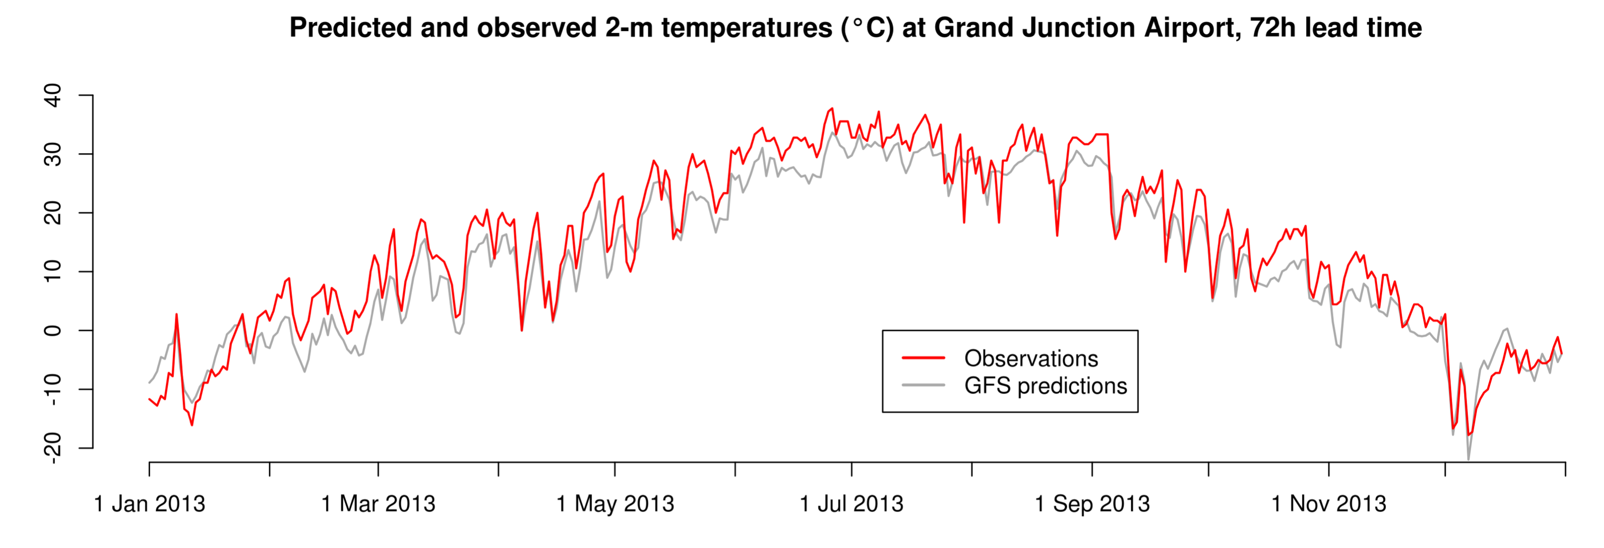
Why meteorological statistical postprocessing?
c/o Michael Scheuerer

Slide 6
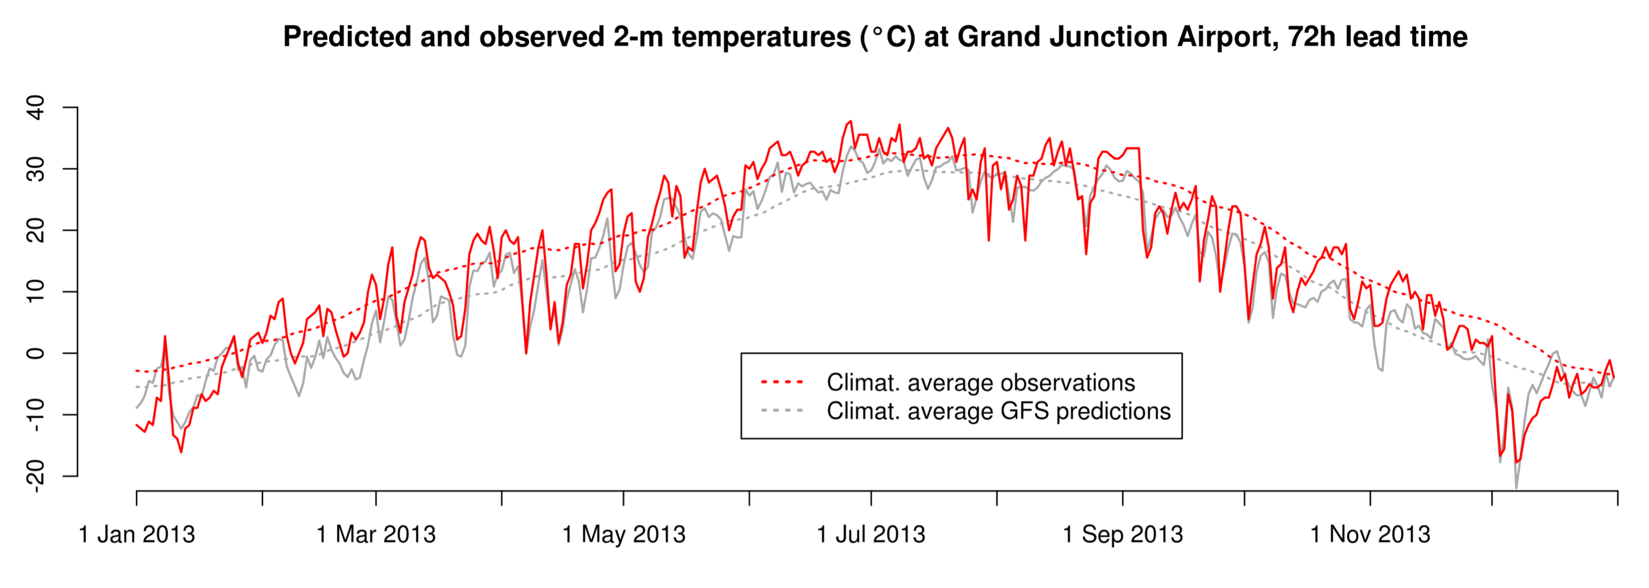
Why meteorological statistical postprocessing?
c/o Michael Scheuerer
The predictions have systematic discrepancies with observations.

Slide 7
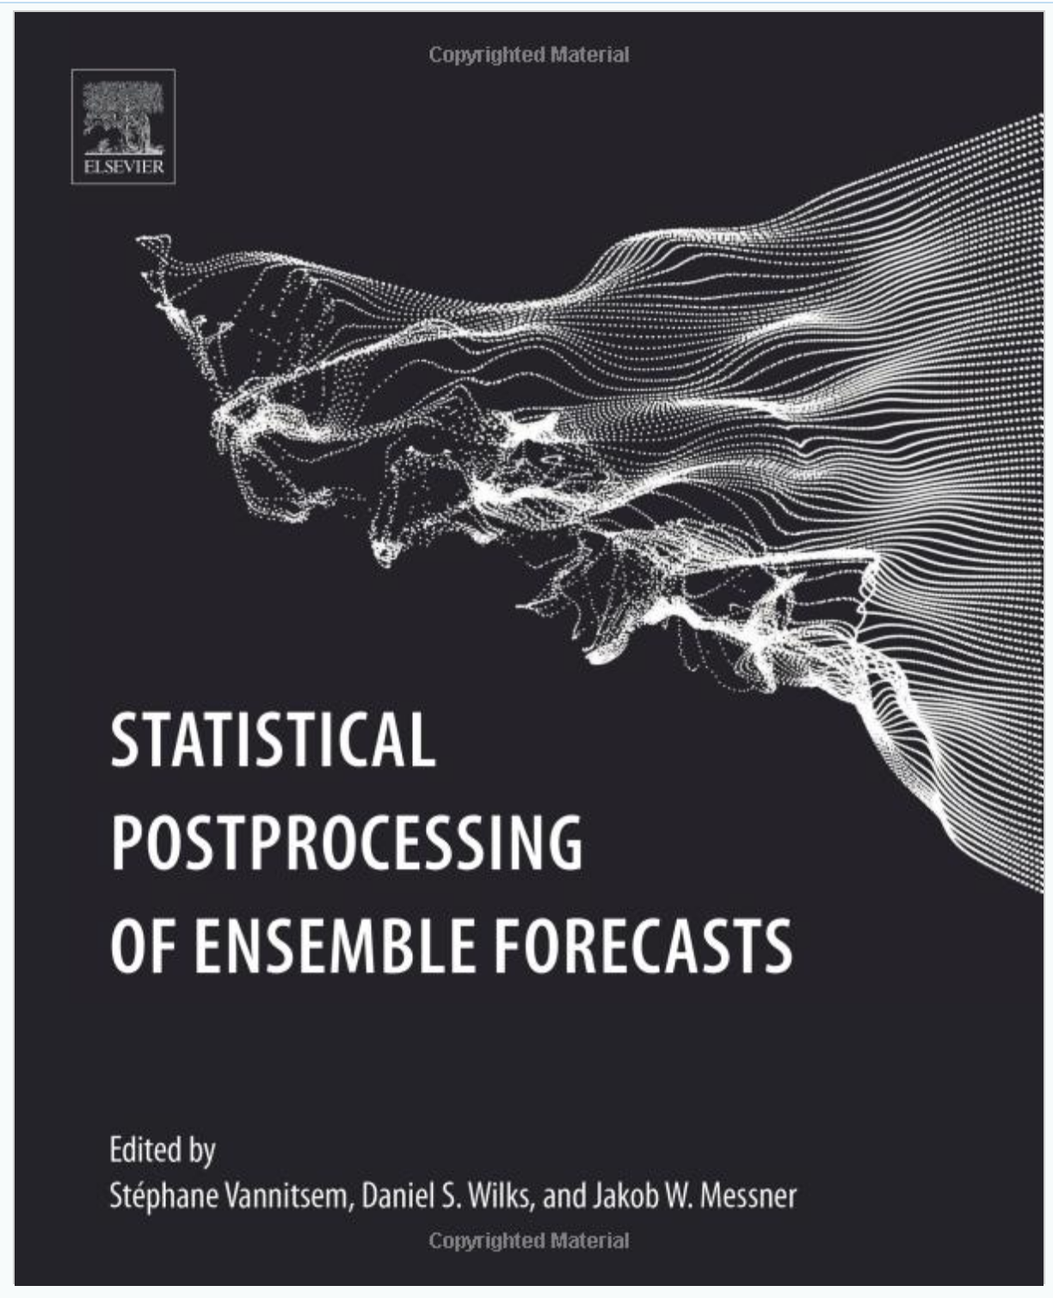
If you are interested in a deeper dive on the topics
discussed today, or if you need a reference text, this
is a good place to start (amazon.com)

Slide 8
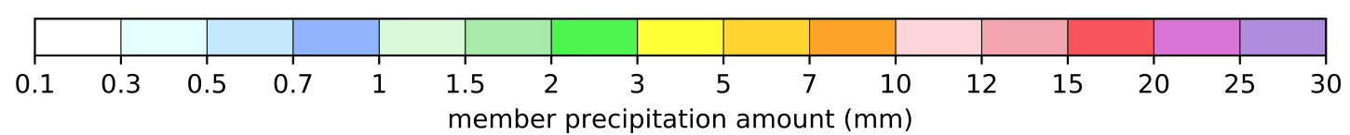
Systematic errors in ensemble predictions - more than just errors in the mean.
00 UTC 8 January 2019
initialization, 84-96 h
ECMWF precipitation
amount forecasts.
Note:
Small-scale detail missing in space, perhaps in time.
In several regions, e.g., S CO, verifying analysis outside the range of any of the ensemble members.

Slide 9
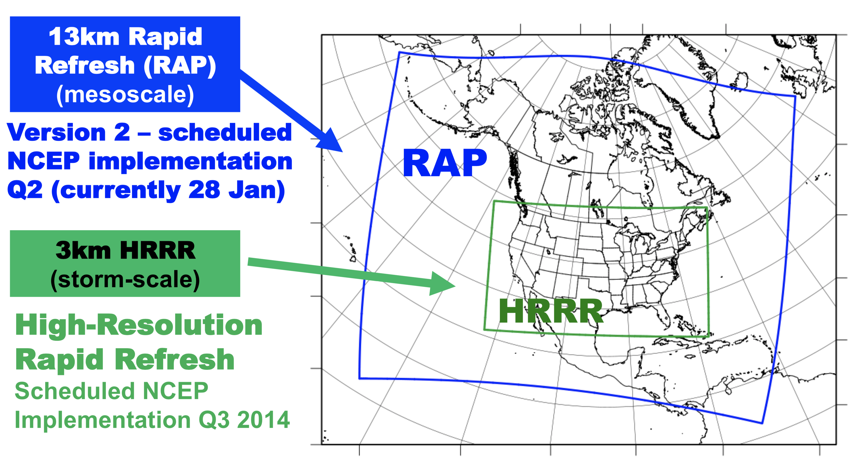
Dynamical downscaling, i.e., higher-resolution numerical weather predictions.
Advantages:
Provides high-resolution guidance, including some features that cannot be restored through postprocessing.
Variables (temperature, precipitation type, amount) are internally consistent, from scales large to small.
Disadvantages:
Computational expense may prohibit application of large ensembles, extending forecasts to long leads, and require the use of smaller domains with numerical artifacts at boundaries.
These predictions can still exhibit bias requiring statistical adjustment.

Slide 10
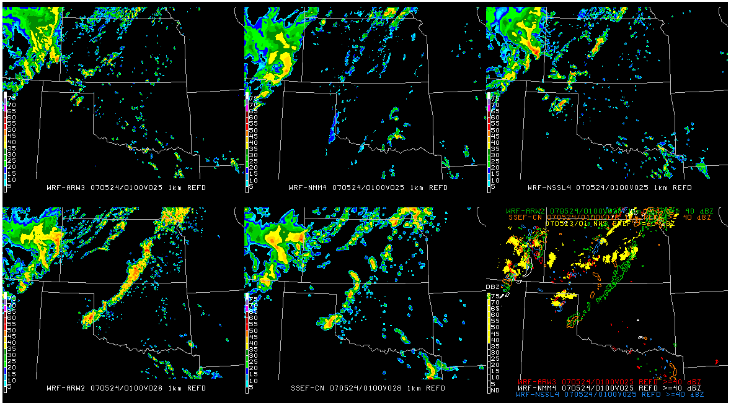
The potential of ensembles and dynamical downscaling.
Simulated reflectivity from regional, high-resolution ensemble members used in US NWS Storm Prediction Center’s 2007 “Spring Experiment”. Observed is nicely bracketed by ensemble, simulations suggest rotating severe thunderstorms of type that may spawn tornadoes. This sort of detail is very challenging to bring about with statistical postprocessing.
yellow = radar
observed > 40 dBZ
Despite the appeal of dynamical downscaling, we now focus on statistical downscaling and postprocessing.
c/o Steve Weiss, Jack Kain, many others at NSSL and SPC.

Slide 11
Some desirable functions of meteorological post-processing for hydrology.
Downscale the model guidance to provide precipitation and temperature variability at scales not resolved by the model.
Adjust for systematic errors such as biases in the mean as well as higher moments, providing “calibrated” probabilistic forecasts at each location.
  Possibly adjust for systematic position errors.
  Provide maximal “sharpness” (specificity) subject to reliability (Gneiting).
Possibly, synthesize information from multi-model ensemble predictions.
If postprocessing is generating univariate pdfs at grid points, reconstruct synthetic ensembles with realistic variability in space and time, consistent with the postprocessing.

Slide 12
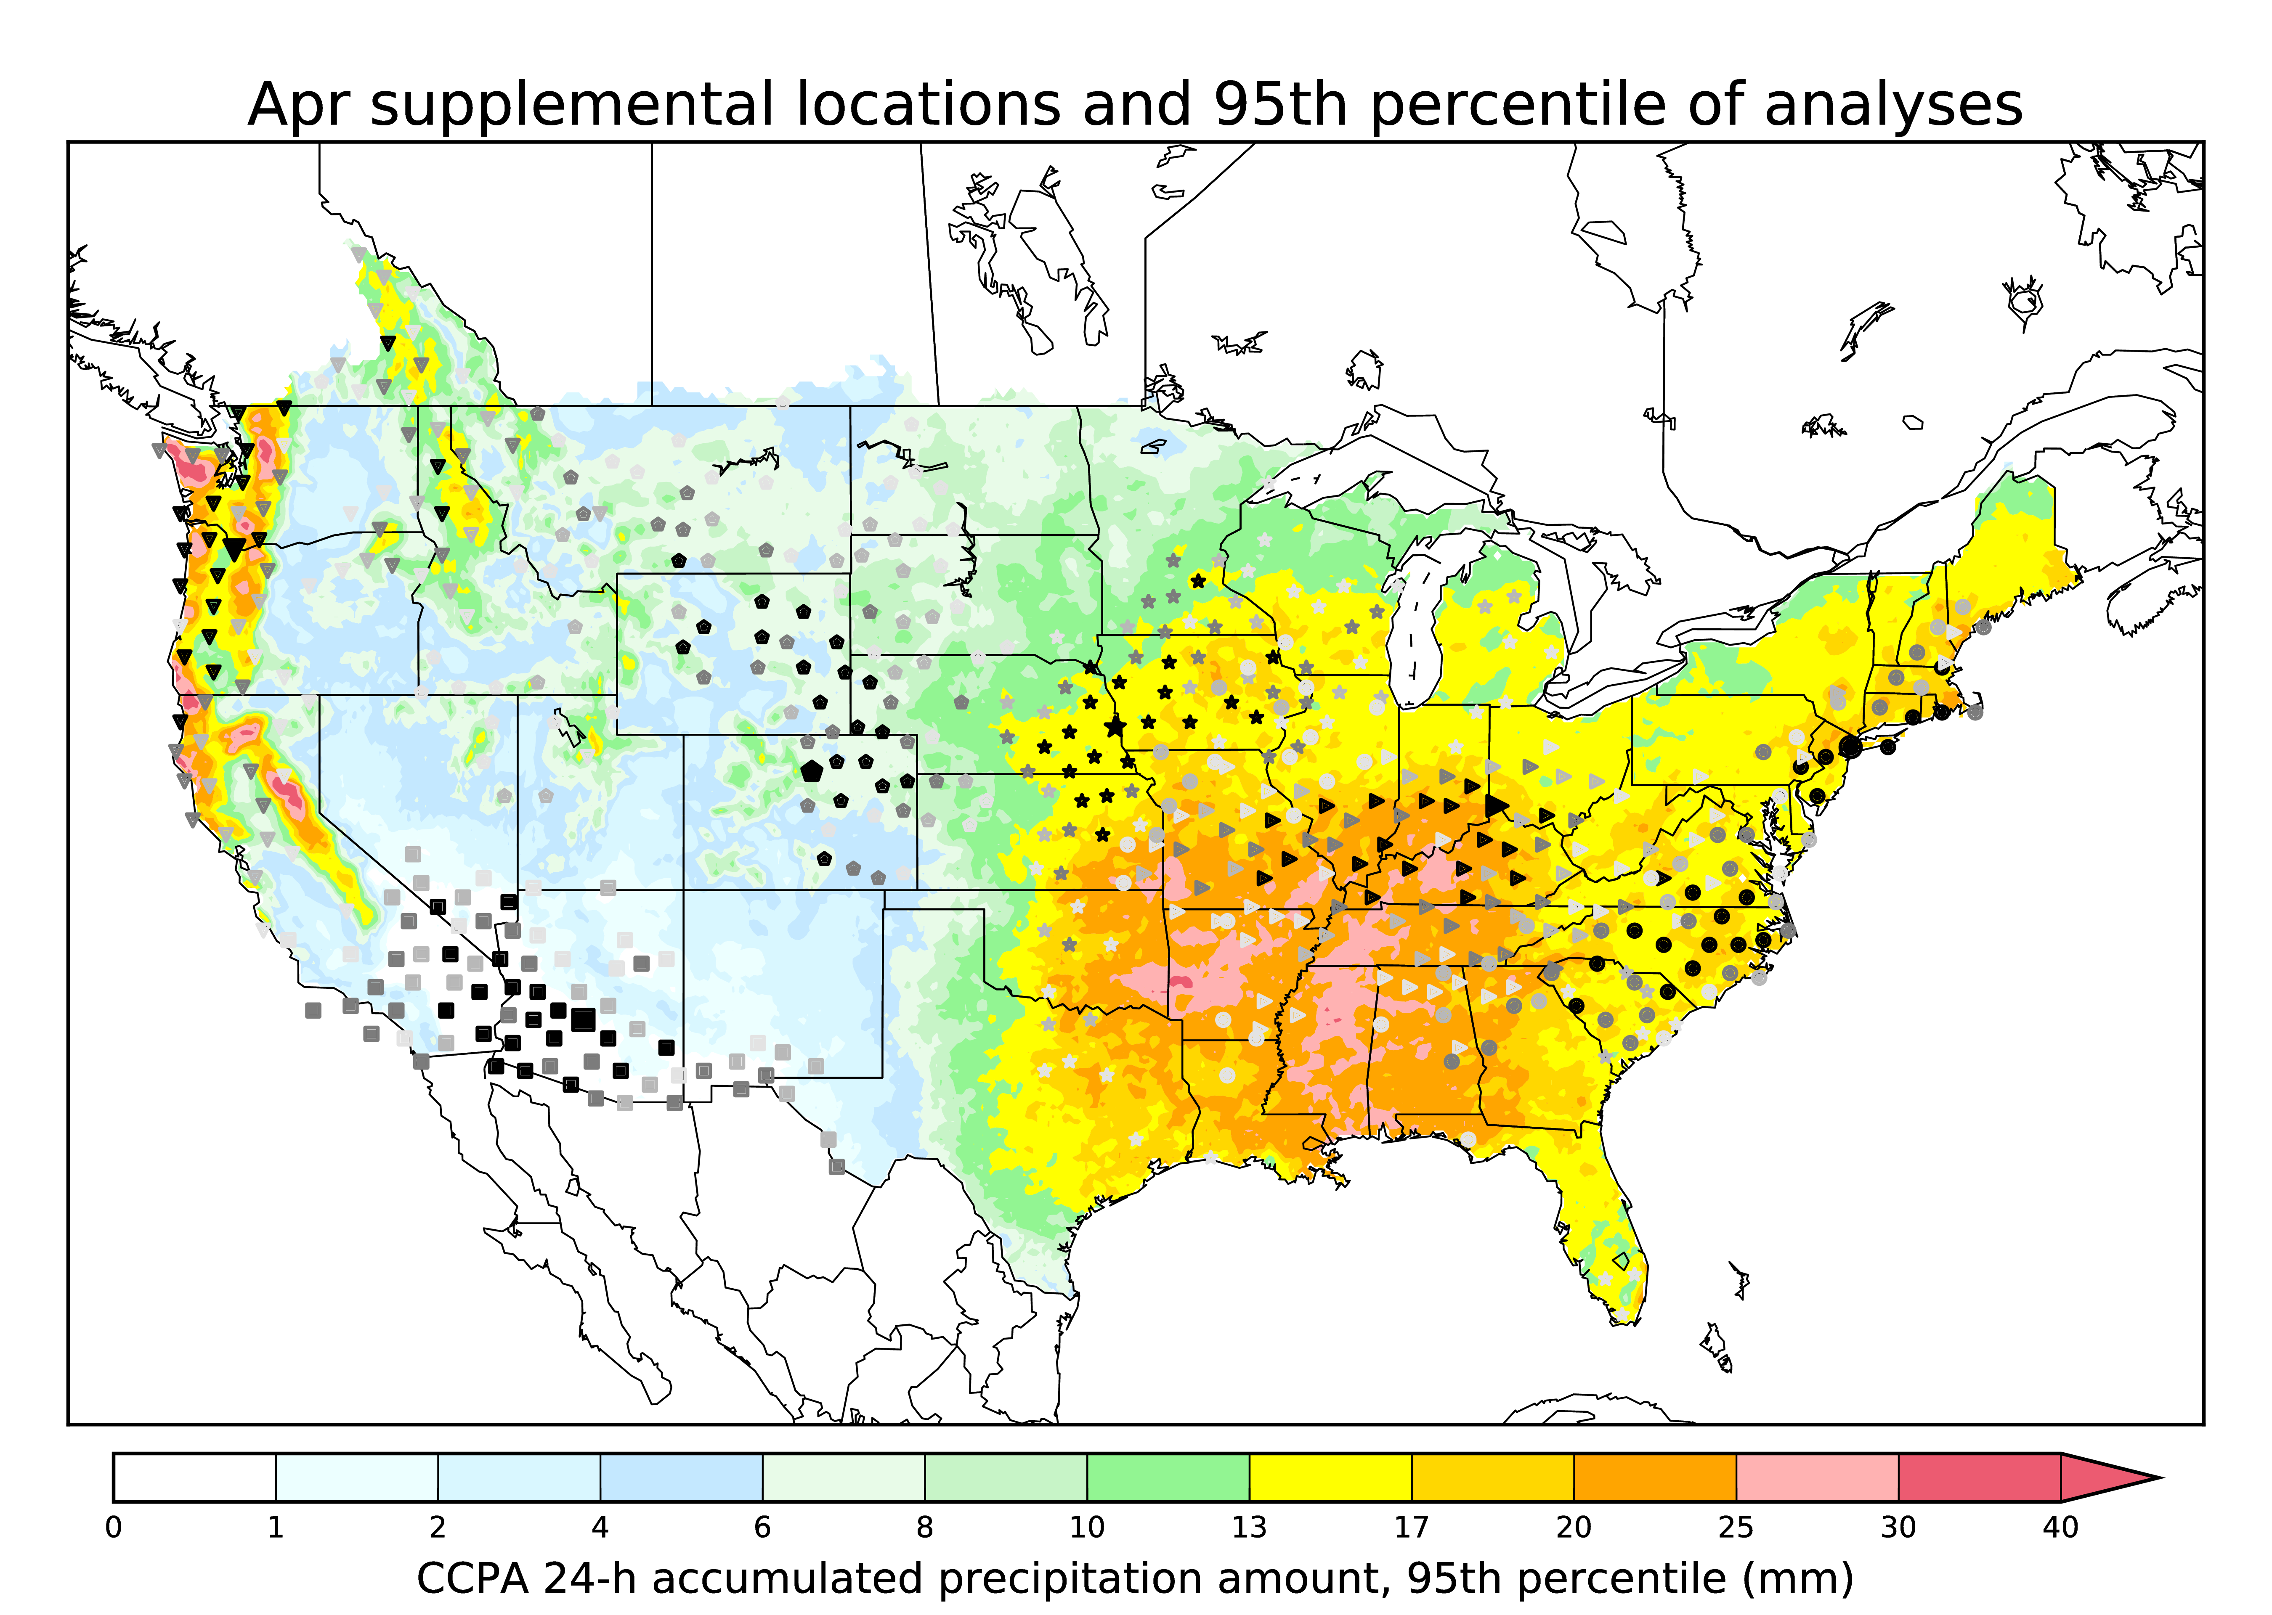
Pooling of data to increase sample size: supplemental locations
Precipitation forecast systematic errors,
from experience, have some relationship to the terrain characteristics and to climatology.
Rather than pooling data over an arbitrarily large region like the US, an alternative procedure may be used, called “supplemental locations.”
For each model grid point, other grid points are identified that have similar
precipitation climatologies, terrain elevation, and terrain orientation. Training data at the supplemental locations may be used to increase the training sample size.
Ref: Hamill, T.M., E. Engle, D. Myrick, M. Peroutka, C. Finan, and M. Scheuerer, 2017: The U.S. National Blend of Models for Statistical Postprocessing of Probability of Precipitation and Deterministic Precipitation Amount.
Mon. Wea. Rev., 145, 3441-3463, https://doi.org/10.1175/MWR-D-16-0331.1

Slide 13
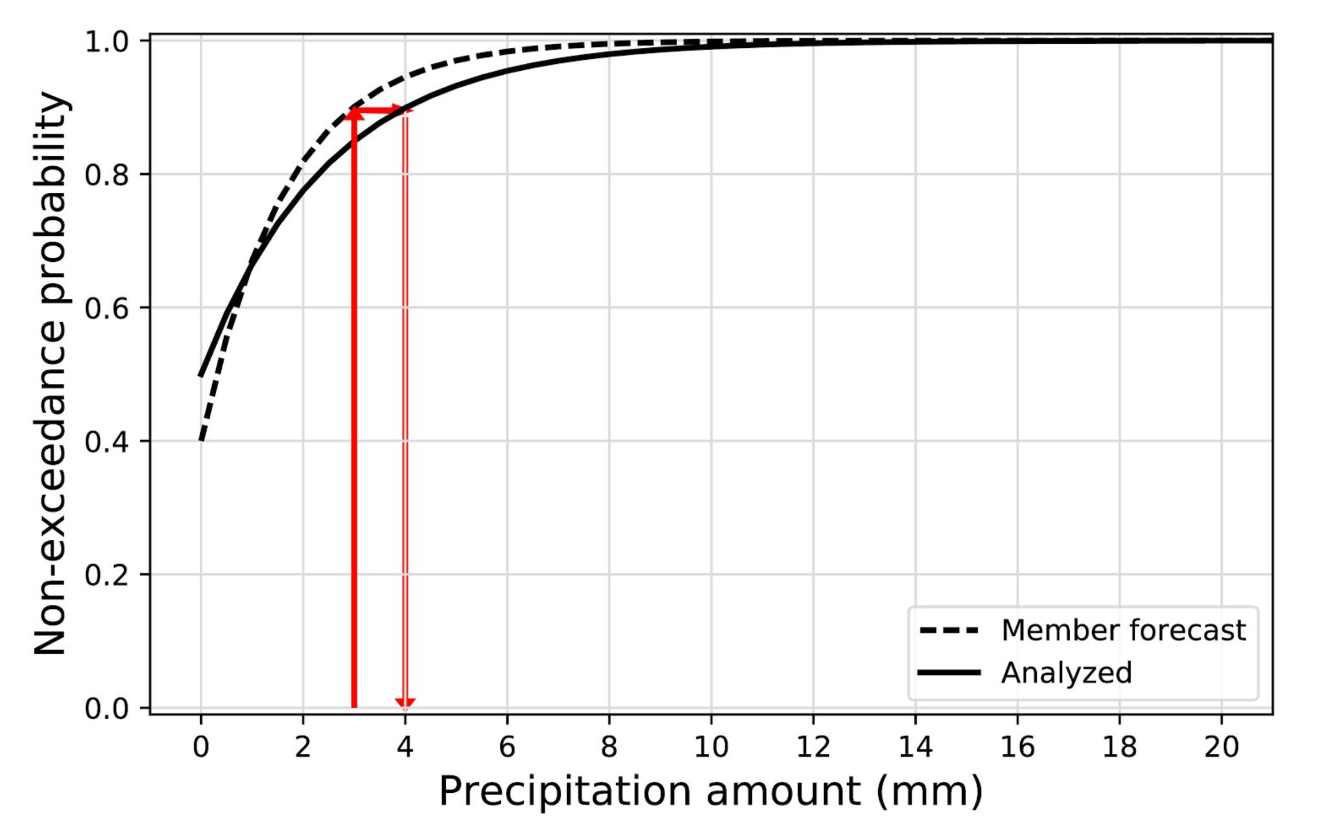
Quantile mapping.
One of the simpler
postprocessing methodologies.
It renders the forecasts
more consistent with draws
from the analyzed
precipitation distribution.
This may need lots of samples to
have a stable distributions.
We’ve found that use of
something like supplemental
locations is a practical
necessity if the training
sample size is small.
Ref: Hamill, T. M., 2018: Practical Aspects of Statistical Postprocessing. Chapter 7 in Statistical Postprocessing of Ensemble Forecasts (Elsevier Press).

Slide 14
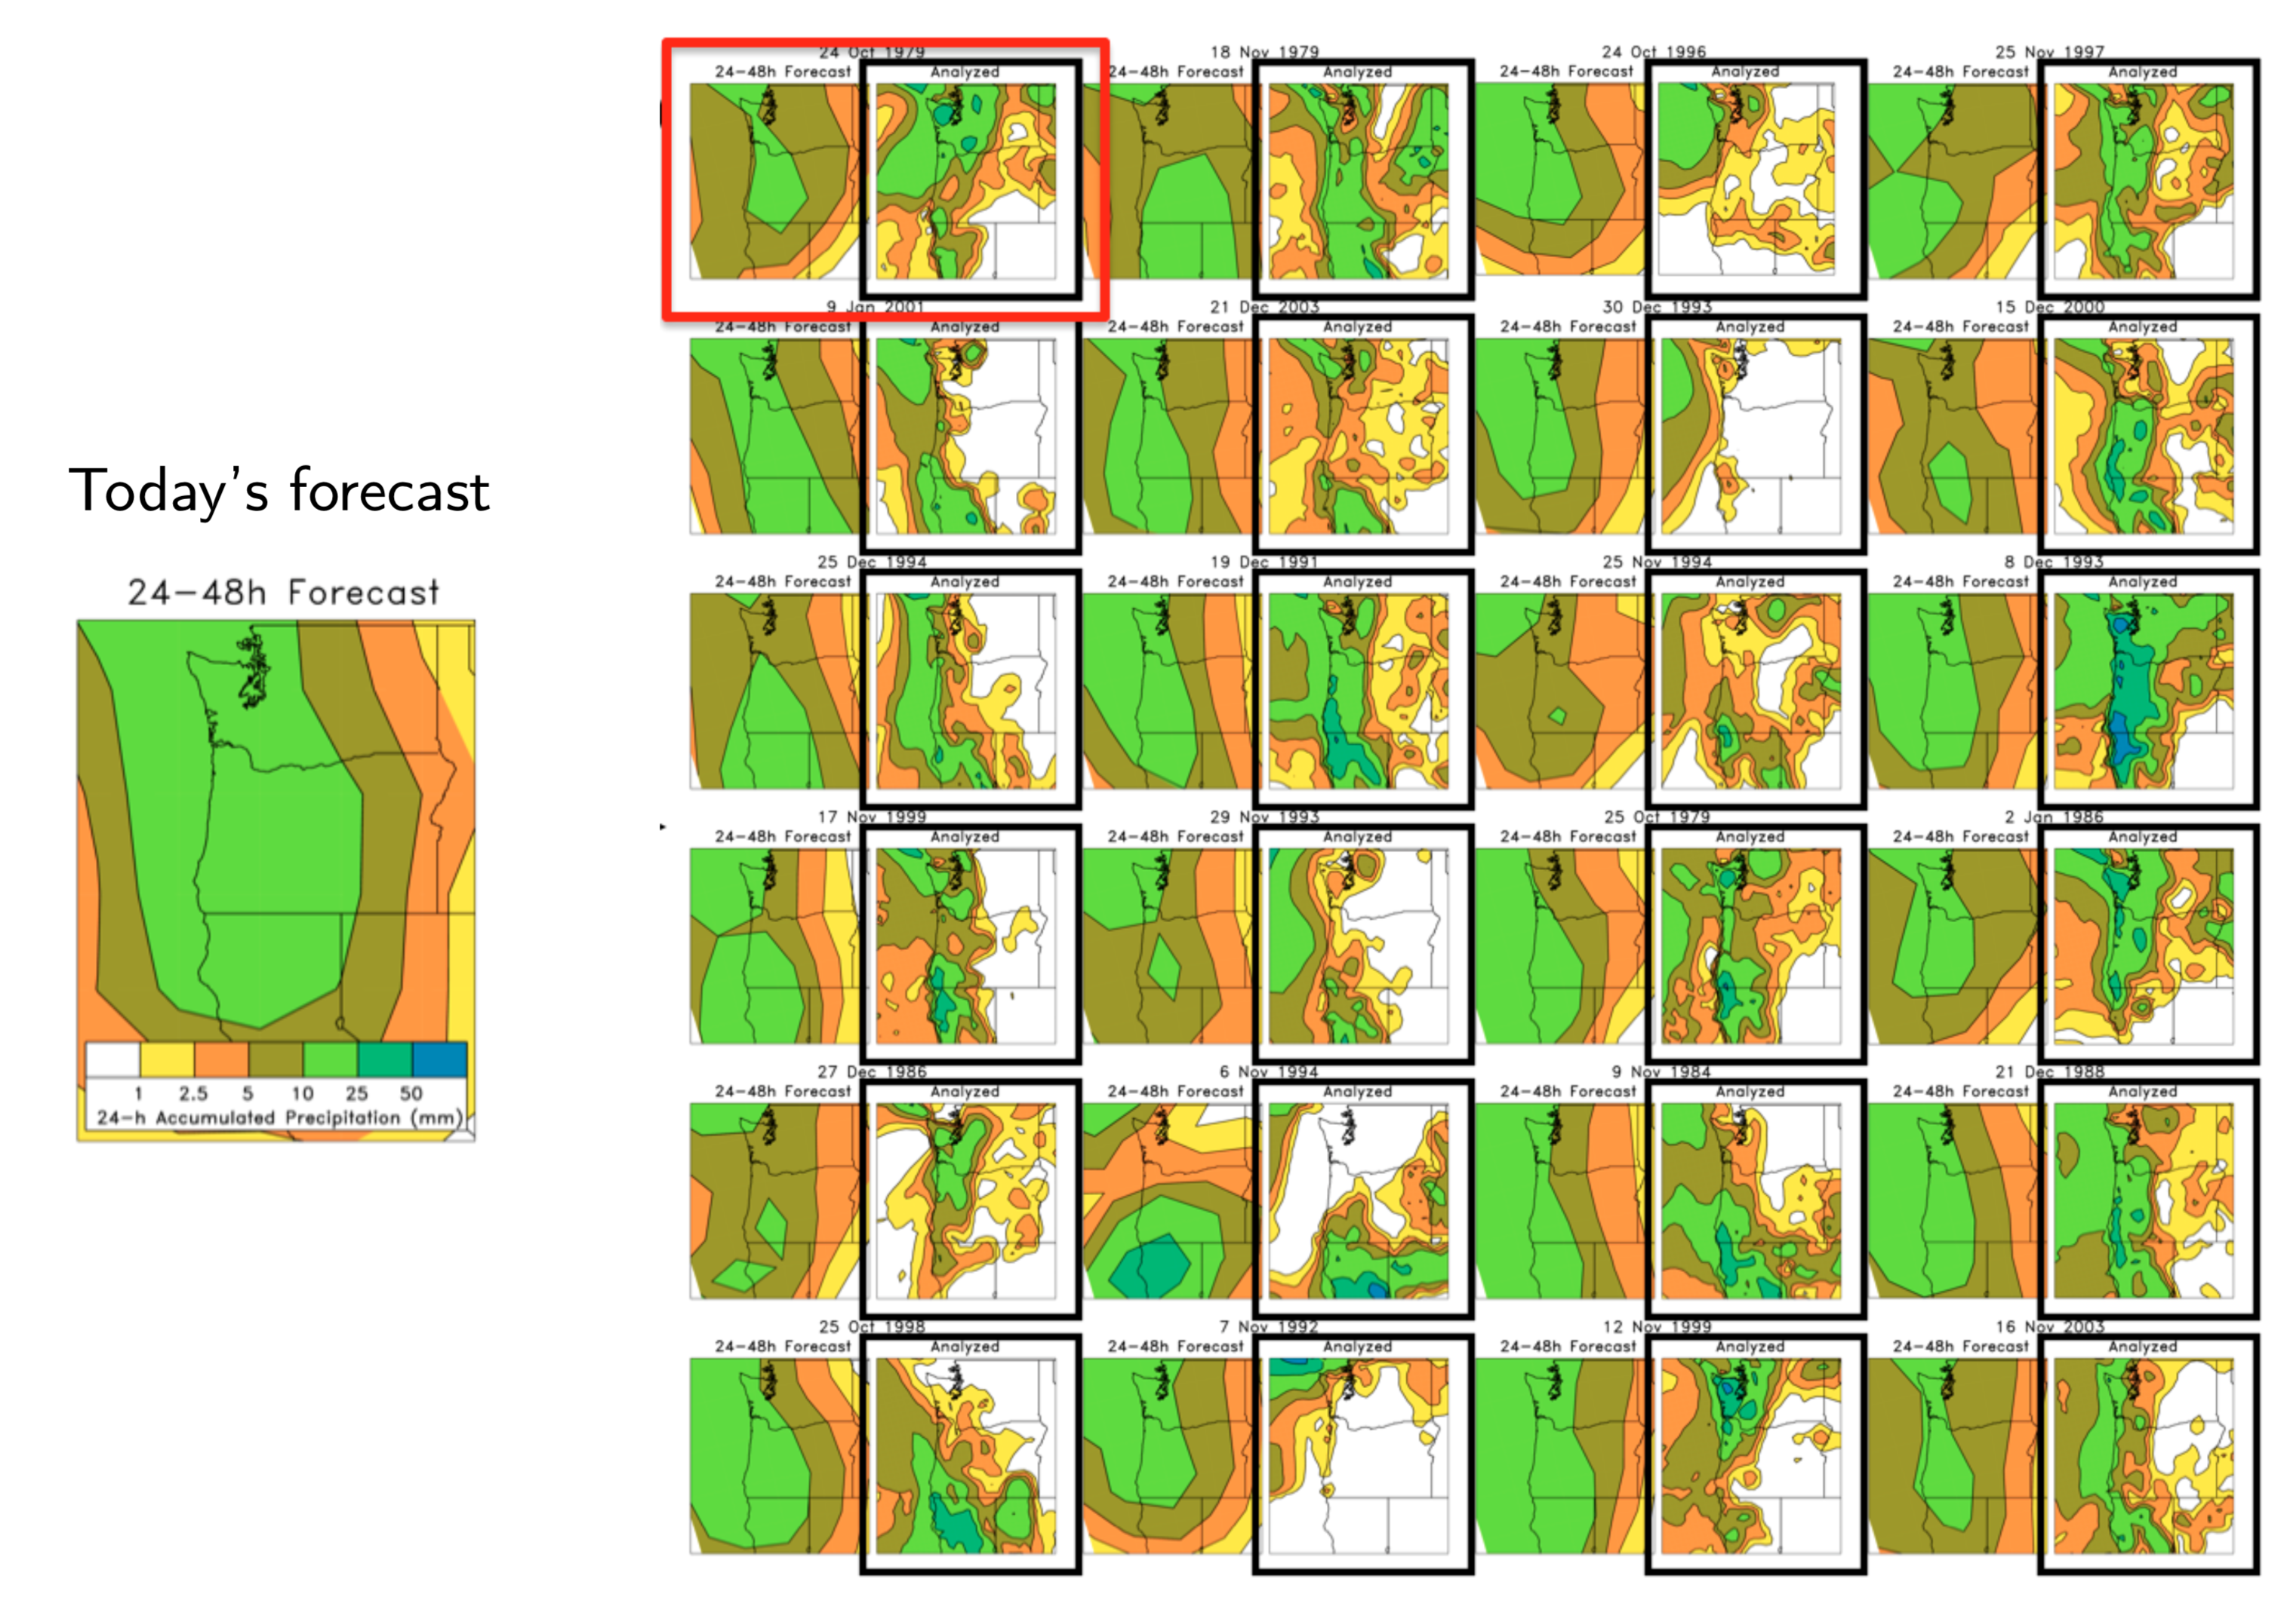
Analog methods for postprocessing.
Past forecasts and analyses
With today’s current forecast,
we examine training samples
for situations when the past
forecast resembled the current
forecast. We form a probability
distribution from the analyzed
precipitation states on the dates
of analog forecasts with greatest
similarity.
If analyzed conditions have greater
spatial detail or have different
climatology, this will be reflected
in the resulting probabilities.

Slide 15
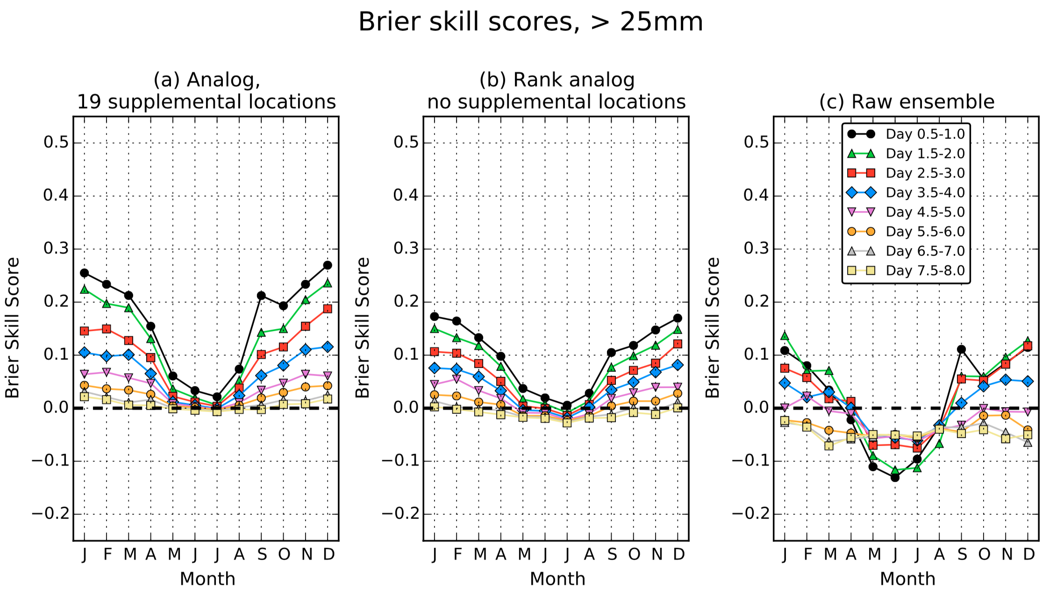
Verification of analog and raw ensembles
Verified against
1/8-degree precipitation
analyses over the CONUS.
Hamill, T. M., M. Scheuerer, and G. T. Bates, 2015: Analog probabilistic precipitation forecasts using GEFS Reforecasts and
Climatology-Calibrated Precipitation Analyses. Mon. Wea. Rev., 143, 3300-3309. Also: online appendix A and appendix B.

Slide 16
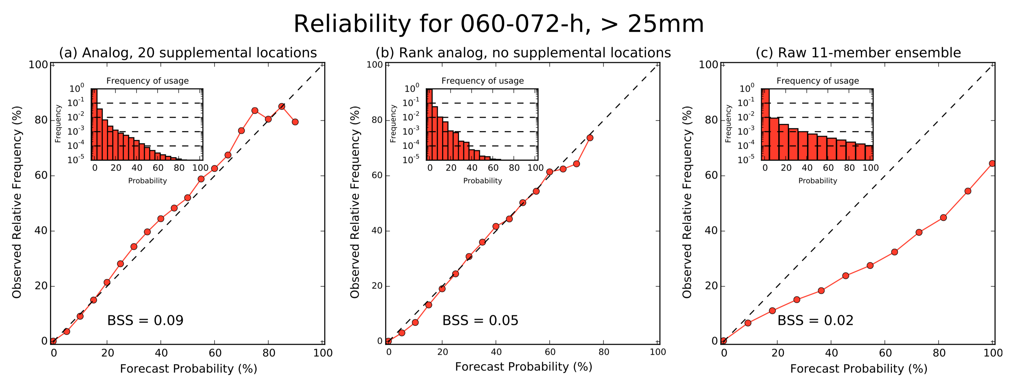
Reliability, analog and raw
A properly designed postprocessing algorithm will improve skill and reliability, though often at the expense of sharpness.
Ref: ibid.

Slide 17
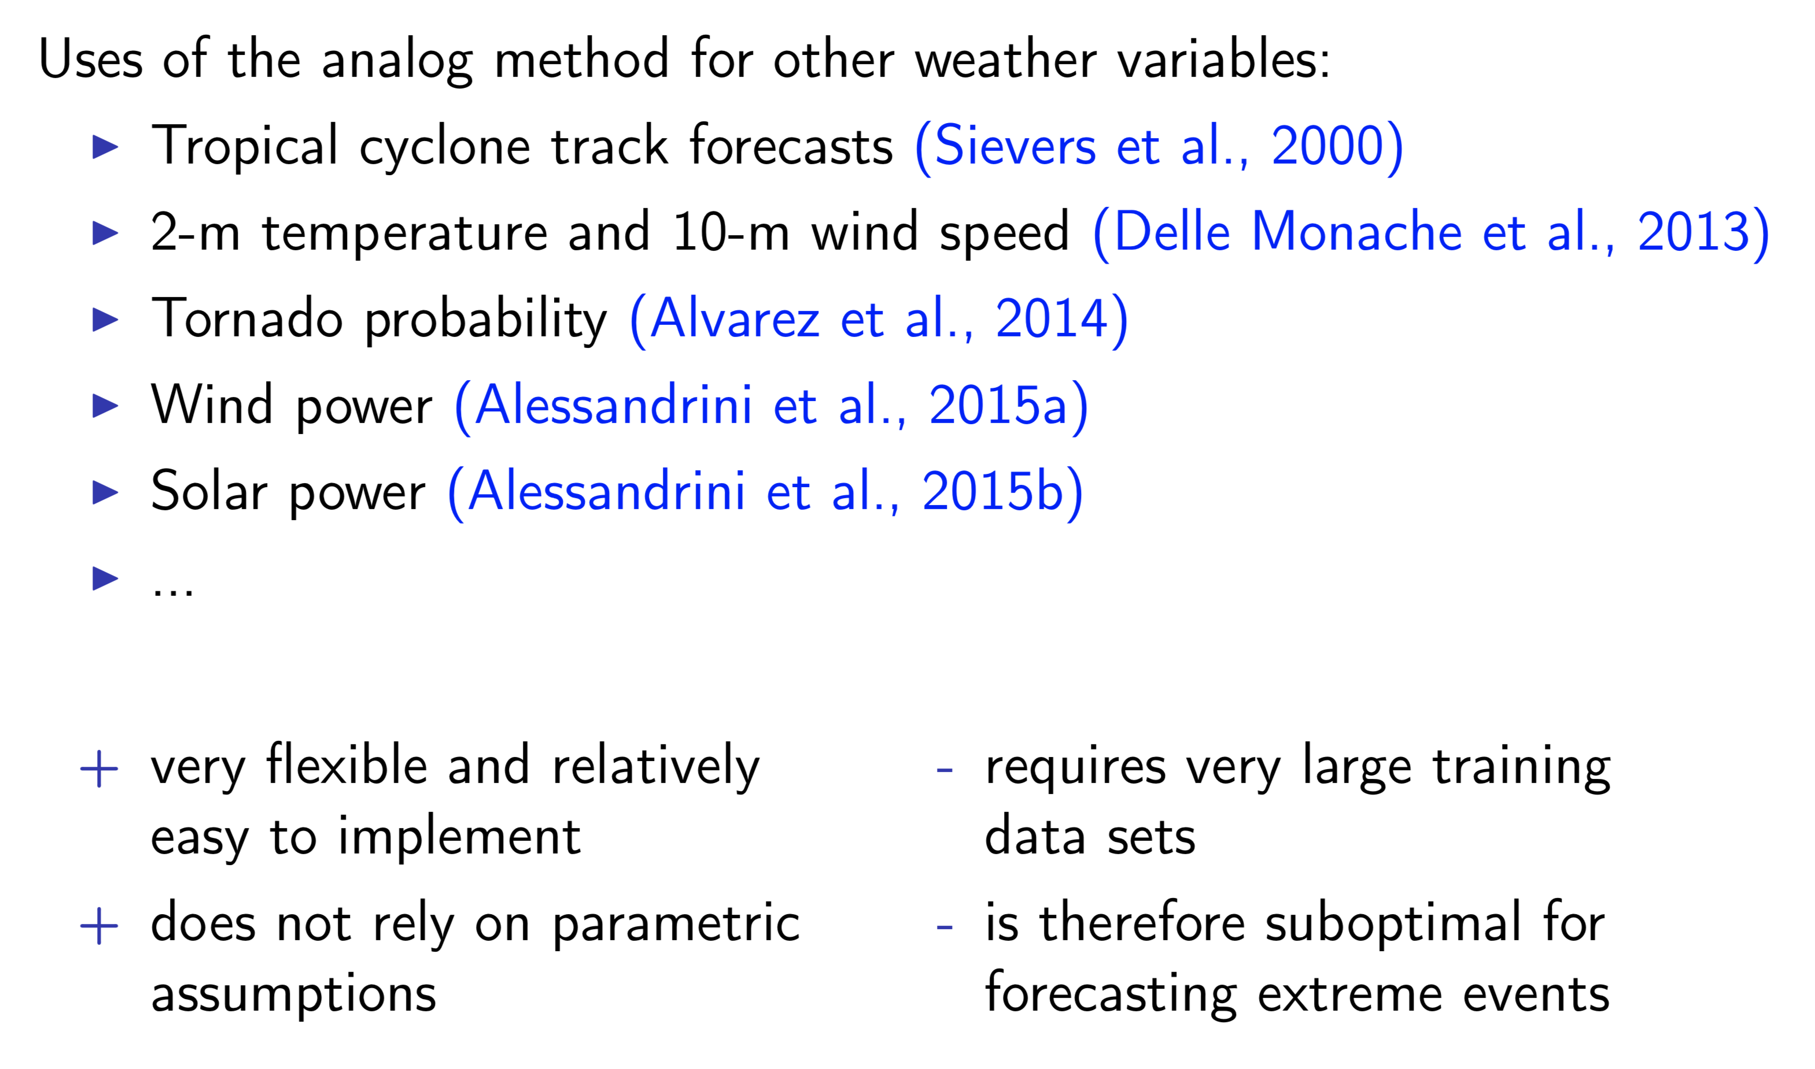
Analog methods in the peer-reviewed literature

Slide 18
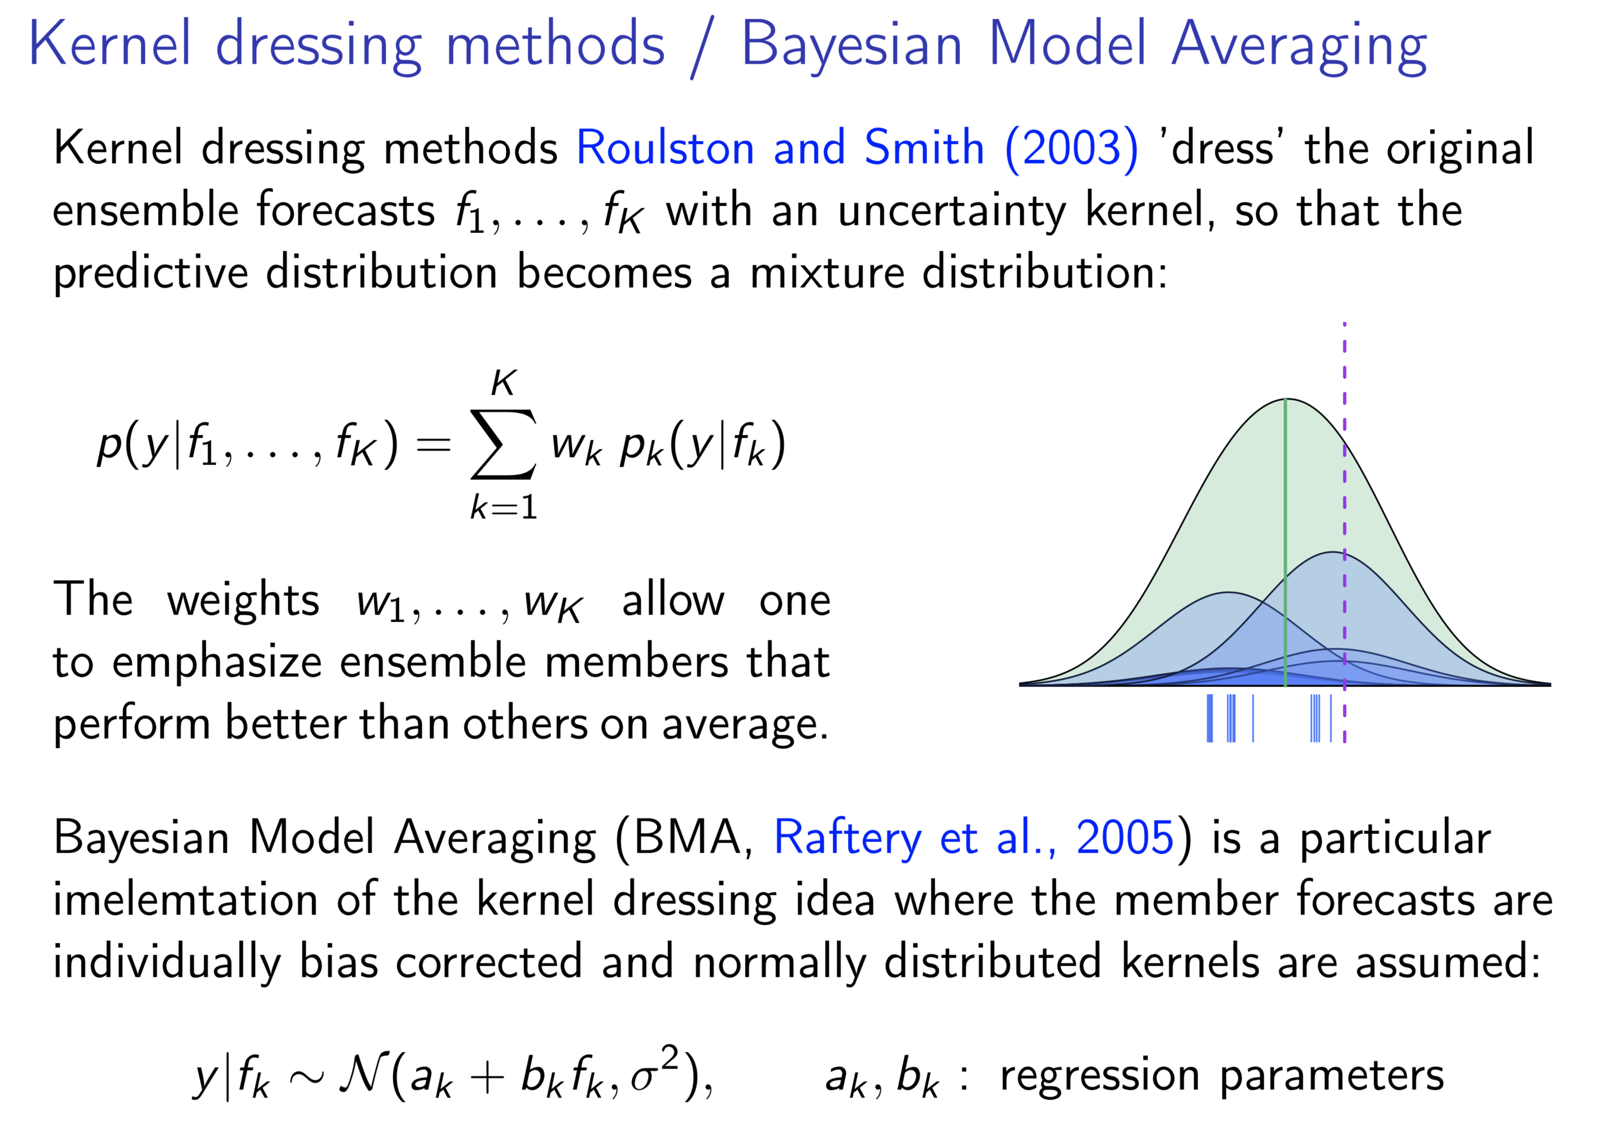

Slide 19
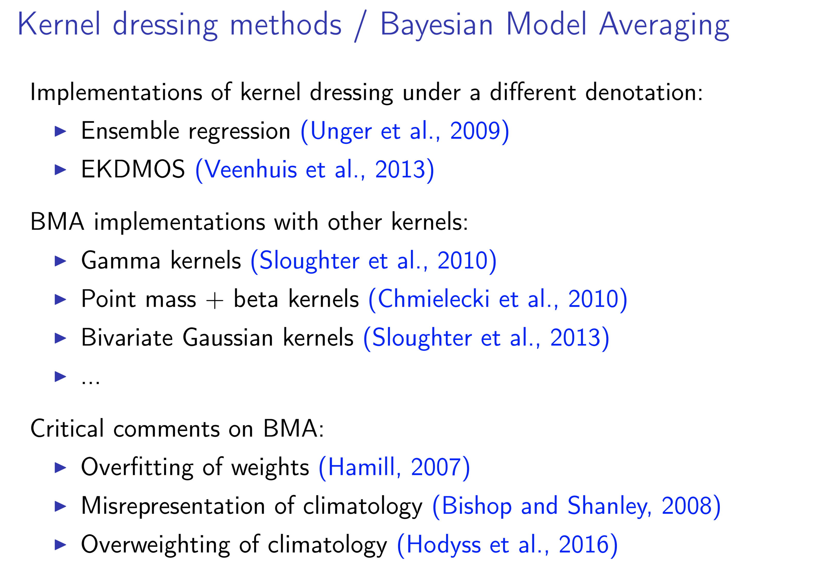

Slide 20
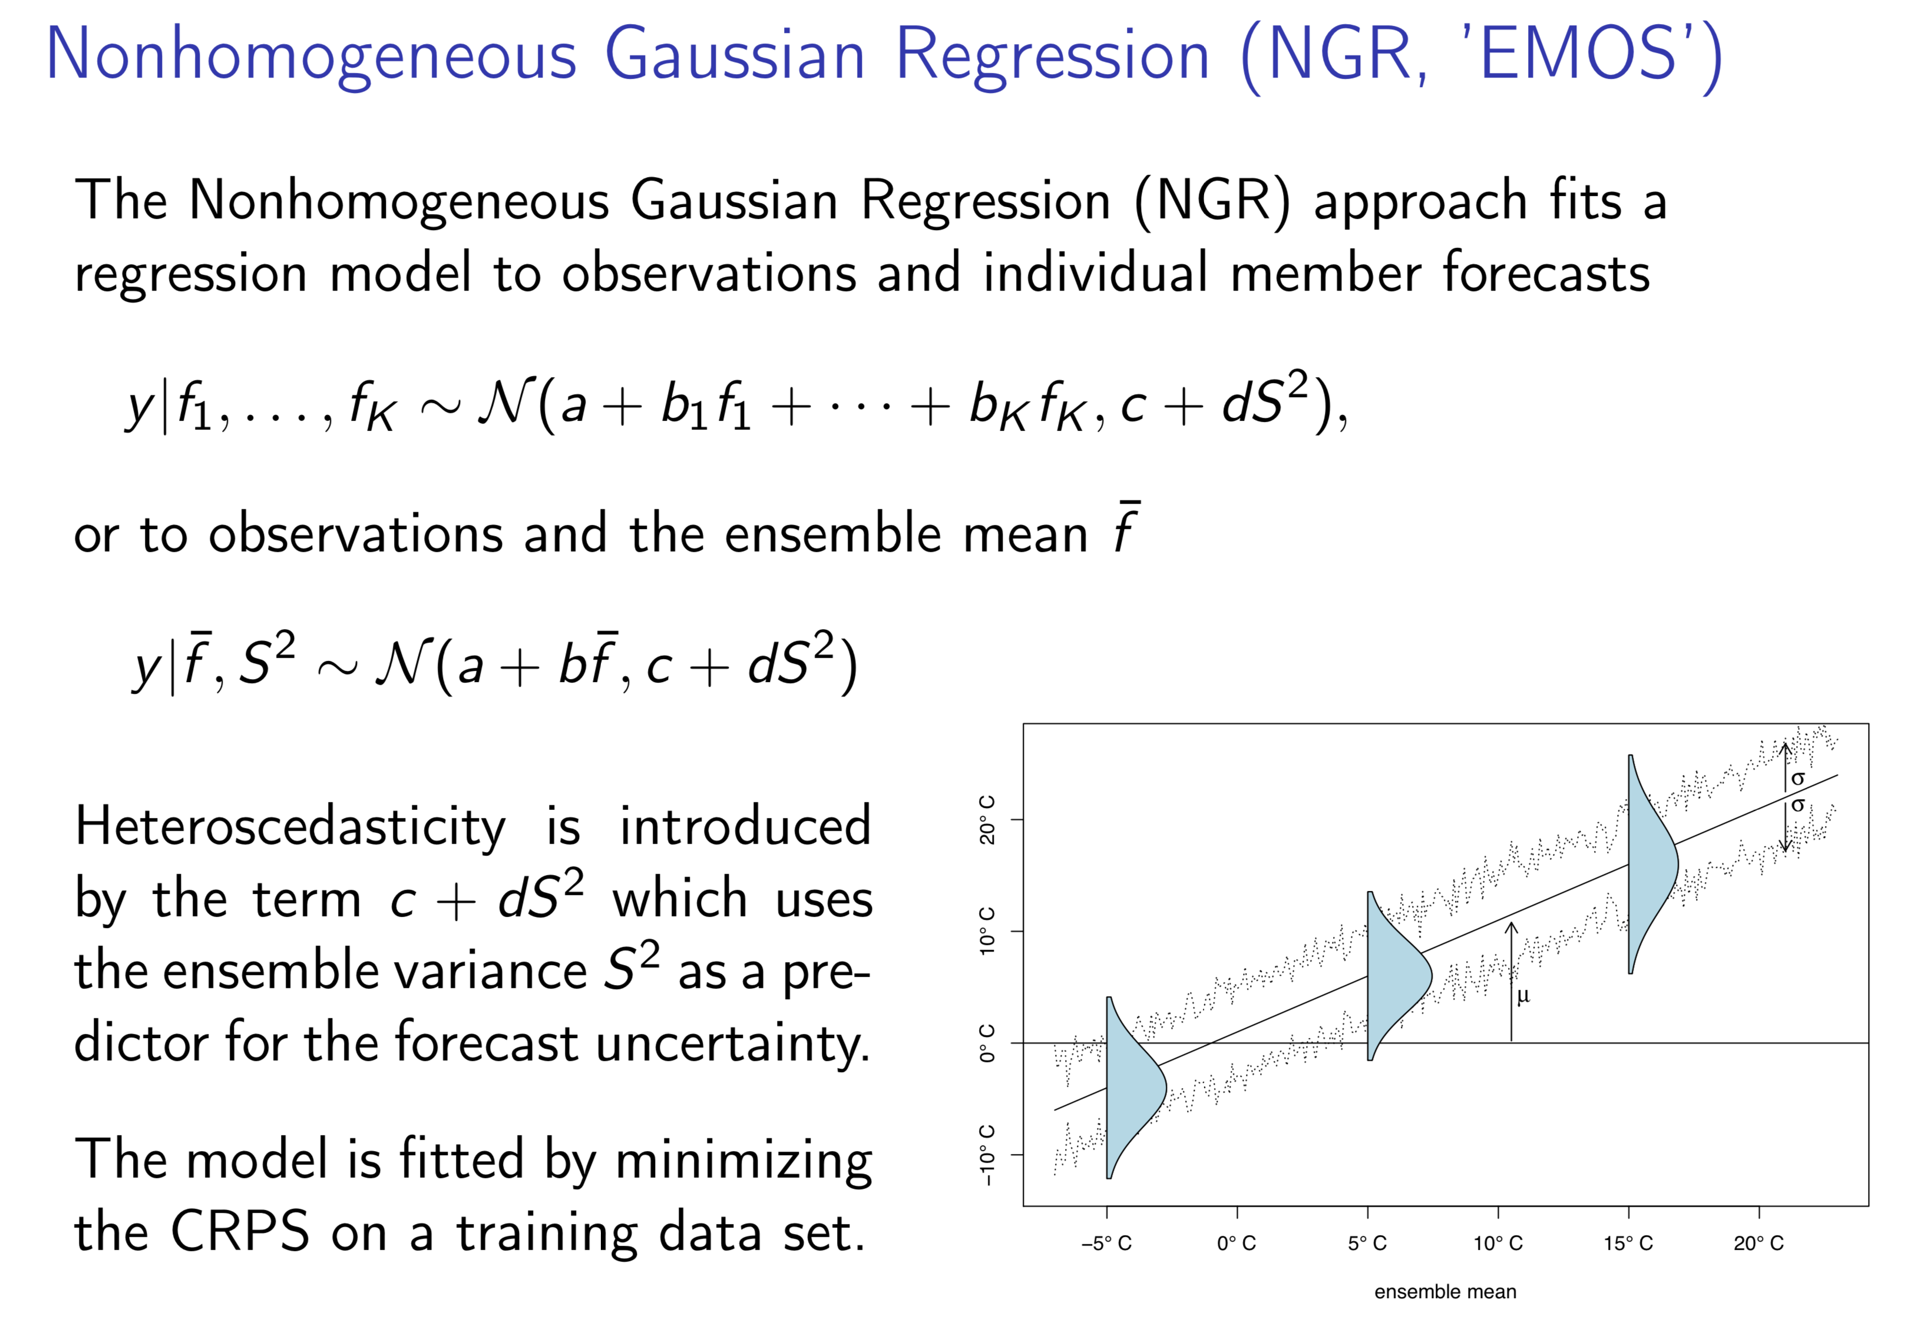

Slide 21
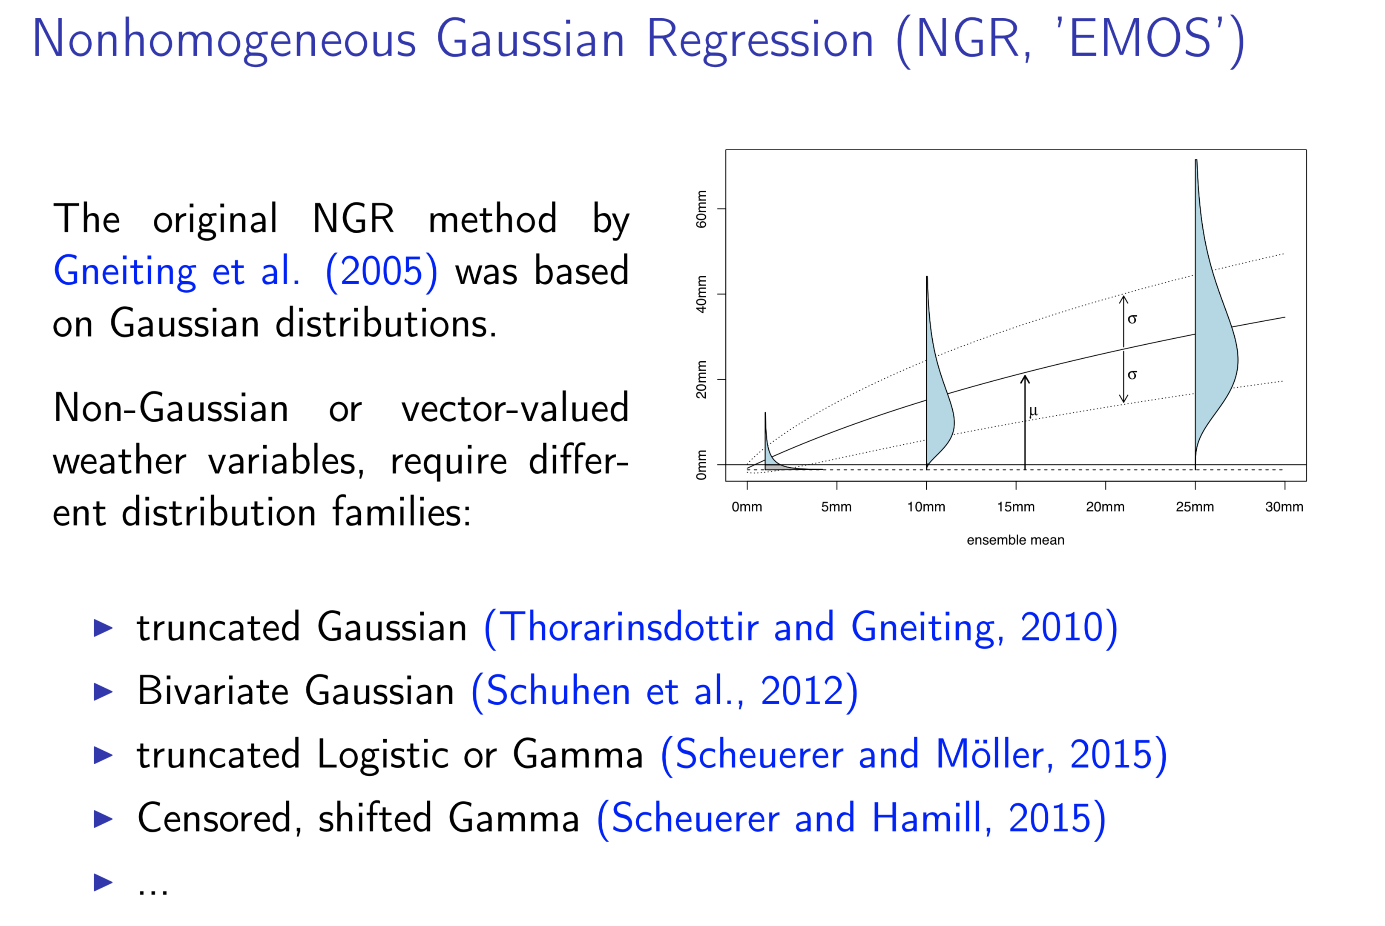

Slide 22
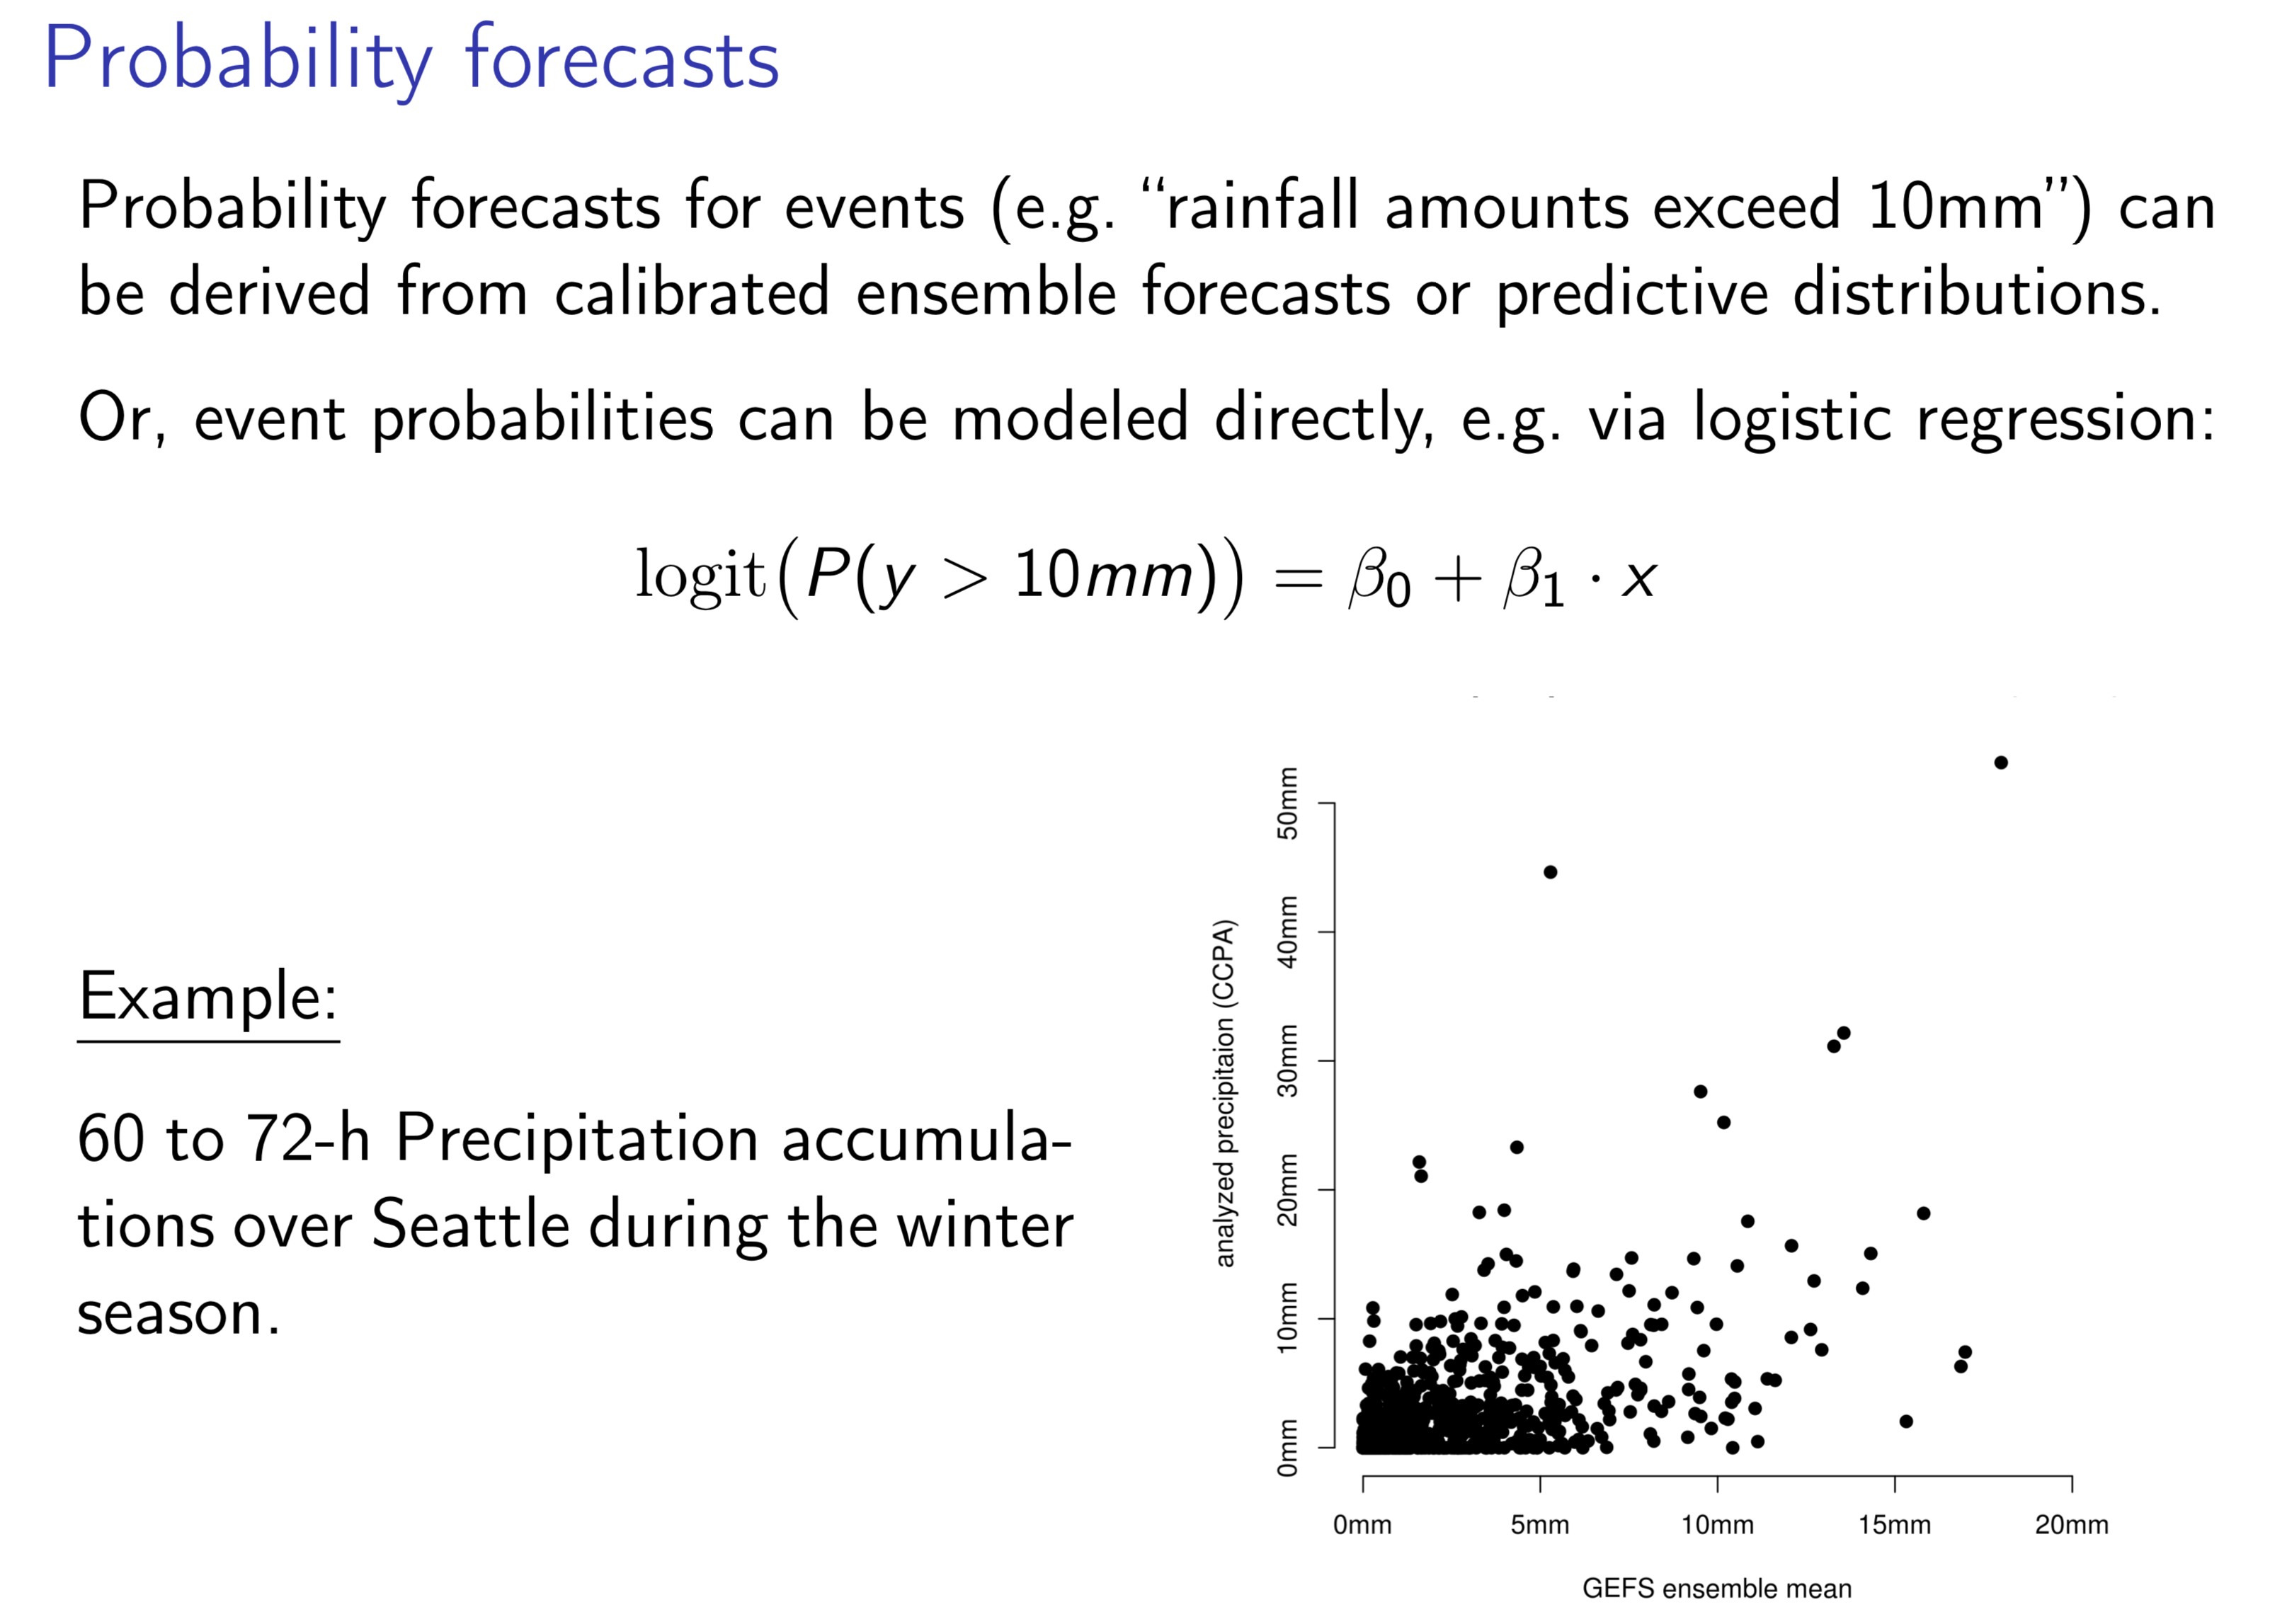

Slide 23
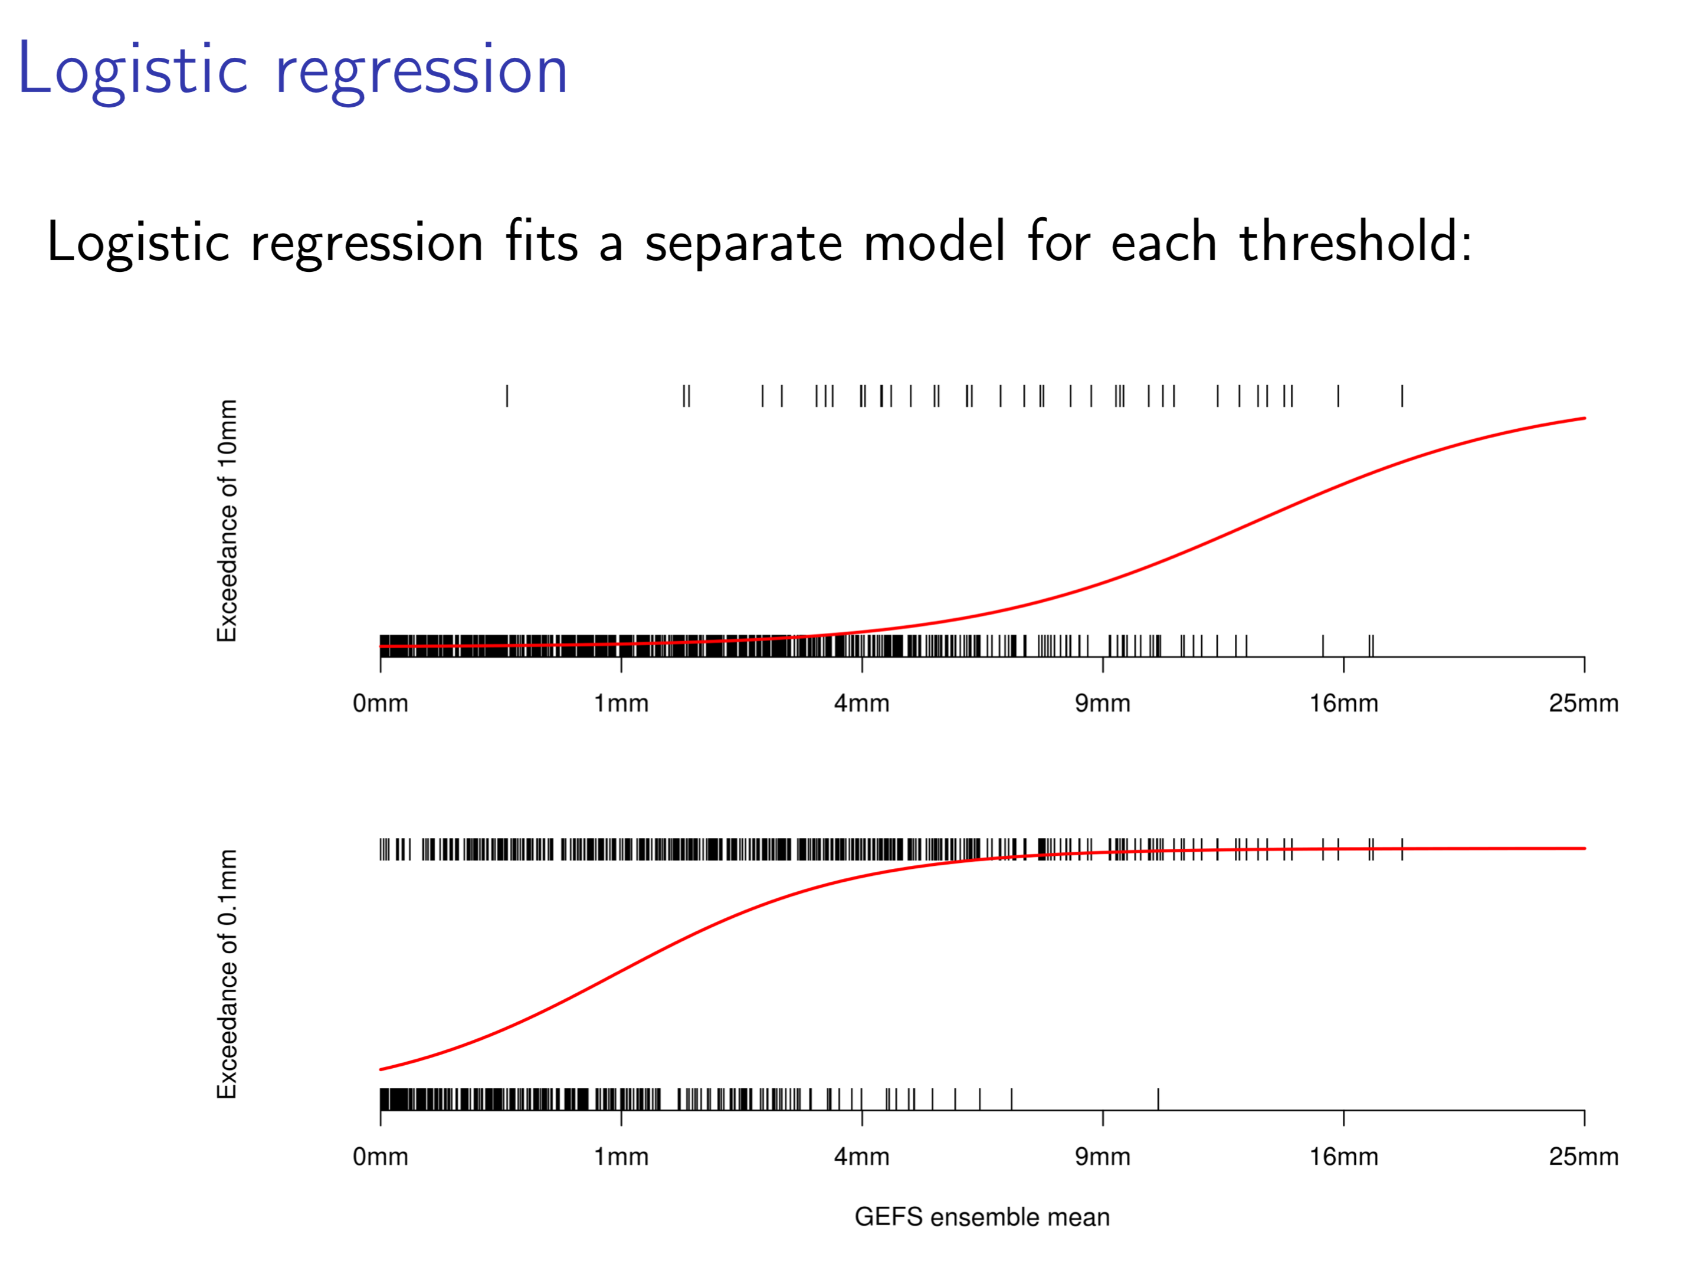

Slide 24
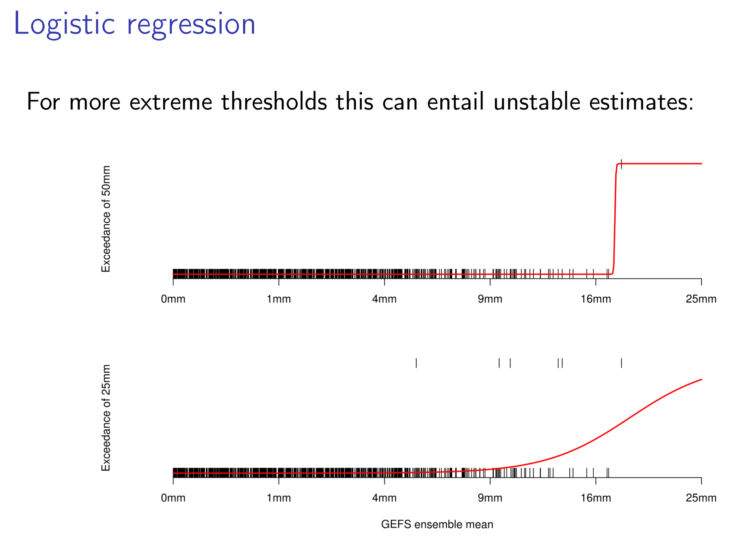

Slide 25
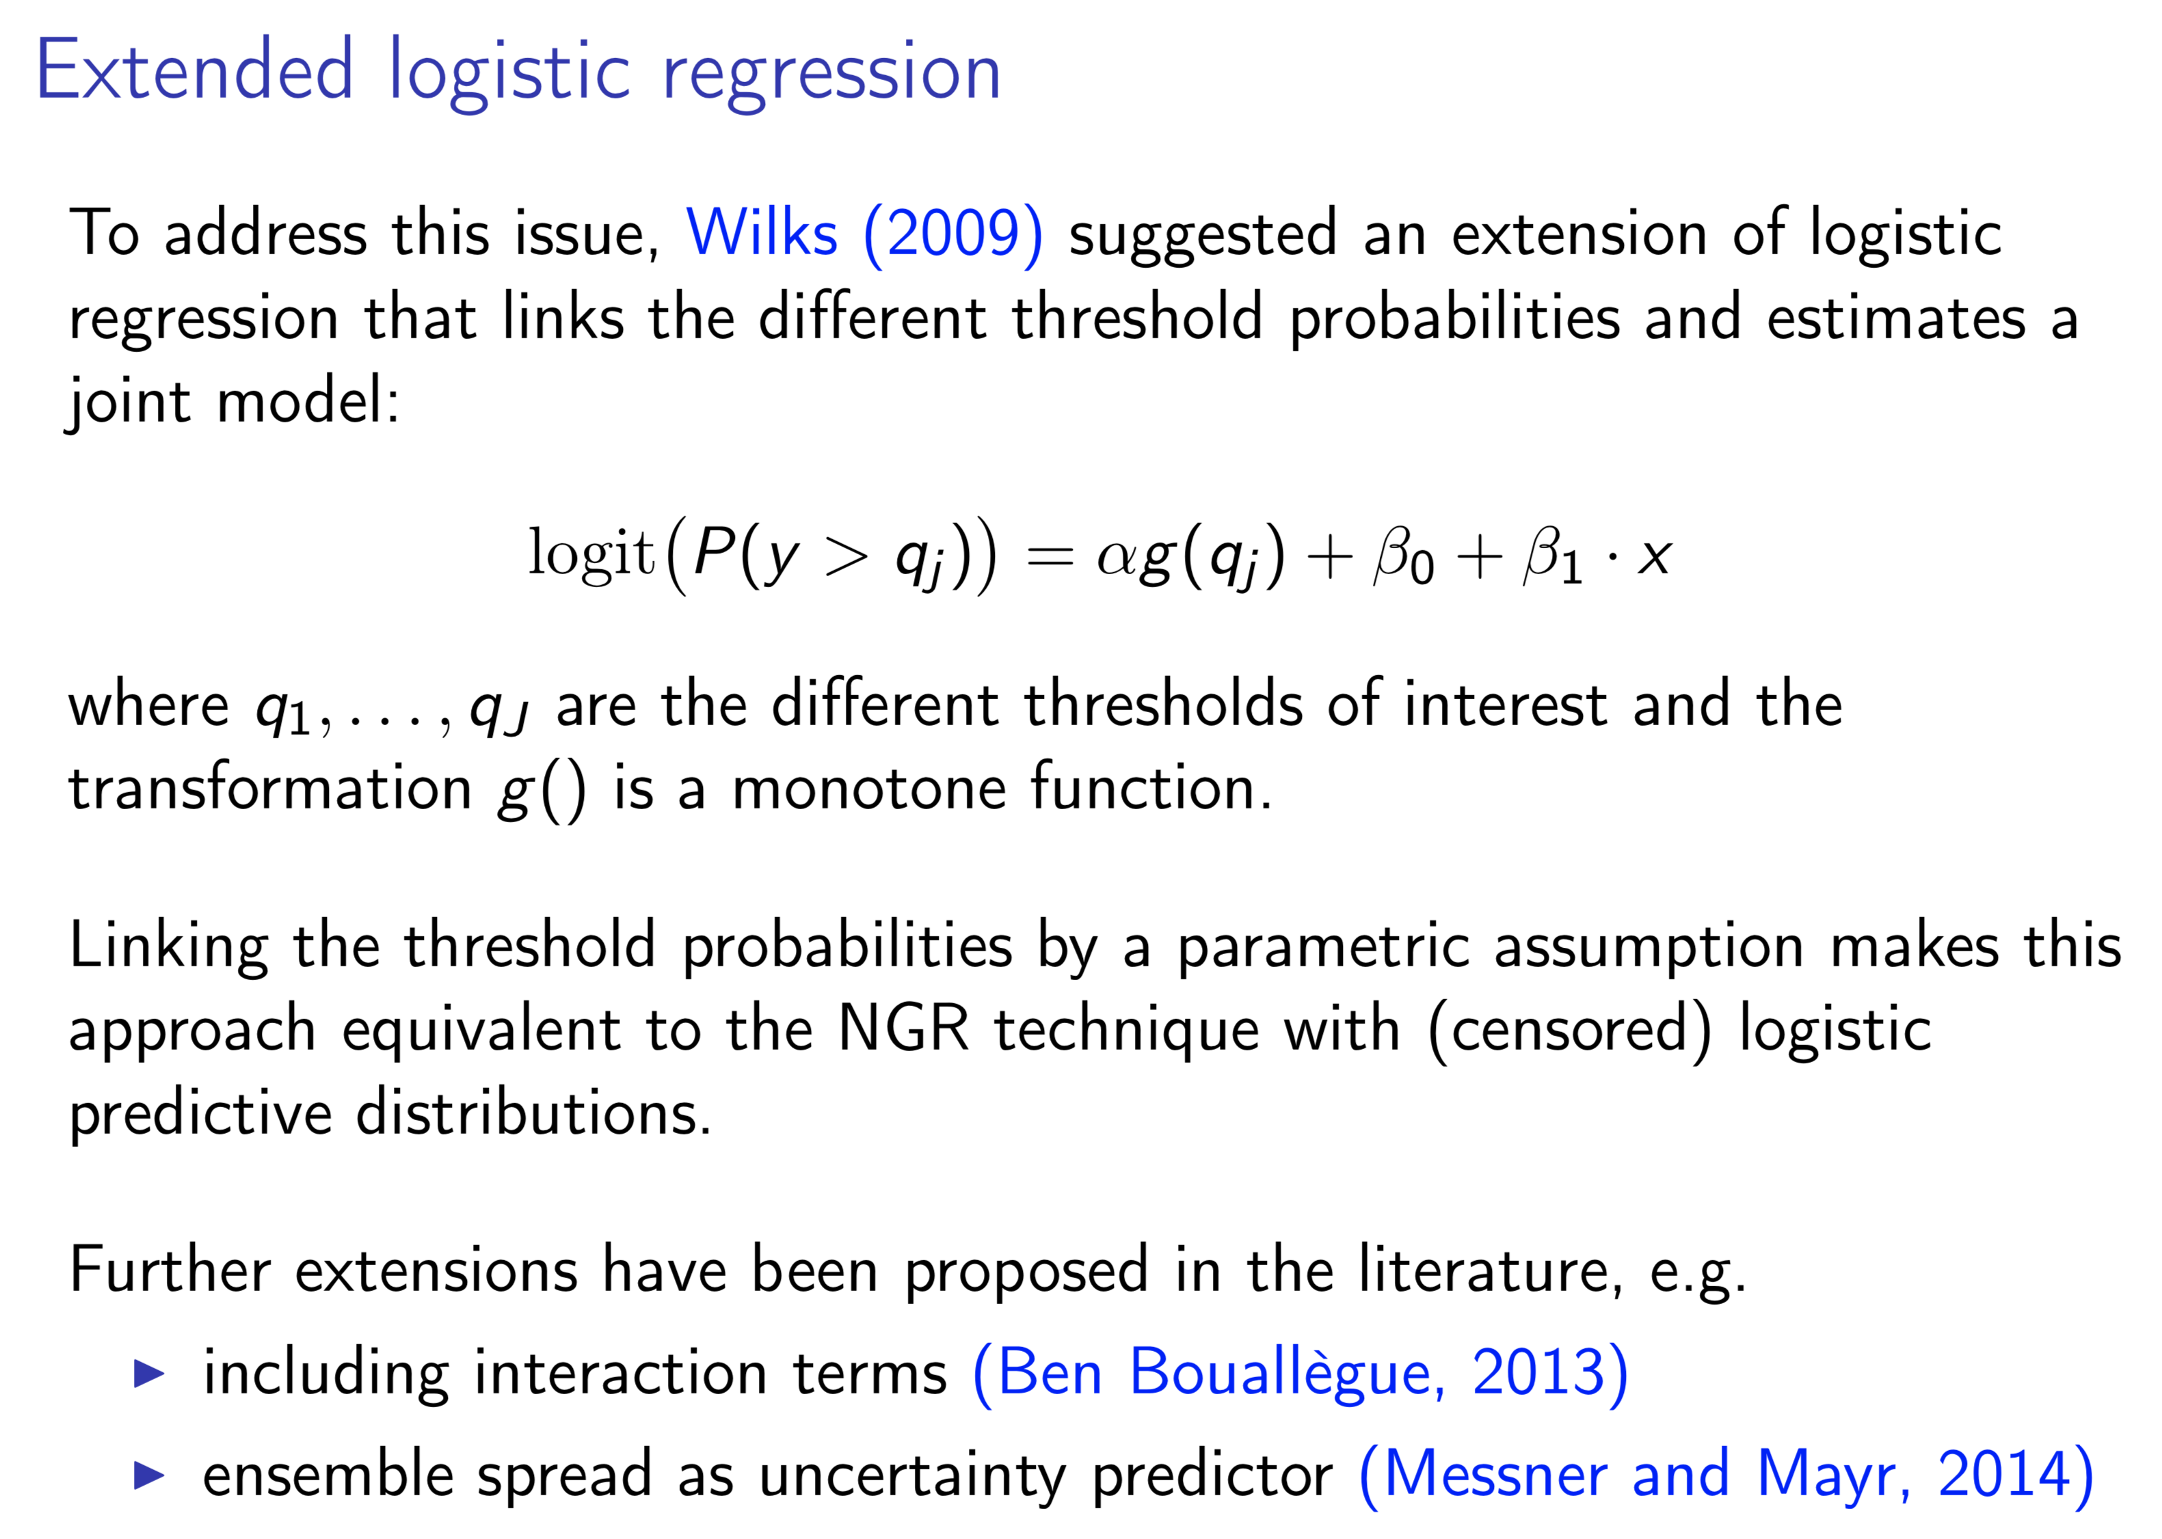

Slide 26
A practical example: multi-model ensemble precipitation postprocessing over the US.
Methodology consists of:
  quantile mapping each member of a multi-model ensemble.
  forming probability from a weighted linear combination of sorted, dressed ensemble members. Weights are determined from “closest-member histogram” statistics, akin to rank histograms.
Underlies the US National Blend of Models, which produces probabilistic and deterministic postprocessed multi-model guidance over the US.

Slide 27
NCEP forecast example

Slide 28
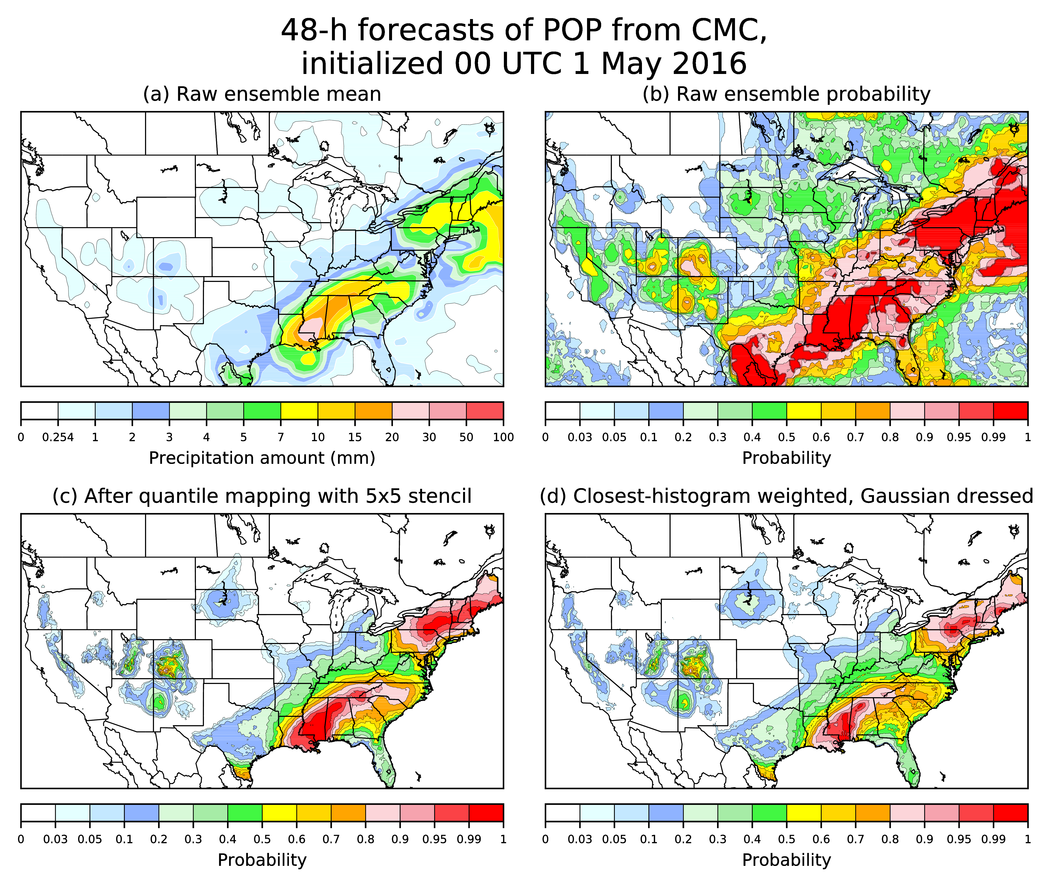
CMC forecast example

Slide 29
ECMWF forecast example

Slide 31
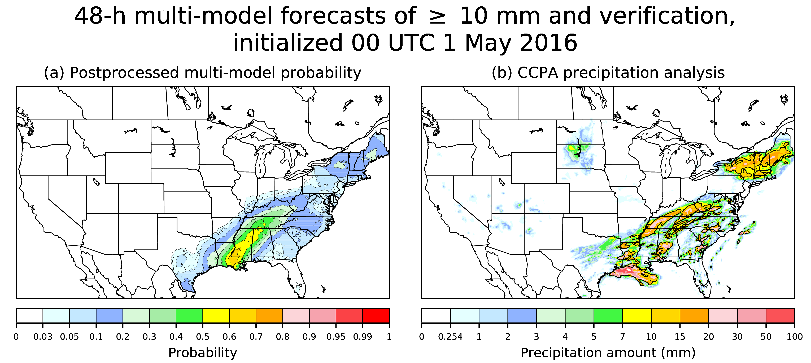

Slide 32
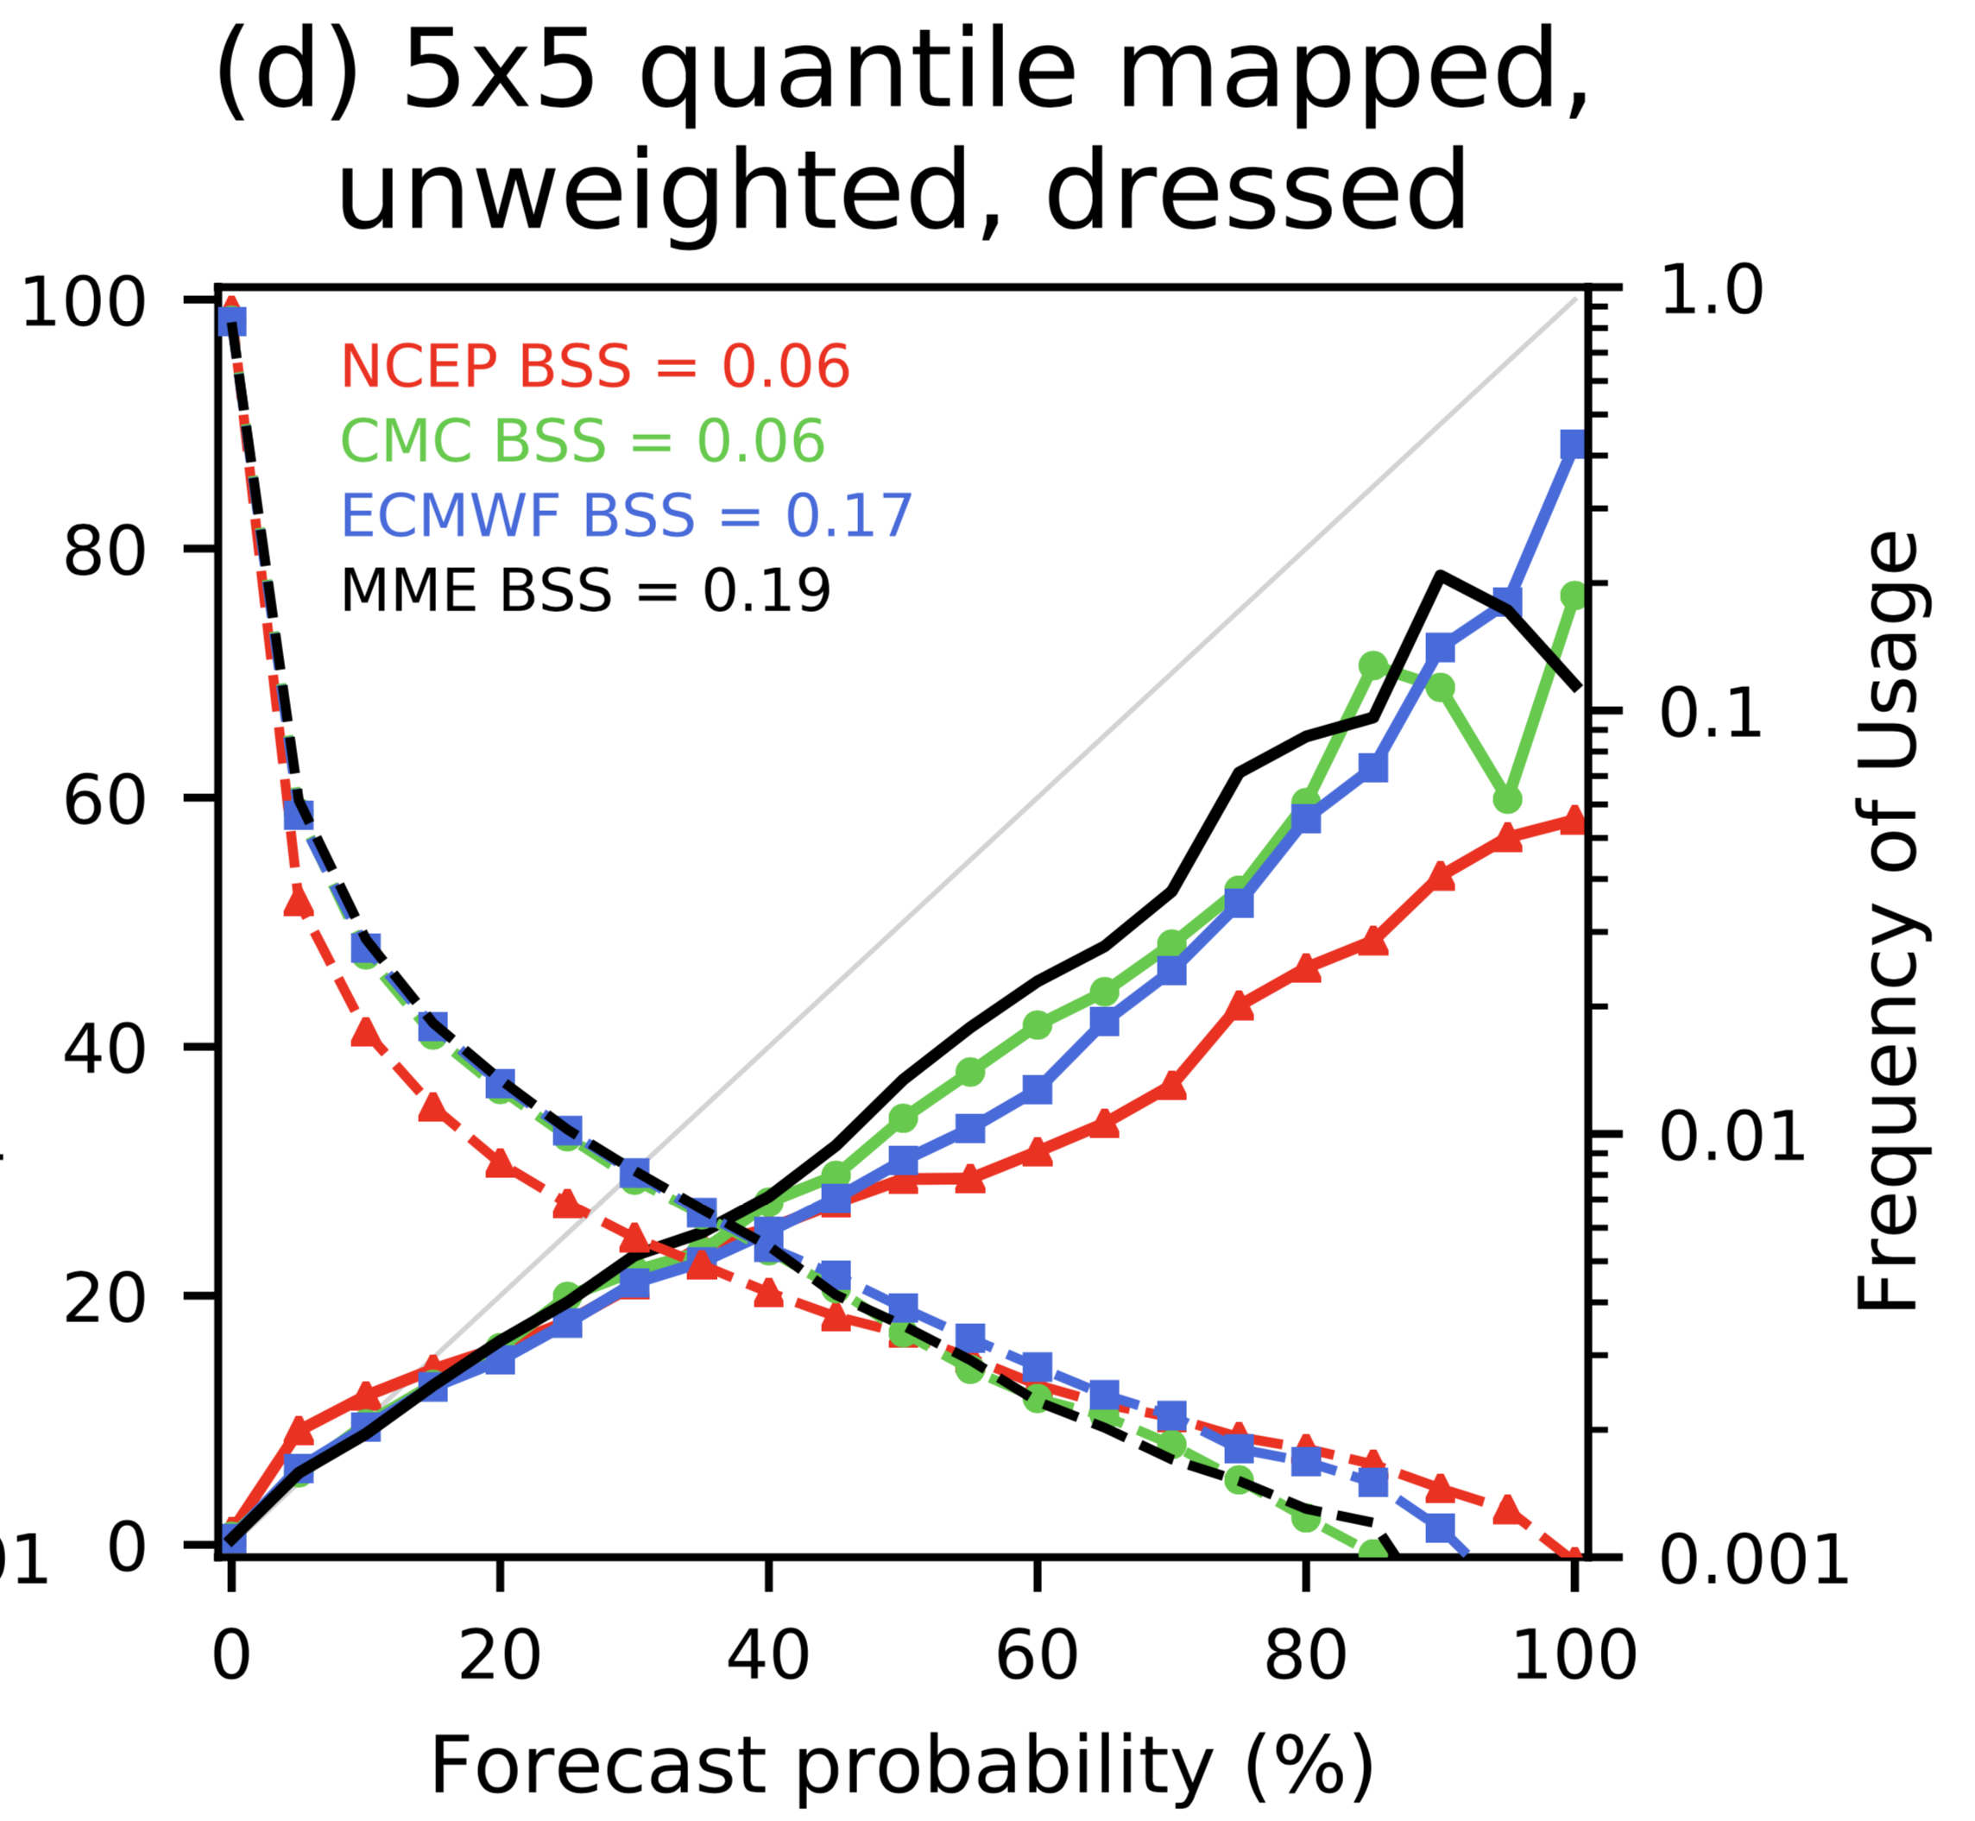
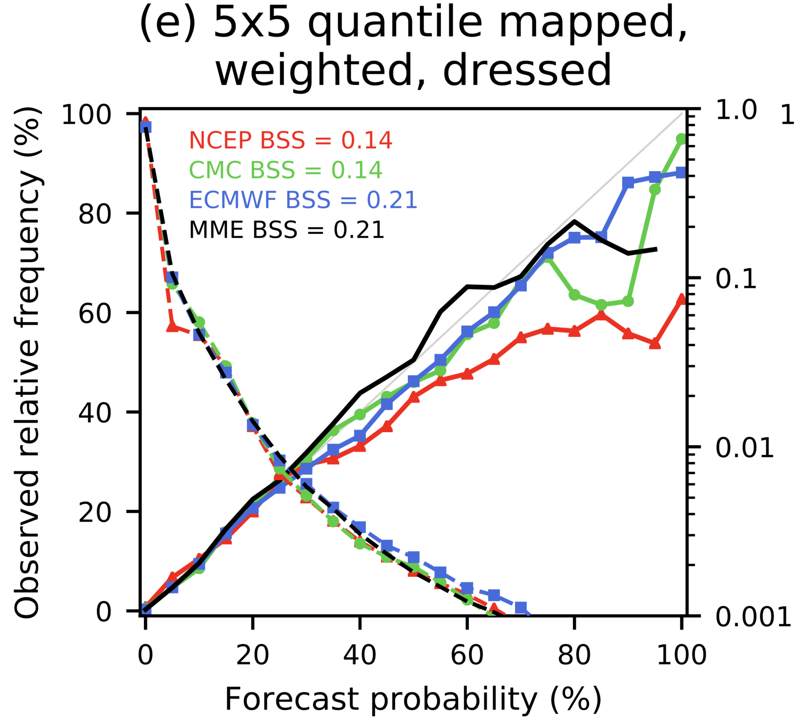
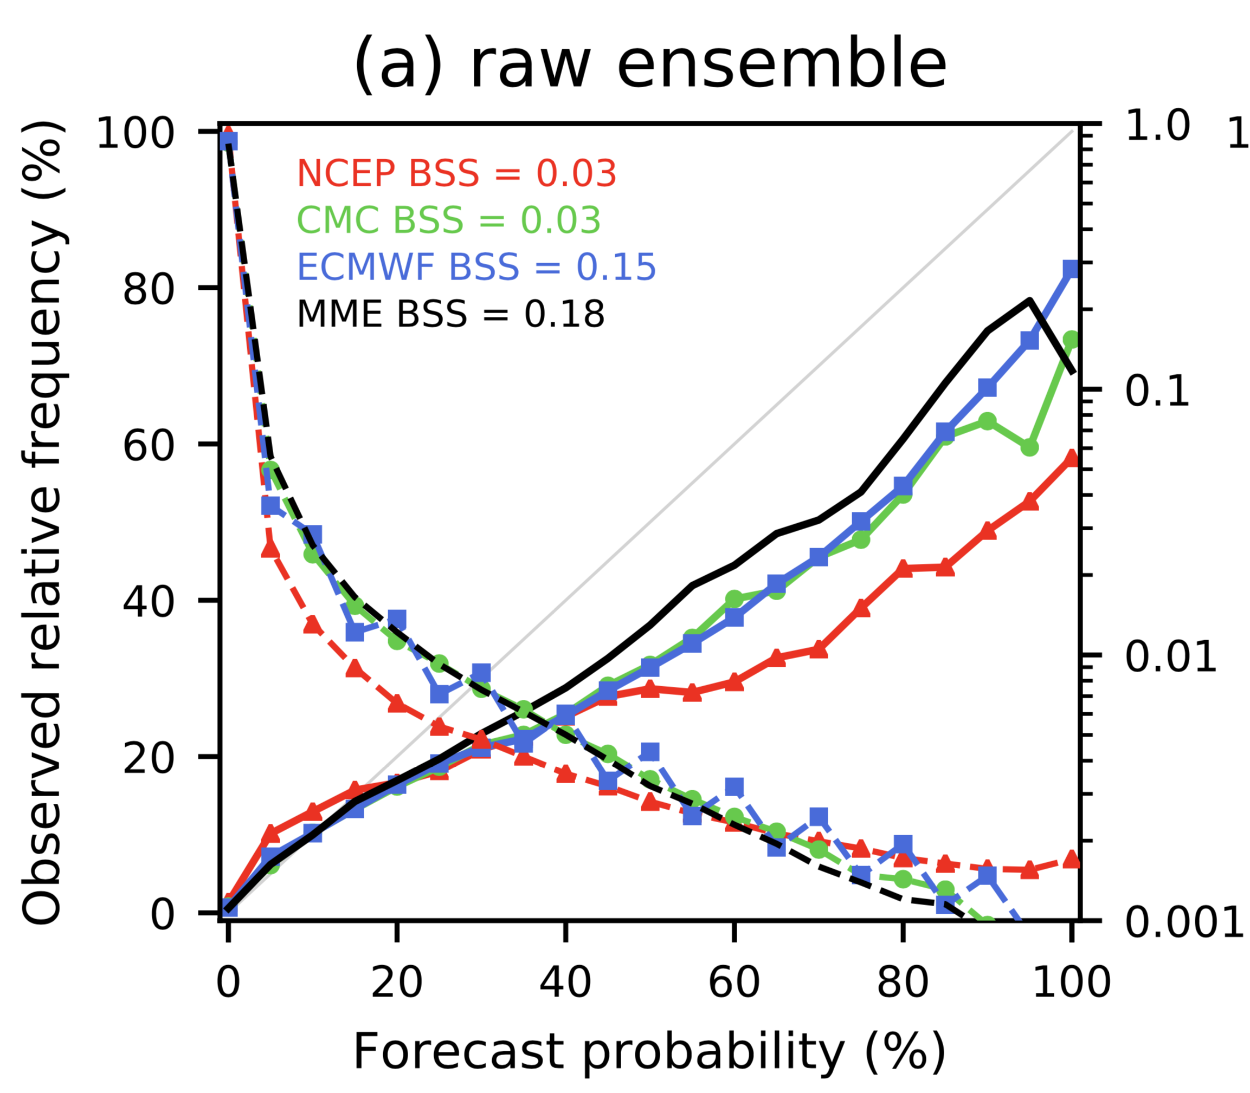
Reliability, > 10 mm 12 h⁻¹ threshold.
(c) Quantile-mapped and closest-
member histogram weighted
(a) Raw ensemble
(b) Quantile-mapped ensemble

Slide 33
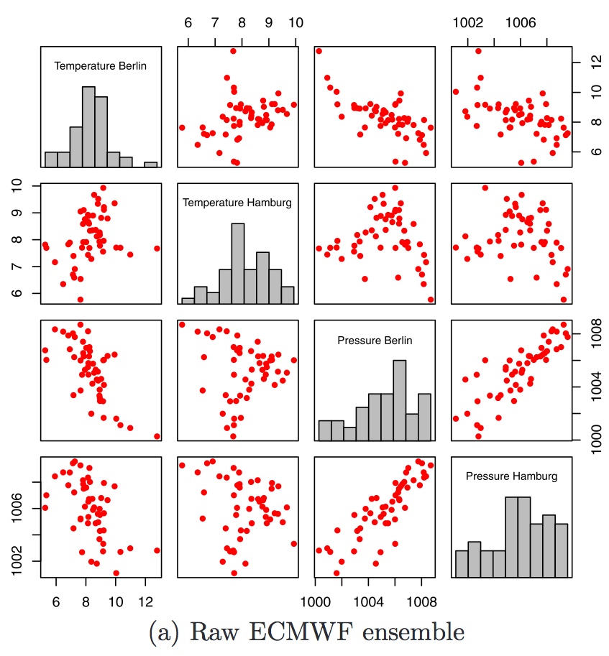
Generating synthetic ensemble members that with realistic space-time variability from postprocessed ensemble.
“Ensemble copula coupling.”
Here, 50 raw ECMWF ensemble
forecasts of temperature
and pressure at two
locations.
from Schefzik et al. , Statistical Science 2013, 28, 616–640

Slide 34
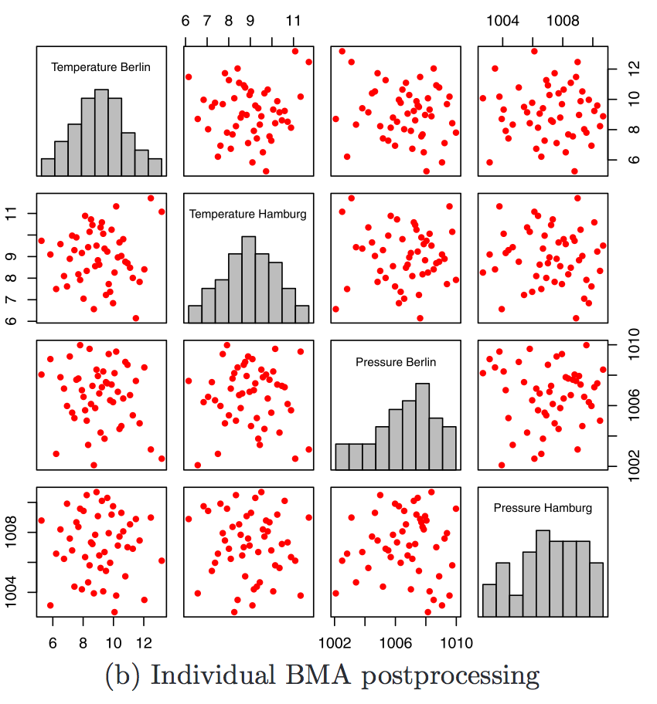
Post-processing takes
place independently for each
variable using BMA following
Fraley et al., MWR, 2010.
50 discrete samples are
regenerated independently
for each variable from the
BMA PDF.
The correlative structure
in the raw ensemble is lost.
from Schefzik et al. , Statistical Science 2013, 28, 616–640

Slide 35
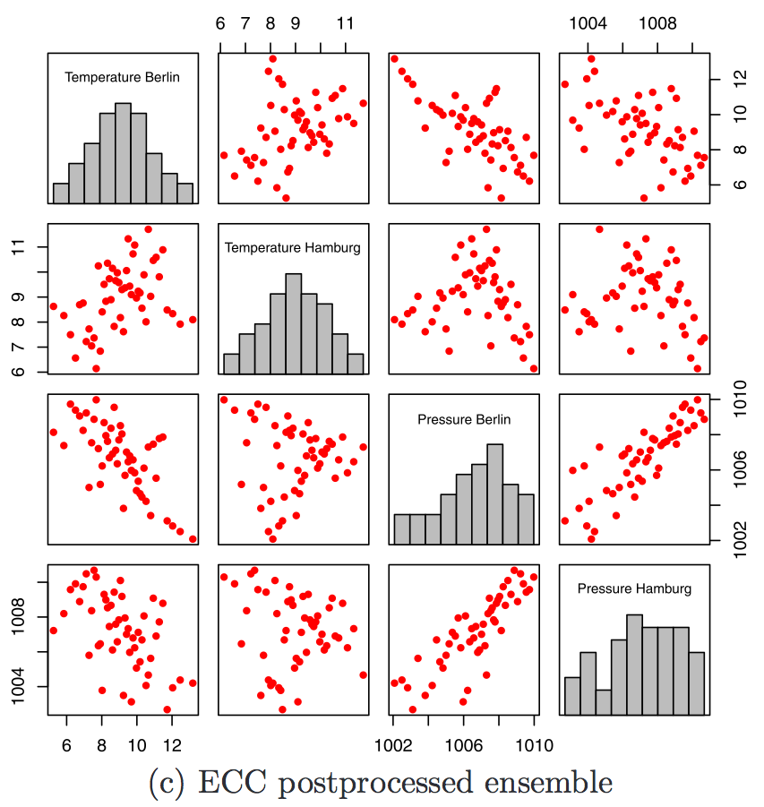
Ensemble copula coupling:
rank-order statistics
are used to restore the
rank dependence structure
of the raw data while
preserving the bias and
spread corrections
produced by BMA.
Q: were those correlations
properly estimated by the
forecast model?
Wilks (2014; DOI:
10.1002/qj.2414) provides
an example of where the
“Schaake Shuffle”
(climatological covariances)
are preferred.
from Schefzik et al. , Statistical Science 2013, 28, 616–640

Slide 36
Conclusions
Raw guidance from ensemble weather prediction systems is contaminated by systematic errors and may contain insufficient spatial detail.
Their direct use as forcing of hydrologic predictions may result in sub-optimal hydrologic ensemble forecasts.
Consequently, the ensemble guidance is typically statistically postprocessed.
Methods for univariate postprocesssing of ensembles are relatively mature.
Methods for generating synthetic ensembles that are consistent with postprocessing are less mature, still in development in our team and by other researchers.

Slide 37
Supplemental slides.

Slide 38
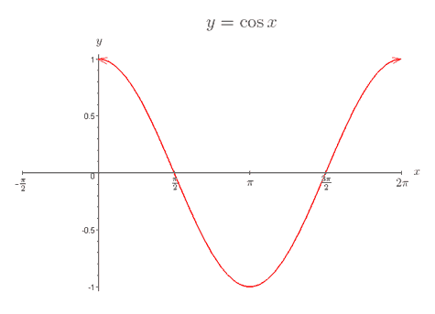
“Bias-variance tradeoff”
Let’s demonstrate NCEP/EMC’s “decaying average” filter for estimating bias with simulated data
Generate daily time series of truth, simulated observations (100x), and simulated forecasts (100x) under the condition of seasonally varying bias:
Truth T = 0.0 (always)
Bias: The true (but unknown) forecast bias for julian day t: B_{t} = cos (2πt/365)
Analyzed for day t = truth + random obs error:
x_{t}^{A} = T + e_{t}^{A}, where e_{t}^{A} ~ N(0, 1/3), iid each day.
Simulated biased forecasts for day t generated w. auto-correlated error via Markov Chain:
x_{t}^{f} - B_{t} = k•(x_{t-1}^{f} – B_{t-1} ) + e_{t}^{f} , where e_{t}^{f} ~ N(0,1), iid each day; k = 0.5
EMC’s decaying-average bias correction: bias estimate B_{t} is
B_{t} = (1-α)•B_{t-1} + α•(x_{t}^{f} – x_{t}^{A})
α is a user-defined parameter that indicates how much to weight most recent bias estimate;
large α akin to overfitting in regression analysis.

Slide 39
With small α,
the bias
estimates
have smaller
variance
over the 100
replications
but lag the
true bias.
Akin to
regression with
few predictors.
True Bias
Estimated
With large
α, bias
estimates
have large
variance
but don’t
much lag
the true
bias. Akin
to regression
with many
predictors.
(plots shown
after 60-day
spinup)

Slide 40
Minimizing the impact of the bias-variance tradeoff
Sometimes, simply change form of model and/or choice of predictors:
  Adjusted forecast = a + b•fcst + c•cos(2πt/365) + d*sin(2πt/365)
Increase the training sample size.
  Overall increase (use reforecasts, i.e. retrospective forecasts with long period of training data).
  Selective increase*: estimate some parameters with local data, others with regional or global data.
  Example: precipitation forecast adjustment.
    Parameters related to terrain-related bias: local data.
    Parameters related to ubiquitous drizzle over-forecast: regional data.
(* Stimulated by Scheuerer, & König, 2014: Gridded, locally calibrated, probabilistic
temperature forecasts based on ensemble model output statistics. QJRMS, 140, 2582-2590.

