Slide 1


Examining characteristics of analysis and short-range forecast errors using TIGGE
NOAA Earth System
Research Laboratory
Tom Hamill
NOAA Earth System Research Lab
Physical Sciences Division, Boulder CO
(303) 497-3060; tom.hamill@noaa.gov
1 Dec 2011 presentation to NCEP/EMC/GMB. Acknowledgments: Daryl Kleist, Jeff Whitaker

Slide 2
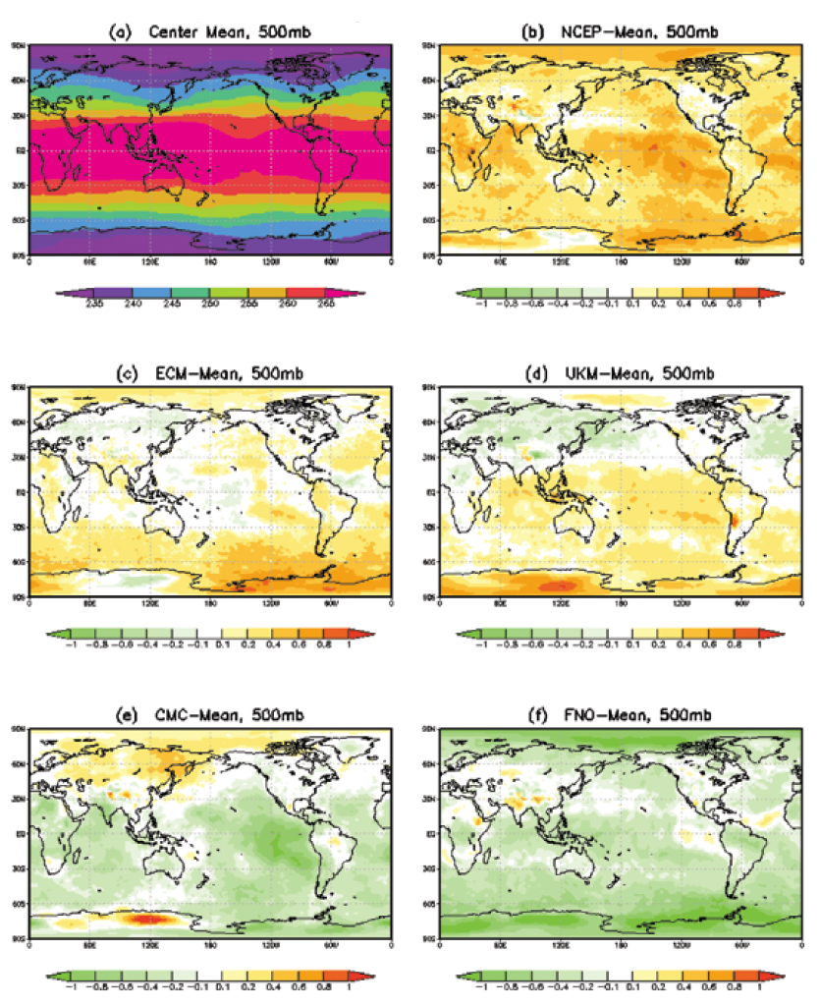
Original motivation
There are systematic differences
between analyses from different centers,
indicating that analyses are likely biased.
Supposition from WMO/JWGV:
since short-range forecasts might
inherit analysis bias, and forecast
bias may not be fully removed in next
analysis, it’s difficult to compare two
centers’ forecasts against one single
center’s analysis.
What then are the guiding principles,
if any, for use of analysis data in
verification?
from Wei et al. 2010

Slide 3
When I started playing with the data, I started asking different questions.
What can we understand about the characteristics of analysis errors by comparing analyses from different centers (supplied via THORPEX’s new TIGGE database) ? [important for ensemble initialization]
Can we learn anything about potential forecast model and assimilation system biases from examining analyses and short-range forecasts using TIGGE’s multi-center data?
Assuming differences between centers’ analyses are representative of analysis error, how well do various ensemble perturbation methodologies do in mimicking the properties of analysis errors?

Slide 4
Some related literature
Wei, M., Toth, Z., Zhu, Y., 2010: Analysis differences and error variance estimates from multi-center analysis data. Australian Meteorological and Oceanographic Journal, 59, 25-34. pdf
Langland, R.H., Maue, R.N. and Bishop, C.H. 2008. Uncertainty in atmospheric temperature analysis. Tellus, 60A, 598-603.
Park, Y.-Y., Buizza, R. and Leutbecher, M. 2008. TIGGE: Preliminary results on comparing and combining ensembles. QJRMS, 134, 2029-50.
Bougeault, P., et al., 2010:The THORPEX Interactive Grand Global Ensemble (TIGGE). Bull Amer. Meteor. Soc., 91, 1059-1072. [link]

Slide 5
Data and analysis methods
I downloaded 00Z analyses, perturbed initial conditions, and deterministic forecasts at 2.5 degree resolution from ECMWF’s TIGGE portal.
Period is 1 Oct 2010 to 30 Sep 2011, 1 full year.
Data from NCEP, ECMWF, UKMO, CMC, CMA (China).
Variables: 2-meter temp, 10-m wind components, sea level pressure; temperature, wind components, and geopotential height at 50, 200, 250, 300, 500, 700, 850, and 925 hPa.
Data to be shown
  Time average of daily spread (sample standard deviation) of analyses about their daily mean.
  Time series of analyses for select variables, at selected grid points, raw data and with +/- 15 day smooth.
  24-h forecast time tendencies, and how they differ from analysis tendencies, to get a sense as to whether the forecast model contributes a systematic bias that may be hard to remove in the analyses.
  The power spectra of analysis differences, and how differences in perturbed initial conditions resemble these spectra.

Slide 6
Assumptions of this study
Individual centers’ analyses will have biases (almost certainly true, as will be shown).
Biases between various analyses are uncorrelated, so the mean of multiple centers is less biased (unclear how much this is true ).
Hence, the difference of a given center from the multi-center mean may indicate something about the bias in that analysis system.

Slide 7
Let’s look at 2-m temperatures…

Slide 8
Analysis spread, 2-meter temperature
red dots are locations of time series in subsequent plots
Here, I calculated the
spread (sample std.
dev.) on each day
among the 5 analyses.
The plot is the yearly
average of these
daily spreads.
> 1K spread over
continents is typical,
even in data dense
regions.
see also Fig 4. of
Wei et al. 2010 ref.

Slide 9
Time series of analyses, central US
Looking at this plot, the various
line colors overlap quite a bit,
suggesting that the differences
have a substantial random
component. However, looking
at the yearly averaged temperature
(listed in the box in the upper left),
notice for example that NCEP’s
analysis is > 2 K colder than CMA’s,
on average.

Slide 10
Time series of analyses, central US
(smoothed)
Here smoothed using
average of +/- 15 days.
Warmer CMA analyses
in last 4 months stands out.
Even in a relatively data-rich
region, there are apparent
biases in analyses that may
complicate their use for
forecast verification.

Slide 11
Time series of analyses,
Amazon basin, South America
At this point in the Amazon basin,
the analyses are quite different
from each other, even in yearly
means, which range from 296.7K
to 301.5K. NCEP is rather
consistently the coldest, UKMO
the warmest. This suggests that
a primary difference between
analyses, especially in relatively
data-sparse regions, may be a
systematic bias in each analysis
system.

Slide 12
Time series of analyses,
Amazon basin, South America, smoothed
Both the warmer UKMO
and cooler NCEP analyses
stand out here.

Slide 13
Time series of analyses, southern Saharan Desert, Africa
The relative order of which
analysis is colder, which is warmer
is different than in the Amazon,
but there still appears that a
substantial portion of the variability
may be explained by systematic
differences in the mean.

Slide 14
Time series of analyses, southern Saharan Desert, Africa
The rather consistent differences
in the analyses is highlighted
with the 30-day mean; CMC
is rather consistently the warmest,
CMA the coolest.

Slide 15
Time series of analyses, central Greenland
The analyses agree, Greenland
was not the place you wanted to
vacation on St. Patrick’s Day in
2011 (March 17).

Slide 16
Time series of analyses, central Greenland (smoothed)

Slide 17
Time series of analyses,
Mongolia
Does ECMWF have the best
analyses? They certainly didn’t
agree with any other center on
the temperature in Mongolia
last winter. The Chinese were
the iconoclasts during the
Mongolian summer.

Slide 18
Time series of analyses,
Mongolia

Slide 19
Sources of bias in analyses
Model bias inherited from prior first-guess forecast.
Different methods of processing satellite data, i.e., different bias correction algorithms, different cloud clearing algorithms.
Poor models of error covariances.
Different data assimilated, perhaps due to different QC methods, data cutoffs.
Etc.

Slide 20
Using 24-h time tendencies to diagnose possible model/DA system bias
Neglecting the change of seasons, one would expect a long time series of <F_{t+24} – A_{t}> would be unbiased, i.e., no systematic tendencies in 1-day forecasts. < . > is time average.
Can account for change of seasons by calculating <F_{t+24} – A_{t}> but then subtracting <A_{t+24} – A_{t}>.
Subsequent plots show this.

Slide 21
Average 0-24 h tendencies in 2-m temp
<dF/dt> - <dA/dt>, Oct-Nov-Dec 2010
The plots show 3-month averaged forecast minus 3-month averaged observed
tendencies, which hopefully are a reasonable diagnostic of day +1 model drift.
Here, NCEP consistently exhibits positive tendencies over land, ECMWF negative
tendencies over land. Let’s focus on NCEP. Dots convey statistical significance.
NCEP
ECMWF
Note: other season’s plots in supplementary slides, after conclusions.

Slide 22
Average 0-24 h tendencies in NCEP
2-m temp <F> - <A>, Jul-Aug-Sep 2011
What’s going on here in the Amazon is rather puzzling. The 24-h forecasts are > 2K warmer
on average than the analyses, which would lead one to believe that in this relatively
data sparse region the analysis might thus have a warm bias with respect to the other
analyses. Is this some case where there may be a repeated inappropriate negative
(cooling) analysis increment in the data assimilation, and the 24-h forecast “snaps back”
to a more reasonable climatology?
NCEP

Slide 23
Time series of analyzed and 24-h forecast
2-m temp (smoothed) in the Amazon
This suggests that perhaps for this location, since NCEP’s 24-h forecasts become
more consistent with the others while UKMO’s become even more of an outlier,
NCEP’s problem is more likely due to some issues with the assimilation, while
UKMO’s problem is a forecast model bias problem.
analysis
24-h forecast

Slide 24
Differences of NCEP analyses and 24-h forecasts from multi-center mean
analysis
24-h forecast
Generally NCEP land 2-m temperature analyses are cooler than other analyses, but by
24-h this is reversed and the NCEP forecasts are warmer in many locations.
Is the model restoring itself from some disequilibrium during the analysis process, or are
we seeing a general forecast bias? Let’s look at some longer leads.

Slide 25
Differences of 24-h and 48-h forecasts from multi-center mean
24 h
48 h
24-h and 48-h forecasts look amazingly similar for 2-m temp, suggesting that the
change in the first 24 h may be an adjustment due to inconsistencies introduced
during the assimilation process.

Slide 26
NCEP 0-24 h and 24-48 h tendencies in 2-m temp <dF/dt> - <dA/dt>
This confirms the 0-24 h tendencies for this field are transient adjustments.
0 to 24 h
24 to 48 h

Slide 27
Let’s look TIGGE analysis spread for other variables…

Slide 28
Analysis spread, 10-m u component

Slide 29
Time series of 10-m u wind, equatorial west Pacific
CMA analyses appear very
different than the others in
this region of critical ENSO
and MJO variability.

Slide 30
Time series of 10-m u wind, equatorial west Pacific, smoothed
CMA analyses appear very
different than the others in
this region of critical ENSO
and MJO variability.

Slide 31
Analysis spread, mean sea-level pressure

Slide 32
Time series of SLP analyses, southern ocean
CMA analyses seem to have a lot
less variability, not capturing the
depth of the lows, strength of the
highs here.
At dates indicated by red arrow, note
that all other centers agree on
a period of sustained low pressure
of ~ 970 hPa, while CMA is ~ 990 hPa.
20 hPa different!

Slide 33
Time series of SLP analyses, southern ocean (smoothed)
CMA’s reduced variability is
evident as well in the 30-day
mean.

Slide 34
Example: ECMWF (red) & CMA (blue)
MSLP analyses, 2010/12/25/00Z
where’s
the
cyclone?

Slide 35
Analysis spread, temperature at 850 hPa

Slide 36
Time series of 850 hPa temperature, south of Galapagos
Life in the subtropical ocean
stratus deck. Differences
appear more random. Probably
there are some large differences in
how the models parameterize
stratus clouds and their radiative
impacts.

Slide 37
Time series of 850 hPa temperature, south of Galapagos (smoothed)
Again, CMA appears to have
less temporal variability.
For several periods, UKMO is
the outlier.

Slide 38
Average 0-24 h tendencies in 850 T
<dF/dt> - <dA/dt>, Oct-Nov-Dec 2010
The systematic tendencies for NCEP are much larger than for ECMWF, and very
large (>2K/day) over Antarctica, Greenland (but effectively below ground). Over
the oceans, there are almost uniformly negative tendencies for NCEP in first 24h.
NCEP
ECMWF

Slide 39
NCEP 0-24 h and 24-48 h tendencies in 850 hPa temp <dF/dt> - <dA/dt>
Again, NCEP 0-24 h tendencies for this field are dominated by transient adjustments,
and the magnitude of the average of the tendencies is radically smaller on day 2 than
day 1.
0 to 24 h
24 to 48 h

Slide 40
Analysis spread,
500 hPa geopotential height
This looks more
“well behaved”,
with more
variability
somewhat in the
storm tracks
(another sign of
how 500Z is
unlike many other
variables of
interest).

Slide 41
Average 0-24 h tendencies in 500Z
<dF/dt> - <dA/dt>, Oct-Nov-Dec 2010
Again, very large tendencies over Antarctica for NCEP. Geopotential height falls
there indicate, presumably, a strong anomalous cooling of air from surface to
500 hPa. Also: large height rises on poleward side of S. Hem. jet, indicating a
systematic weakening of the jet.
NCEP
ECMWF

Slide 42
Average 0-24 h and 24-48 h NCEP tendencies in 500Z <dF/dt> - <dA/dt>
Consistent negative tendencies over Antarctica. Otherwise, the patterns show
little similarity, and amplitudes of 24-48 h tendencies are comparable to those
for 0-24 h. Also, note the lack of dots corresponding to many regions with
intense colors. Despite relatively large changes, these are not statistically
significant.
0-24 h
24-48 h

Slide 43
Analysis spread,
250 hPa u component
What’s going on
in tropical
eastern Pacific
and tropical
western Indian
Oceans?

Slide 44
Time series of 250 hPa u-wind, eastern equatorial Pacific
CMA, and to lesser extent NCEP,
have much stronger westerly
winds.

Slide 45
Time series of 250 hPa u-wind, eastern equatorial Pacific (smoothed)

Slide 46
Time series of 250 hPa u-wind, western equatorial Indian Ocean
CMA has much stronger westerly
component, especially early during
this period.

Slide 47
Time series of 250 hPa u-wind, western equatorial Indian Ocean
CMA has much stronger westerly
component, especially early during
this period.
It seems like these biases might
have an effect on MJO.

Slide 48
Time series of 500 hPa u-wind, western equatorial Indian Ocean
CMA is no longer the outlier here

Slide 49
Time series of 700 hPa u-wind, western equatorial Indian Ocean
At 700 hPa, CMA is now consistently too easterly rather than westerly.
CMA may have some anomalous analyzed zonal circulation?

Slide 50
Using TIGGE multi-center analyses to evaluate methods for initializing ensembles
Theoretically, ensembles ought to sample the distribution of possible analysis states.
  Therefore, ensemble perturbations ought to have the same statistics as analysis errors.
Hypothesize that the differences between multi-center analyses represent realistic samples of analysis uncertainty.
Let’s compare ensemble perturbation statistics to multi-analysis differences.

Slide 51
Power spectra from analysis data
ECMWF used for base state; ECMWF - NCEP used for differences.
Spectra computed daily, then averaged over the full year.
T @ 500 hPa
U @ 250 hPa
wave# 4 dominant
meridional wave 2 dominates
(cold pole, warm equator)
winter/
summer
hemisphere
temp difference
Larger analysis “errors” (i.e., differences) at larger scales than at smaller scales, but …
Large signal-to-noise ratio (S/N) at large scales, small S/N at smaller scales.
Are analysis errors really that large at the largest scales? Probably yes for some
models with larger biases, no for others with smaller biases (e.g., ECMWF).

Slide 52
Power spectra of ensemble perturbations, NCEP ensemble
Suggests this ETR perturbation ensemble have insufficient power at planetary scales.
This is consistent with the assumption made in the ETR that the analysis is unbiased while
analyses between different centers suggest there is bias.
(2) ETR’s underestimate of initial amplitude is the least for the small baroclinic scales.
This may be because the breeding method inside the ETR generates perturbations
that project onto the (finite amplitude) Lyapunov vectors, dominated by baroclinic scales.

Slide 53
Power spectra of ensemble perturbations, ECMWF ensemble
estimated too large?
For wind, ECMWF’s under-estimate of perturbation size is more dramatic than in
NCEP’s system. However, (a) their (energy norm) singular-vector perturbations may
grow more rapidly, so this under-estimate may not be as pronounced in the forecast, and
(b) various other diagnostics shown here today suggest ECMWF’s analysis may have less
model bias, hence the estimate of analysis error from difference between ECMWF and
NCEP may overestimate the error spectrum for their system.

Slide 54
Power spectra of ensemble perturbations, GFS EnKF
Generally more power at all wavenumbers relative to ETR.
Overestimate of power (i.e., amplitude of perturbations) at small scales. Likely this
is attributable to inappropriate analysis increments due to the use of smaller-than ideal
ensemble size (n=80) in the EnKF.
(3) Still some underestimate of power at large scales.

Slide 55
Power spectra of ensemble perturbations, CMC ensemble
Reasonably well calibrated overall for t500; a bit of an overestimate of variance for u250.

Slide 56
Conclusions
Analyses, assumed to be unbiased, do exhibit substantial bias, as diagnosed from comparisons between analyses of different centers.
Diagnostics suggest that NCEP’s bias may be due in large part to issues related to data assimilation. There is greater consistency with other models after 24 h.
Ensemble perturbations may be too small relative to multi-model estimates of analysis error, especially their size for the planetary scales. This under-estimate reflects the common assumption that the analysis is unbiased.
Diagnostics such as these, leveraging TIGGE data, may prove useful for detecting forecast and assimilation system deficiencies. Consider such diagnostics for more widespread use?

Slide 57
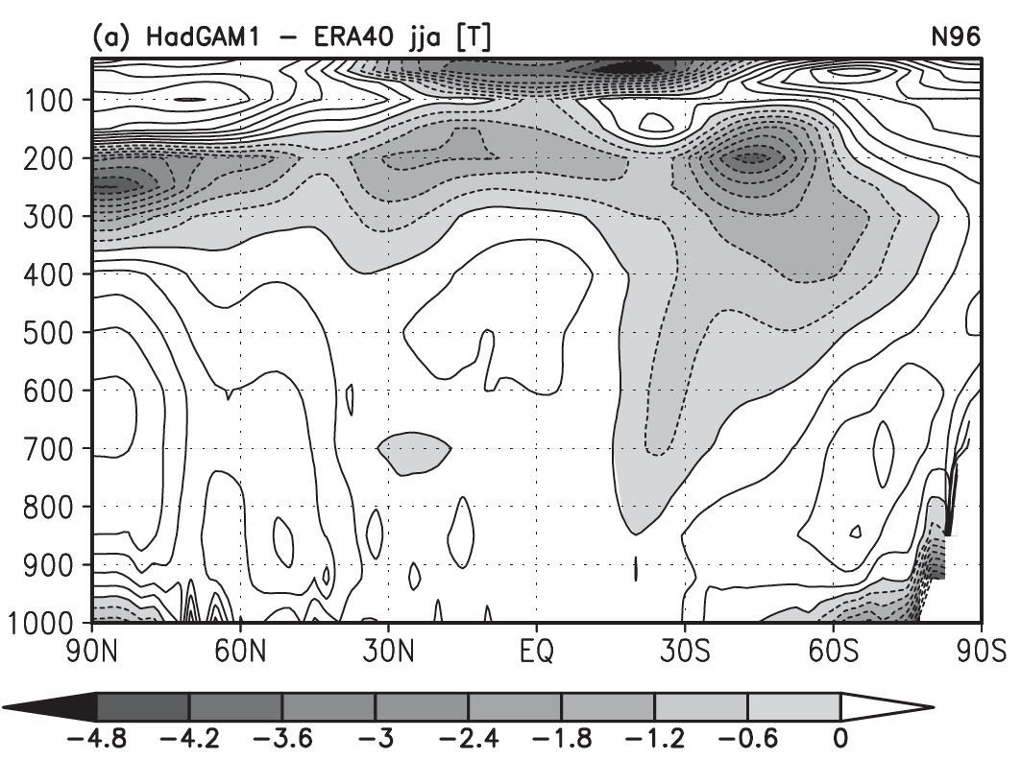
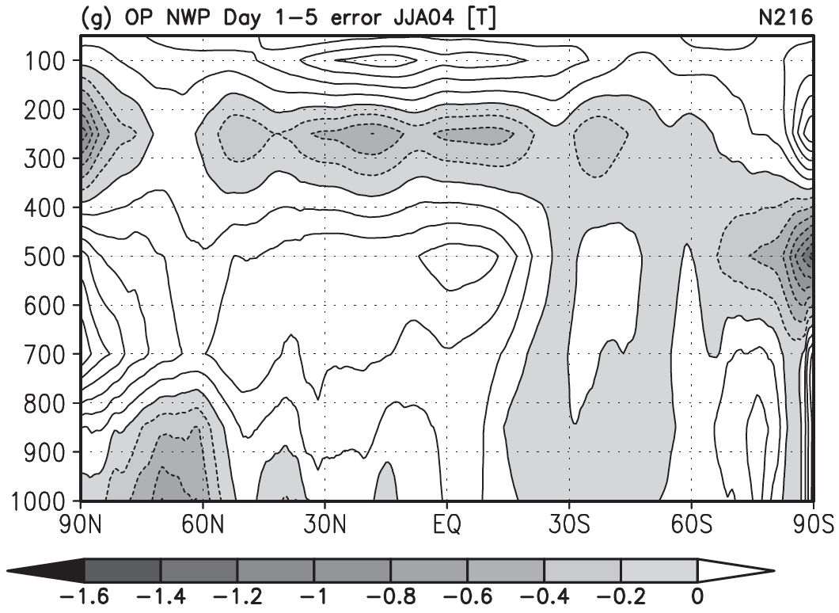
An aside: this sort of analysis underlies AMIP^{T}, where climate models are run in weather mode.
10-year climate forecast temperature bias
with respect to reanalysis
JJA 2004 1-5 day forecast error, UKMO
model biases in climate models similar to what’s observed in short-range forecast, so can use
short-range forecast to improve and validate climate models.
ref: Martin et al., J. Clim, 15 Nov 2010

Slide 58
Average 0-24 h tendencies in 2-m temp
<dF/dt> - <dA/dt>, Jan-Feb-Mar 2011
Dots convey mean is statistically significantly different than zero,
via 2-sided t-test, α=0.05 (field significance would be better).
NCEP
ECMWF

Slide 59
Average 0-24 h tendencies in 2-m temp
<dF/dt> - <dA/dt>, Apr-May-Jun 2011
NCEP
ECMWF

Slide 60
Average 0-24 h tendencies in 2-m temp
<dF/dt> - <dA/dt>, Jul-Aug-Sep 2011
NCEP
ECMWF

Slide 61
Average 0-24 h tendencies in 500Z
<dF/dt> - <dA/dt>, Jan-Feb-Mar 2011
NCEP
ECMWF

Slide 62
Average 0-24 h tendencies in 500Z
<dF/dt> - <dA/dt>, Apr-May-Jun 2011
NCEP
ECMWF

Slide 63
Average 0-24 h tendencies in 500Z
<dF/dt> - <dA/dt>, Jul-Aug-Sep 2011
NCEP
ECMWF

Slide 64
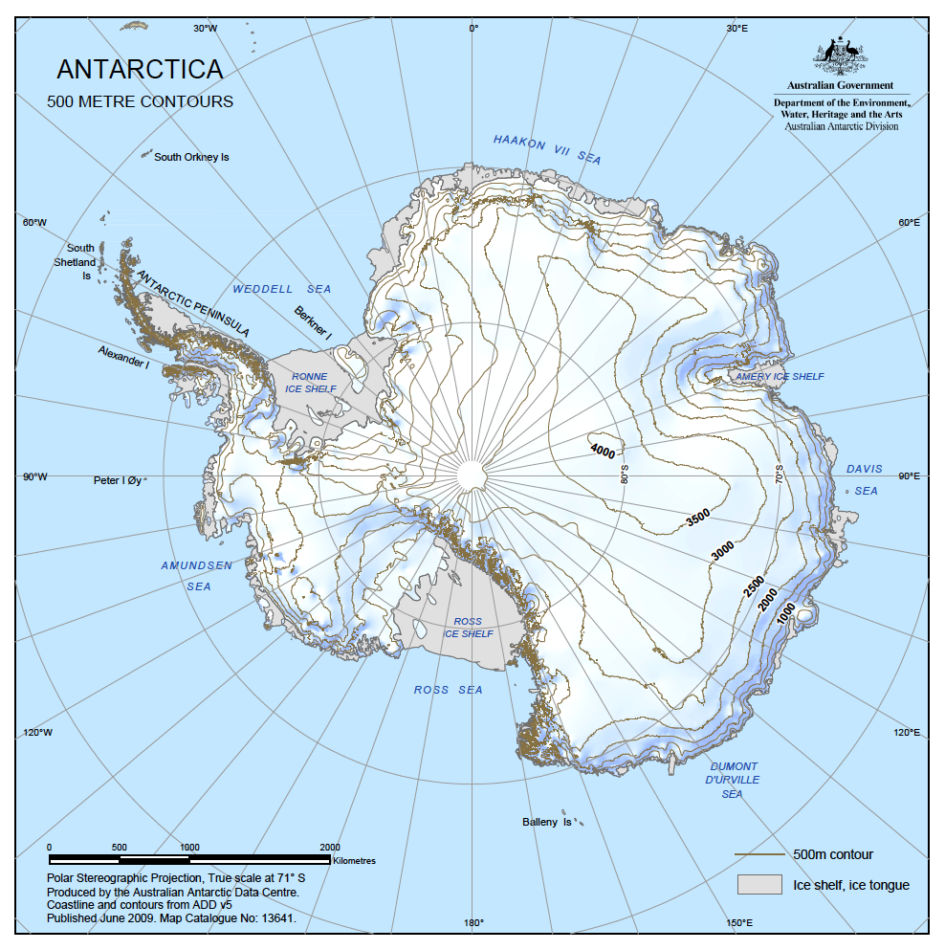
Recall: Antarctica’s terrain
Typical 850 hPa geopotential
height over Antarctica: ~ 1300 m.
Hence nearly all of Antarctica
P_{sfc} < 850 hPa.
Typical 700 hPa geopotential
height over Antarctica: ~ 2600 m.
Approximately half of Antarctica
P_{sfc} < 700 hPa.

Slide 65
Average 0-24 h tendencies in 850 T
<dF/dt> - <dA/dt>, Jan-Feb-Mar 2011
Negative NCEP tendencies over oceans happens for other seasons, too.
NCEP
ECMWF

Slide 66
Average 0-24 h tendencies in 850 T
<dF/dt> - <dA/dt>, Apr-May-Jun 2011
NCEP
ECMWF

Slide 67
Average 0-24 h tendencies in 850 T
<dF/dt> - <dA/dt>, Jul-Aug-Sep 2011
Are negative tendencies over the ocean for NCEP worse in the winter hemisphere?
NCEP
ECMWF

Slide 68
Average 0-24 h tendencies in 850 & 500 T
<dF/dt> - <dA/dt>, Oct-Nov-Dec 2011
Implies a general stabilization of 850 to 500 hPa layer in short-term forecast.
NCEP T500
NCEP T850

Slide 69
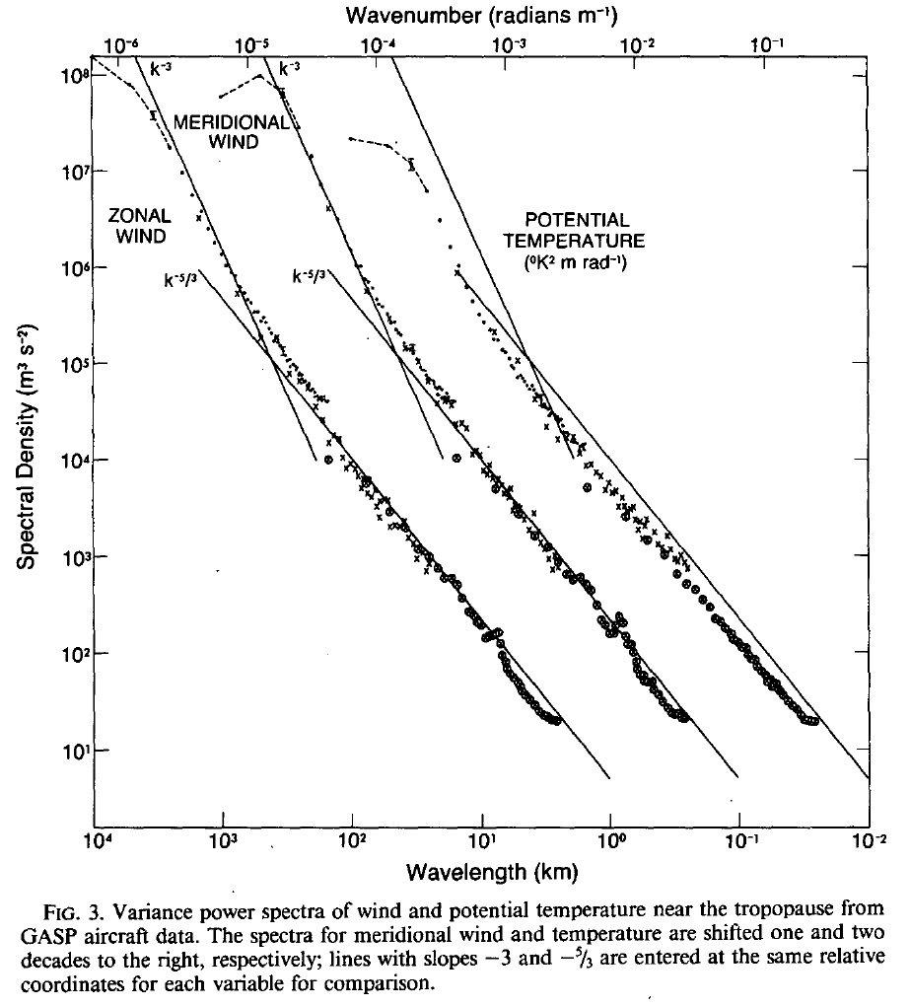
Recall: Nastrom & Gage (1984), energy spectra from plane observations
Now let’s look at the power spectra.
Recall that Nastrom and Gage
experimentally confirmed the result
that at the larger (synoptic) scales,
the power spectra roughly follow
a k⁻³ power law, and at smaller
scales, a k^{-5/3} power law.
With the 2.5-degree analysis data
used here, we can’t expect to see
much of the region of the spectra
with k^{-5/3}.

Slide 70
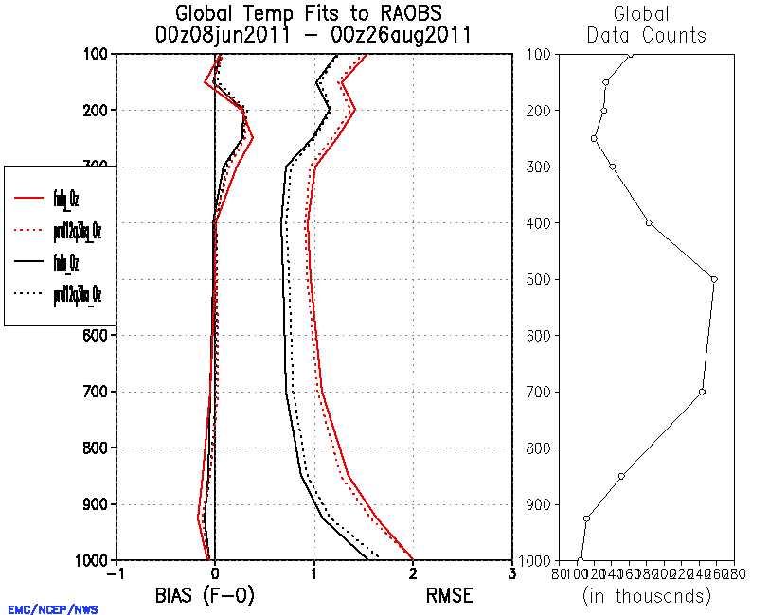
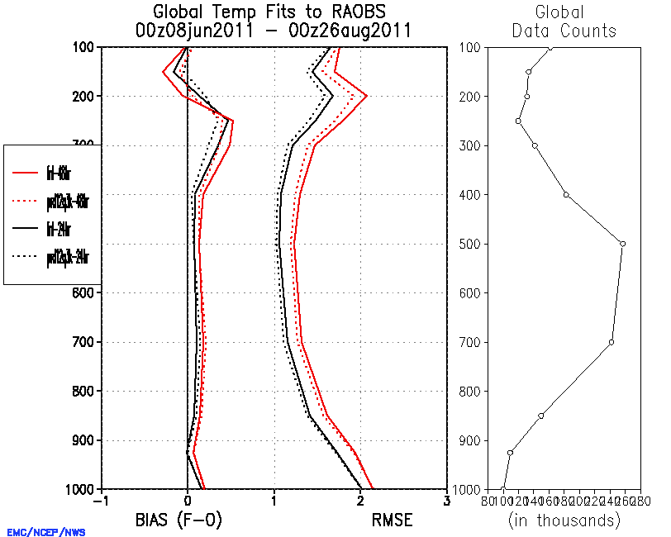
We’ll end trying to understand what’s behind this seemingly modest change
Recent statistics from parallel run that includes hybrid EnKF/GSI
At 0 hours, low-level temperature
analyses are biased too cold.
At 24 h, temperature
forecasts are biased too warm.

