Slide 1
Ensemble prediction review for WGNE, 2010
Tom Hamill¹ and Pedro de Silva-Dias²
¹NOAA/ESRL
²Laboratório Nacional de Computação Científica
tom.hamill@noaa.gov

Slide 2
Sources of improvement in probabilistic forecasts
Make the model better
Improve methods of generating initial conditions
Treat model uncertainties in physically realistic fashion
stochastic effects
post-processing
Better use of ensembles

Slide 3
Making the model better
An example from NSSL-SPC Hazardous Weather Test Bed, forecast initialized 20 May 2010
http://tinyurl.com/2ftbvgs
30-km SREF P > 0.5”
4-km SSEF P > 0.5 “
Verification
With warm-season QPF, coarse resolution and parameterized convection of SREF clearly
inferior to the 4-km, resolved convection in SSEF.

Slide 4
Ranked Probability Score Area: Full NAE domain
Example: UK Met Office’s
MOGREPS-R upgrade to 70 levels
850hPa Temperature
2m Temperature
10m wind speed
6hrly Precipitation
c/o Richard Swinbank, UK Met Office.

Slide 5
Improve initial conditions for ensembles
ECMWF: replacing evolved singular vectors with “ensemble data assimilations”
Ensemble Kalman Filter (EnKF) progress
Hybridizations of EnKF and Var.

Slide 6
ECMWF’s ensembles of data assimilation (EDA)
Want to better quantify analysis uncertainty.
10 independent, lower-res 4D-Vars (T255 outer, T95/159 inner loops) with perturbed obs, perturbed SSTs, perturbed model tendencies comprise the EDA.
Not sure how the 10 are combined with the 50 initial-time SVs…

Slide 7
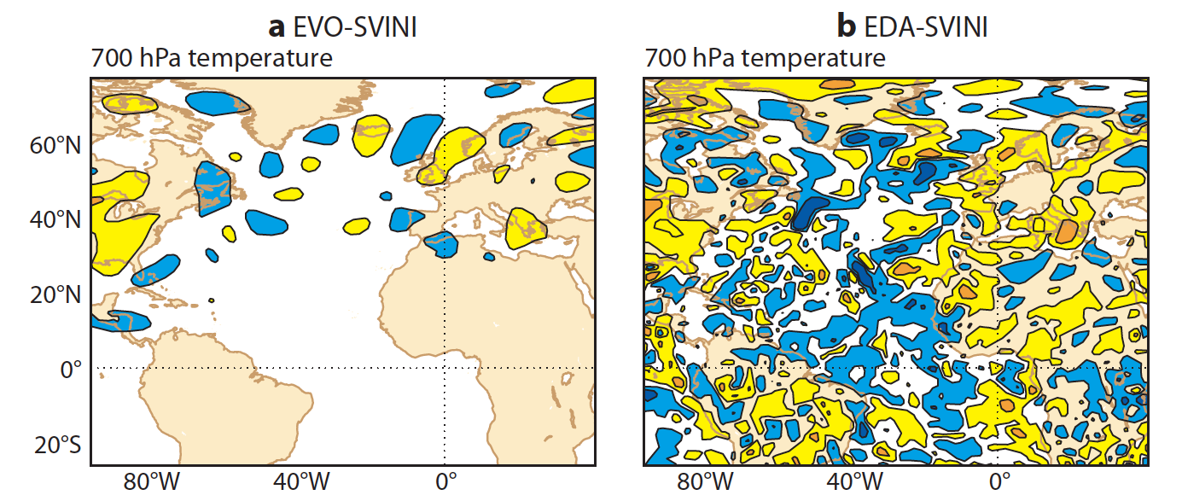
Perturbed initial condition, old technique of evolved singular vectors vs. new EDA
Analysis error of course not just confined to the storm track, so perturbations shouldn’t,
either.
Ref: ECMWF Newsletter 123

Slide 8
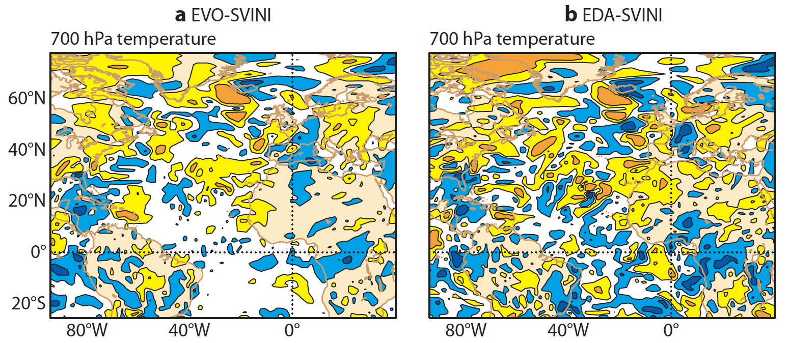
Perturbed forecast, 24 h later…
At 24-h lead, the EVO-SVINI perturbation have spread out, but there are still many regions
with effectively no differences (i.e., forecast uncertainty is estimated to be negligible).
Ref: ECMWF Newsletter 123

Slide 9
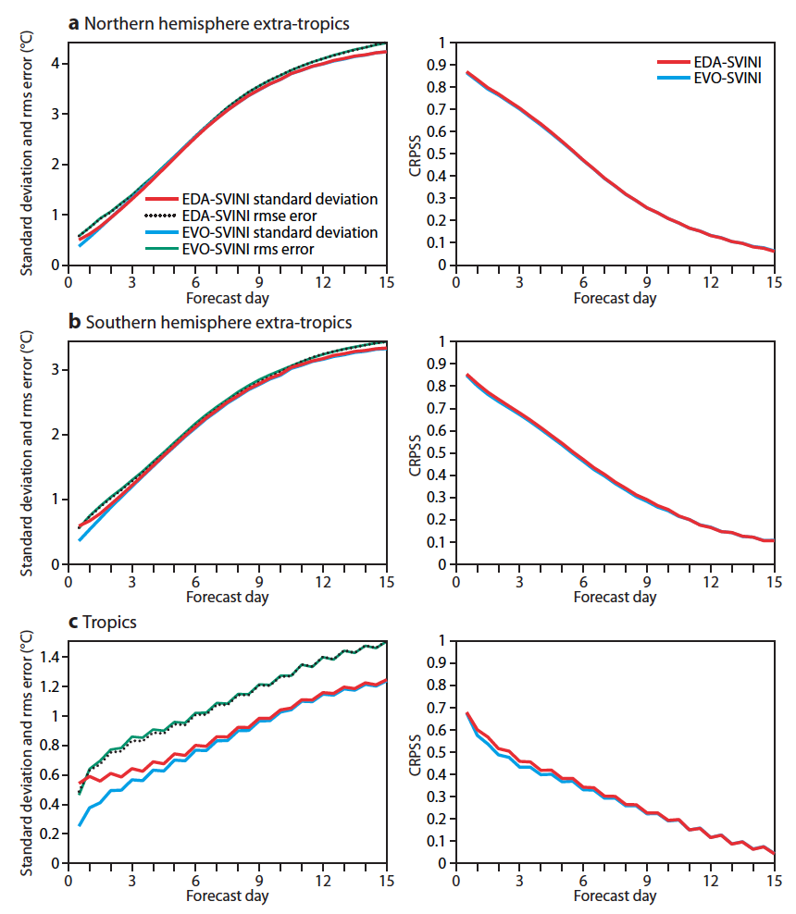
ECMWF: impact of EDA vs. old evolved singular vectors, T850
Ref: ibid

Slide 10
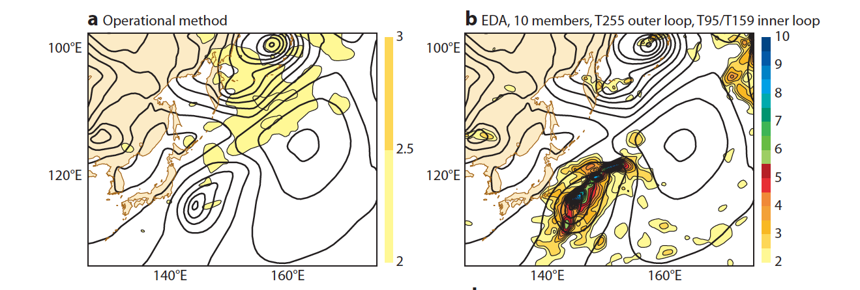
Use in data assimilation: ECMWF’s T850 wind background-error estimate, old and EDA
Still isotropic background-error covariances, at least at
beginning of assimilation window.
ovarianc
Ref: ibid

Slide 11
EnKF in comparison, uses ensemble to estimate covariance structure, too.
update to an observation 1K greater than mean background at dot.
Other practical advantages of EnKF are that (1) it’s comparatively easy to code and
maintain, and (2) it parallelizes rather easily. Main computational expense is
propagating the n forecasts forward to the next analysis time; with M processors
available, use M/n for each forecast. For the update, there are algorithms that
load-balance and achieve very good scaling.

Slide 12
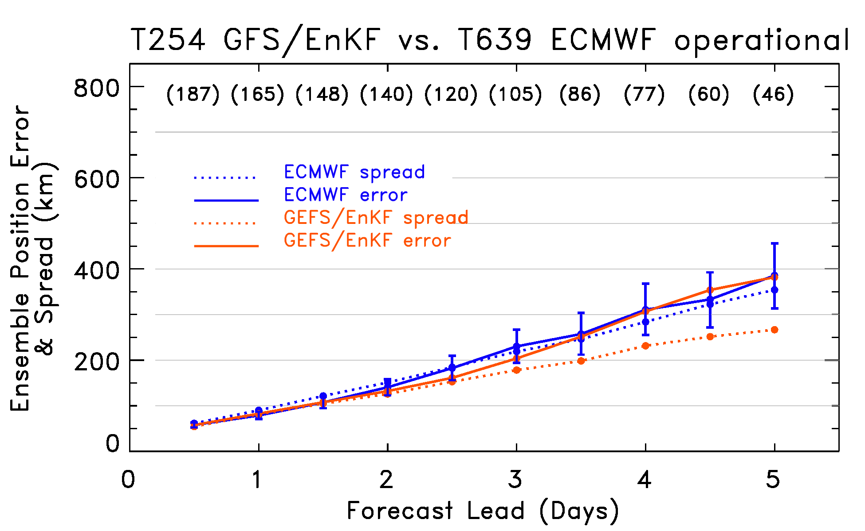
Global statistics, GFS/EnKF vs. ECMWF (ensemble statistics, 5 June to 21 Sep 2010; all basins together)
GFS/EnKF competitive despite lower resolution (T254 vs. ECMWF’s T639). GFS/EnKF has less
spread than error this year, more similar last year. Is this due to this year’s T254 vs.
last year’s T382?

Slide 13
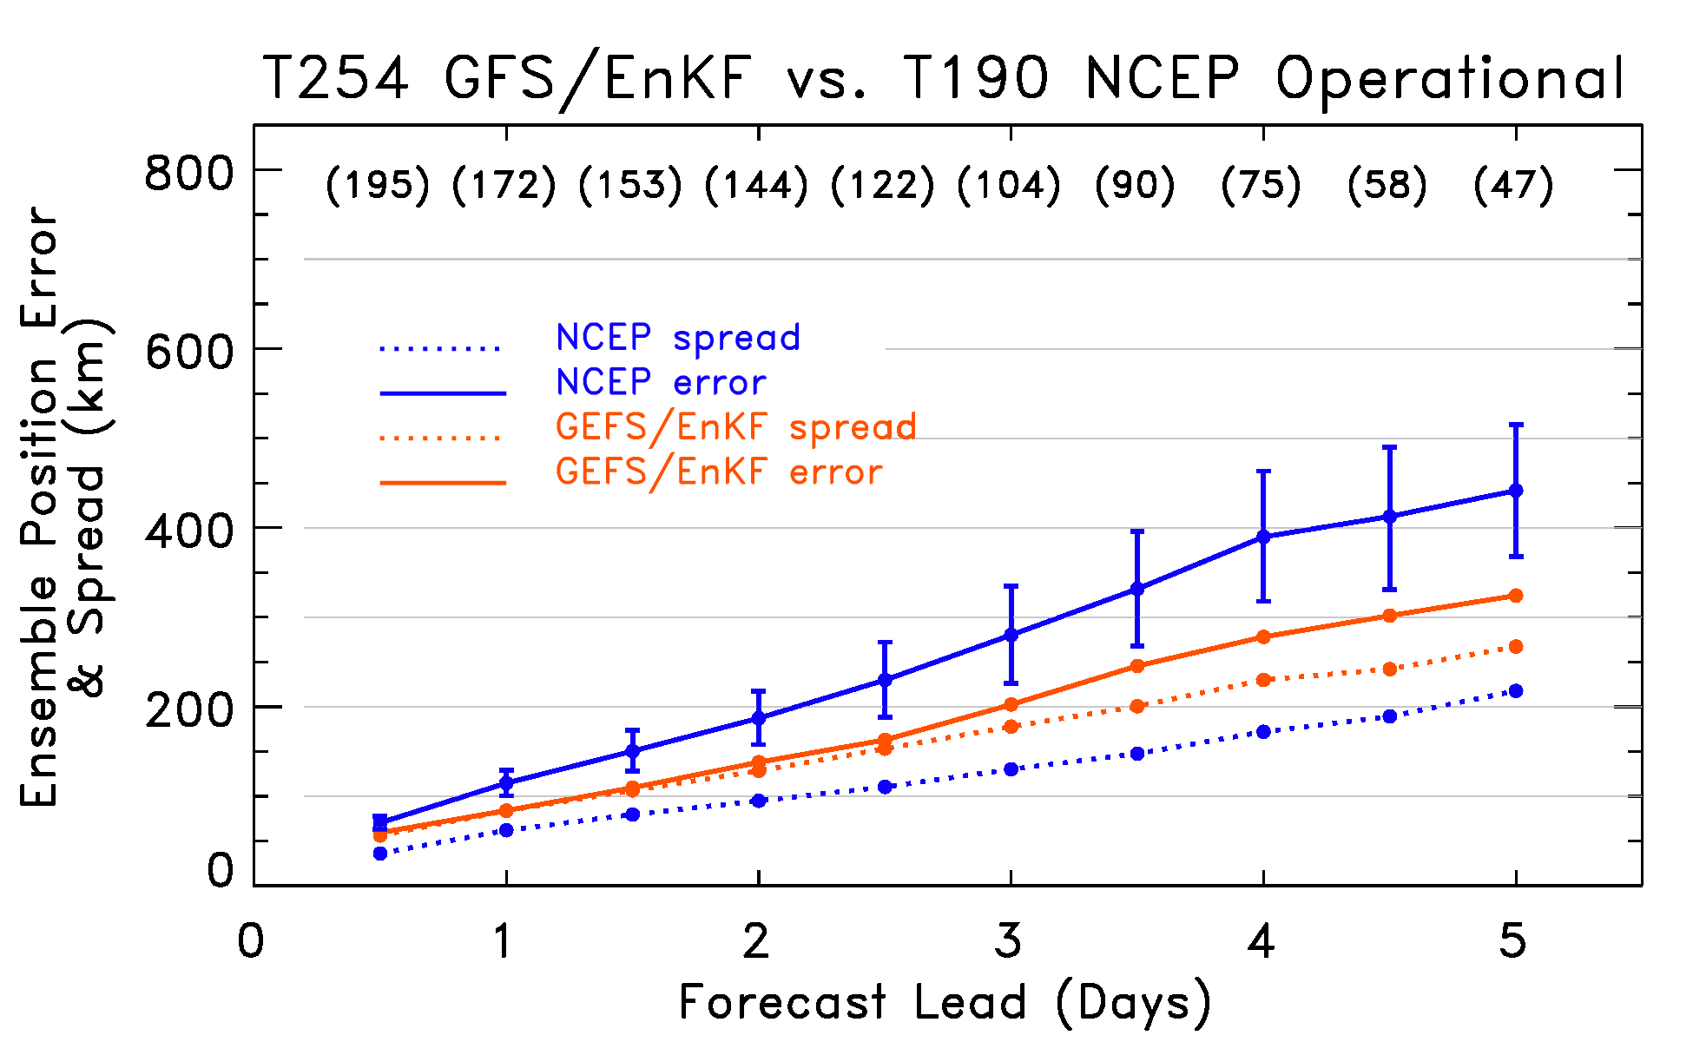
Global statistics, GFS/EnKF vs. NCEP
At most every lead, GFS/EnKF is statistically significantly better than NCEP operational ens.,
which uses (a) older GFS model, lower resolution; (b) ETR perturbations around GSI control,
and (c) vortex relocation.

Slide 14
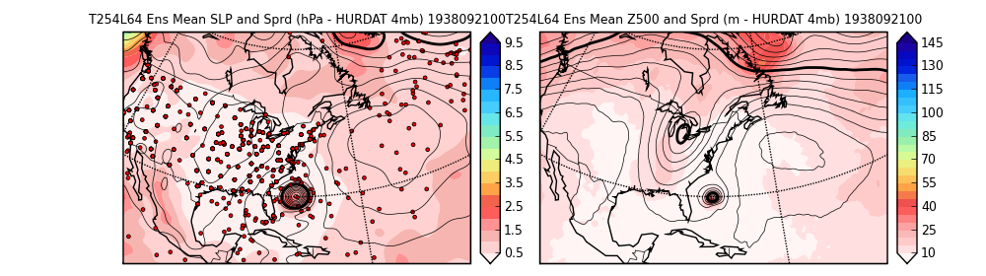
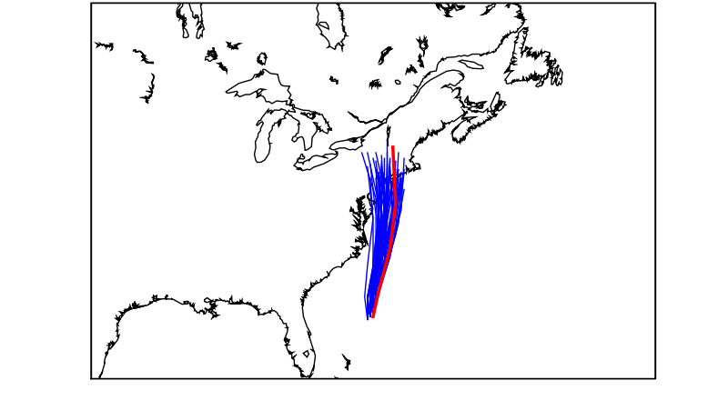
EnKF being used for climate reanalysis also (particularly advantageous with sparse data)
Reanalysis of the 1938 New England Hurricane using only p_{s} obs
MSLP (mean and spread, plus ob locations)
500 hPa height (mean and spread)
24-h track forecasts (red observed)
Notes:
As we will show, EnKF is particularly good at extracting info from sparse obs.

Slide 15
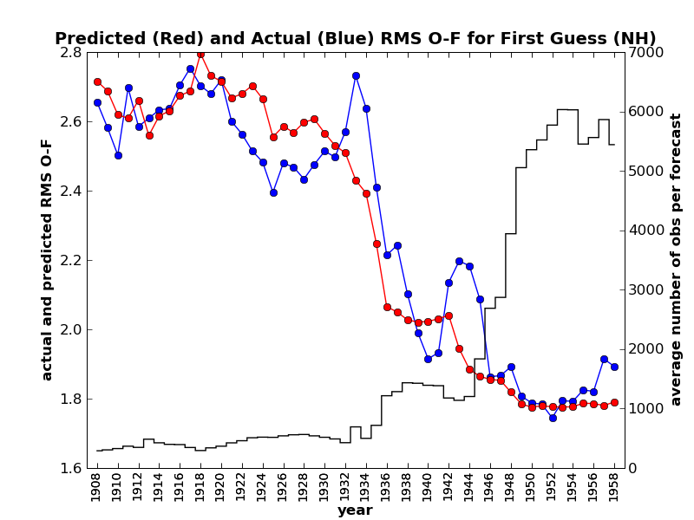
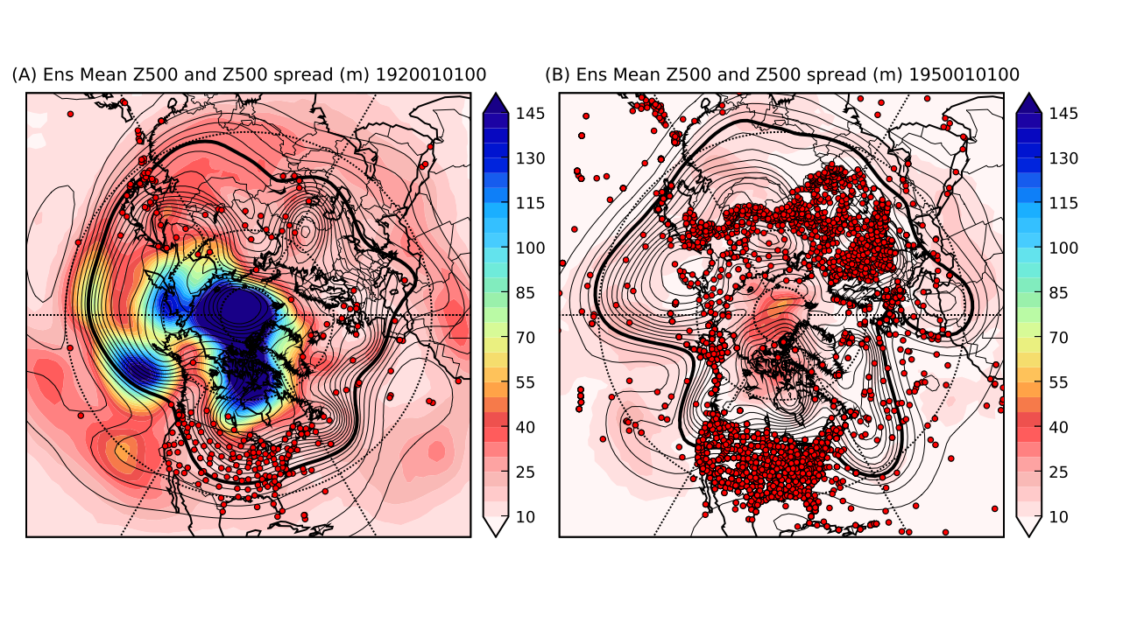
Estimating space and time-varying uncertainty in reanalyses (20th Century Reanalysis Project, led by Gil Compo)
# obs
EnKF accurately captures changing uncertainty as observing network changes.
Notes:
Reference Gil’s talk (poster?)
Doesn’t show application.

Slide 16
www.esrl.noaa.gov/psd/data/20thC_Rean

Slide 17
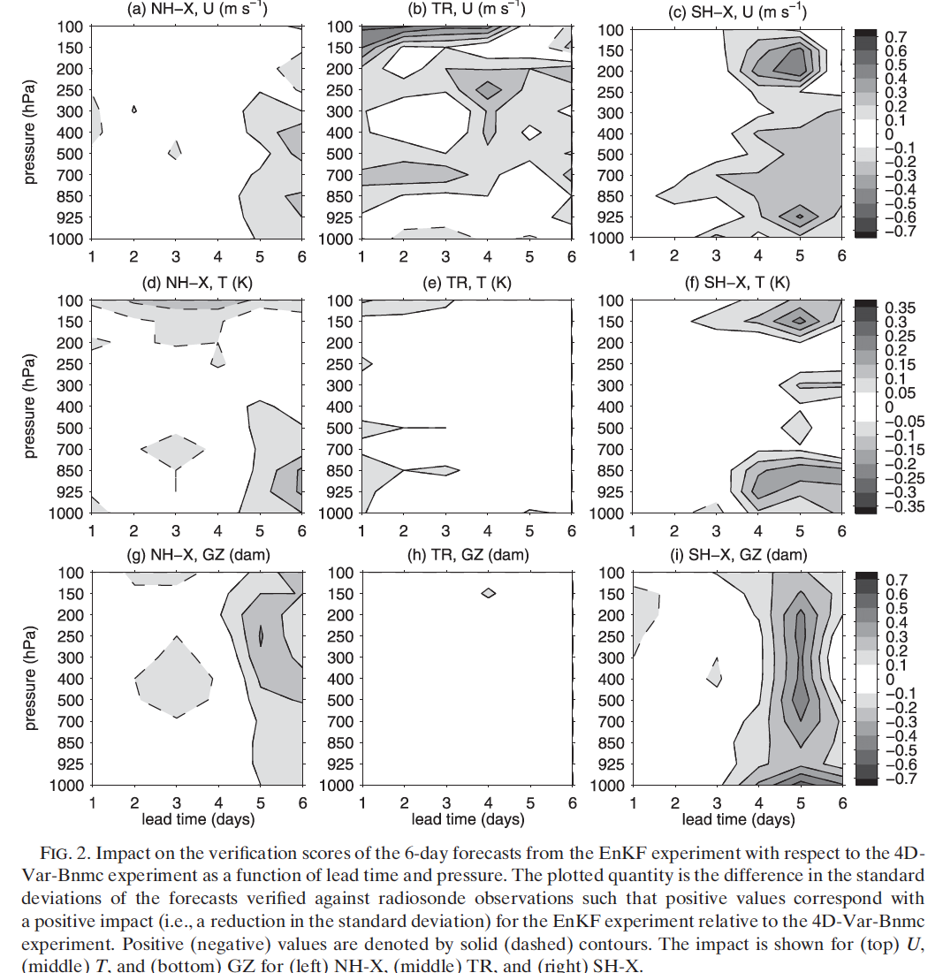
CMC’s comparison of EnKF vs. 4D-Var with static covariances
Ref: Buehner et al.,
MWR, 2010

Slide 18
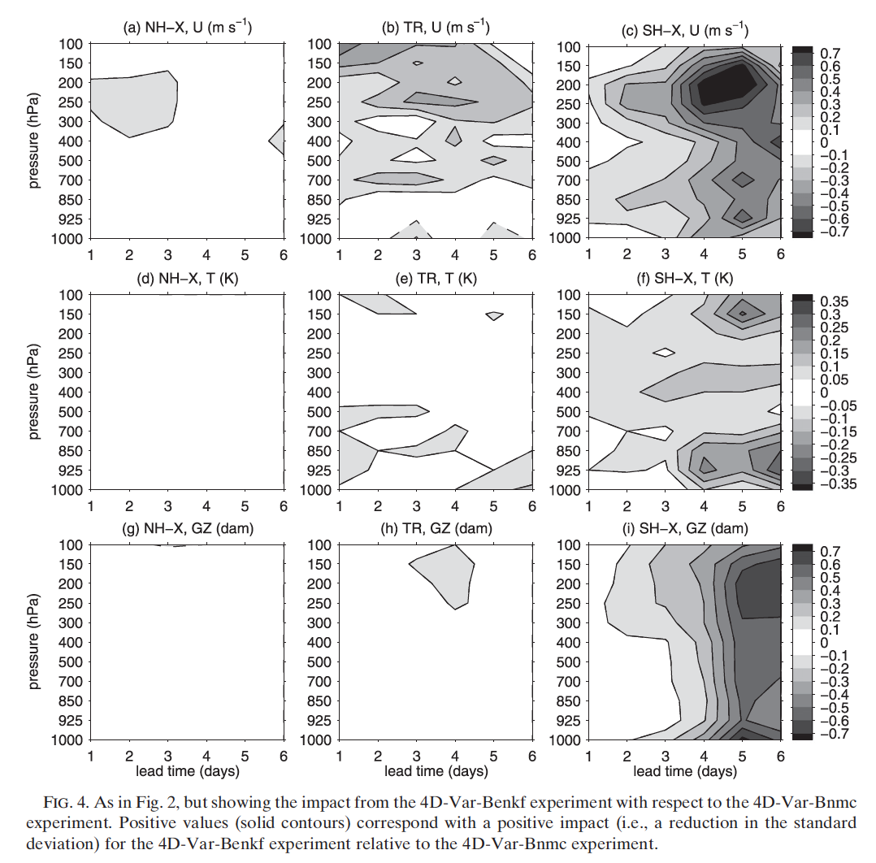
CMC’s hybrid, with EnKF covariances used in 4D-Var
ref: Buehner et
al., MWR, 2010

Slide 19
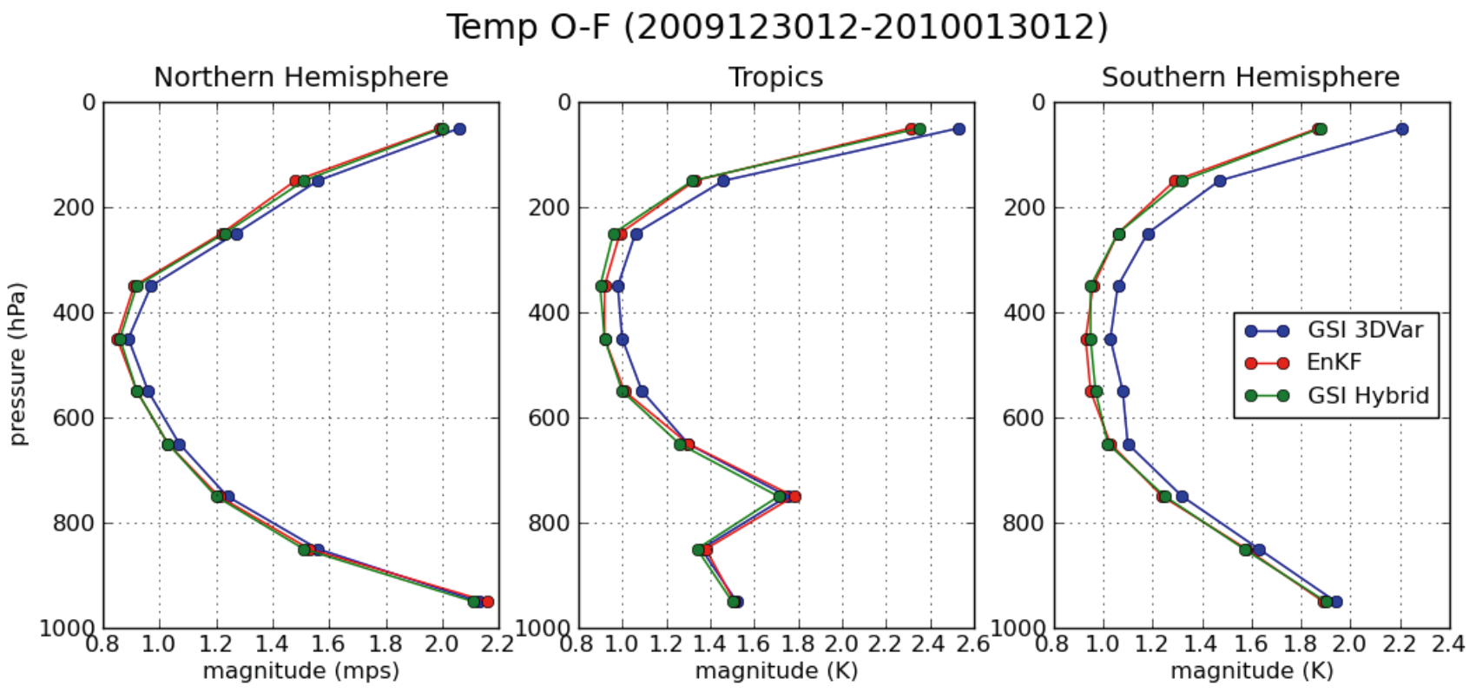
Preliminary EnKF-GSI hybrid results
In very early tests with little tuning, for temperature, EnKF-GSI and EnKF
comparable in error (50-50 split between GSI & EnKF covariances).

Slide 20
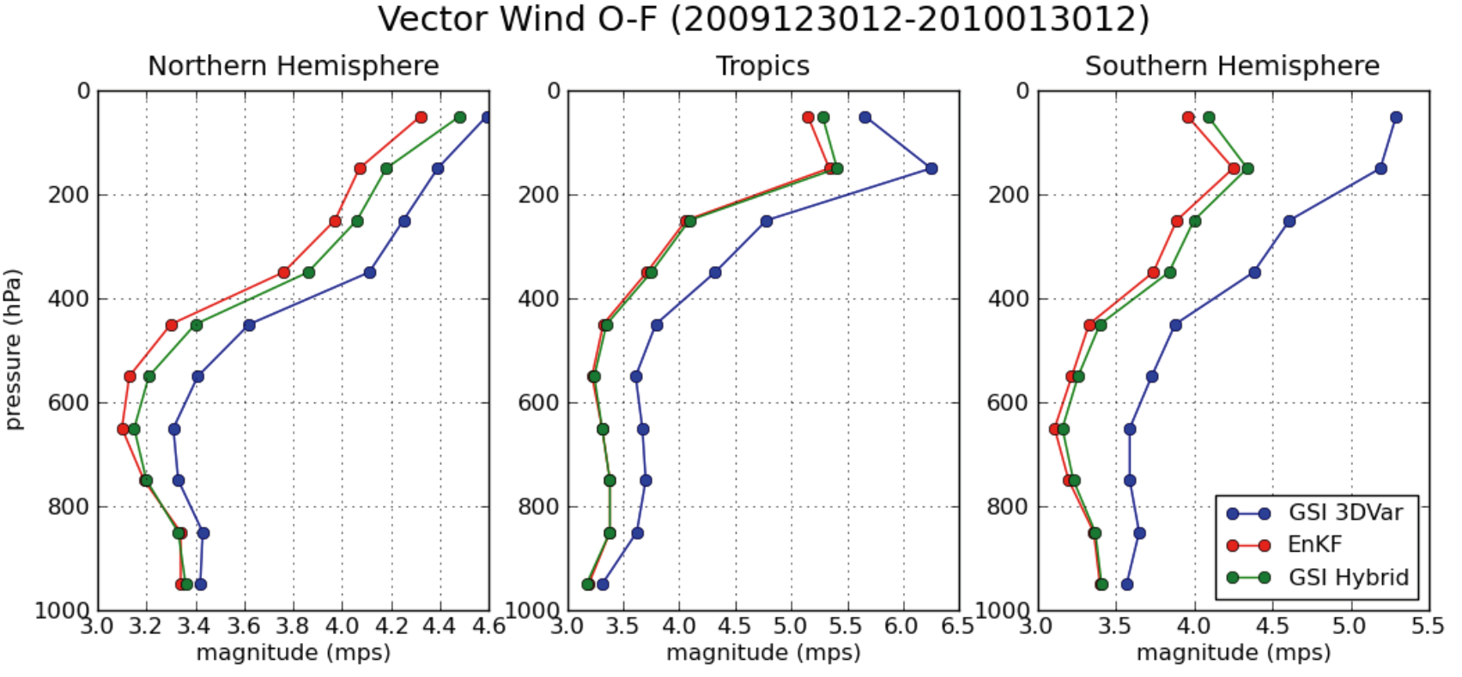
Preliminary EnKF-GSI hybrid results
For winds, EnKF-GSI slightly higher than EnKF outside of tropics. Operating hypothesis
is that EnKF can assimilate data over time window, while current hybrid can only assimilate
synoptic observations. This will not be the case with a 4D-Var hybrid. Also, room to
adjust how much to weight EnKF and XD-Var covariances. Hence, expect hybrid to improve.

Slide 21
Accounting for model uncertainty
Forecast error grows not only because of chaos, but because of model imperfections
limited resolution
bugs
less than ideally formulated (and deterministic) parameterizations
Remedies
multi-model ensembles
post-processing
stochastic elements introduced into forecast model.

Slide 22
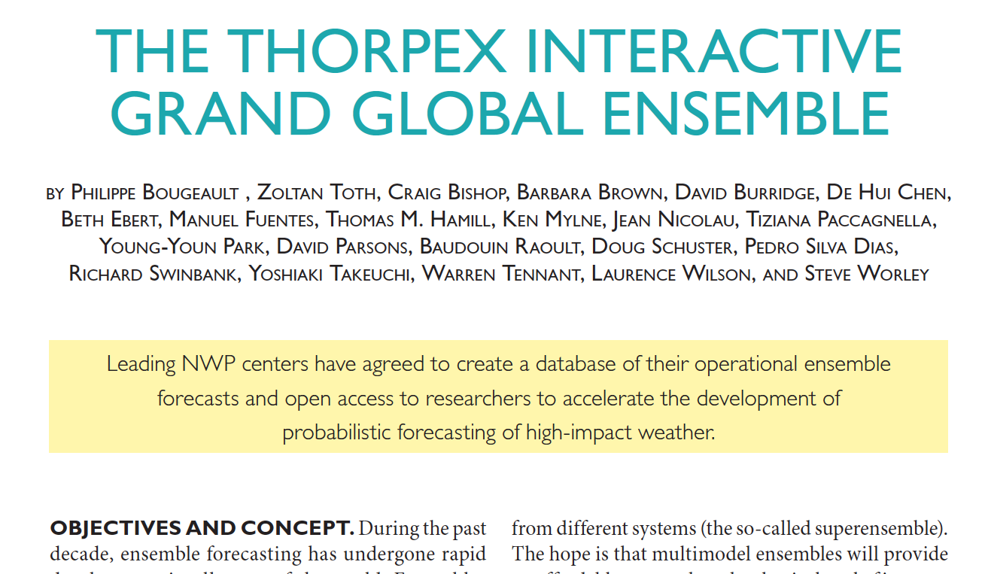
BAMS article, August 2010

Slide 23
Multi-model ensembles
Pros: Equally skillful, independently developed models make better probabilistic forecasts than what each produces individually.
Cons: what if talent and resources were pooled to develop one (or a few) really good models rather than disperse the effort? (as evidence, consider ECMWF vs. the rest of the TIGGE community).

Slide 24
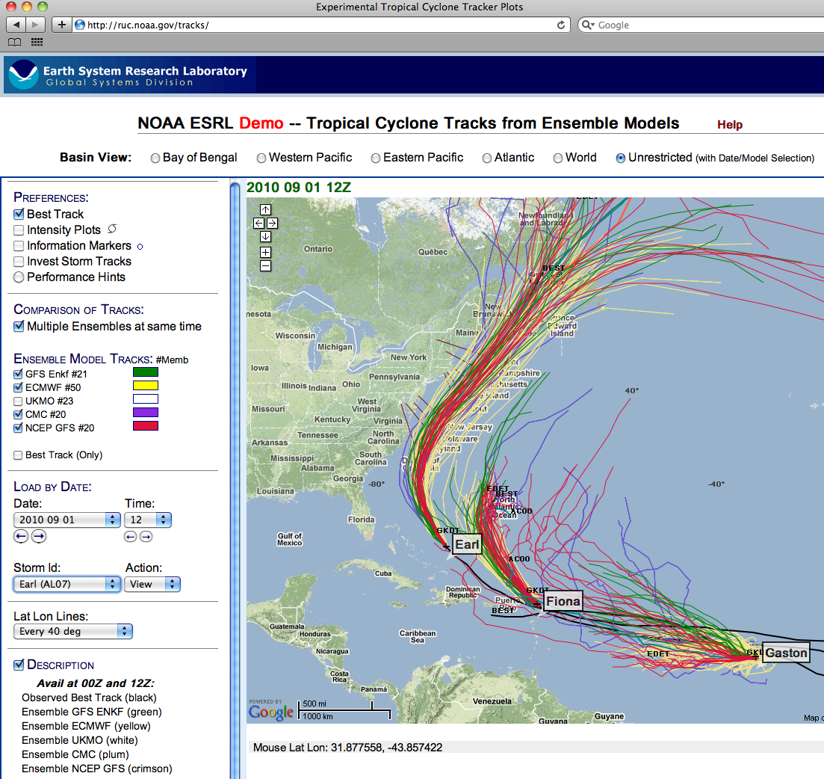

Slide 25
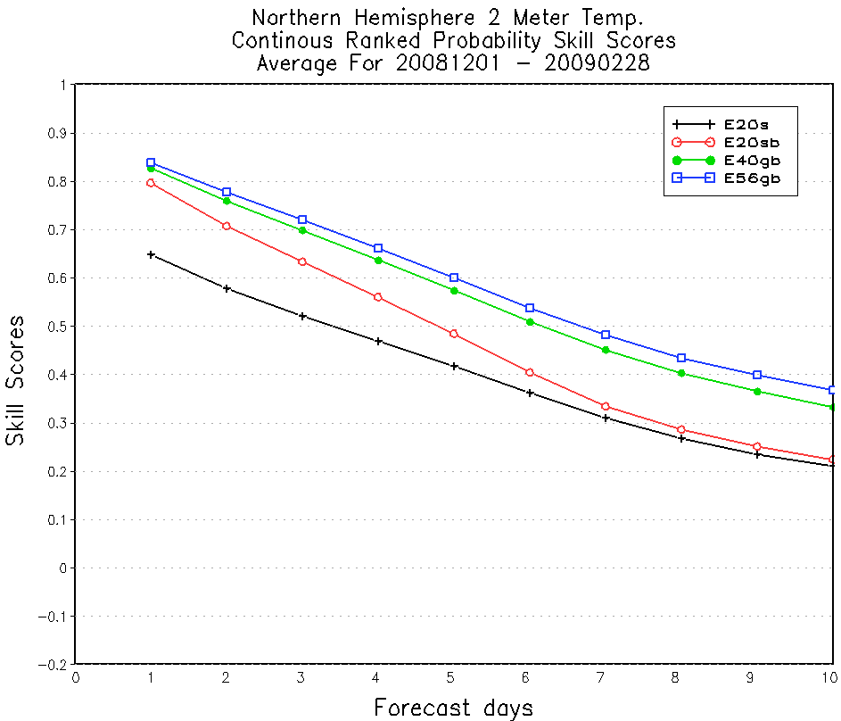
Pro: Example of multi-model improvement from NAEFS
Raw NCEP
Statistically adjusted NCEP
Adjusted NCEP + CMC
Adjusted NCEP + CMC + Navy

Slide 26
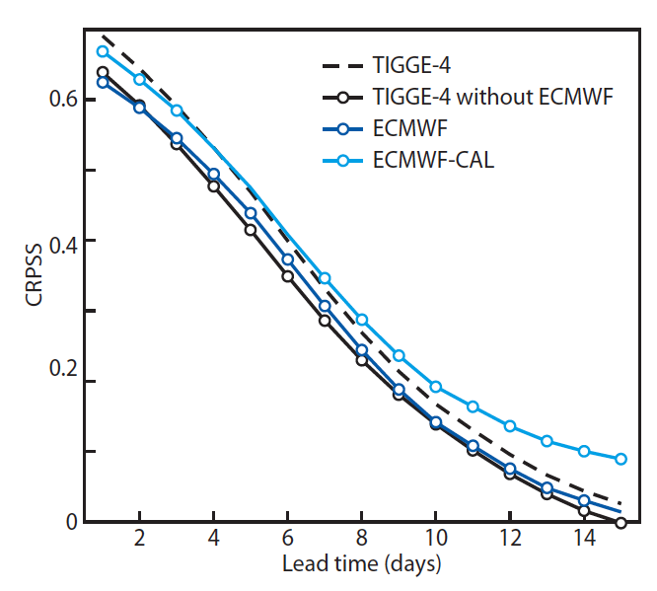
Con: T2m forecasts, ECMWF-reforecast vs. multi-model
TIGGE-4: combination of
ECMWF, CMC, NCEP, and
UKMO 30-day bias corrected
ensembles.
ECMWF-CAL: their forecasts,
corrected using a combination
of previous 30-day bias and
20-year reforecast using “nonhomogeneous Gaussian
regression.”
Here, ERA-Interim used for
verification (controversial,
since analyses have biases.
However, verification against
station obs similar).
Ref: Hagedorn et al. 2010, MWR, conditionally accepted.

Slide 27
Potential value of reforecast approach
Post-processing with large training data set can permit small-scale detail to be inferred
from large-scale, coarse model fields. Large training data set especially helpful with rare
events.

Slide 28
NOAA to generate new reforecast data set
Will generate 11-member ensemble to 16 days lead using GFS every day over 30-year period.
Data set to be freely available, hopefully by mid 2011.
Common variables like those from TIGGE data set available on fast-access archive.
Full model fields archived to tape.
Will continue to run model in real time, somehow, somewhere (either at NOAA’s EMC or ESRL)

Slide 29
Some recent work on stochastic parameterizations
Stochastically perturbed physical tendencies (ECMWF).
Stochastic backscatter (ECMWF, Met Office, CMC, others).
Stochastic convective parameterization (universities, Met Office, NOAA/ESRL, US Navy, others)
Field is in its relative infancy. WGNE/THORPEX Workshop at ECMWF planned, 11-14 June 2011.

Slide 30
Conclusions
EnKF rapidly moving from exotic technology to being widely exploited for data assimilation and ensemble prediction.
Statistical post-processing and multi-model techniques may be helpful.
Physically plausible stochastic methods to treat model uncertainty the next frontier
discussion of June 2011 workshop later in WGNE

