Slide 1
NOAA's Key Scientific Needs for Improving Sub-seasonal to Seasonal (S2S) Forecasts.
Tom Hamill
NOAA Earth System Research Lab, Physical Sciences Division
Boulder, Colorado
(303) 497-3060 ; tom.hamill@noaa.gov
seminar to University of Michigan CLaSP, 27 March 2018

Slide 2
NOAA’s mission
“To understand and predict changes in climate, weather, oceans, and coasts, to share that knowledge and information with others, and to conserve and manage coastal and marine ecosystems and resources. Dedicated to the understanding and stewardship of the environment.”
NOAA is a service agency (providing forecasts) – this differs from the NSF, with a research mission. Hence the weather research that NOAA funds is directed toward improved prediction.

Slide 3
Topics today
Why NOAA’s increased interest in S2S forecasts?
NOAA’s NGGPS and S2S projects
S2S predictability: potential sources of skill for S2S forecasts, and research challenges/needs to model them correctly.
S2S forecast initialization: coupled data assimilation, R&D needs.
Observations and other data sets needed to advance S2S prediction.
Statistical postprocessing for S2S & needed R&D.
Your feedback:
Are we missing key areas where research is needed?
Your view of the role of UM and sister institutions in helping NOAA.

Slide 4
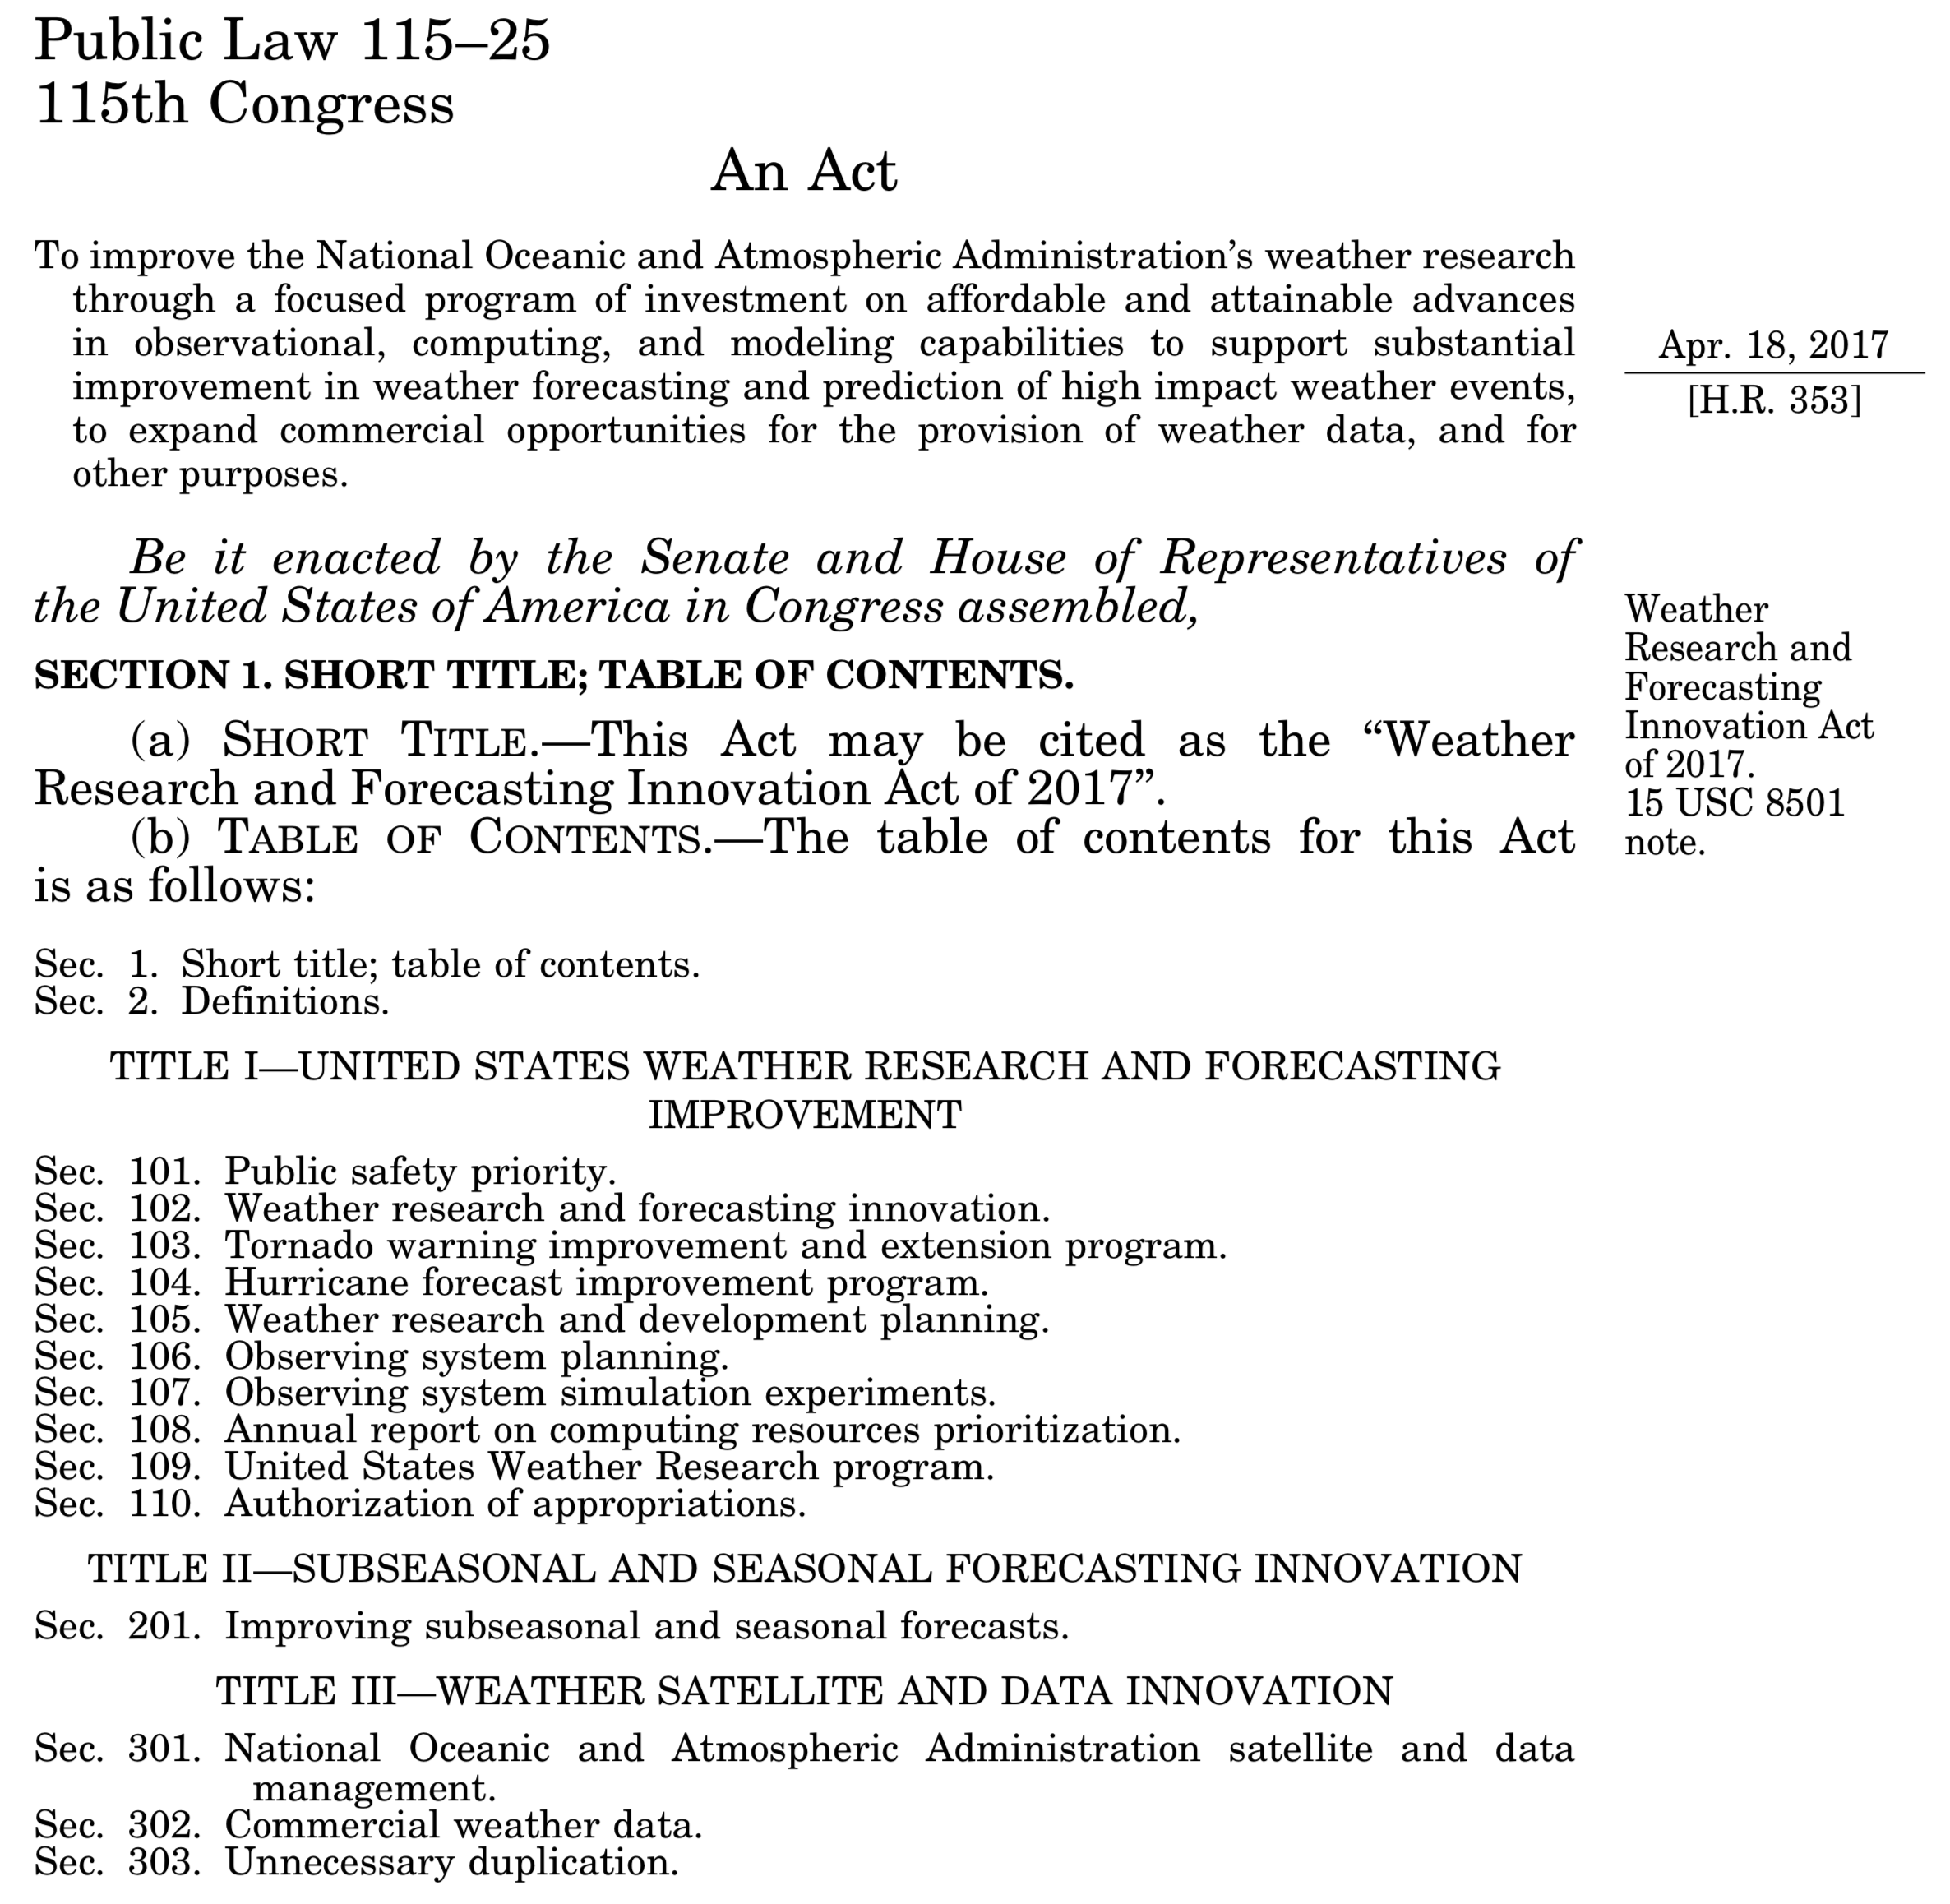
Weather Research
and Forecast
Innovation Act
of 2017
Sub-seasonal: 2 weeks - 2 months
Seasonal: 3 months - 2 years
Many other agencies in the government as well as the private sector are requesting improved S2S forecasts from NOAA.

Slide 5
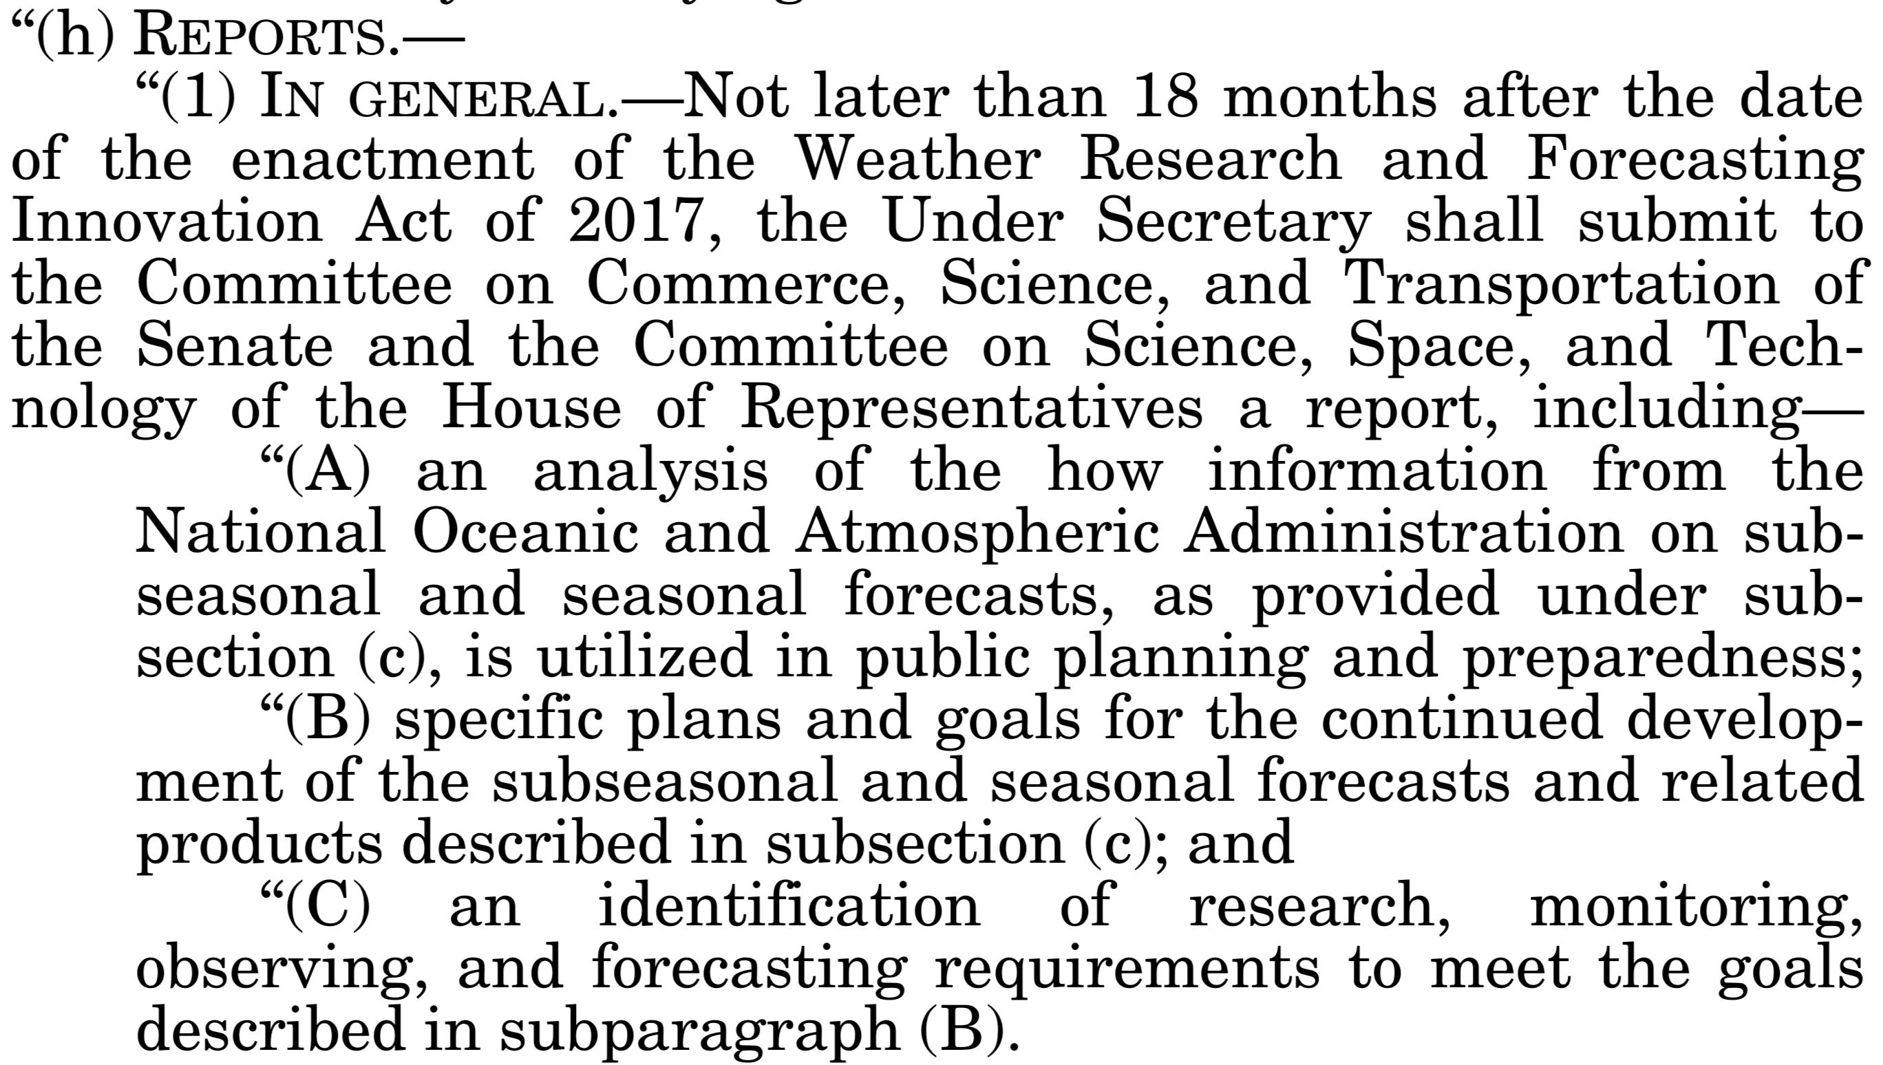
S2S
verbiage
in the bill.
Note the
strong interest
in improved
operational
prediction

Slide 6
R&D directed
to operational
improvement.
This is what
my colleagues
and I are
actively
writing now.

Slide 7
Via:
a diverse writing team.
posting for comment in the Federal Register, and
feedback in seminars like this.

Slide 8
NGGPS and S2S programs
2014
2018
2022
Next-Generation Global Prediction System
Atmospheric dycore selection (FV3)
Coupling component systems via NEMS →
Parameterization development & more →
GEFS reanalysis, reforecast data sets
Deploy community system
Implement GFS to +10 days
Implement GEFS to +35 days
etc.
System
• NOAA will expect its funded S2S R&D development to leverage NGGPS community system and to improve NGGPS, not other systems.
• Follow the ECMWF paradigm; concentrate
resources to develop one great system. Multi-model internationally, perhaps not nationally.
• S2S: build out from week +3 to week +4 to month to season to inter-annual.
Upcoming S2S project
Prediction system improvements related to S2S;
others will still handled through NGGPS.

Slide 9
S2S predictability and prediction: (1) potential sources of skill for S2S forecasts (2) research challenges/needs to model them correctly

Slide 10
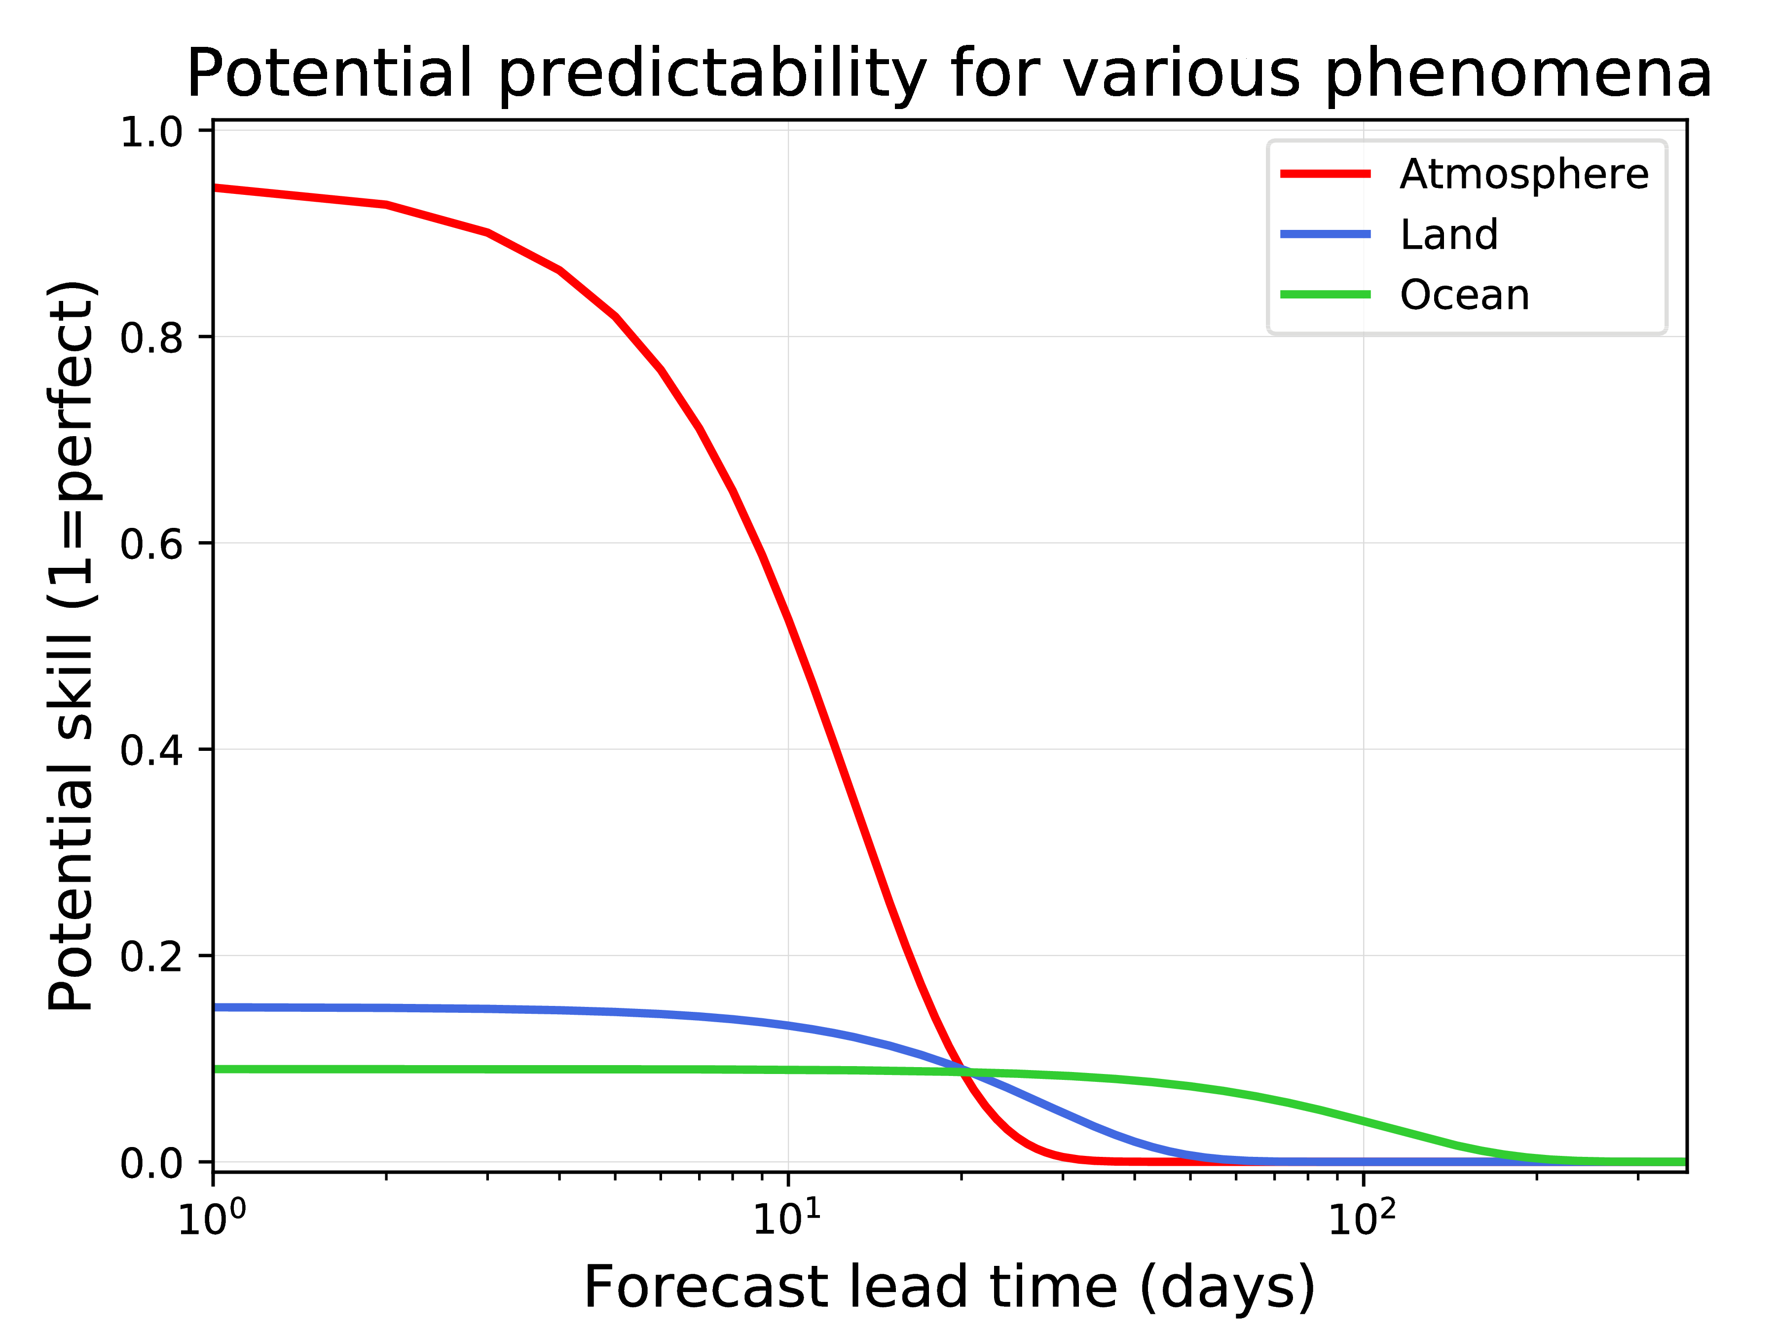
Each curve represents roughly the forecast skill in current prediction systems at a continental location in the absence of information on the other two state components.
This is conceptual – absolute values not to be trusted.

Slide 11
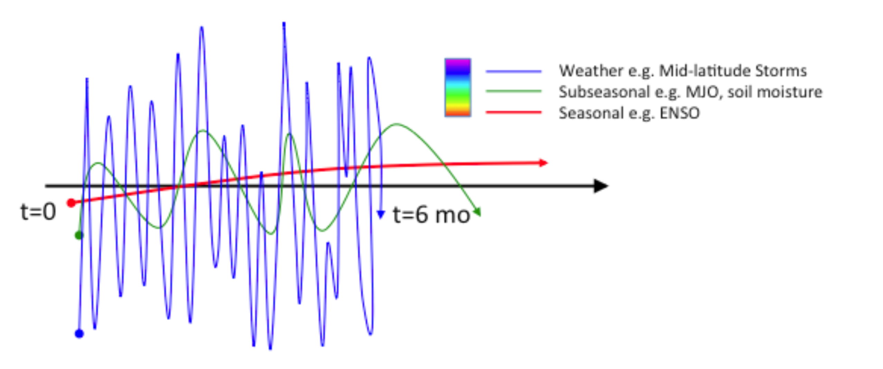
Weather, sub-seasonal, and seasonal variations.
Another way of thinking about this is that the
day-to-day weather mean and variability may be
modulated by more low-frequency variability
in atmosphere and boundary forcings.
from 2016 NAS report on S2S improvement, here.

Slide 12
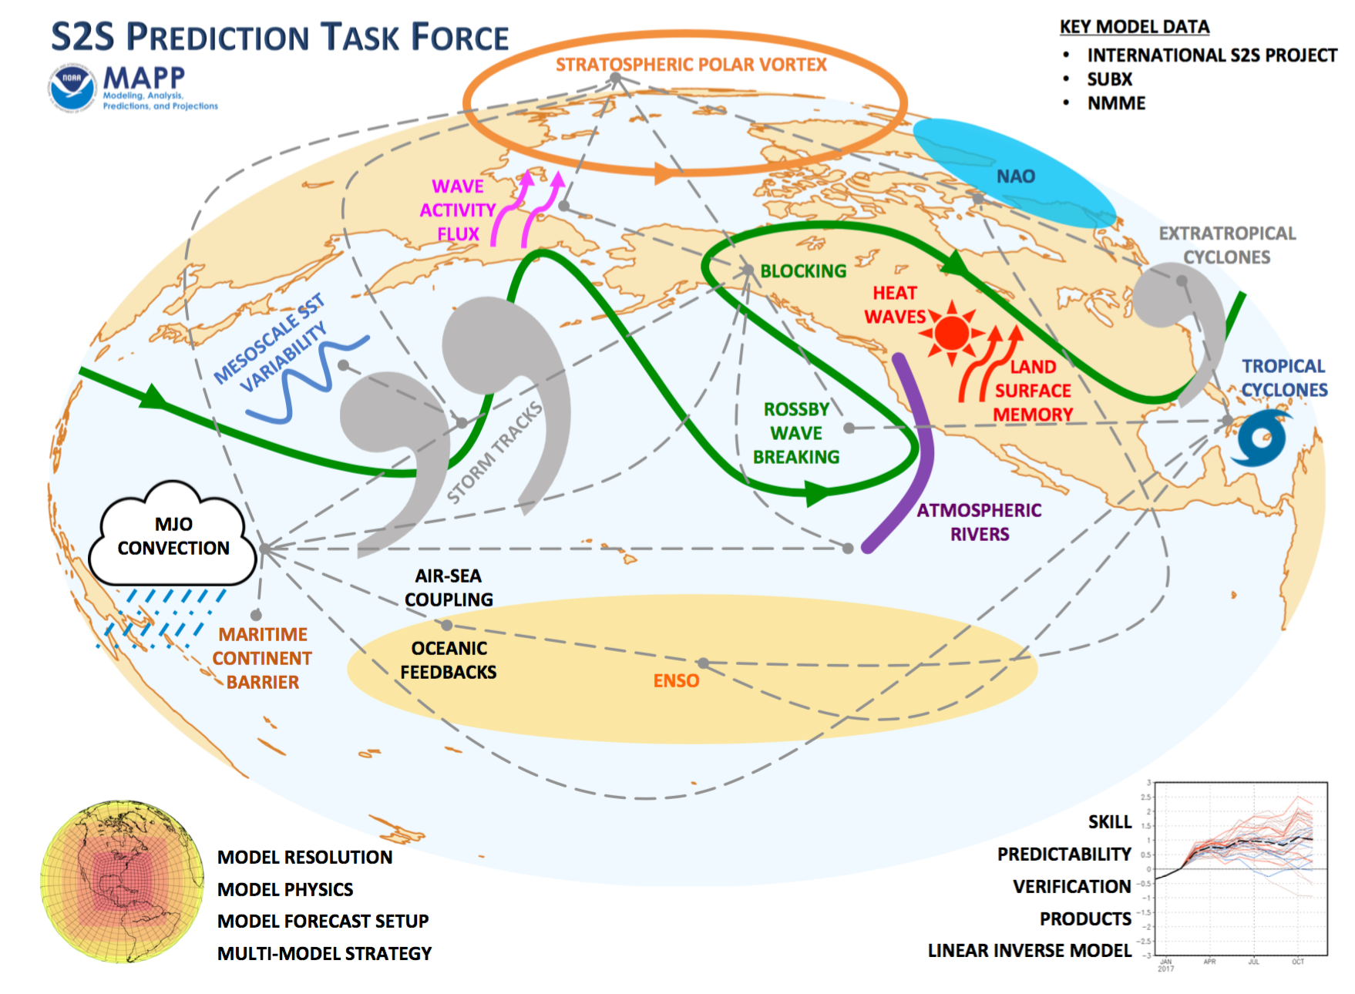
Inter-connected sources of skill for S2S forecasts, and research challenges in modeling them correctly.
Madden-Julian Oscillation
Polar stratospheric anomalies & NAO.
Blocking
Sea-surface temperature anomalies, especially El Nino/La Nina.
Land-surface state anomalies.
Snow anomalies
Sea-ice anomalies
and more.

Slide 13
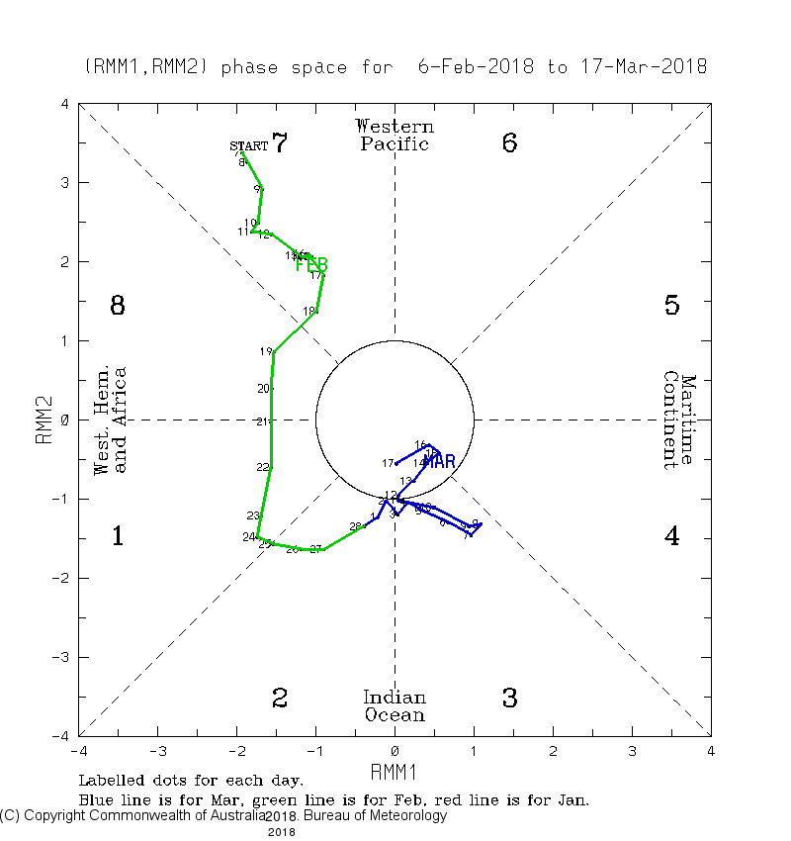
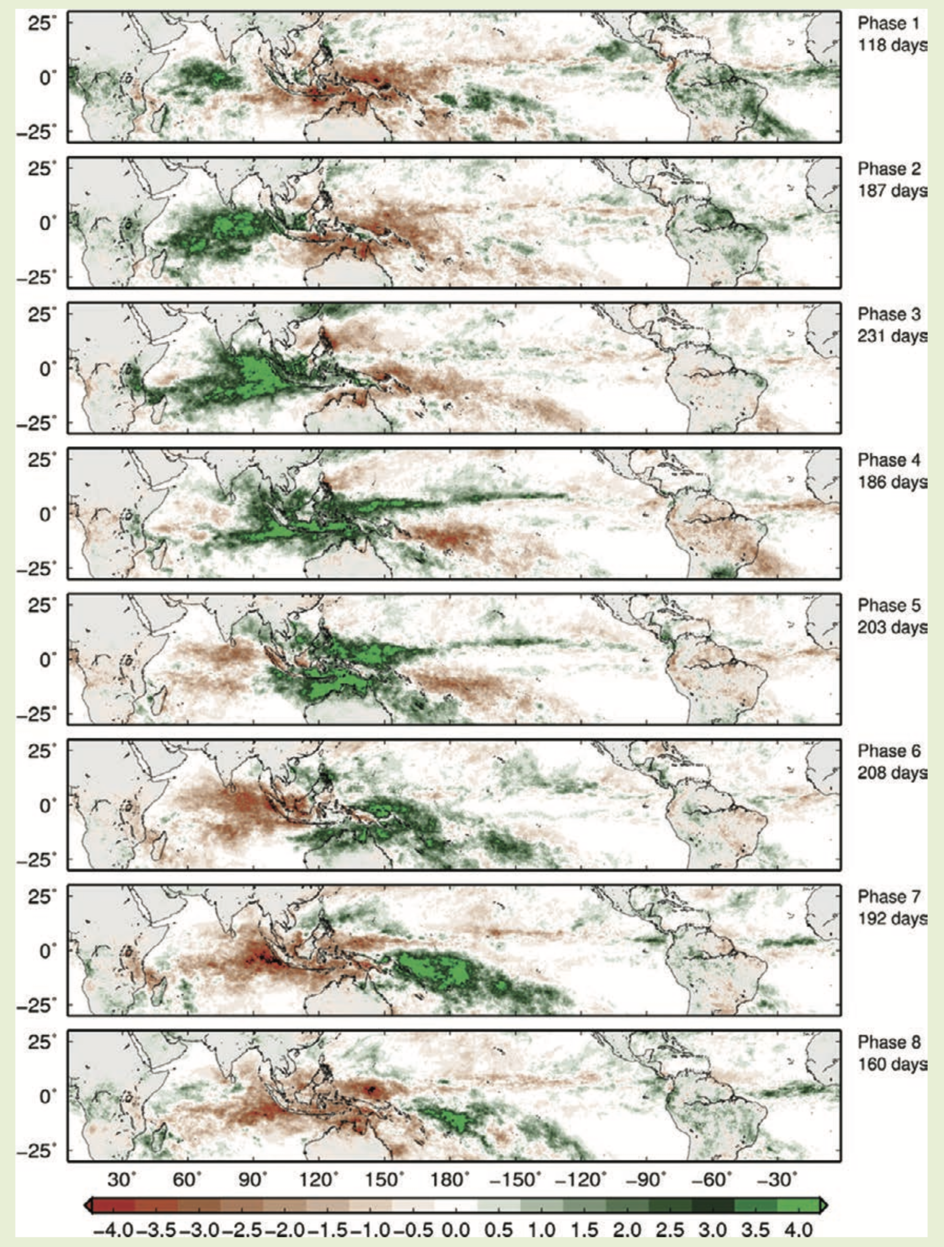
RMM1 and RMM2, the leading EOFs of MJO variability.
tropical
precipitation
anomalies
associated
with MJO
phases.
from Zhang 2013 BAMS, here.

Slide 14
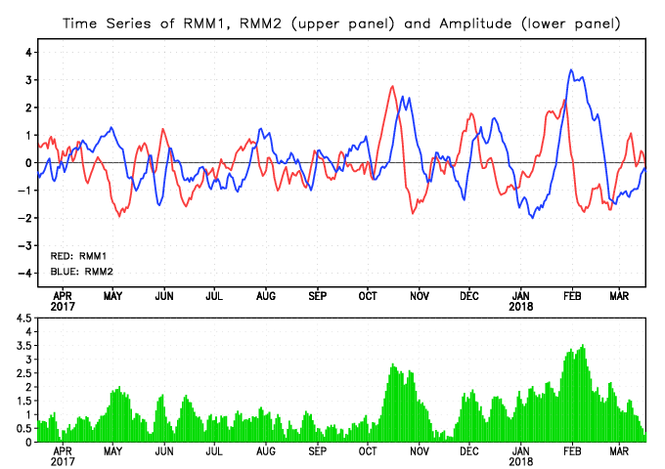
More on the MJO
It’s intermittently active (more in winter; left).
Modulates weather even far from the tropical Pacific, as the organized tropical convection forces mid-latitude Rossby wave train (right).
active
inactive
Illustration of the impact of the phase of the MJO and the rate of snow accumulation in the Sierras, adapted from Guan et al. (2012). The two left panels show outgoing longwave radiation anomalies relative to average conditions for phases 3 and 8 of the MJO. Blue colors indicate enhanced thunderstorm activity, orange colors indicate suppressed activity. The two right-hand panels show the contemporaneous changes in snow accumulation associated with Phases 3 and 8, illustrating how the MJO can modulate precipitation in California.
from https://ds.data.jma.go.jp/tcc/tcc/products/clisys/mjo/rmm.html

Slide 15
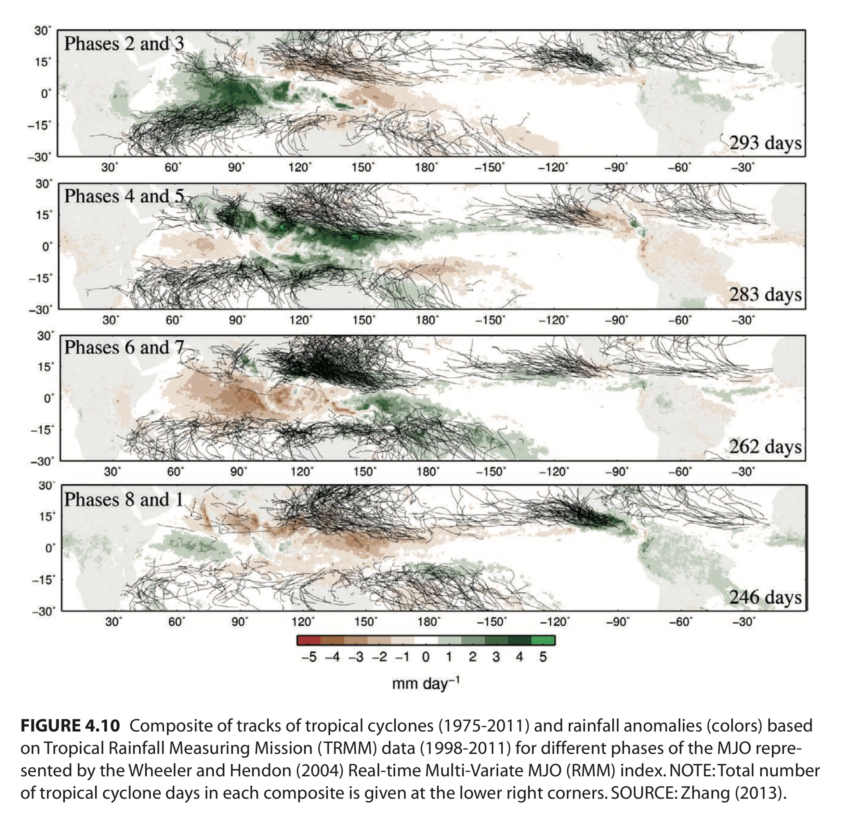
Modulation of tropical cyclone activity by MJO phase.

Slide 16
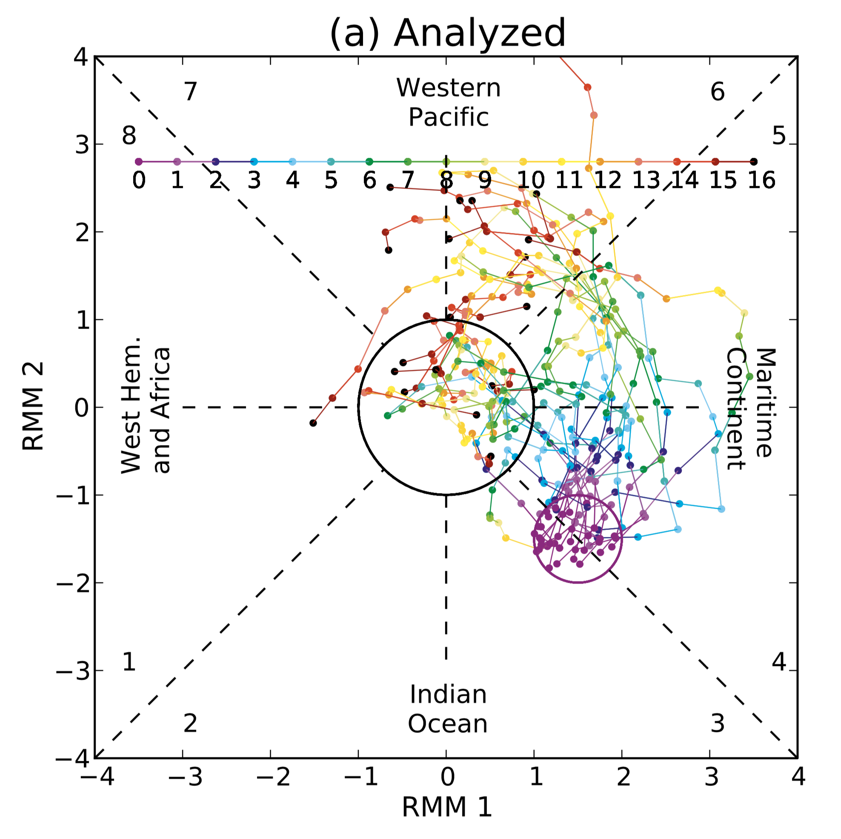
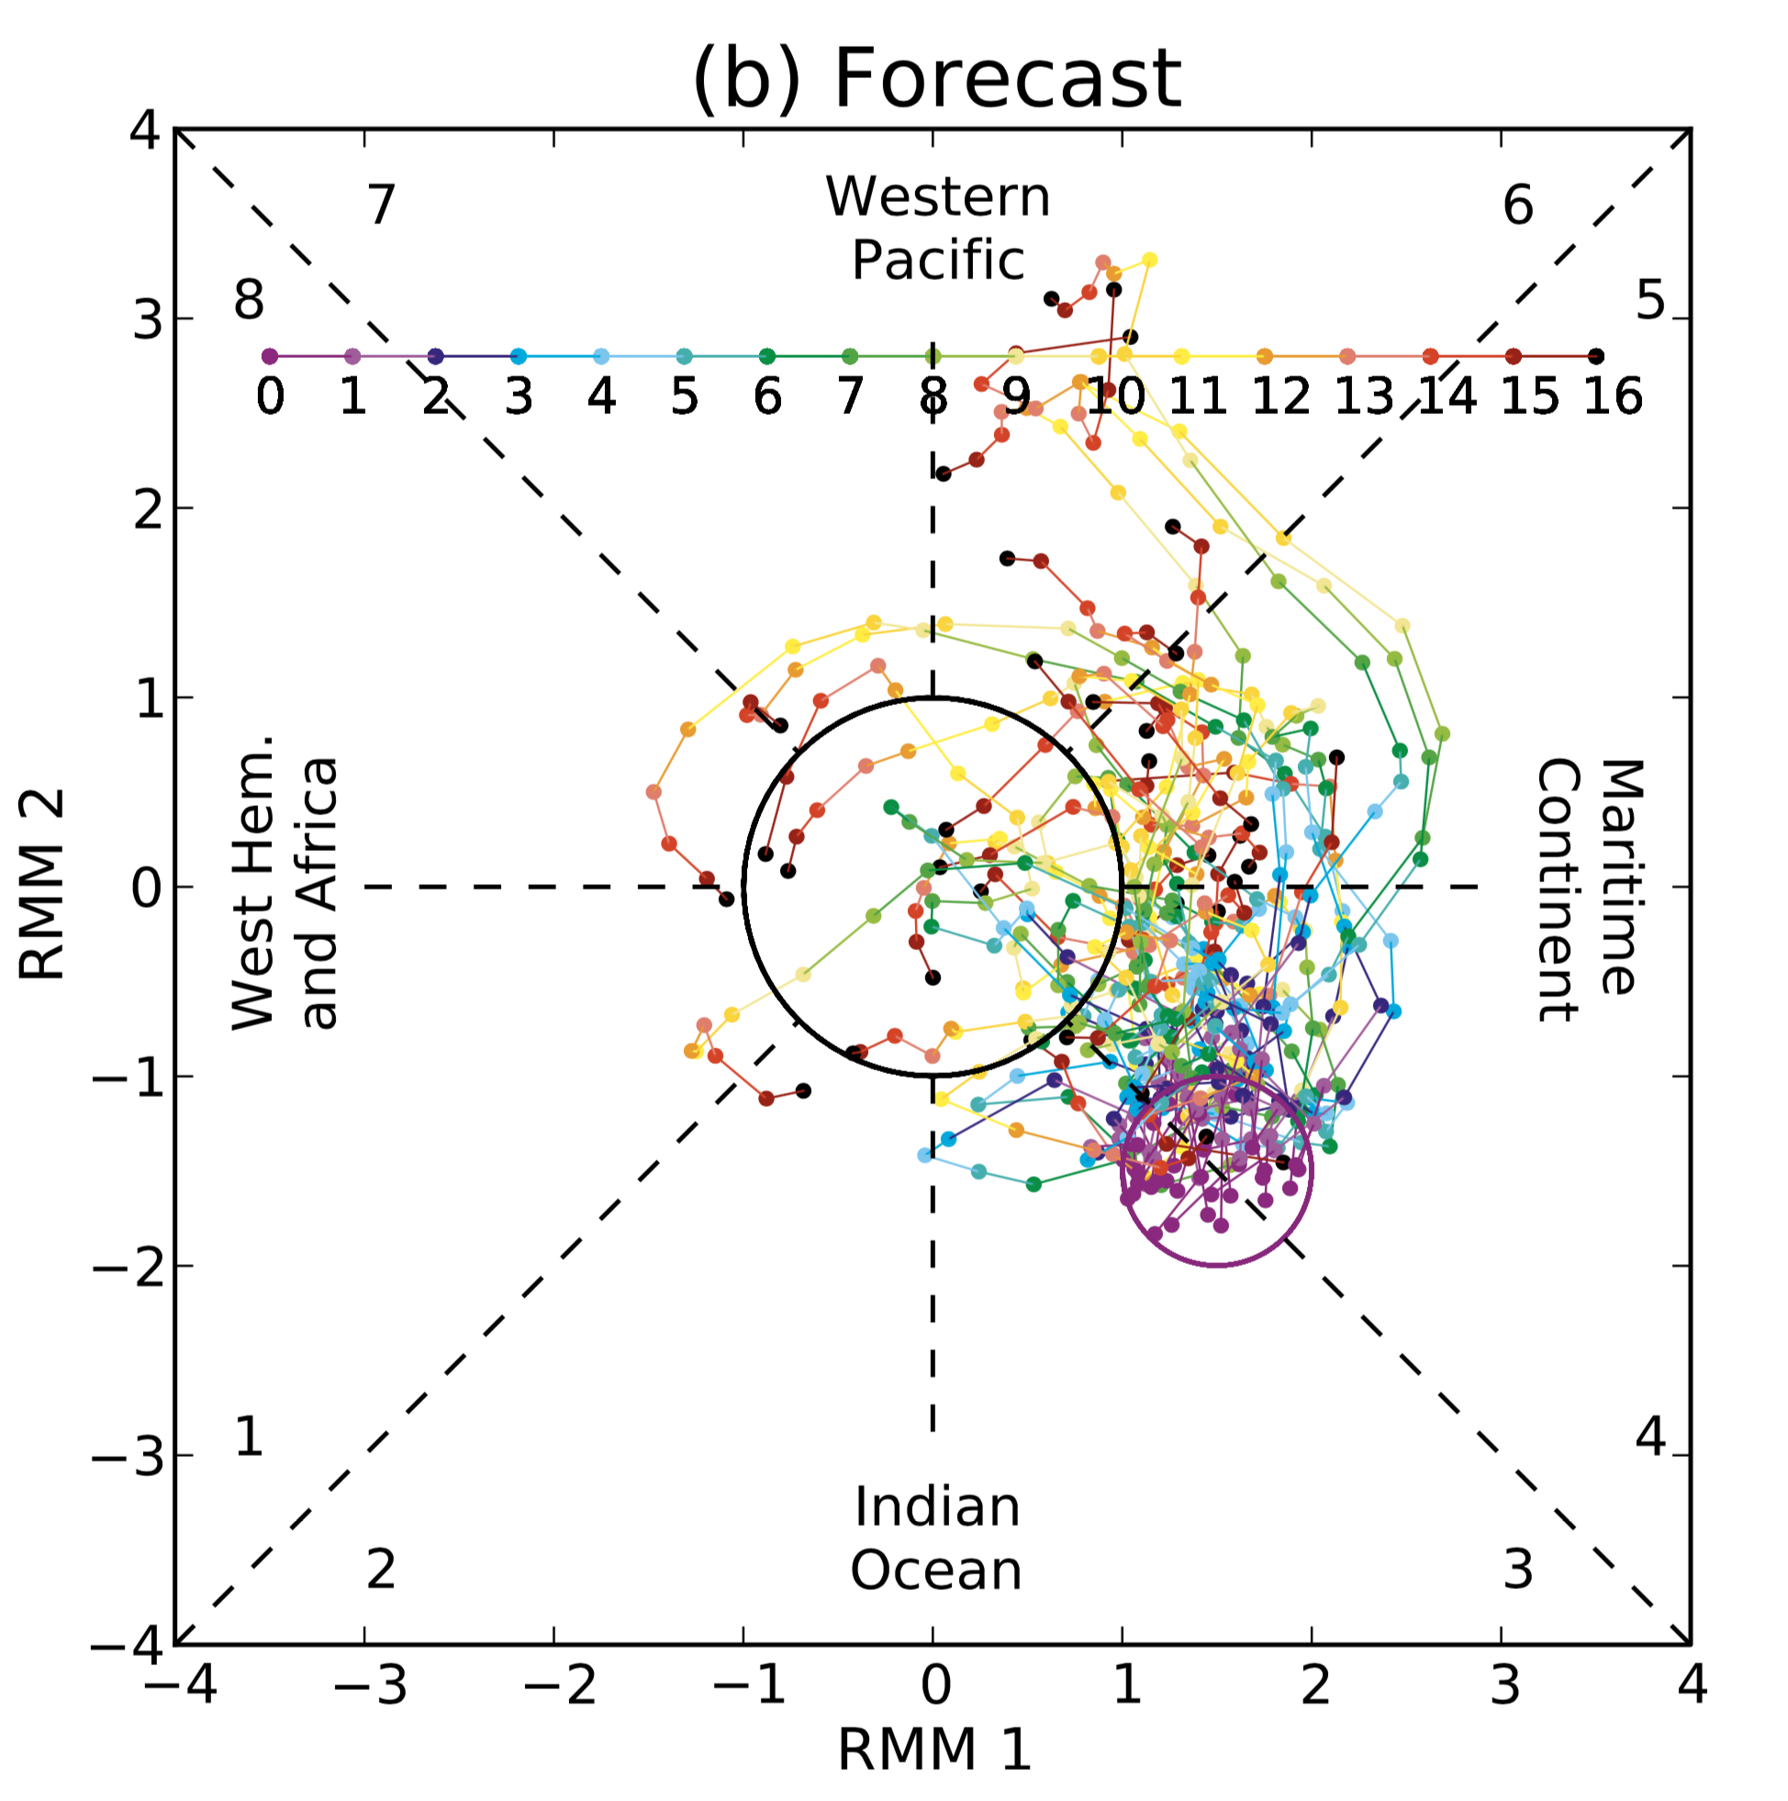
MJO intensity and propagation speed not well modeled in recent NCEP GEFS system.
Circa 2012 version
of GEFS tends to
decrease amplitude
of MJO and propagate
too slowly.
Probably several causes,
including convective
parameterization, lack of
proper stochastic physics,
modeling of SST
response to MJO
thunderstorms, & more.
The current poor
prediction and its effect
on US S2S forecasts
make this a key area of
R&D.
Ref: Hamill and Kiladis MWR 2014, here.

Slide 17
Suggested research needs to improve the MJO prediction.
Improved understanding.
Clarify and refine theory for MJO. Many competing theories now.
Quantify MJO predictability and predictability of teleconnections.
What hinders simulation of MJO propagation across maritime subcontinent?
Improve the prediction system:
Improve deep convective parameterization (NGGPS)
“Non-local” parameterizations.
Move away from deterministic to physically based stochastic parameterization.
Improve their interaction with other parameterizations, including radiation, ocean-surface flux, and boundary layer. (NGGPS)
Some other recs here, also here.

Slide 18
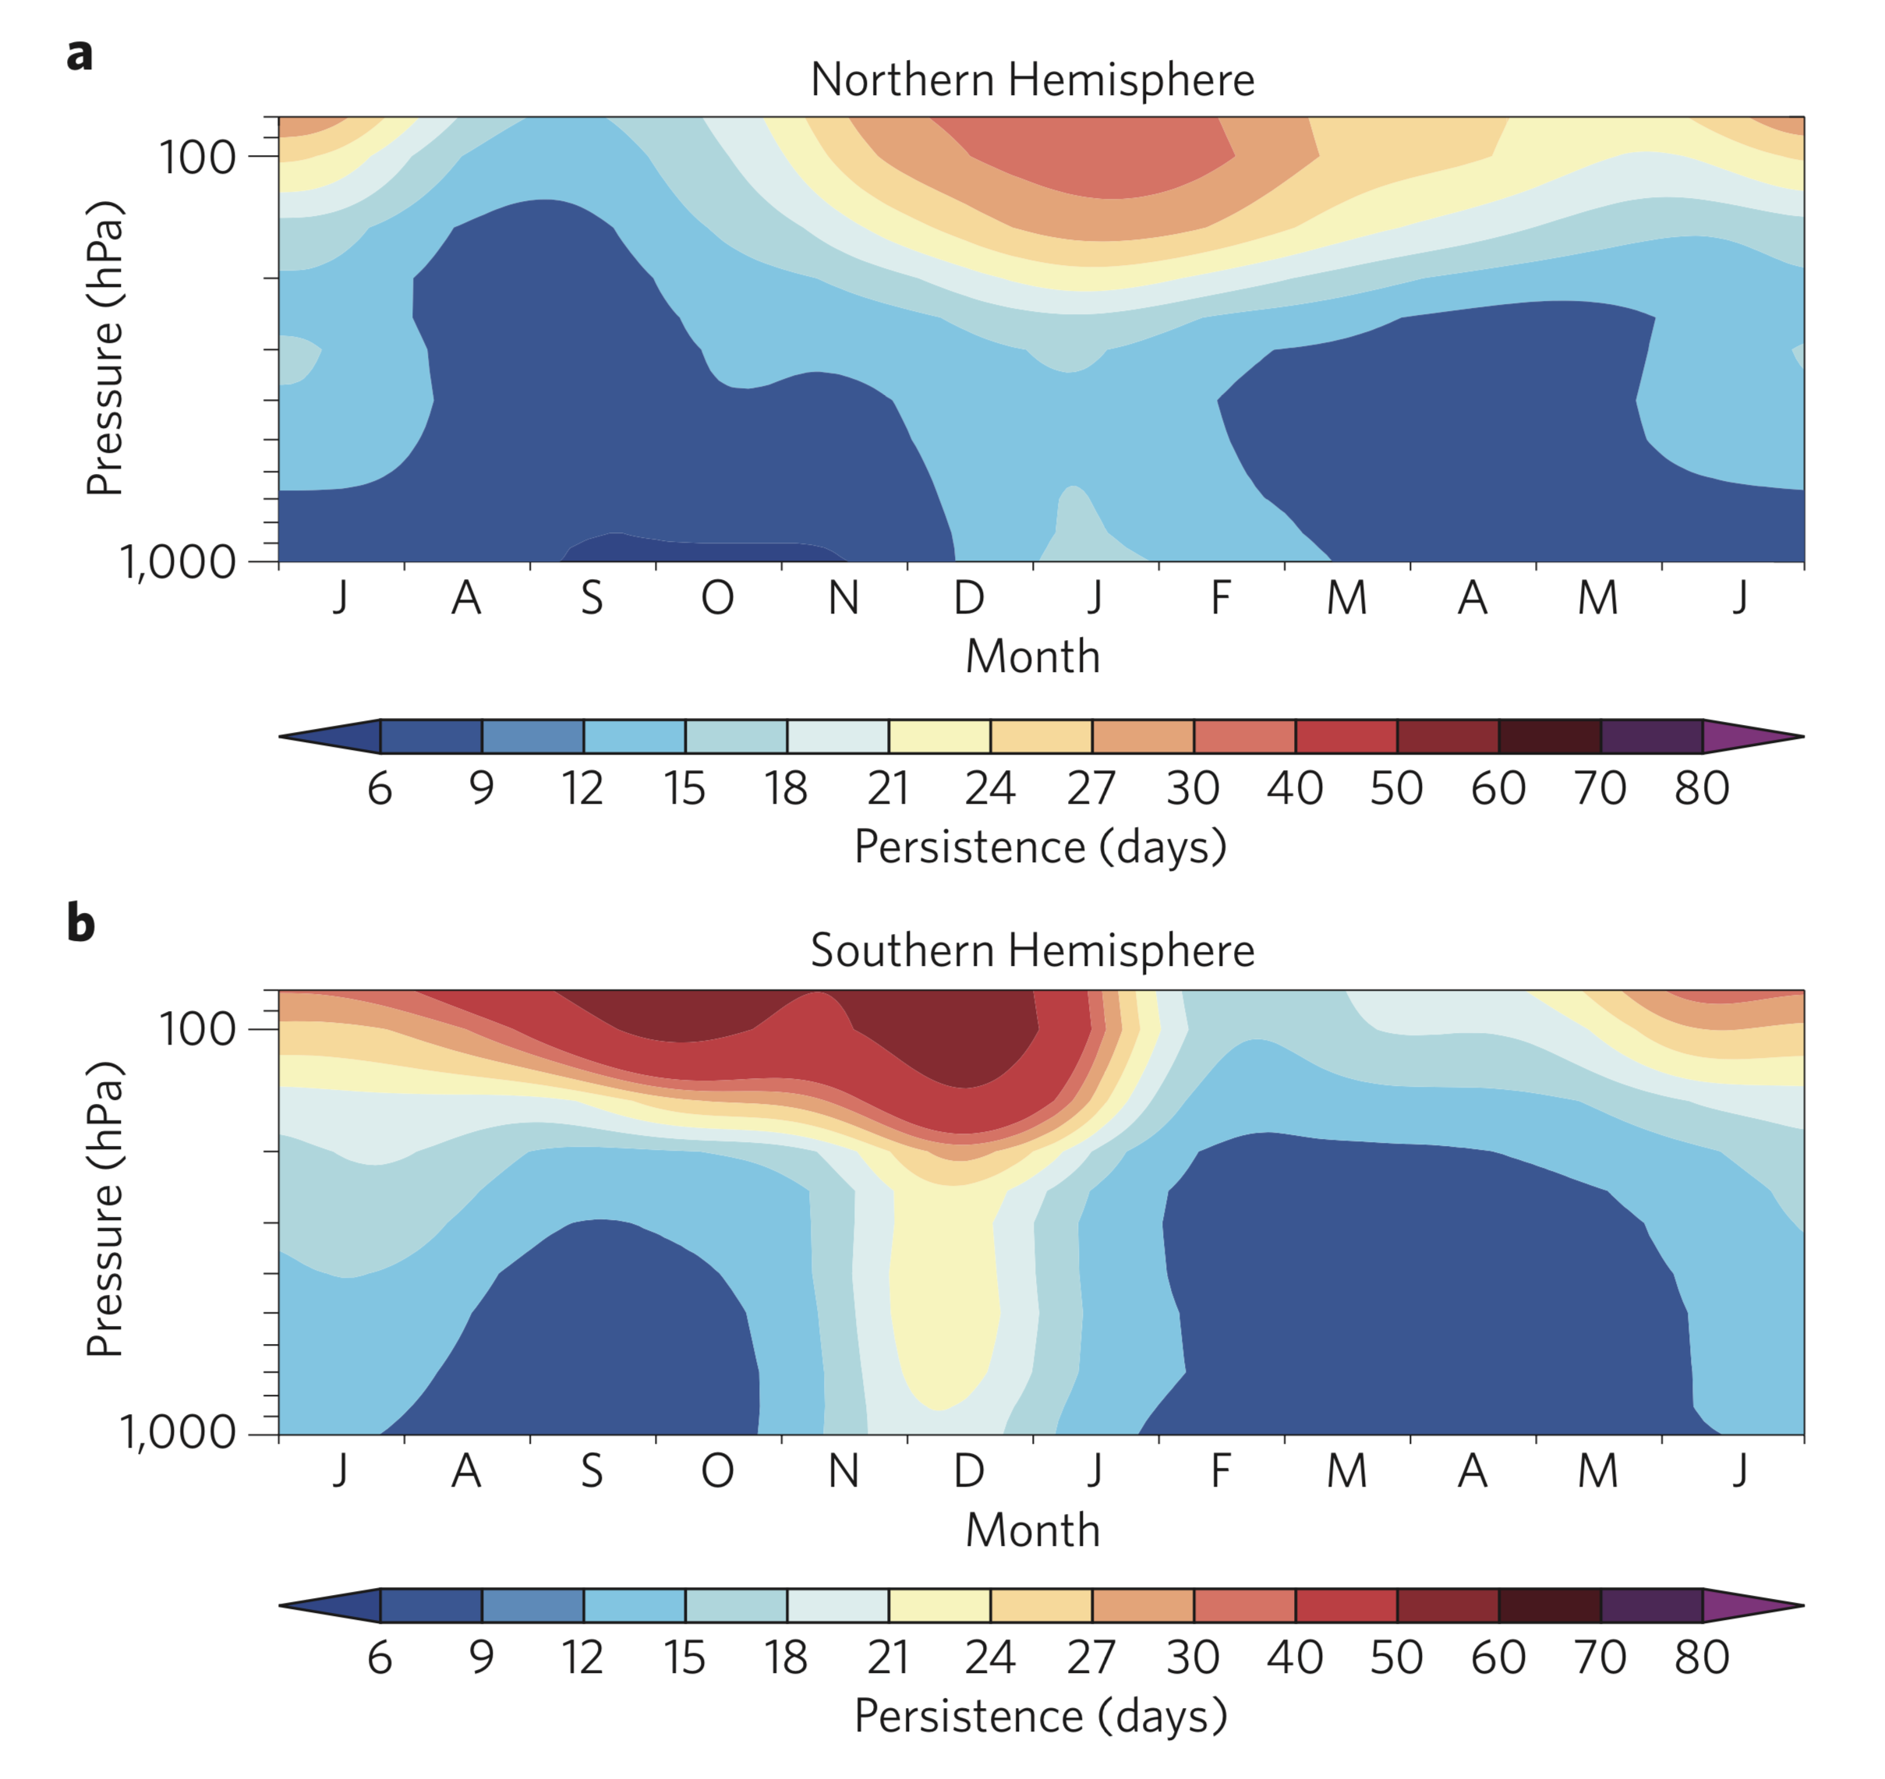
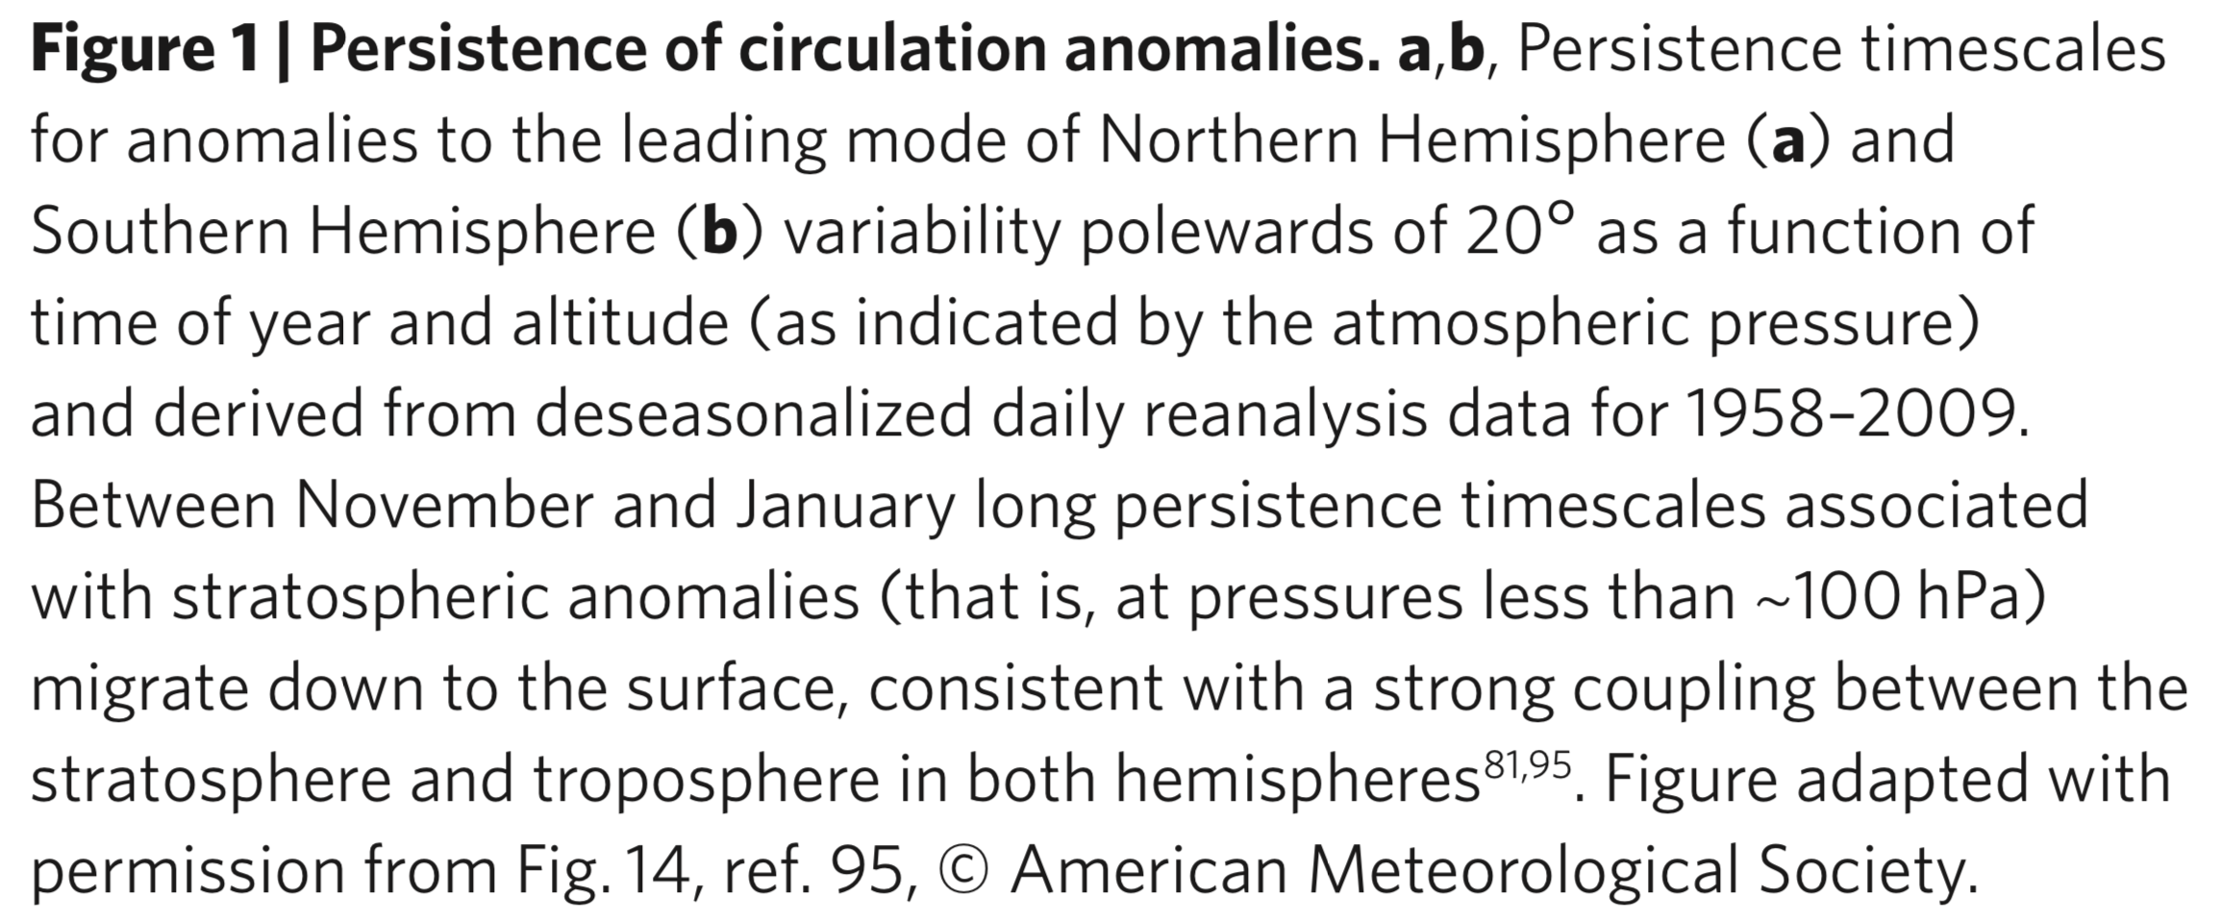
Stratospheric contribution to tropospheric skill at S2S time scales
Increased planetary-wave activity in N. Hem. with mountains,
land-sea contrast. When westerly jet not too strong, waves
can propagate upwards toward stratosphere and break; this
further decelerates winds, warms the stratosphere. Mid-latitude storm track shifts toward the equator; blocking more likely; more likely extreme storms and cold in eastern N. America, Europe with displacement of circum-polar vortex.
With less land-sea contrast & topography, strong circum-polar
vortex suppresses planetary wave variability in Austral winter.
Stratosphere tends to only show variability from Austral
spring into summer, when decreased static stability
permits planetary waves to propagate more easily into the
stratosphere.
from Kidston et al., Nature Geoscience, 2015, here.

Slide 19
Research directions for improving stratospheric predictions and tropospheric coupling (NGGPS)
Increased vertical resolution in stratosphere, e.g., here. Simple, but computationally expensive.
Improved predictions of the extratropical planetary wave train that can break in the stratosphere, e.g., here.
Atmospheric chemistry and parameterization improvements (gravity-wave drag; radiative transfer for resolving UV which drives photolysis; surface emissions of chemicals that affect stratospheric reaction rates).
Stochastification of currently deterministic parameterizations to simulate uncertainty.
More: see WMO Network on Assessment of Predictability (SNAP) project here.
AGU article on stratospheric chemistry recommendations here.

Slide 20
Other atmospheric low-frequency modes of variability.
Blocking
PNA / NAO
Quasi-biennial oscillation in tropical stratosphere.
… and more
Hope and expectation is that system improvements integrated into the operational model
via NGGPS will result in ability of system to predict these phenomena more successfully.

Slide 21
Research needs.
Understanding coupling mechanisms of low-frequency modes.
Understand limits of predictability for these modes.
R&D the various prediction system modifications so the mean and variability of these processes are well simulated.

Slide 22
Shifts in weather patterns due to anomalies in other state components
Upper-ocean heat content, especially ENSO.
Sea ice
Snow pack
Soil moisture
There is massive heat content in these relative to the atmosphere.
Hence they retain a memory of their initial state and impart an inertia … “slowly varying processes.”

Slide 23
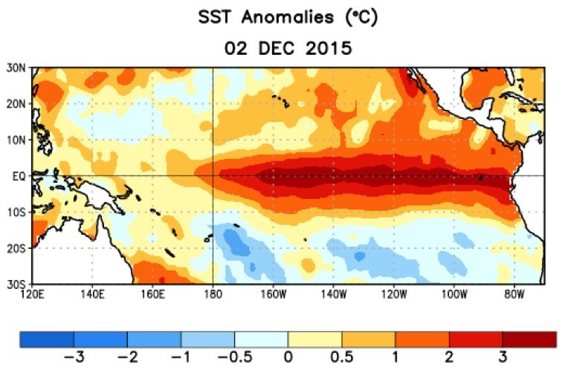
El Nino / Southern Oscillation.
El Nino: warm waters east
of international dateline.
La Nina: warm waters west
of international dateline.

Slide 24
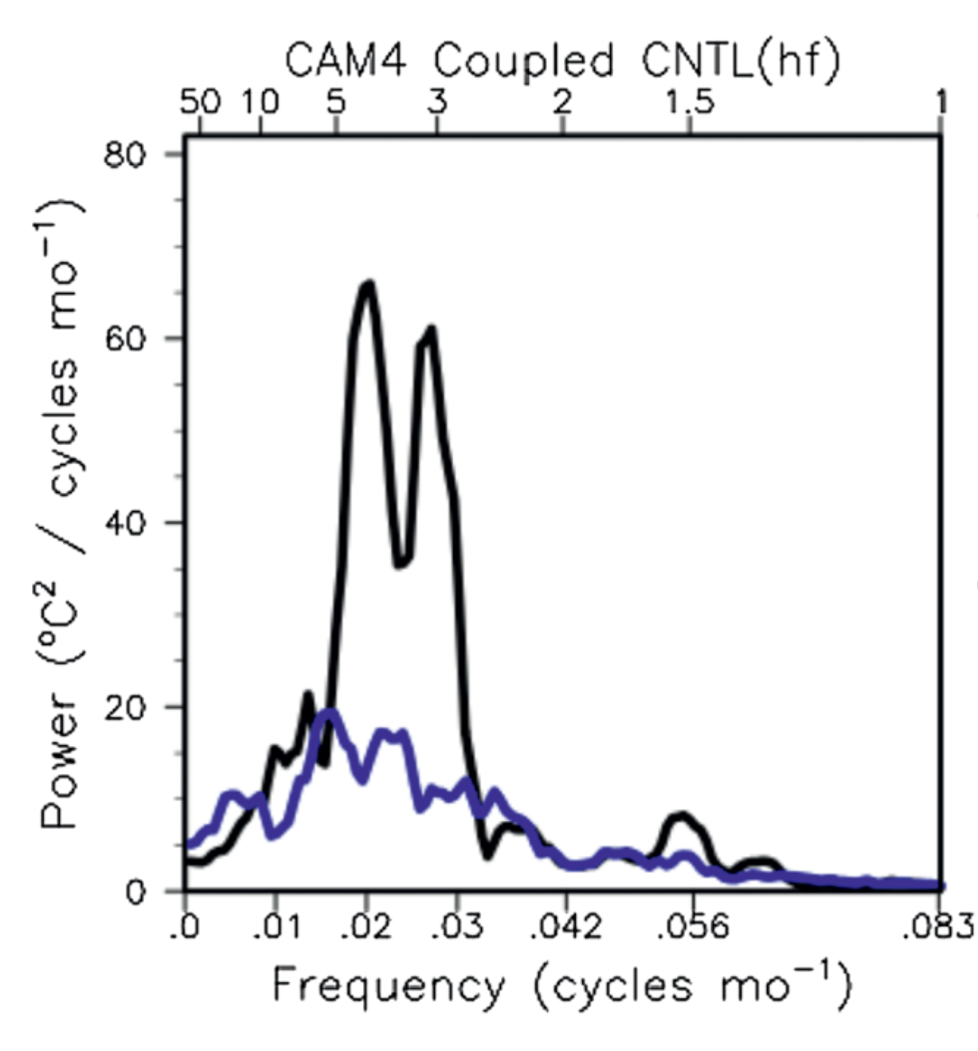
ENSO power spectrum, observed and in a typical climate simulation.
Observed ENSOs have a broad power spectrum, i.e., they are not very regular.
Commonly, recent-generation coupled ocean-atmosphere weather-climate forecast models have a narrower power spectrum, i.e., they are too regular and too intense.
To realize the potential predictability from ENSO in forecasts of months to years, we will have to fix the prediction system so that its power spectrum looks like the observed.
Forecast
Analyzed
Ref: Berner et al. 2017, journals.ametsoc.org/doi/pdf/10.1175/BAMS-D-15-00268.1

Slide 25
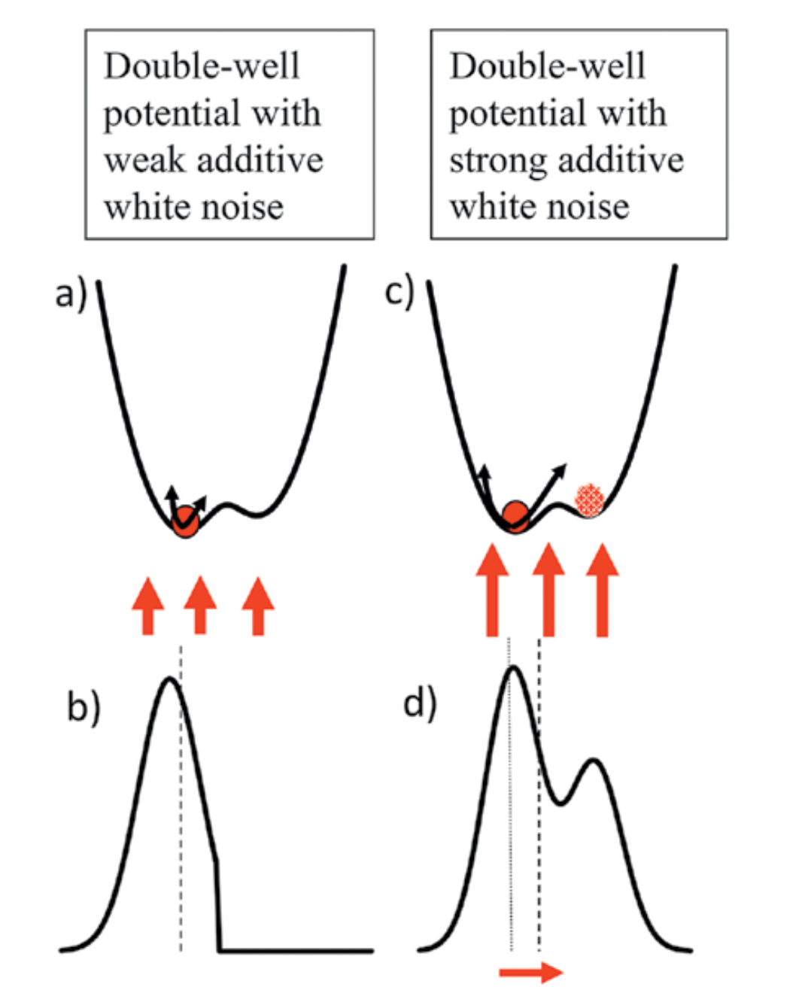
Noise-induced drift: the “double-well” example.
Left: a small amount of additive white noise forcing to a deterministic model of the state dynamics results
in a narrow pdf of system states.
Right: Suppose the system dynamics were not perfectly captured. A larger amount of additive noise permits solutions in the second potential well, a shift of the mean state, and a broadening of the pdf.
Taken from a nice review article on stochastic parameterization,
Berner et al. 2017, journals.ametsoc.org/doi/pdf/10.1175/BAMS-D-15-00268.1

Slide 26
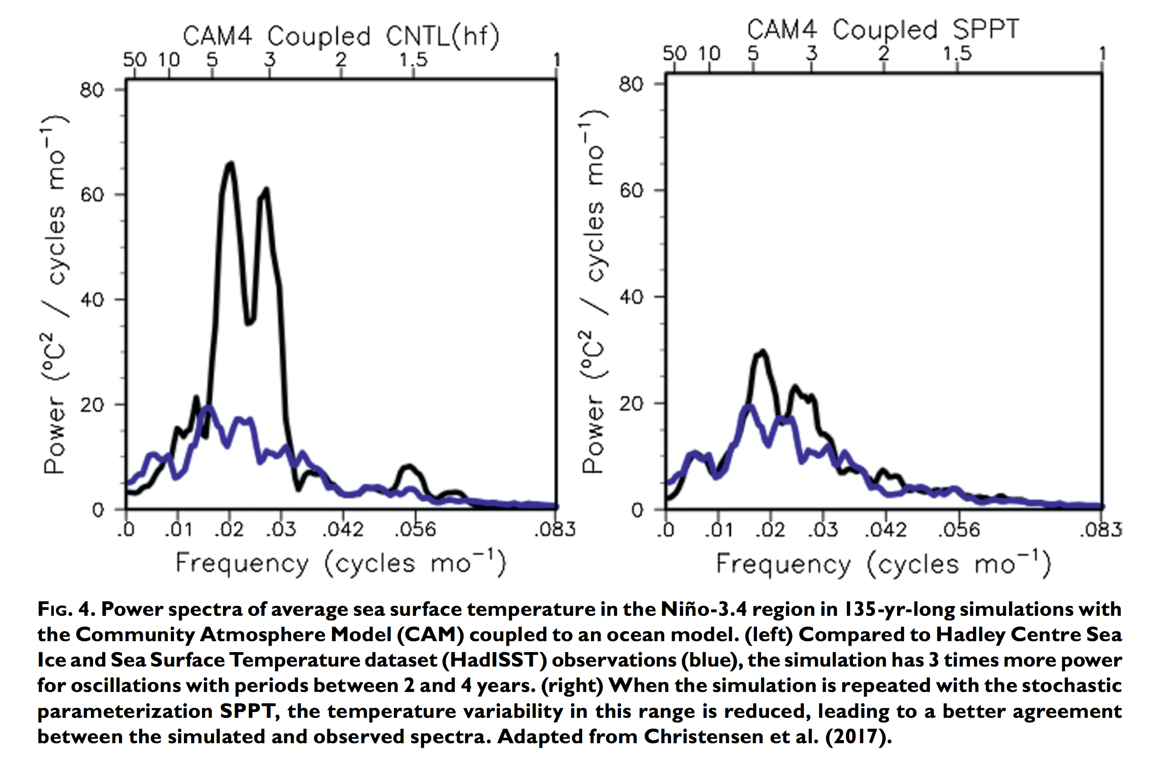
ENSO power spectrum before and after stochastic parameterization
Stochastic parameterization
substantially flattened the ENSO
power spectrum, an example of
noise-induced drift. Changing the system variability changed the mean characteristics.
This highlights the potential importance of the treatment of model uncertainty in S2S ensemble predictions. This may do more than address spread deficiencies, it may ameliorate systematic biases.
without stochastic
parameterization
with SPPT stochastic
parameterization
Berner et al. 2017, journals.ametsoc.org/doi/pdf/10.1175/BAMS-D-15-00268.1

Slide 27
ENSO and ocean prediction research needs
Predictability experiments to better understand sources of predictive skill, interactions with other low-frequency phenomena.
Understand sources of ocean systematic errors such as equatorial cold tongue in western Pacific.
Improve prediction system to reduce these errors.

Slide 28
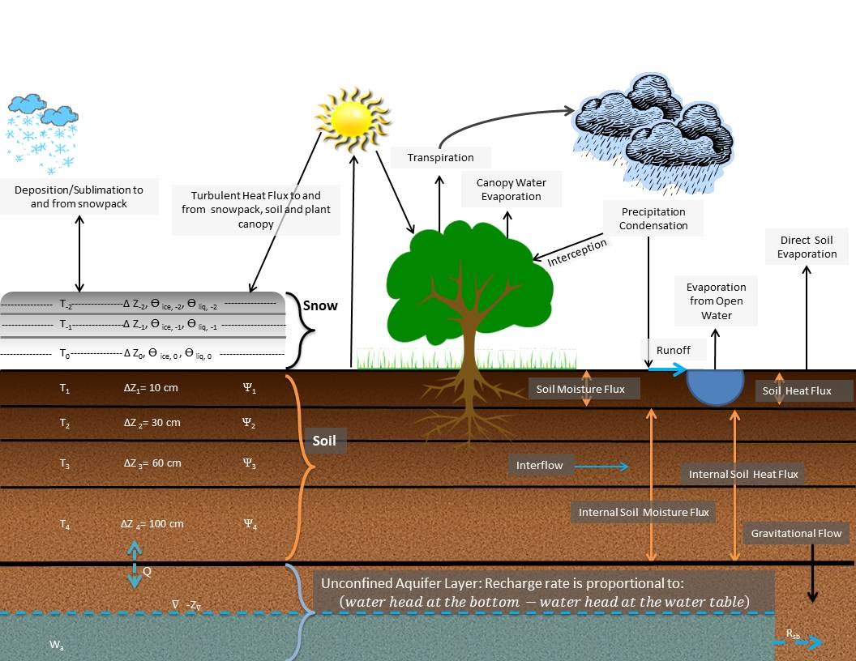
Land-surface parameterizations
The land-surface parameterization responds to fluxes of downward solar and long-wave thermal radiation, and precipitation. It should feed back to the grid box the fluxes of energy from the surface (latent and sensible heating, internal ground heat flux and change in soil moisture and snowfall state).
There can be tremendous variations of
land-use, vegetation, snow, and soil characteristics inside a model grid box.
Ref: https://gcmd.nasa.gov/records/NOAA_NOAH.html.

Slide 29
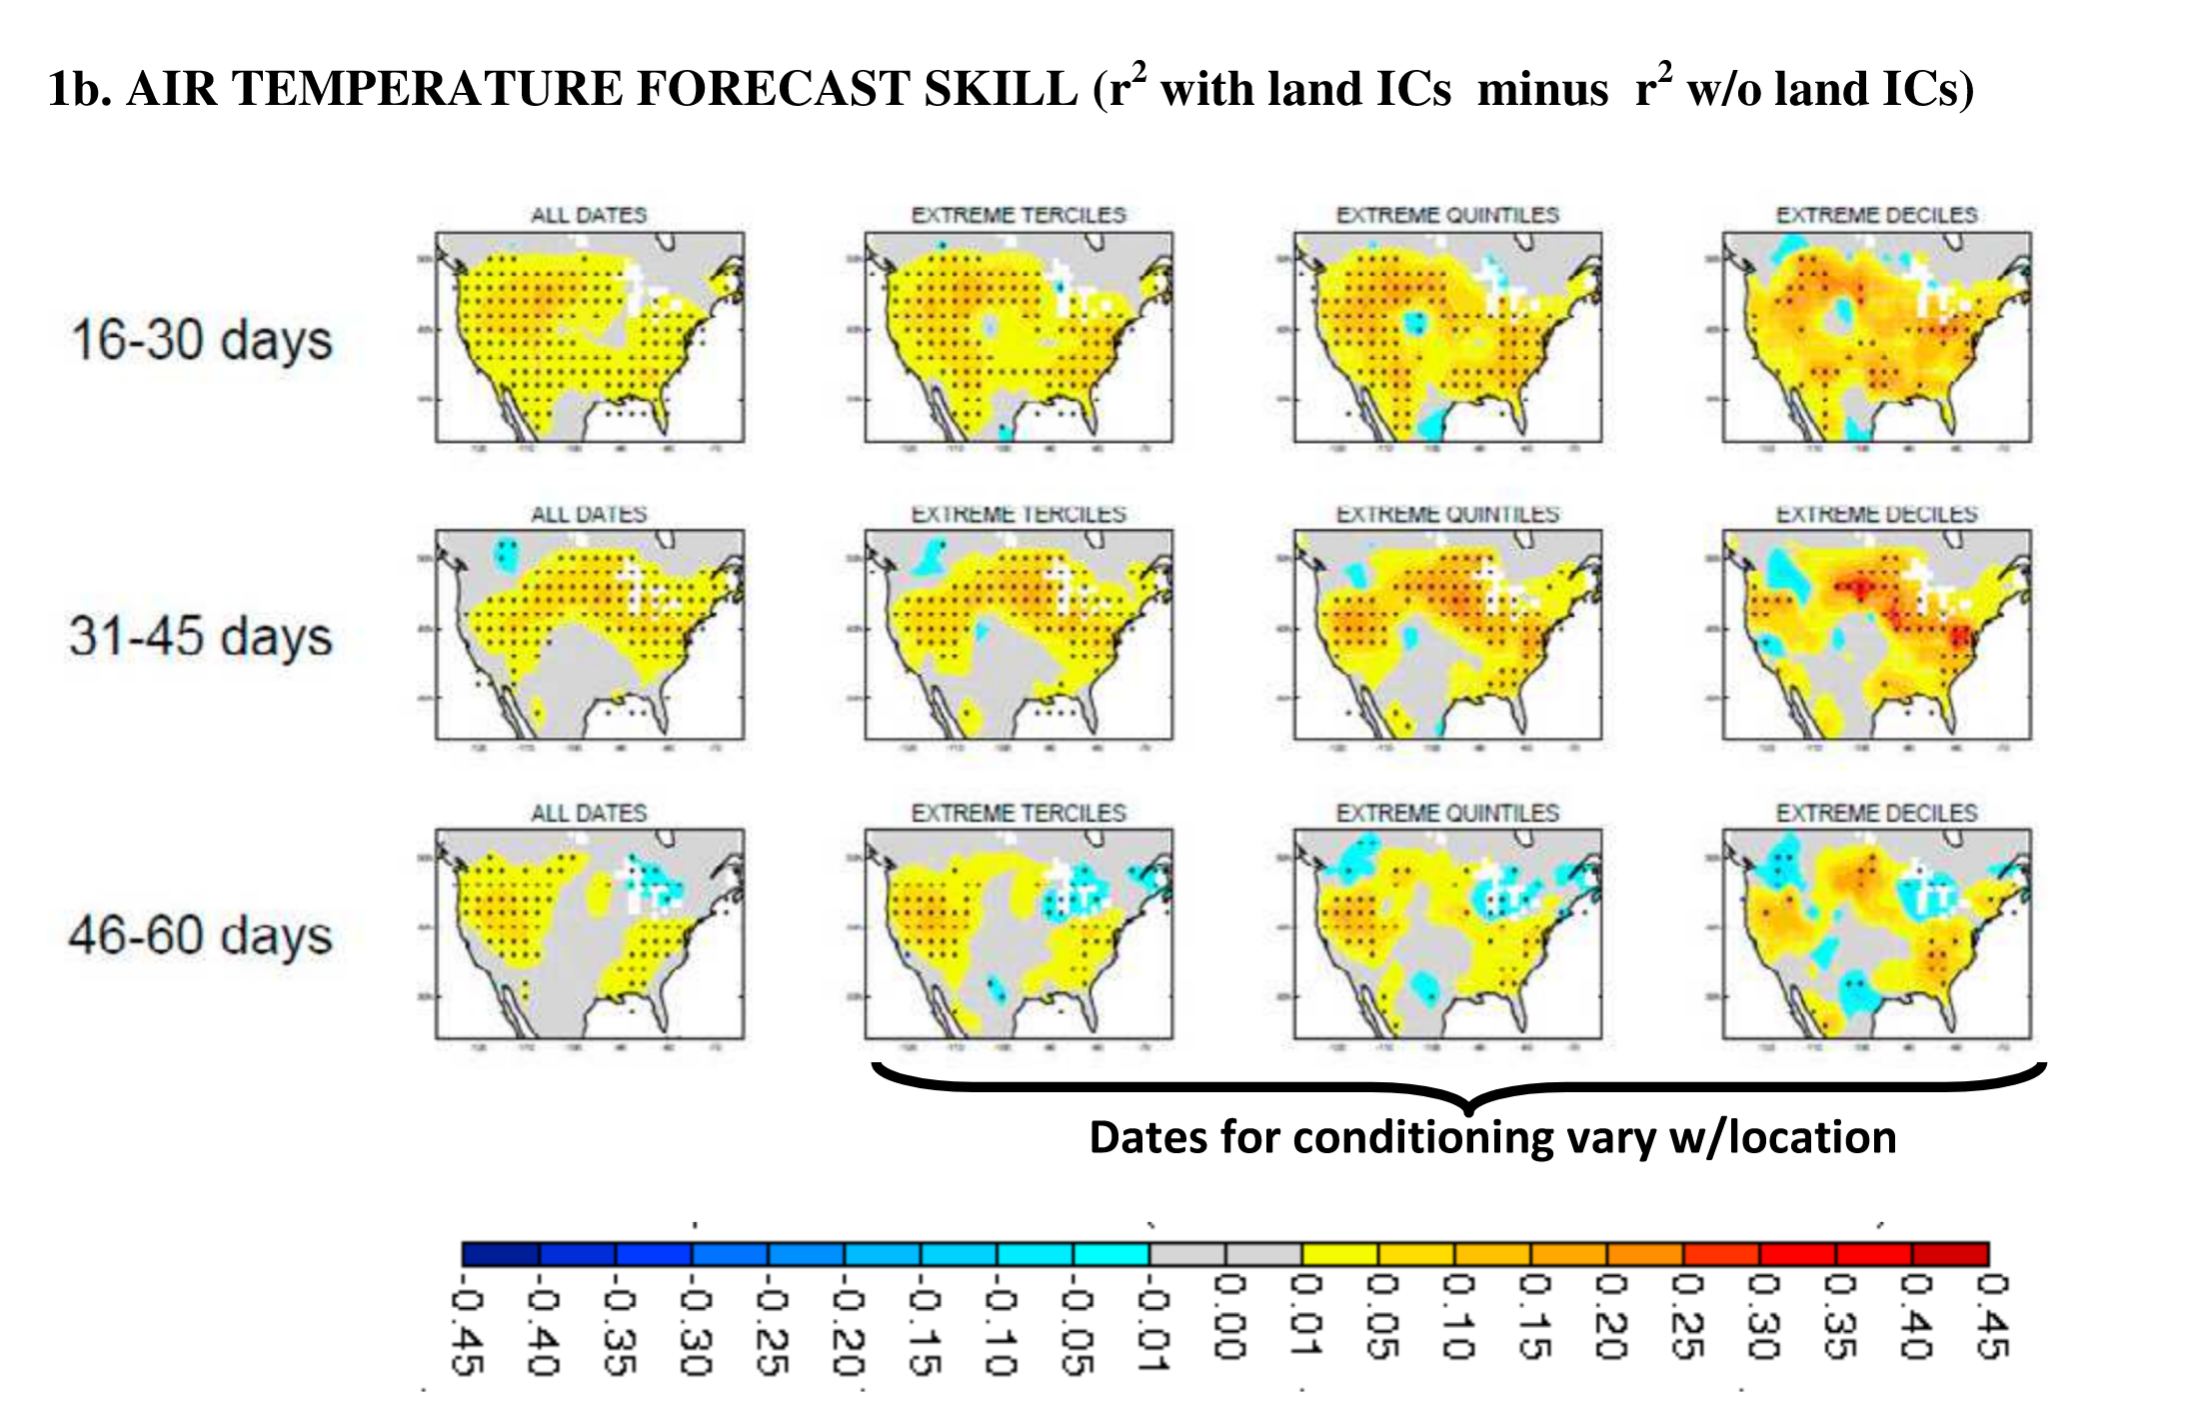
Predictive skill improvement from land-surface anomalies
From Koster et al. 2010 GRL, here.

Slide 30
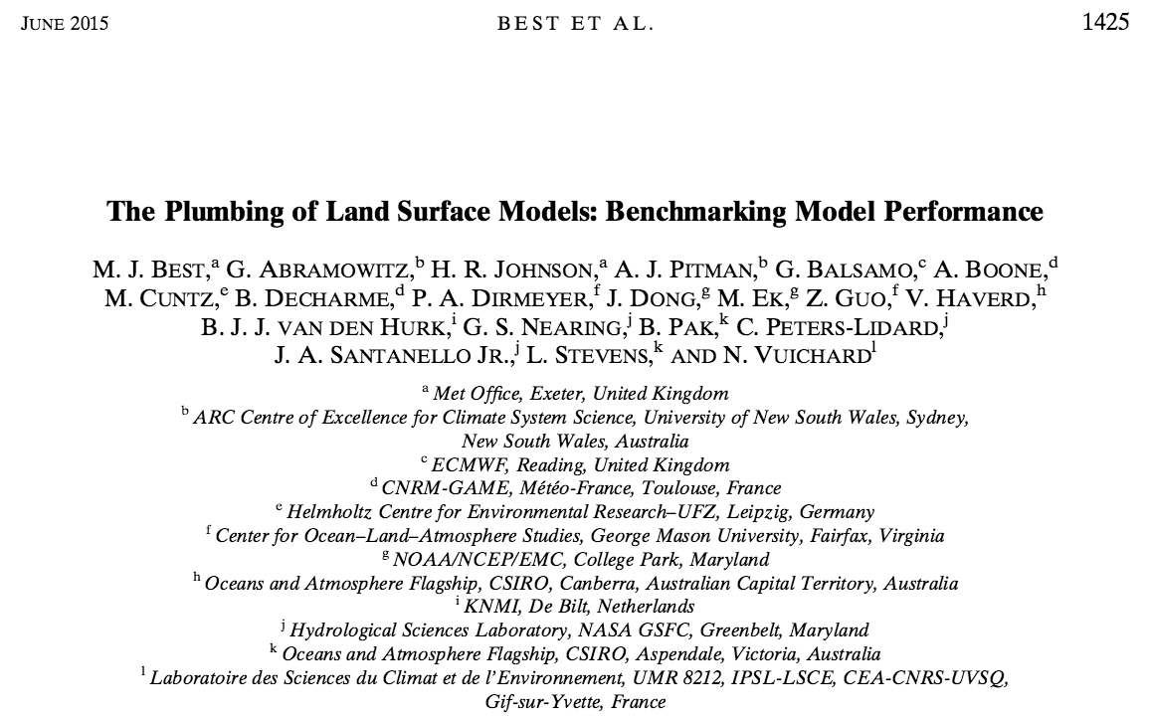
J Hydrometeorology
A critical look at LSMs: “PLUMBER”

Slide 31
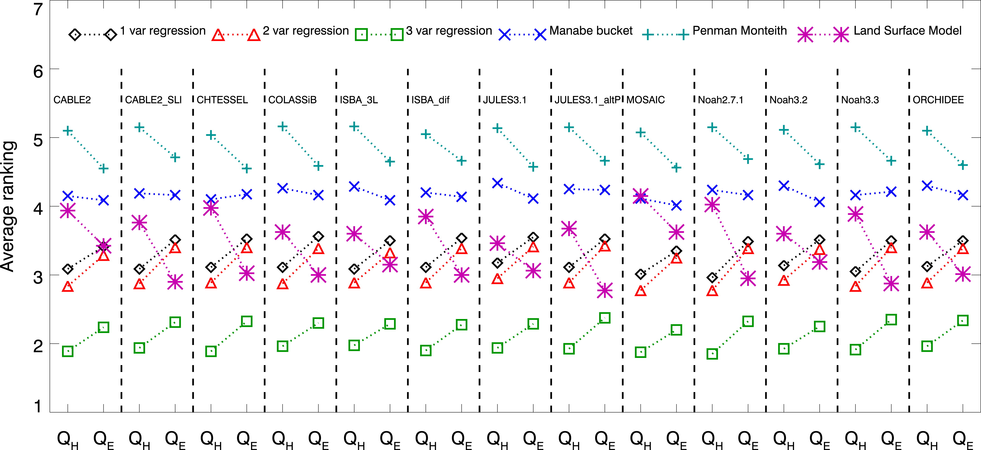
PLUMBER results
Forecast skill
evaluated here
as a relative
ranking of various
approaches
relative to
benchmarks.
Vertical columns are
data from different
LSMs.
Q_{E} latent
Q_{H} sensible heat
Ranking of benchmarks and each model for the standard statistics (MBE, NME, SD, r) across all 20 sites.
(1) LSMs usually better than physical benchmarks Manabe bucket and Penman-Monteith.
(2) LSMs competitive with 1-variable and 2-variable regressions.
(3) LSMs usually inferior to the 3-variable regression benchmark. (4) LSMs actually more competitive with 3-variable regression for latent than for sensible.

Slide 32
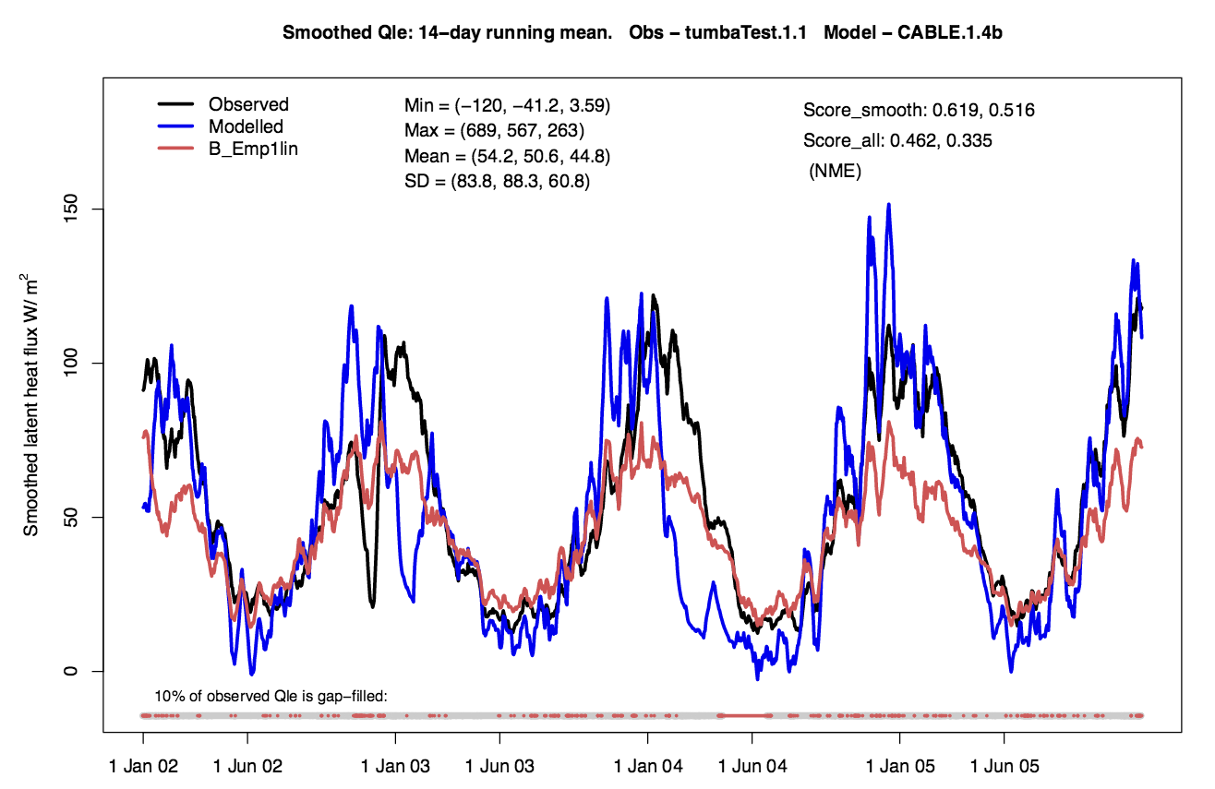
Illustration of smoothing nature of empirical benchmark
The drawback of the simple statistical benchmark: while it minimizes error, it does not predict extremes very well.
Ref: Abramowitz 2012, doi:10.5194/gmd-5-819-2012

Slide 33
Land-surface prediction research needs
Model complexity: how much is appropriate given lack of knowledge of sub-grid details?
Can some more sophisticated statistical model (or machine-learning algorithm) improve upon simple benchmark and be a reasonable surrogate for a complex LSM?
Probably need more land-surface data across a variety of surface types to evaluate this. Return to this point when discussing observations.
Understand current characteristics of NOAA’s land-surface scheme, NOAH, its strengths and weaknesses across various surface types. This then motivates specific research directions.

Slide 34
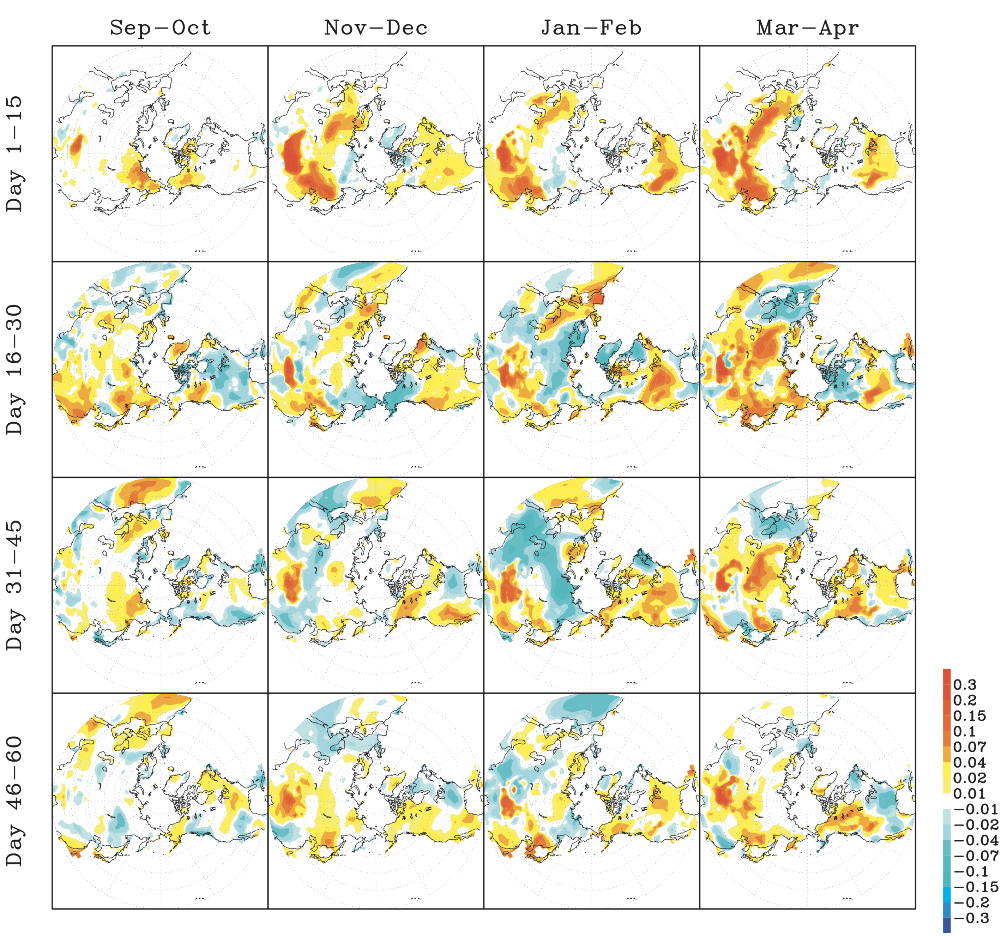
Impact of snow-cover prediction
Change in potential predictability (r²) using the snow-depth initialization vs. not.
Greatest skill improvement largest at short leads.
Variations at longer leads may be a sample-size
issue for this study.
Also snow cover inserted, not in balance with initial atmospheric conditions
Future model improvements may provide better
exploitation of snow initialization.
Ref: Jeong et al., J Climate, 2013, here.

Slide 35
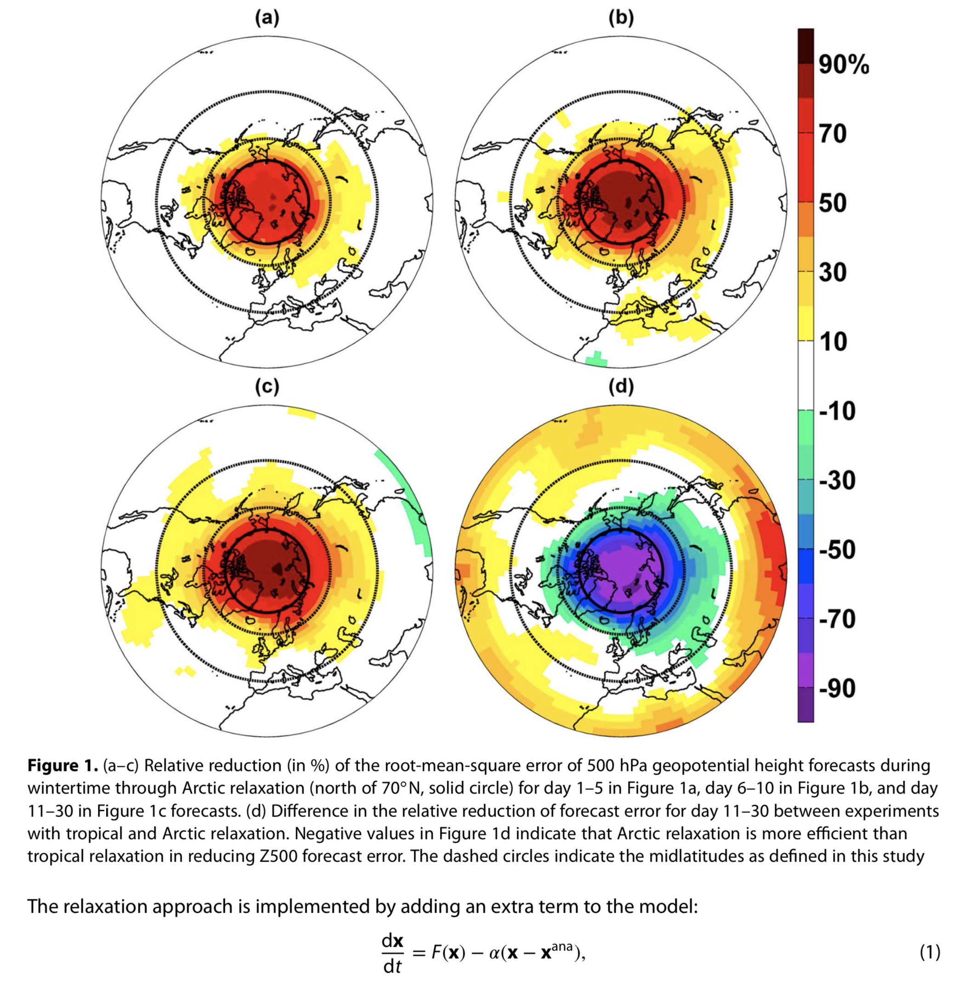
Sea-ice prediction
Jung’s study (left) replaces forecast ice with analyzed ice and examines the reduction in error.
Quantifies upper limit for prediction improvement.
Some reduction in errors outside of polar regions.
Also: general sea-ice loss related to more high-latitude North Atlantic blocks (here).
Ref: Jung et al. 2014 GRL, here.

Slide 36
Sea-ice prediction research needs
Modeling the seasonal melt of young ice, which absorbs more solar heat and is more mobile than old ice.
Research that addresses the physical properties and processes of the ice itself (e.g., ice thickness, topography, and strength; ice motion and deformation; distribution and properties of snow on ice; and melt pond characteristics).
Since sea-ice influenced by the atmosphere above and the ocean below the ice, modeling ocean-ice-atmosphere interactions properly.
General sea-ice R&D recommendations including obs needed here, here.

Slide 37
Coupled data assimilation
Weakly coupled:
Strongly coupled:
Coupled
ocean-atmos.
prediction
system
Ocean
prediction
Ocean data assimilation
Ocean
analysis
1
1
many
operational
centers
using this.
Atmospheric
prediction
Atmos. data assimilation
Atmospheric
analysis
2
2
Coupled
ocean-atmos.
prediction
system
Ocean
prediction
Joint
ocean and atmospheric data assimilation
Ocean
analysis
many operational
centers want
to use this in the
future.
1
1
Atmospheric
prediction
Atmospheric
analysis
2
2

Slide 38
Why is strongly coupled data assimilation desirable?
temperature, humidity obs
land observations
If forecast errors are correlated (e.g., too- warm atmosphere related to too-warm soil) then an observation of one data-rich component (atmosphere) can change the state of the data-sparse component (soil).
However, challenging to work well unless systematic errors at the interface have been tamped down.

Slide 39
Coupled data assimilation research needs.
Development of computationally efficient methods (coupled ocean-atmosphere DA: large ocean state if deep ocean included).
Dealing with bias and over-confidence of joint states at interface:
parameterization improvements.
coupled state stochastic parameterization.
Development of assimilation methods that starts off in balance and without drift, i.e., no prolonged ocean spin-up.
Example: imbalance between the wind stress and stratification (thermocline) will lead to systematic increments in the ocean and the generation of spurious vertical velocities.
Development of non-Gaussian methods for some states where errors are not normally distributed.
Ref: Penny and Hamill, BAMS, 2017, here. Full WMO report with many more recs. here.

Slide 40
Observation and research data set needs.
Given priority of coupled DA and importance of ocean, land-state prediction, need more (ideally inexpensive) ocean and soil observations.
Ocean: particularly missing sub-surface observation data.
Land: observations of land state (soil moisture, temperature), snow depth and fractional coverage, surface fluxes, boundary-layer observations coincident with land observation sites.
Land observations should cover a large variety of surface types.
Given memory, observations needed over long period of time.

Slide 41
Statistical postprocessing challenges and needs
Lack of community infrastructure
Organization
Science
Getting the right data in place.

Slide 42
Process flow for S2S numerical product generation
Statistical
postprocessing
system
S2S ensemble
prediction system
Real-time
ensemble
predictions
Post-processed
guidance

Slide 43
Issues: (1) garbage in, garbage out (improve the underlying prediction system).
Statistical
postprocessing
system
S2S ensemble
prediction system
Real-time
ensemble
predictions
Post-processed
guidance
Example: if the forecast model predicts
the MJO poorly → poor forcing of
extratropical wave train. Statistical
postprocessing cannot ameliorate
such complex model errors. Must improve
forecast system.

Slide 44
Inside the black box.
Reforecast
ensemble
predictions
Observations
or analyses
Train postprocessing method
Post-processed
guidance
S2S ensemble
prediction system
Real-time
ensemble
predictions
Predictors
Apply postprocessing method

Slide 45
Issues: (2) High-quality ensemble reforecasts with statistical characteristics like real-time ensembles
Reforecast
ensemble
predictions
Observations
or analyses
consistent
Train postprocessing method
Post-processed
guidance
S2S ensemble
prediction system
Real-time
ensemble
predictions
Predictors
Ideally, same DA, forecast system at
same resolution, same quality and
number of observations over time,
and reforecasts spanning range
of possible weather scenarios.
Expensive, will need HPC, data storage
planned into procurement.
Apply postprocessing method

Slide 46
Issues: (3) Sub-standard analysis data.
Reforecast
ensemble
predictions
Observations
or analyses
Train postprocessing method
Post-processed
guidance
S2S ensemble
prediction system
Real-time
ensemble
predictions
Predictors
The algorithm is only as good as the data you train against. Invest in building such high-quality retrospective analysis data sets.
Apply postprocessing method

Slide 47
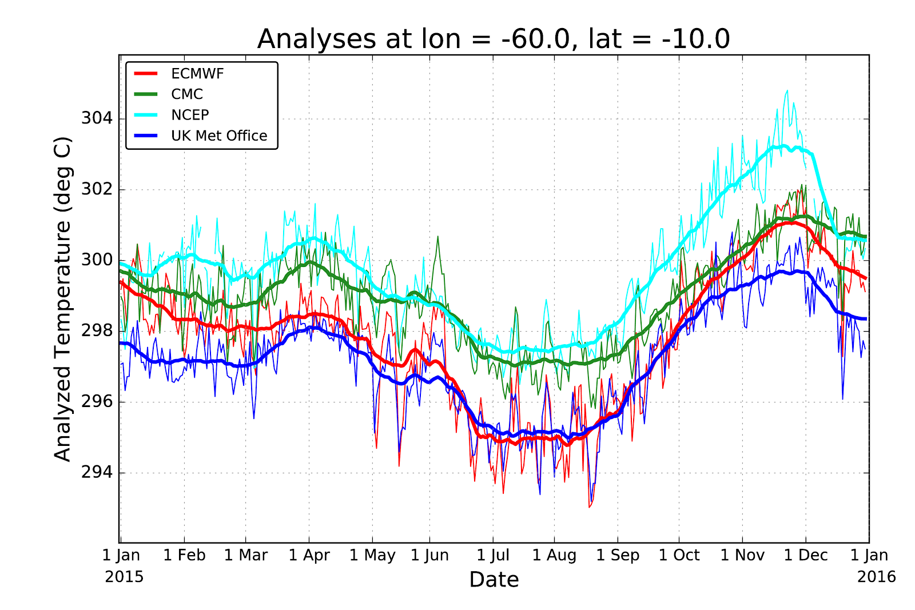
2-meter temperature
In data sparse region of the Amazon Basin. Heavy lines with +/- 15 day smooth.

Slide 48
Process flow for S2S numerical product generation
Reforecast
ensemble
predictions
Observations
or analyses
Train postprocessing method
Post-processed
guidance
S2S ensemble
prediction system
Real-time
ensemble
predictions
Predictors
Apply postprocessing method
There is no one postprocessing method that will work the best across all applications (temperature, precipitation, drought, fire weather, severe weather, hurricane track).
For some variables (e.g., precipitation) there are dozens of proposed methods. Which is best?
A first step would be to develop a community postprocessing infrastructure, use it to compare methods.

Slide 49
A community modular software and data library
It’s hard to determine
whether someone has
made an improvement
when everyone tests
with their own data set,
or codes their own
version of post-processing
methods & verification
methods.
Building and supporting
a reference library
would help our field
immensely.
BMA
logistic
regression
linear
regression
NGR
analog
decaying
average
threat
scores
reliability
diagrams
ROC
track &
intensity
BSS, CRPSS
eco value
post-processing methods
verification methods
Recommendations
on building a
community
system in
supplementary
slides.
temperature
power
transform
precipitation
scatterplot
ANOVA
PCA & CCA
precip type
wave height
histogram
wind power
TC intensity
correlation
standard test data sets
exploratory data analysis
ArcGIS
Bufr
binary
ASCII
Fortran-
python
C++ -Fortran
Grib
netCDF
Grib-Bufr
ASCII-cPickle
Fortran-IDL
I/O routines
Interfaces & conversion

Slide 50
Statistical postprocessing R&D needs
Provide resources for statistical postprocessing technique development and inter-comparison, since it is an essential component in the production of S2S forecasts.
Resource the regular production needed data sets, with some remaining challenges.
HPC sized to allow this.
Regular production of reanalysis/reforecast data, not one-offs.
Improved or new analysis data needed for training.
Resource the development of a community infrastructure for postprocessing, a la JEDI for data assimilation.

Slide 51
Conclusion: R&D needs of particular importance.
Improving parameterization of tropical convection to exploit predictive potential of MJO.
Stochastic parameterizations to more properly simulate variability (and sometimes change mean), including for S2S the stochastic parameterization of interactions between state components.
Land-surface prediction system improvements (possibly with statistical models playing a role).
Strongly coupled DA system development.
Observations of ocean below surface, + land state (including fluxes).

Slide 52
Background material
NAS report on S2S here.

Slide 53
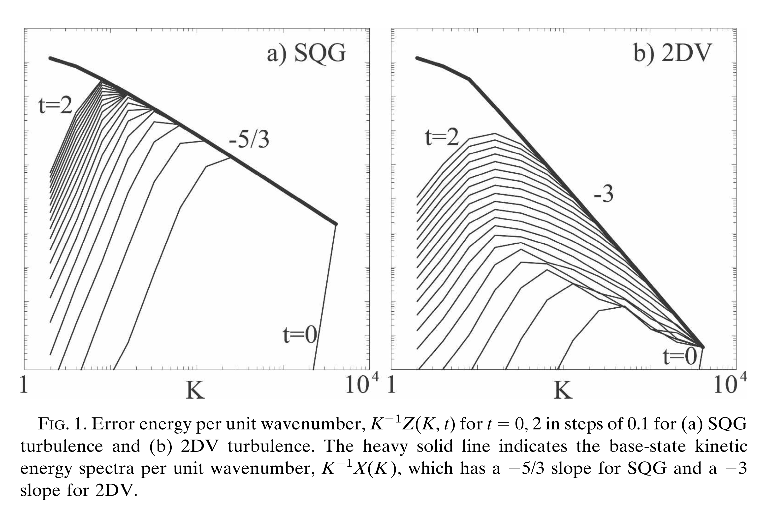
What can we expect from atmosphere at S2S time scales? A modern understanding of atmospheric predictability.
Nastrom and Gage 1984 showed that atmospheric power scales like wavenumber k⁻³ at synoptic scales and k^{-5/3} at mesoscales and below.
Given inevitability of small-scale errors and rapid growth upscale, they will stimulate errors at the synoptic scales.
Thereafter, synoptic scale errors grow more slowly.
By two weeks, most predictive skill lost, except in most slowly varying low-frequency modes like MJO, polar stratosphere.
But: general mean and variability can be situationally modulated to a small extent by other phenomena.
Ref: Rotunno and Snyder, JAS, 2008, here. See also Tribbia and Baumhefner 2004, here.

Slide 54
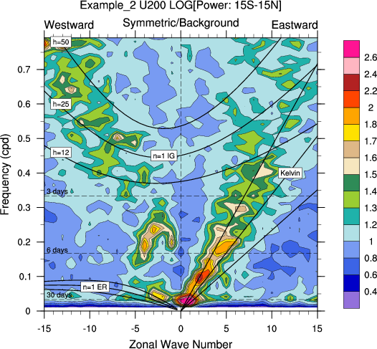
Tropical variability: the Wheeler-Kiladis diagram.
The greatest power is low-frequency variability with a zonal wavenumber of 1. This is the MJO, the Madden-Julian Oscillation.
Ref: Wheeler and Kiladis 1999 JAS, here.
Not modeled well in most current prediction systems.

Slide 55
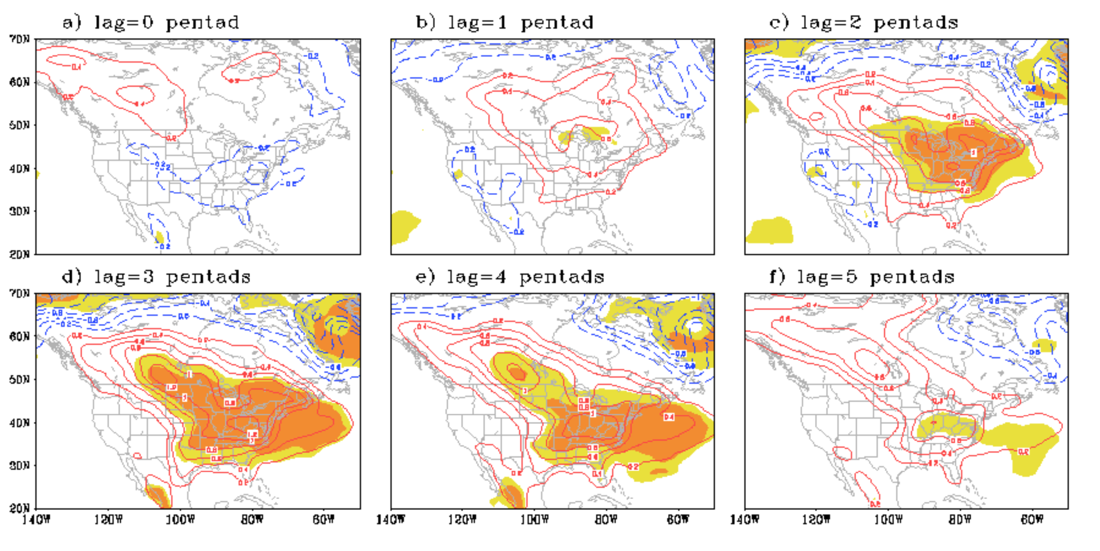
Lagged response of US surface temperature to MJO activity in the Indian Ocean.
Lagged regressions of surface air temperature (SAT) in the North American region onto − RMM2. NOTES: Lag n means that the SAT anomaly lags −RMM2 by n pentads (5 days). The sign of RMM2 is reversed so that it represents enhanced convection in the Indian Ocean and
corresponds to MJO phases 2-3. courtesy of Hai Lin. From NAS report on S2S, here.

