Slide 1


Experimental statistically post-processed guidance based on the NCEP GEFS reforecasts.
NOAA Earth System
Research Laboratory
Tom Hamill and Gary Bates
NOAA ESRL, Physical Sciences Division
tom.hamill@noaa.gov
also: Jeff Whitaker, Don Murray, Francisco Alvarez, Mike Fiorino, Tom Galarneau

Slide 2
Reminder: statistical post-processing for rare events is challenging without a large training sample
Say you want to statistically post-process today’s model precipitation forecast to improve it.
Heavy precipitation events like the one today are the ones you care about the most. How
do you calibrate today’s forecast given past short sample of forecasts and observations?

Slide 3
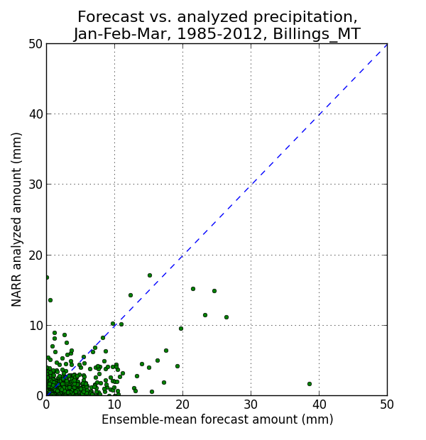
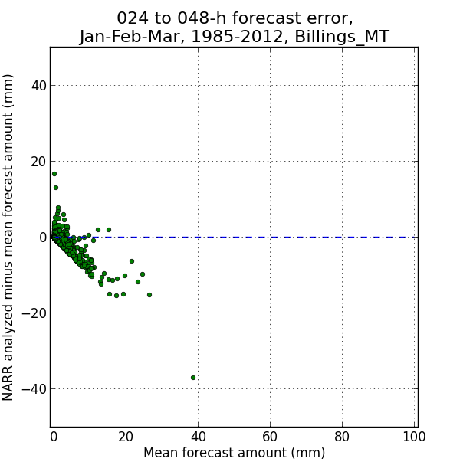
Example of forecast / analysis data
Assuming forecast errors may be location dependent, it’s helpful to have a lot of
samples in order to post-process these rare events.

Slide 4
Reforecasts (hindcasts)
Numerical simulations of the past weather (or climate) using the same forecast model and assimilation system that (ideally) is used operationally.
  Common with climate, uncommon with weather models.

Slide 5
2nd-generation GEFS reforecast: details
Seeks to mimic GEFS operational configuration as of February 2012. This version still operational, though data assimilation method was improved in May 2012.
Reforecasts produced every day, for 1984120100 to current.
Each 00Z, 11-member forecast, 1 control + 10 perturbed.
CFSR (NCEP’s Climate Forecast System Reanalysis) initial conditions (3D-Var) + ETR perturbations (cycled with 10 perturbed members). After ~ 22 May 2012, initial conditions from hybrid EnKF/3D-Var.
Resolution: T254L42 to day 8, T190L42 from days 7.5 to day 16.
Fast data archive at ESRL of 99 variables, 28 of which stored at original ~1/2-degree resolution during week 1. All stored at 1 degree. Also: mean and spread to be stored.
Full archive at DOE/Lawrence Berkeley Lab, where data set was created under DOE grant.

Slide 6
Status of the reforecast v2 archive.
00Z reforecast data and (since mid-2012) 00Z GEFS real-time forecasts are publicly available from our archive.
Download web sites are open to you now:
  NOAA/ESRL site: fast access, limited data (99 fields). Also there, README & info on how to ftp.
    http://www.esrl.noaa.gov/psd/forecasts/reforecast2/
  US Department of Energy: slow access, but full model states. Recent months not uploaded yet.
    http://portal.nersc.gov/project/refcst/v2/

Slide 7
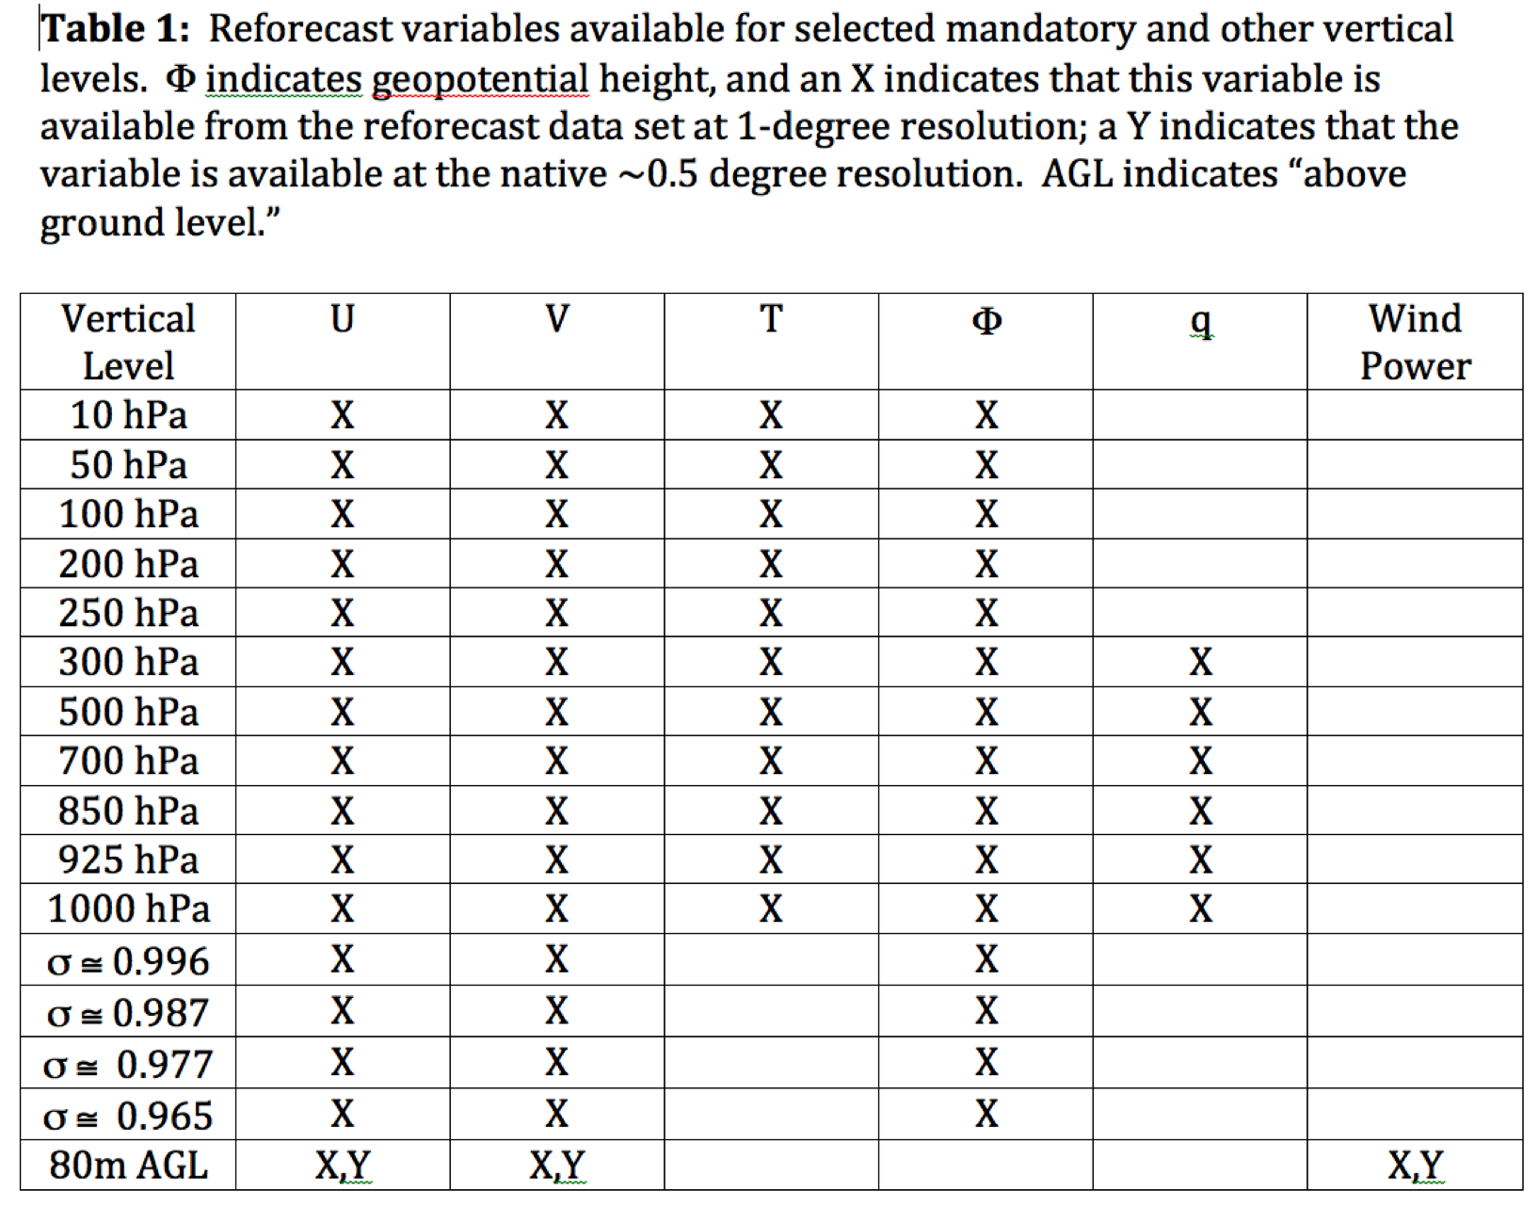
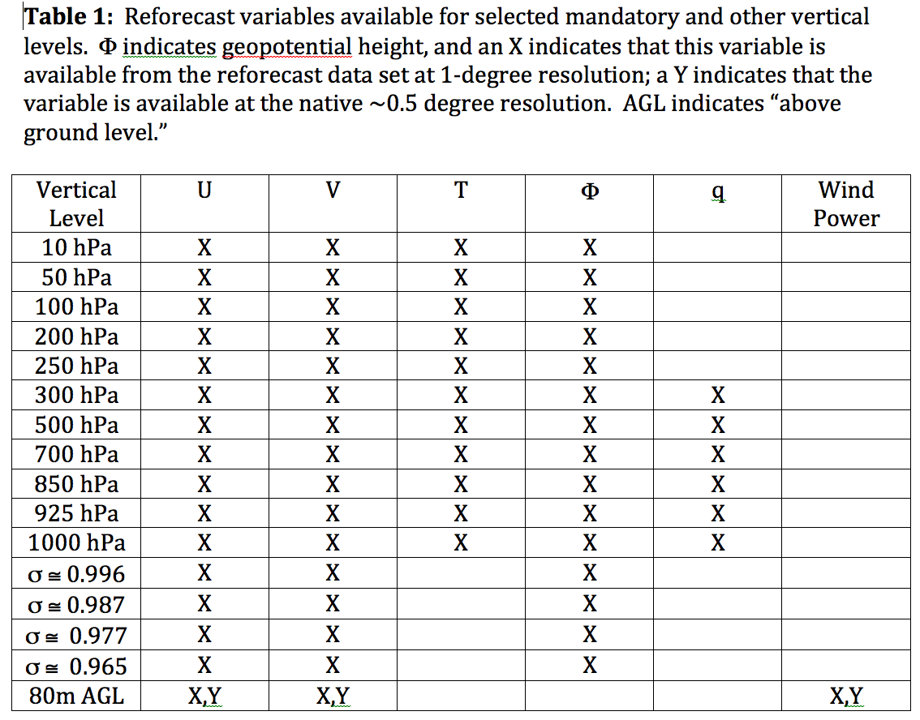
Data that is readily available from ESRL
Also: hurricane track files and other hurricane diagnostic information

Slide 8
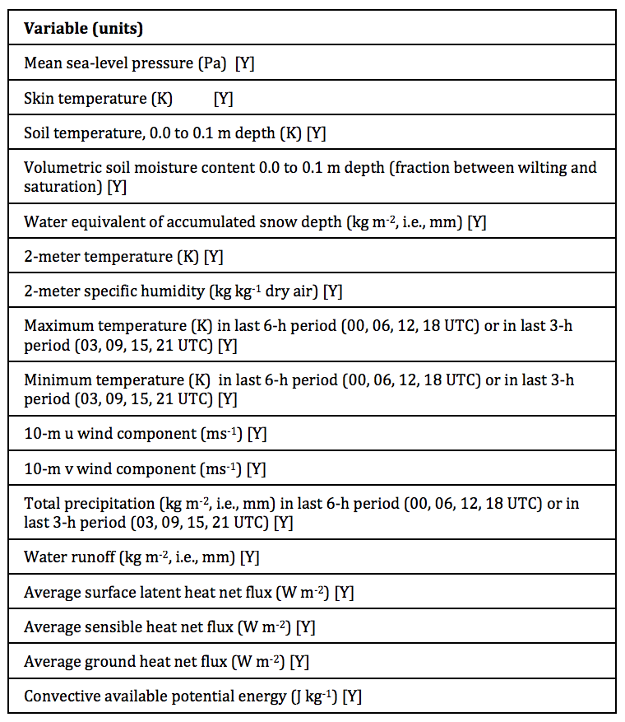
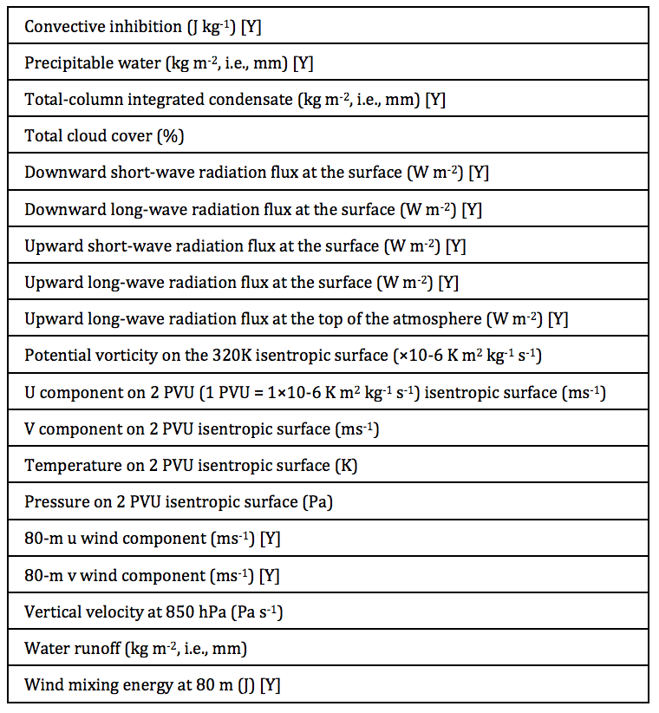
Data that is readily available from ESRL
[Y] indicates that this variable is available at the native ~0.5-degree resolution as well as the 1-degree resolution.

Slide 9
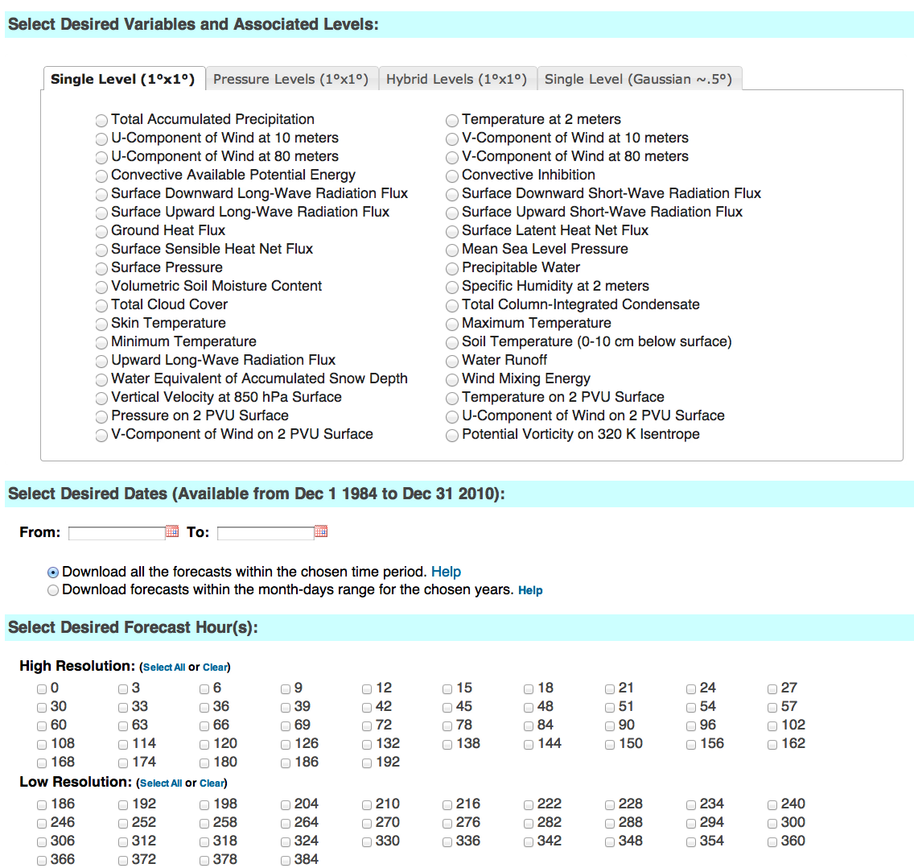
http://esrl.noaa.gov/psd/forecasts/reforecast2/download.html
Produces
netCDF files.
Also: direct
ftp access to
allow you to
download the
raw grib files.

Slide 10
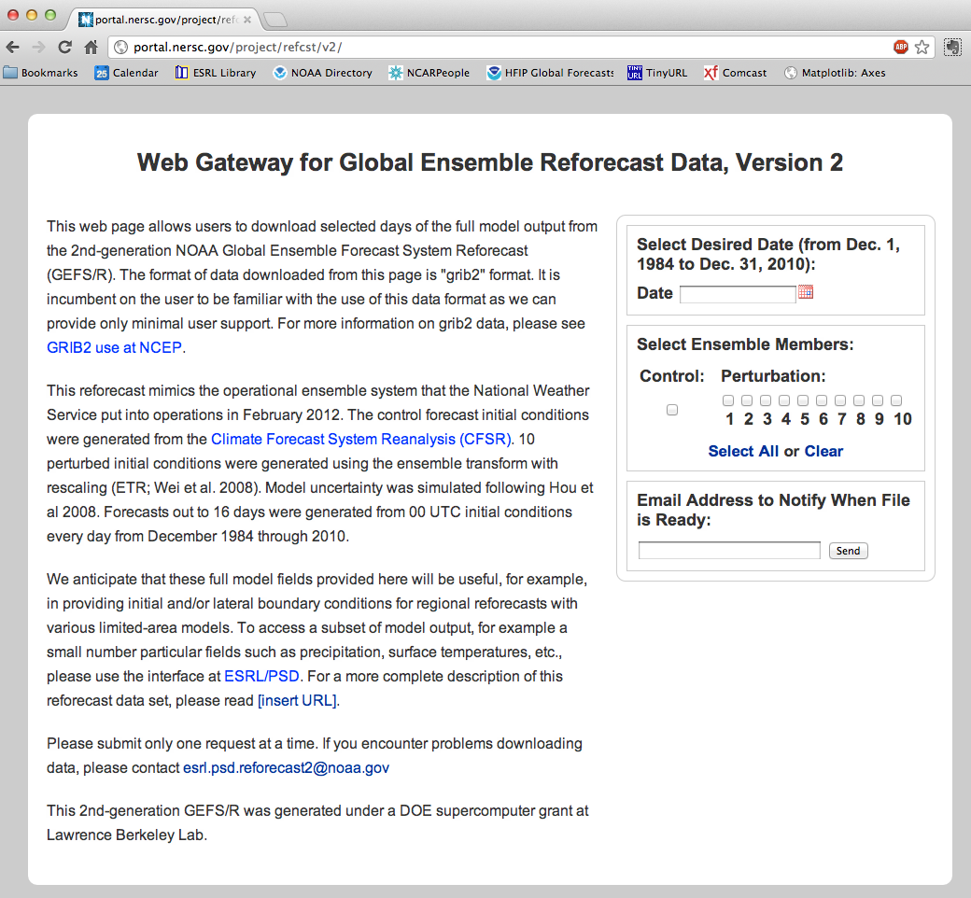
This DOE
site permits
access to
tape storage
of full data
(slower).
Use this to
access full
model state,
e.g., to
initialize
and provide
lateral boundary
conditions to
run WRF on
an old case.

Slide 11
Skill of the raw reforecasts
(no post-processing)

Slide 12
500 hPa Z anomaly correlation
(from deterministic control)
Lines w/o filled colors
for second–generation
reforecast (2012, T254)
Lines with filled colors
for first-generation
reforecast (1998, T62).
Perhaps a 1.5-2.5 day
improvement.

Slide 13
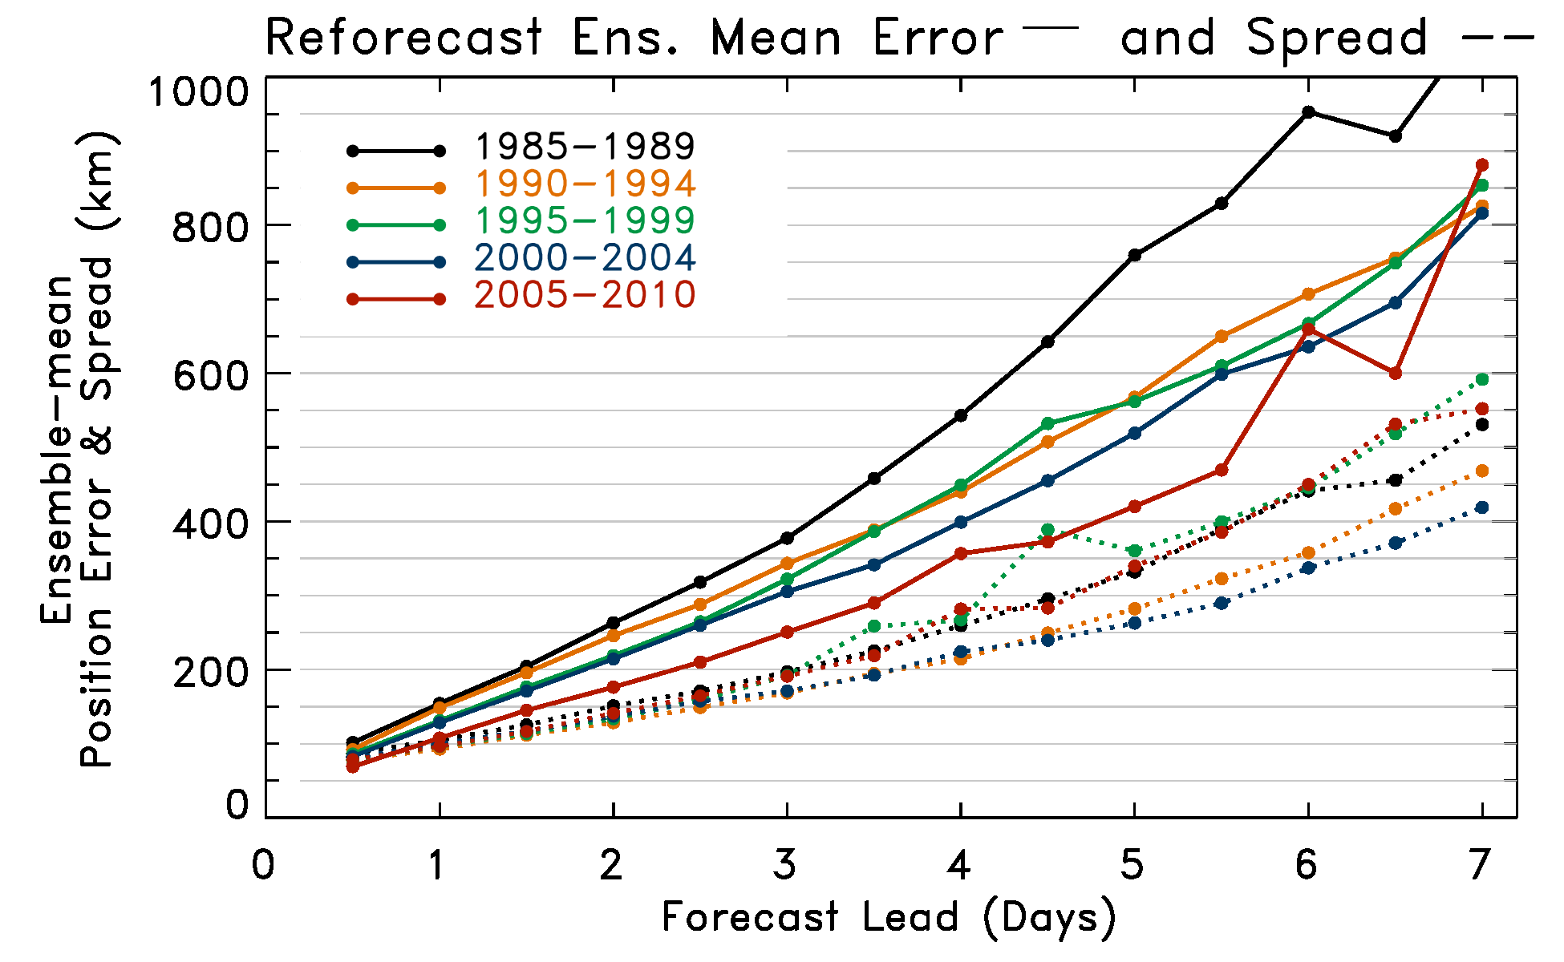
Tropical cyclone track errors
Less statistical consistency of errors over the period of the reforecasts, as opposed
to 500 hPa anomaly correlation, which emphasizes mid-latitude variability.

Slide 14
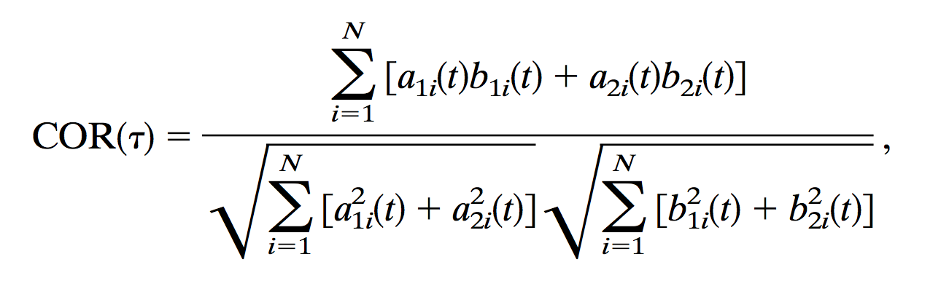
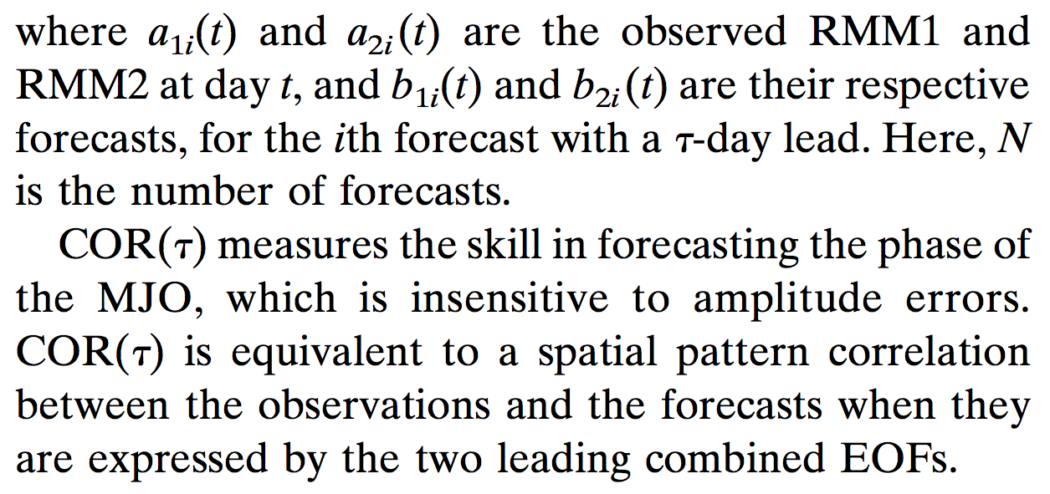
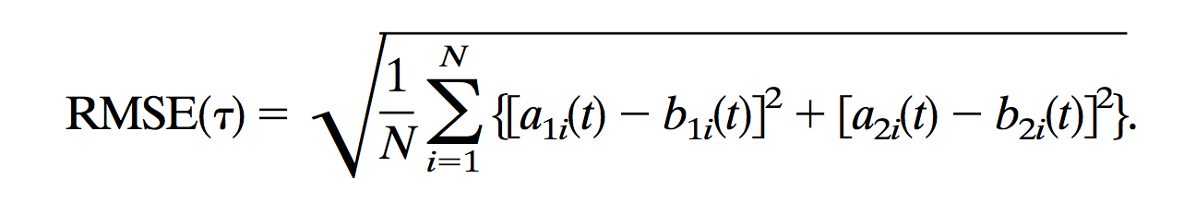
Madden-Julian Oscillation (MJO) deterministic verification metrics
RMM1 (= a₁) and
RMM2 (= a₂) measure
the projection
onto the first two
principal components
of MJO variability.
from Lin et al., Nov 2008 MWR.

Slide 15
MJO: Bi-variate RMM1 and RMM2 correlation and RMSE by half decade
The first 10 years are much less skillful than the subsequent 18.

Slide 16
Dec-Jan-Feb 1985-2010 CFSR data. Blocks defined here by Tibaldi/Molteni algorithm.

Slide 17
N Hem. blocking: more common in winter, spring
Blocking as defined in Tibaldi and Molteni (1990) using Z500. In next slide, we focus on
Dec-Jan-Feb. Grey bands defines Euro/Atlantic and Pacific blocking sectors in subsequent plots.

Slide 18
GEFS blocking skill by half decade
Blocking is evaluated using Tibaldi-Molteni algorithm for every longitude, every day. Skill
of the ensemble in predicting blocking is then evaluated.
Decreased Atlantic sector skill in 1985-1989 period stands out.

Slide 19
Statistical post-processing using reforecasts

Slide 20
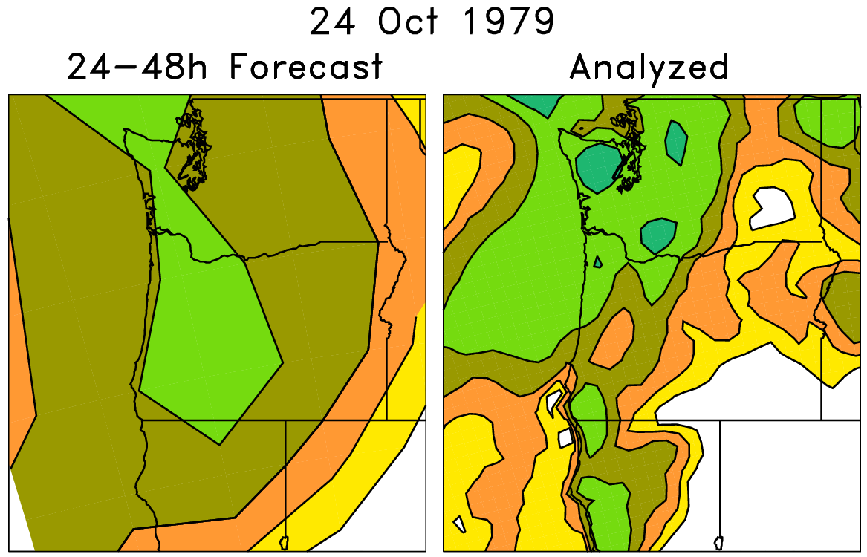
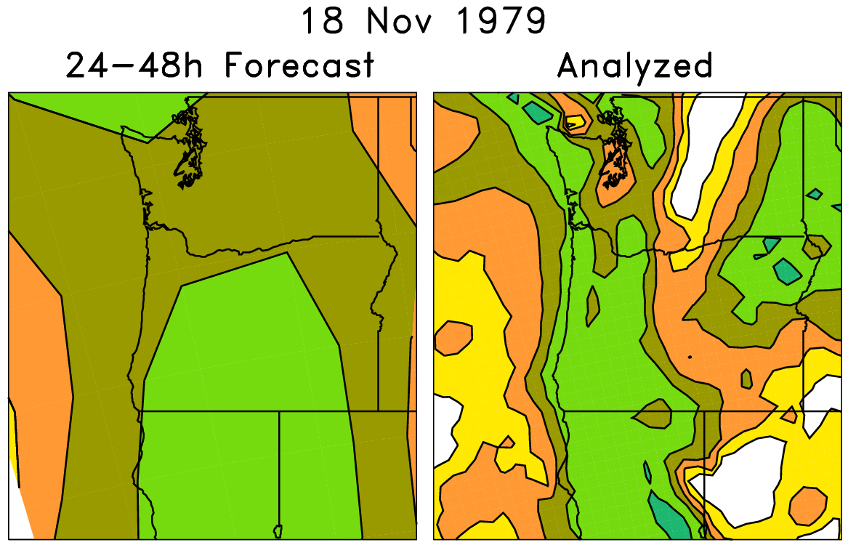
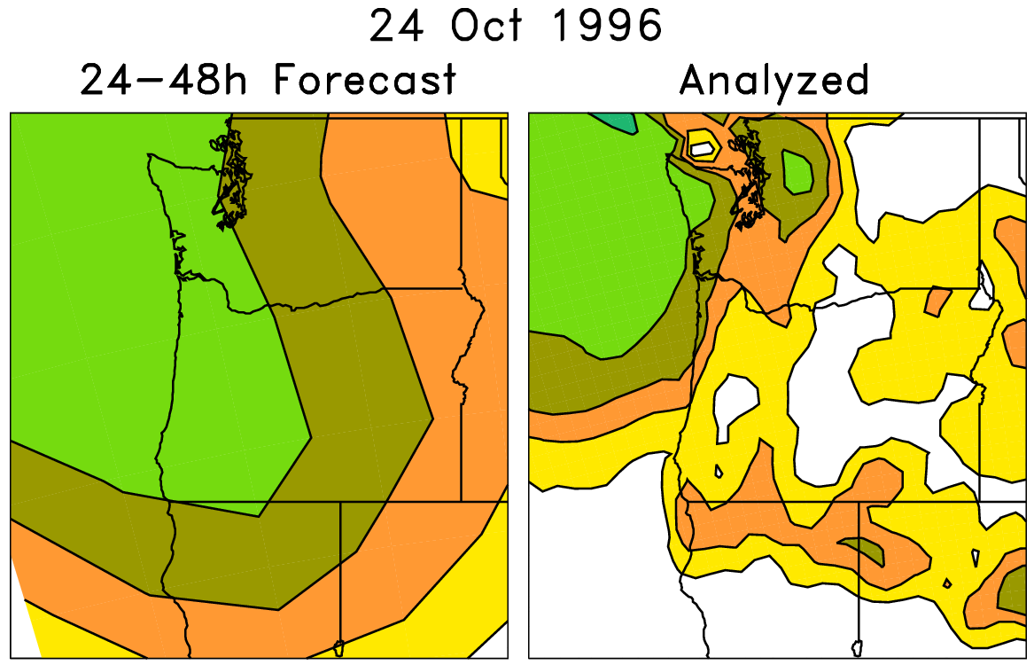
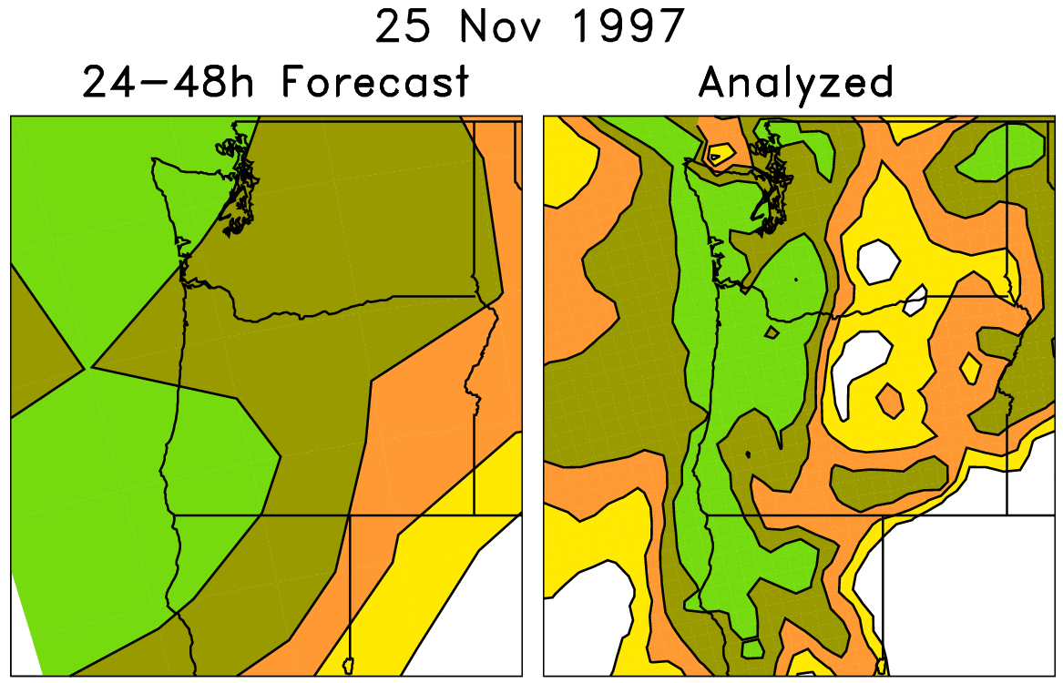
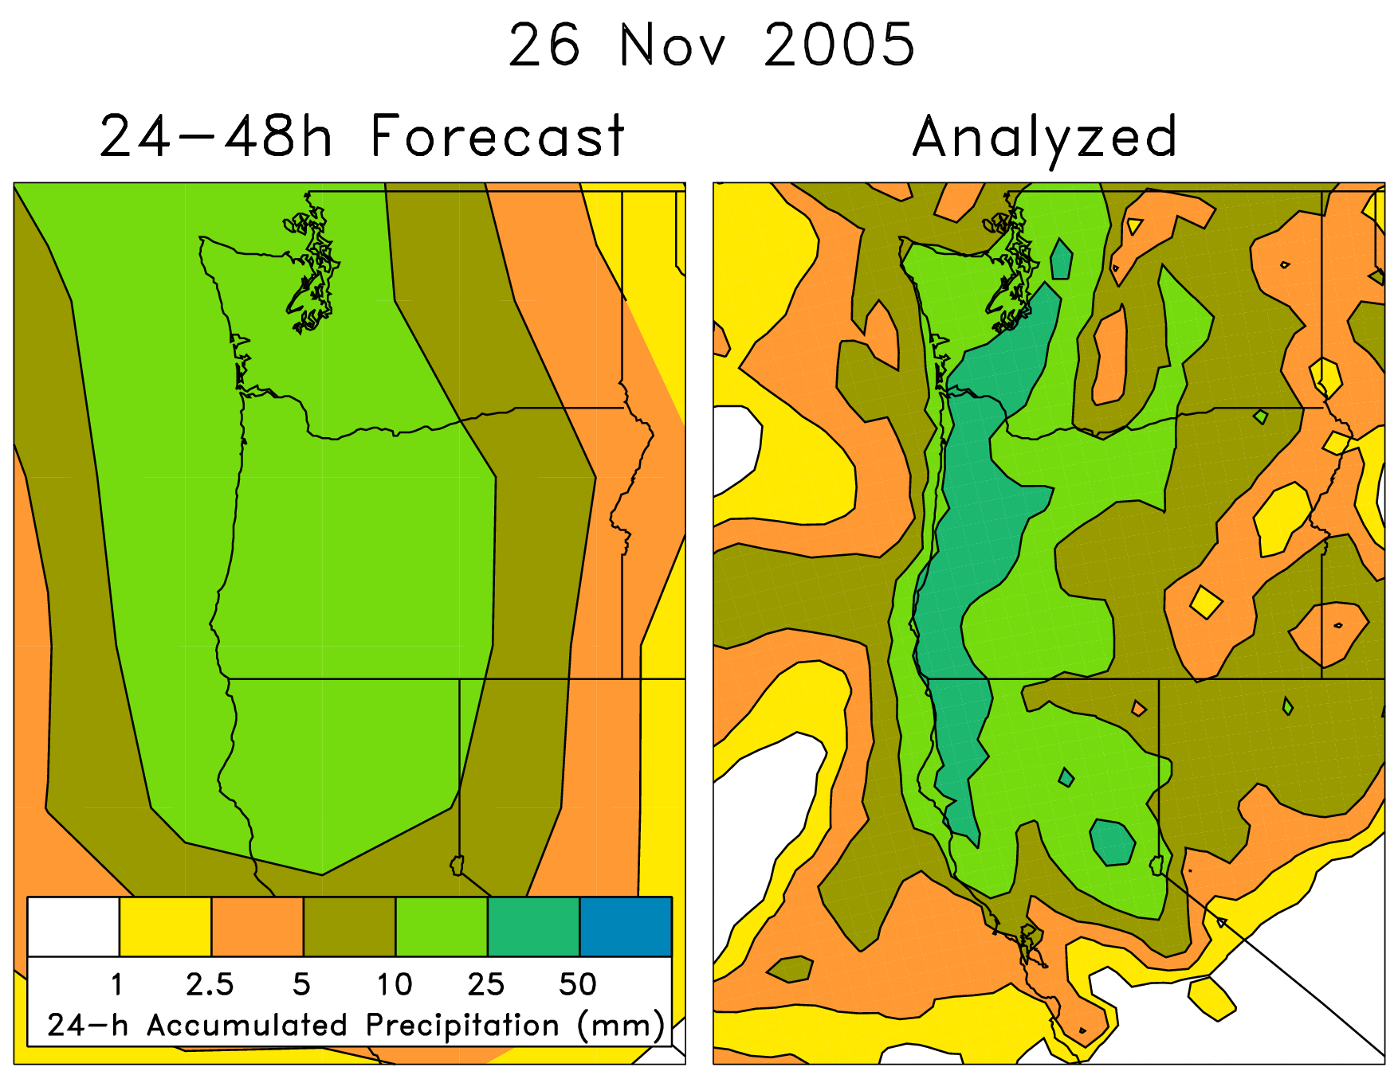
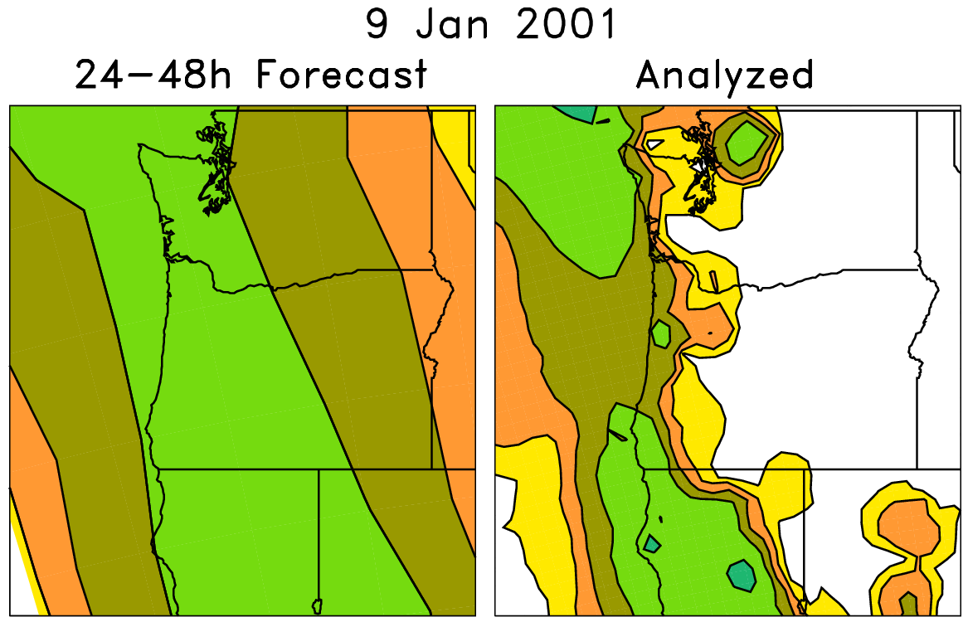
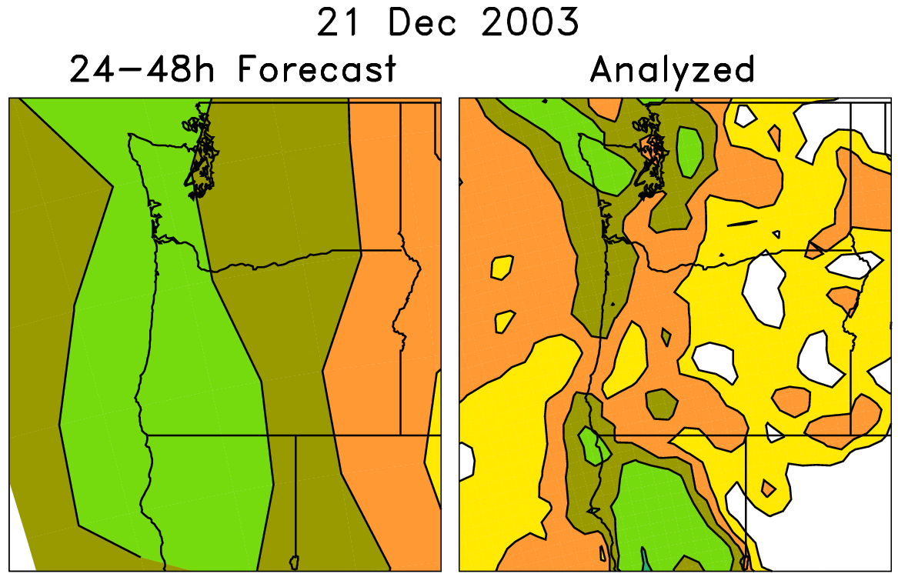
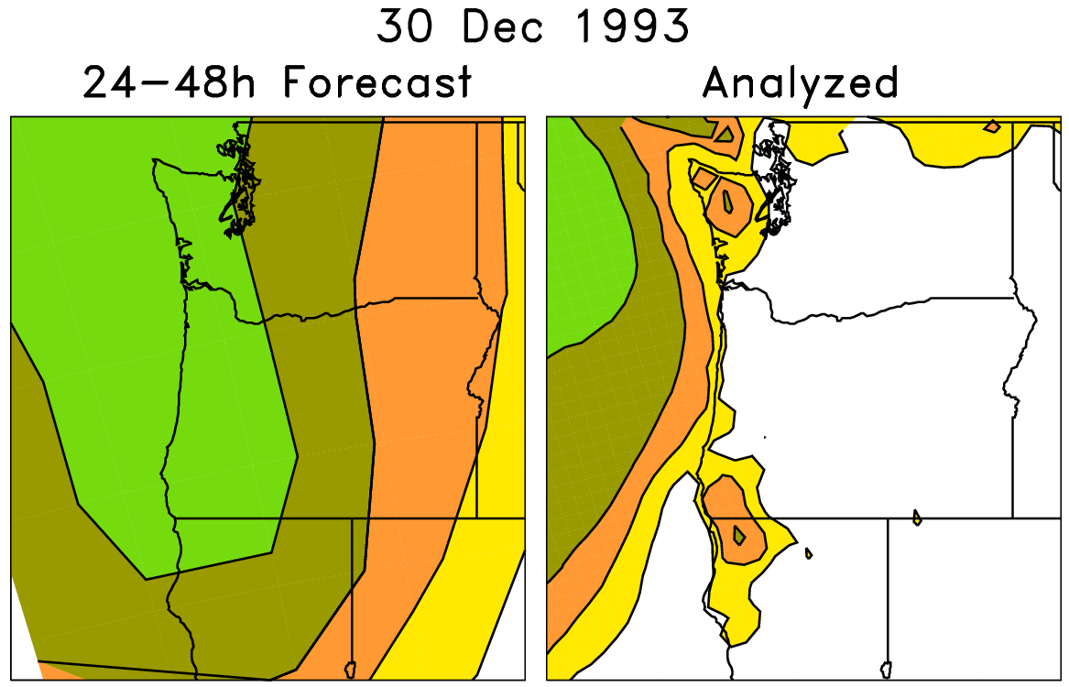
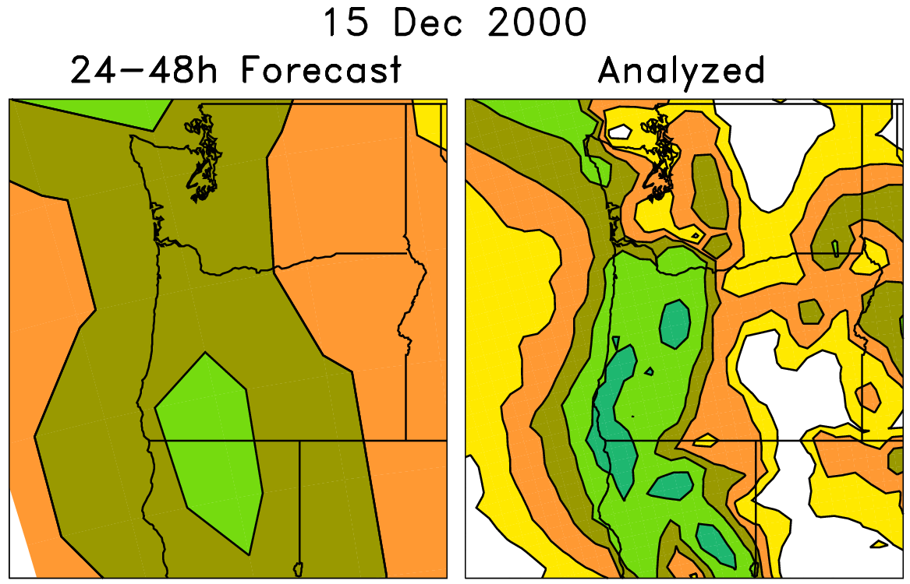
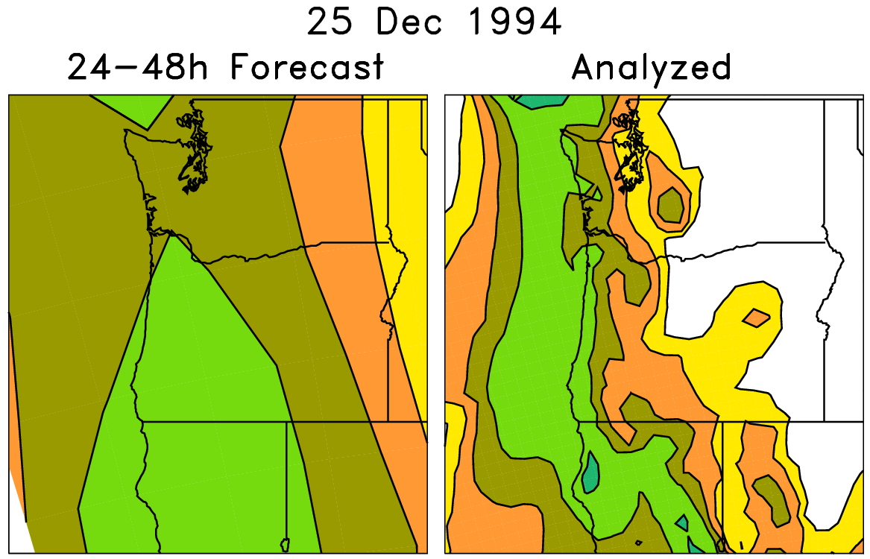
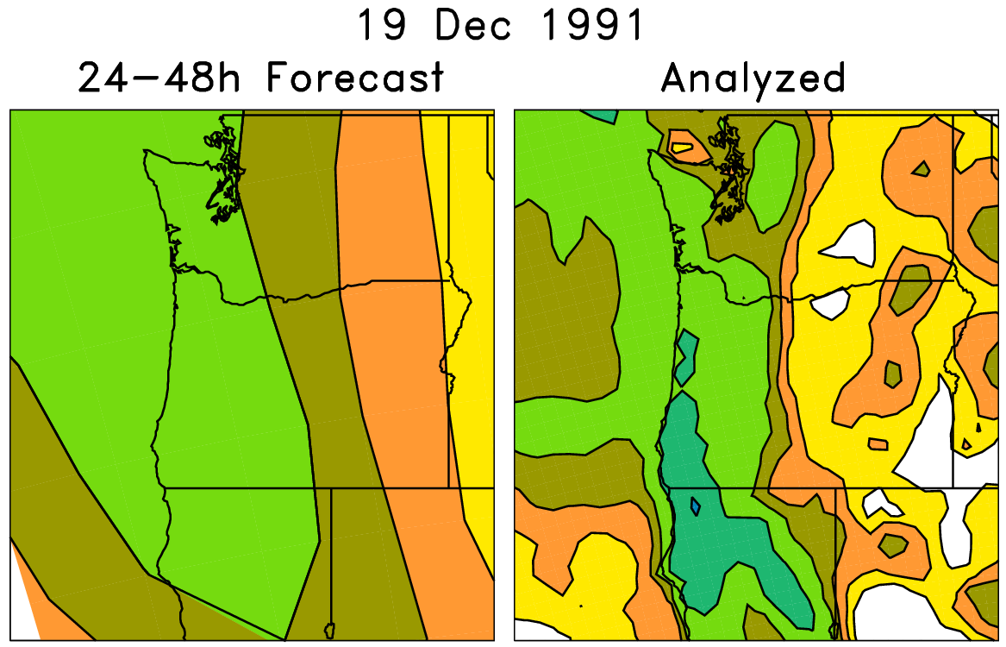
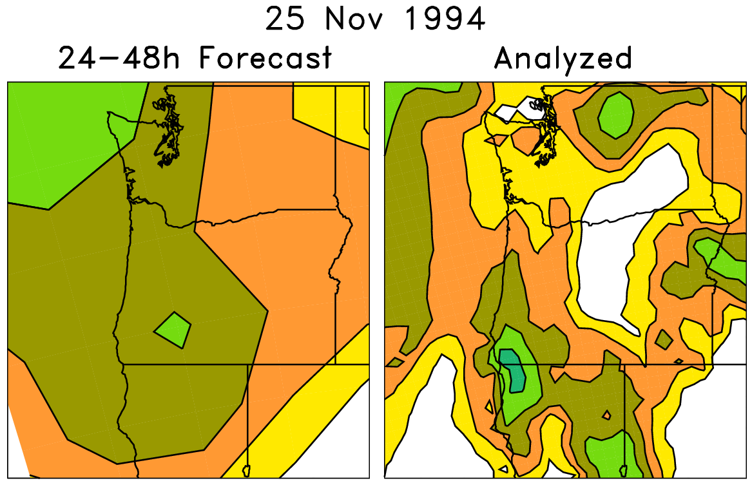
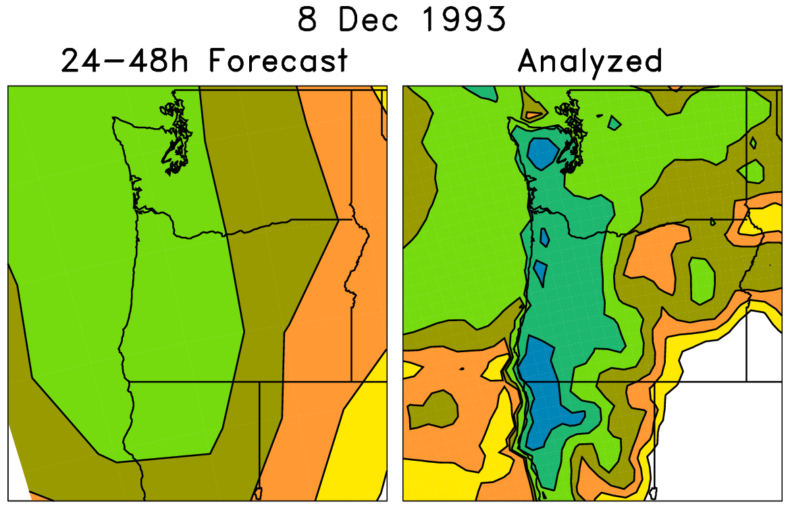
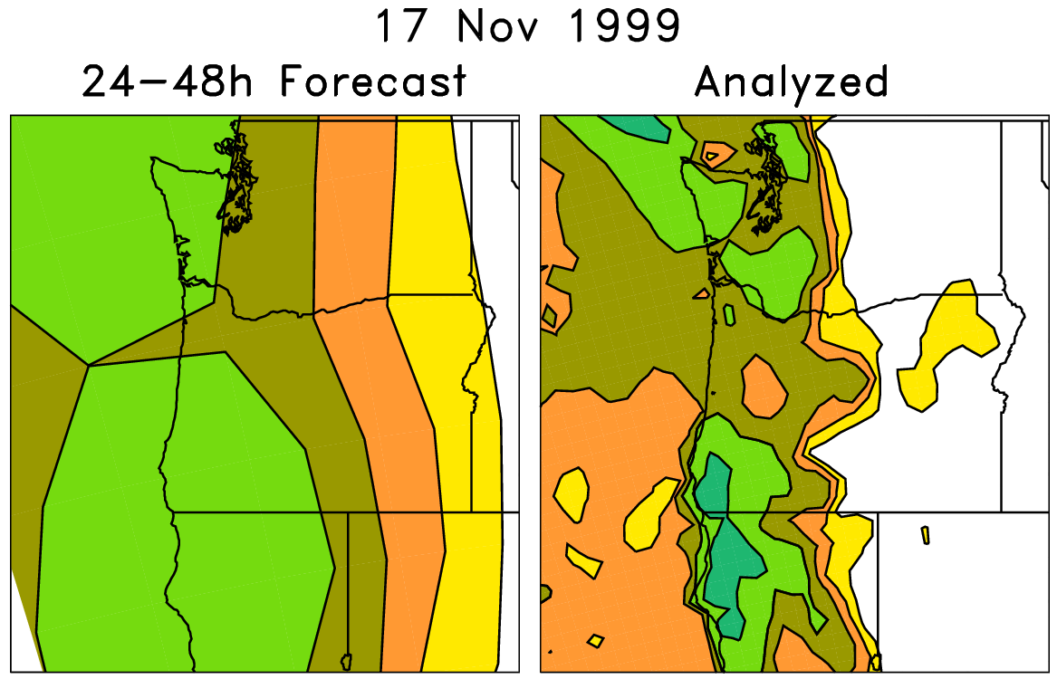
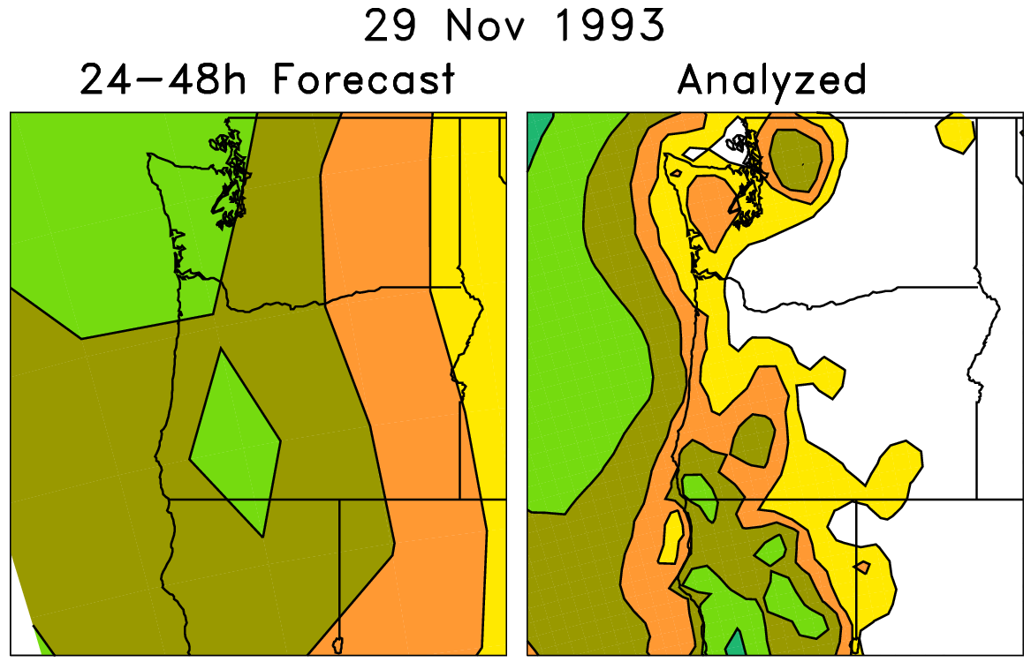
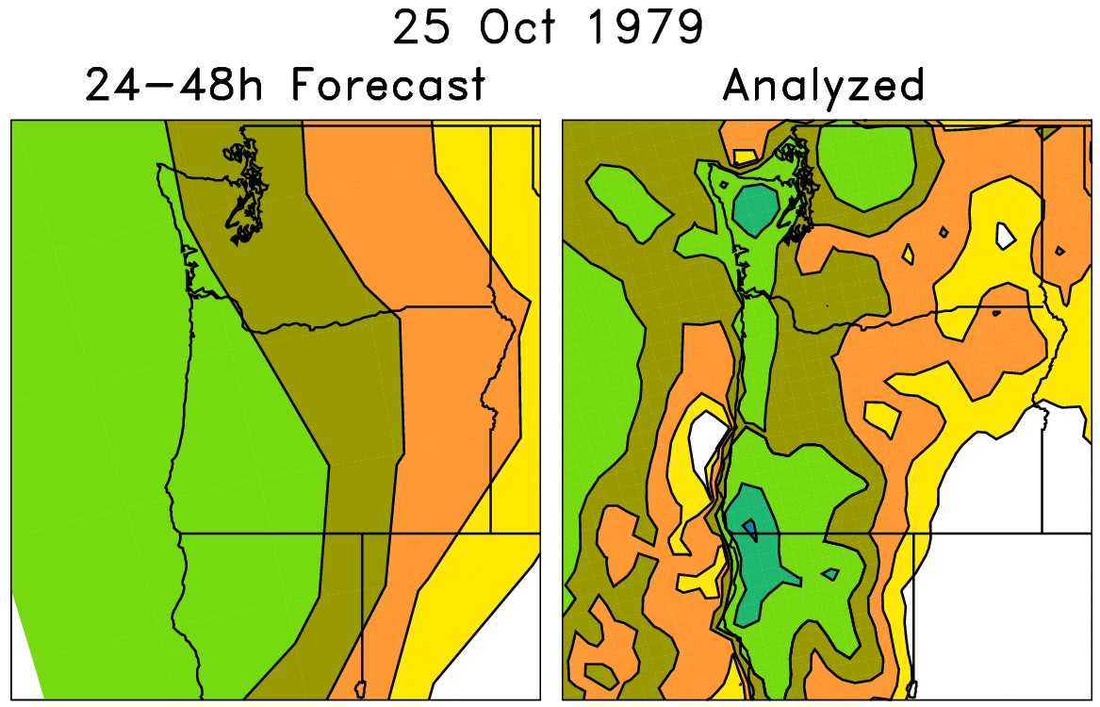
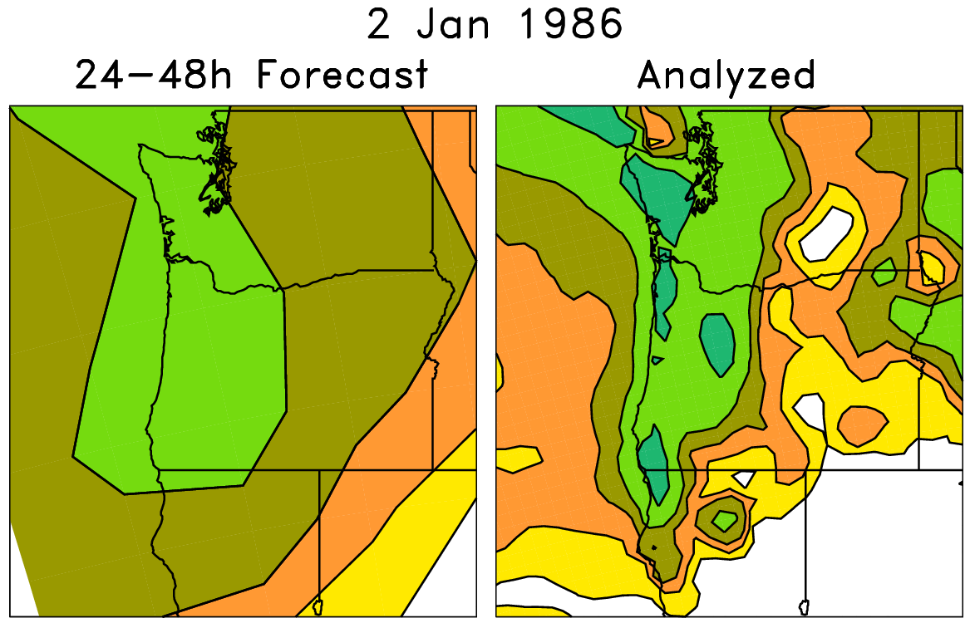
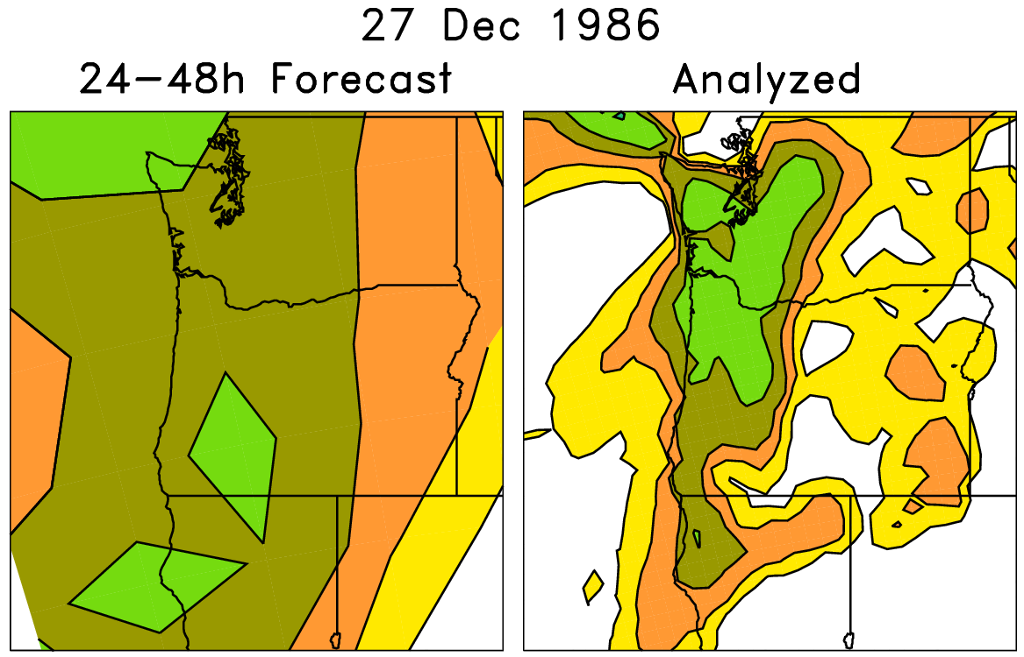
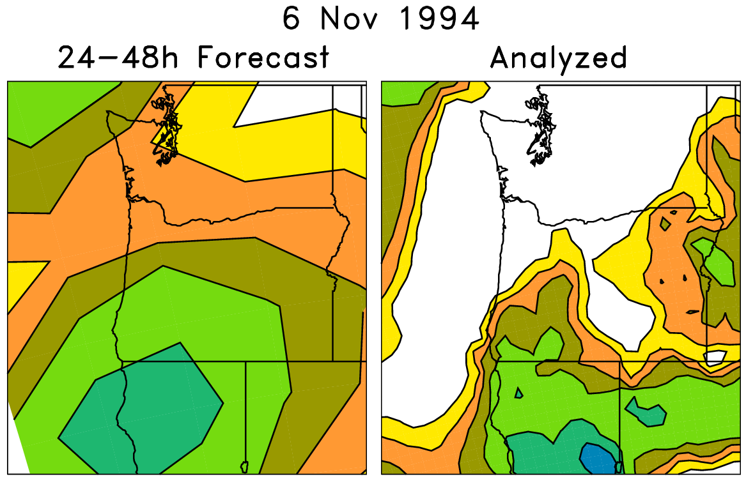
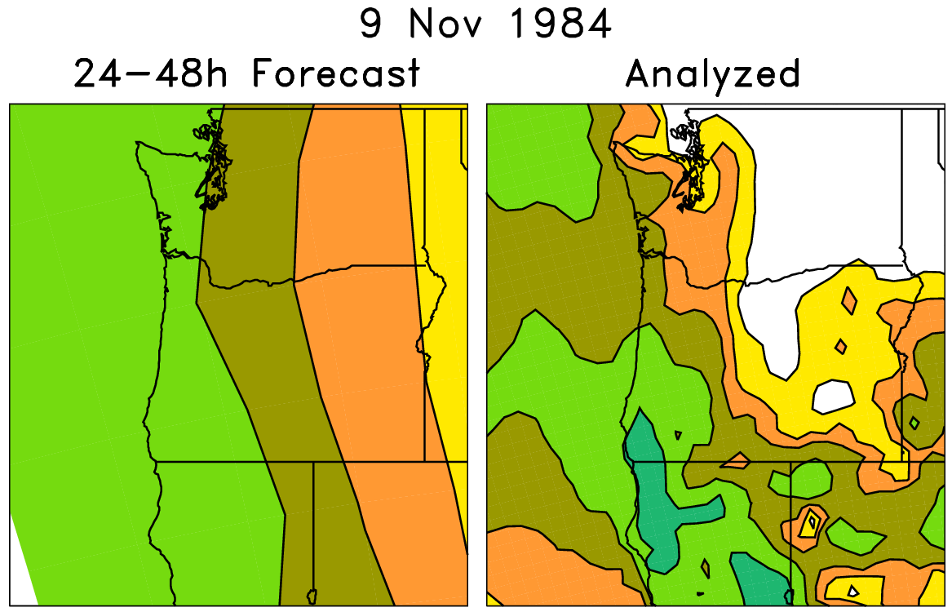
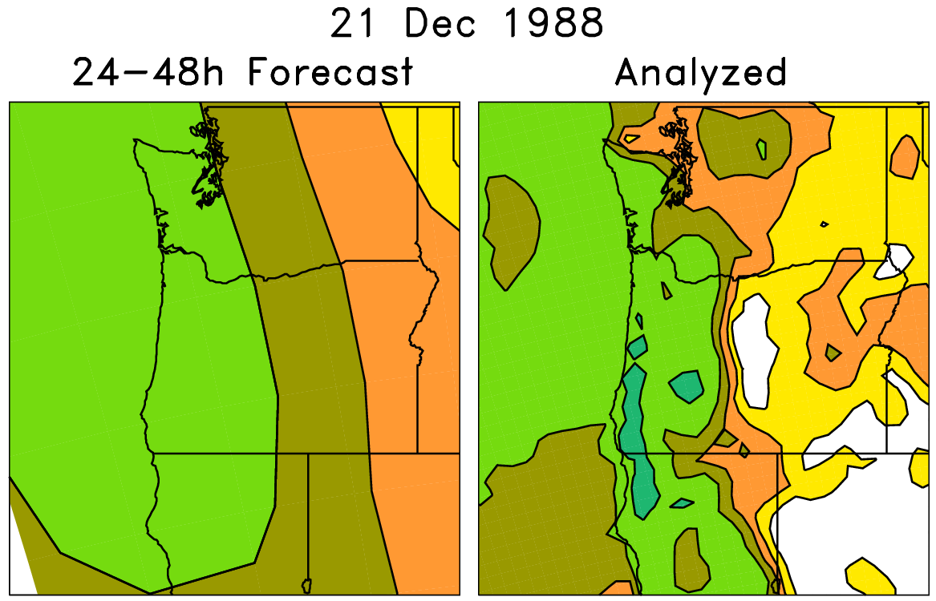
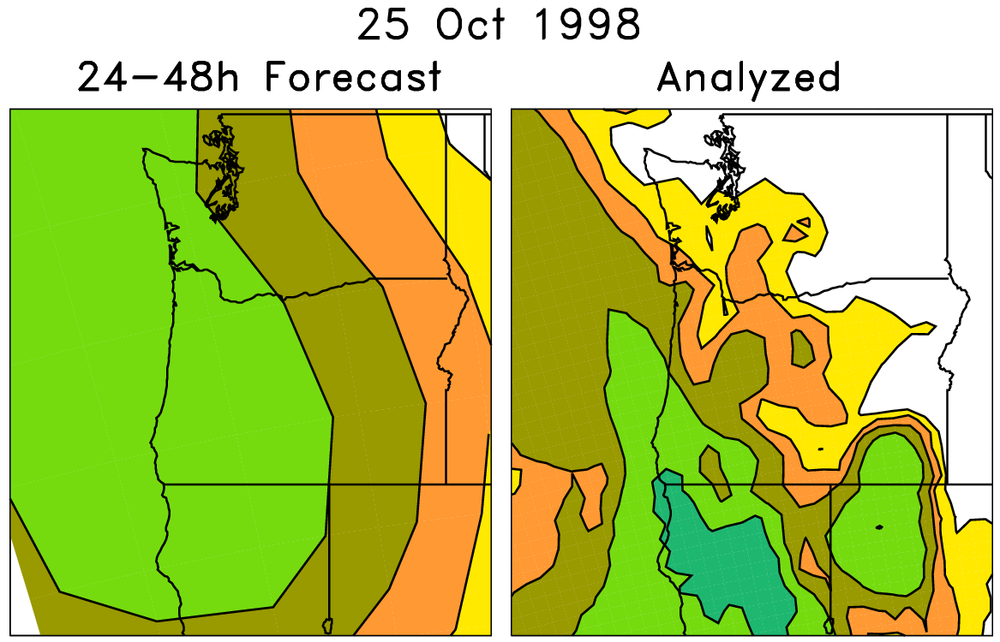
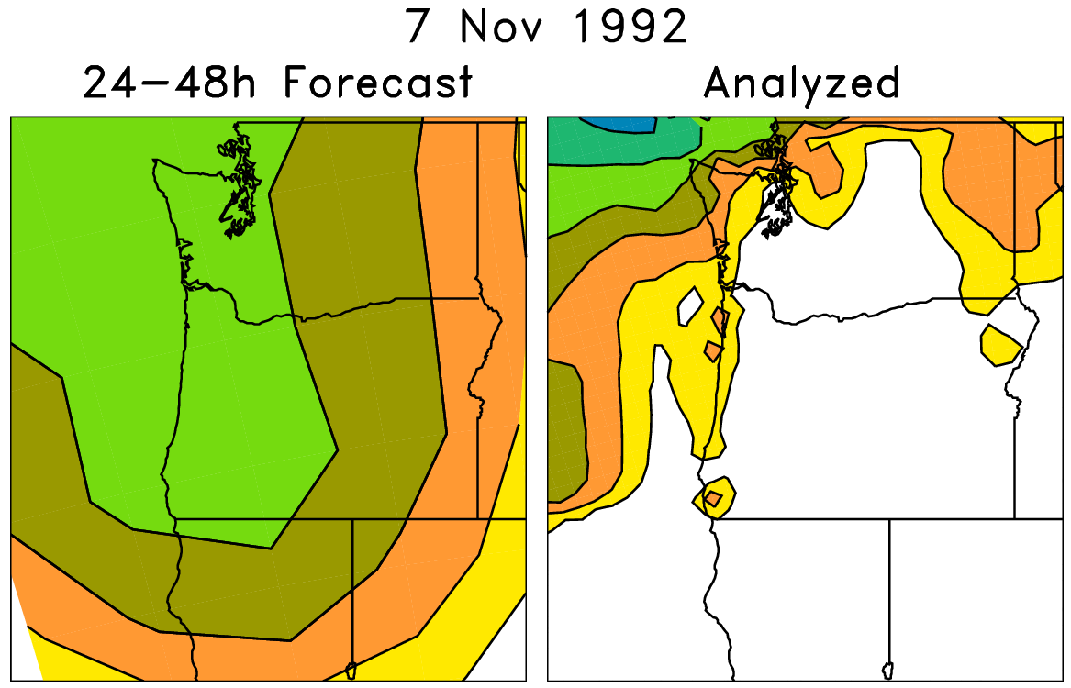
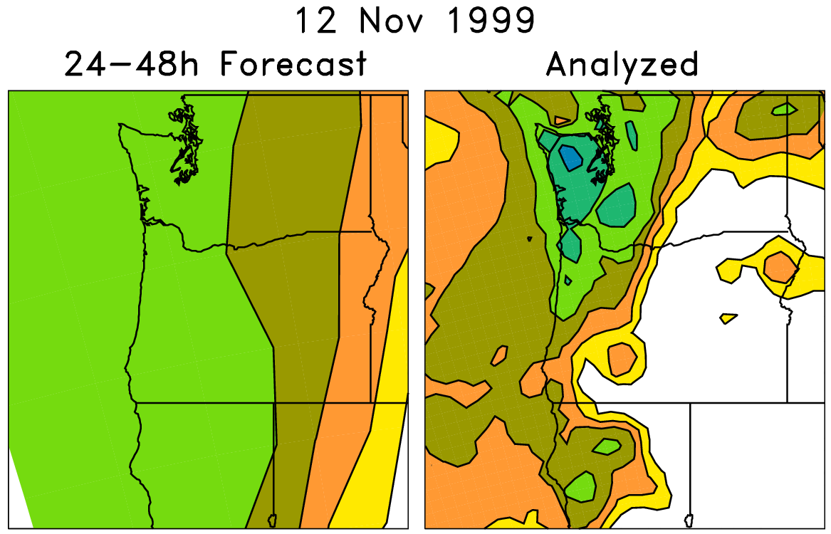
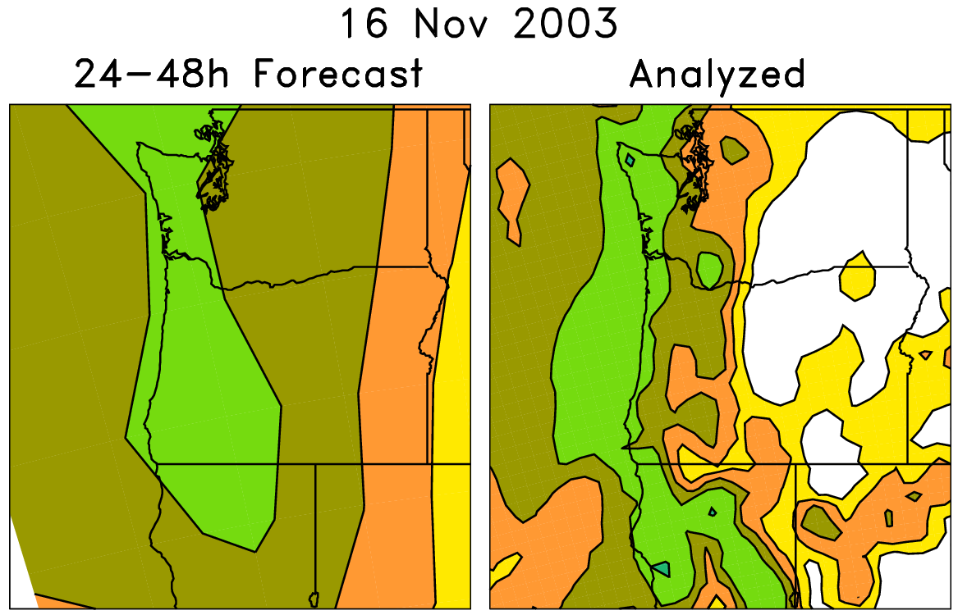
An example of a statistical correction technique using those reforecasts
Today’s forecast (& observed)
For each pair (e.g. red box), on the left are old forecasts that are somewhat similar to this day’s ensemble-mean forecast. The boxed data on the right, the analyzed precipitation for the same dates as the chosen analog forecasts, can be used to
statistically adjust and downscale the forecast.
Analog approaches like this
may be particularly useful for
hydrologic ensemble applications, where an ensemble of weather realizations is needed as inputs to a hydrologic ensemble streamflow system.

Slide 21
Forecasts evaluated operational 2012 GEFS for 2 Jul – 30 Sep 2012 (against CCPA analyses)
Here, the 21-member
ensemble forecasts are
validated against the
1-degree NCEP CCPA
precipitation analysis,
which regresses Stage IV
data against the Higgins
precipitation analysis.

Slide 22
Skill of calibrated precipitation forecasts
(over US, 1985-2010, “rank analog” calibration method)
~ raw
2012
GEFS
+3 day
skill
Verification here against 32-km North American Regional Reanalysis (tougher).
Verification in previous plot against 1-degree NCEP precipitation analysis (easier).

Slide 23
How do v2 2012 reforecast-calibrated precipitation forecasts compare to the v1, 1998 reforecast-calibrated?
solid lines are
reforecasts from
the 2012 GEFS
dashed lines are
reforecasts from
the 1998 GEFS
gray bars are the
5-95% confidence
intervals.
verified against
NARR over CONUS
1985-2012.

Slide 24
Reliability, > 10 mm precipitation 24 h⁻¹
Day +0-1
Day +2-3
Day +4-5
Version 2 (2012 GEFS)
Almost perfect reliability.

Slide 25
Reliability, > 50 mm precipitation 24 h⁻¹
Day +0-1
Day +2-3
Day +4-5
Version 2 (2012 GEFS)
5/95 CI’s
from
“block
bootstrap”

Slide 26
Post-processing to improve deterministic forecasts
Some further modifications to analog technique, including Ebert’s “probability-matched
mean” approach allow post-processed forecasts to improve significantly on deterministic
forecast guidance supplied by the model.

Slide 27
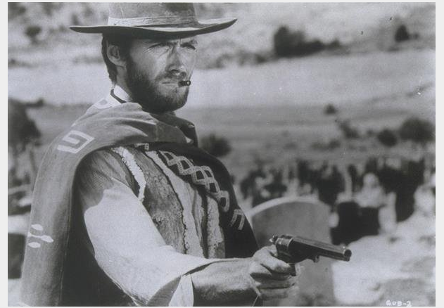
Case studies with
“atmospheric rivers” in the western US: the good, the bad and ugly

Slide 28
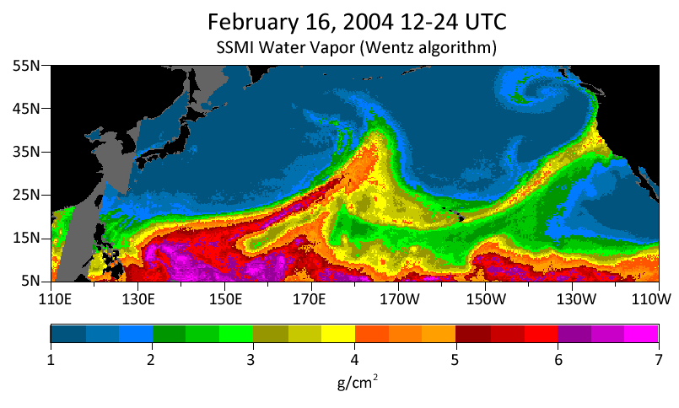
The bad and ugly atmospheric rivers case study
10” rain in the coastal mountains, 4-7” in Russian River
watershed. Streamflows in top 0.2% of historical observations.
Source: http://www.esrl.noaa.gov/psd/atmrivers/events/

Slide 29
+4-day forecast
very little hint of excessive
rainfall in post-processed
guidance over N CA.

Slide 30
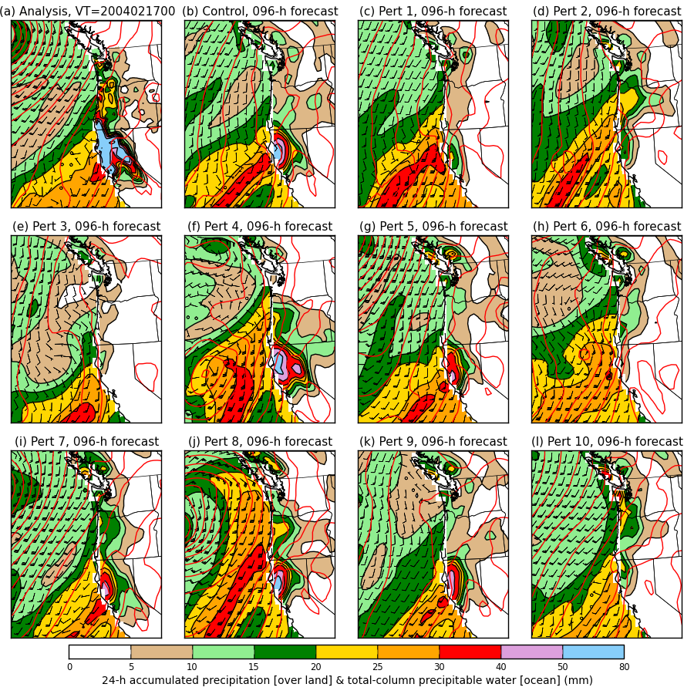
+4-day forecast
Colors: over the
ocean, the total-
column precipitable
water. Over land,
the 24-h accum.
precipitation.
Wind barbs for the
925 hPa level.
Red contours:
mean sea-level
pressure.
Lesson: garbage in,
garbage out.

Slide 31
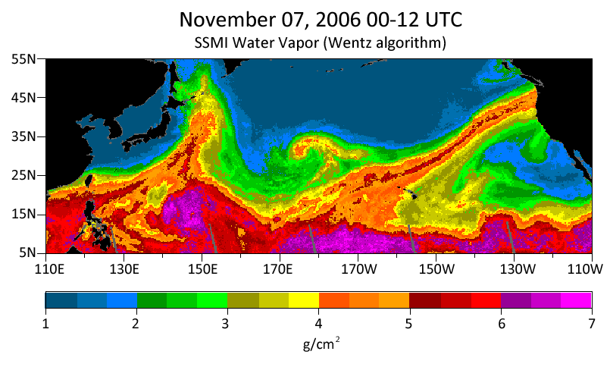
The “good” atmospheric rivers case study:
Nov 2006 Oregon-Washington floods
8-20 inches of rain in Cascades; flooded rivers; extensive damage to Mt. Rainier NP.

Slide 32
+4-day forecast
Now there are reasonably
high probabilities of heavy
precipitation.

Slide 33
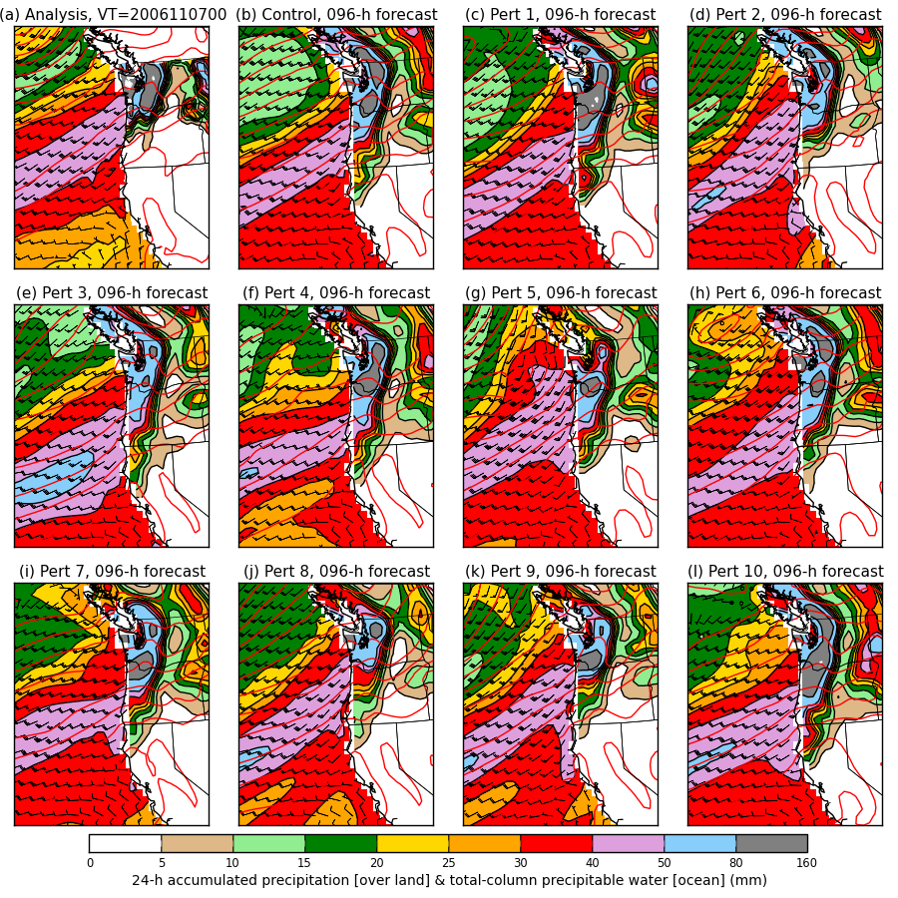
+4-day forecast

Slide 34
Spaghetti
Westerns
Inconsistent forecasts of
orientation of isobars
and hence wind direction
Consistent forecasts of
orientation of isobars
and hence wind direction
The bad and the ugly
Day + 6 ____
Day + 4 ____
Day + 2 ____
Analysis ____
The good

Slide 35
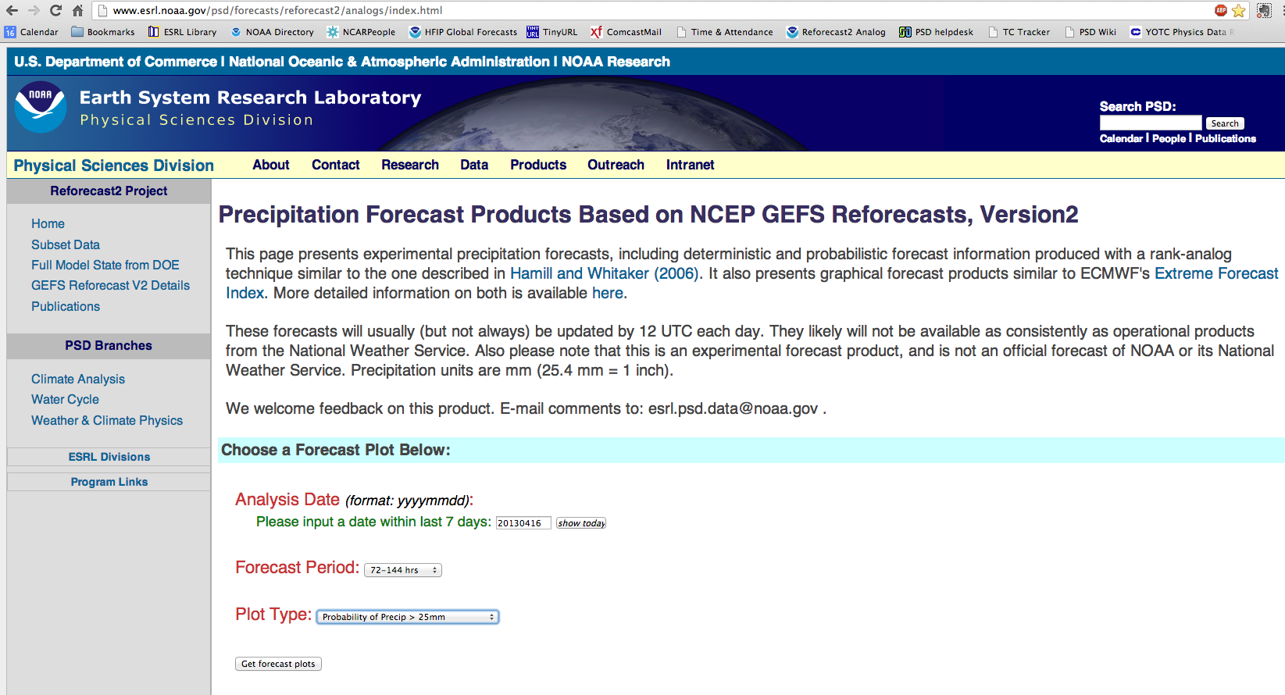
Reforecast precipitation product web page
http://www.esrl.noaa.gov/psd/forecasts/reforecast2/analogs/index.html)

Slide 36
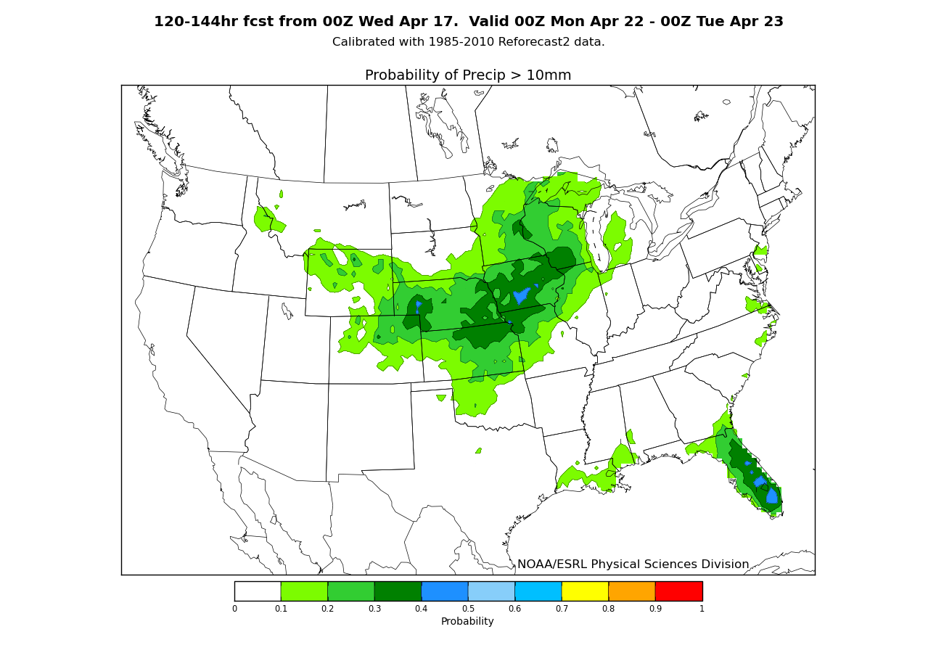
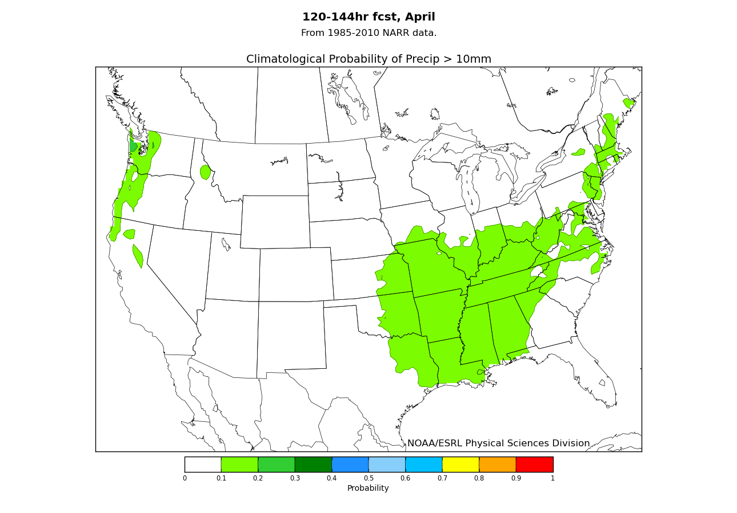
Probability of > 25 mm, 72-144 h forecast from 00Z Tuesday, 17 April 2013
http://www.esrl.noaa.gov/psd/forecasts/reforecast2/analogs/index.html)

Slide 37
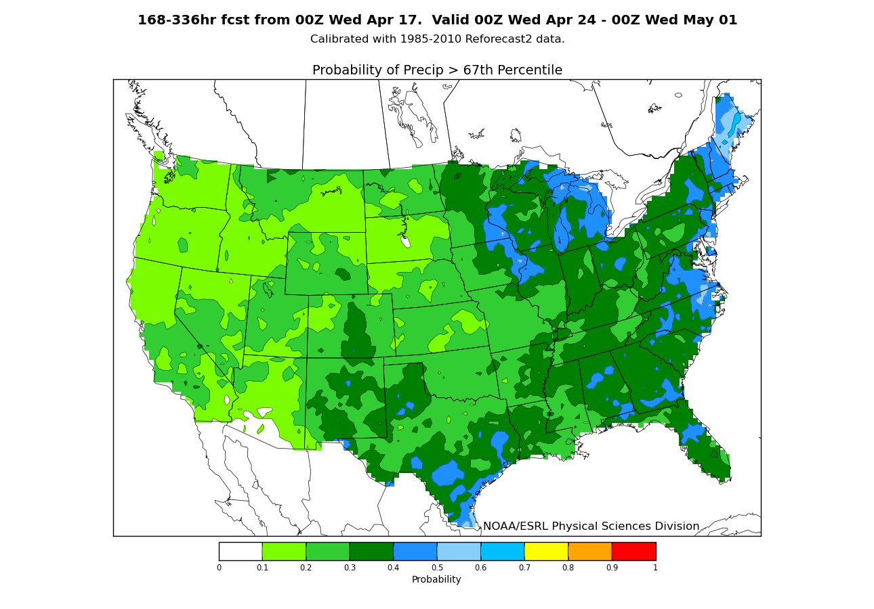
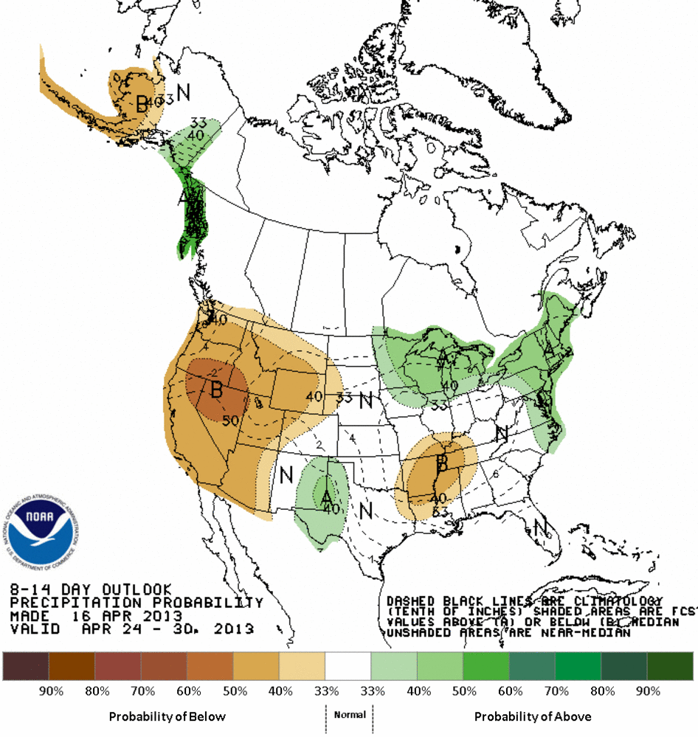
Week-2 forecast,
P(precip > upper tercile)
Note: times don’t match up exactly here;
CPC created during the day yesterday,
ours created overnight.

Slide 38
Post-processed precipitation reliability, upper and lower tercile, days 5-10 (120-240 h lead)
Comparatively, in our 2004 MWR article, for version-1 reforecasts validated
against station data, 6-10 day RPS skill was ~ 0.06.

Slide 39
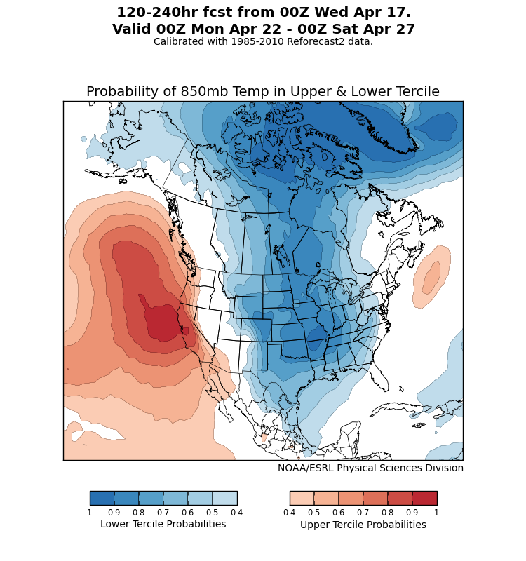
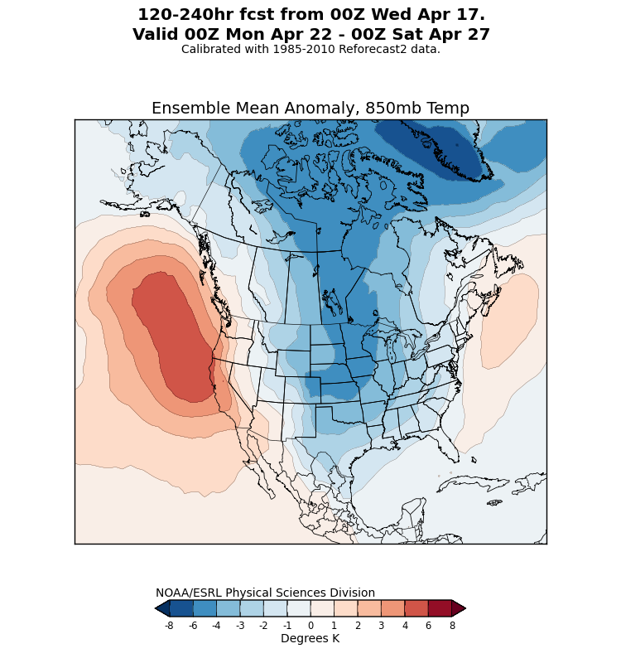
Also: T2m, T850, Z500 calibrated forecast information
http://www.esrl.noaa.gov/psd/forecasts/reforecast2/medrange/index.html

Slide 40
T850 reliability, upper tercile

Slide 41
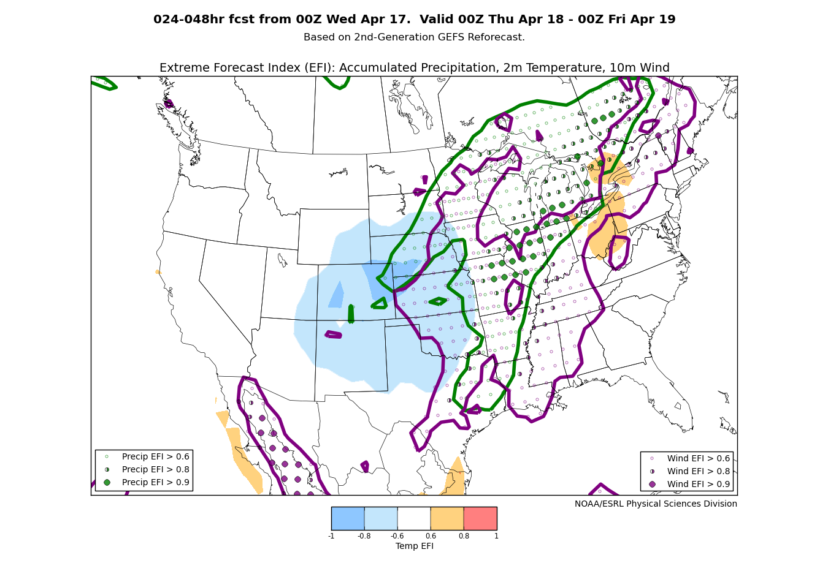
Extreme forecast index
(following ECMWF)
In the absence
of observations
or analyses for
verification, the
EFI can at least
provide you
with a heads-up
of where the
GEFS is unusual
relative to its
own model
climatology
for that time
of the year.
(also available from http://www.esrl.noaa.gov/psd/forecasts/reforecast2/analogs/index.html)

Slide 42

Research application: extended-range tornado forecasting
Francisco Alvarez,
St. Louis University,
is working with me
and others on using the
reforecasts to make
extended-range
predictions of
tornado probabilities.
Ph.D. work,
in progress.

Slide 43
Demo: Regional reforecast with WRF ARW v3.4 using global reforecast for initial, boundary conditions
2-way nested simulation 36-, 12- and 4-km with 36 vertical levels
  12- and 4-km moving nests
Time step: 180, 60, and 20 s
Initial and boundary condition: GFS reforecast ensemble member
Tiedtke cumulus scheme on 36 and 12 km; explicit on 4 km
YSU PBL scheme
HYCOM ocean analysis
WSM6 microphysics
Noah land surface
2D Smagorinsky turbulence scheme
Goddard shortwave radiation
RRTM longwave radiation
Second order diffusion
Positive definite scalar advection
Donelan wind-dependent drag formulation
Garratt wind-dependent enthalpy surface fluxes
c/o Tom Galarneau, NCAR & NOAA HFIP grant

Slide 44

2005 Rita official forecast
(Houston, TX evacuated)

Slide 45



TC Rita (2005)
GFS reforecast ensemble
72-h forecast
initialized at 00Z 22 Sept
P01
P02
P03
P04
P05
P06
P07
P08
P09
P10
P11
OBS
00Z/22
00Z position

Slide 46




TC Rita (2005)
ARW ensemble with GFS reforecast ensemble as boundary and initial conditions
72-h forecast
initialized at 00Z 22 Sept
P01
P02
P03
P04
P05
P06
P07
P08
P09
P10
P11
OBS
00Z/22
00Z position

Slide 47



A synthetic example of using reforecasts
to make track error bias corrections
72-h Forecast Verifying 1200 UTC 9 September
Ensemble Mean, Reforecast Analog,
and Observed Positions
Reforecast Analog
Position Errors
N
Bias-Corrected Ensemble Mean Position
and Probability Ellipse
W
E
Observed
S
Error (km)
Red : mean forecast position
Blue dot: forecast positions of +72-h forecast analogs
End of red tail ___ : observed positions at +72 h

Slide 48
Conclusions
Multi-decadal ensemble reforecast data set was created for current operational NCEP GEFS (circa 2012); useful for statistical calibration, regional reforecasting, understanding model biases, and much more.
Reforecast and real-time forecasts data available now.
Experimental forecast products available.
We welcome your feedback on products, problems to esrl.psd.reforecast2@noaa.gov.
If you find these reforecast products valuable, please communicate that to NCEP/EMC . They need to make decisions about whether & how to conduct reforecasts in the future on their operational system.
An article on the data set and its applications is in press at BAMS,
http://journals.ametsoc.org/doi/pdf/10.1175/BAMS-D-12-00014.1

