Slide 1


Reforecasts: what are they good for?
Using multi-decadal reforecasts from the NCEP Global Ensemble Forecast System.
NOAA Earth System
Research Laboratory
Tom Hamill
NOAA ESRL, Physical Sciences Division
tom.hamill@noaa.gov
also: Jeff Whitaker, Gary Bates, Don Murray, Francisco Alvarez, Mike Fiorino, Tom Galarneau

Slide 2
What’s to be covered here
A quick descriptions of the why / what of this reforecast database.
Skill of raw reforecasts
Post-processing method and examples
Using reforecasts to diagnose forecastability of MJO and blocking.
How you can access the reforecast data for your own applications.

Slide 3
Ensemble simulations of the weather and climate commonly have systematic errors.
Biased 14-day surface temperature forecasts
ensemble-mean
forecast
Temperature
analyzed
Date
Under-spread ensembles
Temperature
Temperature
Temperature
forecast
lead time
forecast
lead time
forecast
lead time

Slide 4
Ensemble simulations of the weather and climate commonly have systematic errors.
Biased 14-day surface temperature forecasts
ensemble-mean
forecast
Temperature
analyzed
We’d like to statistically
adjust the forecast guidance before our customers use it
to make decisions.
Date
Under-spread ensembles
Temperature
Temperature
Temperature
forecast
lead time
forecast
lead time
forecast
lead time

Slide 5
Statistical post-processing for rare events is challenging without a large training sample
Say you want to statistically post-process your model precipitation forecast to improve it.
Heavy precipitation events like the one today are the ones you care about the most. How
do you calibrate today’s forecast given past short sample of forecasts and observations?

Slide 6
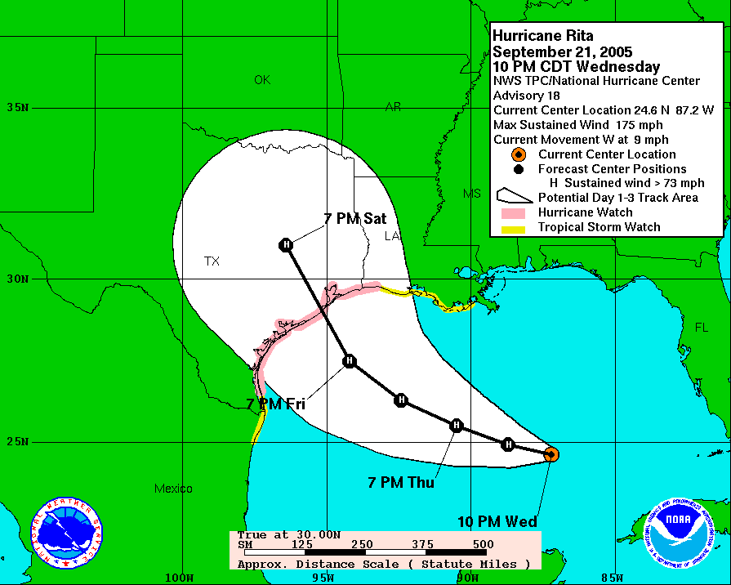
2005 Rita official forecast
(Houston, TX evacuated)

Slide 7
2005 Rita official forecast
(Houston, TX evacuated)
Is the model guidance for Rita
biased too far east or west?
Is the model guidance producing storms that are systematically less intense
than they should be? Does the model
spin up too many hurricanes in the Caribbean? How will you generate
enough samples to know?

Slide 8
Need sufficient samples to understand whether the forecast model can predict low-frequency modes of variability.
The atmosphere suppresses blocking subsequent to an active Indian-Ocean Madden-Julian Oscillation (MJO) during the Northern Hemisphere winter. Does the forecast model suppress blocking as well? How can one detect that with only a season or so of past forecasts and with both blocking and strong MJOs happening infrequently?

Slide 9
Reforecasts (hindcasts)
Numerical simulations of the past weather (or climate) using the same forecast model and assimilation system that (ideally) is used operationally.
  Common with climate, uncommon with weather models.

Slide 10
GEFS reforecast v2 details
Seeks to mimic GEFS (NCEP Global Ensemble Forecast System) operational configuration as of February 2012.
Once daily at 00 UTC, we produce an 11-member forecast, 1 control + 10 perturbed.
These reforecasts were produced every day, for 1984120100 to current.
CFSR (NCEP’s Climate Forecast System Reanalysis) initial conditions (3D-Var) + ETR perturbations (cycled with 10 perturbed members). After ~ 22 May 2012, initial conditions from hybrid EnKF/3D-Var.
Resolution: T254L42 to day 8 (~47-km grid spacing), T190L42 (~ 70 km) from days 7.5 to day 16.
Fast data archive at ESRL of 99 variables, 28 of which stored at original ~1/2-degree resolution during week 1. All stored at 1 degree. Also: mean and spread to be stored.
Full archive at DOE/Lawrence Berkeley Lab, where data set was created under DOE grant.

Slide 11
A few characteristics of the raw reforecasts

Slide 12
v2
v1
CFSR initial conditions used in GEFS generally improve over the decades, leading to slight improvements in GEFS skill.
(2) About a +2 day improvement relative to 1998 GEFS T62 reforecasts.

Slide 13
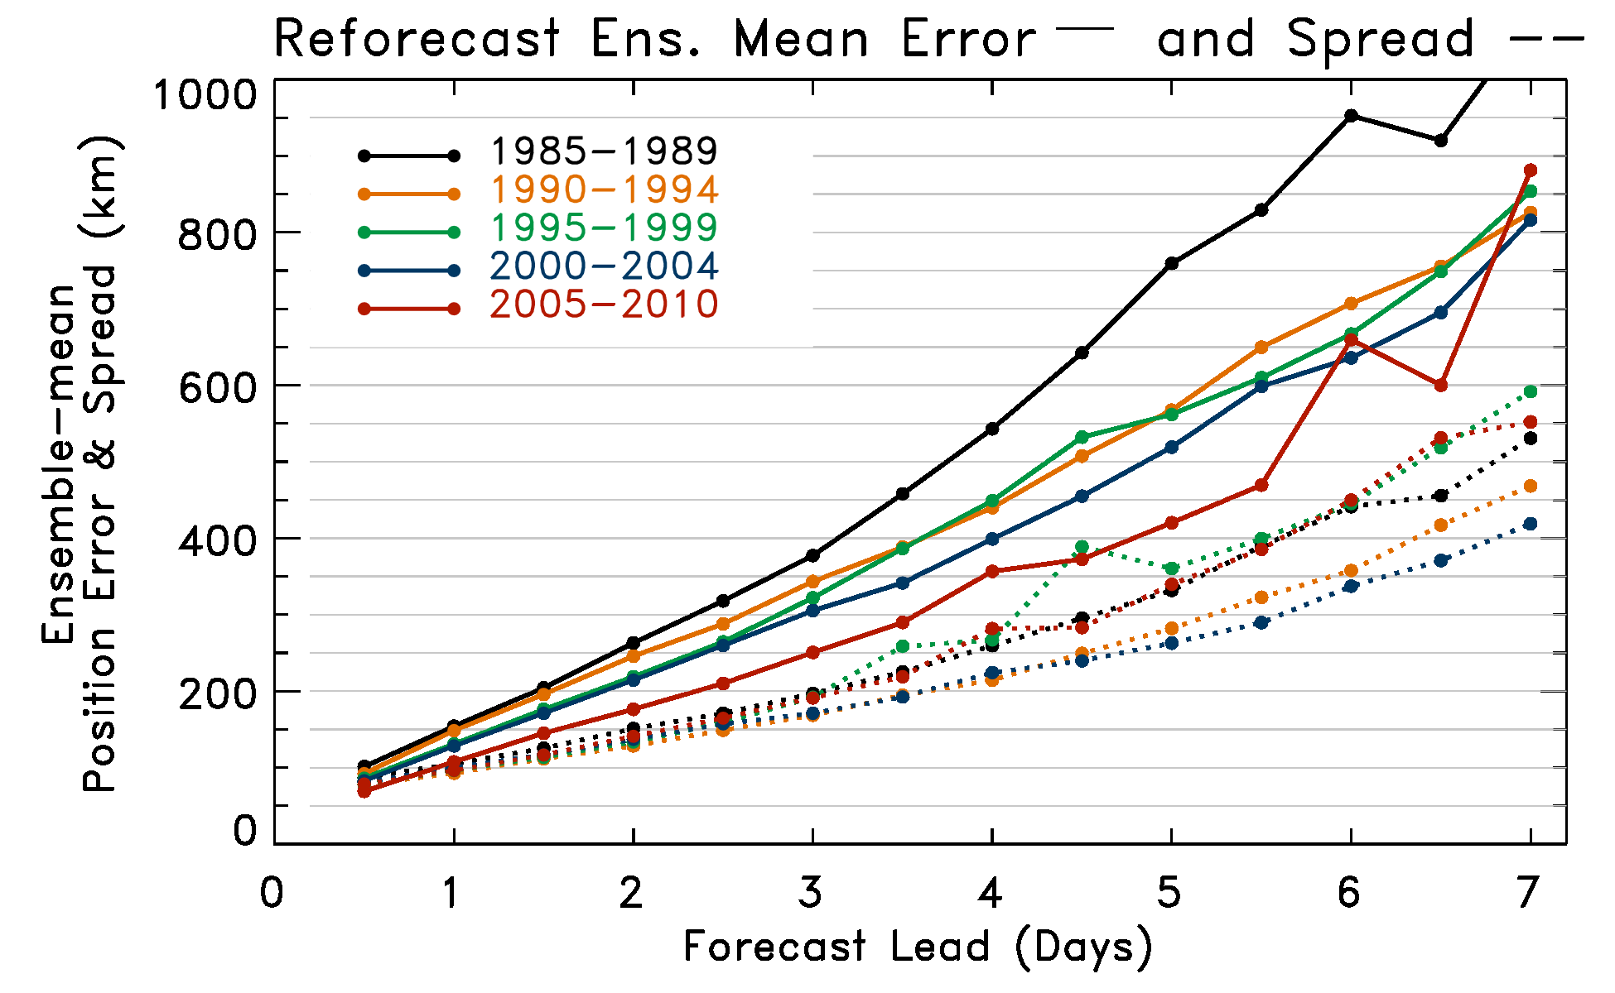
Tropical cyclone track error and spread
A change in skill over time more evident with TCs, and in general with the tropical atmosphere relative to the extratropics.

Slide 14
Daily rainfall climatology
Large over-forecasting of
precipitation on first day of
forecast. Patterns of forecast
precipitation at extended
leads somewhat off, e.g.,
SPCZ not connected as well
to ITCZ.

Slide 15
Application: statistical post-processing using reforecasts

Slide 16
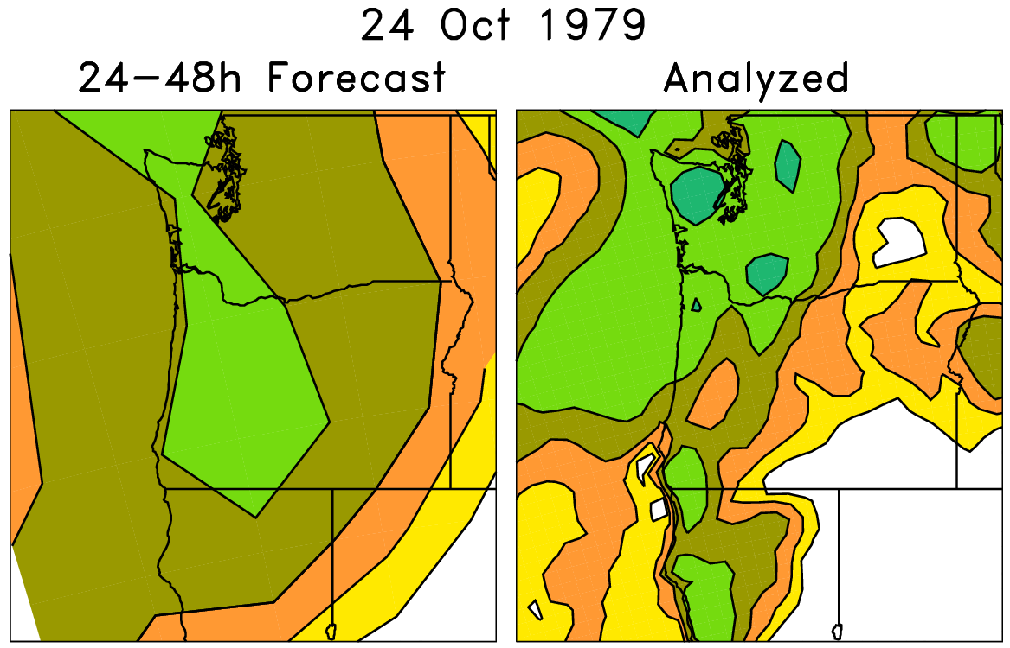
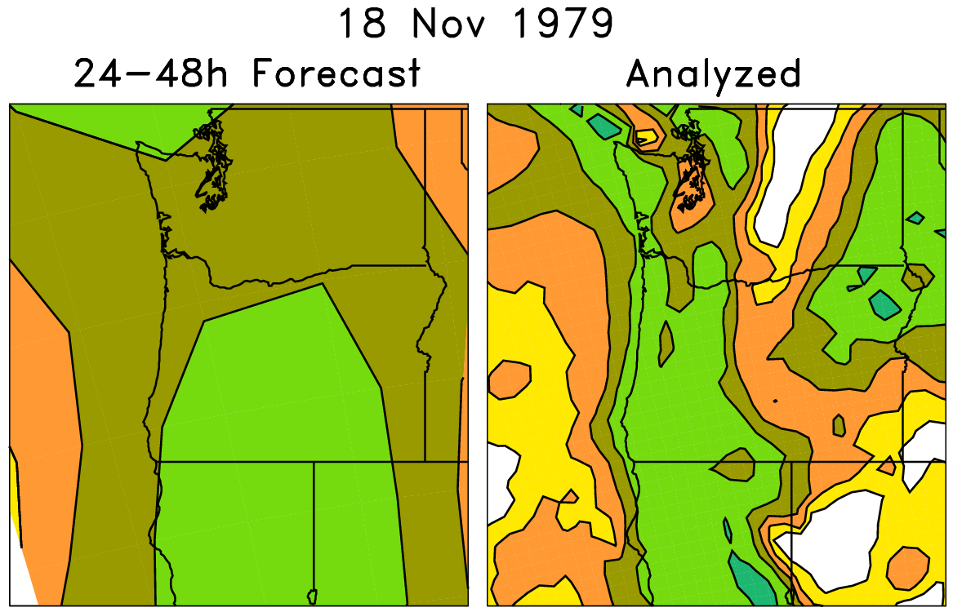
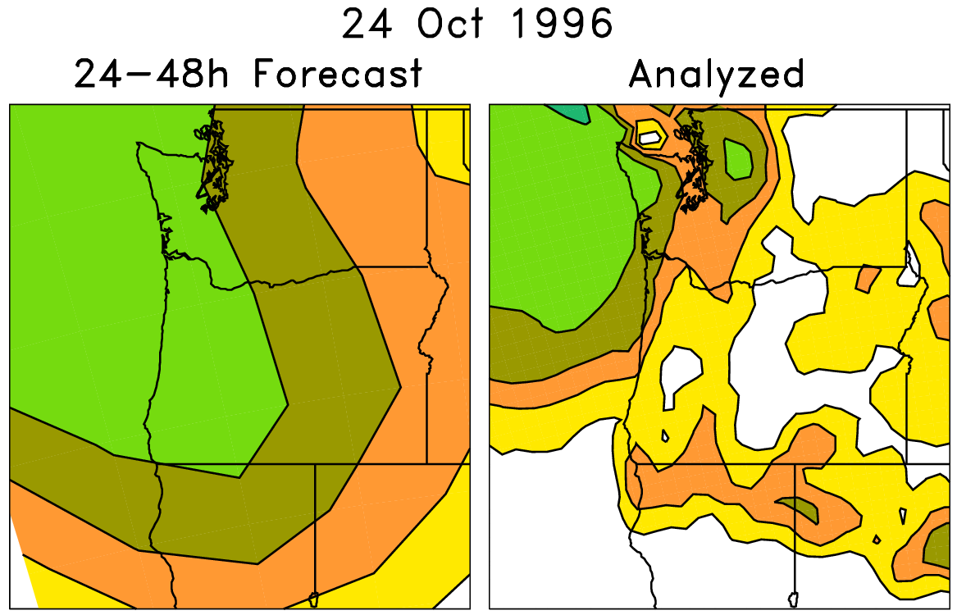
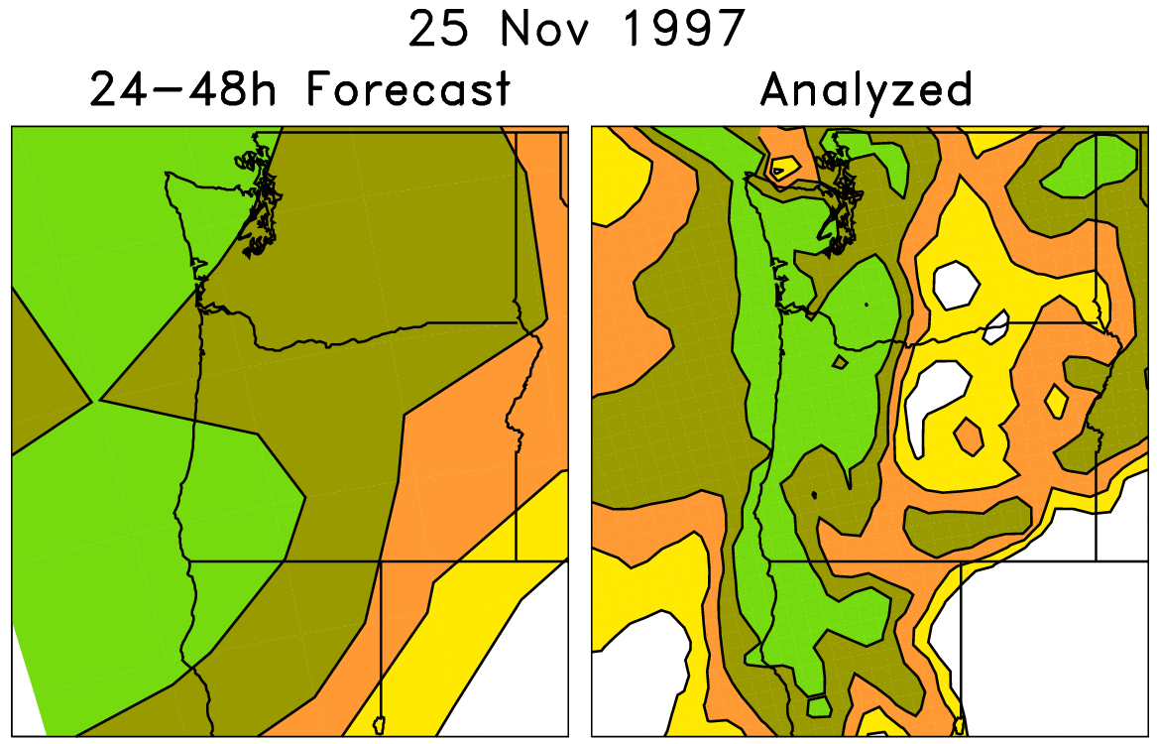
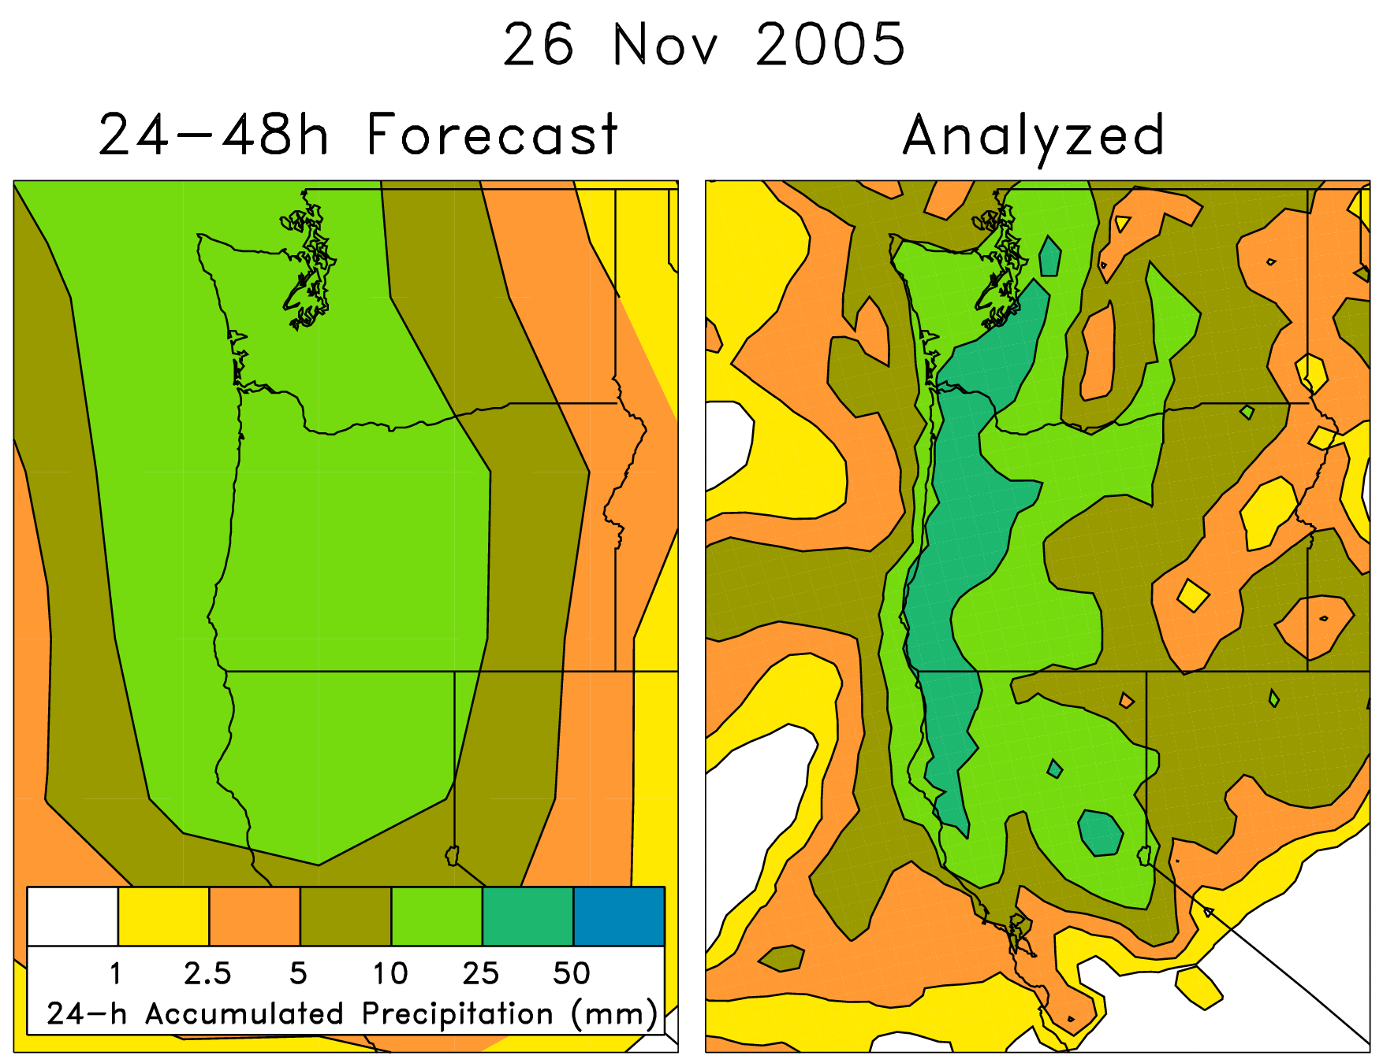
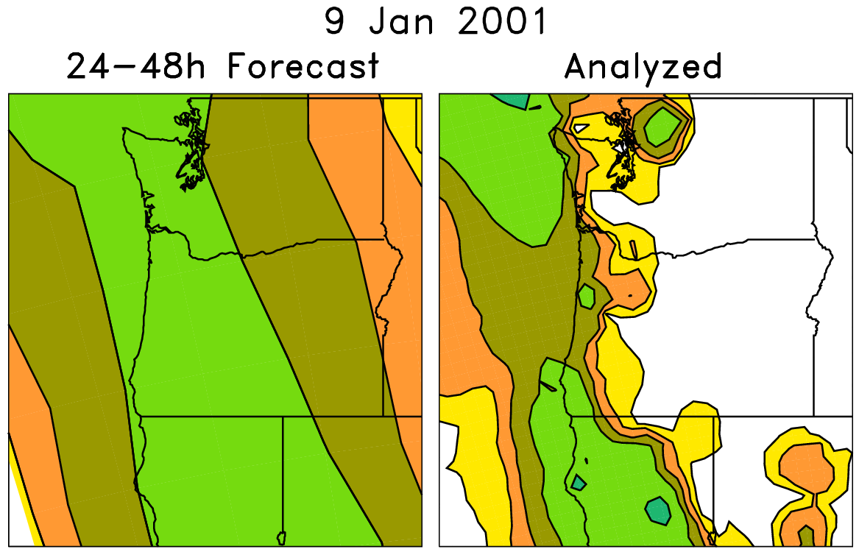
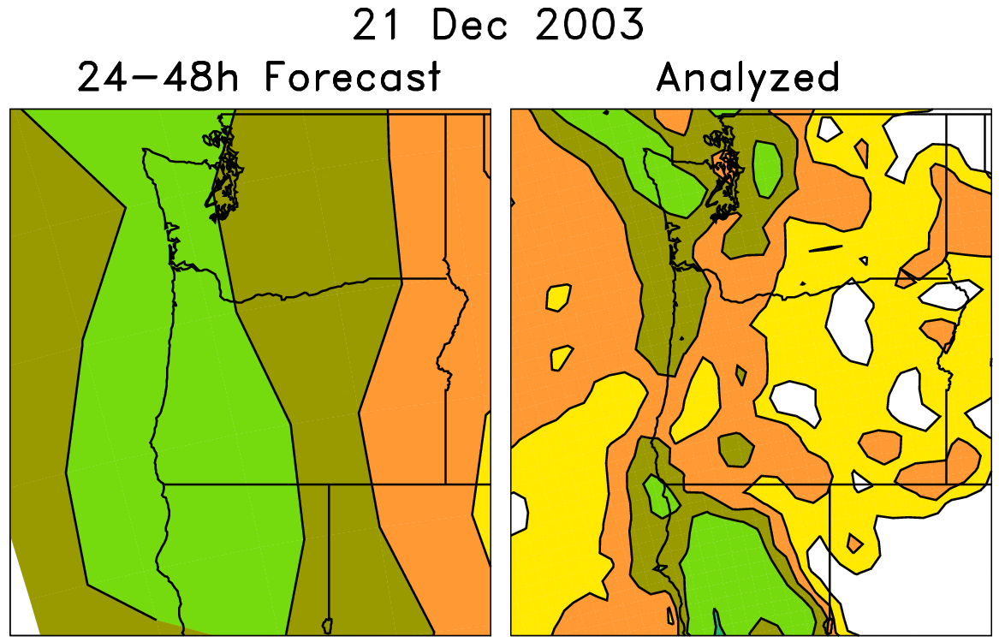
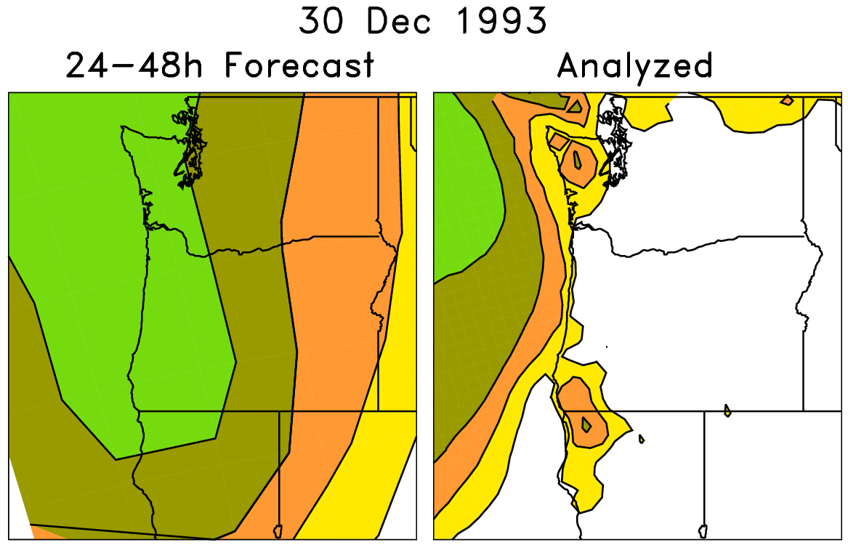
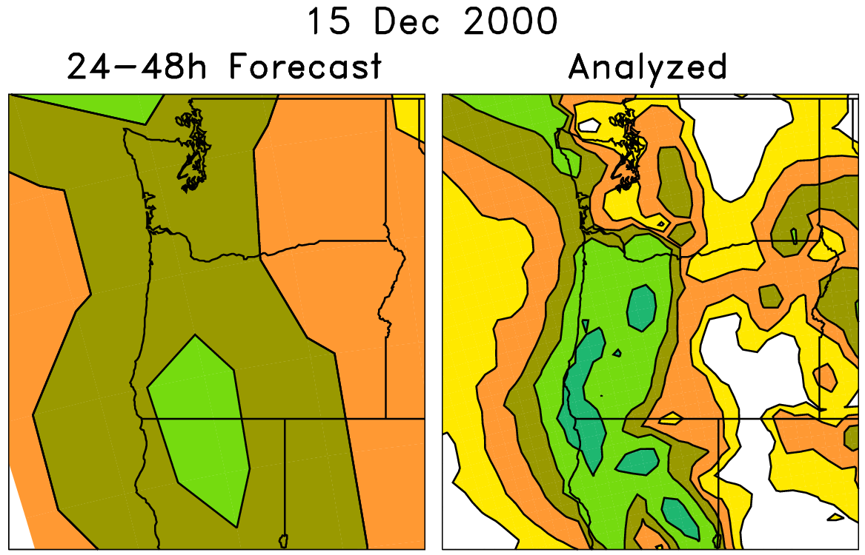
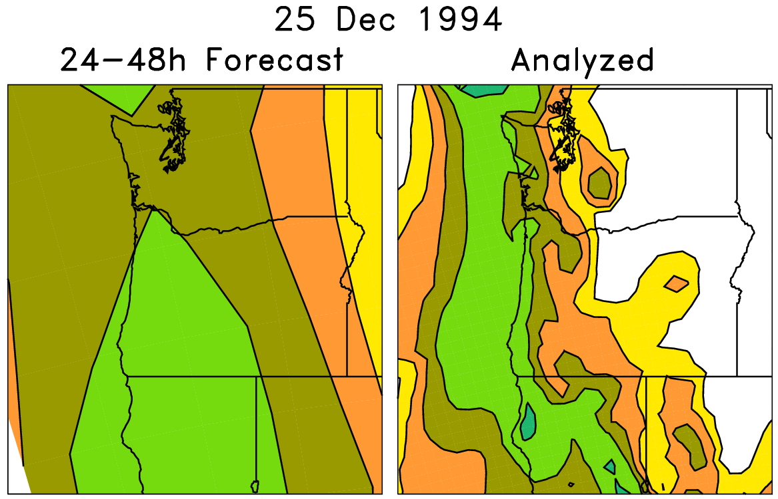
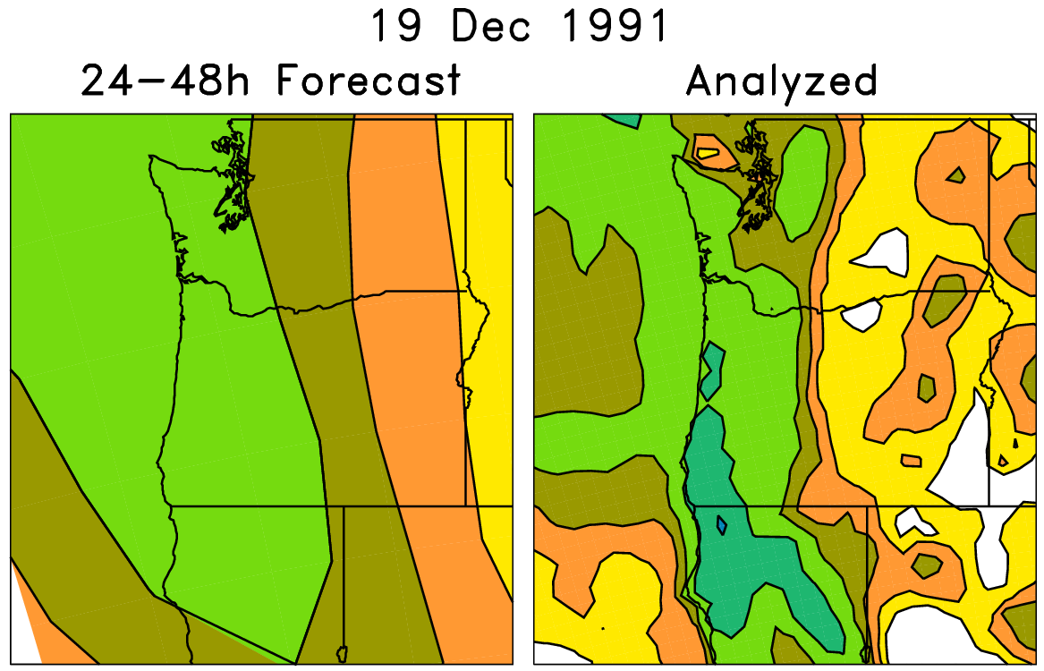
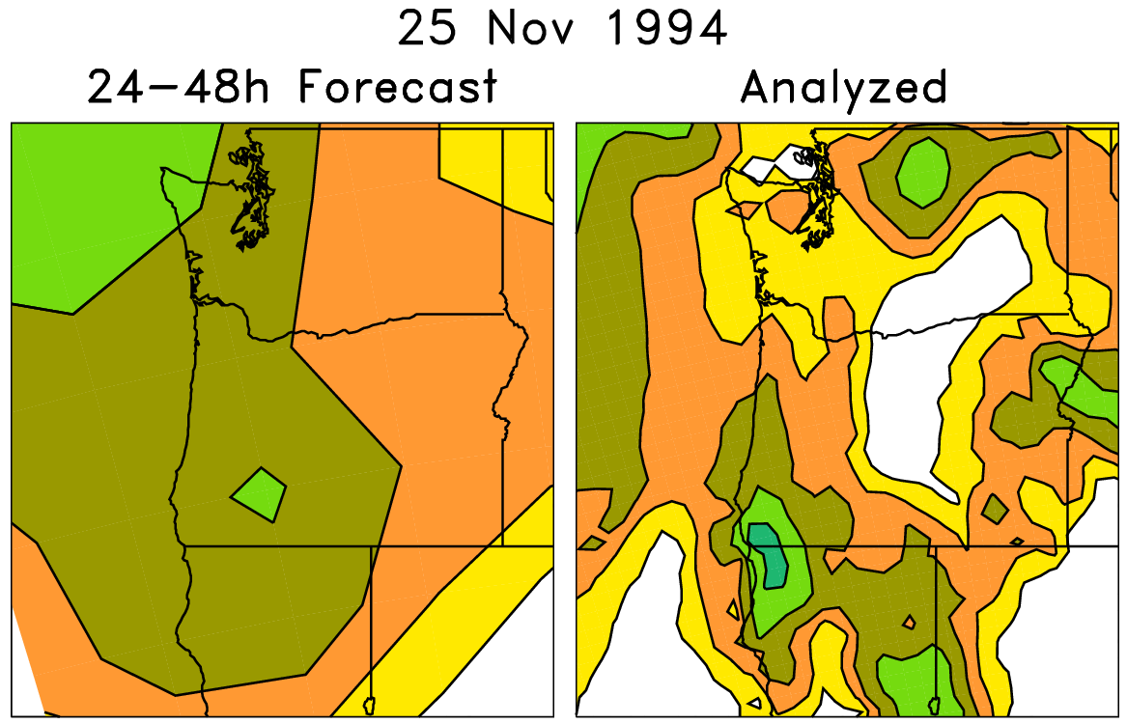
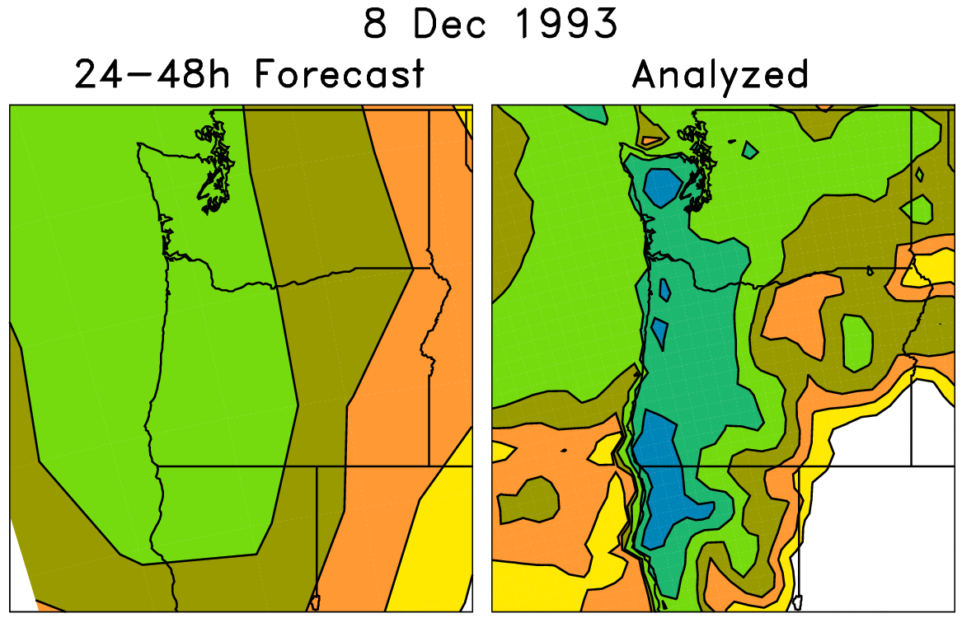
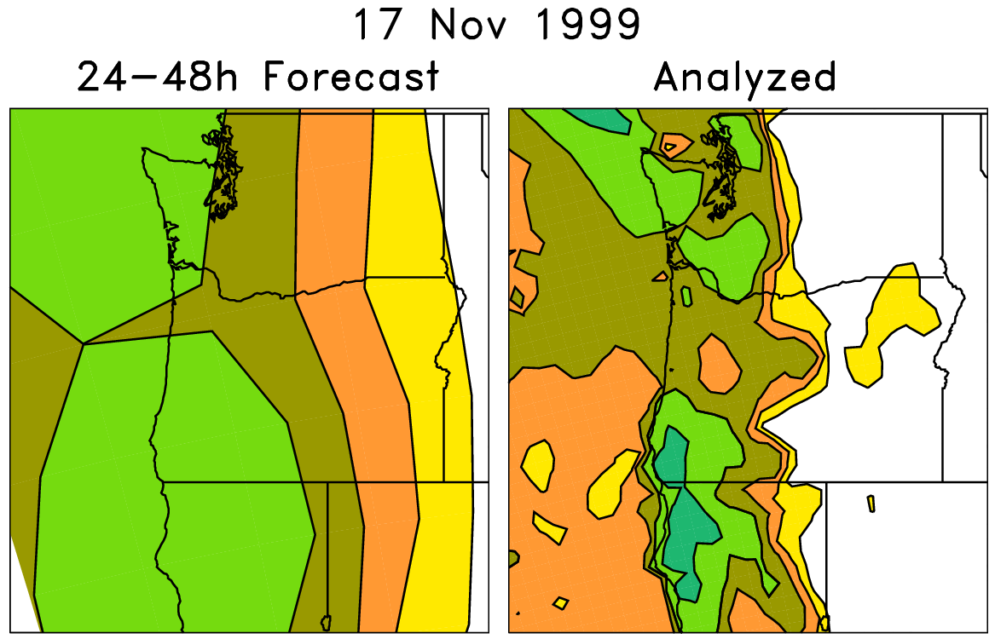
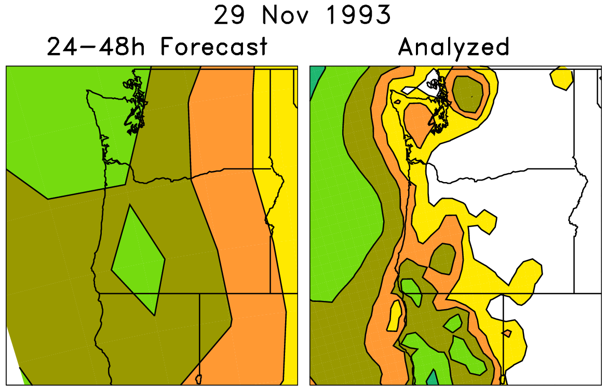
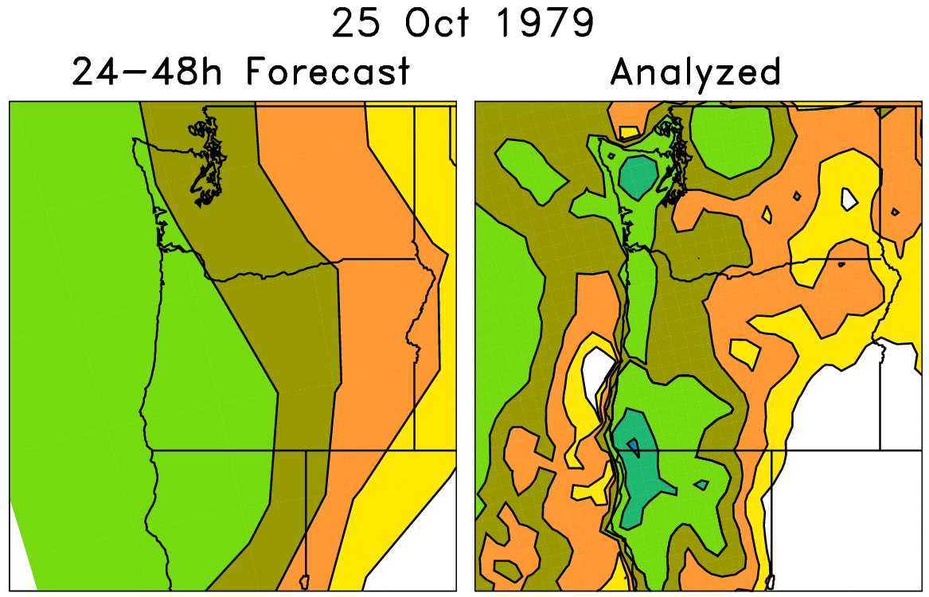
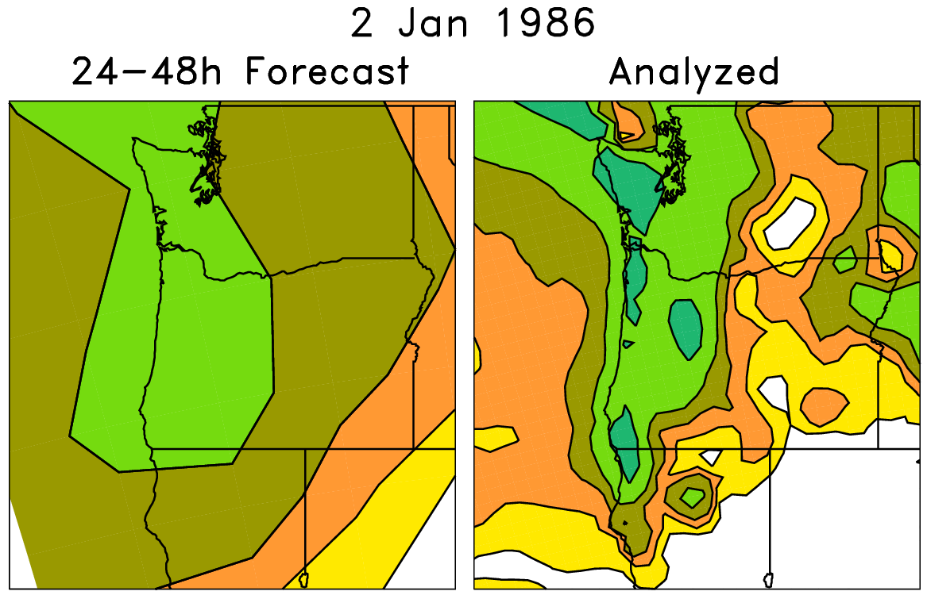
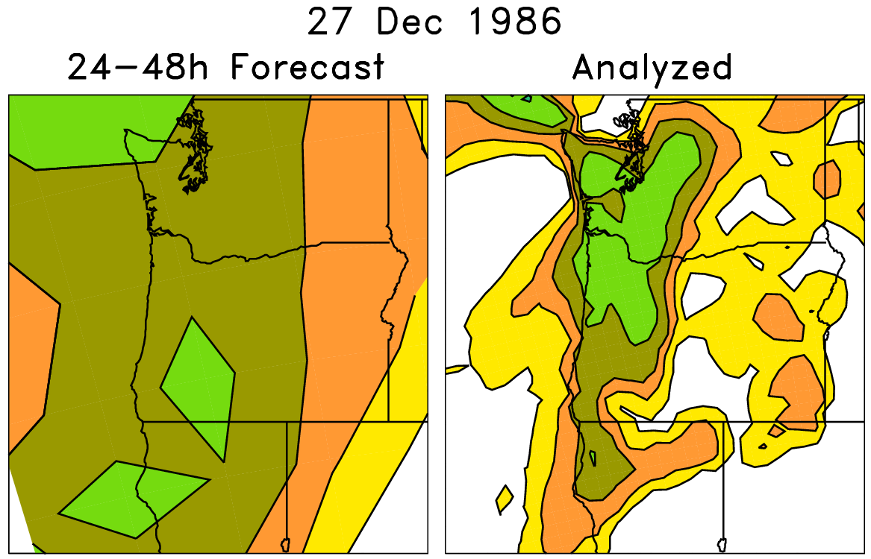
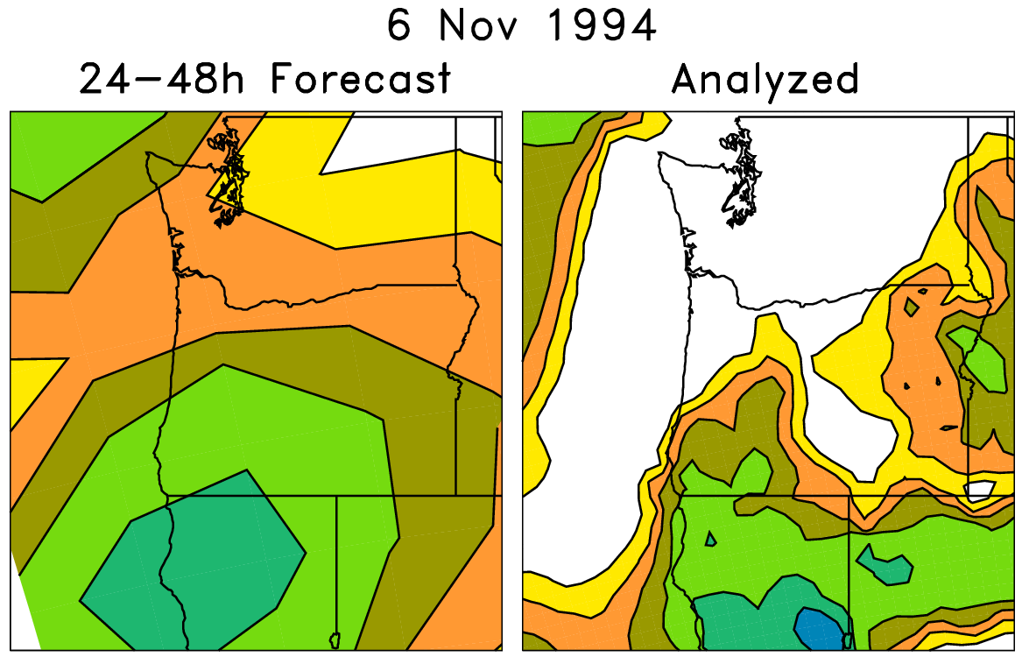
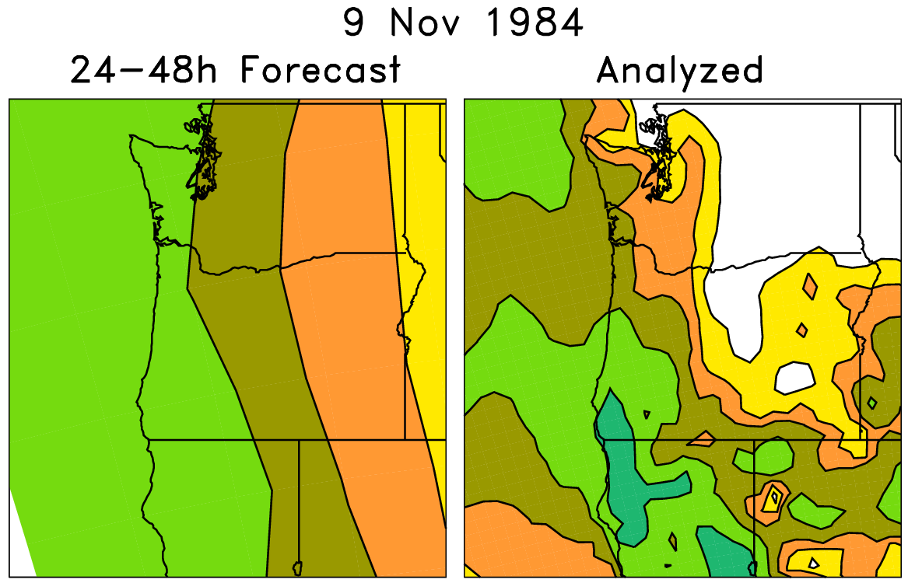
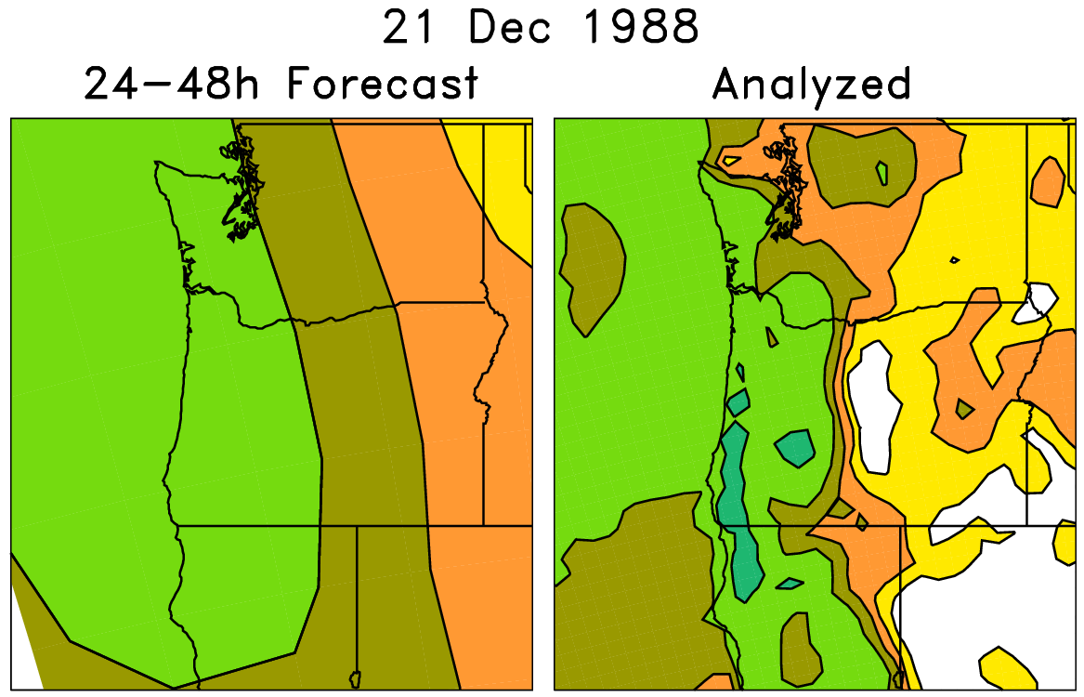
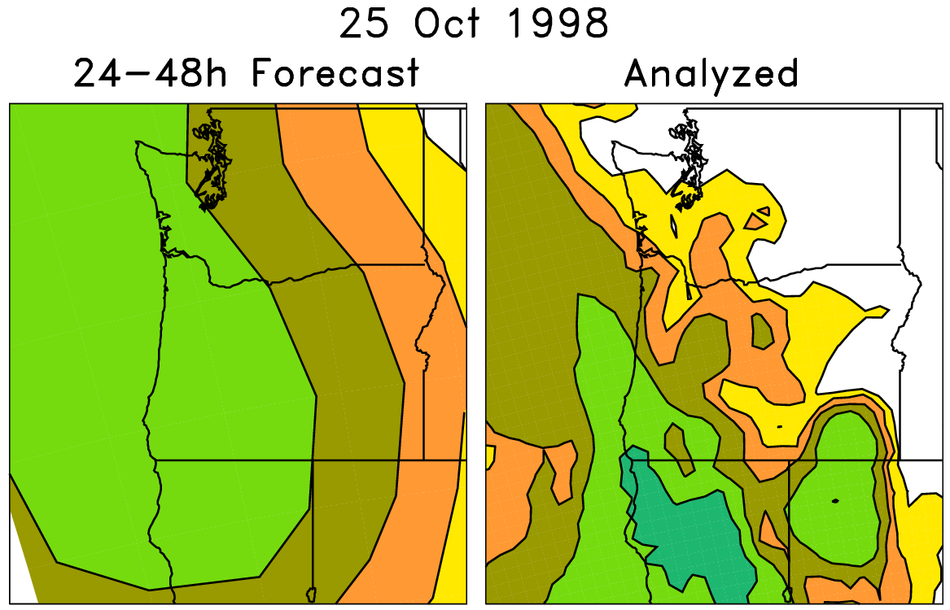
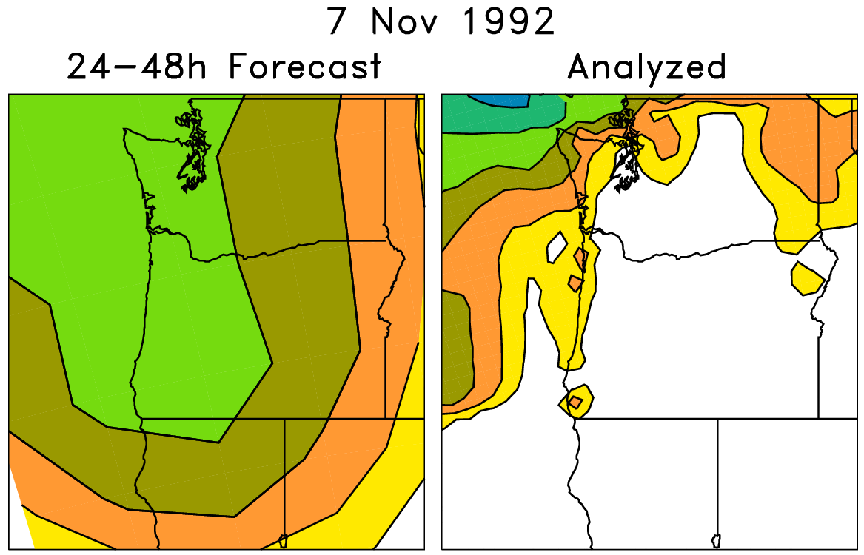
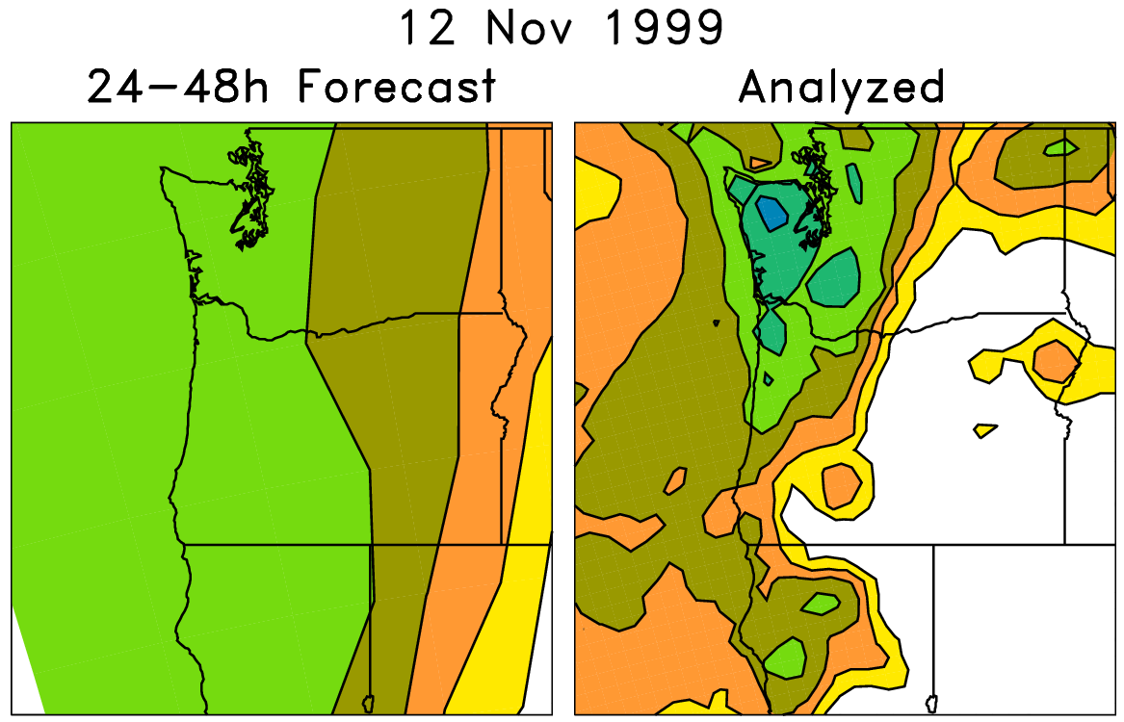
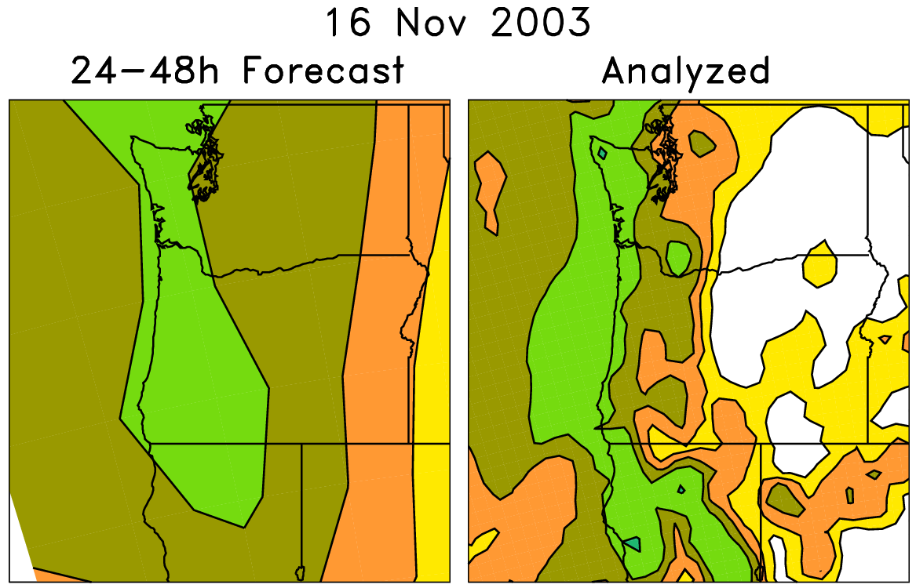
An example of a statistical correction technique using those reforecasts
Today’s forecast (& observed)
For each pair (e.g. red box), on the left are old forecasts that are somewhat similar to this day’s ensemble-mean forecast. The boxed data on the right, the analyzed precipitation for the same dates as the chosen analog forecasts, can be used to
statistically adjust and downscale the forecast.
Analog approaches like this
may be particularly useful for
hydrologic ensemble applications, where an ensemble of weather realizations is needed as inputs to a hydrologic ensemble streamflow system.

Slide 17
Reliability, > 10 mm precipitation 24 h⁻¹
Day +0-1
Day +2-3
Day +4-5
Version 2 (2012 GEFS)
Almost perfect reliability and improved skill is possible through analog-based calibration.
I’d note that this “reforecast” ≠ “analog.” You can apply whatever post-processing method you choose to design, and I suspect many could do even better.

Slide 18
Precipitation reforecast skill
Reforecast skill
of post-processed
precipitation forecasts
compared between
version 1 (1998 T62
model) and version 2
(2012 T254 model).
Grey bars are 5/95 %
confidence intervals.

Slide 19
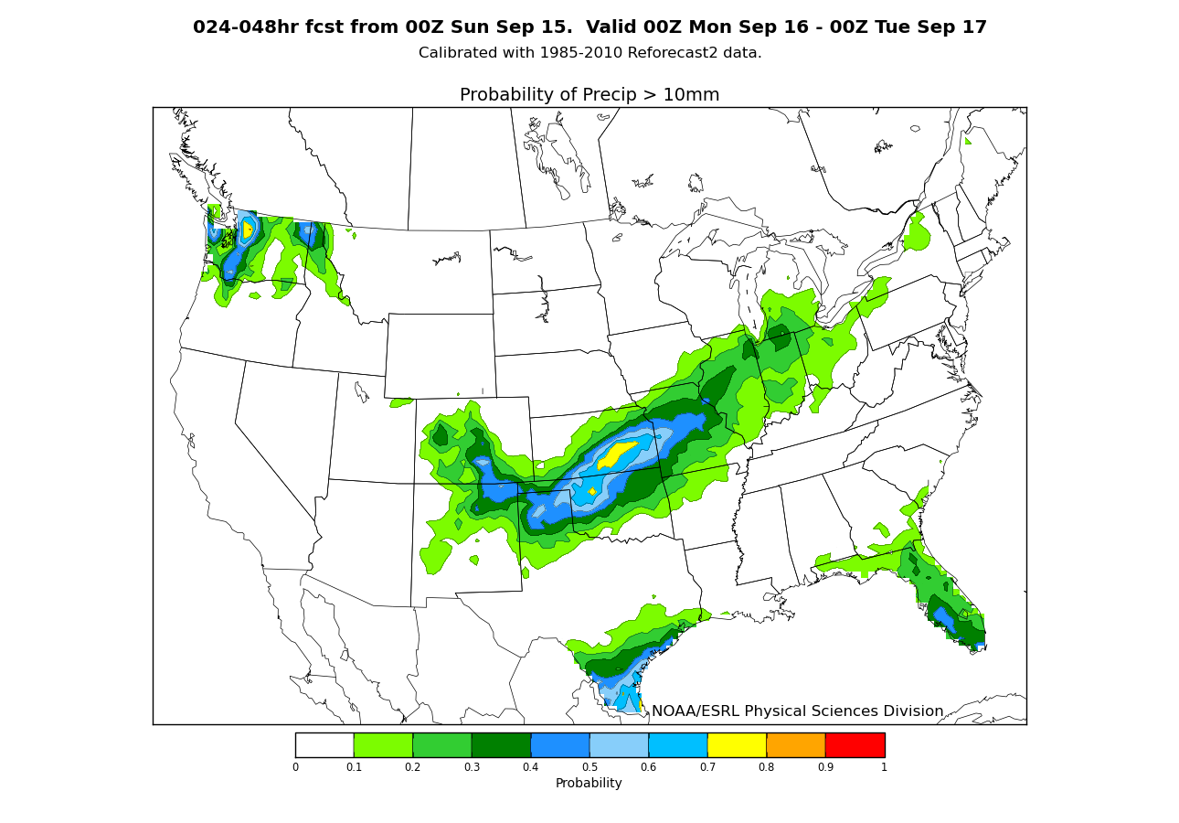
Example: recent forecast graphics
These forecasts
were calibrated
using 1985-2010
NARR 32-km precip.
analyses and
reforecasts.
http://www.esrl.noaa.gov/psd/forecasts/reforecast2/analogs/index.html

Slide 20
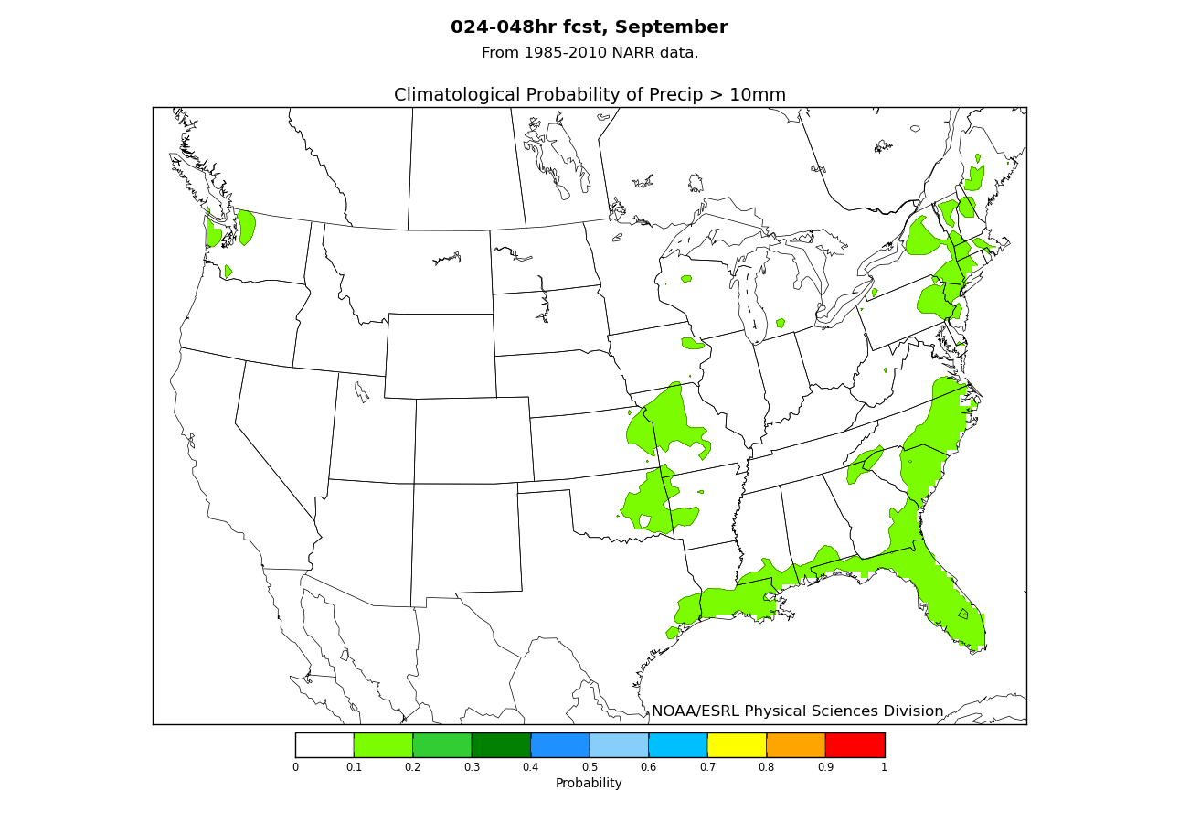
Example: recent forecast graphics
For comparison,
on our web site
we also provide
climatological
probabilities.
http://www.esrl.noaa.gov/psd/forecasts/reforecast2/analogs/index.html

Slide 21
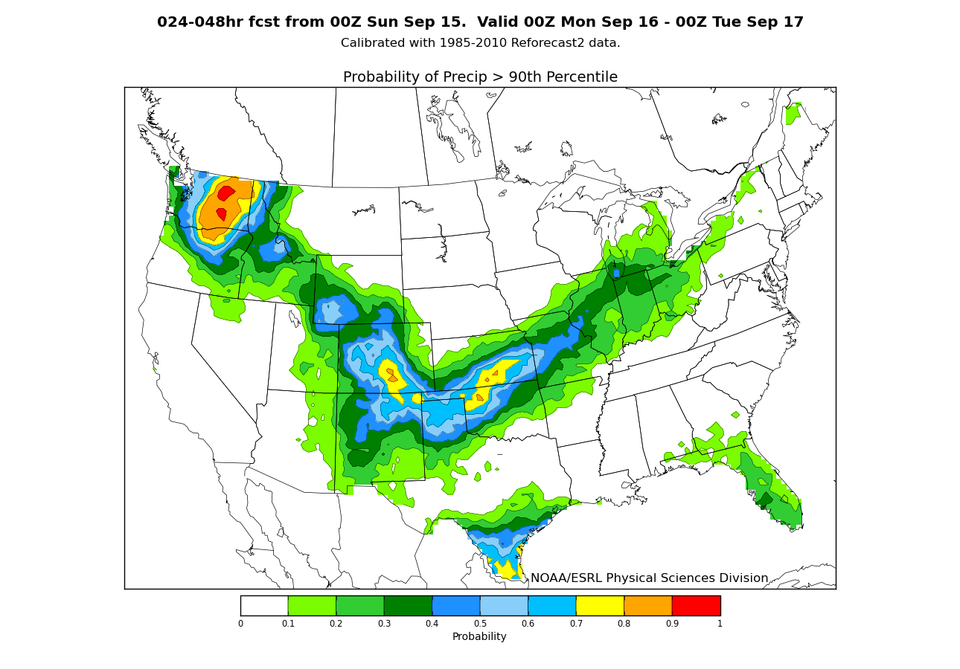
Example: recent forecast graphics
Here are probabilities
of exceeding the
90th percentile of
the climatological
distribution, a way
of normalizing for
how dry each location
is.

Slide 22
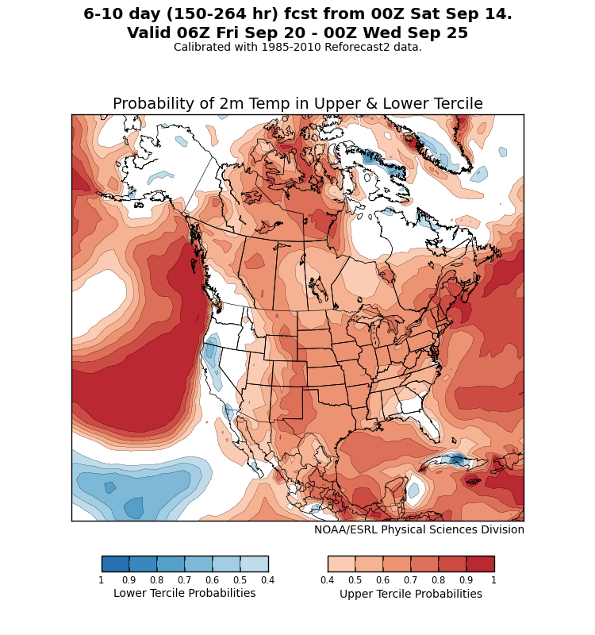
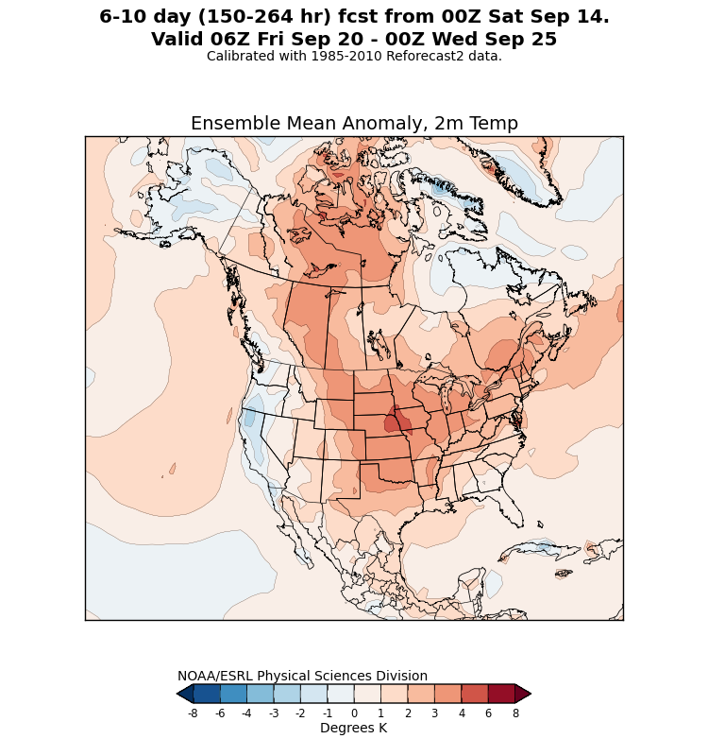
Example: post-processed
2-meter temperature forecasts
http://www.esrl.noaa.gov/psd/forecasts/reforecast2/medrange/index.html

Slide 23
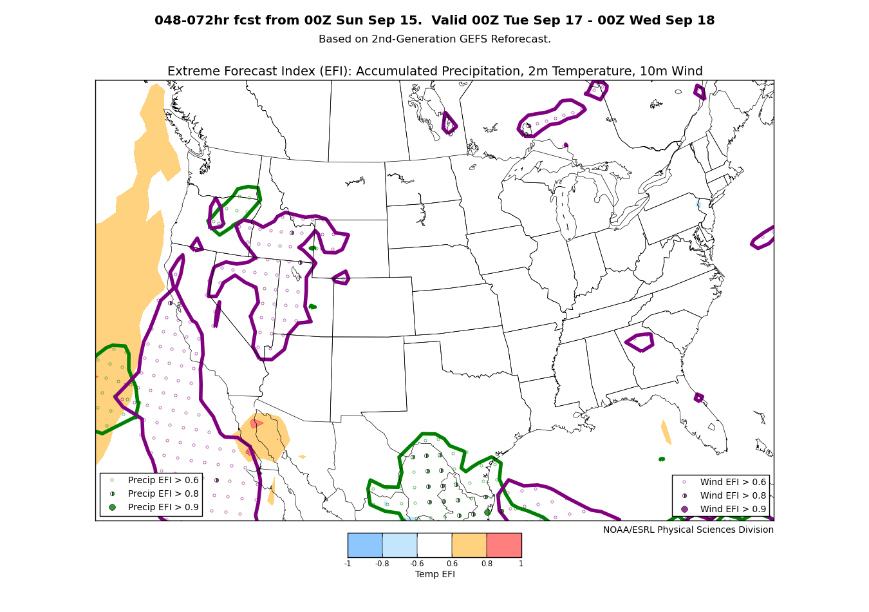
Extreme forecast index
In the absence
of reliable verification
data for training a
post-processing
method, one can
at least compare
today’s forecast and
see how unusual it
is relative to the
model climatology.
This EFI plot is
calculated following
ECMWF’s
methodology.
http://www.esrl.noaa.gov/psd/forecasts/reforecast2/analogs/index.html

Slide 24
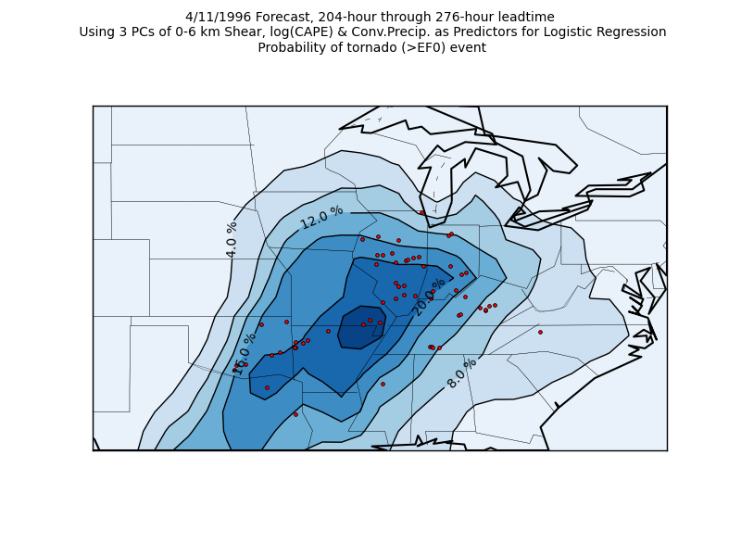
Application: extended-range tornado forecasting
Francisco Alvarez at
St. Louis University,
is working with me
and others on using the
reforecasts to make
extended-range
predictions of
tornado probabilities.
Ph.D. work,
in progress.

Slide 25
Application: providing initial and lateral boundary conditions to permit WRF retrospective forecasts

Slide 26
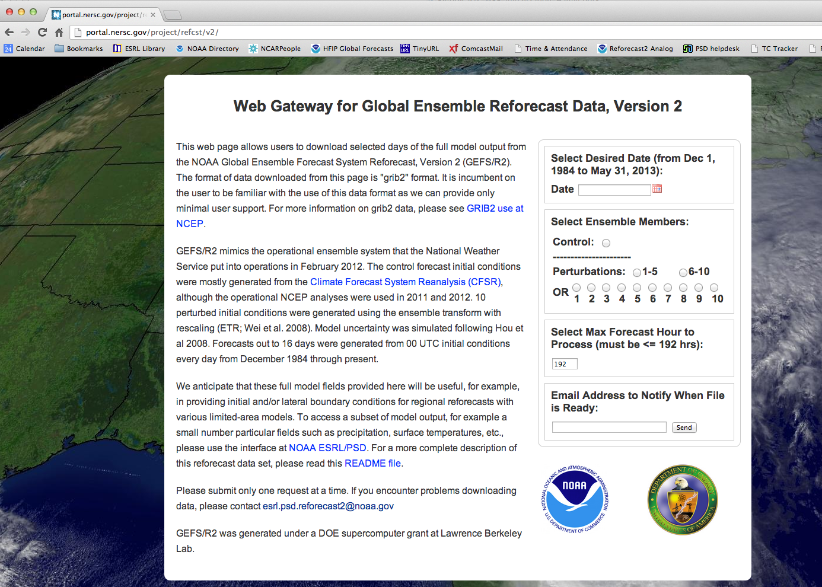
At this URL, a
tape archive of
the full forecast
model states,
suitable for WRF
initialization
and LBC’s

Slide 27
Some notes running WRF using data from this archive
( from http://www.esrl.noaa.gov/psd/forecasts/reforecast2/README.GEFS_Reforecast2.pdf )
The proper Vtable file must be created prior to preprocessing the GEFS reforecast data. To do this, copy Vtable.GFS to your working directory for preprocessing the GRIB2 GEFS reforecast data. Rename the Vtable.GFS file as Vtable.reforecast, and modify the file as follows. First, add a line for specific humidity on pressure levels and at 2 m. The specifications for specific humidity should be as follows:
metgrid Description: Specific Humidity
metgrid units: kg kg­1
metgrid Name: SPECHUMD
GRIB2 Discp=0, Catgy=1, Param=0, Level=100
GRIB1 Param=52, Level Type=100, From Level1=*
metgrid Description: Specific Humidity at 2 m
metgrid units: kg kg­1
metgrid Name: SPECHUMD
GRIB2 Discp=0, Catgy=1, Param=0, Level=103
GRIB1 Param=52, Level Type=105, From Level1=2
Second, remove the GRIB2 parameter number for relative humidity on pressure levels and at 2m. Note that ungrib.exe and metgrid.exe will calculate relative humidity for you if you have specific humidity. Finally, change the GRIB2 parameter number for PMSL from 1 to 0. No other known modifications to the Vtable are needed. Now that the Vtable.reforecast file is properly created, follow the instructions for running WRF­ARW on the WRF Users’ Page [http://www.mmm.ucar.edu/wrf/users/].
The files downloaded from DOE will have the fields for the different forecast lead times merged into one grib file. It will be your responsibility to break up that into separate grib files for each lead time.
Multi-level soil moisture wasn’t saved. README file indicates how to deal with this.

Slide 28
Demo: WRF ARW Regional Reforecast of Hurricane Rita (2005)
An example of generating a WRF high-resolution regional reforecast ensemble using GEFS initial and LBCs
Will show in this case that regional reforecast WRF ensemble provided value-added guidance to global ensemble forecast.
c/o Tom Galarneau, NCAR

Slide 29
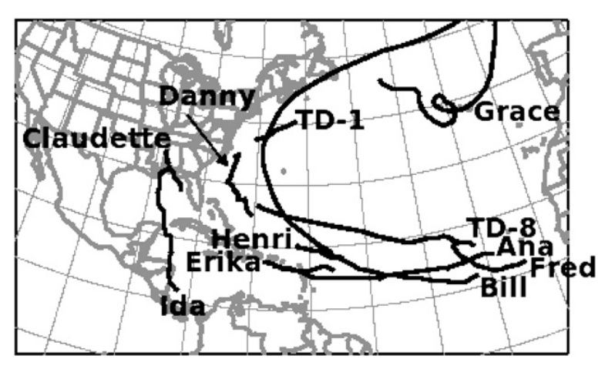
Details of reforecast with WRF ARW v3.4 using GEFS for initial, boundary conditions
Nested simulation 36-, 12- and 4-km with 36 vertical levels
  12- and 4-km moving nests
Time steps: 180, 60, and 20 s
Initial and boundary conditions from GFS reforecast ensemble members
Tiedtke cumulus scheme on 36 and 12 km; explicit on 4 km
YSU PBL scheme
HYCOM ocean analysis
WSM6 microphysics
Noah land surface
2D Smagorinsky turbulence scheme
Goddard shortwave radiation
RRTM longwave radiation
Second order diffusion
Positive definite scalar advection
Donelan wind-dependent drag formulation
Garratt wind-dependent enthalpy surface fluxes
outer WRF domain

Slide 30
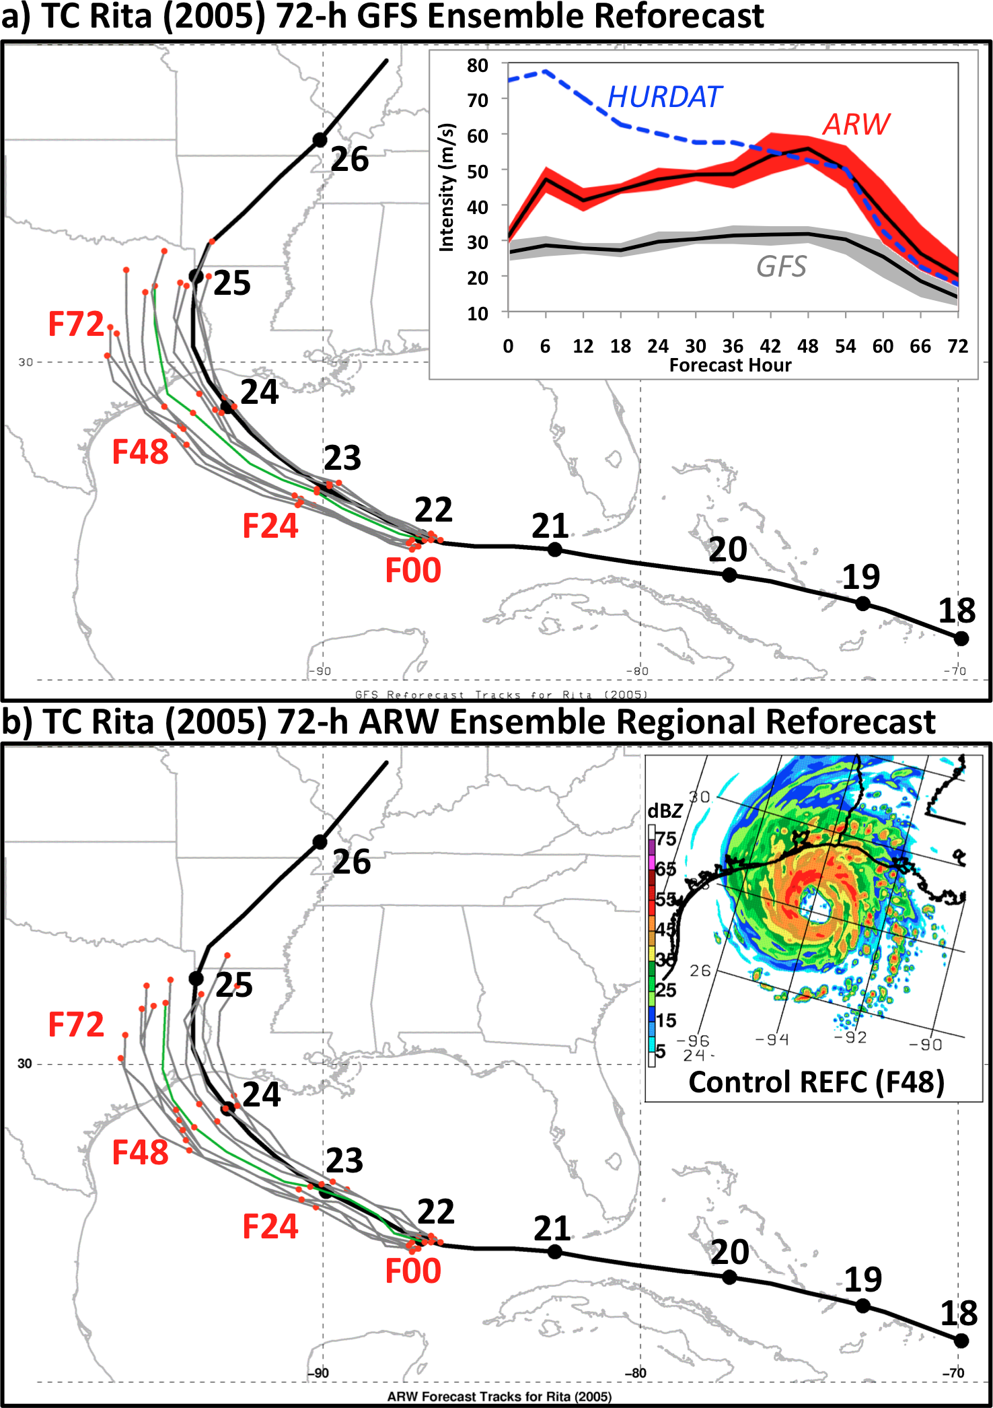
WRF-ARW reforecast ensemble results
Global reforecast ensemble is consistent with NHC forecast; indicating potential impact on Houston
Significant left-of-track error and intensity was underestimated
Rita vortex intensified in ARW regional reforecast despite terrible initial vortex
Similar left-of-track error in ARW; suggests large-scale control on TC motion

Slide 31
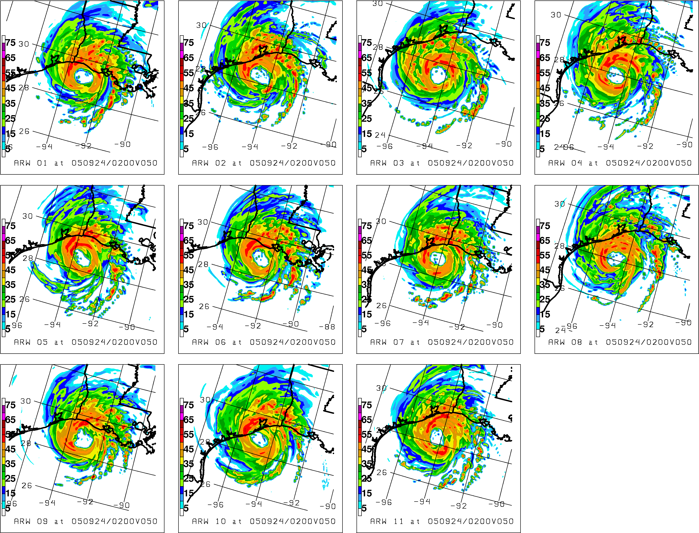
Maximum reflectivity (dBZ)
50-h ARW Forecast
Verifying 02Z/24 Sep ‘05
Control

Slide 32
What else can one do with reforecasts?
Here we use them to examine the ability of the forecast model to skillfully predict low-frequency modes of variability and longer-lead forecasts (where large sample sizes are helpful). Specifically, the MJO and blocking, and their interactions.

Slide 33
Dec-Jan-Feb 1985-2012 CFSR data. Blocks defined here by Tibaldi & Molteni algorithm.

Slide 34
Questions
How well are blocking and MJO predicted in GEFS (reforecasts) at the medium range?
Is blocking modulated by MJO, and is this modulation correctly forecast?

Slide 35
Blocking frequency and inter-annual variability
Blocking as defined in Tibaldi and Molteni (1990) using Z500. Grey bands defines Euro/Atlantic and Pacific blocking sectors in subsequent plots.
The large inter-annual variability of
blocking may give you some sense of
how misleading it may be to examine only a year or two of blocking forecasts.

Slide 36
Blocking skill in GEFS reforecasts
BSS (Brier skill score) as defined in supplementary slides.
Perfect model uses one member of
ensemble as surrogate for analyzed.
Real model: skill in blocking to ~13 days
Perfect model: ~ 3-5 days longer skill.
Onset: date when there are more than 10 subsequent days where at least 20 degrees of longitude in a sector are blocked.
Cessation: date of end of that period.
Statistics include onset and previous 3 days, cessation and previous 3 days.

Slide 37
Blocking skill by half decade
___ actual skill.
--- perfect-model skill.
Decreased Atlantic sector skill in 1985-1989 period stands out.
Actual skill falls far short
of perfect model skill. Some half-decadal variability due
to natural variability, as seen in
corresponding dashed lines.

Slide 38
Reliability diagrams
increasingly
unreliable
(undesirable)
and less sharp
(to be expected)
for longer-lead
forecasts.

Slide 39
MJO diagnostics

Slide 40
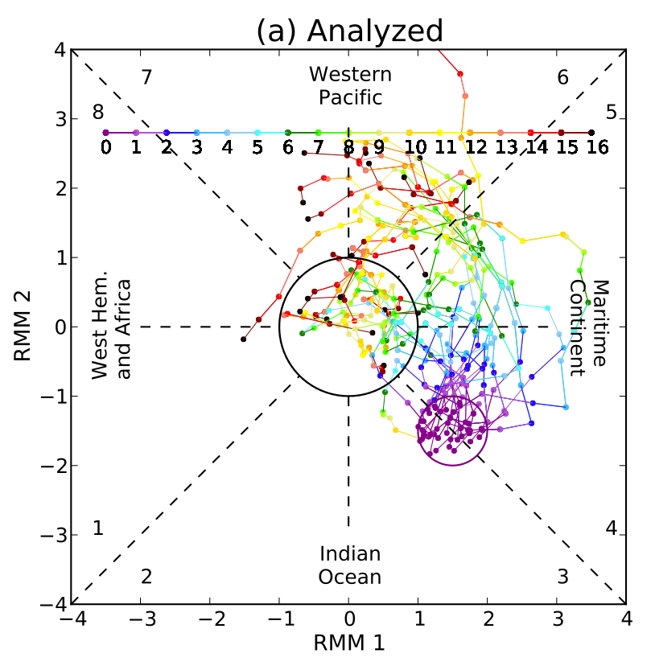
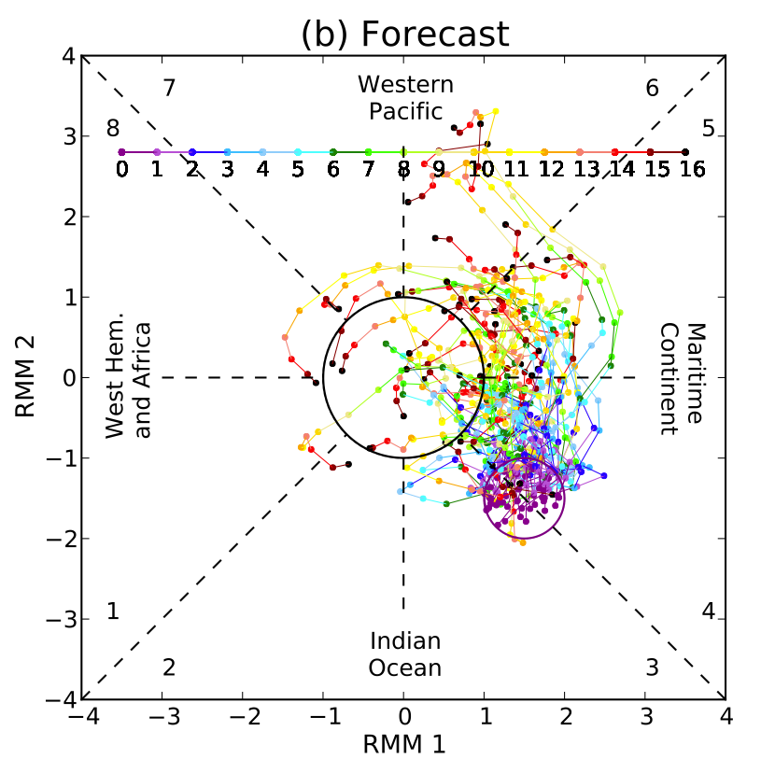
MJO, analyzed and deterministic forecast, E. Indian Ocean
Dates selected (Dec-Jan-Feb 1985-2012) where initial state was inside purple
circle. Examine (RMM1, RMM2) phase plot for analyzed and forecast.

Slide 41
Propagation characteristics
of MJO phase for strong MJO
(magnitude > 1.0, OLR
magnitude > 0.5, RMM2 < 0)
PDF shows change relative to data from a day prior, analyzed and ensemble members.
MJO forecasts propagate more slowly than analyzed, and more so for OLR component than wind components.

Slide 42
Propagation characteristics
of MJO magnitude for strong MJO (magnitude > 1.0, OLR magnitude > 0.5, RMM2 < 0)
Forecast distribution is a bit
more peaked, indicating that
forecasts are more consistent
in time in their magnitude
than with analyzed conditions.

Slide 43
Rank histograms, RMM1 and RMM2 composited
GEFS reforecasts quickly develop insufficient spread and/or biased mean.
RMM most under-spread and/or biased at the medium range.
Especially insufficient variety of forecasts of MJO magnitude, even at short leads.

Slide 44
MJO – blocking interactions

Slide 45
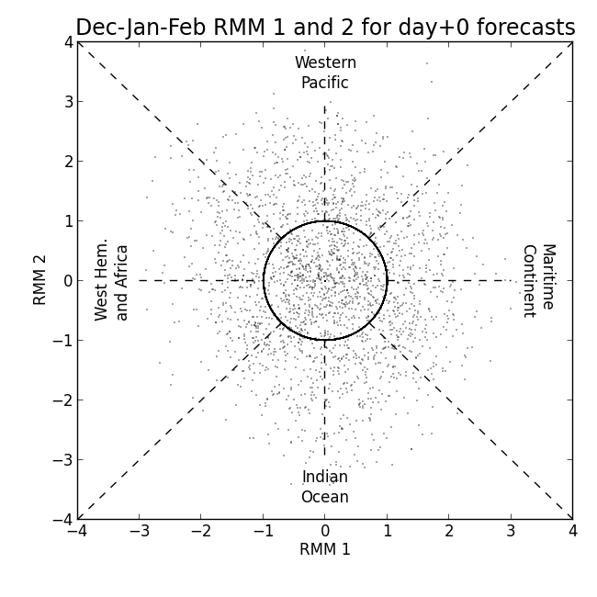
My method of quantifying MJO phase
In subsequent plot you’ll see
I refer to the phase of MJO by
its angle from x axis, a θ in
conventional polar coordinates.
When examining statistics
for θ=θ₀ , I use RMM 1/2
samples with associated
θ₀ +/- 22.5 degrees.
Example below for θ₀=-90
uses samples in blue cone.
A “strong” MJO is in the
top 25% of RMM 1/2
amplitudes within the cone.
θ=+45
θ=0
θ=-45
θ=-135
θ=-90

Slide 46
Blocking MJO relationship with strong MJOs
Top left panel shows, as the
phase of a strong MJO varies
along y axis, the change
in blocking frequency from
the overall climatological
frequency for each given
longitude (x axis). Note, for
example, that as the phase
of the MJO goes from 0°
(Maritime continent) to
120°, Atlantic blocking
frequency changes from
suppressed to much more
active than normal. This
pattern is largely replicable
in day + 4 forecasts, but
much less so in day + 8 and
day +16 forecasts. The GEFS
is not replicating the blocking
response to MJO forcing.

Slide 47
Accessing reforecast data

Slide 48
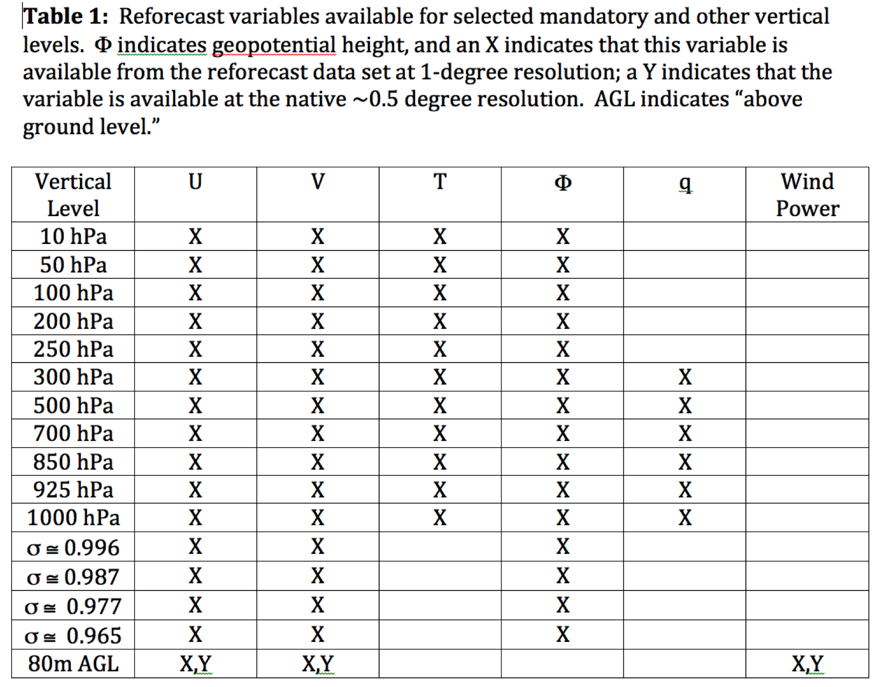
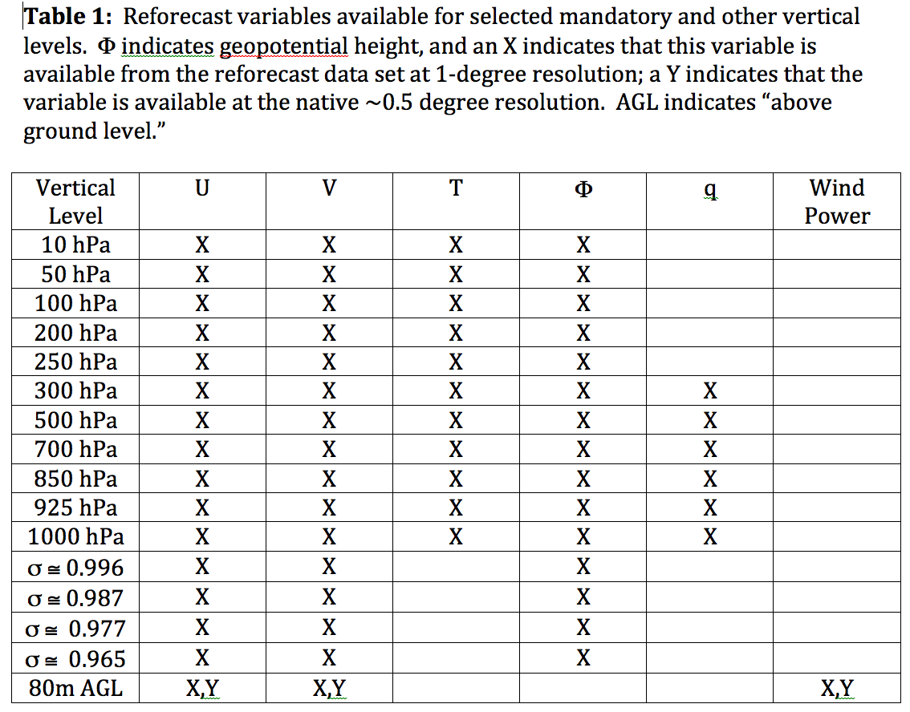
Data that is readily available from ESRL
Also: hurricane track files

Slide 49
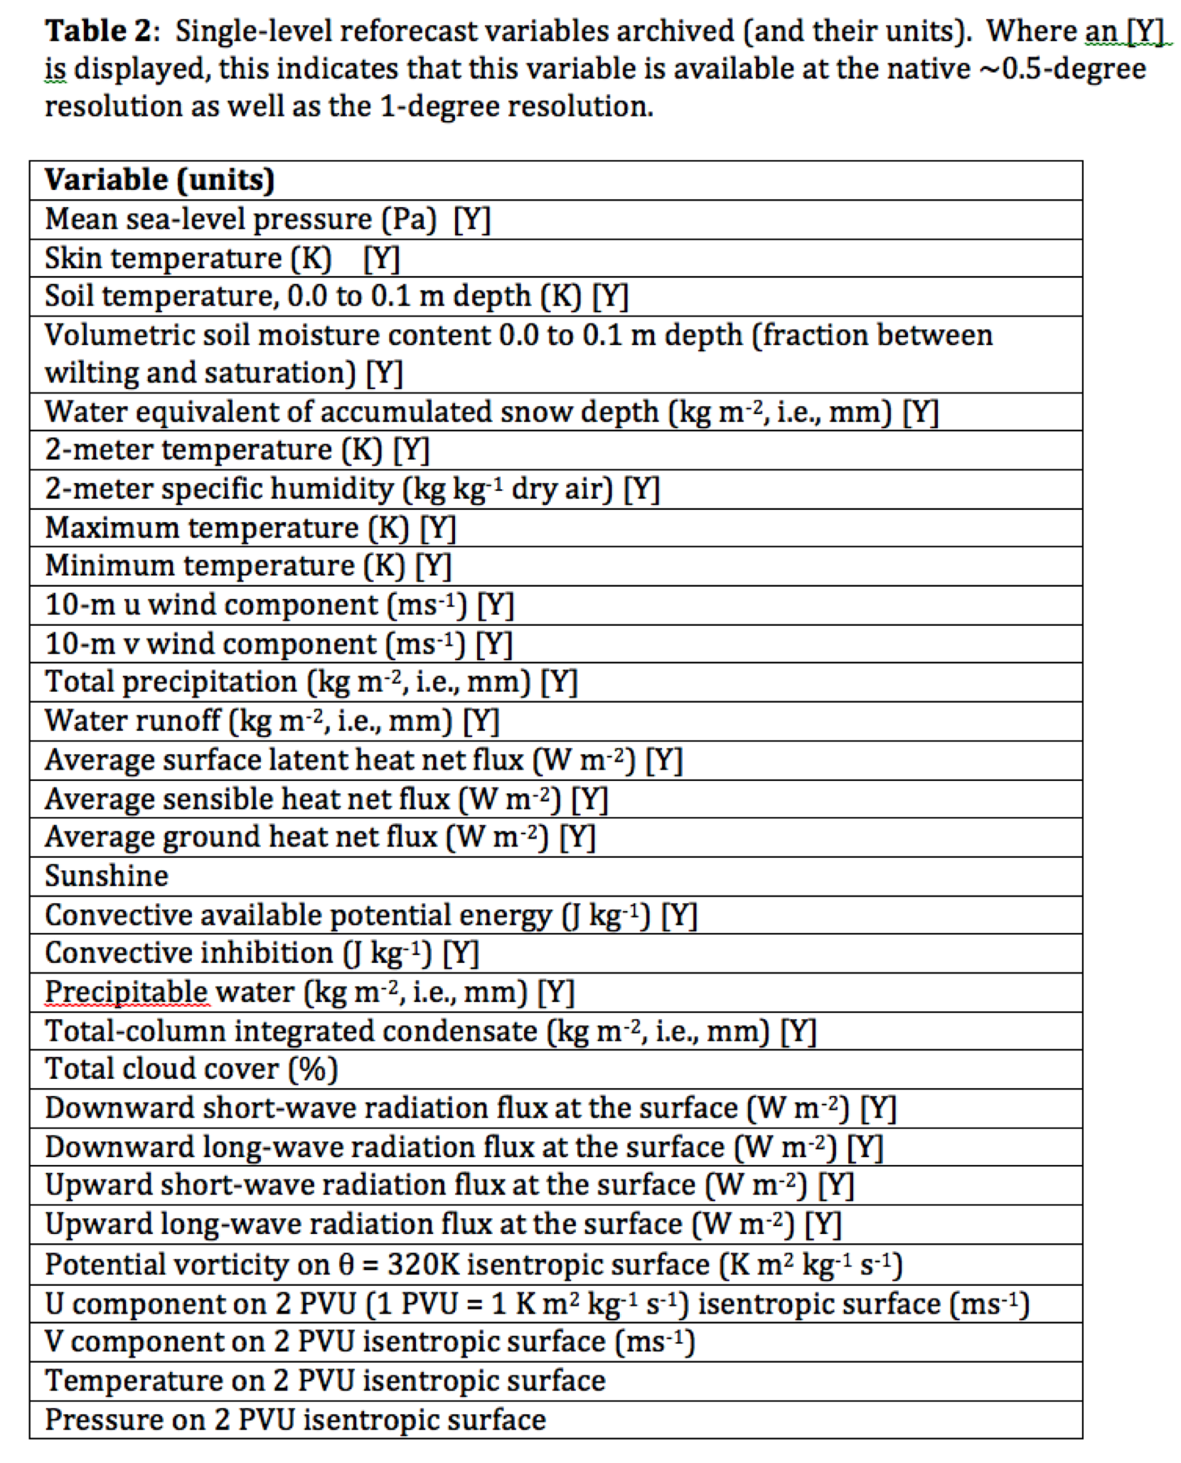
Data that is readily available from ESRL

Slide 50
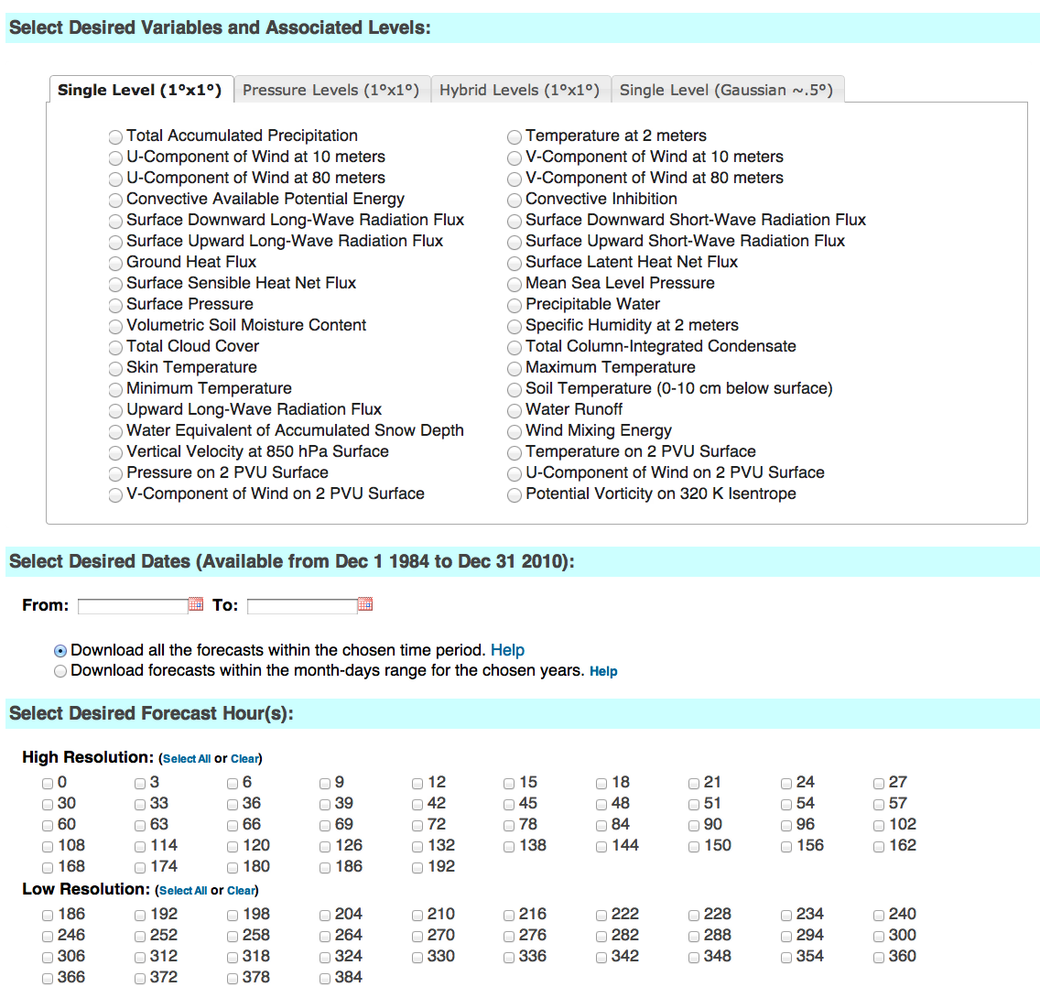
esrl.noaa.gov/psd/forecasts/reforecast2/download.html
Produces
netCDF files.
Also: direct
ftp access to
allow you to
read the raw
grib files.

Slide 51
ftp access is also easy.
$ ftp –i ftp.cdc.noaa.gov
[user anonymous, pass=email address]
cd /Projects/Reforecast2
cd to YYYY/YYYYMM/YYYYMMDDHH of interest, e.g.,
  $ cd 2000
  $ cd 200001
  $ cd 2000010100
  $ ls

Slide 52
directory listing
150 Here comes the directory listing.
drwxr-xr-x 4 99 1201 80 Mar 11 2012 c00
drwxrwxr-x 3 99 1201 80 Jun 27 2012 mean
drwxr-xr-x 4 99 1201 80 Mar 11 2012 p01
drwxr-xr-x 4 99 1201 80 Mar 11 2012 p02
drwxr-xr-x 4 99 1201 80 Mar 11 2012 p03
drwxr-xr-x 4 99 1201 80 Mar 11 2012 p04
drwxr-xr-x 4 99 1201 80 Mar 11 2012 p05
drwxr-xr-x 4 99 1201 80 Mar 11 2012 p06
drwxr-xr-x 4 99 1201 80 Mar 11 2012 p07
drwxr-xr-x 4 99 1201 80 Mar 11 2012 p08
drwxr-xr-x 4 99 1201 80 Mar 11 2012 p09
drwxr-xr-x 4 99 1201 80 Mar 11 2012 p10
drwxrwxr-x 3 99 1201 80 Jun 27 2012 sprd
226 Directory send OK.
ftp>
top level director listing, with subdirectories for each perturbation
number, the mean, and the spread

Slide 53
more directory listings
a select set of fields available
on original Gaussian grid
ftp> cd c00
250 Directory successfully changed.
ftp> ls
229 Entering Extended Passive Mode (|||53711|).
150 Here comes the directory listing.
drwxr-xr-x 2 99 1201 13312 Aug 13 2012 gaussian
drwxr-xr-x 2 99 1201 21504 Aug 13 2012 latlon
226 Directory send OK.
ftp> cd latlon
250 Directory successfully changed.
ftp> ls
229 Entering Extended Passive Mode (|||36968|).
150 Here comes the directory listing.
-rw-rw-r-- 1 99 1201 4236525 Mar 28 2012 apcp_sfc_2000010100_c00.grib2
-rw-rw-r-- 1 99 1201 3277 Aug 13 2012 apcp_sfc_2000010100_c00.grib2.inv
-rw-rw-r-- 1 99 1201 1547 Jun 11 2012 apcp_sfc_2000010100_c00.grib2.pyidx
-rw-rw-r-- 1 99 1201 3419759 Mar 28 2012 apcp_sfc_2000010100_c00_t190.grib2
-rw-rw-r-- 1 99 1201 2525 Aug 13 2012 apcp_sfc_2000010100_c00_t190.grib2.inv
-rw-rw-r-- 1 99 1201 1261 Jun 11 2012 apcp_sfc_2000010100_c00_t190.grib2.pyidx
-rw-rw-r-- 1 99 1201 4447215 Mar 28 2012 cape_sfc_2000010100_c00.grib2
-rw-rw-r-- 1 99 1201 2948 Aug 13 2012 cape_sfc_2000010100_c00.grib2.inv
-rw-rw-r-- 1 99 1201 1547 Jun 11 2012 cape_sfc_2000010100_c00.grib2.pyidx
-rw-rw-r-- 1 99 1201 3394508 Mar 28 2012 cape_sfc_2000010100_c00_t190.grib2
-rw-rw-r-- 1 99 1201 2252 Aug 13 2012 cape_sfc_2000010100_c00_t190.grib2.inv
-rw-rw-r-- 1 99 1201 1261 Jun 11 2012 cape_sfc_2000010100_c00_t190.grib2.pyidx
-rw-rw-r-- 1 99 1201 4683420 Mar 28 2012 cin_sfc_2000010100_c00.grib2
-rw-rw-r-- 1 99 1201 2905 Aug 13 2012 cin_sfc_2000010100_c00.grib2.inv
a larger set available on the
1-degree lat/lon grid

Slide 54
more directory listings
ftp> cd c00
250 Directory successfully changed.
ftp> ls
229 Entering Extended Passive Mode (|||53711|).
150 Here comes the directory listing.
drwxr-xr-x 2 99 1201 13312 Aug 13 2012 gaussian
drwxr-xr-x 2 99 1201 21504 Aug 13 2012 latlon
226 Directory send OK.
ftp> cd latlon
250 Directory successfully changed.
ftp> ls
229 Entering Extended Passive Mode (|||36968|).
150 Here comes the directory listing.
-rw-rw-r-- 1 99 1201 4236525 Mar 28 2012 apcp_sfc_2000010100_c00.grib2
-rw-rw-r-- 1 99 1201 3277 Aug 13 2012 apcp_sfc_2000010100_c00.grib2.inv
-rw-rw-r-- 1 99 1201 1547 Jun 11 2012 apcp_sfc_2000010100_c00.grib2.pyidx
-rw-rw-r-- 1 99 1201 3419759 Mar 28 2012 apcp_sfc_2000010100_c00_t190.grib2
-rw-rw-r-- 1 99 1201 2525 Aug 13 2012 apcp_sfc_2000010100_c00_t190.grib2.inv
-rw-rw-r-- 1 99 1201 1261 Jun 11 2012 apcp_sfc_2000010100_c00_t190.grib2.pyidx
-rw-rw-r-- 1 99 1201 4447215 Mar 28 2012 cape_sfc_2000010100_c00.grib2
-rw-rw-r-- 1 99 1201 2948 Aug 13 2012 cape_sfc_2000010100_c00.grib2.inv
-rw-rw-r-- 1 99 1201 1547 Jun 11 2012 cape_sfc_2000010100_c00.grib2.pyidx
-rw-rw-r-- 1 99 1201 3394508 Mar 28 2012 cape_sfc_2000010100_c00_t190.grib2
-rw-rw-r-- 1 99 1201 2252 Aug 13 2012 cape_sfc_2000010100_c00_t190.grib2.inv
-rw-rw-r-- 1 99 1201 1261 Jun 11 2012 cape_sfc_2000010100_c00_t190.grib2.pyidx
-rw-rw-r-- 1 99 1201 4683420 Mar 28 2012 cin_sfc_2000010100_c00.grib2
-rw-rw-r-- 1 99 1201 2905 Aug 13 2012 cin_sfc_2000010100_c00.grib2.inv
these are the week +1 and week +2 grib files for accumulated precip.
other variables have other (hopefully obvious) names.

Slide 55
more directory listings
ftp> cd c00
250 Directory successfully changed.
ftp> ls
229 Entering Extended Passive Mode (|||53711|).
150 Here comes the directory listing.
drwxr-xr-x 2 99 1201 13312 Aug 13 2012 gaussian
drwxr-xr-x 2 99 1201 21504 Aug 13 2012 latlon
226 Directory send OK.
ftp> cd latlon
250 Directory successfully changed.
ftp> ls
229 Entering Extended Passive Mode (|||36968|).
150 Here comes the directory listing.
-rw-rw-r-- 1 99 1201 4236525 Mar 28 2012 apcp_sfc_2000010100_c00.grib2
-rw-rw-r-- 1 99 1201 3277 Aug 13 2012 apcp_sfc_2000010100_c00.grib2.inv
-rw-rw-r-- 1 99 1201 1547 Jun 11 2012 apcp_sfc_2000010100_c00.grib2.pyidx
-rw-rw-r-- 1 99 1201 3419759 Mar 28 2012 apcp_sfc_2000010100_c00_t190.grib2
-rw-rw-r-- 1 99 1201 2525 Aug 13 2012 apcp_sfc_2000010100_c00_t190.grib2.inv
-rw-rw-r-- 1 99 1201 1261 Jun 11 2012 apcp_sfc_2000010100_c00_t190.grib2.pyidx
-rw-rw-r-- 1 99 1201 4447215 Mar 28 2012 cape_sfc_2000010100_c00.grib2
-rw-rw-r-- 1 99 1201 2948 Aug 13 2012 cape_sfc_2000010100_c00.grib2.inv
-rw-rw-r-- 1 99 1201 1547 Jun 11 2012 cape_sfc_2000010100_c00.grib2.pyidx
-rw-rw-r-- 1 99 1201 3394508 Mar 28 2012 cape_sfc_2000010100_c00_t190.grib2
-rw-rw-r-- 1 99 1201 2252 Aug 13 2012 cape_sfc_2000010100_c00_t190.grib2.inv
-rw-rw-r-- 1 99 1201 1261 Jun 11 2012 cape_sfc_2000010100_c00_t190.grib2.pyidx
-rw-rw-r-- 1 99 1201 4683420 Mar 28 2012 cin_sfc_2000010100_c00.grib2
-rw-rw-r-- 1 99 1201 2905 Aug 13 2012 cin_sfc_2000010100_c00.grib2.inv
these precomputed inventory files allow *much* faster loading with
wgrib2 or python.

Slide 56
Other files of interest
in /Public/thamill you have netCDF files like
refcstv2_precip_ccpa_BBB_to_EEE.nc where BBB is the beginning lead time in hours, EEE is the end lead time in hours. These have 2002-2013 1/8-degree CCPA precipitation analyses and associated forecast information.
(note, if you downloaded these files earlier, please download again, as I corrected some bugs)

Slide 57
Some netCDF file detail
[mac24:~/refcst2] thamill% ncdump -h /Rf2_tests/ccpa/netcdf/refcstv2_precip_ccpa_120_to_132.nc
netcdf refcstv2_precip_ccpa_120_to_132 {
dimensions:
xa = 464 ;
ya = 224 ;
xf = 128 ;
yf = 61 ;
time = UNLIMITED ; // (4228 currently)
ens = 11 ;
variables:
float xa(xa) ;
xa:long_name = "eastward grid point number, precip analysis" ;
xa:units = "n/a" ;
float ya(ya) ;
ya:long_name = "northward grid point number, precip analysis" ;
ya:units = "n/a" ;
float xf(xf) ;
xf:long_name = "eastward grid point number, precip forecast" ;
xf:units = "n/a" ;
float yf(yf) ;
yf:long_name = "northward grid point number, precip forecast" ;
yf:units = "n/a" ;
float time(time) ;
time:units = "hours since 1-1-1 00:00:0.0" ;
int ensv(ens) ;
ensv:long_name = "Ensemble member number (control, perts 1-10)" ;
ensv:units = " " ;
grid dimensions of analysis (xa, ya) and forecast (xf, yf)
number of dates stored
number of ensemble members

Slide 58
more netCDF file detail
longitudes, latitudes of analysis grid; note that when you
read this in via fortran, the internal (y,x) storage gets
flipped to (x,y), but not so when you read it in via python.
float lons_anal(ya, xa) ;
lons_anal:long_name = "longitude" ;
lons_anal:units = "degrees_east" ;
float lats_anal(ya, xa) ;
lats_anal:long_name = "latitude" ;
lats_anal:units = "degrees_north" ;
float lons_fcst(yf, xf) ;
lons_fcst:long_name = "longitude" ;
lons_fcst:units = "degrees_east" ;
float lats_fcst(yf, xf) ;
lats_fcst:long_name = "latitude" ;
lats_fcst:units = "degrees_north" ;
int yyyymmddhh_init(time) ;
yyyymmddhh_init:longname = "Initial condition date/time in yyyymmddhh format" ;
int yyyymmddhh_fcstb(time) ;
yyyymmddhh_fcstb:longname = "Forecast valid date/time in yyyymmddhh format" ;
int yyyymmddhh_fcste(time) ;
yyyymmddhh_fcste:longname = "Forecast valid date/time in yyyymmddhh format" ;
float apcp_anal(time, ya, xa) ;
apcp_anal:least_significant_digit = 2 ;
apcp_anal:units = "mm" ;
apcp_anal:long_name = "Analyzed Accumulated Precipitation from CCPA" ;
apcp_anal:valid_range = 0., 1000. ;
apcp_anal:missing_value = -99.99f ;
float apcp_fcst_ens(time, ens, yf, xf) ;
apcp_fcst_ens:least_significant_digit = 2 ;
apcp_fcst_ens:units = "mm" ;
apcp_fcst_ens:long_name = "Ensemble member forecast accumulated precipitation" ;
apcp_fcst_ens:valid_range = 0., 1000. ;
apcp_fcst_ens:missing_value = -99.99f ;
longitudes, latitudes of forecasts
precipitation analyses
precipitation forecast

Slide 59
more netCDF file detail
float pwat_fcst_mean(time, yf, xf) ;
pwat_fcst_mean:least_significant_digit = 2 ;
pwat_fcst_mean:units = "mm" ;
pwat_fcst_mean:long_name = "Ensemble precipitable water forecast mean, time averaged" ;
pwat_fcst_mean:valid_range = 0., 1000. ;
pwat_fcst_mean:missing_value = -99.99f ;
float CAPE_fcst_mean(time, yf, xf) ;
CAPE_fcst_mean:least_significant_digit = 2 ;
CAPE_fcst_mean:units = "J/kg" ;
CAPE_fcst_mean:long_name = "Ensemble CAPE (convective availble potential energy) forecast mean, time averaged" ;
CAPE_fcst_mean:valid_range = 0., 7000. ;
CAPE_fcst_mean:missing_value = -99.99f ;
float CIN_fcst_mean(time, yf, xf) ;
CIN_fcst_mean:least_significant_digit = 2 ;
CIN_fcst_mean:units = "J/kg" ;
CIN_fcst_mean:long_name = "Ensemble CIN (convective inhibition) forecast mean, time averaged" ;
CIN_fcst_mean:valid_range = -3000, 3000 ;
CIN_fcst_mean:missing_value = -9999.99f ;
float T2m_fcst_mean(time, yf, xf) ;
T2m_fcst_mean:least_significant_digit = 2 ;
T2m_fcst_mean:units = "K" ;
T2m_fcst_mean:long_name = "2-meter temperature forecast mean, time averaged" ;
T2m_fcst_mean:valid_range = 200, 350 ;
T2m_fcst_mean:missing_value = -9999.99f ;
float MSLP_fcst_mean(time, yf, xf) ;
MSLP_fcst_mean:least_significant_digit = 2 ;
MSLP_fcst_mean:units = "Pa" ;
MSLP_fcst_mean:long_name = "Mean sea-level pressure forecast mean, time averaged" ;
MSLP_fcst_mean:valid_range = 85000., 108000. ;
MSLP_fcst_mean:missing_value = -9999.99f ;

Slide 60
Other home-grown software
python script for computing threat scores based on information in these files. Provide the beginning, ending lead times, a file name with a list of dates for end times of (24-h) forecast period, and it computes the threat scores.
analog precip forecast software using this 1/8-degree CCPA precip. analysis information.

Slide 61
Define BSS for evaluating blocking skill
The blocking Brier Skill score is calculated after summing forecast and climatological Brier scores over the relevant longitudes in either the Pacific or Atlantic basins, respectively, then averaged. For example (Pac):

Slide 62
Supplementary slides

Slide 63
Computing the CRPSS of
GEFS RMM1 and RMM2 forecasts
CRPSS = 1 – CRPS(forecast) / CRPS(climatology)
Φ(.) estimated from normal distribution fit to sample mean and standard deviation.

Slide 64
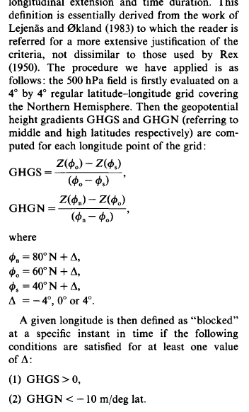
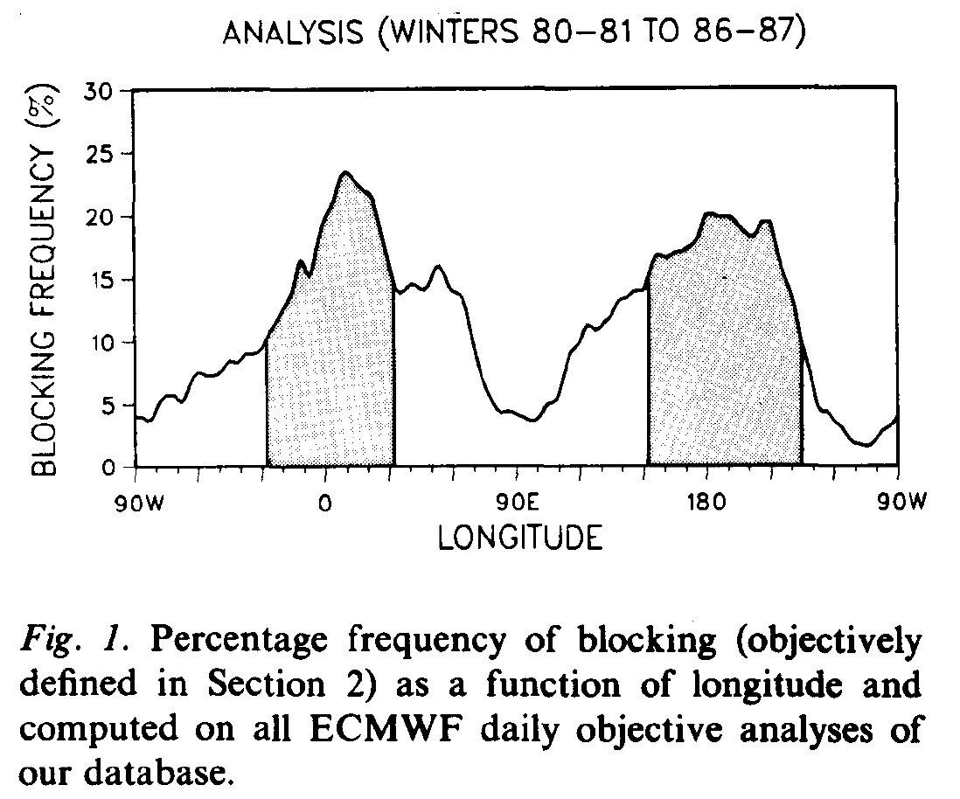
Blocking computation method: follows Tibaldi and Molteni, 1990 Tellus
There are alternatives, such as PV-based
index by Pelly and Hoskins. While these
may have some advantages, this old
standard used hereafter.

Slide 65
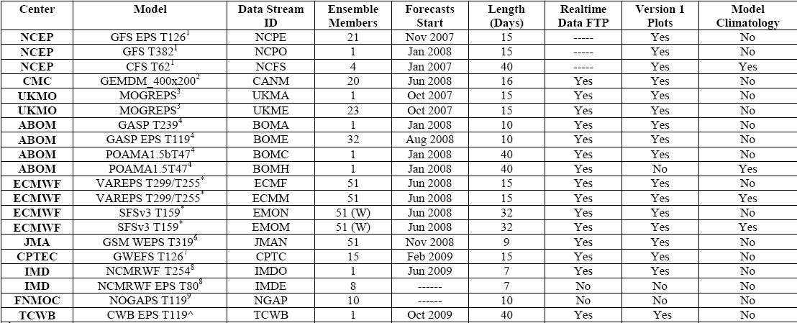
MJO task force data

Slide 66
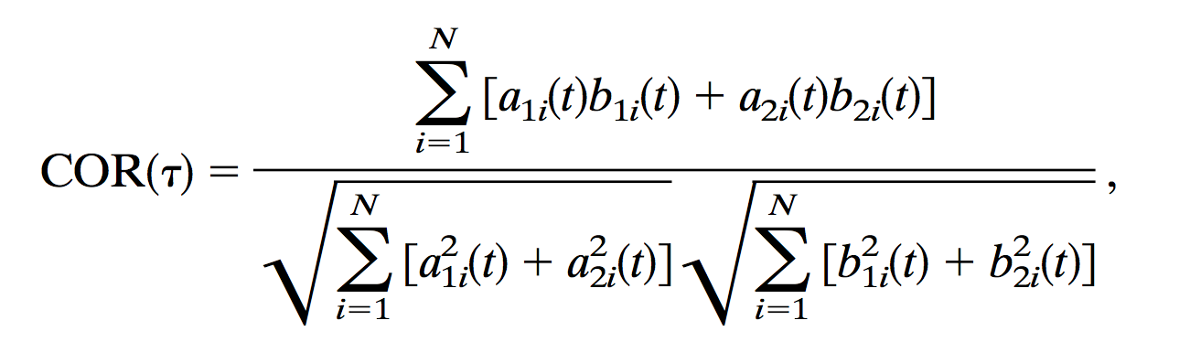
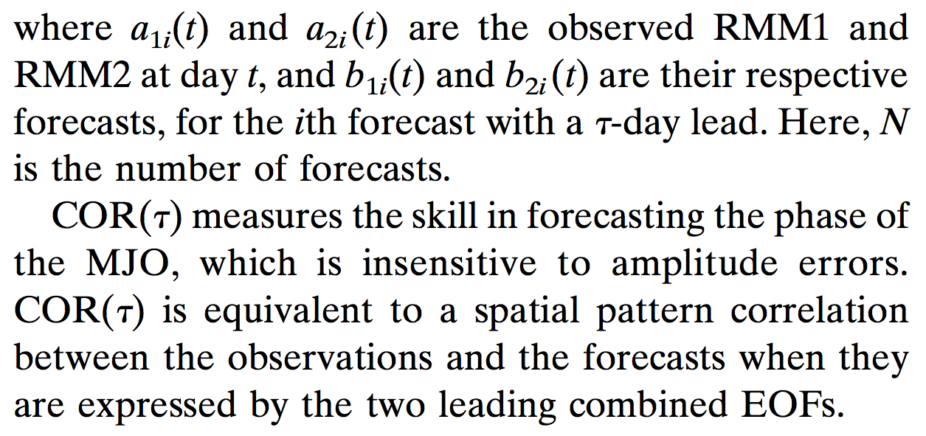

MJO deterministic verification metrics
from Lin et al., Nov 2008 MWR.

Slide 67
Bi-variate
RMM1 and RMM2 correlation and RMSE
Low amplitude: √(RMM1²+RMM2²) < 1
High amplitude: √(RMM1²+RMM2²) ≥ 1

Slide 68
Comparing against MJO task force data…
Nov 2008-Dec 2010 data
GEFS reforecast
c/o Jon Gottschalk

Slide 69
Probabilistic forecast verification: CRPSS
Method for computing CRPSS discussed in supplementary slides. References are
climatology and a regression
model based on lagged persistence using day 0, -5, -10, -15, -20, and -25 RMM1 and RMM2 values.
The extremely high skill of
the perfect-model scenario
likely exaggerates the best
case; as seen in rank histograms, there is undue
consistency among ensemble
members. This inflates
perfect-model skill.

Slide 70
Z500 anomalies under strong
(6-day lagged) Indian Ocean MJO

