Slide 1

The GEFS v12 and its reanalyses and reforecasts
this briefing is on google drive, linked via https://tinyurl.com/y3bulsmt
Jeff Whitaker, Anna Shlyaeva, Gary Bates, Sherrie Fredrick, Phil Pegion, Clara Draper, Maria Gehne, Lisa Bengtsson, Jian-Wen Bao, Tom Hamill
NOAA Physical Sciences Laboratory, Boulder CO
Vijay Tallapragada, Yuejian Zhu, Walter Kolczynski, Dingchen Hou, Kate Zhou, Eric Sinsky, Jack Woollen, and others
NCEP Environmental Modeling Center, College Park, MD (+CPC colleagues)
26 August 2020

Slide 2
Outline
1. Review of major changes with GEFS v12, and comparisons of systems in recent years.
2. Why the large time and effort to generate the reforecasts? Why a new reanalysis this time, too?
3. Reanalysis characteristics relative to previous generation Climate Forecast System Reanalysis:
  Fits to observations.
  Skills of GFS-FV3 forecasts from the two reanalyses.
4. Accessing GEFS v12 data.
5. Looking to the future: GEFS v13 and beyond

Slide 3
1. Review of major changes with GEFS v12 and comparisons of systems in recent years.

Slide 4
GEFS v12 implementation now slated for ~23 Sep 2020
(subject to modification by NCEP Central Operations and NWS HQ)
Key changes:
  New FV3 dynamical core, applied in GEFSv12 at C384 (~ 25 km grid spacing). Key for ensembles is more small-scale variability from less diffusive dycore.
  Real-time forecasts generated 4x/day, 31 members, to + 16 days lead.
  Real-time forecasts 1x/day, 31 members, to + 35 days lead.
  New suite of stochastic physics, following best practices at ECMWF (SPPT and SKEB) provide much more realistic estimates of uncertainty.
  SST evolution occurs via transplantation of anomalies from older CFSR system.
GEFSv12 is accompanied by a new 20-year reanalysis and reforecast.
  Reforecasts actually were computed prior to 1999, but focus here is on 2000-current, as older ones were initialized from the statistically inconsistent CFSR.
  Reforecasts 1x/day (00 UTC) 5 members, 1x/week (00 UTC) 11 members.

Slide 5
Statistical evaluation of GEFSv12 atmosphere
medium-range weather forecast quality
based on 2.5-y retrospective forecasts (June 2017 – Nov. 2019)
EMC, Ensemble Project:
Yuejian Zhu, Dingchen Hou, Xiaqiong Zhou, Bing Fu, Wei Li, Walter Kolczynski,
Xianwu Xue, Yan Luo, Jiayi Peng, Hong Guan, Eric Sinsky and Bo Yang
+
EMC MEG members

Slide 6
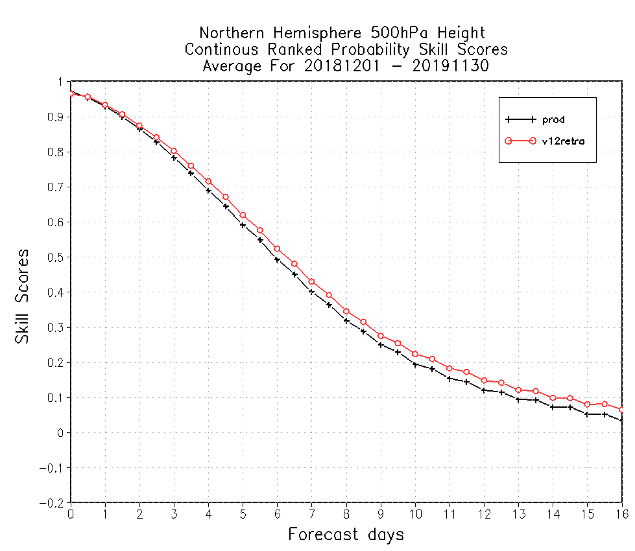

CRPS Skill of 500hPa geopotential height
9.5 days
9.5 days
9 days
9 days
CRPSS – Continuous Ranked Probabilistic Skill Score is one of evaluation tools to measure ensemble based probabilistic forecasts. CRPSS=1 is for perfect forecast, CRPSS=0 is for no skill from reference (climatology), CRPSS=0.25 is similar to PAC=0.6 (pattern anomaly correlation of ensemble mean). GEFS v12 has better CRPSS for both hemispheres of 500hPa heights.

Slide 7
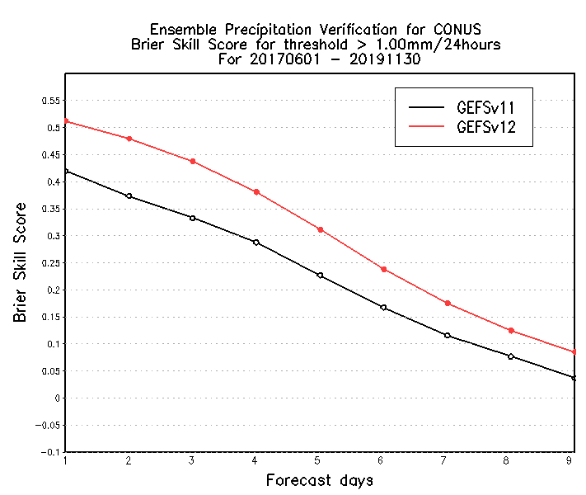
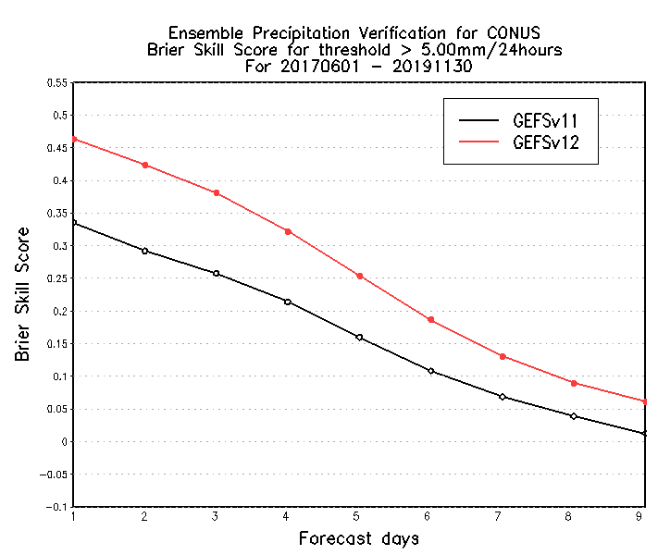
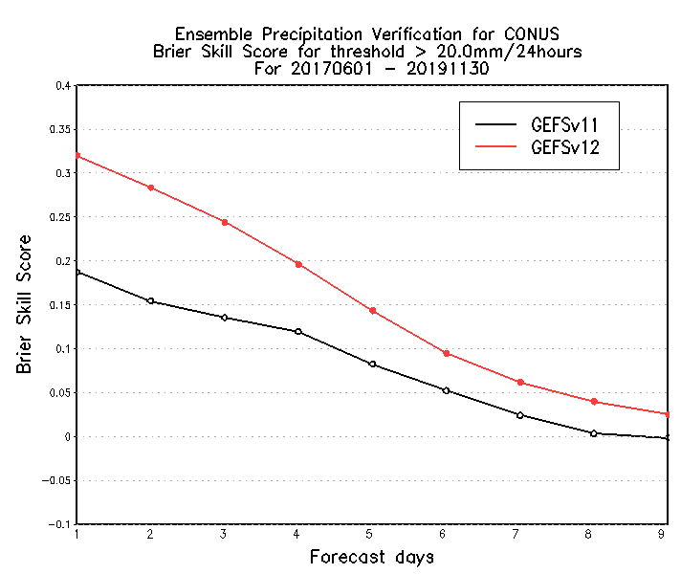
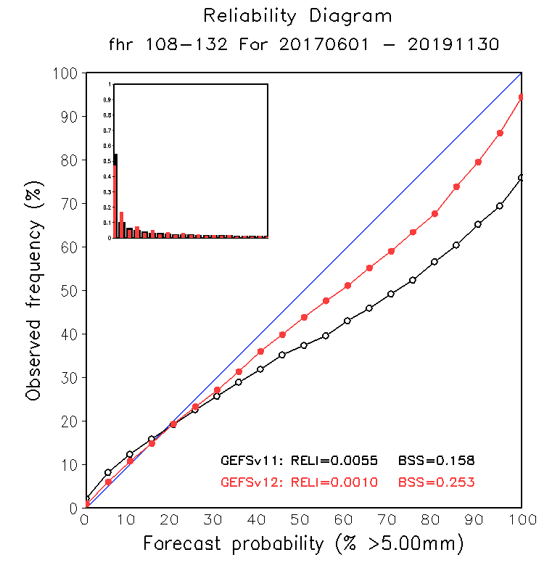
Brier Skill Scores of CONUS PQPF
> 1 mm / 24 h
> 5 mm / 24 h
> 10 mm / 24 h
0.628
0.601
0.603
0.581
Extends skill ~ 1 day
Extends skill >1 day
Extends skill > 1 day
South Hemisphere
0.214
0.179
0.239
0.209
BSS = 1 is for perfect forecast,
BSS = 0 is for no skill from reference climatology.
GEFSv12 forecasts are more reliable than GEFSv11.

Slide 8
Hurricane track forecast error and spread
Include WNP / EP / ATL (all retrospective cases)
GEFS v11 error (solid)
GEFS v11 spread (dash)
GEFS v12 error (solid)
GEFS v12 spread (dash)
Track error /spread (NM)
2018
2019
2017
Forecast lead (h)
Forecast lead (h)
Forecast lead (h)
GEFSv12 increased the track spread and reduced error for all three years (2017, 2018 and 2019).

Slide 9
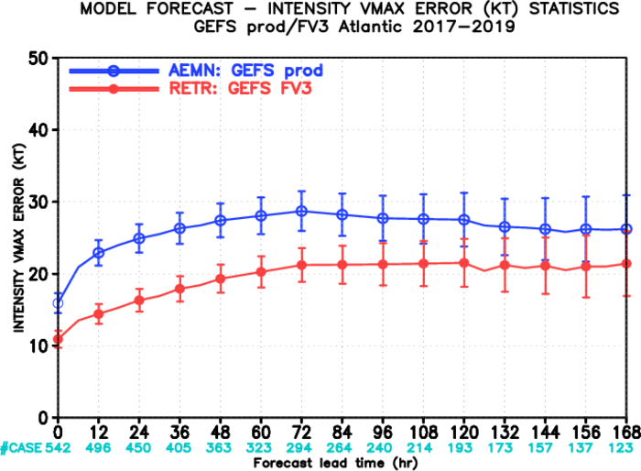
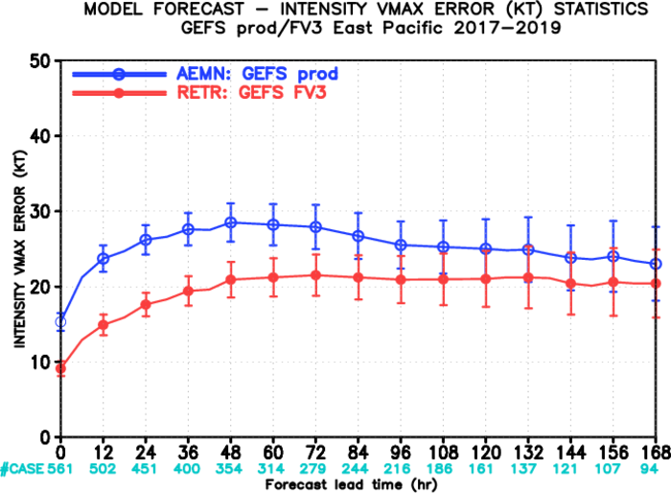
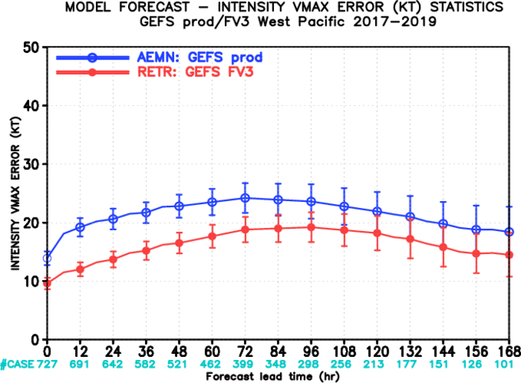
TC intensity verification
2017: 00Z 06/01----11/30; 12Z 07/01----10/31
2018: 00Z 05/01----11/30; 12Z 07/01----10/31
2019: 00Z 05/01----11/30; 12Z 07/01----10/31
Atlantic basin
East Pacific basin
West Pacific basin

Slide 10
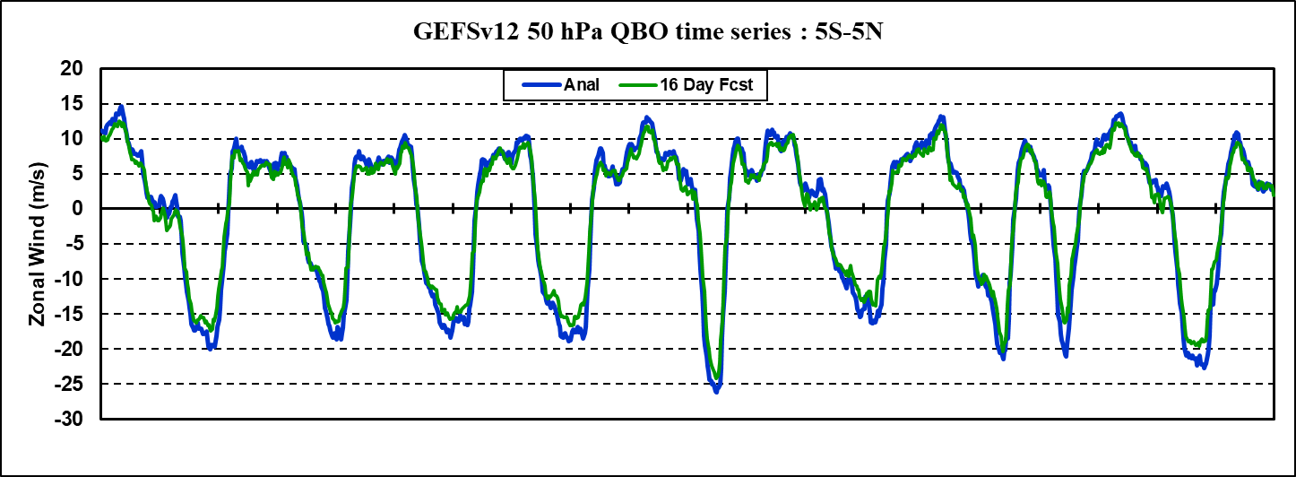
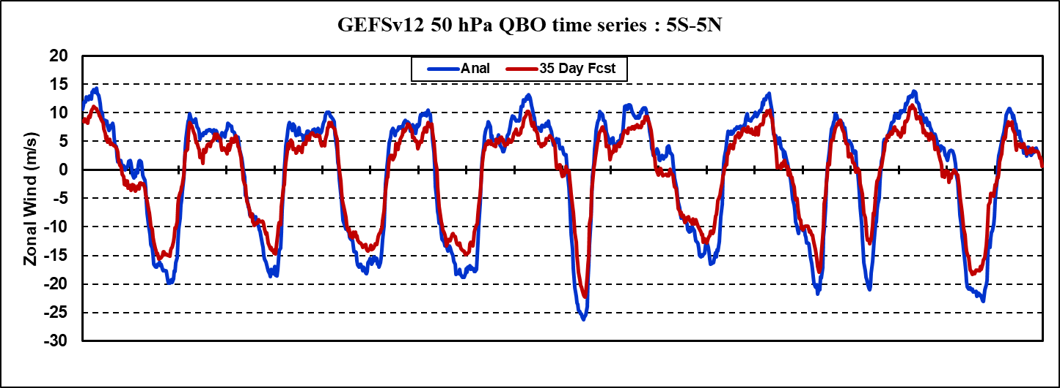
35 day-forecasts: QBO zonal winds at 50 hPa
Notes:
Retention of QBO structure is good. Some S2S models relax their QBO winds to easterlies by 35 days
Westerlies become more under forecast with time, which did not happen at 10 hPa.
Easterlies also become more under-forecast with time.
2000
2005
2010
2015
2020
2000
2005
2010
2015
2020

Slide 11
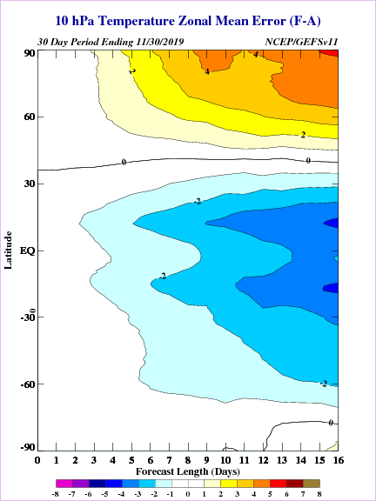
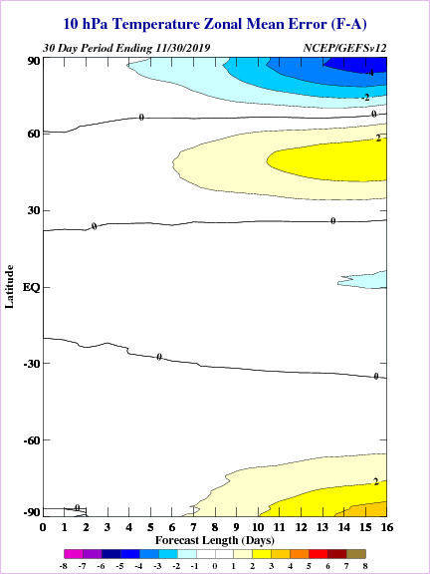
10 hPa temperature forecast errors
30 day errors ending Nov 30, 2019
GEFSv11
GEFSv12 Retro

Slide 12
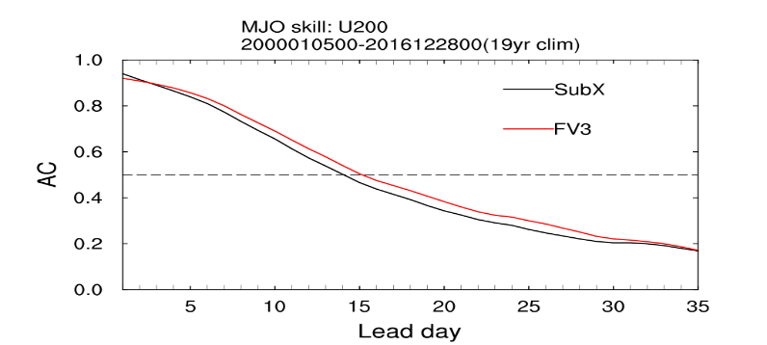
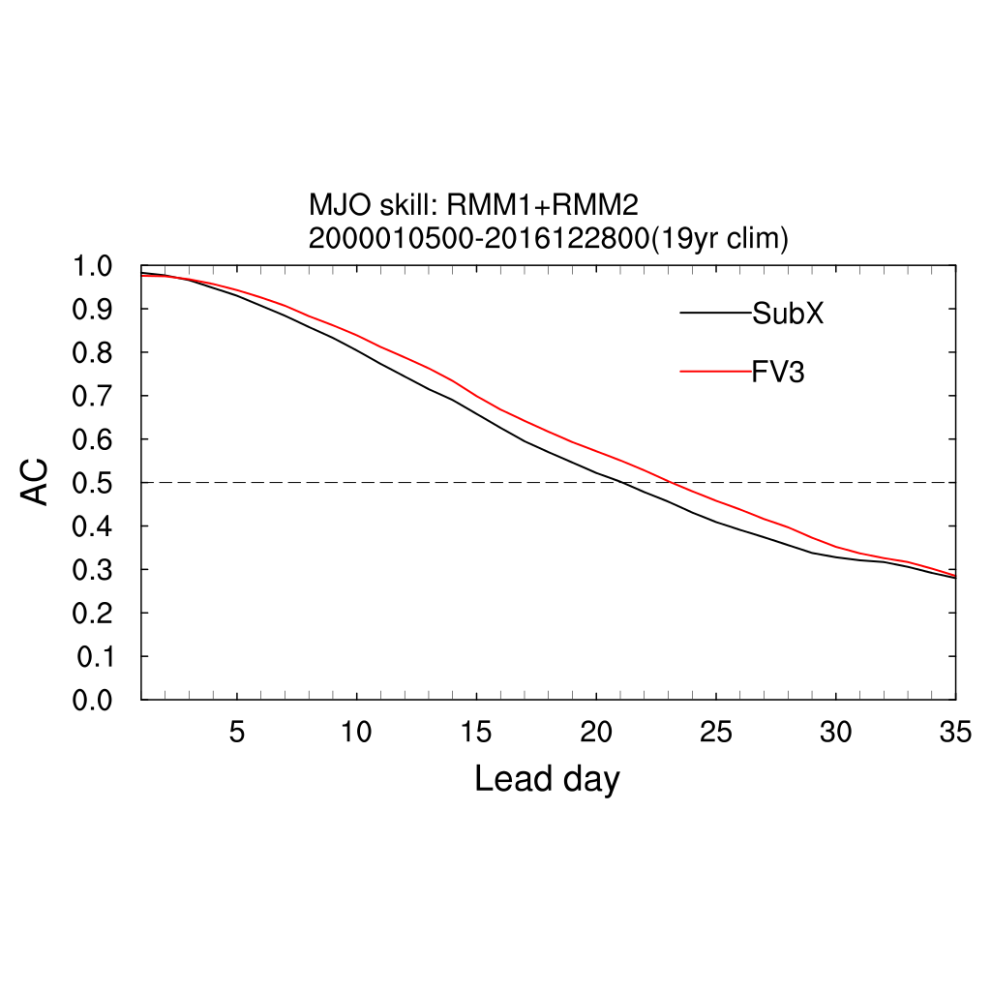
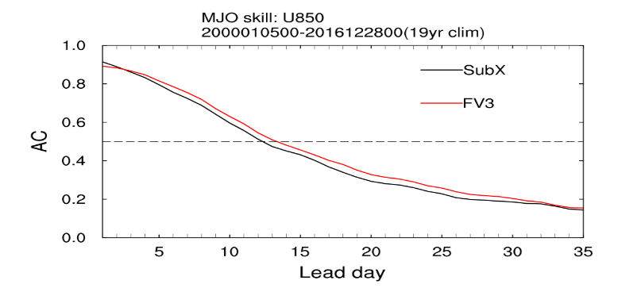
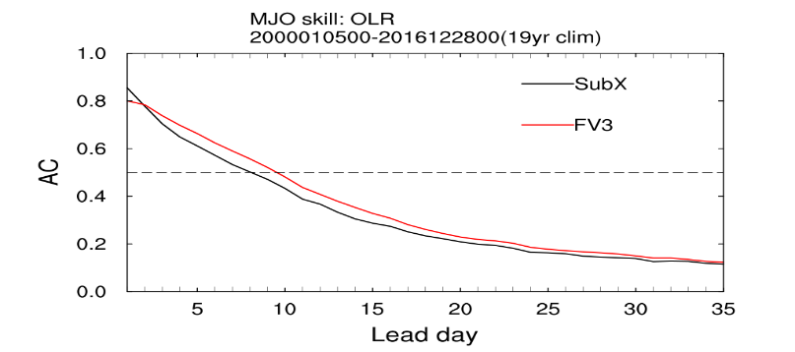
MJO skill comparison 2000-2016, GEFSv12 reforecast vs. SubX
MJO RMMs ACC
U200
GEFSv12
23 days
MJO Components
U850
For MJO RMM skill (bias corrected), GEFSv12 (23+ days) > SubX GEFS for ~ 2 days
For MJO components skill, GEFSv12 > SubX GEFS
OLR

Slide 13
More evaluations
GEFS retrospective verification (includes 45 specific case studies selected by MEG)
  https://www.emc.ncep.noaa.gov/users/meg/gefsv12/verif/
Presentations: https://www.emc.ncep.noaa.gov/users/meg/gefsv12/
  FV3 Dynamical Core Information - Developed by GFDL
  Kickoff to the GEFSv12 Official Evaluation - Presented by Geoff Manikin (2/27/20 MEG Meeting)
  GEFSv12 Official Evaluation Webpages - Presented by Alicia Bentley (2/27/20 MEG Meeting)
  Overview of GEFSv12 Verification Statistics - Presented by Alicia Bentley (3/12/20 MEG Meeting)
  GEFSv12 Retrospective Case Studies: Excessive QPF - Presented by Shannon Shields (3/12/20 MEG Meeting)
  GEFSv12 Retrospective Case Studies: Winter Storms - Presented by Alicia Bentley (3/19/20 MEG Meeting)
  GEFSv12 Retrospective Case Studies: Tropical Cyclones - Presented by Shannon Shields/Alicia Bentley (3/26/20 MEG Meeting)
  GEFSv12 Retrospective Case Studies: Severe Weather - Presented by Logan Dawson (4/2/20 MEG Meeting)
  GEFSv12 Retrospective Case Studies: Low Skill/Dropouts - Presented by Shannon Shields (4/2/20 MEG Meeting)
  GEFSv12 Retrospective Case Studies: Cold-Air Outbreaks - Presented by Geoff Manikin (4/2/20 MEG Meeting)
  GEFSv12 SOO Team Evaluation Overview - Presented by NWS SOO Team (4/16/20 MEG Meeting)
  The MEG GEFSv12 Evaluation Overview - Presented by Alicia Bentley/Geoff Manikin (4/23/20 MEG Meeting)
  GEFS v12 Field Evaluations (Waves/Aerosols/Weeks 2-4) – Presented by Henrique Alves/Deanna Spindler/Jeff McQueen/Shannon Shields (4/30/20 MEG Meeting)
  GEFS v12 Field Evaluations (Days 1-10 Weather)- Presented by Alicia Bentley (4/30/20 MEG Meeting)
  GEFS v12 EMC CCB - Presented by Yuejian Zhu and Geoff Manikin (5/1/20)
  GEFS v12 NCEP OD Brief – Presented by Vijay Tallapragada and Geoff Manikin (5/5/20)
  GEFS v12 Weeks 3&4 CPC Evaluation – Presented by Matthew Rosencrans (5/14/20)

Slide 14
2. Why bother with generating reforecasts?
Why a new reanalysis this time, too?

Slide 15
Reanalysis and reforecasting as part of an integrated UFS prediction system especially for S2S.
Experience shows that the long time series from reforecasts aids postprocessing of rare events, longer-lead forecasts with smaller signals to detect.
ECMWF, and now the NWS, CPC, National Water Center now agree this is integral.

Slide 16
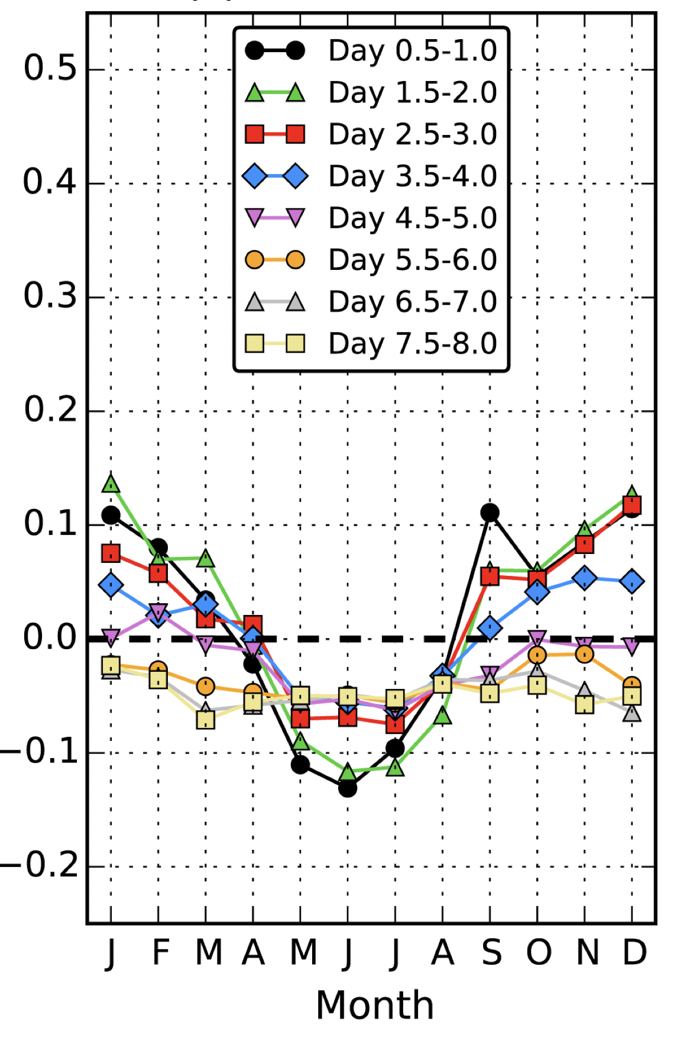
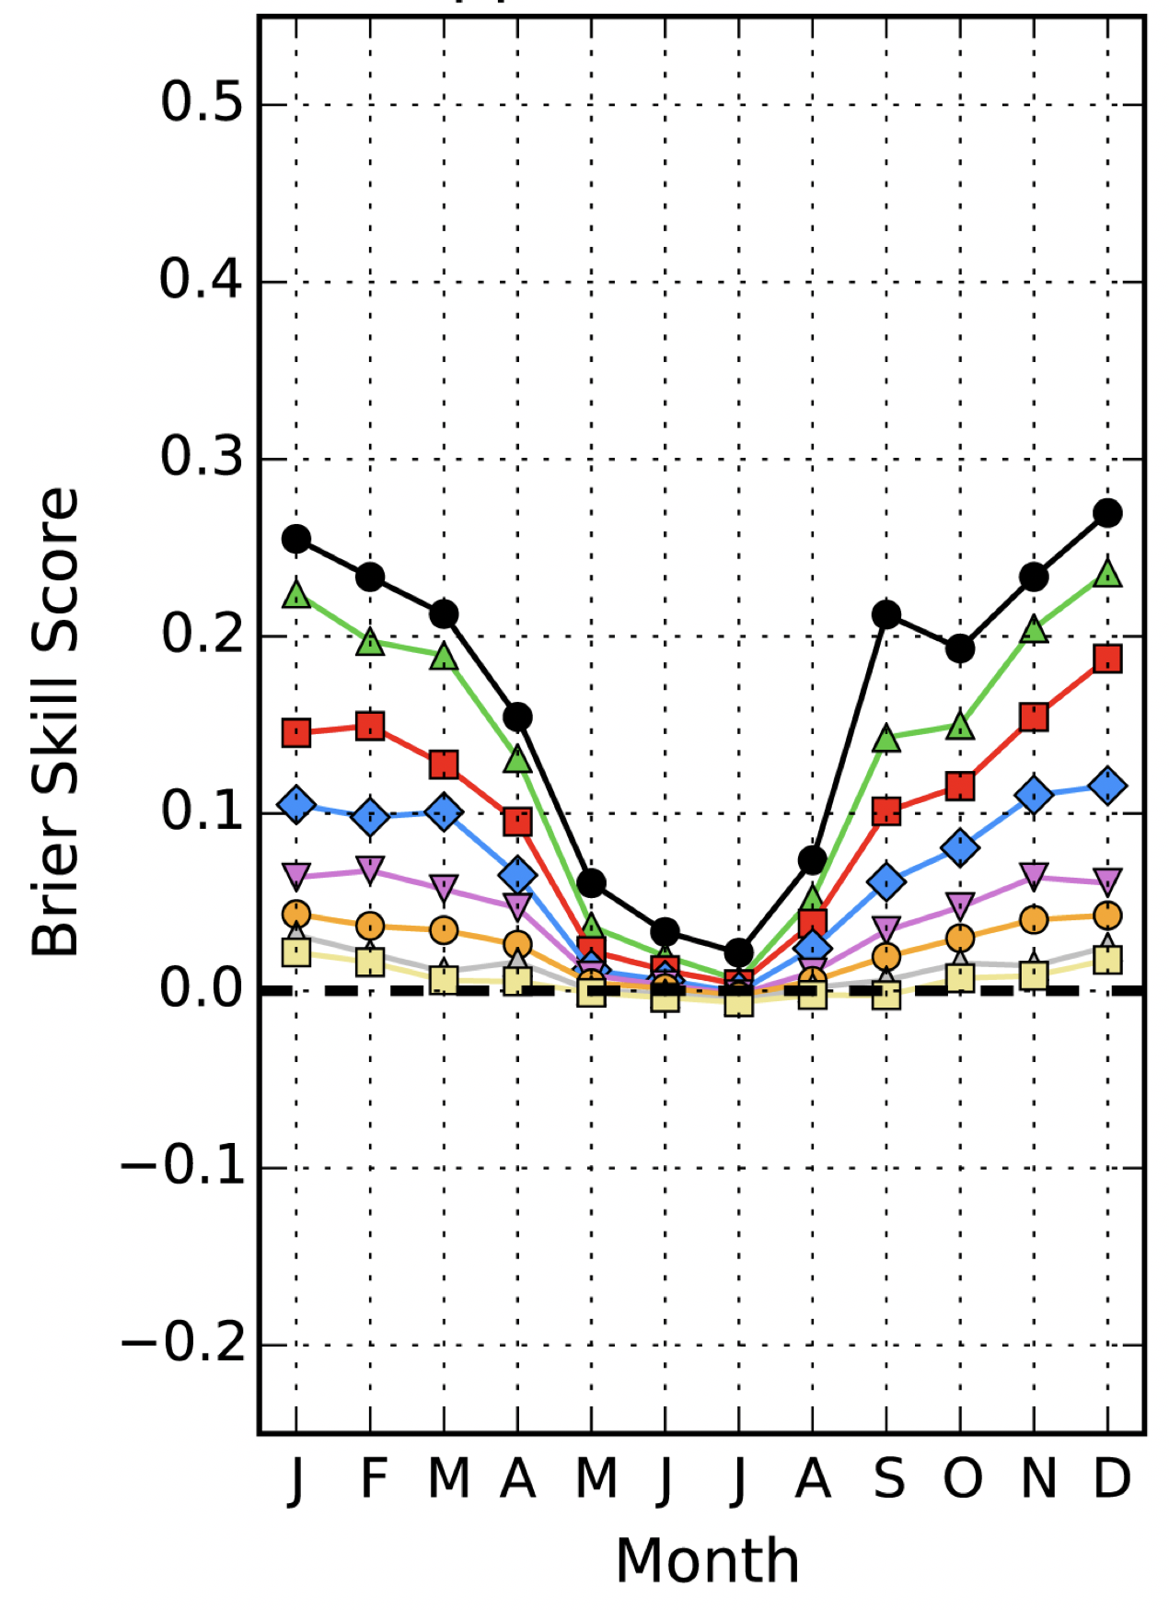
Example: precipitation forecast improvement with reforecast-based postprocessing.
Brier skill scores (1=perfect, 0=skill of climatology)
GEFS v10 raw,
> 25 mm/12 h event
GEFS v10 postprocessed,
> 25 mm/12 h event
Postprocessing of heavy precipitation is compared against the skill of the raw ensemble with GEFS v10 for forecasts from days 0-8.
Yet more skill improvement may be possible with improved GEFSv12 and more sophisticated machine-learning procedures.
Ref: Hamill, T. M., M. Scheuerer, and G. T. Bates, 2015: Analog probabilistic precipitation forecasts using GEFS Reforecasts and Climatology-Calibrated
Precipitation Analyses. Mon. Wea. Rev., 143, 3300-3309. Also: online appendix A and appendix B.

Slide 17
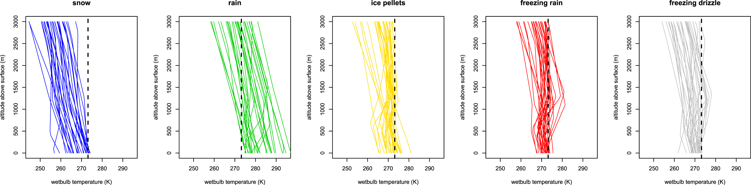
More challenging postprocessing applications will benefit from the additional data saved with GEFSv12
Lower-tropospheric high vertical resolution GEFSv12 data will be available over a 20-year period for improved precipitation type forecasts, for example. This study used limited training data. This hampers postprocessed product quality for rare events.
Ref: Scheuerer, M., S. Gregory, T. M. Hamill, and P. E. Shafer, 2016: Probabilistic precipitation type forecasting based on GEFS
ensemble forecasts of vertical temperature profiles. Mon. Wea. Rev., 145, 1401-1412.

Slide 18
Modern reanalyses are computationally expensive and difficult to produce. Why should we regularly perform them?
00 UTC
Reanalyses commonly exhibit the systematic errors of the background forecasts. Until systematic errors in the analyses are reduced to a negligible level and don’t change from one system version to the next, the reanalyses used to initialize the reforecasts will be a source of inconsistency between the reforecast and the real-time forecast, especially at early forecast leads. This degrades statistical postprocessing.
Hamill, T. M., 2017: Changes in the systematic errors of global reforecasts due to an evolving data assimilation system. Mon. Wea. Rev., 145, 2479-2485.

Slide 19
This reanalysis was optimized for reforecast initialization. Other users: → ERA5.
The goal was not to produce a reanalysis that was tuned to be optimally accurate in its own right, but to produce a reanalysis that was as consistent as practical with the eventual operational analysis system used with GEFSv12. Consistency > absolute accuracy, bias.
  Challenge: observation network has changed much over the last 20 years. Operational DA system generally optimized for current data, not for a changing one used in reanalysis.
If you seek reanalysis data for model verification, climate variability analysis, and other applications, ECMWF/Copernicus ERA5 is probably a better choice.
In the future, with decreases in UFS systematic error and better coupling of analyses between state components, one NOAA reanalysis may serve multiple purposes.

Slide 20
3. Reanalysis characteristics relative to previous- generation Climate Forecast System Reanalysis

Slide 21
Major differences, GEFS v12 vs. previous-generation CFSR reanalysis
Aspect changed | CFSR configuration | GEFS v12 configuration
Period of record | 1978-current | 2000 - 2020
Atmospheric dynamical core and control forecast grid spacing | Spectral, T382L64 (~ 38 km grid) | FV3 (Lin 2004, Putman and Lin 2007), C384L64 (~ 25 km grid)
Microphysical parameterization | Zhao-Carr (Zhao and Carr 1997) | GFDL (Phillips and Donner 2006, Zhou et al. 2019)
Other parameterizations | Saha et al. (2010) | GFSv15 (2020)
Atmospheric data assimilation methodology | 3D-Var through 2011 (Parrish and Derber 1992, Kleist et al. 2009) | Hybrid En-Var C384. (2x lower than operational GFS analysis)
Ensemble usage in data assimilation | None through 2011, then following operations | 80-member EnKF at C128L64 (~ 75 km) to provide background- error covariances (3x lower than operational GEFS analysis)
Ensemble stochastic physics | None (single control member for data assimilation) | Stochastically perturbed physical tendencies (SPPT), stochastic boundary-layer relative humidity (SHUM), and stochastic kinetic-energy backsctatter (SKEB) [this paper]
Snow updates | SNODEP (Kiess and Kopp, 1997) before 1997, NESDIS IMS (Helfrich et al. 2007) thereafter. Updated 4x daily. | NESDIS IMS (Helfrich et al. 2007). Updated only at 00 UTC, otherwise climatology for other 3 cycles (a bug).
Land-surface analysis | Separate land-surface analysis with analyzed forcings (Saha et al. 2010) | Land-surface forcings directly from short-term forecasts.
Ocean analysis | SST via OI (Reynolds et al. 2007); rest of ocean state with 3D-Var using MOM4 ocean and weak coupling | SST via OI (Reynolds et al. 2007). No weak coupling in cycled DA, no full ocean analysis.
Tropical cyclone processing | Vortex relocation to observed position (Liu et al. 1999) | Direct assimilation of central pressure, no relocation

Slide 22
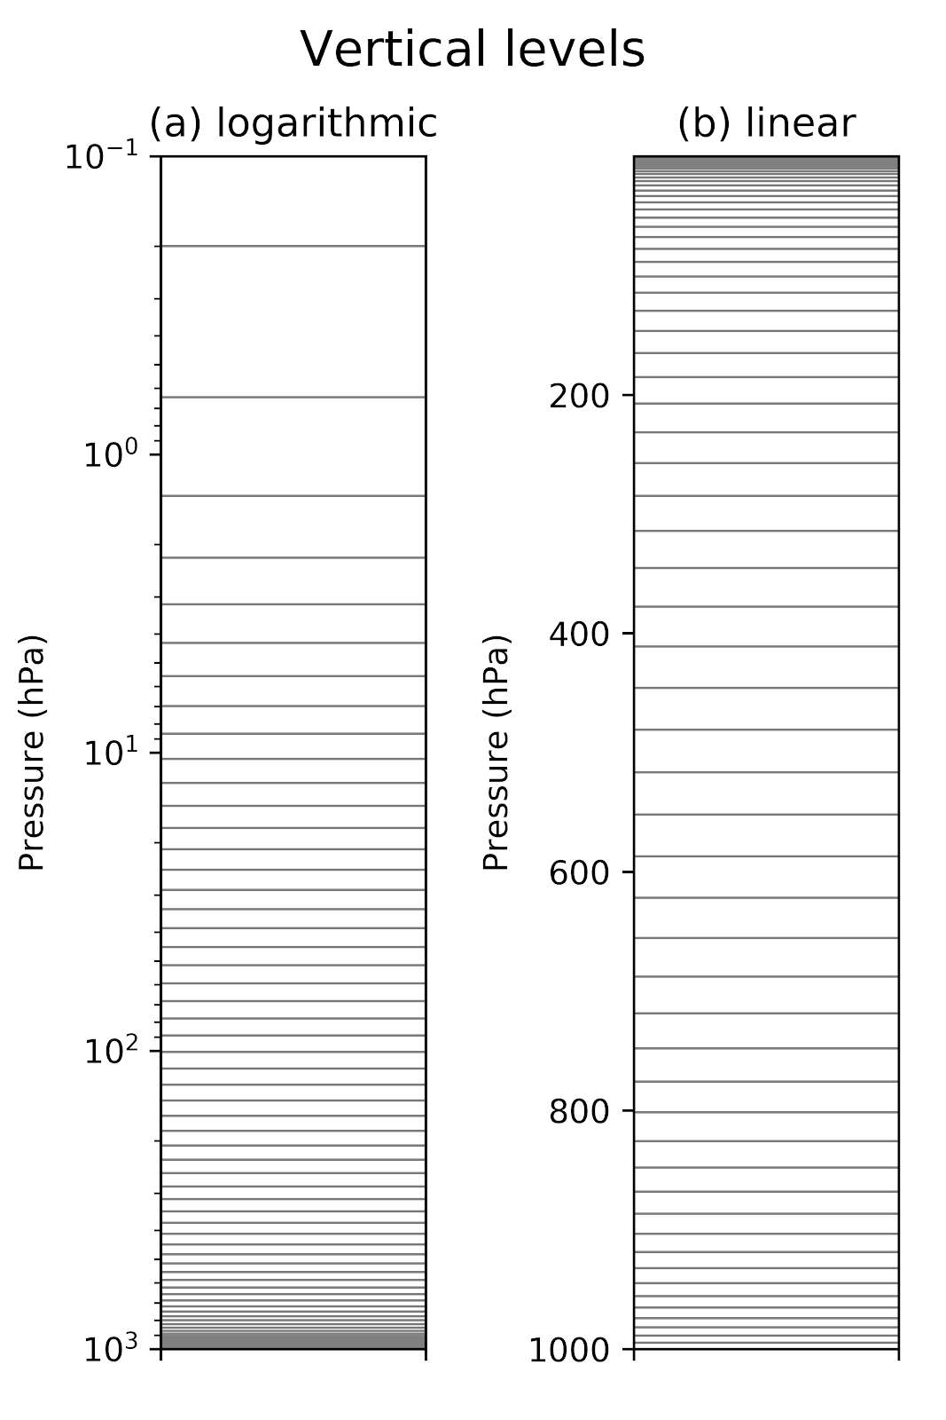
64 vertical levels. Depending on how you look at it, there’s either many vertical levels in the upper
stratosphere, or perhaps not quite enough.
These levels are often critical, for example for gravity-wave momentum deposition, and as a source of extended-range predictability (QBO, Arctic Oscillation, sudden stratospheric warmings).

Slide 23
Major differences between the eventual real-time operational analysis and the reanalysis, + known bugs
Analysis resolution: ½ of operations because of computational expense.
SST: OI in reanalysis vs. NSST in real-time (NSST had large biases in data-sparse cloudy regions early in reanalysis period).
Snow initialization: only refreshed once per day, 00 UTC in reanalysis, while refreshed 4x/day in operations. Addressed somewhat through a “replay” process.
Some velocity-azimuth-display (VAD) winds snuck in with QC problems during periods of bird migration. Turned VAD off when discovered. Too late to reprocess.
There are possibilities of finding more issues as more users look through the data.
A few others (pressure jumps) discussed in subsequent slides.

Slide 24
Evaluation of the GEFSv12 reanalyses
Fit of short-term (background) forecasts to newly available observations as a metric for system improvement.
Deterministic “scout” runs with FV3 GFS from CFSR and GEFS v12 initial conditions, verified against independent (ECMWF) reanalyses.
Other various diagnostics (QBO, checking expected conservation properties).
Ongoing: comparisons of skill during overlap period of GEFSv12 reforecast and GEFS retro.

Slide 25
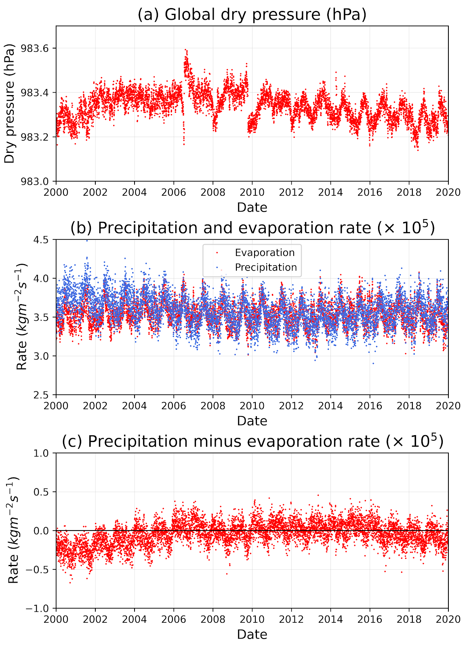
Conservation properties:
analysis time series with
dry-pressure jumps.
Dry pressure (removing contribution of variable water vapor) jumps ~ July 13-15 2006 and Oct 11-13 2009. The first jump is understood (next few slides), the second not well understood.
Notes:
# Evaporation rate can be calculated from the latent heat flux divided by
# the latent heat of evaporation of water (Lwater).
# E = (latent heat flux)/Lwater , where latent heat flux
# read in from netCDF file.
#
# Do the units work out?
#
# Numerator's units: evaporative heat flux units: W/m**2
# 1 W = 1 J/s = 1 Nm/s = 1 kg*m**2/s**3 , so evaporative heat flux
# units are (kg m**2/s**3)*(1/m**2) = kg/s**3
#
# Denominator's units: Lwater as calculated there has units of
# J/gm = (kg*m**2/s**2)/ gm. Hence multiply by 0.001 kg/gm
# to get expressed in m**2/s**2 .
#
# So, the final units are (kg/s**3) / (m**2/s**2) =
# kg/s**3 * s**2/m**2 = kg/(m**2 s)
#
# which coincides with the precipitation rate units in the grib table
# https://www.nco.ncep.noaa.gov/pmb/docs/on388/table2.html

Slide 26
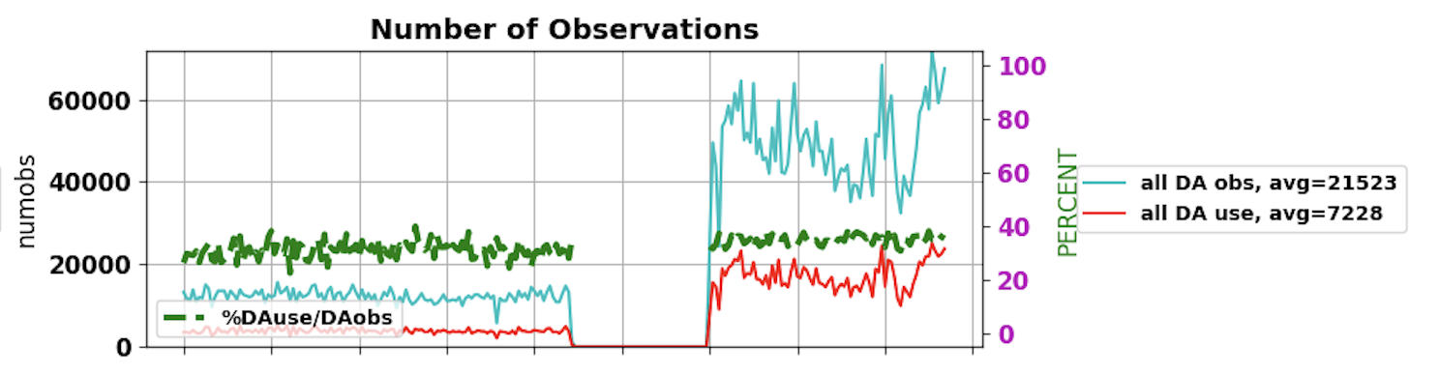
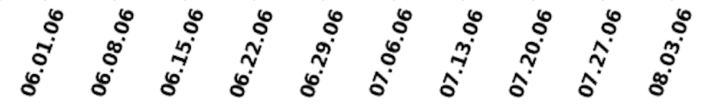
GPS radio occultations observation count during pressure 2006 jump.
The sudden advent of the assimilation of many more GPSRO observations during this period suggests that these
observations both directly affected the thermodynamic characteristics of the atmosphere (its integral reflected in the
surface pressure) and indirectly, by anchoring the satellite radiances (next slide). c/o Anna Shlyaeva.

Slide 27
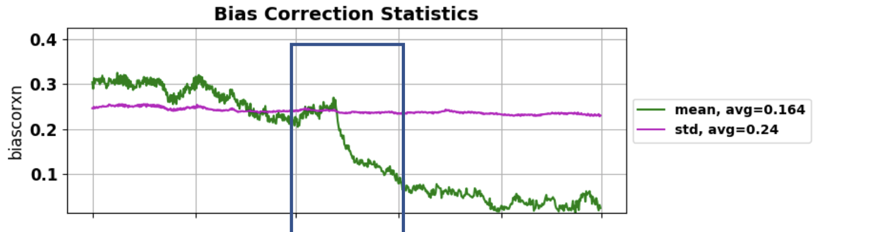
NOAA-15 AMSU-A channel 7 bias corrections
May 06
Jun 06
Jul 06
Aug 06
Sep 06
Oct 06
When (unbiased) GPSRO observations became much more plentiful, it was possible to more effectively bias correct the AMSU-A satellite data. Temperature corrections then caused the pressure jump.

Slide 28
Precipitation minus evaporation
Water cycle appears balanced in the reanalysis to approximately 5%. We’d expect complete closure, but assimilation of observations can affect one directly while not enforcing consistency of the other.
This is similar in quality to MERRA (see supplemental slides) but less balanced than in MERRA-2.

Slide 29
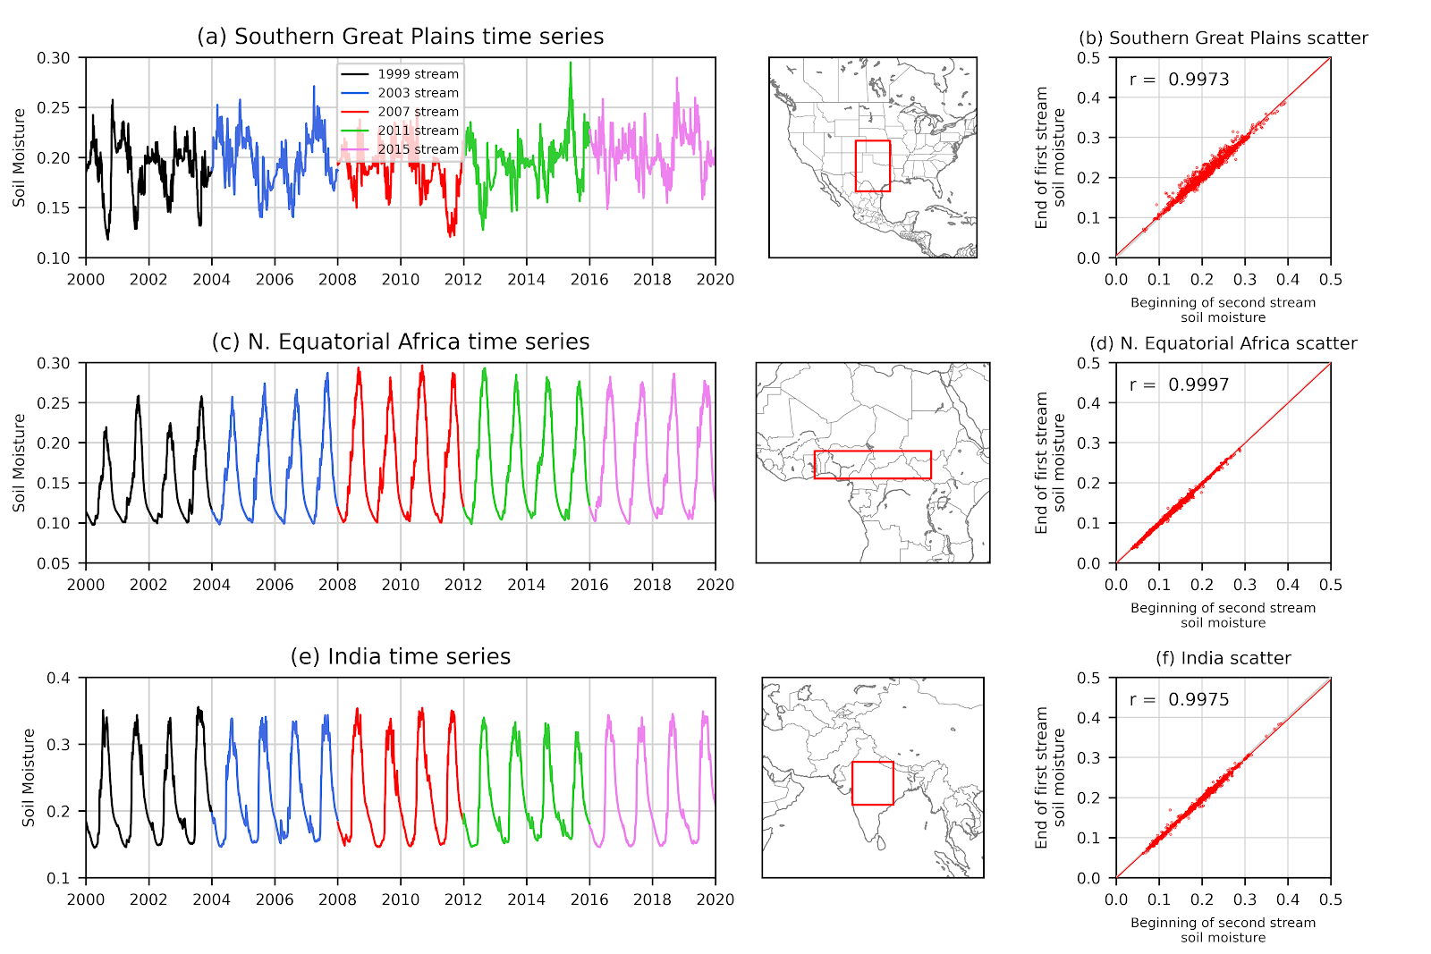
Problems
with soil
moisture
at stream
boundaries?
Illustration of 4-10 cm layer soil moisture for three regions with strong land-atmosphere coupling, following Koster el al. 2006. No sign of problem at stream boundaries.

Slide 30
QBO in this reanalysis
No smoking-gun
problems.
figure c/o
Zac Lawrence,
CIRES and PSL

Slide 31
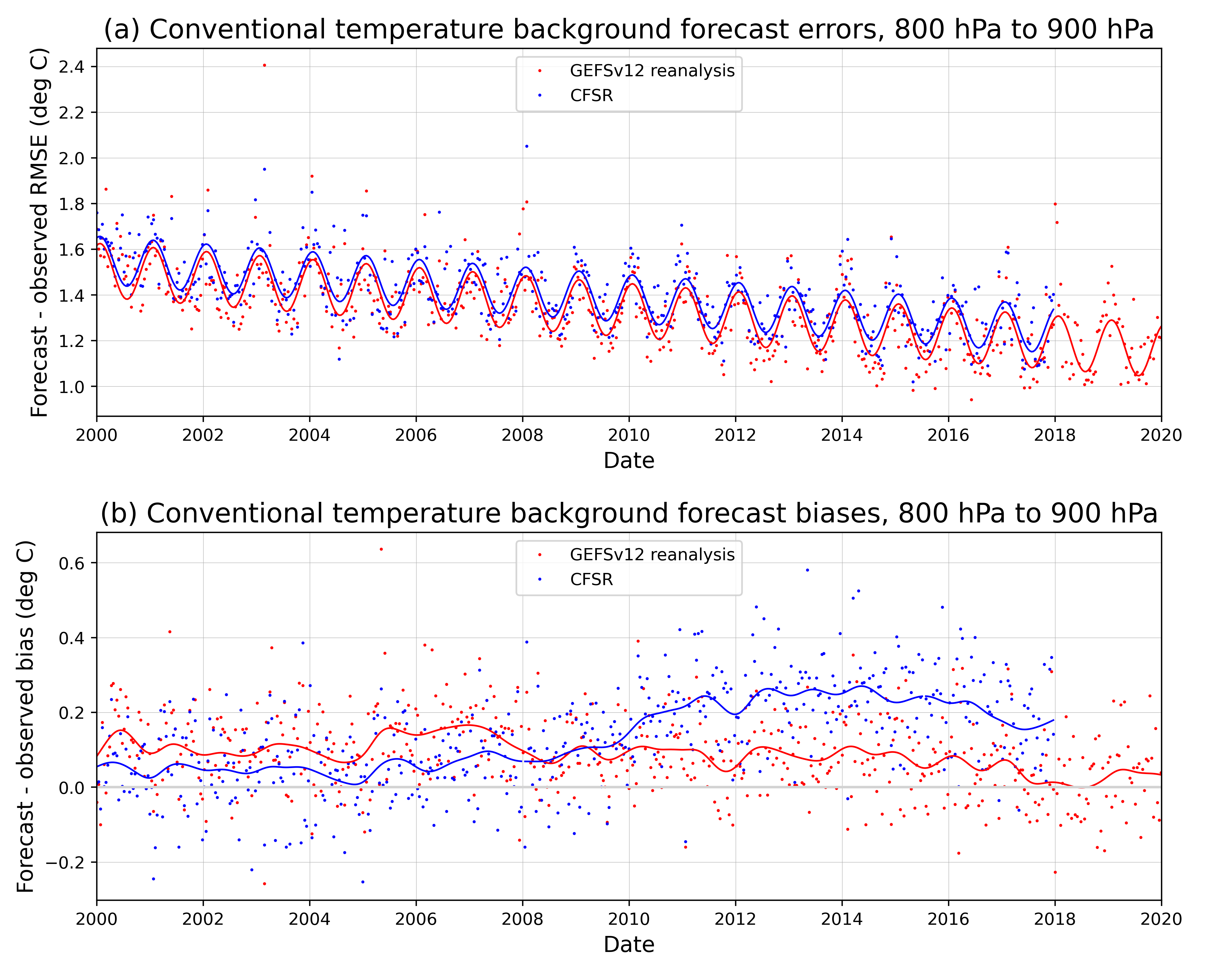
Conventional
data fit to observations
Improvement with GEFSv12
reanalysis in the fits to conventional observations is apparent here.
Top uses regression fit including an annual cycle. Bottom is a Gaussian kernel smoother with a 20-week smoothing timescale.

Slide 32
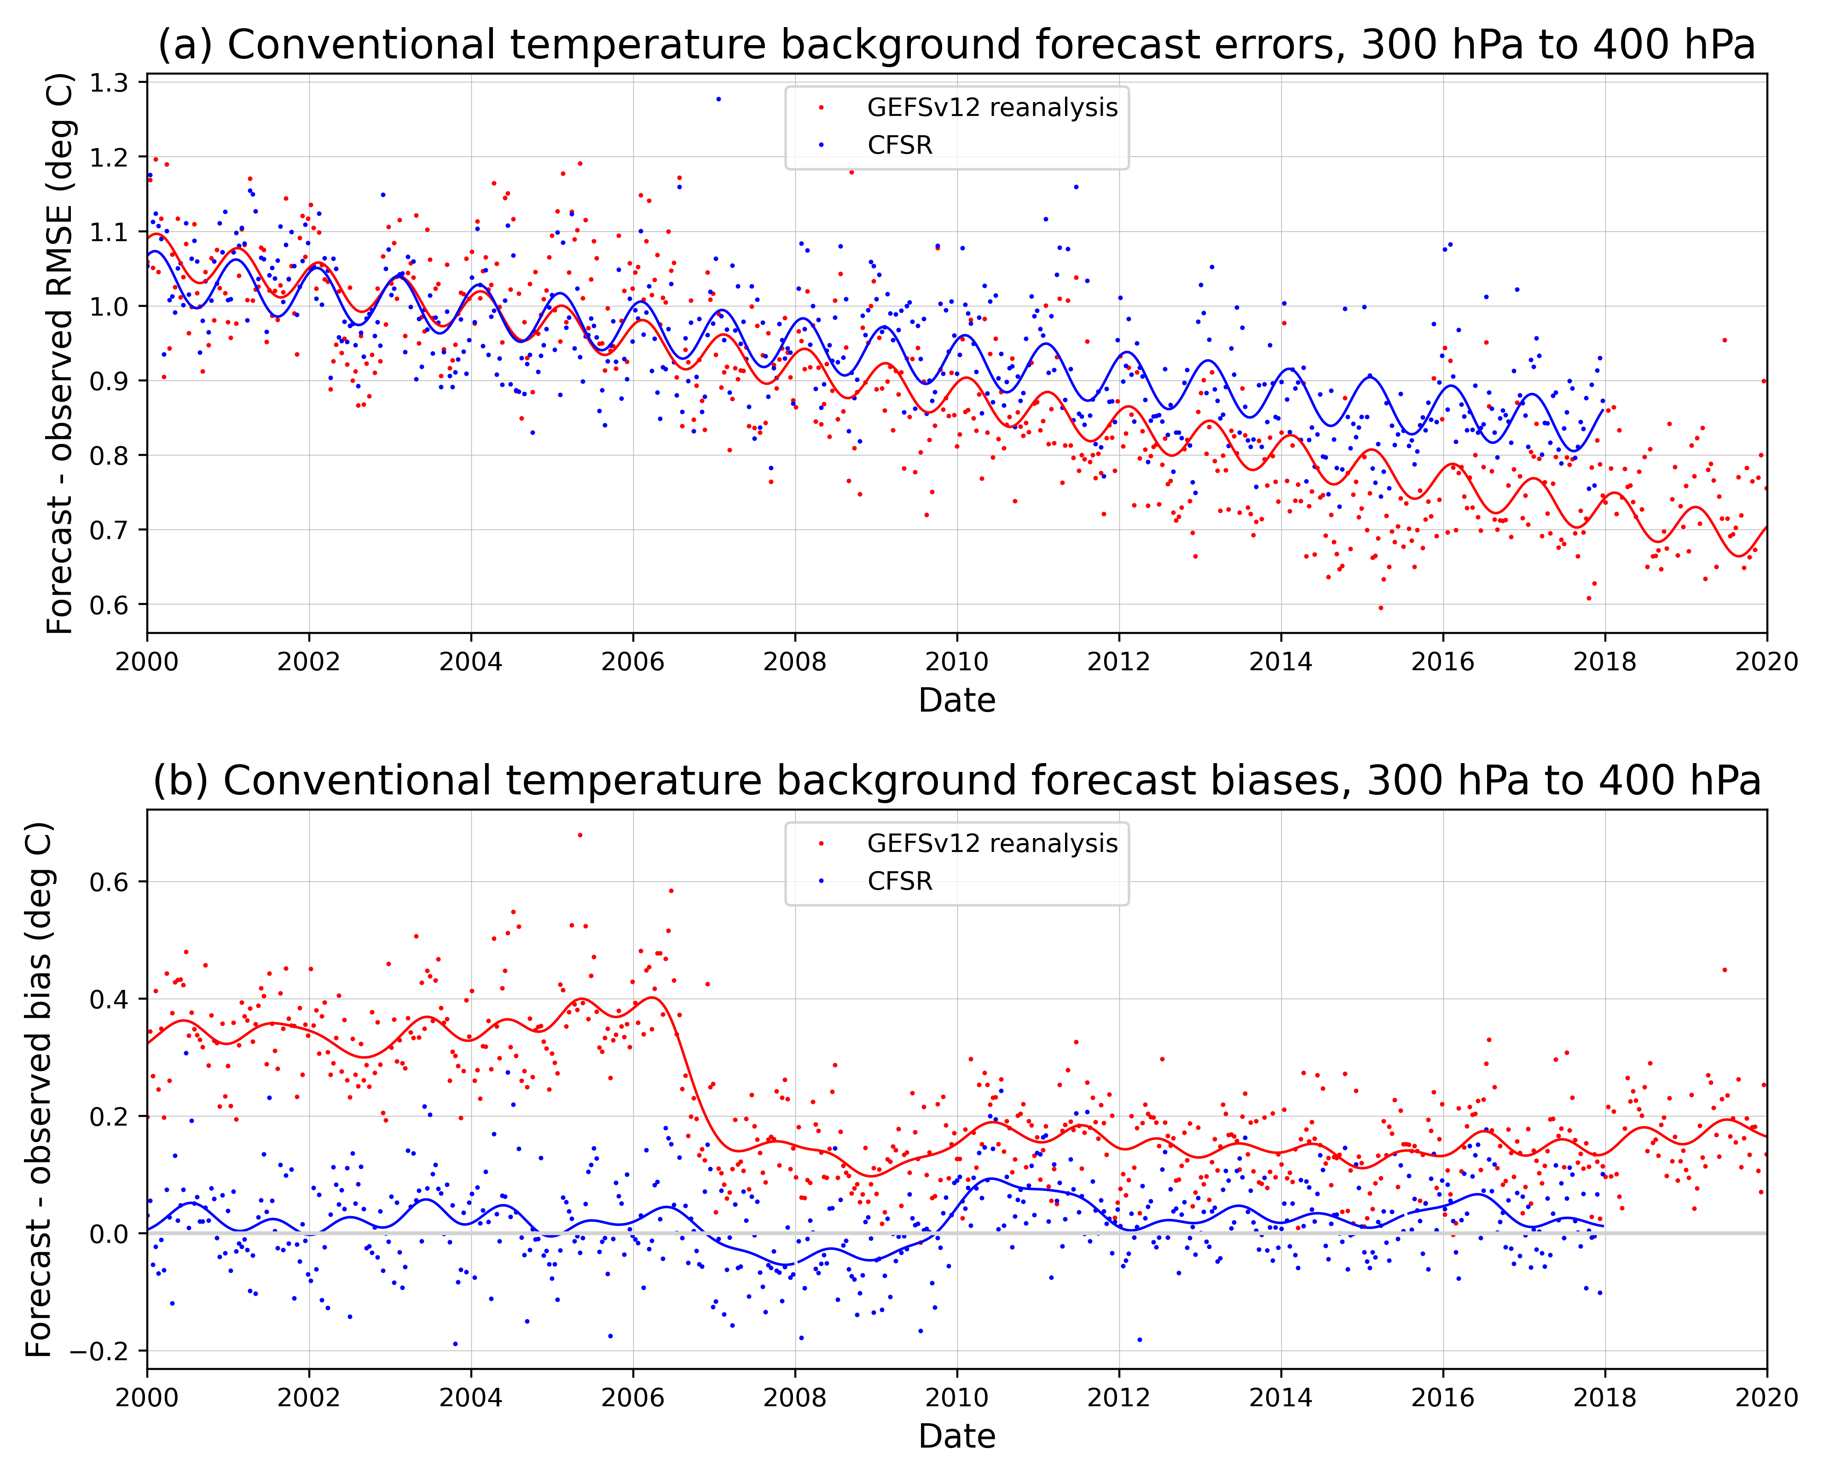
Conventional
data fit to observations
Improvement with GEFSv12
reanalysis in the fits to conventional observations is apparent here.
Improvement in bias roughly coincides with period when GPSRO data became widely available (launch 15 April 2006, data came online slowly thereafter), so likely that helped anchor other observations and reduce bias.

Slide 33
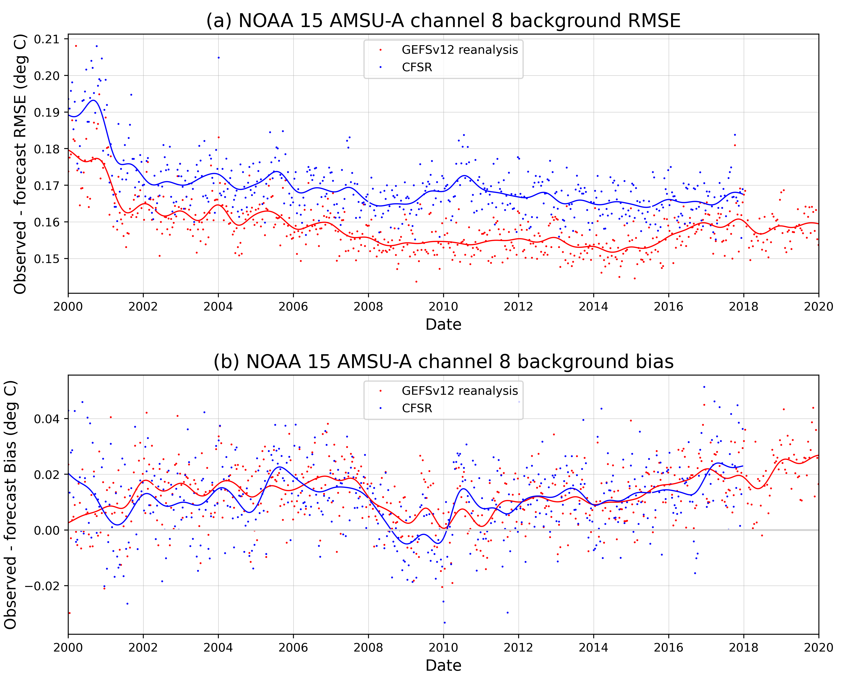
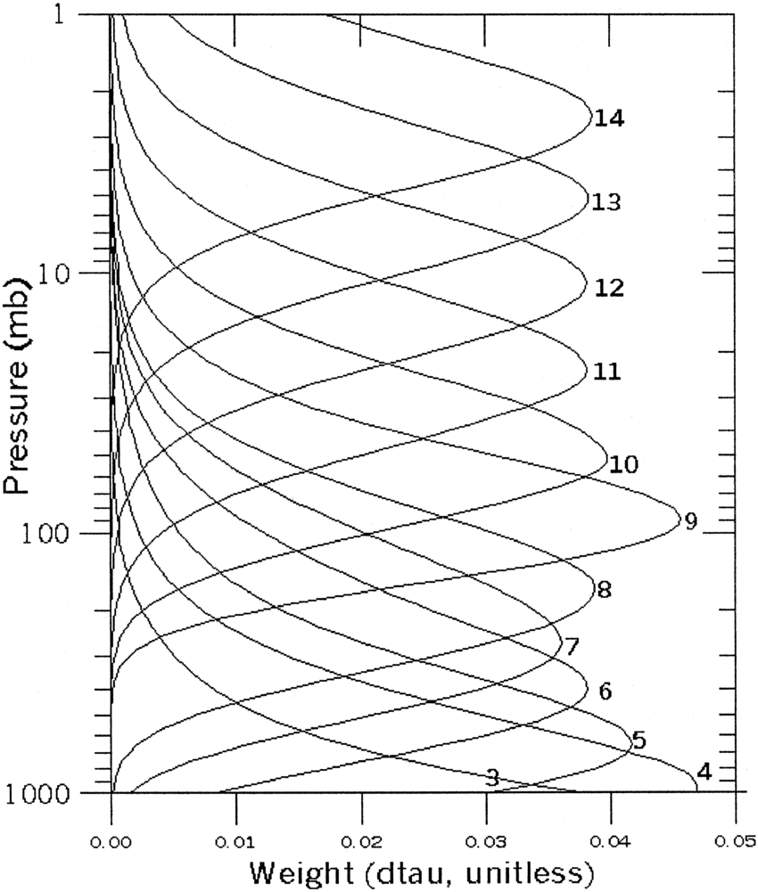
Satellite radiance
fit of background
to observations
AMSU-A channel 8
peaks around 180 hPa.

Slide 34
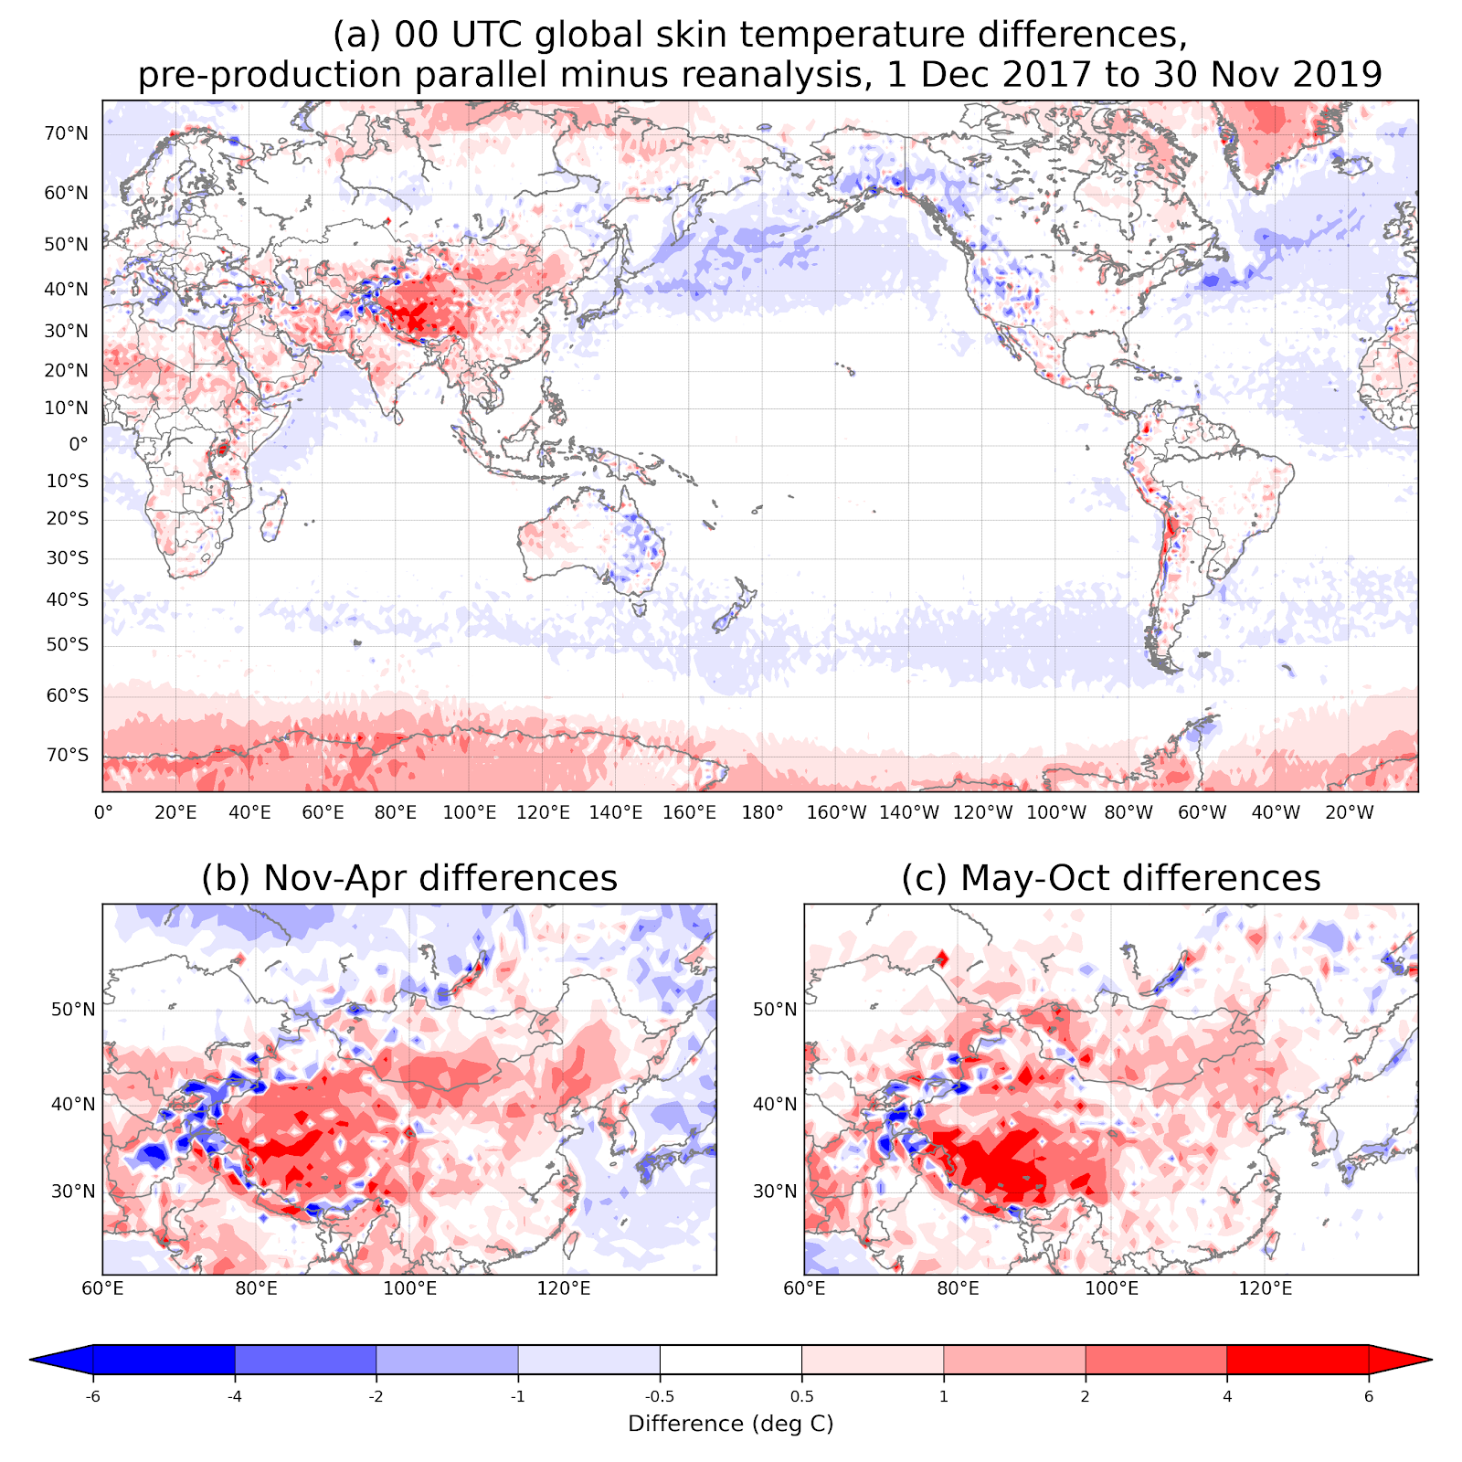
Does skin temperature (effectively SST over the ocean) differ substantially with use of “NSST” in
operations vs. “OI” SST in the reanalysis?
Do skin temperatures over land differ systematically, with GLDAS used in
operations and not in reanalysis? Also perhaps snow analysis deficiency
introduces reanalysis issues.
Largest differences are over the Himalayan plateau, but not just snowy months.
T_{2m} not examined, only skin.

Slide 35
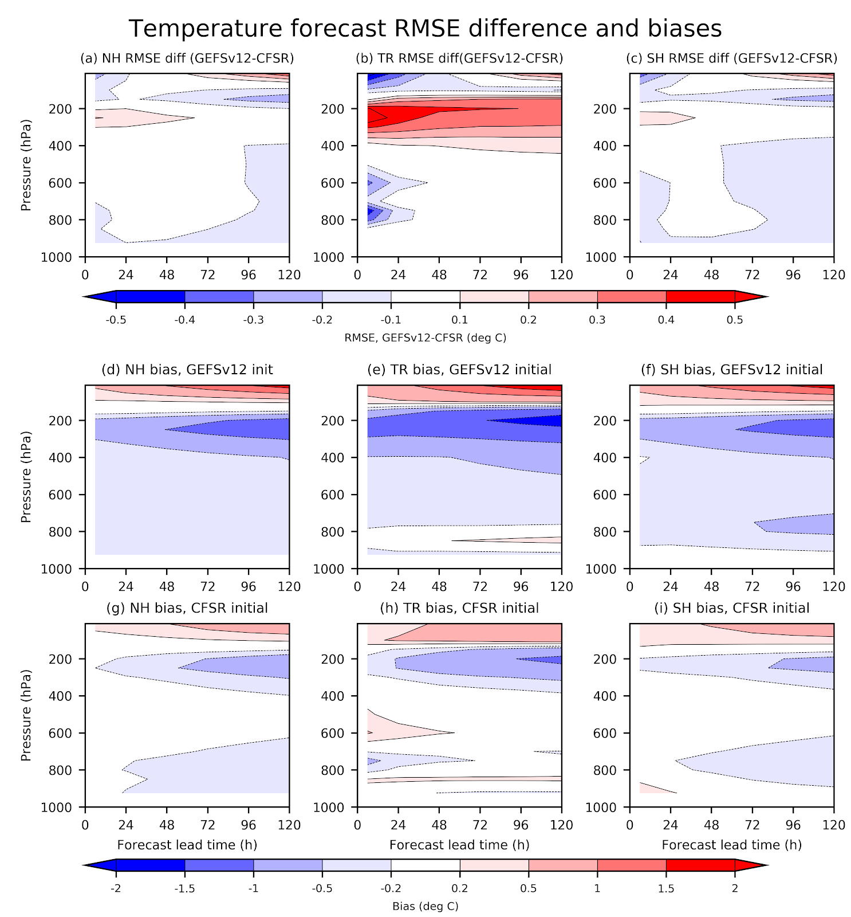
The larger bias around 300 hPa is also seen in this comparison of relative RMSE and bias for GEFSv12 and CFSR compared to ERA-Interim.
(we are working to re-do this comparison with ERA-5 as a replacement for the verification data)
Consistently, NH, TR, SH shows greater bias around 250 hPa in GEFS v12. Major changes that could possibly affect this include FV3 dycore and microphysics (Zhao-Carr → GFDL). An issue for UFS physics team?

Slide 36
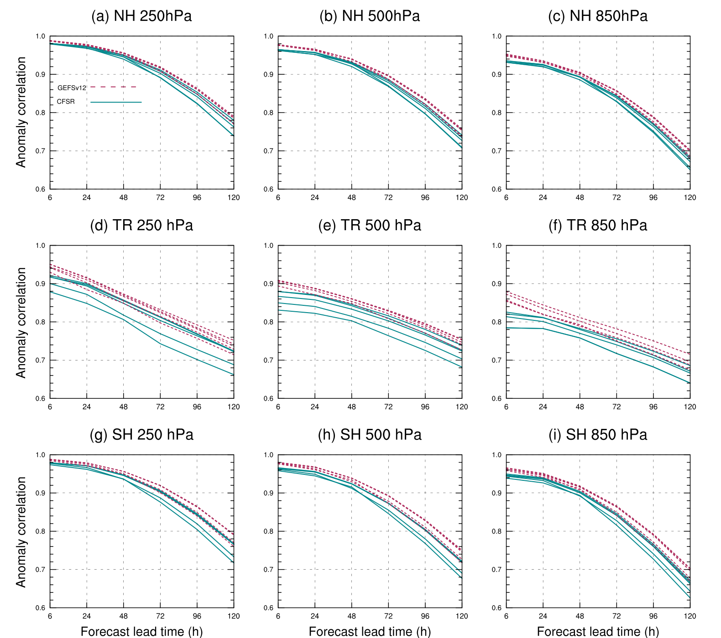
AC “dieoff” curves of
u-wind component.
Different curves for each of the different streams to illustrate temporal variability.
The improvement to forecast skill
from use of the new reanalysis
is evident everywhere, especially
in the tropics.
figure c/o Sherrie Fredrick

Slide 37
4. Accessing GEFS v12 reforecast data.

Slide 38
R/R storage update, AWS and NOAA.
Under NOAA’s “Big Data” project, ~200 reforecast fields are stored from the 2000-current reforecast in the Amazon AWS cloud https://noaa-gefs-retrospective.s3.amazonaws.com/index.html (next slide).
Reforecast (and eventually the control from reanalysis, + spread) will be stored on NOAA-owned disk, attached to the “emcrzdm.ncep.noaa.gov” computer in College Park, MD. In indefinite future we will make this data available for ftp, possibly web-interface access. Delays, given backlogs at NCEP/NCO.

Slide 39
Directory tree structure on AWS
GEFSv12/reforecast/yyyy/yyyymmddhh/pp#
  yyyy is the year, 2000-2019
  yyyymmddhh is the year-month-day-hour.
  pp# is the perturbation number.
    c00 for control
    p01-p04 for daily forecasts to +16 days lead.
    p01-p10 for the weekly reforecasts to +35 days lead.

Slide 40
Horizontal grid spacing, temporal resolution
For most grib2 files, the data are provided on a grid with a 0.25-degree grid spacing, archived every 3 hours for the first 10 days of the forecast.
Beyond 10 days, 0.50 degrees grid spacing is used.
For pressure-level data above 700 hPa, even during the first 10 days of the forecast, data are saved at 0.5-degree grid spacing in order to conserve space.
The grid proceeds from 90° N to 90° S and from 0° E to 359.75° E.

Slide 41
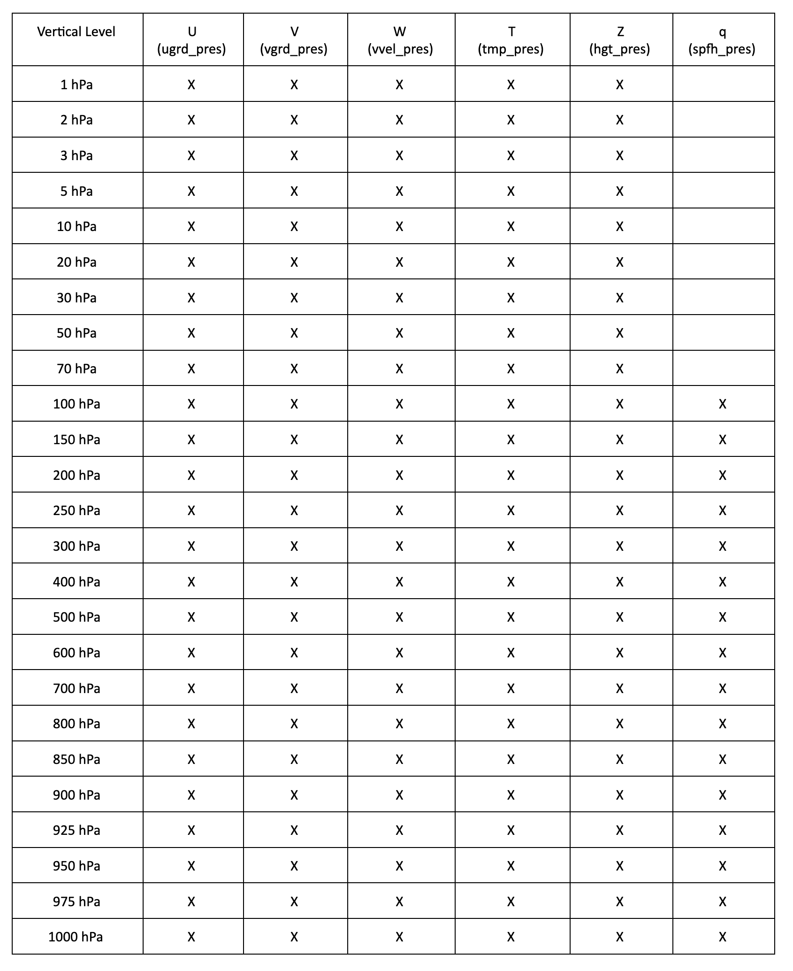
Data saved on pressure levels
Variable name in parentheses. Data is stored in different
files for at and below 700 hPa (the variable name listed below)
and above 700 hPa (with “_abv700mb” appended onto the
end of the variable name).
Individual grib files have file names such as
“variable_yyyymmddhh_member.grib2”
The variable may have names like “ugrd_pres” which, in this case, indicates that the variables stored are u-wind components (east-west) on vertical pressure levels such as the 850 hPa surface.
The “yyyymmddhh” is year-month-day-hour format, so 00 UTC 3 February 2020 would be 2020020300.
For the “member” in the grib file name, the five members for a typical day are named “c00”, “p01”, “p02”, “p03”, and “p04”. The “c00” denotes the control, and the perturbed members (with small amounts of noise added to the initial conditions) denoted with the “p##”.

Slide 42
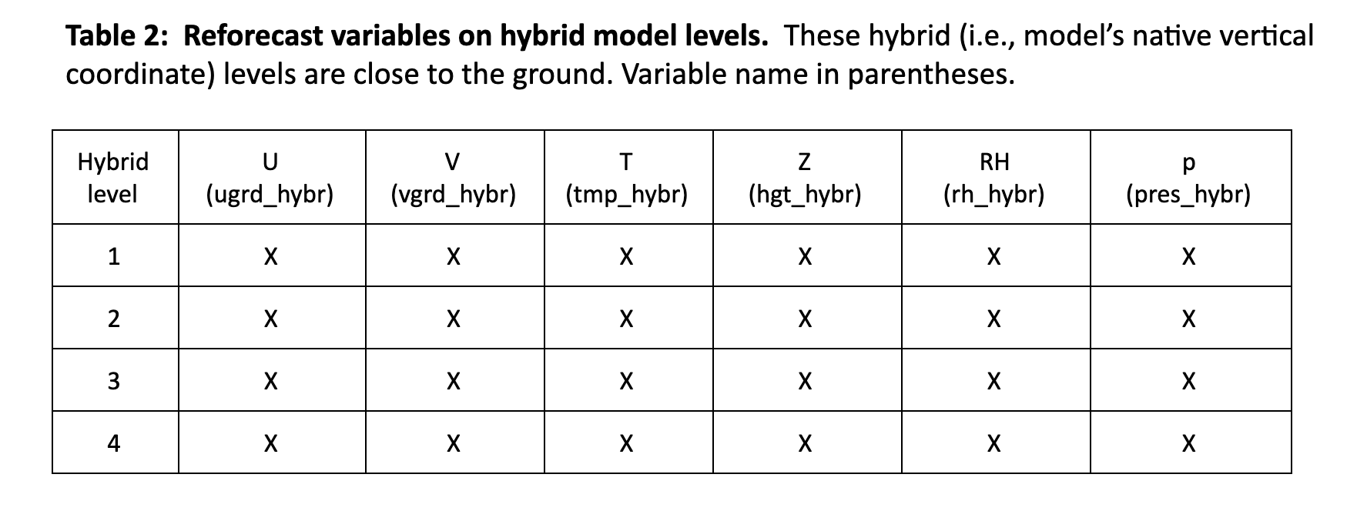
Model vertical coordinate data (near surface)

Slide 43
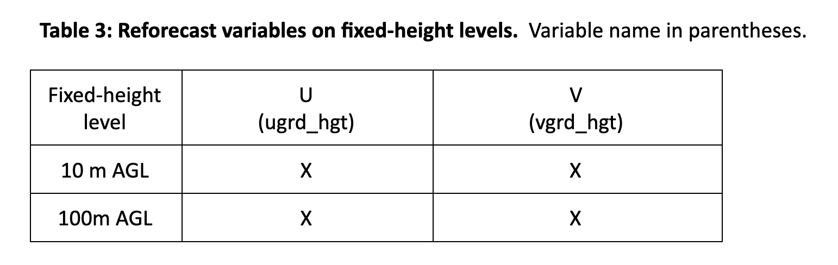
Fixed height data
… anticipating wind-energy applications.

Slide 44
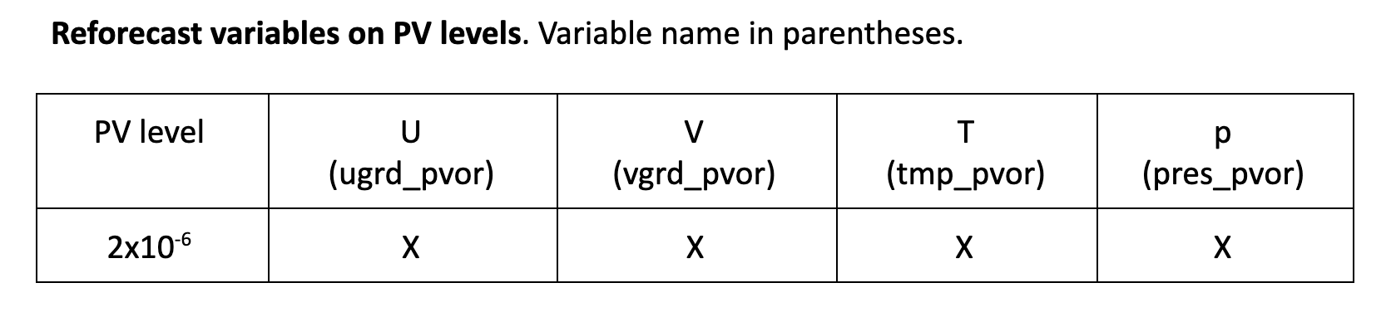
PV data

Slide 45
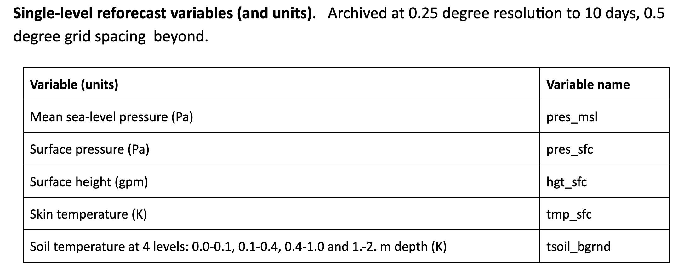
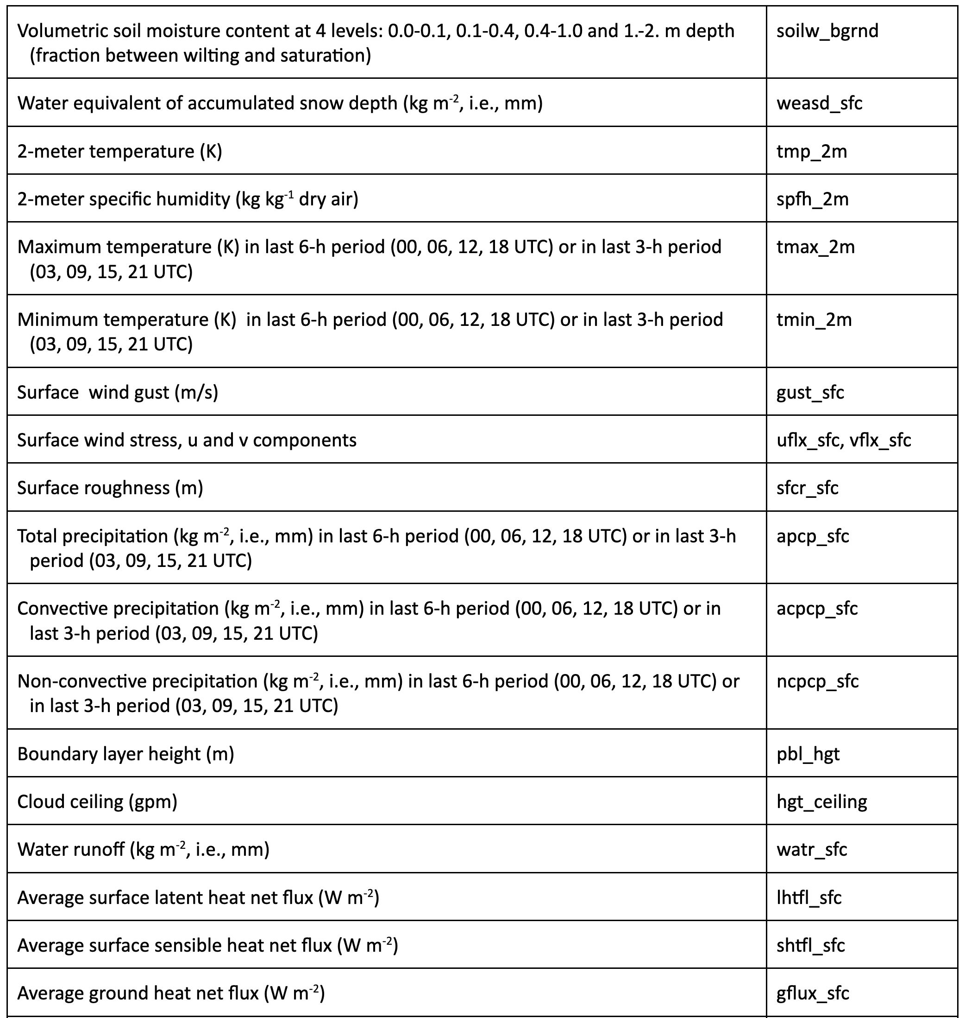
Single-level variables (page 1)

Slide 46
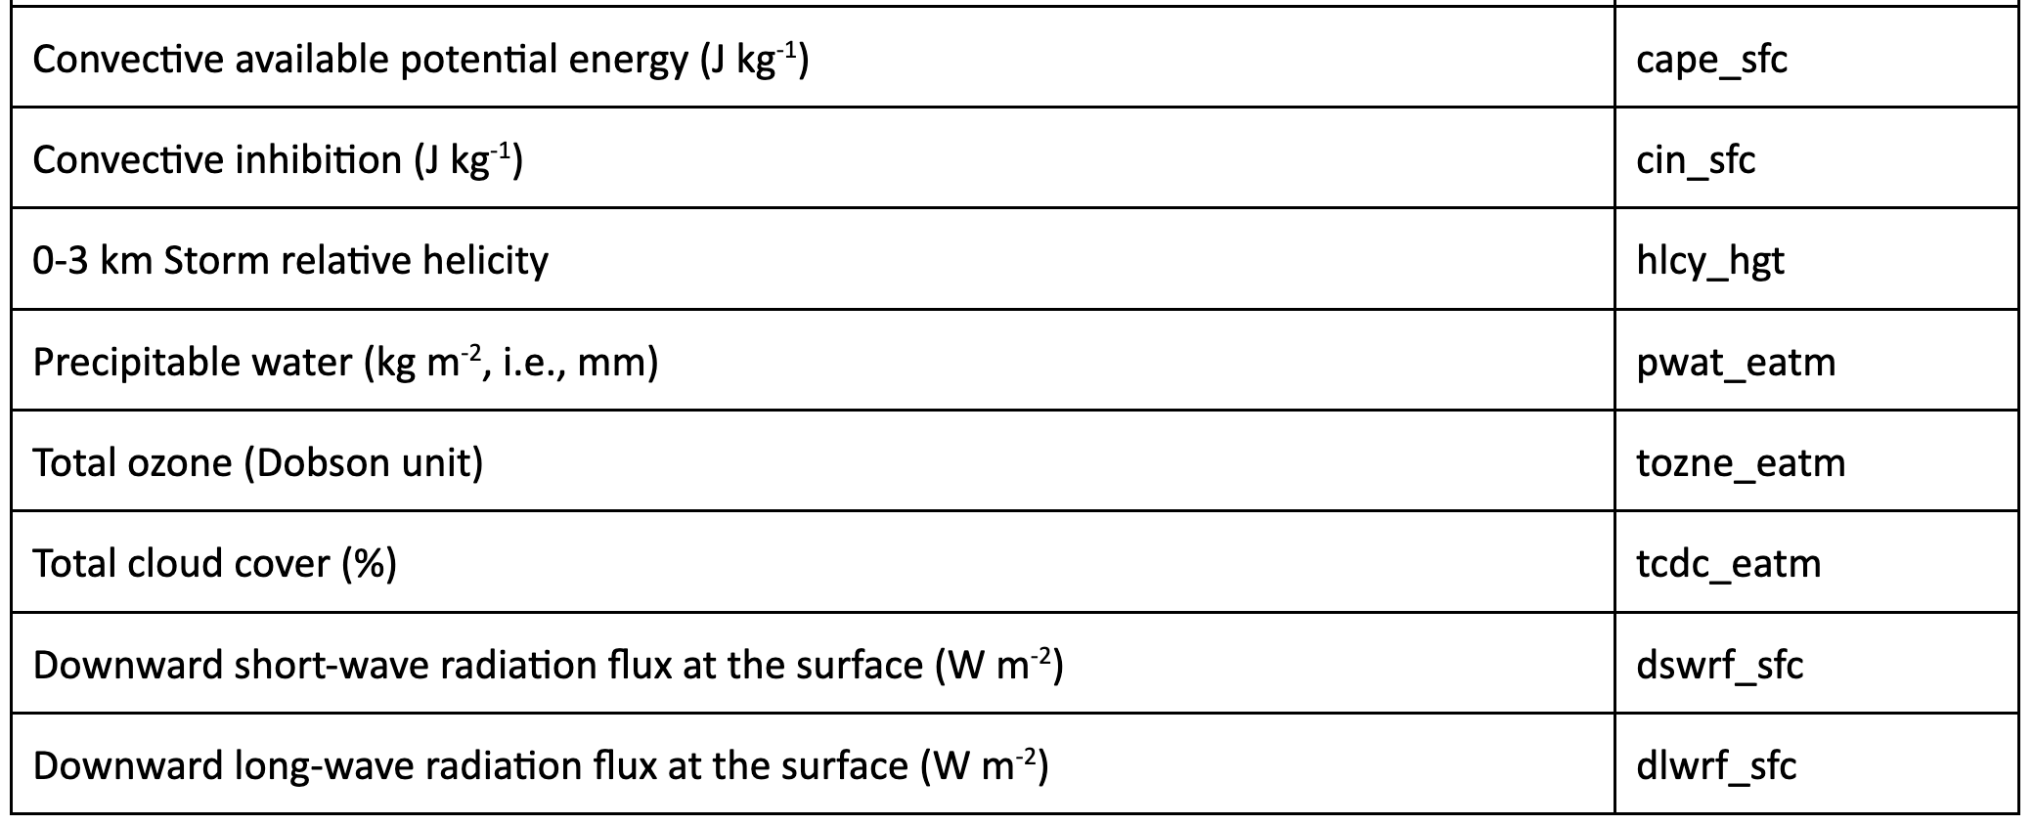
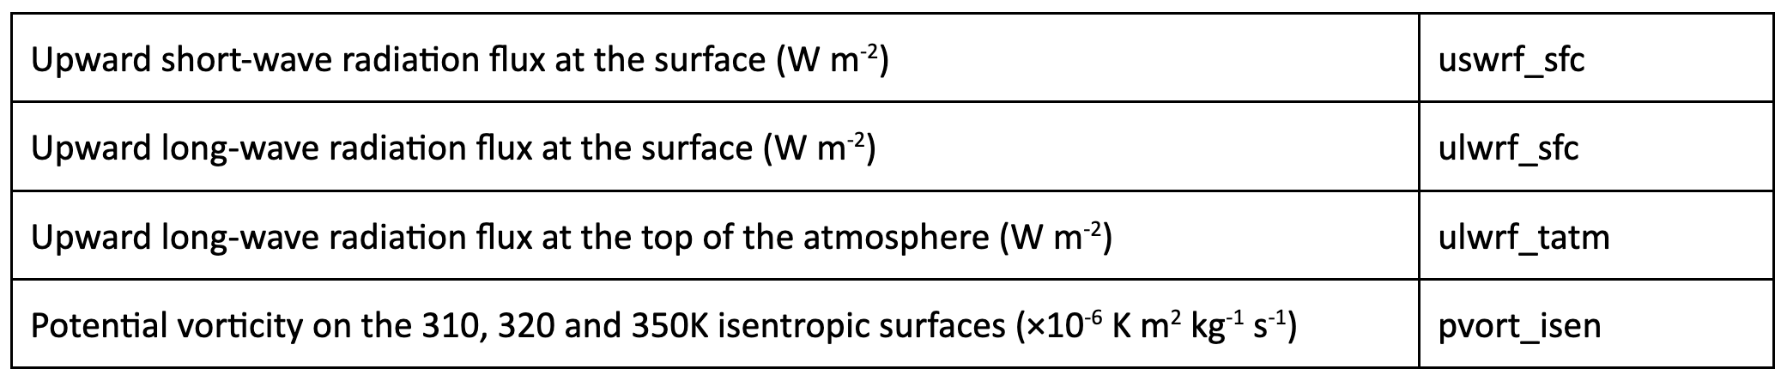
Single level variables
(page 2)

Slide 47
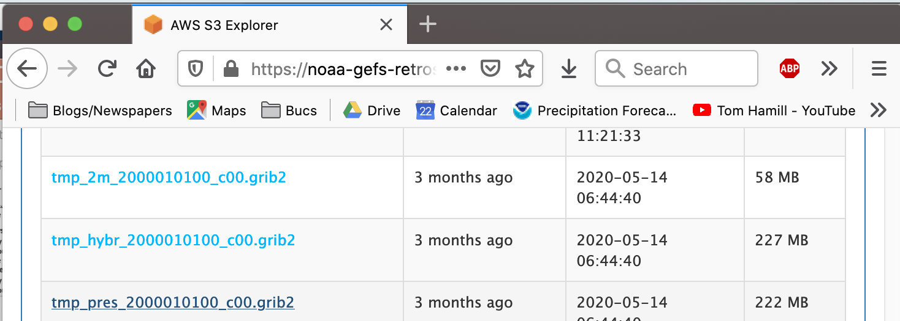
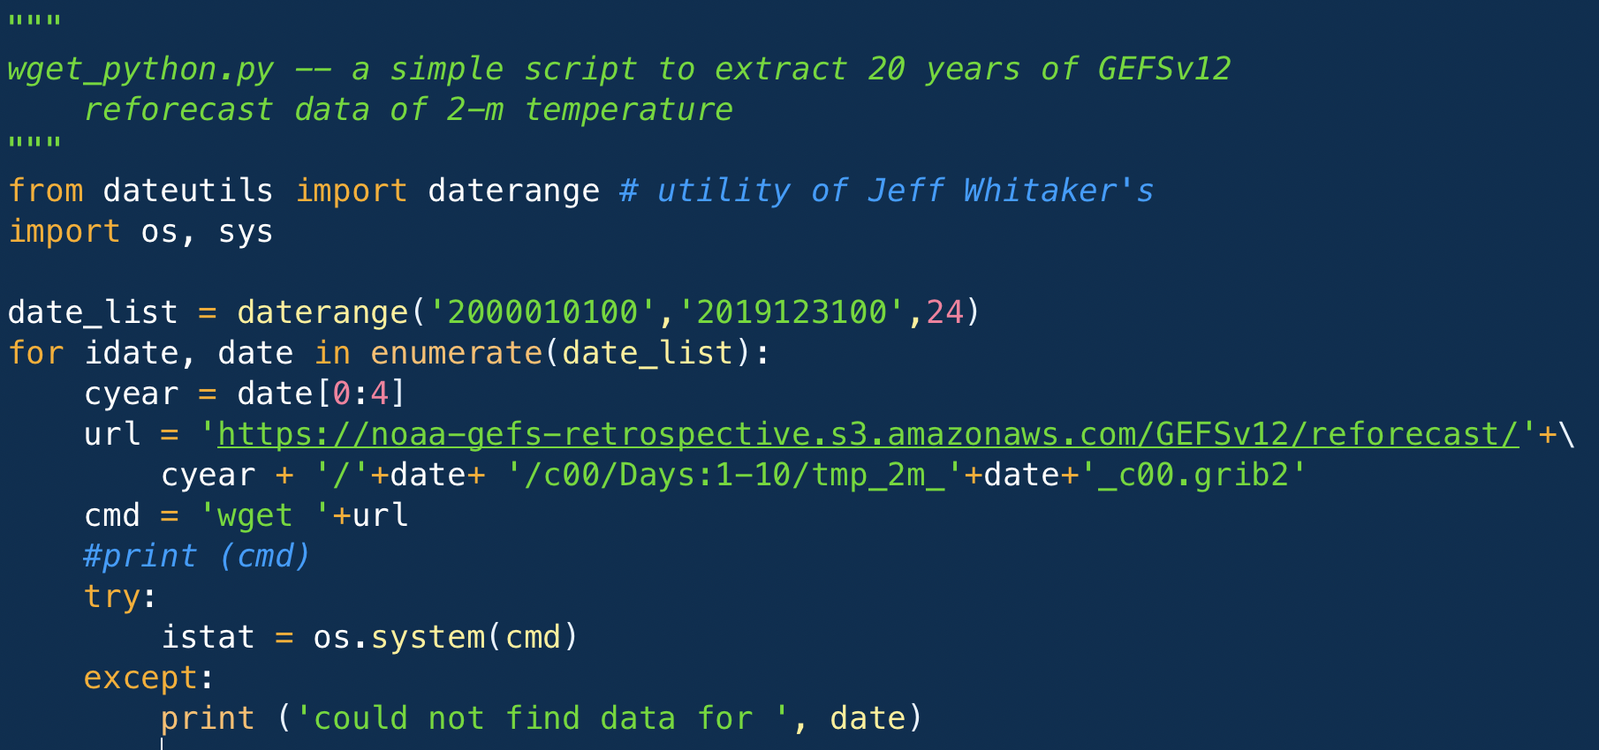
Downloading reforecast data from AWS is easy!
Start at https://noaa-gefs-retrospective.s3.amazonaws.com/index.html
you page down through the AWS directory structure and you’ll see for a particular member, year, and year/month/day,
files like this.
a simple example python script to
download 2000-2019 2-meter
temperature forecast files for
the first 10 days of the forecast.

Slide 48
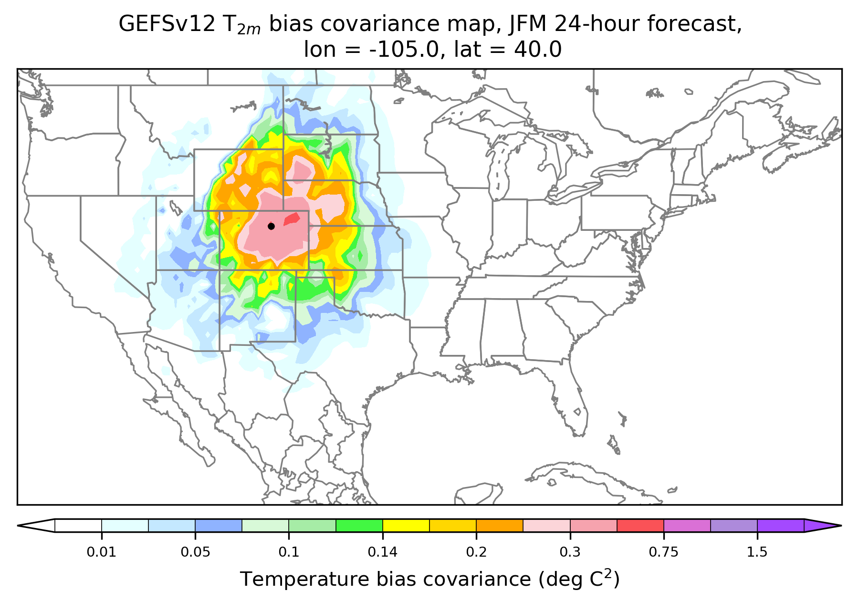
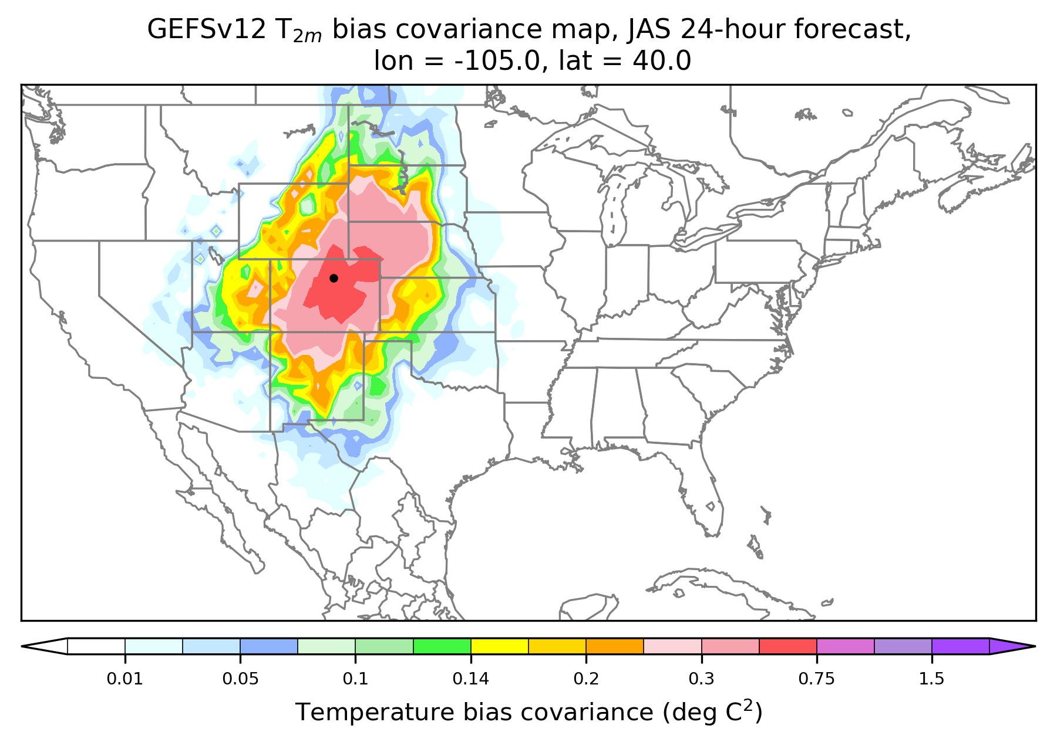
Examples: covariances of 2-meter temperature bias using GEFSv12 reforecasts

Slide 49
5. Looking to the future: GEFSv13 and beyond.

Slide 50

PSL expects to do reanalyses again, to remain consistent with major system changes.
Statistical characteristics of the (re-)analyses are likely to change significantly with increased coupling.
GEFSv12 analyses are uncoupled.
  Forecast: Ocean-state anomalies from climatology transplanted from CFSR.
  Atmosphere analyses: Hybrid 4D-En-Var; control SST background via NSST (diurnal variability)
  Ocean analysis: NSST, GODAS.
GEFSv13 likely to be weakly coupled.
  Forecast: coupled GFS / MOM6.
  Atmosphere to use ocean forecast background(s) in its DA.
  Ocean to use atmospheric forecast background(s) in its DA.
GEFSv14 likely to be strongly coupled.
  Forecast: coupled GFS / MOM6.
  Coupled DA utilizing cross covariances between state components; ocean obs make increments to atmosphere, atmospheric observations make increments to ocean.

Slide 51
A challenge with GEFSv12 reanalysis: the sequencing of reanalysis production with the operational upgrade schedule.
Personnel
spin-up
Reanalysis scout runs, configuration decisions
Reanalysis production
Reforecast
production
Developing system improvements
Reforecast
data handoff to customers
Decide final configuration, tune the system
Gen pre-prod parallels
Evaluate, decide
→ NCO
3 years
prior
2 years
prior
1 year
prior
0 year:
implement

Slide 52
A challenge with GEFSv12 reanalysis: the sequencing of reanalysis production with the operational upgrade schedule.
Personnel
spin-up
Reanalysis scout runs, configuration decisions
Reanalysis production
Reforecast
production
Developing system improvements
Reforecast
data handoff to customers
Decide final configuration, tuning system
Gen pre-prod parallels
Because of computational expense, reanalysis production
begins long before final system configuration is decided upon.
Evaluate, decide
→ NCO
3 years
prior
2 years
prior
1 year
prior
0 year:
implement

Slide 53
Surging reanalysis/reforecast in the cloud.
Potentially leveraging a cloud surge, we can wait to produce reanalyses till after next-gen configuration is more settled.
Reanalysis scout runs, configuration decisions
Reanalysis production
Reforecast
production
Developing system improvements
Reforecast
data handoff to customers
Decide final configuration, tune the system
Gen pre-prod parallels
Evaluate, decide
→ NCO
3 years
prior
2 years
prior
1 year
prior
0 year:
implement
53

Slide 54
Conclusions
GEFSv12 implementation is accompanied by new reanalysis and reforecast data.
Many v12-based postprocessing applications are in development.
  CPC is readying new 6-10, 8-14, and hazards products based on the v12 reforecasts.
  Office of Water Prediction is updating their hydrologic ensemble forecast system to leverage the new GEFSv12 data.
  PSL has a project to incorporate reforecast-based postprocessing into the “National Blend of Models.”
  S2S hurricane, week 2 fire weather, weeks 3-4 precipitation, other projects will leverage.
GEFSv12 represents NOAA’s current state of the art. Understanding its strengths helps us envision new products. Understanding its weaknesses helps determine what is needed in v13 and beyond.

Slide 55
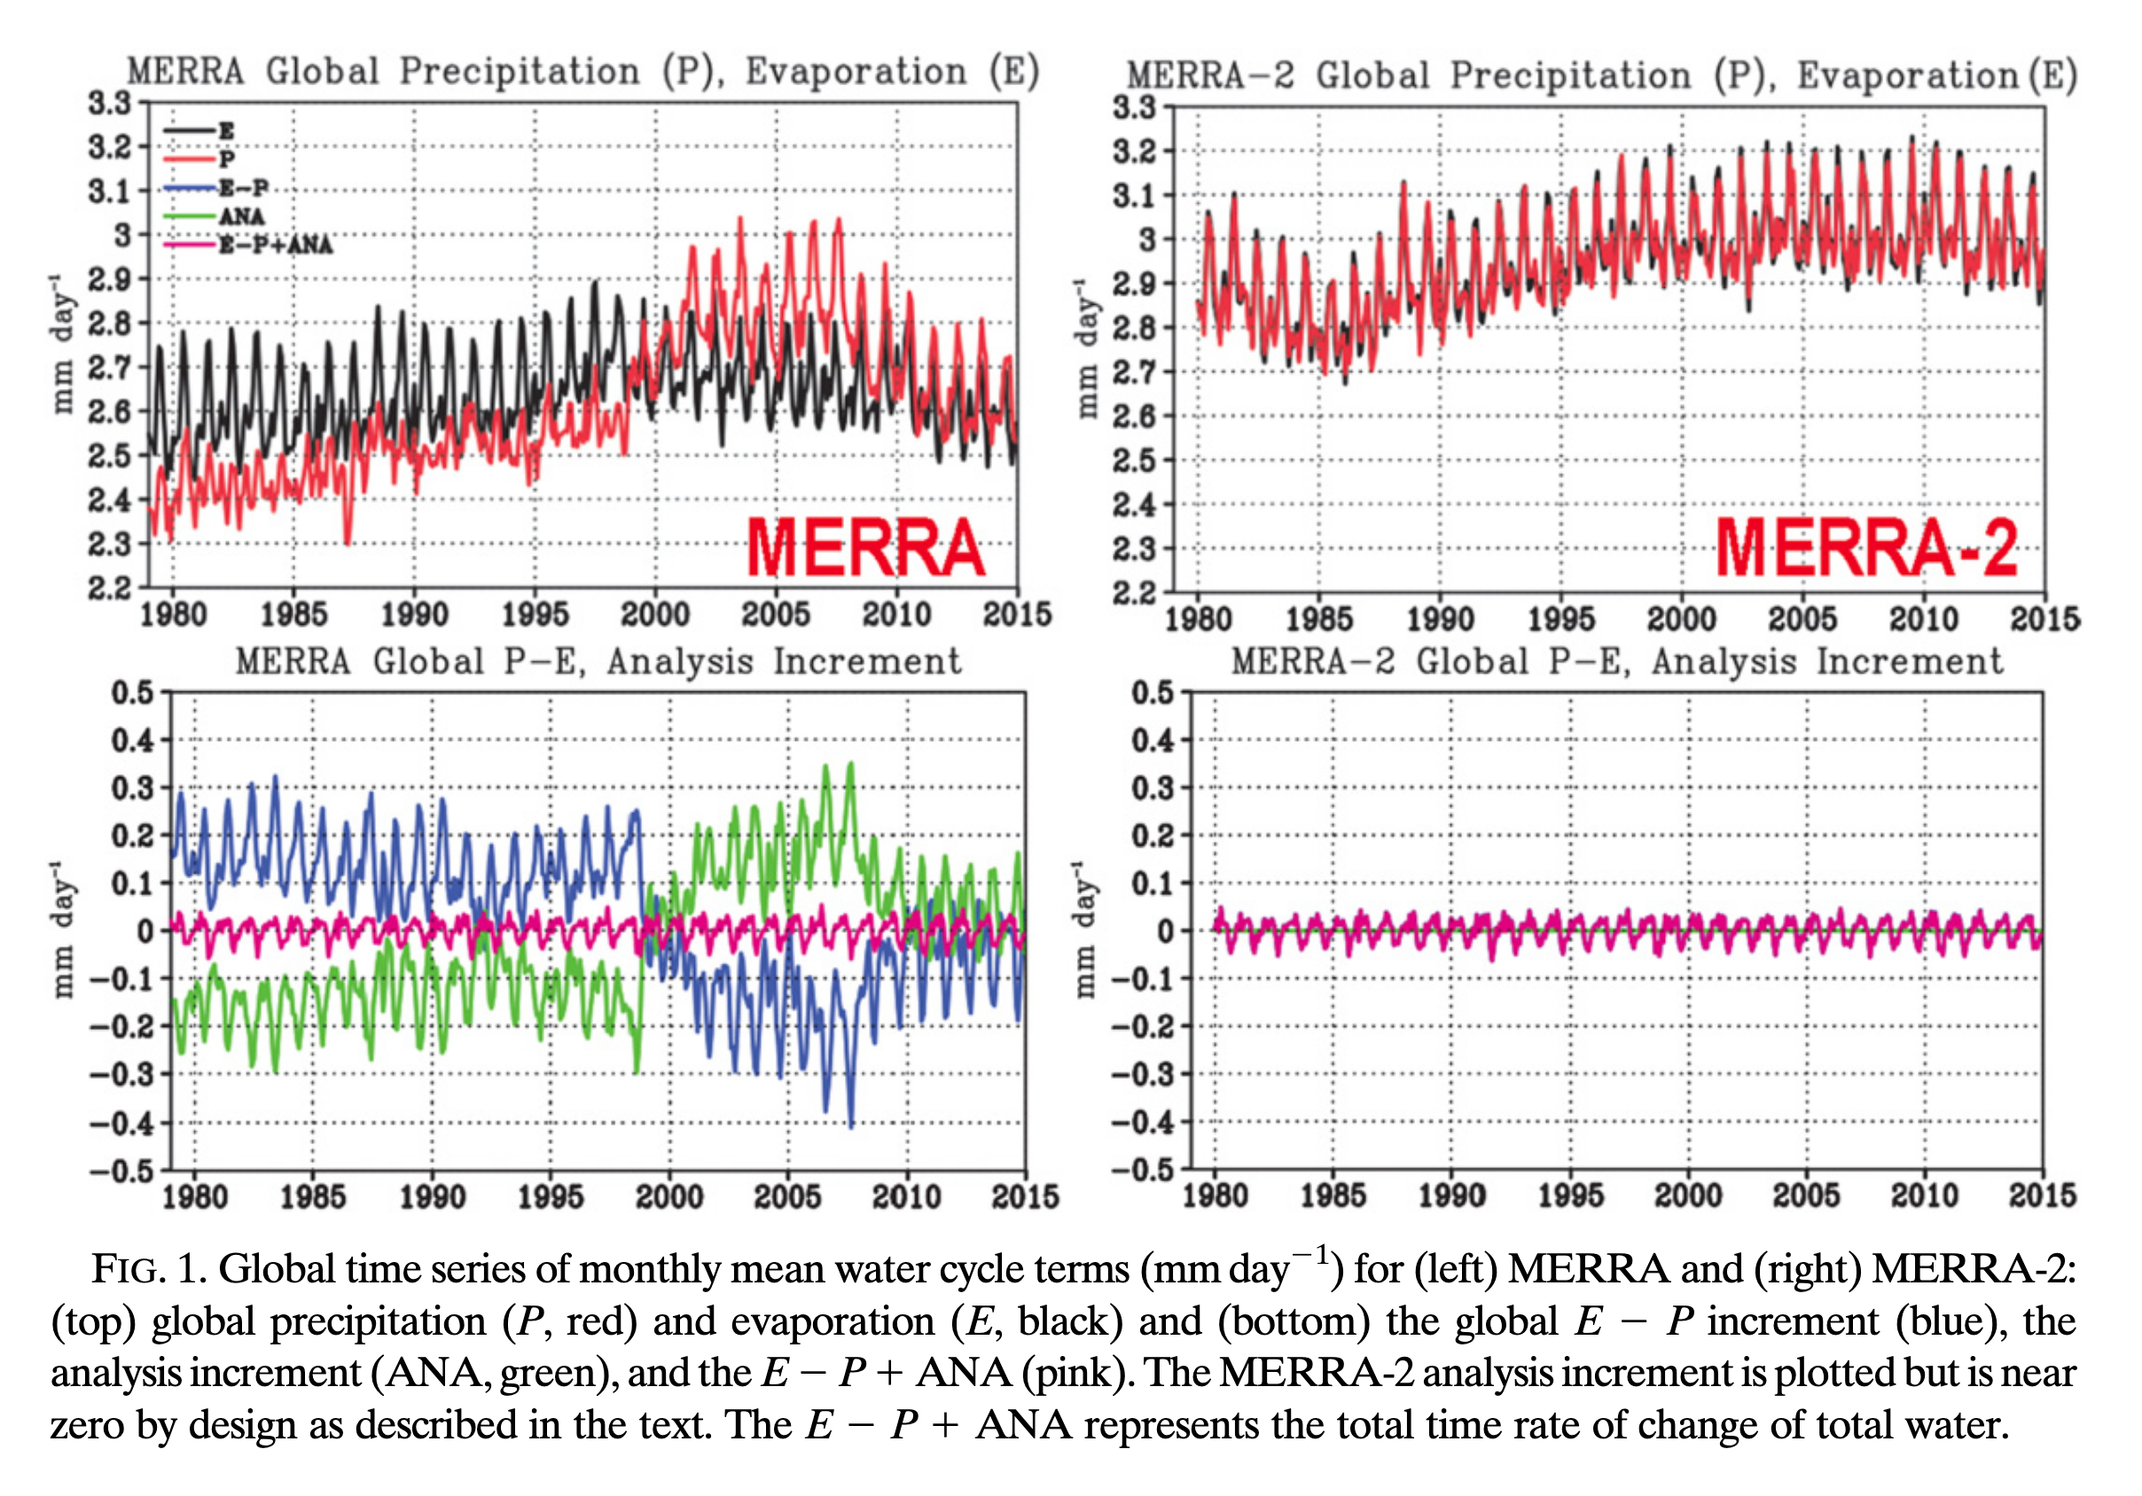
Similar figure from MERRA-2 article

