Slide 1

Briefing to NOAA leadership on recommendations for statistical post-processing
Tom Hamill (ESRL/PSD); Barb Brown (NCAR), Kathy Gilbert (WPC/OPC),
Matthew Peroutka, Dave Rudack (MDL), Yuejian Zhu (EMC)
With thanks to ~90 other participants from universities, foreign weather services, and private companies.
February 2016

Slide 2

This briefing synthesizes the recommendations from a recent workshop on statistical post-processing, held in College Park MD, Jan 2016.
It included > 90 participants from NOAA, labs, universities, other met services, and corporations.
The workshop recommendations will be used to update the NGGPS post-processing implementation plan.
The workshop also intended to inform planning for post-processing across NOAA, and facilitating post-processing in the wider weather-climate enterprise.

Slide 3
Today’s contents
Some background on post-processing.
Challenges we face with current practices.
Recommendations for how we should change.

Slide 4
What’s desired from senior leadership today.
Your feedback on the proposed recommendations.
  Silence = tacit agreement.
Feedback especially desired on:
  Proposed organizational changes.
  Issues touching on resources (staffing, compute).
  Legal issues (e.g., barriers to community collaboration).
  Extensive reforecasts desired by National Water Center.
  Context of how this fits (or doesn’t fit) with broader NWS and NOAA plans.

Slide 5
Refresher: UMAC over-arching recommendations
(UMAC is NCEP’s external production suite review committee)
Simplify.
  Fewer systems. Rate of product improvement slowed by way too many systems, many under-resourced, sometimes competing.
  Organization should concentrate on what they do best and transfer what they don’t.
Systems engineering approach to managing weather product portfolio.
  Clarify requirements, current and anticipated.
  Design the (simplest) suite of products that will address the requirements.
  Build the simplest¹ scientifically valid suite of forecast tools necessary to provide those products with high quality.
Apply best practices for scientific software development.
Evidence-based decision making.
  Data objectively and transparently evaluated.
  Agree on evaluation process, metrics for measuring success before developing the product.
¹ Simple but extensible, with flexibility to accommodate evolving requirements in mind.

Slide 6
Why the emphasis on post-processing?
Why should we consider making substantial changes in current practices?

Slide 7
Why post-process?
ensemble
members’
trajectories
t=t+Δt
t=0
To correct for systematic and random errors
in the raw numerical guidance. Using many
samples of past cases and what actually happened,
we make statistical adjustments to today’s forecast.
Systematic errors like this are all too common for
variables like temperature and precipitation.
More here.
reality

Slide 8
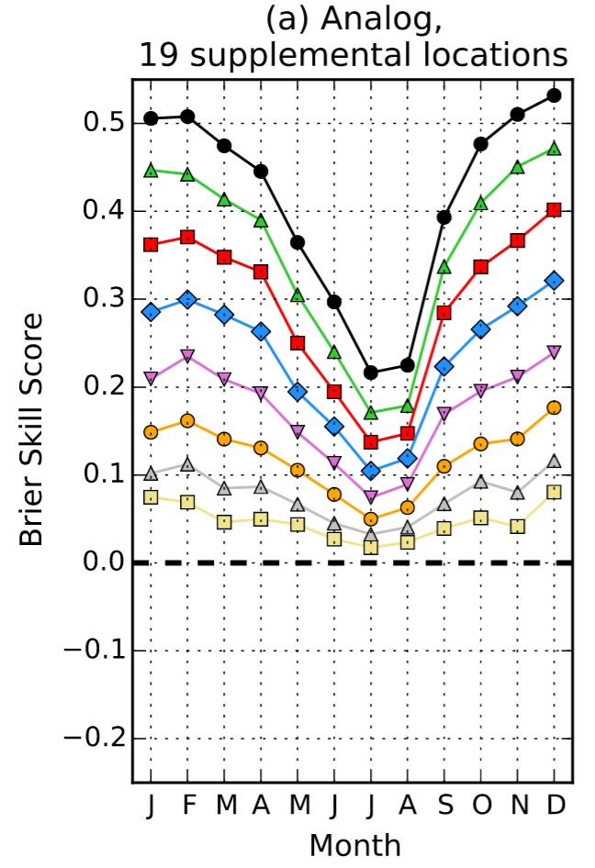
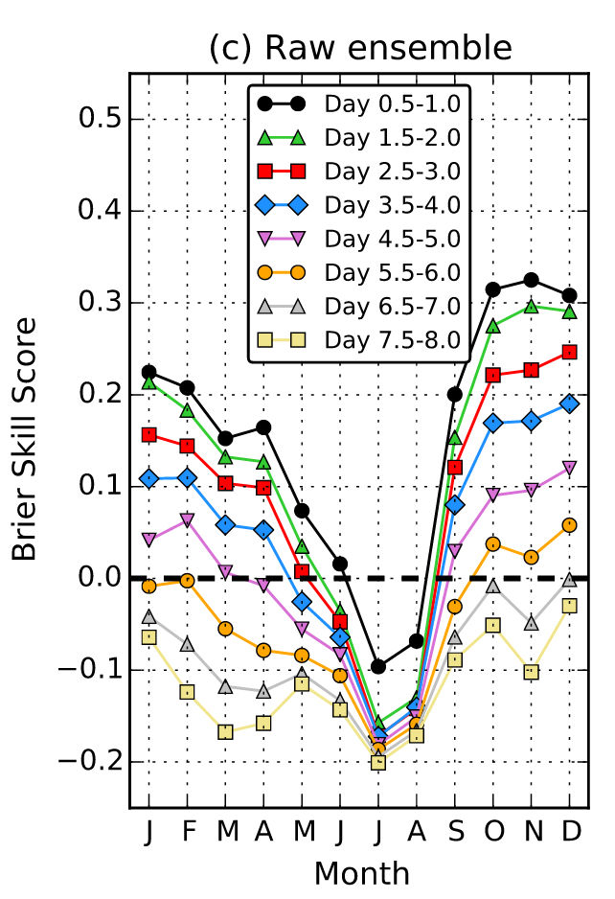
Given high-quality reforecast and analysis training data, post-processing will improve skill.
b
Post-processing of > 1-mm precipitation forecasts over CONUS from GEFS using reforecasts. Note that a 3- or 4-day post-processed forecast is of similar skill to a 1-day unprocessed forecast. With raw NWP guidance improving 1 day per decade, post-processing here thus adds value comparable to 20 years of model improvement.
Ref: Hamill, T. M., M. Scheuerer, and G. T. Bates, 2015: Analog probabilistic precipitation forecasts using GEFS
Reforecasts and Climatology-Calibrated Precipitation Analyses. Mon. Wea. Rev., 143, 3300-3309.

Slide 9
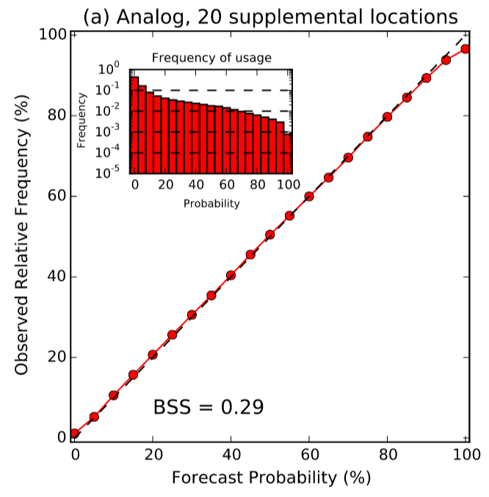
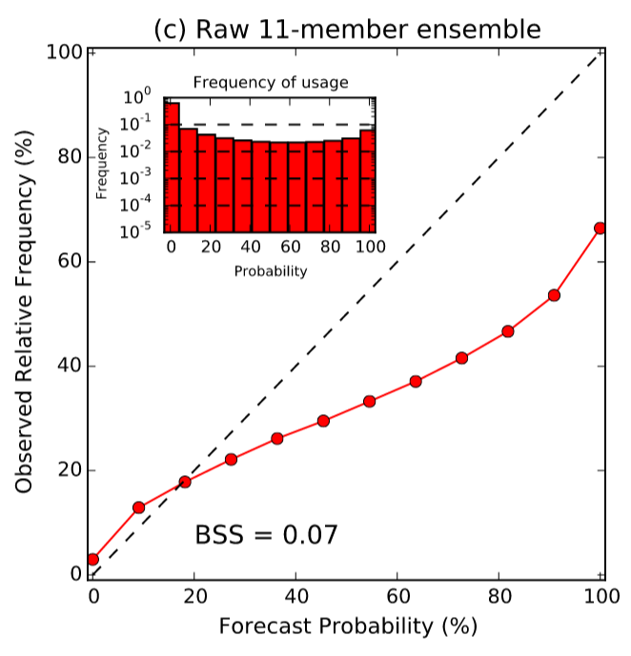
Post-processing also improves probabilistic forecast reliability.
b
Users can have confidence that the event will happen 20 percent of the time when we make a
20 percent forecast. This is important for Weather-Ready Nation decision support.
Ref:ibid.

Slide 10
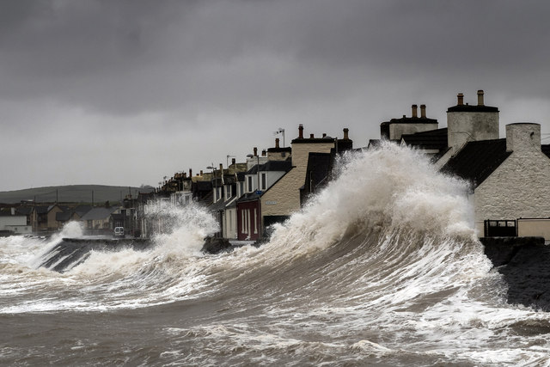
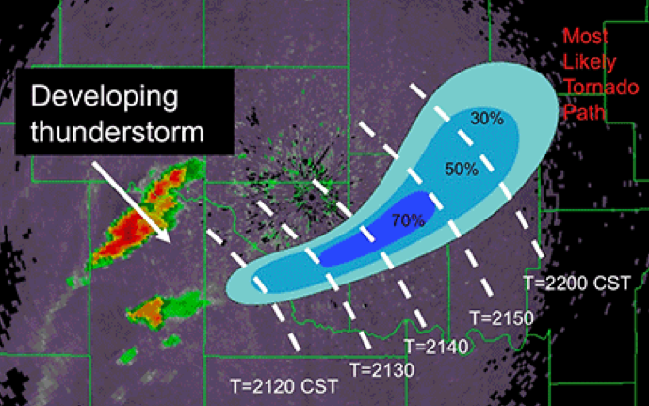
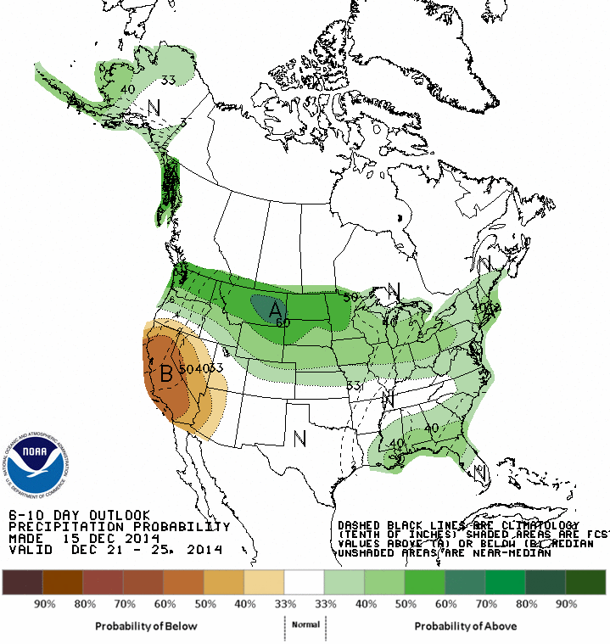
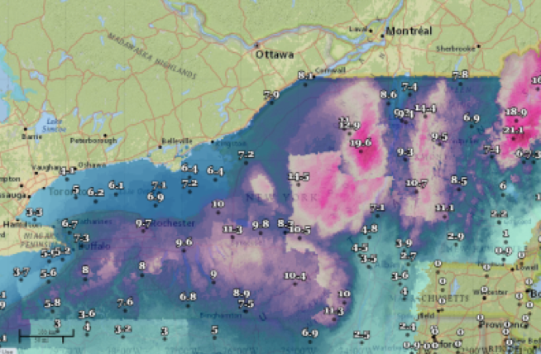
Broadening customer demand for post-processed guidance
Intensity and
storm surge
FACETS or
“Warn on Forecast”
Sub-seasonal:
extracting
signal from
systematic
error and
chaos.
Lightening forecaster
workload and improving spatial
consistency with improved
post-processed guidance –
“the National Blend of Models”

Slide 11
Post-processing challenges
Lack of community infrastructure
Organization
Note the
substantial
overlap.
Science
Getting the right data in place.

Slide 12
Post-processing challenges
Lack of community infrastructure
Organization
Science
Getting the right data in place.

Slide 13
Science challenges.
Product quality.
  Atmospheric scientists, not statisticians, have traditionally guided the post-processing development. Need both.
NOAA produces overlapping post-processed guidance using with a variety of methods. Which method is best? We don’t know.
Product quality limited by quality of input data (garbage in, garbage out).
  Reforecasts of high quality and statistical consistency are needed, but NOAA isn’t producing them regularly yet.
    Is an extensive new reforecast needed with every model change? We also need procedures for determining when the last version is sufficient.
  Post-processed skill is also limited by the quality of the observation/analysis data; higher-resolution, higher-quality reanalysis data needed for training and validation.
Few new methodologies are in place to leverage the high-quality training data we expect in the future.
  Past development was focused on shorter training data sets, and observations more so than analyses.
  More here.

Slide 14
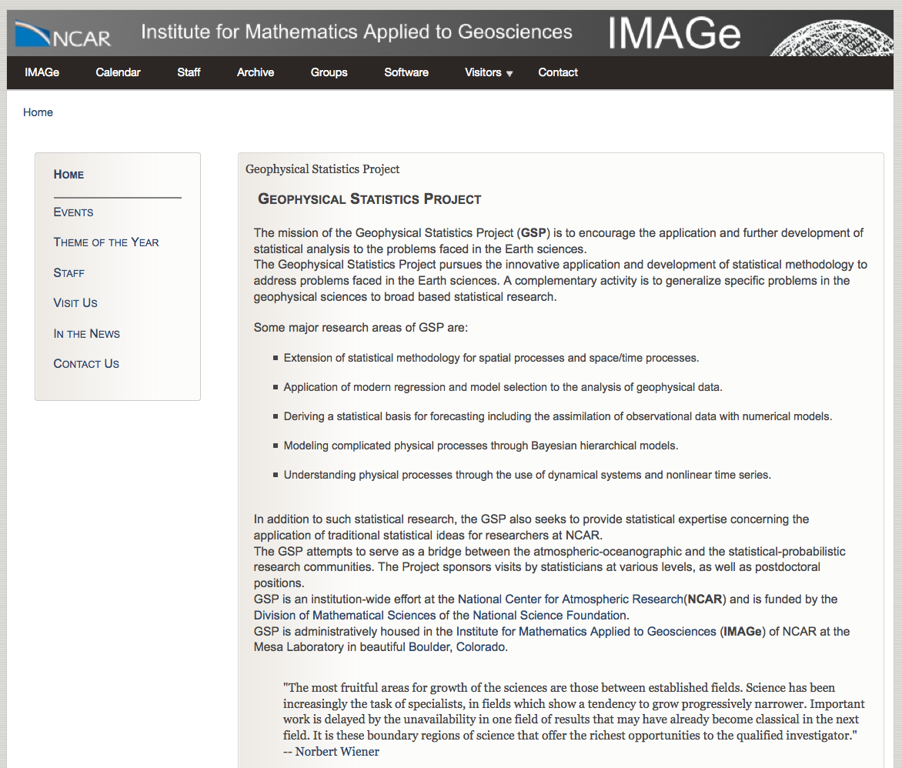
NCAR’s Geophysical Statistics Project, an exemplar for utilizing statisticians in service of atmospheric science.
Recognizing that atmospheric scientists did not always have the statistics background needed, NCAR built a staff of professional statisticians to collaborate
with the atmospheric scientists.
https://www2.image.ucar.edu/gsp

Slide 15
Overlapping products: which is the preferred underlying methodology?

Slide 16
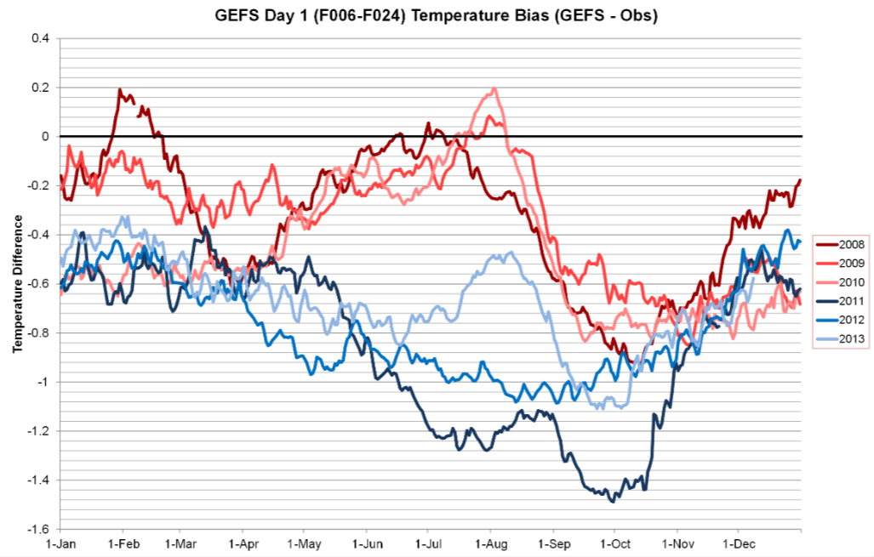
Garbage in, garbage out: bias inconsistencies in reforecasts introduced by a change in the data assimilation.
After a modest change in the model resolution used in the data assimilation between
2010 and 2011, the GEFS v10 reforecast bias changed significantly.
c/o Mike Charles and Melissa Ou, CPC; see http://www.esrl.noaa.gov/psd/people/tom.hamill/White-paper-reforecast-configuration.pdf

Slide 17
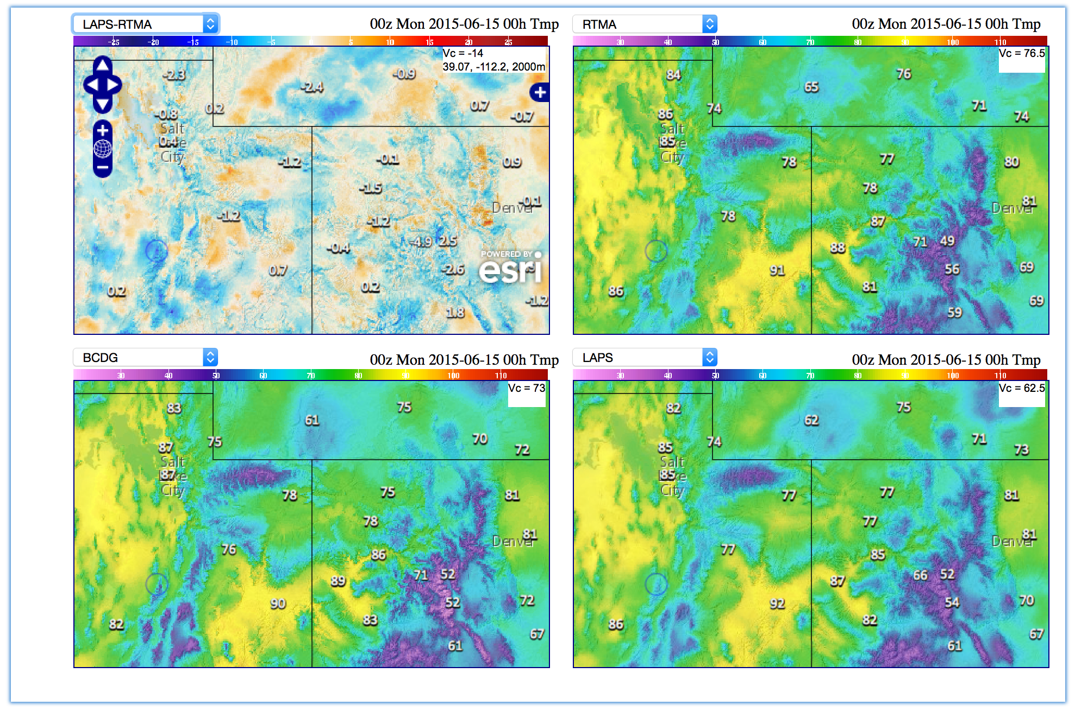
Post-processing product skill will be limited by the quality of training data.
Example: uncertainty in T_{2m} analyses used in the National Blend of Models project.
14 degrees F different!
Upper left shows the differences between two surface-temperature analyses. The methods are broadly similar; the main difference is that different forecast models provide the first guess in each. When the first guess is different and surface observations are sparse, the analyses are likely to be lower in quality.
From (internal NOAA) http://www.mdl.nws.noaa.gov/~blend/blender.prototype.php

Slide 18
Post-processing challenges.
Lack of community infrastructure
Organization
Science
Getting the right data in place.

Slide 19
Organizational challenges.
  Customers want high-quality, seamless forecasts. Our organizations don’t collaborate as much as they should, producing duplicative products that are not seamless and which could be higher in quality.
  Also, NWS has requirements/requests for many new post-processed products, but staff are maintaining the many existing (duplicative) ones.
Existing post-processing infrastructure is complex and hard to maintain.
  Loss of productivity as we engineer around 20-year old software.
  Not set up for new era of archiving reforecasts and making that data readily available to developers, inside and outside NWS.
R2O is very difficult and is not served by current organizational paradigm (discussed more in community infrastructure).

Slide 20
Post-processing challenges.
Lack of community infrastructure
Organization
Science
Getting the right data in place.

Slide 21
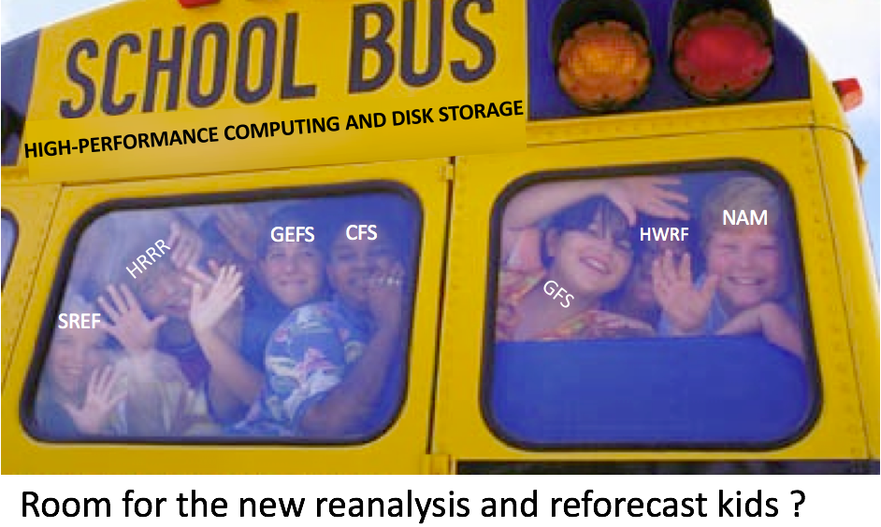
Data challenges (1): Need HPC plan for routine reanalysis, reforecast.
Need their regular production reflected in requirements for future HPC purchases (and EMC staffing).
Here are EMC’s plans. Resources for getting started have been cobbled together (NGGPS, CPO).
Prediction system | Implementations every … | Forecasts for lead times to: | Reanalysis / reforecast length
GFS (Global Forecast System) | ~ 1 year | ~ 1 week | a few years
GEFS (Global Ensemble Forecast System) | ~ 2 years | ~ 1 month | ~ 2000 - current
CFS (Climate Forecast System) | ~ 4 years | ~ 1 year | 3 or more decades

Slide 22

Data challenges (2): easy sharing.
Reforecast, real-time forecast, and hi-res. analysis data need to be made readily available to developers.
  able to be read into post-processing algorithms quickly (i.e., modern data formats, storage of crucial data on disk, not tape).
  readily accessible by OAR, university, and corporate partners.

Slide 23
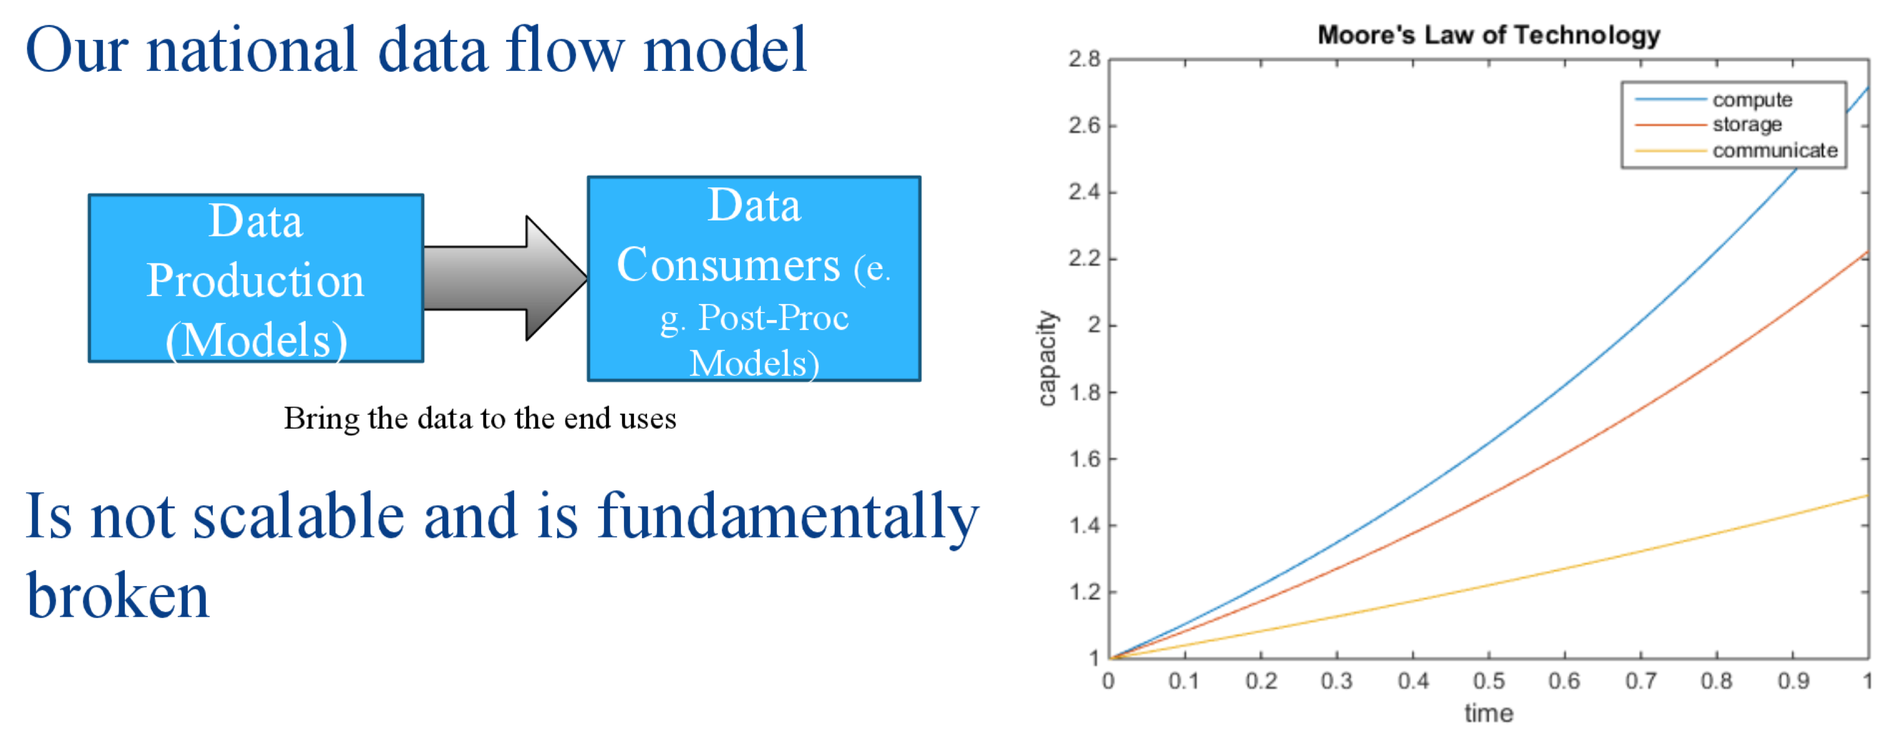
Data challenges context: moving data around is getting harder.
A data storage plan that’s convenient for NWS internal development may not be convenient for broader NOAA, industry, academia, or inter-governmental collaboration.
Performing the post-processing development on different systems from the production of data will cause even greater challenges in the future, as CPU increases faster than disk and communication.
slide c/o Peter Neilley, the Weather Company

Slide 24
Post-processing challenges.
Lack of community infrastructure
Organization
Science
Getting the right data in place.

Slide 25
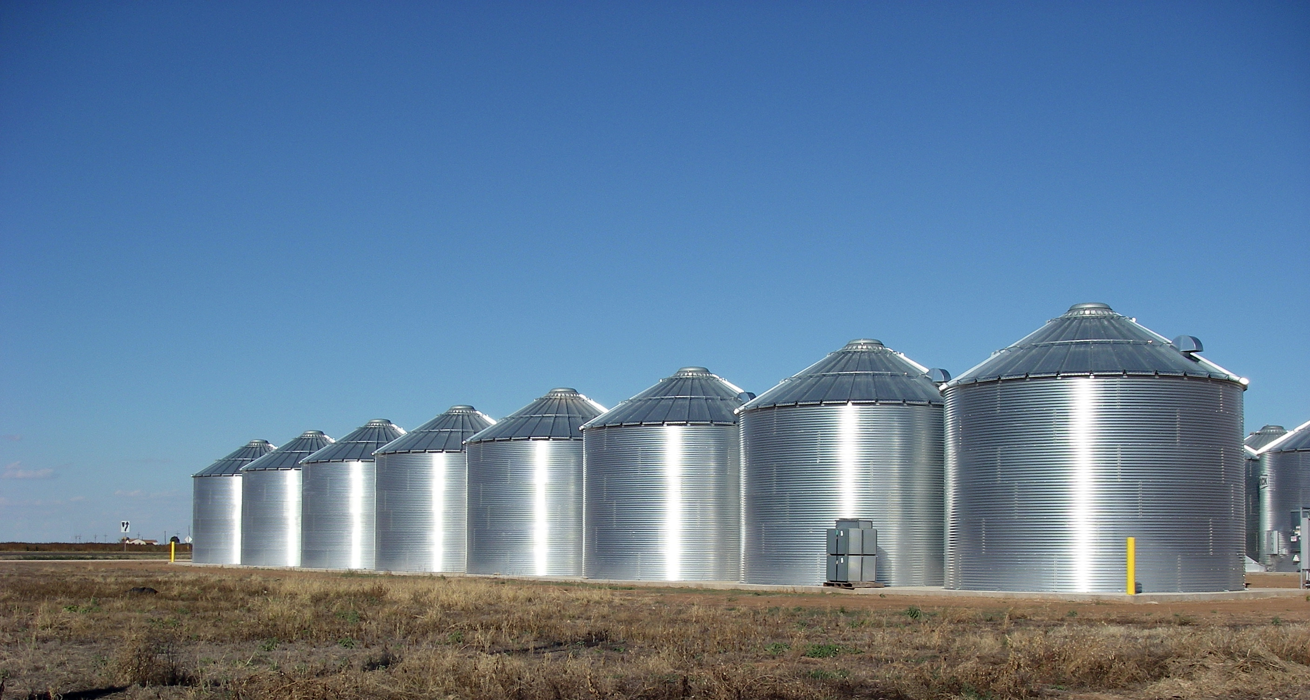







Little sharing of post-processing software and test data.
OAR
(Mostly) unconnected silos of software development; hard to find each other’s code; sub-standard documentation;
unclear policies on NOAA use of GitHub and other public repositories; lack of modern version control; training data hard to get.

Slide 26

Sharing software is easier than ever.
The tools are available to make co-development much easier and faster, to facilitate inter-comparisons.
Workshop participants strongly encouraged community source development model.
Strong push in this direction from international and private-industry partners.

Slide 27
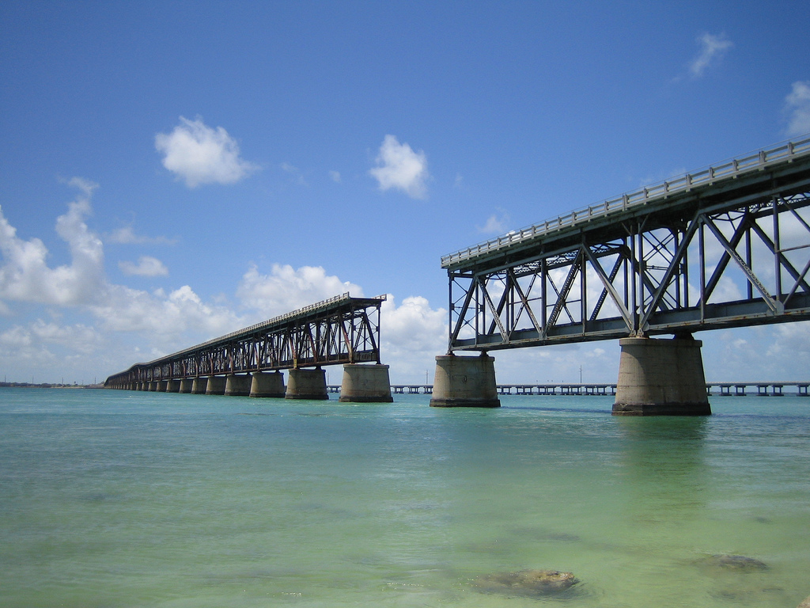

Consequence of current paradigm:
Software development and transition
“bridge of death.”
OAR
Runs on the operational WCOSS system.
Developed on WCOSS also to facilitate implementations.
Coded to internal data formats like “TDLPack”
Source code is highly protected.
Not on WCOSS, on other platforms, e.g. desktops.
Coded to read other formats, e.g., reforecasts packaged into netCDF files.
Software not under strict protections.

Slide 28
What will success look like?
High-quality numerical guidance with significant value added through post-processing, enabling rapid evolution of the NWS toward Weather Ready Nation goals.
  The necessary data sets readily and widely available to support high-quality post-processing.
  Use of this high-quality data throughout the organization.
  The best science reflected in our products.
  World-class staff working on the most important problems.
  Rapid adoption of great ideas, including from outside NOAA.
  An infrastructure that facilitates the development of a robust post-processing community outside of NOAA, facilitating improved R2O.

Slide 29
Recommendations provided for these topics:
Improving NOAA’s post-processing science.
Organizational changes.
Building a community infrastructure.
Putting the data in place.
Potential cost savings highlighted in RED.
Risks in PURPLE.

Slide 30
Improving the science (1). Hire experts.
Hire ~4 professional statisticians to work with atmospheric scientists.
  UMAC recommended 4 Ph.D.-level statisticians at MDL.
  Interim measure: summer visitors from prominent university programs.
  Existing staff will be more productive with oversight.

Slide 31
Improving the science (2)
Develop and deploy a consolidated post-processing code base to produce “foundational” guidance spanning time scales.
  Perform systematic comparisons of existing and proposed algorithms.
    Determine parameters (e.g., precipitation) where unified code possible.
    Define the methods of evaluation before seeing results.
    Re-code the best algorithm(s) so that they can be applied broadly across prediction systems and time scales.
    Test for CPC, MDL, WPC, EMC, etc. applications.
    Decide.
    Optimize performance.
    Deploy.
  Improved software maintainability can lead to a more efficient use of resources throughout the organization.
  More seamless products, increasing NWS credibility with customers.

Slide 32
Improving the science (3): data generation.
Generate high-quality reanalysis and reforecast data, and generate them regularly.
Generate high-quality, high-resolution analysis data.

Slide 33
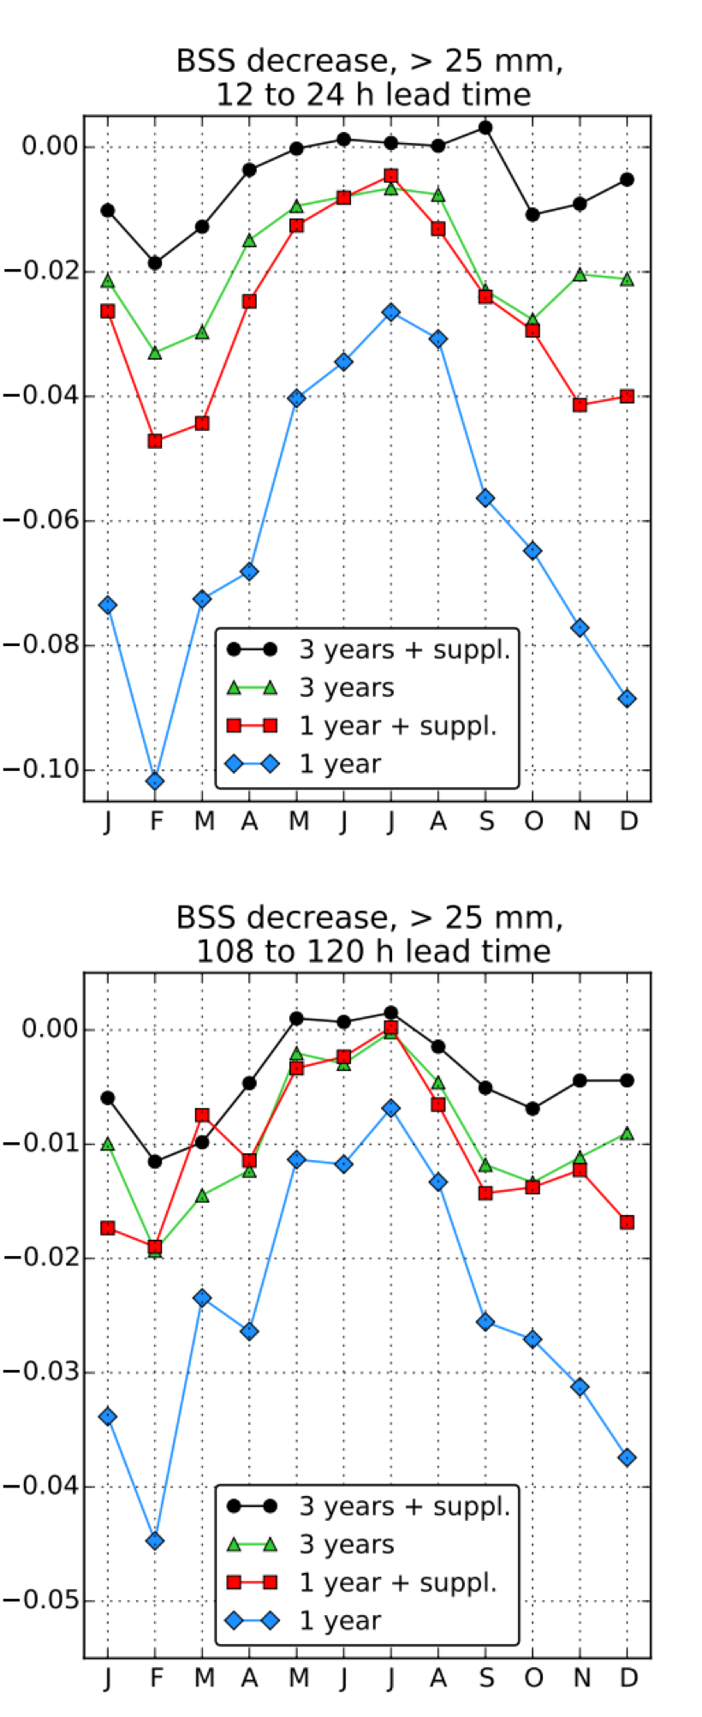
Improving the science (4): determine how to do more with less (fewer reforecasts).
After we determine which post-processing method is preferred, we should explore algorithmic modifications that will allow us to generate post-processed guidance with reduced training data sets, i.e. shorter-duration reforecasts (to minimize reforecast computations/storage).
Example: the baseline skill for precipitation forecasts is one trained with 11 years of reforecast data. Its reference skill is 0.0. The degradation in skill with lesser training data is shown here.
3 years of data leveraging “supplemental locations” [more here] produces skills that are only marginally worse than 11 years without supplemental locations.
Note: this doesn’t address National Water Center requests for larger reforecasts to support validation of unusual events (still an issue).
from Scheuerer, M., and T. M. Hamill, 2015: Statistical post-processing of ensemble precipitation forecasts by fitting censored, shifted Gamma distributions. Mon. Wea. Rev., 143, 4578-4596. Also appendix A and appendix B and appendix C..

Slide 34
Organizational recommendations: (1)
Improve the procedures for defining statistical post-processing requirements, following UMAC recommendations.
Develop a 5-year NOAA strategic plan and roadmap for post-processing. Use it.
  Risk: many such plans in NOAA in past haven’t been executed.

Slide 35
Organizational recommendations (2):
Re-engineer the post-processing support infrastructure, such as the archival of training data. [i.e., “WISPS” -- underway at MDL].
  Create requirements and guidelines for meta-data for forecasts, reforecasts, and post-processed data.
  During development, must also maintain current system.
  Reduced software maintenance cost down the road.
Develop a community support infrastructure. Leveraging developments elsewhere → more rapid product improvement. Options:
  Cross-organizational team with strong MDL presence to build and maintain a community hub for software, test data, verification.
  New NOAA test bed for post-processing could assume this responsibility.

Slide 36
Organizational recommendations: (3)
Provide resources to train staff in software best practices and modern languages.
  Scientific best practices: see, e.g., http://software-carpentry.org/
  Much more rapid long-term rate of software improvement.
  Short-term decrease in productivity while training.
Management should reward collaboration, reward streamlining of products across organizations.

Slide 37
Organizational recommendations (4): proposed reorganization possibilities
(not mutually exclusive).
Continue distributed post-processing development, but with strong governance and oversight, i.e., a post-processing leader and science steering committee.
MDL becomes the NOAA center for production of the base post-processing elements. Move duplicative product development from other organizations to MDL (with augmented / reallocated MDL staff).
New post-processing testbed for accelerating R2O, testing advanced techniques.
  Many configurations possible.

Slide 38
Reorganization advantages, disadvantages.
Proposed change | Advantages | Disadvantages
Distributed post-processing development, but with strong post-processing governance and oversight. | • Minimal disruption to existing organizations. • Better coordination, reduction in duplication → more seamless products. | • What if organizational leaders have different vision and priorities from those providing oversight?
Post-processing test bed (from virtual to physical test bed). | • Some positive examples with other testbeds of accelerated R2O. | • Return on past investment in test beds mixed. • Many of greatest post-proc needs not in the middle of R2O funnel, where testbeds flourish. • With community infrastructure and visitor program, importance of physical test bed lessened.
MDL as hub for post-processing development. | • Makes organizational roles more clearly defined, reduces duplication → more seamless products. | • Federal employees hard to move. • New expectations from MDL will require new resources there.
Senior staff should express their preferences.

Slide 39
Community infrastructure recommendations (1): Build a community repository, and …
Establish modern, widely-utilized distributed version control system to facilitate R2O and O2R¹.
  Git and GitHub are established industry standards, but NOAA has investment in VLab, which makes non-NOAA community participation more difficult.
  Potential tiers in the repository following Auligné (JCSDA) suggestion:
    inner: NOAA, closely maintained;
    middle: undergoing testing for eventual transition to ops;
    outer: with comparative ease for external collaborators to use and modify.

Slide 40
Community infrastructure recommendations (2)
Establish governance plans to enable groups to work together and methods of making decisions¹.
  Institute a ticket-tracking system to monitor requested product improvements and their disposition.
  Establish process and allocate resources to manage incorporation of internal and external code contributions into the main repository, i.e., a change control board.
Establish requirements for metadata, tests, and documentation¹.
Establish common vocabulary and use it¹.
Establish a centralized location for documentation and data access (e.g., data.gov). Focus on a few core documents¹.
Leverage work already done by 18F (digital government), as well as work with them on creating guidelines and standards¹.
Work with the community to determine two or three modern common data formats that should be used (e.g., netCDF, HDF, geoJSON) that will satisfy operational, research, collaboration, and archival purposes¹.
Provide assistance to collaborators¹.
¹ Tom Auligné calls this “entropy management” for his proposed data assimilation code refactor, and envisions a team to govern this; we suggest something similar.

Slide 41
Data and infrastructure recommendations: (1)
Incorporate reforecast / reanalysis production into future HPC, storage planning.
NOAA should post-process and make readily available “foundational data” for use in NOAA and across the broader enterprise.
  Foundational data: variables like 2-m temp, precipitation, others in NDFD.
  Private companies heavily use NOAA post-processed guidance.
Quality global data sets (reanalysis, reforecast, post-processed, satellite, radar, point data) should be made easily accessible, if possible.
  Via public servers and/or cloud.
  Risks: computational expense, questionable quality in data-sparse regions.

Slide 42
Data / community infrastructure recommendations (2):
Explore alternative community storage paradigms, including:
Create an area where data can be accessed and processed by internal and external collaborators easily, including international collaborators.
Convenient workaround for storage, I/O bottleneck, especially for corporate partners.
Risk: can security concerns be addressed?
NOAA
high-performance
computing
R/W
Disk and tape
storage of the
massive datasets
R
Private computing
resource for
post-processing
R/W
smaller, value-
added datasets,
easier to transfer
proposal inspired by Peter Neilley, the Weather Company, following UK Met Office paradigm.

Slide 43
Data and infrastructure recommendations: (3)
Follow up the workshop with a structured survey of post-processing product developers to make sure we are saving on disk the relevant predictor information.
  Some notes on preliminary survey are in the supplementary slides.
Requirements for products should incorporate predictability considerations.
  Example: production and storage of day +7 hourly precipitation forecasts at 1 km not warranted.

Slide 44
Next steps.
Incorporate your feedback.
Update NGGPS implementation plan.
Write a broader NOAA post-processing implementation plan (?)
  Who writes? Who manages?
If overhaul significant enough, describe in BAMS article.

Slide 45
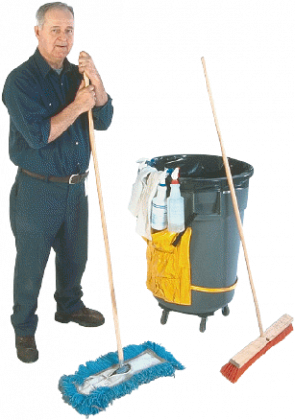
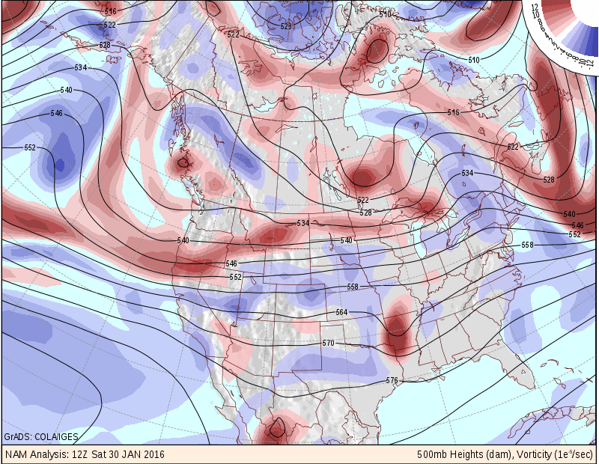
Conclusion:
Post-processing is the janitorial service of weather prediction, the cleaning up of NWP messes.
We need job-specific tools to do our work
(mops = reforecasts, brooms = hi-res analyses).
Through modest changes and collaboration, we can make NWP spic and span.

Slide 46

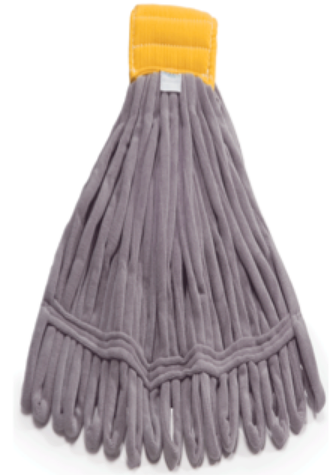
What to call this effort?
Model Output Post-processing Unification Project
a “MOP-UP” Operation?

Slide 47
Supplementary slides

Slide 48
Links to specific breakout group facts, findings, and recommendations.
Methodology group here.
Community infrastructure group here.
Data/requirement group here.
Folder with all post-processing workshop material here.

Slide 49
More background information

Slide 50
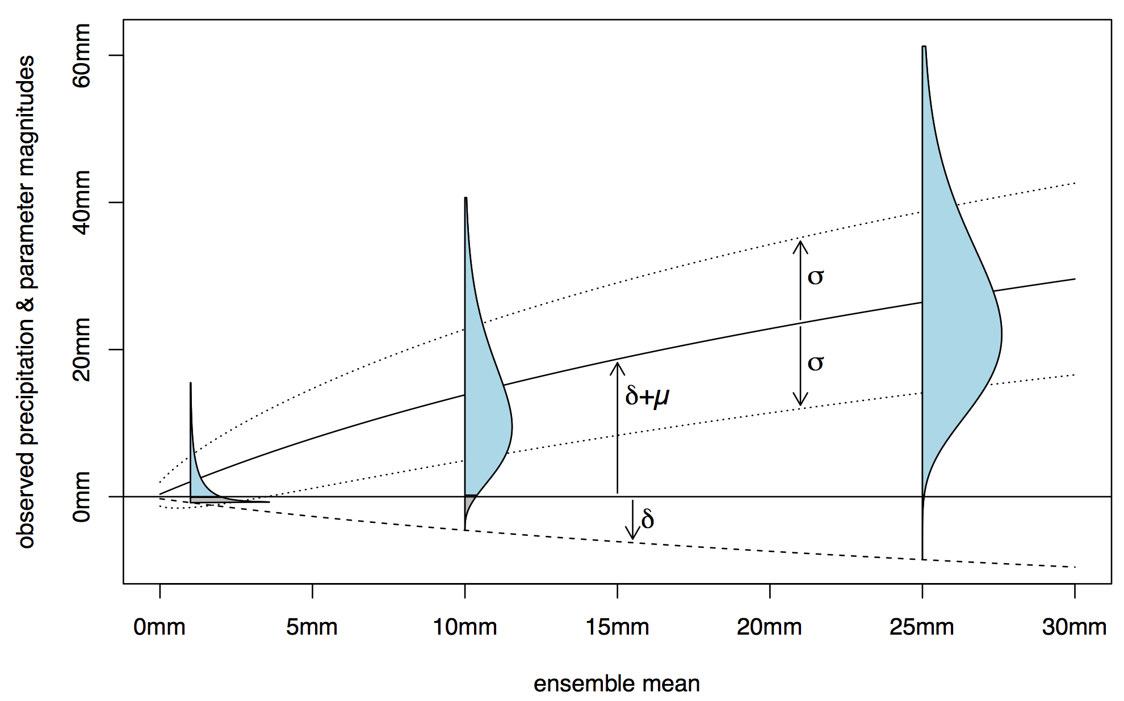
Post-processing example: the fitting of different probability distributions for three different ensemble-mean forecasts.
We seek a probability distribution of the truth given information from our forecast system. Here three PDFs for precipitation are shown as a function of the ensemble mean. Past cases, forecast and observed, are used to estimate the parameters of the underlying censored, shifted Gamma distribution.
Ref: Scheuerer, M., and T. M. Hamill, 2015: Statistical post-processing of ensemble precipitation forecasts by fitting censored, shifted Gamma distributions.
Mon. Wea. Rev., 143, 4578-4596. Also appendix A and appendix B and appendix C.

Slide 51
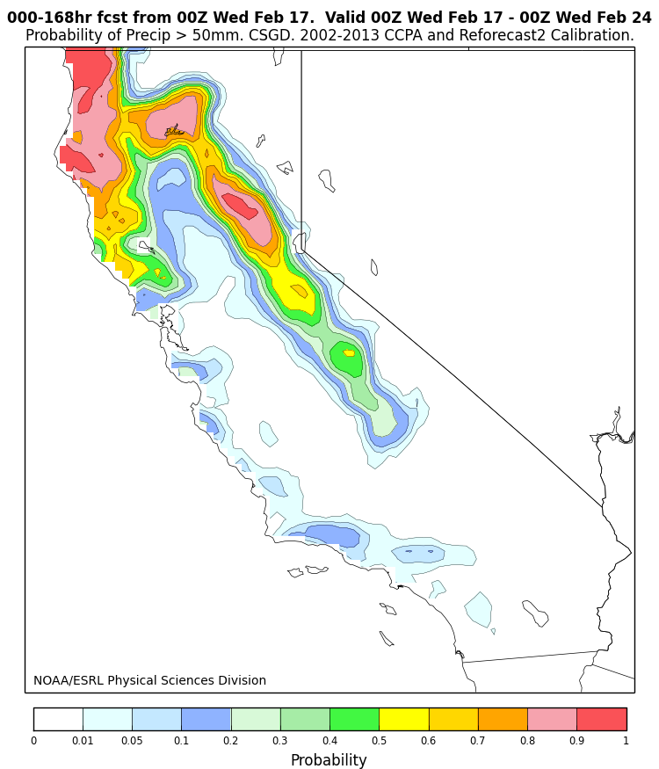
Example of experimental forecast produced for CNRFC and others.
Underlying this is the censored, shifted Gamma
distribution fitting shown in the previous slide.
from www.esrl.noaa.gov/psd/forecasts/reforecast2/calif-csgd/index.html

Slide 52
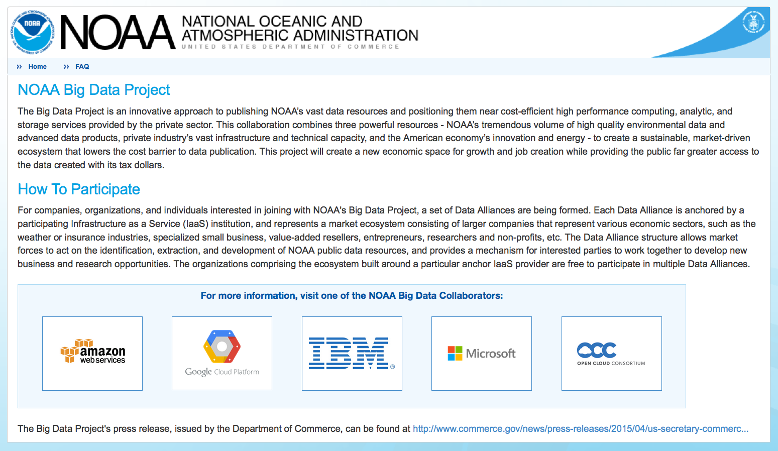
Post-processing data sets can provide value to
NOAA Big Data Project.
Pending customer interest, possible cloud storage of reanalysis / reforecast data.
see https://data-alliance.noaa.gov/

Slide 53
More on post-processing challenges

Slide 54
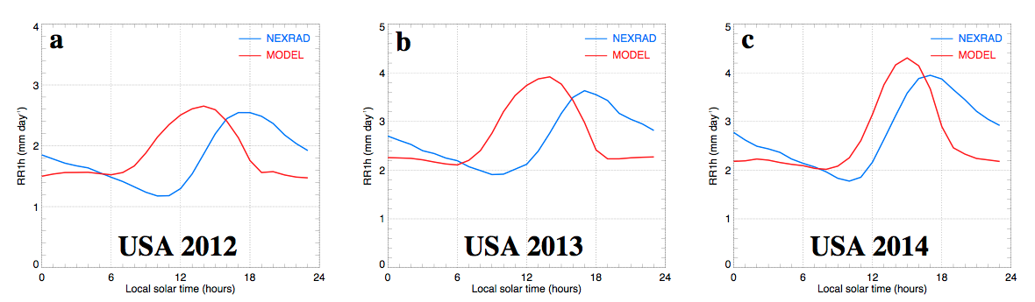
More yet to do: for example, we’re not yet correcting for errors in the diurnal cycle of precipitation.
Below, errors for three consecutive years from the ECMWF ensemble
prediction system relative to Stage IV data over the CONUS.
ECMWF forecasts are getting better with time, but most thunderstorm-based
precipitation falls too early in the day.
I haven’t seen any post-processing methods that attempt to correct for errors in the
timing of precipitation.
Reference: ECMWF Tech Memo 728

Slide 55
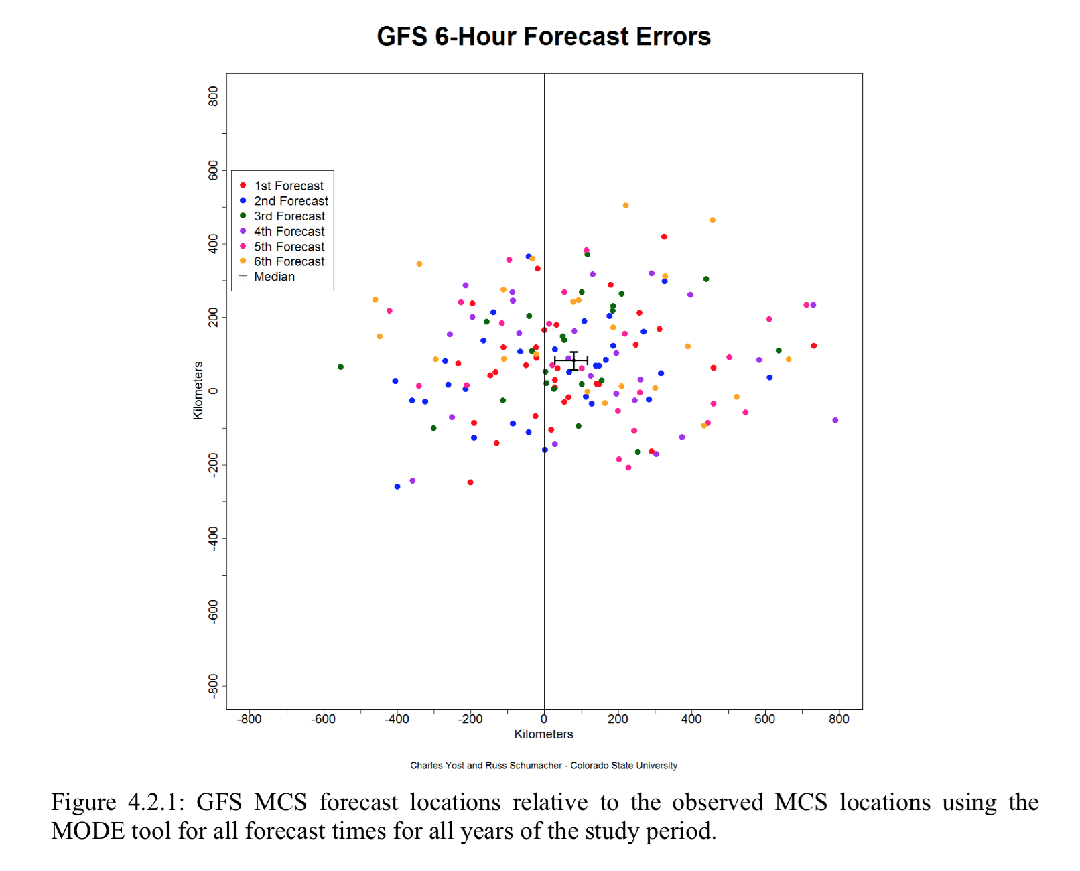
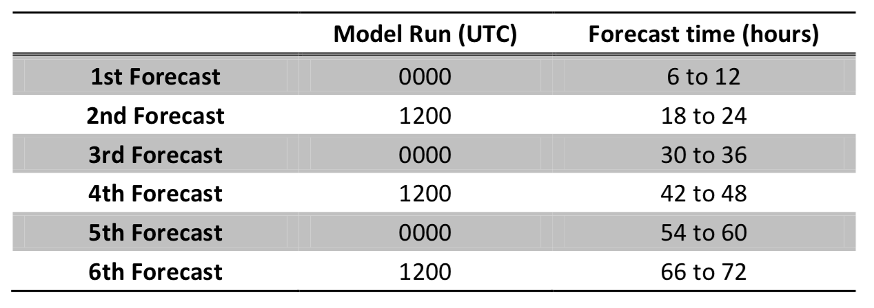
Our current methods don’t correct for errors in the tracks of summer thunderstorm complexes.
too far north
GFS tends to propagate
mesoscale convective
systems (MCSes) which
produce the majority of heavy summer rain in the central US) too far north
and east on average.
Most post-processing
algorithms are not designed
to adjust for systematic errors in position, either.
too far
west
too far
east
too far south
ref: Charles Yost M.S. thesis under Russ Schumacher, Colorado State University.

Slide 56
More on recommendations

Slide 57
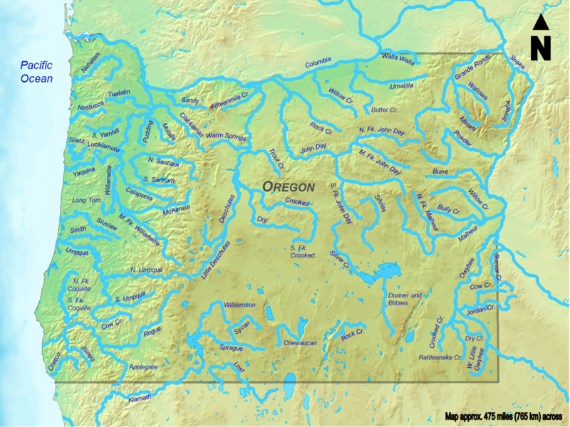
Improving the science.
Investigate methods that promise equal (or greater) skill with less training data using extensive reforecast data available for GEFS v10. Use this knowledge to set future reforecast configurations.
Different systematic errors exist even at nearby locations, making it complicated to supplement training data with data from other locations based simply on physical proximity.
Under-forecast bias
Over-forecast bias

Slide 58
A method for compositing training data across multiple locations
Illustration of one method that helps improve skill with smaller training data sets, the supplementation of training data from other locations with similar climatologies and terrain characteristics.
Statistical model for Portland would thus be developed with Portland data, but also data at other dots.
Lighter-shade dots resemble Portland less than darker-shade dots.
More background on the supplemental location selection procedure at http://tinyurl.com/supp-locns

Slide 59

Improving the science : Investment in the development and evaluation of post-processing methods for multi-variate calibration.
Example: hydrologists
want to know not only
the intensity of rainfall,
but whether or not
that intense rainfall
will fall simultaneously
in many nearby
sub-basins.
What is the “copula”
structure, i.e., the joint
probabilities?
Decision makers save
with better decisions.
Reservoir
Reservoir
Dam
Dam
a problem
when either marginal or joint probs.
are not well
forecast
No problem
(thanks to conversations with John Schaake)

Slide 60
A few other science recommendations.
Producing gridded post-processed guidance: determine which is preferable:
  Train against gridded analyses, or
  Train at stations, then intelligently extrapolate to grid points in between.
Determine whether post-processing is improved when split into stages, e.g.,
  Adjustment for large-scale biases, followed by
  Statistical downscaling.
  [If this works, software modularity is attractive].
Evaluation should include confidence intervals defined with appropriate methods, e.g., resampling.

Slide 61
Synthesis of various organization’s product and data needs related to post-processing.

Slide 62
MDL data needs (Matt Peroutka)
Would like to see a nice centralized repository (or hyperlinks) to all the various observation / analysis data.
Observations to support hi-resolution product demand, e.g., snowfall at less than 24-h accumulation.

Slide 63
OPC needs (Joe Sienkiewicz)
Seek improved (global) wind speed and direction and gusts, cyclone track and intensity, wave height, period, direction, visibility, freezing spray rate. Related, seek PBL improvements
Implicitly, if training against analyses, these analyses need unbiased 10-m wind data.
Ships take 20 days to transit Pacific at 10 knots, so need long-lead forecasts to support them.
Key data: Metop-A, -B scatterometer for ocean winds. For wave height use satellite altimetry and buoy data.
Extreme Forecast Indices can be helpful.

Slide 64
NWC requirements (Ernie Wells)
Reforecasts consistent with operational forecasts.
Would like 25-30 years, >= 1 cycle/day; 5 members ok.
Need strategy for transition between model versions.
Use the reforecasts for post-processing, comprehensive validation, optimization of decision support.
Would be interested in exploring smart thinning of forecasts.
Need objective way of deciding when changes significant enough to require production of new reanalysis/reforecast.
More studies on how to sub-sample reforecasts.
Objective and transparent process to determine tradeoff of model improvement vs. reforecast / post-processing value added.

Slide 65
CPC requirements (Melissa Ou)
Need good communication with respect to model changes.
2-3 months advanced access to training data, if not more, before a model change.
Need clearly organized, easily downloadable reforecast data with good file naming schema.
Sufficient length of reforecasts; > 20 years from CPC studies, preferably 30. Longer reforecasts necessary for longer-lead, time-averaged products.
  Span multiple climate regimes, e.g., ENSO phases.
5-6 members, 1x or 2x weekly ok.

Slide 66
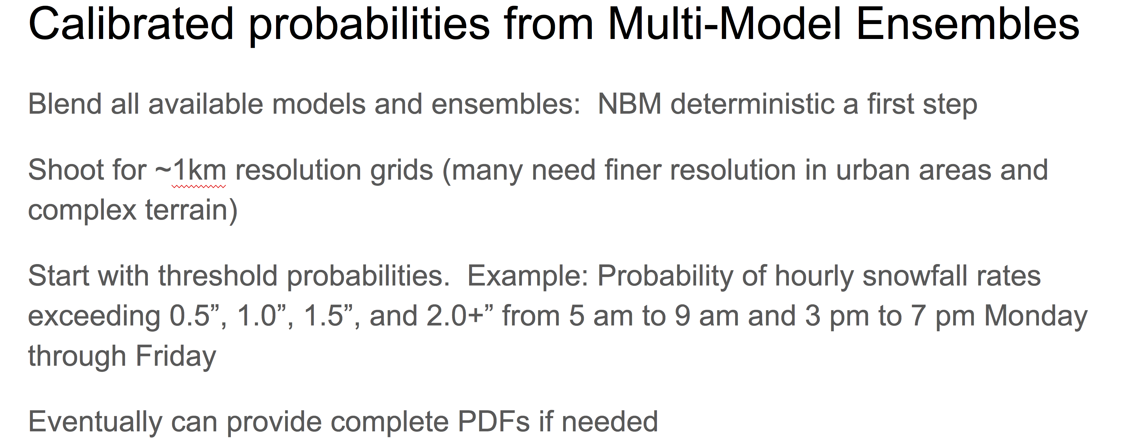
NWS Central Region (Jeff Craven)

Slide 67
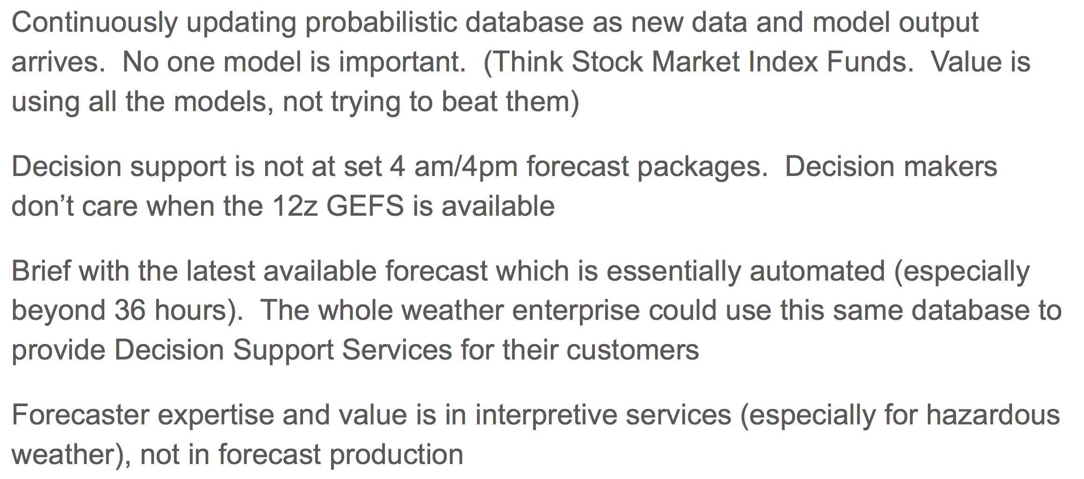
NWS Central Region continued (Jeff Craven)

Slide 68
NWS Western Region (David Bright)
Challenging, as more observational voids out west.
Use EFI’s and web-based products, would like to see them migrated into mainstream NWS products.
Want evolution of products to keep in mind Western Region’s investment in forecast confidence toolkit and situational awareness
  see https://sites.google.com/a/noaa.gov/nws-wr-stid/projects/forecast-confidence
  see http://ssd.wrh.noaa.gov/satable/

Slide 69
National Hurricane Center (Chris Landsea)
Presentation focused on new product for wave height.
We need to follow up with NHC to get a more comprehensive set of data requirements related to their post-processing.

Slide 70
Weather Company (Peter Neilley)
Would like global forecast and analysis (truth) data; native vertical resolution preferred; hourly useful.
Seek NWS post-processed foundational guidance; we’ll blend with other estimates.

Slide 71
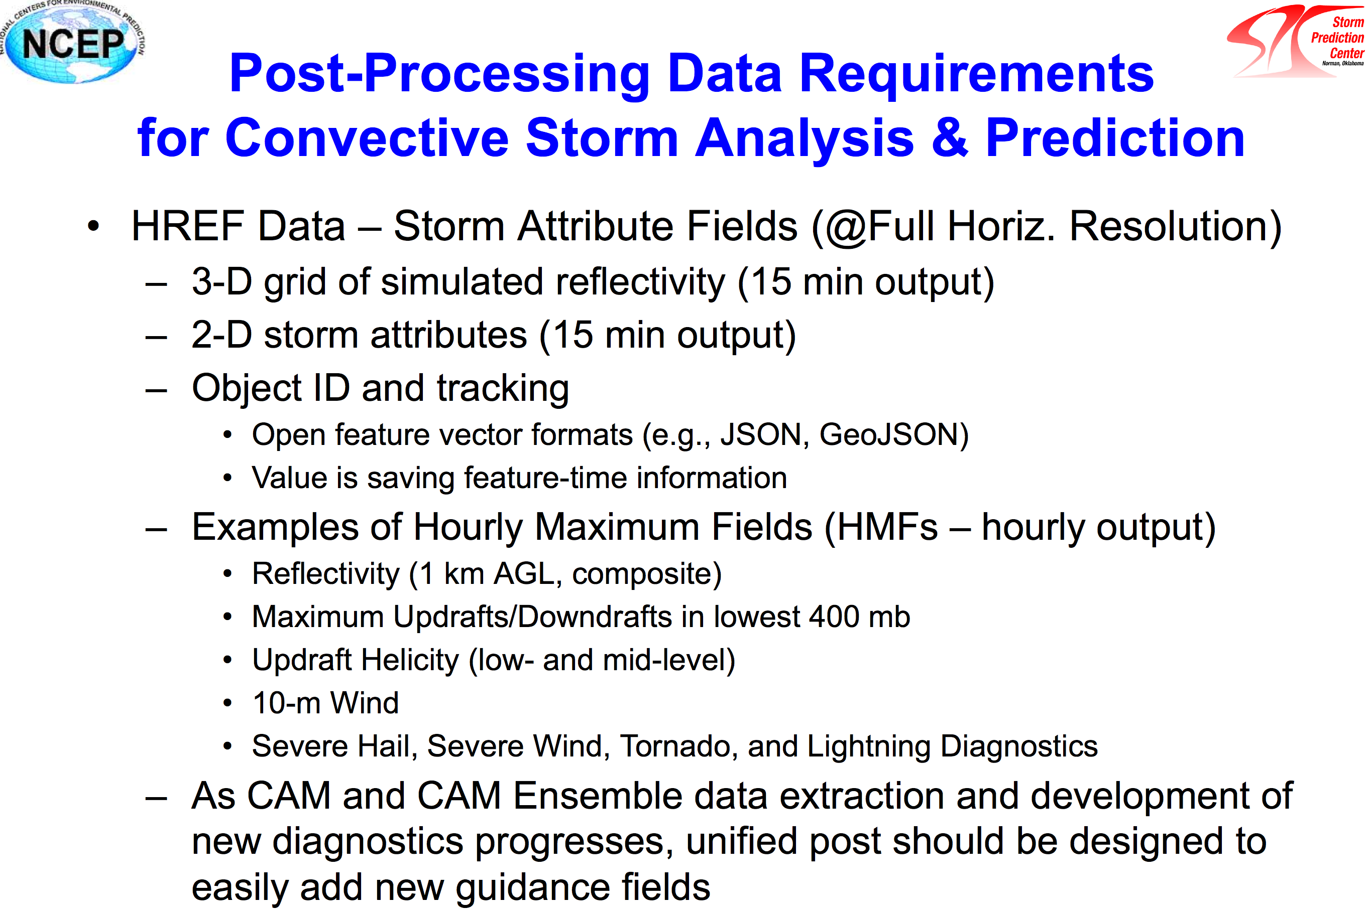
c/o
Russ
Schneider

Slide 72
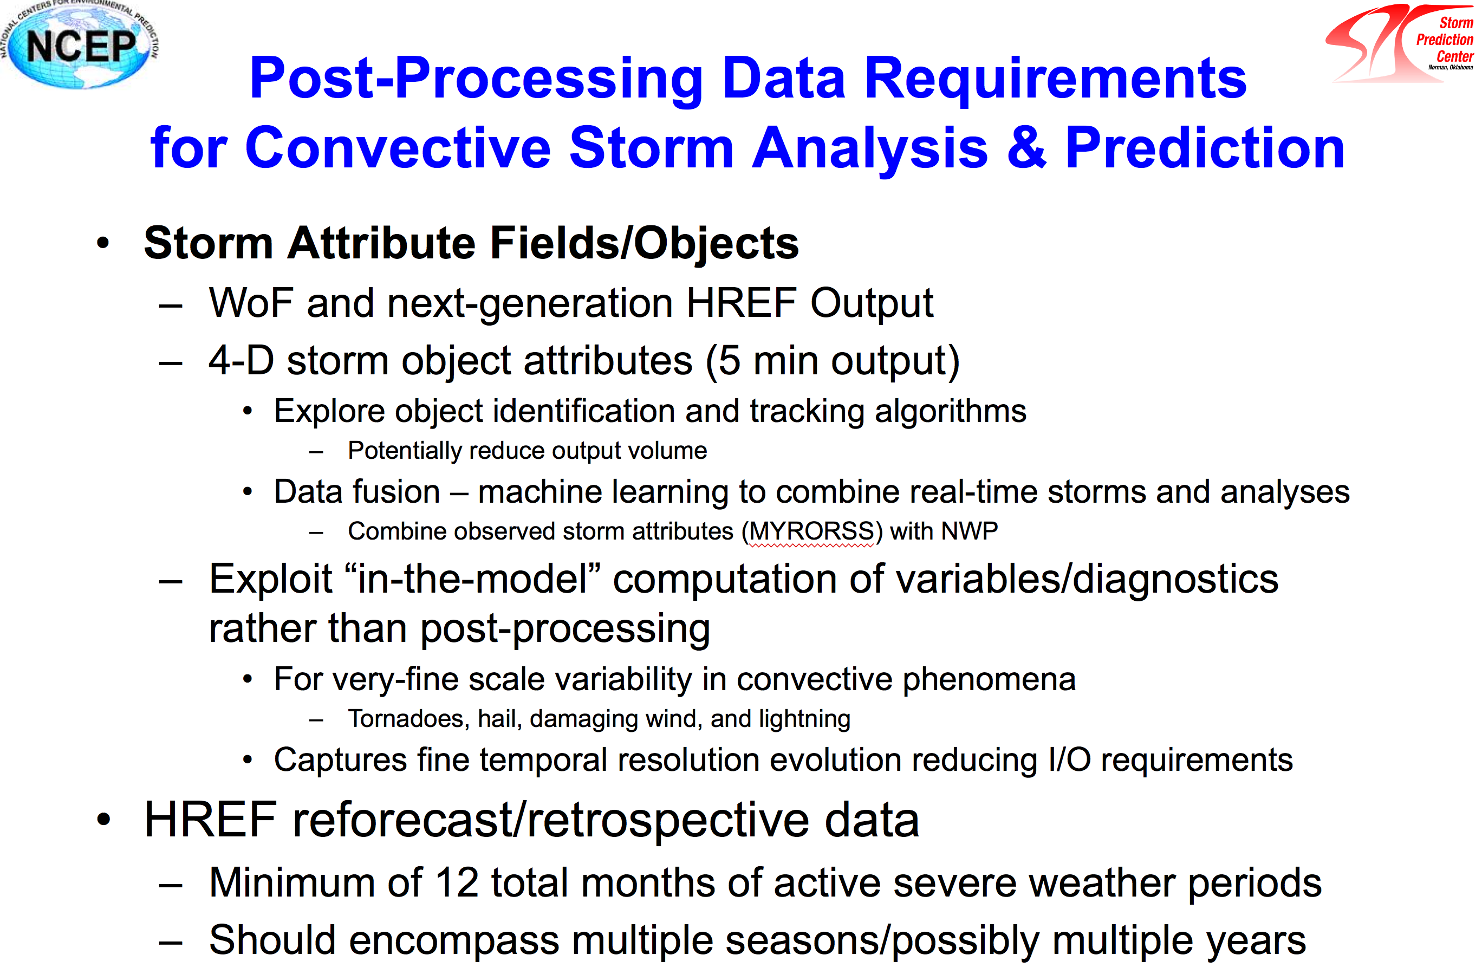

Slide 73
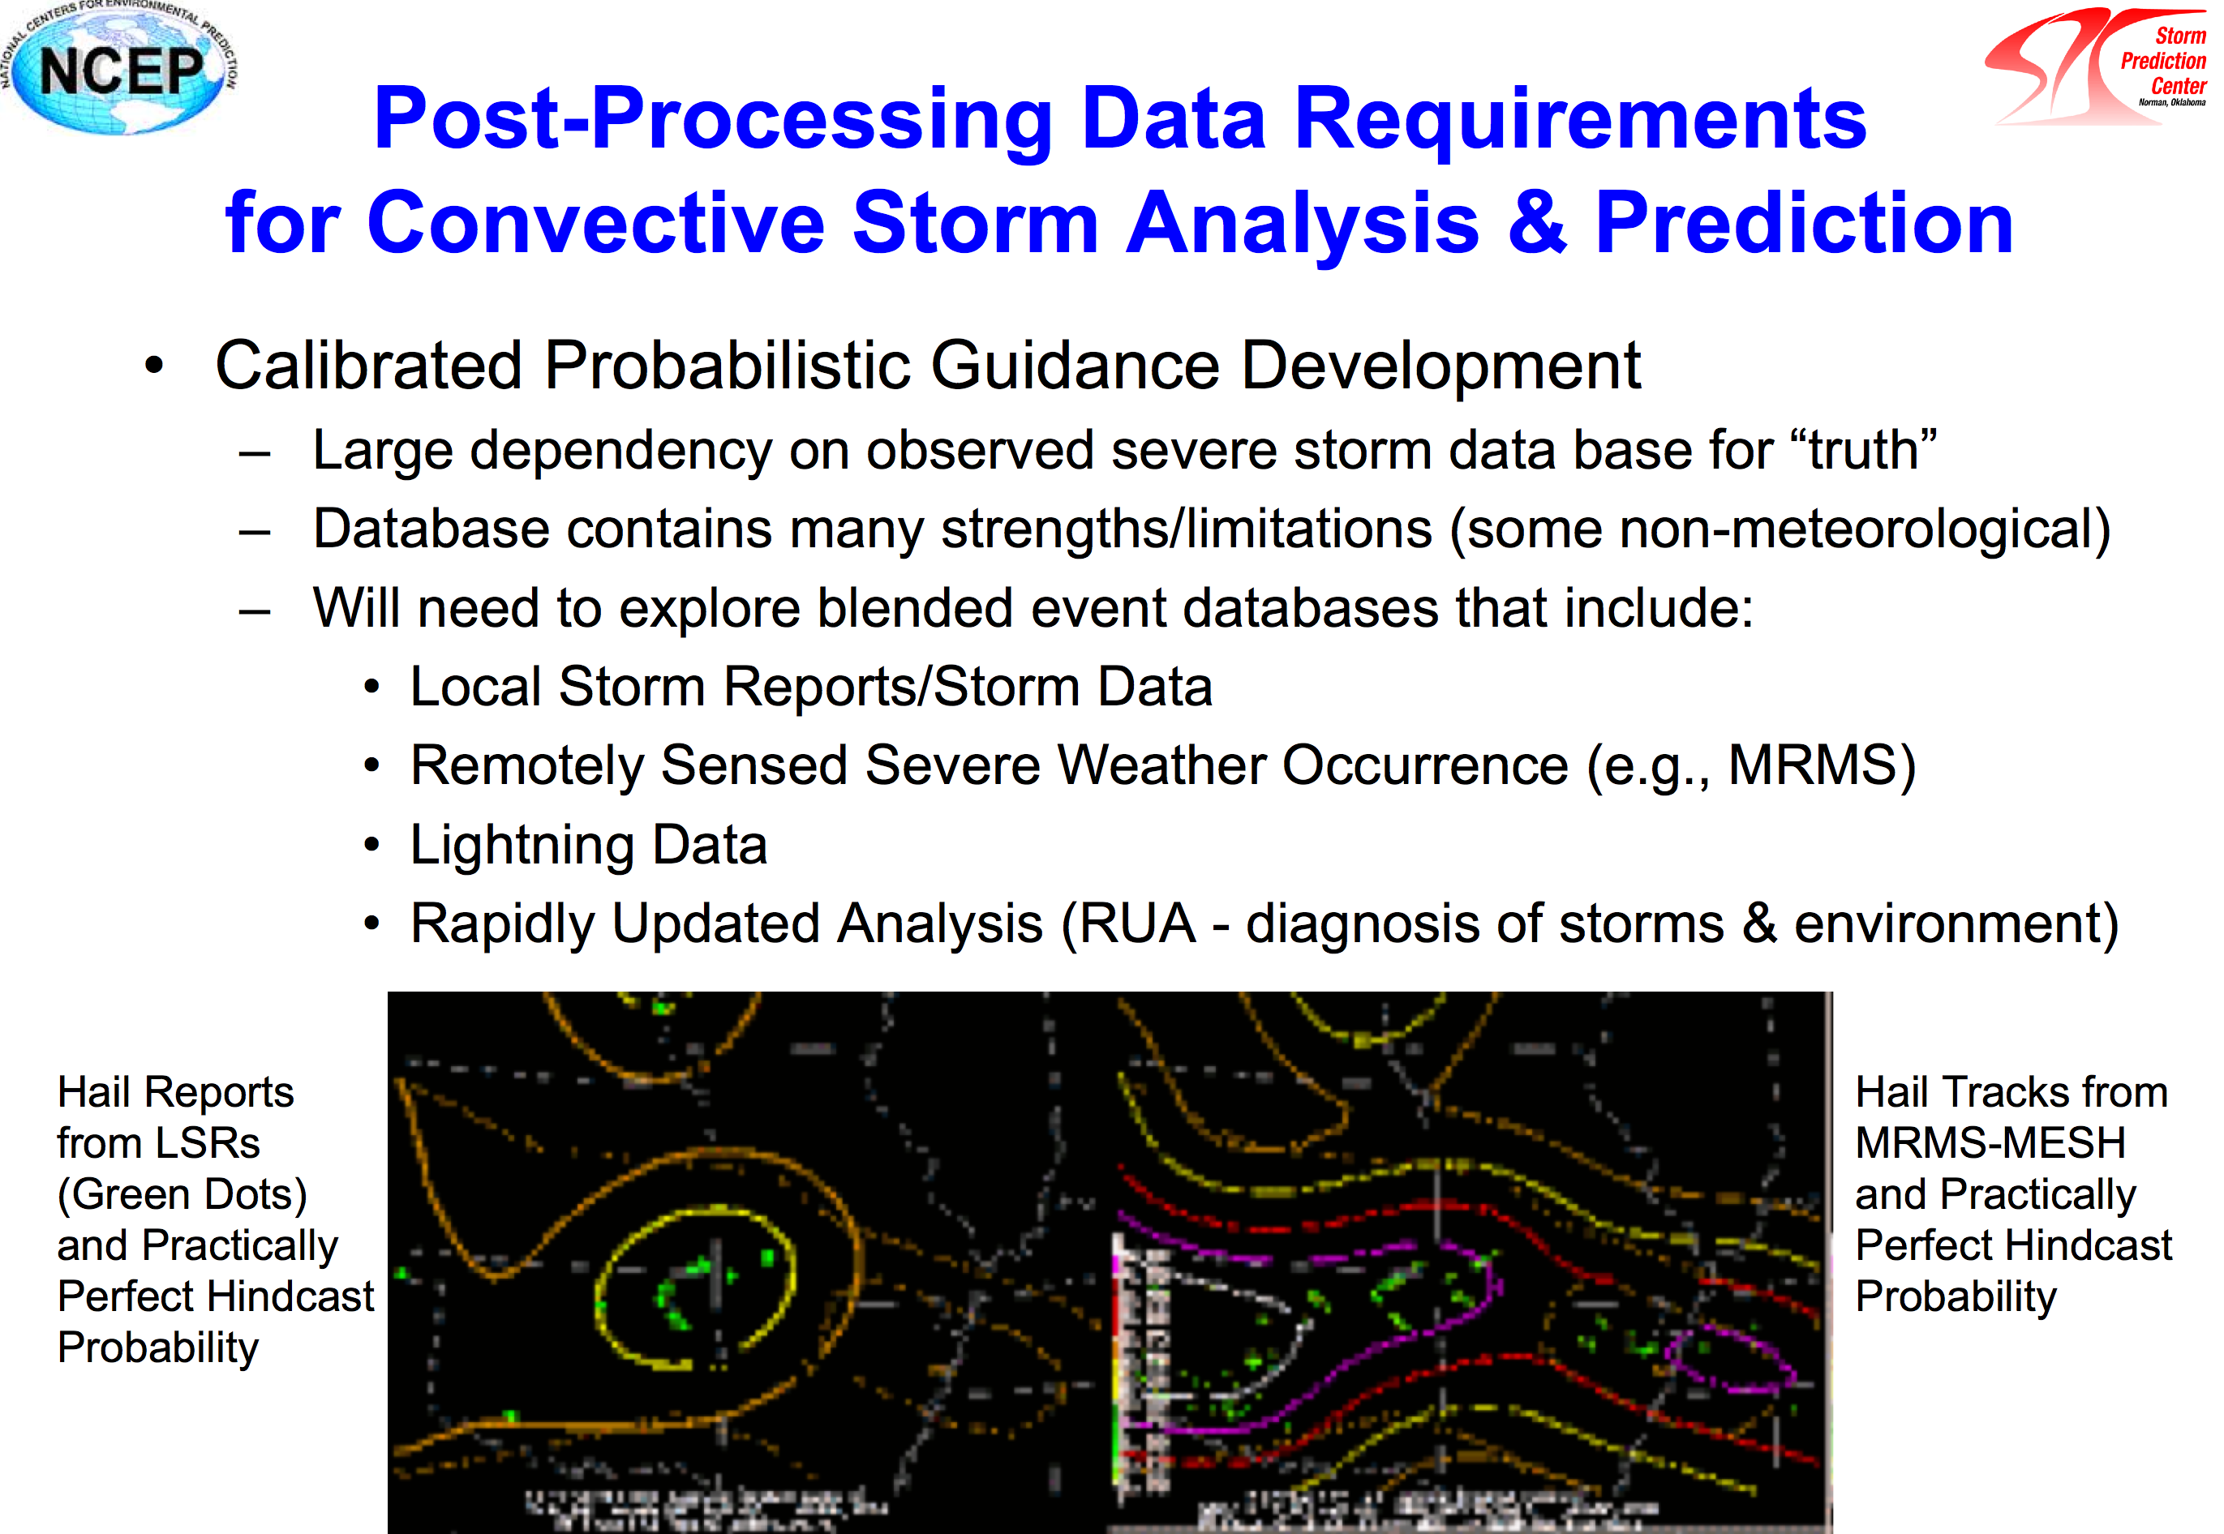

Slide 74
NSSL / SPC requirements and notes
Past development using parameterized models has included post-processing of SREF parameters to predict severe weather. Extremely valuable at leads of 1-3 days.
  If product development to shift to GEFS, need that to have equal or better quality of such environmental parameters than SREF. Seek variables like CAPE that are consistently unbiased and calculated in same manner across forecast models.
  Key parameters:
    CAPE/CIN (SB, ML, MU parcels); layer specific (e.g., 0-3 km, -10C to -30C)
    Bulk Shear (0-1 km, 0-3 km, 0-6 km, effective layer
    SRH (0-1 km, 0-3 km, effective layer)
    SCP, STP composite parameters
Via HWT, significant focus on use of and post-processing of convection-permitting models.
  use storm attributes (e.g., isolated cell vs. line vs. MCS) as additional predictor.
  new development anticipated: probabilistic lightning for fire weather, severe wind and hail from MCSes.
  increased focus on societal impacts of forecasts as well for FEMA response, preparations, decision making.
Model output characteristics:
  Would like 1-day to 1-week guidance with hourly output, 15 minutes for HREF.
  >12 months training data for severe weather, spanning multiple seasons, multiple years.

Slide 75
Climate Corporation (Holly Dail)
They appreciate high spatial res, data sets going back 30 years, information on rural as well as urban.
Want reforecasts statistically consistent with operations, updated regularly, available easily, structured for easy extraction.
Temporal resolution, production frequency appropriate to use case.
Big users of and contributor to open source software.

Slide 76
Alaska Region (Gene Petrescu)
Given data paucity in Alaska, they are interested in raw NWP, i.e. dynamical downscaling perhaps more than in CONUS.
A HRRR as good as possible serves AK region, including improved treatment of stable boundary layer, as that is highly problematic there.
Forecasters spend a lot of time editing terrain-related detail; would be nice to have tools that simplify this task.

Slide 77
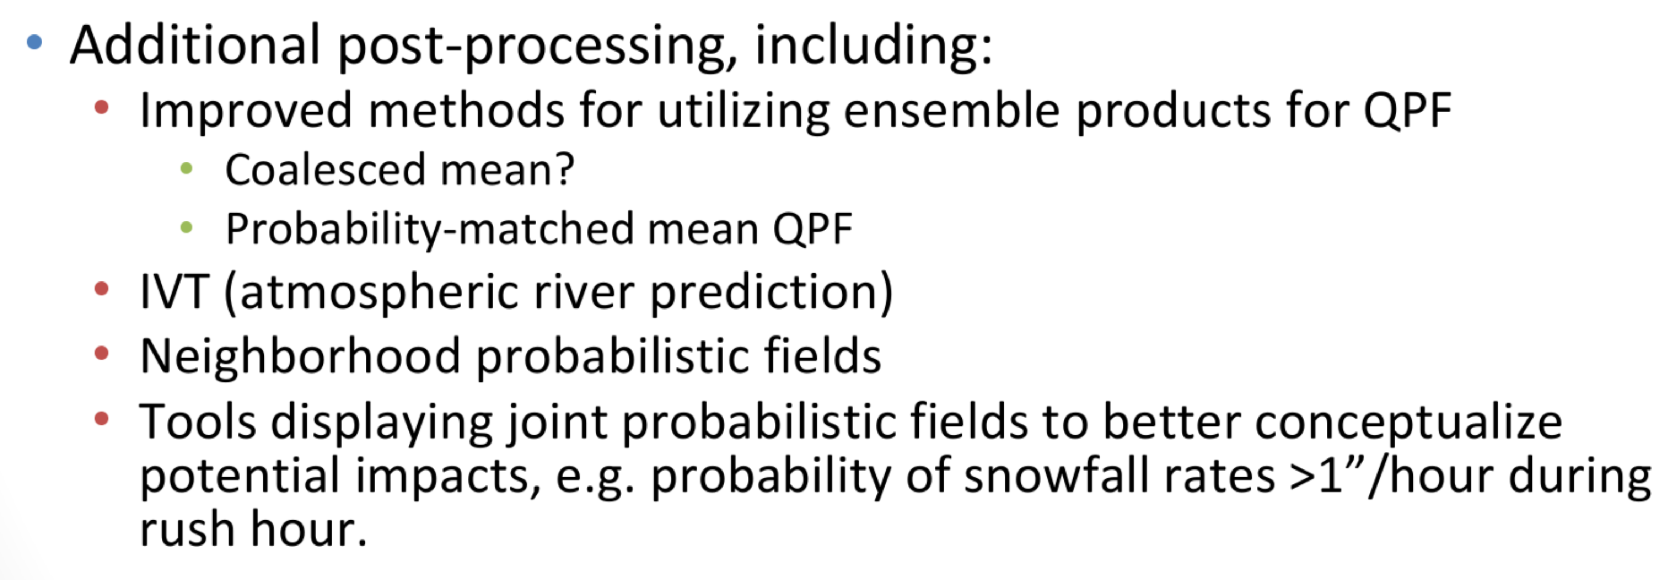
WPC (Mark Klein)
Much of their infrastructure is related to synthesizing information from multiple sources and permitting forecaster to modify/add value to the guidance.
Seek operational products in future based on reforecasts.
Incorporate hi-res ensemble guidance into future post-processed guidance of precipitation, especially for smaller-scale precip phenomena.
Seek improved tools for synthesizing information

Slide 78
WPC continued (Mark Klein)
Seek evolution toward more probabilistic products
  EFI, Day 8-10 temp and precip, info to help with flash floods.
Tools to measure uncertainty/predictability, assess forecast confidence, synthesize multiple streams of forecast output data.
Tools that allow forecaster editing of one aspect, e.g., mean of precipitation, to affect full pdf.

