Slide 1
Jump-starting PSL collaborations with tomorrow.io on satellite-based precipitation radar
Tom Hamill
NOAA Physical Sciences Laboratory
1 March 2022
tom.hamill@noaa.gov, +1 (303) 516-0340
with slides borrowed from John Springmann and Thomas Cavett of tomorrow.io

Slide 2
Is precipitation adequately observed?

Slide 3
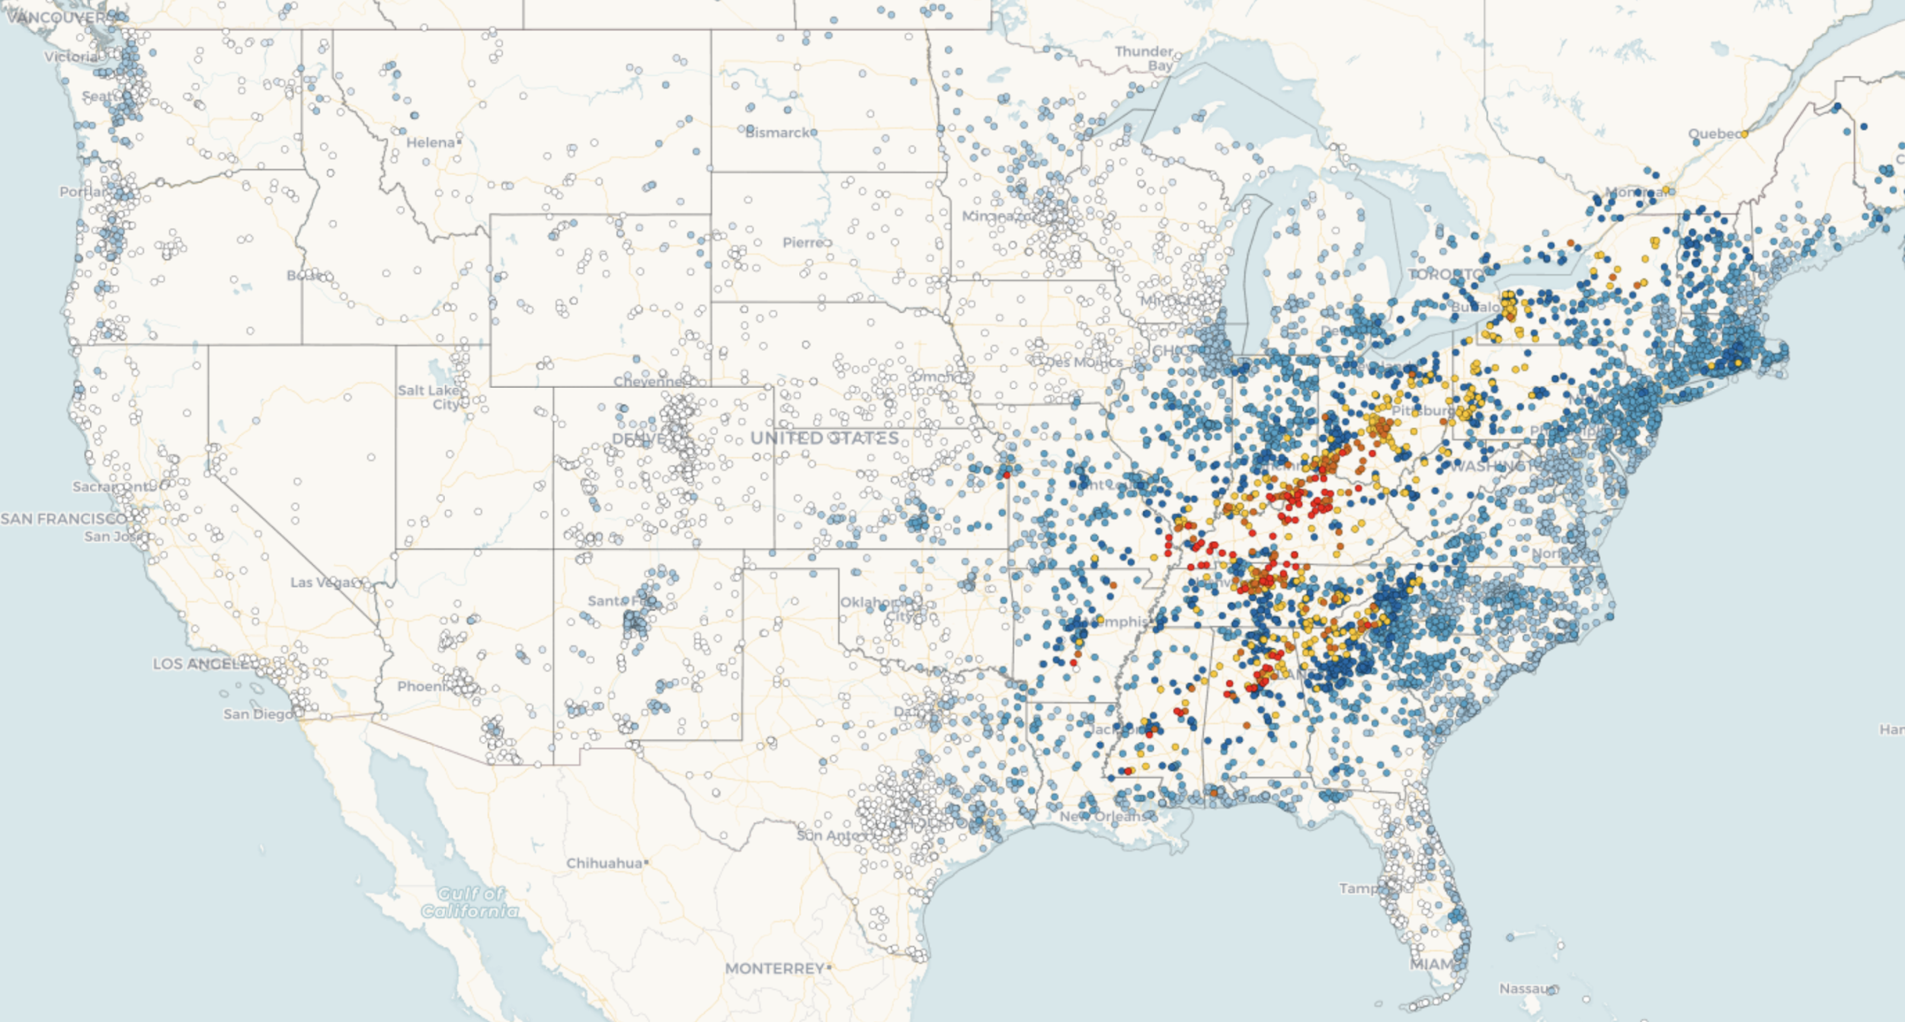
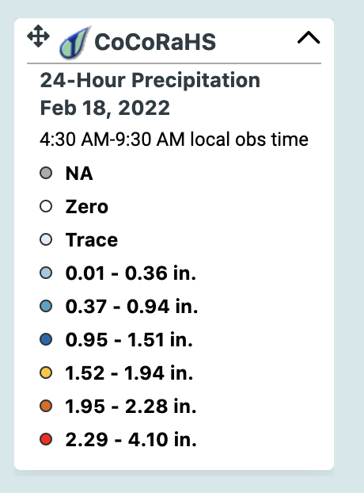

Slide 4
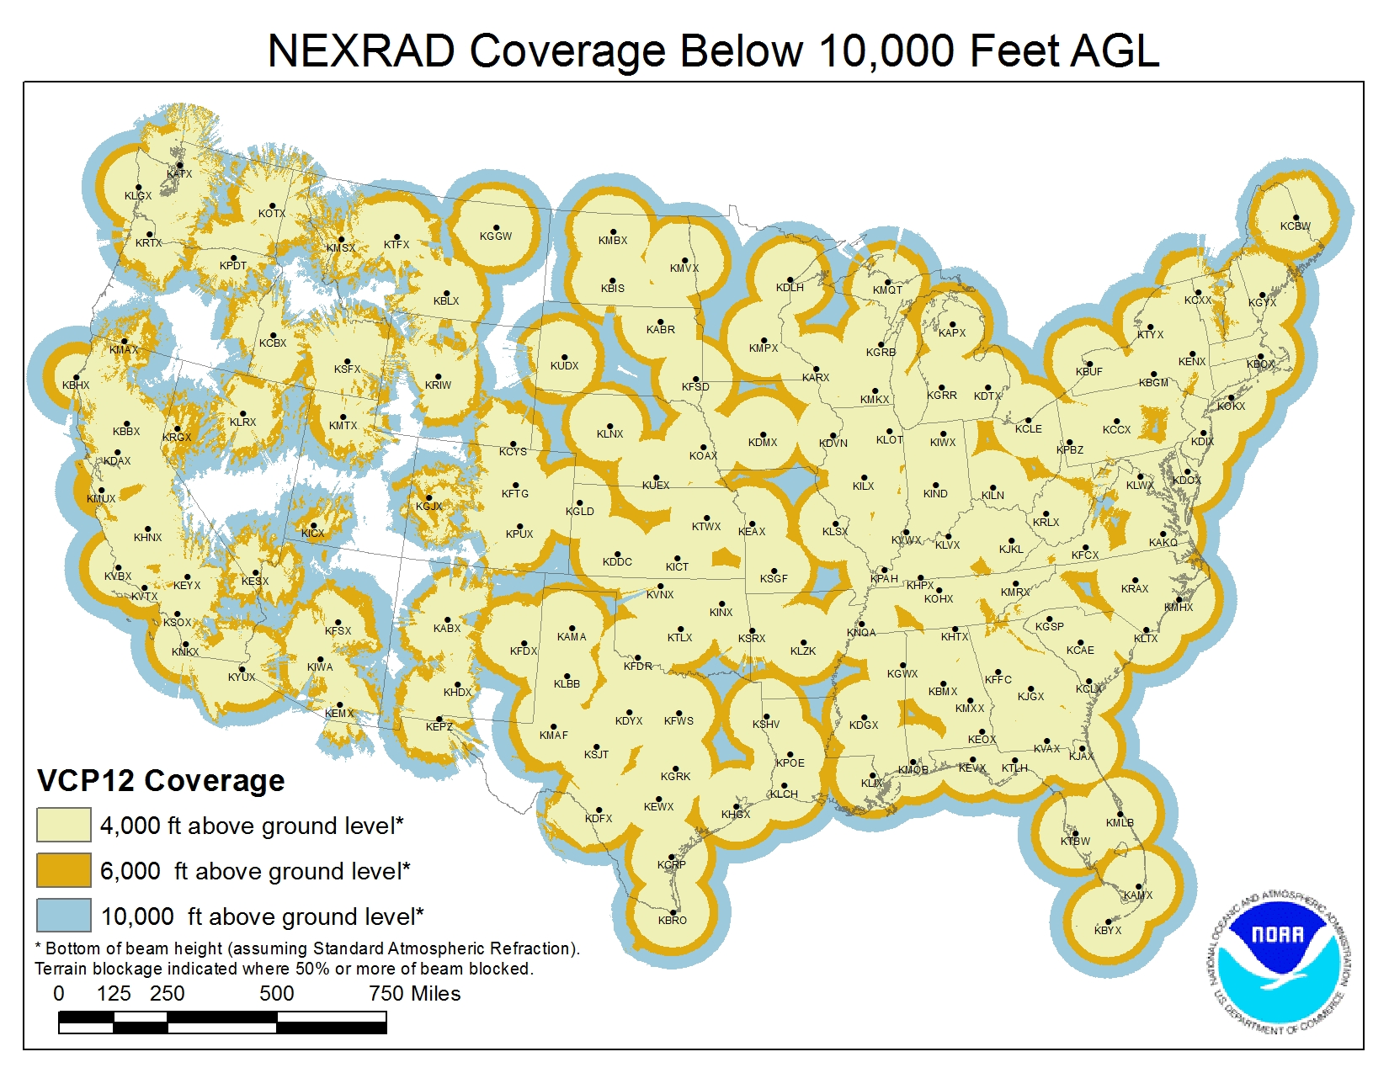

Slide 5
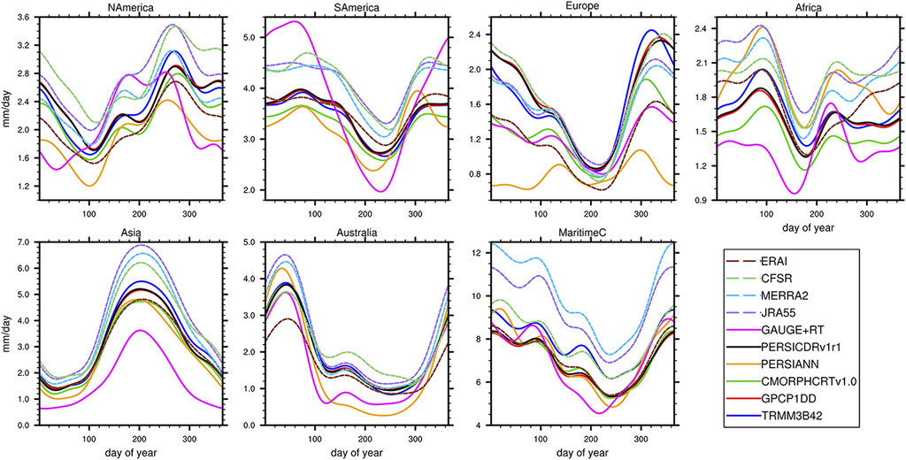
Mean annual cycle for the 10 datasets at 1° daily resolution for 2001–12 averaged over the continental regions. The annual cycle is computed as the first four harmonics of the mean daily seasonal cycle at each grid point and then averaged over the continental regions.

Slide 6
Might global precipitation observations help improve global DA and NWP?

Slide 7
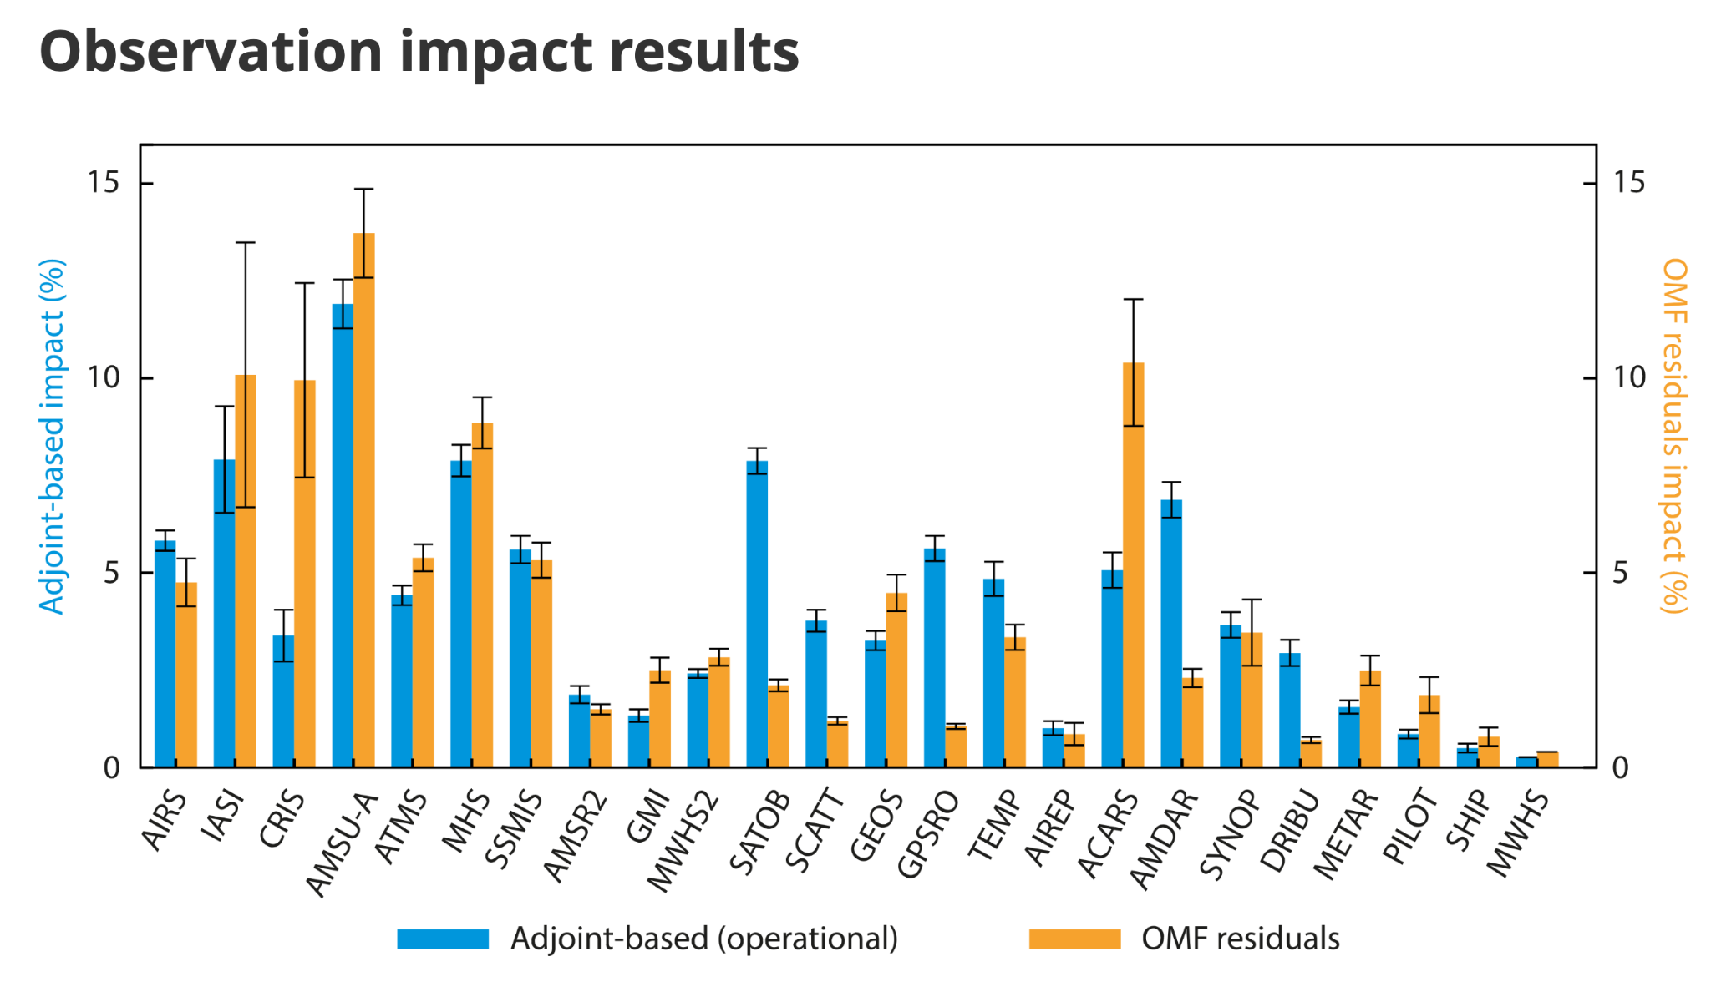
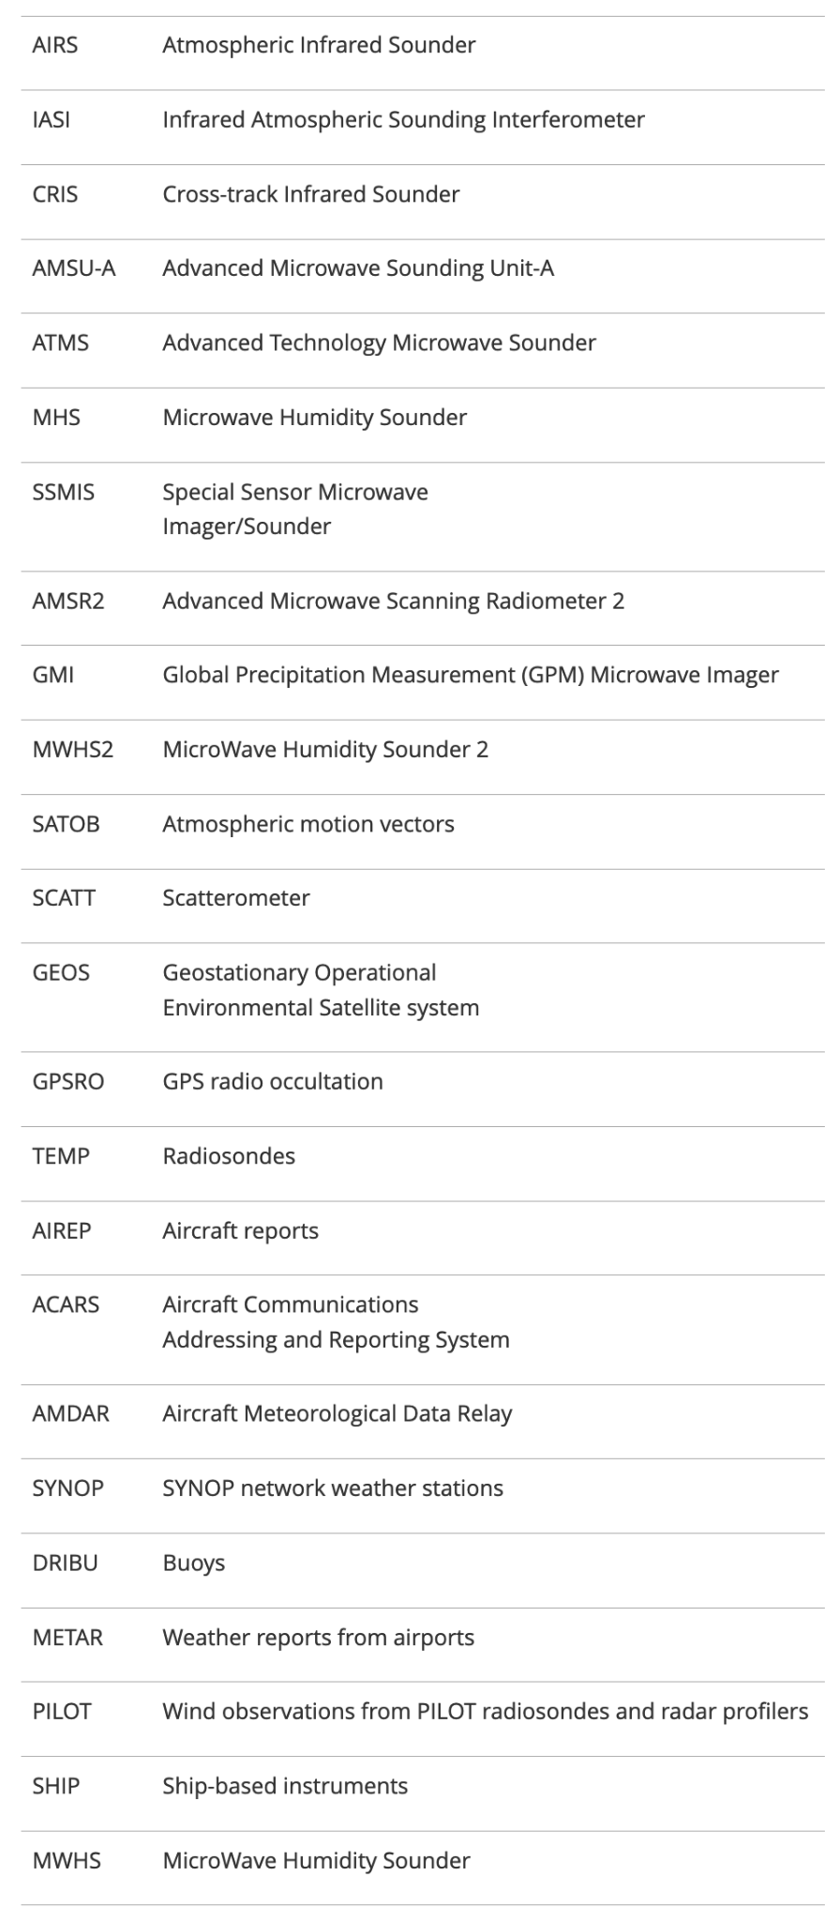
(2016)
Ref: Dahoui et al., ECMWF, 2016:
https://www.ecmwf.int/en/newsletter/152/meteorology/assessing-impact-observations-using-observation-minus-forecast

Slide 8
(2016)
Raobs
Aircraft wind/temp
Global satellite
radiances
Global observation impact is dominated by systems that provide many observations with global coverage
(This doesn’t account for the “anchoring” value of obs)

Slide 9
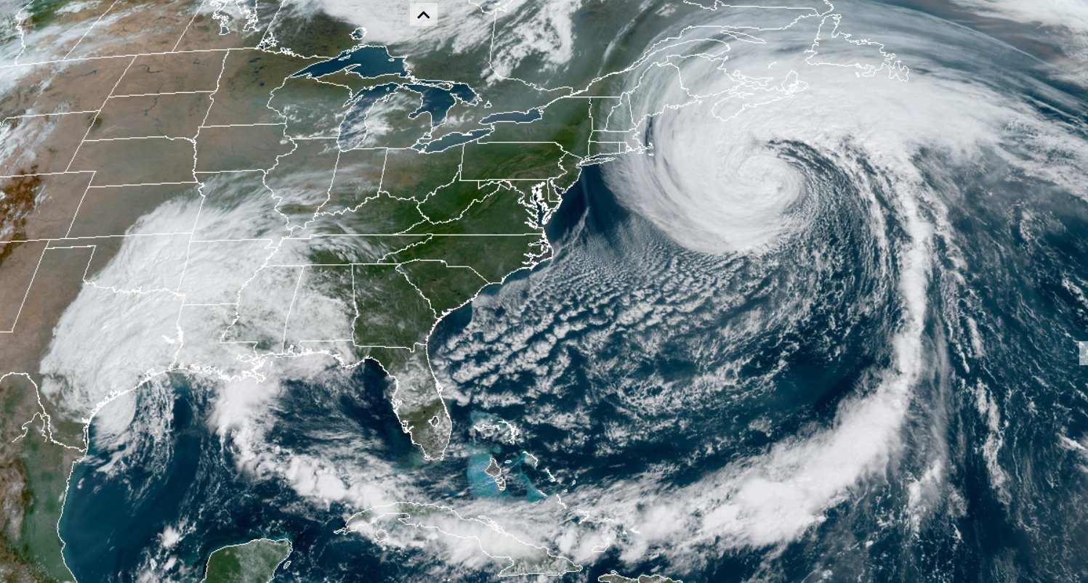
Where are there gaps in the current global observing system?

Slide 10
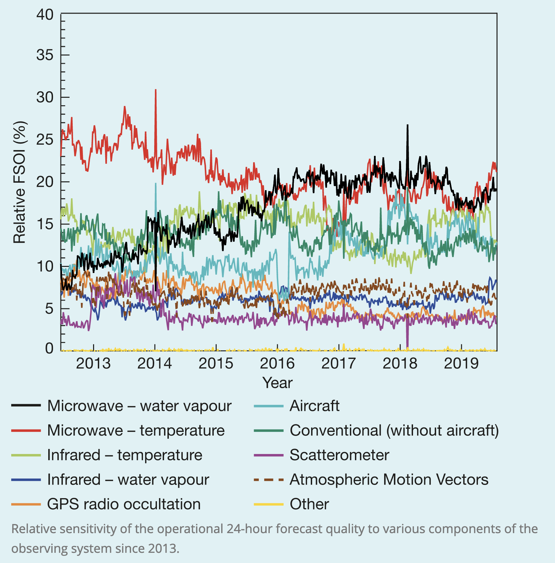
As more cloudy radiances are assimilated, the impact of microwave water vapor observations has increased.
But:
Some microwave imager channels have sensitivities to low-level rain and water cloud.
However, these channels over land are currently discarded (at ECMWF) due to their high sensitivity to the surface.
The difficulty is the poor accuracy in the simulated brightness temperatures due to uncertainties in the emissivity and skin temperature over land.
from Geer et al., ECMWF Newsletter, 2019
https://www.ecmwf.int/en/newsletter/161/meteorology/recent-progress-all-sky-radiance-assimilation

Slide 11
What is best to observe? Large-scale patterns or smaller?
Are there locations and times when the small-scale detail is important to observe?

Slide 12
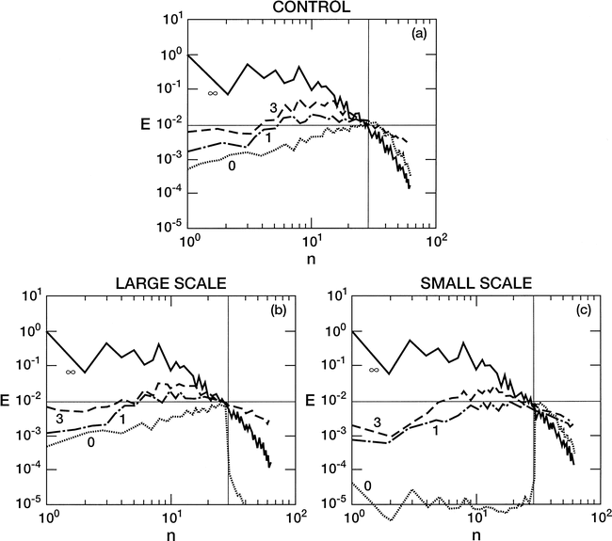
Energy spectrum of a
global nature run
Energy spectrum of initial perturbations that simulate analysis errors at various lead times in days.
Baumhefner and Tribbia 2004, MWR
https://journals.ametsoc.org/view/journals/mwre/132/3/
1520-0493_2004_132_0703_siaapa_2.0.co_2.xml

Slide 13
What happens if we were able to eliminate errors in the small scales but leave errors in the larger scales?
What happens if we were able to eliminate errors in the largest scales but
leave errors in the small scales?

Slide 14
Observation systems that allow us to tamp down errors in the larger scales of motion will have more global impact.
What happens if we were able to eliminate errors in the small scales but leave errors in the larger scales?
What happens if we were able to eliminate errors in the largest scales but
leave errors in the small scales?

Slide 15
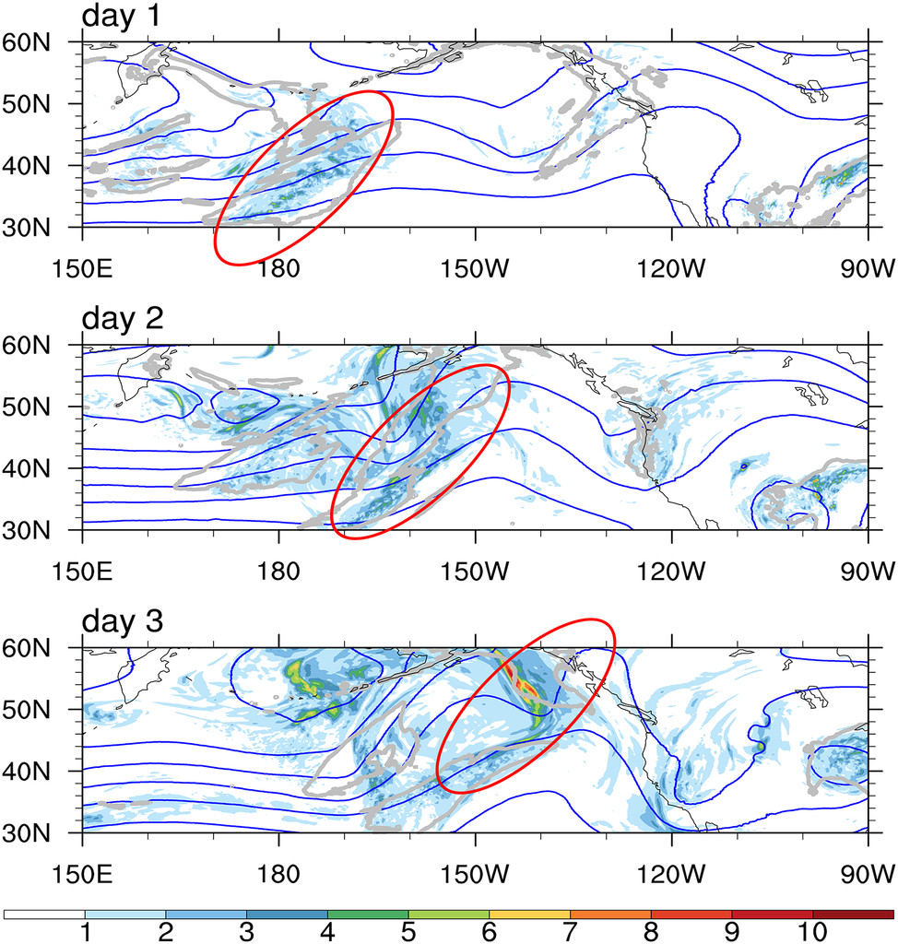
Forecast uncertainty is often related to initial- condition uncertainty in areas of precipitation.
Here, growth of 500 hPa spread in an ensemble of simulations.
This suggests that in certain regions, small-scale errors may rapidly grow upscale to affect the larger-scale weather patterns. And those commonly happen in areas with developing cyclones.
see also https://www.google.com/url?q=https://confluence.ecmwf.int/pages/
viewpage.action?pageId%3D228877072&sa=D&source=editors&ust=1645310394534309&
usg=AOvVaw3kj9JmFUi1zMB4QZfbZGKl

Slide 16
Hypotheses of precipitation observation data assimilation impact based on a literature review.
We need observation platforms with global coverage and that can help us closely estimate the position of larger-scale features.
Despite advances in all-sky assimilation, the regions under shields of heavy clouds are somewhat poorly observed relative to clear areas.
Reducing the analysis error of smaller-scale details such as locations of developing fronts and cyclones is likely to be particularly helpful to reducing forecast errors.

Slide 20
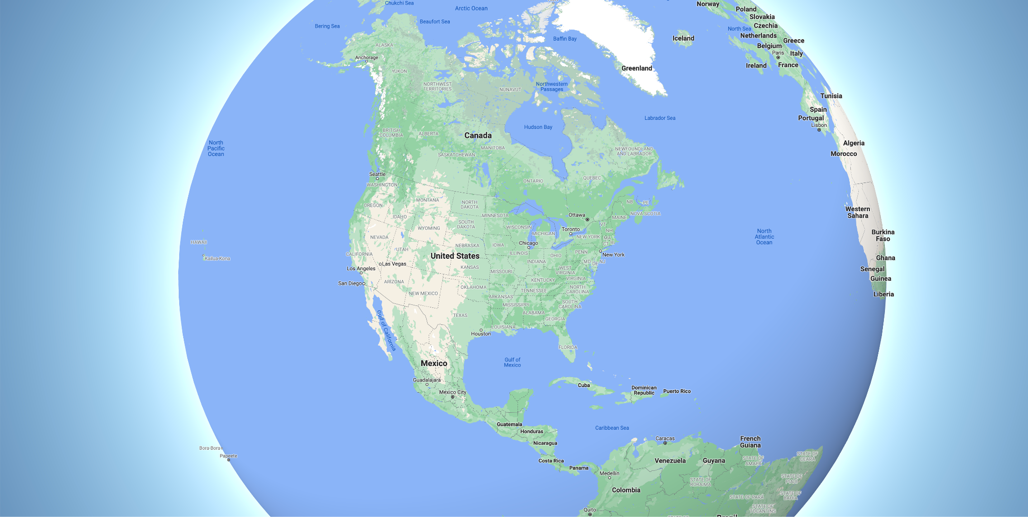
(scale of radar scan slightly exaggerated, ~ 400 km diameter)

Slide 21
(scale of radar scan slightly exaggerated, ~ 400 km diameter)

Slide 22
(scale of radar scan slightly exaggerated, ~ 400 km diameter)

Slide 24
Cal/val campaign executed in collaboration
with NOAA. Radar reflectivity is from
hurricane Ida (Aug 2021) as observed by
airborne conical scan Doppler radar
(Image credit: NOAA/NESDIS/STAR)

Slide 27
PSL and NOAA interest in these data
Evaluating the quality of these data, their impact on improvement in numerical weather prediction, on quantitative precipitation estimation, and more.
Should NOAA buy, and what is a reasonable cost based on the evidence?
Presuming positive impact of the data, prepare NOAA for the operational assimilation of these data soon after the purchase agreement is signed.
Forward operators developed and tested.
QC algorithms ready, and error statistics quantified.
Ready to incorporate into precipitation analysis products, MRMS, Stage IV, CCPA, etc. for model validation, postprocessing.
Better quantification and understanding of hydrometeorological extremes.
Global extreme rainfall statistics.
Data for precipitation process understanding and model diagnostics.
More precise quantification of spatial precipitation variability for MJO diagnostics.
Data to compare against other NOAA and PSL data.
Your thoughts on potential PSL usage.

Slide 28
Collaborating with tomorrow.io
A CRADA (Cooperative Research and Development Agreement) has been signed. NESDIS, NOS, NWS/EMC, AOML, NSSL also co-signers.
Tomorrow.io will provide simulated and non-real time data free of charge, likely through cloud providers.
We agree to share research results, work together on technologies like the data assimilation forward operator, jointly publish interesting results.
Their precipitation mission may eventually incorporate other sensing capabilities (snow, ice, ocean-surface winds, ocean currents), and they are considering microwave sounders. PSL may be involved with evaluating those at a later point.

Slide 29
Next steps
New hire through CIRES to work on the forward operator and tests in cycled data assimilation.
Identify other PSL and NOAA partners that wish to participate in evaluation of the data.
Refine the list of science questions we intend to ask and answer.
Get to work.

Slide 30
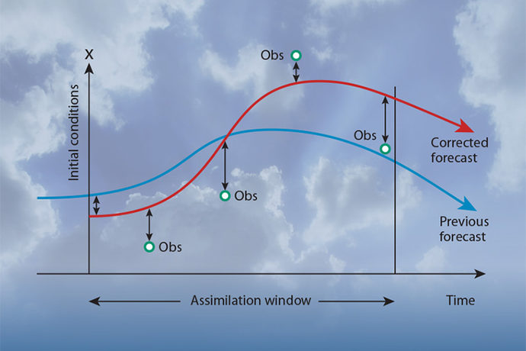
Observations and their impact on data assimilation
observations in a time window
model state; we seek the one that minimizes
the functional J(x)
background model state from prior forecast(s)
observation-error covariance matrix
background-error covariance matrix
forward operator, converting model data to
observation space.
diagram ℅ ECMWF

