Slide 1
Ways to improve atmospheric river forecasts for the western US.
Tom Hamill
NOAA Physical Sciences Laboratory, Boulder CO
16 March 2022
POC: tom.hamill@noaa.gov, (303) 516-0340
Disclaimer: these represent some of my personal hypotheses but
do not reflect the official NOAA organizational position.

Slide 2
Propositions
A large atmospheric river may dump ten or more of inches of precipitation over California, and reservoir operators need lead times of many days to weeks if they must spill reservoirs.
Looking backward in time a week from an atmospheric river landfall, the key storm may not have formed yet, and when it does, it may form far away from California.
Hence, global weather forecast models are needed to provide forecast guidance with sufficient lead times to make water-management decisions.
New observing systems such as a constellation of weather radars may provide unprecedented observations in the current Pacific Ocean data void.

Slide 3
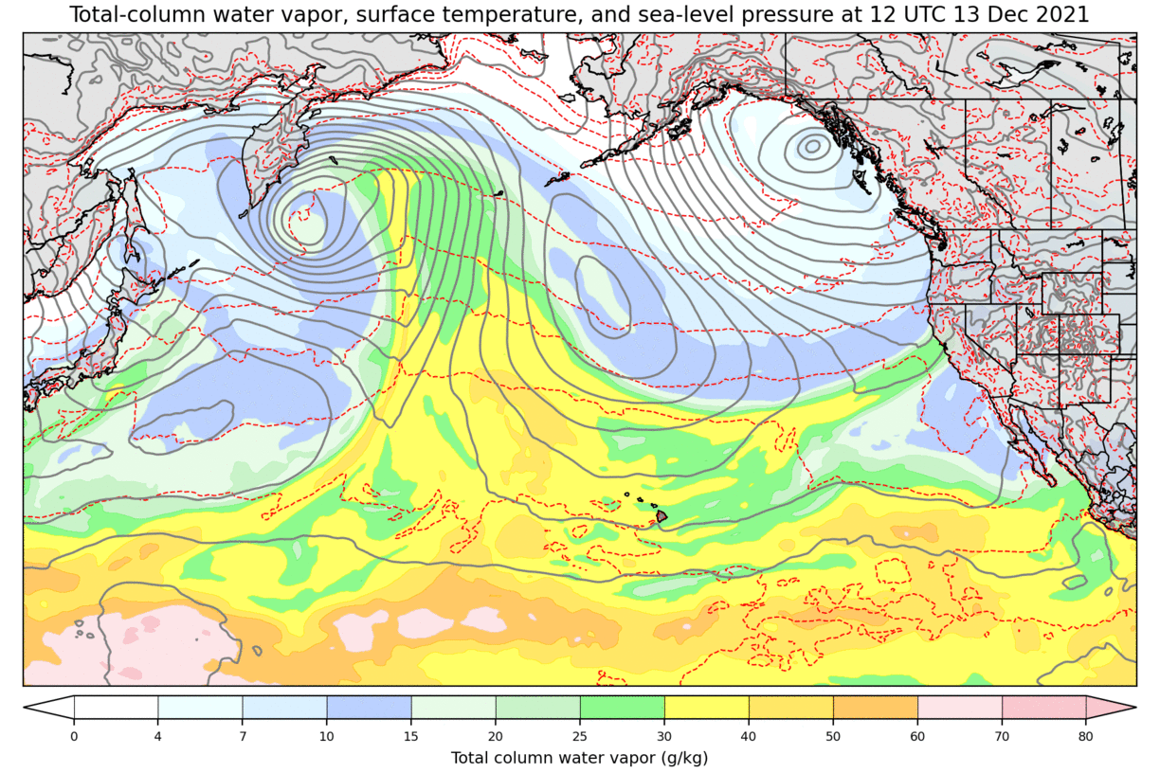
Backward in time from atmospheric river landfall
A major atmospheric river impacted
the US west coast on 13 Dec 2021.
Let’s animate weather analyses
backward in time.

Slide 4
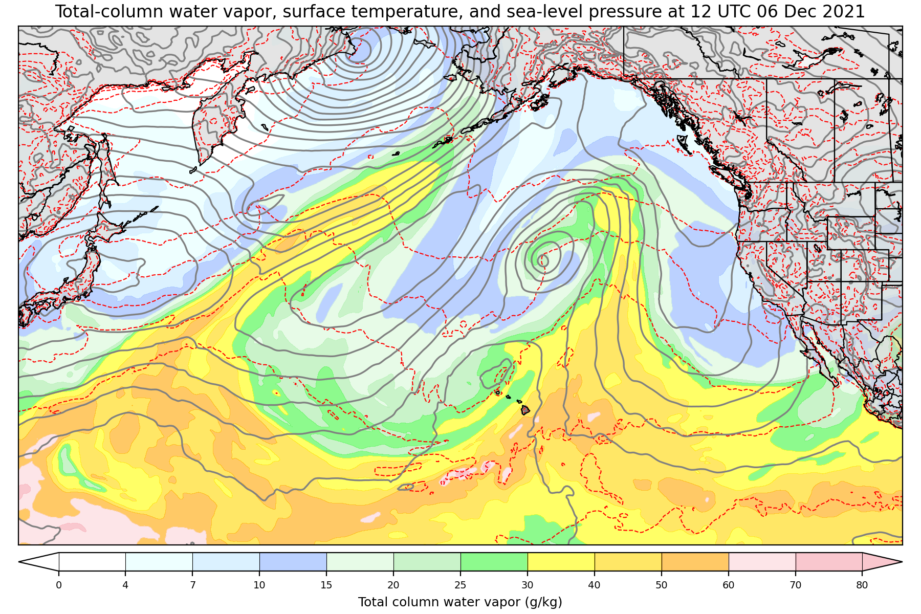
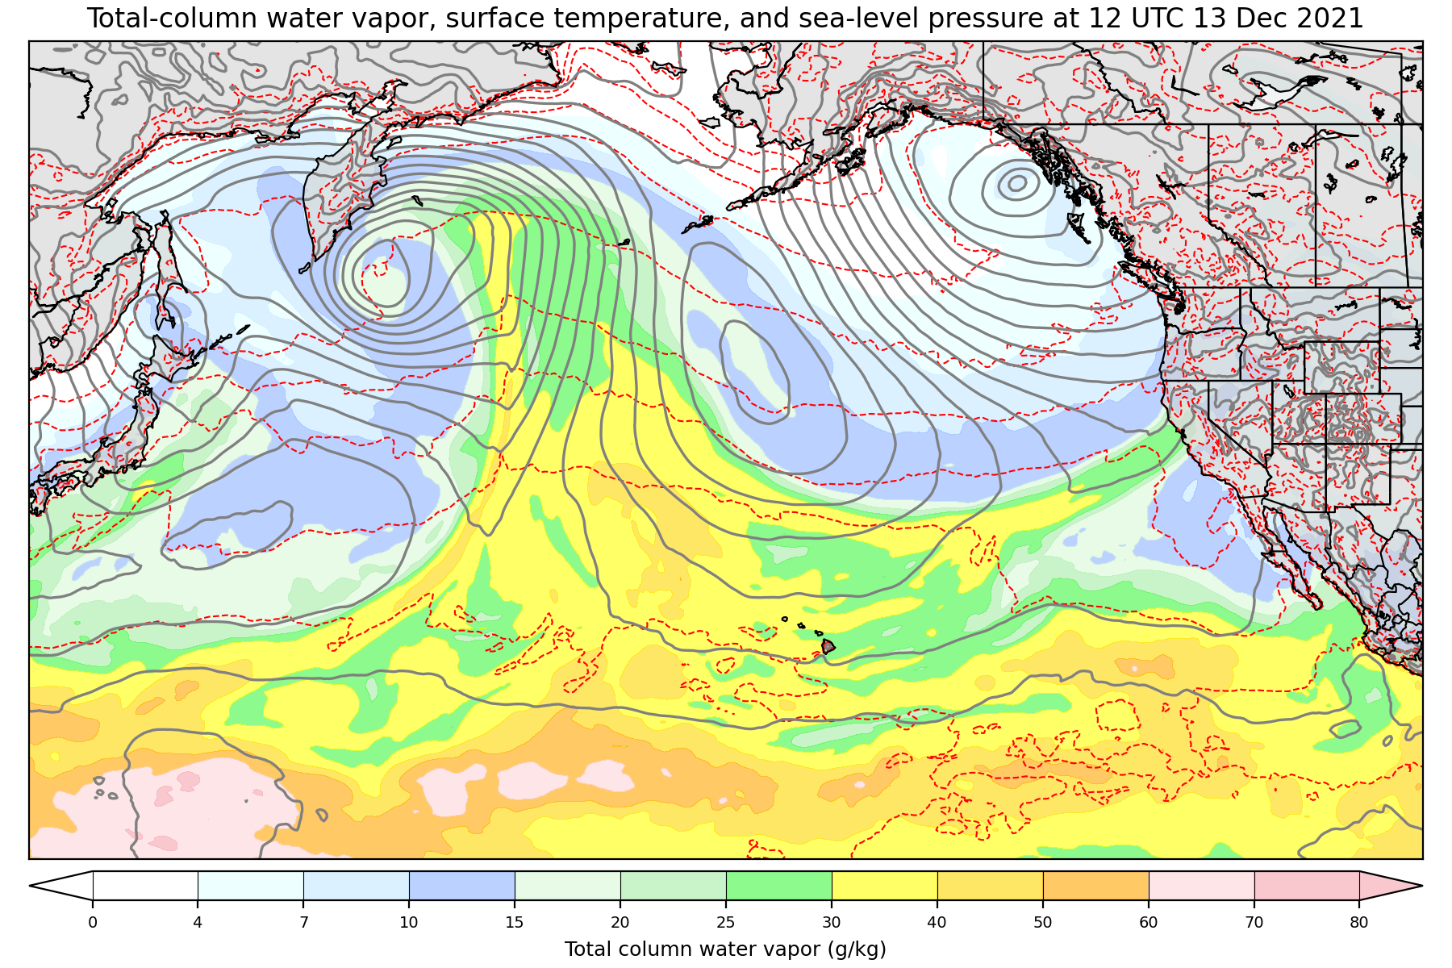
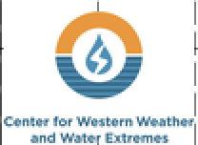
Where was the storm that produced the AR?
The land-falling AR here and the storm responsible for it here
… had not formed yet 7 days prior, but
will do so approximately here.
Approximate WRF West domain of
We need global models that capture global weather patterns to forecast ARs with actionable lead time.

Slide 5
5-km, ~ hourly observations
consistently over Pacific data void

Slide 6
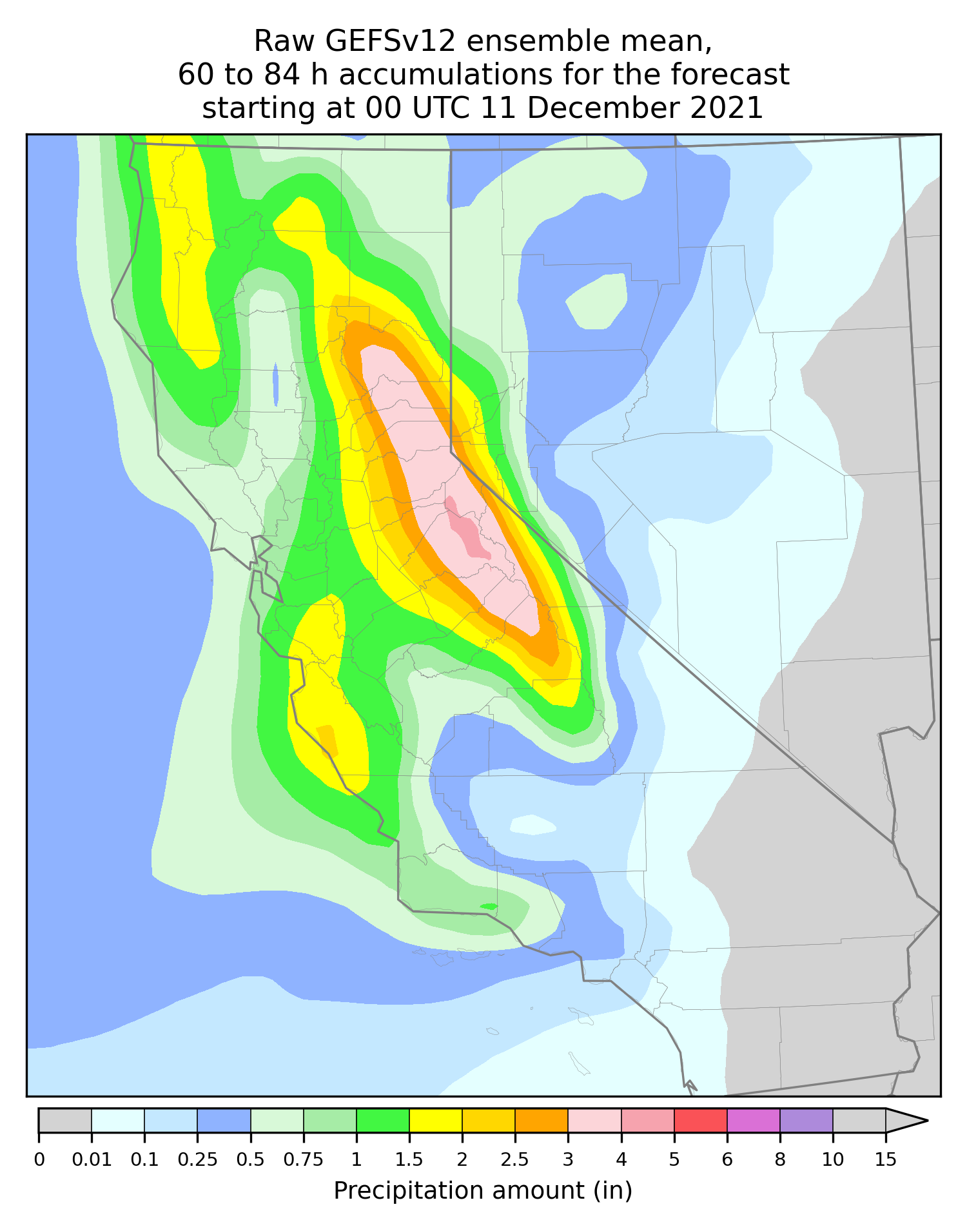
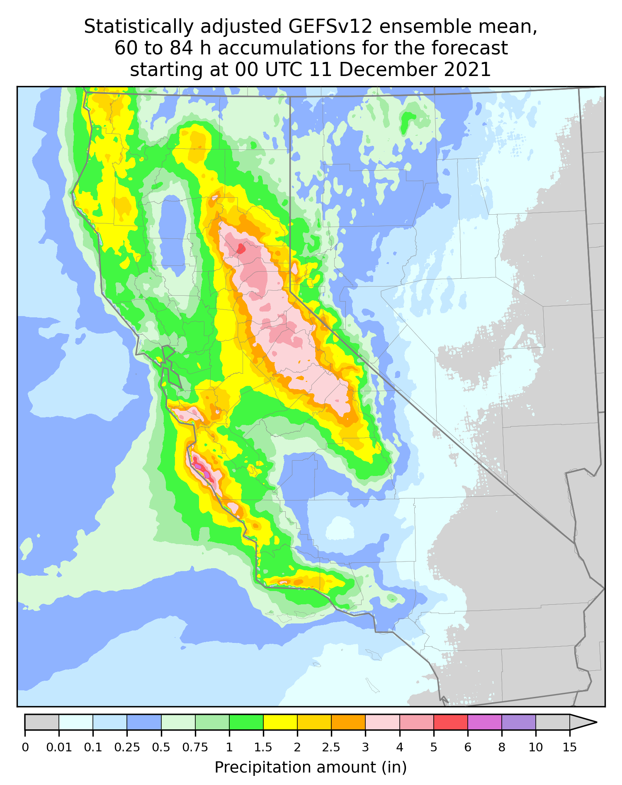
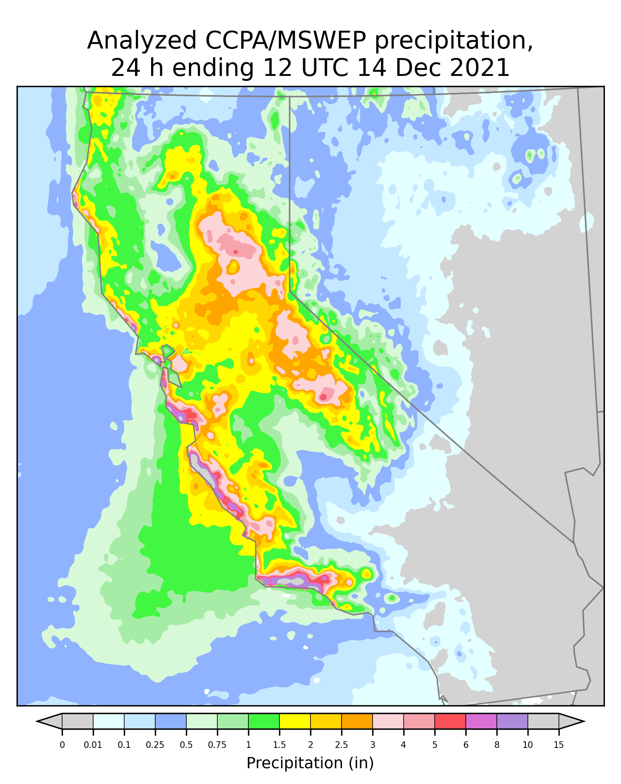
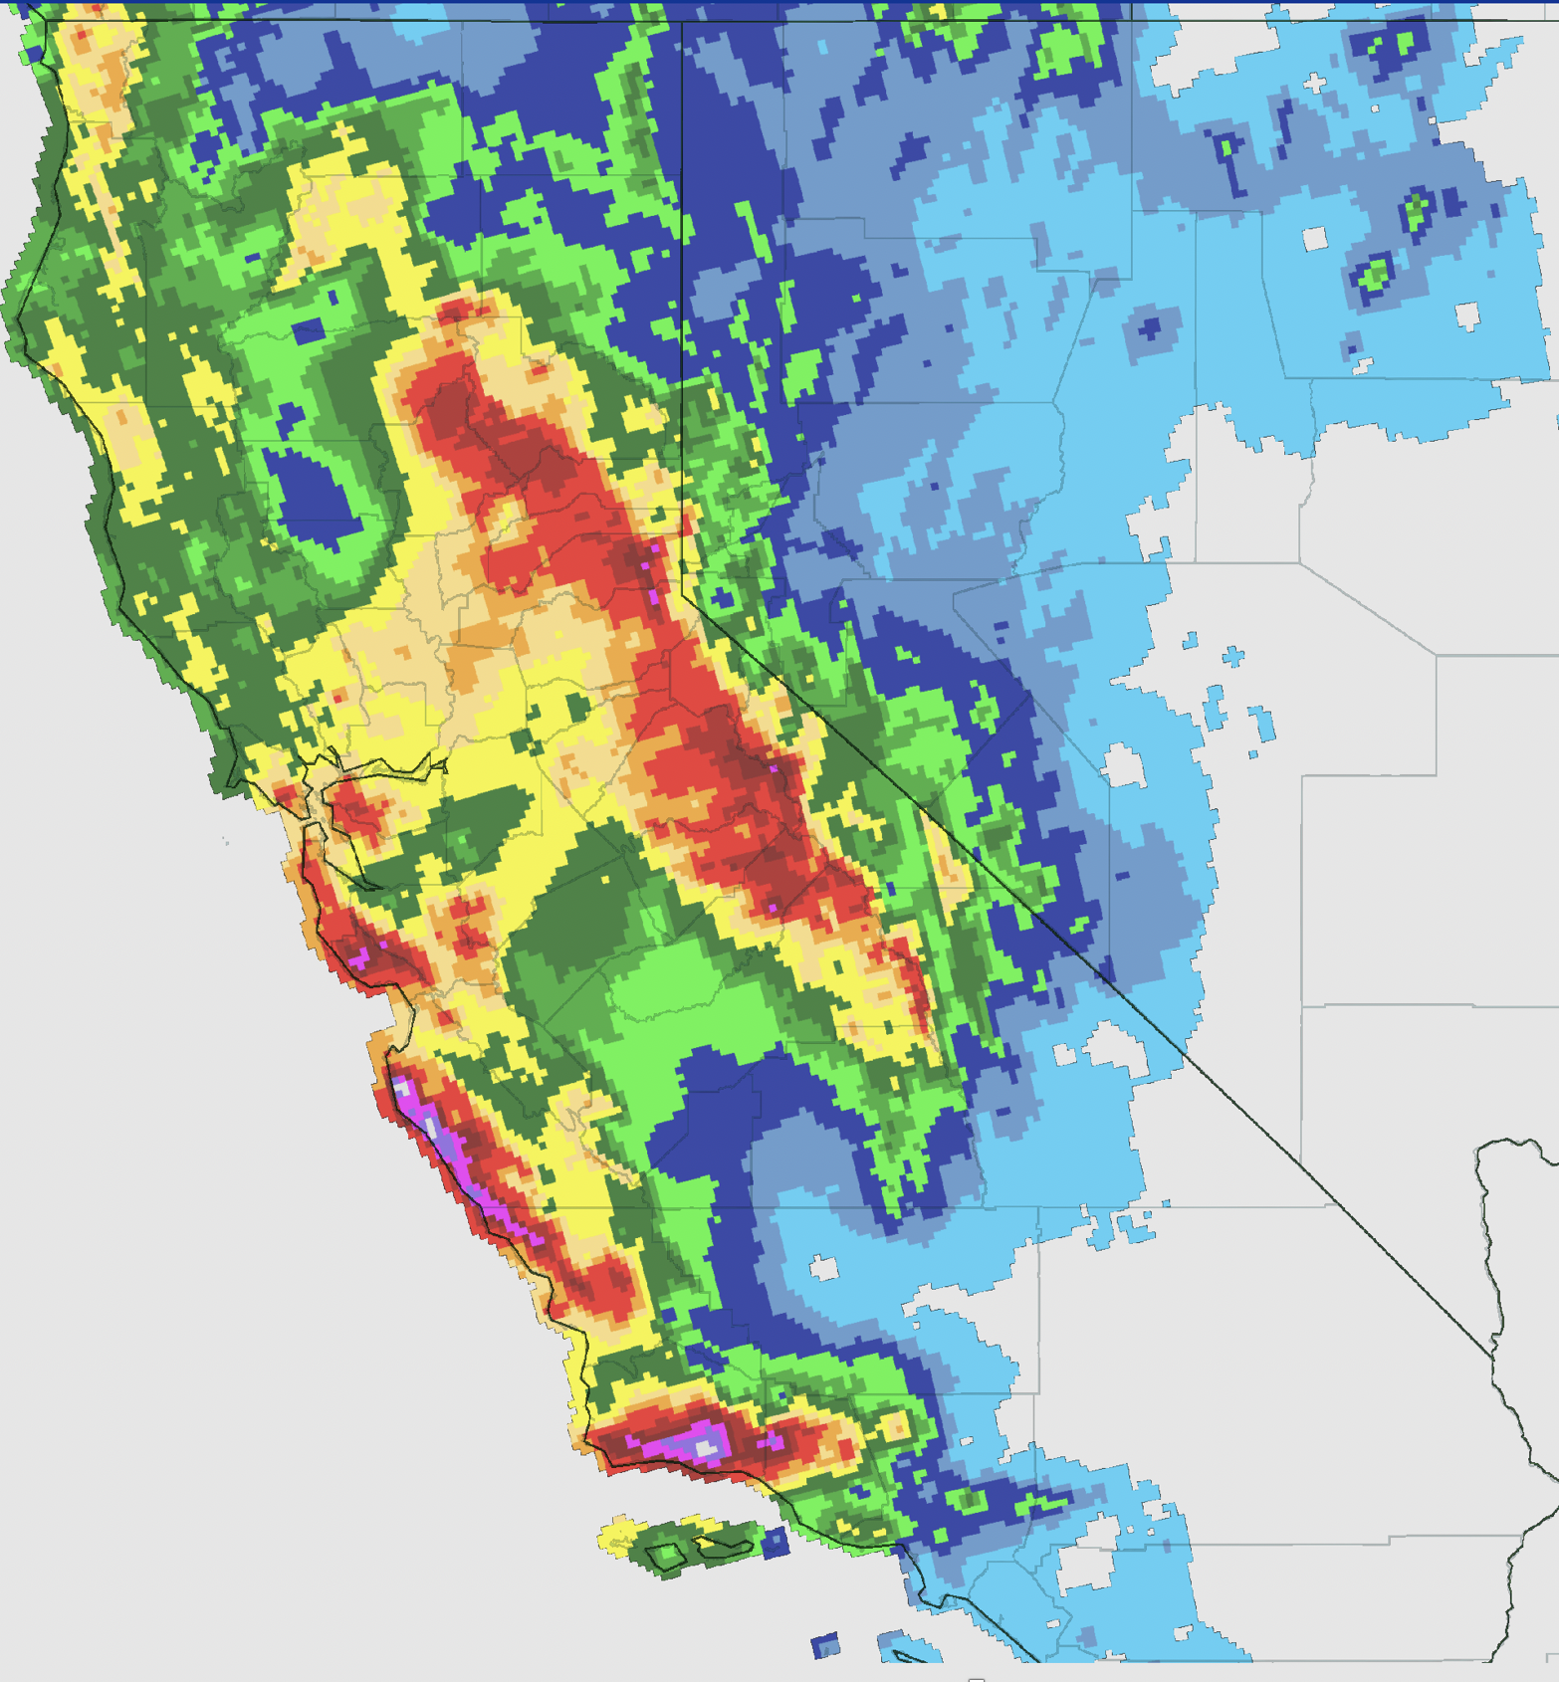
Raw global model guidance + statistical adjustment provides small-scale terrain detail
representing work at the NOAA Physical Sciences Lab using global ensemble reforecasts, in transition to NWS

Slide 7
Conclusions
NOAA’s existing global forecast model development and its refinement will be key to providing AR forecasts with sufficient lead time to make decisions.
Global models + statistical adjustment can provide the high-resolution detail of regional models without their disadvantage of not modeling global weather patterns.
We hypothesize that the operational usage of upcoming satellite-based radar will fill in many data gaps in the Pacific Ocean and elsewhere, improving forecasts.

