Slide 1


The impact of targeted observations from 2011 Winter Storms Reconnaissance on deterministic forecast accuracy
NOAA Earth System
Research Laboratory
Tom Hamill
NOAA Earth System Research Lab, Physical Sciences Division
also: Fanglin Yang, Carla Cardinali, Sharanya Majumdar
contact: tom.hamill@noaa.gov
presentation at AMS Annual Conference 2013, Austin, TX

Slide 2
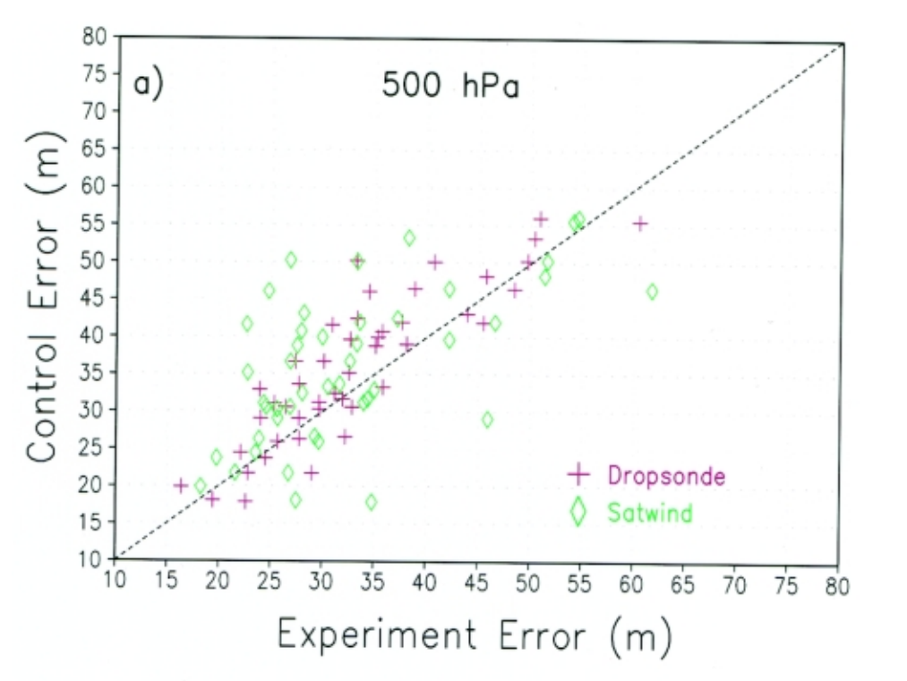
Previously (~10 years ago) there were many optimistic assessments on the impact of mid-latitude targeted observations
Example: results from 1998. Over many
cases, where either extra cloud-drift
wind measurements or dropsonde
data were assimilated in pre-defined
sensitive regions, there was a reduction
in error in the target verification area.
From Langland et al. July 1999
BAMS article on NORPEX-98 expt.

Slide 3
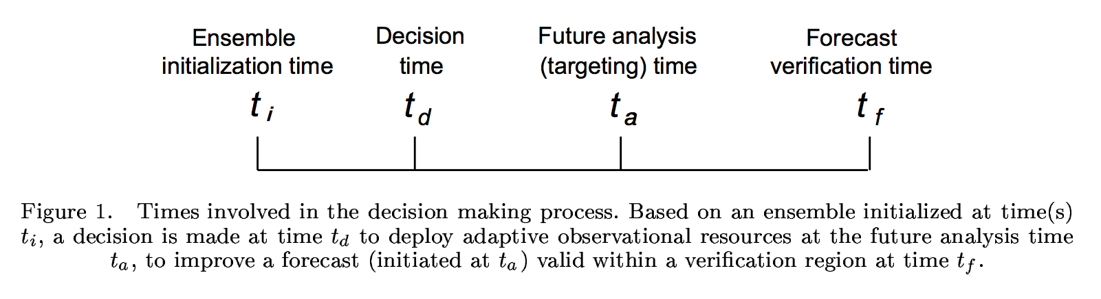
Targeted observation concept

Slide 4
Will mid-latitude dropwindsonde targeting have the same effect in the 2010’s?
More observations, especially satellite, so fewer “gaps” in the global observing system.
Better models.
Better data assimilation systems.

Slide 5
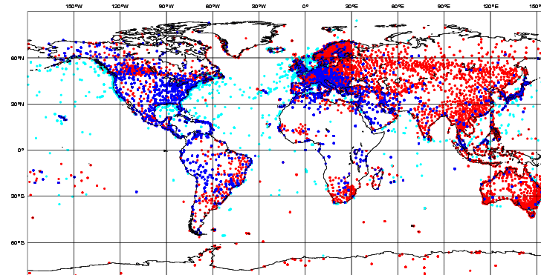
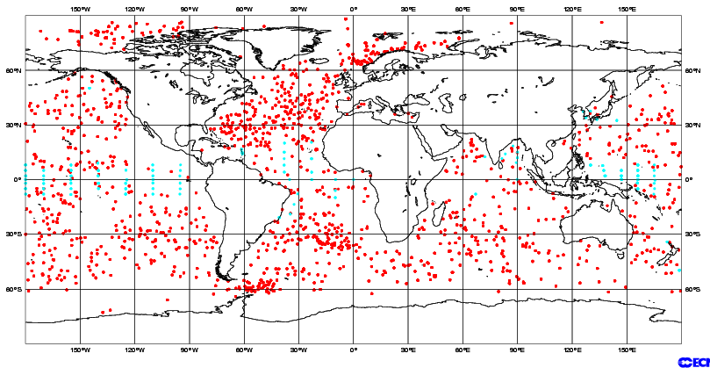
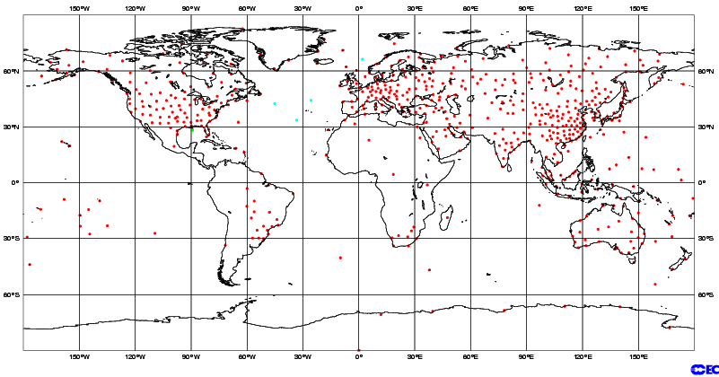
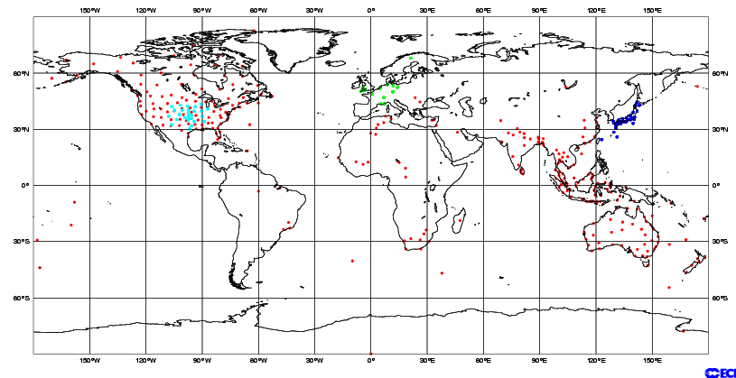
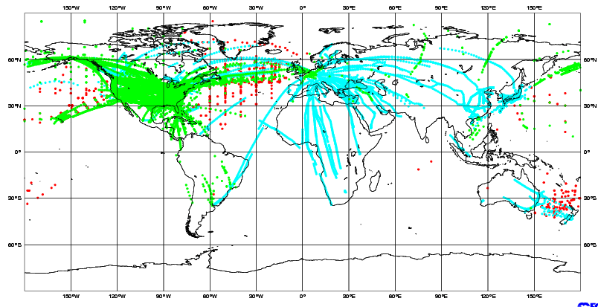
ECMWF: conventional observations used
SYNOP/METAR/SHIP:
MSL Pressure, 10m-wind, 2m-Rel.Hum.
DRIBU: MSL Pressure, Wind-10m
Radiosonde balloons (TEMP):
Wind, Temperature, Spec. Humidity
PILOT/Profilers: Wind
Aircraft: Wind, Temperature

Slide 6
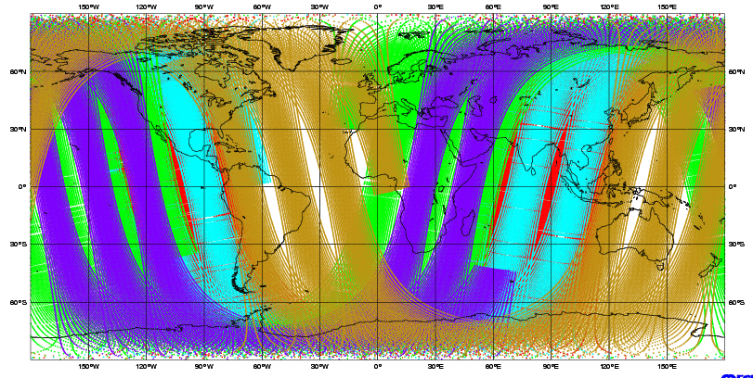
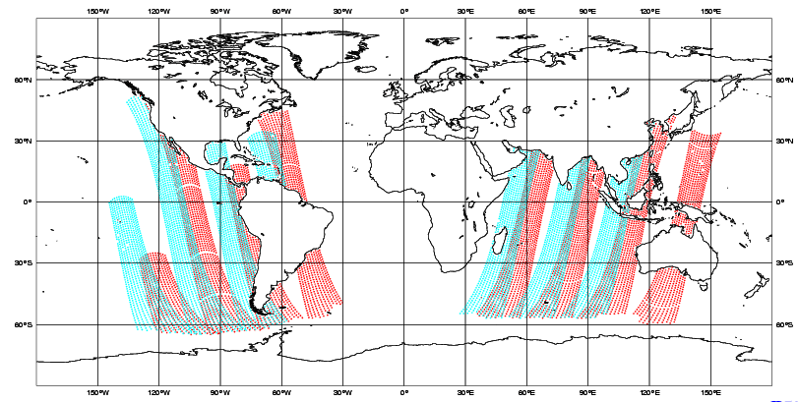
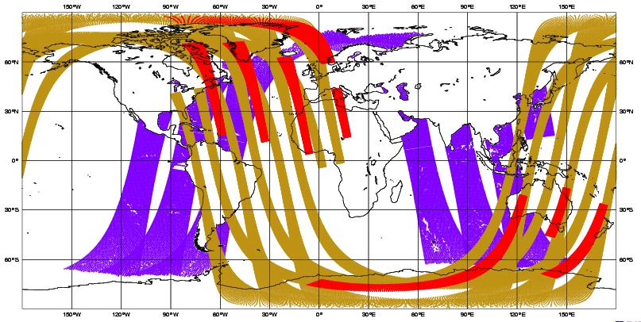
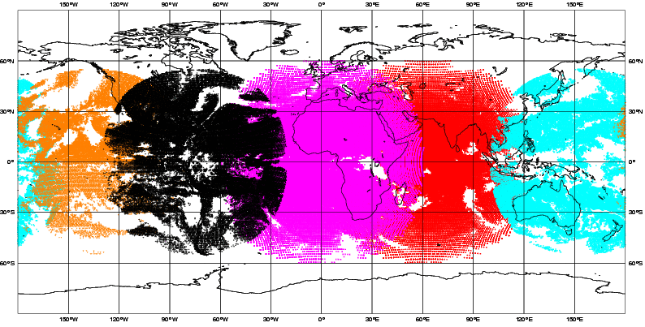
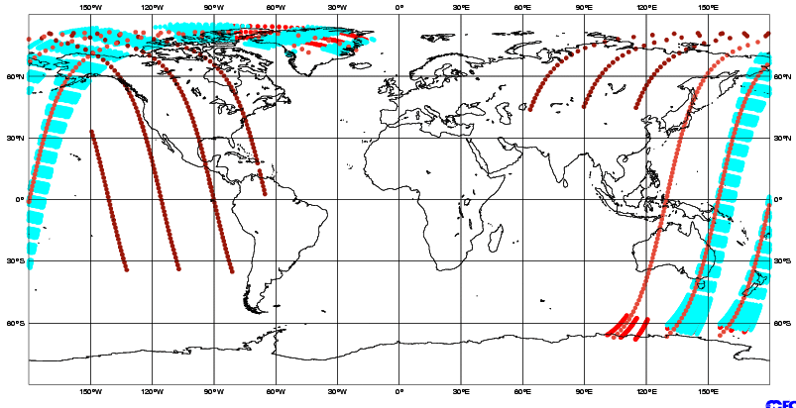
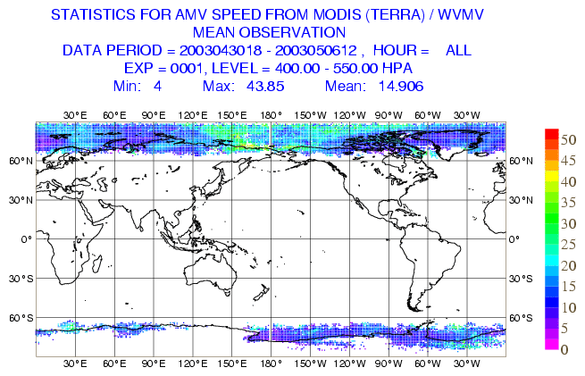
Satellite data sources used in the operational ECMWF analysis
13 Sounders: NOAA AMSU-A/B, HIRS, AIRS, IASI, MHS
5 imagers: 3xSSM/I, AMSR-E, TMI
3 Scatterometer sea winds: ERS, ASCAT, QuikSCAT
Geostationary, 4 IR and 5 winds
4 ozone
2 Polar, winds: MODIS
6 GPS radio occultation

Slide 7
Satellite data usage at ECMWF, past, present and near future
Millions of observations assimilated per 24h period

Slide 8
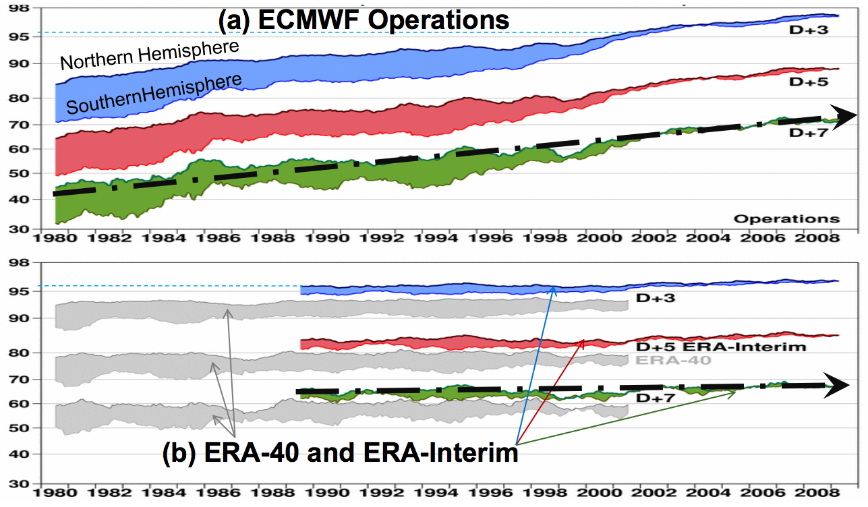
…though it’s probably more the improved assimilation techniques and models that have improved skill.
http://www.ecmwf.int/newsevents/training/
meteorological_presentations/pdf/DA/ERA.pdf

Slide 9
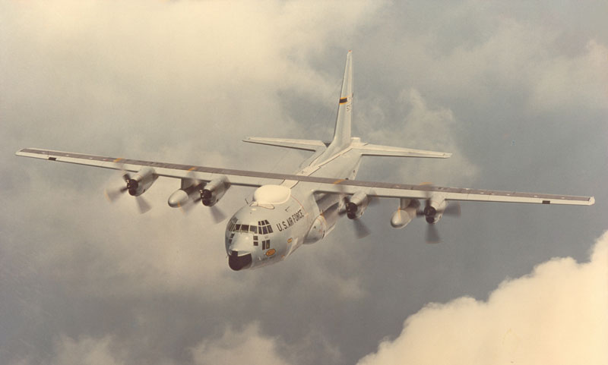
Are targeted observations still valuable enough to merit expensive plane flights (and staff time to run targeted observation program)?

Slide 10
NOAA’s Winter Storms Reconnaissance Program
Each winter day, NOAA forecasters ID systems that may impact US during the next week.
Forecasters consider automated guidance (ensemble transform Kalman filter, or “ETKF”) to identify regions of longer-range forecast uncertainty and what uncertainty in earlier forecast features were primarily responsible.
Examine ETKF’s estimates of potential reduction of analysis/forecast errors were observations taken in a given constellation.
Determine approximately optimal flight path to reduce analysis errors the most.
Assign subjective importance to case (low/med/high), determine a target verification region where high-impact forecasts are expected, and suggest reconnaissance mission to pilots.
Pilots fly the mission and take targeted observations (typically dropwindsondes).
Extra observations are assimilated alongside the normal observations.

Slide 11
What hasn’t been done over the past decade.
Parallel assimilations and forecasts, with and without the targeted observations, using …
A modern data assimilation method (e.g., 4D-Var, ensemble Kalman filter, or hybrid), and …
A modern generation, higher-resolution global forecast model.
A systematic comparison of forecast errors with and without targeted observations.

Slide 12
2011 WSR Impact Study
22 high, 62 medium, 14 low-priority cases, and 776 dropwindsondes deployed.
Target verification times from +12 to +120 h.

Slide 13
Impact study design
Assimilate with ECMWF 4D-Var (version 37r2 of IFS; T511L91 outer loop, linearized T159, T159, and T255 inner loops).
Parallel assimilation and forecast cycles without (“NODROP”) and with (“CONTROL”).
Deterministic forecasts to +5 days lead, T511L91
Verification in ~ total energy norm in 20x20-degree target verification region, and over PNA region. Verification against CONTROL analysis.
Also: verification of precipitation forecasts over CONUS.

Slide 14
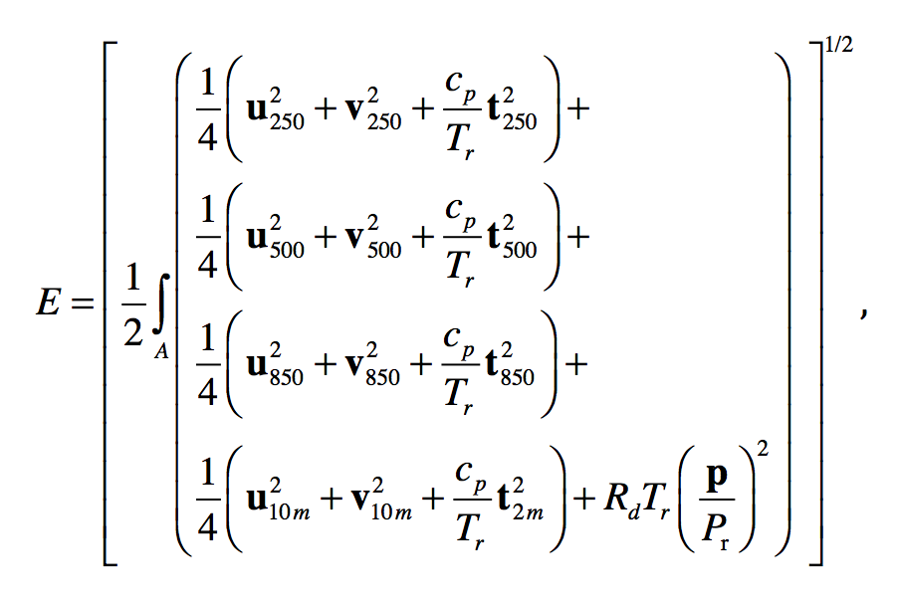
(Approximate) total-energy norm

Slide 15
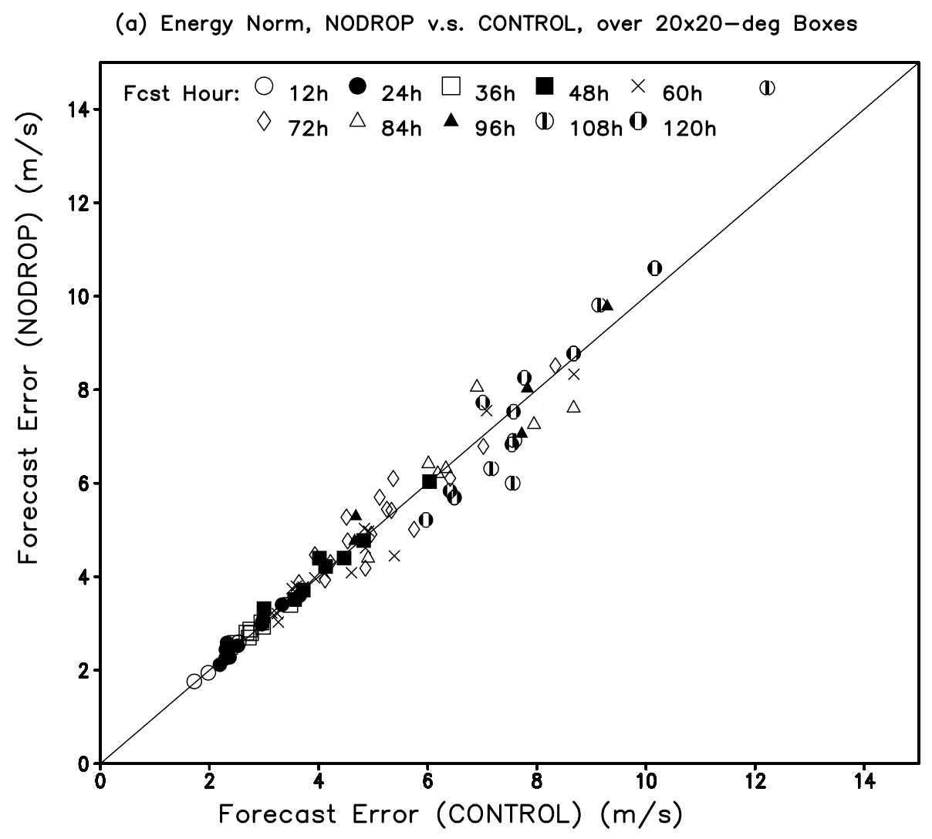
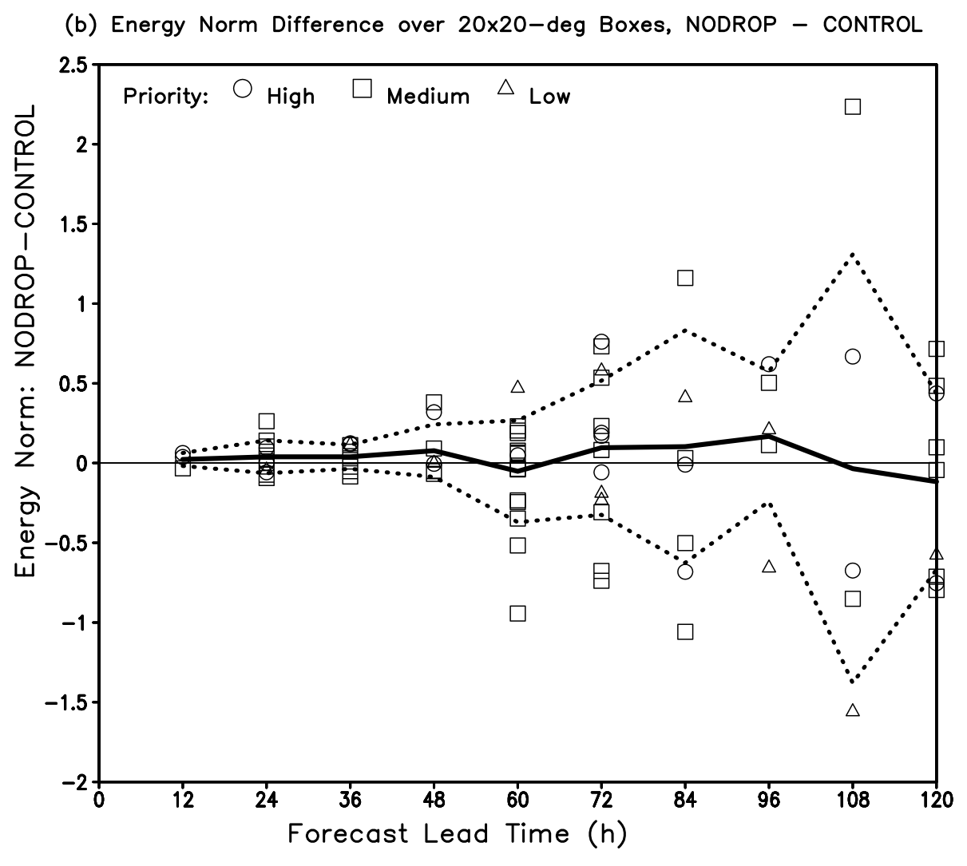
Results over target verification region

Slide 16
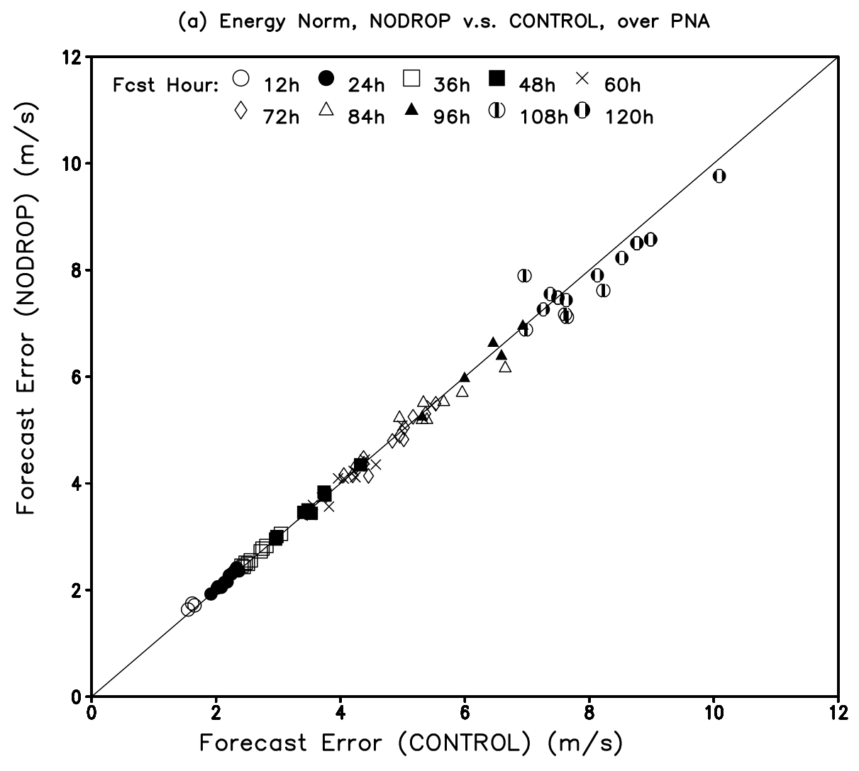
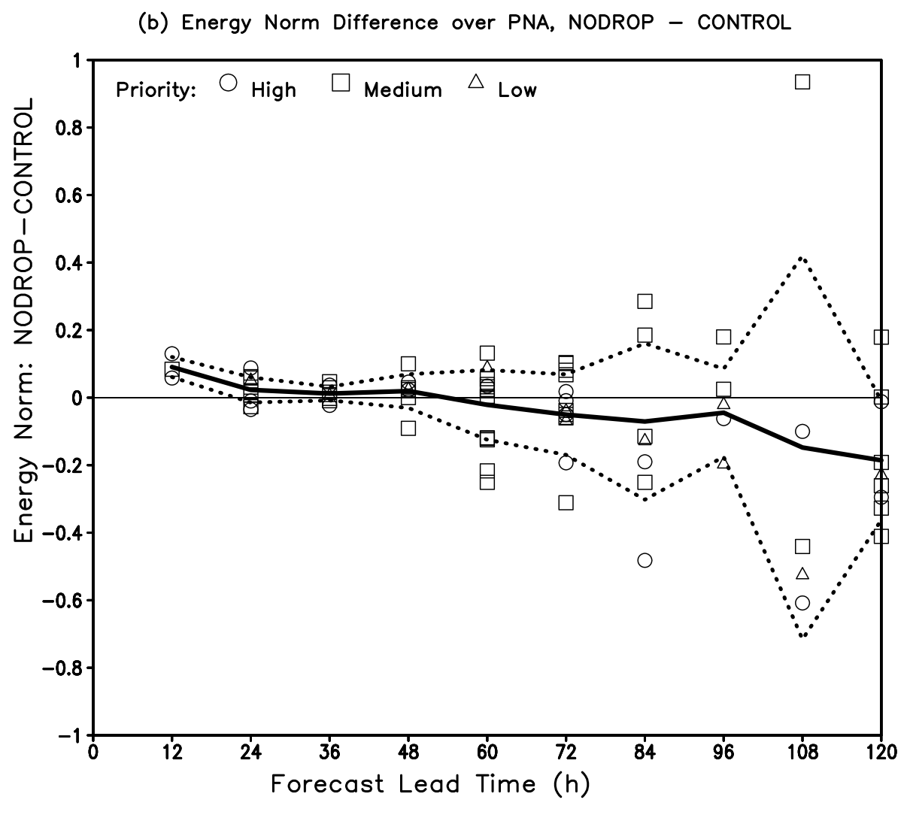
Results over broader PNA region

Slide 17
24-48 h precipitation forecast skill

Slide 18
+48-72 h precipitation forecast skill

Slide 19
Conclusions
No significant positive forecast impact from assimilation of 2011 WSR data in ECMWF system.
Possible reasons:
  Incomplete targeting of sometime relatively large initial sensitive regions.
  Better forecast and assimilation systems.
  More observations
What next?
  Targeted observations more focused on increased use of satellite data (cloud-drift winds, radiances, etc.).

Slide 20

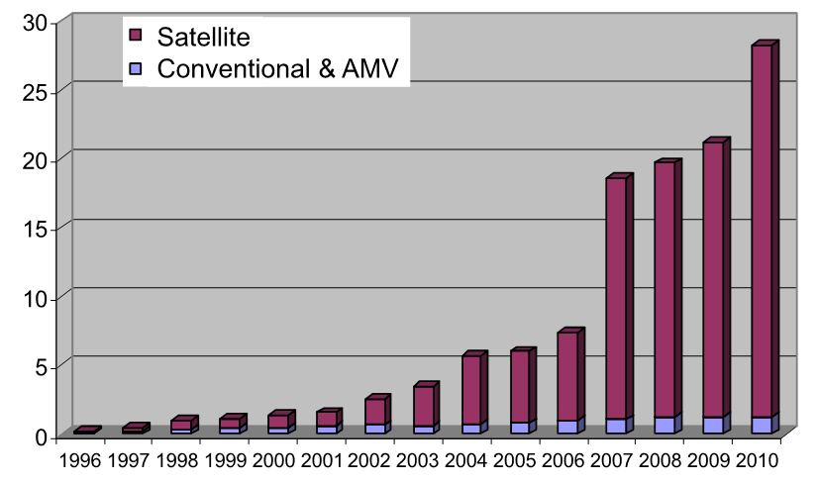
Significant increase in number of observations assimilated
Conventional and satellite data assimilated at ECMWF 1996-2010
from tinyurl.com/ecmwf-satreport

