Slide 1
A primer on ensemble weather prediction and the use of probabilistic forecasts
NOAA Earth System
Research Laboratory
Tom Hamill
NOAA Earth System Research Laboratory
Physical Sciences Division
tom.hamill@noaa.gov
Presentation to 2011 Albany Utility Wind Integration Workshop

Slide 2
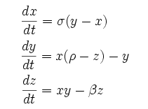
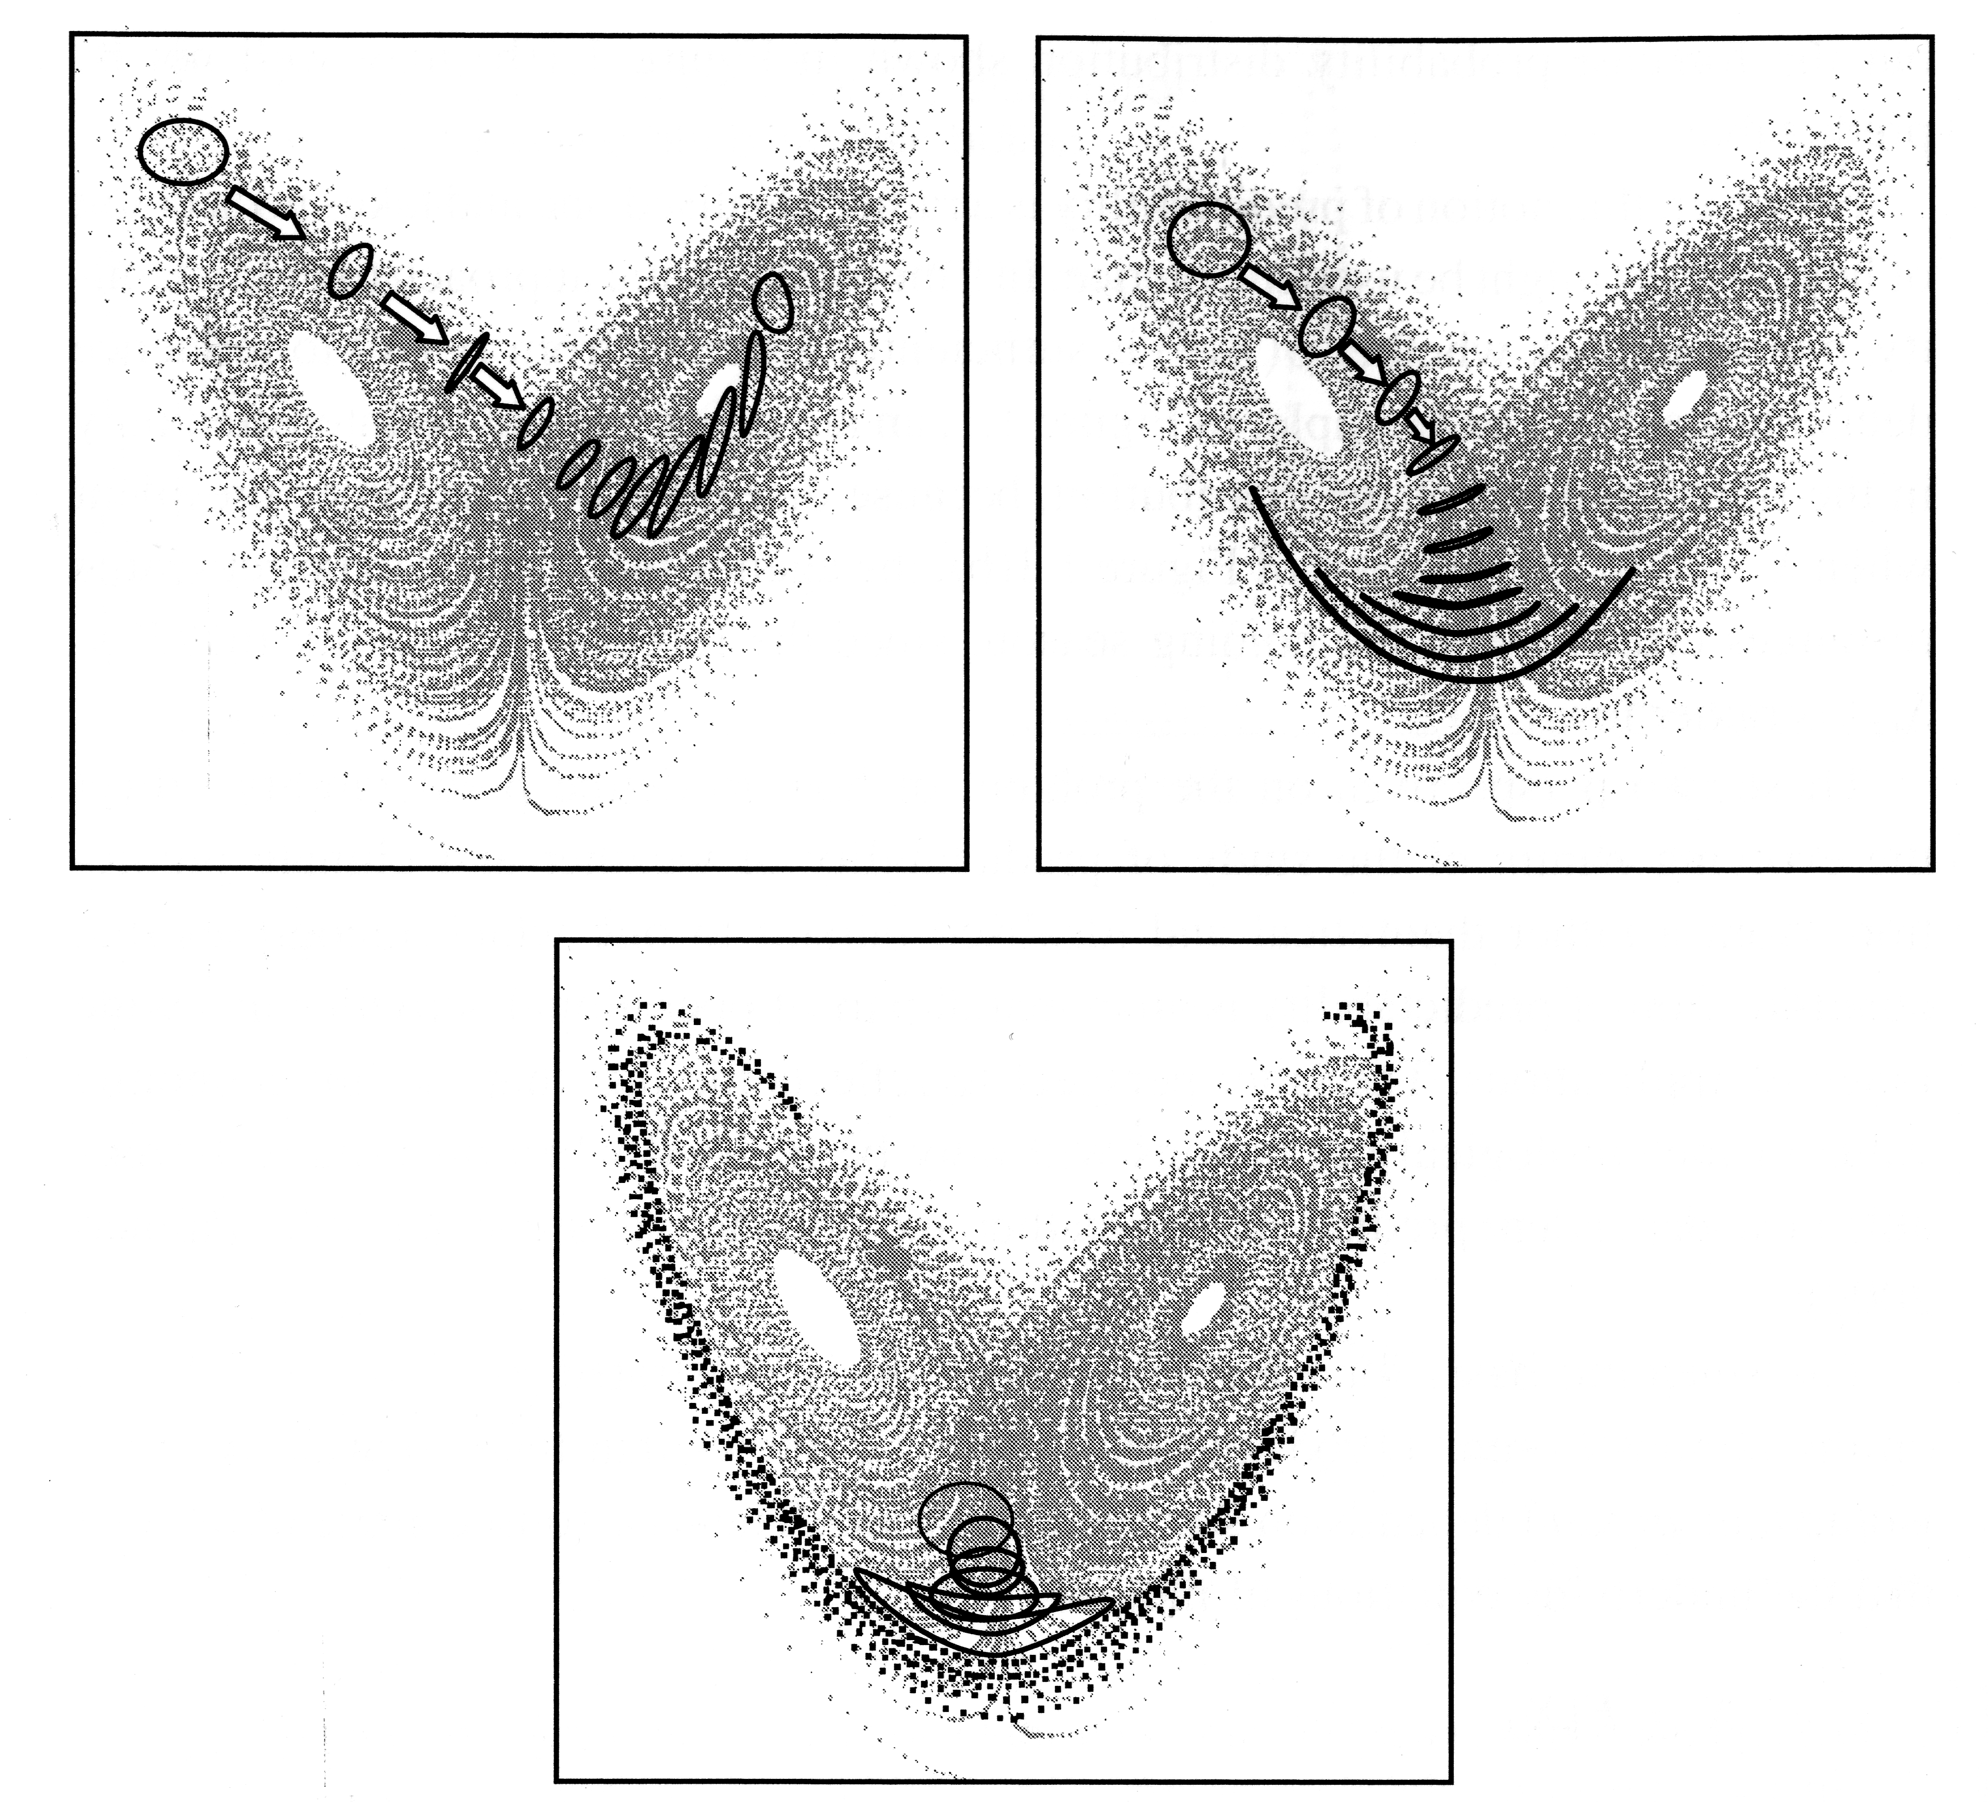
Uncertainty is inevitable, and “state dependent”
The Lorenz (1963) model
σ, ρ, β αρε φιξεδ.
A toy dynamical system that illustrates
the problem of “deterministic chaos” that
we encounter in weather prediction models. Forecast uncertainty grows more quickly for some initial conditions than others.
from Tim Palmer’s chapter in 2006 book “Predictability of Weather and Climate”

Slide 3
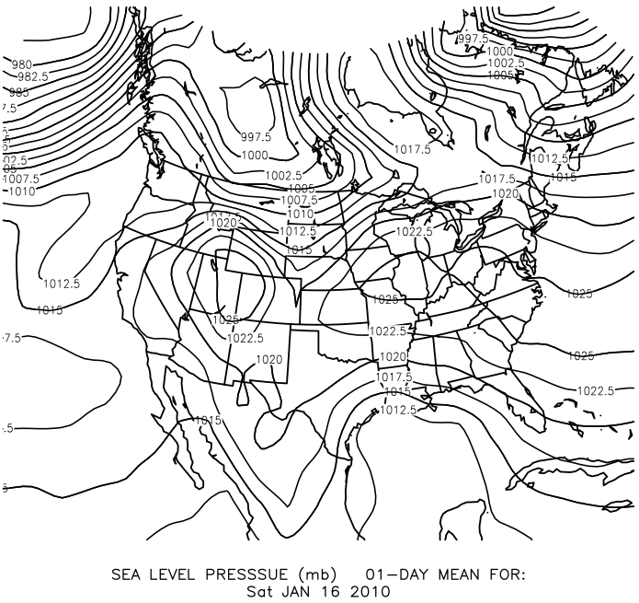
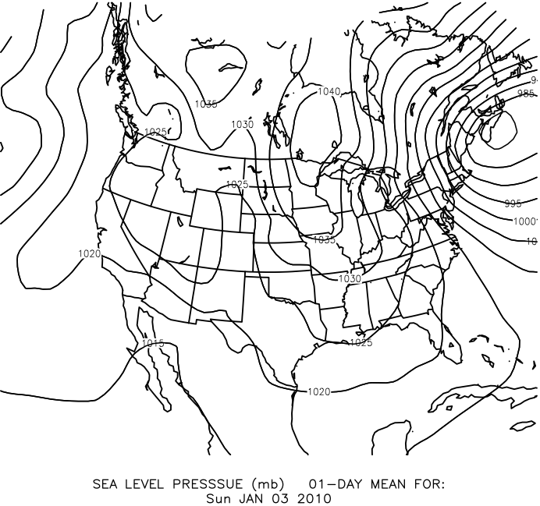
Amount of uncertainty depends on weather regime.
High wind uncertainty;
timing & strength of trough.
Lower wind uncertainty;
no major weather systems around.

Slide 4
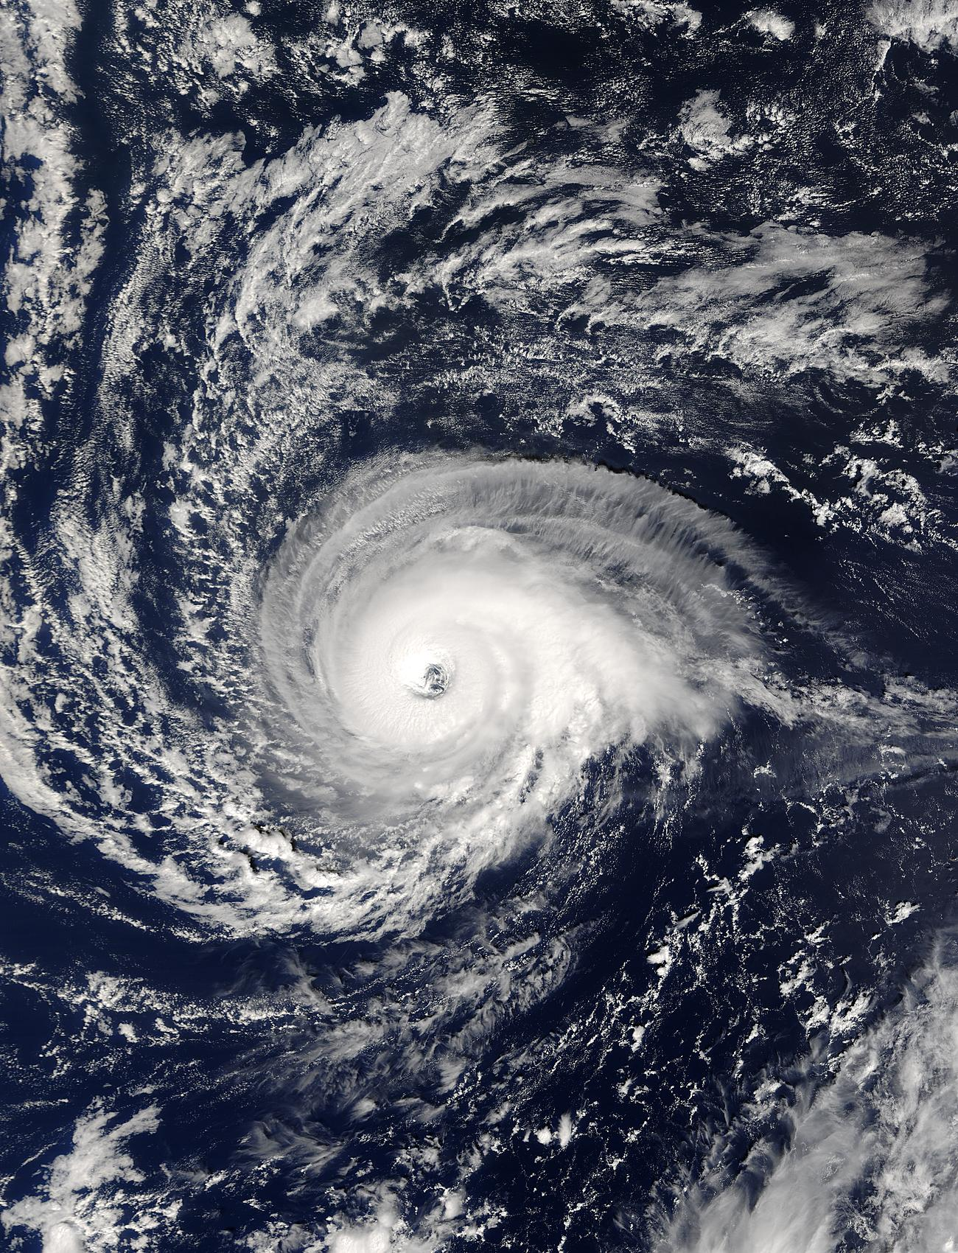
Forecast uncertainty also contributed by model imperfections
“Parameterizations”
Much of the weather occurs at scales smaller than those resolved by the weather forecast model. A forecast model must treat, or “parameterize” the effects of the
sub-gridscale on the resolved scale.
Problems: (1) no variability at scales smaller than the box from this model; (2) parameterizations are approximations, and often not good ones.

Slide 5
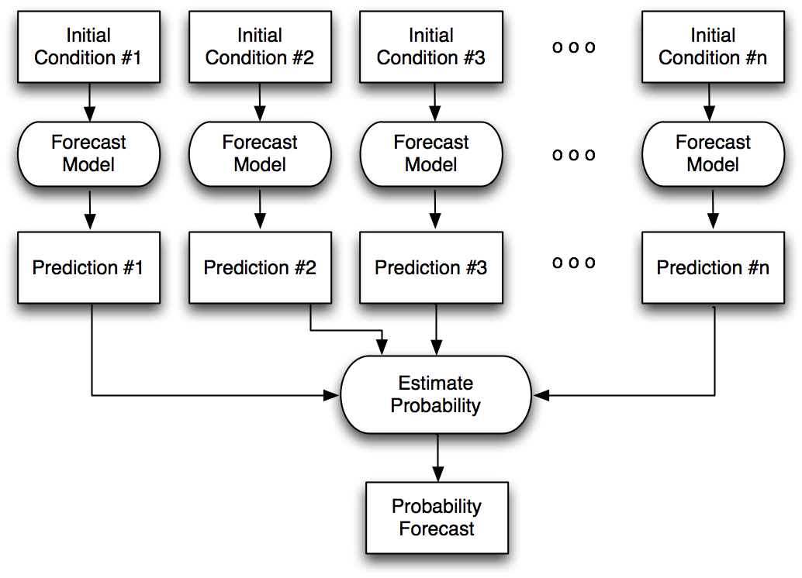
“Ensemble prediction”
Perhaps different
forecast models,
or built-in
stochastic effects
to account for
model uncertainty

Slide 6
Desirable properties of probabilistic forecasts & common methods to evaluate them.
Reliability/calibration: when you say X%, it will happen X% of the time.
calibration: observed and ensemble considered samples from the same probability distribution
Specificity of the forecast, i.e., sharpness. Deviations from the climatological. We want forecasts as sharp as they can be as long as they’re reliable.

Slide 7
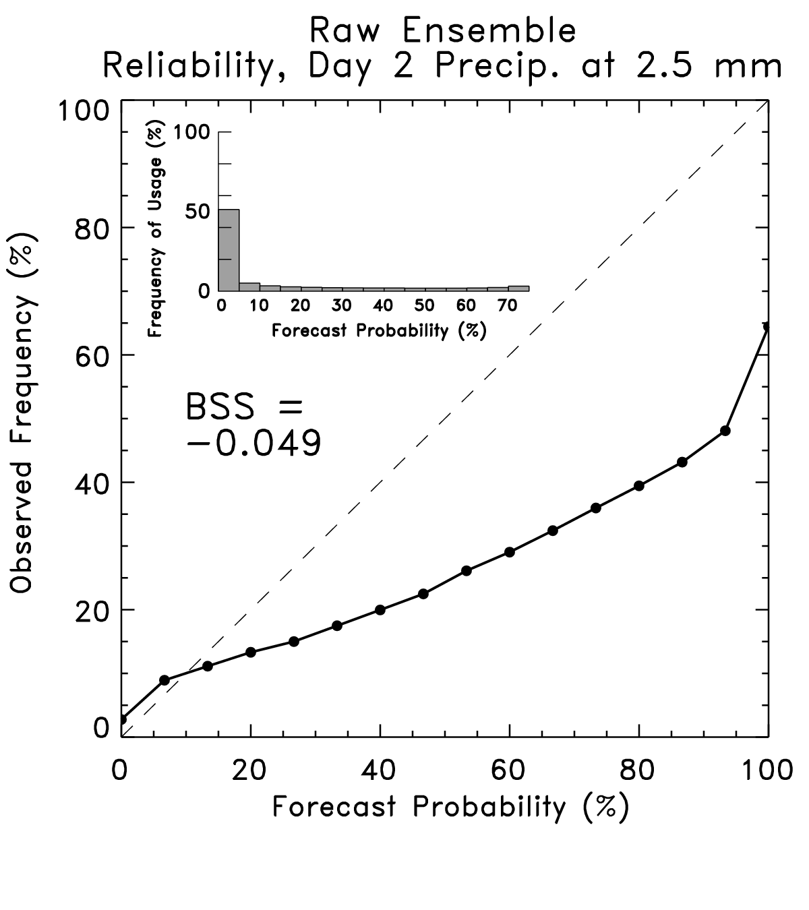
Reliability diagrams (built with lots of samples)

Slide 8
Reliability diagrams
Curve tells you what
the observed frequency
was each time you
forecast a given probability.
This curve ought to lie
along y = x line. Here this
shows the ensemble-forecast
system over-forecasts the
probability of light rain.
Ref: Wilks text, Statistical Methods in the Atmospheric Sciences

Slide 9
Reliability diagrams
Inset histogram tells
you how frequently
each probability was
issued.
Perfectly sharp:
frequency of usage
populates only
0% and 100%.
Ref: Wilks text, Statistical Methods in the Atmospheric Sciences

Slide 10
Reliability diagrams
BSS = Brier Skill Score
BS(•) measures the
Brier Score, which you
can think of as the
squared error of a
probabilistic forecast.
Perfect: BSS = 1.0
Climatology: BSS = 0.0
Ref: Wilks text, Statistical Methods in the Atmospheric Sciences

Slide 11
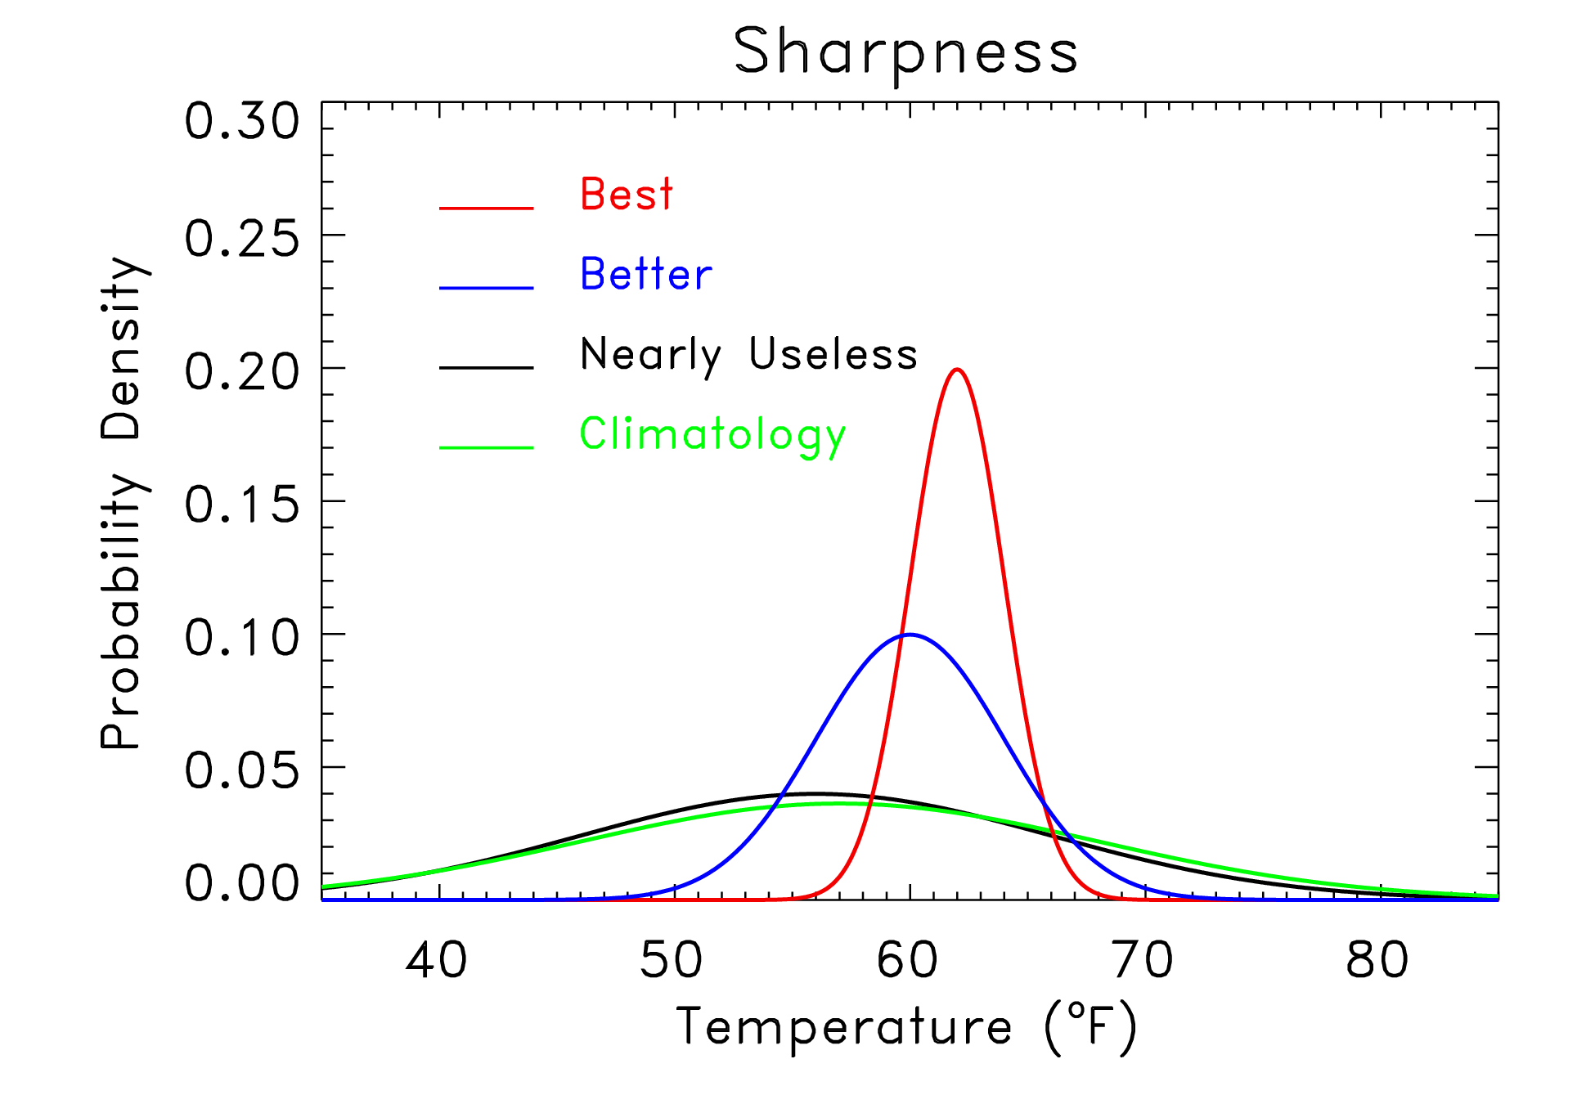
Sharpness
“Sharpness”
measures the
specificity of
the probabilistic
forecast. Given
two reliable forecast
systems, the one
producing the
sharper forecasts
is preferable. Might
be measured with
standard deviation of
ensemble about its
mean.
But: don’t want
sharp if not reliable.
Implies unrealistic
confidence.

Slide 12
“Spread-error” relationships are important, too.
Small-spread ensemble forecasts should have less ensemble-mean error than large-spread forecasts, in some sense a conditional reliability dependent upon amount of sharpness.
ensemble-mean
error from a sample
of this pdf on avg.
should be low.
ensemble-mean
error should be
moderate on avg.
ensemble-mean
error should be
large on avg.

Slide 13
General benefits from use of ensembles
Averaging of many forecasts reduces error.
Proper use of probabilistic information permits better decisions to be made based on risk tolerance.

Slide 14
Dangers of “ensemble averaging” (smoothes out meteorological features)
individual members
wind speed
decision
threshold
Here the ensemble tells you something useful… a wind ramp is coming, but the exact timing is uncertain. Information lost if you boil it down to its average.
time
ensemble average
wind speed
decision
threshold
time

Slide 15
Two general methods of providing you with useful local probabilistic information
Dynamical downscaling (run high-resolution ensemble systems to provide local detail).
Statistical downscaling (post-process coarser resolution model to fill in the local detail and missing time scales).

Slide 16
Potential value of dynamic downscaling
An example from high-resolution ensembles run during the
NSSL-SPC Hazardous Weather Test Bed, forecast initialized 20 May 2010
http://tinyurl.com/2ftbvgs
32-km SREF P > 0.5”
4-km SSEF P > 0.5 “
Verification
With warm-season precipitation, coarse resolution and parameterized convection of
operational SREF clearly is inferior to the 4-km, resolved convection in SSEF.

Slide 17
We still have a way to go to provide sharp, reliable forecasts directly from hi-res. ensembles. Case: Arkansas floods
An example from NSSL-SPC Hazardous Weather Test Bed, forecast initialized 10 June 2010
http://tinyurl.com/34568hp
SREF P > 2.0”
4-km SSEF P > 2.0 “
Verification (radar QPE)
A less than 30% probability of > 2 inches rainfall from SSEF, while better than SREF,
probably does not set off alarm bells in forecasters’ heads.

Slide 18
Statistical downscaling
Direct probabilistic forecasts from a global model may be unreliable, and perhaps too coarse time granularity for your purposes (winds every 3 h).
Assume you have:
a long time series of wind measurements.
a long time series of forecasts from a fixed model that hasn’t changed (“reforecasts”)
Can correct for discrepancies between forecast and observed using past data, adjust today’s forecast, quantify uncertainty.
Proven technique in “MOS” – what’s new here is the especially long time series of ensemble forecasts, helpful for making statistical adjustments in long-lead and rare events.

Slide 19
Potential value of statistical downscaling using “reforecasts”
Post-processing with large training data set can permit small-scale detail to be inferred
from large-scale, coarse model fields.

Slide 20
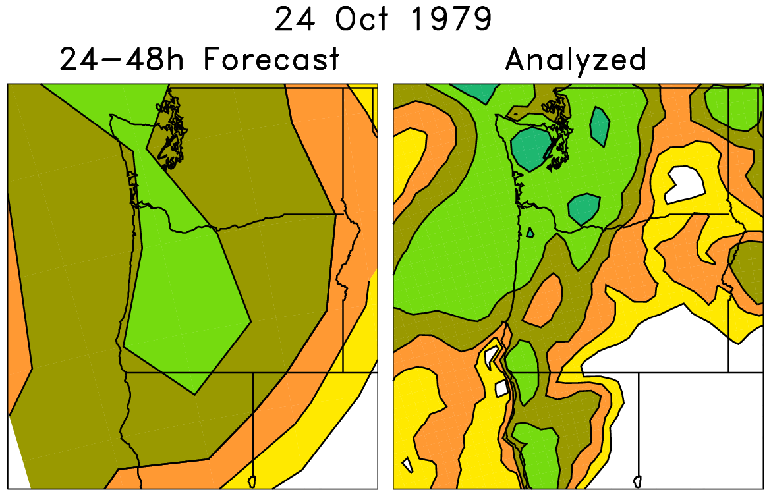
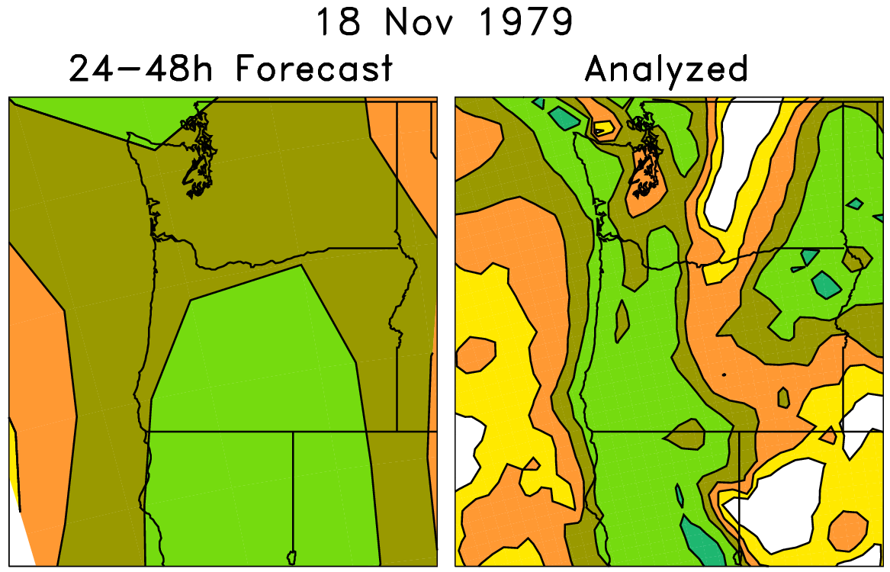
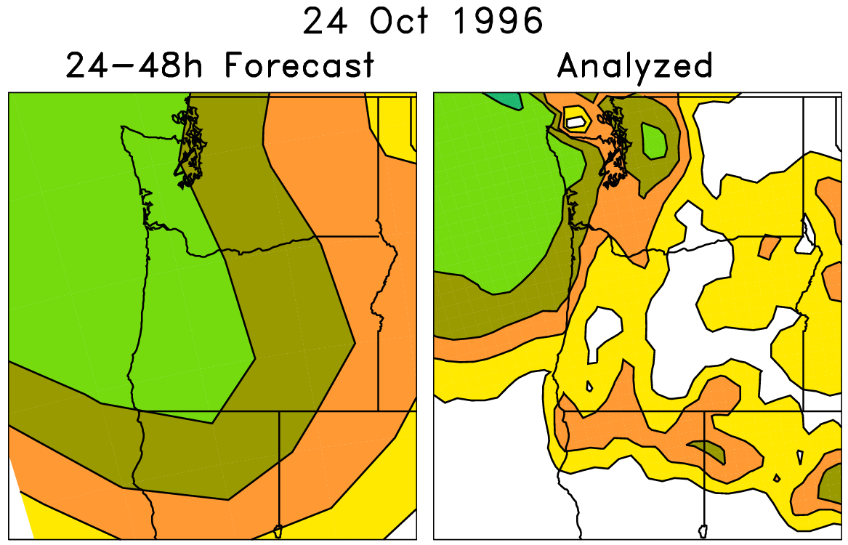
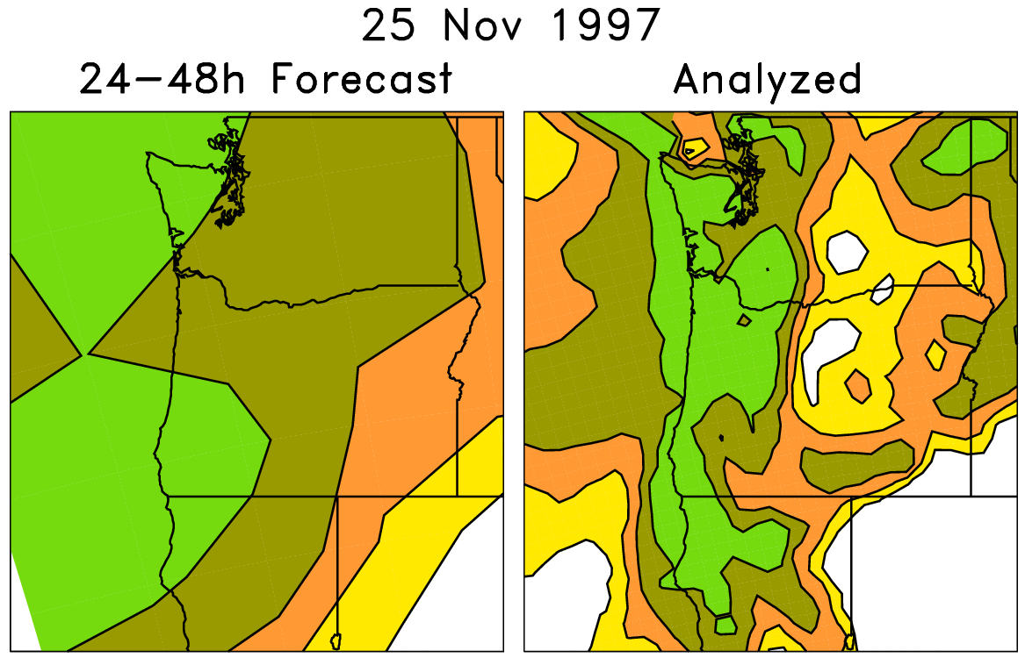
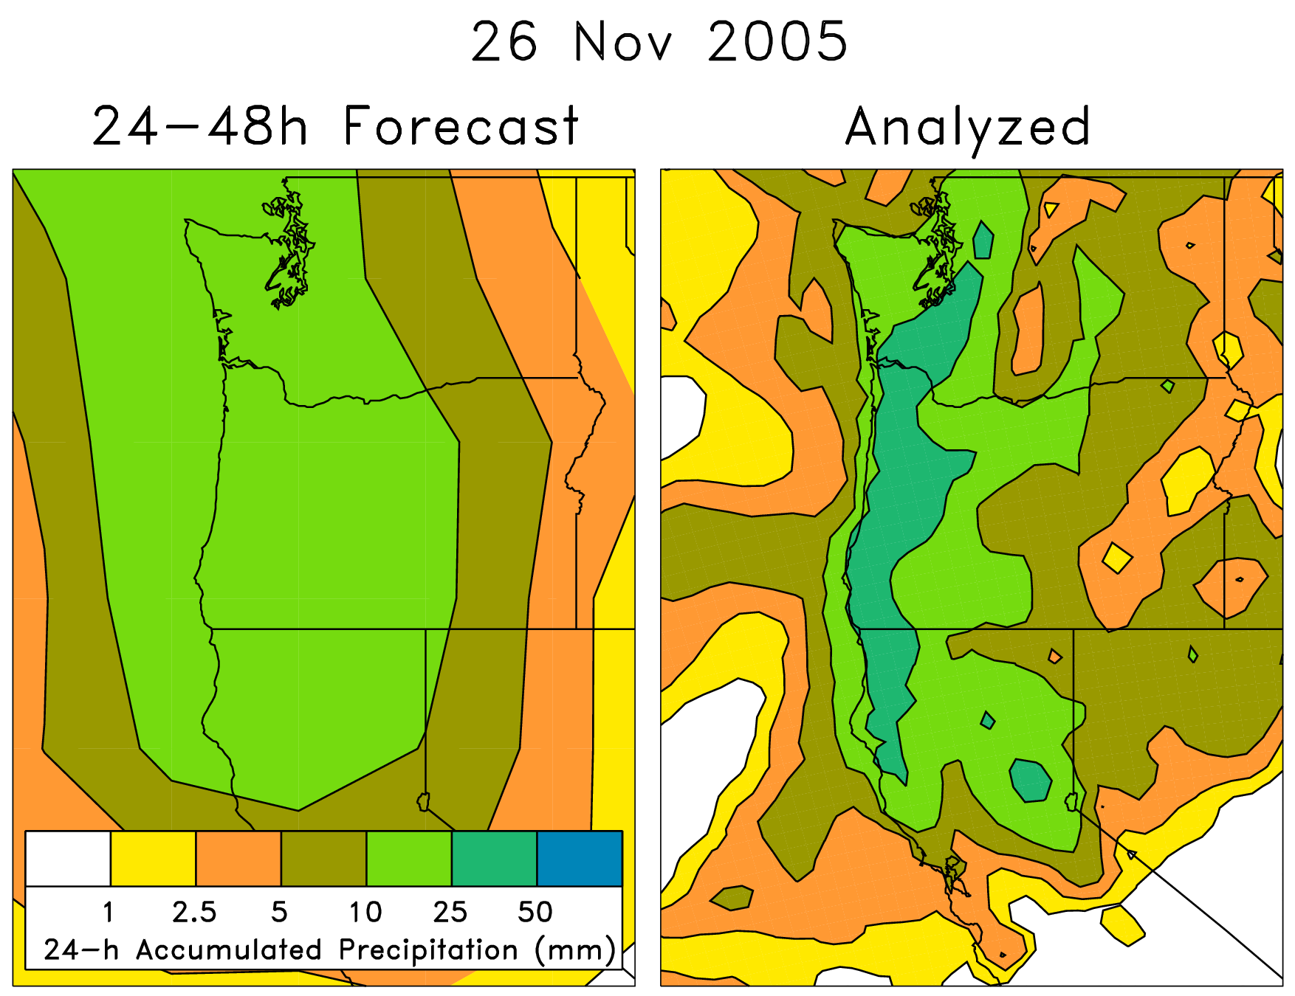
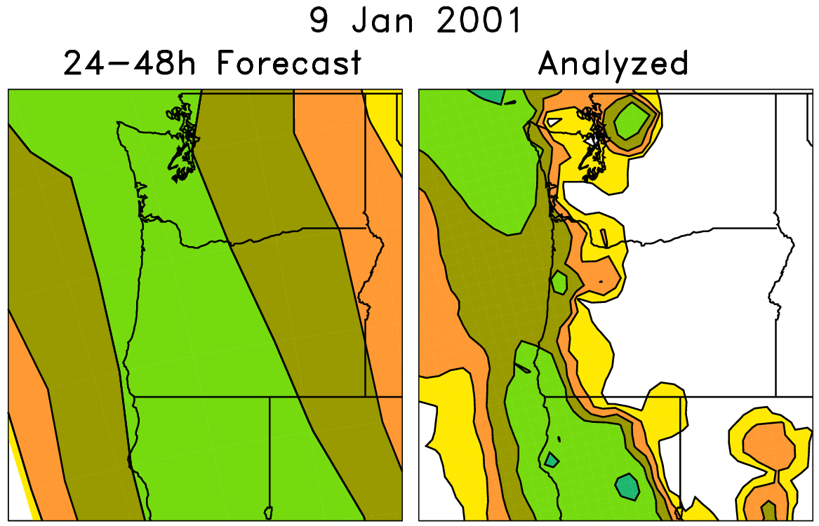
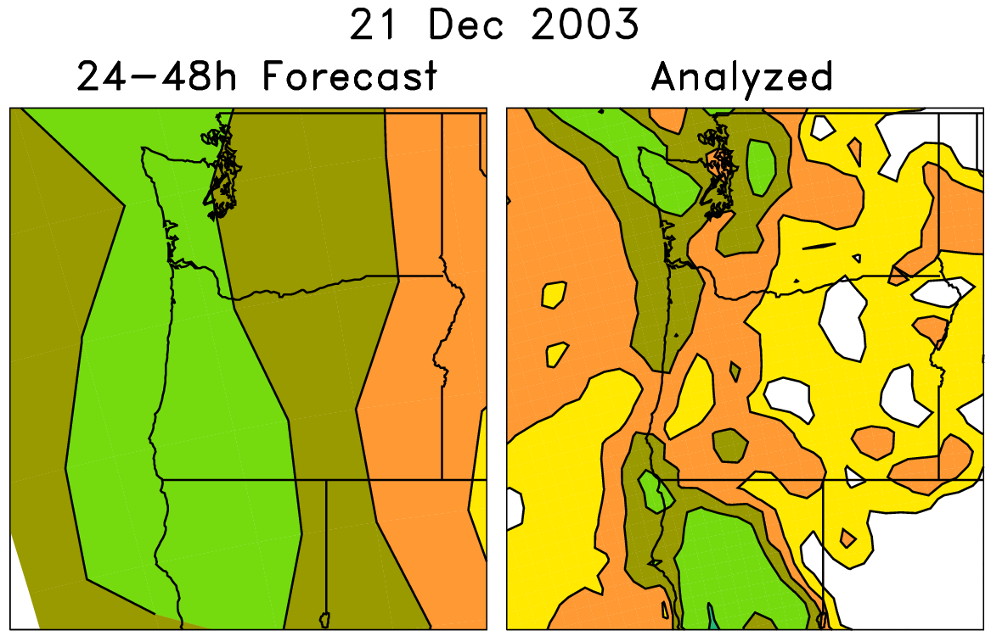
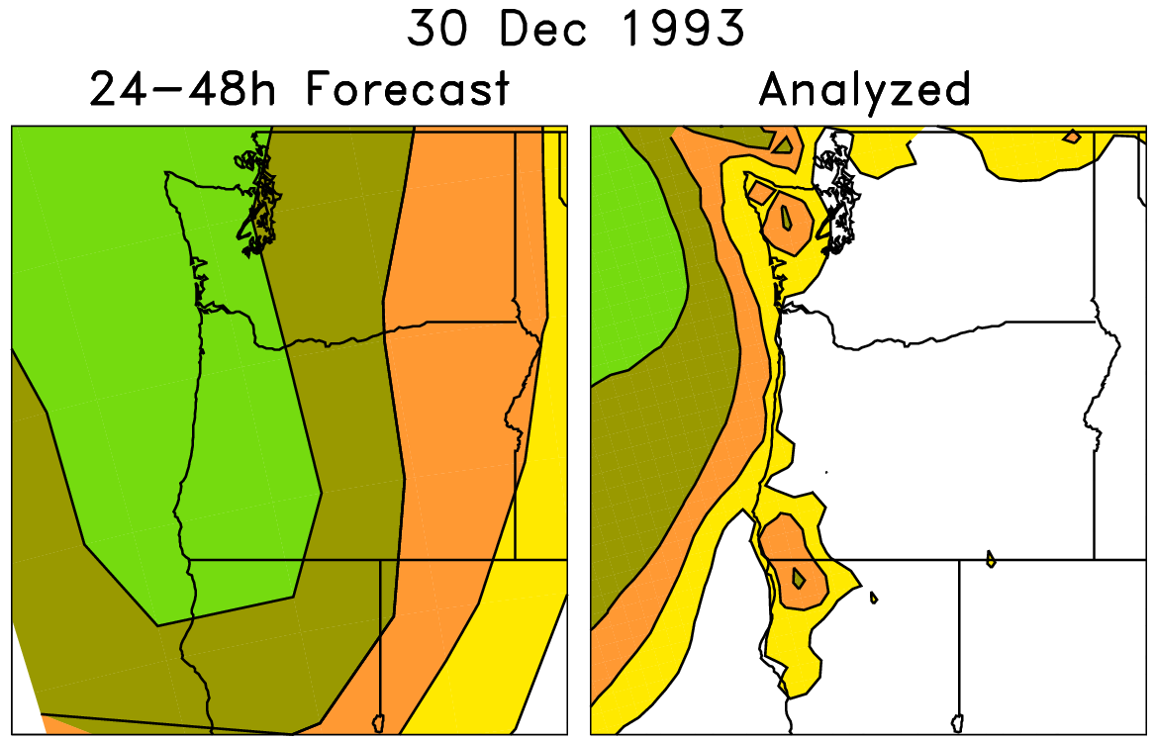
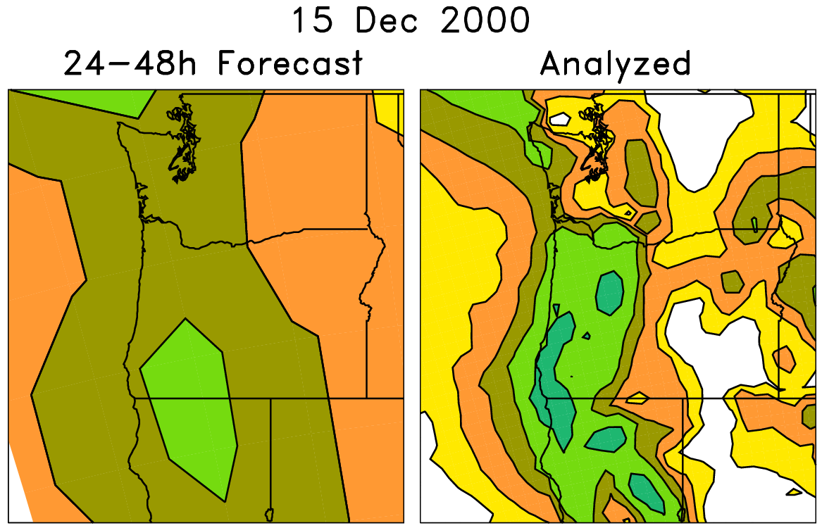
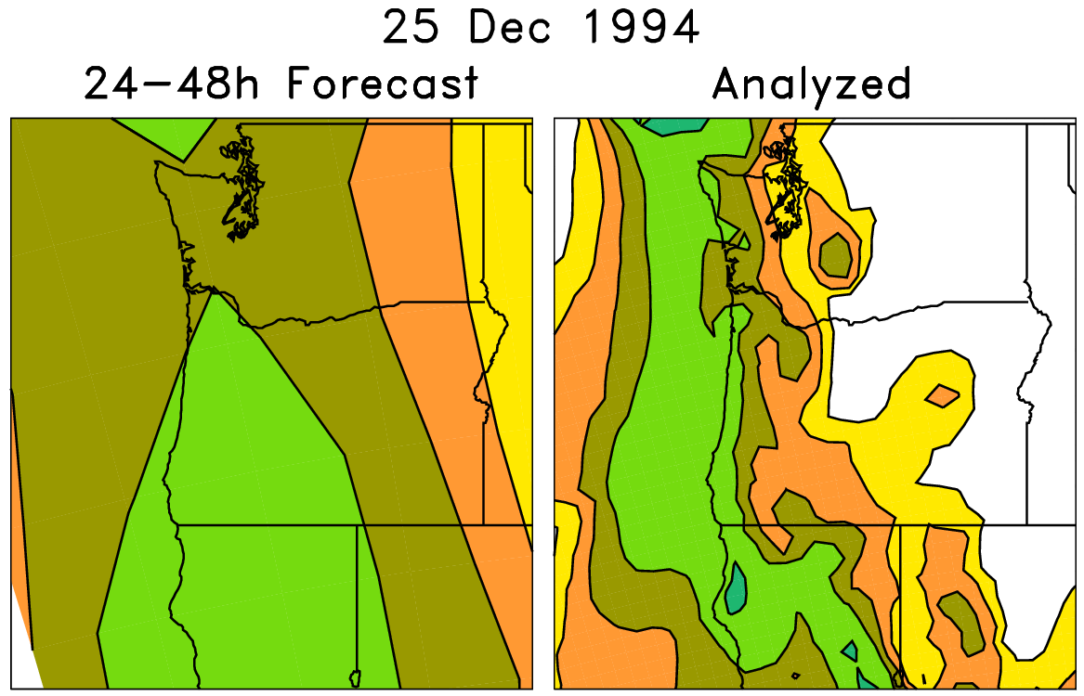
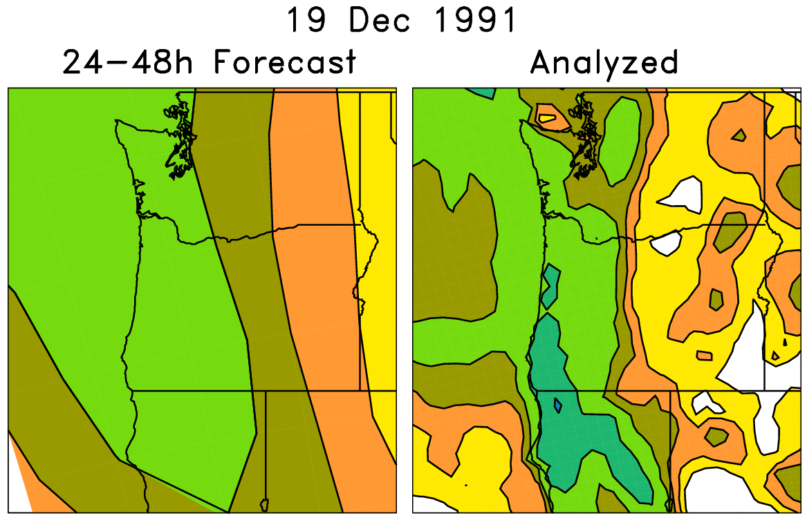
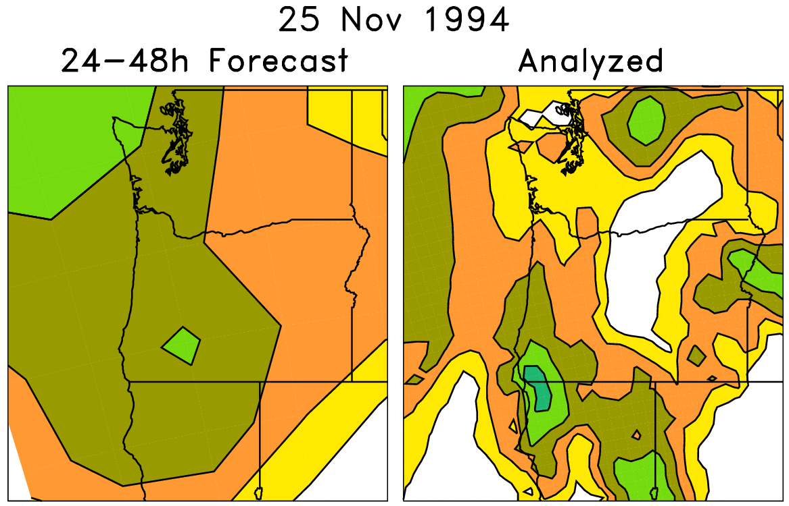
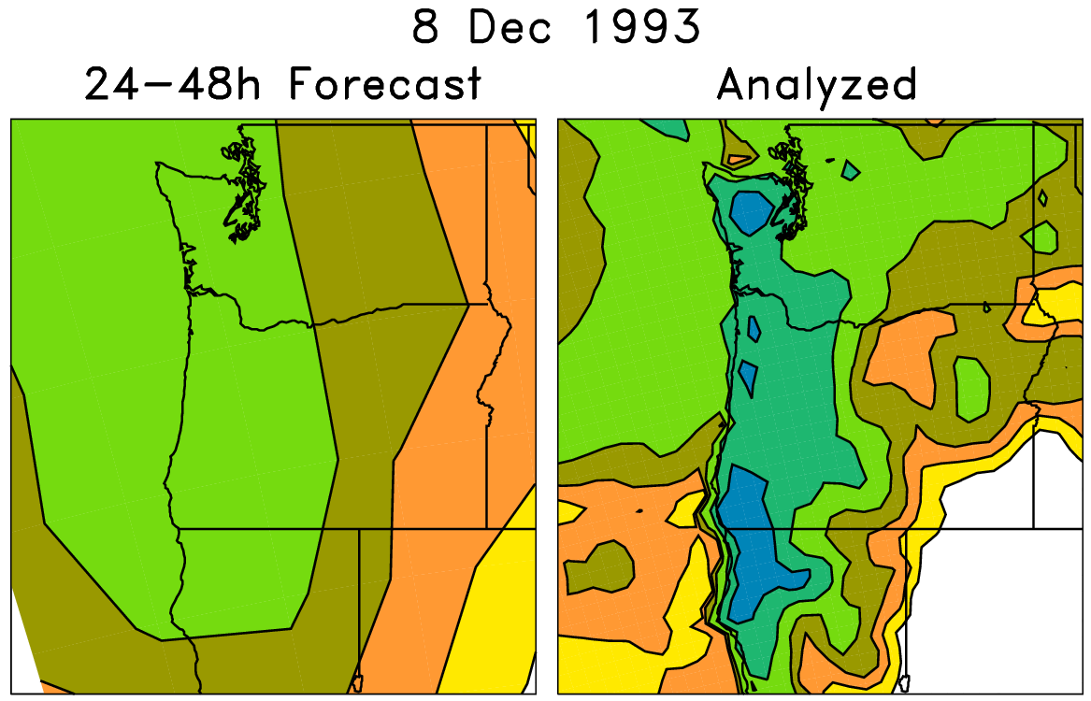
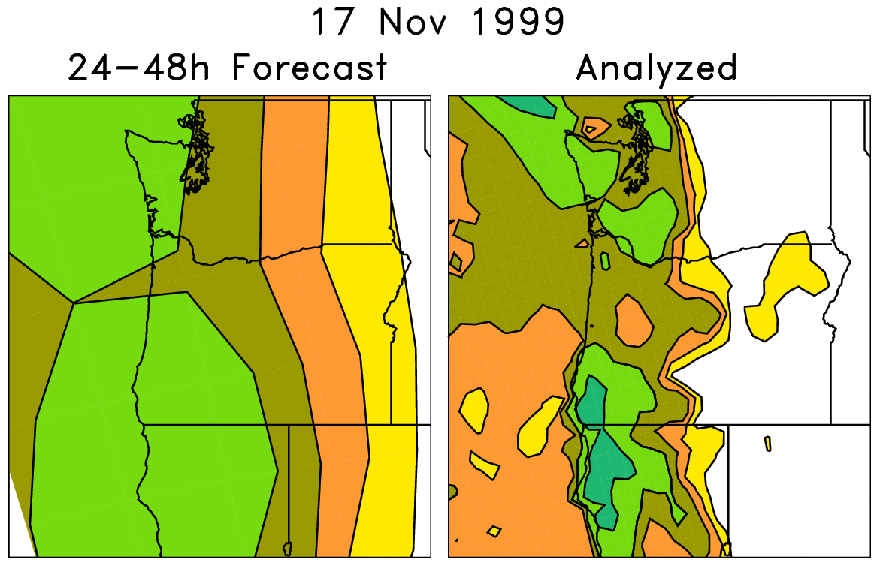
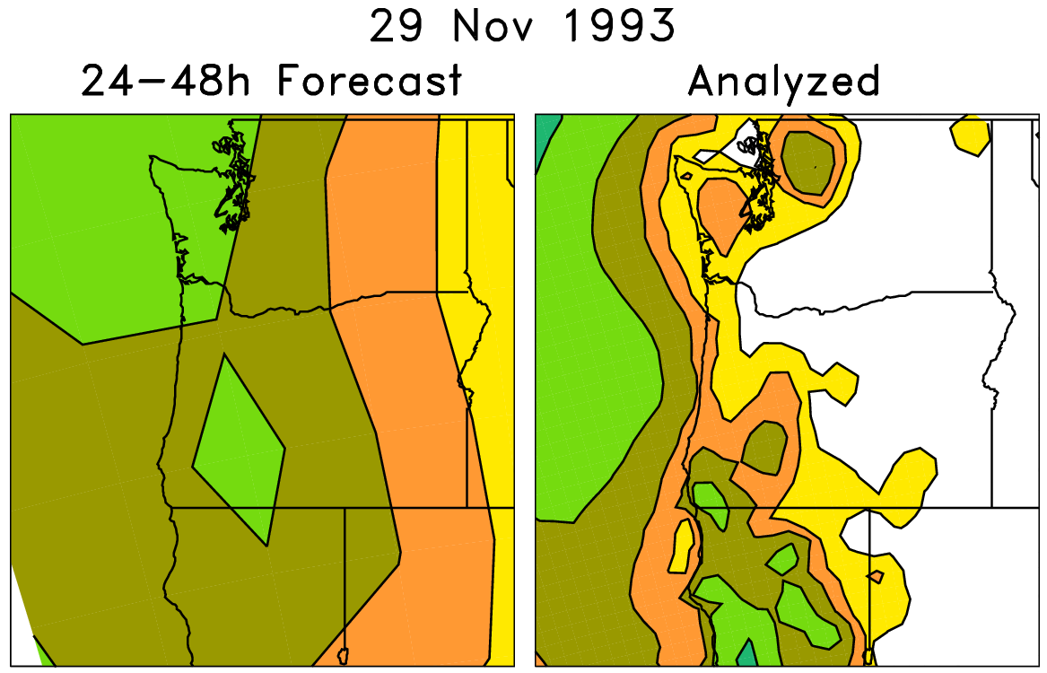
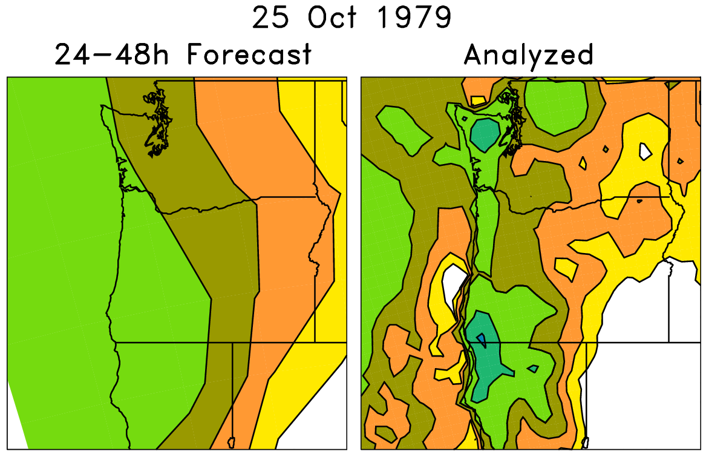
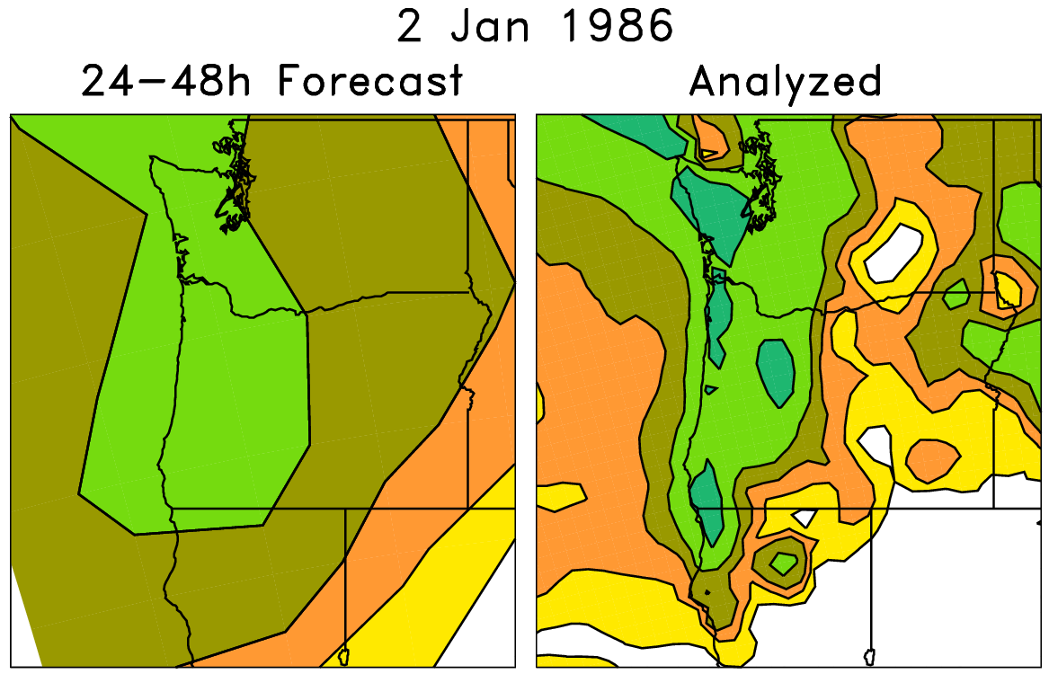
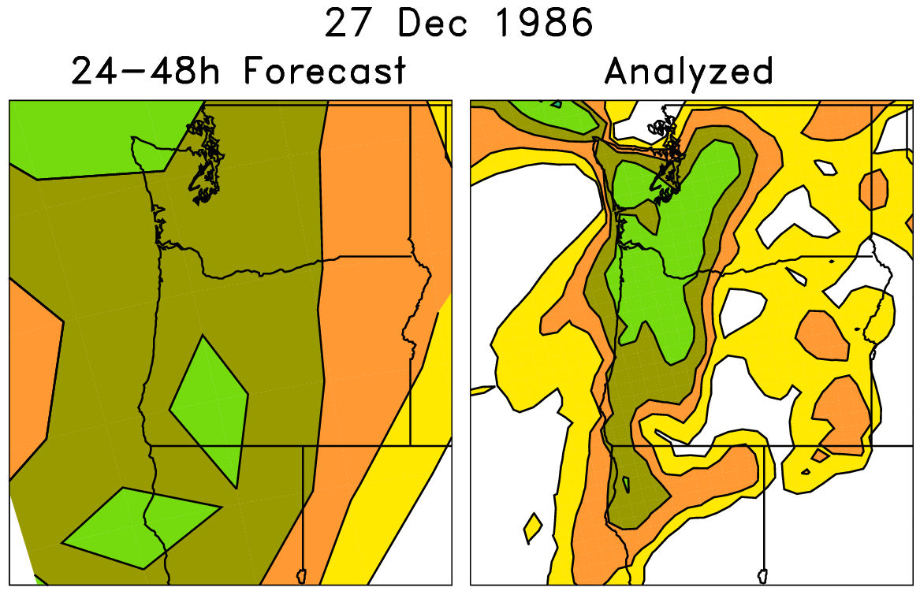
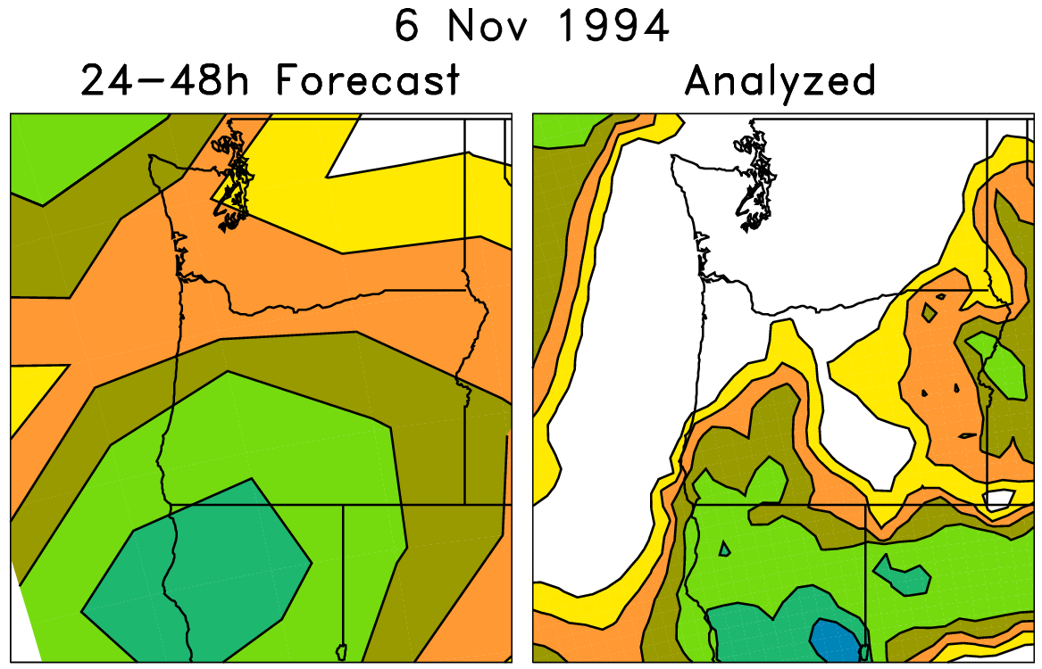
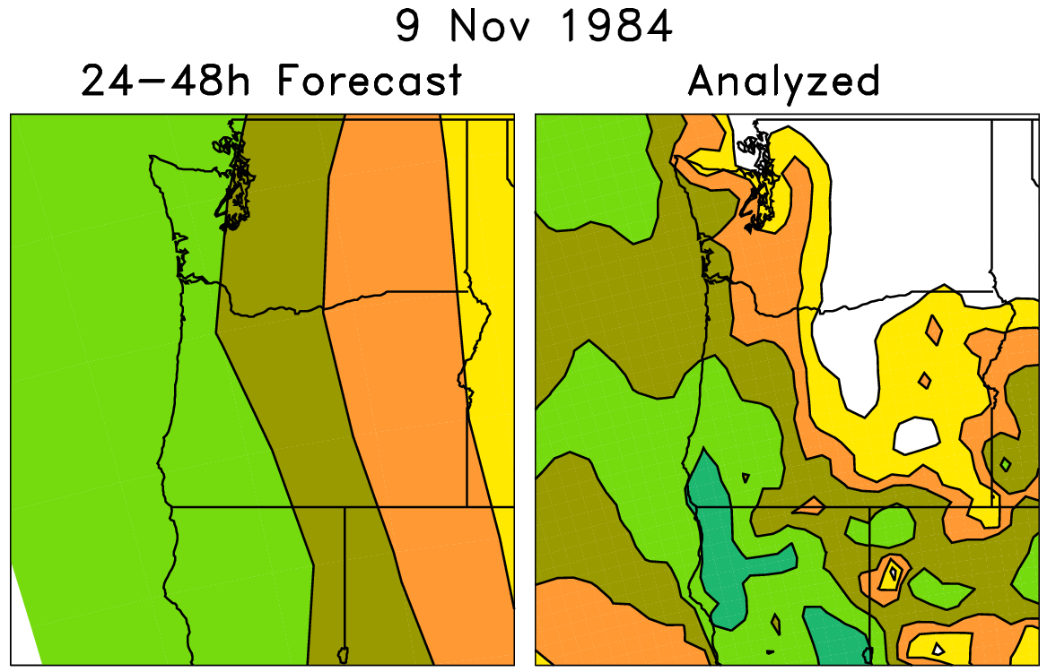
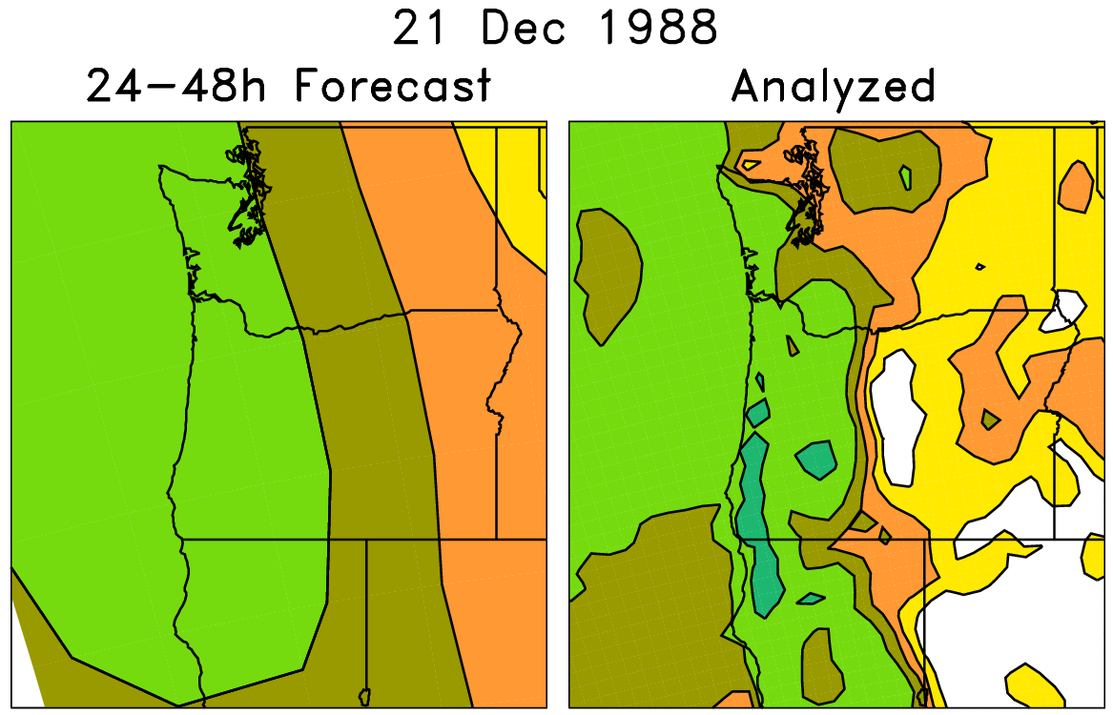
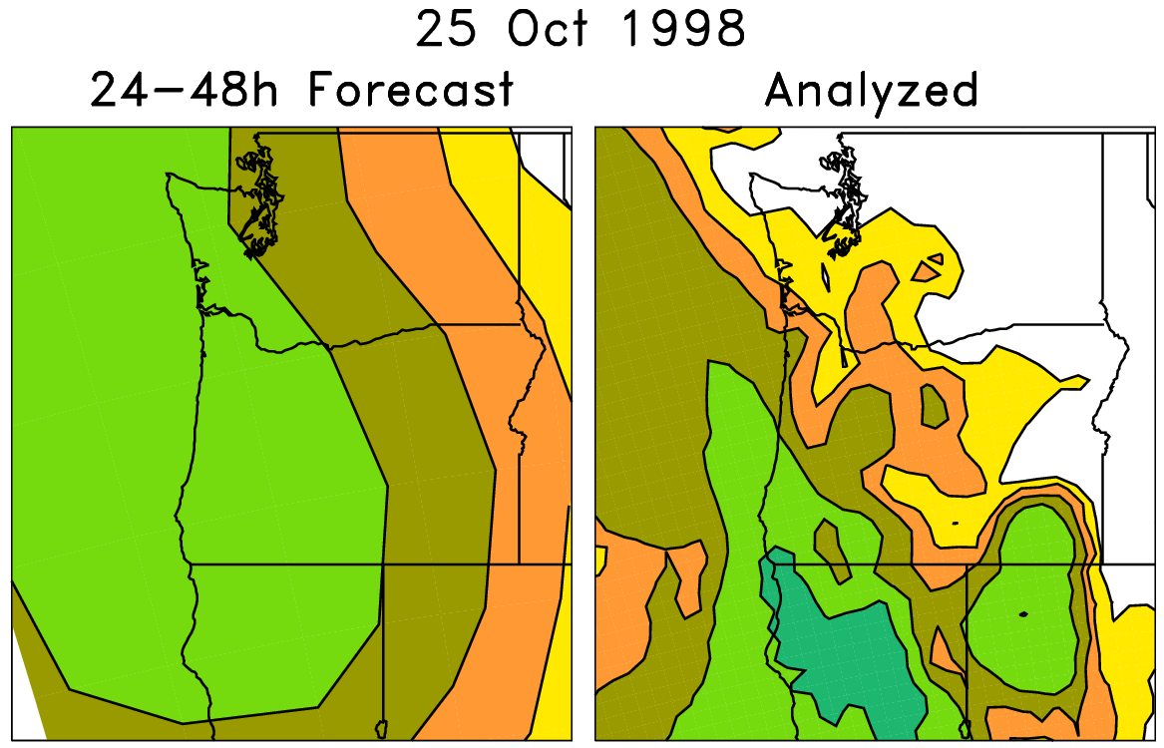
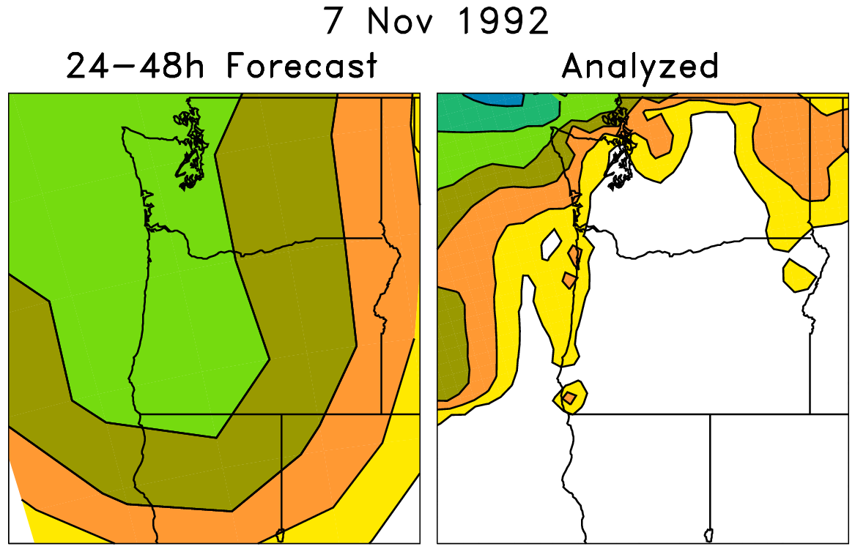
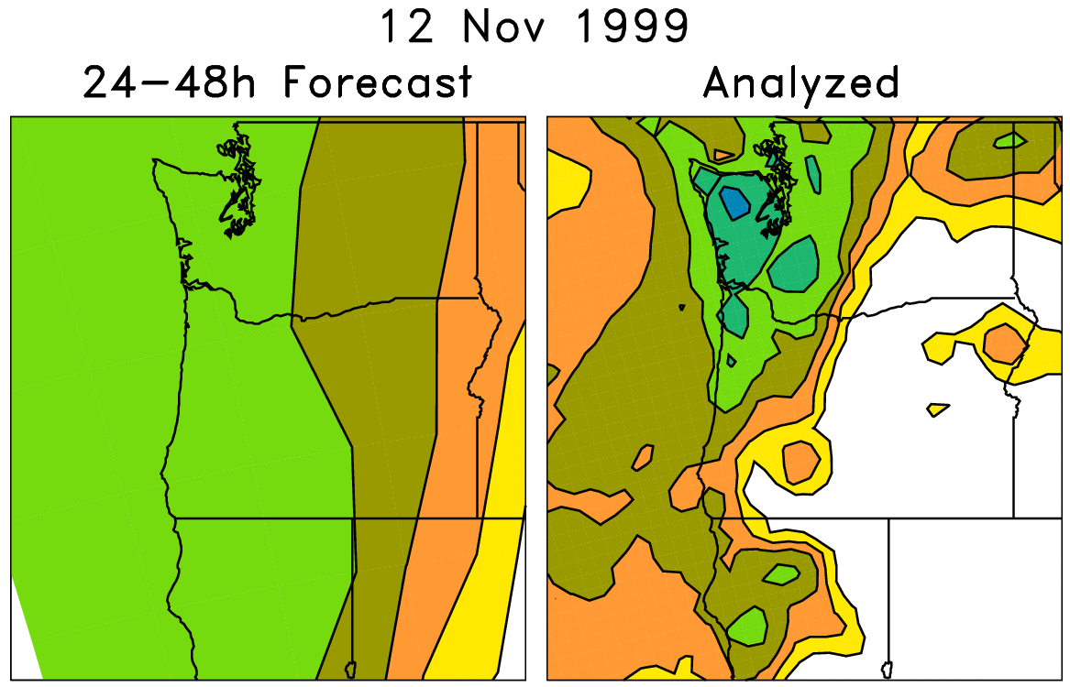
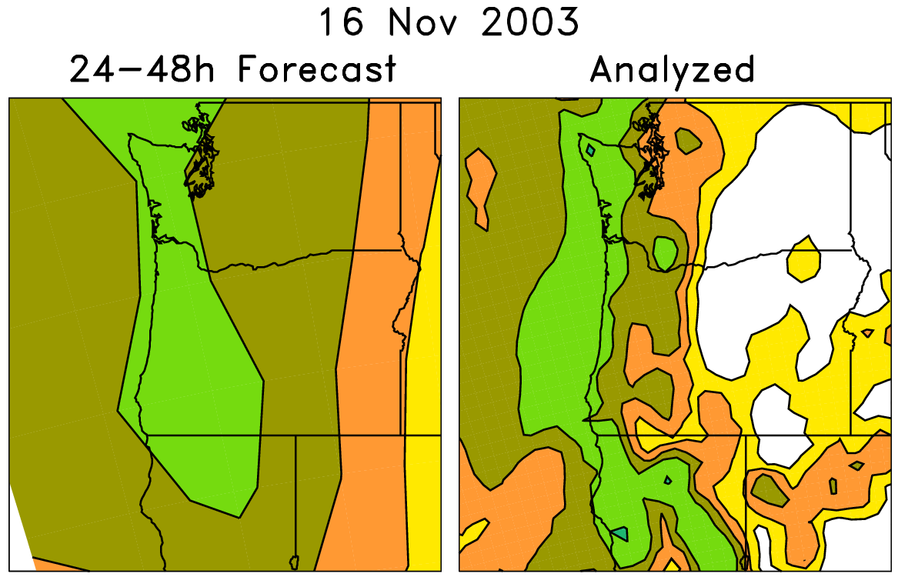
An example of a statistical correction technique using those reforecasts
Today’s forecast (& observed)
For each pair (e.g. red box), on the left are old forecasts that are somewhat similar to this day’s ensemble-mean forecast. The boxed data on the right, the analyzed precipitation for the same dates as the chosen analog forecasts, can be used to
statistically adjust and downscale the forecast.
Analog approaches like this
may be particularly useful for
hydrologic ensemble applications, where an ensemble of weather realizations is needed as inputs to a hydrologic ensemble streamflow system.

Slide 21
A next-generation reforecast
Model: NCEP GFS ensemble that will be operational later in 2011.
Reforecast: at 00Z, compute full 10-member forecast, every day, for last 30 years out to 16 days.
Continue to generate real-time forecasts with this model for next ~5 years.
Reforecasts computed by late 2011.
More details in supplementary slides.

Slide 22
Making reforecast data available to you
Store 130 TB (fast access) of “important” agreed-upon subset of data.
Will design software to serve this out to you in several manners (http, ftp, OPeNDAP, etc.).
Archive full 00Z reforecasts and initial conditions ~=778 TB. DOE expected to store this for us (slow access).

Slide 23
Expected fields in the “fast” archive
Mean and every member
For wind energy, 10-m and 80 m winds, 80-m wind power.
3-hourly out to 72h, then 6-hourly thereafter.
Lots of other data (details in backup slides)

Slide 24
Conclusions
Ensembles may provide significant value-added information to you.
I’m interested in talking with you more to understand how ensembles information (especially reforecasts) can be tailored to help with your decision making.

Slide 25
Backup slides

Slide 26
Expected fields we’ll save in the reforecast “fast” archive
Mandatory level data:
Geopotential height, temperature, u, v, at 1000, 925, 850, 700, 500, 300, 250, 200, 100, 50, and 10 hPa.
Specific humidity at 1000, 925, 850, 700, 500, 300, 250, 200
PV (K m² kg⁻¹ s⁻¹ ) on θ = 320K surface.
Wind components, potential temperature on 2 PVU surface.

Slide 27
Fixed fields to save once
field capacity
wilting point
land-sea mask
terrain height

Slide 28
Proposed single-level fields for “fast” archive
Surface pressure (Pa)
Sea-level pressure (Pa)
Surface (2-m) temperature (K)
Skin temperature (K)
Maximum temperature since last storage time (K)
Minimum temperature since last storage time (K)
Soil temperature (0-10 cm; K)
Volumetric soil moisture content (proportion, 0-10 cm) –
Total accumulated precipitation since beginning of integration (kg/m²)
Precipitable water (kg/m², vapor only, no condensate)
Specific humidity at 2-m AGL (kg/kg; instantaneous) –
Water equivalent of accumulated snow depth (kg/m²) –
CAPE (J/kg)
CIN (J/kg)
Total cloud cover (%)
10-m u- and v-wind component (m/s)
80-m u- and v-wind component (m/s)
Sunshine duration (min)
Snow depth water equivalent (kg/m²)
Runoff
Solid precipitation
Liquid precipitation
Vertical velocity (850 hPa)
Geopotential height of surface
Wind power (=windspeed³ at 80 m*density)

Slide 29
Proposed fields for “fast” archive
Fluxes (W/m² ; average since last archive time)
sensible heat net flux at surface
latent heat net flux at surface
downward long-wave radiation flux at surface
upward long-wave radiation flux at surface
upward short-wave radiation at surface
downward short-wave radiation flux at surface
upward long-wave radiation at nominal top
ground heat flux.

Slide 30
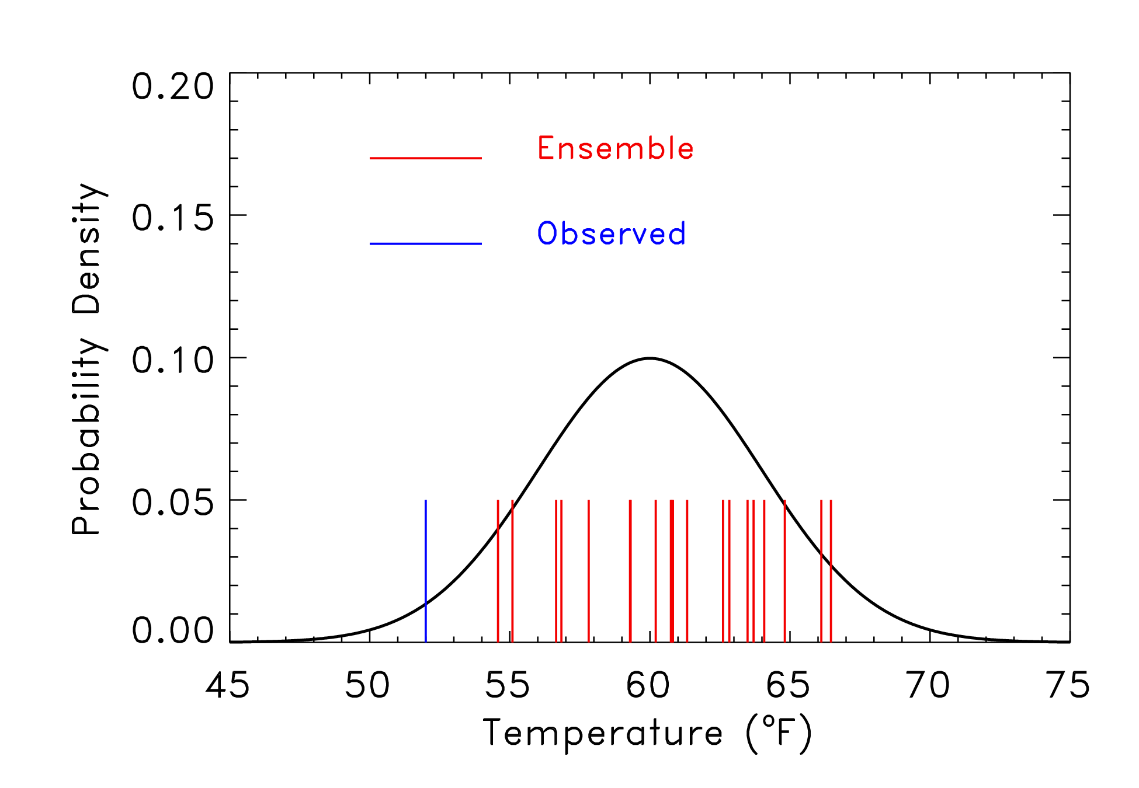
Uncalibrated ensemble?
Here, the observed is outside of the range of the ensemble,
which was sampled from the pdf shown. Is this a sign of
a poor ensemble forecast?

Slide 31
Uncalibrated ensemble?
You just don’t know; it’s only one sample.
You just don’t know…it’s only one sample
Here, the observed is outside of the range of the ensemble,
which was sampled from the pdf shown. Is this a sign of
a poor ensemble forecast?

Slide 32
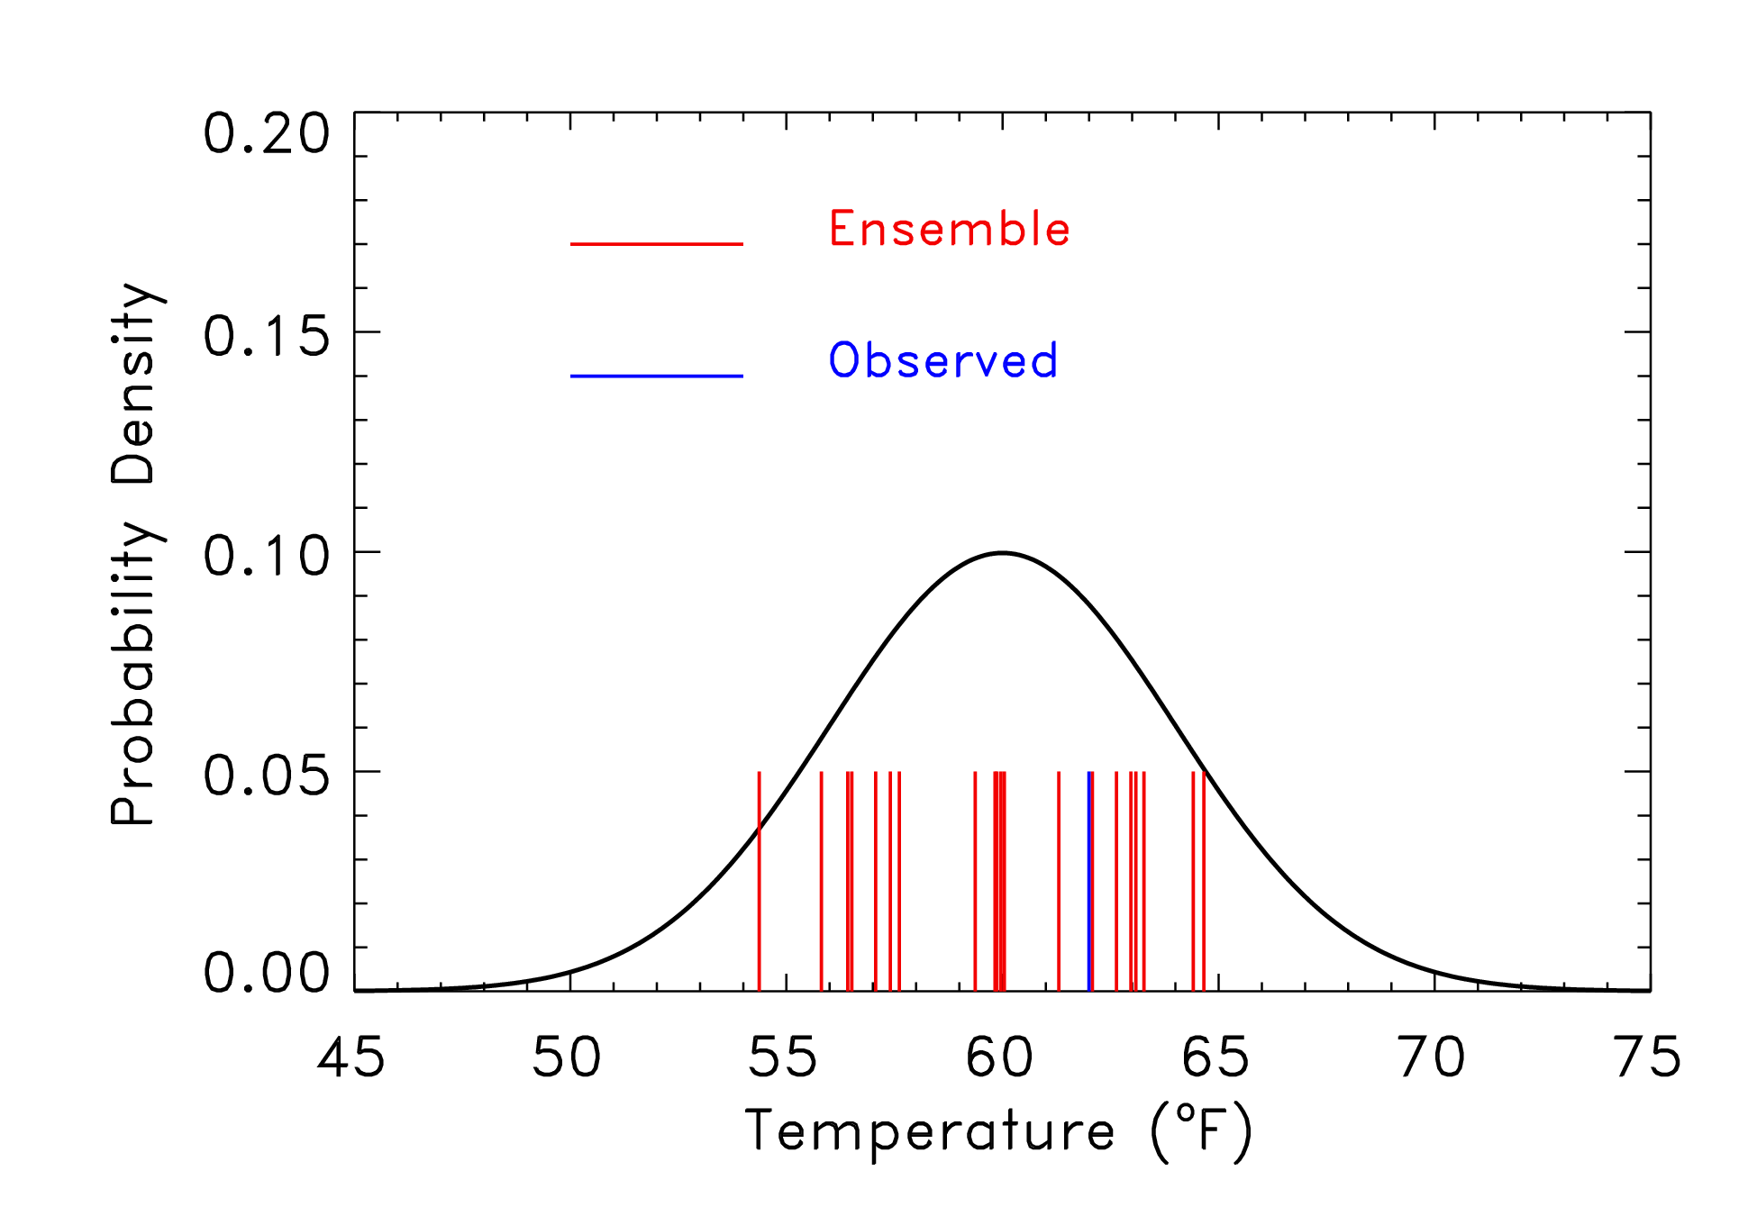
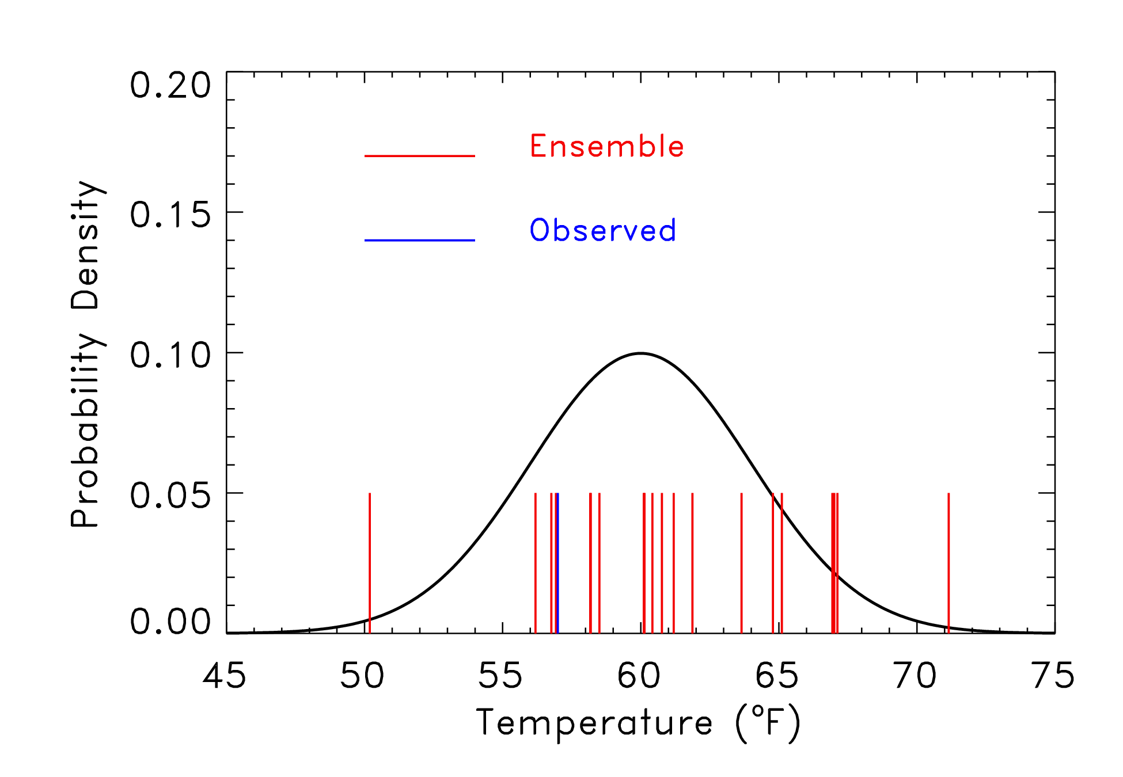
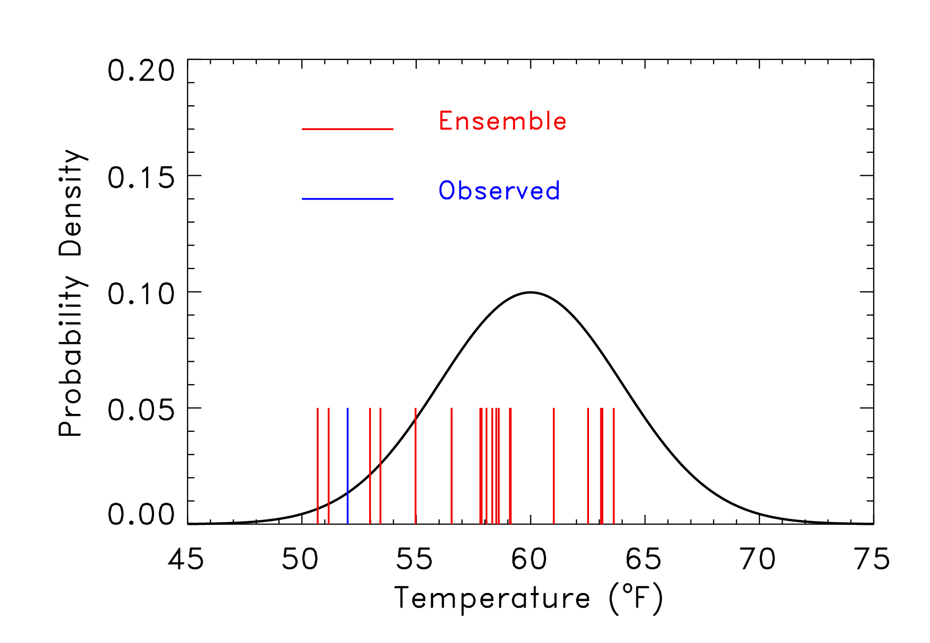
Rank 1 of 21
Rank 14 of 21
Rank 5 of 21
Rank 3 of 21

Slide 33
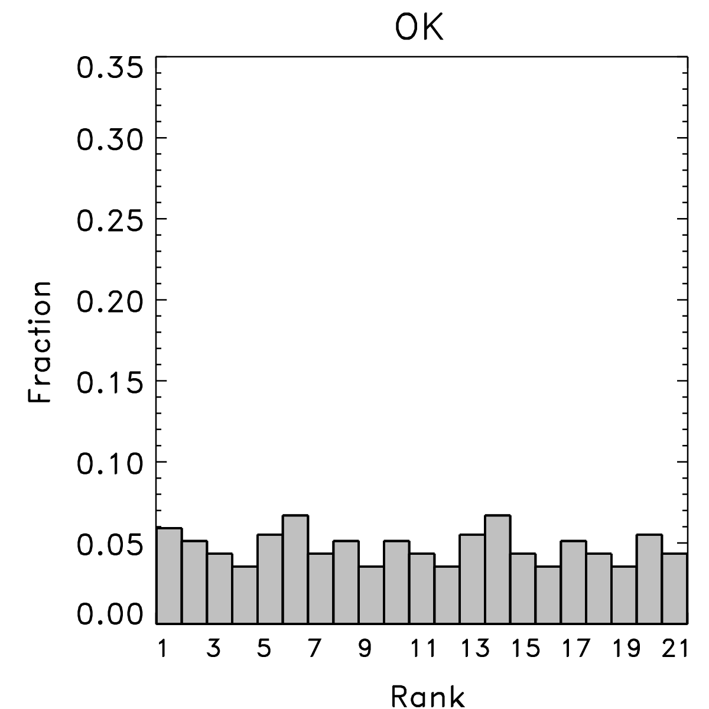
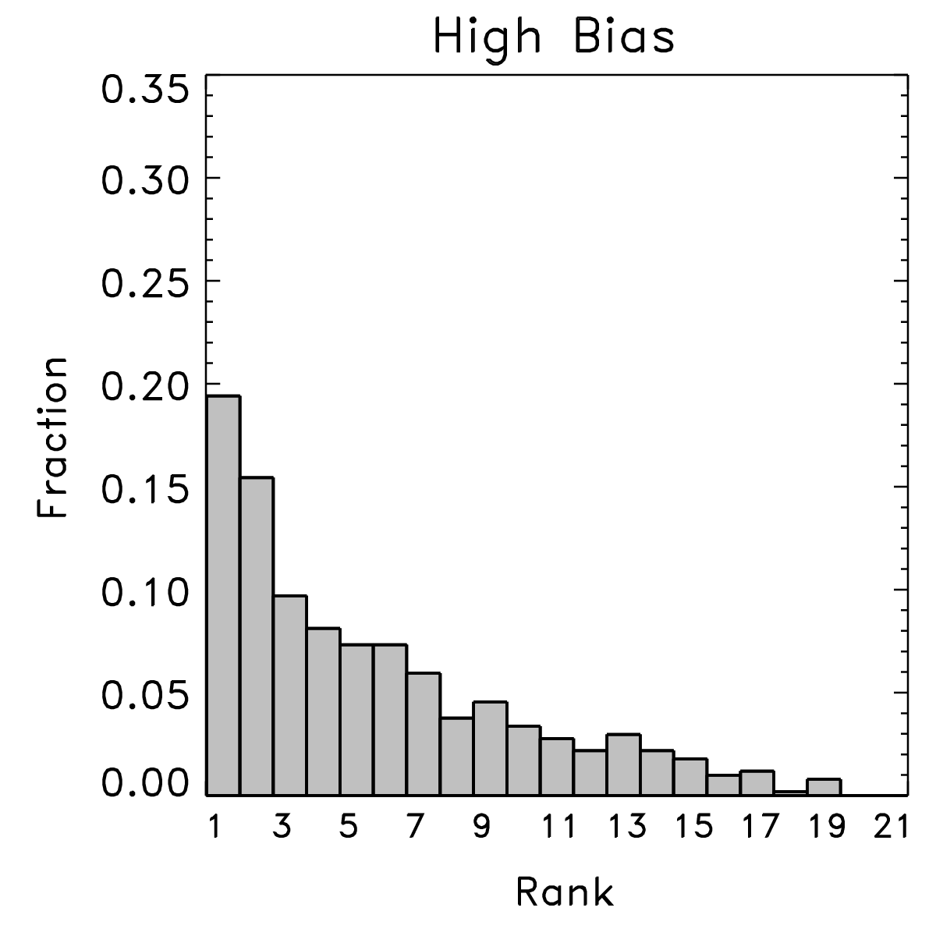
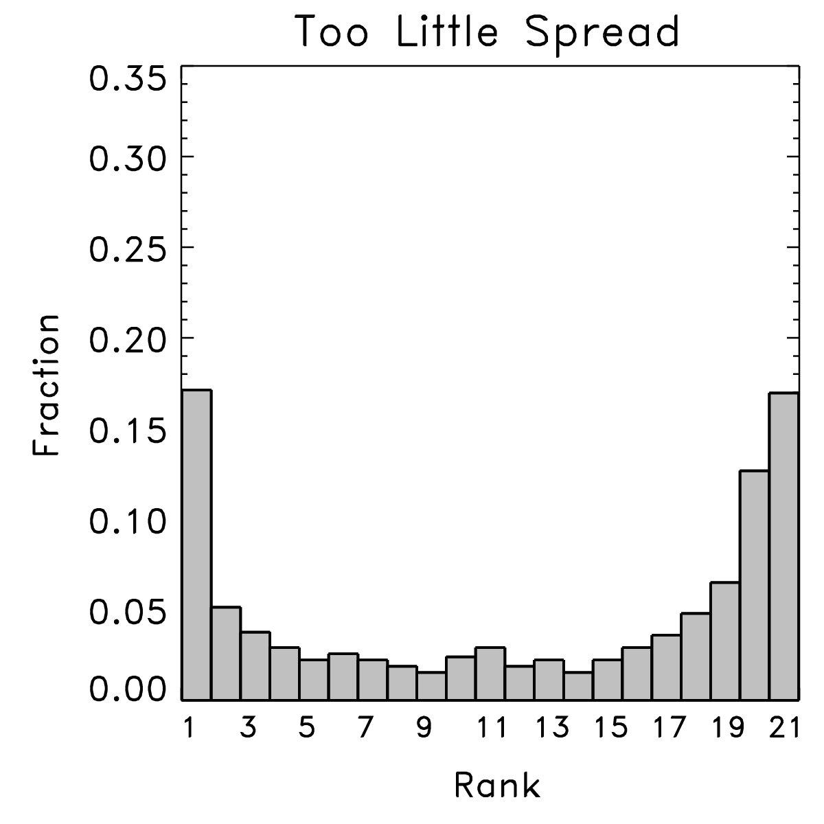
Rank histograms
With lots of samples from many situations, can evaluate the characteristics of the ensemble.
Happens when
observed is
indistinguishable
from any other
member of the
ensemble. Ensemble
hopefully is reliable.
Happens when
observed too
commonly is
lower than the
ensemble members.
Happens when
there are either
some low and some
high biases, or when
the ensemble doesn’t
spread out enough.
ref: Hamill, MWR, March 2001

