Slide 1
Global Ensemble Predictions of 2009’s Tropical Cyclones Initialized with an Ensemble Kalman Filter
NOAA Earth System
Research Laboratory
Tom Hamill and Jeff Whitaker
NOAA Earth System Research Lab
Physical Sciences Division

Slide 2
All due credit to Jeff Whitaker, chief number cruncher, EnKF innovator
(he’s at ECMWF currently
implementing
the EnKF code there)

Slide 3
The ensemble Kalman Filter (EnKF)
A method for the initialization of ensemble forecasts that is conceptually appealing for hurricanes
“Flow-dependent” background-error covariances may be useful to achieving quality analyses
figure c/o Xuguang Wang, University of Oklahoma
(more)

Slide 4
Questions
Can hurricane ensemble forecasts from a global model be improved substantially by:
using an EnKF for data assimilation & ensemble initialization?
using a higher-resolution version of global model?
using new “TCVitals” sea-level pressure observations in the data assimilation?
How much of any improvement can be attributed to EnKF vs. higher resolution model vs. new obs?
How do experimental forecasts compare with operational forecasts from worldwide centers?
Multi-model ensembles provide improvement?

Slide 5
Testing performed
Ran a global ensemble square-root filter (“EnKF”) data assimilation
T382L64 (~35 km) version of NCEP GFS, 60 members
Full observational data stream + “TCVitals” (min central pressure)
20-member ensemble forecasts to 7 days for most active days during hurricane season, late July to early October 2009.
Other operational ensembles (next page)
Also useful: deterministic forecasts from T382 GFS/EnKF, operational GFS/GSI and parallel GFS/GSI with TCVitals
Compare against “best track” files compiled by NHC and Joint Typhoon Warning Center

Slide 6
Ensemble systems evaluated
Run ourselves on NSF U Texas computer:
T382L64 “GFS/EnKF” (experimental)
30-km NOAA “FIM” off GFS/EnKF IC’s (experimental)
For diagnostics at the end of the talk, “T126L28 GFS/EnKF” initialized off T382L64 EnKF ICs
Operational:
“NCEP” T126L28 GFS/GSI/ETR
“CMC” ensemble, 0.9-degree, L28, EnKF perts around 4D-Var control.
“UKMO” MOGREPS ensemble, 1.25*0.83-degree, L38, ETKF perts around 4D-Var control
“ECMWF” T399L62, v. 35r2 and 35r3 (with stochastic physics upgrade). Singular vector perts around 4D-Var control

Slide 7
What we don’t have, and wish we did
T382L64 GFS/EnKF and subsequent ensembles, without TCVitals observations
T126L28 GFS/EnKF and subsequent ensembles (or T190L64) to cleanly examine effect of resolution
A bigger sample (lackluster Atlantic season, only global-composite statistics likely to be worth interpreting).

Slide 8
Rules for including a particular storm in “homogeneous” comparisons of models A vs. B
Storm must be tracked and at least tropical depression strength at initial time of forecast
Ensemble scores computed only when at least 20 members’ forecasts computed.
At least 8 members must be tracking the storm to compute statistics; mean error and spread computed from sample of storms tracked.
When performing “homogeneous” comparison of forecast model A to forecast model B, count a storm as a sample only when both models have forecast available.
This rule conveniently allows us to skirt
the issue of whether the forecast model
over-forecasts TC-genesis. In fact, both
T382 GFS/EnKF and FIM/EnKF did
over-forecast.

Slide 9
Definitions & metrics
Absolute error (km) of ens.-mean track forecast for the ith of m samples
Abs. difference of the jth of n members from the ens mean:
Track average error:
Spread for i^{th} sample ………………….
Average spread :

Slide 10
Data availability

Slide 11
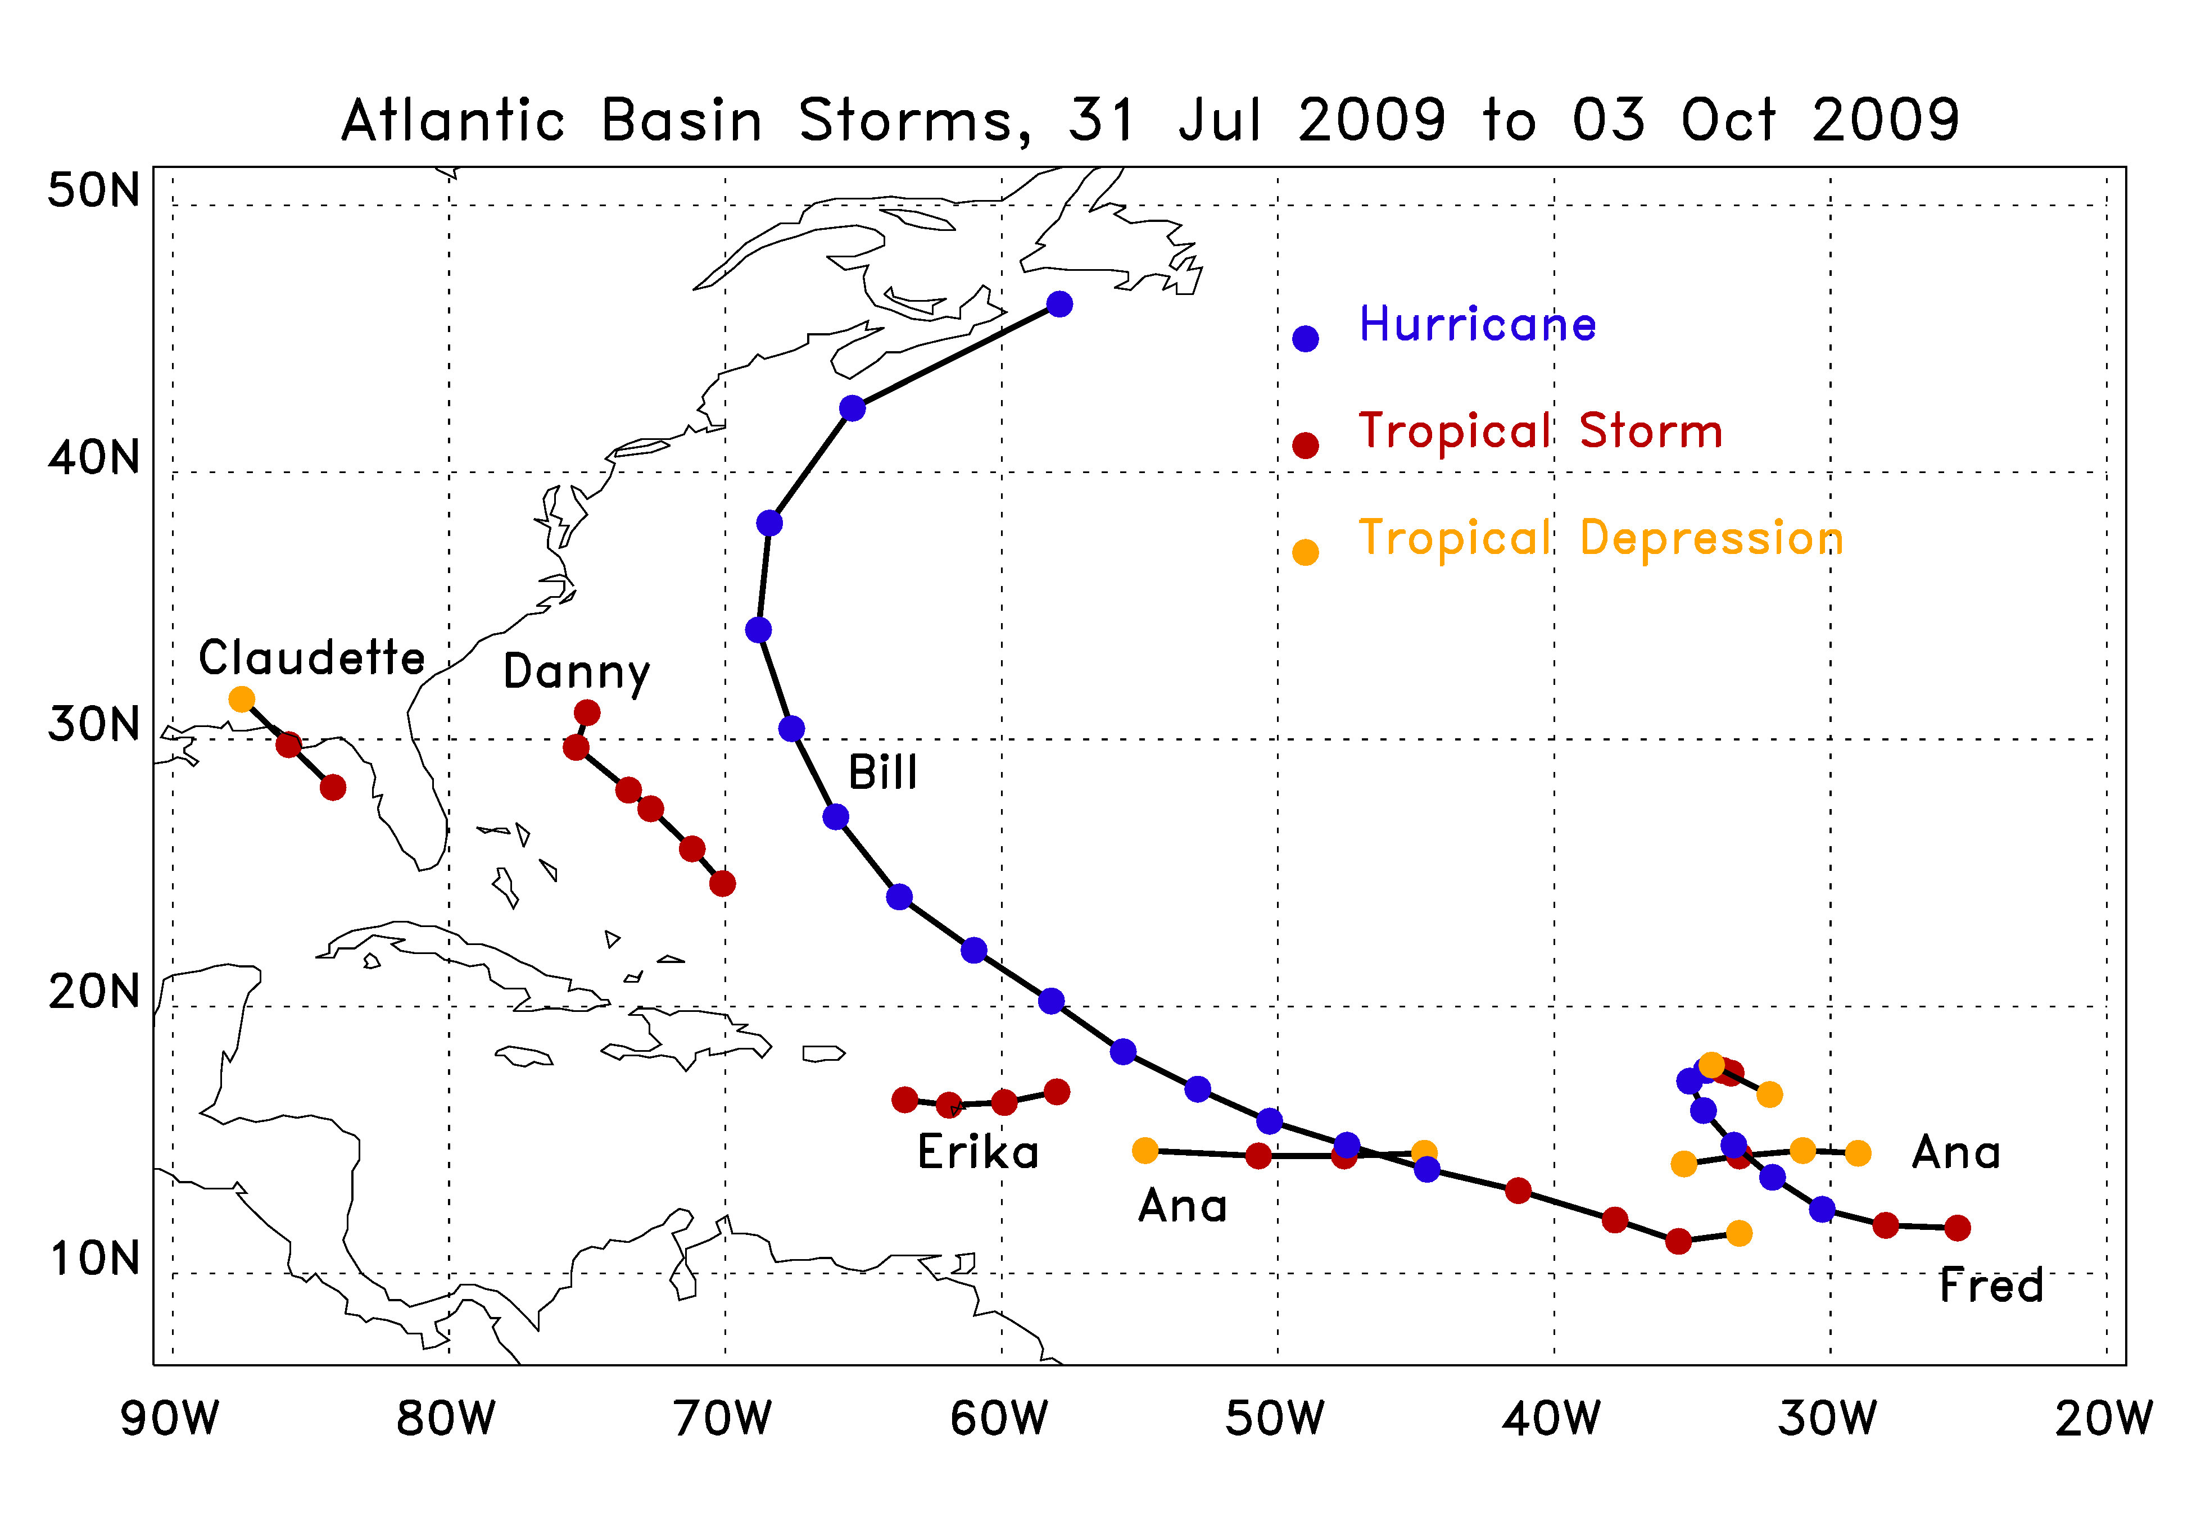
Review of Atlantic Basin activity

Slide 12
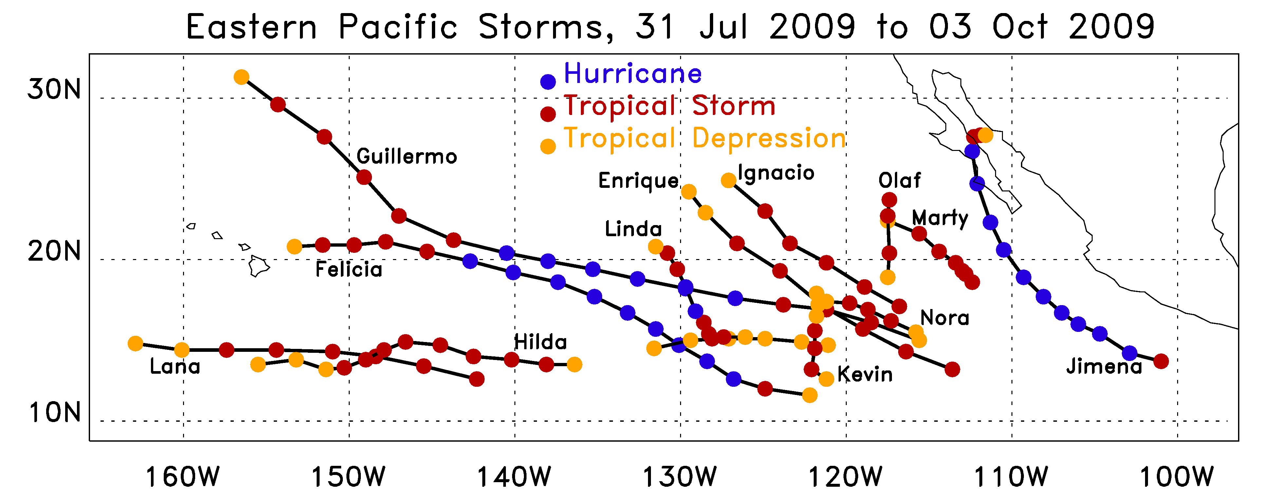
Review of Eastern-Pacific activity

Slide 13
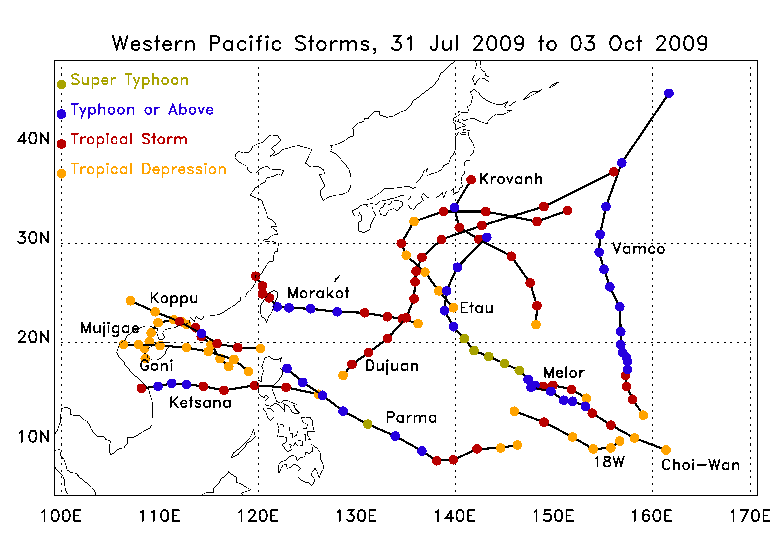
Review of Western-Pacific activity

Slide 14
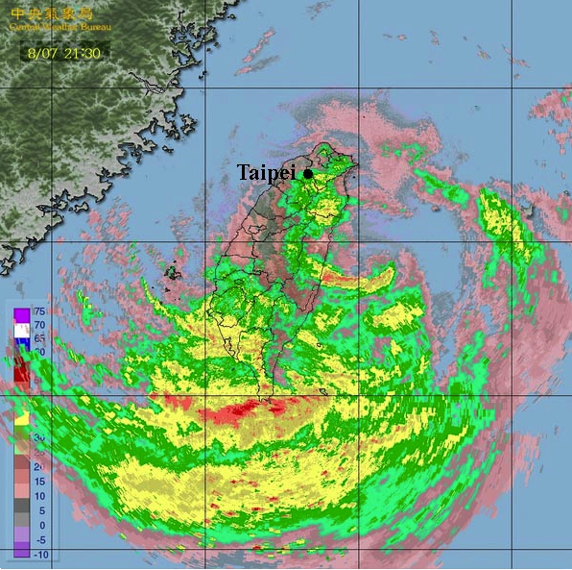
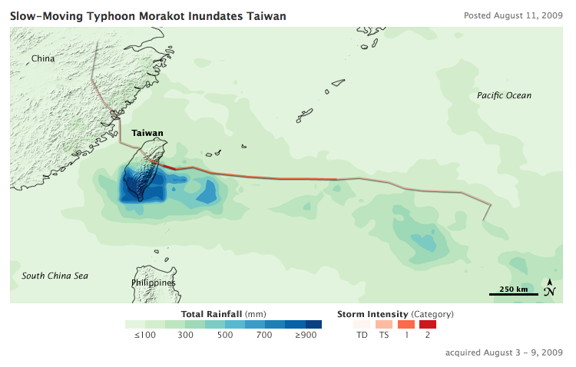
Typhoon Morakot (Taiwan floods)
1403 mm max (55 inches)
http://earthobservatory.nasa.gov/IOTD/view.php?id=39747
14

Slide 15
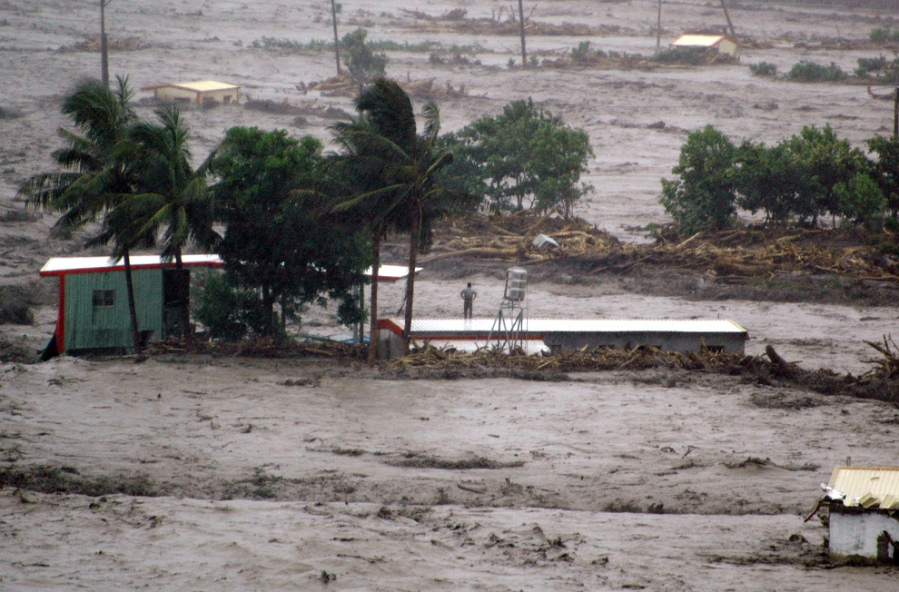
http://www.boston.com/bigpicture/2009/08/typhoon_morakot.html

Slide 16
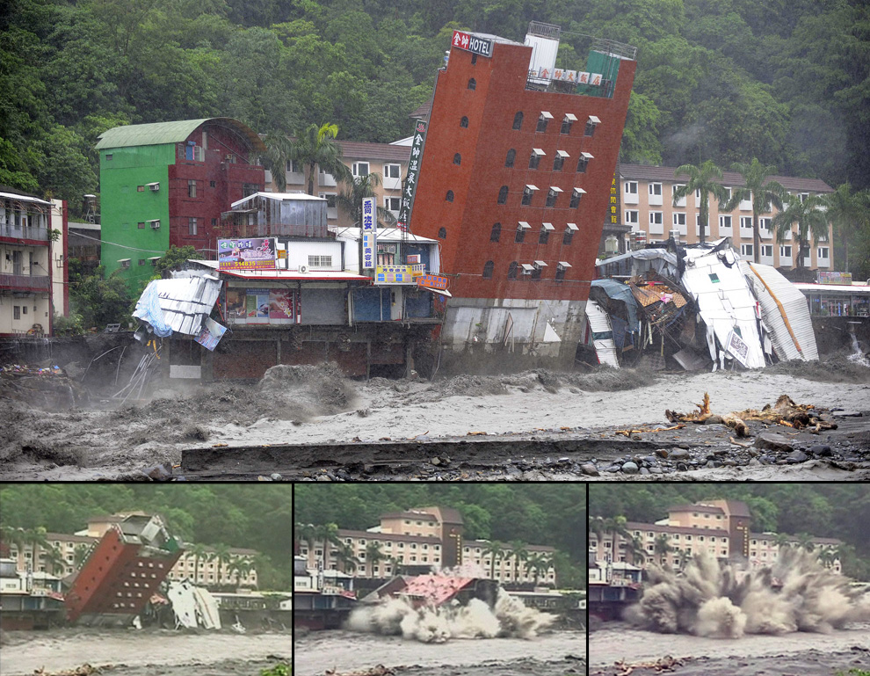
http://www.boston.com/bigpicture/2009/08/typhoon_morakot.html

Slide 17
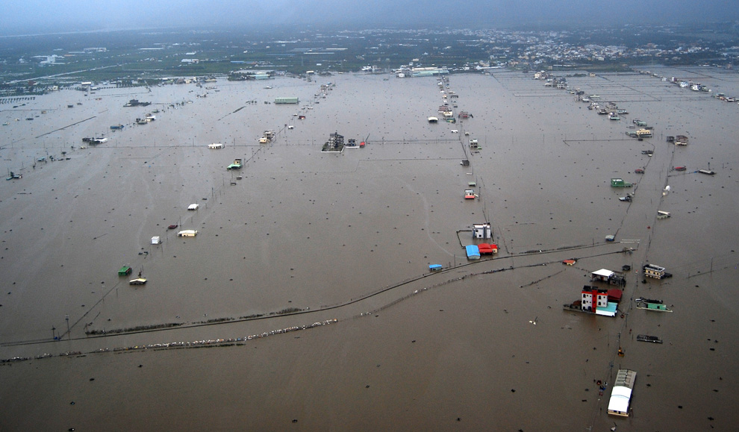
http://www.boston.com/bigpicture/2009/08/typhoon_morakot.html

Slide 18
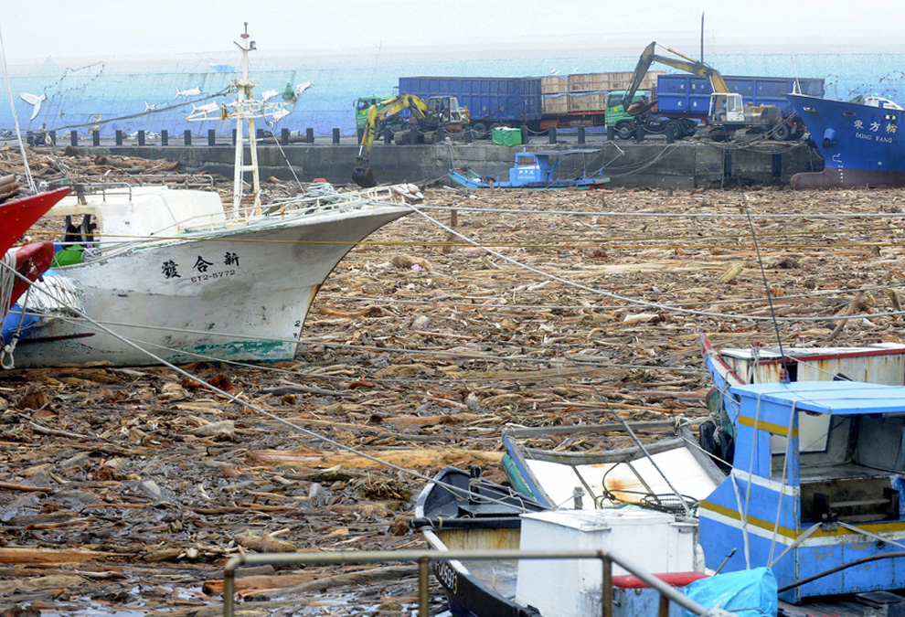
http://www.boston.com/bigpicture/2009/08/typhoon_morakot.html

Slide 19
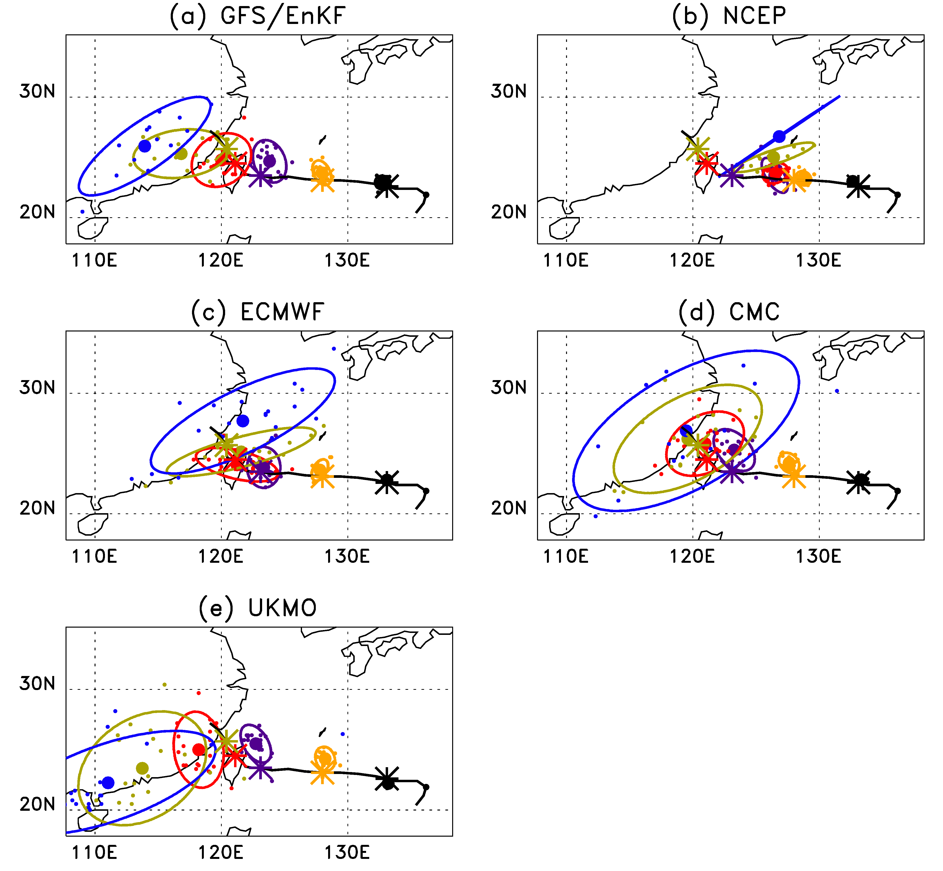
Example: Typhoon Morakot
Initialized 00 UTC
5 August 2009.
* indicates observed best-track position.
Bi-variate normal distribution fit to ensemble member positions; contour encloses 90% of fitted probability.
GEFS/EnKF a bit north and too fast.
NCEP has northward & westward bias, few members track.
ECMWF tracks decent up to Taiwan landfall
CMC has very large spread, esp. after landfall.
UKMO too north,
too fast.
Day 5
Day 2
Day 1
Day 4
Day 3
Day 0

Slide 20
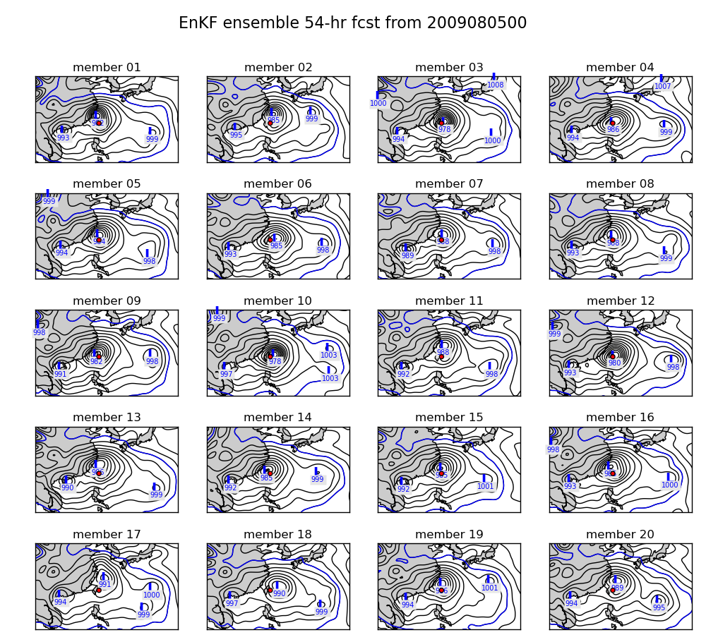
54-h ensembles from T382 GFS & EnKF initial conditions.
Intense vortices in forecasts, with ensembles of forecast positions relatively close
to the observed position (red dot).
20

Slide 21
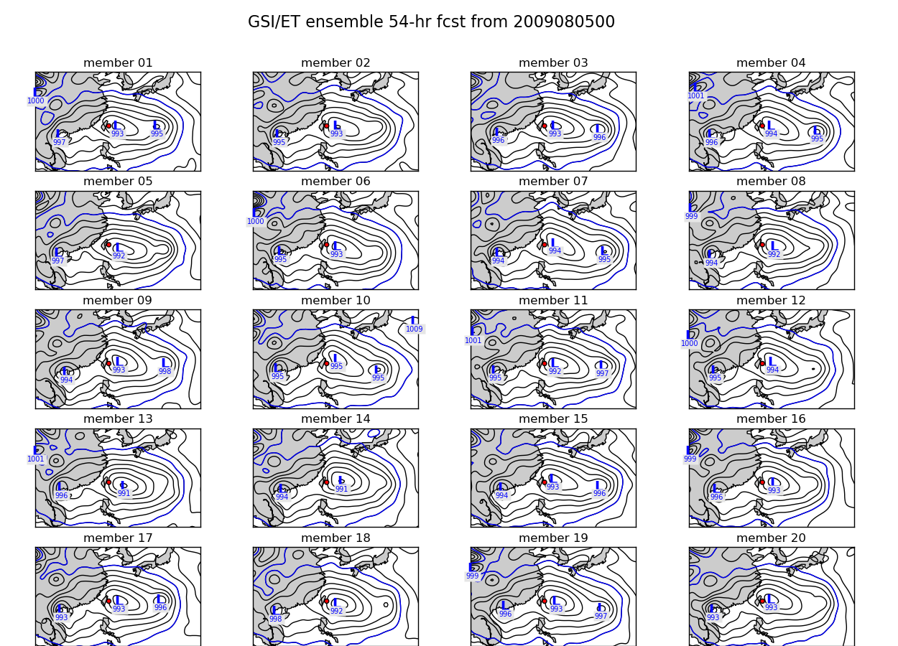
54-h ensembles from experimental T382 GFS & GSI / operational ET perturbations
Note that GFS
model resolution
is much greater
than current
operational, T126
GSI-ET initialized ensemble produces less intense vortices, and forecasts are slow in moving typhoon west.
This operational version of GSI did not include TCVitals central pressure obs.
21

Slide 22
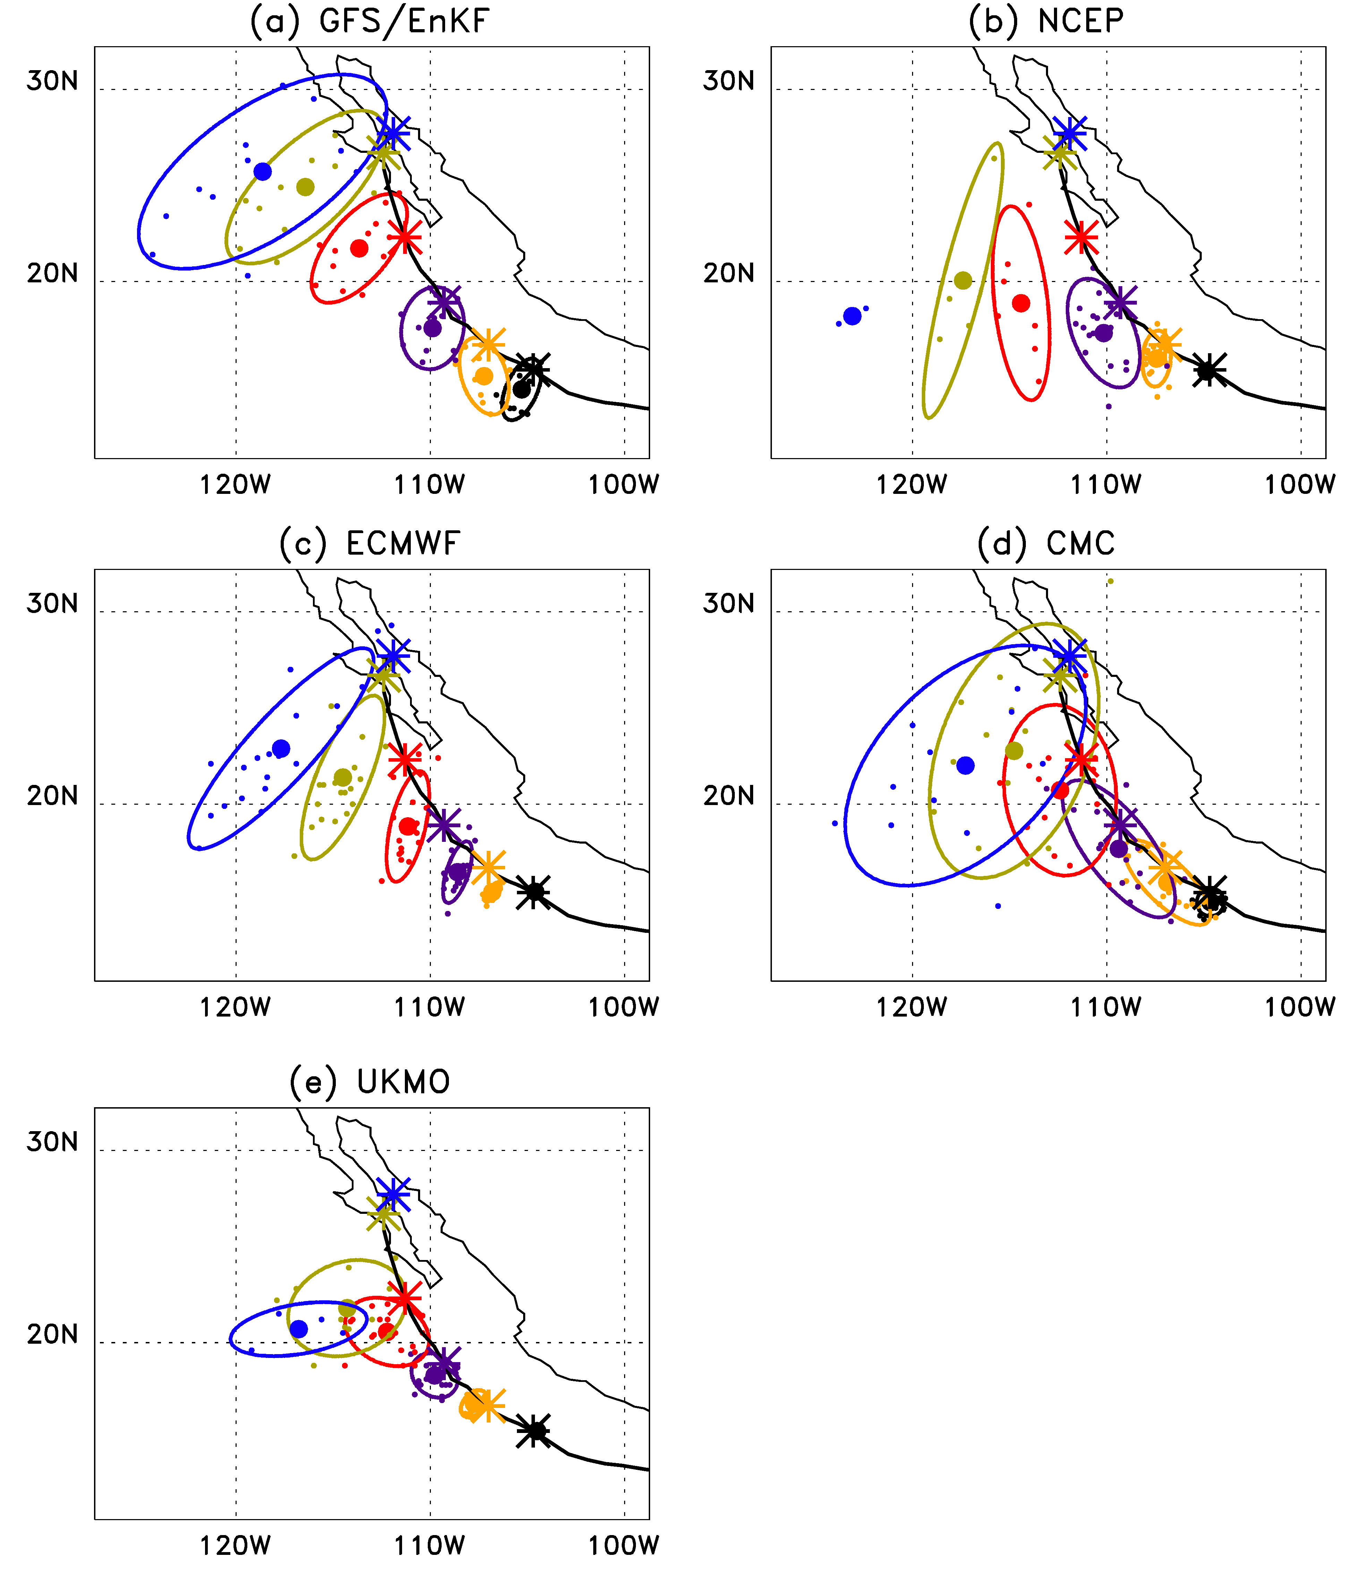
Example: hurricane Jimena
Initialized 00 UTC 30 Aug 2009
all models have westward
bias; none of the forecasts
particularly good.

Slide 23
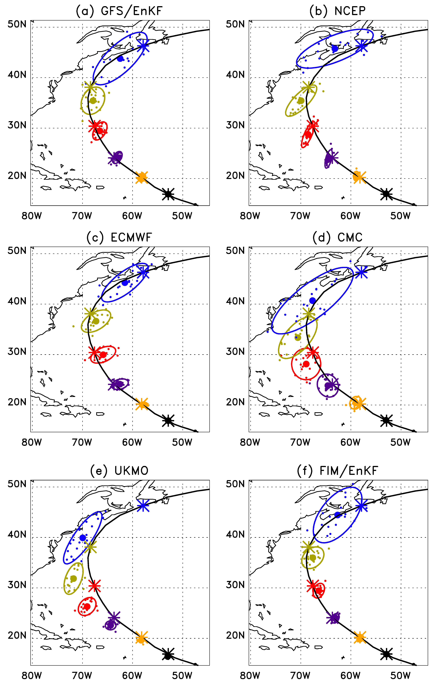
Example: Hurricane Bill
Initialized 00 UTC 19 August 2009.
All models slow, to varying extents.
GEFS/EnKF, ECMWF , NCEP, FIM tracks decent.
UKMO, CMC have westward bias.

Slide 24
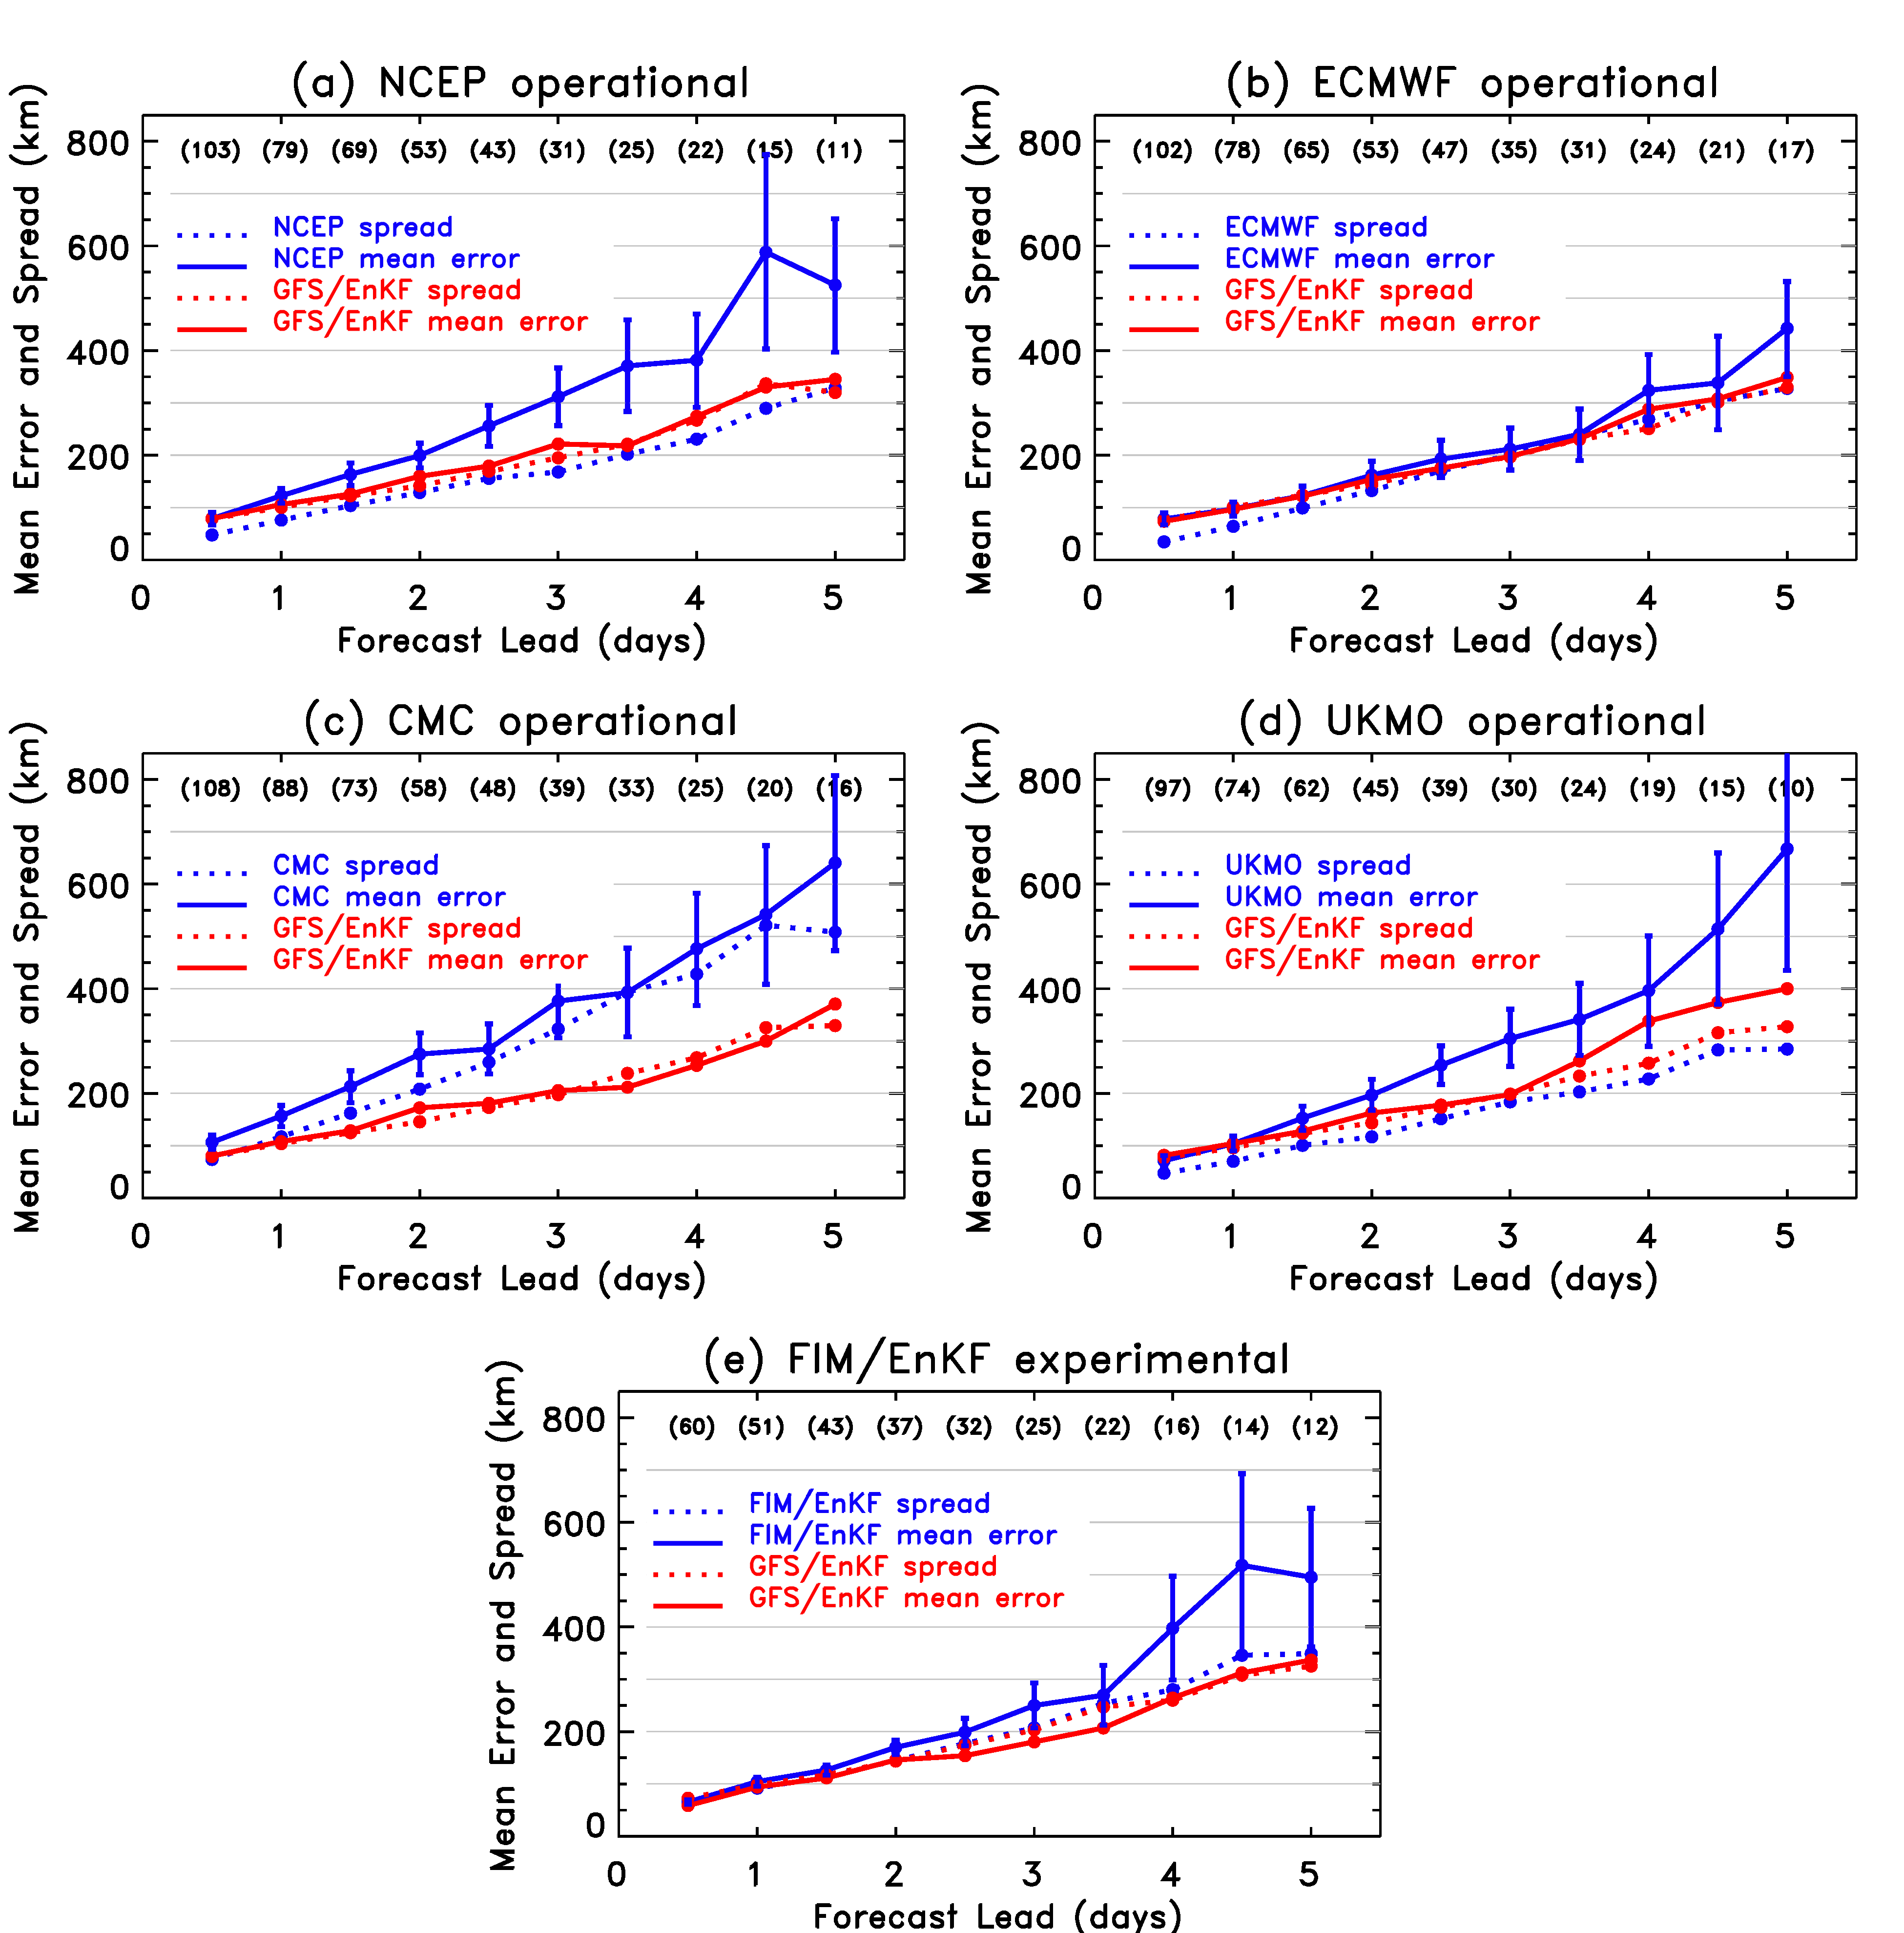
Track error major findings:
Experimental T382
GFS/EnKF beats NCEP operational handily.
(2) Experimental T382
GFS/EnKF competitive
with ECMWF
(3) Experimental T382 GFS/EnKF has overall spread-error calibration.
(4) FIM/EnKF not quite as skillful as GFS/EnKF.
(5) CMC not as skillful, but calibrated.
(6) UKMO not as skillful, under-spread.

Slide 25
Track error major findings:
Experimental T382
GFS/EnKF beats NCEP operational handily.
(2) Experimental T382
GFS/EnKF competitive
with ECMWF
(3) Experimental T382 GFS/EnKF has overall spread-error calibration.
(4) FIM/EnKF not quite as skillful as GFS/EnKF.
(5) CMC not as skillful, but calibrated.
(6) UKMO not as skillful, under-spread.
A notable success for NCEP GFS and ESRL EnKF!
A word of caution: look at other norms, and ECMWF still has a substantial lead.

Slide 26
Example: RMS error and AC, Z500

Slide 27
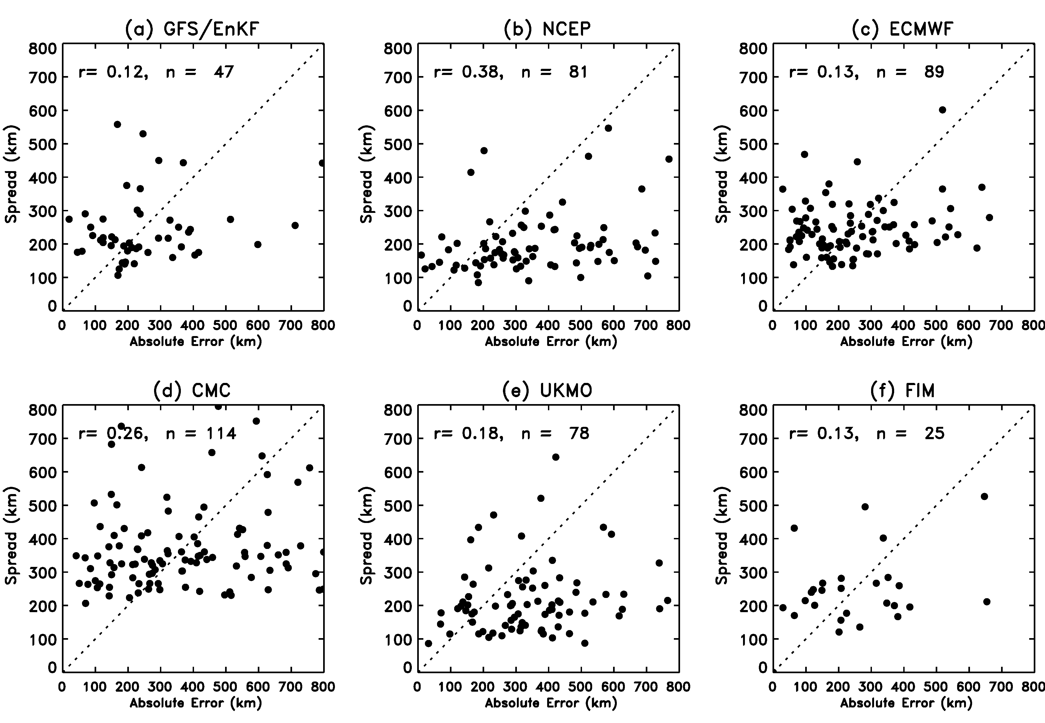
Spread-error relations? (Day-3)

Slide 28
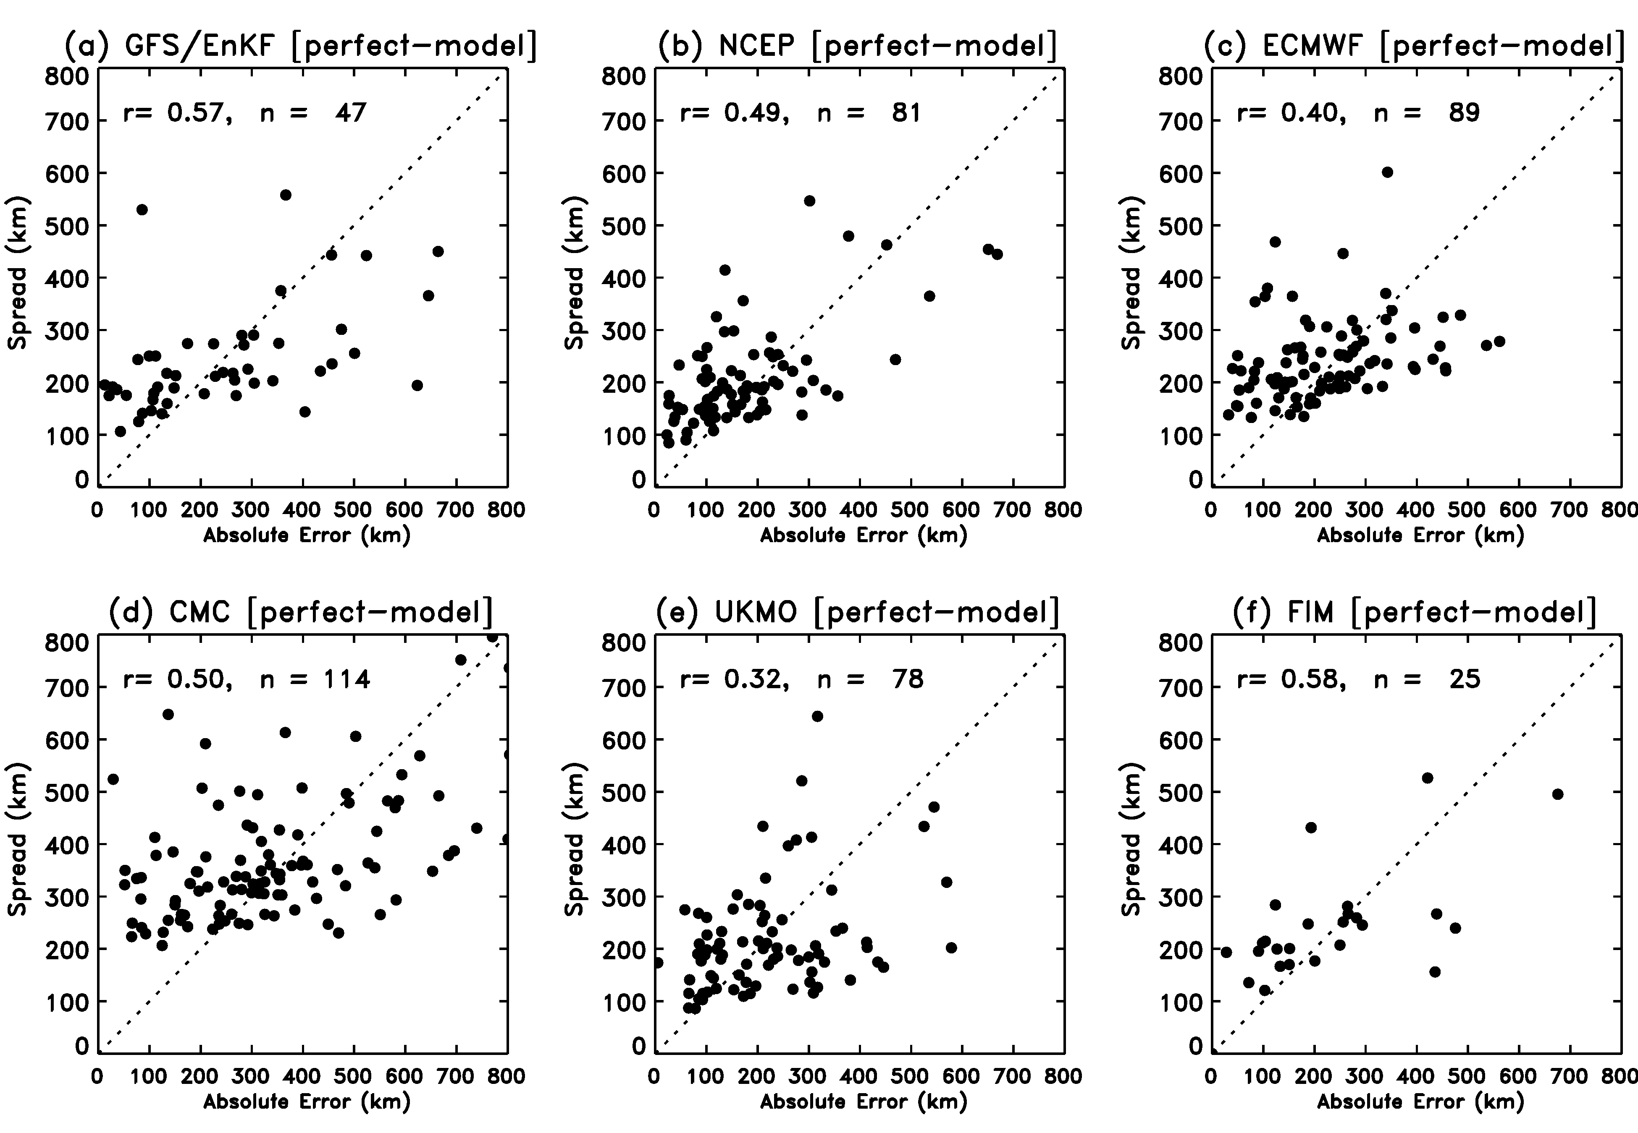
Spread-error relations, perfect-model assumption

Slide 29
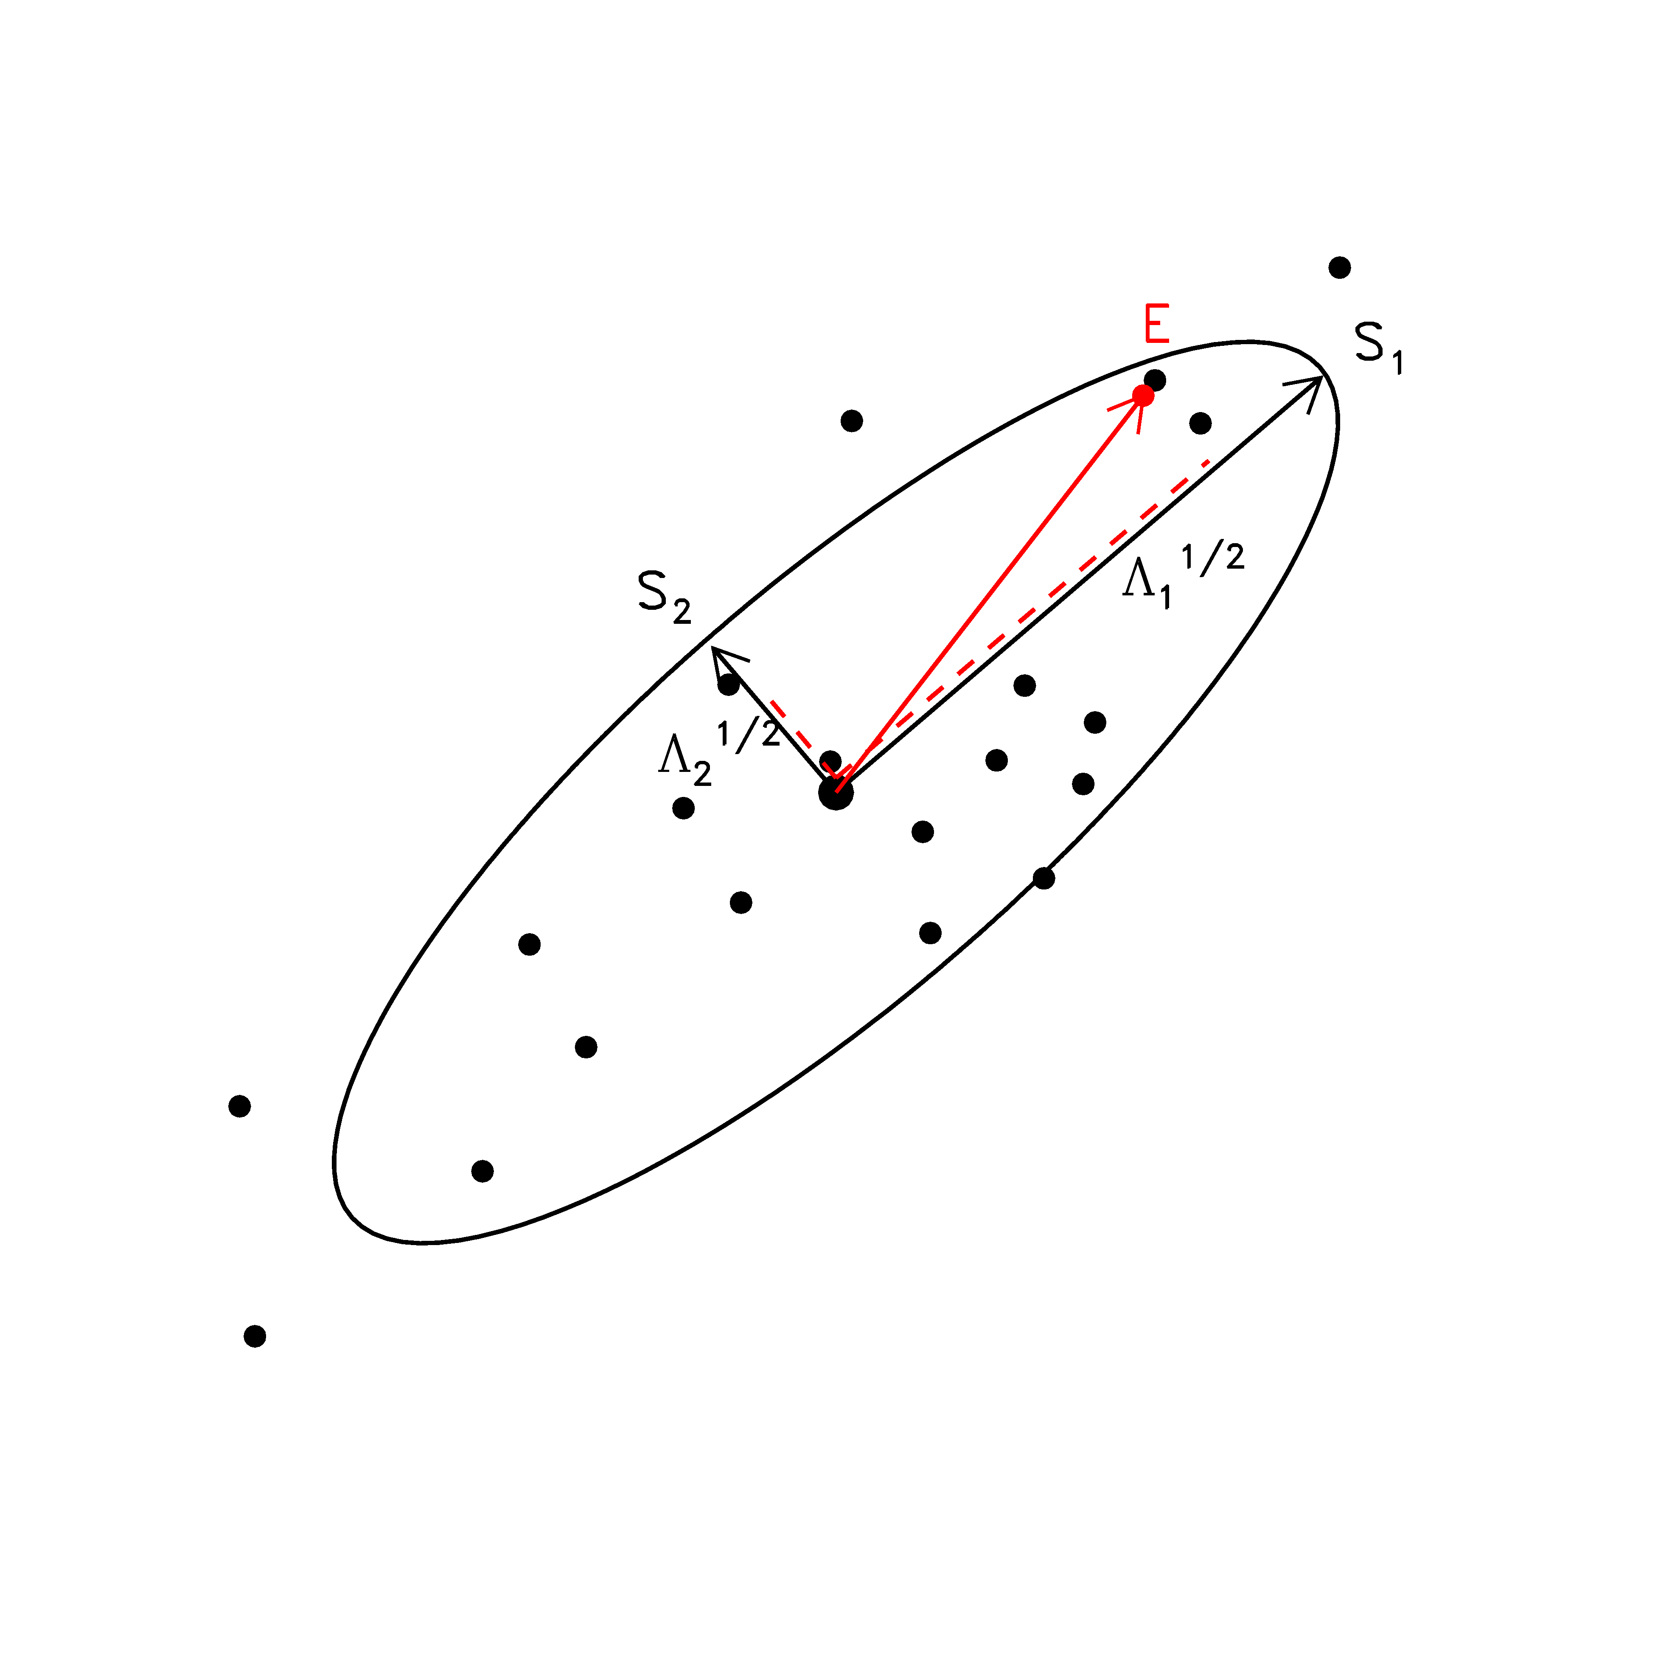
Ellipse eccentricity analysis
Question: are errors projections larger along the direction
where the ellipse is stretched out?

Slide 30
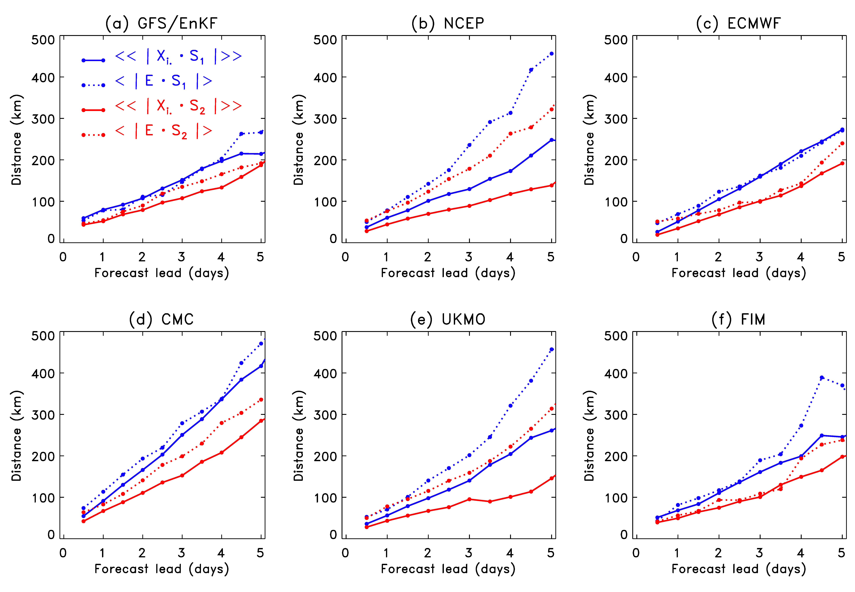
Ellipse eccentricity analysis
Notes for GFS/EnKF:
Along major axis of ellipse, consistent average projection error of errors and projection of members; spread well estimated.
Along minor axis of ellipse, slightly larger projection of errors than projection of members. Too little spread.
Together, imply more isotropy needed.
Still (dashed lines) some separation of projection of error onto ellipses indicates there is some skill in forecasting ellipticity.
(non-homogeneous)

Slide 31
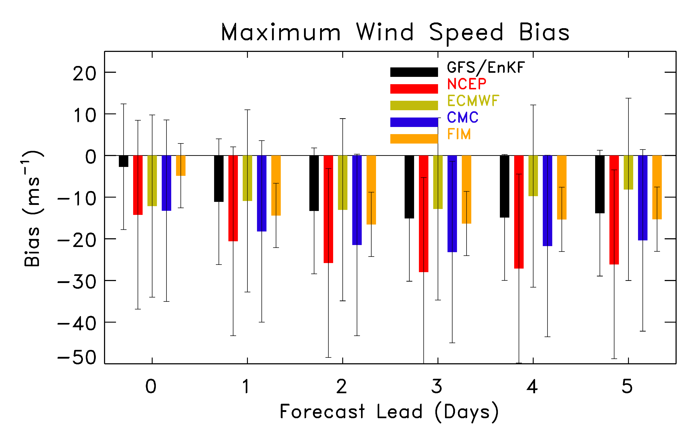
non-homogeneous; error bars are 5th, 95th percentiles of normal distribution fit to data.

Slide 32
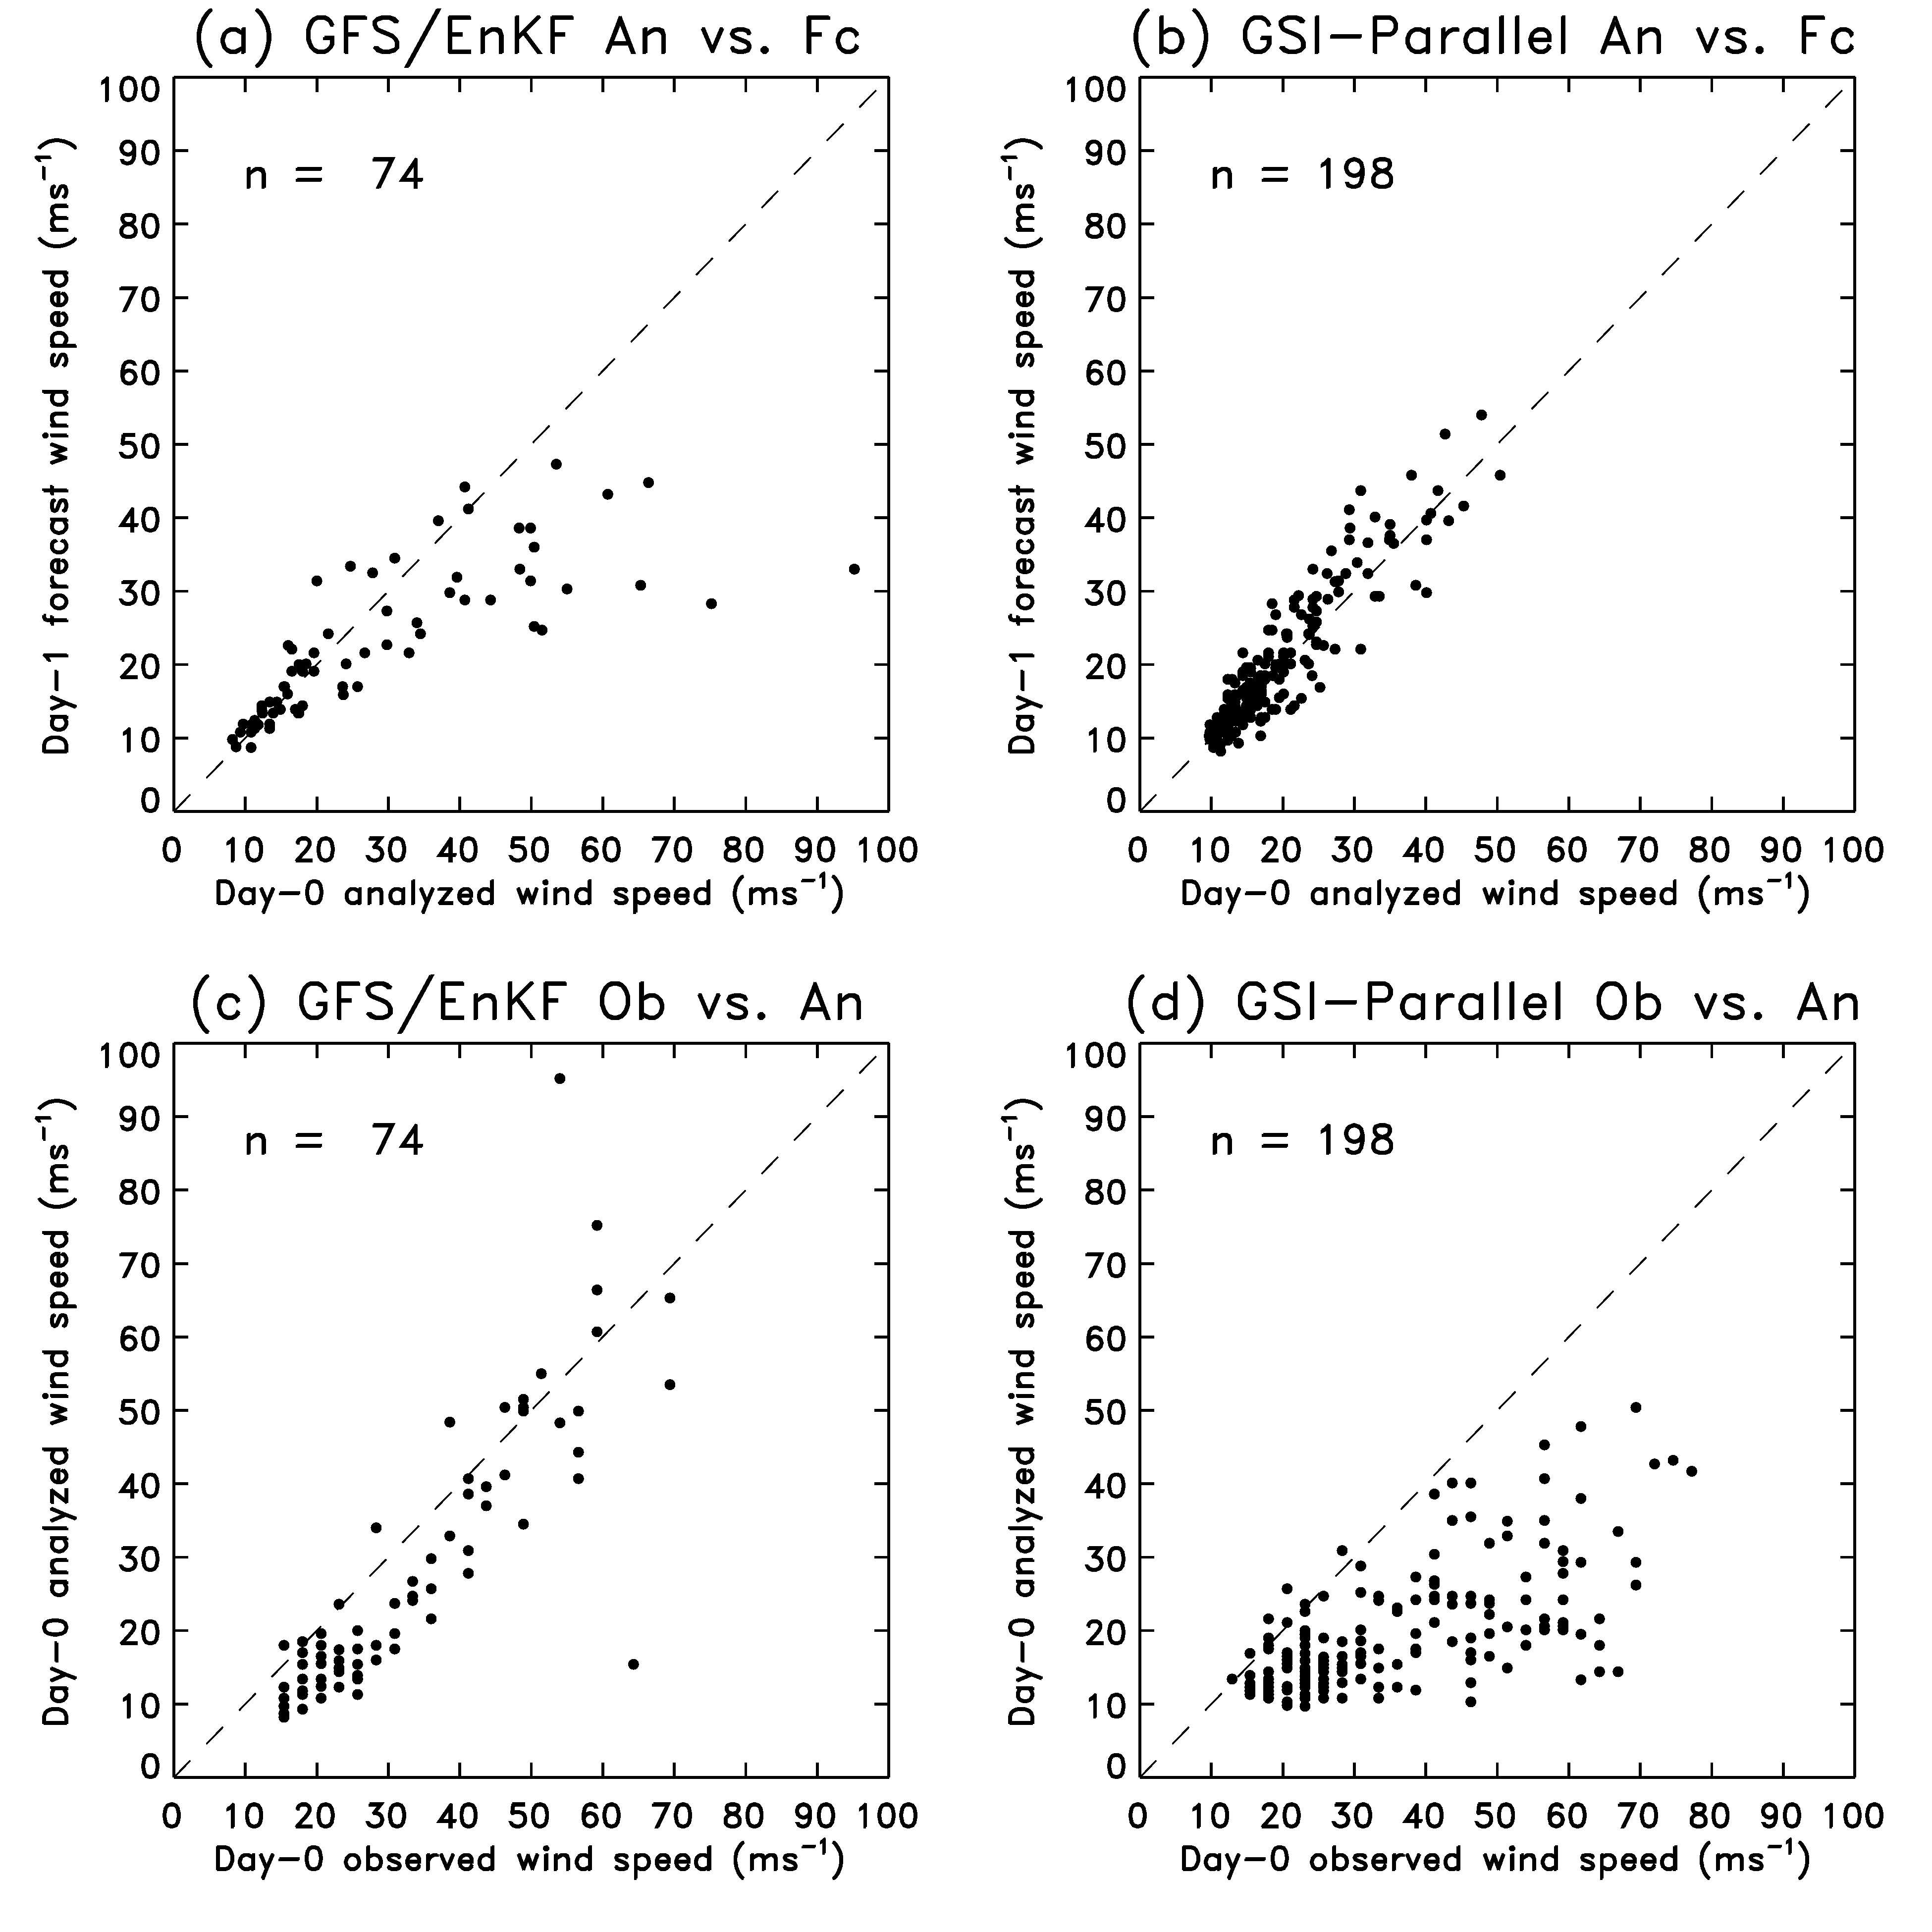
Source of rapid decrease of GFS/EnKF wind speeds between day 0 and day 1?
Rapid decrease in speed
of GFS/EnKF forecasts;
not so for GSI initialized
But looking at analyzed
wind speeds, GFS/EnKF
produces appropriately
strong vortex, GSI does not.

Slide 33
Why the persistent under-forecast of the strength of vortices?
at coarse resolution the model simply cannot
support intense vortices, even if properly analyzed
first-guess
vortex
during the
subsequent
6-h forecast
EnKF, after
adjustment
to observations
model reproduces
a vortex at the only
scales it can support

Slide 34
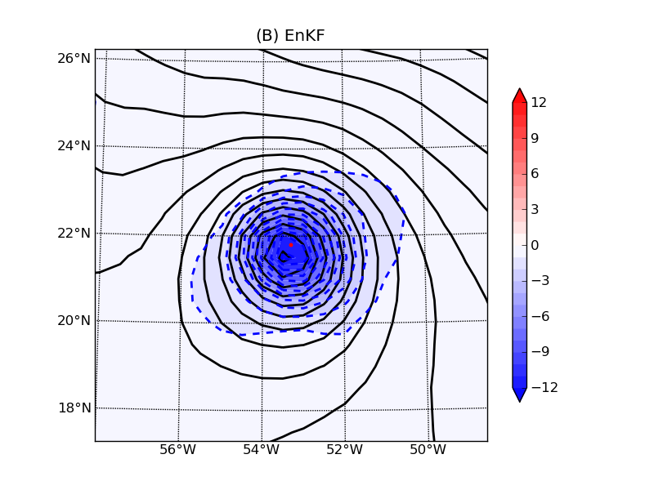
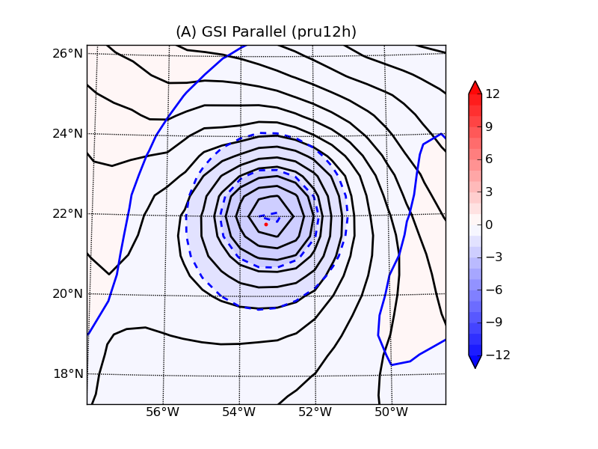
Increments in GFS/EnKF and GSI-parallel to TCVitals SLP
Hurricane Ike, 00 UTC 4 September 2008
Change to EnKF initializes much deeper, tighter vortex; contours every 1 hPa.

Slide 35
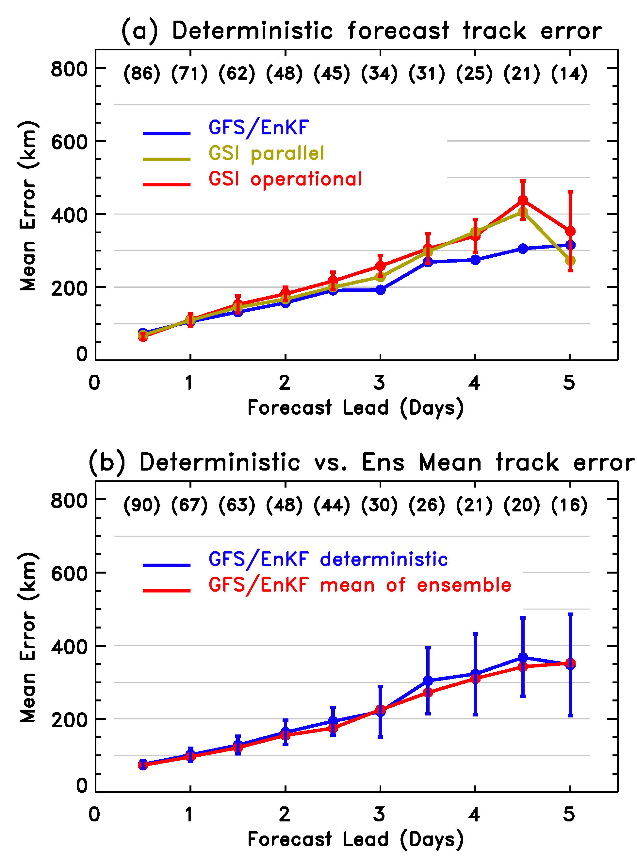
Trying to understand effects of TCVitals, EnKF, resolution, ensemble averaging
Surprisingly, GFS parallel with TCVitals didn’t have appreciably lower errors than GSI operational. Maybe different effect with EnKF? Also, note Daryl Kleist, NCEP/EMC saw bigger impact with 2008 season.
Ensemble averaging did not appear to have a large effect on track forecast performance.

Slide 36
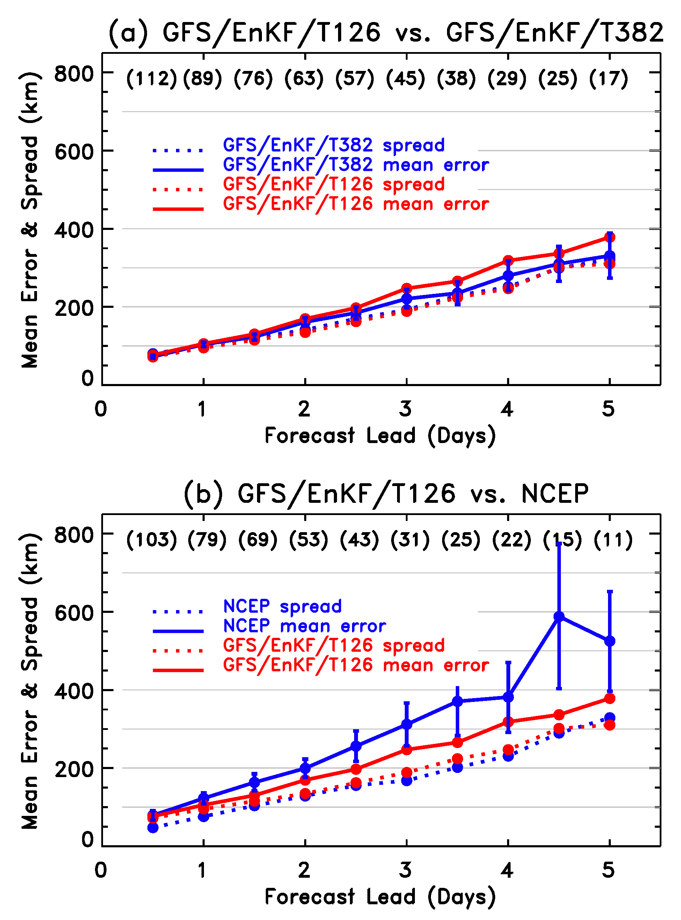
Trying to understand effects of TCVitals, EnKF, resolution,
ensemble averaging
modest impact on track forecast
from degrading the resolution
of the forecast (still T382 during the data assimilation).
larger impact of GFS/EnKF at T126 vs. operational. However,
2009 operational version had more diffusion, so that complicates analysis.

Slide 37
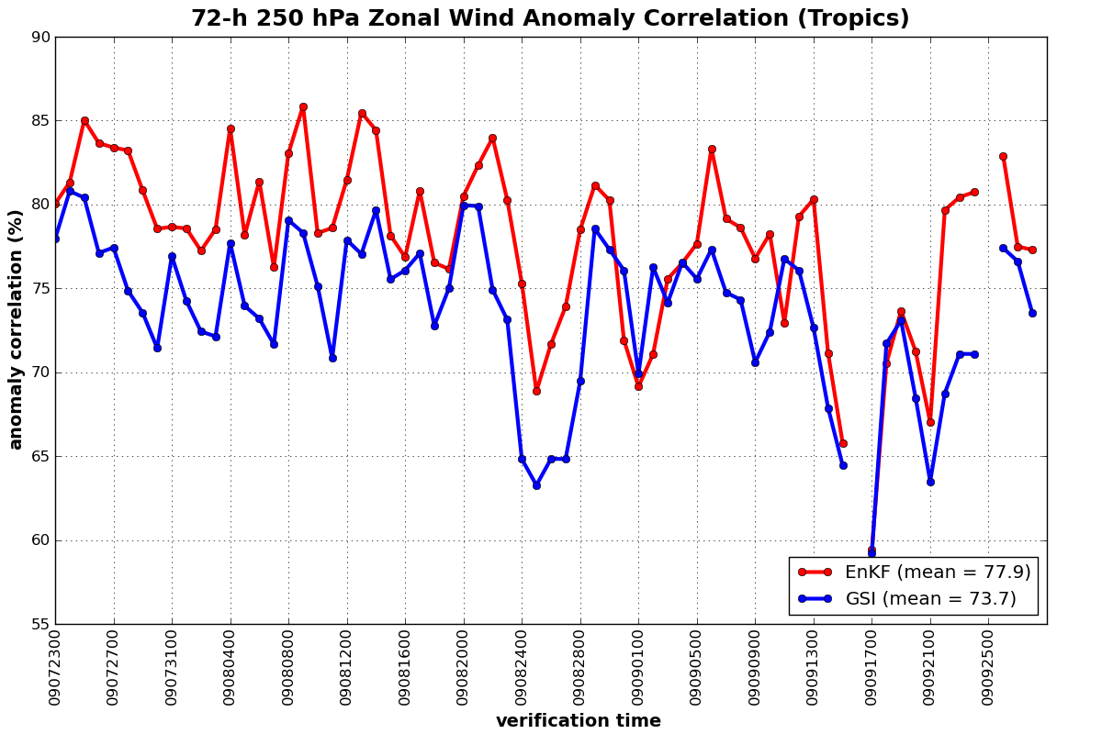
Tropical winds from parallel tests of deterministic T382 GFS/GSI & GFS/EnKF
EnKF provides consistently better wind forecasts; better steering of tropical cyclones?

Slide 38
Improvements next summer
Higher resolution, if possible.
Vortex relocation to ens. mean prior?
TCVitals obs error estimates incorporated into data assimilation?
Also: estimate representativeness errors of TCVitals
Better treatment of model-error covariances.
 | Dvorak | vs. | in-situ | error | (mb)
TD | TS | Cat 1 | Cat 2 | Cat 3 | Cat 4 | Cat 5
3.3 | 6.1 | 9.5 | 11.7 | 13.9 | 16.1 | 19.1
* table c/o Ryan Torn, U Albany

Slide 39
Multi-model forecast? Hurricane Bill
Initialized 00 UTC 19 August 2009.
What if we combine the forecasts
in some fashion, using their error
statistics?

Slide 40
Proposed multi-model technique
Estimate average absolute error σ_{m,t} of the ensemble-mean forecast for a given lead time t and forecast model m, quasi-cross validated (e.g., when estimating error for Bill, don’t use Bill data, but ok to use every other storm).
Set weights for every available member forecast to be 1/σ²_{m,t}
Estimate weighted ensemble mean and weighted ensemble covariance matrix.

Slide 41
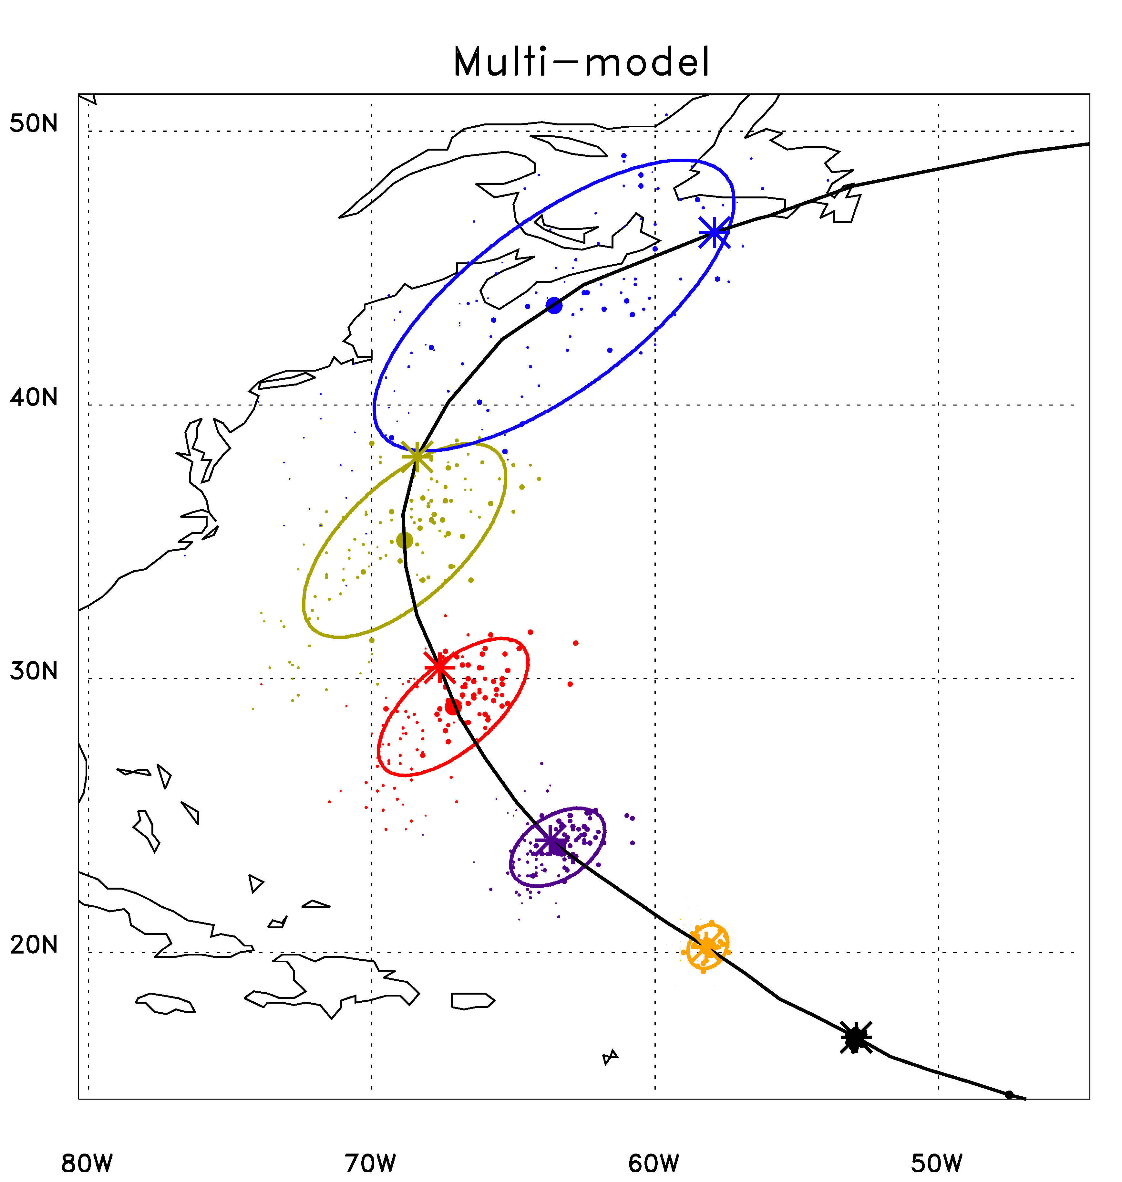
An experimental multi-model product
Dot area is proportional to the weighting applied to that member
= ens. mean position
* = observed position
Day 5
Day 4
Day 3
Day 2
Day 1
Day 0

Slide 42
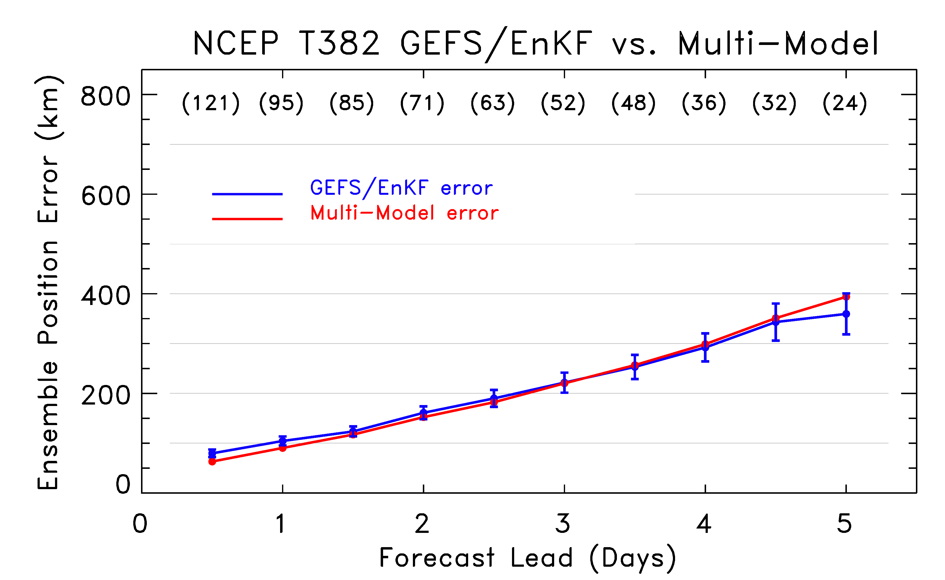
Multi-model error (GEFS/EnKF, ECMWF, FIM, UKMO, CMC, NCEP)
Not much improvement from multi-model. Why?

Slide 43
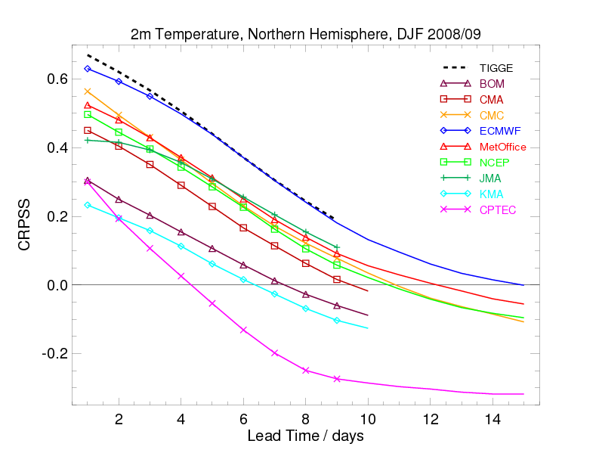
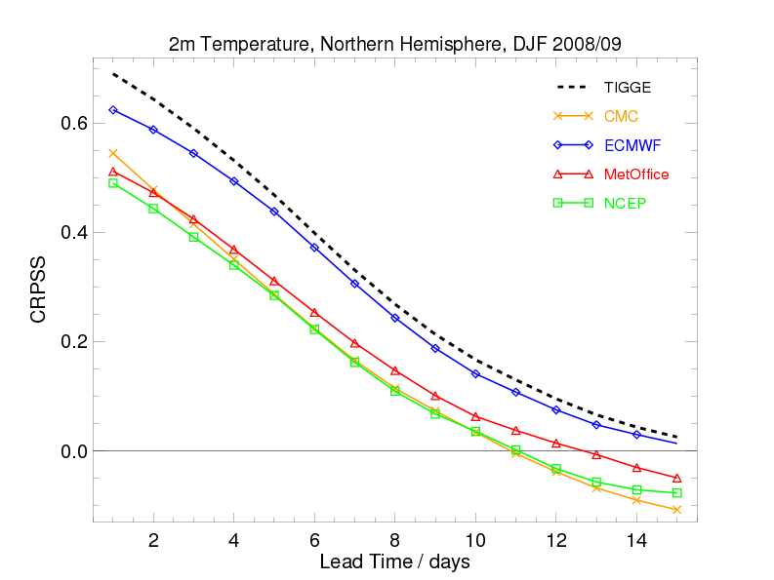
Multi-model 2-m temperature forecasts
All models (with 30-day bias correction)
& multi-model “TIGGE”
Best 4 models (with 30-day bias correction)
& multi-model “TIGGE”
collaborative work led by Renate Hagedorn, ECMWF; conditionally accepted, MWR
Lesson: discard less skillful models?

Slide 44
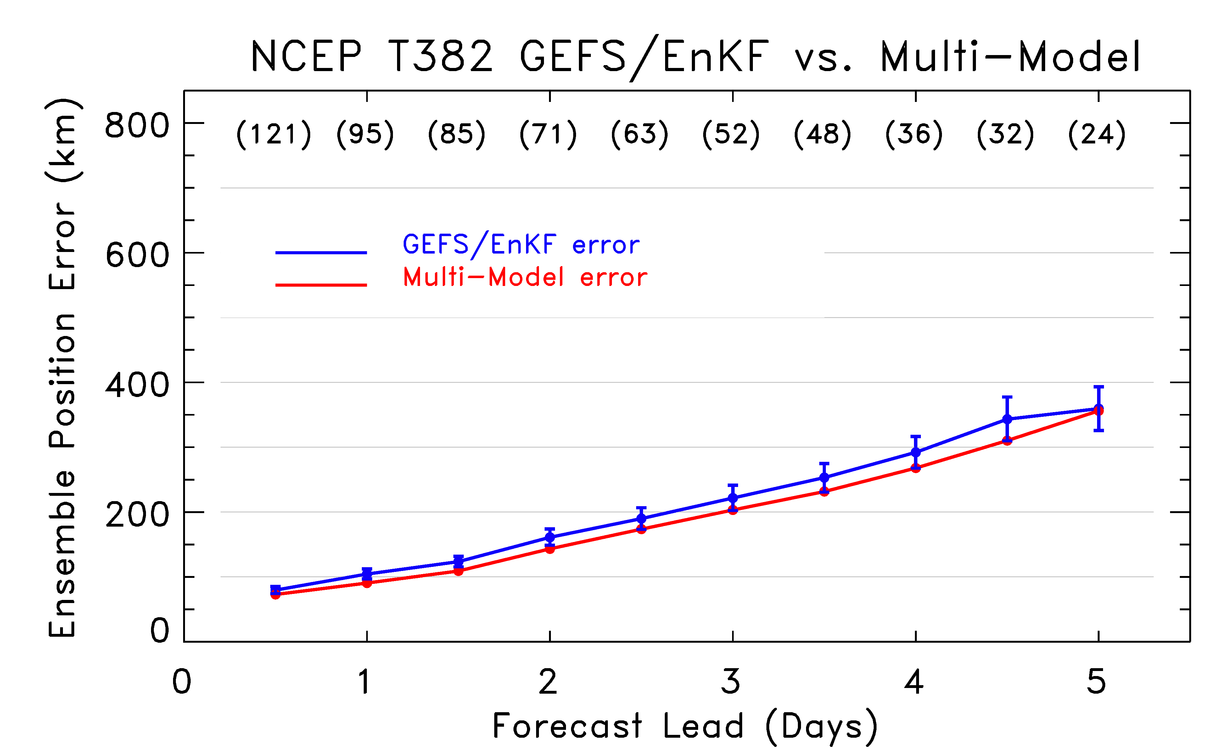
Multi-model error (GEFS/EnKF, ECMWF only)
Now some improvement, ~ 6 - 9 hours lead.

Slide 45
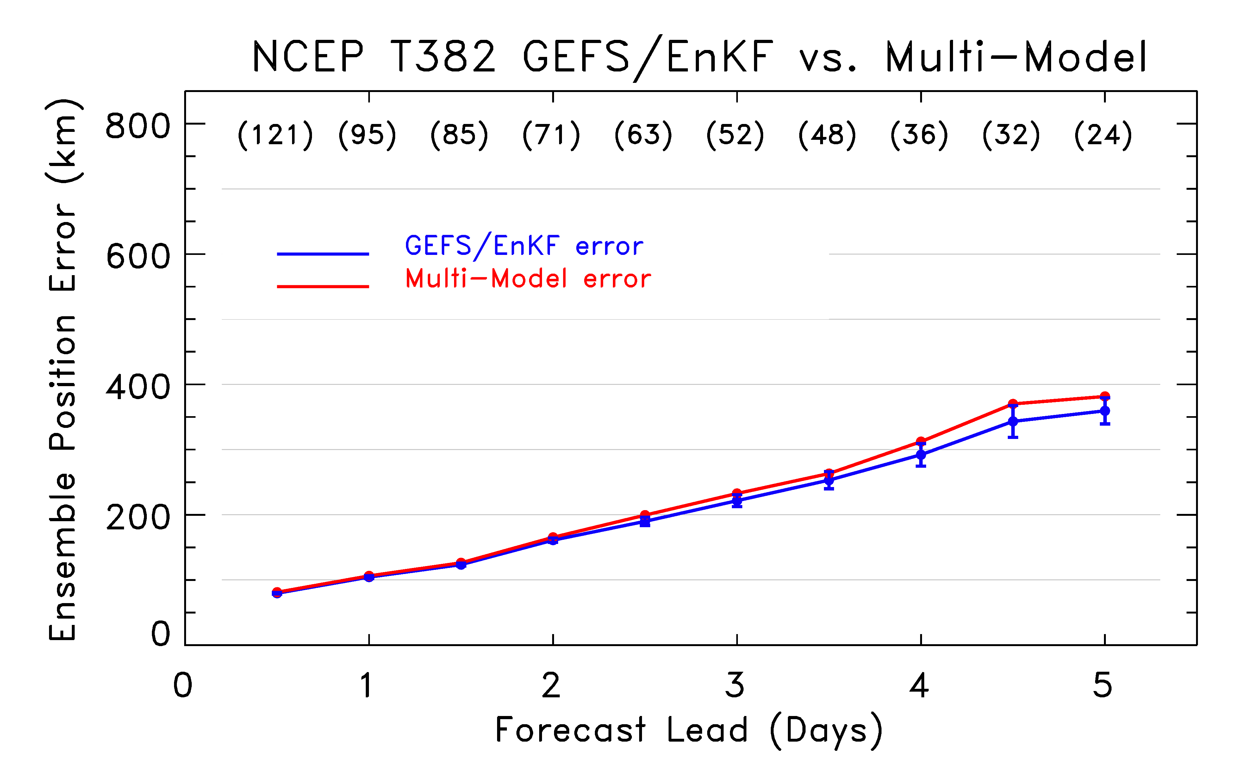
Multi-model error (GEFS/EnKF, FIM only)
Degradation relative to GFS/EnKF alone. Why?

Slide 46
Correlation of errors, GFS/EnKF & FIM
r is the Spearman rank correlation.
Multi-model forecasts generally predicated on the assumption that models
provide independent information. In this case, FIM errors are highly co-linear
with GFS/EnKF errors.

Slide 47
Correlation of errors, GFS/EnKF & ECMWF
Less co-linearity of forecast errors between GFS/EnKF & ECMWF systems; the
greater independence of their forecast errors permits a multi-model improvement.

Slide 48
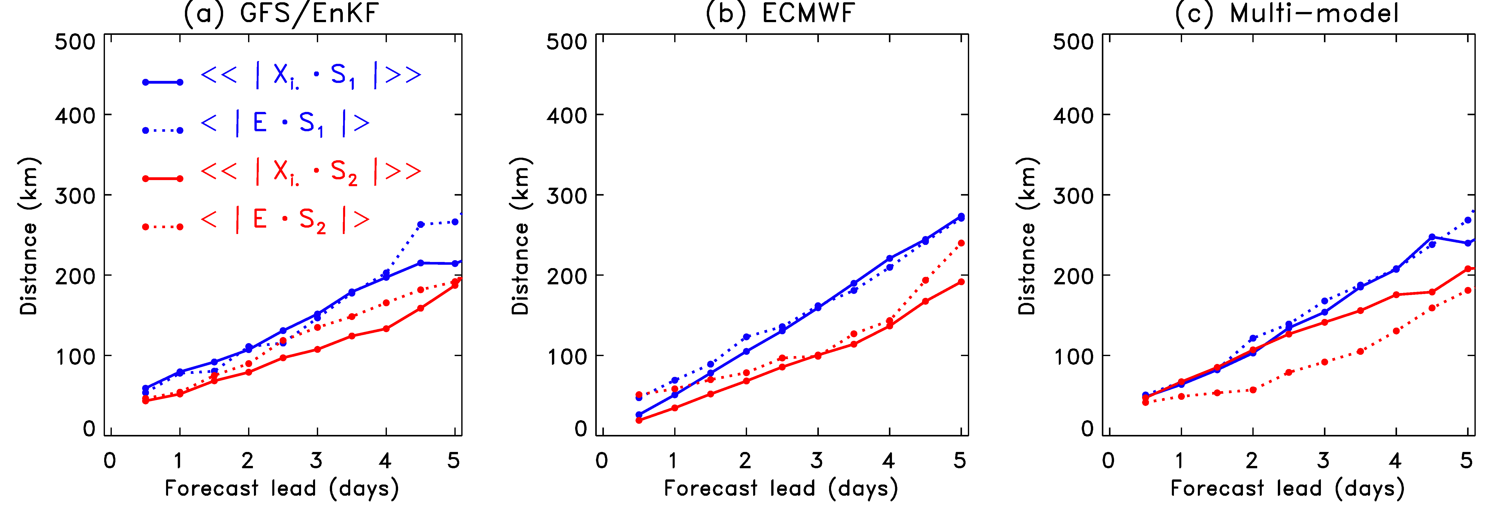
Multi-model ellipse eccentricity
suggests that multi-model forecast now has a bit too much spread in
directions of trailing eigenvectors. Also, the projection of error onto
the trailing eigenvector has decreased.

Slide 49
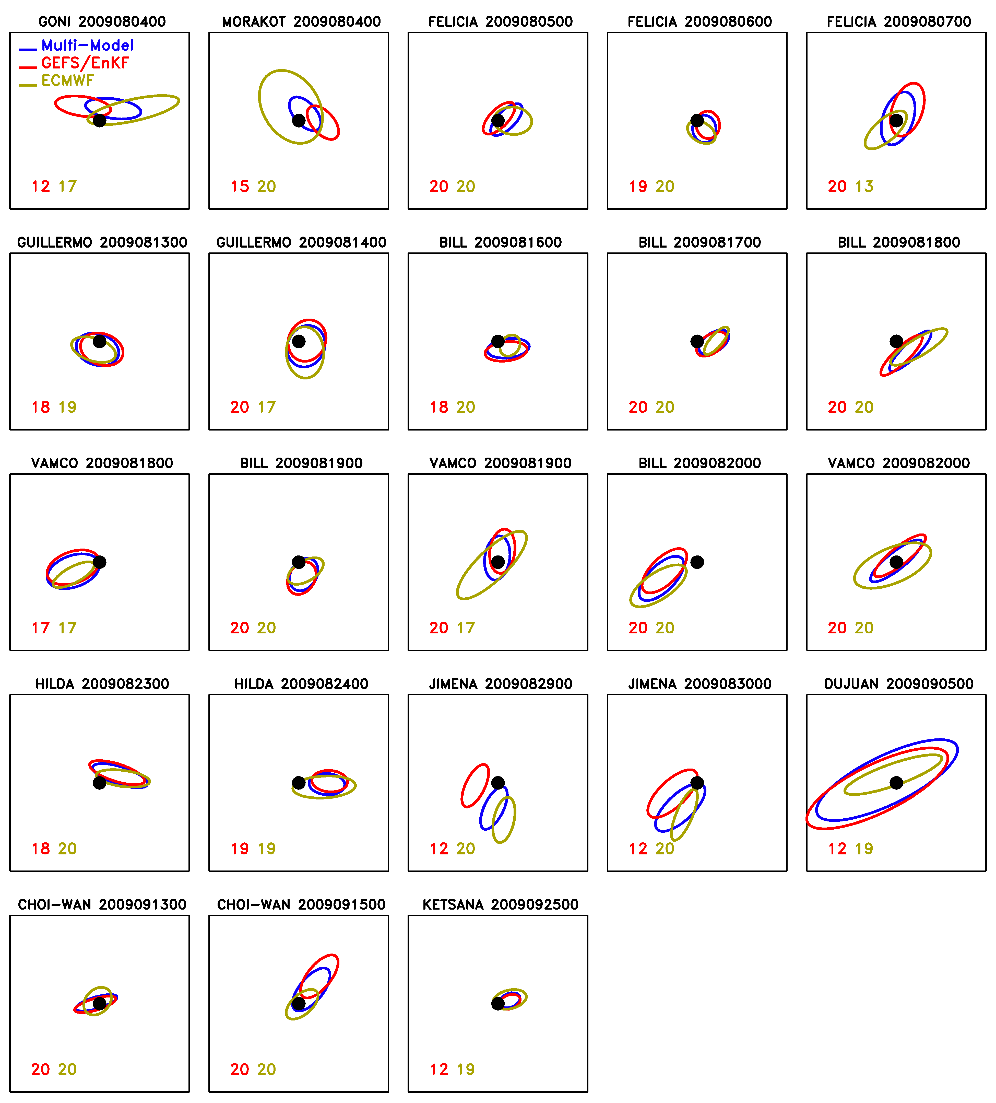
Day-4 Ellipses
Dot: observed position
(always at center)
Red oval: GEFS/EnKF
Green oval: ECMWF
Blue oval: Multi-model
Numbers: # members
tracked
30 degrees
(not sure this is that illuminating)

Slide 50
Conclusions, part 1
EnKF + high-resolution global model showed remarkable success in 2009 season
track forecasts competitive with state-of-the art ECMWF forecast ensemble.
track forecasts clearly better than NCEP, CMC operational, FIM.
good consistency between ensemble spread and error.
generally better tropical wind analyses.
information on ellipticity of track positions useful
Improvement in TC forecasts likely due to increased model resolution, EnKF, and TCVitals.
however, forecast resolution had smaller impact when data assimilation with hi-res EnKF
TCVitals had small impact in GSI; parallel tests with/without in EnKF not conducted. Presumed effect larger.

Slide 51
Conclusions, part 2
Multi-model forecasts provided some benefit to tracks
No benefit when using all ensemble systems, including poorer ones
Some benefit of just GFS/EnKF + ECMWF
Some questions
improve methods for vortex initialization in EnKF. Incorporate relocation?
methods for treating hurricane-related model error?
resolution impacts of global model in EnKF?
effect of assimilating position and intensity of TCVitals separately?
will nesting of high-resolution regional EnKF and SREF forecasts provide even better results?

Slide 52
The future
ESRL and EMC have a signed agreement to work together toward the development of a hybrid XD-Var/EnKF, operational 3 years hence.
We will continue testing the EnKF with as high a resolution global model as possible through HFIP.
We partner with AOML scientists to develop a consistent nested regional WRF/EnKF system.

Slide 53
Acknowledgments
NOAA HFIP program for 2009 summer test support
NOAA THORPEX, ESRL base for EnKF development
U. Texas NSF supercomputer for CPU cycles
Phil Pegion for programming support, analysis.
Mike Fiorino (tracker files, software sanity check)
Other ESRLites, e.g., Chris Harrop for scripting, Stan Benjamin for FIM development and management, Paula McCaslin for display software
Tim Marchok (tracker files)
Daryl Kleist (GFS parallel runs)
Chris Snyder, Jeff Anderson for ensemble bull sessions and algorithmic ideas.
and you, for your constructive feedback

Slide 54
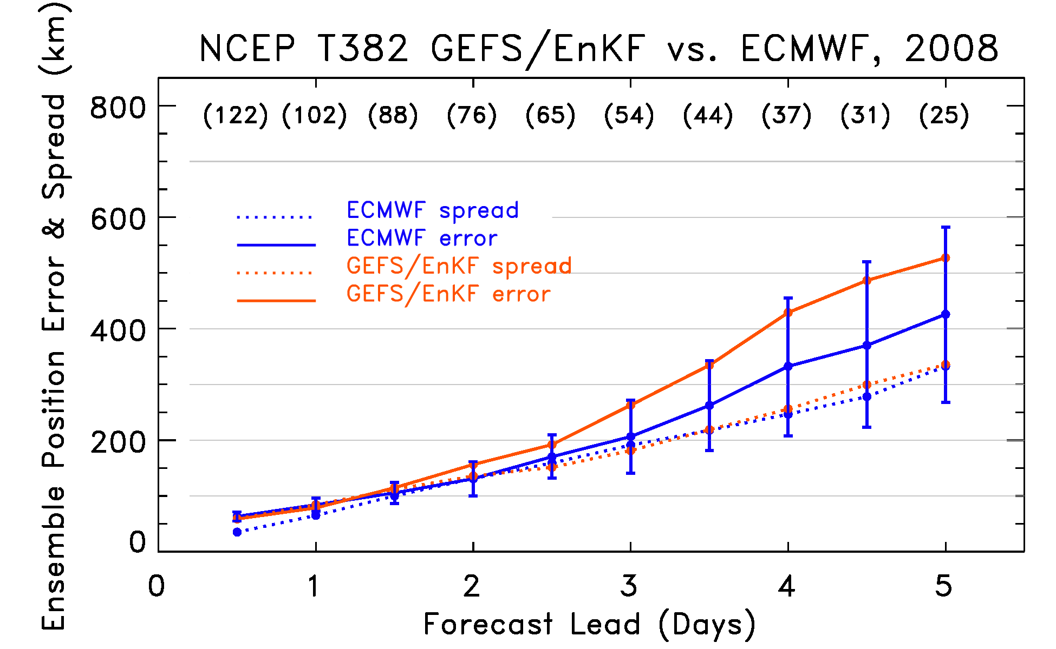
2008 season, GFS/EnKF vs. ECMWF
For 2008, EnKF-based system does not compare favorably to ECMWF. Why?

Slide 55
Typhoon Hagupit, 2008 GFS/EnKF bust
GFS statistics are strongly affected by two samples from Typhoon Hagupit. Here’s one.

Slide 56
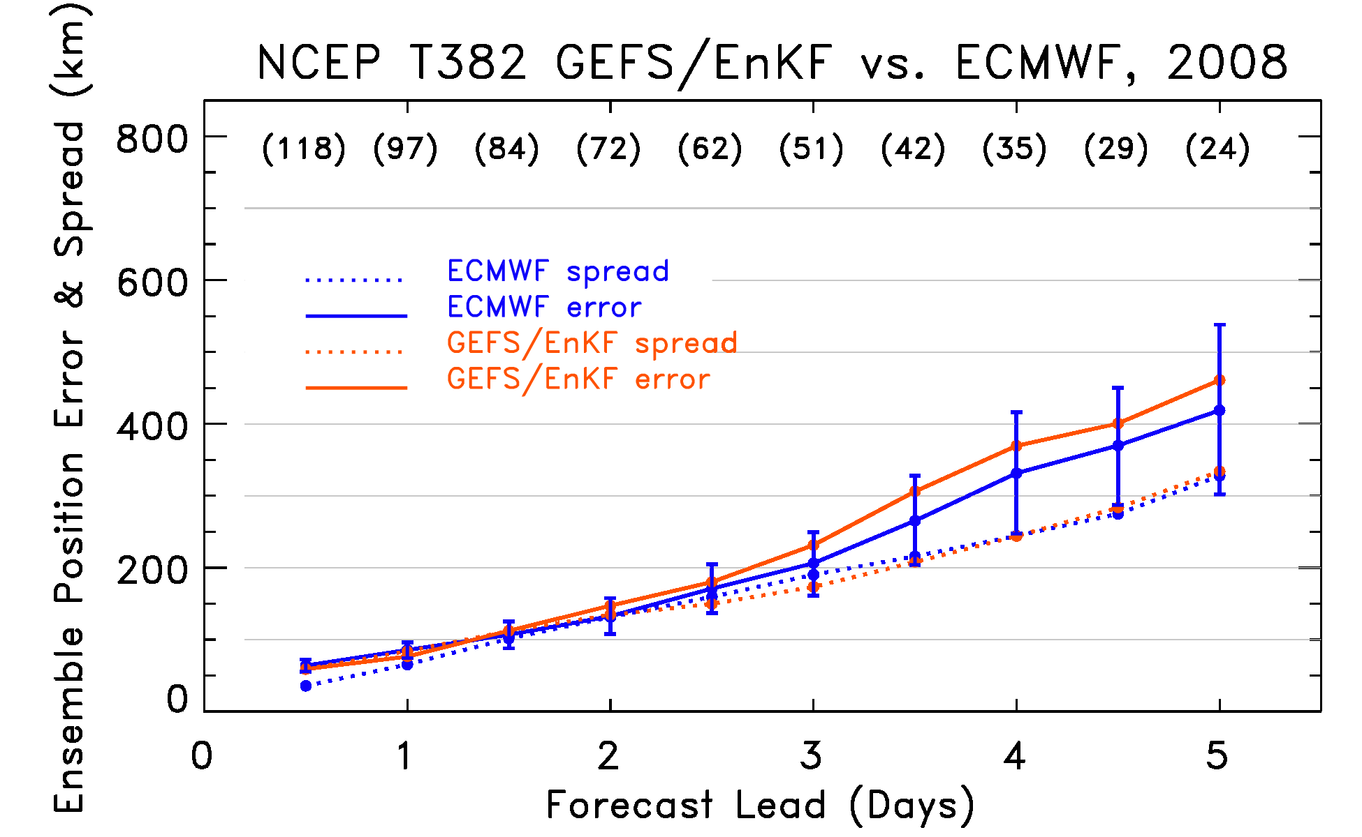
2008 season, GFS/EnKF vs. ECMWF (without Hagupit)
Now GFS/EnKF is more similar in performance, though in 2008 both systems
exhibit a lack of spread.

Slide 57
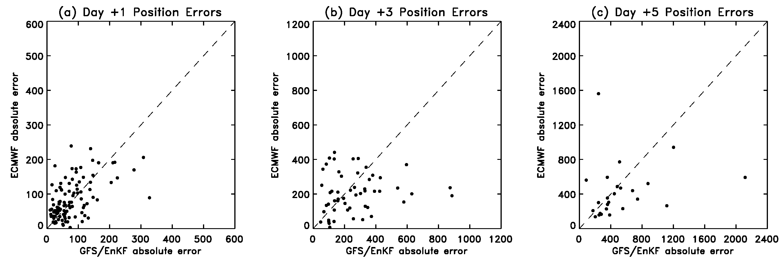
GFS/EnKF vs. ECMWF track errors
S
H
H
H
H
H = Hagupit, S = Sinlaku

Slide 58
Canonical EnKF update equations (for time t)
Notes:
An ensemble of n parallel data assimilation cycles is conducted, assimilating perturbed observations .
Background-error covariances are estimated using the ensemble.
(back)

Slide 59
Propagation of state and error covariances in EnKF
(Pª never
explicitly
formed)
if forecast model is “perfect”; M is
forward model operator
- or -
…or something similar,
if forecast model imperfect.

Slide 60
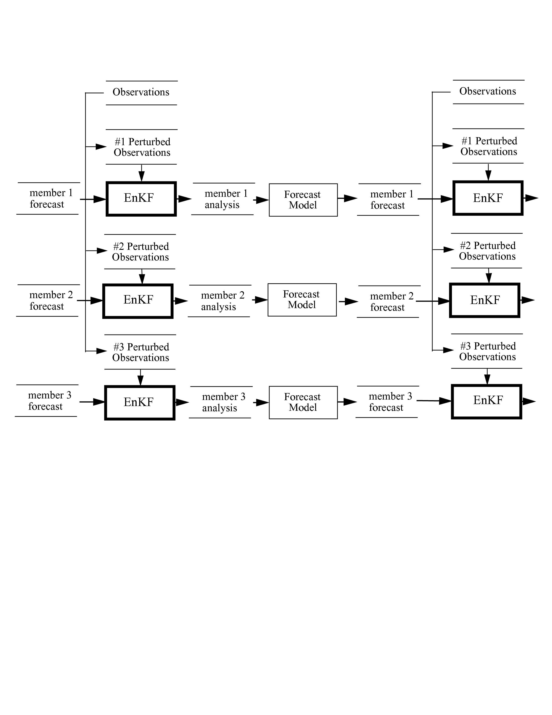
Perfect-model EnKF schematic
(This schematic
is a bit of an
inappropriate
simplification,
for EnKF uses
every member
to estimate
background-
error covariances)

