Slide 1

New Directions in Statistical Post-Processing
Tom Hamill
NOAA ESRL Physical Sciences Division
Boulder, Colorado USA
tom.hamill@noaa.gov
Acknowledgments: Michael Scheuerer, CIRES An invited presentation to Glahn Symposium, 2015 AMS Annual Meeting

Slide 2
We mean many things by
“statistical post-processing”
Distribution fitting.
Perfect-prog methods.
Physically based statistical models (e.g. DeMaria’s LGEM).
Model output statistics (MOS; thanks Bob Glahn)
  Implicitly, many methods, not just multiple linear regression.
  Develop predictive relationships between past observed and forecast.
  From this, estimate probability distribution of observed given today’s forecast.
Etc.

Slide 3
Identify forecast
question.
The statistical
model-building
process
Gather forecasts &
obs. or analyzed data.
Identify potential
predictors and
model type.
Build statistical model.
Test & verify with independent data.
NO
are
you happy with
results?
YES
Implement and
disseminate forecasts
NO
customers
satisfied?
YES

Slide 4
Identify forecast
question.
The statistical
model-building
process
Gather forecasts &
obs. or analyzed data.
Identify potential
predictors and
model type.
Build statistical model.
Test & verify with independent data.
NO
are
you happy with
results?
YES
Implement and
disseminate forecasts
Sooner or
later, the
model must
change.
NO
customers
satisfied?
YES

Slide 5
Identify forecast
question.
The statistical
model-building
process
Gather forecasts &
obs. or analyzed data.
Identify potential
predictors and
model type.
Build statistical model.
Test & verify with independent data.
The quality and value to the customer of post-processed
guidance can be limited by problems in any one of these steps. Each one requires
due diligence.
NO
are
you happy with
results?
YES
Implement and
disseminate forecasts
Sooner or
later, the
model must
change
NO
customers
satisfied?
YES

Slide 6
Identify forecast
question.
The statistical
model-building
process
Gather forecasts &
obs. or analyzed data.
Identify potential
predictors and
model type.
Build statistical model.
Test & verify with independent data.
NO
are
you happy with
results?
YES
Implement and
disseminate forecasts
NO
customers
satisfied?
YES

Slide 7
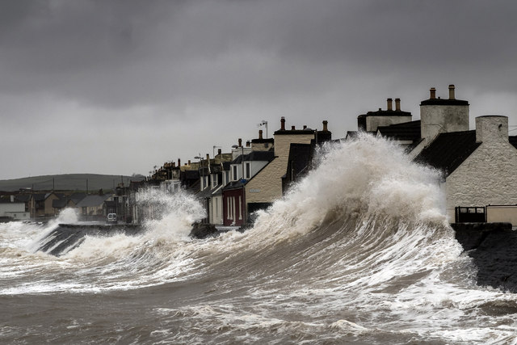
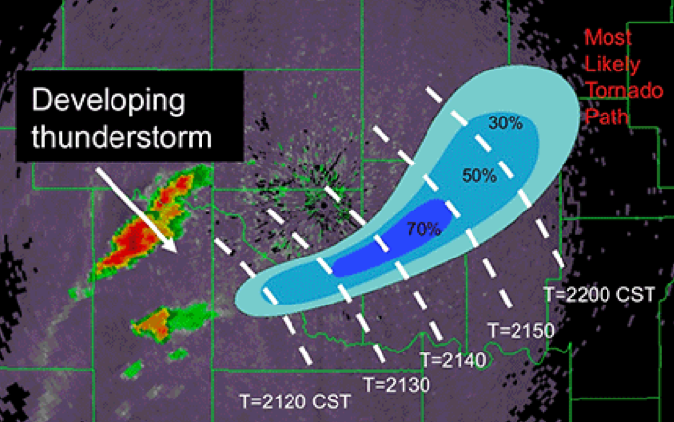
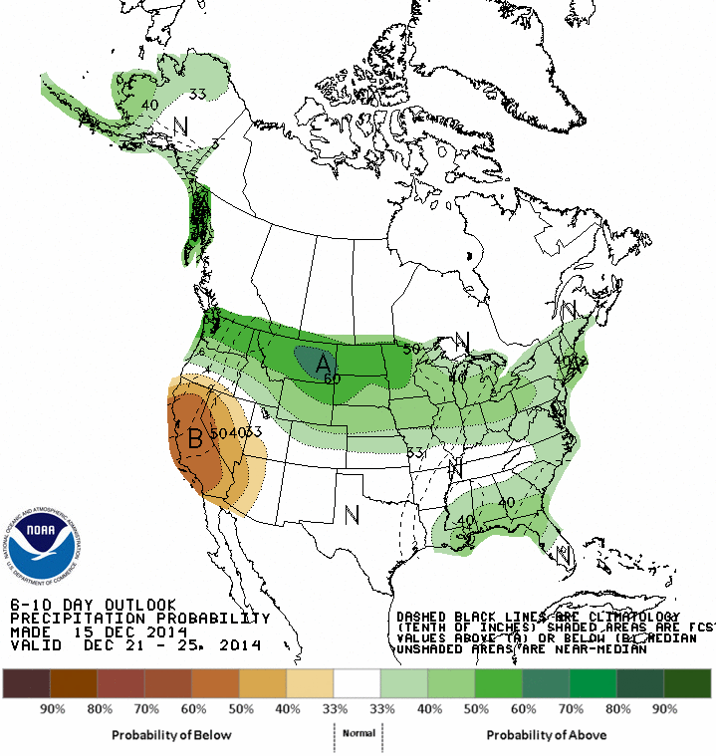
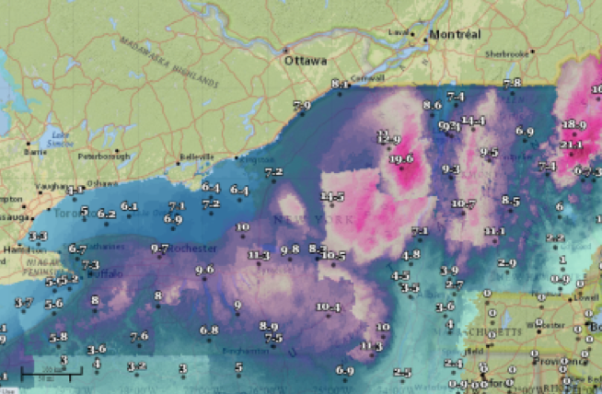
Identifying the forecast question

Slide 8
What are customers asking for?
Increasingly, post-processed guidance for weather related to high-impact events.
Applications
  Precipitation amount and type, and drought.
  Cloud amount, type, ceiling, visibility, insolation (for solar energy).
  Aviation: Icing, turbulence, winds en route, thunderstorm areal coverage.
  Ship routing, wave height.
  Wind, gustiness.
  Wind power and its “ramps.”
  Tropical cyclogenesis probabilities, TC intensity, location.
  Tornadoes and severe weather.
  Temperature, humidity.
Characteristics:
  High-resolution (spatial & temporal).
  Low-error deterministic and reliable & sharp probabilistic.
  Probabilities of extremes.
  Time scales: nowcast to decadal-centennial.
  Spatial and temporal correlation structures (multi-variate).
And so forth.
Post-processing resources for development and
maintenance are limited. How to choose?

Slide 9
Identify forecast
question.
The statistical
model-building
process
Gather forecasts &
obs. or analyzed data.
Identify potential
predictors and
model type.
Build statistical model.
Test & verify with independent data.
NO
are
you happy with
results?
YES
Implement and
disseminate forecasts
NO
customers
satisfied?
YES

Slide 10

Gathering forecasts, observations, & analyzed data.
High-
performance
computing
Higher-resolution models,
more models, run more
frequently
Improved assimilation methods
Improved physics
Frequent model updates &
bug fixes
More ensemble members
High-quality reanalyses for
initialization, statistical model
development, verification
Retrospective forecasts
More stable models
HPC funds to disk space
for rapid access to
past forecasts
Can we resolve
this tension?

Slide 11
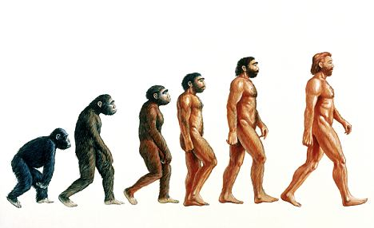
NCEP/EMC plans for evolution of model implementation process
(from 2014 Production Suite Review)
GFS: implementations yearly, with 2-3 years of reanalyses and reforecasts.
GEFS: implementations every other year, with reanalysis &reforecast from ~ 1999-present.
CFS: implementations every 4th year, with modern-era reanalysis reforecast.
We are grateful to NCEP.
Now we need spiffy new methods worthy of this rich data.

Slide 12
Data set details to iron out.
Reanalyses.
  Regular production for reforecast initialization; same model, same resolution, same assimilation methodology.
  High-res., high-quality surface reanalyses for training, verification.
Reforecast
  # members/cycle? # cycles/day? Frequency? How far into the past? Structure satisfactory to all while being computationally tractable? [See NOAA white paper for a start]
  ~ homogeneous forecast errors and bias over reforecast period.
Plentiful, non-proprietary observations (e.g., precipitation type, severe weather, stream flow, wind power)
Robust supporting infrastructure.
  HPC for reanalysis, reforecast.
  Large amount of rapid-access disk space.
  Computer cycles for post-processing model development.
  Bandwidth for dissemination of high-res. probabilistic products.

Slide 13
Retrospective analyses:
RTMA/URMA
NWS’s ~ 2.5 - 3 km mesoscale hourly surface analysis
  covers N America, AK, HI, PR, Guam
  temp, dewpoint, winds, visibility.
  used for verification, training in prominent “National Blend” project.
Implementation soon: 3-km HRRR and 4-km NAM blend for first-guess forecasts.
Improving, but still concerns about analysis quality, esp. in mountainous terrain.
Will need RTMA run in past to cover the same period as reforecasts.
http://www.mdl.nws.noaa.gov/~blend/blender.prototype.php

Slide 14
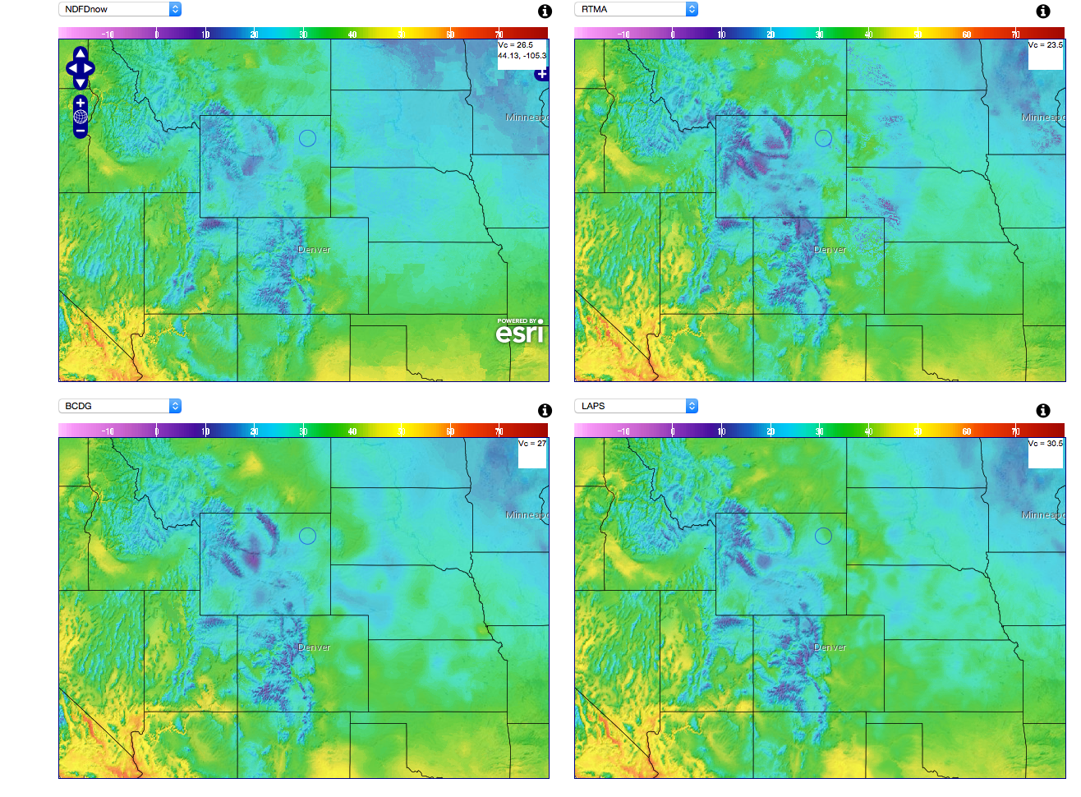
Noticeable differences between mesoscale analyses
http://www.mdl.nws.noaa.gov/~blend/blender.prototype.php (internal NOAA)

Slide 15
Reforecast sample size: how many?
Amount
Post-processing application
a few are
sufficient
Short-range forecasts of surface temperature, dew point
Short-range wind forecasts
Forecasts of light precipitation events
Wind-power “ramp” events and wind-error spatial correlations
Extended-range temperature and precipitation, temperature extremes
Forecasts of heavy precipitation events
Tornado forecasts
Space-time correlation structure of hydrologic forecast errors
a very
large
number
needed
There is no one optimal reforecast configuration for all applications.

Slide 16
Identify forecast
question.
The statistical
model-building
process
Gather forecasts &
obs. or analyzed data.
Identify potential
predictors and
model type.
Build statistical model.
Test & verify with independent data.
NO
are
you happy with
results?
YES
Implement and
disseminate forecasts
NO
customers
satisfied?
YES

Slide 17

This step can be time consuming.
We need the exploratory data analysis and fast modeling tools of science fiction.
“Majority Report”

Slide 18
Identify forecast
question.
The statistical
model-building
process
Gather forecasts &
obs. or analyzed data.
Identify potential
predictors and
model type.
Build statistical model.
Test & verify with independent data.
NO
are
you happy with
results?
YES
Implement and
disseminate forecasts
NO
customers
satisfied?
YES

Slide 19

Building a high-quality statistical model
Old problems are new problems
  “ bias-variance tradeoff ”
  “ extrapolating the regression ”
  “ curse of dimensionality ”
More modular, reusable software.

Slide 20
Building a high-quality statistical model
Old problems are new problems
  “ bias-variance tradeoff ”
  “ extrapolating the regression ”
  “ curse of dimensionality ”
More modular, reusable software.

Slide 21
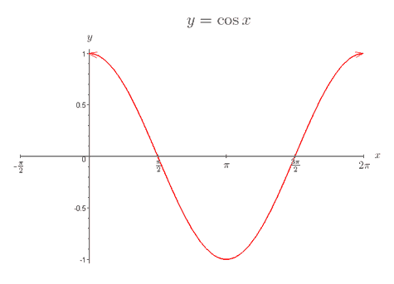
“Bias-variance tradeoff”
Example: let’s demo NCEP/EMC’s “decaying average” filter used in NAEFS
for estimating bias with simulated data
Generate daily time series of truth, simulated observations (100x), and simulated forecasts
(100x) under the condition of seasonally varying bias:
Truth T = 0.0 (always)
Bias: The true (but unknown) forecast bias for julian day t: B_{t} = cos (2πt/365)
Analyzed for day t = truth + random obs error:
x_{t}^{A} = T + e_{t}^{A}, where e_{t}^{A} ~ N(0, 1/3), iid each day.
Simulated biased forecasts for day t generated w. auto-correlated error via Markov Chain:
x_{t}^{f} - B_{t} = k•(x_{t-1}^{f} – B_{t-1} ) + e_{t}^{f} , where e_{t}^{f} ~ N(0,1), iid each day; k = 0.5
EMC’s decaying-average bias correction: bias estimate B_{t} is
B_{t} = (1-α)•B_{t-1} + α•(x_{t}^{f} – x_{t}^{A})
α is a user-defined parameter that indicates how much to weight most recent bias estimate;
large α akin to overfitting in regression analysis.

Slide 22
With small α,
the bias
estimates
have smaller
variance
over the 100
replications
but lag the
true bias.
Akin to
regression with
few predictors.
True Bias
Estimated
With large
α, bias
estimates
have large
variance
but don’t
much lag
the true
bias. Akin
to regression
with many
predictors.
(plots shown
after 60-day
spinup)

Slide 23
Minimizing the bias-variance tradeoff
Sometimes, change form of model and/or choice of predictors:
  Forecast = a + b•fcst + c•cos(2πt/365) + d*sin(2πt/365)
Increase the training sample size.
  Overall increase (reforecasts).
  Selective increase*: estimate some parameters with local data, others with regional or global data.
  Example: precipitation forecast adjustment.
    Parameters related to terrain-related bias: local data.
    Parameters related to ubiquitous drizzle over-forecast: regional data.
(* Stimulated by Scheuerer, & König, 2014: Gridded, locally calibrated, probabilistic
temperature forecasts based on ensemble model output statistics. QJRMS, 140, 2582-2590.

Slide 24
Building a high-quality statistical model
Old problems are new problems
  “ bias-variance tradeoff ”
  “ extrapolating the regression ”
  “ curse of dimensionality ”
More modular, reusable software.

Slide 25
Extrapolating the regression
(that is, getting accurate predictions at and beyond the fringes of training data)
Data from grid point over Ithaca, NY,
and 19 “supplemental” locations with
similar climatologies, terrain features.
Split GEFS reforecast and analyzed
precipitation data over the
2002-2013 period into 4 batches.
Perform Dan Wilks’ “extended logistic
regression” (ELR) on each (power-
transformed) batch.
The GEFS 36-48 h ensemble-mean
forecast is the sole predictor, and
the method produces PDFs or CDFs
of predicted precipitation amount.

Slide 26
Predictive CDFs for the four batches
(given GEFS mean forecasts of 5 mm, 25 mm)
Despite the use of supplemental training data, there is great predictive uncertainty
from ELR amongst the four batches when the forecast = 25 mm.

Slide 27
Predictive CDFs for the four batches
(given GEFS mean forecasts of 5 mm, 25 mm)
What is P(obs > 25 mm)?
~ 25%? ~ 50%?
Despite the use of supplemental training data, there is great predictive uncertainty
from ELR amongst the four batches when the forecast = 25 mm.

Slide 28
Ameliorating predictive model uncertainty when forecasts are extreme
Some post-processing methods may be more sensitive than others, so test, test, test.
Again, increase sample size.
  Data from supplemental locations.
  Reforecasts and analyses spanning decades.
ID additional predictors with correlations to predictand.

Slide 29
Building a high-quality statistical model
Old problems are new problems
  “ bias-variance tradeoff ”
  “ extrapolating the regression ”
  “ curse of dimensionality ”
More modular, reusable software.

Slide 30

The curse of dimensionality: a motivation
Hydrologists want
to know not only the
intensity of rainfall,
but whether or not
that intense rainfall
will fall simultaneously
in many nearby
sub-basins.
What is the “copula”
structure, i.e., the joint
probabilities?
Reservoir
Reservoir
Dam
Dam
a problem
when marginal & joint probs.
are not well
forecast
No problem
(thanks to conversations with John Schaake)

Slide 31
Simulation study: observations & two forecasts
Suppose we want to know
the probability that the
obs > 4.0 | forecast 1 > 4.0

Slide 32
Simulation study: observations & two forecasts
Suppose we want to know
the probability that the
obs > 4.0 | forecast 1 > 4.0.
We can make some crude
estimation from counting:
# fcsts > 4.0 AND # obs > 4.0
# fcsts > 4.0

Slide 33
Simulation study: observations & two forecasts
Suppose we want to know
the probability that the
obs > 4.0 | f1 AND f2 > 4.0.
We can make some estimation
from counting (grey dots):
# f1 > 4.0 AND f2 > 4.0 AND # obs > 4.0
# f1 > 4.0 AND f2 > 4.0

Slide 34
Simulation study: observations & two forecasts
Suppose we want to know
the probability that the
obs > 4.0 | f1 and f2 > 4.0.
We can make some estimation
from counting (grey dots):
# f1 > 4.0 AND f2 > 4.0 AND # obs > 4.0
# f1 > 4.0 AND f2 > 4.0
This under-sampling problem
gets worse and worse with
higher and higher dimension;
the “curse of dimensionality.”

Slide 35
Estimating joint probabilities and ameliorating curse of dimensionality.
More training samples.
Model them parametrically.
  Suppose the joint probabilities depend on the spatial characteristics of weather forecast, e.g., scattered heavy rain vs. widespread heavy?
  Then you could sub-divide your training data (scattered batch, widespread batch); must evaluate whether sub-division improves the model more than the reduced sample size degrades it.
Exploit the joint probability information in the raw ensemble (“ensemble copula coupling”)?
Schefzik et al., Statistical Science 2013, 28, 616–640.

Slide 36
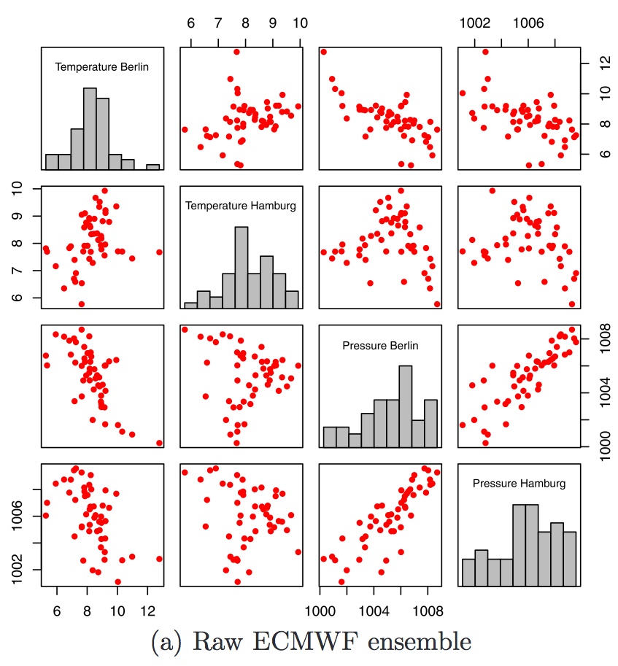
50 raw ECMWF ensemble
forecasts of temperature
and pressure at two
locations.
from Schefzik et al. , Statistical Science 2013, 28, 616–640

Slide 37
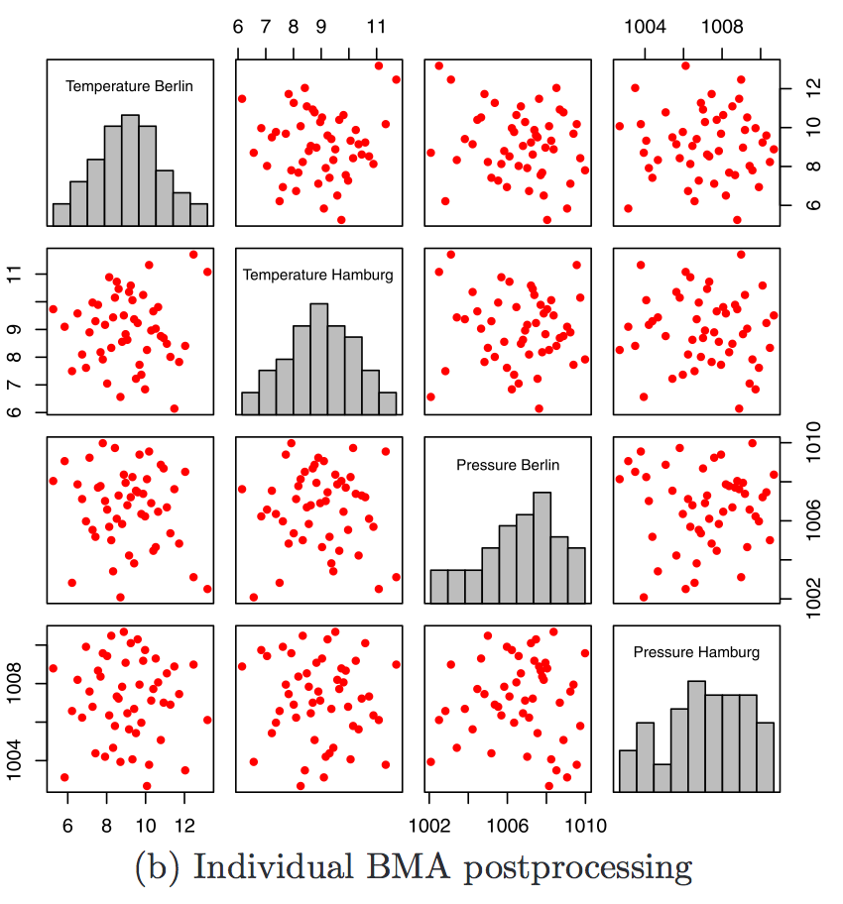
Post-processing takes
place independently for each
variable using BMA following
Fraley et al., MWR, 2010.
50 discrete samples are
regenerated independently
for each variable from the
BMA PDF.
The correlative structure
in the raw ensemble is lost.
from Schefzik et al. , Statistical Science 2013, 28, 616–640

Slide 38
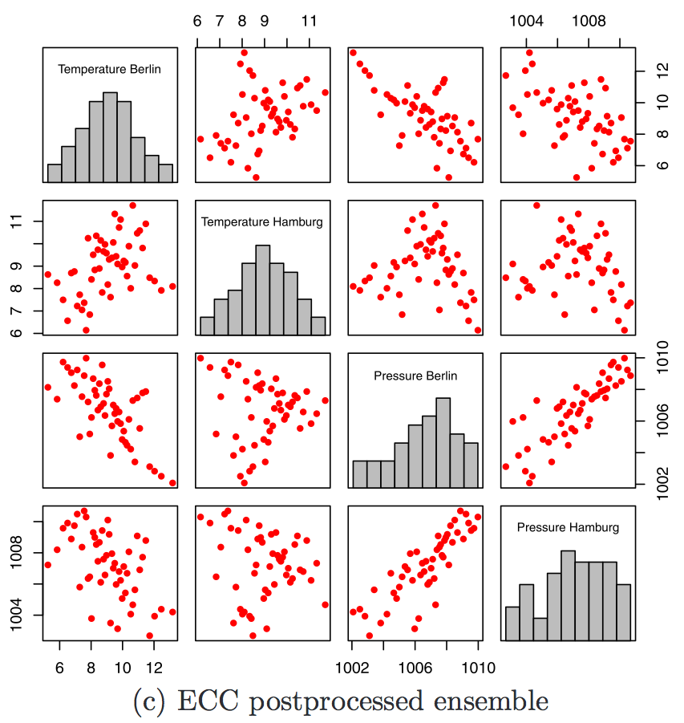
Ensemble copula coupling:
rank-order statistics
are used to restore the
correlative structure of
the raw data while
preserving the bias and
spread corrections
produced by BMA.
Q: were those correlations
properly estimated by the
forecast model?
Wilks (2014; DOI:
10.1002/qj.2414) provides
an example of where the
“Schaake Shuffle”
(climatological covariances)
are preferred.
from Schefzik et al. , Statistical Science 2013, 28, 616–640

Slide 39
Building a high-quality statistical model
Old problems are new problems
  “ bias-variance tradeoff ”
  “ extrapolating the regression ”
  “ curse of dimensionality ”
More modular, reusable software.

Slide 40

Modular software and data library
It’s hard to determine
whether someone has
made an improvement
when everyone tests
with their own data set,
or codes their own
version of post-processing
methods & verification
methods.
Building and supporting
a reference library
would help our field
immensely.
BMA
logistic
regression
linear
regression
NGR
analog
decaying
average
threat
scores
reliability
diagrams
ROC
track &
intensity
BSS, CRPSS
eco value
post-processing methods
verification methods
temperature
power
transform
precipitation
scatterplot
ANOVA
PCA & CCA
precip type
wave height
histogram
wind power
TC intensity
correlation
standard test data sets
exploratory data analysis
ArcGIS
Bufr
binary
ASCII
Fortran-
python
C++ -Fortran
Grib
netCDF
Grib-Bufr
ASCII-cPickle
Fortran-IDL
I/O routines
Interfaces & conversion

Slide 41
Identify forecast
question.
The statistical
model-building
process
Gather forecasts &
obs. or analyzed data.
Identify potential
predictors and
model type.
Build statistical model.
Test & verify with independent data.
NO
are
you happy with
results?
YES
Implement and
disseminate forecasts
NO
customers
satisfied?
YES

Slide 42

NOAA has lots
of test beds.

Slide 43
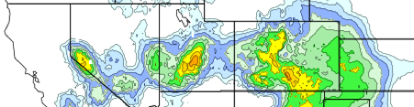
Is post-processing
development
handled best when
it’s dispersed
amongst many
test beds, by
application?
Or is a standalone
post-processing
test bed with links
to other test beds
a preferred
approach?
Post-processing Testbed
PPT supports development of
improved decision support tools
through the statistical post-processing
of numerical weather guidance. It
works hand-in-hand with other
testbeds.

Slide 44
Conclusions
Users increasingly seek more post-processed model guidance; they can’t wait for ensembles to become unbiased, perfectly reliable.
The end product (high quality post-processed guidance) depends on doing each of many steps (data gathering, model selection, evaluation, etc.) well.
Thorny old statistical challenges still underlie today’s impediments to improved forecasts.
Greater collaboration and sharing will accelerate progress.
Finally, thanks to Bob Glahn (and many others at MDL) for their pioneering work.

Slide 45
Supplementary slides

Slide 46
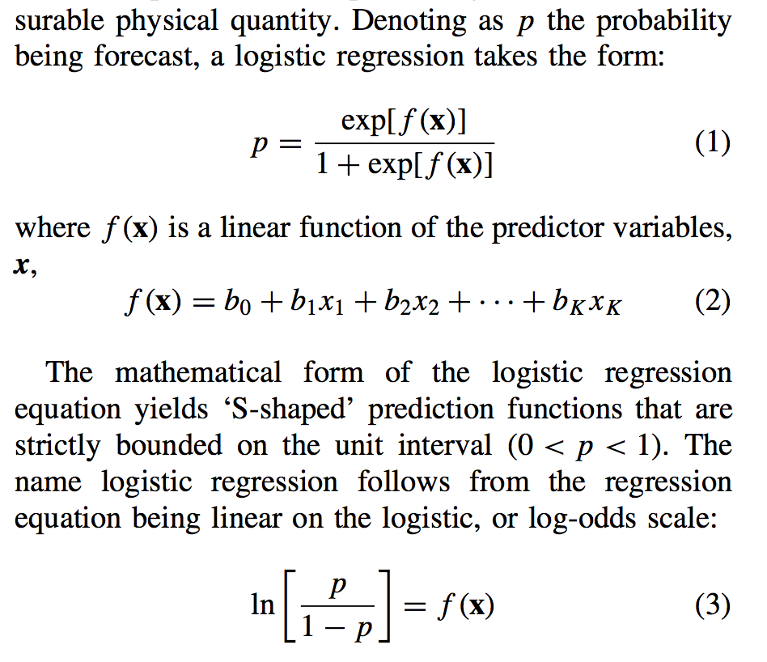
Conventional logistic regression
from Dan Wilk’s article on extended logistic regression, Met Apps, 2009

Slide 47
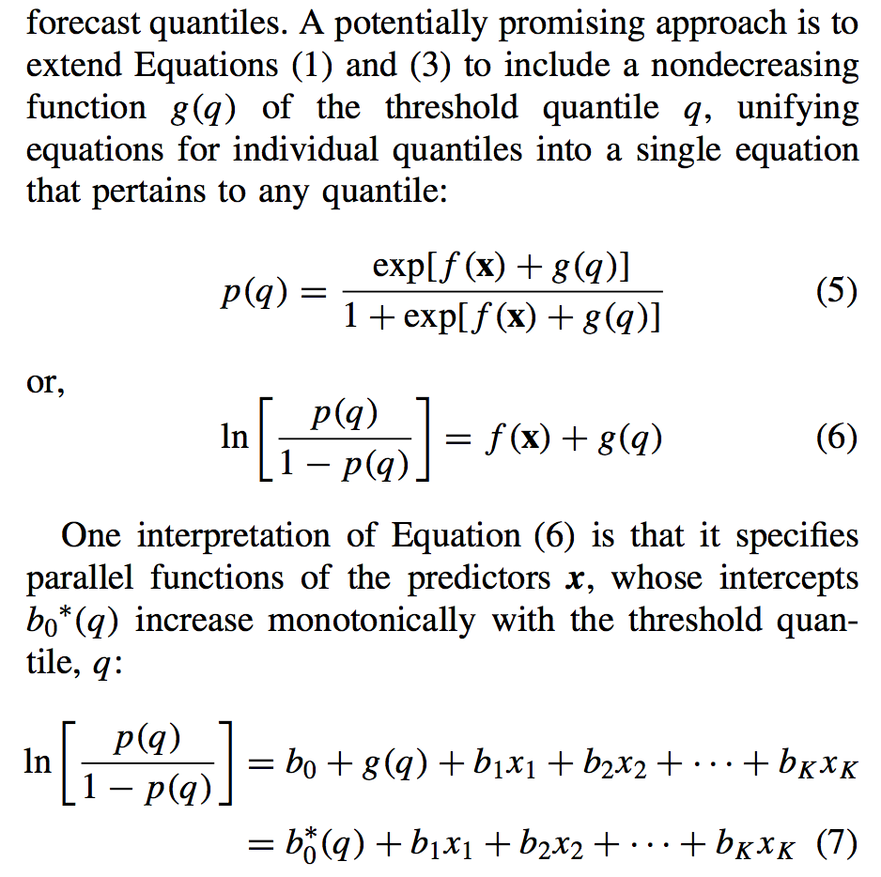
Wilks’ extended logistic regression
g(q) = SQRT(q); square-root transformation applied to precipitation data as well.

