Slide 1

Ensemble prediction and post-processing team reports to NGGPS
Tom Hamill
ESRL, Physical Sciences Division
tom.hamill@noaa.gov (303) 497-3060

Slide 2
Proposed team members
Ensemble system development | Post-processing
Tom Hamill (ESRL/PSD) | Tom Hamill (ESRL/PSD)
Yuejian Zhu (EMC) | Kathy Gilbert (WPC)
Dave Novak (WPC) | Matthew Peroutka (MDL)
Carolyn Reynolds (NRL) | Jeff Craven (NWS/Central Region)
Malaquias Peña (EMC) | Trevor Alcott (ESRL/GSD)
Walt Kolczynski (EMC) | Dan Collins (CPC)
Isidora Jankov (ESRL/GSD) | Michael Scheuerer (ESRL/PSD)
Phil Pegion (ESRL/PSD) | Dan Hodyss (NRL)
Zoltan Toth (ESRL/GSD, pending) | Yuejian Zhu (EMC)
 | Zoltan Toth (ESRL/GSD, pending)
Draft NGGPS implementation plan for ensemble development and post-processing here.

Slide 3
Part 1:
Ensemble prediction system development

Slide 4
Ensemble prediction system development:
NGGPS major objectives
(1) Develop and implement improved methods for initializing ensemble predictions (see also the DA component of NGGPS plan), including the initialization of the coupled environmental state (ocean, atmosphere, land, sea ice, and so forth).
(2) Develop methods to accurately quantify model uncertainty in ensemble prediction systems.
(3) Develop ensemble prediction system improvements that will facilitate the generation of reliable and maximally skillful guidance to lead times of + 30 days and beyond.
These all contribute to making more skillful and reliable probabilistic forecasts for
high-impact weather at lead times of concern to NOAA and its customers.

Slide 5
Objective 1: initialization of ensembles
4D-En-Var or other related method is likely to be operational by early 2016, providing automatic atmospheric ensemble initialization. While more adjustments are contemplated, technology is comparatively mature, except:
Methods for ocean, land, and sea-ice ensemble initialization.
  Ensemble spread of T_{2m}, u,v @ 10m, precipitation are much more under-spread than, say, Z500.
  Current GEFS doesn’t provide realistic initial range of soil moisture
  Initialization procedure should provide realistic covariances (e.g., no member with super-dry analyzed 2-m dewpoint over sopping-wet analyzed soil).
  This technology is adolescent; some work at other centers to guide us.
Position errors of coherent features (immature).
Minimizing noise in analyzed state – this limits spread growth.
  from small sample sizes.
  from sub-optimal model uncertainty treatments.
  adolescent; existing methods like Lynch filter sub-optimal.
Interactions with NGGPS data assimilation, land-surface, ocean teams expected.

Slide 6
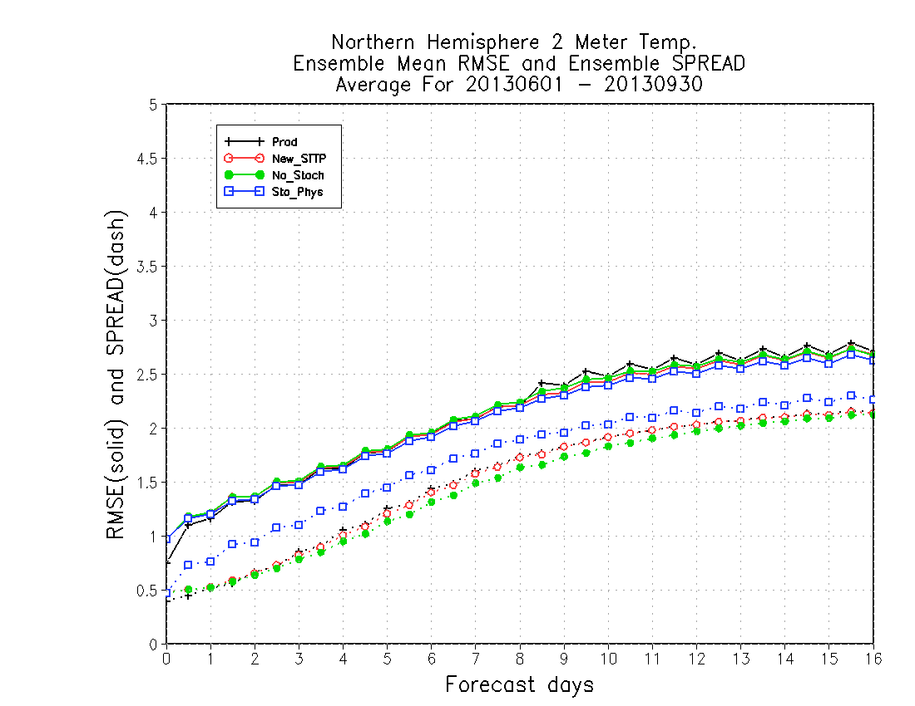
Why is ocean, land, and sea-ice ensemble initialization a priority? In part because surface fields (and precipitation) are under-spread.
Even with modernized stochastic physics suite (discussion to come), surface temperature is under-spread, leading to unreliable probabilistic forecasts.
Are attempting to remedy this
somewhat by:
perturbations to soil moisture.
land-surface parameter perturbation (discussed later).
figure c/o Walt Kolczynski, EMC.

Slide 7
Work in progress (via Sandy Supplemental): initialization of soil moisture.
Determine what are realistic soil moisture perturbations by driving land-surface analyses with different precipitation data sets (cycled over many years).
GPCP
GPCP
GPCP
GLDAS
soil
moisture
GLDAS
soil
moisture
GLDAS
…
soil
moisture
Jan 1
Jan 2
Jan 3
how different?
PERSIANN
PERSIANN
PERSIANN
GLDAS
soil
moisture
GLDAS
soil
moisture
GLDAS
…
soil
moisture
The differences in soil moisture (variance, covariance, etc.) will be used to determine a
reasonable perturbation methodology for initial soil moistures.
experiments by Maria Gehne, ESRL/PSD, with help from EMC land-surface team.

Slide 8
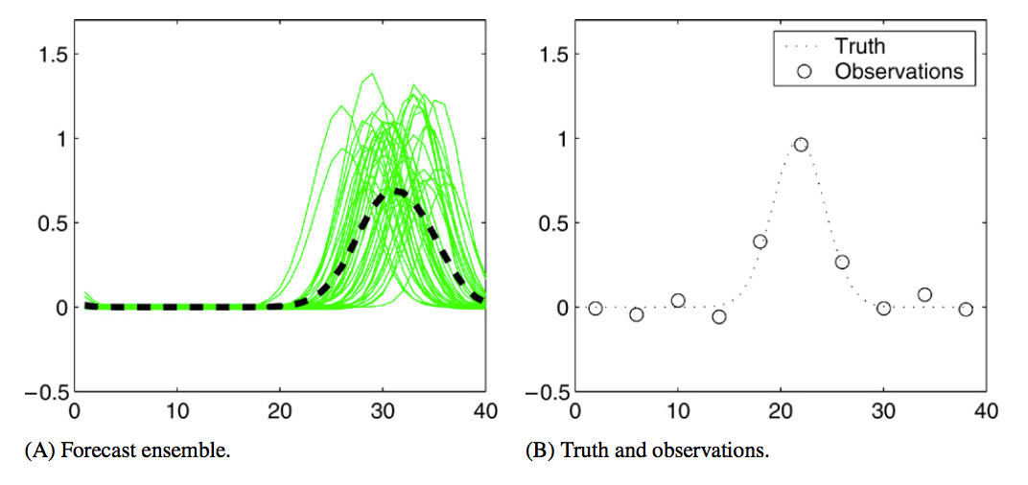
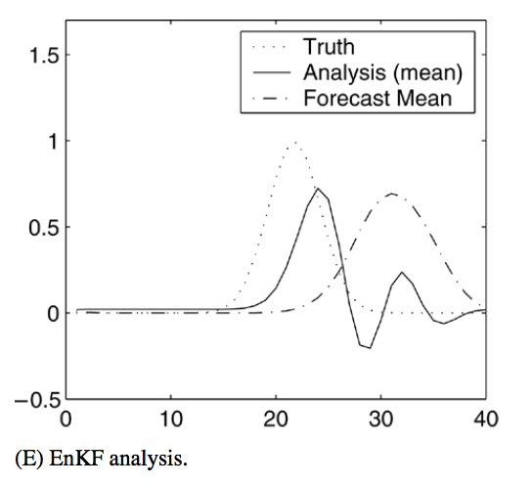
Position errors of coherent features
(“field alignment” or “feature calibration and alignment”)
Above: first guess ensemble is mistaken about the position of a coherent feature. Resulting analysis has two small features, one at observation location, one at first-guess location; current data assimilation not well set up to handle consistent position errors.
We’ve seen this problem with tropical cyclones. Would like to get beyond more ad-hoc “vortex relocation.”
More rapid updates (hourly?) could ameliorate this, but there are other challenges to that, such as numerical noise with ensemble-based systems.
Ref: Ravela et al. 2007, http://dx.doi.org/10.1016/j.physd.2006.09.035. See also recent articles by Nehrkorn et al., MWR.

Slide 9
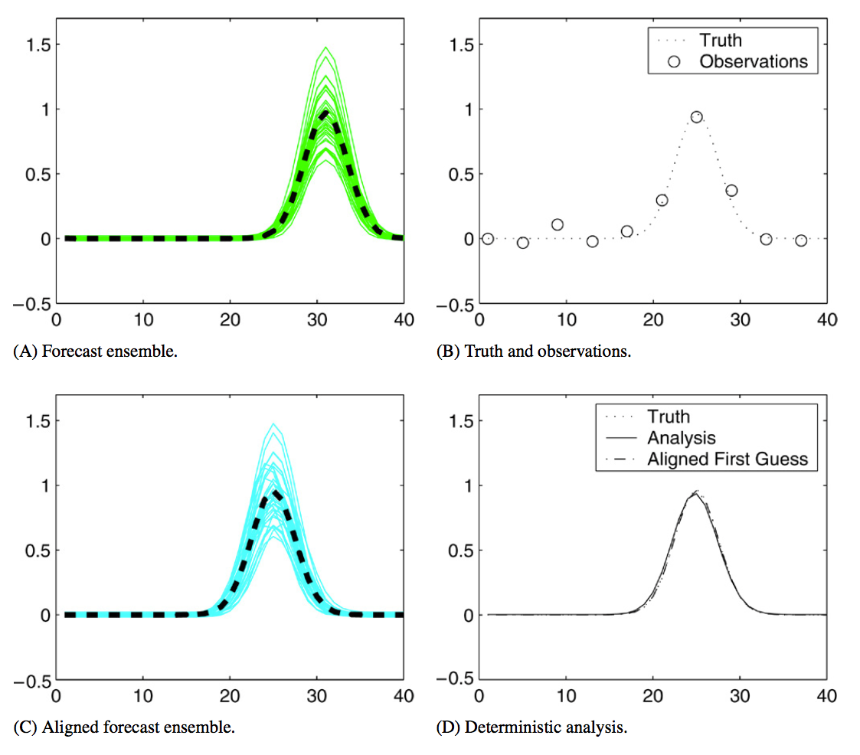
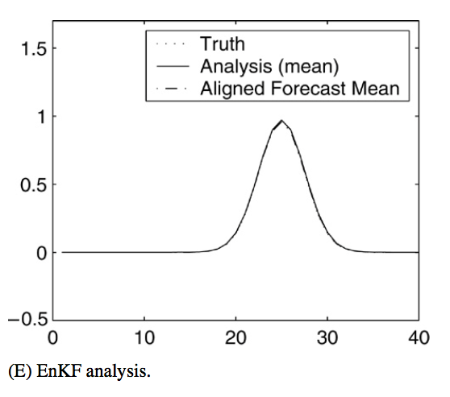
“Field alignment”
Under field alignment
and related techniques,
data assimilation is
split into two steps:
adjustment for
position errors, and
(2) adjustment for
amplitude errors.
Ref: ibid.

Slide 10
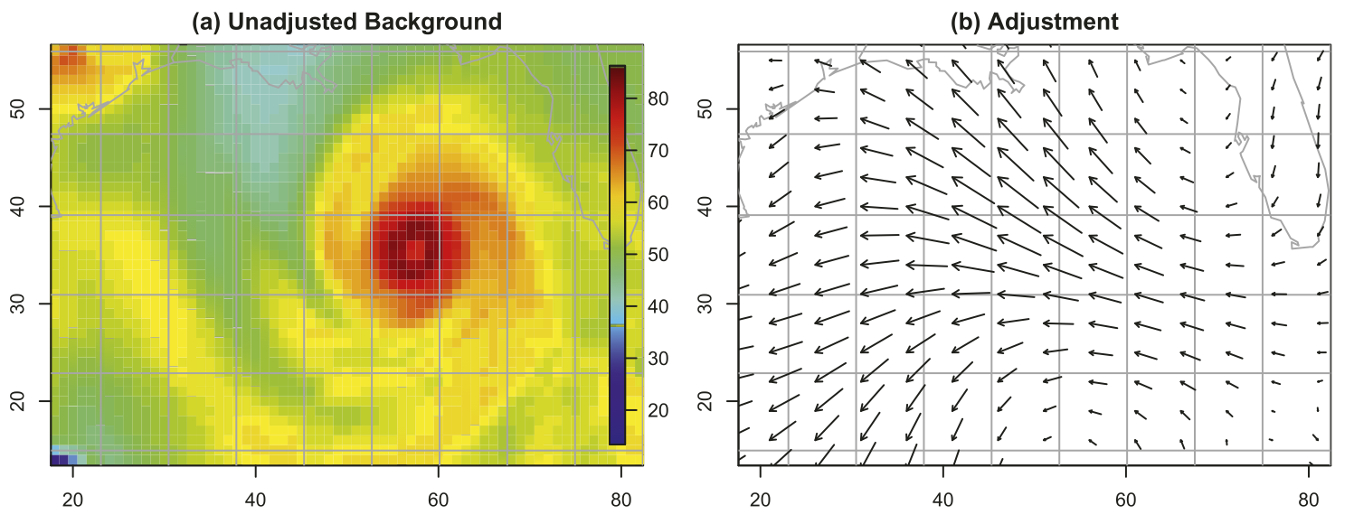
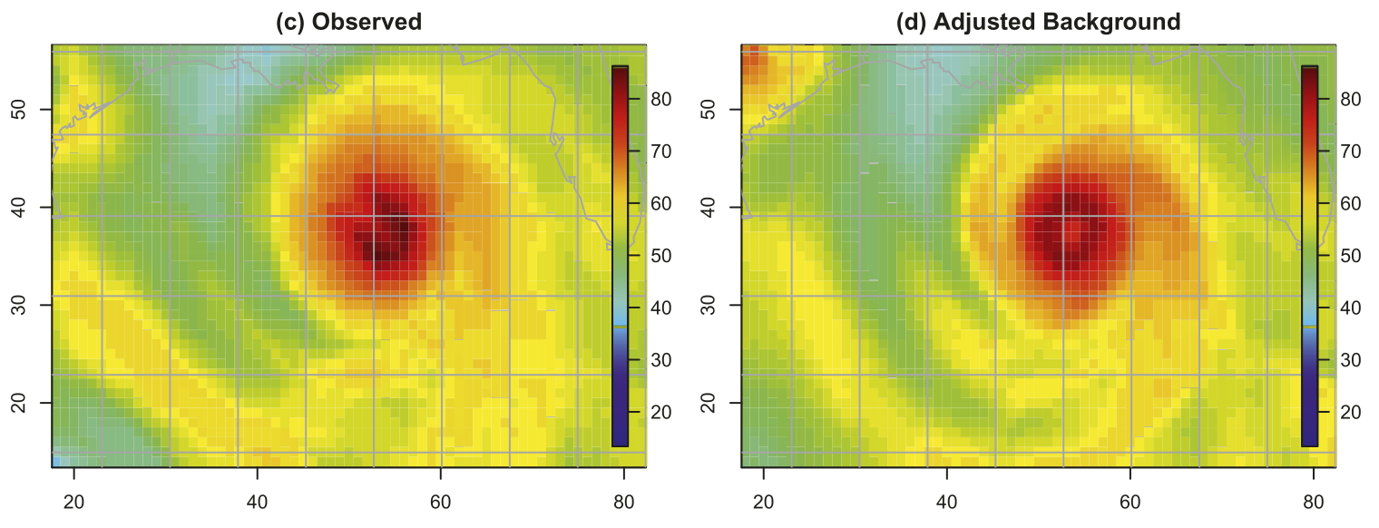
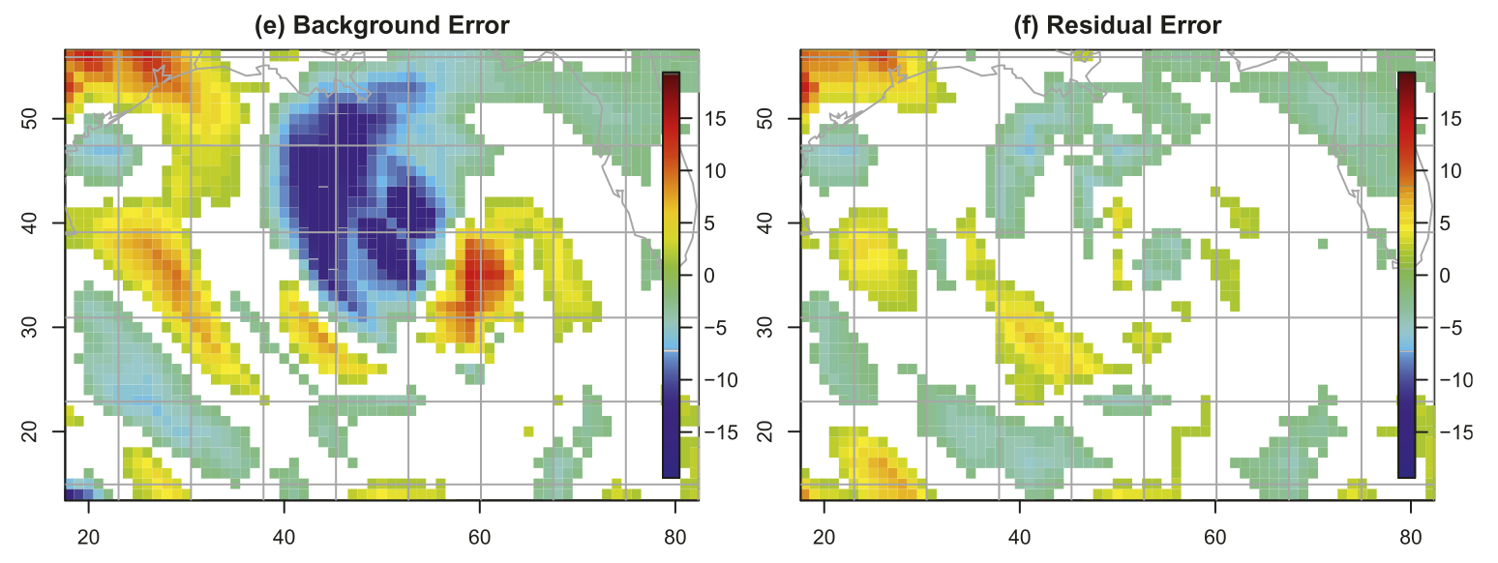
Example: hurricane position adjustment to water-vapor imagery
A field of adjustment vectors
(panel b) warps the background
forecast so it is more consistent
with the observed. There is
a smoothness penalty to
avoid over-fitting.
Ref: Nehrkorn et al. 2014,
MWR, DOI: 10.1175/MWR-D-13-00164.1

Slide 11
Ensemble prediction system objective 2: treatment of model-related uncertainty
Ensemble prediction systems contain imperfections (e.g., finite resolution, sub-optimal numerics) and inappropriate deterministic assumptions (in parameterizations, model constants).
These contribute to bias and limit spread growth of ensembles, resulting in biased, over-confident predictions.
Methods for dealing with model uncertainty in physically realistic ways is relatively immature but greatly needed.
Envision collaborative work with NGGPS physics team.

Slide 12
Some approaches to dealing with model uncertainty
Approach | Benefits | Drawbacks
Multi-model / multi-parameterization ensemble | Shown many times over to increase spreads. “No-brainer” if sharing data between centers (NAEFS, National Blend of Models). | Members with different errors, biases. Difficult for one center to maintain and update a suite of models, parameterizations. Difficult to provide lengthy reforecasts.
“Simple” stochastic prediction methods (SPPT, SKEB) | Established, shown to provide benefit, comparatively easy | In some circumstances, not physically based. Can cause unexpected problems (e.g., SPPT introduces bias in climate simulations).
Physically based stochastic parameterizations | Ideally, one gets right answer (increased spread) for the right reason. | More in the realm of basic research; few methods are ready right now.
Post-processing | Major improvements in skill, reliability possible. Comparatively easy to implement. | Large reforecast and reanalysis data sets needed; doesn’t fix underlying model problems.

Slide 13
Model uncertainty activities, Sandy Supplemental (SS) and NGGPS proposed
Preparing an implementation of simple methods, many tested at other centers (SPPT, SKEB, SHUM; underway now via SS). Gratifying results. [fairly mature]
Estimating parameter uncertainties associated with the land surface (underway now, not funded through to implementation, though). [adolescent] {see supplemental slides}.
Stochastic parameterization (proposed).
  Stochastic backscatter from convection (low-hanging fruit, demonstrated at UK Met Office). [adolescent]
  Others harder, more basic research needed [immature].

Slide 14
Testing of simple and existing model uncertainty parameterizations
Currently in GEFS: STTP (Stochastic Total Tendency Perturbations)
Planned for next (≥ 2016) GEFS implementation (we’re at knob-twiddling stage now):
  SPPT (Stochastically Perturbed Physical Tendencies, from ECMWF)
    tweaks by Phil Pegion to make precip. consistent with q tendency.
  SKEB (Stochastic Kinetic-energy Backscatter, from ECMWF and Met Office)
  SHUM (Stochastically perturbed boundary-layer RH, developed by Jeff Whitaker)
via USWRP, Sandy Supplemental, and HIWPP funds; c/o Phil Pegion (ESRL/PSD), Walt Kolczynski (EMC)

Slide 15
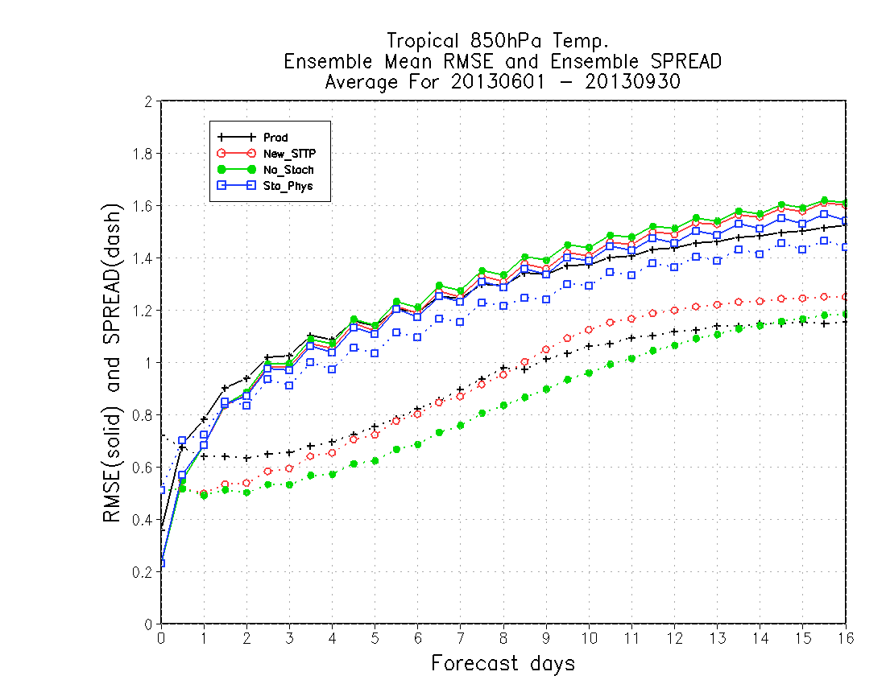
Summer results, 850-hPa temperature
Tropics
RMSE (solid) and spread (dotted)
Much better spread with SP
Production
New STTP
No Stoch
Sto. Phys
(SPPT, SKEB,
SHUM)
(not all improvements are this impressive; figure c/o Walt Kolczynski, EMC).

Slide 16
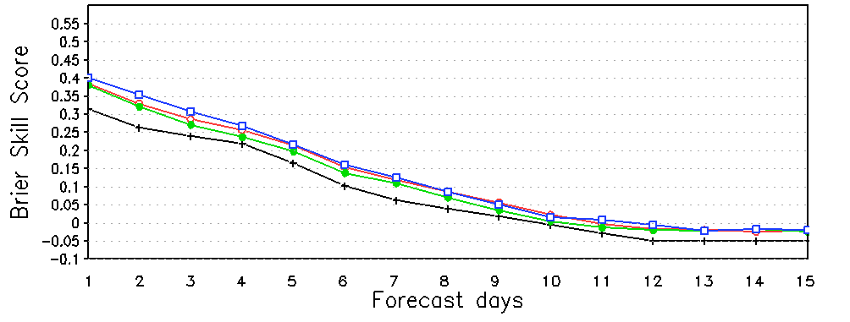
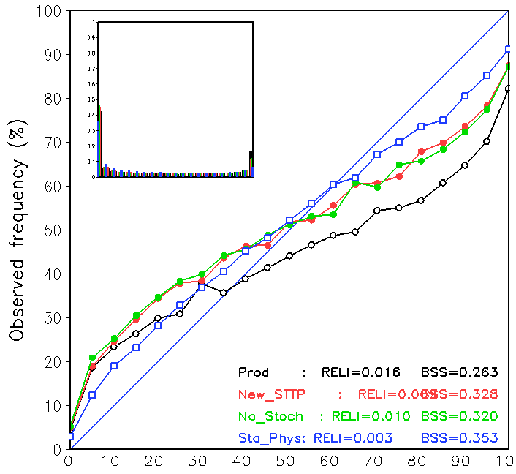
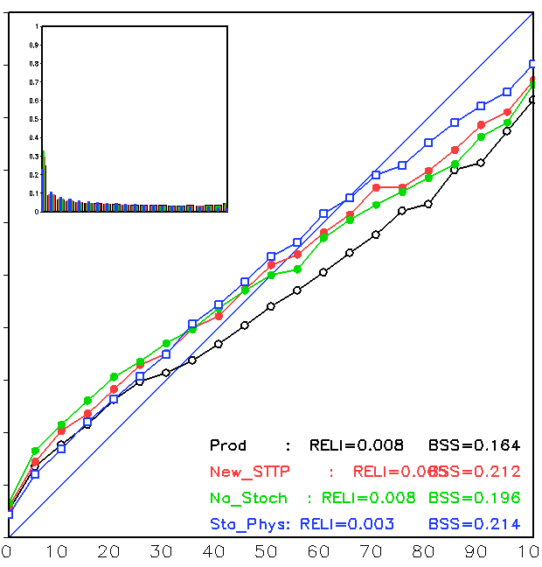
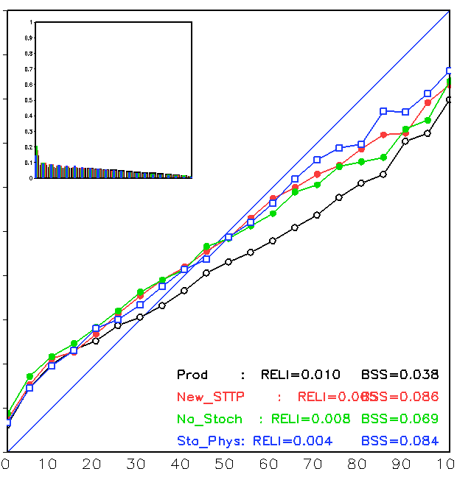
Summer results, CONUS precipitation
verification against CCPA over CONUS on 1-degree grid.
Improvement in Brier Skill for first week with SP
Brier Skill Score
> 1 mm threshold
Production
New STTP
No Stoch
Sto Phys
Day +2 reliability
Day +5 reliability
Day +8 reliability
Much better reliability

Slide 17
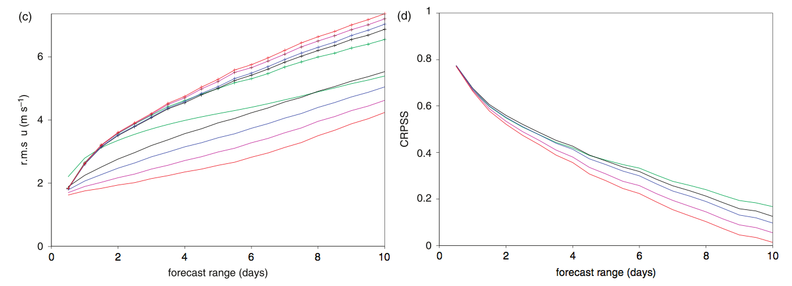
Physically based stochastic parameterization.
Example of some “low-hanging fruit” in an otherwise basic-research area: recent Glenn Shutts (QJ, in press) stochastic backscatter for convection (SCB).
Tropics, U200 RMS error and spread
Tropics U200 CRPSS
opn’l ECMWF
no stoch phys
SPPT
SKEB
SCB
SCB increases spread, here at early leads, decreases RMS error, and improves probabilistic
skill. Here SCB in isolation of other methods; more realistically, combined with them.
c/o Glenn Shutts: Ref: http://onlinelibrary.wiley.com/doi/10.1002/qj.2547/epdf

Slide 18
Ensemble prediction system objective 3:
“GEFS” to infinity and beyond!
(well, at least to six weeks)
Whole Atmosphere Model
NGGPS
Unified Global Coupled Model
“GFS”
“GEFS”
“CFS”
Actionable weather
Weeks
+1 to +6
Seasonal to annual
Update frequency | 1 y | 2 y | 4 y
Length of Reanalysis | 3 y | 20-25 y | 1979 - present
Cycles per day | 4 | 1-4 | TBD
Production machine | WCOSS | WCOSS | TBD

Slide 19
Extension of forecasts to week +6
Experiment with GEFS system now, later in context of evolving unified coupled global model system
Key science and technical questions
  What sort of coupling is appropriate to +45 days lead? No direct ocean coupling, mixed layer, full coupling?
  Develop methods for generating physically consistent atmosphere, ocean, land perturbations.
  What configuration (ensemble size, resolution, reforecast duration/frequency) provides best use of available CPU resources?
  Reanalysis / reforecast on WCOSS or other compute platform?
  Does the prediction system faithfully model the (few) low-frequency modes of variability that may have predictable skill at 3-6 weeks?
    MJO
    Blocking / AO
    ENSO

Slide 20
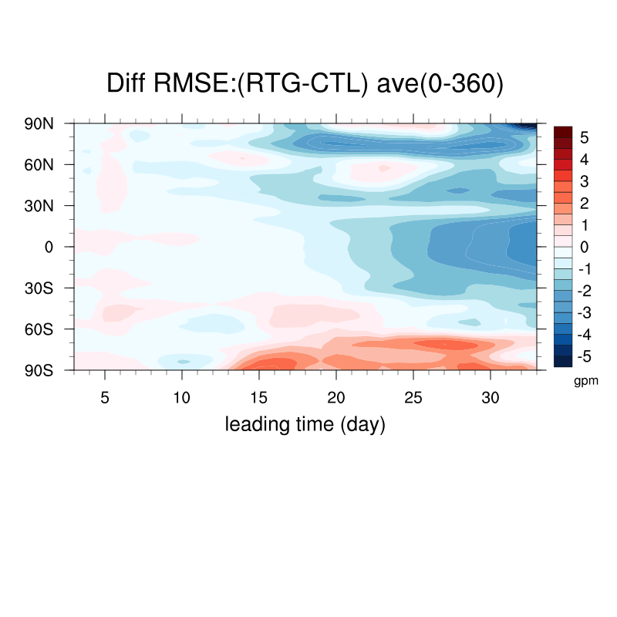
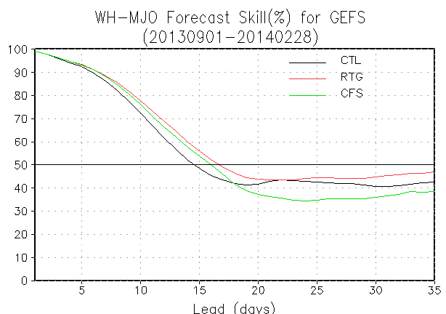
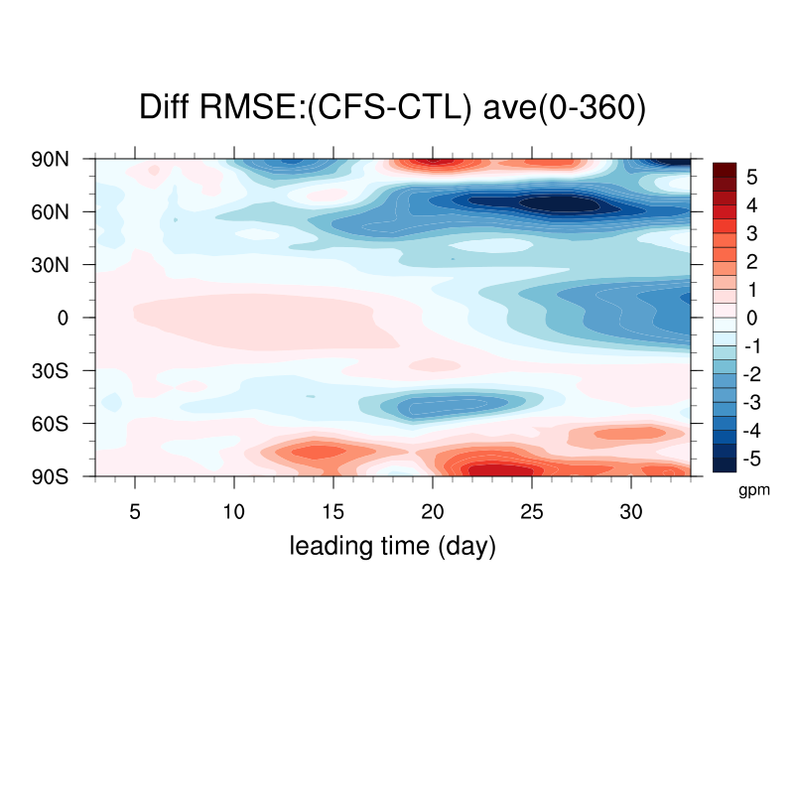
Skill potential with
perfect SST forcing (AMIP)
Evolution of error Z500 difference
5-day running mean (09/01/2013 – 2/28/2014)
improvement
relative to CFS
when forced with observed SST
  Control (CTL or PARA): analysis SST relaxes to climatology
  Optimum (RTG): realistic SST forcing every 24 hours (AMIP like)
  Forcing (CFS): CFSv2 predicted SST forcing every 24 hours
Week MJO period
c/o of Wei Li; see also Barsugli et al, 1998 BAMS, 80, 1399-142.
c/o Qin Zhang following Ferranti et al. 1990, JAS, 125, 2177 – 2199.

Slide 21
NGGPS external PI grants in 2015
Development and testing of a multi-model ensemble prediction system for sub-monthly forecasts. Andrew W. Robertson, PI, Columbia University.
  Activities: Develop and test a multi-model ensemble (MME) prediction system for sub-monthly forecasts (NCEP CFSv2, ECMWF and the Environment Canada model, and other models that become available).
Accelerating development of NOAA’s next generation global coupled system for week-3 and week-4 weather prediction Jim Kinter, PI George Mason University.
  Activities: Conduct a series of model development and rigorous testing exercises designed to (1) correct systematic biases; (2) quantify the predictability and skill of weather forecasts for weeks 3-4.
An investigation of the skill of week-two extreme temperature and precipitation forecasts at the NCEP WPC. Lance Bosart, PI, University at Albany, SUNY,
  Activities: Evaluate newly proposed percentile forecast methods, persistent flow anomalies, and NH climate database in context of WPC’s development of new forecast formats for Days 8-10. These forecast formats and methodologies for identifying EWEs will be tested in the WPC Hydrometeorological Testbed, and then will be implemented into WPC operations.
Exploitation of Ensemble Prediction System Information in support of Atlantic Tropical Cyclogenesis Prediction. Chris Thorncroft, Pi, University at Albany, SUNY.
  Activities: To ensure that recent and current research concerned with the variability of African easterly waves (AEW) structures and downstream tropical cyclogenesis probability is transferred into operational decision-making at NHC, and to develop and evaluate tools that exploit key information in dynamical ensemble prediction systems in support of tropical cyclogenesis prediction.

Slide 22
Management issues
Is the NGGPS priority to fund:
  Development of next-generation system, or
  Incremental improvements to this generation’s system, or
  Both? In what mix?
Related, what mix of high-risk/high-reward vs. low-risk/low reward in portfolio?
  (Please don’t expect low-risk/high-reward. If such things existed, we’d be doing them already).

Slide 23
Part 2: post-processing.

Slide 24
NGGPS post-processing objectives
Conduct post-processing “summit” [mature]
Regularly generate supporting data sets, reanalysis/reforecast [technology mostly mature; human, software, hardware infrastructure immature].
  necessary to support the advanced post­processing development.
  should include high-resolution reanalyses from a markedly improved RTMA or similar system.
Improve post-processing algorithms for National Blend [adolescent]
  Improve the post-processing and blending methods, allowing them to fully exploit the information in the improved ensembles
  Extend the post-processing and blending methods to include extra high-impact forecast variables and a wider range of forecast lead times.
Develop post-processing techniques specific to the forecast problems of longer-lead forecasts (weeks 2-4) [adolescent].
For more, see recent white paper on major NWS changes in post-processing, here.

Slide 25
Objective #1: “Summit”
Major change #1: Reanalysis/reforecast to be regularly generated; implies major changes to how we do post-processing. Need to sort these out.
Major change #2: Post-processing to become increasingly oriented around National Blend and be probabilistic.
Build roadmap: How can we organize and collaborate better?
  Dispersed post-processing R&D now (MDL, EMC, ESRL, NSSL/SPC, AOML/NHC, WPC, CPC, etc.). Re-evaluate dispersed model, brainstorm ways of working together more effectively.
  What is needed for more rapid technology transfer from OAR, NWS regions, academic sector?
  What supporting tools/infrastructure needed? Libraries of common post-processing software, verification data sets, verification methods, etc.?
  Lay out roadmap to manage the processes for these major changes.

Slide 26
Major change #1: regular global reanalysis/reforecast.
Routine usage of reanalysis/reforecast (R/R) will dramatically improve post-processed guidance (see white paper).
Hendrik Tolman at 2014 NCEP Production Suite review said EMC intends to move to a more ordered implementation and reanalysis/reforecast procedure:
  Seasonal: ~ 4-year upgrade cycle, multi-decadal reanalysis/reforecast.
  Weekly: ~ 2-year upgrade cycle, decadal reanalysis/reforecast.
  GFS or NGGPS replacement: ~ 1-year upgrade cycle, a few years reanalysis/reforecast.
Infrastructure (compute, storage, software, diagnostics) not in place yet. Underlying technology to perform R/R is mostly mature, NWS infrastructure to do this regularly is immature.
Hence support to institutionalize reanalysis/reforecast/supporting infrastructure is a post-processing priority for NGGPS.
Status: ESRL/PSD has funds to jump-start reanalysis system development, with anticipated additional funding for ESRL/PSD, EMC, CPC to support production. MDL seeking storage infrastructure funds.

Slide 27
Major change # 2:
“National Blend” product development
National Blend concept:
  Ingest multi-model, multi-center deterministic and ensemble forecasts.
  Post-process and downscale them to 2.5-km NDFD grid.
  Populate all NDFD elements with National Blend guidance as starting point for local WFO forecasters.
  Possibly extend NDFD in future to include more probabilistic information.
Anticipated result:
  very high quality automated guidance.
  less manual intervention by forecasters, thus greater consistency between WFOs.
  forecasters ready and able to take on more decision-support roles.
post-processing concepts adolescent, supporting infrastructure immature.

Slide 28
National Blend challenges.
Reaching data-sharing agreements with international partners.
Ideally, need reforecasts to achieve consistently high-quality post-processed guidance.
Need quality hi-res. surface reanalyses for training, validation (see next slide).
  need them CONUS, AK, HI, Guam, PR.
Developing new algorithms to exploit richness of ensemble data and potentially longer training data sets.
  For all variables, including more difficult ones like snowfall amount, precipitation type, sky cover.
Similar in concept to NAEFS; should they be integrated?

Slide 29
NGGPS objective #2: regularly generate supporting data sets, reanalysis/reforecast (R/R).
Global reanalysis procedures are mature, with exception of handling changes in observing systems.
Infrastructure immature
  Dedicated compute cycles;
  Disk / cloud storage;
  Re-usable, extendable observations database;
  Diagnostic tools.
Procedures for freezing models immature and runs contrary to EMC’s past practices.
  Especially difficult at times of major change.
Hi-res surface reanalysis adolescent (next slide)
collaboration with NGGPS data assimilation group anticipated.

Slide 30
High-resolution surface analysis /reanalysis (currently RTMA) challenges
Inherited biases from NWP model: most DA systems correct model first guess to new observations.
  If first guess is biased (usually is near surface), then analysis biased, especially in data-sparse regions.
Procedures are relatively costly to run; not sure EMC has set aside the time to run a retrospective RTMA back several decades.

Slide 31
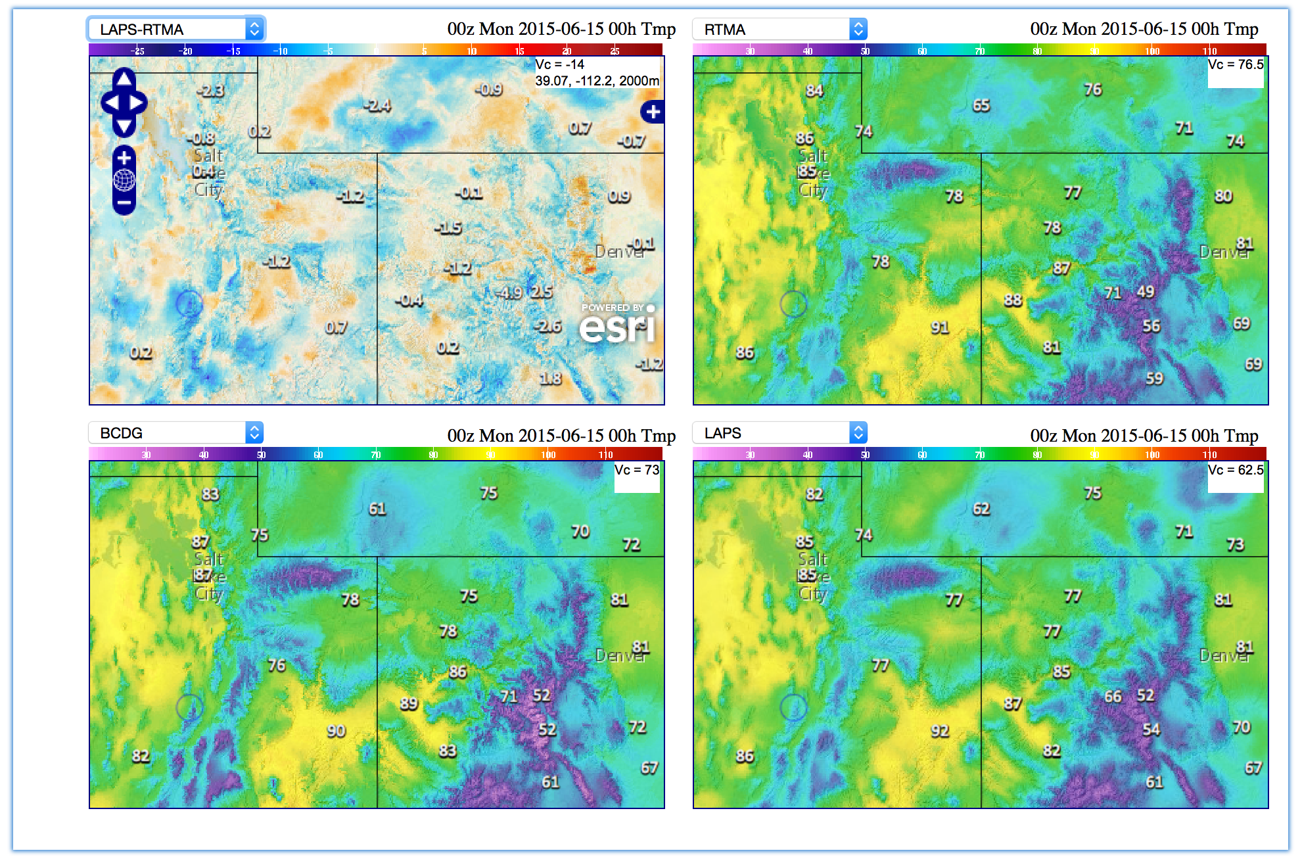
Example of T_{2m} analysis differences
14 degrees F different!
From (internal NOAA) http://www.mdl.nws.noaa.gov/~blend/blender.prototype.php

Slide 32
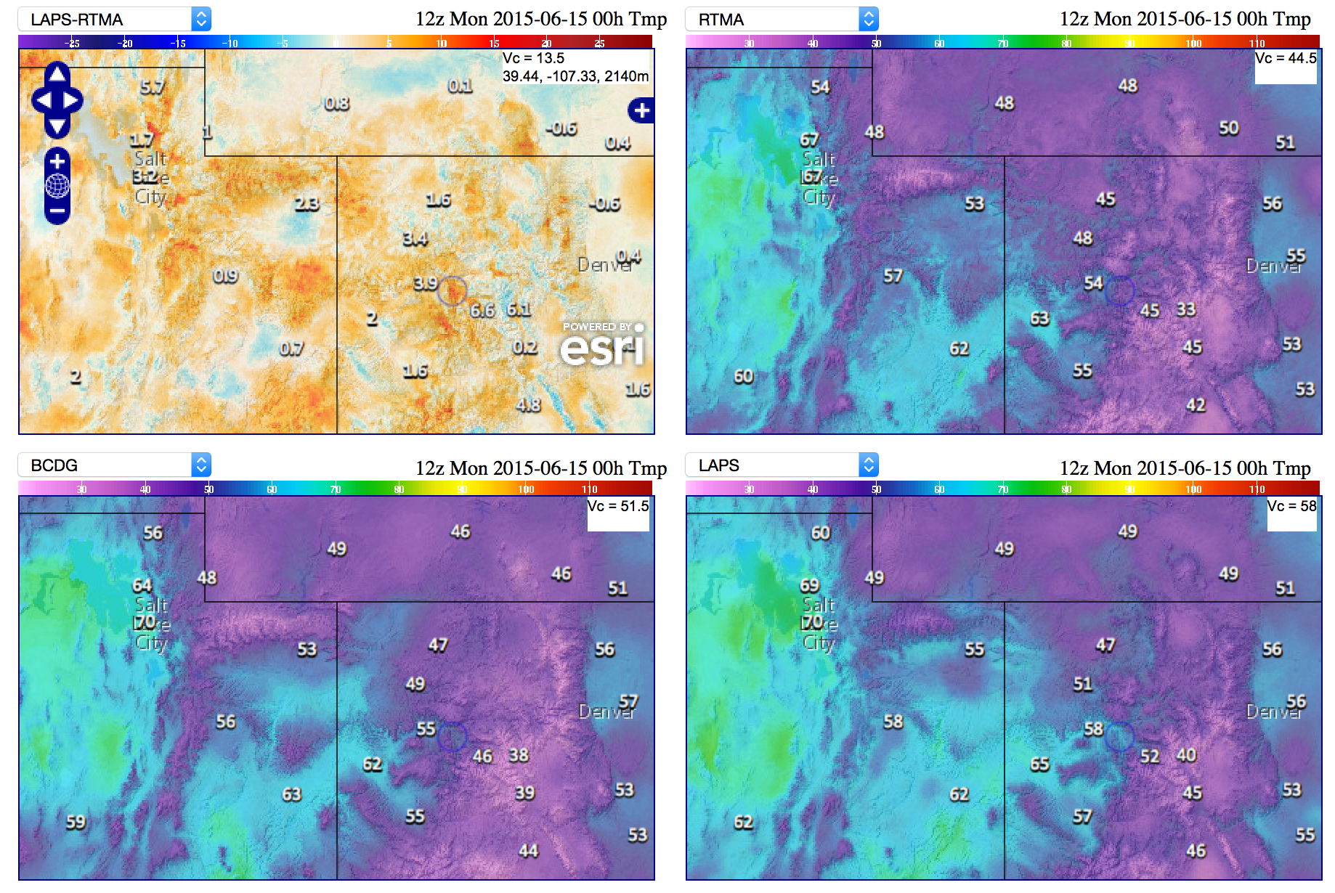
Another example of T_{2m} analysis differences
13.5 degrees F different
From (internal NOAA) http://www.mdl.nws.noaa.gov/~blend/blender.prototype.php

Slide 33
Time series of observed temperatures and deviations at Albany, NY.
A new, old idea:
What about statistical model for the first guess, based on deviation from climatology?
Cheap, potentially unbiased.
Here, note that last hour’s temperature deviation from climatology is frequently a decent first guess approximation for this hour’s temperature deviation (and thus temperature, by adding back climatology).

Slide 34
How does last hour’s temperature deviation from climatology predict this hour’s temperature deviation?
Before the analysis, I had developed a climatology for Albany for each hour of the day and each day of the year. Hence, 10 AM’s Local climatological temp is a bit
warmer than 9 AM’s temp. Persistence of last hour’s deviation is pretty good.

Slide 35
Proposed statistical model to generate first guess
T’(forecast next hour) =
  T’(analyzed this hour) +
  b₁*(analyzed cloud cover) +
  b₂*(soil moisture) + … +
  b_{n-1}*(850 hPa vertical velocity)
  b_{n}*(forecast 925 hPa temperature change)
T’ is the deviation from the climatological mean
for this time of day, day of year.

Slide 36
Statistical model first-guess errors at stations after regression
Lagged deviation from climo produces much lower error than RTMA at stations.
A small but noticeable further reduction of errors using predictors suggested in previous slides. (from de Pondeca et al., W&F, Oct 2011)
Results are not cross validated, but for a few selected stations,
this appeared to have a negligible effect given the large
training sample size (> 900).
~ half the error of (2011) RTMA
Procedure for producing a gridded a first guess in progress.

Slide 37
Objective #3: improving post-processing algorithms
Advanced techniques are in development with Sandy Supplemental and NGGPS funds;
more support will be needed for unusual, high-impact variables. Adolescent.
c/o Michael Scheuerer, ESRL/PSD.

Slide 38
Objective #4: post-processing of weeks +3 to +4
Initial-condition skill mostly gone, except episodically:
  ENSO, MJO, blocking/AO.
Small detectable signal buried in large amount of chaotic error, model bias.
Lengthy reforecasts, stable models needed to tease out what skill there is.
New post-processing techniques may be needed, tailored to unique challenges of these time scales.
Adolescent.

Slide 39
NGGPS grants in 2015
Development of Ensemble Forecast Approaches to Downscale, Calibrate and Verify Precipitation Forecasts. Dave Novak, WPC, PI
  Activities: Enhance the skill of high-resolution quantitative precipitation forecasts (QPF) for detection of high-impact events via downscaling, quantile mapping
Calibration and Evaluation of GEFS Ensemble Forecasts at Weeks 2-4. Ping Li, PI, SUNY Stony Brook.
  Activities: Decompose GEFS extended range into a limited number of principal components to calibrate with observations.
Probabilistic Forecasts of Precipitation Type and Snowfall Amounts based on Global Ensemble Forecasts. Tom Hamill, ESRL/PSD.
  Activities: Develop novel experimental post-processing methods for precipitation type and snowfall amount.
An Investigation of Reforecasting Applications for Next Generation Aviation Weather Prediction: An Initial Study of Cloud and Visibility Prediction. Dr. David Bright, NOAA/NWS/NCEP Aviation Weather Center, PI.
  Activities: Utilize NOAA’s second-generation Global Ensemble Forecast (GEFS) reforecast dataset, and be the first aviation-based GEFS reforecast study to construct a model climatology and downscaled calibrated prediction of instrument meteorological conditions (IMC).
Improved Statistical Post-Processing with the Bayesian Processor of Ensemble (BPE). Zoltan Toth, PI, NOAA/OAR/ESRL/GSD.
  Activities: Develop scientifically based, comprehensive algorithms and software for use in unified NWS statistical post-processing operations to address both the calibration of prognostic variables and the derivation of additional user variables. Test and demonstrate the algorithms for the calibration of prognostic variables.

Slide 40
Post-processing management issues
Big changes (R/R, National Blend) – is NWS prepared for them?
  Dedicated compute cycles.
  Process maturity; regular model implementations, frozen periods to conduct reforecasts.
  Efficient storage/retrieval of the R/R and multi-model data sets needed.
  Is post-processing truly regarded as part of the production cycle?
  Leadership and coordination of this in NWS with diffuse activities; beyond part-time NGGPS committee.

Slide 41
Your feedback
Major objectives missed in ensemble or post-processing plans?
Are we anticipating the right set of challenges?
Are we consistent with NGGPS goals and other teams’ plans?
thanks!

Slide 42
Supplemental material

Slide 43
Land-surface parameter uncertainty also affects energy balance (and surface temp, moisture)
How freely does water evaporate
from the canopy? (“stomatal resistance”)

Slide 44
Land-surface parameter uncertainty also affects energy balance (and surface temp, moisture)
how much of the grid cell is covered
by vegetation, and how much bare soil?
(“vegetation fraction”)

Slide 45
Land-surface parameter uncertainty also affects energy balance (and surface temp, moisture)
how reflective is the land and vegetation (albedo)?

Slide 46
Land-surface parameter uncertainty also affects energy balance (and surface temp, moisture)
how rough is the surface?
(heat, momentum
roughness lengths)

Slide 47
Land-surface parameter uncertainty also affects energy balance (and surface temp, moisture)
how permeable is the soil?
(“hydraulic conductivity”)

Slide 48
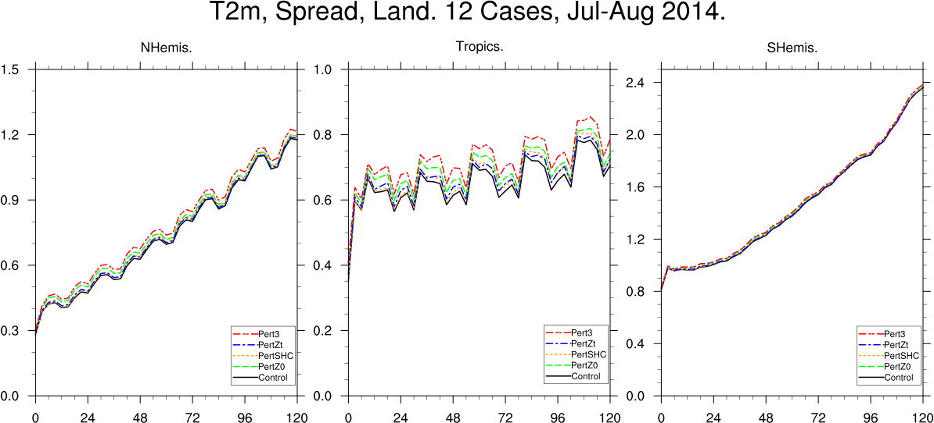
Work in progress (via Sandy Supplemental): initialization of land state
Examine effects of perturbing heat, momentum roughness lengths, soil hydraulic conductivity on T2m, precipitation.
ensemble spread (K)
lead time (hours)
Some preliminary testing of perturbing soil hydraulic conductivity (SHC), momentum roughness length (z0), and heat/momentum roughness length ratios (zt) in reduced resolution GEFS (c/o Gary Bates, ESRL/PSD). Small increases in surface spread, more in tropics and summer hemisphere.
Would like to gather estimates of these parameters from various operational centers to set the uncertainty bounds. Also may explore perturbations to LAI, stomatal resistance, albedo.
Note: interesting paper on conceptual difficulties with LSMs: Best et al. June 2015, J. Hydrometeor.

Slide 49
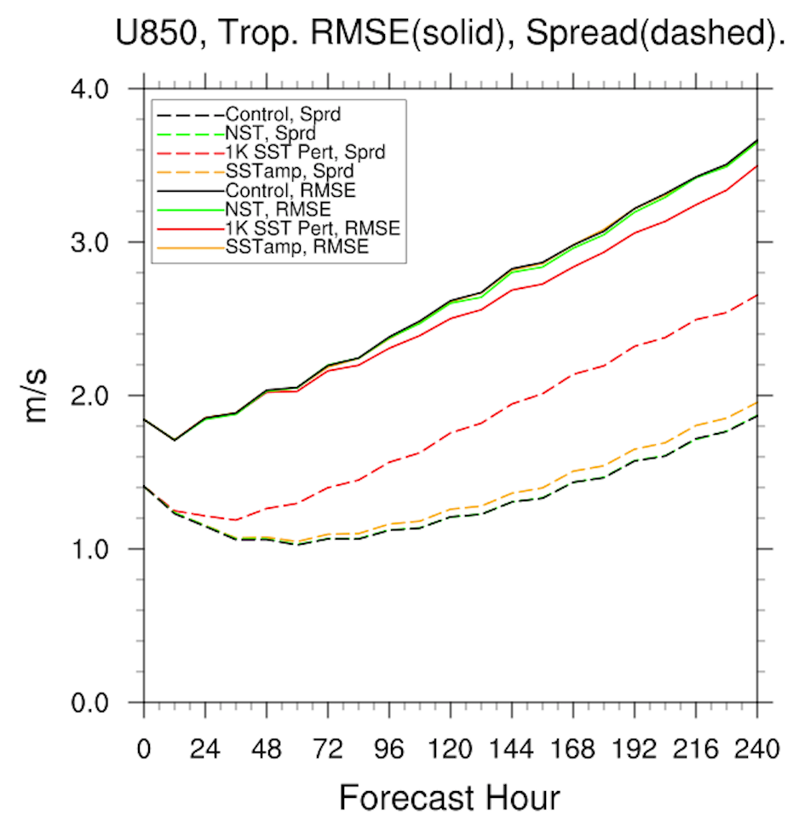
Perturbing the ocean state and diurnal SST variation effect.
4 experiments:
1. Control (no SST perts)
2. NSST (ocean skin temps permitted to vary with weather, insolation)
3. O(1K) random perts applied over all oceans (larger than justifiable)
4. Ocean initial perts varying geographically based on estimated error; Std dev ~ 0.2-0.3 K except ~1 K in some Southern Ocean.
Other regions and variables, less impact.
Here, perturbations random and not designed to co-vary with atmospheric perturbations in a realistic way.
c/o Gary Bates, ESRL/PSD. See also recent Tennant and Beare, 2013 QJRMS, DOI: 10.1002/qj.2202. Also, McClay et al., 2012 JGR, DOI: 10.1029/2011JD016937

