Slide 1

“Coalescence” – a potential method for using ensembles to improve deterministic precipitation forecasts
Tom Hamill
NOAA Earth System Research Lab, Physical Sciences Division, Boulder CO USA
tom.hamill@noaa.gov
+1 (303) 497-3060
Presentation to US-UK-Canada postprocessing group, 1 May 2019

Slide 2
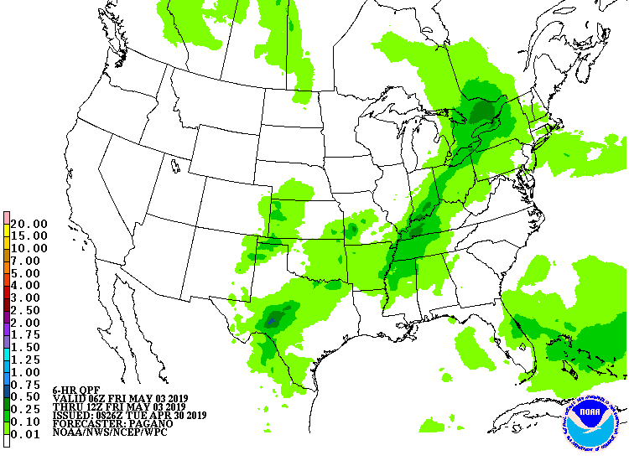
Problem statement
An example of an operational forecast product of
deterministic precipitation amount
While probabilistic forecasts useful, customers still find the information compression in deterministic forecasts desirable.
The expected maxima and most likely position of a precipitation event is challenging to determine through examination of ensembles.
  Variety of positions.
  Diminishment of magnitude in ensemble mean.

Slide 3
“Feature calibration and alignment” literature
1. Nehrkorn, T., R. N. Hoffman, C. Grassotti, and J.-F. Louis, 2003: Feature calibration and alignment to represent model forecast errors: Empirical regularization. Quart. J. Roy. Meteor. Soc., 129, 195–218, doi:10.1256/qj.02.18
2. Nehrkorn, T., 2014: Correcting for position errors in variational data assimilation. JCSDA Seminar, Joint Center for Satellite Data Assimilation, available online at http://www.jcsda.noaa.gov/JCSDASeminars2014.php.
3. Nehrkorn, T., B. K. Woods, T. Auligné, and R. N. Hoffman, 2014a: Application of feature calibration and alignment to high-resolution analysis: examples using observations sensitive to cloud and water vapor. Mon. Wea. Rev., 142, 686–702. doi: http://dx.doi.org/10.1175/MWR-D-13-00164.1
4. Nehrkorn, T., B. K. Woods, R. N. Hoffman, and T. Auligné, 2015: Correcting for position errors in variational data assimilation. Mon. Wea. Rev., 143 (4), 1368-1381, doi: http://dx.doi.org/10.1175/MWR-D-14-00127.1.

Slide 4
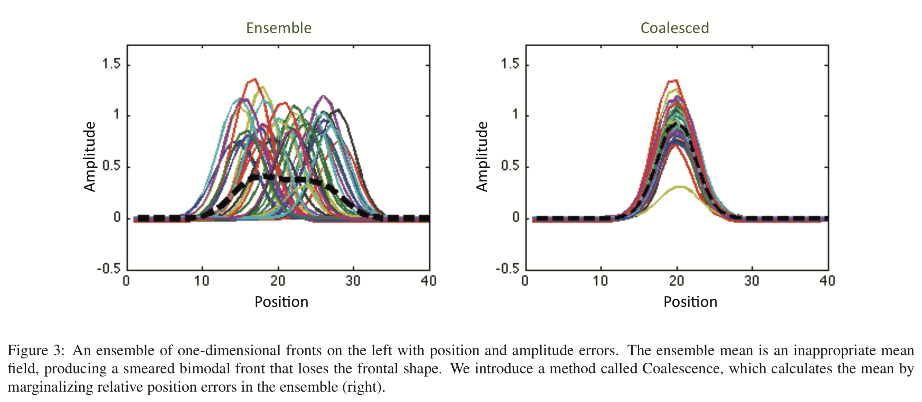
Relevant background literature: Sai Ravela (MIT)
“Data assimilation by field alignment” (https://doi.org/10.1016/j.physd.2006.09.035)
“Quantifying uncertainty for coherent structures” (https://doi.org/10.1016/j.procs.2012.04.128)

Slide 5
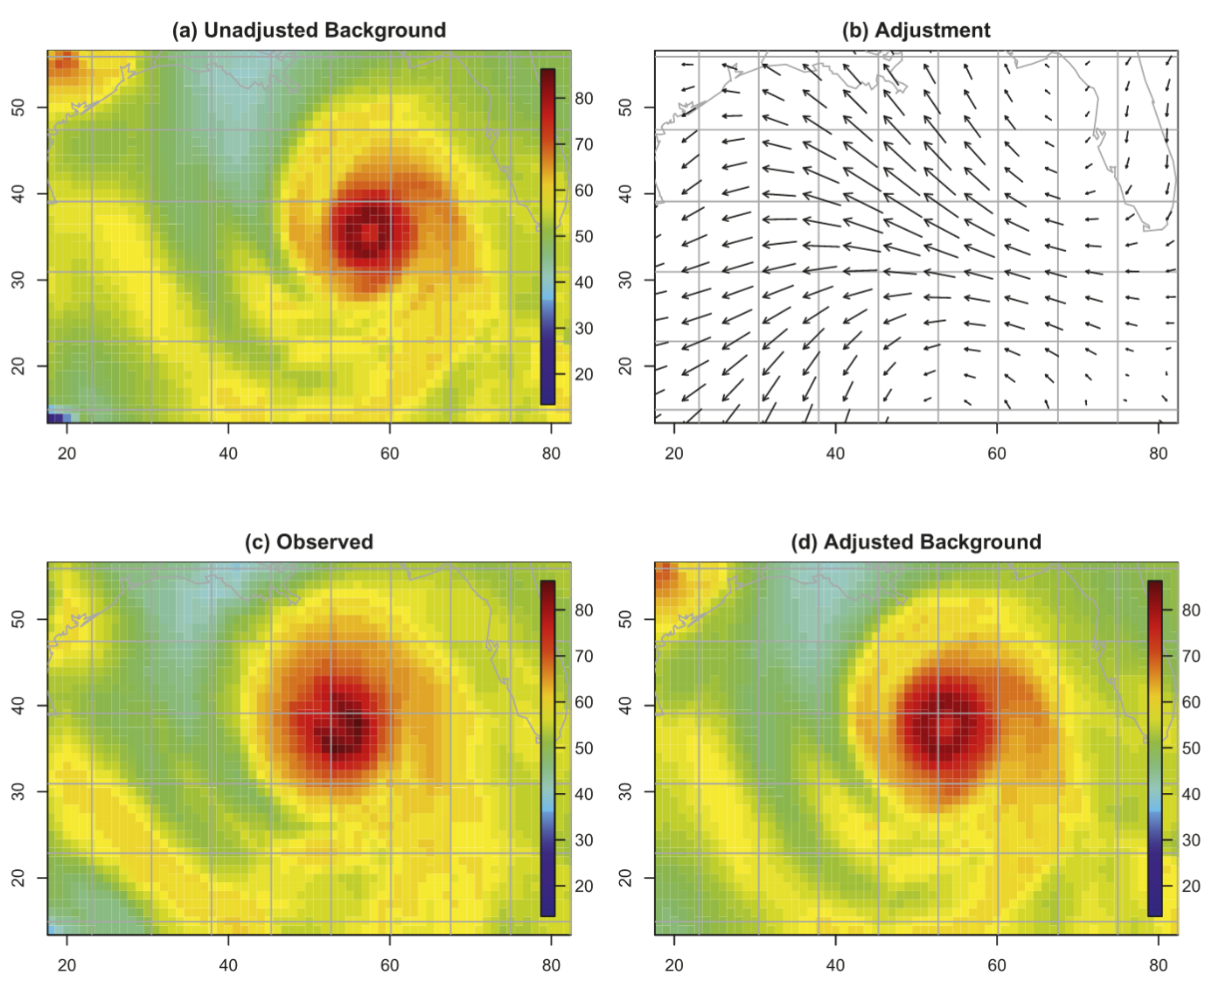
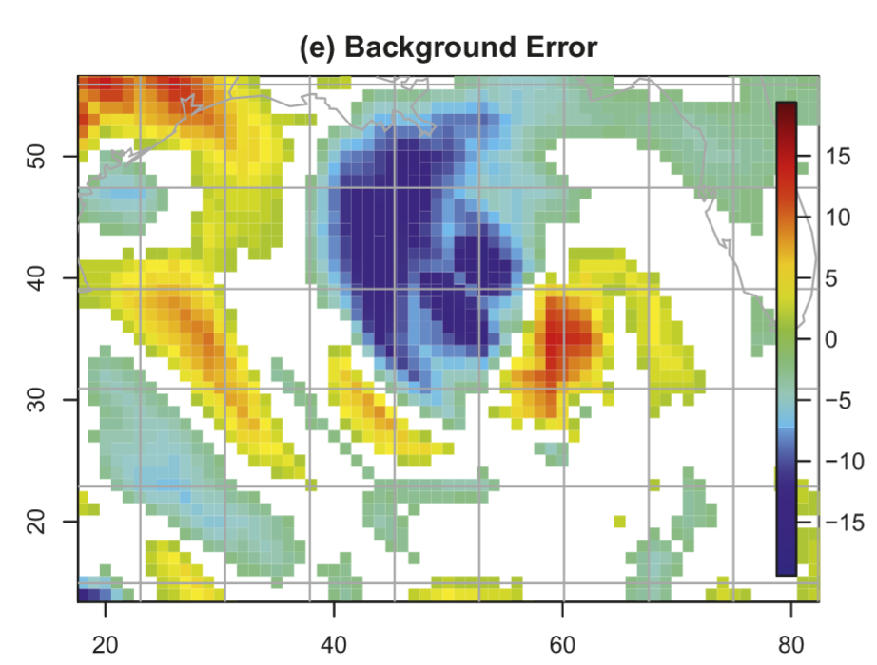
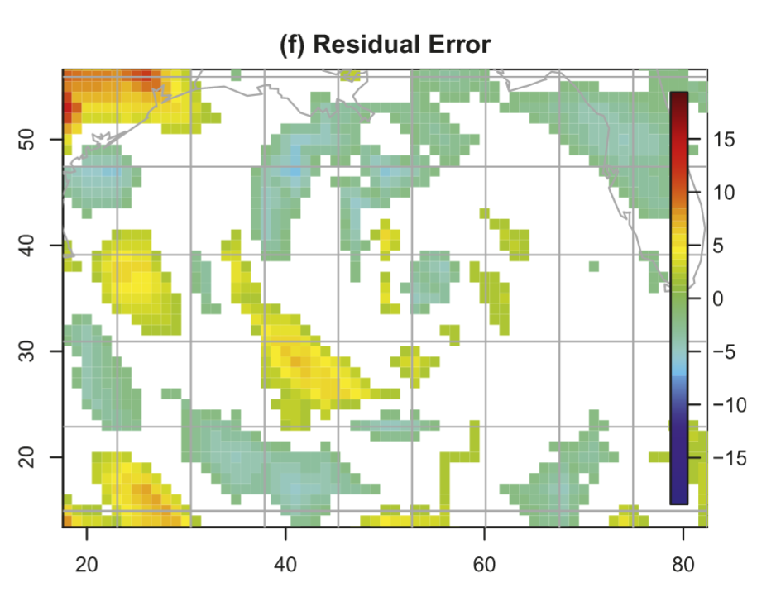
Nehrkorn et al (Ref 3 on previous page)
Conventional data assimilation methods do not handle position error well. The authors propose to use feature
calibration and alignment to adjust background position(s) to the observed before assimilating to correct magnitudes.

Slide 6
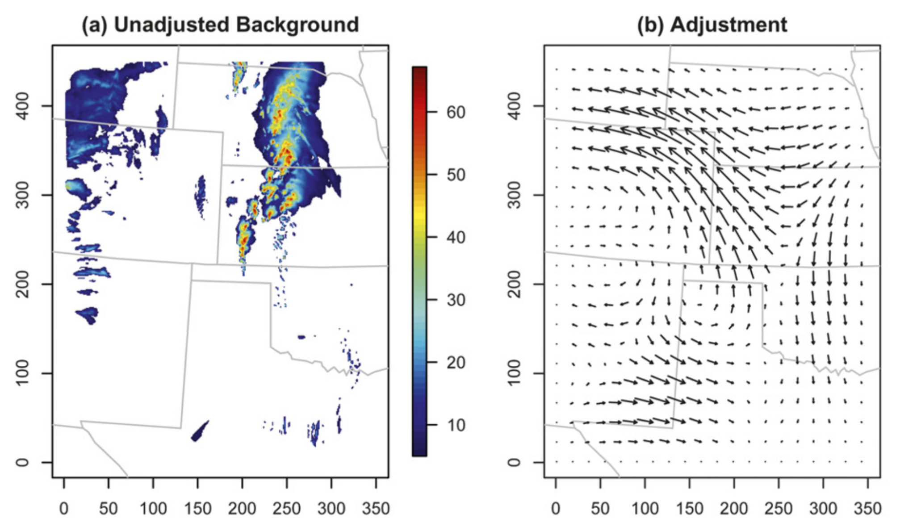
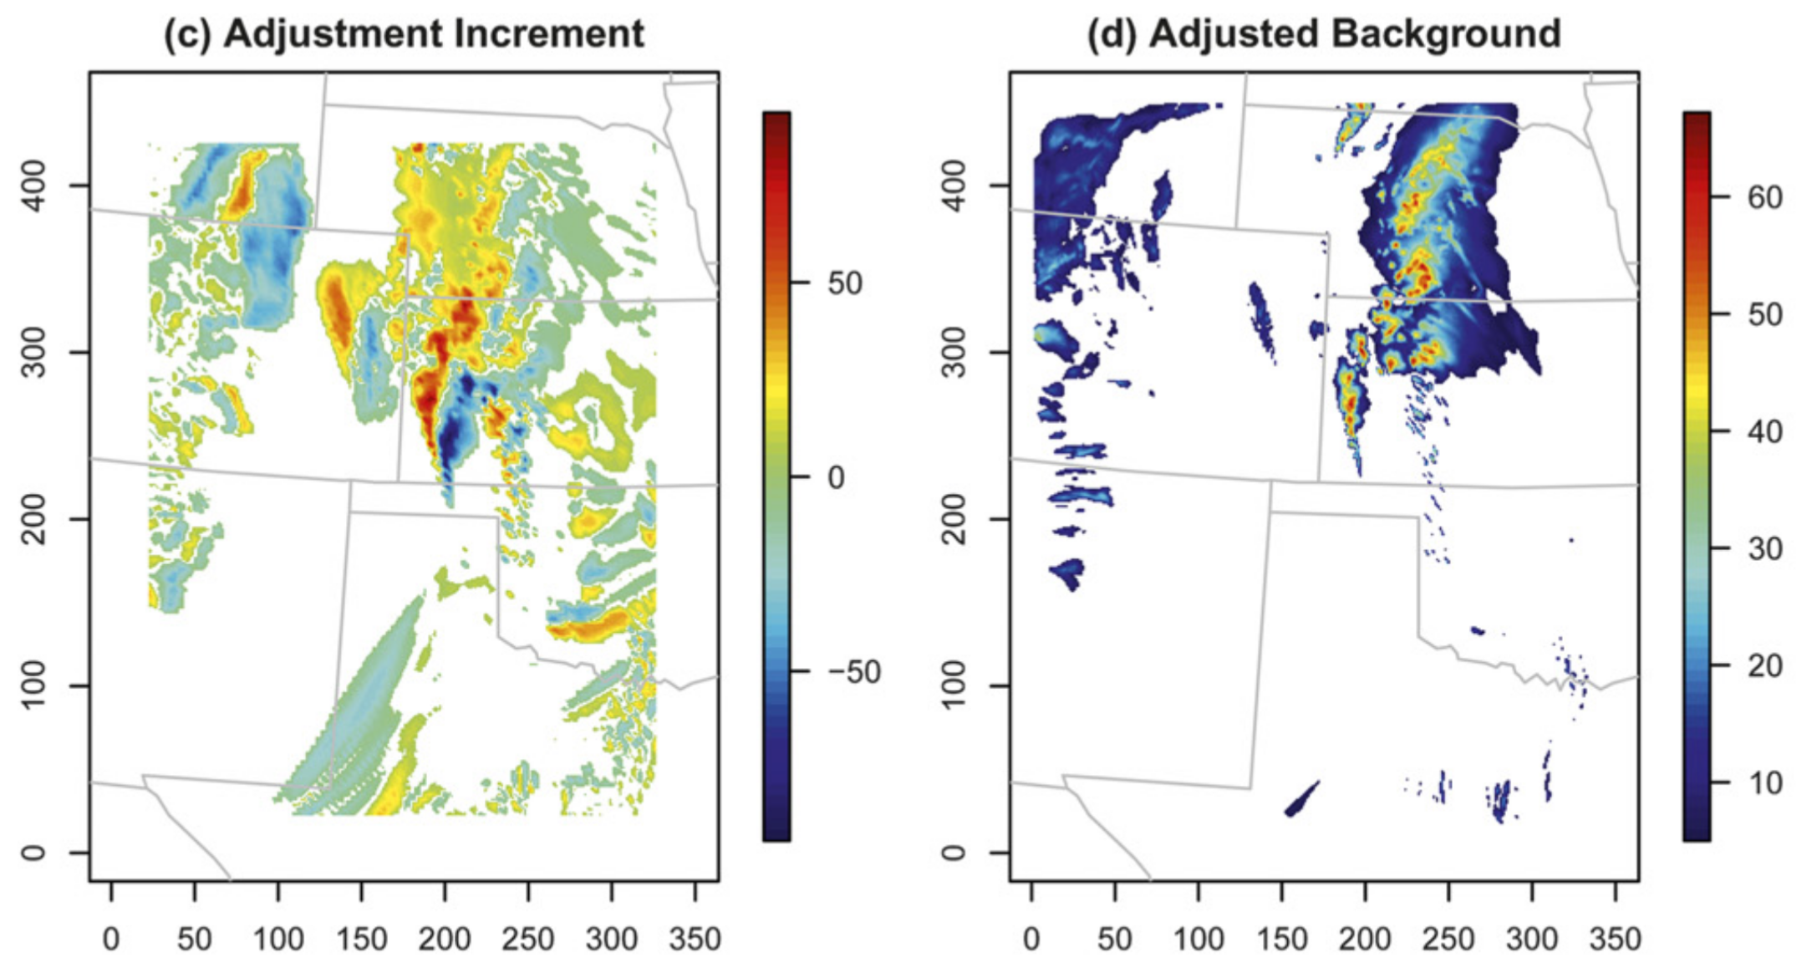
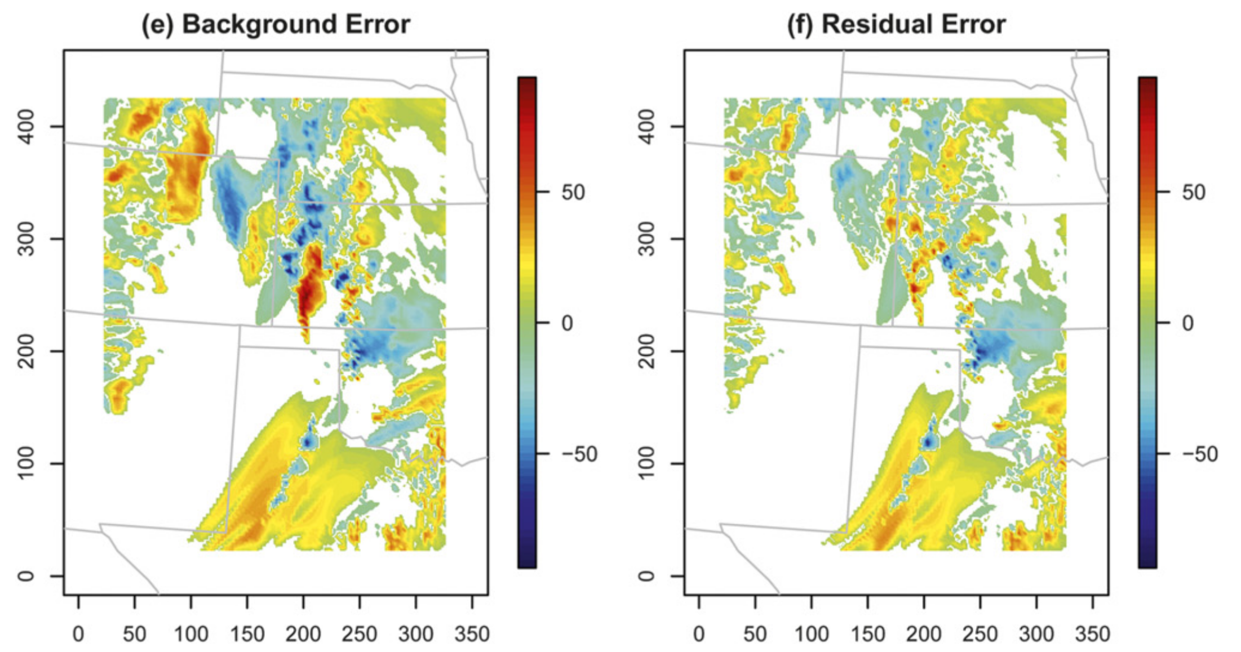
Mid-latitude example (Nehrkorn et al. reference 4)

Slide 7
Applying this to a precipitation ensemble: data and methods.
20 members of ECMWF precipitation and precipitable water forecasts on ½-degree grid (coarser than raw data).
Case study is 00 UTC 8 January 2019 initialization, 84-96 h forecasts.
Displacement vectors to achieve coalescence based on 50/50 blend of precipitation and precipitable water, to fill in field of zero precip.
Displacement vectors chosen by maximizing pattern correlation between member and ensemble mean, a quick-and-dirty alternative to the variational minimization proposed in the literature.
  Penalty function applied that increases for large displacements, to favor small ones (be conservative). A variational-type kludge.
Many other approximations, e.g., when morphing fields, do so using nearest neighbor instead of interpolation.
No objective verification of forecasts; proof of concept only.

Slide 8
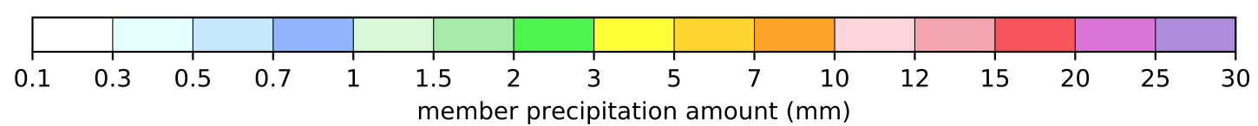
Here are the raw members we
seek to coalesce, i.e.,
to move to a common position.

Slide 9
Here is the
ensemble
mean precipitation
amount.
Compare with
stamp maps
to see the
diminishment
of precipitation
maxima.

Slide 10
member 1
precipitation
and displacement vectors
ensemble mean
precipitation

Slide 11
member 1
precipitable water
and displacement vectors
ensemble mean
precipitable water

Slide 12
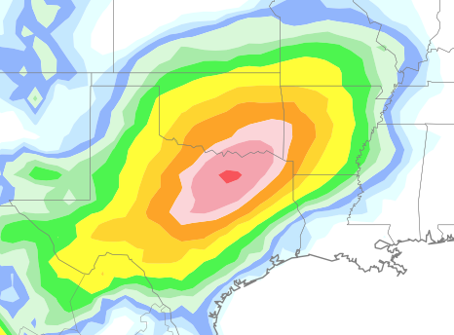
previous
ens mean
after first
iteration.

Slide 13
Here are the raw members we
seek to coalesce, i.e.,
to move to a common position.

Slide 14
Stamp map of
members after
first iteration
of coalescence.

Slide 15
Stamp map of
members after
second iteration
of coalescence.

Slide 16
original
ens mean
after first
iteration.

Slide 17
original
ens mean
after second
iteration.
slight shift
of centroid
may be due
to nearest
neighbor
interpolation.

Slide 18
Next steps, questions.
Many areas of development needed to bring this to possible operational maturity.
For example, we would probably want to swap out the current displacement vectors via pattern matching for their definition through variational minimization.
We would test various configuration options, e.g., lead-time dependence of covariance matrix for displacement errors.
Would alternatives be needed to make the algorithm useful for terrain-locked precipitation features? Possible transformation of forecast to quantiles, coalesce using transformed data?
We should verify the coalescence algorithm against modern alternatives, e.g., quantile mapping of ensemble mean discussed in Hamill, T.M., E. Engle, D. Myrick, M. Peroutka, C. Finan, and M. Scheuerer, 2017: The U.S. National Blend of Models for Statistical Postprocessing of Probability of Precipitation and Deterministic Precipitation Amount. Mon. Wea. Rev., 145, 3441-3463, https://doi.org/10.1175/MWR-D-16-0331.1.
We don’t have funding for such research yet (were previously turned down by US Weather Research Program).

