Slide 1
Performance of hurricane forecasts from global ensemble prediction systems during the 2009 season
NOAA Earth System
Research Laboratory
Tom Hamill, Jeff Whitaker,
Stan Benjamin, and Mike Fiorino
NOAA Earth System Research Lab
Boulder, Colorado
tom.hamill@noaa.gov

Slide 2
The ensemble Kalman Filter (EnKF)
A method for the initialization of ensemble forecasts that is conceptually appealing for hurricanes
“Flow-dependent” background-error covariances may be useful to achieving quality analyses
figure c/o Xuguang Wang, University of Oklahoma

Slide 3
Testing performed
Ran a global ensemble square-root filter (“EnKF”) data assimilation
T382L64 (~30 km) version of NCEP GFS, 60 members
Full observational data stream + “TCVitals” (min central pressure)
20-member ensemble forecasts to 7 days for most active days during hurricane season.
T382L64 GFS ensemble (GEFS) from EnKF initial conditions
30-km “FIM” model from GFS EnKF initial conditions
ECMWF (T399) and CMC via “TIGGE” database.
Deterministic forecasts from T382 GFS/GSI and GFS/EnKF
Compare against “best track” files compiles by NHC and Joint Typhoon Warning Center
Also: Jeff Whitaker presentation yesterday on global EnKF (IOAS-AOLS 6B.1) for tropical cyclones

Slide 4
Track plotting software http://ruc.noaa.gov/tracks/
software developed
by Paula McCaslin,
ESRL/GSD
uses Google Maps; black line is observed “best track”;
white lines are forecast members; green is ensemble mean; yellow is control

Slide 5
Rules for including a particular storm in comparisons of models A vs. B
Storm must be tracked and at least tropical depression strength at initial time of forecast
Ensemble scores computed only when at least 20 members’ forecasts computed
but if storm dies out in some members, compute mean error and spread from remaining ones.
When comparing forecast model A to forecast model B, count a storm as a sample only when both models have forecast available.

Slide 6
Experimental T382 GEFS/EnKF vs. operational T126 GEFS/ET
higher resolution + EnKF = clear improvement
but how much from resolution vs. EnKF?

Slide 7
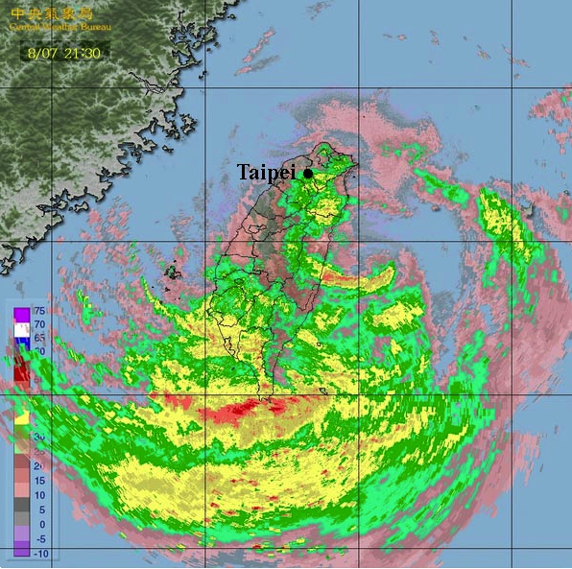
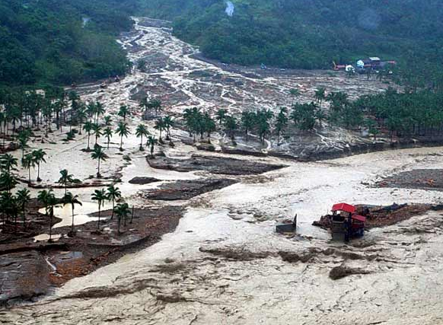
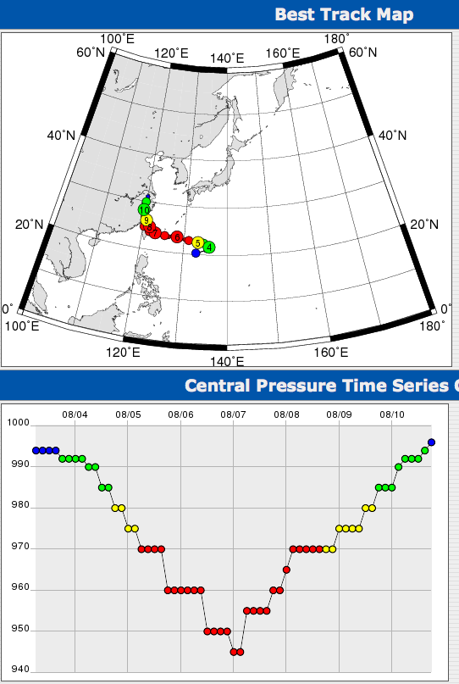
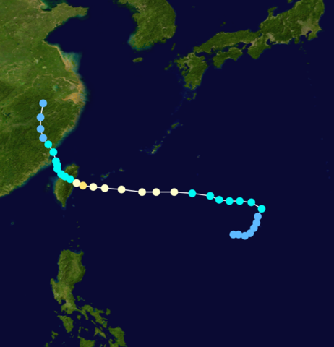
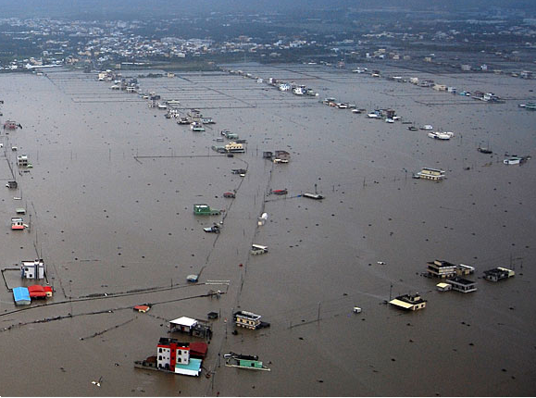
EnKF performance with 2009 typhoon Morakot (Taiwan floods)
7

Slide 8
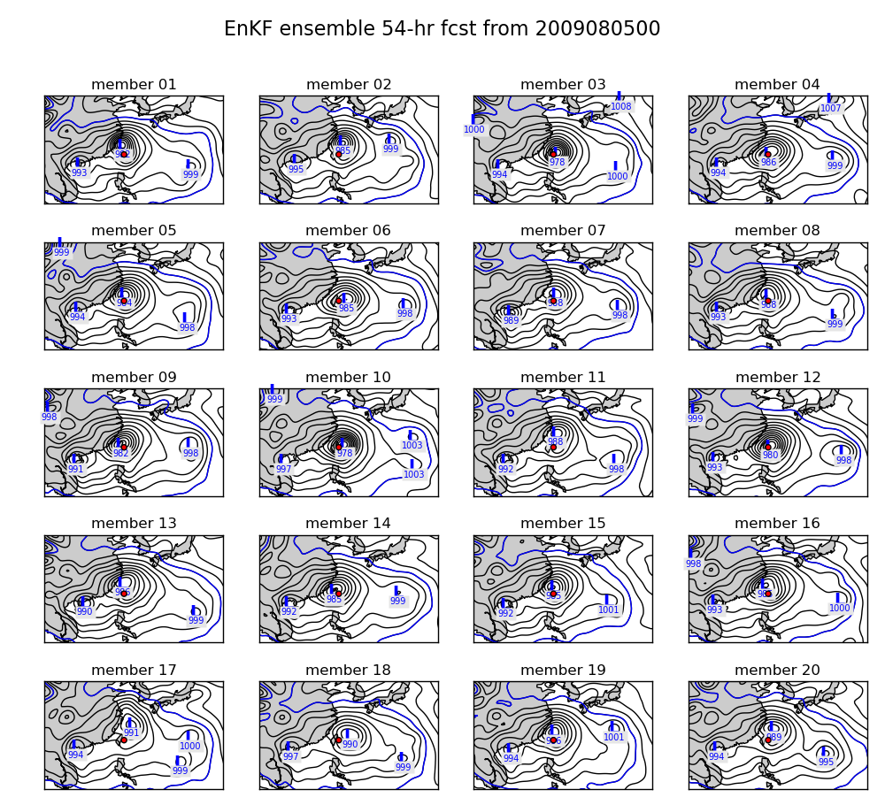
54-h ensembles from T382 GFS & EnKF initial conditions.
Intense vortices in forecasts, with ensembles of forecast positions relatively close
to the observed position (red dot).
8

Slide 9
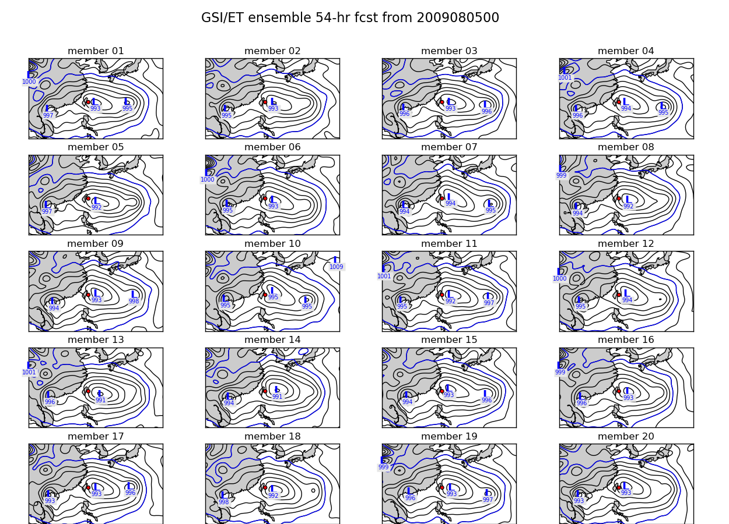
54-h ensembles from experimental T382 GFS & GSI / ET perturbations (operational).
Note that GFS
model resolution
is much greater
than current
operational, T126
GSI-ET initialized ensemble produces less intense vortices, and forecasts are slow in moving typhoon west.
This operational version of GSI did not include TCVitals central pressure obs.
9

Slide 10
T382 GEFS/EnKF vs. operational T399 ECMWF
competitive with ECMWF in position error

Slide 11
T382 GEFS/EnKF vs. operational Canadian Centre EnKF
lower in error than CMC; they run EnKF at
lower resolution and do no assimilate TCVitals

Slide 12
T382 GEFS/EnKF vs. experimental FIM/EnKF
FIM ensemble with somewhat higher errors than GEFS

Slide 13
Deterministic track forecasts from parallel T382 GFS/GSI vs. T382 GFS/EnKF
This “parallel” version of GSI now uses TCVitals min pressure pseudo-obs
General slight improvement of EnKF except at longest lead (small sample).

Slide 14
Tropical winds from parallel tests of T190 GFS/GSI & GFS/EnKF
EnKF provides better wind forecasts; better steering of tropical cyclones?

Slide 15
Deterministic max wind speed forecast bias from parallel T382 GFS/GSI vs. T382 GFS/EnKF
EnKF appears to have improved max wind speed bias relative to GSI.

Slide 16
Conclusions
EnKF + high-resolution global model showed remarkable success in 2009 season
track forecasts competitive with state-of-the art ECMWF forecast ensemble.
track forecasts clearly better than NCEP, CMC operational, FIM.
good consistency between ensemble spread and error.
generally better tropical wind analyses.
user-friendly, real-time tracker software.
Improvement in TC forecasts likely due to both to increased model resolution and EnKF
Some questions
improve methods for vortex initialization in EnKF. Incorporate relocation?
methods for treating hurricane-related model error?
resolution impacts of global model in EnKF?
effect of assimilating position and intensity of TCVitals separately?
will nesting of high-resolution regional EnKF and SREF forecasts provide even better results?
Acknowledgments: NOAA HFIP program for support, U. Texas NSF supercomputer for CPU cycles
to make real-time ensemble forecasts; Tim Marchok (tracker files); Darryl Kleist (GFS parallel runs).

Slide 17
FIM model (fim.noaa.gov)
icosahedral grid; nearly uniform resolution
hybrid sigma/theta or sigma/pressure vertical coordinate.
physics ported from GFS
being developed & tested at NOAA ESRL as a candidate for future operational global forecast model.

Slide 18
Canonical EnKF update equations (for time t)
Notes:
An ensemble of n parallel data assimilation cycles is conducted, assimilating perturbed observations .
Background-error covariances are estimated using the ensemble.

Slide 19
Propagation of state and error covariances in EnKF
(Pª never
explicitly
formed)
if forecast model is “perfect”; M is
forward model operator
- or -
…or something similar,
if forecast model imperfect.

Slide 20
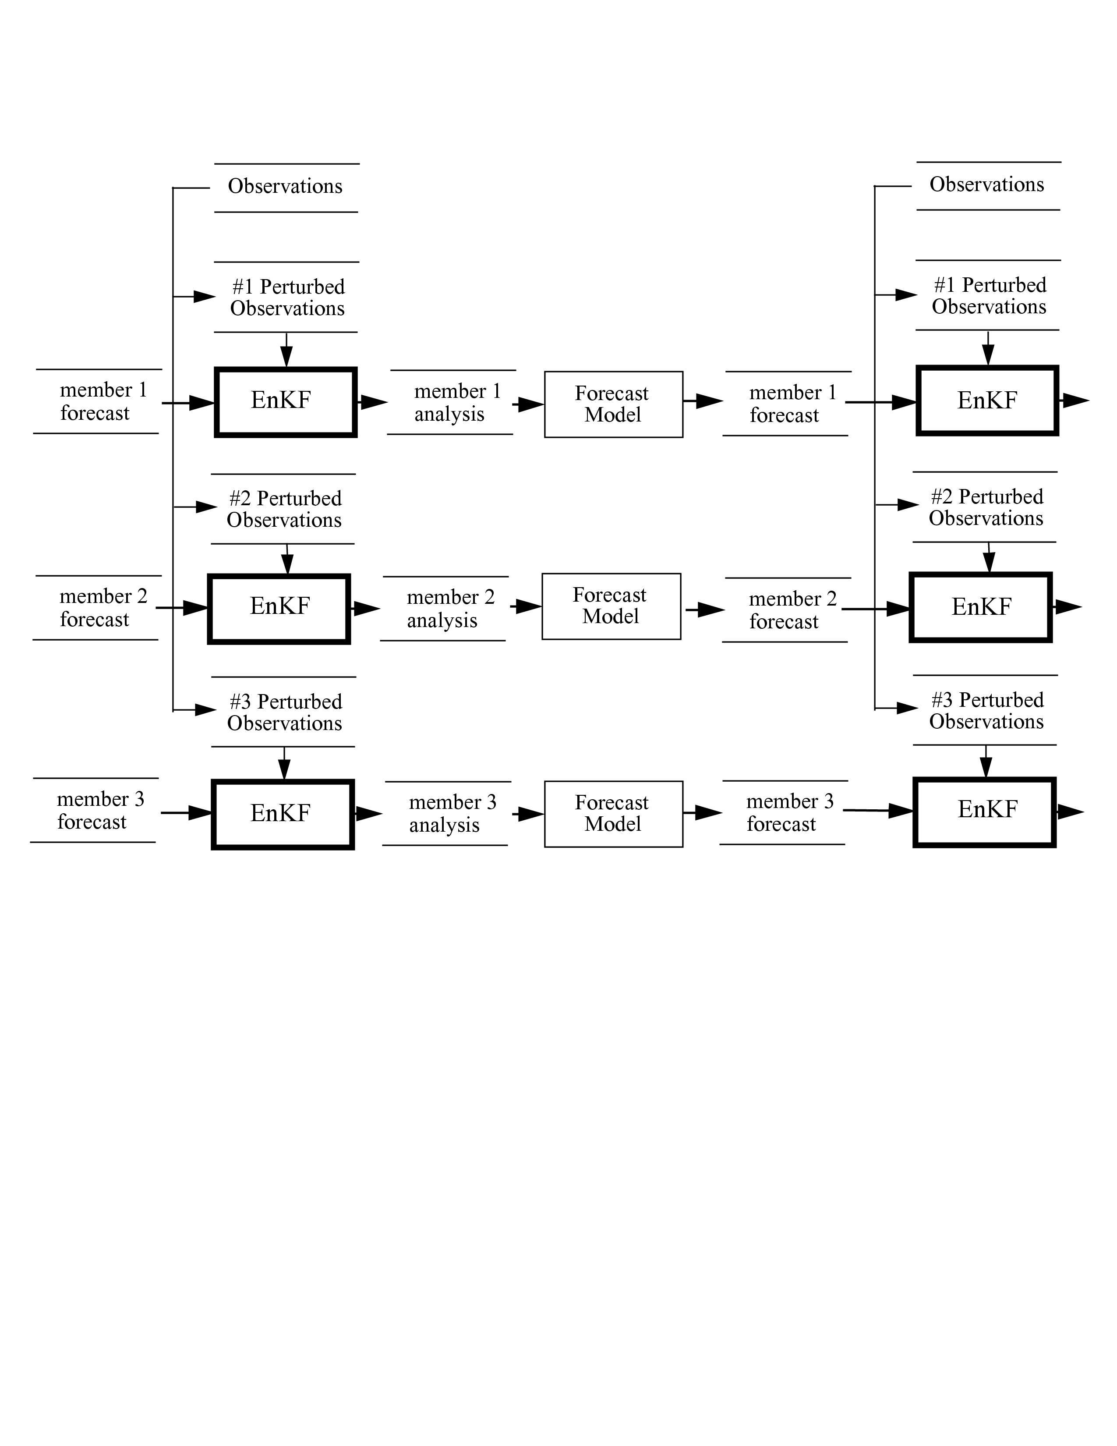
Perfect-model EnKF schematic
(This schematic
is a bit of an
inappropriate
simplification,
for EnKF uses
every member
to estimate
background-
error covariances)

