Slide 1
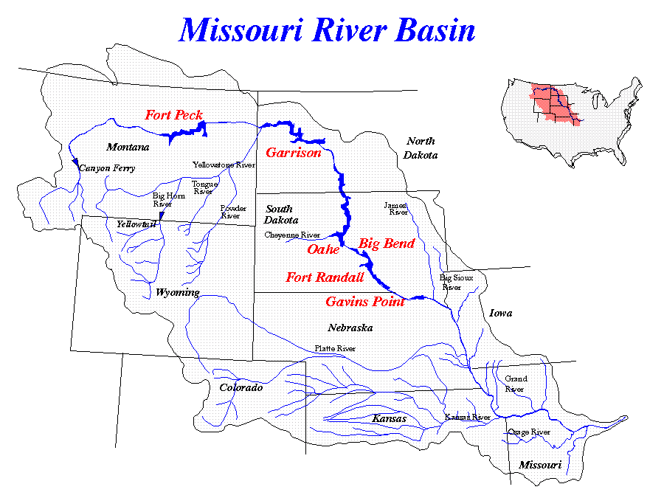
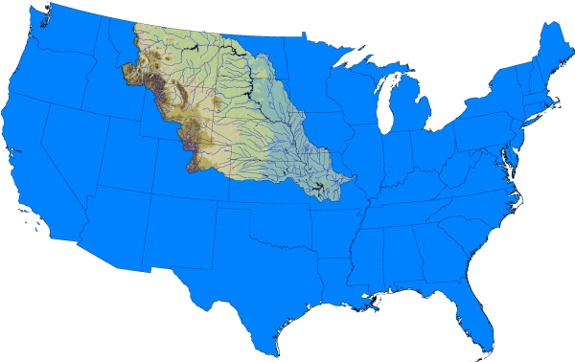
The 2010-2011 Missouri River Flood:
An experimental rapid assessment of weather and climate conditions leading to high flows
Robert Webb Doug Kluck
David Easterling Arun Kumar
Martin Hoerling Jon Eischeid David Anderson Russel Vose Scott Applequist Tom Gurss Gregg Schalk Juliann Meyer Chunzai Wang
Tom Perkins and the NRCS Snow Survey and Water Supply Forecasting Staff

Slide 2
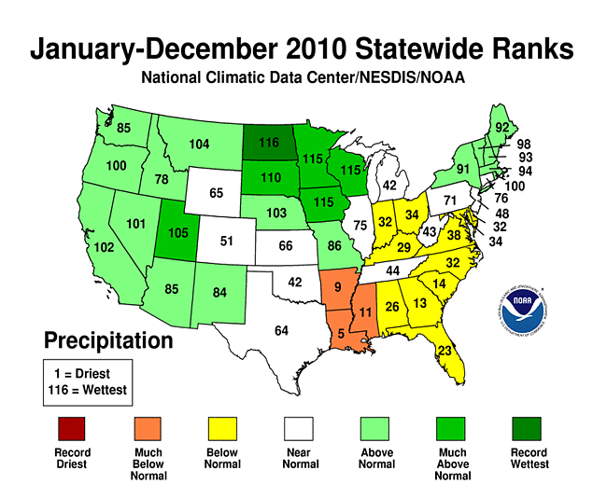
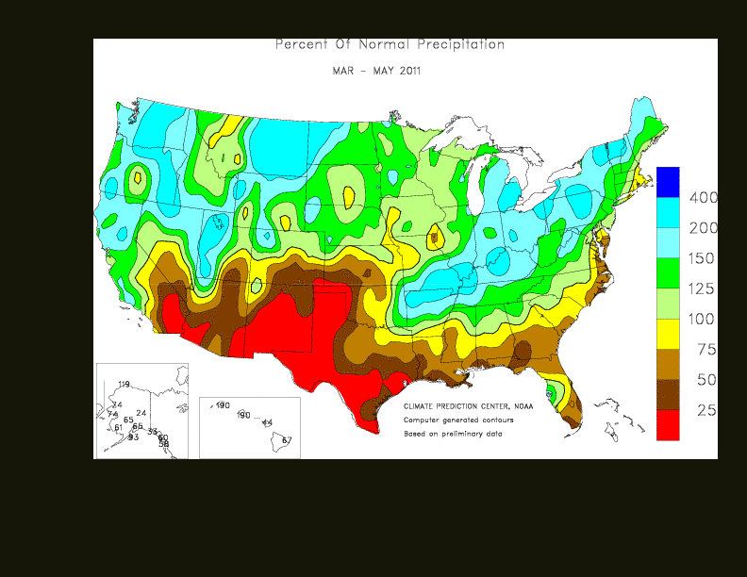
Missouri River Basin Precipitation
March-April-May 2011 Observed Seasonal Mean Precipitation (% of Normal)

Slide 3
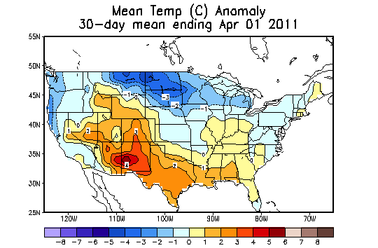
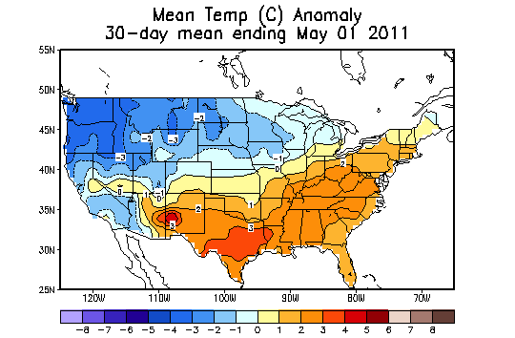
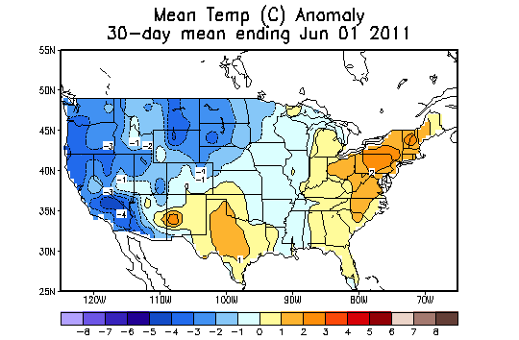
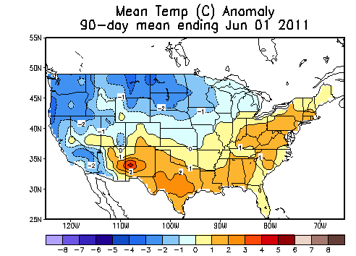
January – June 2011 Observed Temperature (departure from normal) - °C
March 11
April 2011
May 11
MAM 11

Slide 4
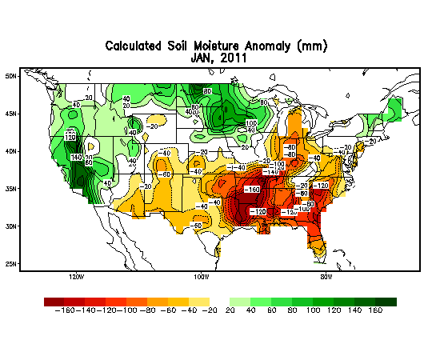
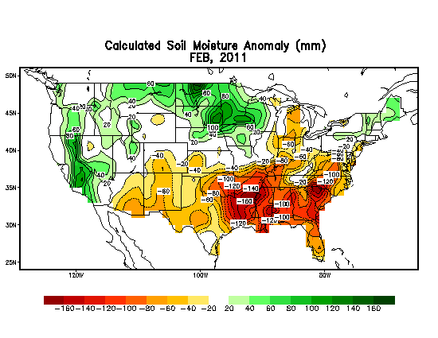
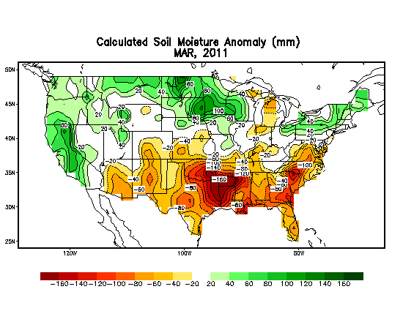
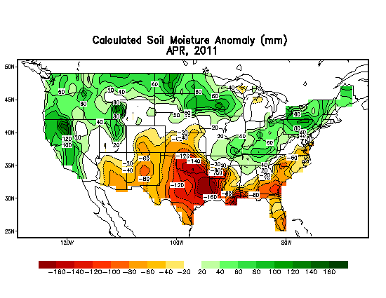
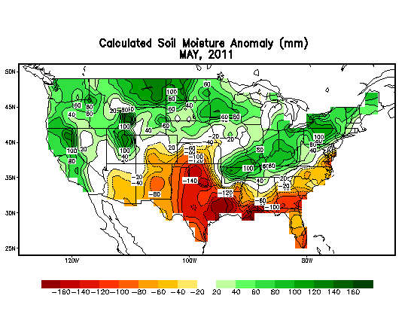
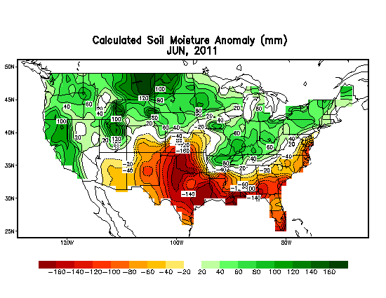
NOAA Soil Moisture Anomaly Analysis
http://www.cpc.ncep.noaa.gov/soilmst/index_jh.html

Slide 5
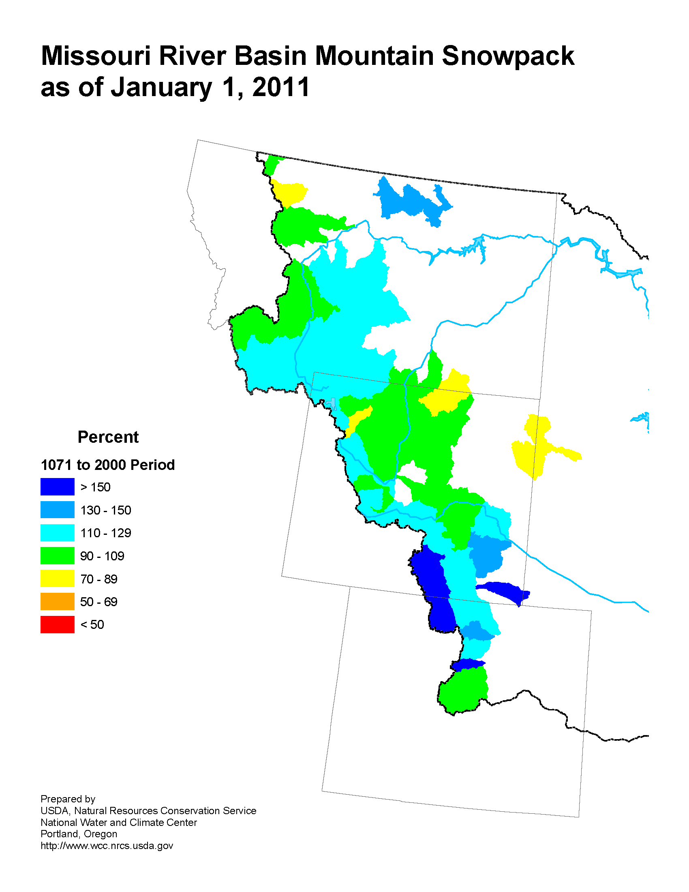
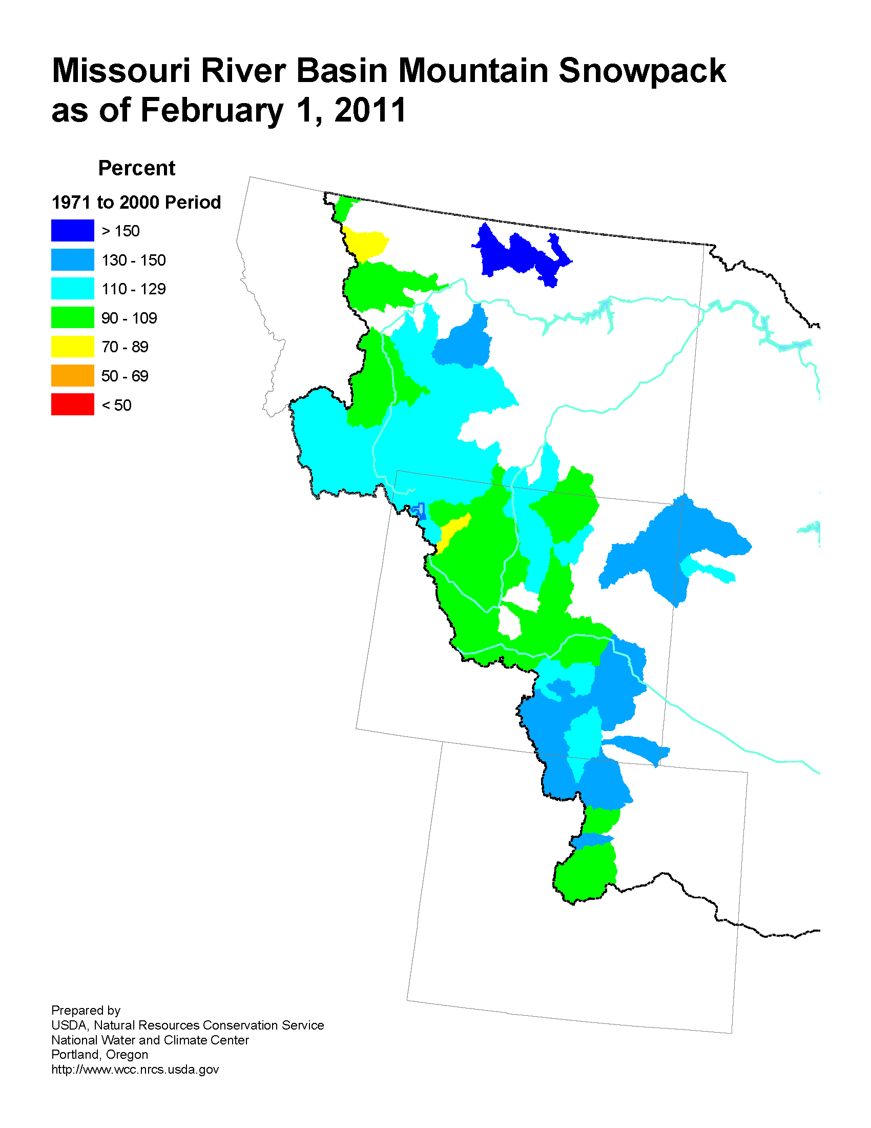
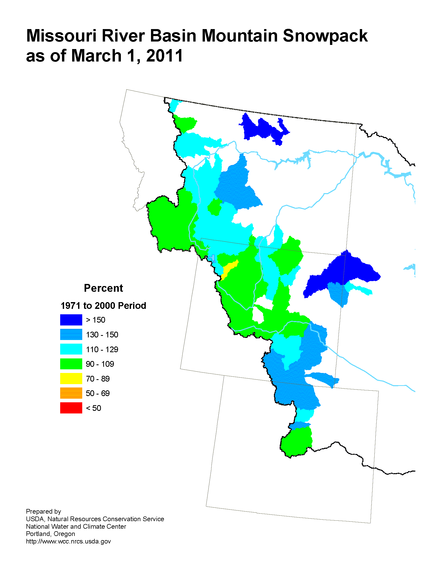
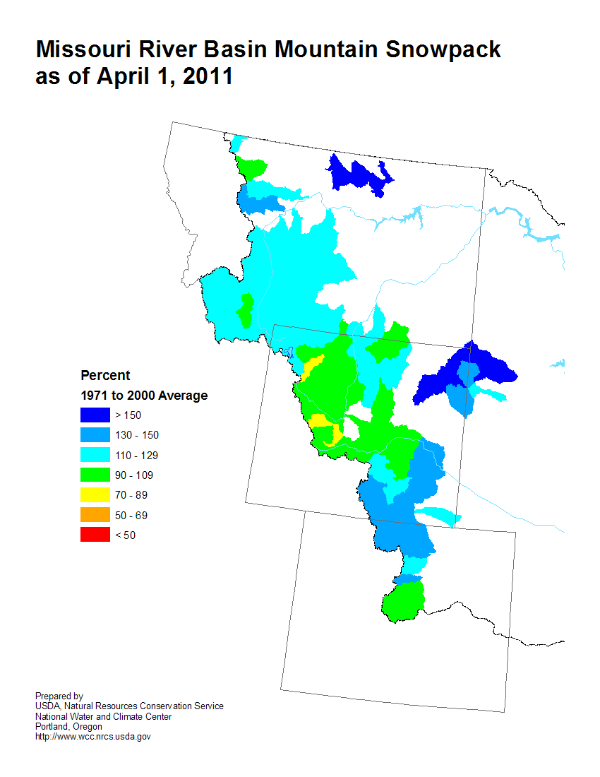
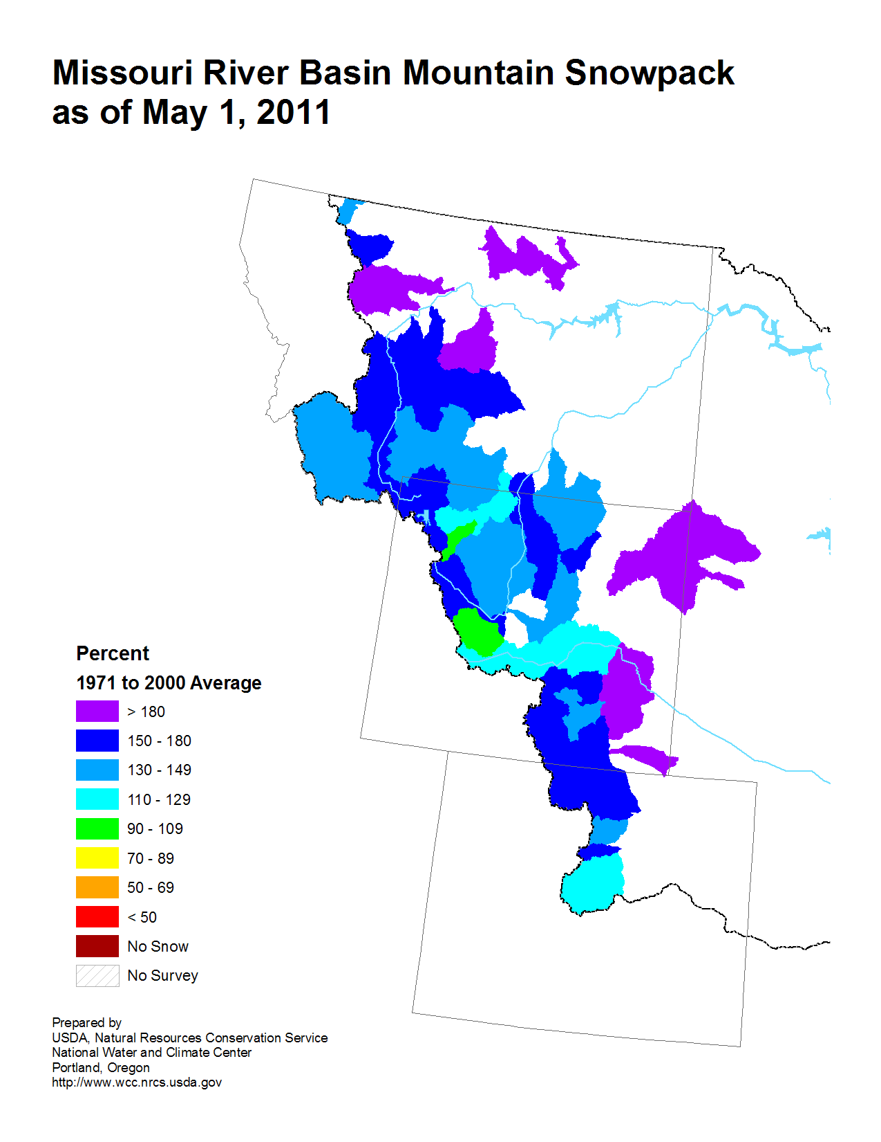
NRCS Snowpack Maps for the Missouri River Basin
Prepared by USDA Natural Resources Conservation Service, National Water and Climate Center, Portland, Oregon
JAN 2011
FEB 2011
MAR 2011
APR 2011
MAY 2011
JUN 2011
http://www.wcc.nrcs.usda.gov/cgibin/misssnow.pl?state=missouri_river

Slide 6
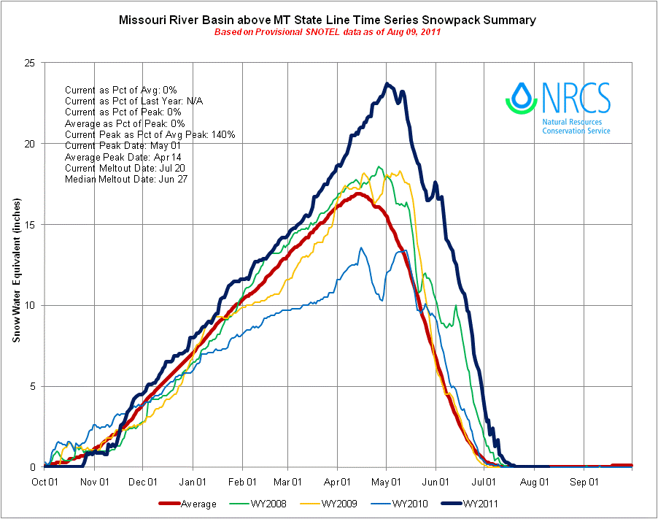
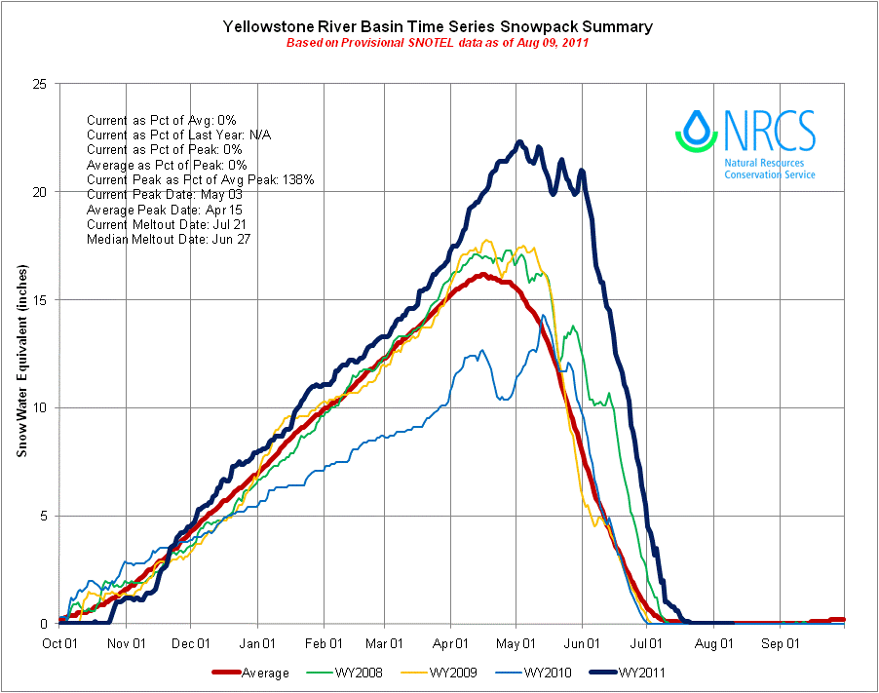
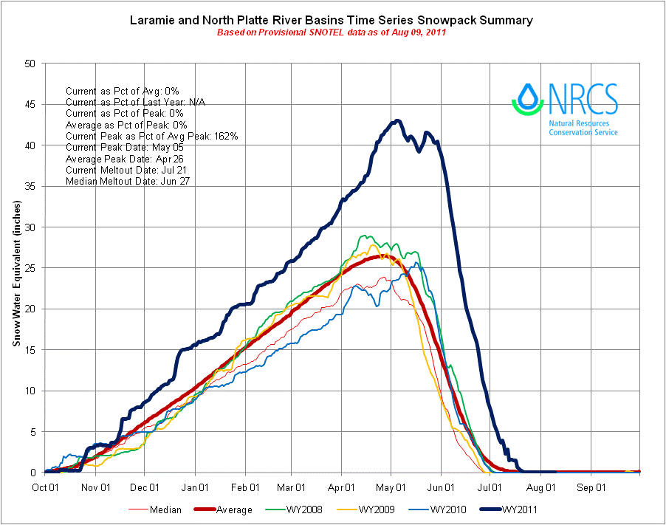
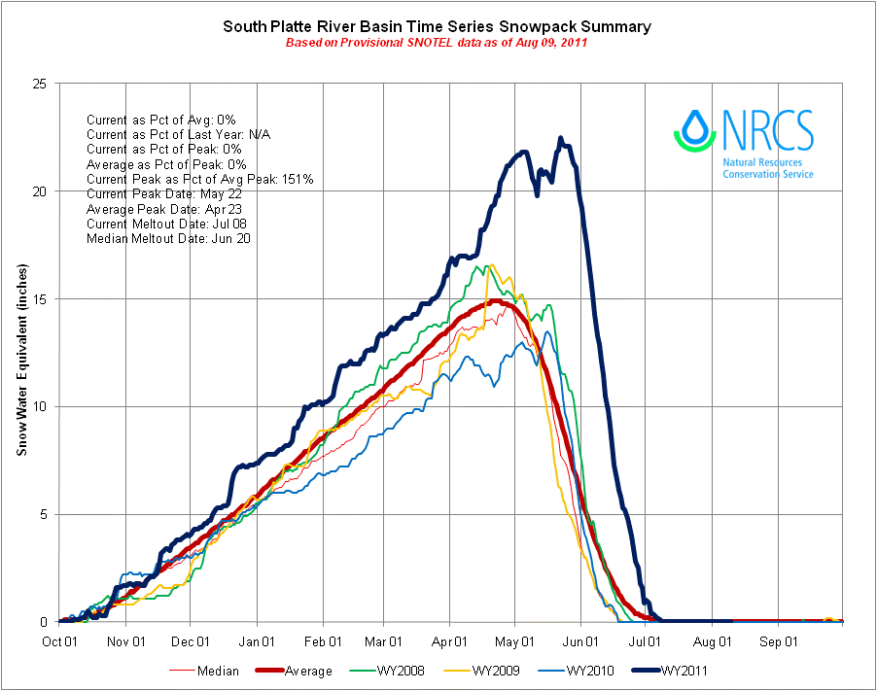
Missouri River Basin Snowpack Evolution
Wet Spring Caused Late Increase in Upper Basin Snowpack.
Cold Spring Extended Snowpack Peaks to the end of May.

Slide 7
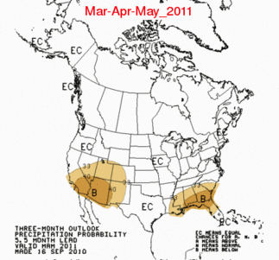
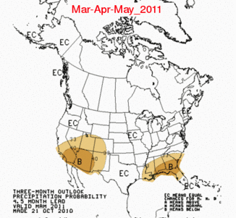
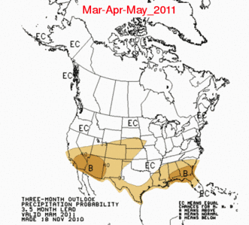
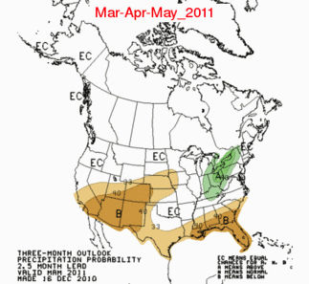
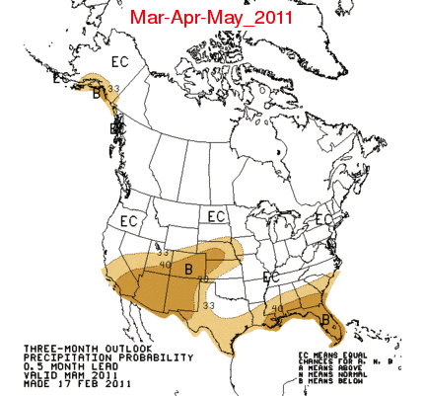
NOAA CPC Precipitation Forecast for MAM 2011
September 10
October 10
November 10
December 10
January 11
February 11

Slide 8
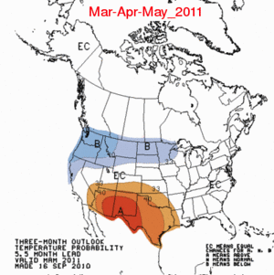
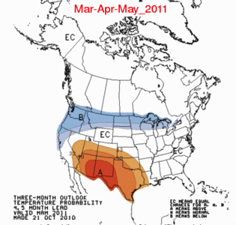
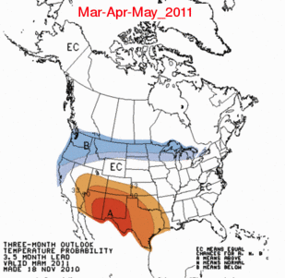
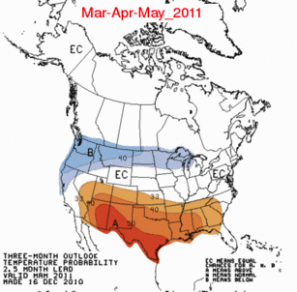
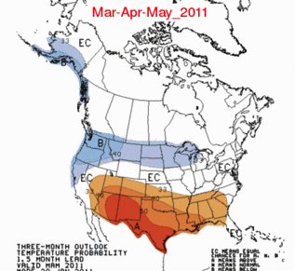
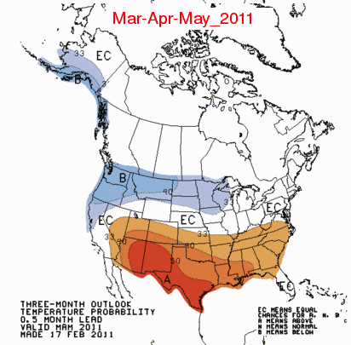
NOAA CPC Temperature Forecast for MAM 2011
September 10
October 10
November 10
December 10
January 11
February 11

Slide 9
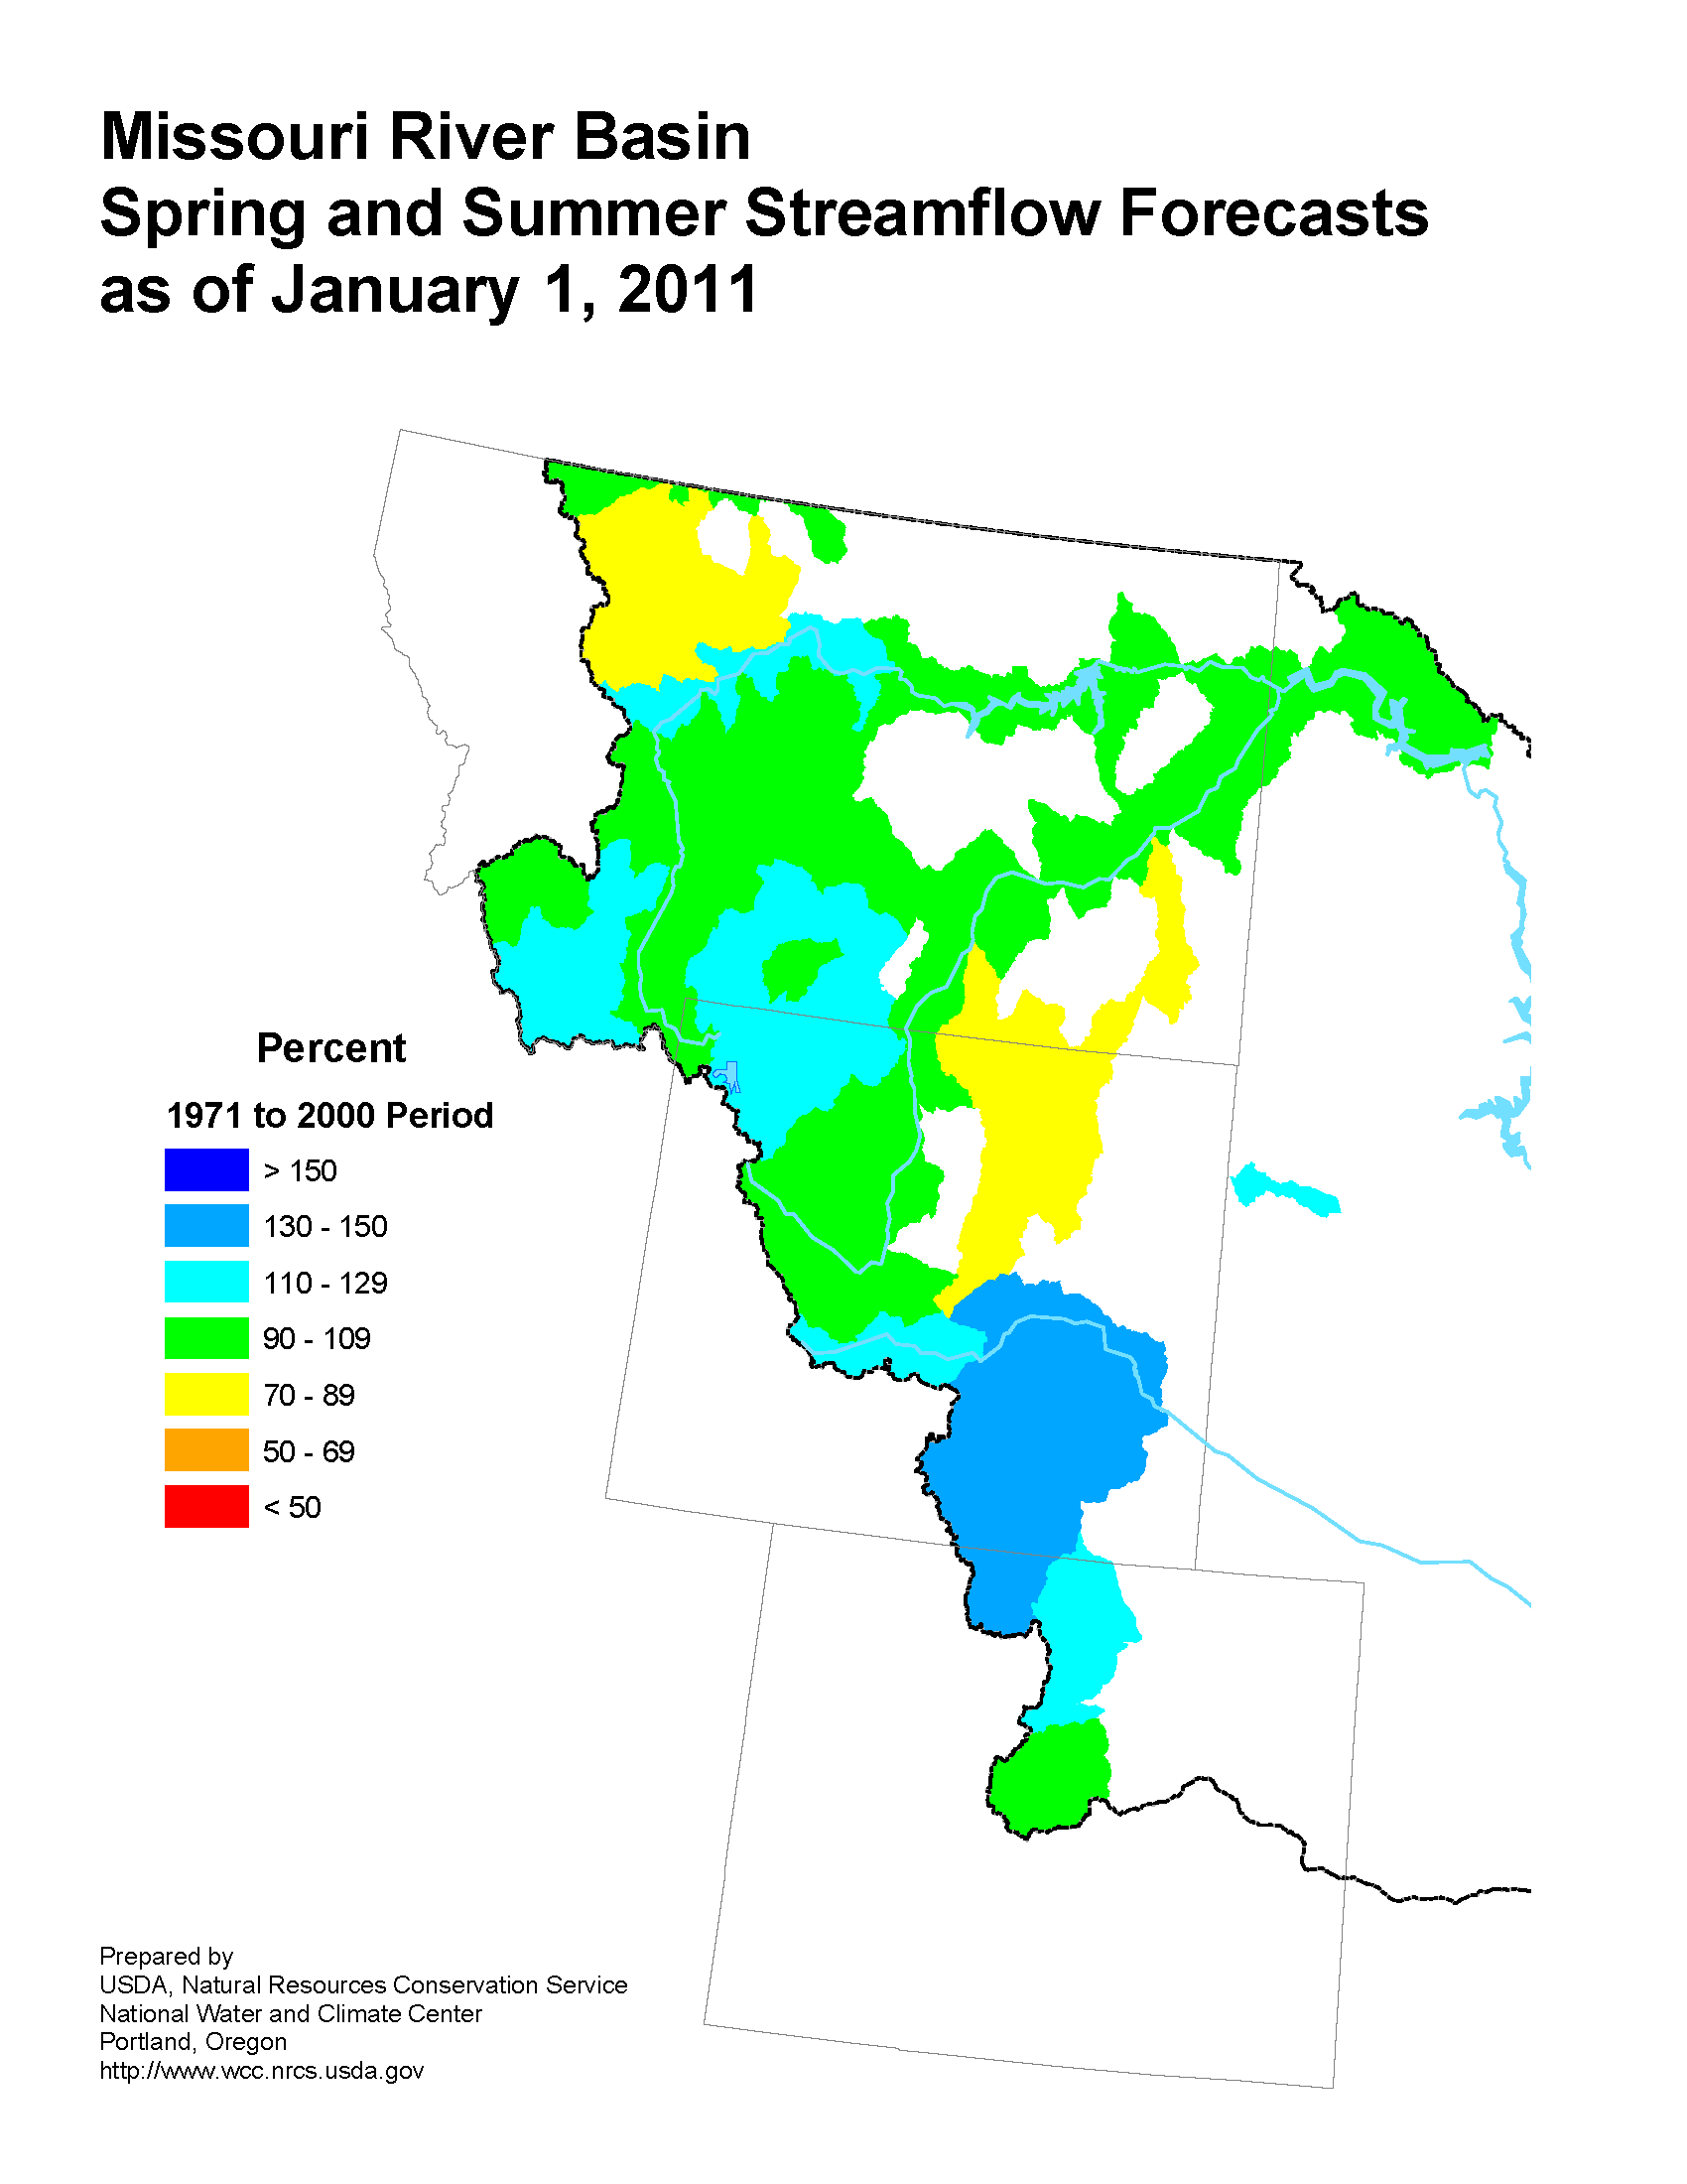
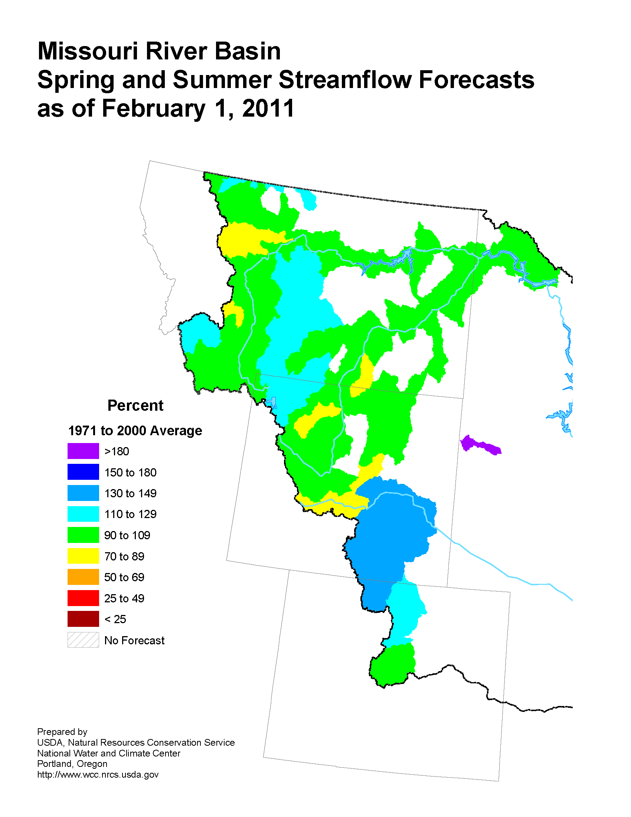
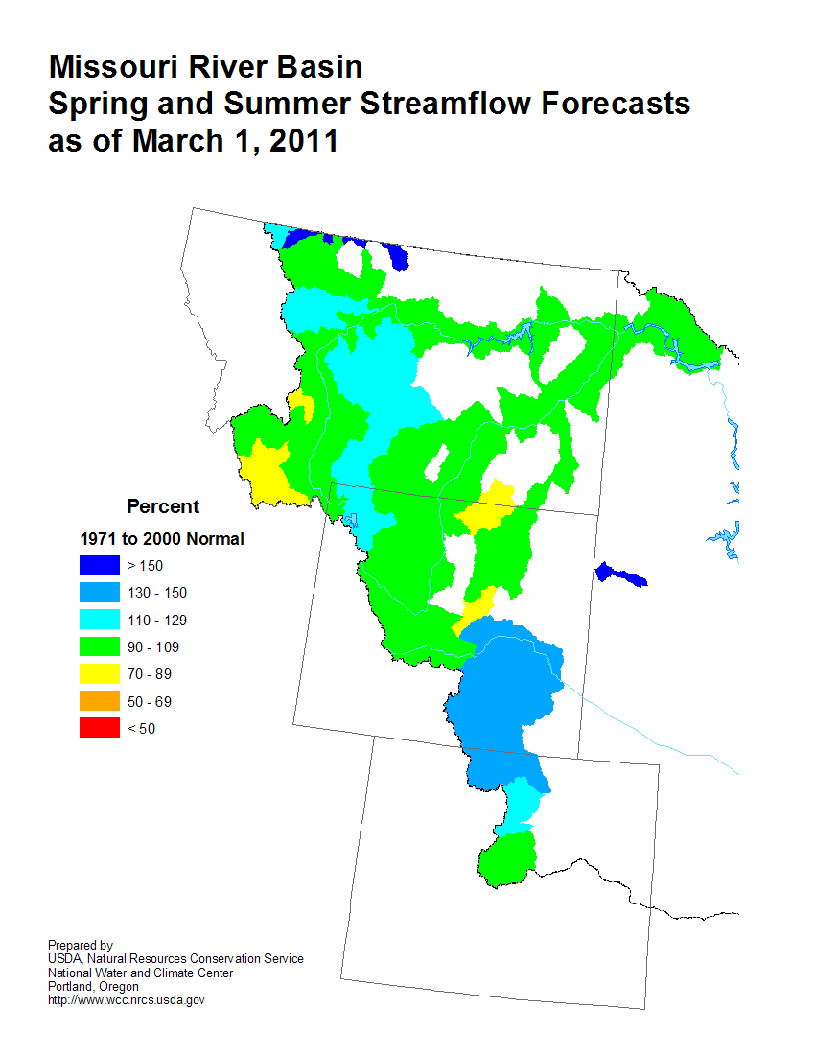
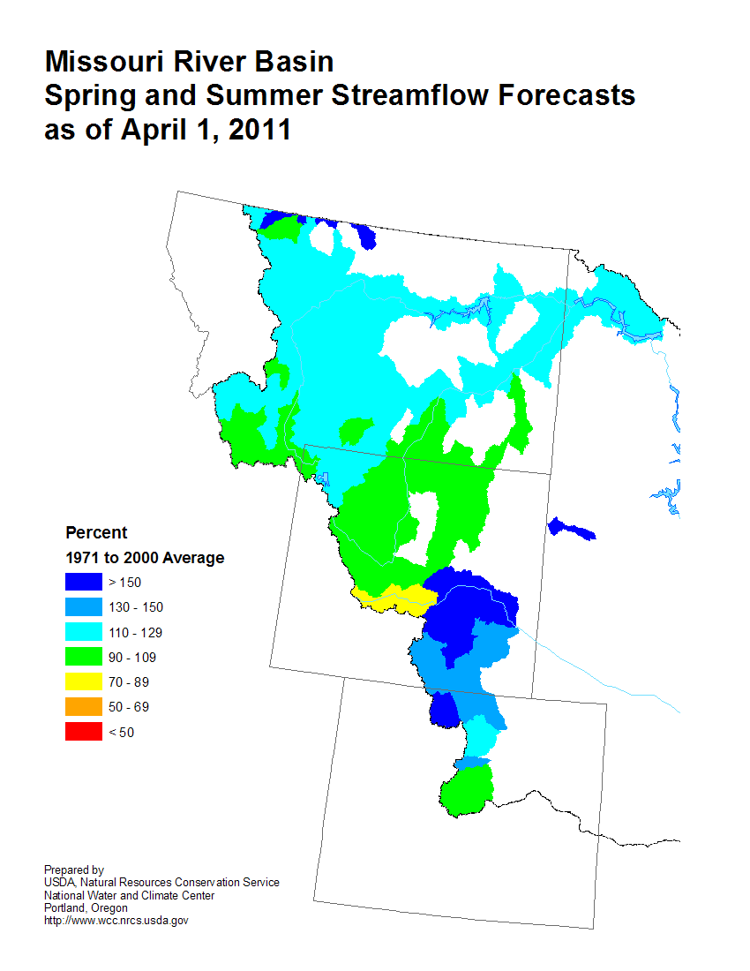
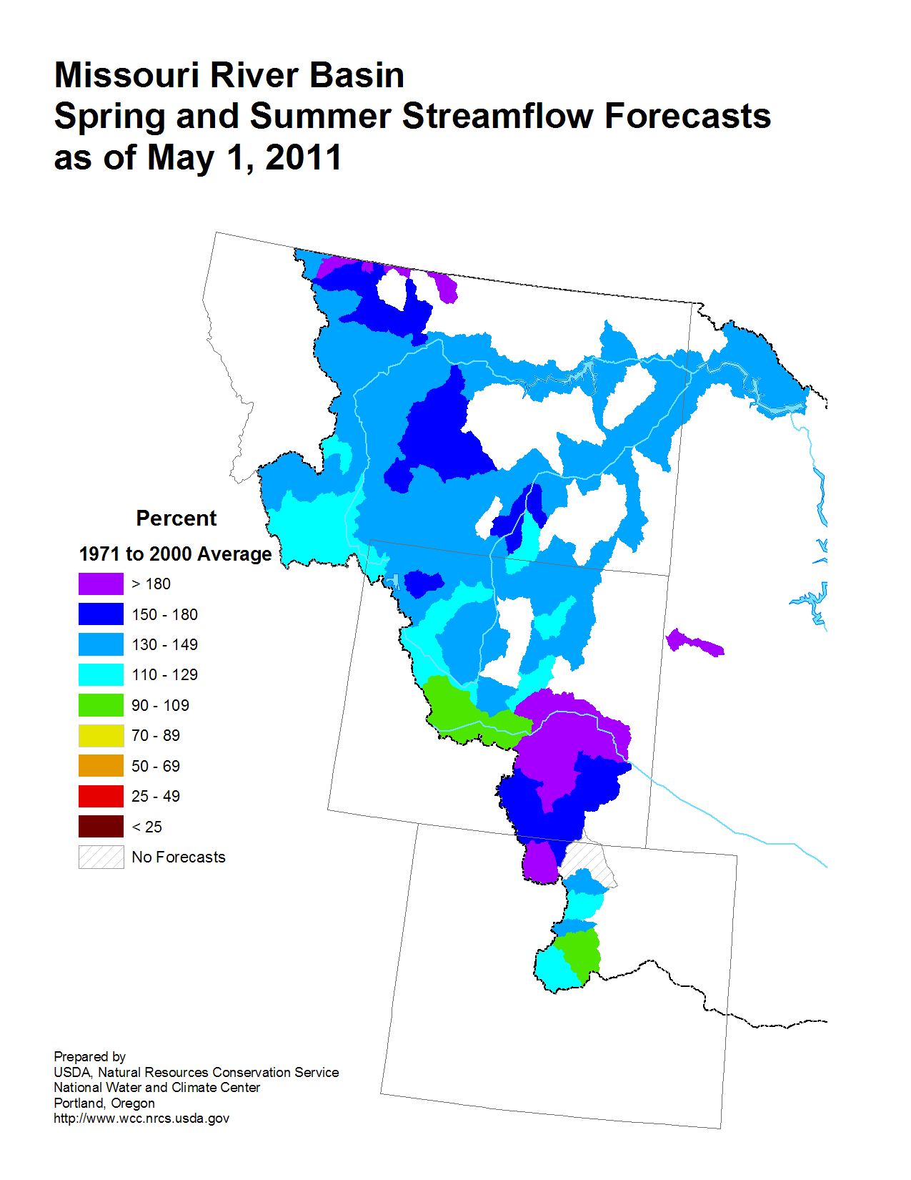
NRCS Spring & Summer Streamflow Forecast Maps for the Missouri River Basin
JAN 2011
FEB 2011
MAR 2011
http://www.wcc.nrcs.usda.gov/cgibin/miss_strmflow.pl?state=missouri_river
APR 2011
MAY 2011
JUN 2011
Prepared by USDA Natural Resources Conservation Service, National Water and Climate Center, Portland, Oregon

Slide 10
April to September 2011 Most Probable Streamflow for select Missouri River Forecast Points
308
* May to September
** June to September
Most Probable as a Percent of 1971 - 2000 Average
NOAA Missouri Basin River Forecast Center Water Supply Statements issued in cooperation with USDA NRCS

Slide 11
Paleoclimate Perspective Tree ring reconstructions of Palmer Drought Severity Index (PDSI)
Wet
Upper Missouri Basin
Dry
Wet
Lower Missouri Basin
Dry
Year AD
Interannual and decadal climate variability resulting in shifts between wet and dry conditions common over the last 1000 years
Cook, E.R., et al. (2008)
Data from NOAA National Climatic Data Center

Slide 12
Missouri River Basin: Long term Climate Trends (Jan-Dec)
warming trends
Year AD
NOAA National Climatic Data Center

Slide 13
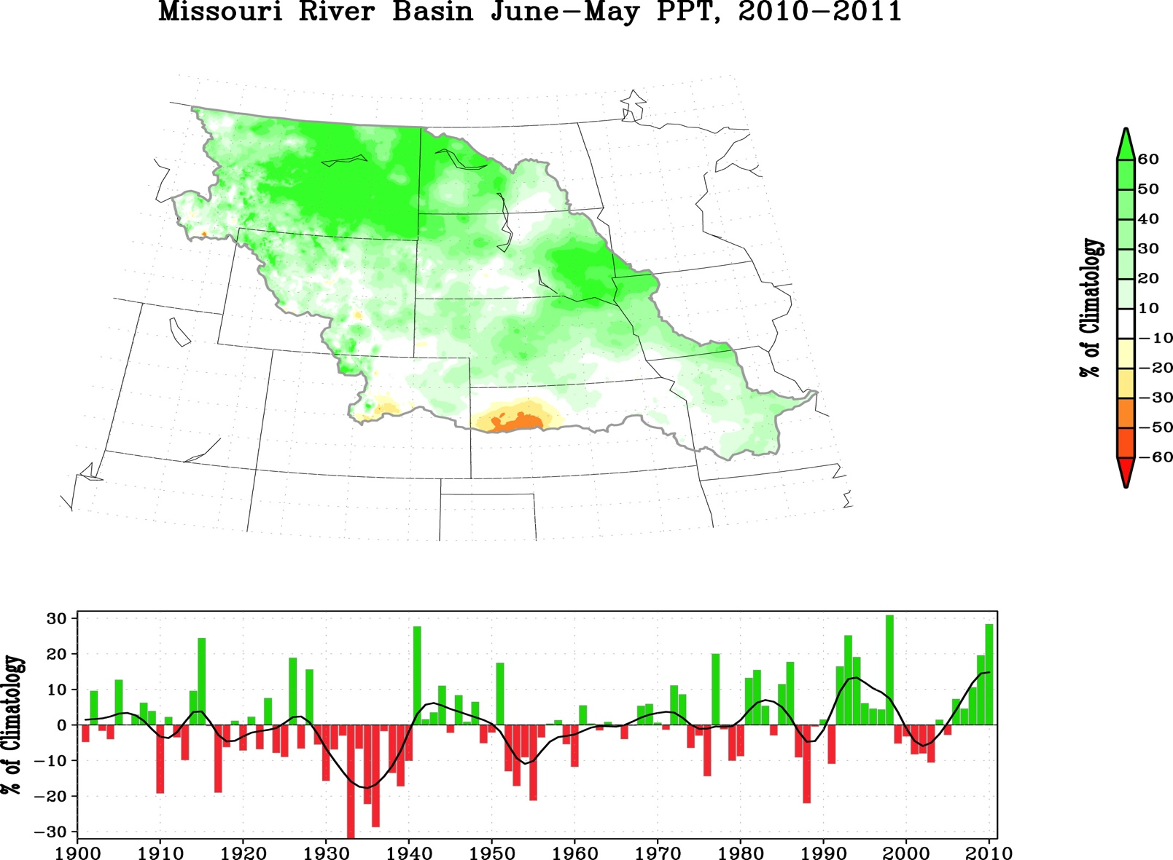
Missouri River Drainage Basin 12-month Precipitation Departures: June 2010 – May 2011
% of Climatology; Data Source PRISM
1901-2011 Time Series of June-May Missouri Basin PCPN
2010/11 Ranks Among the Top 3 Wettest Years for the Missouri Basin

Slide 14
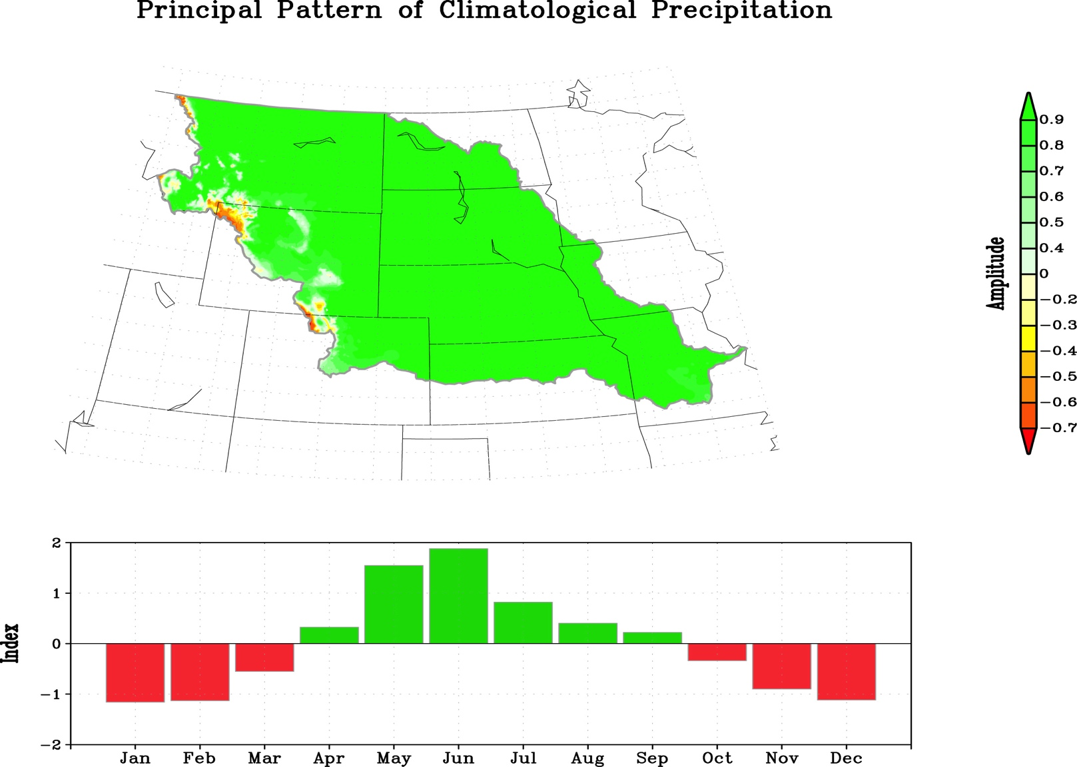
Seasonality of Precipitation Spring is the Missouri Basin’s Rainy Season
But, severe Missouri River floods often stem from the combination of a prolonged wet period,
rapid snowmelt, and heavy spring rains.

Slide 15
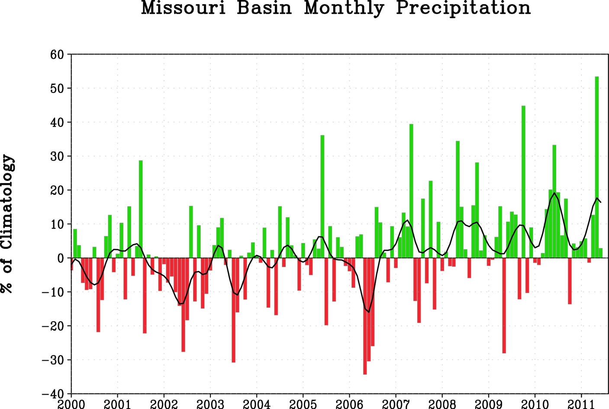
Spring 2011 Was Very Wet : May 2011 Second Wettest since 1901
° Caused a Late Surge in Upper Basin Mtn Snowpack
°
May 2011
Departures, % of Climatology

Slide 16
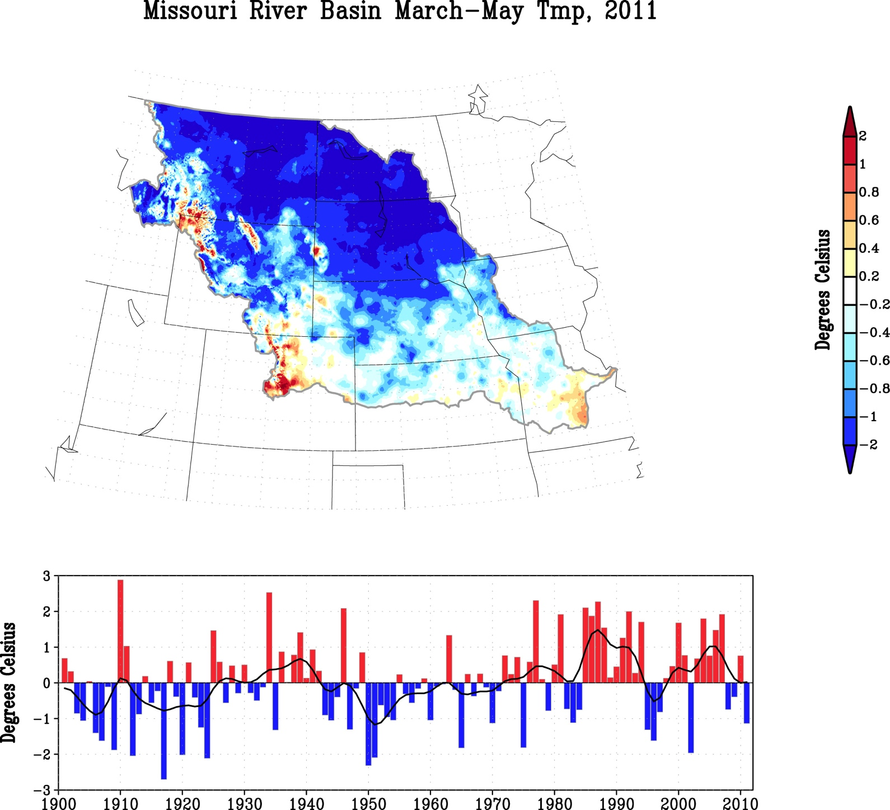
Spring Was Unusually Cold : Contrary to a Recent Warming Trend
° The Cold Spring Extended Snowpack Peak into May
1901-2011 Time Series of March -May Missouri Basin SfcT

Slide 17
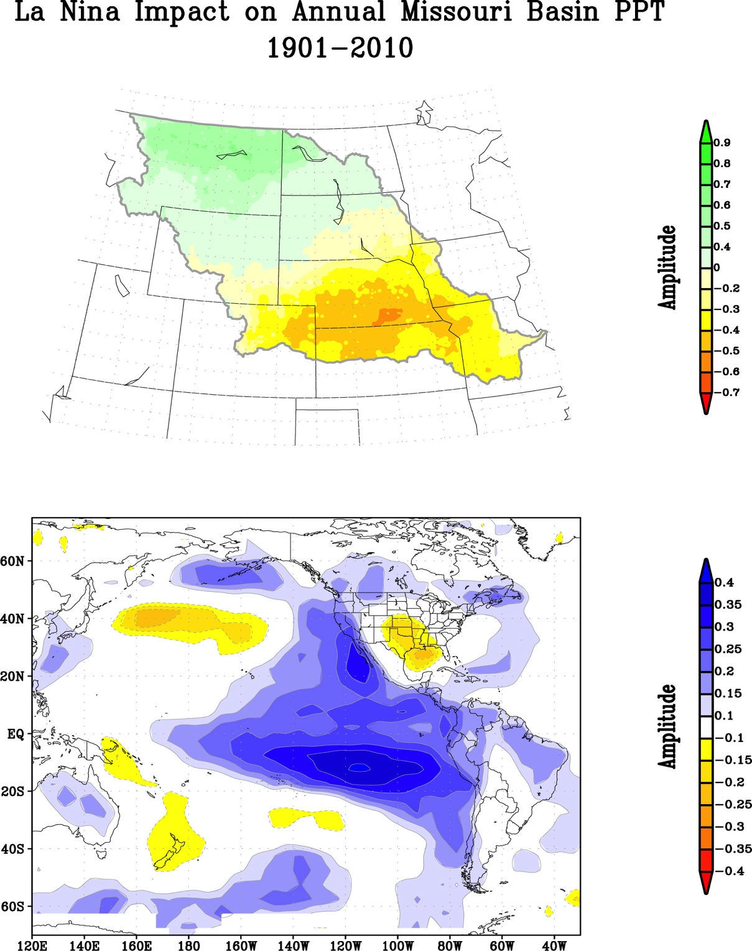
La Nina Has A Strong Impact on Missouri Basin Annual Climate
Precipitation
Temperature

Slide 18
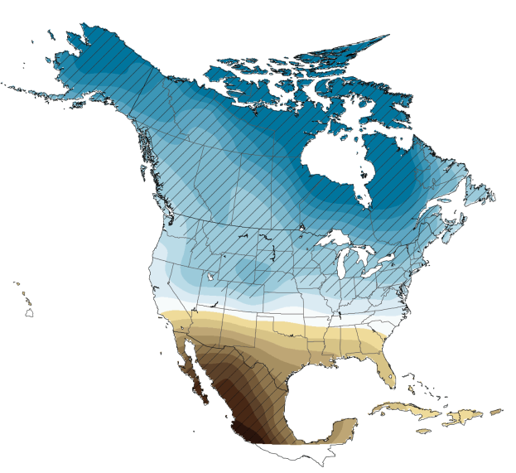
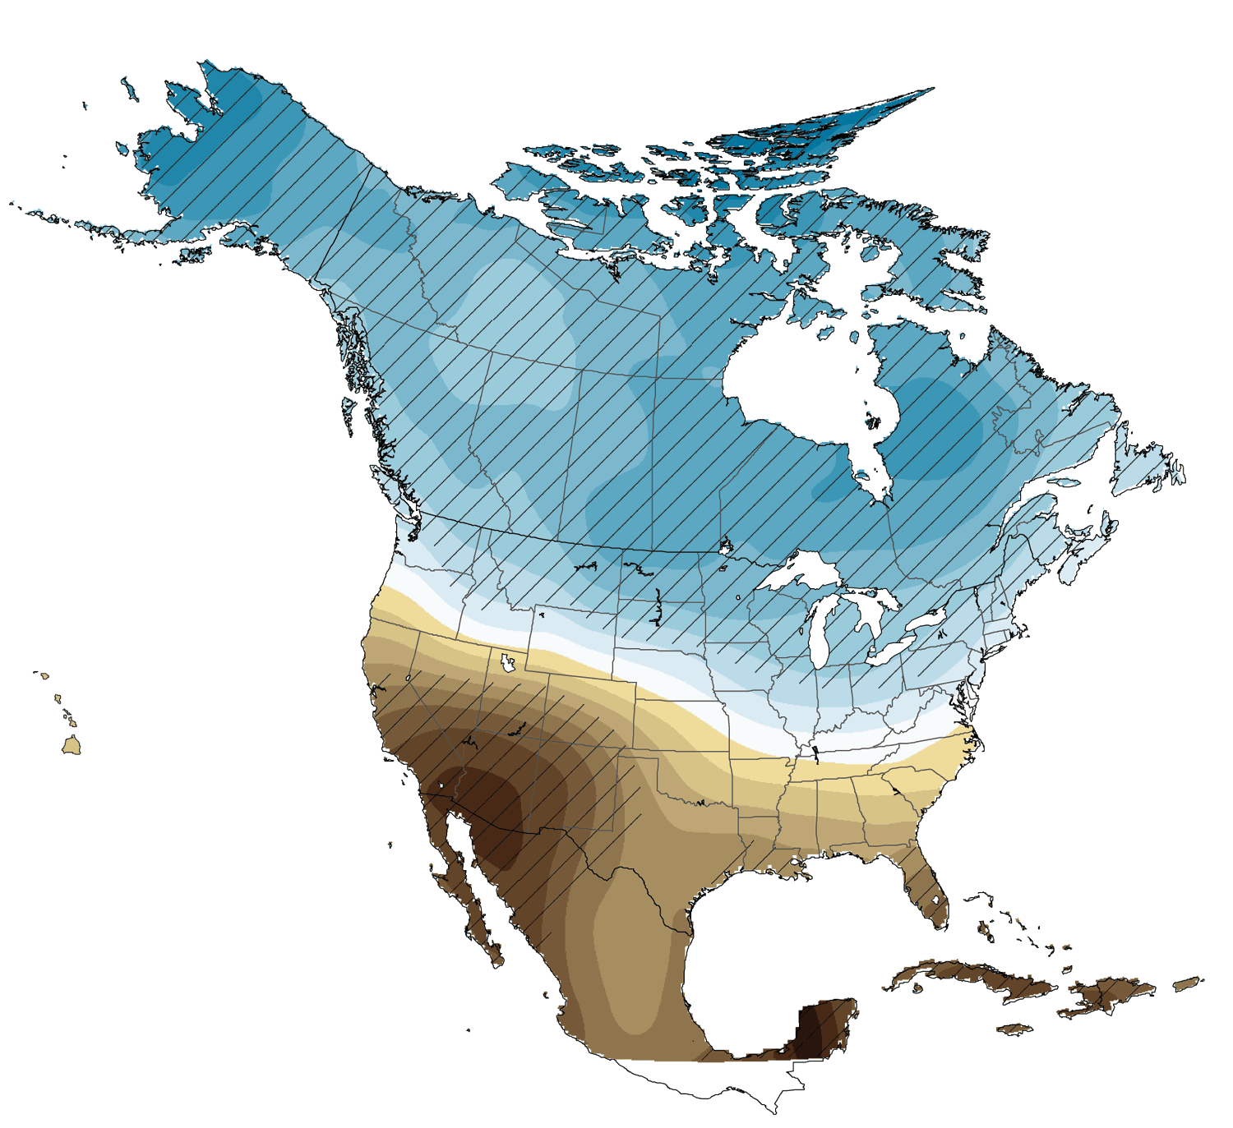
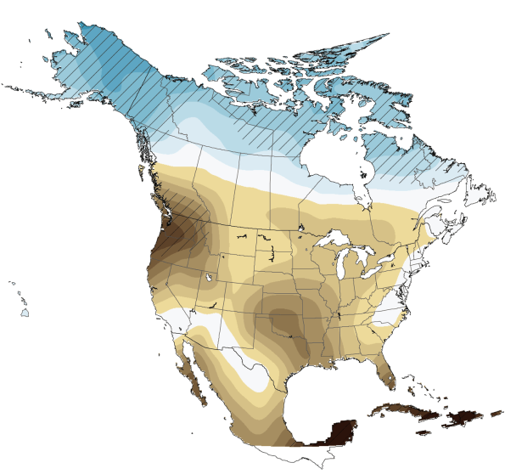
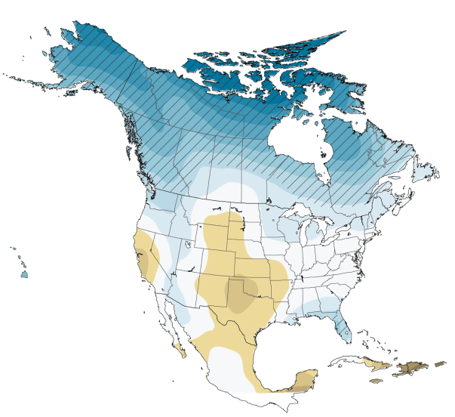
Projected Future Climate Change Impact on North American Precipitation 2080-2099 Ensemble mean from 15 climate models for high emission scenario (A2)
Winter
Spring
Summer
Fall
Global Climate Change Impacts in the United States. Karl, Melillo, and Peterson, (eds.), 2009.

Slide 19
NOAA El Niño/Southern Oscillation (ENSO) Diagnostic Discussion
EL NIÑO/SOUTHERN OSCILLATION (ENSO)
DIAGNOSTIC DISCUSSION
issued by
CLIMATE PREDICTION CENTER/NCEP
4 August 2011
ENSO Alert System Status: La Niña Watch*
*Watch: Issued when conditions are favorable for the development of La Niña conditions within the next six months.
ENSO-neutral conditions are present across the equatorial Pacific.
Sea surface temperatures (SST) are near-average across the equatorial Pacific Ocean.
Atmospheric circulation anomalies still reflect aspects of La Niña.
ENSO-neutral is expected to continue into the Northern Hemisphere fall 2011, with ENSO-neutral or La Niña equally likely thereafter.
Summary From Weekly update prepared by Climate Prediction Center/NCEP 8 August 2011
http://www.cpc.ncep.noaa.gov/products/analysis_monitoring/enso_advisory/

Slide 20
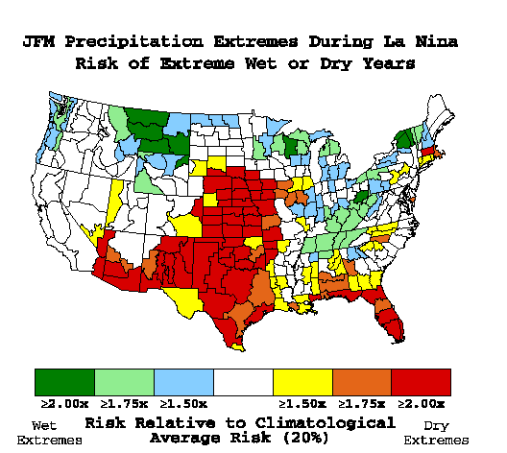
La Niña Winter Impacts
Temperature (°C)
Snowfall (In)
Mean composite anomalies for January/February/ March relative to the 1981-2010 average.
www.cpc.ncep.noaa.gov/products/precip/CWlink/ENSO/composites/EC_LNP_index.shtml
Precipitation (mm)
NOAA ESRL Physical Sciences Division

Slide 21
Take Away Points
For the Missouri River Drainage Basin :
° June 2010-May 2011 Ranked Among the Top 3 Wettest 12-month Periods Since 1901.
Yet, the other 2 wettest June-May periods (1941/42 & 1998/99) did not have severe, basin wide flooding
° A Monthly Sequence of Almost Unbroken Wet Months Began in early 2010.
High soil moisture content conducive to immediate runoff to streams.
° Spring (March-May) 2011 was Unusually Cold
Western basin snowpack melt was deferred at least 1 month, until May 2011.
° May is a Climatological Wet Month---May 2011 was the 2nd Wettest on Record Since 1901.
Heavy May rains commingled with high May snowpack, and antecedent saturated soils to induce severe flooding
° Since 1901, La Nina Has Impacted Missouri Basin Precipitation and Temperature.
The 2010-11 La Nina event was very likely an important contributing factor to the flooding event.

