Slide 1
Supplemental Material
Manuscript | GCM(s)/RCM(s) | AR detection criteria | AR change* | Precip change*
Shields and Kiehl 2016 | High-resolution CCSM4 | Wind and shape thresholds, as well as moisture anomalies that are based on relative anomalies similar to Zhu and Newell 1998 (i.e., will ignore changes due to more moisture) | Find changes (both increases and decreases) that are latitude/month dependent | Generally increased AR precipitation (looked at distributions during events)
Dettinger 2011 | CMIP3 subset | IWV>2.5cm, upslope wind >10 m/s; only 1 grid point (central CA) | Modest increases in magnitude; nothing appreciable in frequency; DJF only | Did not examine
Hagos et al. 2016 | CESM-LE | Bias-corrects model before analysis; PW>2cm+length+width requirement; 32-60N | Increase in AR frequency; DJF only | Decrease in the probability of extreme precipitation during AR days
Warner and Mass 2015 | CMIP5 subset | IVT>99th historical percentile along near-coastal ocean grid points | Increases in future days exceeding historical 99th percentile | Increases in 99th percentile precipitation along same near-coastal ocean points
Radic et al. 2015 | CMIP5 subset | SOM-based identification (trained on historical AR IVT) | Significant increase in all but one model; focused on British Columbia, Canada | Increase in total precipitation
Gao et al. 2015 | CMIP5 | Exceeding 85th percentile IVT, plus length and width criteria | Increase in the number of AR days for all coastal western US latitudes and seasons | Increases in AR-related precipitation
Lavers et al. 2015 | CMIP5 | None (not strictly examining ARs) | 95th percentile IVT increases significantly in storm-track regions | Did not examine
Rivera and Dominguez 2016 | NARCCAP and CMIP3 subset | IVT percentile-based (with varying percentiles for different locations)+length requirement | Increase in IVT but mixed frequency results across models (2 increase, 2 decrease) | Mixed results (both increases and decreases; inconsistencies across models)
Gershunov et al 2019 | CMIP5, LOCA downscaled precipitation | IVT>250 kg/m/s, IWV>15mm, length>1500km, duration>18hours | Increase in AR frequency and intensity (more pronounced in their highest-quality GCMs) | Increase (Reduction) in CA wide AR (non-AR) precipitation
Table S1: Summary of selected recent manuscripts investigating response of ARs to climate change.
*end of century unless noted.

Slide 2
Model name (short name in parenthesis, where applicable)
ACCESS1-0 | GFDL-ESM2M* (GFDL)
ACCESS1-3 | GISS-E2-H
BCC-CSM1-1-M | GISS-E2-R
BCC-CSM1-1 | HADGEM2-AO
BNU-ESM | HADGEM2-CC
CAN-ESM2* (Can) | HADGEM2-ES* (HadGEM)
CCSM4 | INMCM4
CESM1-BGC | IPSL-CM5A-LR
CESM1-CAM5 | IPSL-CM5A-MR
CMCC-CESM | IPSL-CM5B-LR
CMCC-CM | MIROC-ESM-CHEM
CNRM-CM5 | MIROC-ESM
CSIRO-MK3-6-0 | MIROC5
EC-EARTH* (EC) | MPI-ESM-LR* (MPI)
FGOALS-G2 | MPI-ESM-MR* (MPI)
FGOALS-S2 | MRI-CGCM3
FIO-ESM | NORESM1-ME
GFDL-CM3 | NORESM1-M
GFDL-ESM2G
Table S2: CMIP5 simulations used in this manuscript. All simulations but EC-EARTH were used in the construction of Figure 1a. Simulations used as boundary conditions for NA-CORDEX are noted with an asterisk followed by parentheses containing the short naming convention used in Table 1.

Slide 3
 | 31°N | 35°N | 40°N | 45°N | 48°N
|Cat 1| (250 kg m⁻¹ s⁻¹) | 96.83 | 94.08 | 85.84 | 79.04 | 82.72
|Cat 2| (500 kg m⁻¹ s⁻¹) | 99.79 | 99.28 | 97.39 | 94.49 | 96.34
|Cat 3| (750 kg m⁻¹ s⁻¹) | 100.0 | 99.93 | 99.69 | 98.92 | 99.54
|Cat 4| (1000 kg m⁻¹ s⁻¹) | 100.0 | 100.0 | 99.96 | 99.88 | 99.97
|Cat 5| (1250 kg m⁻¹ s⁻¹) | 100.0 | 100.0 | 100.0 | 99.99 | 99.99
Table S3: Percentile associated with each AR category’s IVT magnitude (Ralph et al. 2019) at several latitudes for the historical ERA-I.WRF.
 | 31°N | 35°N | 40°N | 45°N | 48°N
|Cat 1| (250 kg m⁻¹ s⁻¹) | 93.56 (89.27) | 91.44 (86.82) | 84.73 (79.30) | 80.17 (73.47) | 85.00 (77.74)
|Cat 2| (500 kg m⁻¹ s⁻¹) | 99.13 (97.49) | 98.55 (96.88) | 97.51 (94.12) | 94.74 (91.42) | 96.93 (93.93)
|Cat 3| (750 kg m⁻¹ s⁻¹) | 99.90 (99.37) | 99.84 (99.32) | 99.77 (98.48) | 99.20 (97.58) | 99.70 (98.78)
|Cat 4| (1000 kg m⁻¹ s⁻¹) | 99.98 (99.88) | 99.98 (99.87) | 99.99 (99.64) | 99.94 (99.38) | 99.99 (99.78)
|Cat 5| (1250 kg m⁻¹ s⁻¹) | 99.99 (99.98) | 99.99 (99.98) | 100.0 (99.96) | 100.0 (99.88) | 100.0 (99.96)
Table S4: Percentile associated with each AR category’s IVT magnitude (Ralph et al. 2019) at several latitudes for the historical (future) MPI.WRF.
 | ERAi.WRF | HadGEM.WRF | GFDL.WRF | MPI.WRF
Moderate | 857 | 829 (766) | 935 (848) | 855 (780)
Extreme | 155 | 146 (169) | 172 (180) | 149 (164)
Table S5: Number of IVT-events in each simulation for the historical (future) periods.

Slide 4
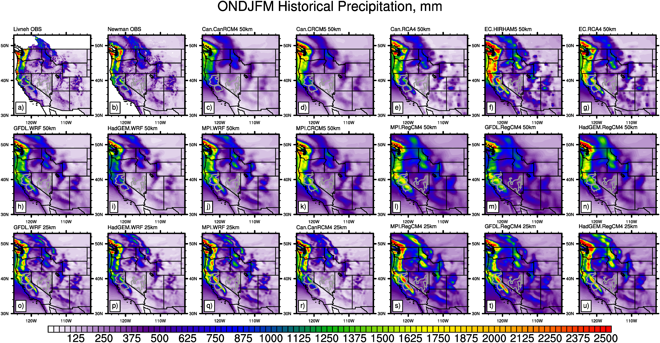
Figure S1: Cool season total mean precipitation (mm) (1979-2010) from (a) Livneh and (b) Newman observations-based datasets; (c-u) NA-CORDEX models. Gray contours outline three watersheds: Sacramento (top left), San Joaquin (bottom left), and Central Nevada River Basin (right).

Slide 5
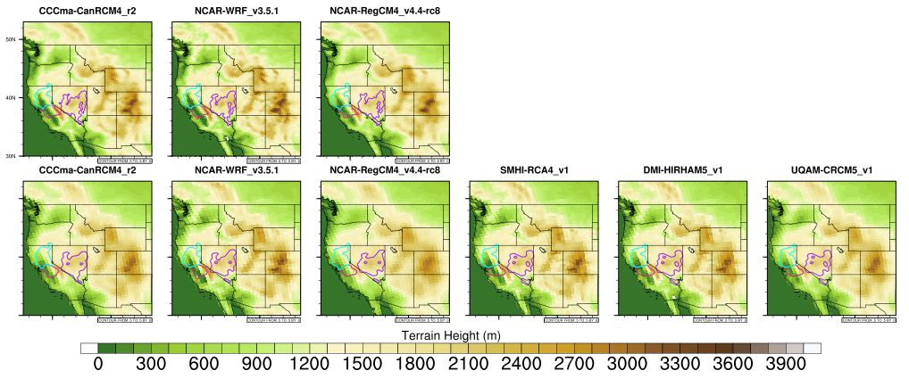
Figure S2: Terrain of each of the RCMs. Top row shows ~25 km RCMs and bottom row shows ~50 km RCMs. Cyan, red, and purple contours display locations of Sacramento, San Joaquin, and CNDB watersheds, respectively.

Slide 6
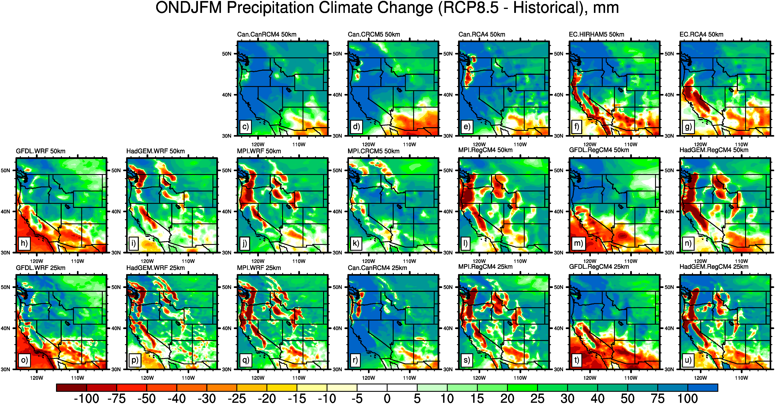
Figure S3: Cool season (ONDJFM) total mean precipitation change (mm) (RCP8.5 minus historical) from NA-CORDEX models. Note that (h-j) and (o-q) are identical to panels (d-f) and (g-i) of Figure 1, respectively, except for slightly differing color ranges.

Slide 7
Figure S4: (left) Mean IVT during cool-season months (ONDJFM) during historical period (1980-2010), and (right) changes in cool-season IVT (future- historical), in 25 km WRF simulations.

Slide 8
Figure S5: a) Estimated probability distribution functions of cool-season (ONDJFM) integrated water vapor transport (IVT) sampled every 3 hours at coastal locations (b) in the 1980-2010 25 km ERAi.WRF.

Slide 9
HadGEM.WRF
GFDL.WRF
MPI.WRF
Figure S6: Estimated probability distribution functions (ePDF) of cool-season (ONDJFM) integrated water vapor transport (IVT) sampled every 3 hours at coastal locations (Figure S5b) during: (a, c, e) historical and (b, d, f) difference (i.e., future-historical) in IVT ePDF, for (a, b) 50 km HadGEM.WRF, (c, d) 50 km MPI-ESM-LR.WRF, (e, f) 50 km GFDL.WRF.

Slide 10
moderate
extreme
all
Figure S7: Contribution to cool season total precipitation associated with (left) moderate IVT events, (center) extreme IVT events, and (right) all IVT events in (top) ERAi.WRF, (second row) HadGEM.WRF, (third row) GFDL.WRF, and (bottom) MPI.WRF in 50 km WRF simulations.

Slide 11
San Joaquin
Sacramento
CNDB
Historical
Difference
MPI.WRF
Figure S8: (top) Historical mean, and (bottom) difference (RCP8.5-historical) in monthly mean precipitation from IVT events for (left) San Joaquin watershed, (middle) Sacramento watershed, and (right) CNDB watershed. Red/green/blue lines show values from GFDL.WRF, HadGEM.WRF, and MPI.WRF 25 km simulations. Subsets of IVT events are indicated by line type, with dash-x lines for extreme IVT-events, dash-o lines for moderate IVT-events, and solid lines for all IVT-events. Locations of watersheds are shown on Figure 1. The y-axis range is smaller than that shown in figure 2, and is much smaller for the CNDB.

