Slide 1
Ocean WRIT at NOAA/PSL
Tools for mapping, time-series, and spatial correlations ocean reanalyses and observational time-series.
https://psl.noaa.gov/data/writ_new/
Presentation given May 2020.
Additional datasets, variables, and features have been added since.

Slide 2
Ocean Datasets
Reanalyses | Original horizontal resolution | Original Time range | Original vertical resolution
GODAS | 418x360 | 1979-present | 40 levels
SODA3 | 330x720 | 1980-2017 | 50
ORAS5 | 180x360 (a higher res irregular grid available) | 1979-2018 (some 1958→) | 75
EN4 | 173x360 | 1980-2017 | 42
Dataset | Original horizontal resolution | Original Time range | Original vertical resolution
HadISST1.1 | 360x180 | 1870-present | N/A

Slide 3
Variables
Have
Depth
Single Level
Temperature
Salinity
u, v currents
SSH
Sea Surface/Skin Temp
Heat Content (0-300)
Total downward heat flux at surface
Salt Flux
Ocean mixed layer depth
Ocean isothermal layer
To be calculated
Heat Content (0-700, 900-1800?)
Bottom Temperature
Momentum flux (u,v)
Depth of the 20 C isotherm (tropics)
Depth of other surfaces, e.g. some density (sigma levels)?
Bottom temperature & salinity
Meridional overturning stream function?
Meridional ocean heat transport

Slide 4
Interpolated Dataset Resolution
Longitude: 1degree. 0,1,2,3…359
Latitude: 1 degree -89.5,-88.5…88.5,89.5
Vertical: 10, 20, 30, 50, 75, 100, 125, 150, 175, 200, 250, 300, 400, 500, 750, 1000, 1500m
Interpolation Method
Data was interpolated at each grid to the vertical levels using a simple linear interpolation
Each level was then interpolated to 1x1 grid using NCL bilinear interpolation
“Missing” latitudes were filled in with missing values so all datasets -89.5 to 89.5

Slide 5
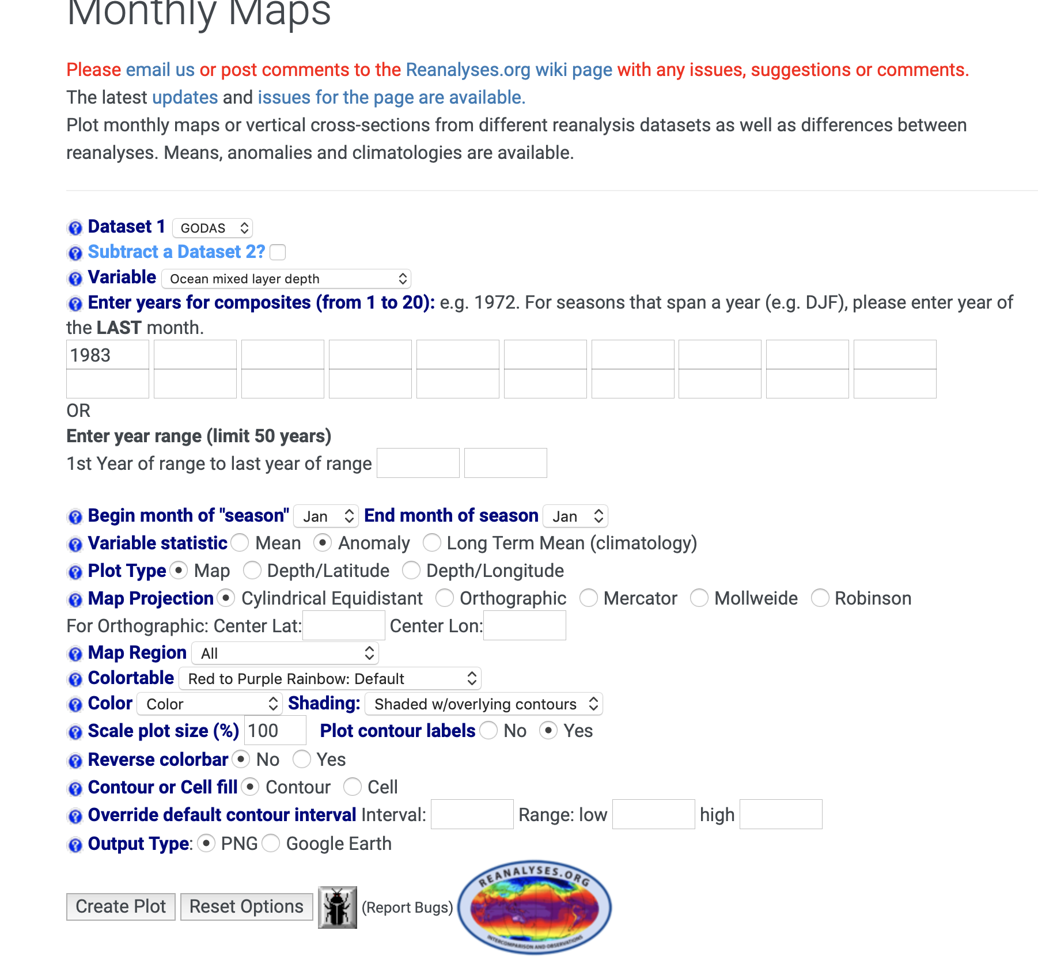
Ocean WRIT Mapping Page

Slide 6
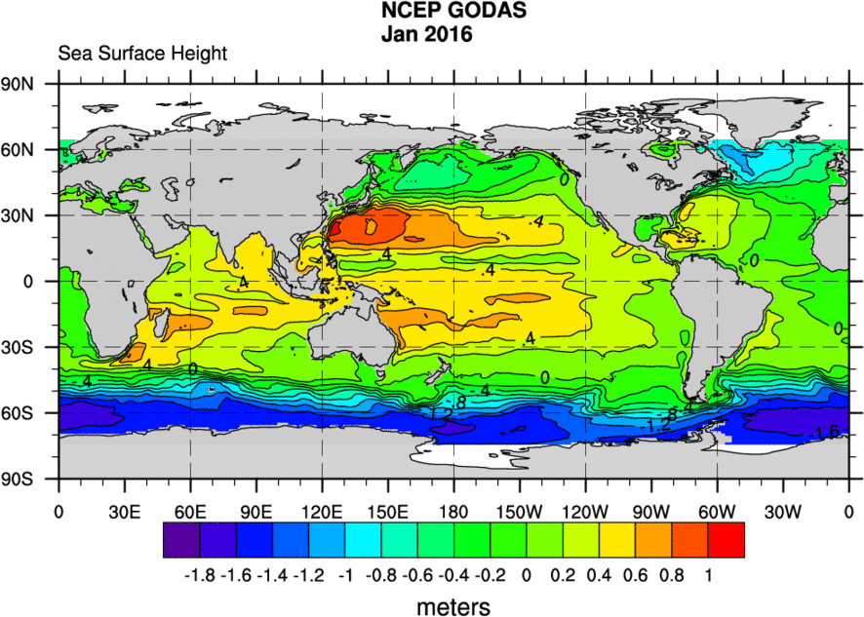
GODAS SSH for Jan 2016

Slide 7
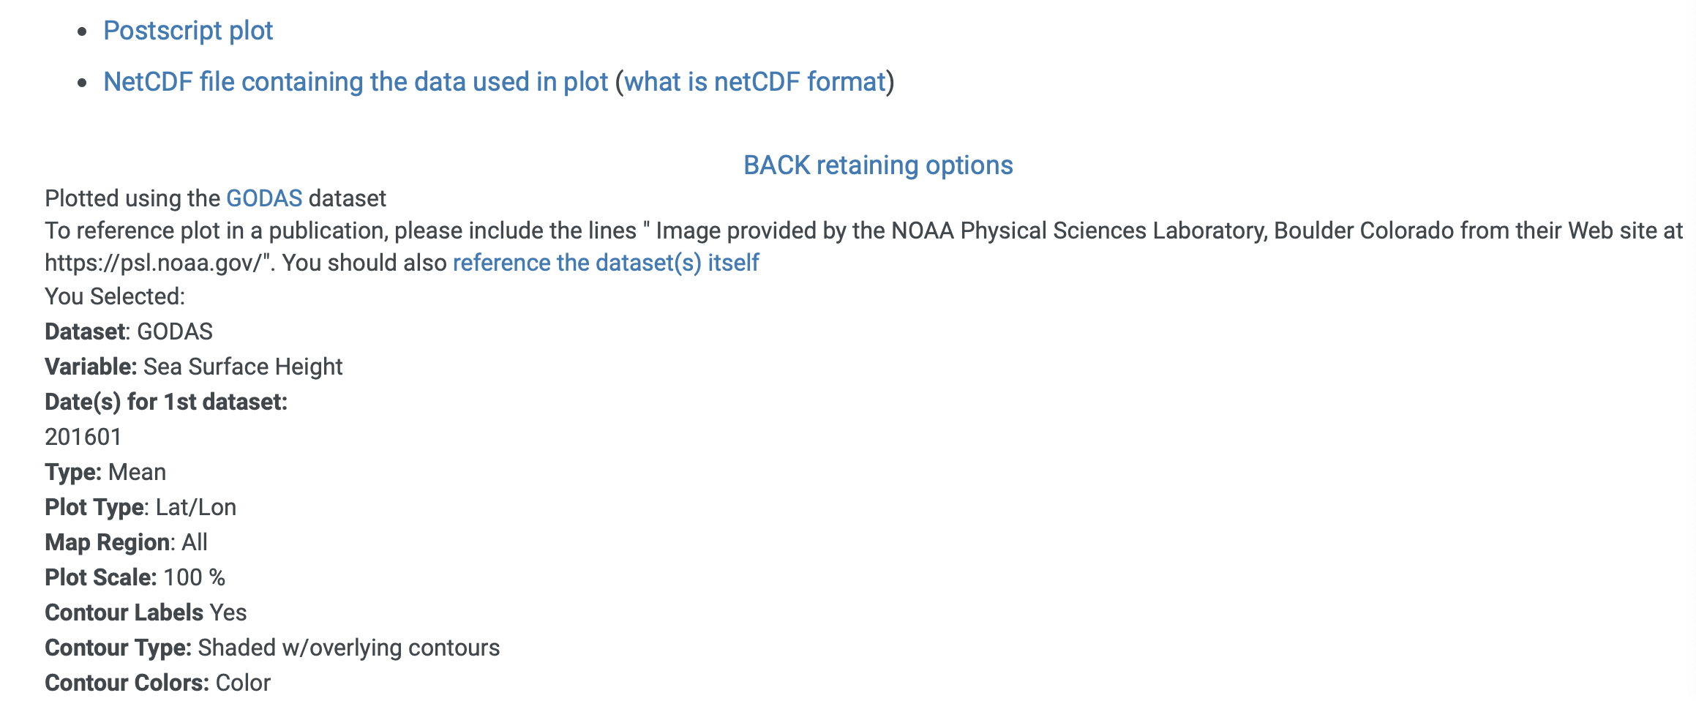
Maps: Returned content

Slide 8
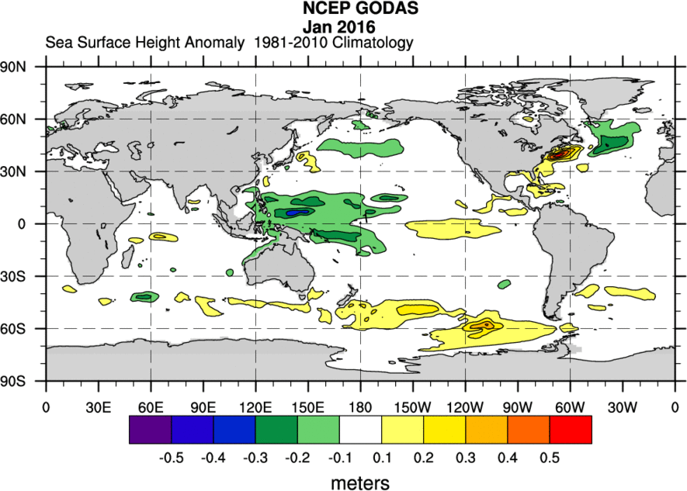
Map: Jan 2016 SSH: GODAS Mean and Anomaly

Slide 9
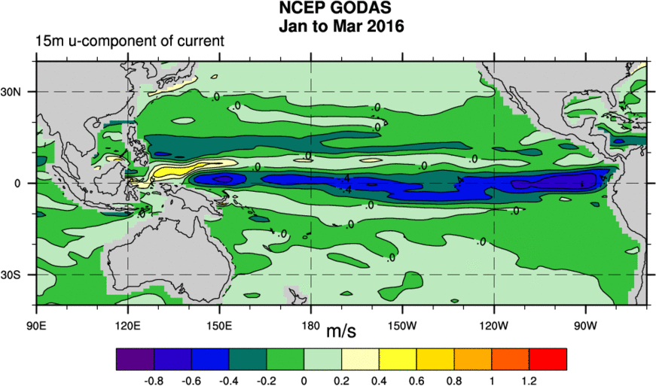
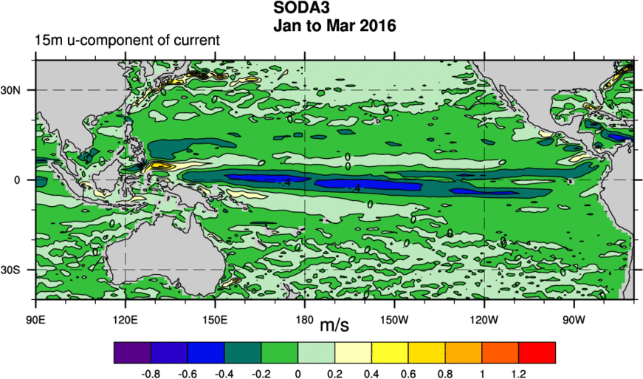
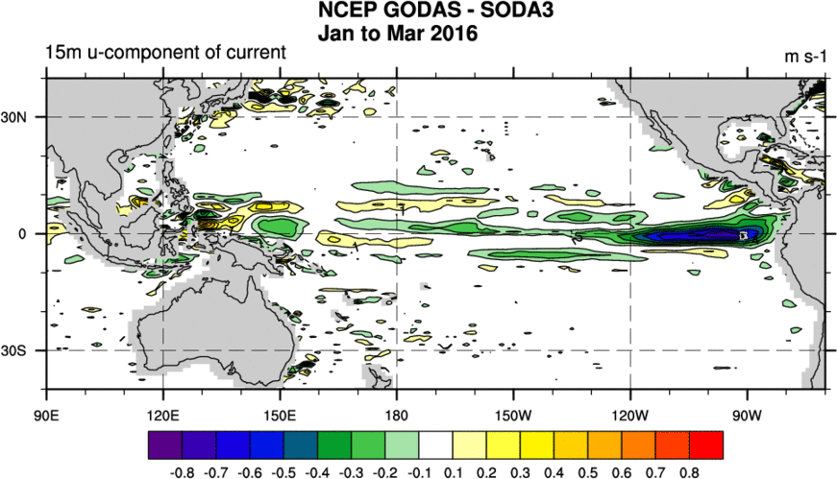
Compare GODAS, SODA3 15m u-current Jan 2016

Slide 10
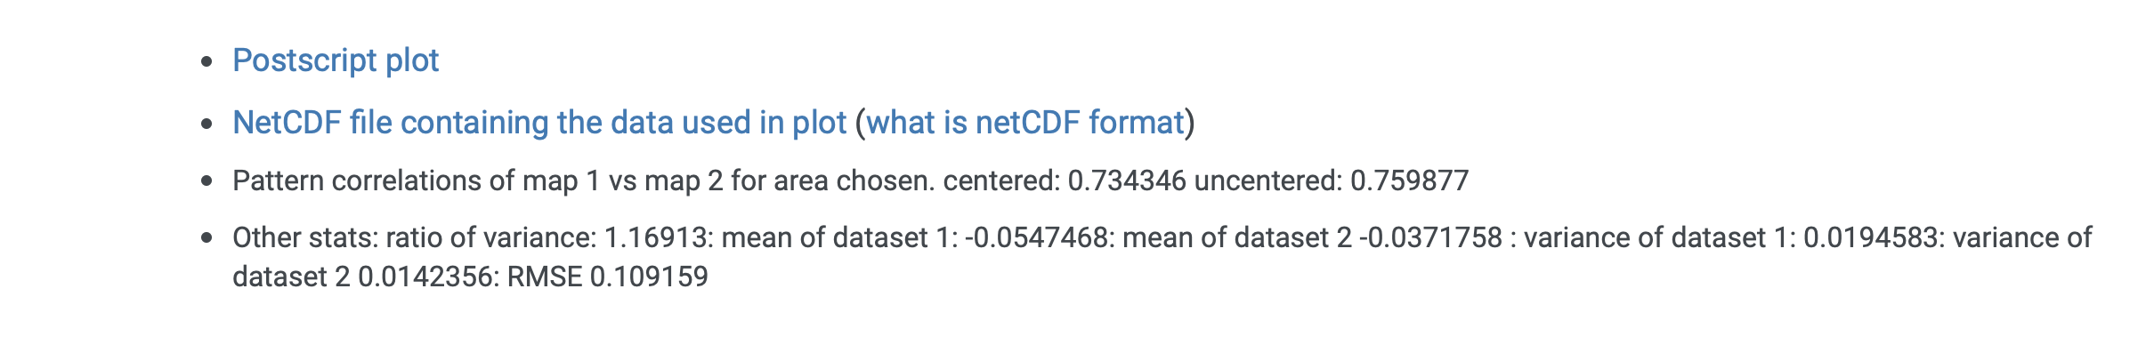
Compare GODAS, SODA3 15m u current Jan 2016:
Statistics

Slide 11
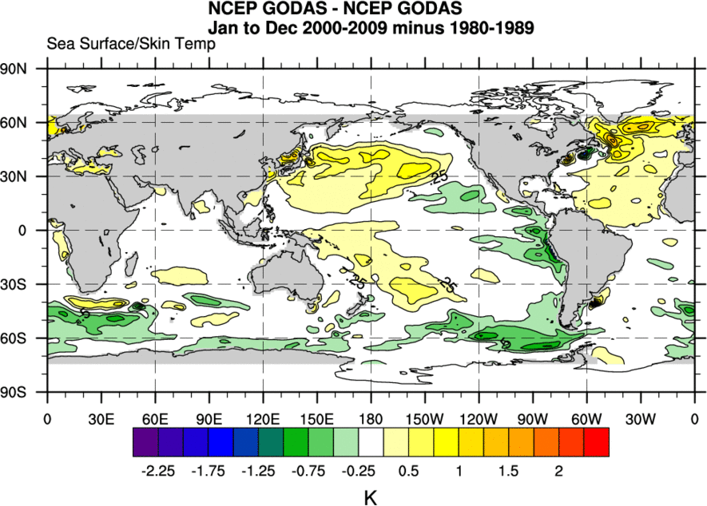
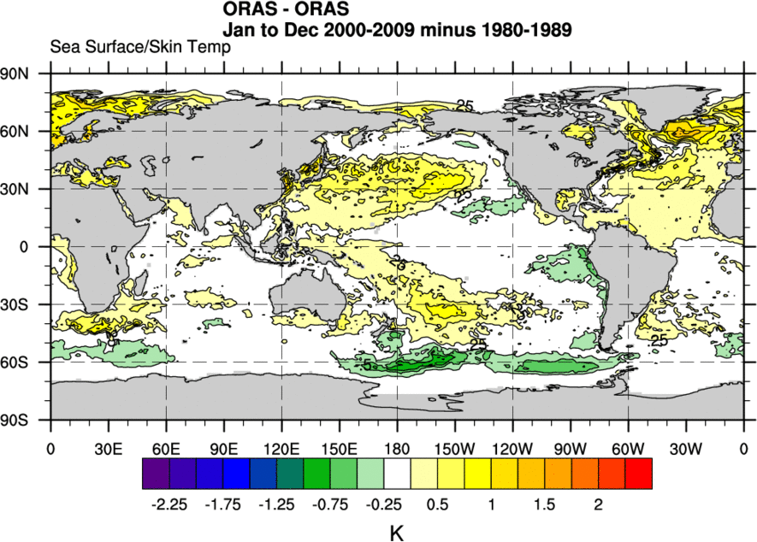
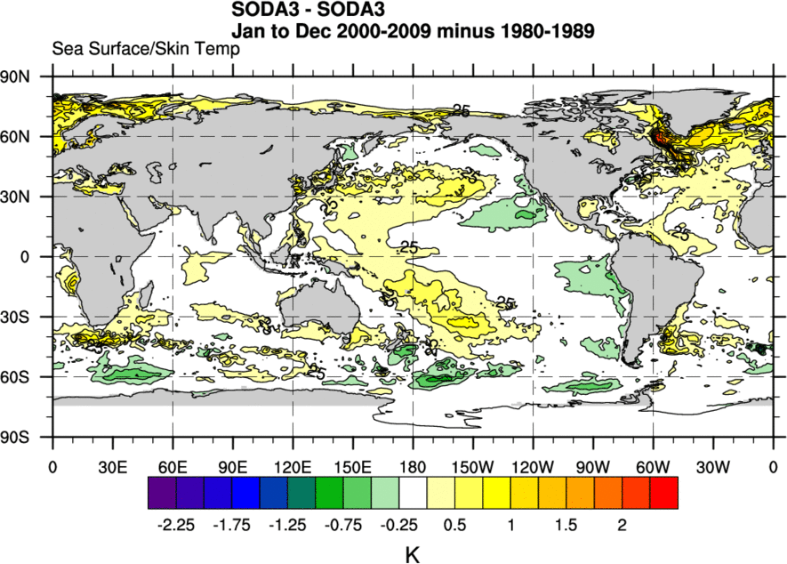
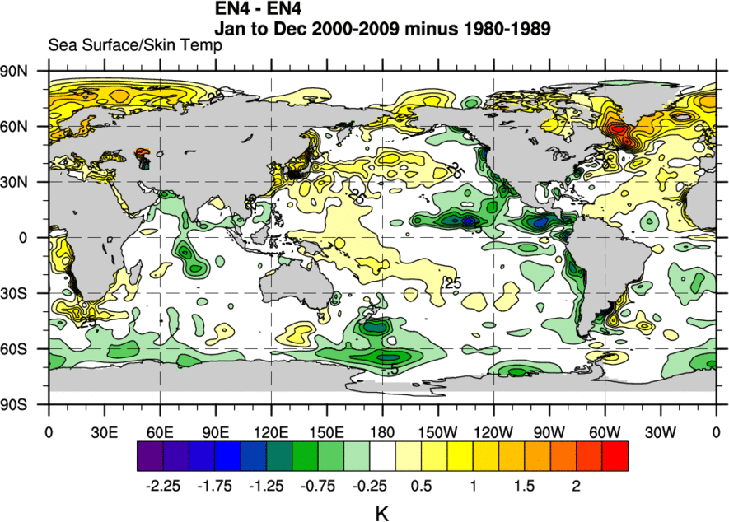
Compare GODAS and ORAS5 Decadal Difference SST

Slide 12
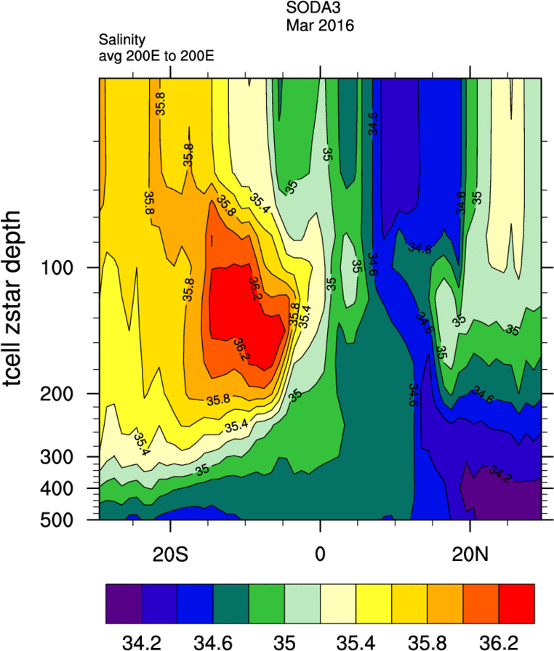
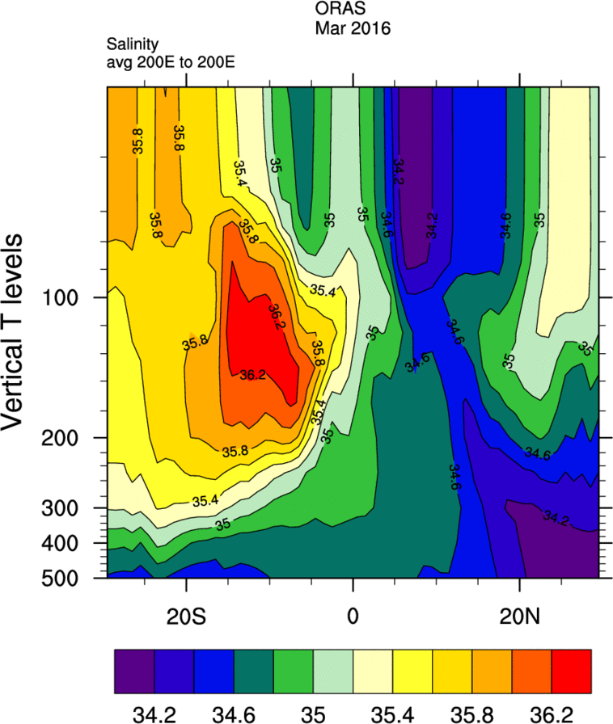
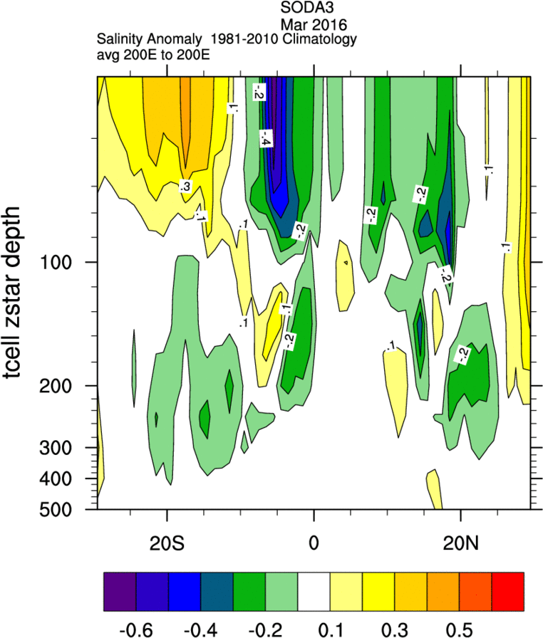
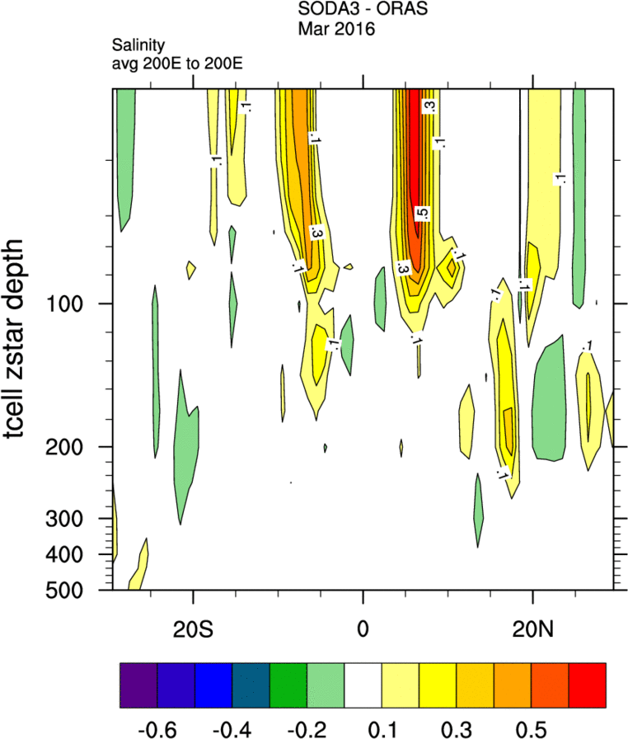
Compare SODA3,ORAS5 Salinity 0N,200E Mar 2016

Slide 13
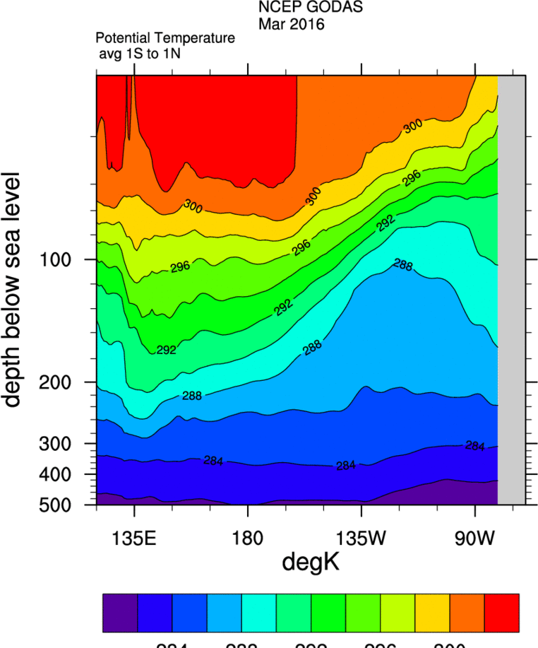
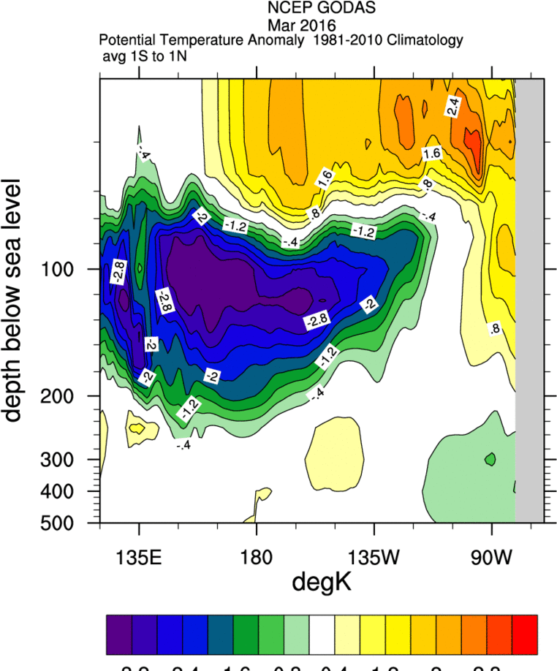
GODAS temperature Mar 2016 1S:1N

Slide 14
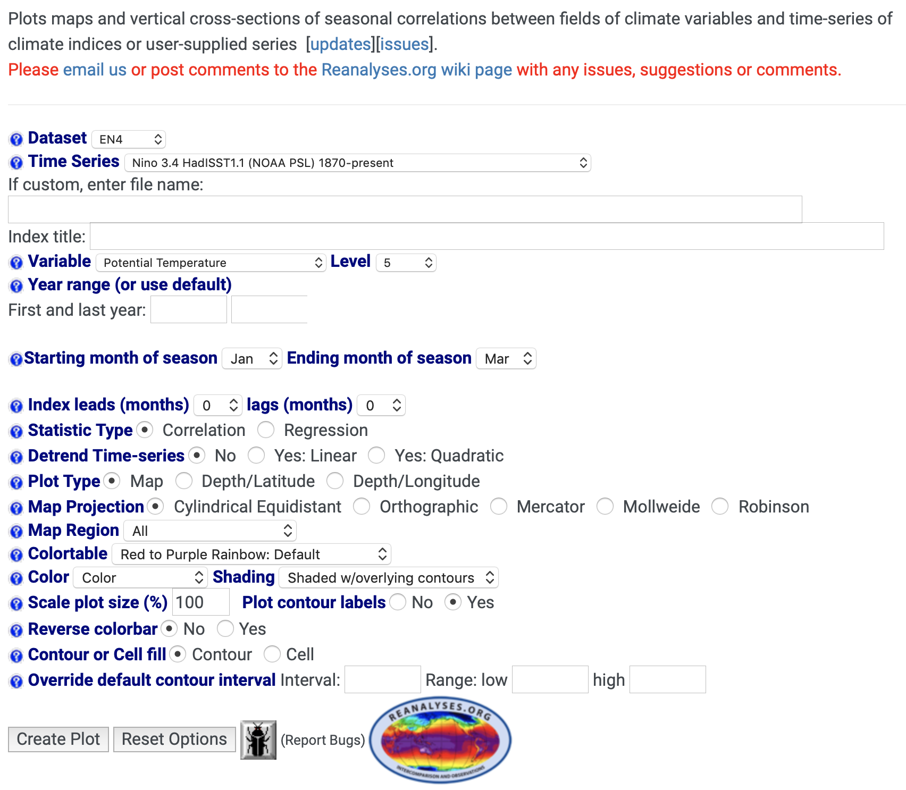
Ocean WRIT Correlation Tools

Slide 15
Available Time-series
AO: Arctic Oscillation R1 (NOAA/CPC) 1950-present
AO: Arctic Oscillation 20CRV2C (NOAA PSL) 1871-present
SOI: Southern Oscillation Index (CRU) 1866-present
Nino 12: HadISST1.1 (NOAA PSL) 1870-presentt
Nino 3 HadISST1.1 (NOAA PSL) 1870-present
Nino 3.4 HadISST1.1 (NOAA PSL) 1870-present
Nino 4 HadISST1.1 (NOAA PSL) 1870-present
MEI Extended (NOAA PSL) 1871-2005
MEI (NOAA PSL) 1950-2018
MEI V2(NOAA PSL) 1979-present
Global Average Land and SST Temperature (NASA) 1880-present
NP: North Pacific Index (NCAR) 1899-present
DMI Dipole mode Index HadISST1.1 (JAMSTEC) 1870-present
NAO: North Atlantic Oscillation (CRU) 1821-present
GBI: Greenland Blocking Index 1851-present",
ALBSA: Aleutian Low and Beaufort Sea Anticyclone (NOAA PSL) 1948-present
PDO: Pacific Decadal Oscillation (U Washington) 1900-present
PDO: Pacific Decadal Oscillation (NOAA PSL) 1891-present
NPGO: North Pacific Gyre Oscillation (U Georgia) 1950-present
AMO: Atlantic Meridional Oscillation (NOAA PSL) 1856-present
QBO: Quasi-biennial Oscillation R1(NOAA PSL) 1948-present
ONI: Oceanic Nino Index (NOAA/CPC) 1950-present
AMM: Atlantic Meridional Mode (U Wisconsin) 1948-present
MM: Pacific Meridional Mode (U Wisconsin) 1948-present
Solar Flux Index 10.7cm (NOAA/NCEI) 1948-present
TNI: Trans Nino Index HadISST1.1 (NOAA PSL) 1870-present
PNA: Pacific North American Index (NOAA/CPC) 1950-present
PNA: Pacific North American Index 20CRV2c (NOAA PSL) 1871-2014
Central Pacific Heat Content (NOAA/CPC) 1979-present
SAM: Southern Annular Mode from 20CRV2c (NOAA PSL) 1851-2011
TPI: Tripole Index HadISST1.1 (CRU) 1870-2015
Sewell Tidal Index (PSL) 1980-2018
Battery Park Tidal Index (PSL) 1856-2018
San Diego Tidal Index (PSL) 1906-2018
Honolulu Tidal Index (PSL) 1905-2018
Kwajalein Tidal Index (PSL) 1946-2018",
Sunspots Monthly Mean (WDC-SILSO) 1749-2017
NH Ice Extent (NSIDC) 1978-present
NH Ice Area (NSIDC) 1978-present
SH Ice Extent (NSIDC) 1978-present
SH Ice Area (NSIDC) 1978-present
Atlantic Hurricane Days (Klotzbach) 1851-2018
Atlantic Hurricane ACE (Klotzbach) 1851-2018
NW Pacific Hurricane Days (Klotzbach) 1950-2018
NW Pacific Hurricane ACE (Klotzbach) 1950-2018
NE Pacific Hurricane Days (Klotzbach) 1971-2018
NE Pacific Hurricane ACE (Klotzbach) 1971-2018
Equatorial C. Pacific Heat Content 160E-80W (NOAA/CPC) 1979-present
N Sierra 8 Station Precipitation Index (CDEC): 1921-present
C Sierra 5 Station Precipitation Index (CDEC): 1921-present
S Sierra 6 Station Precipitation Index (CDEC): 1921-present
Lees Ferry Natural Flow (USBR): 1905-2015
Upper Colorado Basin Temperature (NCEI): 1895-2017
Upper Colorado Basin Precipitation (NCEI): 1895-2017
CO2: Mauna Loa (GMD): 1958-present
CO2: Global Average (GMD): 1980-present
Trend

Slide 16
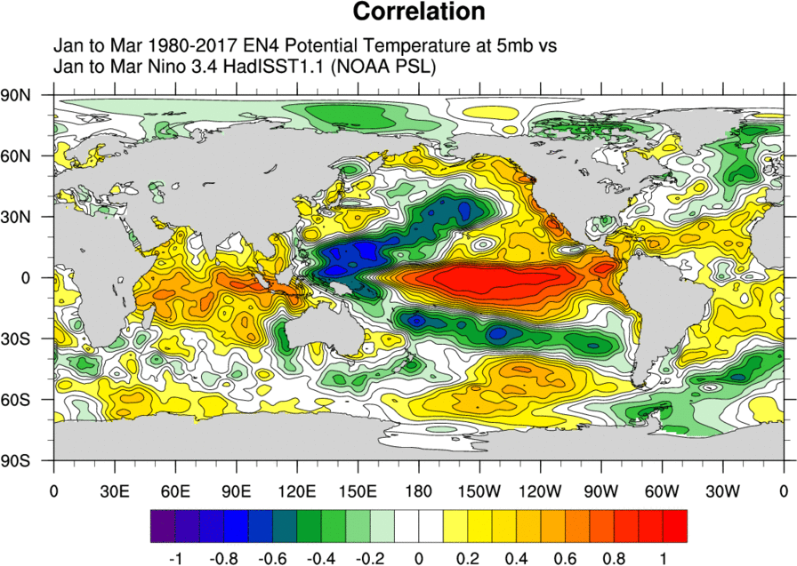
Map of Correlations: EN4 SST and 3.4

Slide 17
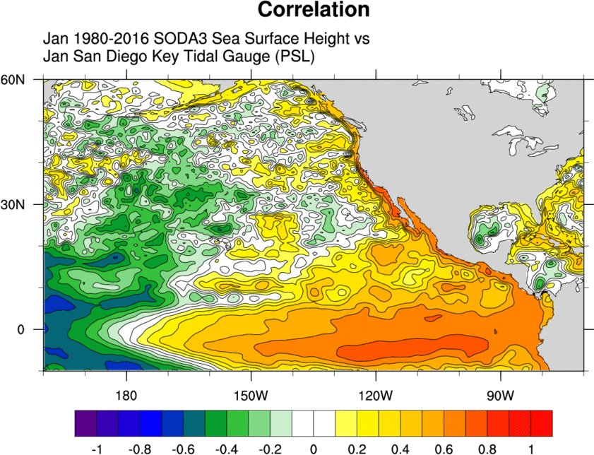
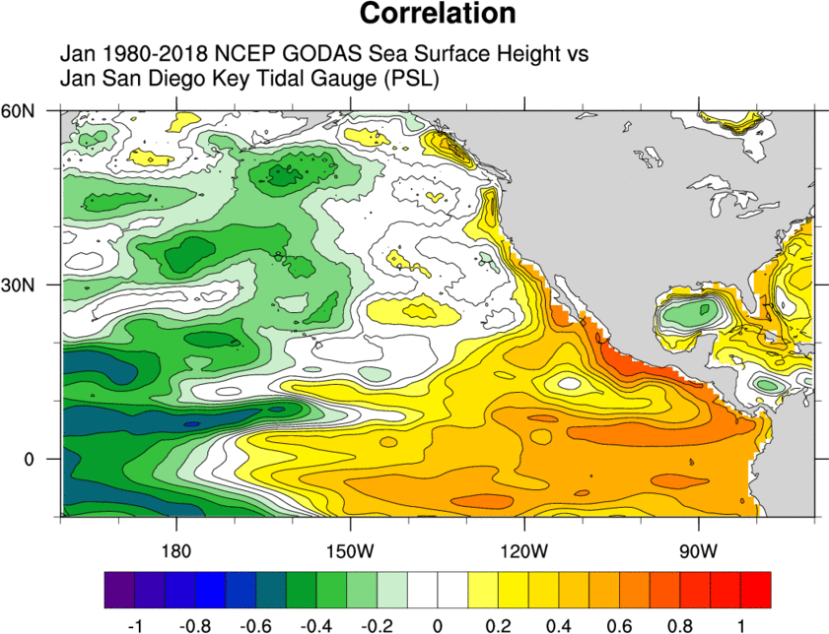
Correlation Jan SSH and San Diego Tidal Time-series

Slide 18
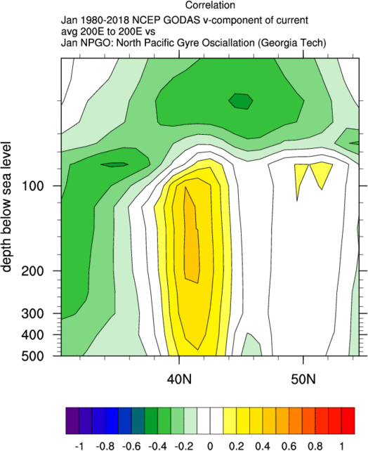
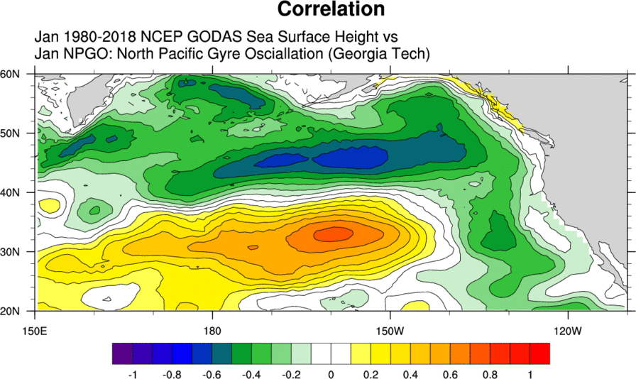
NPGO Time-series correlated with Jan GODAS SSH and v-current

Slide 19
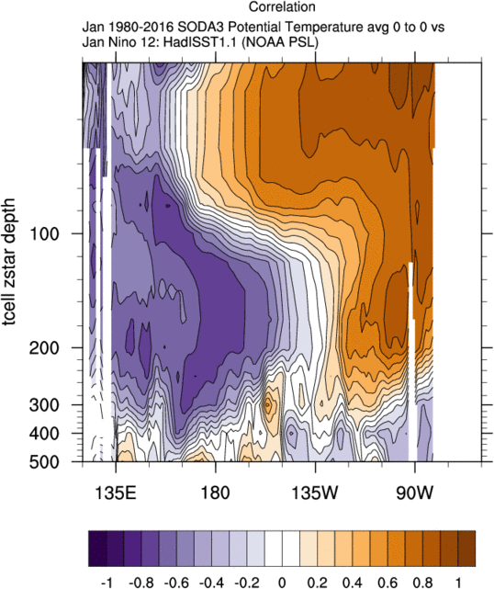
Correlation Nino 1.2 with Jan SODA temperature: Color-Scale Change

Slide 20
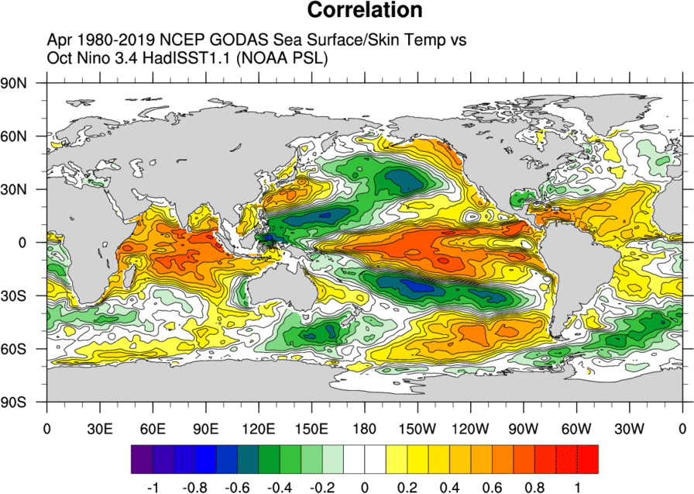
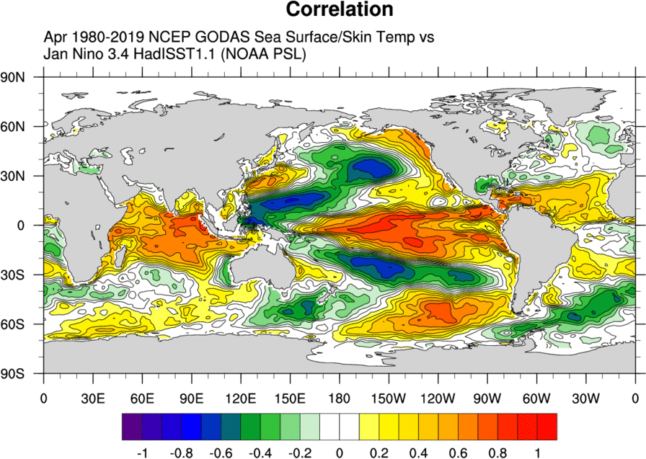
Correlation Nino3.4 3 vs 6 month lead SST

Slide 21
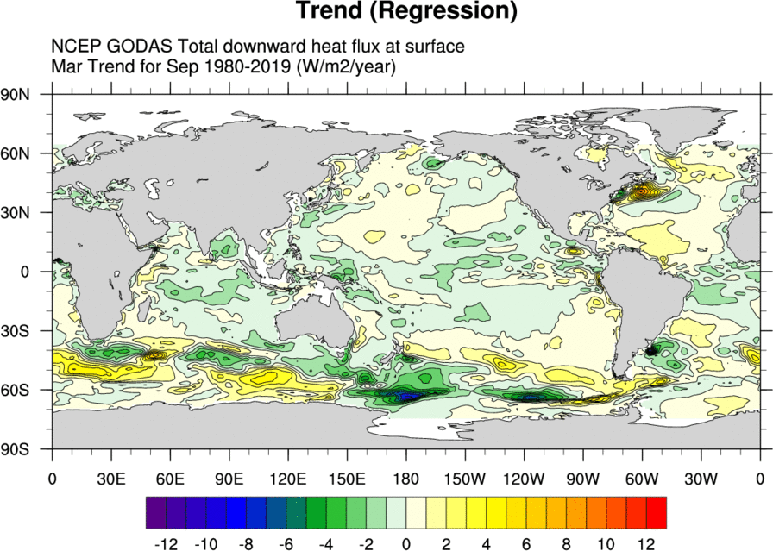
Trend of GODAS Mar Surface Heat Flux

Slide 22
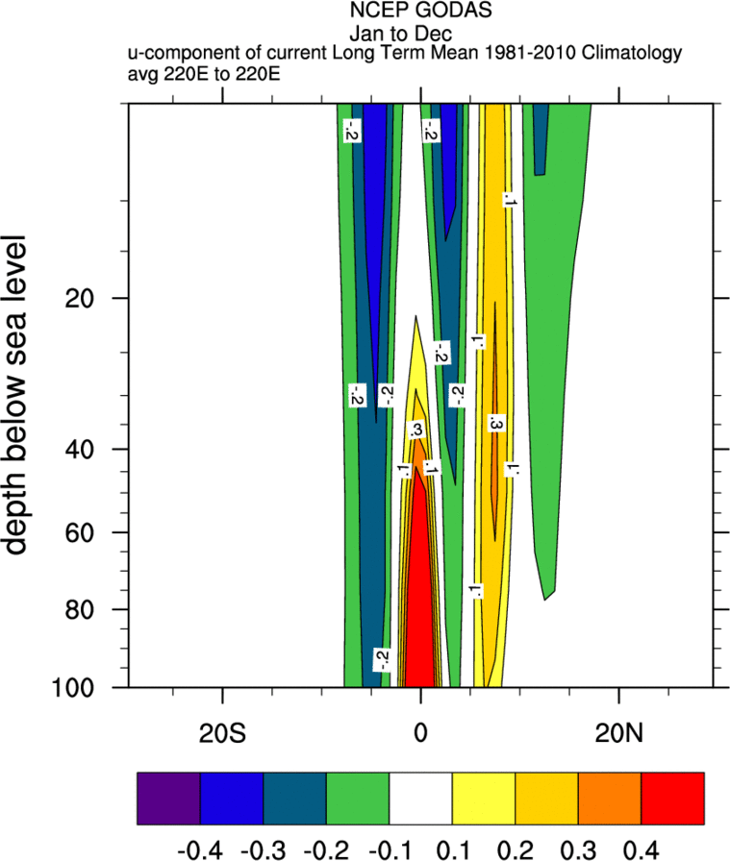
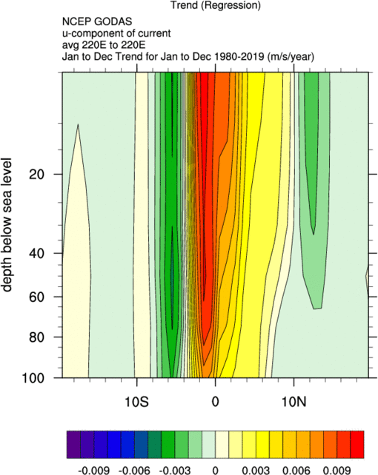
Top Panel from: Cook, K.H., Vizy, E.K. & Sun, X. Multidecadal-scale adjustment of the ocean mixed layer heat budget in the tropics: examining ocean reanalyses. Clim Dyn 50, 1513–1532 (2018). https://doi.org/10.1007/s00382-017-3703-0
U-current: lat/depth for GODAS annual mean and trend

Slide 23
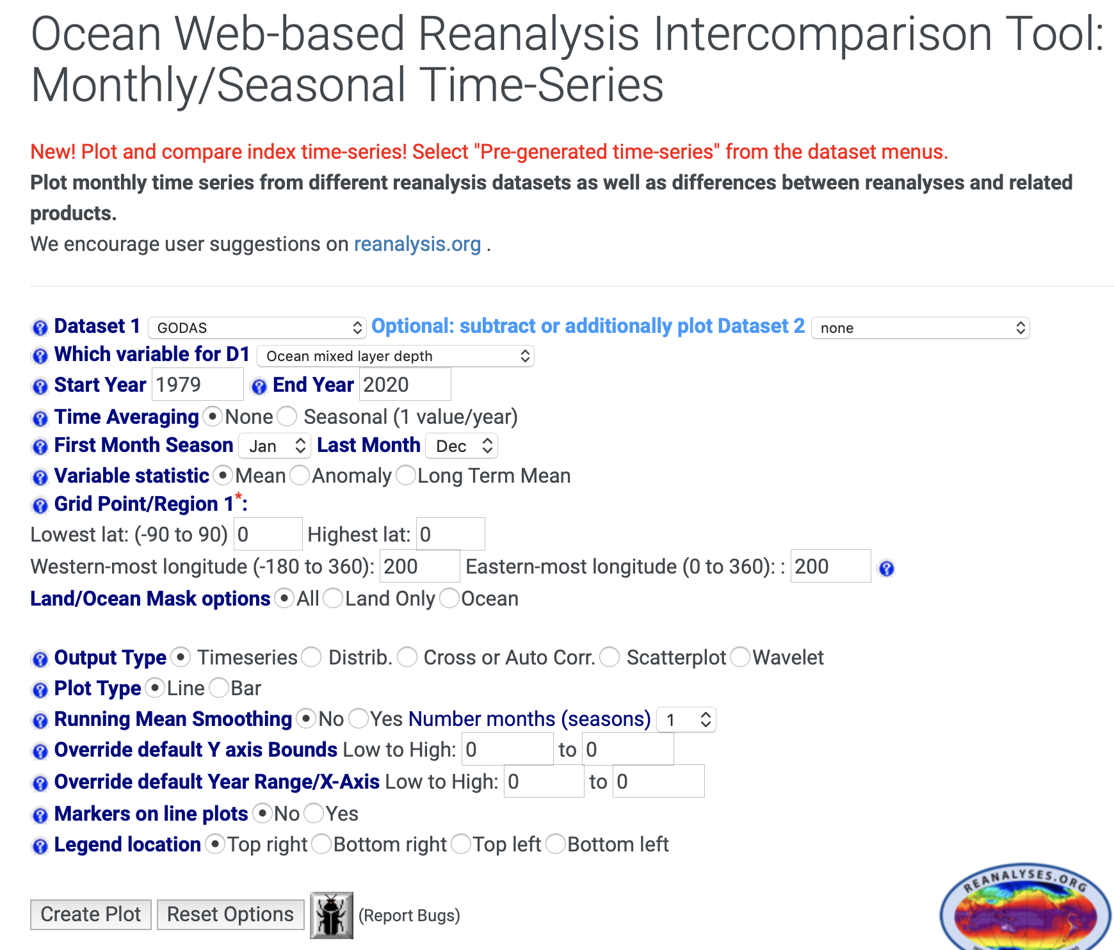
Ocean WRIT Time-series

Slide 24
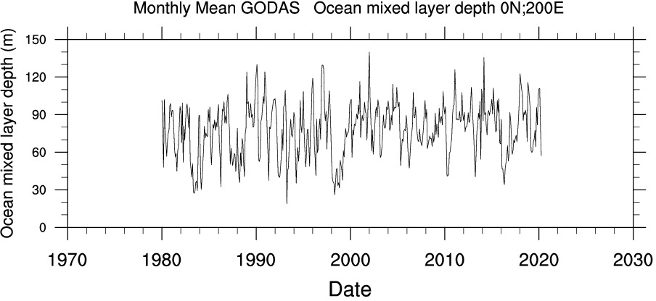
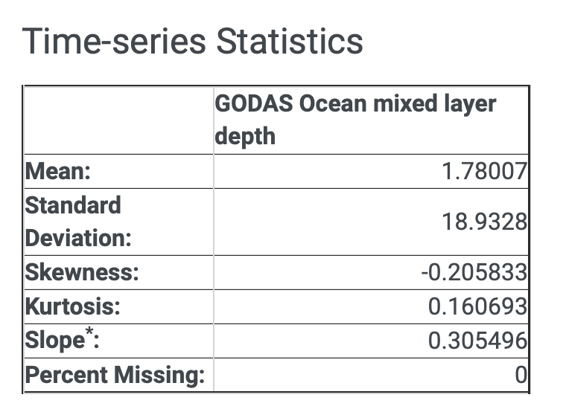
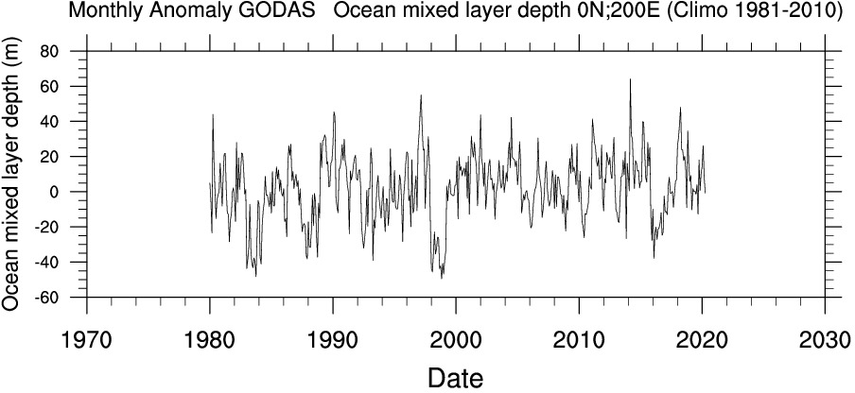
Time-series: Mixed Layer Depth GODAS 0N,200E

Slide 25
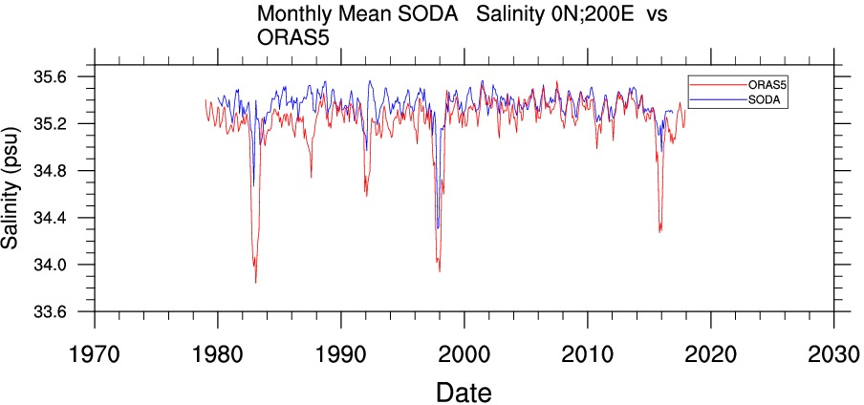
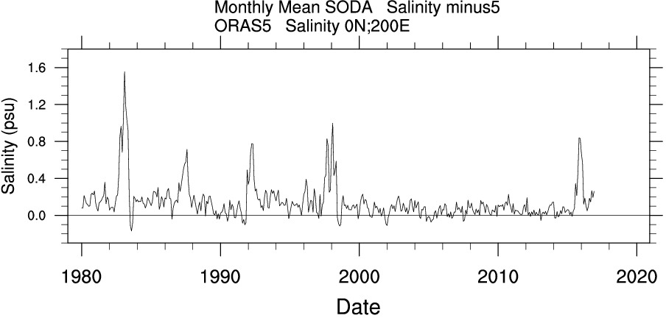
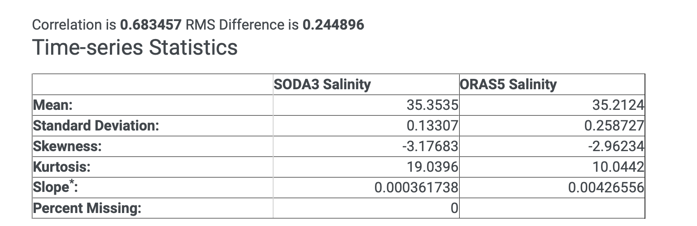
Time-series: Salinity 50m ORAS5 vs SODA3 0N,200E

Slide 26
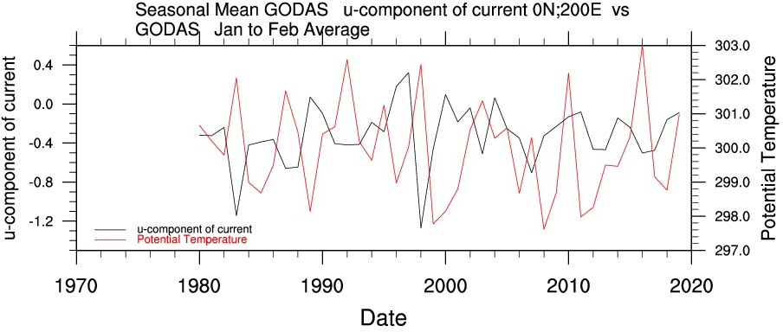
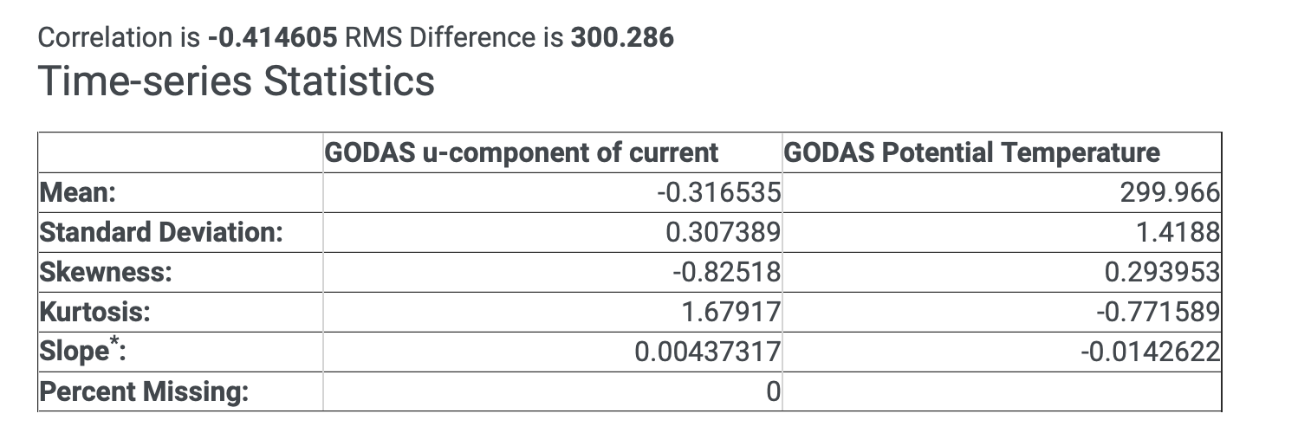
Time-series: Winter Temp vs u current 0N,200E

Slide 27
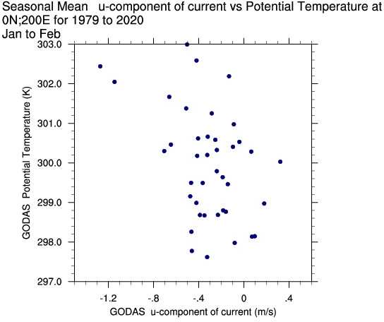
Scatter Plot: Winter Temp vs u current 0N,200E

Slide 28
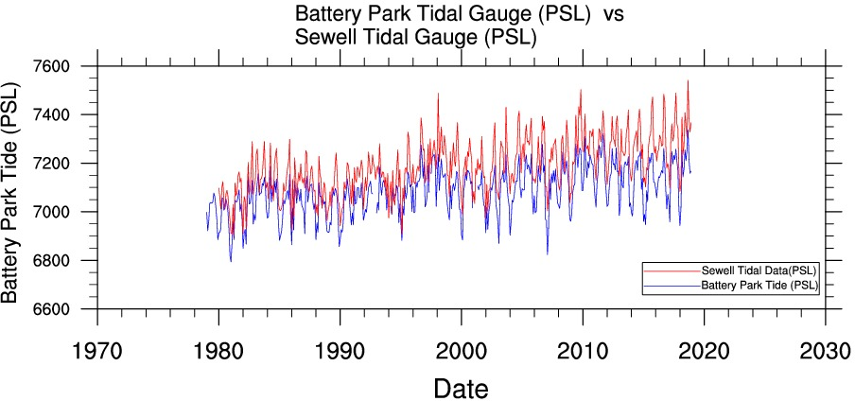
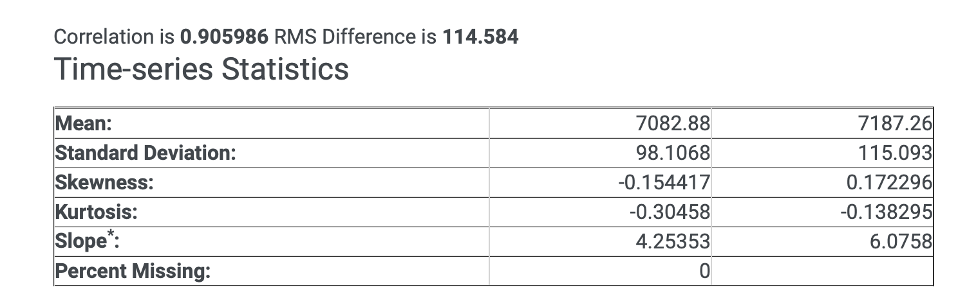
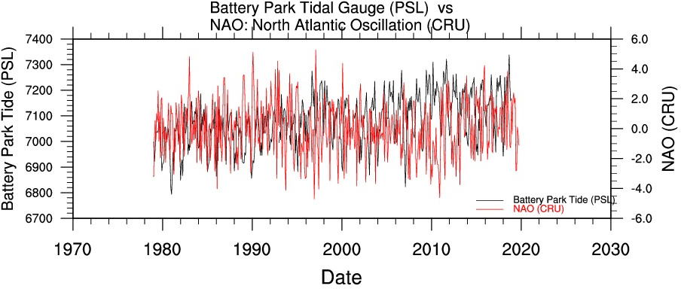
Pre-generated Time-series

Slide 29
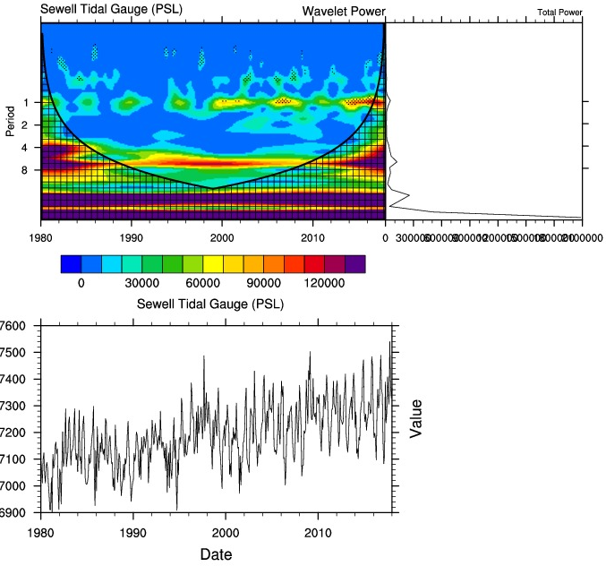
Wavelet Analysis: Sewell Tidal Gauge

Slide 30
Future
Add more datasets
Improve plots
Add lead/lag for timeseries
Calculate more variables
Add years for datasets that are updated (GODAS)
Add SST or SLP or other observational datasets
Consider add coupled variables
Obtain more ‘ocean’ timeseries. Fish? Plankton?
Add biological datasets

