Slide 1
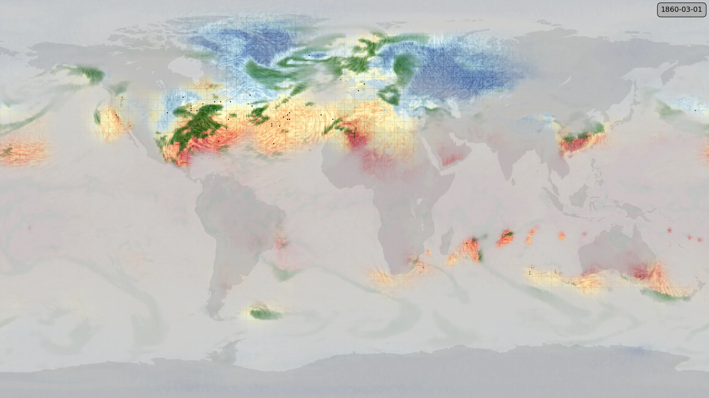
The 20th Century Reanalysis (20CR) provides a global, 200-year history of sub-daily weather
by assimilating surface pressure observations into a modern NOAA weather model
20CRv3 weather, obs, and “fog of ignorance” (selected dates 1860—1952)
NOAA-CIRES-DOE 20th Century Reanalysis Version 3 facilitated by ACRE
Global: 75km horizontal, 64 level grid
3-hourly resolution
Spans 1836-2015 [1806-1835 experimental]
Provides 80 estimates of temperature, wind, precipitation, pressure, humidity, & other variables, from the ground to the top of the atmosphere
Used to, e.g., validate climate models and understand extreme weather and climate over the last 200 years.
https://vimeo.com/410322672
https://go.usa.gov/XTd
Slivinski, Compo, Whitaker, Sardeshmukh, Giese, McColl, Allan, Yin, Vose, Titchner, Kennedy, et al, QJRMS, 2019
Slivinski, Compo, Sardeshmukh, Whitaker, McColl, Allan, Brohan, Yin, Smith, Spencer, et al, J. Clim., submitted, 2020

