Slide 1
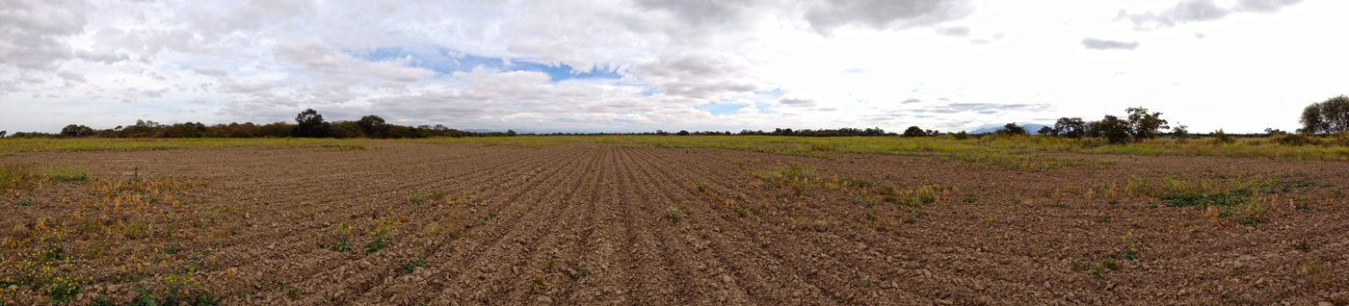



The Physics of Great Plains Drought:
Its Predictability and Its Changed Risk in a Warmer World
Martin Hoerling and Ben Livneh

Slide 2
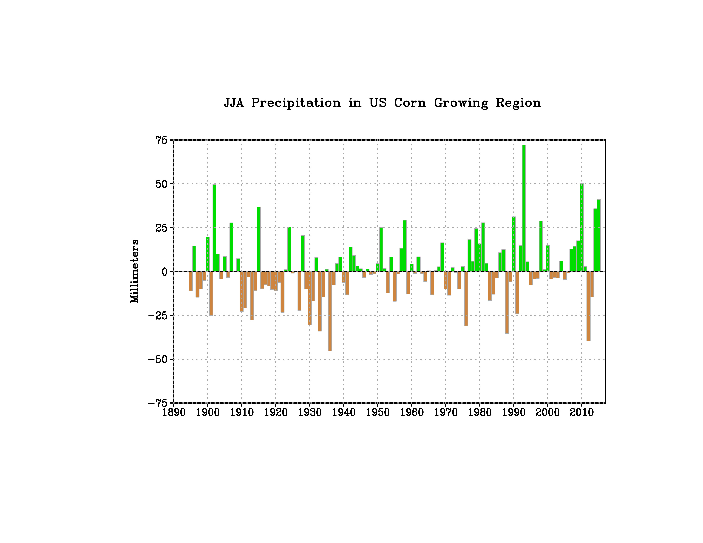
Are Droughts and Rainfall Deficits Synonymous?
1988
2012 “Flash Drought”
Data: NOAA NCEI

Slide 3
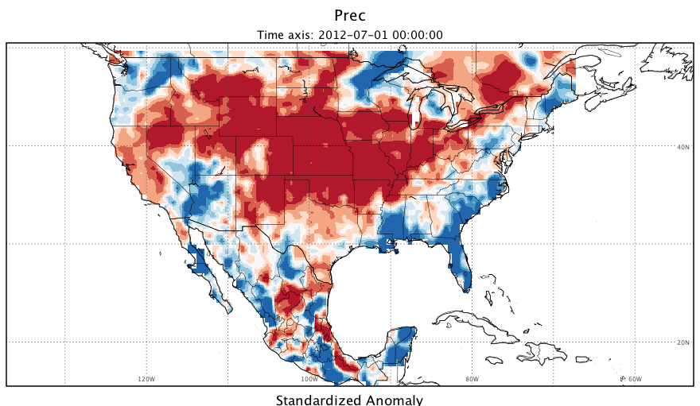
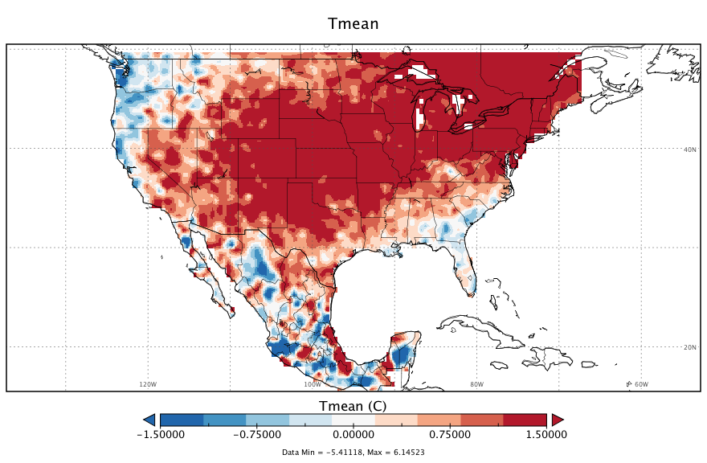
Is The Drought Prediction Problem Merely
The Seasonal Rainfall Prediction Problem?
May-August Standardized Anomaly, 1981-2010 reference period:
Precipitation
Temperature
Livneh et al. (2015) Gridded Station Data¹

Slide 4
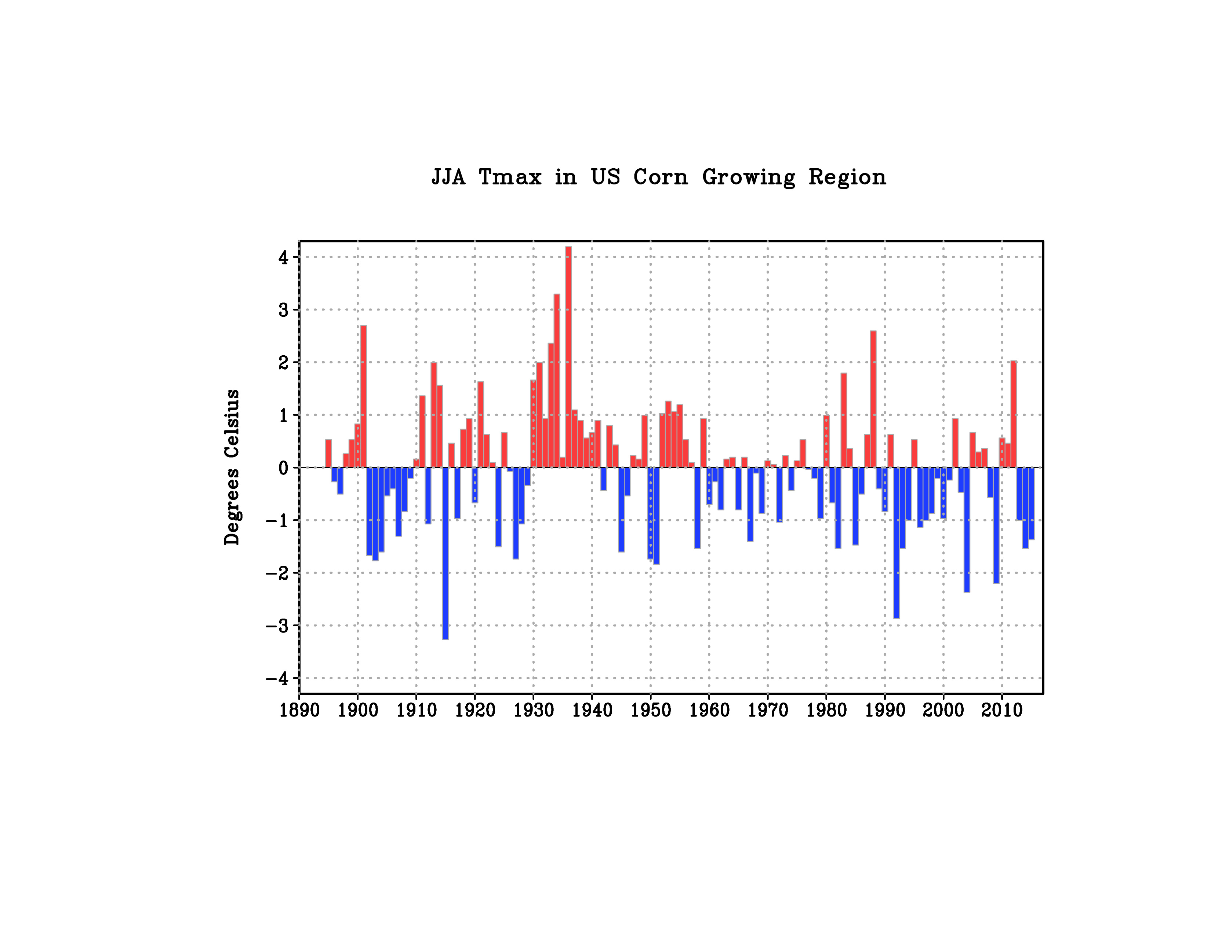
How Are Droughts Linked to High Temperatures?
“Hot Dustbowl”
1988
2012
Data: NOAA NCEI

Slide 5
How Will Droughts Change As Climate Warms?
Merged Time Series of Paleo-Reconstructed Drought and Climate Model Projections
Cook et al. 2015: “Unprecedented 21st Century Drought Risks in the American Southwest and Central Plains

Slide 6
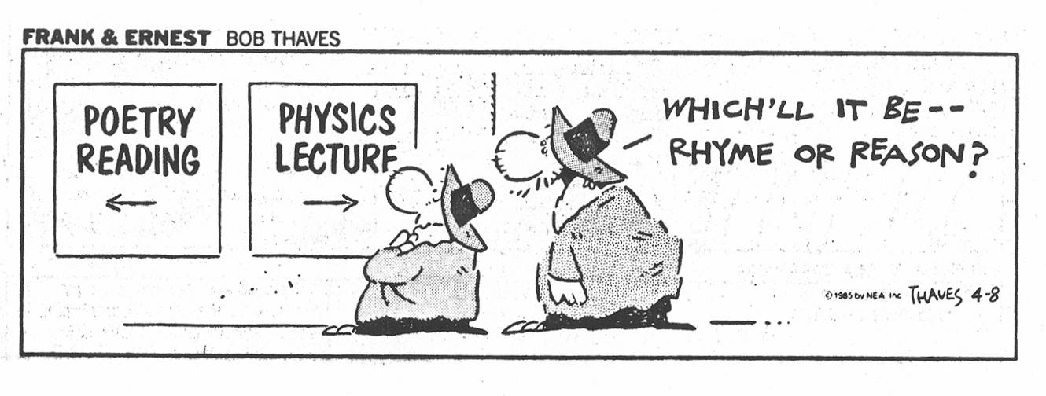
On the Fundamental Physics of Great Plains Drought

Slide 7
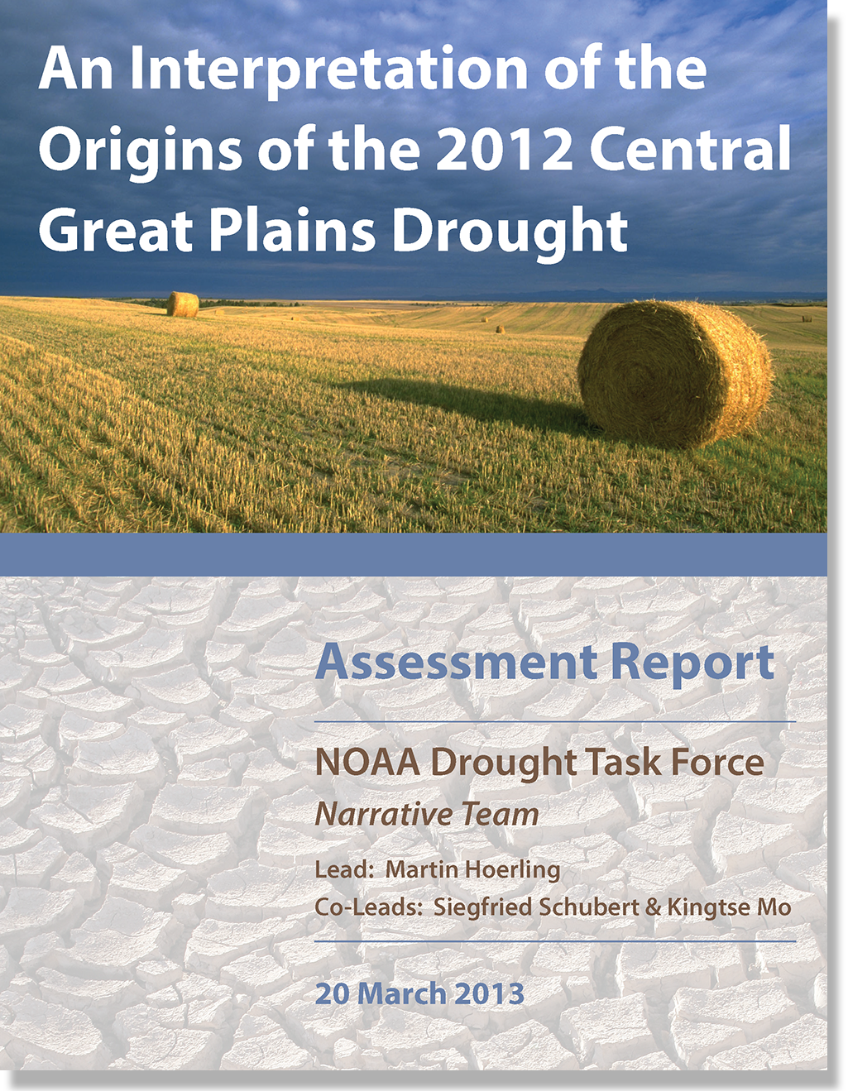
On the Fundamental Physics of Great Plains Drought

Slide 8

The Gulf Source of Moisture….Bermuda High

Slide 9
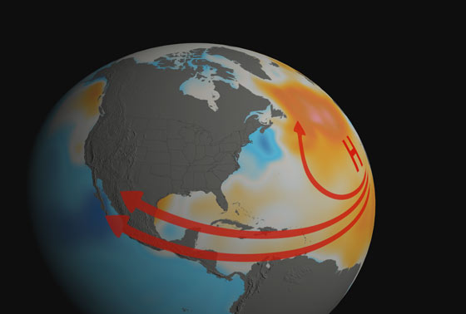
2012 (as in 1930s): Gulf Moisture Untapped
see Schubert et al, 2004 : Causes of the Dustbowl

Slide 10
Executive Summary: Meteorological Causes for The 2012 Drought
The 2012 Central Plains Drought developed suddenly, with near normal antecedent precipitation during winter and spring giving little forewarning of subsequent failed rains. The event did not appear to be just a progression or a continuation of the prior year’s record drought over the southern Plains, but appeared to be a discrete extreme event that developed in situ over the central US.

Slide 11
Executive Summary: Meteorological Causes for The 2012 Drought
The proximate cause for the drought was principally a reduction in atmospheric moisture transport from the Gulf of Mexico. Climate simulations and empirical analysis suggest that neither the effects of ocean surface temperatures nor changes in greenhouse gas concentration's produced a substantial summertime dry signal over the Central Plains during 2012. The interpretation is of an event resulting largely from internal atmospheric variability having limited long lead predictability.

Slide 12
Physics of Land Surface Response
Land-surface oriented understanding of proximal causes of drought.
Land surface model experiments—2012 Great Plains Drought
Predictability of Drought ---- from a Land Surface Perspective
Exploring Drought Severity in a Warmer World

Slide 13
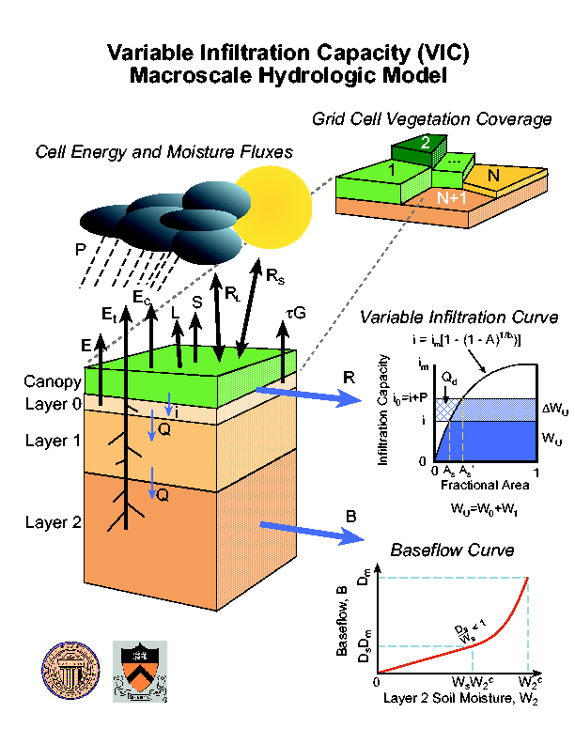
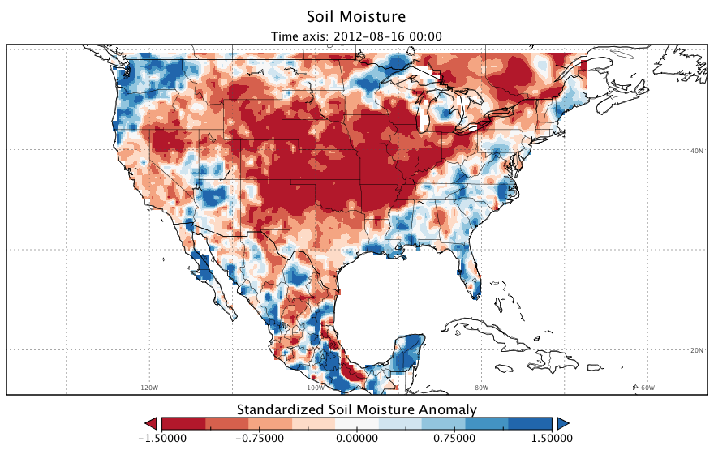
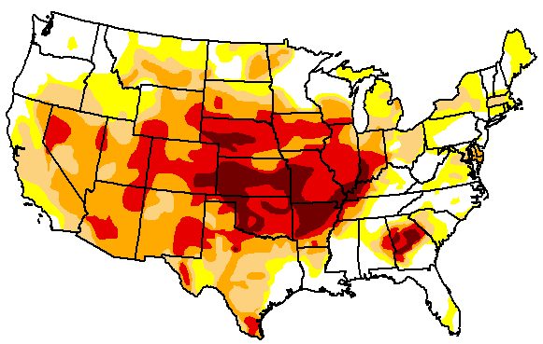
Soil Moisture Deficits in 2012
VIC soil moisture deficits (top 1m of soil)
August Standardized Anomaly, 1981-2010 reference period:
VIC Simulated Soil Moisture: August 2012
U.S. Drought Monitor, 14 Aug 2012
http://droughtmonitor.unl.edu/MapsAndData/MapArchive.aspx
Notes:
VIC soil moisture matches the main features of USDM to first order.
TO UNDERSTAND DROUGHT SEVERITY, WE EXPLORE SIMULATED SOIL MOISTURE DEFICITS BY DRIVING THE VIC MODEL WITH THE OBSERVED GRIDDED METEOROLOGY.
VIC IS A FULLY DISTRIBUTED, PHYSICALLY BASED, WATER AND ENERGY BALANCE MODEL THAT HAS BEEN APPLIED TO A BROAD RANGE OF DROUGHT STUDIES NATIONALLY AND GLOBALLY.
A KEY ASSUMPTION IS WE CONSIDER HERE THE TOP 1m OF SOIL AS A REFERENCE, A BALANCE BETWEEN A SHALLOWER AND PERHAPS MORE SENSITIVE SOIL COLUMN DEPTH, AND A DEEPER, MORE ENCOMPASSING DEPTH. HOWEVER, IT IS SAFE TO ASSUME THE MAJORITY OF VEGETATION/CROPS WOULD BE ROOTED IN THE TOP 1M OF SOIL SO THIS DEPTH IS LIKELY TO BE LARGELY REPRESENTATIVE OF THOSE DYNAMICS.
AS IN INDEPENDENT ESTIMATE, WE COMPARE THE MEAN AUGUST 2012 SOIL MOISTURE WITH THE US DROUGHT MONITOR (A PRODUCT THAT CONTAINS A VARIETY OF DISPARATE INFORMATION SOURCES) AND WE SEE GOOD CORRESPONDENCE AT THE CENTER OF THE DROUGHT EVENT, ALSO CAPTURIUNG OTHER MINMIMA IN W. NV AND THE S.E.
THIS COMPARISON WAS MADE TO BUILD CONFIDENCE IN THE MODEL
top 1 m of soil (wheat, soy) with corn going slightly deeper.
NOW WE COMPARE WITH AN INDEPENDENT ESTIMATE, the US DROUGHT MONITOR [based on hydrologic and climatic measurements and indices, as well as hundreds of reports and some subjective judgment).
SHOWN IS MONTHLY AUG 212FOR COMPARISON, NOT EXACTLY 1-TO-1. Also compares favorably with NLDAS product and the CPC model.
This allows us to BUILD CONFIDENCE IN THE MODEL, which captures the major features of drought [CENTRAL PLAINS, NW NEVADA, SOUTHEAST).
----- Meeting Notes (12/3/14 20:07) -----
NEXT: HOW AND WHY DID DROUGHT DEVELOP???
half degree, upscale drought monitor, subjective, other products SPI, PDSI
could be soil depth, smaller sigma bigger impactsß
Root zone distribution, 50 cm may have more sensitivity.
MOST OF ROOT DENSITY IS WITHIN TOP METER OF SOIL
----- Meeting Notes (12/13/14 10:17) -----
CHANGE ANIMATION ORDER
Then say, although I'm showing results for August, as a frame of reference the May-August anomaly is...
CROPS AFFECTED ARE LARGELY ROOTED IN THE TOP 1M (CERTAINLY TRUE FOR WHEAT AND SOY), PERHAPS CORN EXTENDS DEEPER
----- Meeting Notes (12/13/14 11:40) -----
HYDROLOGICALLY BASED LAND SURFACE MODEL
----- Meeting Notes (12/15/14 16:48) -----
Drought monitor--products
LACK OF IRRIGATION--good drought indicator

Slide 14
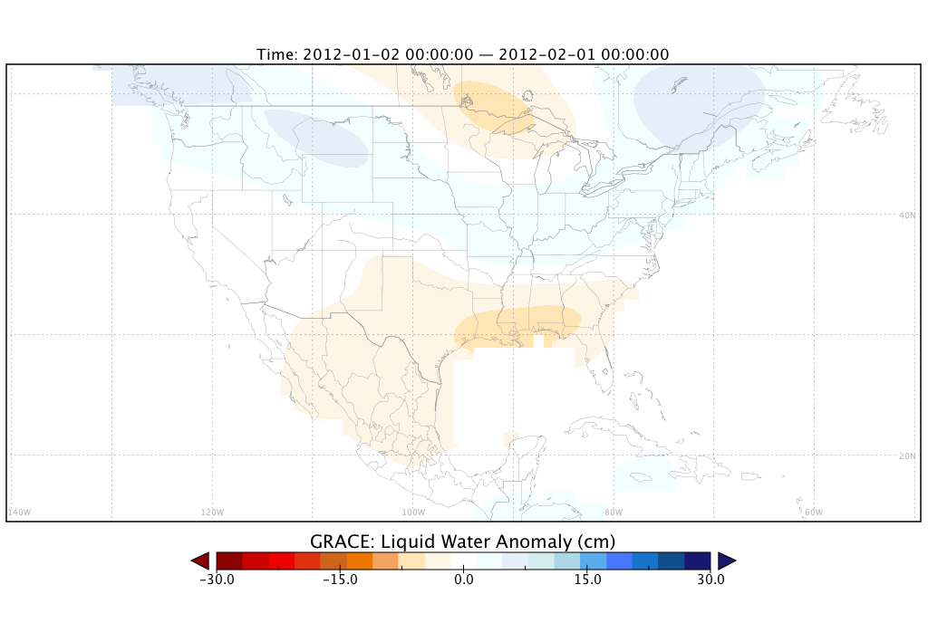
Validation Data
Gravity Recovery and Climate Experiment (GRACE) twin satellites
Short record (since 2002), means long-term changes inferred by models.
Parallel Simulations Using the Unified Land Surface Model
Notes:
TERRESTRIAL WATER IS TOUGH TO OBSERVE
ONE WAY TO INFER IT IS USING GRACE SATELLITE—SHOW OF HANDS HOW MANY FAMILIAR WITH IT?
Another way to partially observe drought is through satellites. SO HERE I’LL HELP YOU VISUALIZE THE CHARACTER OF GRACE, which estimates liquid water changes [click]
GRACE twin satellites were launched in March, 2002, and make detailed measurements of the Earth’s gravitational field from which the MASS OF WATER IS INFERRED
in summary GRACE doesn't directly observe water or drought, but infers it
Also, the spatial resolution is coarse (as you can see) and not simply defined, but approximately 300 km spatially. (Stokes coefficient)
In summary, GRACE maps the gravity field by measuring the distance between the two satellites using GPS and a microwave ranging system

Slide 15
Central Great Plains Moisture Anomalies
Precipitation
GRACE
VIC
ULM
Monthly anomalies (2002-2013) for observed precipitation (right ordinate axis), GRACE, ULM, and VIC terrestrial water (left ordinate axis) averaged over the Great Plains domain.
Notes:
MAIN POINTS:
1. The land response to the large negative precipitation anomaly (brown) is offset [lag] by several months
2. 2012 drought is apparent in the GRACE data, and is the most extreme dry event on record (albeit short) for this domain
3. Uncalibrated land surface models driven by observed meteorology, i.e. independent from GRACE, also show a large negative anomaly, however, this anomaly is not as pronounced as in GRACE, of comparable magnitude to 2006. In the historical record since 1950, this response is ranked below the 1950’s multi-year drought.
Clearly these products affir

Slide 16
Historical Context of Meteorological Anomalies
*Central Great Plains domain.
May-August conditions (1950-2013) standardized by the same reference period (1981-2010)
P vs T relationship is of importance for drought
2012
1988
Notes:
Inverse T-P relationship observed for the study domain [compute correlation; the physics of this relationship can be reconciled; plot tie series of T and P]
2012 falls within the relationship T-P, it is just more extreme,
2012 is not clearly a climate change driven event – more like ‘flipping a coin’
Make a multi-panel with sm for each….1950s show the imporatnce of SM as
Here I show the anomalies from 2012 with respect to conditions over the past 64 years, normalized the same as in the previous plots.
CLEARLY 2012 FALLS WITHIN THE P-T RELATIONSHIP, WHERE BOTH P AND T ARE 2 SIGMA EVENTS AND BOTH EXCEPTIONAL.
FOR REFERENCE, THE OTHER IMPORTANT DROUGHT IN RECENT MEMORY IS SHOWN HERE, NOT AS EXTREME MAY-AUG BUT CERTAINLY IT HAD LONGER SUSTAINED CONDITIONS. THE OTHER DROUGHT WITH BIG PRECIP DEPARTURES WAS 1953, PART OF A LONGER DROUGHT SEQUENCE.
2012, 1988, 1953, 1976

Slide 17
1988
2012
1953
1955
1954
1956
Precipitation stronger relationship with soil moisture than temperature.
Soil moisture integrates weather over long time periods, 1950s droughts shows this importance
2012 had a relatively rapid onset.
Notes:
You don’t need to run a test to see that temperatures have weaker relationship with soil moisture than precipitation
1950s show the importance of SM as an integrator, suggests those are antecedent dry which is important to uncerdstand physics, whereas 2012 was more normal moisture, but warm spring.
2012, 1988, 1953

Slide 18
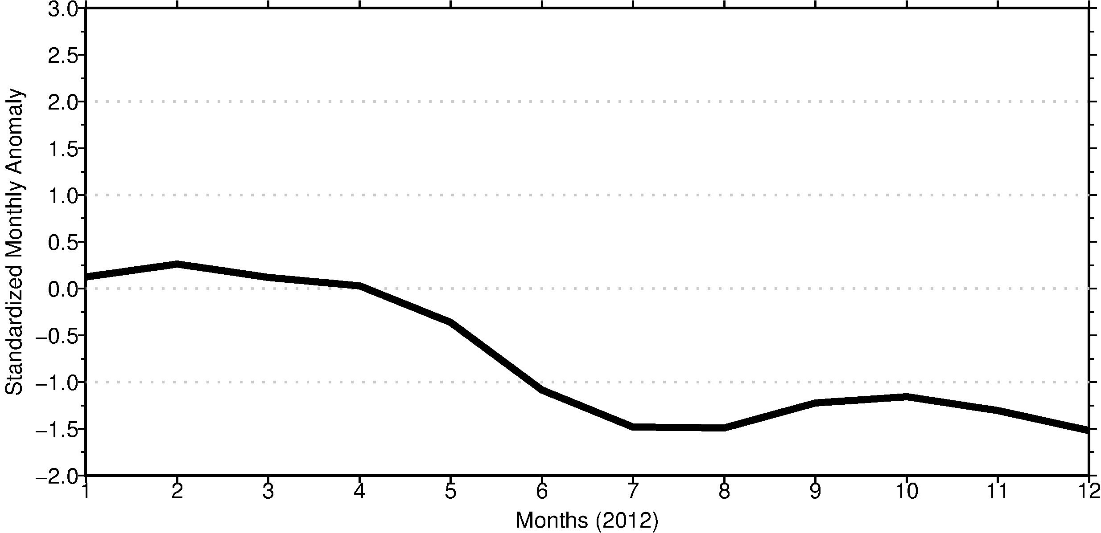
Time Evolution of Soil Drying and Meteorology
Soil Moisture: VIC driven by observed P and T
January
April
August
November
Notes:
we respect the non-guassian nature, but for ease of demonstration we show standardized anomalies.
THE LAST SLIDE SET, SHOWS THE TIME EVOLUTION OF SOIL DRYING AND THE IMPORTANCE OF THE TEMPERATURE-PRECIPITATION RELATIONSHIP
SHOWN HERE IS THE MONTHLY SOIL MOISTURE ANOMALIES FOR 2012, SIMULATED WITH OBSERVED PRECIP AND TEMPERATURE, CALLED THE ‘SYNTHETIC TRUTH’ CASE

Slide 19
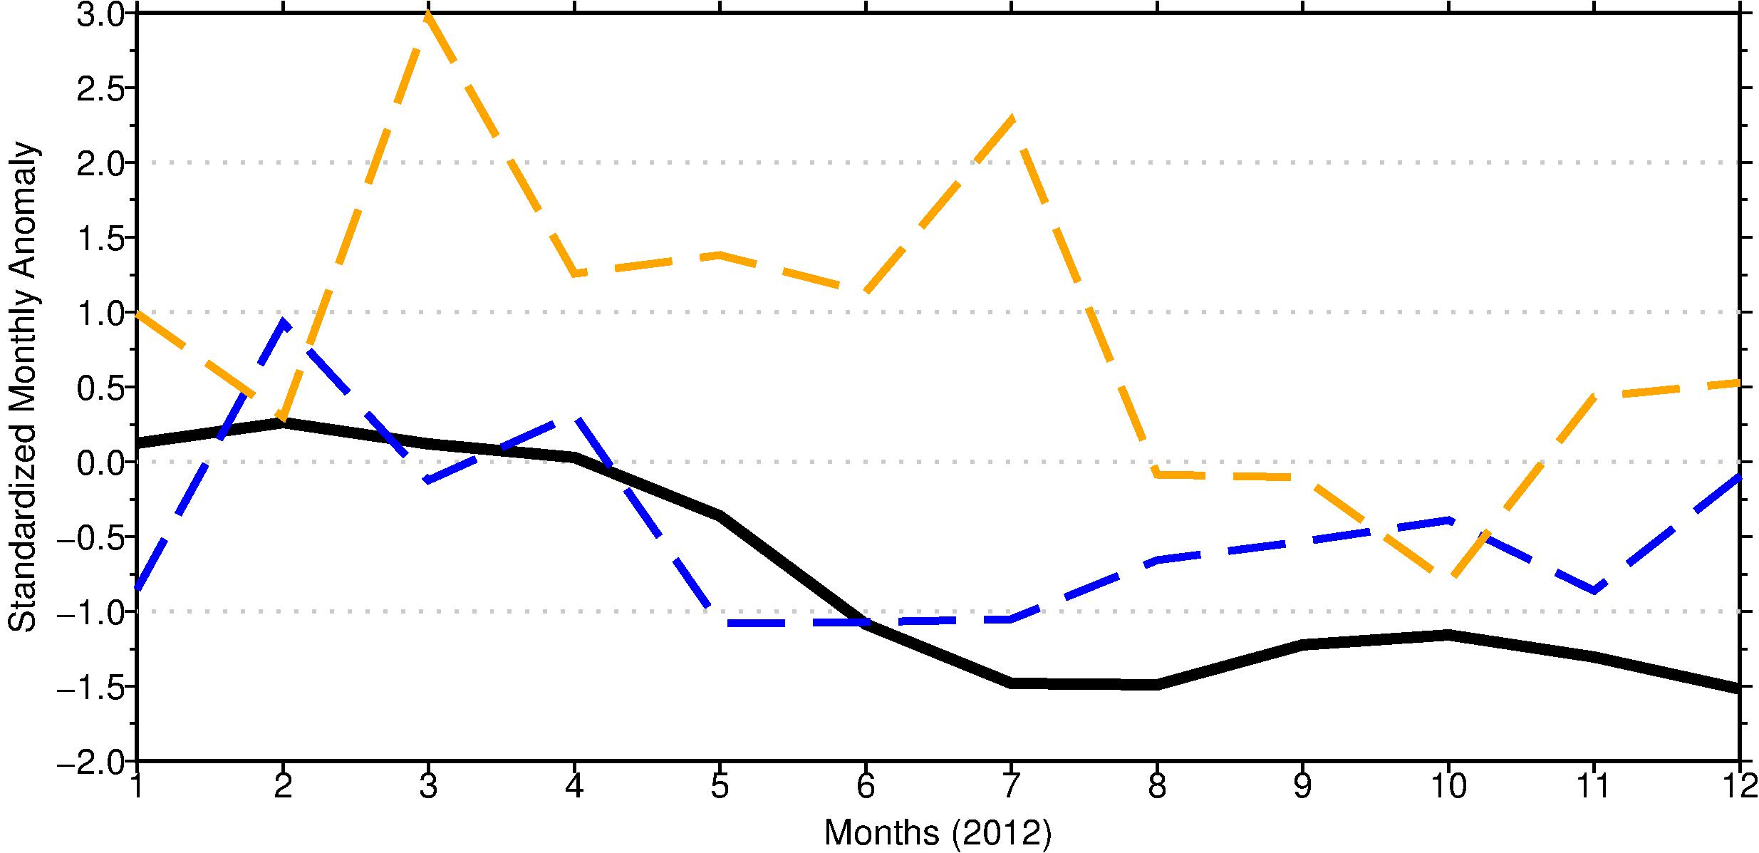
Time Evolution of Soil Drying and Meteorology
Temperature
Precipitation
Soil Moisture: VIC driven by observed P and T
January
April
August
November
Notes:
ADDED THE ACTUAL T AND P ANOMALIES
TEMPERATURES ARE HIGH, PRECIPITAITON DROPS MARKEDLY IN MAY, THERE IS A LAG BEFORE SM RESPONDS

Slide 20
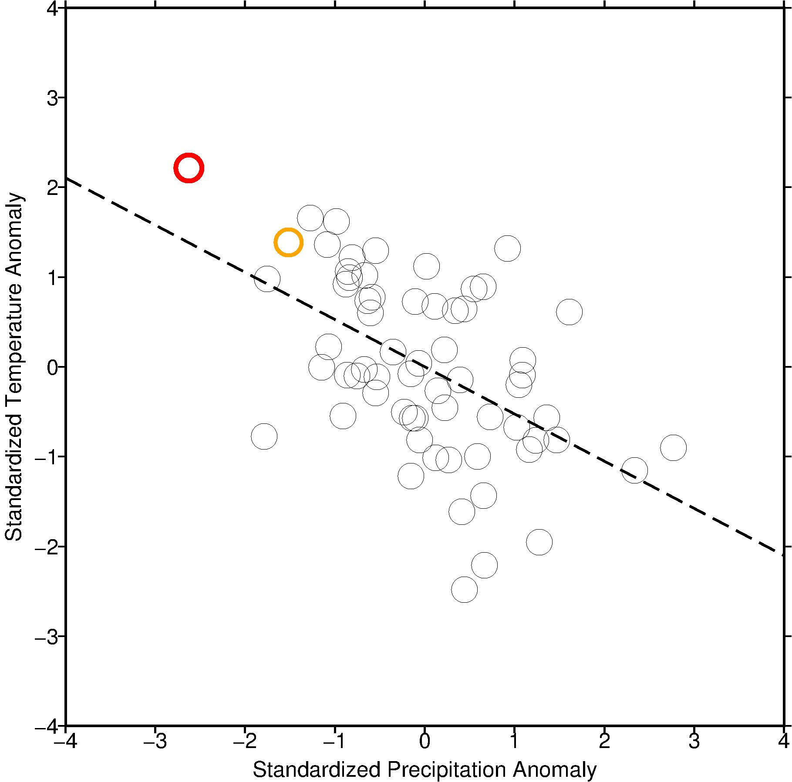
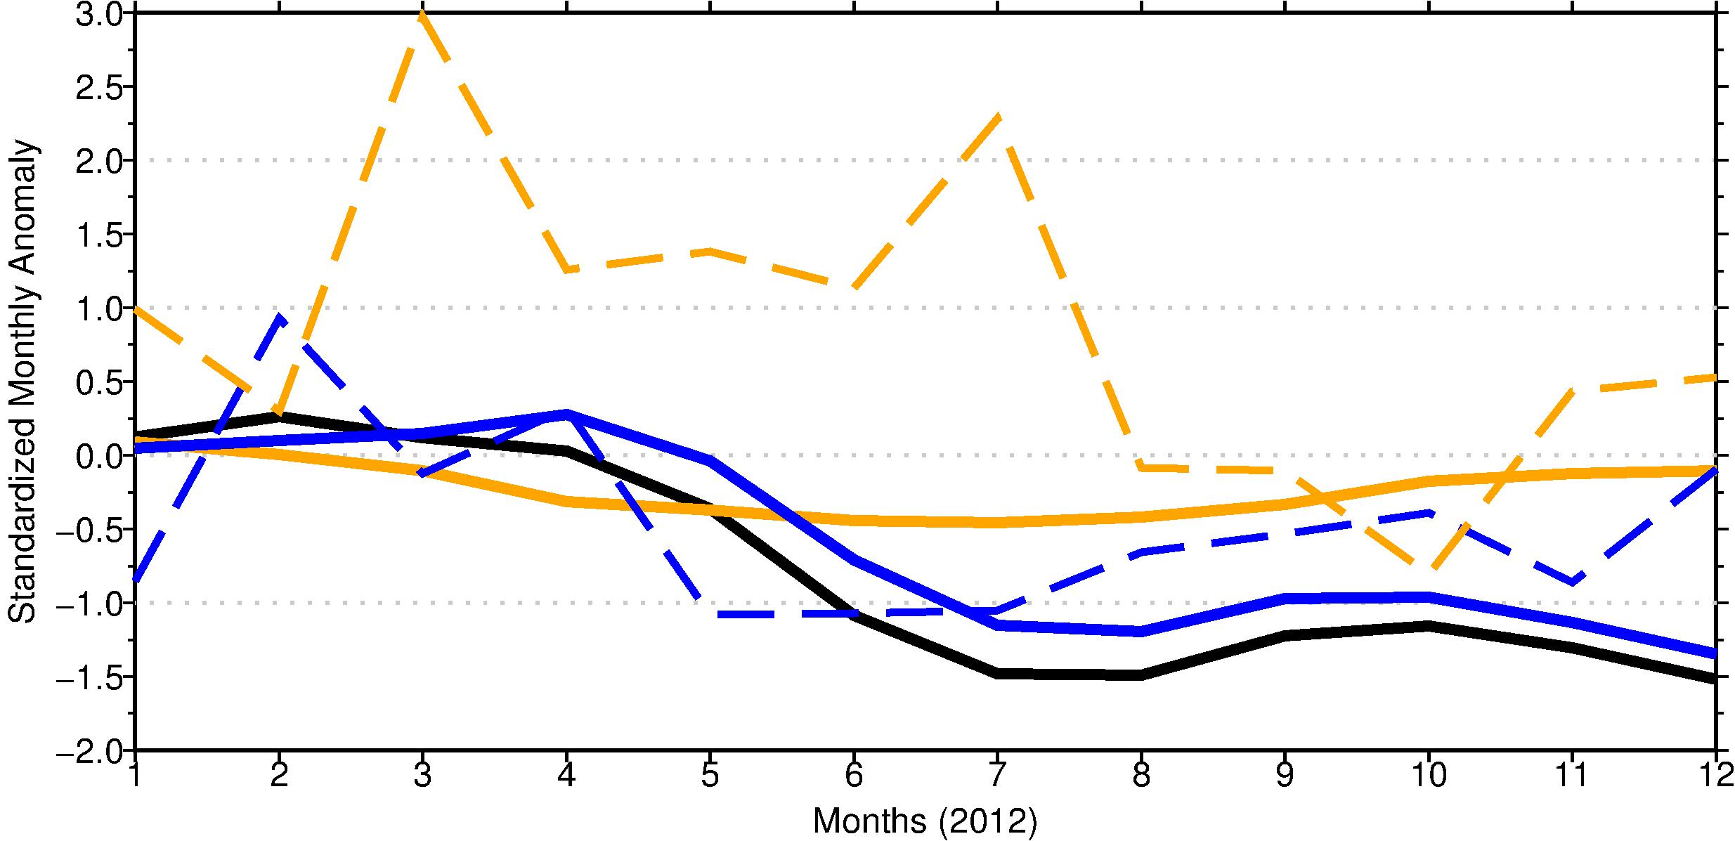
Time Evolution of Soil Drying and Meteorology
Recall, T and P come together, so the P-isolated sensitivity might be understated
Apply the regression to *adjust* monthly temperatures during the precipitation deficit case [based on monthly regressions at each point]
Temperature
Soil Moisture: T isolated
Precipitation
Soil Moisture: VIC driven by observed P and T
Soil Moisture: P isolated
January
April
August
November
Notes:
FINALLY, WE SEE THE SOIL MOISTURE ANOMALIES FROM THE TWO SYNTHETIC ISOLATED CASES, WHERE P-ISOLATED MATCHES THE VARIABILITY OF THE FULLY-OBSERVED-DRIVEN SOIL MOISTURE CLOSELY, DISPLAYING THE CLEAR IMPORTANCE OF PRECIPITATION HERE;
INTERSTINGLY, THE SMALL T-DRIVEN ANOMALY CAN ALMOST BE LINEARLY ADDED TO P-DRIVEN CASE TO GET THE FULLY-OBSERVED BLACK LINE
BUT RECALL THAT THE PRECIPITATION SENSITIVITY MIGHT BE UNDERSTANDED, SINCE p and t come together in a package,
so add precipitation driven (EB) part of the temperature into the climatological case.
could to a shading (b/w blue and black; orange and the zero line), pop up regression of the scatterplot.
Simply state in words the precipitation carries with it an implied temperature anomaly (i.e. P deficit is accompanied by high T) so that blue should be closer to black. By same logic, high T is accompanied by P deficit, which will make the orange line 'less severe’, since “average P” would actually be associated with cooler Temperatures. **THIS LINE OF REASONING USES PRECIP. AS THE CHANGING AGENT”
gaussian assumption, guides return period estimate
----- Meeting Notes (12/13/14 10:17) -----
call the "OBSERVED" the "SYNTHETIC TRUTH"

Slide 21
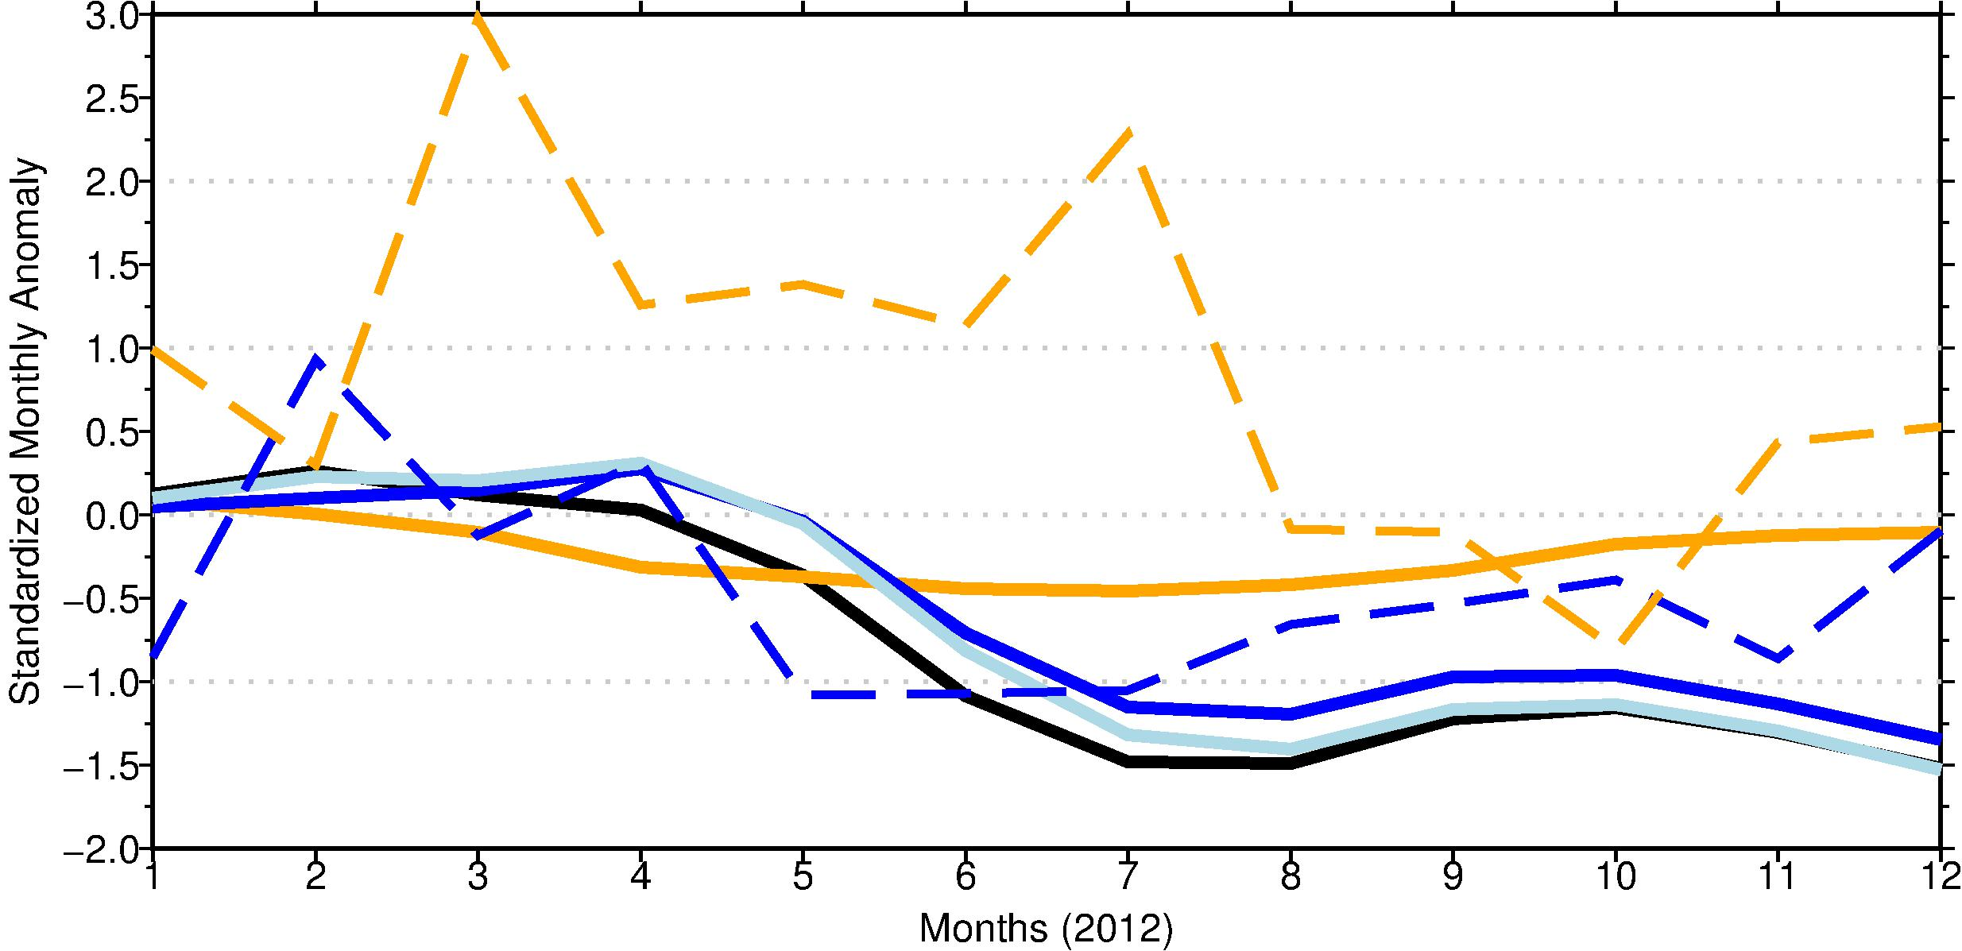
Time Evolution of Soil Drying and Meteorology
Recall, T and P come together, so the P-isolated sensitivity might be understated
Apply the regression to *adjust* monthly temperatures during the precipitation deficit case [based on monthly regressions at each point]
Temperature
Soil Moisture: P isolated
*Adjusted*
Soil Moisture: T isolated
Precipitation
Soil Moisture: VIC driven by observed P and T
Soil Moisture: P isolated
January
April
August
November
Notes:
LAST TERM-TEMPERATURE RESIDUAL, IRRESPECTIVE OF PRECIPITATION
Temperature offset, likely an extreme estimate of Temperature
p and t come together in a package, because of the 0.7 correlation behavior;
so add precipitation driven (EB) part of the temperature into the climatological case.
could to a shading (b/w blue and black; orange and the zero line), pop up regression of the scatterplot.
Simply state in words the precipitation carries with it an implied temperature anomaly (i.e. P deficit is accompanied by high T) so that blue should be closer to black. By same logic, high T is accompanied by P deficit, which will make the orange line 'less severe’, since “average P” would actually be associated with cooler Temperatures. **THIS LINE OF REASONING USES PRECIP. AS THE CHANGING AGENT”
gaussian assumption, guides return period estimate

Slide 22
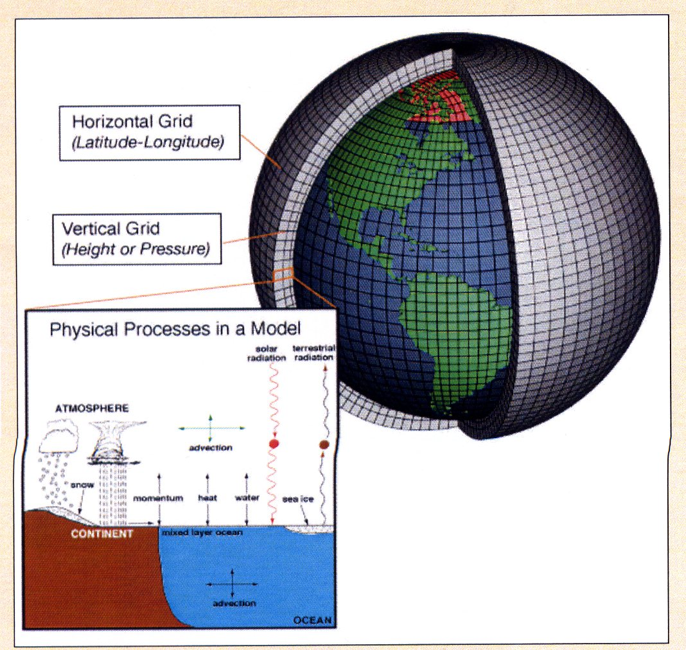
GCM Ensemble to Explore General Drought Characteristics and Predictability
Overcomes the limited observed sample size (e.g. 64 years)
° 1050 years of ‘current climate’ simulations. 30 ECHAM-5 ensemble members, 1979-2013.
° AMIP-style driven with observed Greenhouse Gases (GHG) and Sea Surface Temperatures
° Global 85 km spatial resolution
° Interactive Land Surface
(see Seager and Hoerling 201, JClimate)
Notes:
I’m showing daily precipitation from a GCM simulation here, to HELP YOU VISUALIZE GCM scales and processes.
We wish to USE MODEL TO INCREASE THE NUMBER OF REALIZATIONS OF UNIQUE DROUGHT EVENTS TO BOLSTER OUR UNDERSTANDING
BECAUSE INITIAL CONDITIONS IS REALLY WHAT WE’RE WORKING WITH FOR PREDICTING THESE THINGS.

Slide 23
Observed
ECHAM5
Mean monthly meteorology (1979-2013) over the Great Plains domain for observations [Livneh et al., 2015] and a 30-member ensemble mean ECHAM5 values (white bar); error bars denote minimum and maximum member values.
Notes:
MAIN POINTS: COULD PITCH THIS MODEL STUFF AS WHAT WE’RE GOING TO DO NEXT, FUTURE WORK. THIS WILL BE A SEGUAY—SHOW ONE OR TWO AT MOST; BULLETS, WHAT IS THE NEXT STEP:
A LIMITING ASPECTS OF STUDYING A CASE, IT’S ONLY ONE, WE WANT MORE EPIDEPIOLOGICAL, AND MORE FUNDAMENTAL, WE’RE LIMITED BY SAMPLE SIZE, COMPARABLE CASE; WHAT WE PROPOSE TO IN NEXT YEAR, TO LEVERAGE LONG CLIMATE SIMULATIONS WITH A HIHG RES GCM THAT WE’VE BEGUN EXPLORING; SHOW THE FIRST TWO, THIS AND NEXT—JUST TO SHOW THAT I’VE BEGUN PROBING THE MODEL FOR IT’S SUITABILITY. LEAD IN A RHETORICAL SENSE, THE QUESTIONS THAT ARE BEING ASNKED/ANSWERED IN THE FOLLOWING PLOTS : Q1—MORE COMPLETE DESCRIPTION OF COUPLED LAND/ATMOSPHERE CONDITION—NOT AN ASSESSMENT OF PREDICTABILITY; WHAT IF I HAVE A GOOD HISTORY OF MET AND LAND SUFACE, HOW CONSTRAINED IS THE SUMMER IN THE GREAT PLAINS FOR PREDICTABILITY?; 2. MOTIVATION: USE THE QUOTE (PG 22) FROM THE REPORT ASSESSMENT, SAYING CONTSTRAIN ON MET WAS WEAK WITH LOW PREDICTABIILTY; THE TACT WE TAKE FOR FUTURE IS TO SEE WHETHER ANTECEDENT LAND SURFACE HAS CONTROL ON DROUGHT AS A NEW LINE OF INQUIRY. F
USE AMIP RUNS TO FORM PHENOTYPES OF DROUGHT, WORK FORWARDS OR BACKWARDS FROM ANTECEDENCE, TO UNDERSTAND FUNDAMENTAL PHYSICS INVOLVED. VIC LETS US SEPARATE THE COUPLING IN A MORE CAUSAL SENSE. WE ONLY HAVE 1 ANTECEENT FOR 2012. FIRST PART IS 2012 REDUX, THEN WE GO INTO THE FUNDAMENTAL PHYSICALS.
The seasonality of precipitation is well replicated by the ECHAM5 ensemble for the 30-year period with all the observed months contained within the ensemble spread except for July;
ECHAM5 temperatures also capture observed seasonality, while possessing a warm bias.
Marty:
The results on analysis of the 2012 event raise a variety of questions about the physics of Great Plains drought. These are themselves not addressable from the historical observations alone because there are too few samples from which to derive robust, and more generally applicable conclusions on the importance of various physical processes. The paper therefore next turns to coupled ocean-atmosphere-land model simulations of drought using a large ensemble of historical climate simulations of ECHAM5. The goal is not to explore the predictability of 2012 (see Hoerling et al for that), but to select from the available ~1000 yrs of ECHAM5 simulations a collection of drought occurrences in the model, and to stratify those by various indices of pcpn deficits, and antecedent conditions. This Slide 6 demonstrates the excellent fidelity of the model in producing a realistic late spring/early summer wet season over the GP domain with realistic surface temperatures. The goal will be to diagnose the land surface response during drought events in ECHAM5, using both the GCMs soil moisture, and the diagnosis of how pcpn, sfcT, and antecedent conditions played roles in GP droughts by conducting off-line VIC simulations driven by ECHAM5 meteorology.

Slide 24
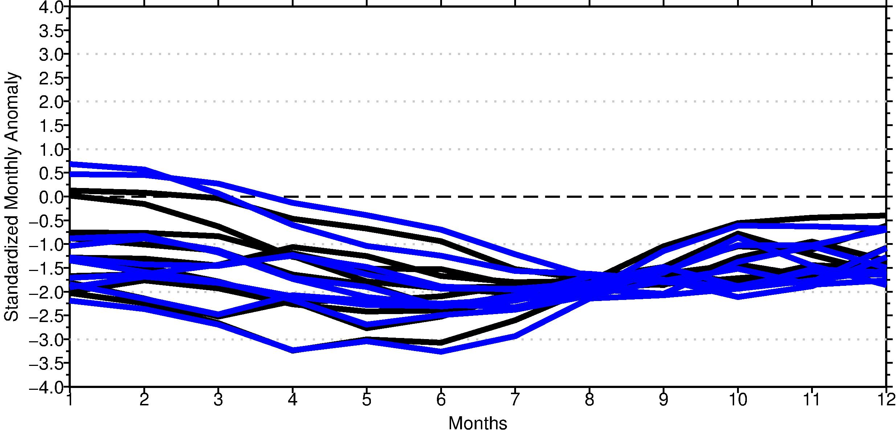
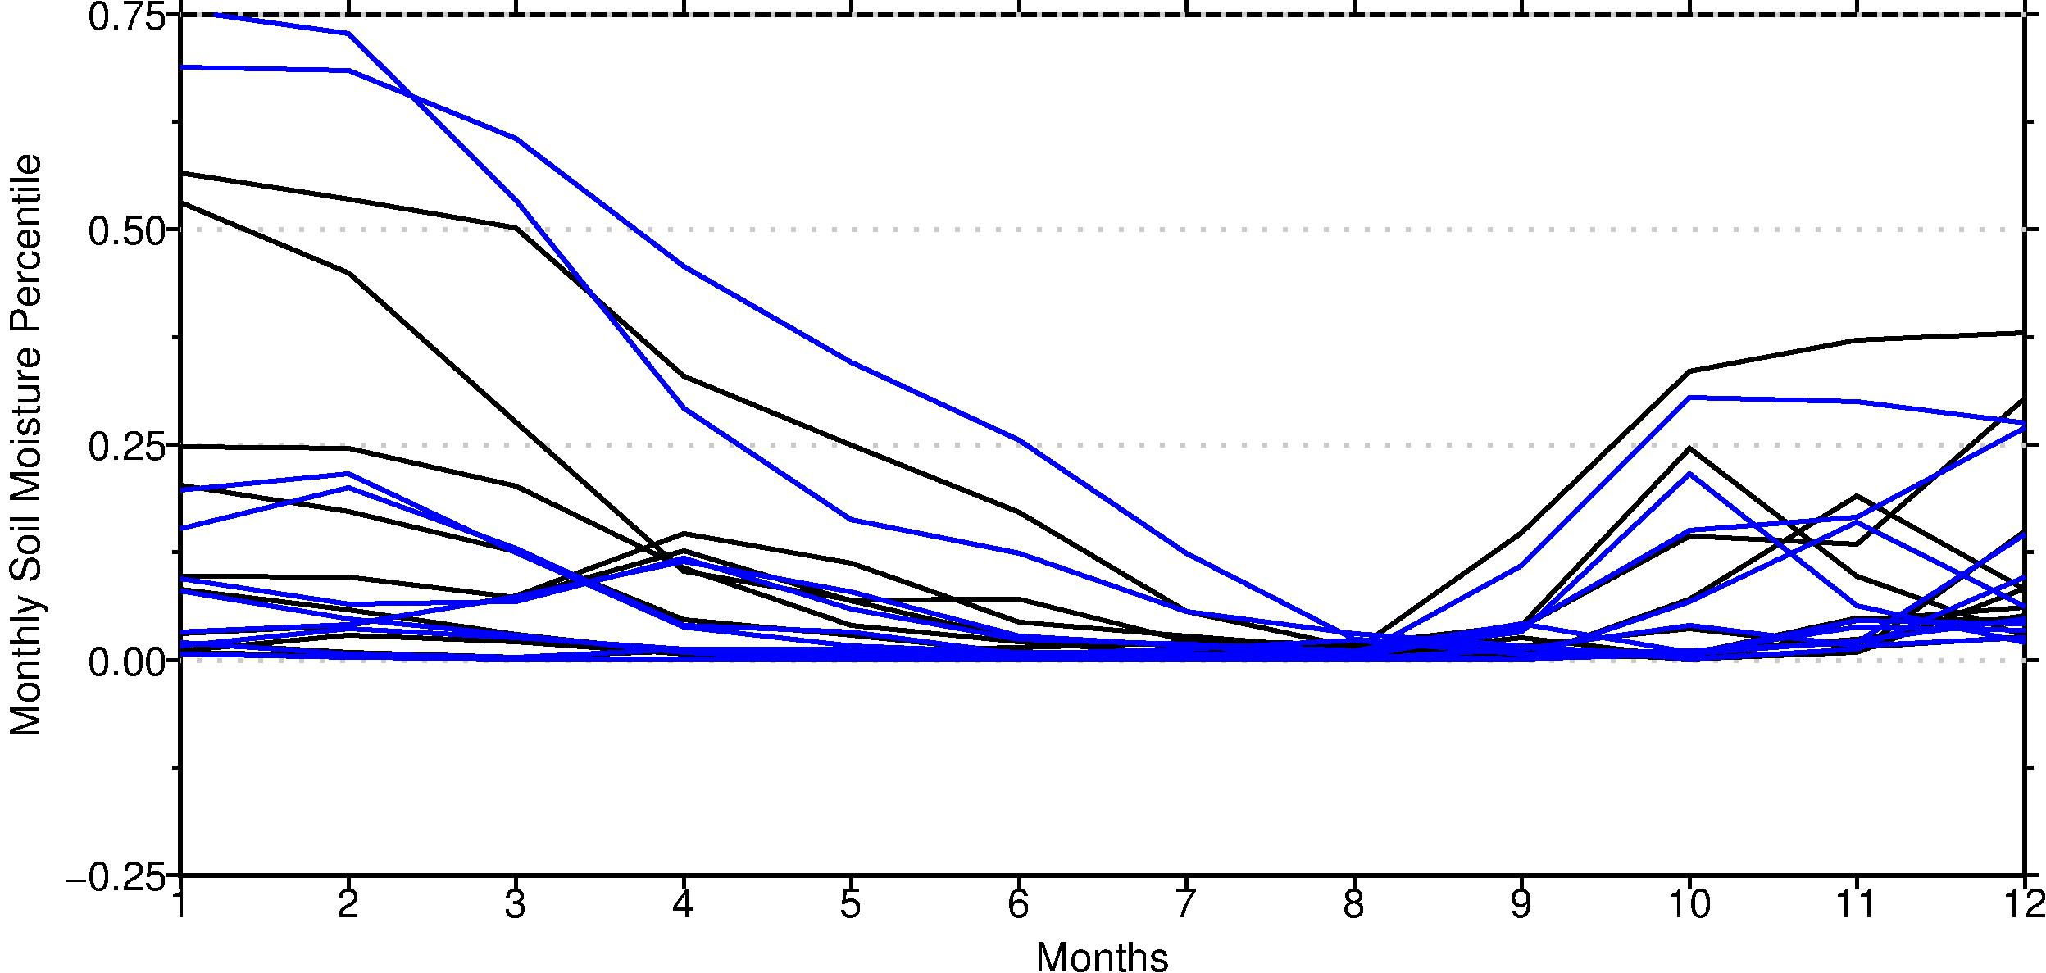
Importance of Initial Conditions
Prominence of Precipitation Control on Soil Moisture
Isolated 1% (out of 1050 years) Lowest Precipitation May-August
ECHAM
VIC (driven with ECHAM)
Standardized
Soil Moisture Anomaly
Convergence
Month
Notes:
OUT OF THE 1050 SIMULATED YEARS, I ISOLATED THE 1% OF RUNS WITH LEAST PRECIPITATION DURING MAY-AUGUST AND PLOTTED THEIR SOIL MOISTURE.
SEVERITIES SIMILAR TO 2012 DROUGHT
Shown is SOIL MOISTURE ANOMALY, FOR ECHAM DIRECTLY OUT OF MODEL
VIC DRIVEN BY GCM→EXPLORE UNCERTAINTIES IN THE LAND SURFACE
What is interesting, is the DIVERSITY OF INITIAL CONDITIONS—i.e. NO MATTER WHERE YOU START OUT, THE DRY SUMMER CAUSES MOISTURE TO CONVERGE—PRECIP IS A STRONG CONTROL

Slide 25
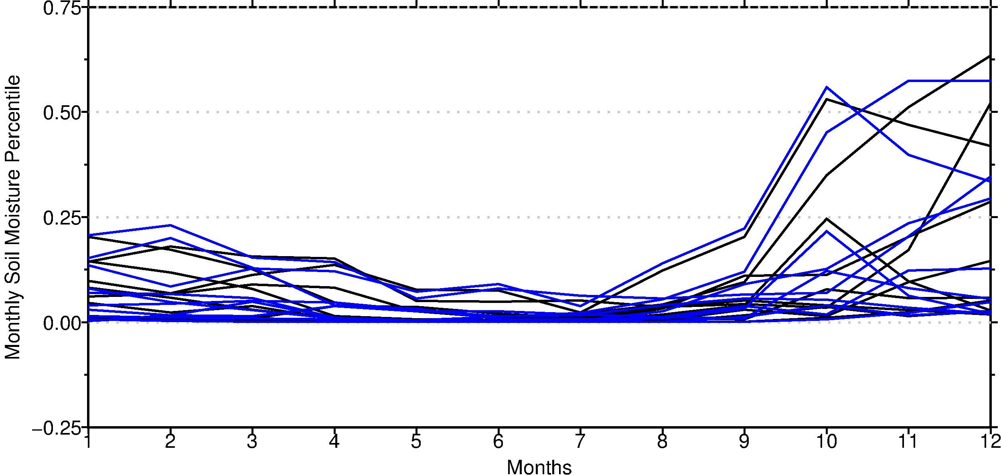
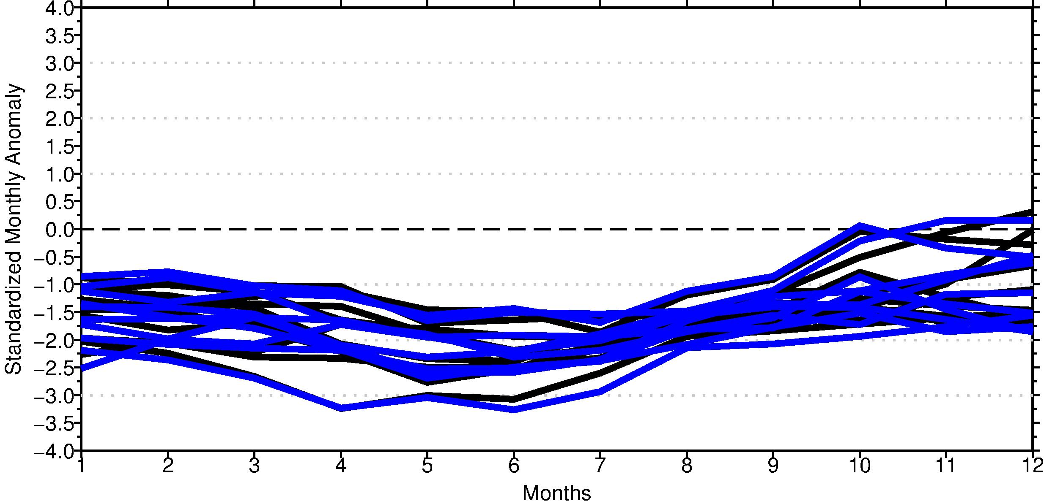
Importance of Initial Conditions
Antecedent Soil Moisture’s Strong Effect of Summer Heat
Isolated 1% (out of 1050 years) Highest Temperature May-August
ECHAM
VIC (driven with ECHAM)
Standardized
Soil Moisture Anomaly
Less Convergence
Month
Notes:
In contrast to the previous plot, here I isolate the 1 % hottest summers (May-August)
2 THINGS VERY INTERESTING
1. We see less convergence by the end of summer, suggesting that temperature HAS WEAKER CONTROL on soil moisture
2. IMPORTANT FOR PREDICTABILITY, notice all the HOT SUMMERS are PRECEEDED BY DRY SPRINGS—here is where there may be potential to predictability, and where ongoing efforts are focused

Slide 26
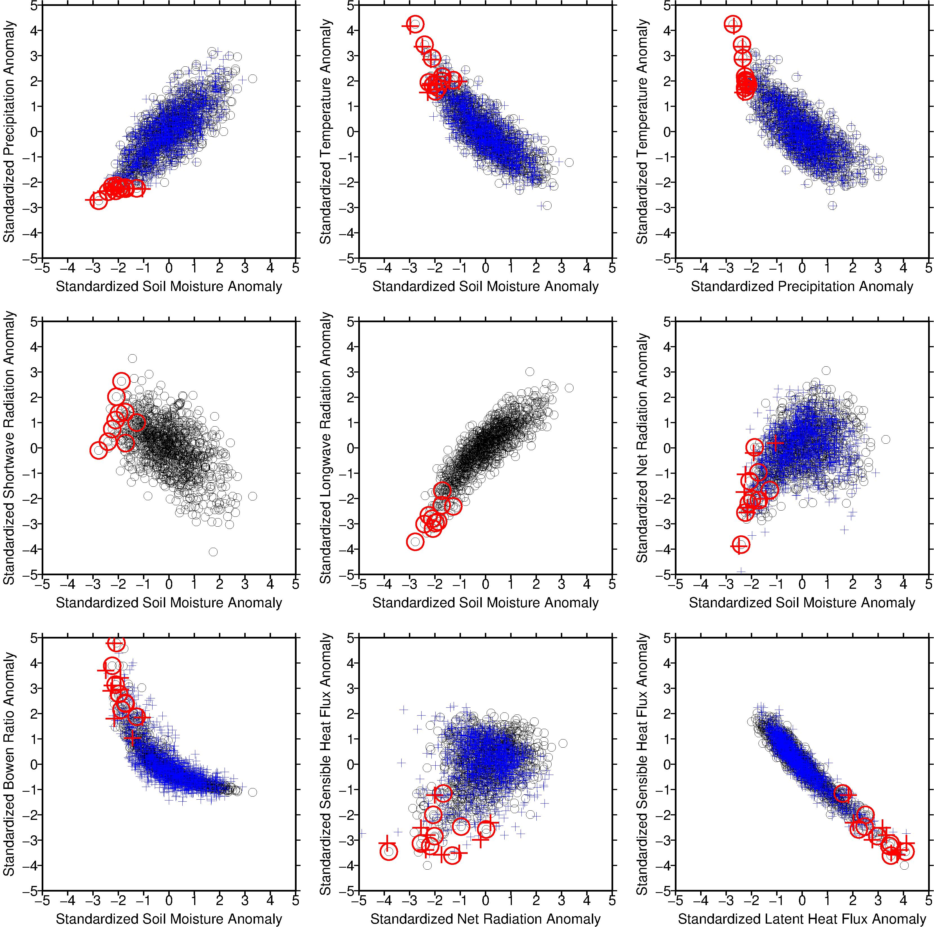
(a)
(b)
(c)
(d)
(e)
(f)
MJJA standardized anomalies P, T, SM, & fluxes: ECHAM5 (circles) and VIC (crosses)
Lowest 1% MJJA precipitation simulations are highlighted in red.
Notes:
MAIN POINTS:
The two hydrology simulations follow reasonably well, providing an estimate of uncertainty in land surface response
For the most extreme dry cases, there is a tight range among the 1% precip, while the soil moisture spread is fairly broad, indicative of weaker constraint
The coherence between longwave radiation and soil moisture anomalies is much stronger during drought than shortwave, the result of which is that during drought Rnet is negative, which may not be entirely intuitive. Longwave cooling is dominant, however there is a slight warm temperature bias (Figure 6), which contributes XXX W/m**2
Marty:
A key figure that illustrates some of the key physical processes occurring during low soil moisture states. The VIC simulations are
now shown, driven by the ECHAm5 meteorology. The results from ECHAm5 land model and VIC downscaled are very similar. Key features: low soil moisture occurs in concern with low pcpn and high sfcT. There is a nonlinear relation between sfcT and pcpn that emerges for the drier states. The sfc energy balance indicates that long wave radiation is strongly constrained by soil moisture, hene the strong sfcT response to pcpn conditions, but shortwave anomalies show a less constrained beahvior in relation to soil moisture, though a generally increased SW during low soil states is expected form the reduced pcpn. The Bowen ratio shows the dramatic nonlinear feedback effect that characterizes the energy balance in the GP domain.
I suggest boiling this down to 6 images, in which each has "Standardized Soil Moisture" as its x-axis. This will make the variable dependency easier to understand from panel-to-panel.
The remaining 3 panels that would be excluded could be referred to, I find the most interesting to be sfcT vs pcpn, and the sensible vs latent fluxes. In many ways, these speak to a similar physics, and could be formed into a 2-panel? I find the sensible flux vs net radiation to be the least informative.

Slide 27
Drought Sensitivity to Scenarios of Climate Change
• What Severity for 2012 Drought in a Warmer/Drier World?
• What Intensity of Aridification in a Warmer/Drier World?
From Cook et al. 2015
Notes:
MAIN POINTS

Slide 28
Drought Sensitivity to Scenarios of Climate Change
• What Severity for 2012 Drought in a Warmer/Drier World?
• What Intensity of Aridification in a Warmer/Drier World?
“The CP drying is driven primarily
by the increased evaporative demand. This increase in PET
is one of the dominant drivers
of global drought trends in the
late 21st Century”
--- Cook et al. 2015
Notes:
MAIN POINTS

Slide 29
VIC (Observed Met.)
1.2 P
1.1 P
0.9 P
0.8 P
VIC (Observed Met.)
T - 4
T - 2
T - 1
T + 1
T + 2
T + 4
Monthly standardized anomalies for 2012 (relative to 1981-2010) for VIC simulations using observed meteorology in black, with (a) synthetic precipitation scaling shown in blue shading and (b) synthetic temperature deltas shown orange shading applied relative to observations for all months respectively.
Notes:
MAIN POINTS

Slide 30
VIC (Observed Met.)
0.9 P
1.2 P
0.8 P
1.1 P
VIC (Observed Met.)
T + 1
T - 4
T + 2
T - 2
T + 4
T - 1
Monthly standardized anomalies for the recent decade 2004-2013 (relative to 1981-2010) for VIC simulations using observed meteorology in black, with (a) synthetic precipitation scaling shown in blue shading and (b) synthetic temperature deltas shown orange shading applied relative to observations for all months respectively.
Notes:
MAIN POINTS

Slide 31
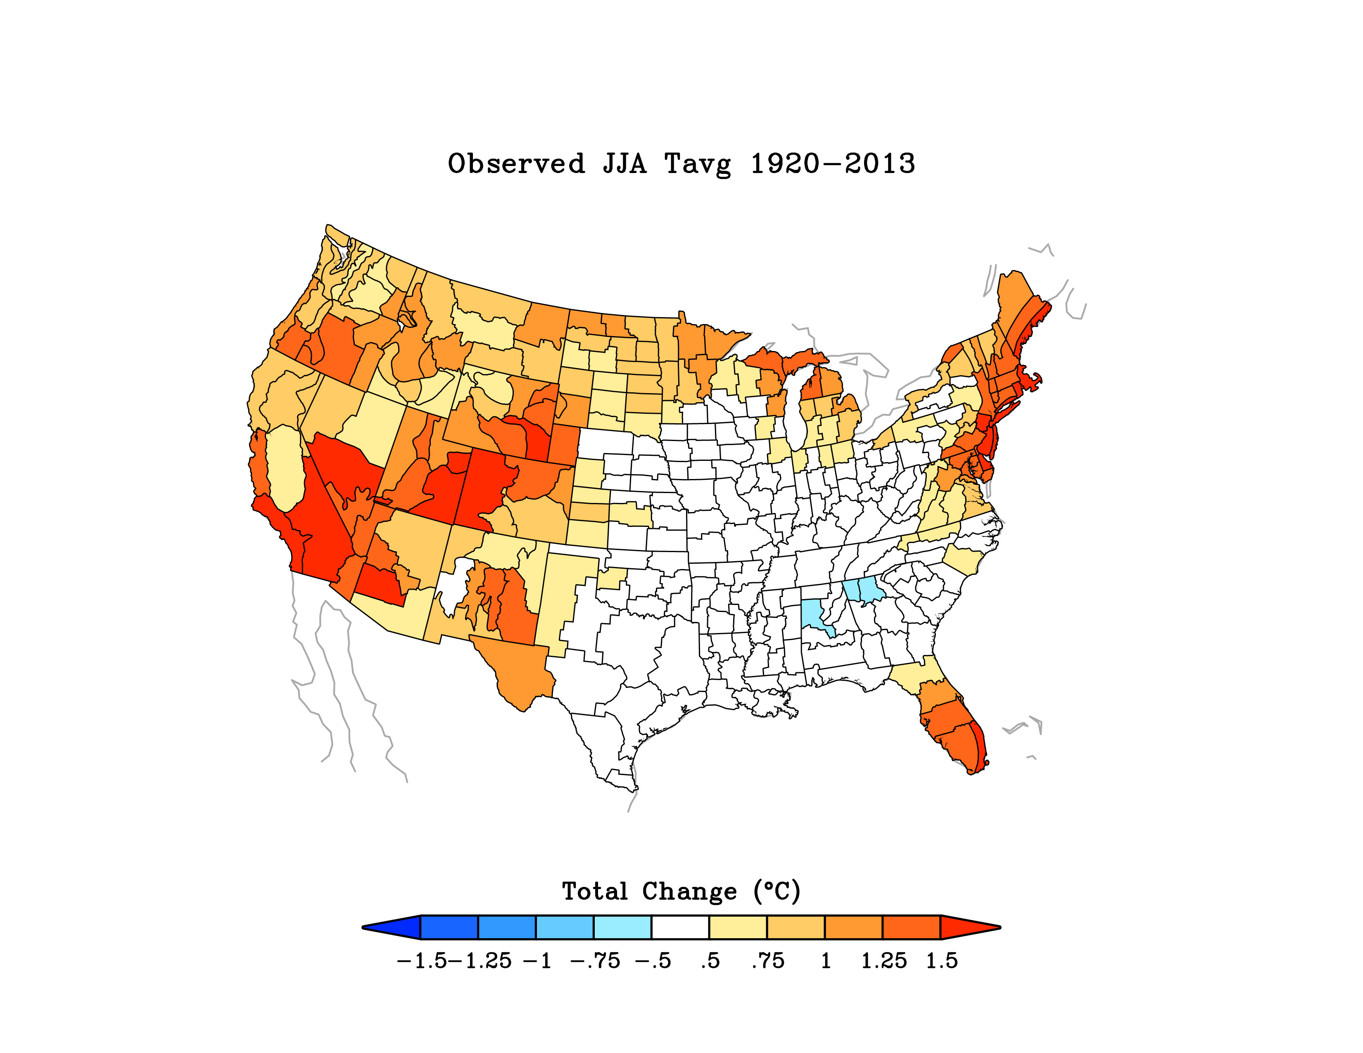
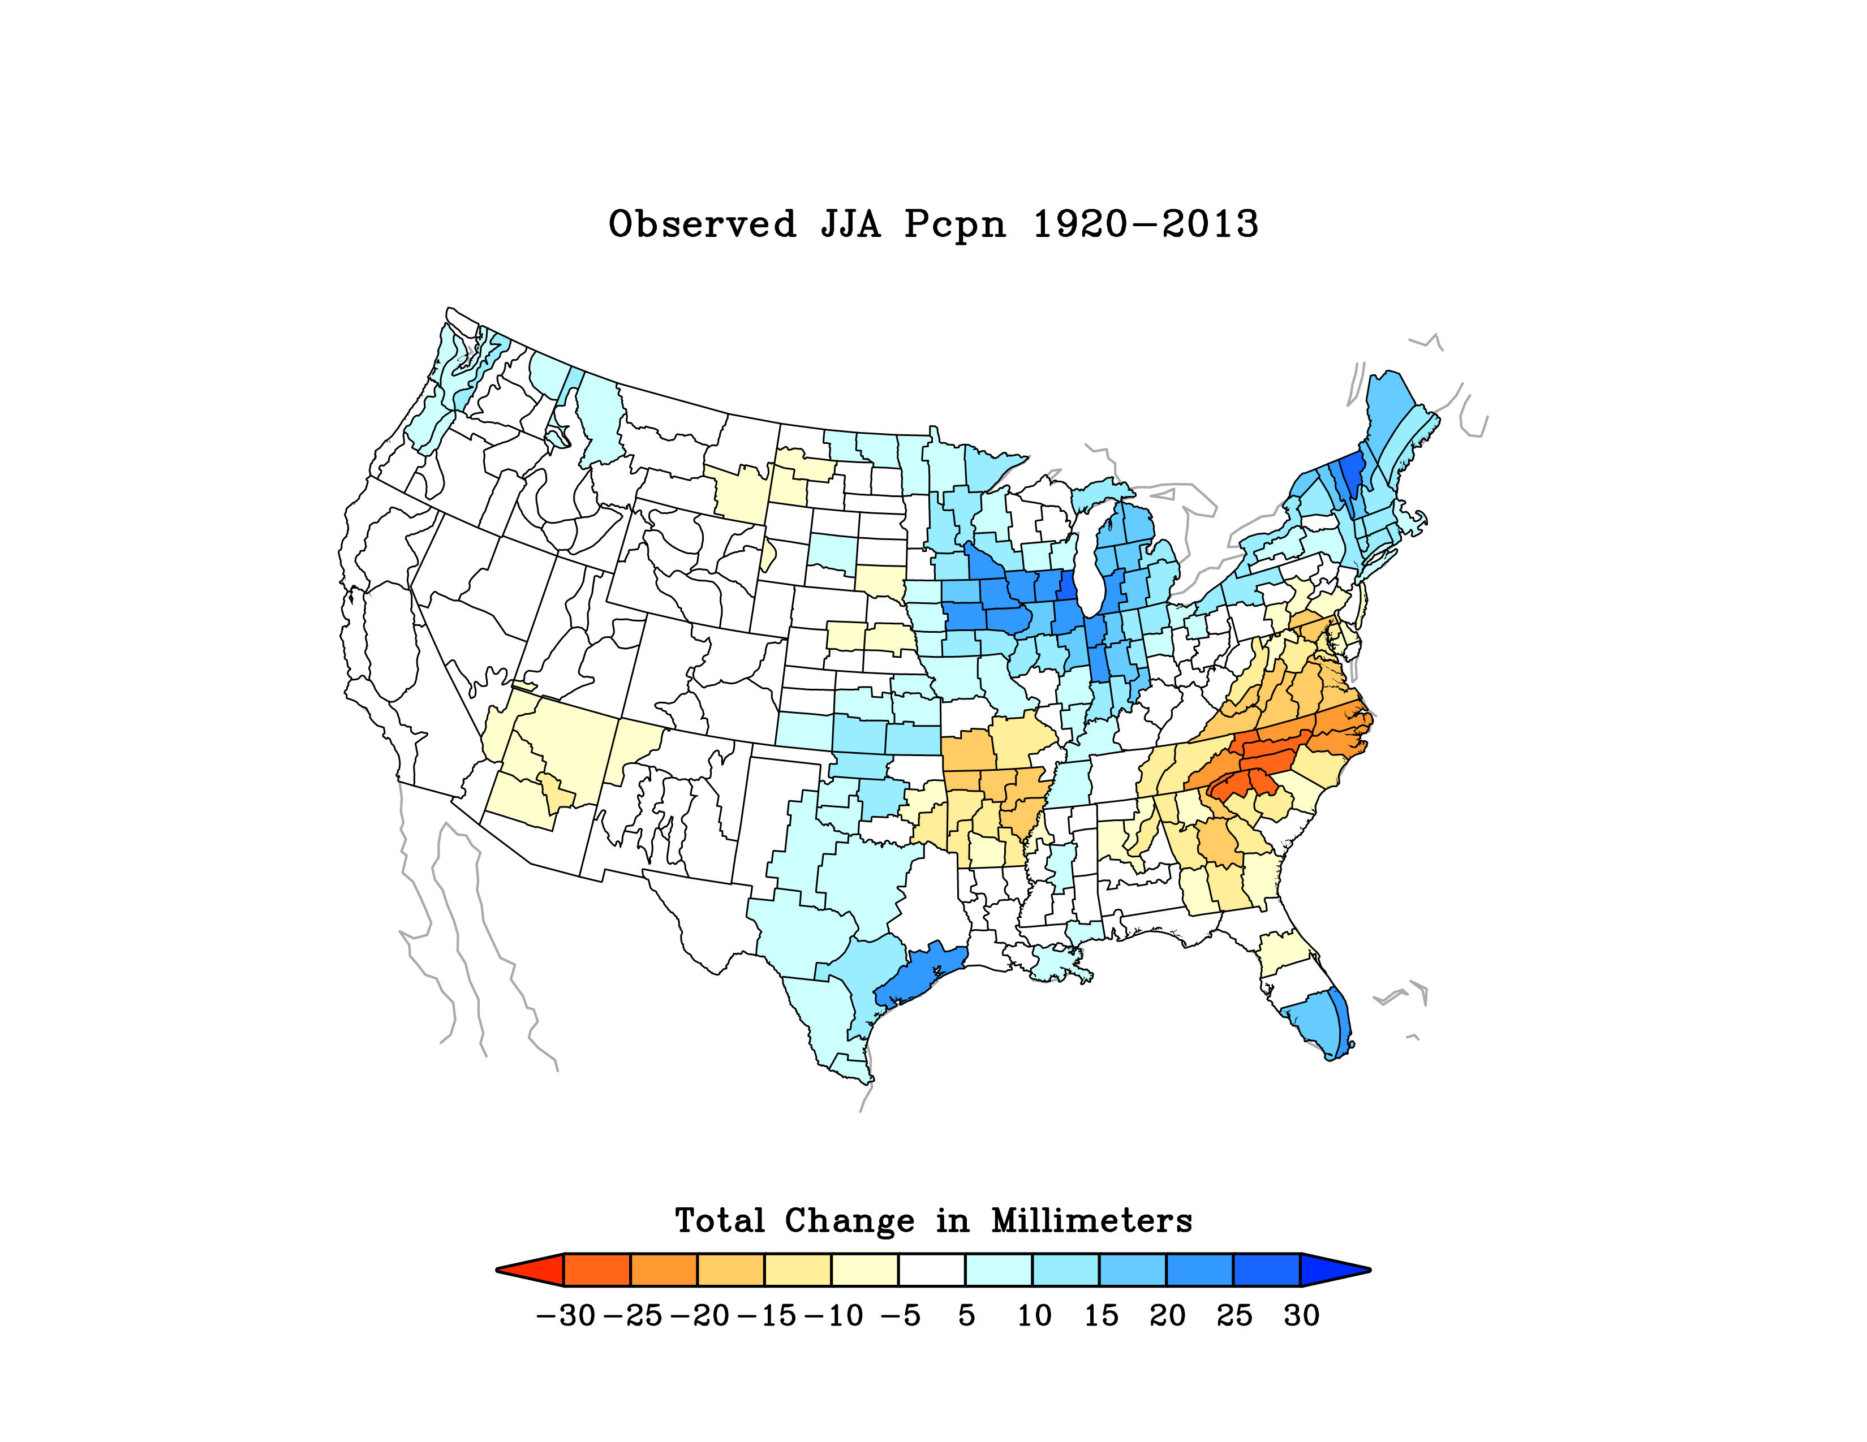
Why Has Great Plains Climate Become
More Favorable for Ag?
Diagnosis: Calculate 1920-2013 Summertime Surface Temperature Trends
in a New Large Ensemble (40-member) of Historical Simulations
Using the Latest NCAR Community Modeling System (CESM1)
Note : There are Other Factors, Including Land Surface Change
and Land Use Change, That Are Not Directly Treated Herein

Slide 32
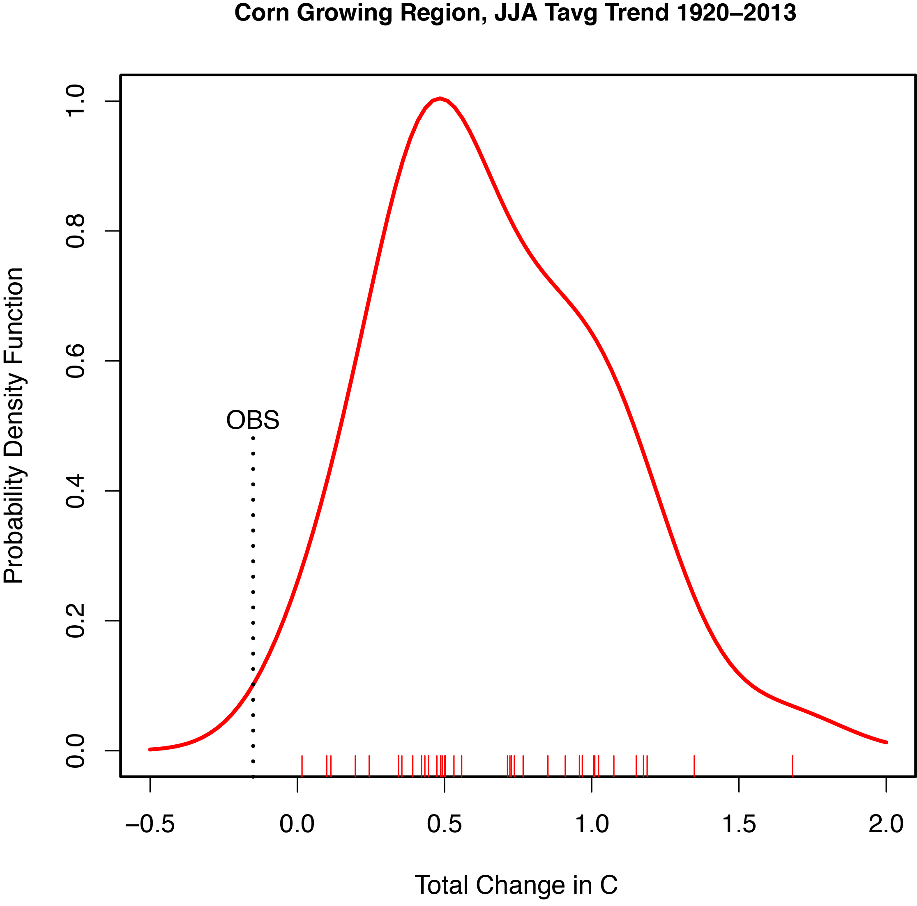
CESM1 Historical Simulations vs OBS
Climate Model Histogram

Slide 33
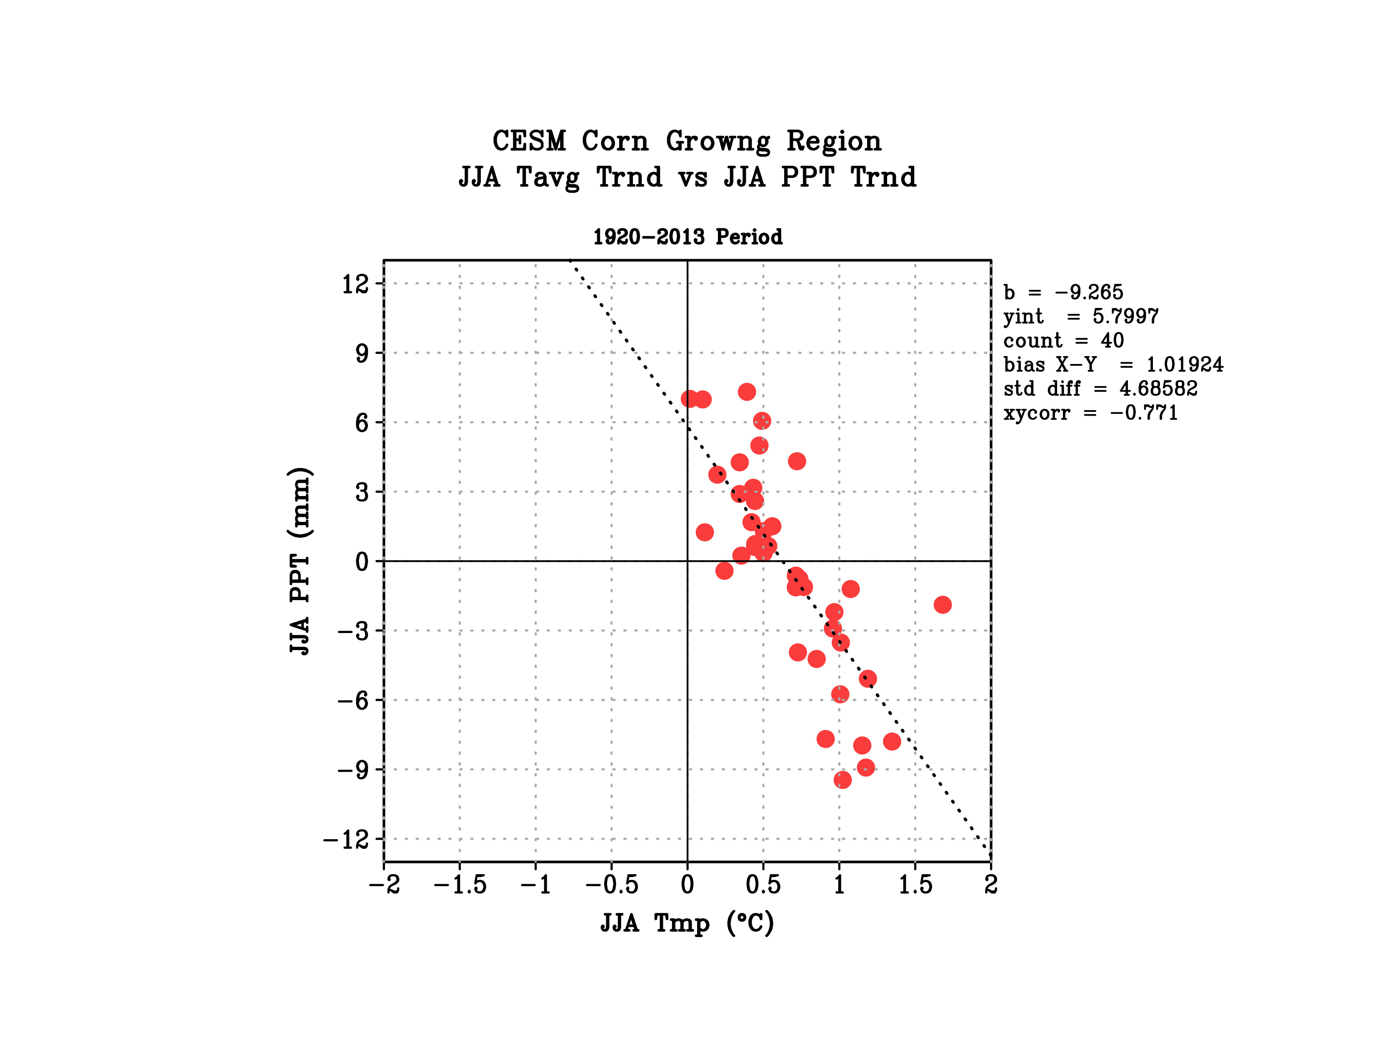
Large Century-Long Precipitation Trends Can Occur Due to Natural Variability
These Can Act to Mask/Enhance Human-Induced Warming
∗
Greater Wet Trend
Greater Warming Trend

Slide 34
Summary
LSM simulations indicate precipitation explained ~ 70% of soil moisture depletion during the 2012 drought, and drove most of CP soil moisture variability since 1950.
Energy balance reveals growing season temperature variability strongly driven by precipitation, indicating its even larger effect on soil moisture variability.
A non-linear relationship between soil moisture and the Bowen ratio indicates an amplifier of heat waves during severe drought conditions.
Antecedent wintertime meteorological and soil moisture conditions affect growing season soil moisture, which appreciably affects summer temperature.
Notes:
MORE INSIGHT, USING LIGHT BLUE AND RESIDUALGiven the open question: this work provides a framework to understand the importance of warming on drought—recent published work J. Clim—suggests climate change has contributed to subtle, detectable warming in the western U.S. , although the impact of this on drought has yet to be fully explored.

Slide 35
Summary
LSM simulations reveal only a modest soil moisture response to temperature, even for +4°C warming, indicating semi-permanent future drought conditions are unlikely to emerge from warming alone.
Summer cooling in the Corn Belt has been a “Climate Surprise”
Cooler summers have resulted from thermodynamic effects of increased rainfall, the latter likely due mostly to internal atmospheric variability.
Notes:
MORE INSIGHT, USING LIGHT BLUE AND RESIDUALGiven the open question: this work provides a framework to understand the importance of warming on drought—recent published work J. Clim—suggests climate change has contributed to subtle, detectable warming in the western U.S. , although the impact of this on drought has yet to be fully explored.

