Slide 1
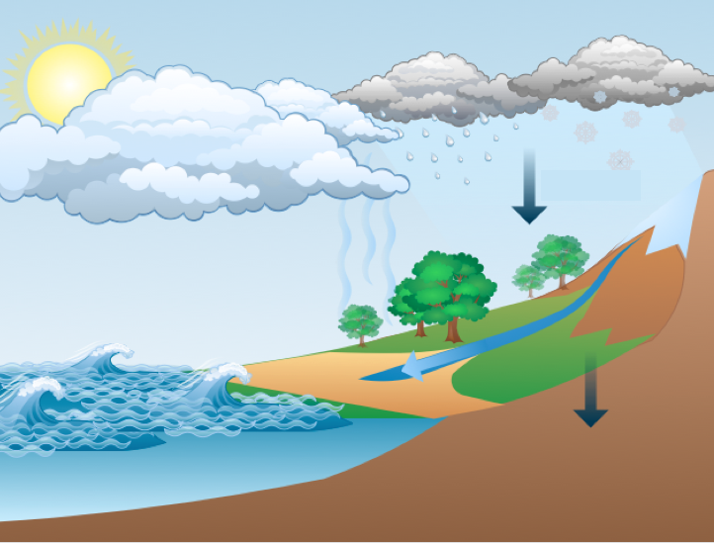
Advanced Quantitative Precipitation Information System
What is it?
Precipitation Forecasts
Stream Flow and Stage
Coastal Inundation
Precipitation Estimates

Slide 2
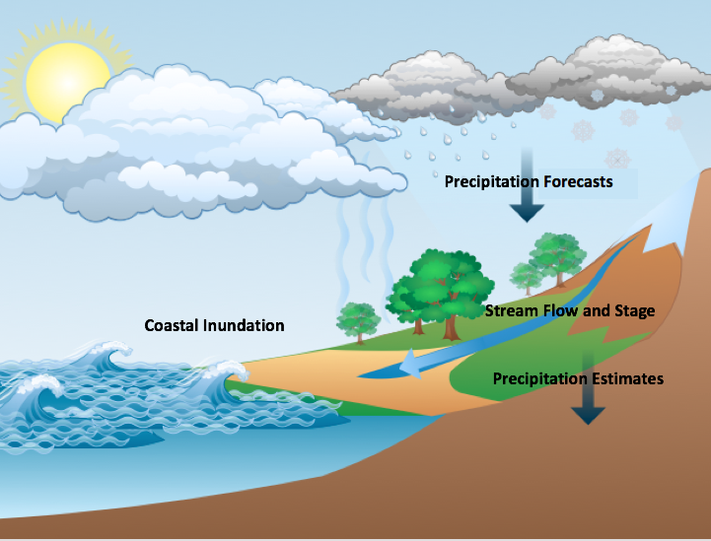
Advanced Quantitative Precipitation Information System
How do we build it?
Collaborative spiral development process.
Collaborative
Bay area water agencies
National Oceanic and Atmospheric Administration (NOAA)/Oceanic and Atmospheric Research (OAR)
Cooperative Institute for Research in the Atmosphere (CIRA)
United States Geological Survey (USGS)
Scripps Research Institute
Spiral development
Evaluate
Gather Requirements
Refine Requirements
Test
Design
Develop

Slide 3
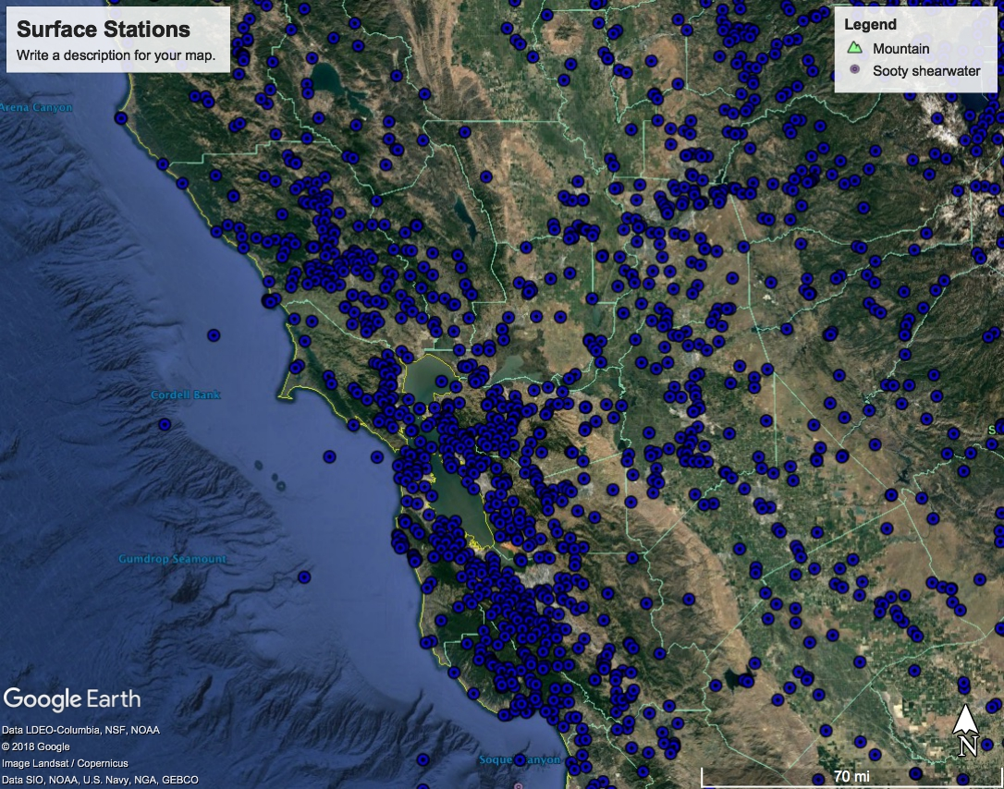
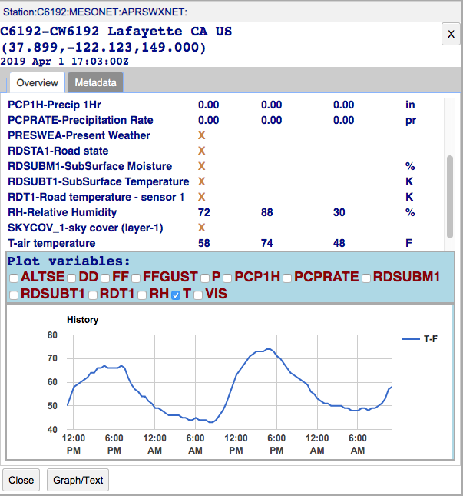
Advanced Quantitative Precipitation Information System
What is inside the Black Box?
Surface Observations
A centralized collection of data:
Surface Observations
Providing current conditions for:
Precipitation (rates and accumulation)
River (stage and flow)

Slide 4
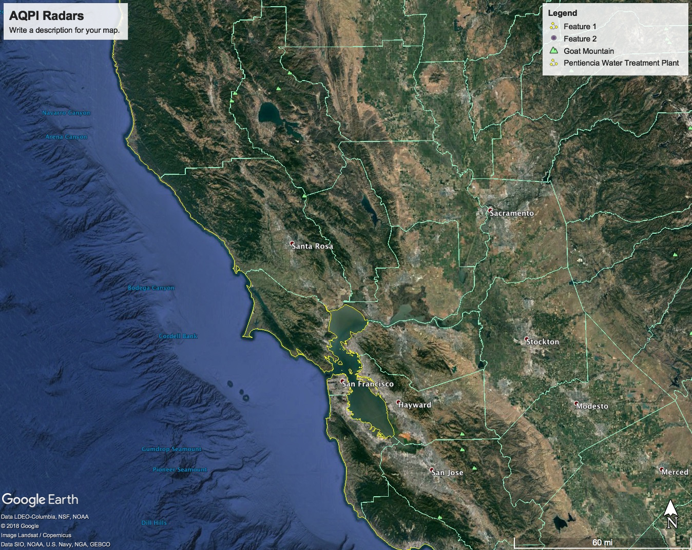
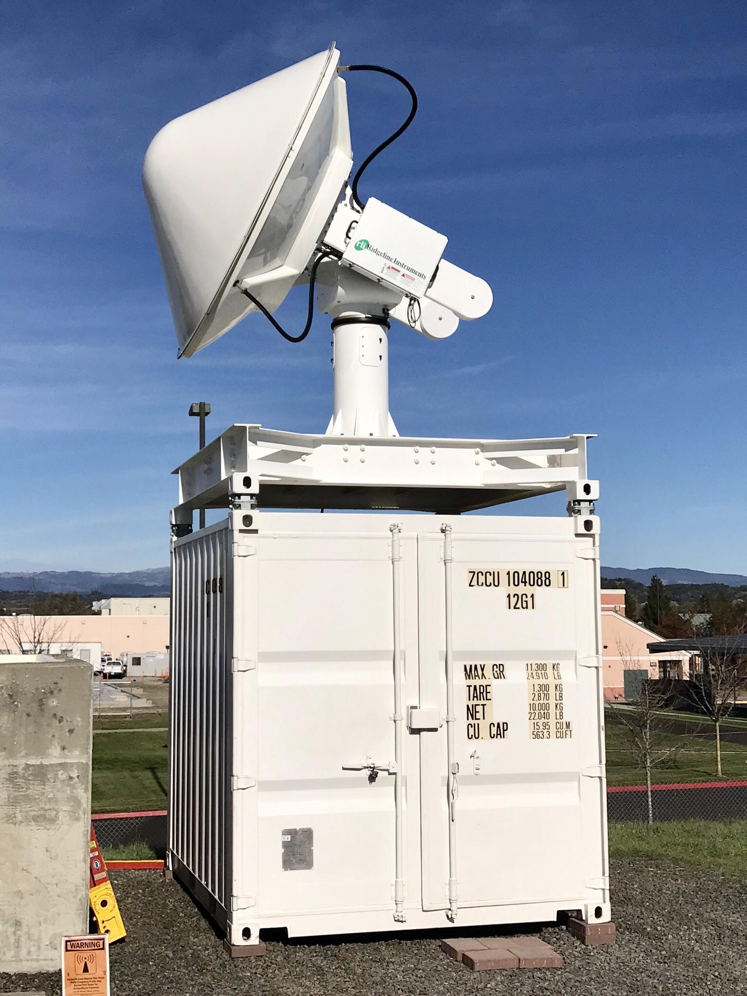
Advanced Quantitative Precipitation Information System
What is inside the black box?
Surface Observations
Radar
Data
A centralized collection of data:
Surface observations
Gap-filling radars

Slide 5
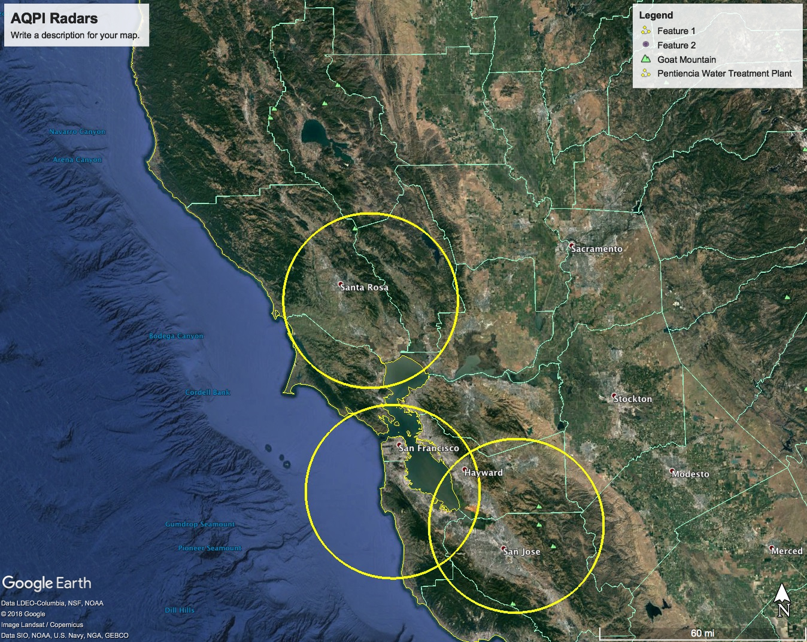
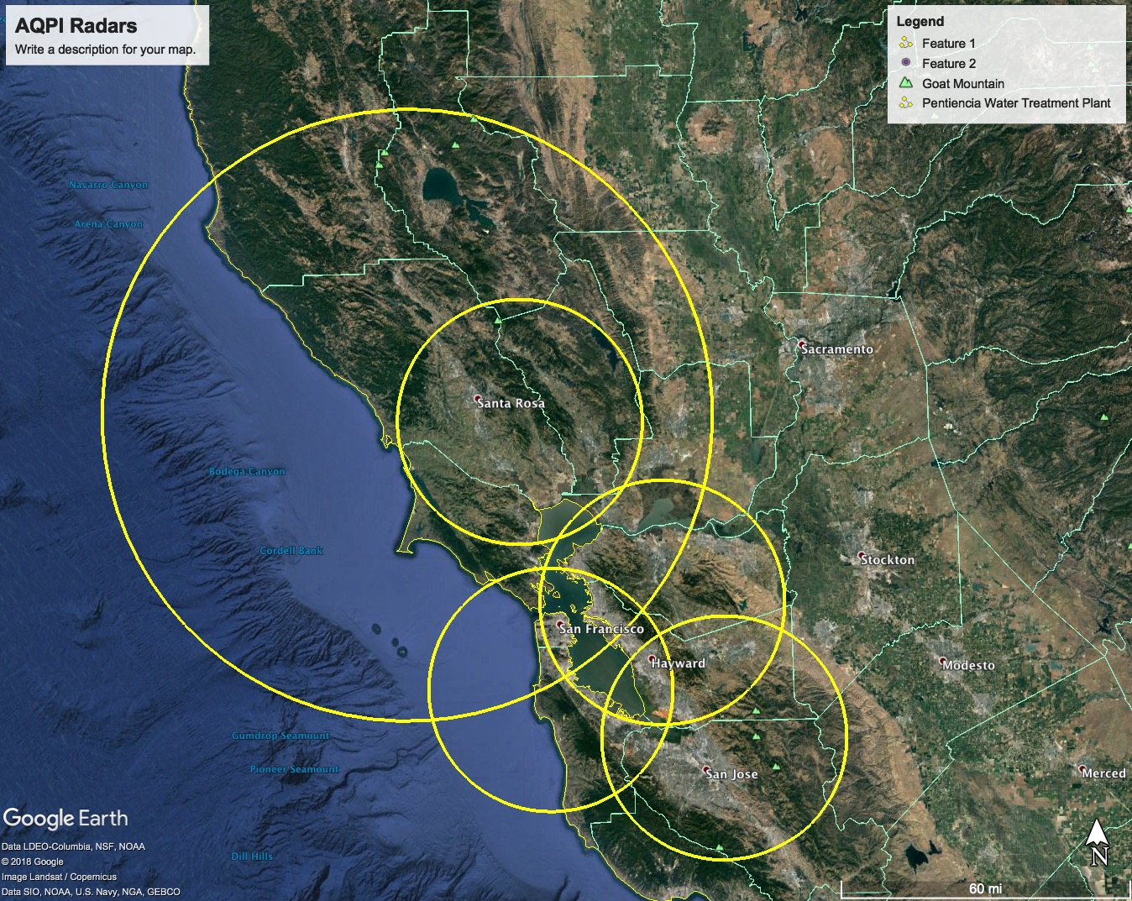
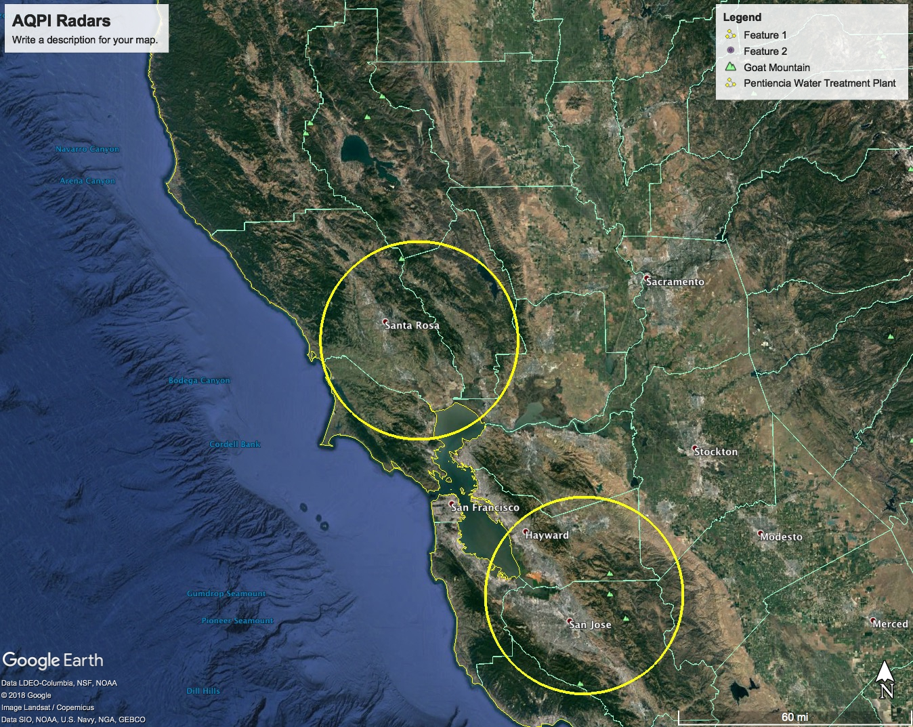
Advanced Quantitative Precipitation Information System
What is inside the black box?
Surface Observations
Radar
Data
A centralized collection of data:
Surface observations
Gap-filling radars
Radars will be sited at:
Sonoma county
Santa Clara county
Montara Peak
Rocky Ridge
And Bay Hill

Slide 6
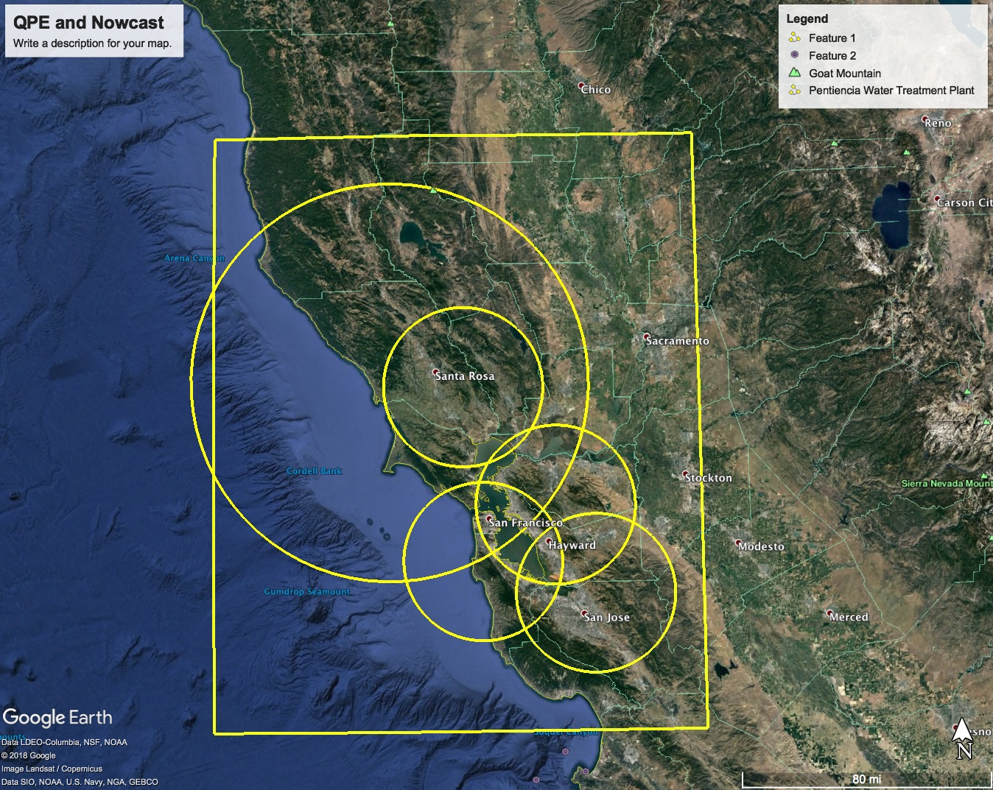
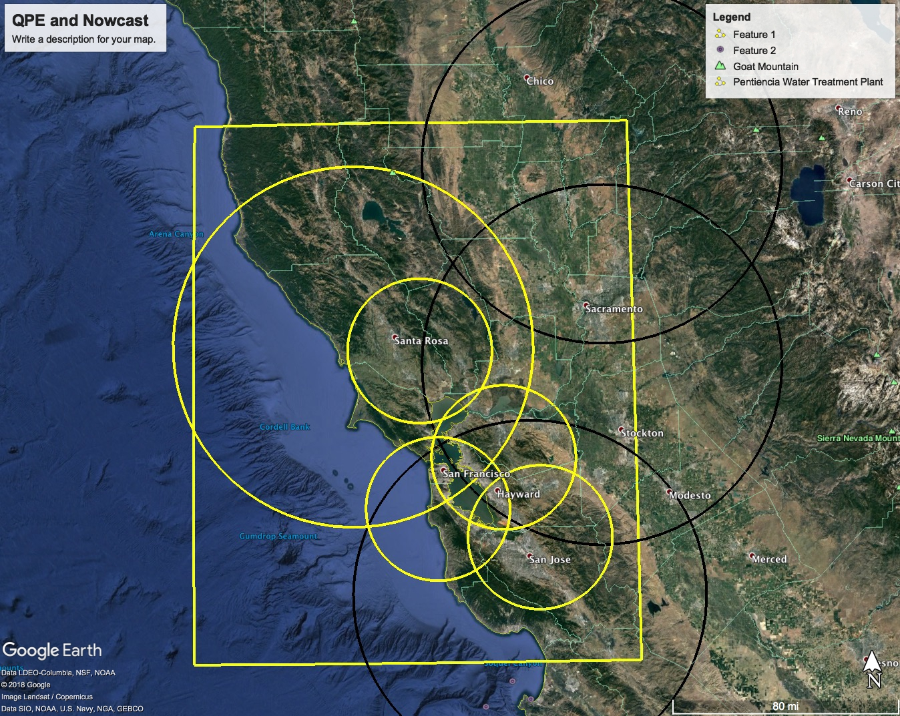
Advanced Quantitative Precipitation Information System
What is inside the black box?
Surface Observations
A centralized collection of data:
Surface observations
Gap-filling radars
Radar
Data
Better precipitation estimates and short-term forecasts of precipitation, called “Nowcasts”, will be produced in the boxed area by combining the gap filling radar data with National Weather Service radars.

Slide 7
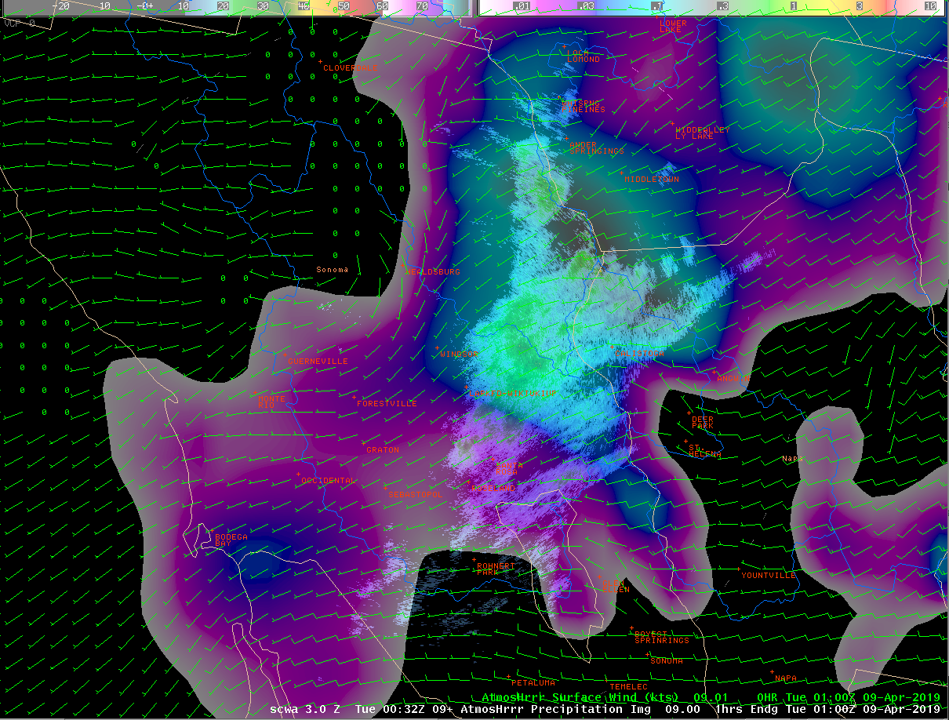
Advanced Quantitative Precipitation Information System
What is inside the black box?
Surface Observations
A centralized collection of data:
Surface observations
Gap-filling radars
Precipitation Forecasts
Radars
X-Band
C-Band
HRRR
The National Weather Service’s High-Resolution Rapid Refresh model will provide precipitation forecasts out to 12 hours.

Slide 8
Advanced Quantitative Precipitation Information System
What is it?
Surface Observations
A centralized collection of data:
Surface observations
Gap filling radars
4-Xband
1-CBand
Radars
X-Band
C-Band
HRRR
Bay Area
Users
National
Water
Model
Better rain estimates and short term forecasts of rain, called Nowcasts, will be produced in the boxed area by combining the gap filling radar data with National Weather Service radars.
CoSMoS

Slide 9
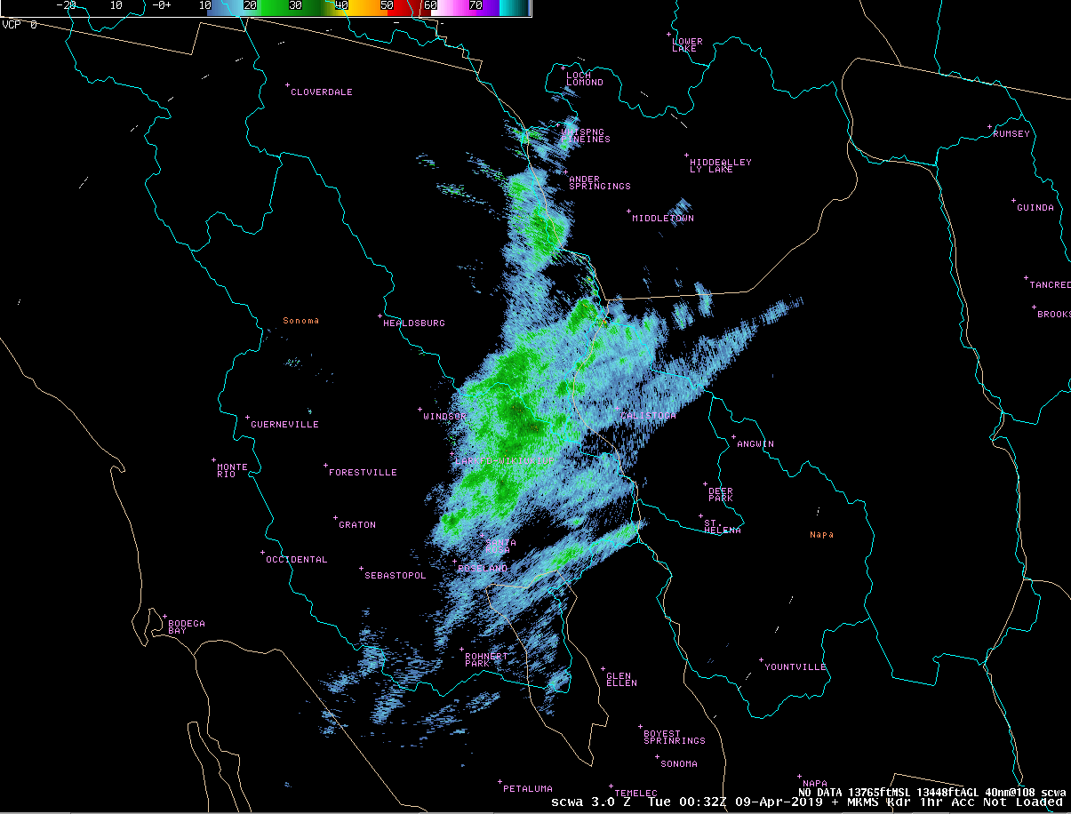
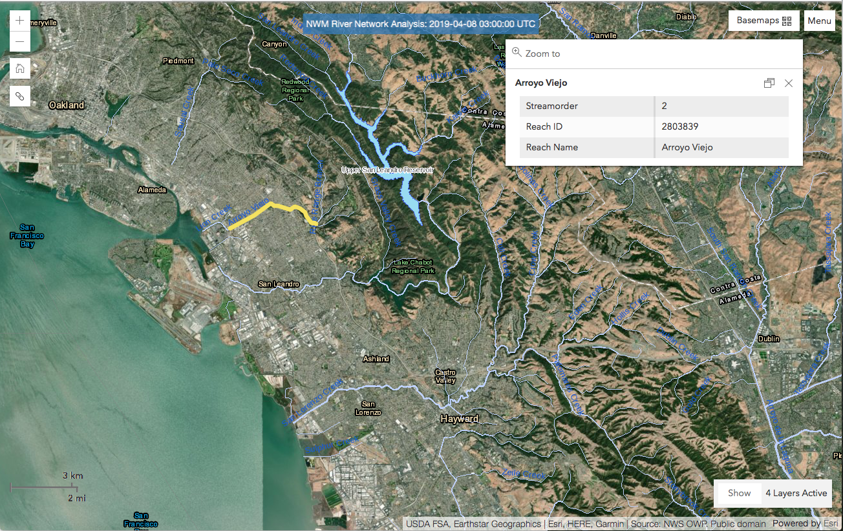
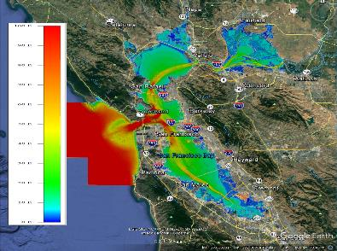
a
Surface Observations
Calibrate/Validate
Precipitation
Estimates &
Nowcast
QCed Radar
Precipitation
Analysis &
Forecast
AQPI
User
Interface
Bay Area
Users
Precipitation Forecast
River Stage & Flow Analysis & Forecast
River Stage/Flow Forecast
Coastal Inundation Analysis & Forecast

